Slide 1


WELCOME!
Network Breakfast
ASTC 2016
www.nisenet.org

Slide 2
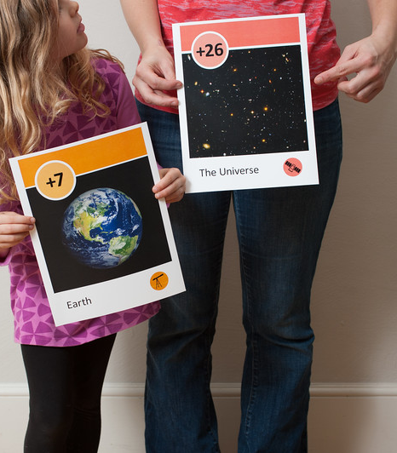
Overview
NEW IDENTITY
“Nanoscale” to “National”
CURRENT PROJECTS
Nanotechnology
Synthetic biology
Sustainability
Earth and space
NEW PROJECTS
Frankenstein (science and society)
Chemistry
FUTURE DIRECTIONS
Discussion
Notes:
NEW IDENTITY: Larry and Paul
CURRENT PROJECTS, NEW PROJECTS & FUTURE DIRECTIONS: Rae

Slide 3
NEW IDENTITY

Slide 4

Notes:
10+ years of funding through NSF for nanoscale science, engineering, and technology.

Slide 5
Notes:
Now have diversified our funding and the STEM topics we cover.
Leadership for the network: SMM (Paul Martin), MOS (Larry Bell), ASU (Rae Ostman)

Slide 6
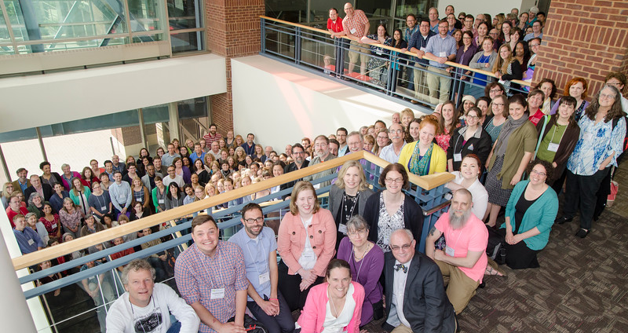
NISE Net is now the National Informal STEM Education Network.
Notes:
As always, you are a member of the network if you participate in our work (projects).

Slide 7
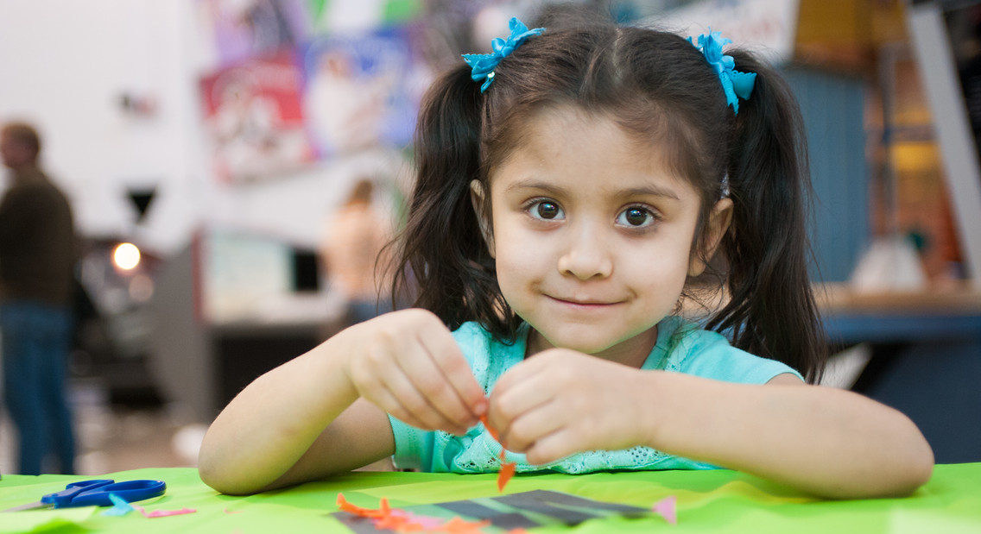
NISE Net supports informal learning about STEM in communities across the United States.
Notes:
“New” network now includes all areas of STEM = science, technology, engineering, and math.
The network is continuing our work in three areas:
--Engaging the public
--Increasing capacity (advancing the field)
--Building collaborations

Slide 8
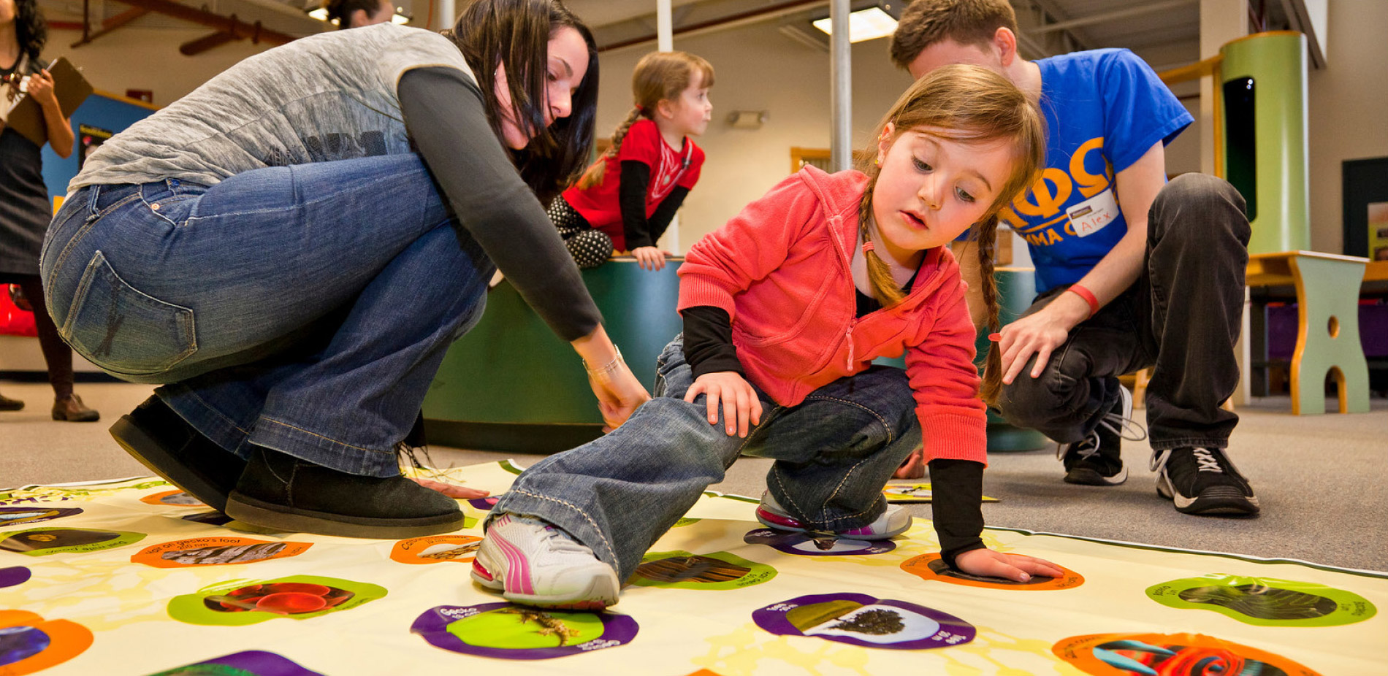
NISE Net engages all audiences in learning about STEM in ways that are fun and easy to understand.
Notes:
Engaging the public: accessible to and appropriate for multiple and diverse audiences

Slide 9
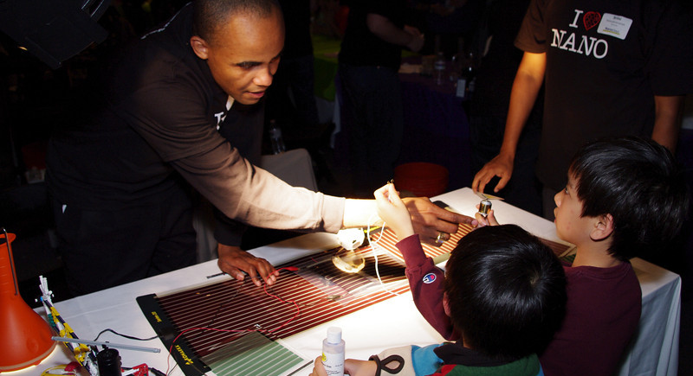
NISE Net improves the practices and skills of educators and scientists.
Notes:
Generating knowledge and providing resources that increase the capacity of the ISE field.

Slide 10
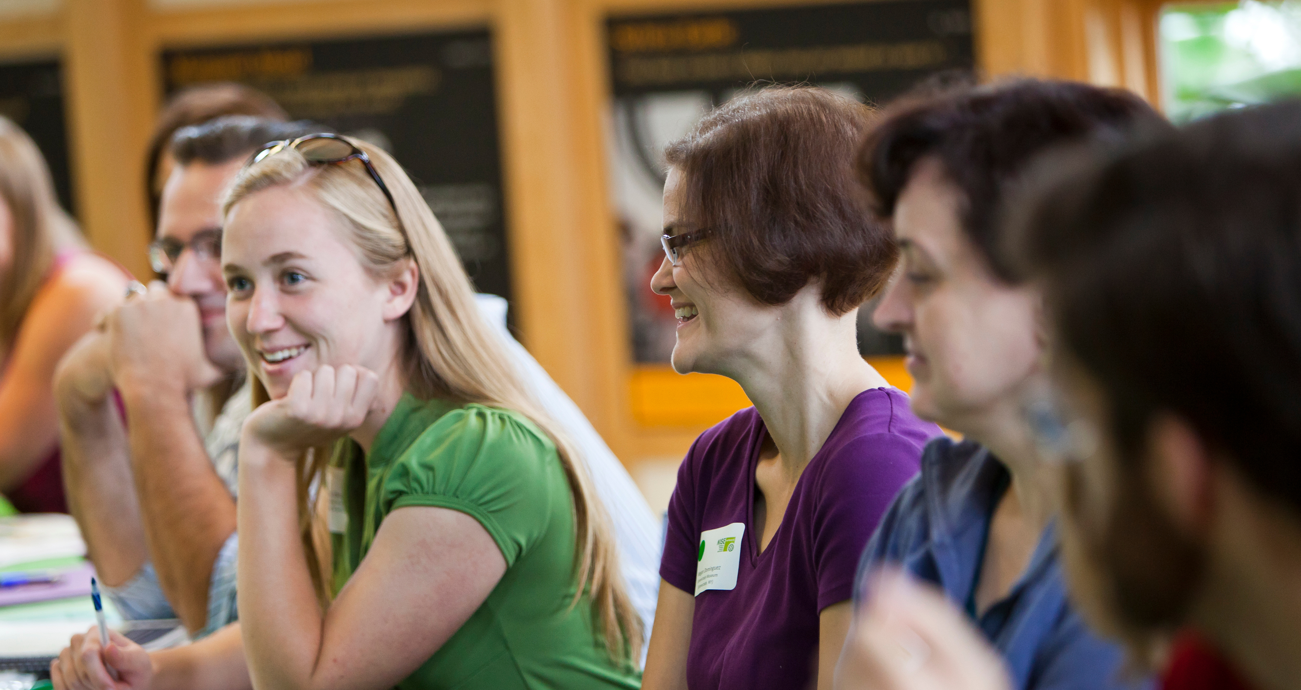
NISE Net creates lasting relationships among individuals and organizations.
Notes:
Building collaborations.
“We built the network by doing work together.”

Slide 11
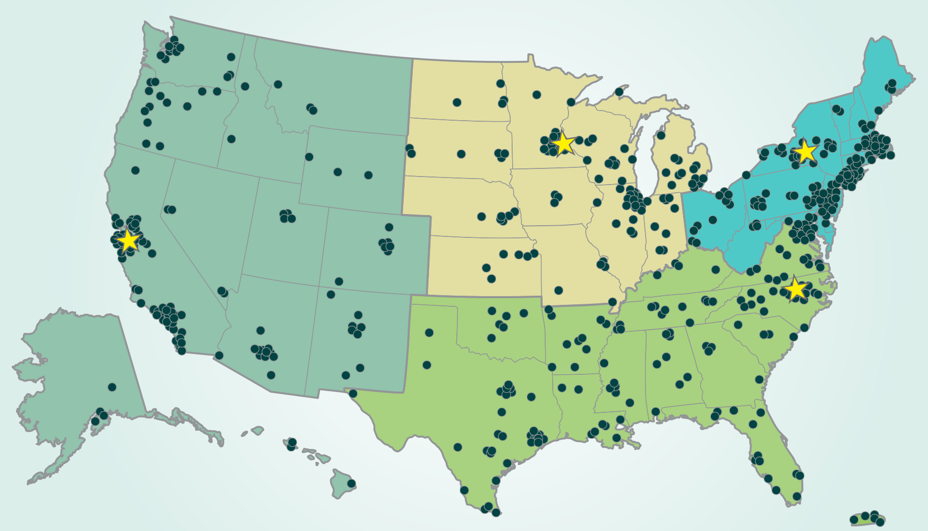
Over 600 organizations regularly participate in Network activities.
Notes:
~400 museums
~200 universities

Slide 12
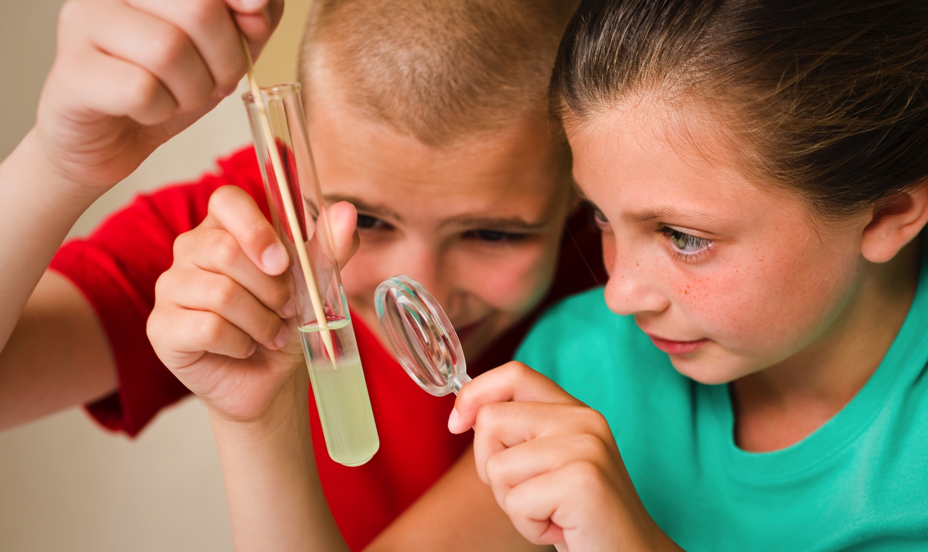
NISE Net reaches millions of people each year!
Notes:
All 50 states and Puerto Rico

Slide 13
CURRENT
PROJECTS

Slide 14
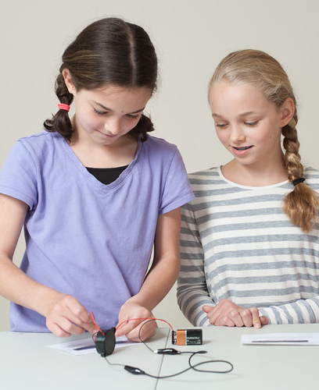
“Nano” network
GOALS
Create a national community of partners, including educators and scientists
Develop and distribute educational products that raise public awareness and understanding of nano
Generate knowledge about public and professional learning through evaluation and research
Notes:
PI: Larry Bell, Museum of Science

Slide 15
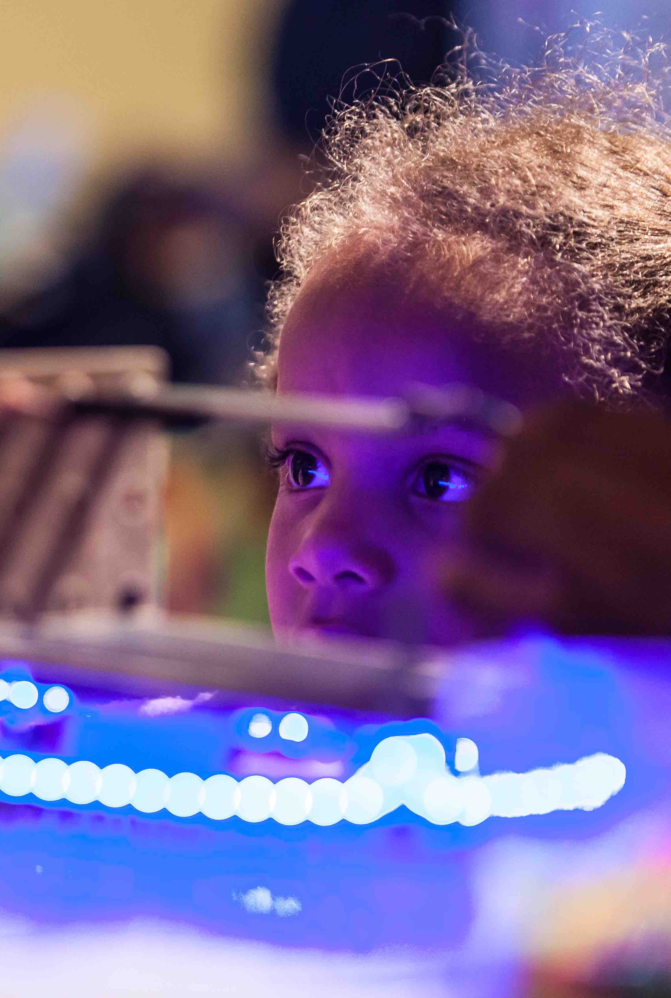
“Nano” network
ACTIVITIES
Public engagement
NanoDays events
Programs and forums
Exhibits and media
Building collaborations
Regional meetings, and network-wide meetings
Increasing capacity
Professional development guides and media
In-person and online workshops
Generating knowledge
Evaluation of public and professional impacts
Research on learning, partnerships, organizational change, and more
Notes:
Broadest reach:
NanoDays
Nano exhibitions (93 copies, over 140 sites)
We have planned continued access to nano resources—and support related to those—but largely the nano project is now in its sustainabililty phase. It’s being sustained by all the continued work you do with the resources you’ve integrated into your program, the skills you’ve gained through participation in the Network, and the knowledge the network has contributed to the field.

Slide 16
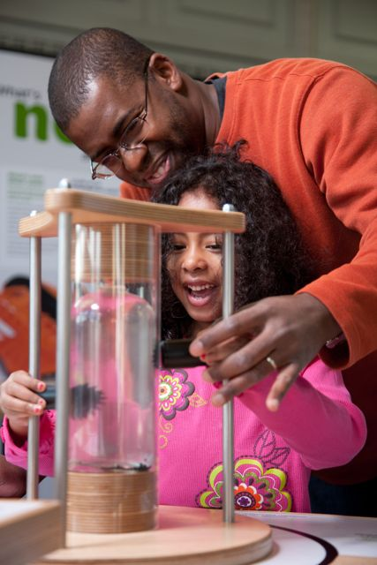
Research and evaluation
PUBLIC IMPACTS
Reach
11 million people per year
30 million people to date
Learning
Enjoyment
Key concepts
Relevance
Notes:
As the nano project concludes, our R&E teams have been completing many studies.
Here sharing highlights from just 2 reports, related to public and professional impacts.
REACH: Through the work of all of us.
LEARNING: Enjoyment, learning, connections to own lives
NanoDays:
- 98% of adults say nanodays is enjoyable
-96% of children say nanodays is fun
-It increased adults' confidence in their abilities to talk about and describe different aspects of nano (Rae, I can make this more specific if you want)
Nano exhibition:
- 96% of visitors say the exhibition is interesting
- 96% of visitors say the exhibition is enjoyable
62% of visitors can name one of the exhibitions four key concepts
Research on relevance in the Nano exhibition findings:
-All visitor groups were able to make a relevance connection while in the exhibition.
-Visitor groups found relevance predominantly at the exhibition panels where most of the content about applications and societal issues was contained.

Slide 17
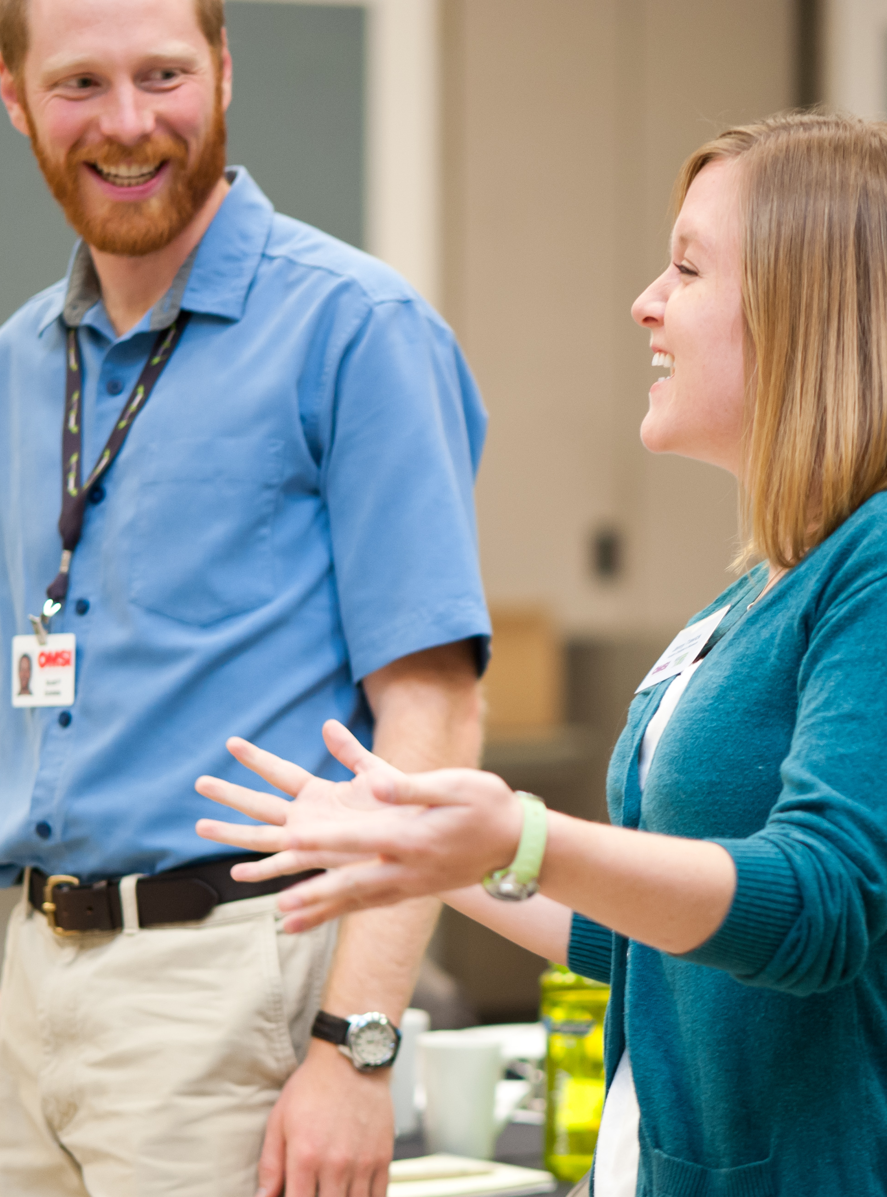
Research and evaluation
PROFESSIONAL IMPACTS
Increase in sense of community and understanding of nano
Positive change, especially related to nano and society content
Integration of Network learning into areas of work unrelated to nano
Reports available online:
nisenet.org
Notes:
SELECTED FINDINGS FROM PROFESSIONAL IMPACTS:
- NISE Net professional partners reported that their sense of
community increased after they became involved with the
Network and that NISE Net affected their understanding of nano.
- NISE Net professional partners reported engaging the
public with all types of Network products and practices, though some were used less than others.
Evidence indicates that a range of NISE Net professional partners integrated aspects of NISE Net into their work that is unrelated to nano.
MORE: Example: Nano online: Tracking the NISE Net's digital footprint
R&E reports are available on nisenet.org

Slide 18
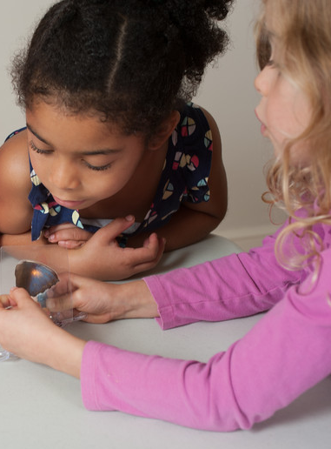

Museum & Community Partnerships
GOALS
Engage new audiences in nano
Develop and strengthen local partnerships
ACTIVITIES
100 partners received kits
CURRENT STATUS
Public engagement and evaluation ongoing
Digital kits available online:
nisenet.org/explorescience-nano
Exploring possibilities for future work
Notes:
Examples of partnerships: afterschool programs, libraries, scouts, other community organizations
Note: the link to this kit (and all other kits) are on the flyer you received.

Slide 19
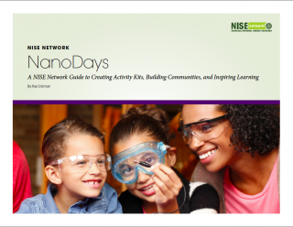
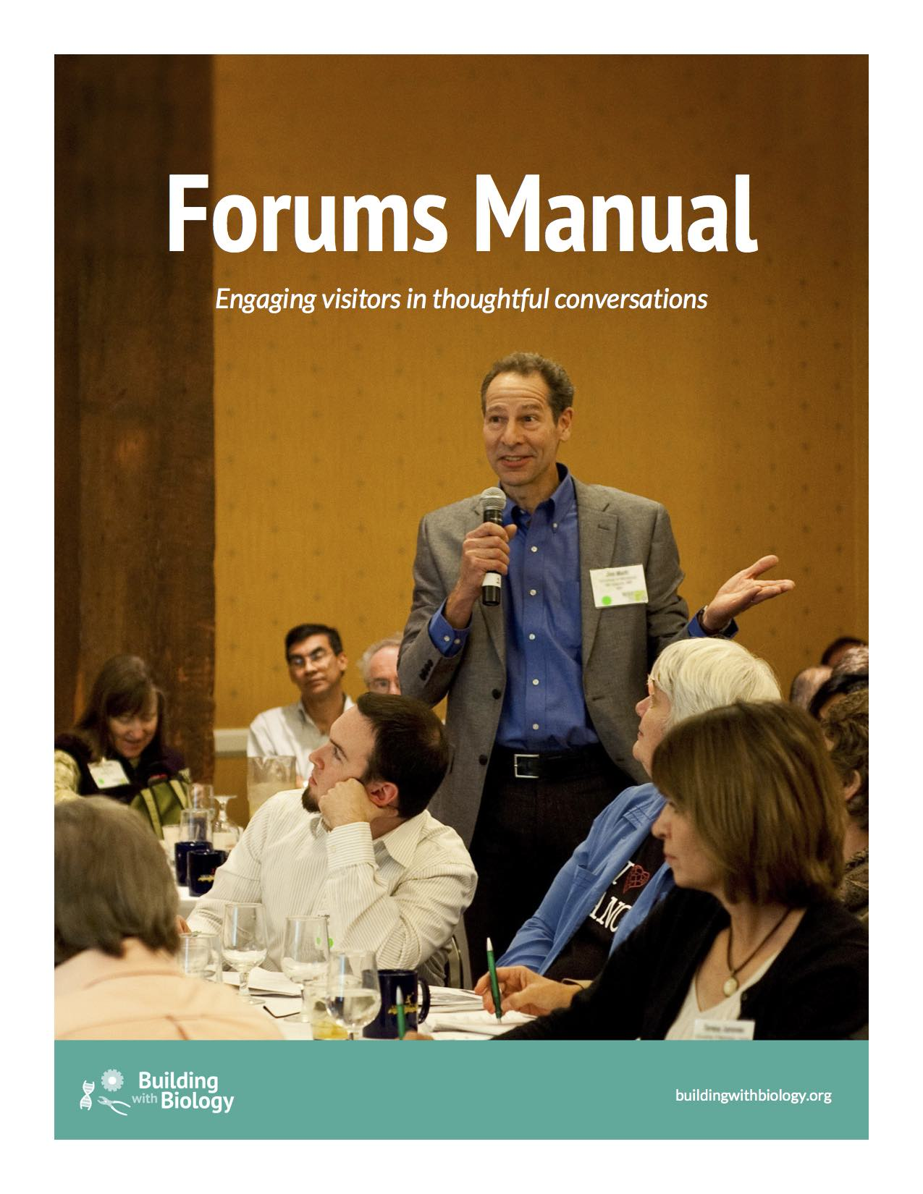
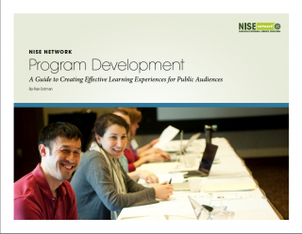
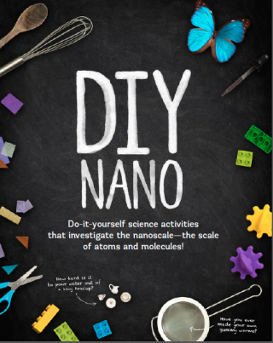
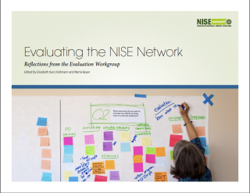
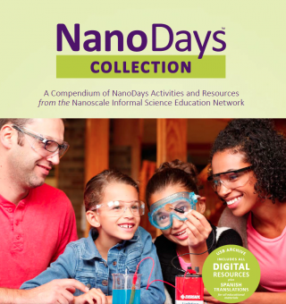
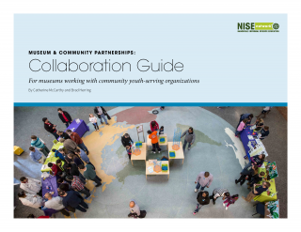
New resources
GUIDES
Collaborations
Programs
NanoDays
Forums
Evaluation
COLLECTIONS
NanoDays
DIY Nano
Available online:
nisenet.org
Notes:
New professional resources:
Guides to professional processes and practices
Collections of educational materials

Slide 20
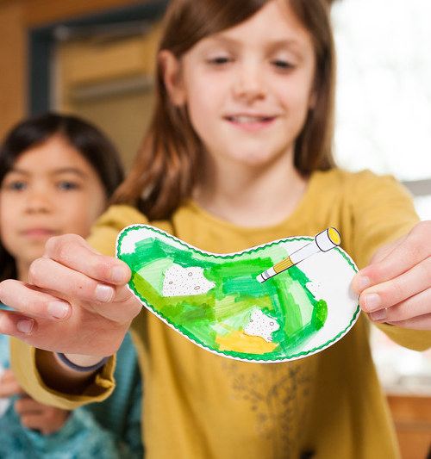
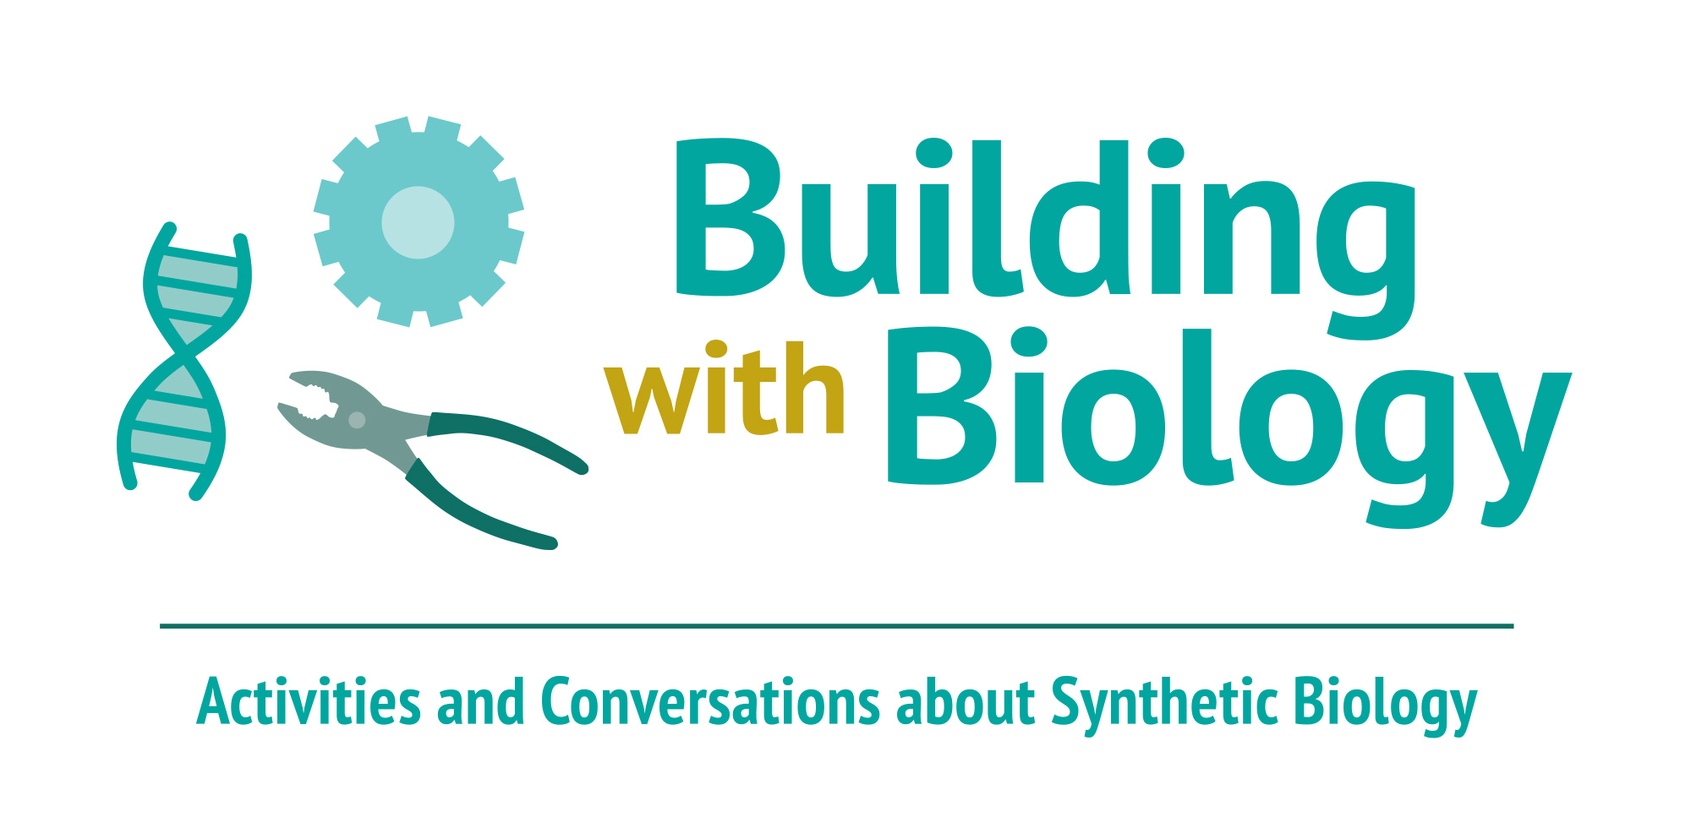
Synthetic biology
GOALS
Conversations between scientists and members of the public
Resources and practices related to social dimensions of science and technology
ACTIVITIES
200 kits of hands-on activities and a forum
Evaluation of public and professional impacts
Notes:
Building with Biology (MSPES = Multi-Site Public Engagement in Science)
PI = Larry Bell, Museum of Science
GOALS
Conversations: Multi-directional and mutually influential (Public Engagement in Science rather than Public Understanding of Science)
Resources: Learning that is transferable to other topics
ACTIVITIES
Kits: Network partners, iGEM teams.

Slide 21
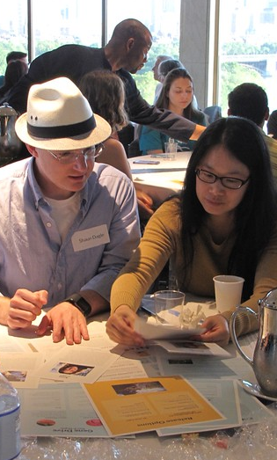
Synthetic biology
CURRENT STATUS
Public engagement and evaluation ongoing
Digital kits available online:
nisenet.org/building-with-biology-kit
A few physical kits are still available!
buildingwithbiology.org/get-involved

Slide 22
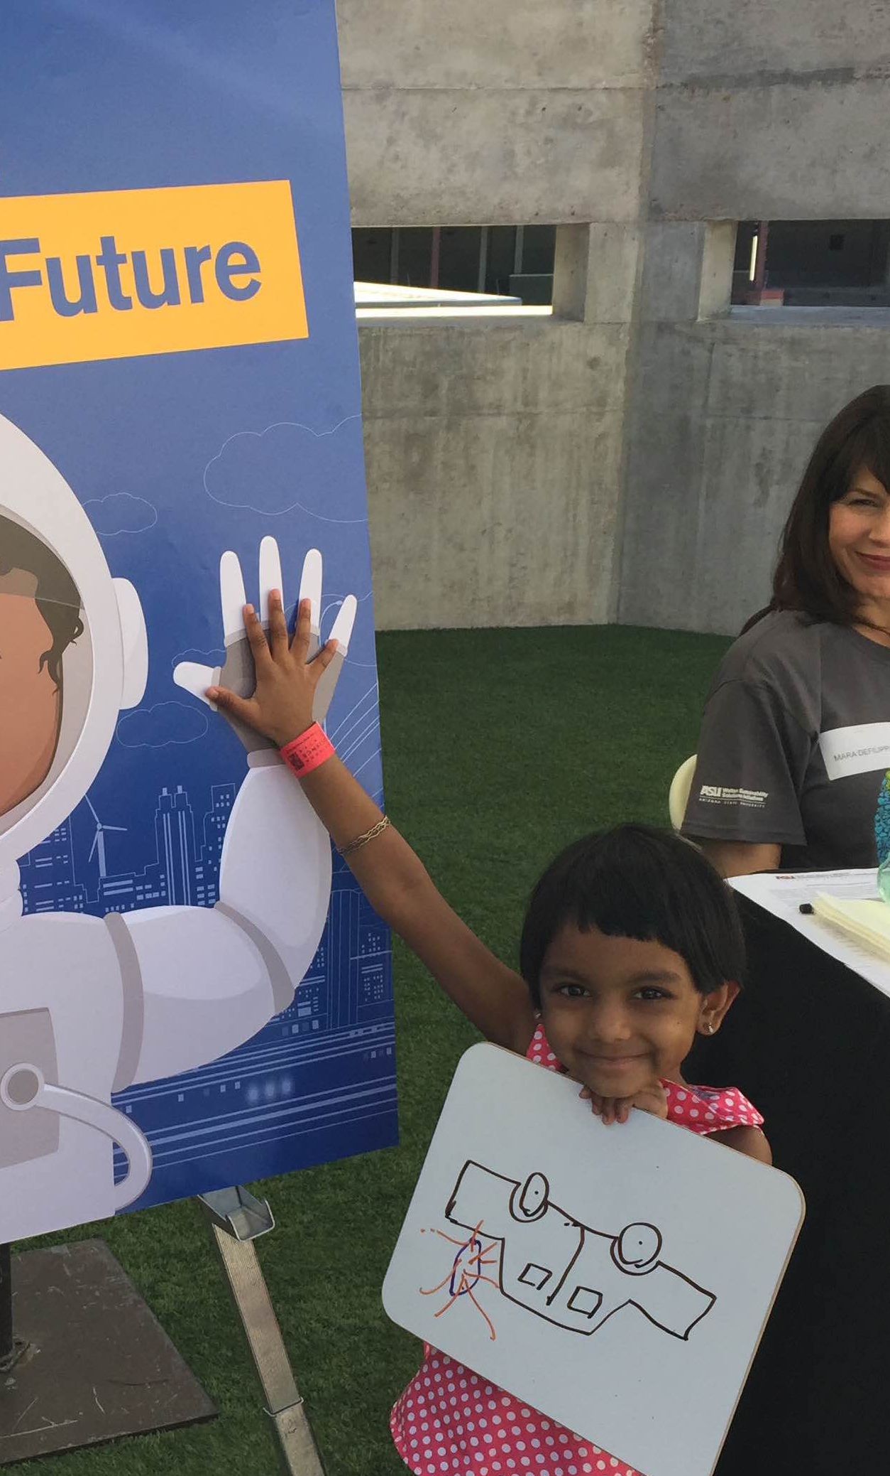
Sustainability
GOAL
Engage the public in learning about sustainability
ACTIVITIES
Pilot kits of hands-on activities
(partnership of ASU and NISE Net)
Sustainability fellowships
(through Walton Sustainability Solutions Initiatives)
CURRENT STATUS
Public engagement and evaluation ongoing
Digital kits available online:
nisenet.org/sustainable-kit
Notes:
In collaboration with Arizona State University.

Slide 23
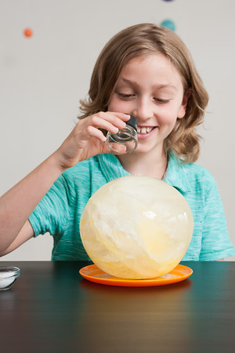

Earth and space
GOALS
Engage public and professional audiences in learning about Earth and space sciences
Encourage new and strengthened partnerships among national and local organizations that support informal and lifelong learning
ACTIVITIES
250 toolkits of hands-on activities (4 years)
Online workshops
50 small-footprint exhibitions
Evaluation of public and professional outcomes
Notes:
SEISE = Space and Earth Informal STEM Education
PI = Paul Martin, Science Museum of Minnesota
In collaboration with NASA. One of 27 STEM Education projects funded by NASA’s Science Mission Directorate. 5 years.

Slide 24

Earth and space
CURRENT STATUS
Application now open for first toolkit!
Nov 4, 2016: Application deadline
Dec 2016: Notification of awards
Jan 2017: Toolkits delivered
Jan-Mar 2017: Online workshops
Mar-May 2017: Public events
Jun 15, 2017: Reports due
More information:
nisenet.org/earthspacekit-apply
Notes:
There is also a recorded online workshop that presents the project and goes over the application process. You can find a link to it on nisenet.org.

Slide 25
NEW
PROJECTS

Slide 26
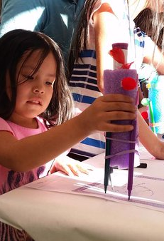
Frankenstein – Science and society
GOALS
Engage the public in creative activities and reflecting on responsible innovation
Increase the capacity of museum staff to engage the public in science and society content
Investigate learning in a transmedia environment
Celebrate the bicentennial of Frankenstein
ACTIVITIES
50 “footlockers” of hands-on making activities
Digital interactives and online challenges
Professional development workshop
Research and evaluation
CURRENT STATUS
Kit applications fall 2017
Programming to celebrate the bicentennial, beginning Jan 2018
Notes:
In collaboration with Arizona State University (PI Ed Finn)
Bicentennial: 200th anniversary of the publication of Mary Shelley’s novel, Frankenstein

Slide 27
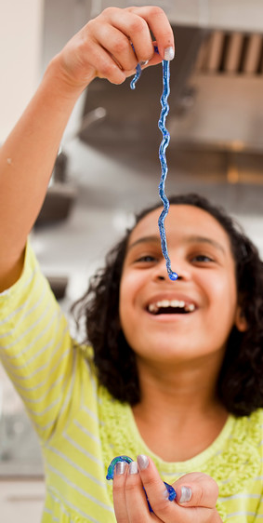
Chemistry
GOALS
Generate knowledge about strategies for influencing public interest, understanding, perception of relevance, and feelings of self-efficacy about chemistry
Engage the public in learning about chemistry
Increase the capacity of museum staff to engage the public in chemistry
ACTIVITIES
Design-based research
250 kits of hands-on chemistry activities
Professional development resources
CURRENT STATUS
Funded!
Notes:
ChemAttitudes
In collaboration with American Chemical Society
PI = Larry Bell, Museum of Science
Kit applications in Fall 2018; implementation beginning in early 2019

Slide 28
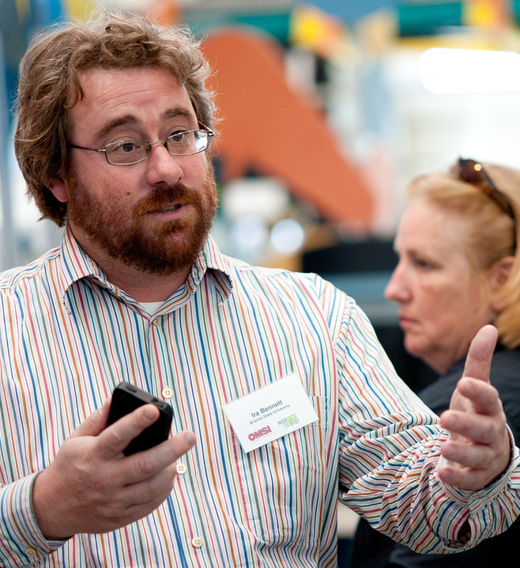
Stay in the loop!
  Website:
  nisenet.org
  Newsletter:
  nisenet.org/newsletter
  Social media:
  nisenet.org/social
  Be sure to add your name to the breakfast sign-in sheet!
  Visit our booth in the exhibit hall!
Notes:
That was a lot of projects! You can find the critical information on your flyer.
To stay up to date on everything related to the network, be sure you’re on all our lists.
We’re continuing to use our website, newsletter, and social networking.

Slide 29
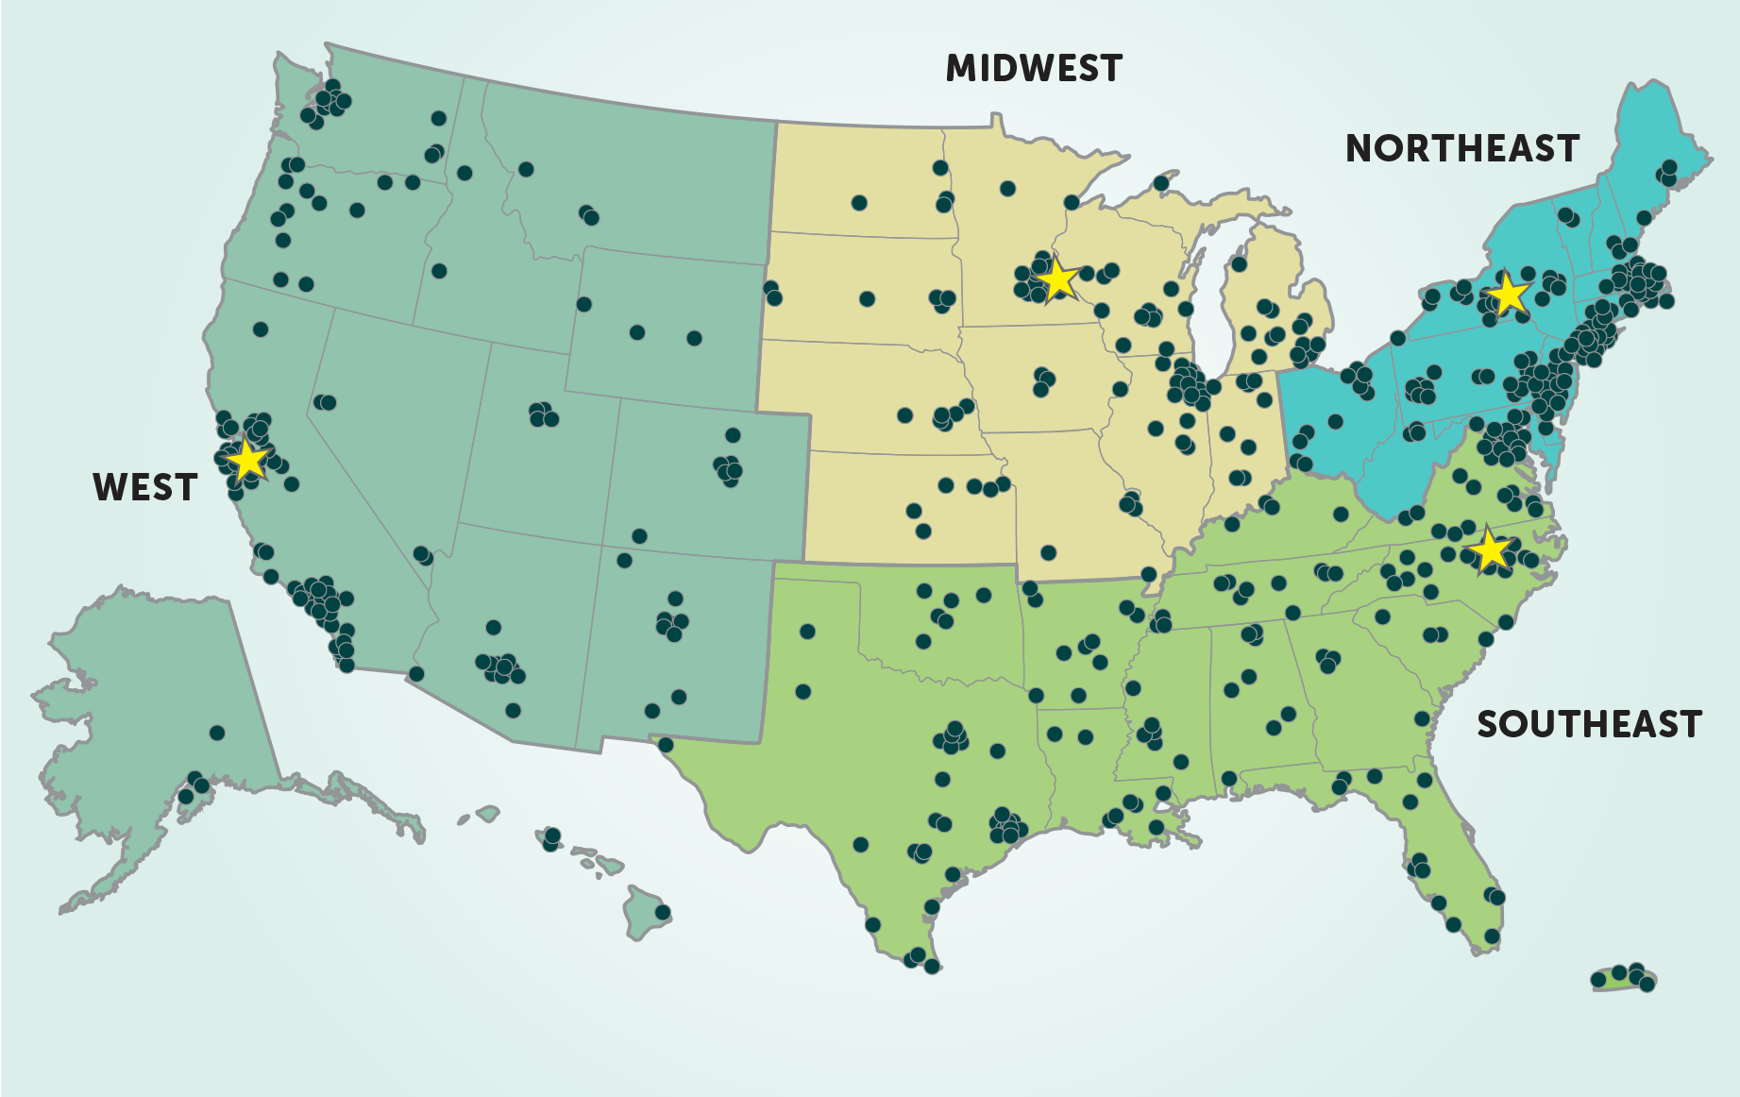
Stay in the loop!
Regional hub leaders:
nisenet.org/contact
Notes:
And most importantly, get to know your regional hub leader!
See your flyer to learn which hub you belong to, and to find the contact info for your regional hub leaders.
MW: Christina Leavell, Science Museum of Minnesota
NE: Ali Jackson, Sciencenter
SE: Brad Herring, Museum of Life + Science
W: Frank Kusiak, Lawrence Hall of Science

Slide 30
FUTURE
DIRECTIONS

Slide 31
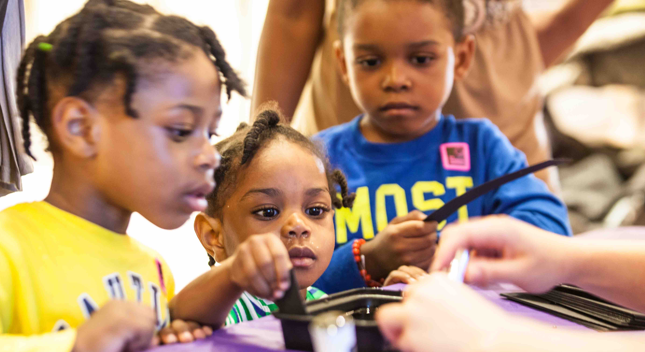
NISE Net seeks to broaden participation in STEM learning—at school, at home, and in the community.
Notes:
One priority: Audiences underserved by STEM-rich institutions; groups underrepresented in STEM fields
This work began with MCP project (supplement) and we’re exploring ways to continue it.

Slide 32
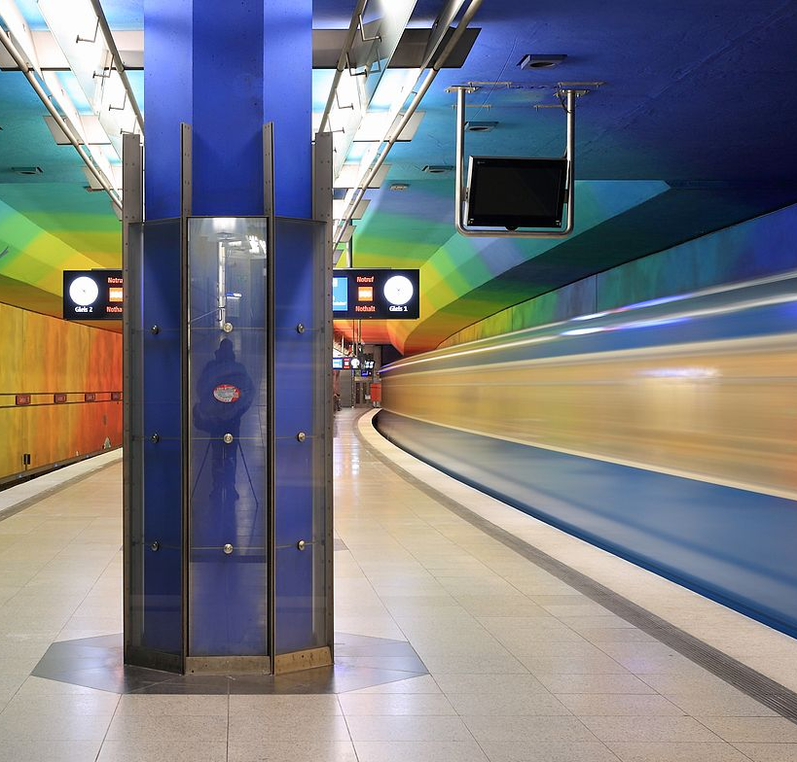
Possible directions
Engaging the public
Current science
Science and society
Citizen science
Small-footprint exhibitions
Gaming approaches
Building relationships
Community organizations
Scientists
Increasing capacity
Broadening participation
Best practices
Evaluation
Notes:
Other possibilities we’ve discussed

Slide 33
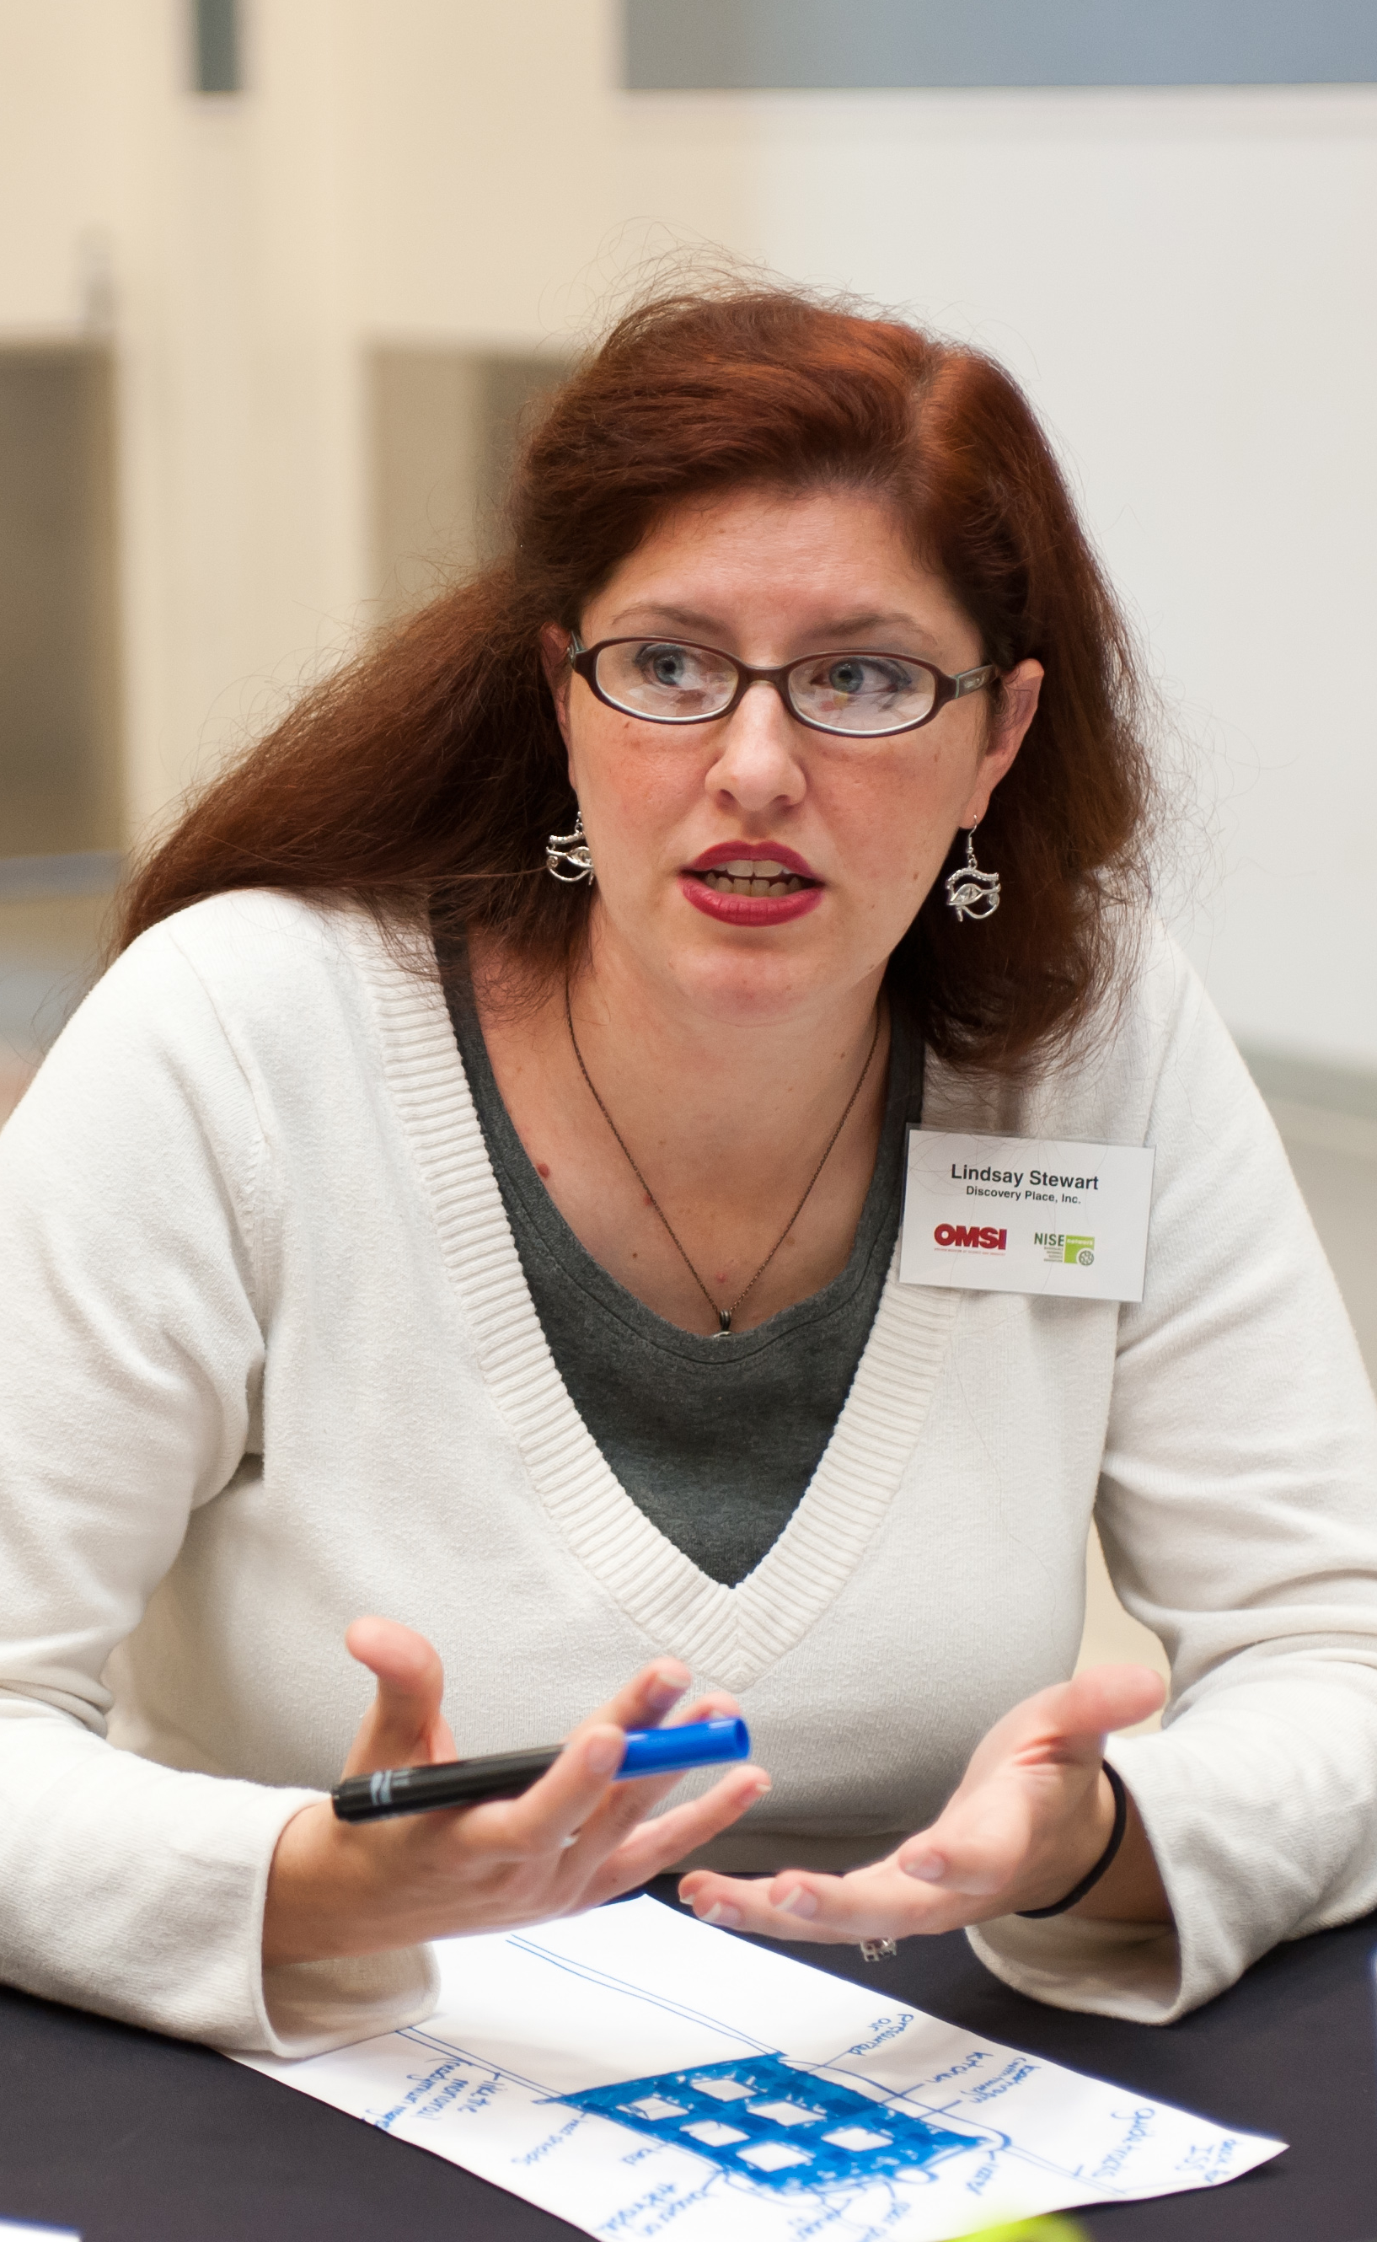
Discuss!
What big challenges do you face that could be tackled effectively through the network?
In other words, how can the network help you do the things that are most important to you?
What important work are you doing that could benefit others in the network?
In other words, what are you working on that could be shared through the network?
Notes:
We also want to know what YOU would like the network to do, and how you’d like to participate.
Please discuss these questions at your table, and jot your ideas down to share with the leadership team.
Fundamentally, these questions are about how we can work together to leverage the network to benefit the network (infrastructure and competencies).

Slide 34



Thank you
The Nanoscale Informal Science Education Network is supported by the National Science Foundation under award numbers 0532536 and 0940143. Multi-Site Public Engagement in Science is supported by the National Science Foundation under award number 1421179. Transmedia Museum is supported by the National Science Foundation under award number 1516684. ChemAttitudes is supported by the National Science Foundation under award number 1612482. Any opinions, findings, and conclusions or recommendations expressed in this presentation are those of the authors and do not necessarily reflect the views of the Foundation.
Sustainability in Science Museums is supported by the Walton Sustainability Solutions Initiatives at Arizona State University (ASU) and is a collaboration with the Center for Engagement and Training in Science and Society at ASU.
Space and Earth Informal STEM Education is supported by NASA under cooperative agreement number NNX16AC67A. Any opinions, findings, and conclusions or recommendations expressed in this material are those of the author(s) and do not necessarily reflect the view of the National Aeronautics and Space Administration (NASA).

Slide 35
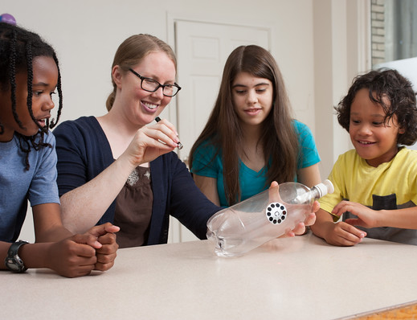
www.nisenet.org

