Slide 1
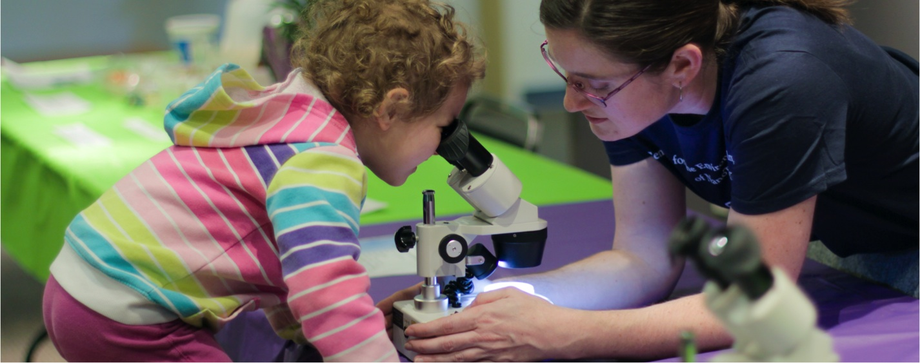

New National Collaborative Network
Provides Opportunities for U.S. Museums and Science Centers Around STEM Topics
ASTC Conference
September 26, 2016
www.nisenet.org
Notes:
CATHERINE

Slide 2
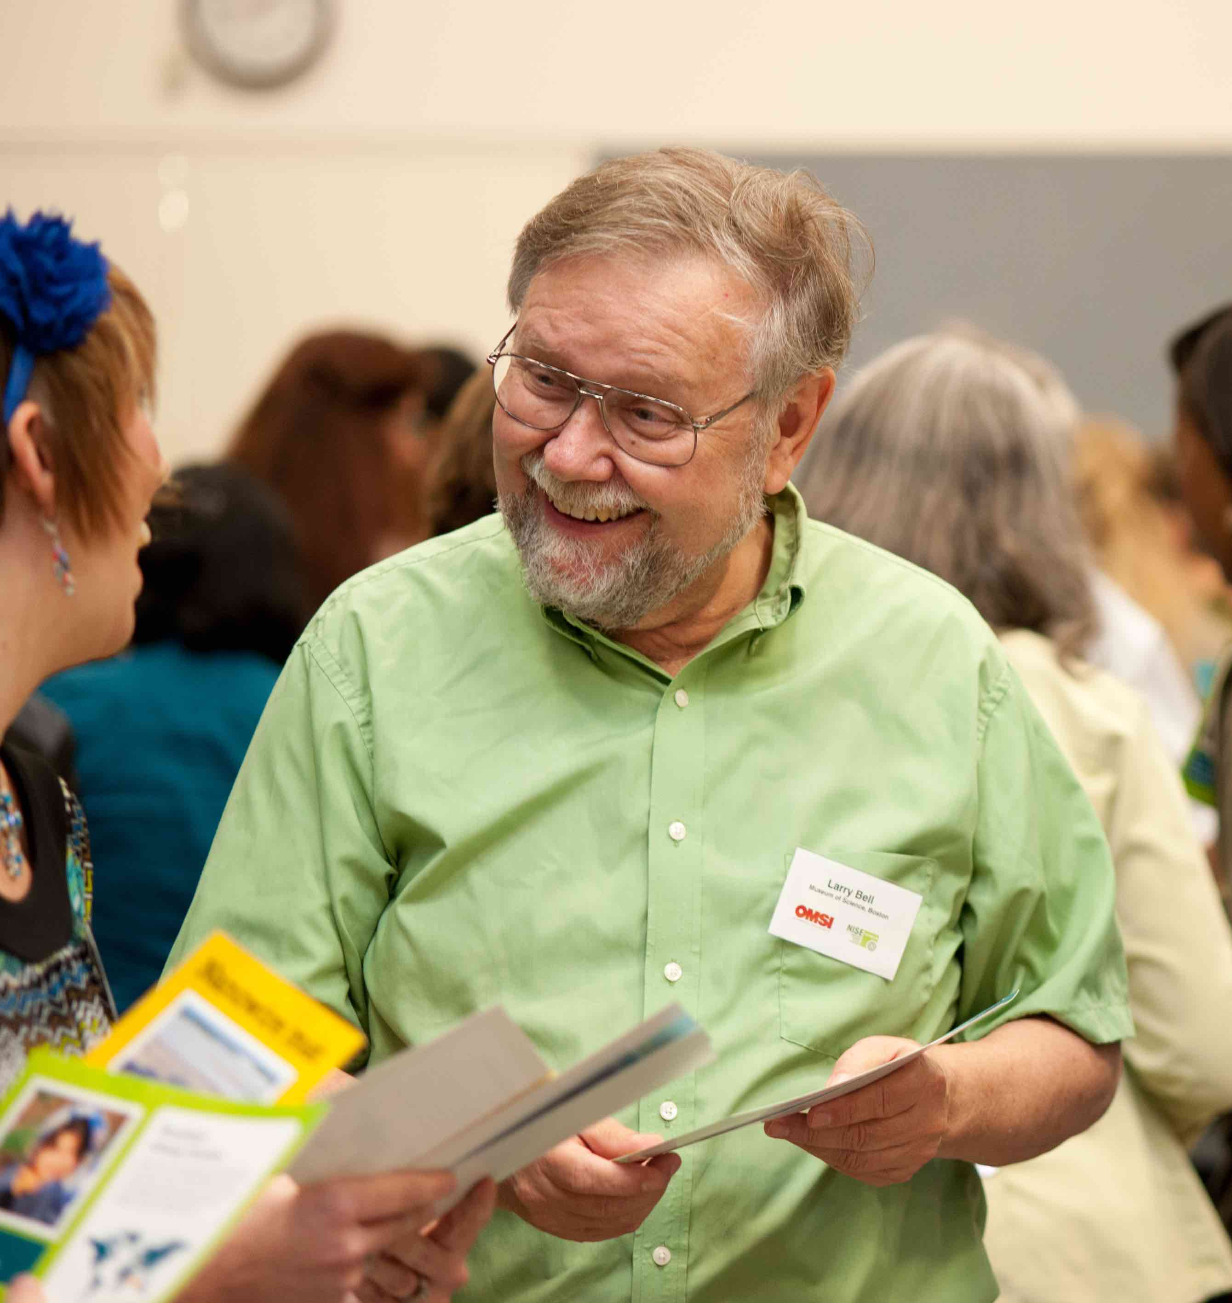
Presenters
Catherine McCarthy
Science Museum of Minnesota
cmccarthy@smm.org
Larry Bell
Museum of Science, Boston
lbell@mos.org
Rae Ostman
Arizona State University
rostman@asu.edu
Notes:
Paul Martin unfortunately not able to be with us

Slide 3
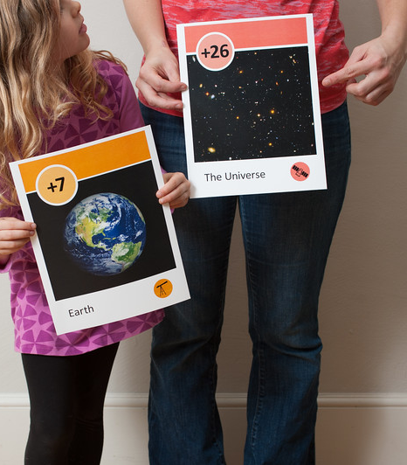
Overview
Introduction (5 min.)
NISE Network overview (15 min.)
Opportunities to participate (15 min.)
Future plans (40 min.)
Notes:
INTRO: Catherine
OVERVIEW: Rae
OPPORTUNITIES: Larry
FUTURE DIRECTIONS: Catherine (small group discussions)

Slide 4
INTRODUCTION
Notes:
CATHERINE

Slide 5

The Nanoscale Informal Science Education Network…
Notes:
10+ years of funding through NSF for nanoscale science, engineering, and technology.
Original project:
“a national community of researchers and informal science educators dedicated to fostering public awareness, engagement, and understanding of nanoscale science, engineering, and technology.”

Slide 6
… is now the National Informal STEM Education Network.
Notes:
Now have diversified our funding and the STEM topics we cover.
Leadership for the network: SMM (Paul Martin), MOS (Larry Bell), ASU (Rae Ostman)

Slide 7
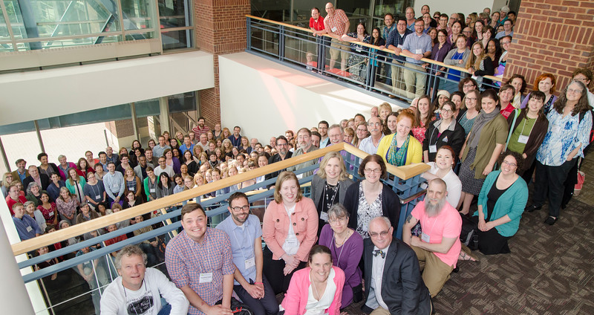
Does your organization already participate in NISE Net?
Notes:
Before we start, we’d like to get a sense of who is in the room.
Would you raise your hand if you already participate in the NISE Net?
How many of you attended our NISE Network partner breakfast yesterday?
If you’ve participated in NISE Net in the past, you’re still a member! If you’d like to join the Network, you become a partner just by joining in the work we’re doing through our different projects.

Slide 8



Were you part of these NISE Net projects?
Notes:
Please raise your hands if you have participated in the NISE Network through our “nano” projects, such as NanoDays kits and events, the Nano mini-exhibition, or the Explore Science: Zoom into Nano kits…

Slide 9


Were you part of these NISE Net projects?
Notes:
Please raise your hands if you have participated in the NISE Network through projects on other topics, such as Building with Biology or SustainABLE…

Slide 10
Network overview
Notes:
RAE

Slide 11
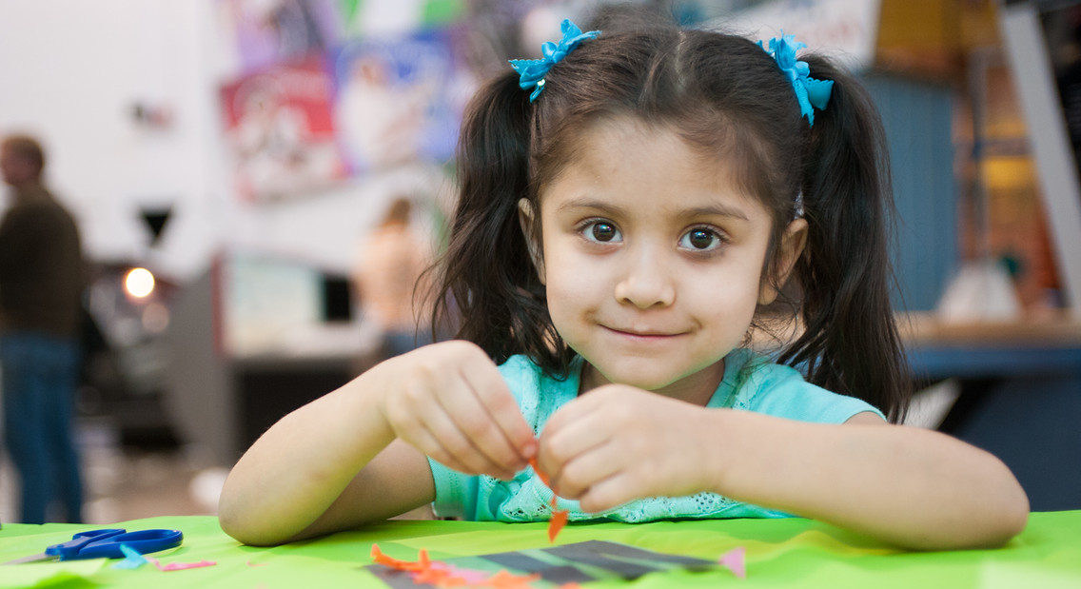
NISE Net supports informal learning about STEM in communities across the United States.
Notes:
“New” network now includes all areas of STEM = science, technology, engineering, and math.
The network is continuing our work in three areas:
--Engaging the public
--Increasing capacity (advancing the field)
--Building collaborations

Slide 12
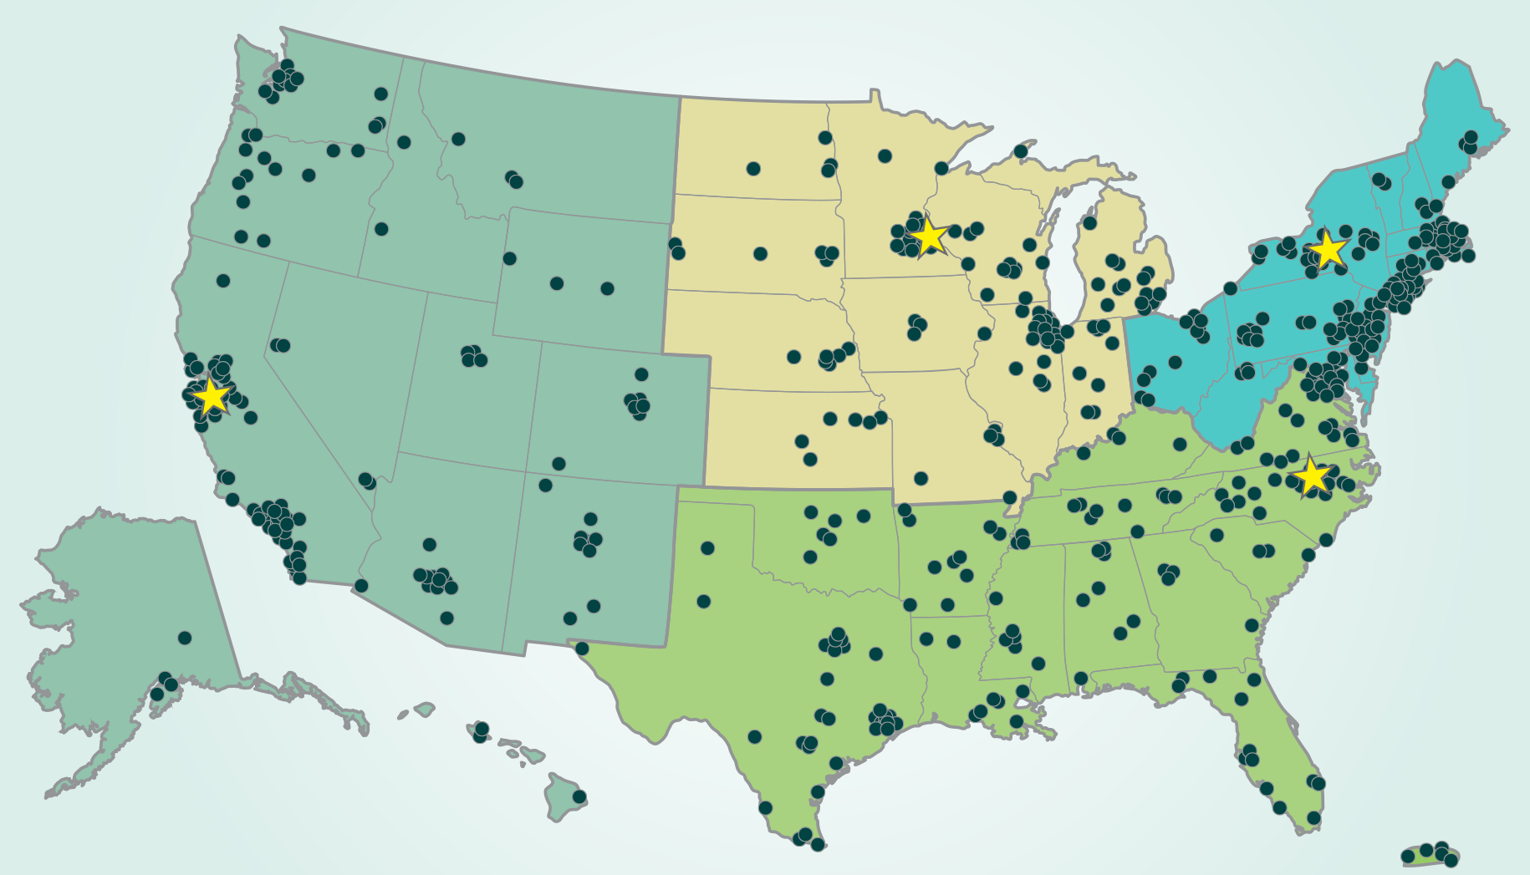
Over 600 organizations regularly participate in Network activities.
Notes:
Who are we?
~400 museums
~200 universities

Slide 13
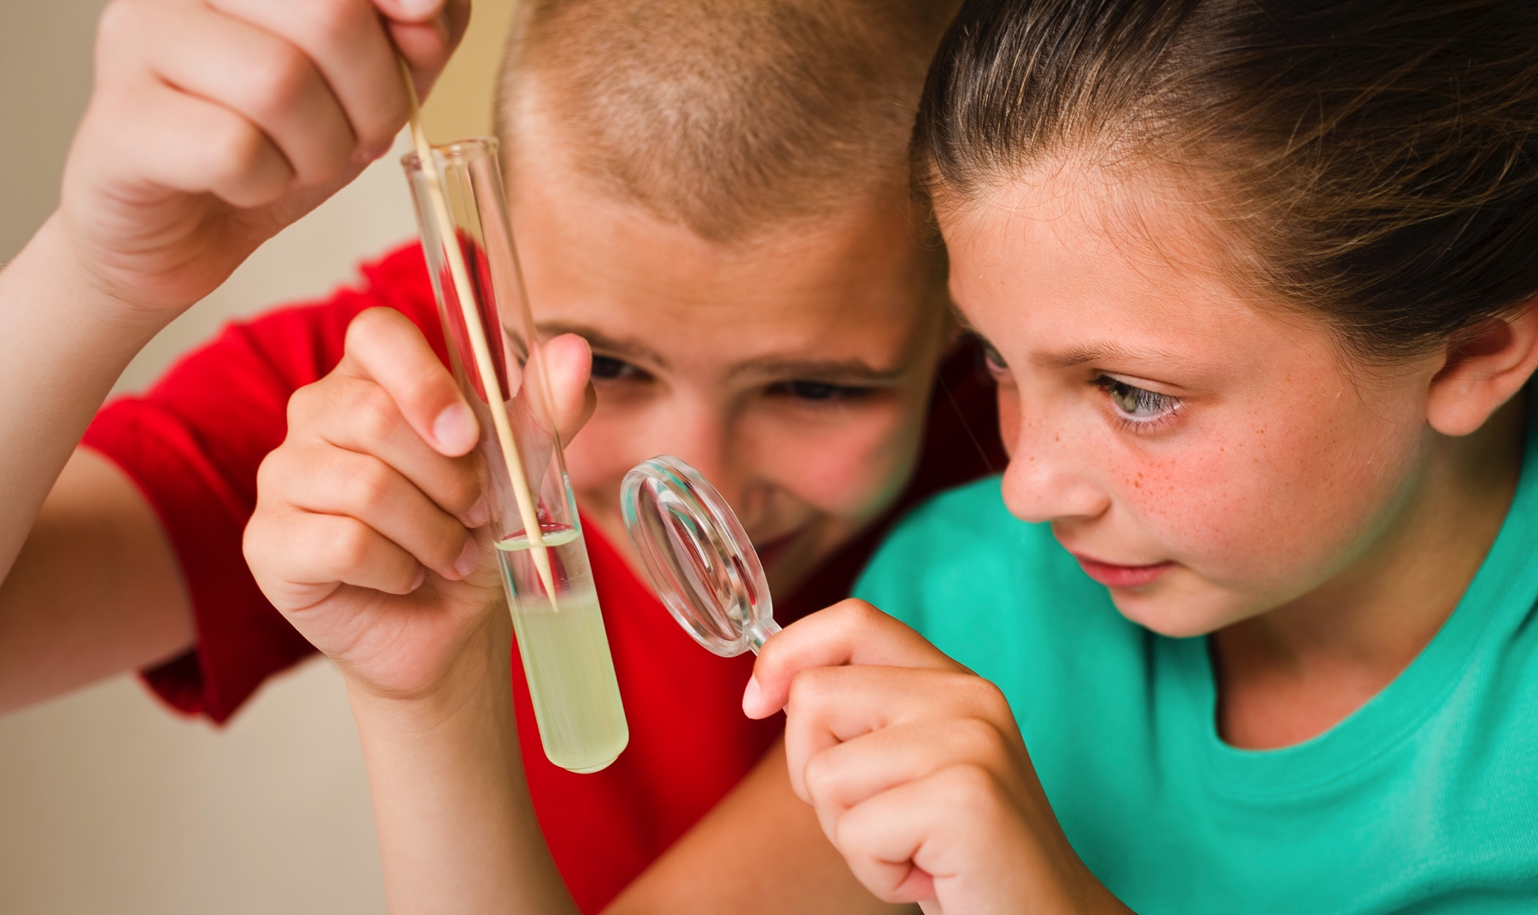
Together we reach millions of people each year!
Notes:
All 50 states and Puerto Rico

Slide 14
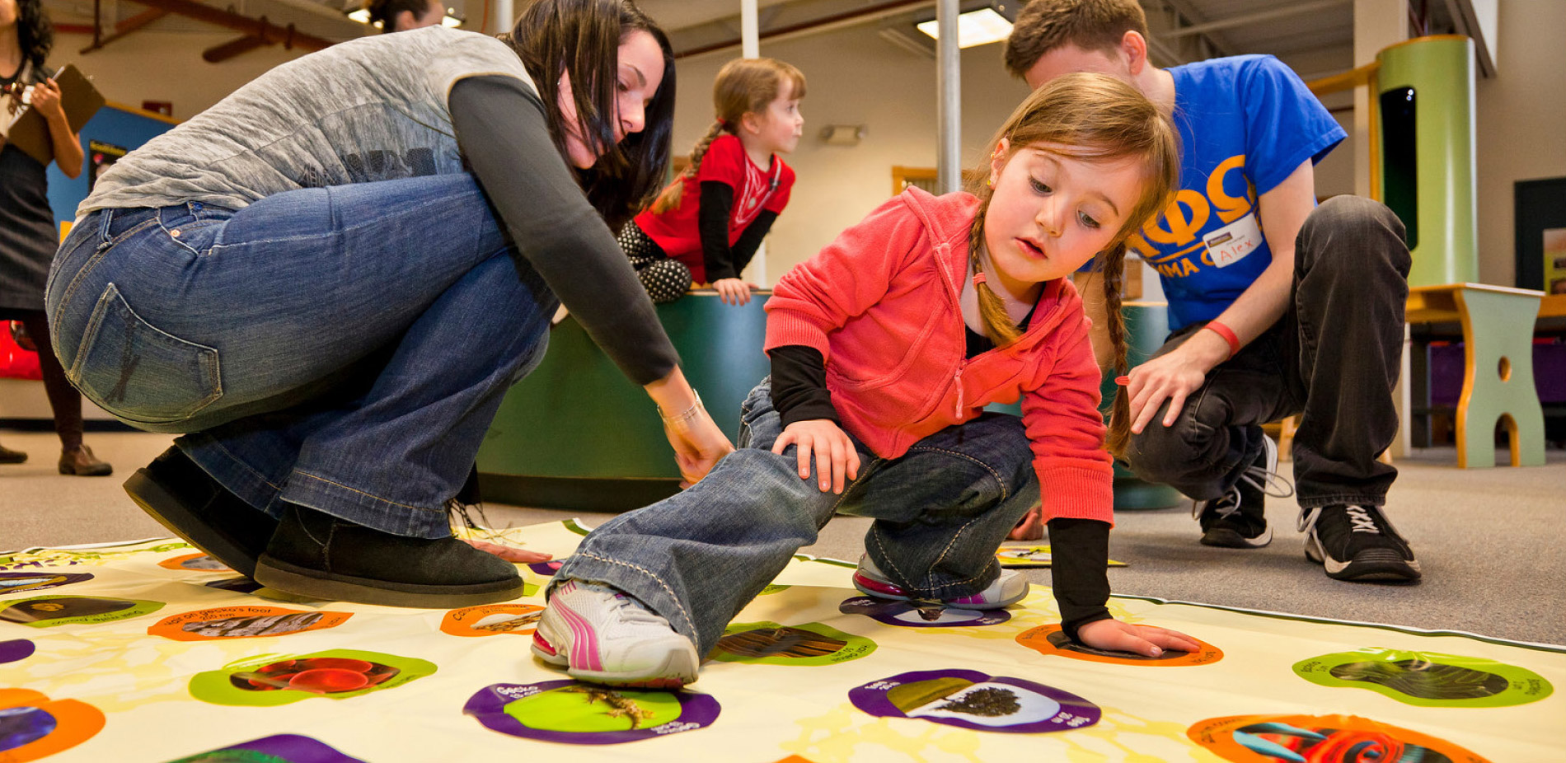
NISE Net engages all audiences in learning about STEM in ways that are fun and easy to understand.
Notes:
Accessible to and appropriate for multiple and diverse audiences

Slide 15
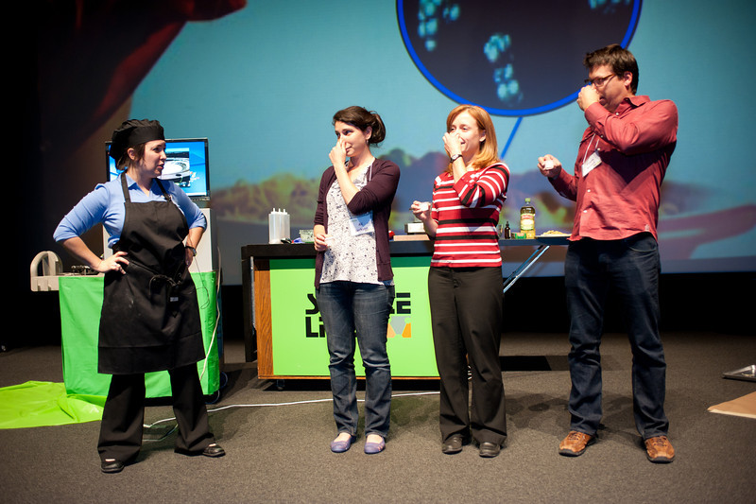
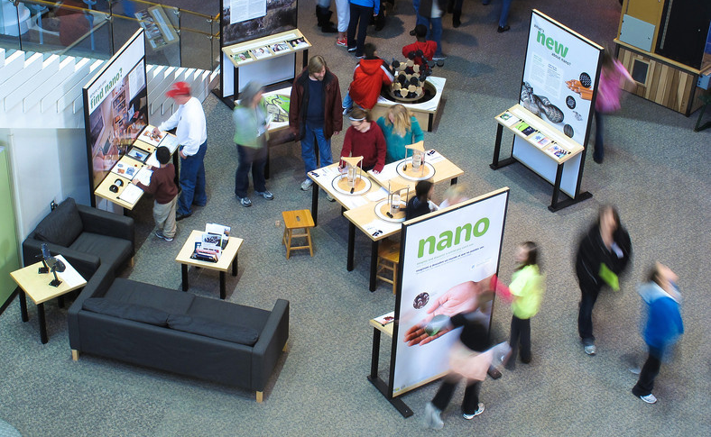
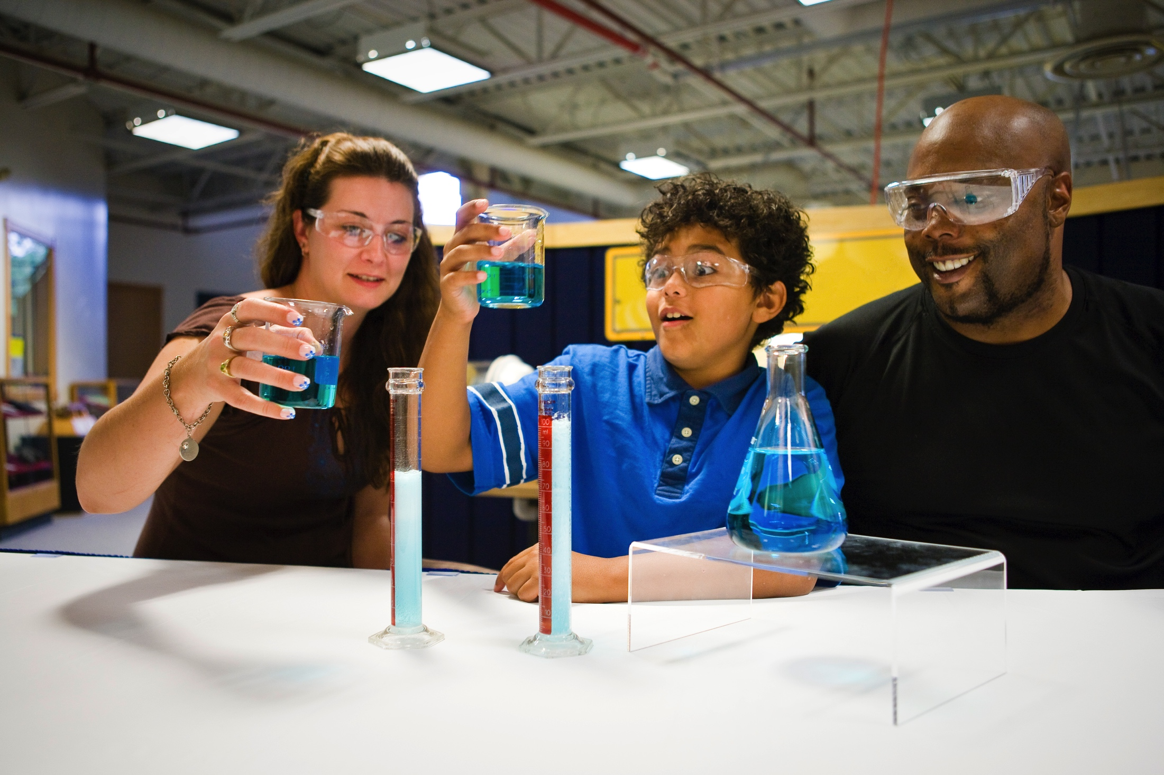
Programs
Media
Exhibits
Hands-on activities

Slide 16
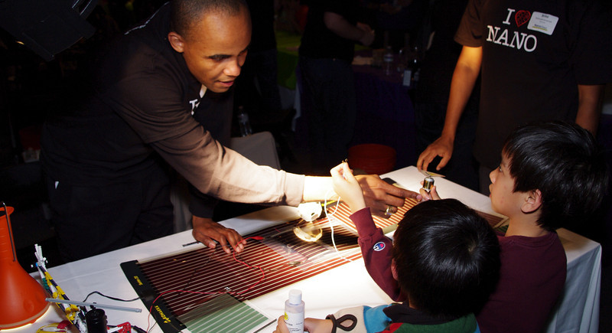
NISE Net improves the practices and skills of educators and scientists.
Notes:
Generating knowledge and providing resources that increase the capacity of the ISE field.

Slide 17
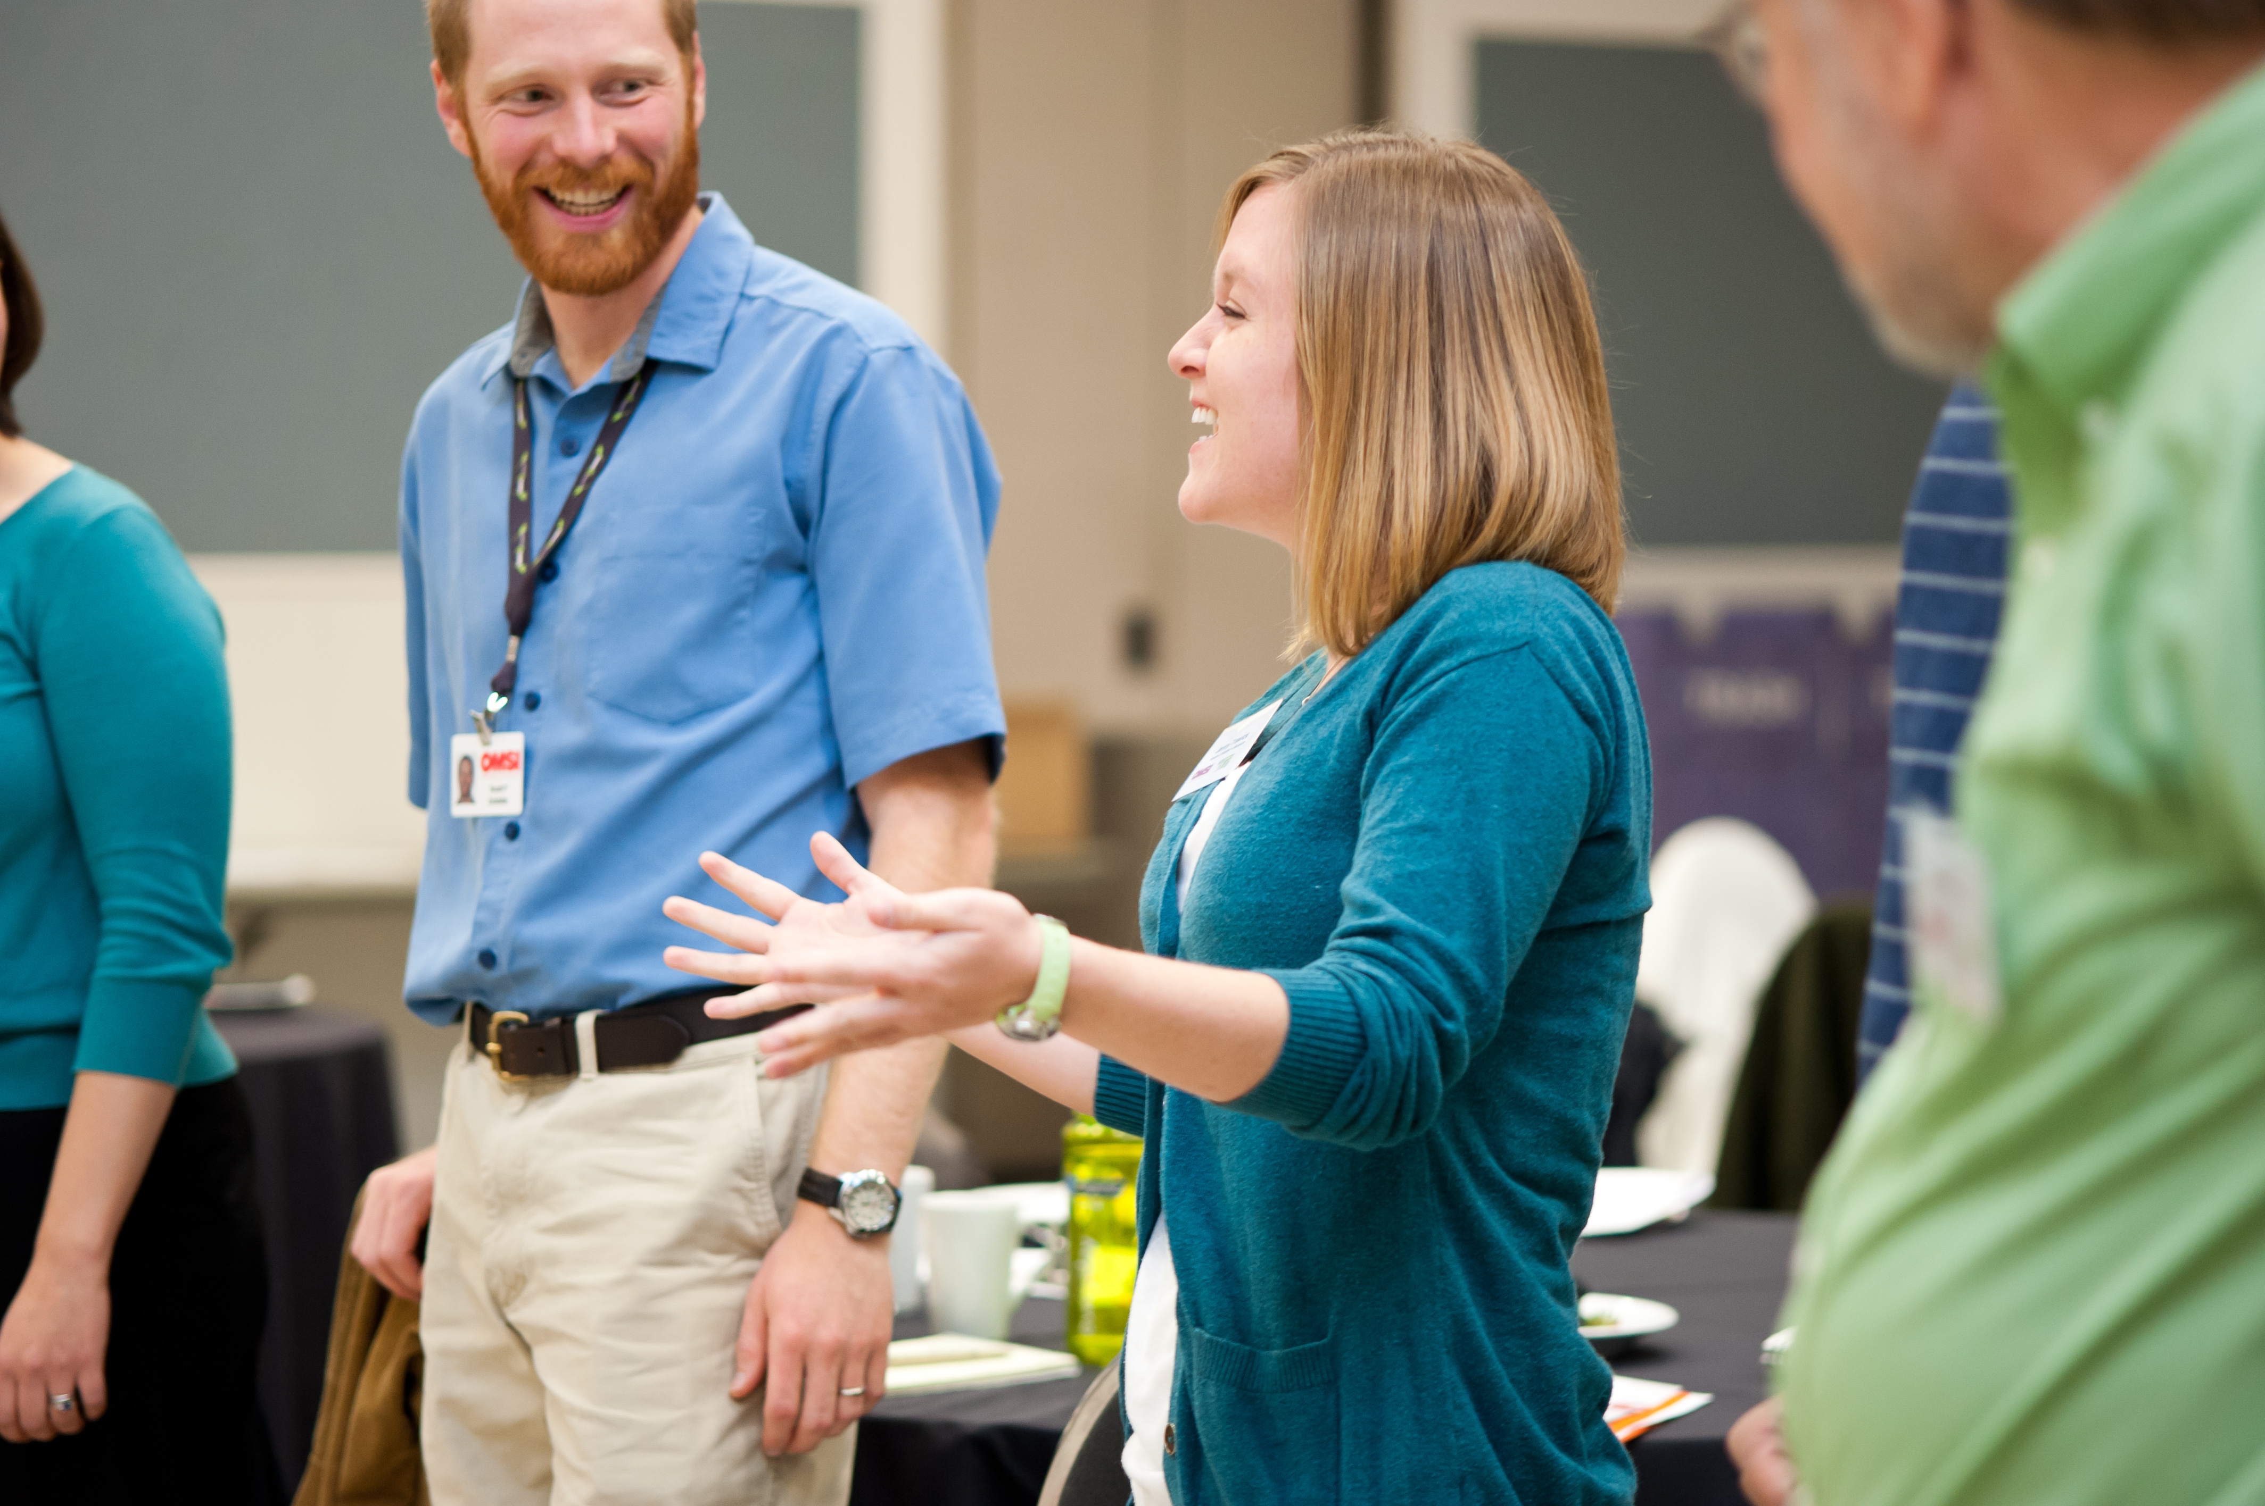
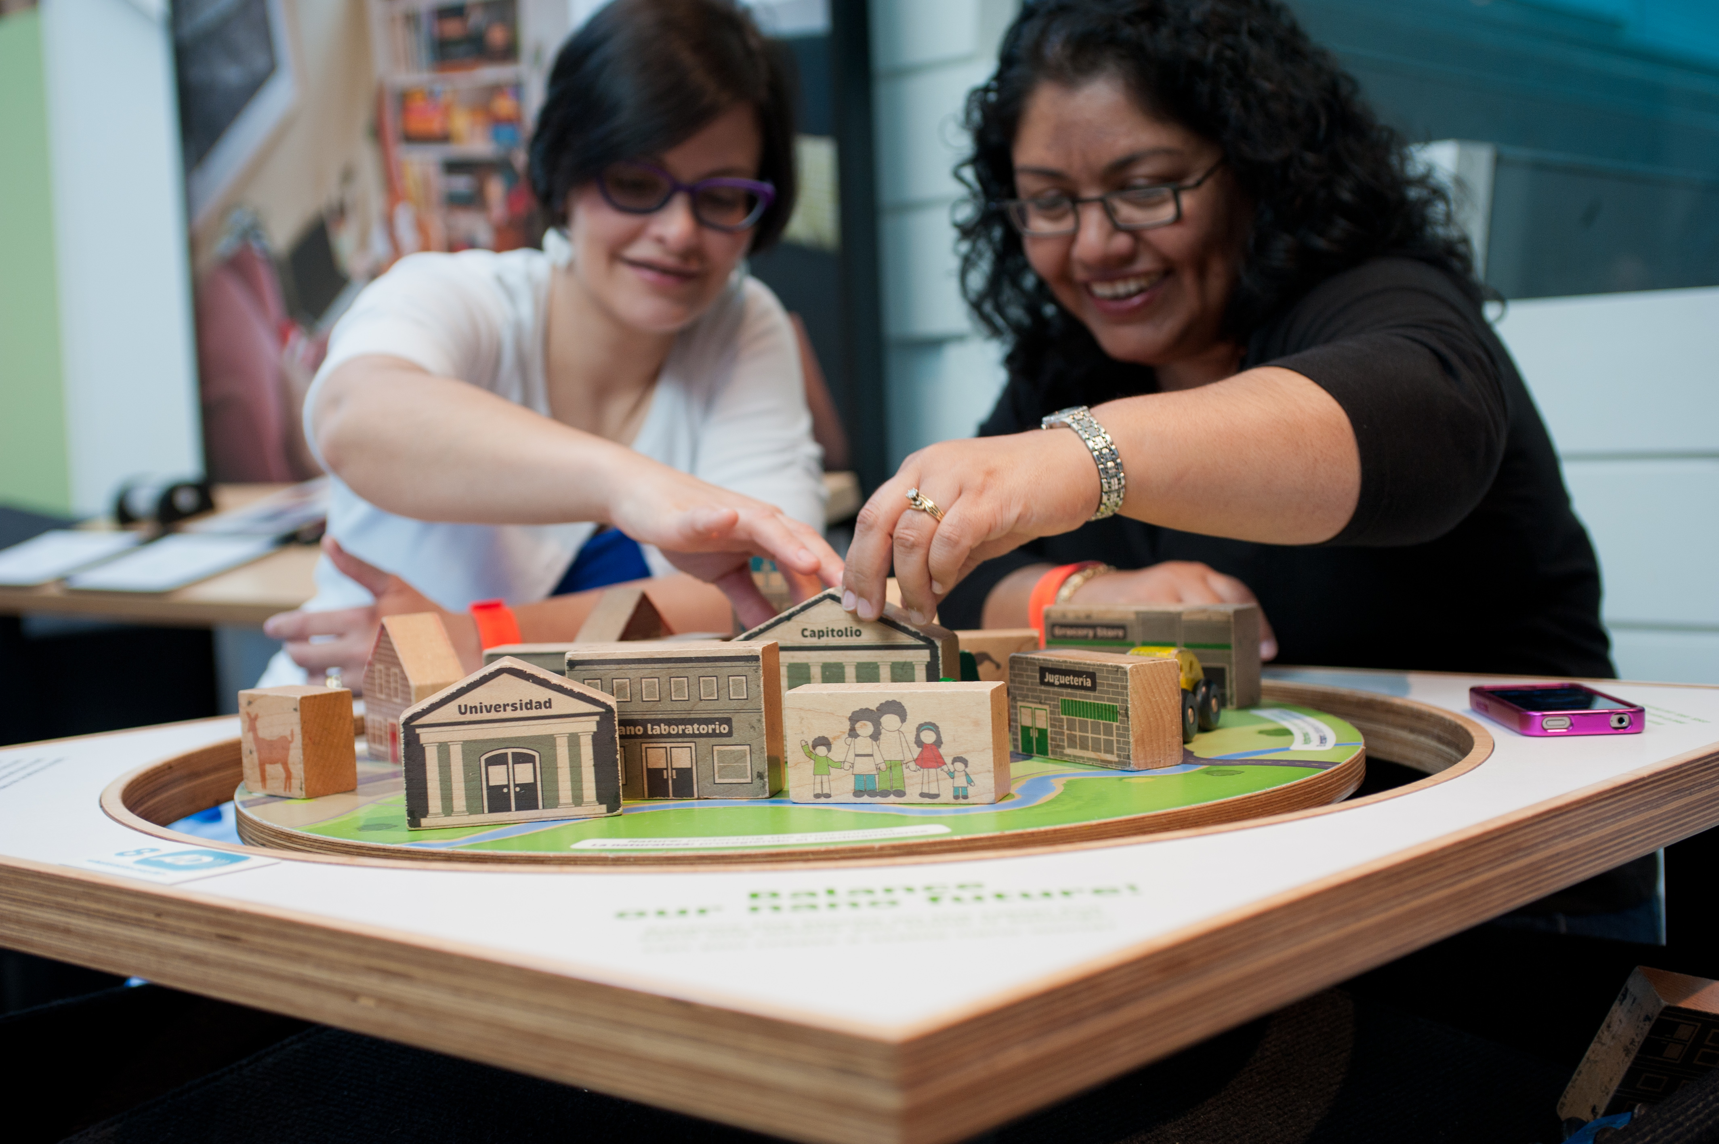
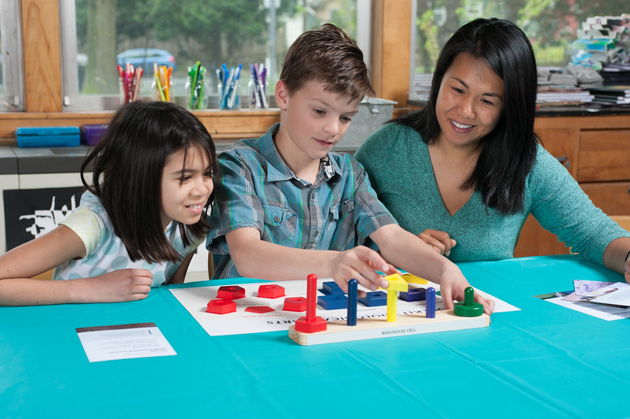
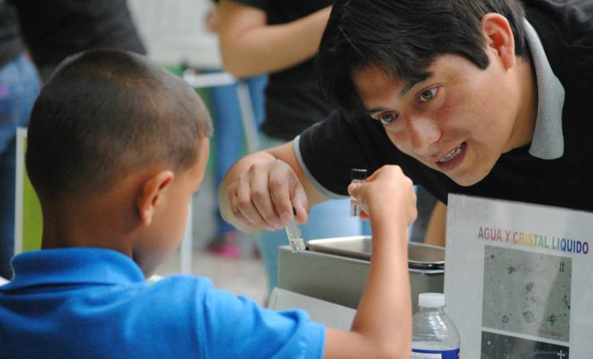
Team-based inquiry
Inclusive approaches
Science and society
Community partnerships
Notes:
Breakfast: As we continue on, we also recognize that we need to continue doing some things, because new organizations join the network and new people join partner organizations,

Slide 18
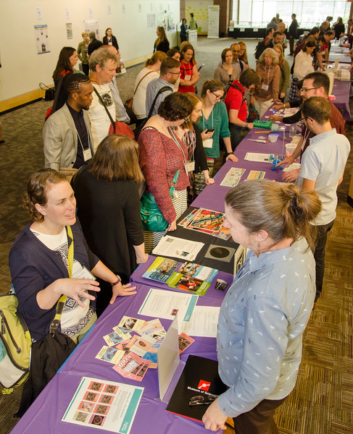
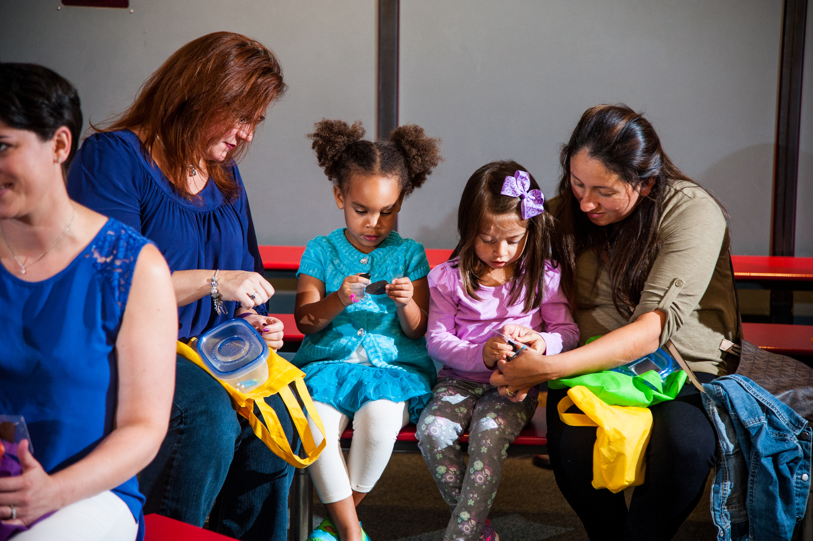
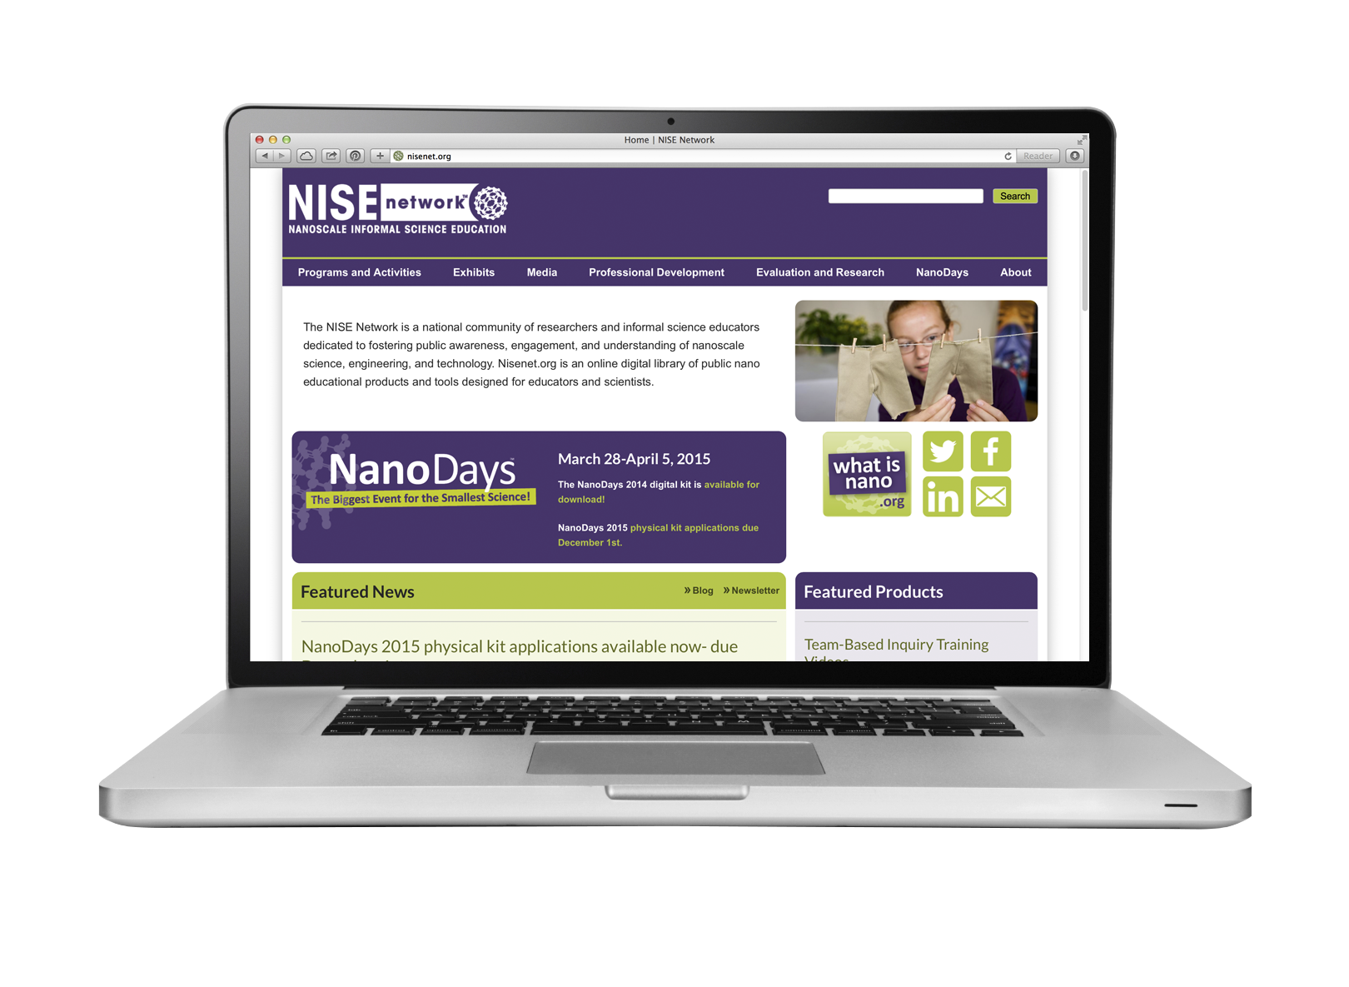
Mini-grants
Meetings
Resources

Slide 19
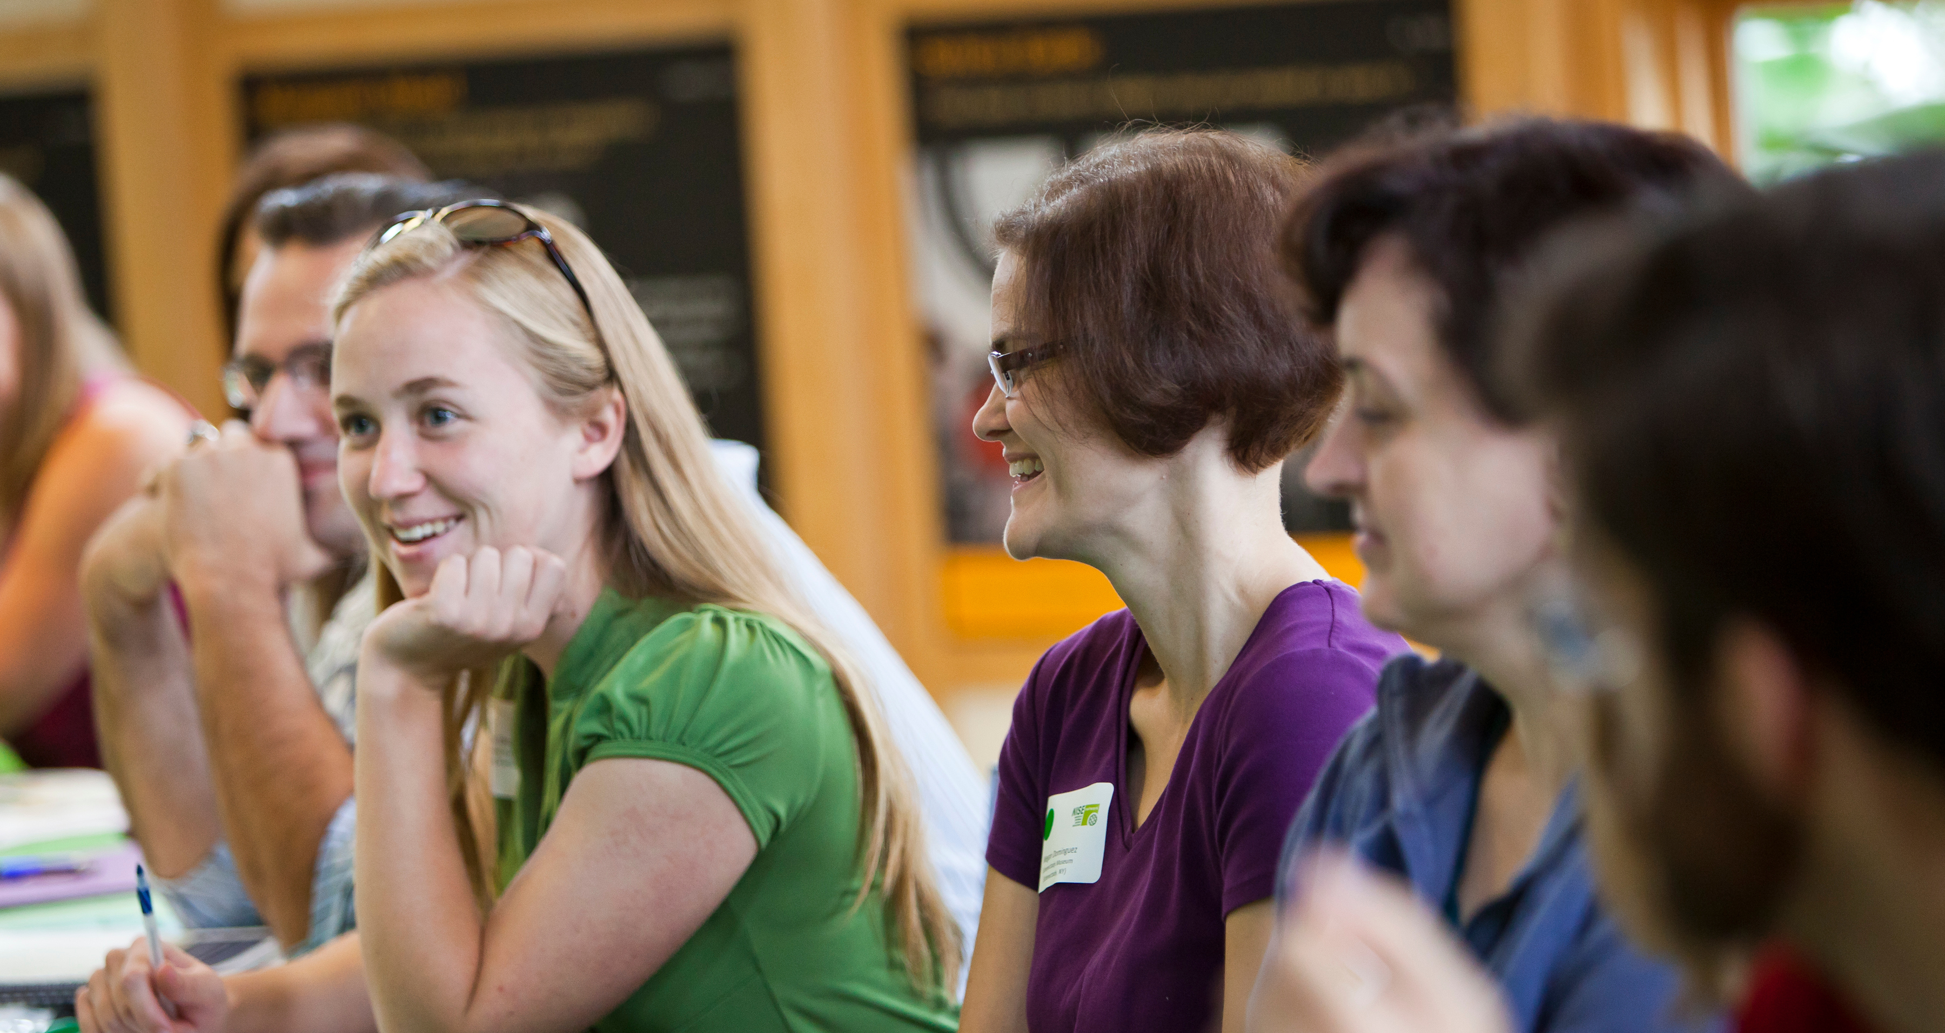
NISE Net creates lasting relationships among individuals and organizations.
Notes:
Building collaborations.
“We built the network by doing work together.”
All network partners have capacity in our three areas of focus:
--Engaging the public
--Increasing capacity (advancing the field)
--Building collaborations

Slide 20
Who we are
The “new” network is built on relationships and knowledge we developed over the past 11+ years.
Network
and project leadership
Other networks
and communities
Regional hubs
Core partners
Extended partners
Notes:
Leadership: Core, extended + advisors

Slide 21
Network leadership has evolved over the past 11+ years.
Core leadership
P Martin, SMM
L Bell, MOS
R Ostman, ASU
Extended leadership
M Benne, OMSI
I Bennett, ASU
M Dahlager, SMM
J Das, TFI
B Herring, MLS
E Kollmann, MOS
M Kortenaar, SC
C McCallum, CMH
C McCarthy, SMM
K Ostfeld, CMH
D Porcello, UCB
D Sittenfeld, MOS
R Vandiver, TCM
J Wetmore, ASU
Regional hubs
B Herring, MLS
A Jackson, SC
F Kusiak, UCB
C Leavell, SMM
Advisors
J Bell, CAISE
A Krishnamurthi, AA
L Huerta Migus, ACM
K Peterson, NGCP

Slide 22
The Network focuses on projects that benefit our partners and the field.
Project products and activities
educational products and professional development
Core partners
US museums and science centers
Engage public audiences in STEM learning
Increase the capacity of the informal science education (ISE) field
resources
implementation
Extended partners
local collaborators
and project partners
feedback

Slide 23
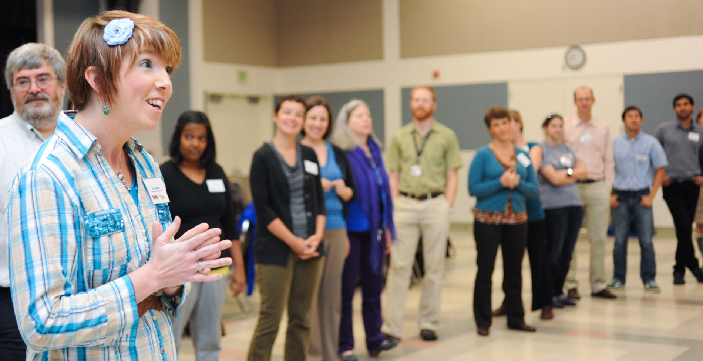
We choose projects that are important to us, and we’re positioned to do well.
Notes:
Considerations:
We can do things together that are difficult for an individual organization to do (working at scale, rigorous process for current science).
We choose projects that accomplish network goals, that we know partners are interested in, and we have the capacity to develop and implement at scale. On a practical level, someone needs to find the funding and lead the project ☺

Slide 24










NISE Net partners with professional associations and networks.
Associations
Notes:
We work with museum/ISE professional associations, but we are different: we join together to work on projects. We don’t serve the whole field in a comprehensive way, and we don’t want to compete or duplicate efforts.
We also partner with scientific associations, helping with outreach/public engagement.
And we work on a network-to-network basis with national organization
In addition, our partners work with many national organizations on a local basis, such as YMCAs, Boys and Girls Clubs, Girl Scouts, Boy Scouts

Slide 25



Website clearinghouses
NISE Net shares resources through our own website and others.
Notes:
Our website primarily focuses on educational products and professional development resources that we have created (by the network, for the network)
There are lots of great clearinghouses featuring different kinds of information and resources from other projects
We also share our resources with some of those web resources.

Slide 26
OPPORTUNITIES to participate
Notes:
LARRY and PAUL

Slide 27
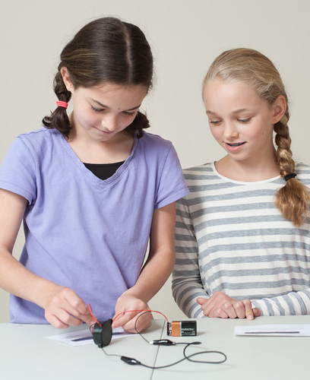
“Nano” network
GOALS
Create a national community of partners, including educators and scientists
Develop and distribute educational products that raise public awareness and understanding of nano
Generate knowledge about public and professional learning through evaluation and research
Notes:
LARRY

Slide 28
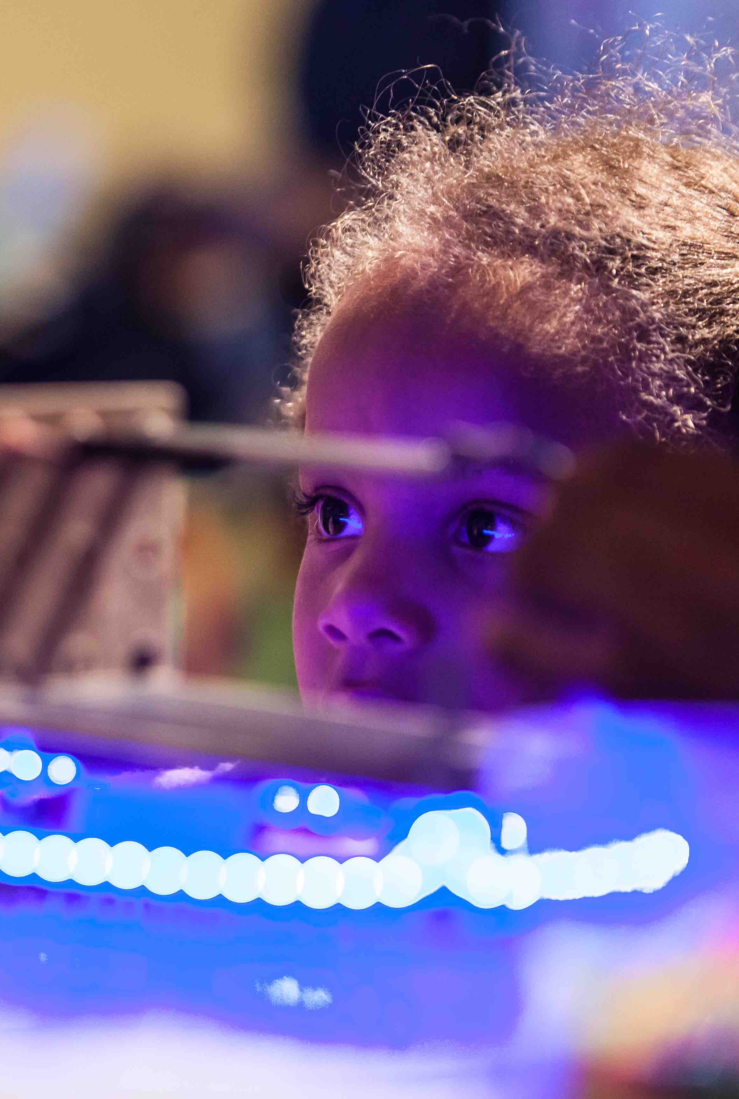
“Nano” network
ACTIVITIES
Public engagement
NanoDays events
Programs and forums
Exhibits and media
Building collaborations
Regional meetings, and network-wide meetings
Increasing capacity
Professional development guides and media
In-person and online workshops
Generating knowledge
Evaluation of public and professional impacts
Research on learning, partnerships, organizational change, and more

Slide 29
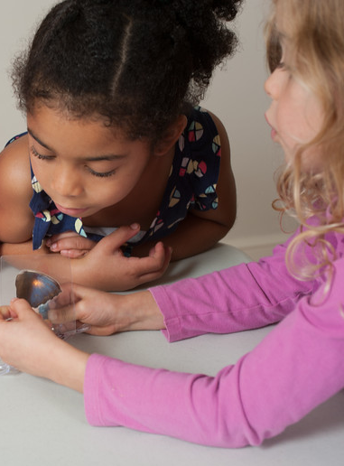
Museum & Community Partnerships
GOALS
Engage new audiences in nano
Develop and strengthen local partnerships
ACTIVITIES
100 partners received kits
CURRENT STATUS
Public engagement and evaluation ongoing
Digital kits available online:
nisenet.org/explorescience-nano
Notes:
Examples of partnerships: afterschool programs, libraries, scouts, other community organizations
Note: the link to this kit (and all other kits) are on the flyer you received.

Slide 30
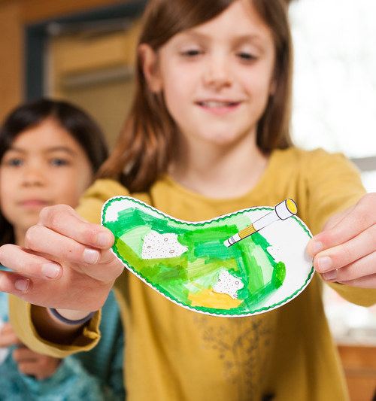
Synthetic biology
GOALS
Conversations between scientists and members of the public
Resources and practices related to social dimensions of science and technology
ACTIVITIES
200 kits of hands-on activities and a forum
Evaluation of public and professional impacts
Notes:
Building with Biology (MSPES = Multi-Site Public Engagement in Science)
PI = Larry Bell, Museum of Science
GOALS
Conversations: Multi-directional and mutually influential (Public Engagement in Science rather than Public Understanding of Science)
Resources: Learning that is transferable to other topics
ACTIVITIES
Kits: Network partners, iGEM teams.

Slide 31
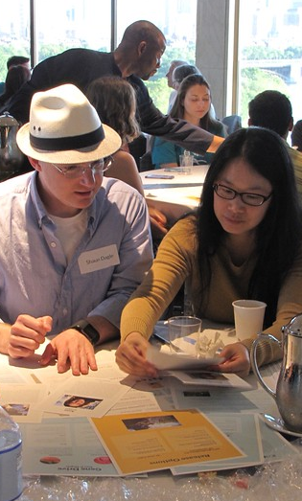
Synthetic biology
CURRENT STATUS
Public engagement and evaluation ongoing
Digital kits available online:
nisenet.org/building-with-biology-kit
A few physical kits are still available!
buildingwithbiology.org/get-involved

Slide 32
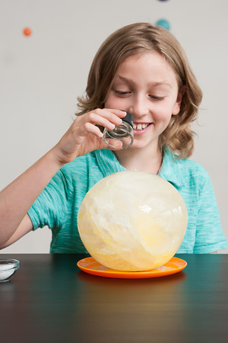

Earth and space
GOALS
Engage public and professional audiences in learning about Earth and space sciences
Encourage new and strengthened partnerships among national and local organizations that support informal and lifelong learning
ACTIVITIES
250 toolkits of hands-on activities (4 years)
Online workshops
50 small-footprint exhibitions
Evaluation of public and professional outcomes
Notes:
SEISE = Space and Earth Informal STEM Education
PI = Paul Martin, Science Museum of Minnesota
In collaboration with NASA. One of 27 STEM Education projects funded by NASA’s Science Mission Directorate. 5 years.

Slide 33

Earth and space
CURRENT STATUS
Application now open for first toolkit!
Nov 4, 2016: Application deadline
Dec 2016: Notification of awards
Jan 2017: Toolkits delivered
Jan-Mar 2017: Online workshops
Mar-May 2017: Public events
Jun 15, 2017: Reports due
More information:
nisenet.org/earthspacekit-apply
Notes:
There is also a recorded online workshop that presents the project and goes over the application process. You can find a link to it on nisenet.org.

Slide 34
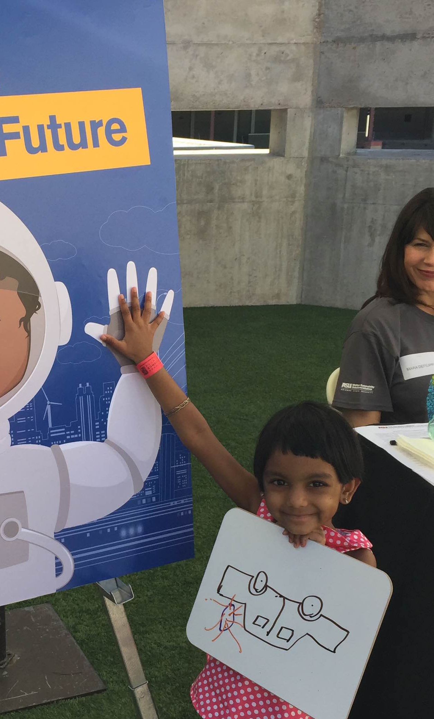
Sustainability
GOAL
Engage the public in learning about sustainability
ACTIVITIES
Pilot kits of hands-on activities
(partnership of ASU and NISE Net)
Sustainability fellowships
(through Walton Sustainability Solutions Initiatives)
CURRENT STATUS
Public engagement and evaluation ongoing
Digital kits available online:
nisenet.org/sustainable-kit
Notes:
PAUL
In collaboration with Arizona State University.

Slide 35
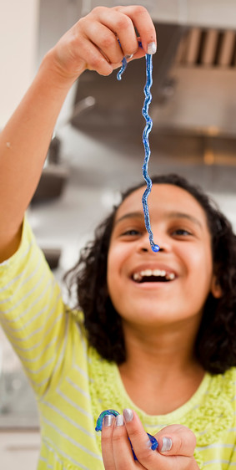
Chemistry
GOALS
Generate knowledge about strategies for influencing public interest, understanding, perception of relevance, and feelings of self-efficacy about chemistry
Engage the public in learning about chemistry
Increase the capacity of museum staff to engage the public in chemistry
ACTIVITIES
Design-based research
250 kits of hands-on chemistry activities
Professional development resources
CURRENT STATUS
Funded!
Notes:
ChemAttitudes
In collaboration with American Chemical Society
PI = Larry Bell, Museum of Science
Kit applications in Fall 2018; implementation beginning in early 2019

Slide 36
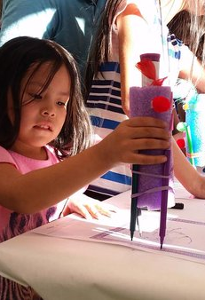
Frankenstein – Science and society
GOALS
Engage the public in creative activities and reflecting on responsible innovation
Increase the capacity of museum staff to engage the public in science and society content
Investigate learning in a transmedia environment
Celebrate the bicentennial of Frankenstein
ACTIVITIES
50 “footlockers” of hands-on making activities
Digital interactives and online challenges
Professional development workshop
Research and evaluation
CURRENT STATUS
Digital kit available fall 2017
Programming to celebrate the bicentennial, beginning Jan 2018
Notes:
In collaboration with Arizona State University (PI Ed Finn)
Bicentennial: 200th anniversary of the publication of Mary Shelley’s novel, Frankenstein

Slide 37
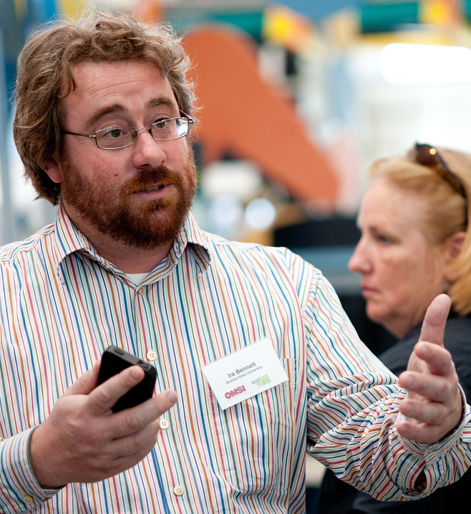
Stay in the loop!
  Website:
  nisenet.org
  Newsletter:
  nisenet.org/newsletter
  Social media:
  nisenet.org/social
Notes:
That was a lot of projects! You can find the critical information on your flyer.
To stay up to date on everything related to the network, be sure you’re on all our lists.

Slide 38
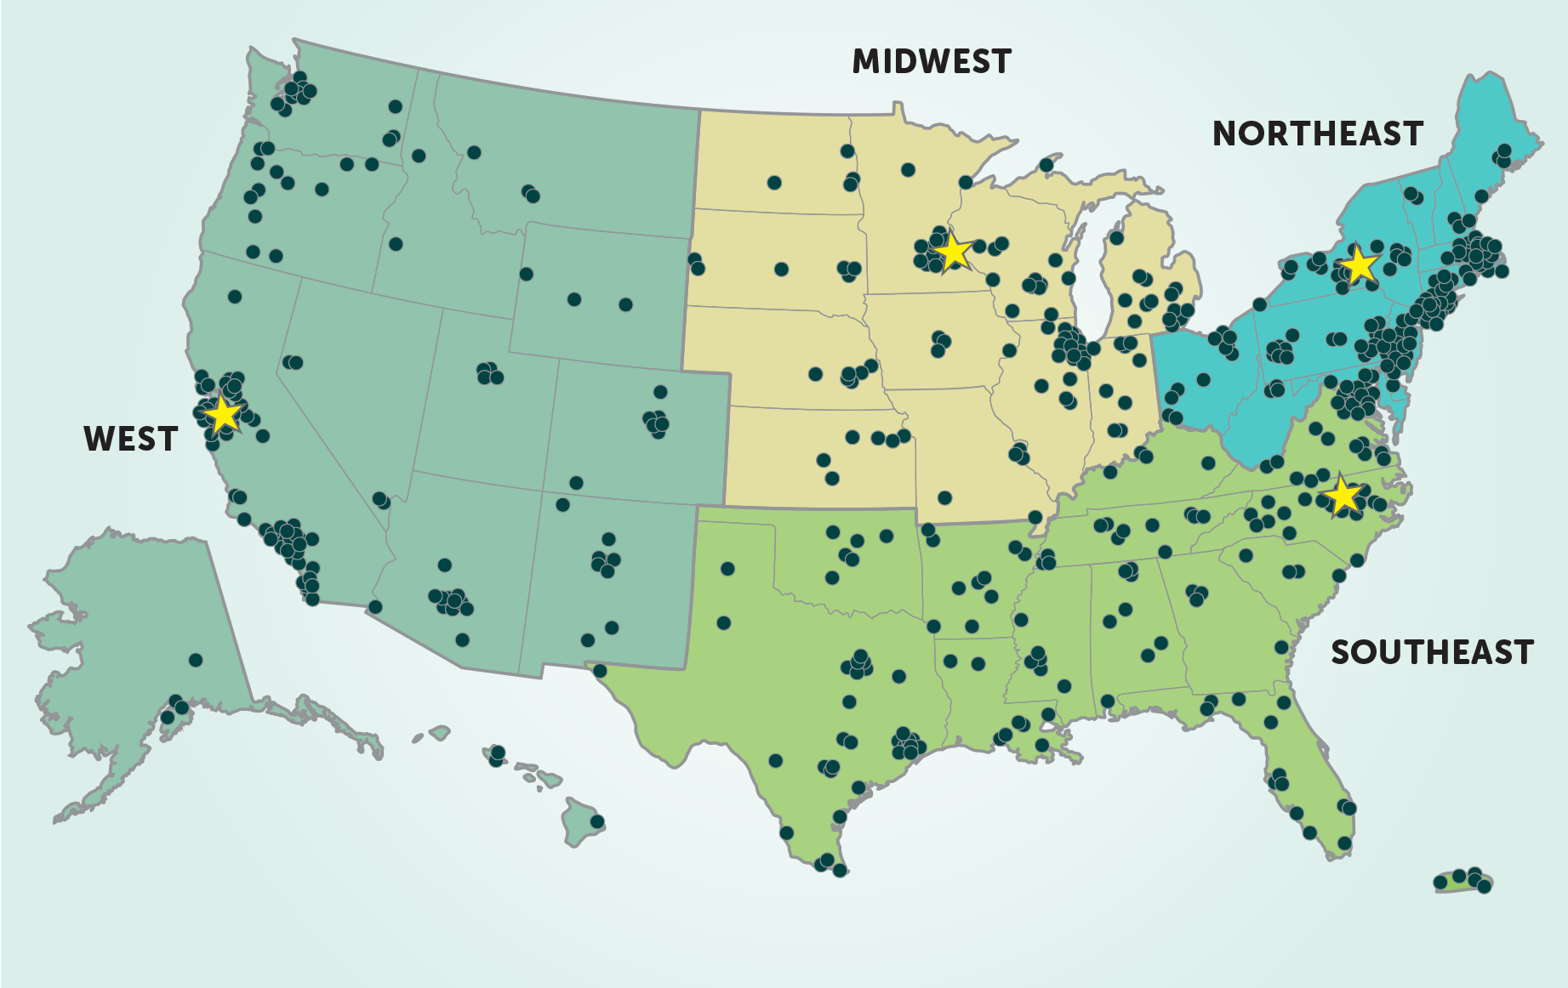
Stay in the loop!
Stay in the loop!
Regional hub leaders:
nisenet.org/contact
Notes:
And most importantly, get to know your regional hub leader!
See your flyer to learn which hub you belong to, and to find the contact info for your regional hub leaders.
MW: Christina Leavell, Science Museum of Minnesota
NE: Ali Jackson, Sciencenter
SE: Brad Herring, Museum of Life + Science
W: Frank Kusiak, Lawrence Hall of Science

Slide 39
FUTURE
DIRECTIONS
Notes:
CATHERINE
Discussion

Slide 40
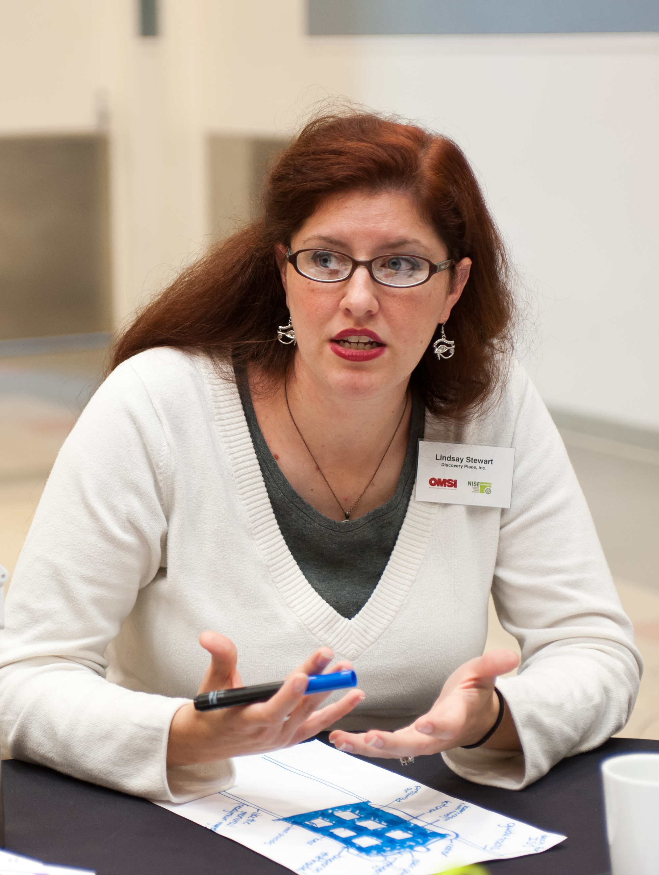
Discussion topics
Engaging the public
Current science
Science and society
Citizen science
Small-footprint exhibitions
Games
Diverse audiences
Building relationships
Museums and community organizations
Museums and scientists
Increasing capacity
Broadening participation
Best practices
Evaluation
Notes:
We’ve asked partners attending our breakfast about future directions
Show of hands to choose which topics
Divide into groups

Slide 41



Thank you
The Nanoscale Informal Science Education Network is supported by the National Science Foundation under award numbers 0532536 and 0940143. Multi-Site Public Engagement in Science is supported by the National Science Foundation under award number 1421179. Transmedia Museum is supported by the National Science Foundation under award number 1516684. ChemAttitudes is supported by the National Science Foundation under award number 1612482. Any opinions, findings, and conclusions or recommendations expressed in this presentation are those of the authors and do not necessarily reflect the views of the Foundation.
Sustainability in Science Museums is supported by the Walton Sustainability Solutions Initiatives at Arizona State University (ASU) and is a collaboration with the Center for Engagement and Training in Science and Society at ASU.
Space and Earth Informal STEM Education is supported by NASA under cooperative agreement number NNX16AC67A. Any opinions, findings, and conclusions or recommendations expressed in this material are those of the author(s) and do not necessarily reflect the view of the National Aeronautics and Space Administration (NASA).

Slide 42
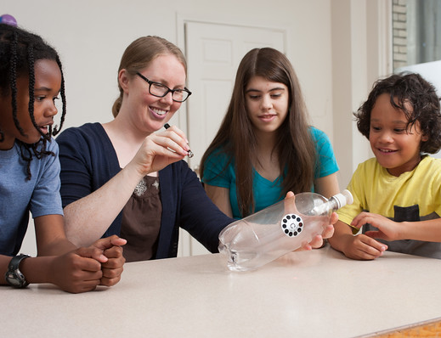
www.nisenet.org

