Slide 1
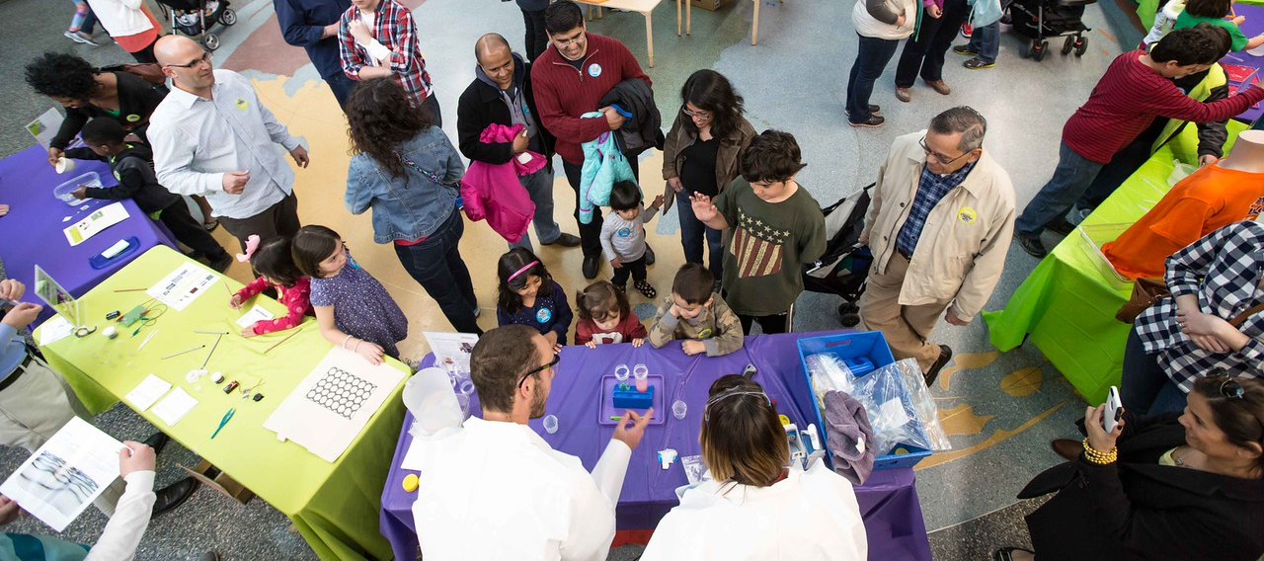
Great Ideas for Planning and Hosting Special Events
Marbles Kids Museum, NC
Catherine McCarthy
cmccarthy@smm.org
May 2015
Notes:
Good morning

Slide 2
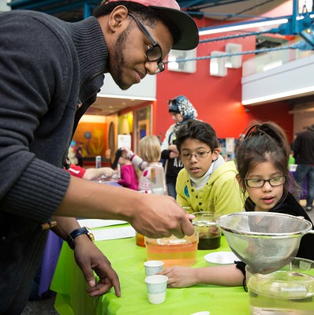
Why Special Events?
offer unique programming experiences
celebrate special occasions
appeal to new audiences
foster community relationships and collaborations
Marbles Kids Museum, NC
Notes:
offer unique programming experiences for our visitors that we don’t offer every day
a way to celebrate special occasions (holidays, historical, cultural events,...)
appeal to new audiences
foster community relationships and bring in special collaborators

Slide 3
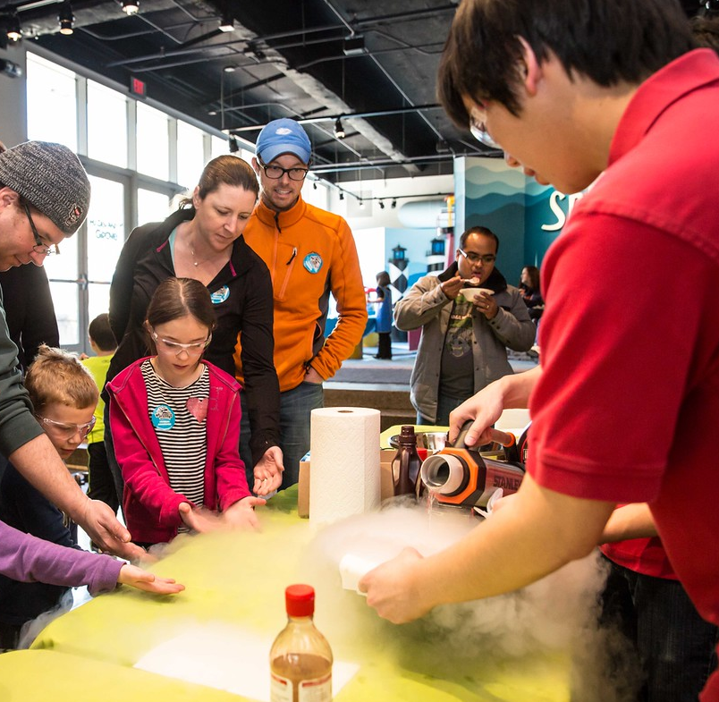
Special events also bring needs for
planning
logistical challenges
staffing
training
special marketing
new programming
collaborations
Marbles Kids Museum, NC
Notes:
Special events are WONDERFUL!
but they also require the need for planning, present logistical challenges, staff and training needs, special marketing, and new programming, and collaborations, specials
But we're not in it alone. we have some great presenters today to share their experiences

Slide 4
Great Ideas for Planning and Hosting Special Events
Michelle Kortenaar, Sciencenter, NY
Liz Leahy, The Discovery Museums, MA,
Becky Wolfe, The Children’s Museum of Indianapolis, IN
Juliet Gray-Moliere, Brooklyn Children's Museum, NY
Aaron Guerrero & Kevin Velasquez, Children's Museum of Houston, TX
Brad Herring, Museum of Life and Science, NC
Ali Jackson, Sciencenter, NY
Breakout into tables
Notes:
This session brings together a wealth of resources and experience to share. Session panelists will each speak for about six minutes or less on ways we can each make local events higher impact and more successful. Together we'll cover a range of event themes that bridge science, history, culture, art, and national holidays.
Then we’ll break into for more detailed information and resources.

Slide 5
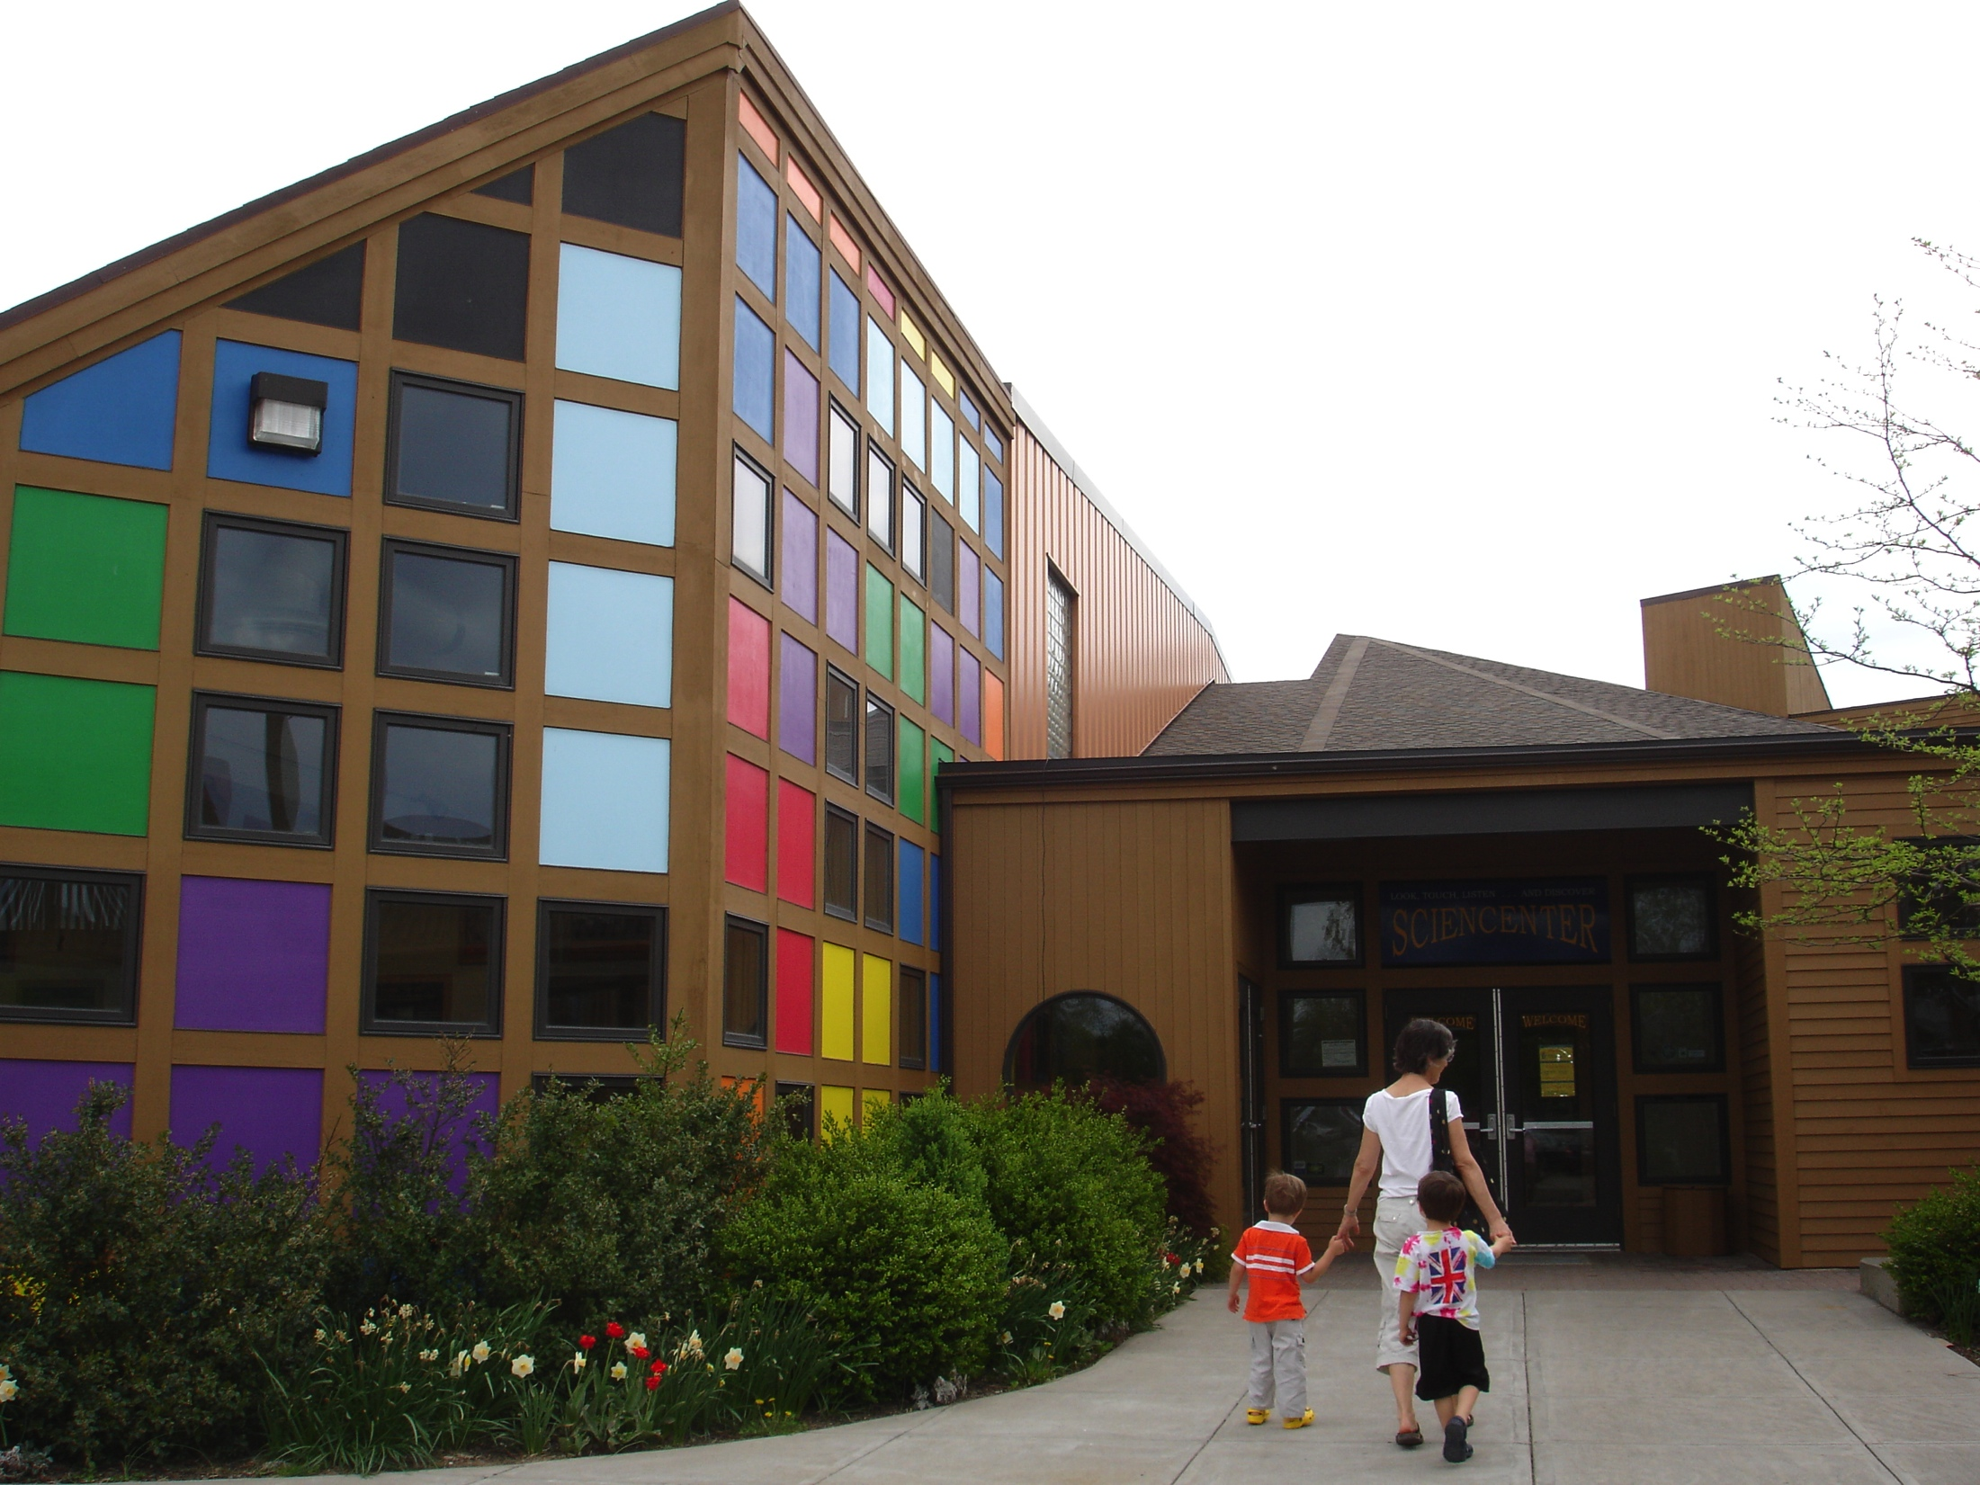
Michelle Kortenaar
Director of Education
Sciencenter
Ithaca, NY
Notes:
Location: Ithaca, Ney York
The Sciencenter started as a community outreach effort by two educators – afterschool
We are deeply rooted in our community – the Sciencenter itself was built by community volunteers
The Sciencenter is located in an underserved, lower socio-economic community. Ithaca is surrounded by rural upstate NY. How do we invite those communities in?

Slide 6
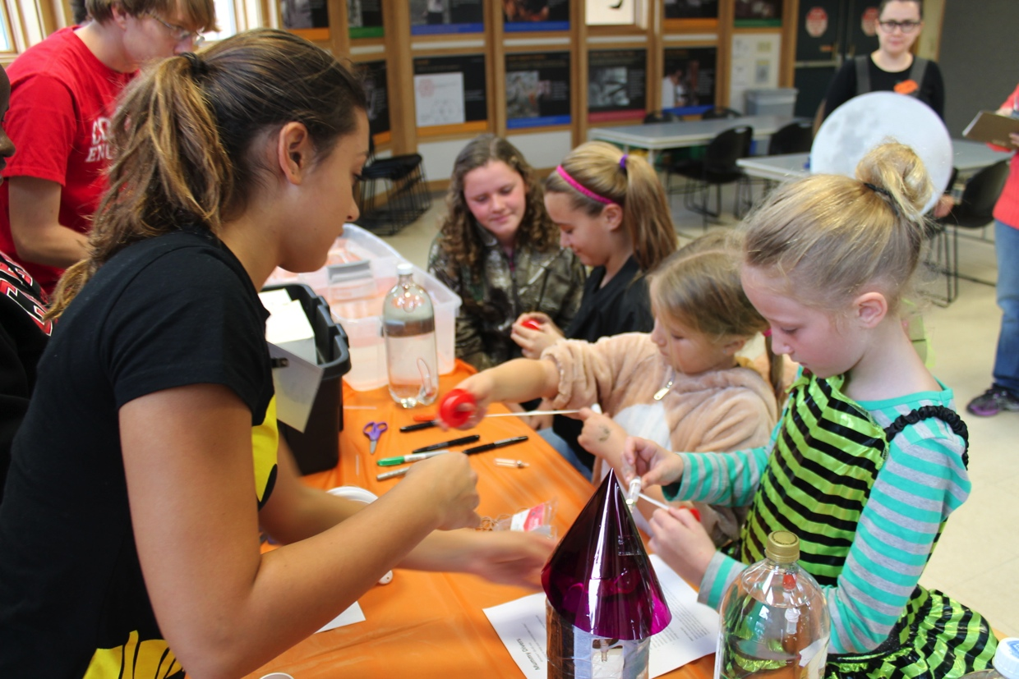
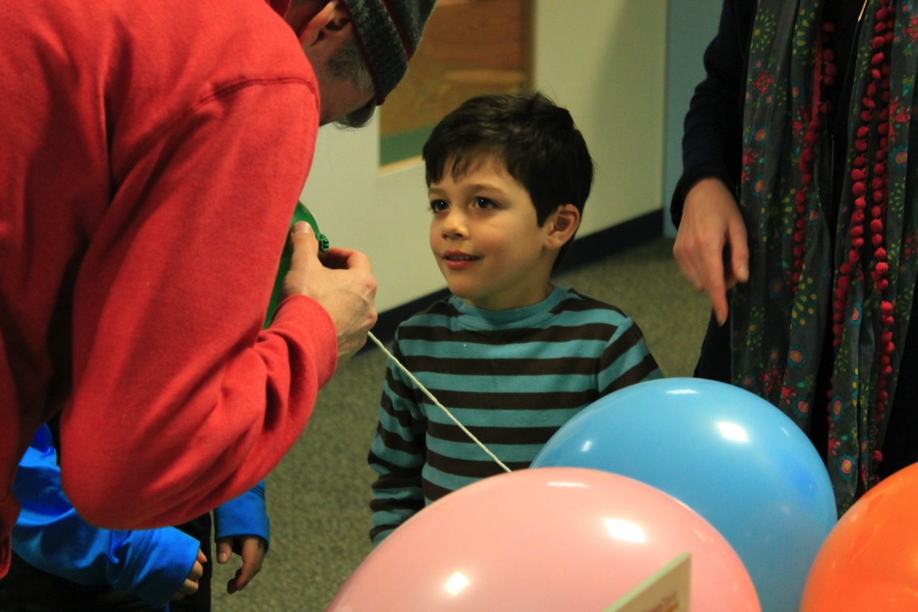
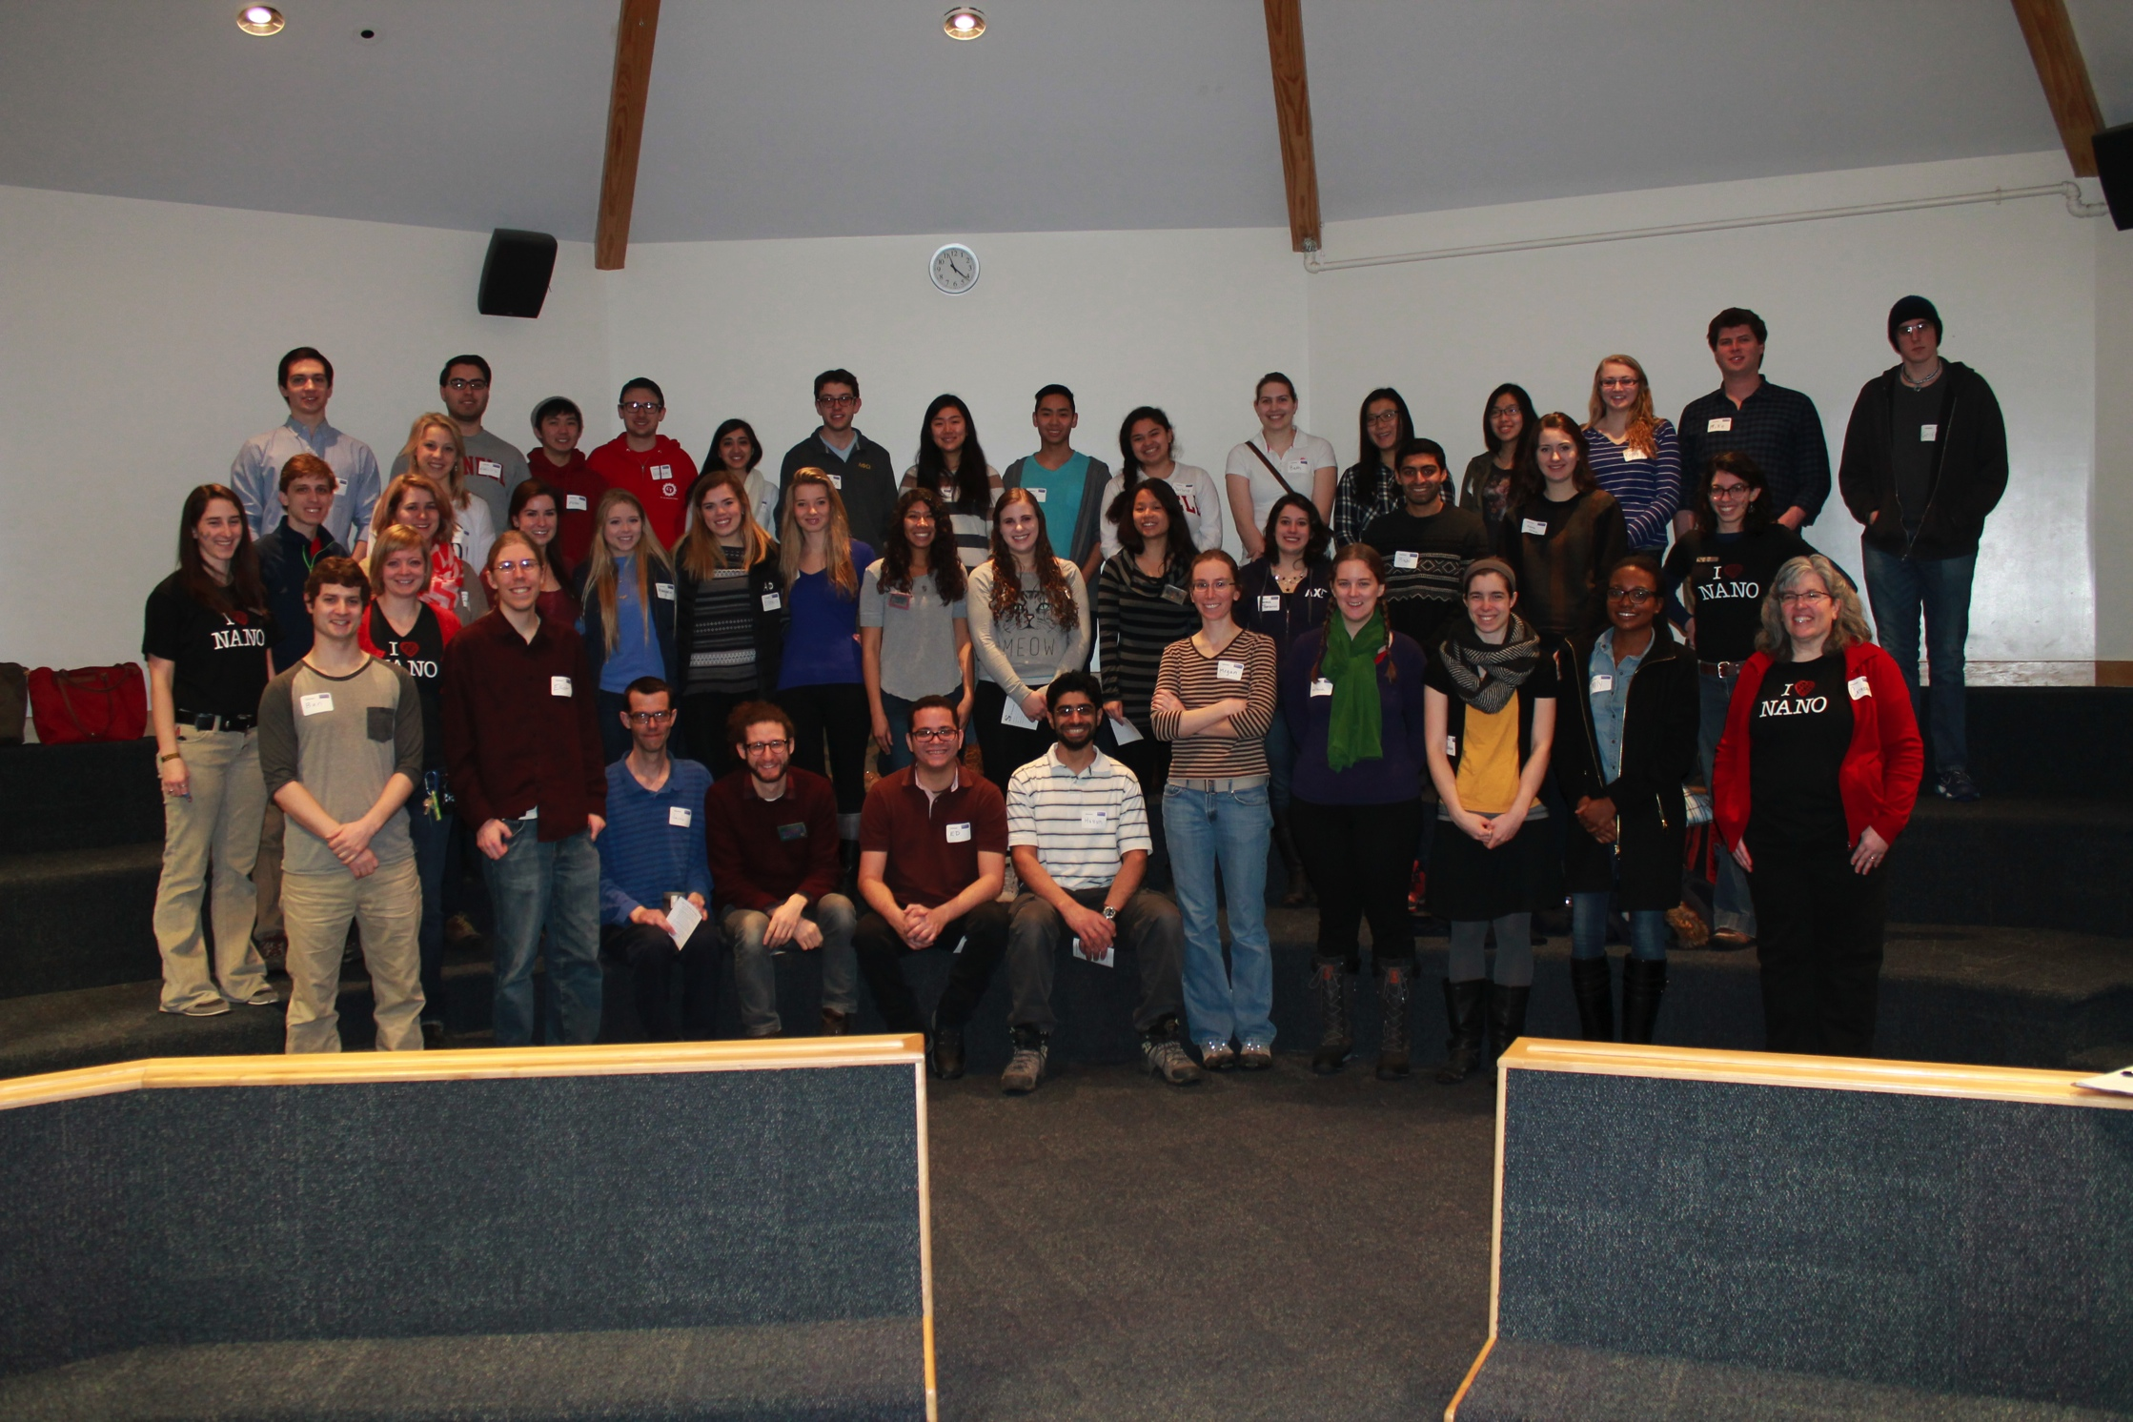

Slide 7
Great Ideas for Planning and Hosting Special Events
Michelle Kortenaar, Sciencenter, NY
Liz Leahy, The Discovery Museums, MA,
Becky Wolfe, The Children’s Museum of Indianapolis, IN
Juliet Gray-Moliere, Brooklyn Children's Museum, NY
Aaron Guerrero & Kevin Velasquez, Children's Museum of Houston, TX
Brad Herring, Museum of Life and Science, NC
Ali Jackson, Sciencenter, NY
Breakout into tables

Slide 8
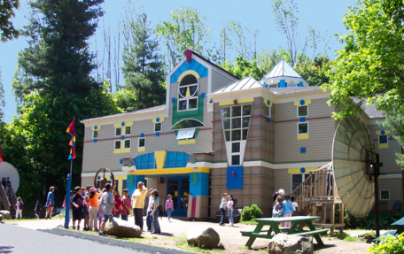
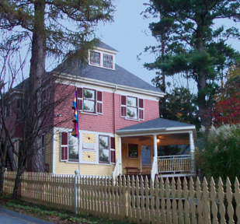
Acton, Massachusetts
www.discoverymuseums.org
Elizabeth Leahey
Assistant Director of Learning Experiences
eleahey@discoverymuseums.org

Slide 9
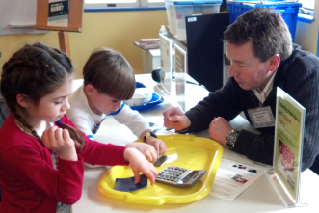
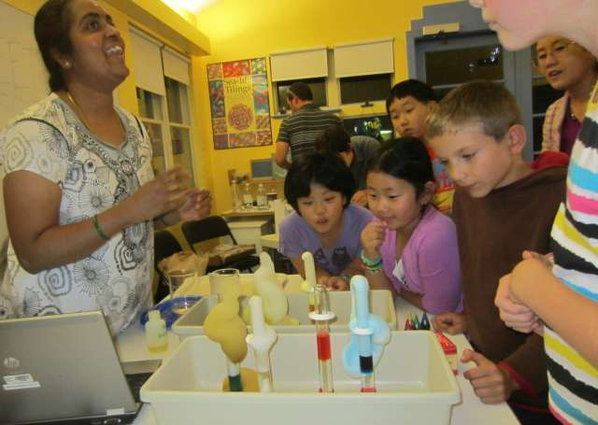
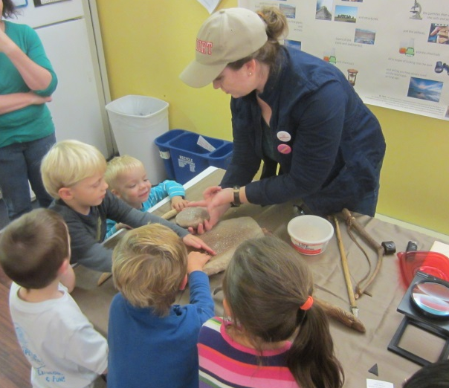
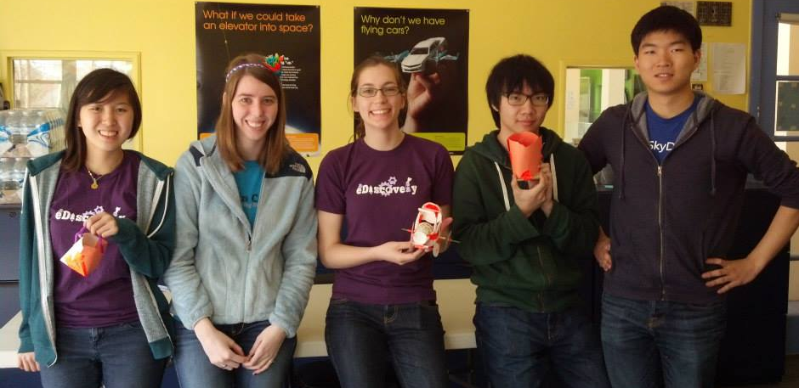
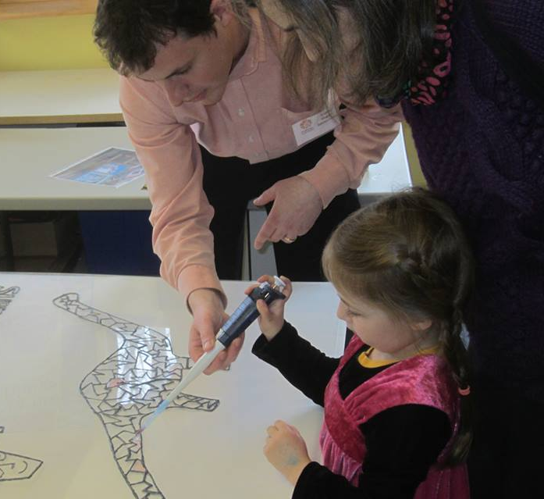
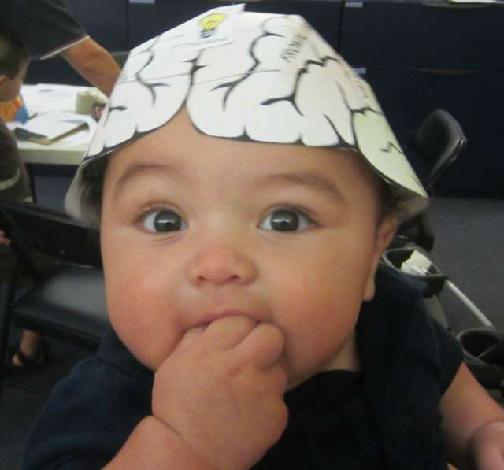
Great Ideas For Planning and Hosting Special Events
Collaborating with scientists
NanoDays with Dr. Gareth McKinley, Massachusetts Institute of Technology
National Chemistry Week with
Dr. Mathangi Krishnamurthy,
Fitchburg State University
Massachusetts Archaeology Month with Dr. Suanna Selby Crowley
Olin College Engineering Discovery Team
Meet the Scientists!
Portal to the Public
a national network of museums bringing scientists and the public together in face-to-face interactive programs

Slide 10
Great Ideas for Planning and Hosting Special Events
Michelle Kortenaar, Sciencenter, NY
Liz Leahy, The Discovery Museums, MA,
Becky Wolfe, The Children’s Museum of Indianapolis, IN
Juliet Gray-Moliere, Brooklyn Children's Museum, NY
Aaron Guerrero & Kevin Velasquez, Children's Museum of Houston, TX
Brad Herring, Museum of Life and Science, NC
Ali Jackson, Sciencenter, NY
Breakout into tables

Slide 11
Special Events for School Groups Becky Wolfe

Slide 12
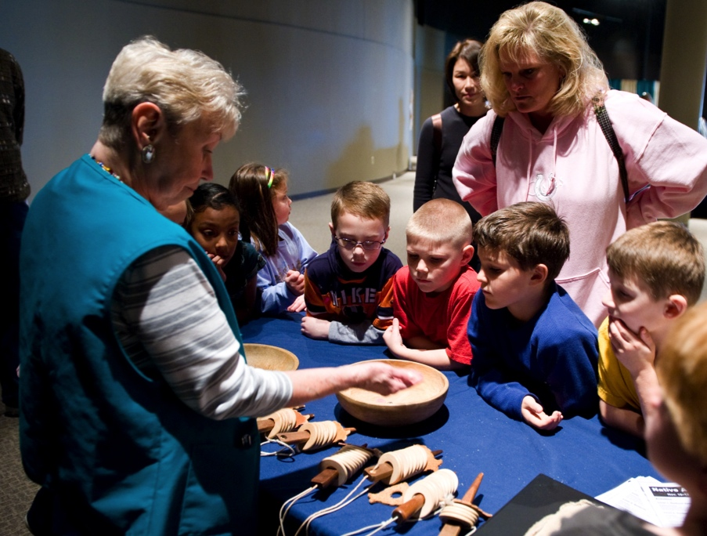
Why events for schools?
Reach large number of students
Broad content themes
Bring in community groups
Showcase of museum programs
Single-day WOW presentation
Notes:
Family learning focus
Consider entire experience when designing shows, programs and exhibits.

Slide 13
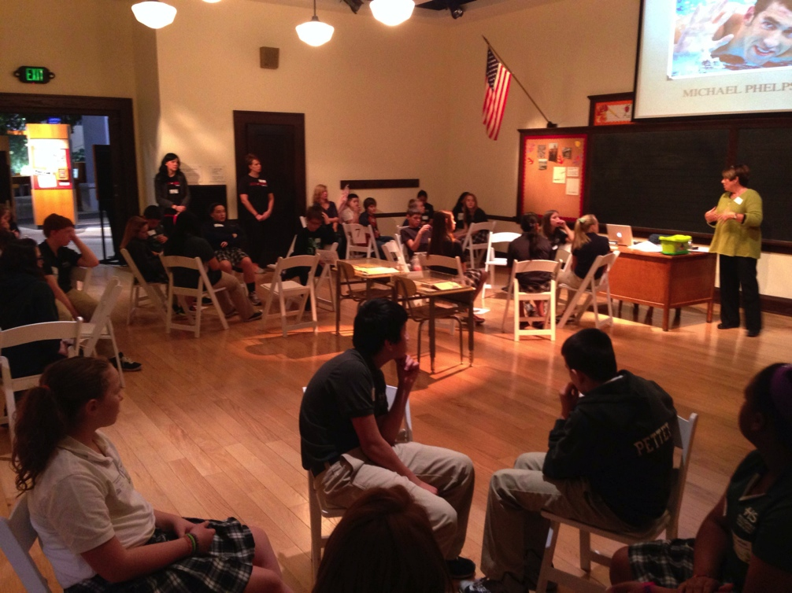
Summits
Mini-conference format
Large presentation
Breakout sessions
Community exhibit hall

Slide 14
Holocaust Remembrance Day
Theater production by local high school
Table top activities around the museum
Scheduled time in Anne Frank exhibit with additional interpretation programs
Partnership with Bureau of Jewish Education

Slide 15
Great Ideas for Planning and Hosting Special Events
Michelle Kortenaar, Sciencenter, NY
Liz Leahy, The Discovery Museums, MA,
Becky Wolfe, The Children’s Museum of Indianapolis, IN
Juliet Gray-Moliere, Brooklyn Children's Museum, NY
Aaron Guerrero & Kevin Velasquez, Children's Museum of Houston, TX
Brad Herring, Museum of Life and Science, NC
Ali Jackson, Sciencenter, NY
Breakout into tables

Slide 16
Great Ideas for Planning and Hosting Special Events
Michelle Kortenaar, Sciencenter, NY
Liz Leahy, The Discovery Museums, MA,
Becky Wolfe, The Children’s Museum of Indianapolis, IN
Juliet Gray-Moliere, Brooklyn Children's Museum, NY
Aaron Guerrero & Kevin Velasquez, Children's Museum of Houston, TX
Brad Herring, Museum of Life and Science, NC
Ali Jackson, Sciencenter, NY
Breakout into tables

Slide 17
Sensory Friendly Day

Slide 18
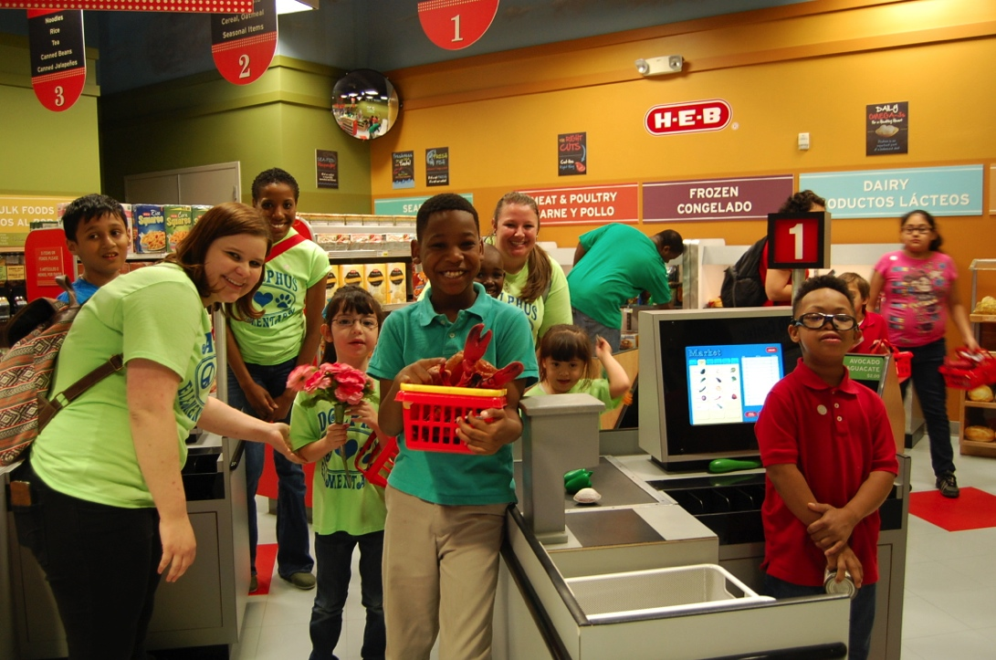
Background
Exclusive event for children with Autism Spectrum Disorders (ASD) and sensory processing differences
Held on days closed to the public
Limited amount of visitors: pre– registration required

Slide 19
Promotion
News alerts to local media
Social media, e-blasts, newsletters
Mostly digital since many attendees do not regularly visit Museum
Future possibilities:
Promoting at similar events
Word-of-mouth through on-site specialists
Advertising in Sensory Friendly-focused media

Slide 20
Museum Transformation
Dimmed lights
Limiting of audio
Extra signage
Specially trained staff
On-site specialists

Slide 21
Museum Story Guide
Guide to help families familiarize yourself with the Museum beforehand
Written from a child’s perspective, the guides can be helpful in planning for visitors

Slide 22
Tips and Takeaways
Give clear 1-2 step directions
Kids with special needs love structure and routine
Remember not to “yell” when you are talking to kids who have special needs. Some of them are very sensitive to sound.
Don’t speak too fast. Talk slowly and pause between directions.
Do not use sarcasm, figurative language, or jokes. Children with special needs do not usually understand this type of language and may find it offensive.
Do not be offended if the children are not looking at you when you are speaking to them, it doesn’t mean they are not listening. Some people with Autism find it painful to look at people in the eye.

Slide 23
Great Ideas for Planning and Hosting Special Events
Michelle Kortenaar, Sciencenter, NY
Liz Leahy, The Discovery Museums, MA,
Becky Wolfe, The Children’s Museum of Indianapolis, IN
Juliet Gray-Moliere, Brooklyn Children's Museum, NY
Aaron Guerrero & Kevin Velasquez, Children's Museum of Houston, TX
Brad Herring, Museum of Life and Science, NC
Ali Jackson, Sciencenter, NY
Breakout into tables

Slide 24
Create a place of lifelong learning
where people, from young child to senior
citizen, embrace science as a way of knowing
about themselves, their community, and their world.

Slide 25
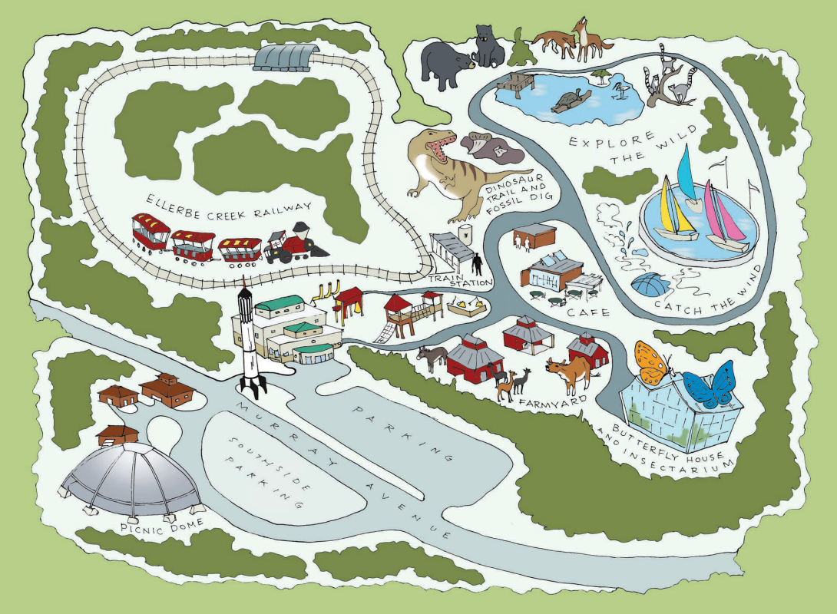
Museum of Life and Science – Know Wonder
84-acre interactive science park with over 60 species live animals
Annual attendance is around 440,000 with about 9,800 member households
Notes:
Located just blocks from downtown Durham, the Museum of Life and Science is one of North Carolina’s top family destinations. Situated on 84-acres, our interactive science park includes a two-story science center, one of the largest butterfly conservatories on the East Coast and beautifully landscaped outdoor exhibits which are safe havens for rescued black bears, lemurs, and endangered red wolves. Other popular attractions include over 60 species of live animals, Dinosaur Trail, Ellerbe Creek Railway, and Into the Mist.

Slide 26
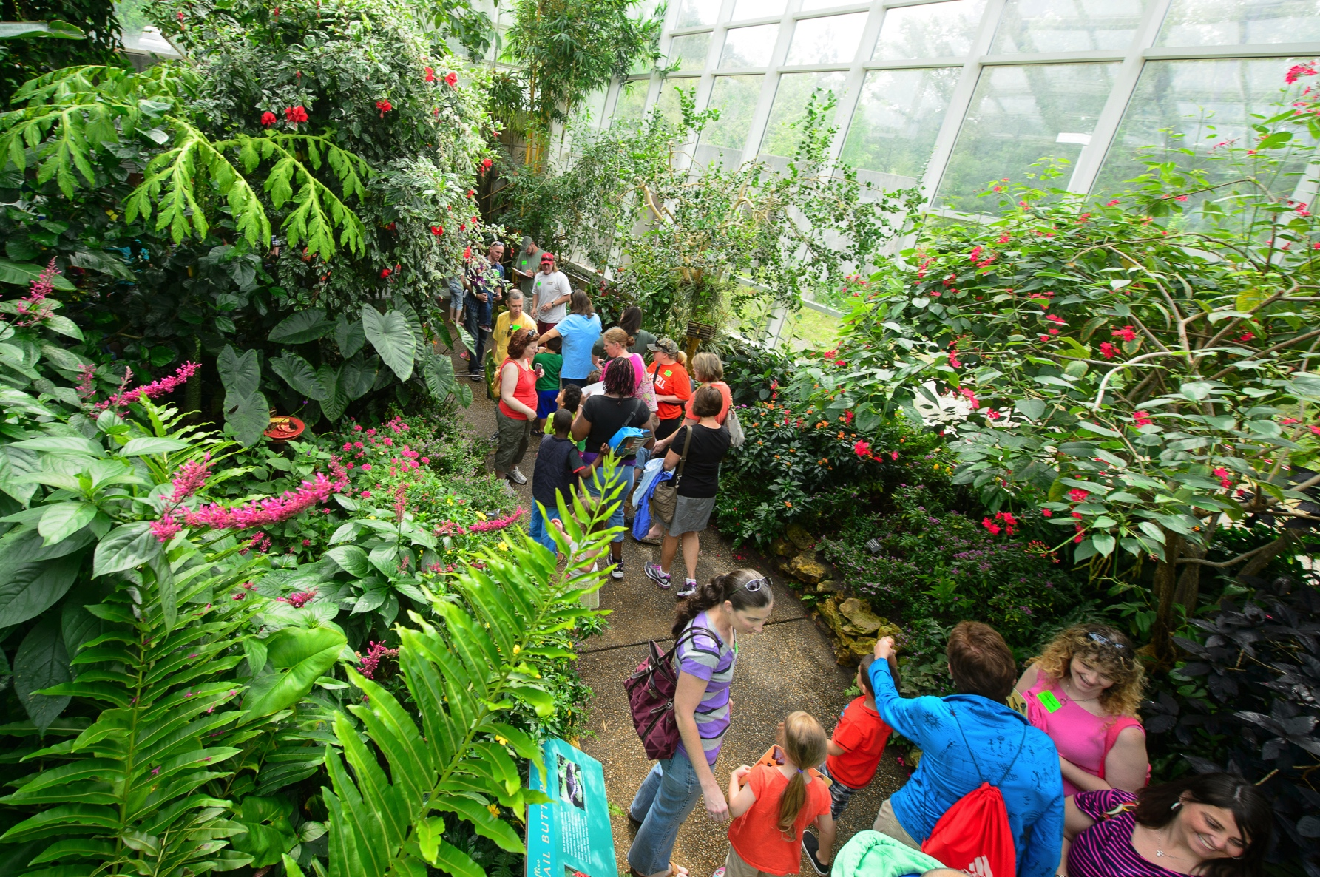
Museum of Life and Science – Know Wonder

Slide 27
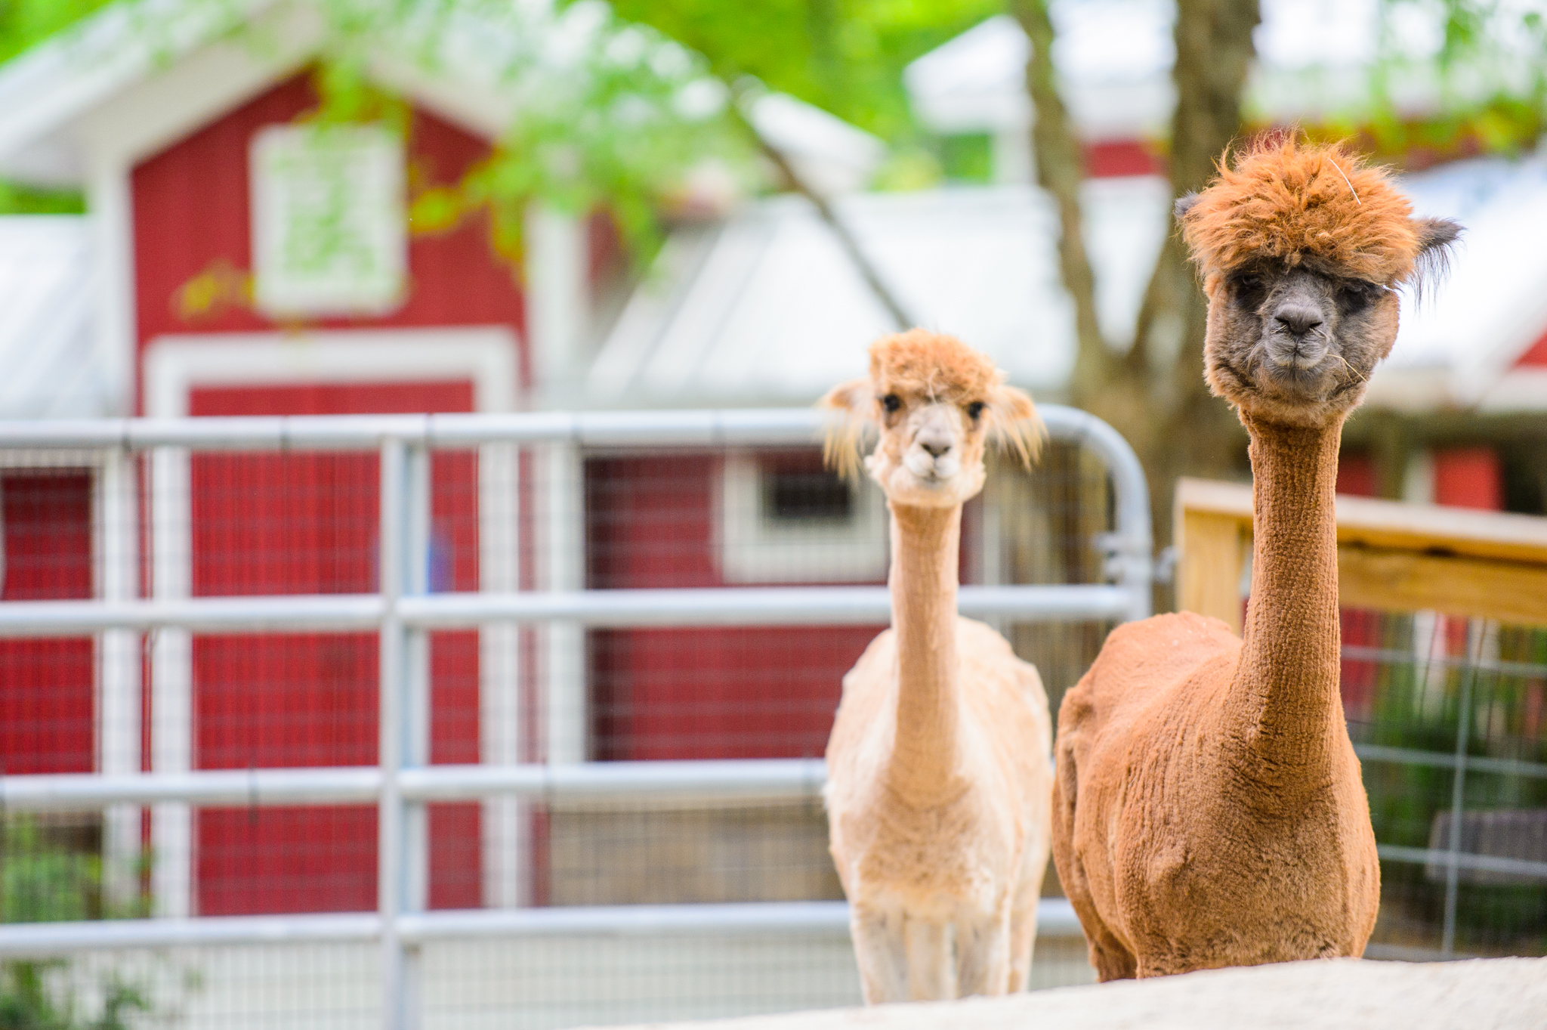
Museum of Life and Science – Know Wonder

Slide 28
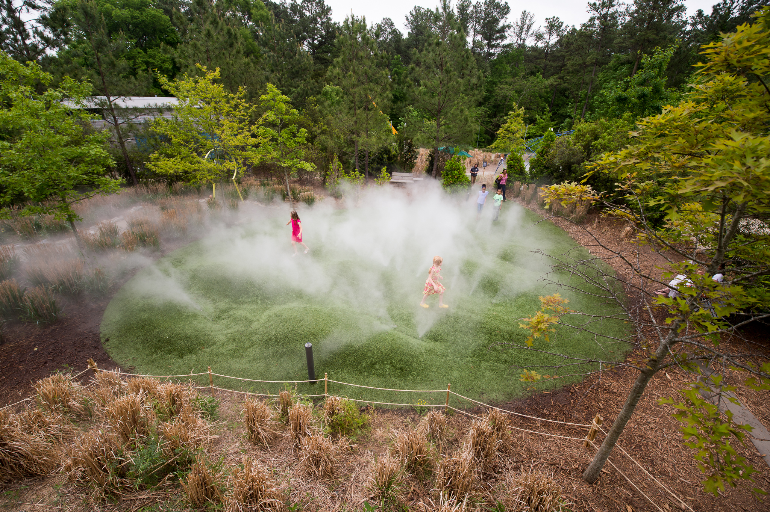
Museum of Life and Science – Know Wonder

Slide 29
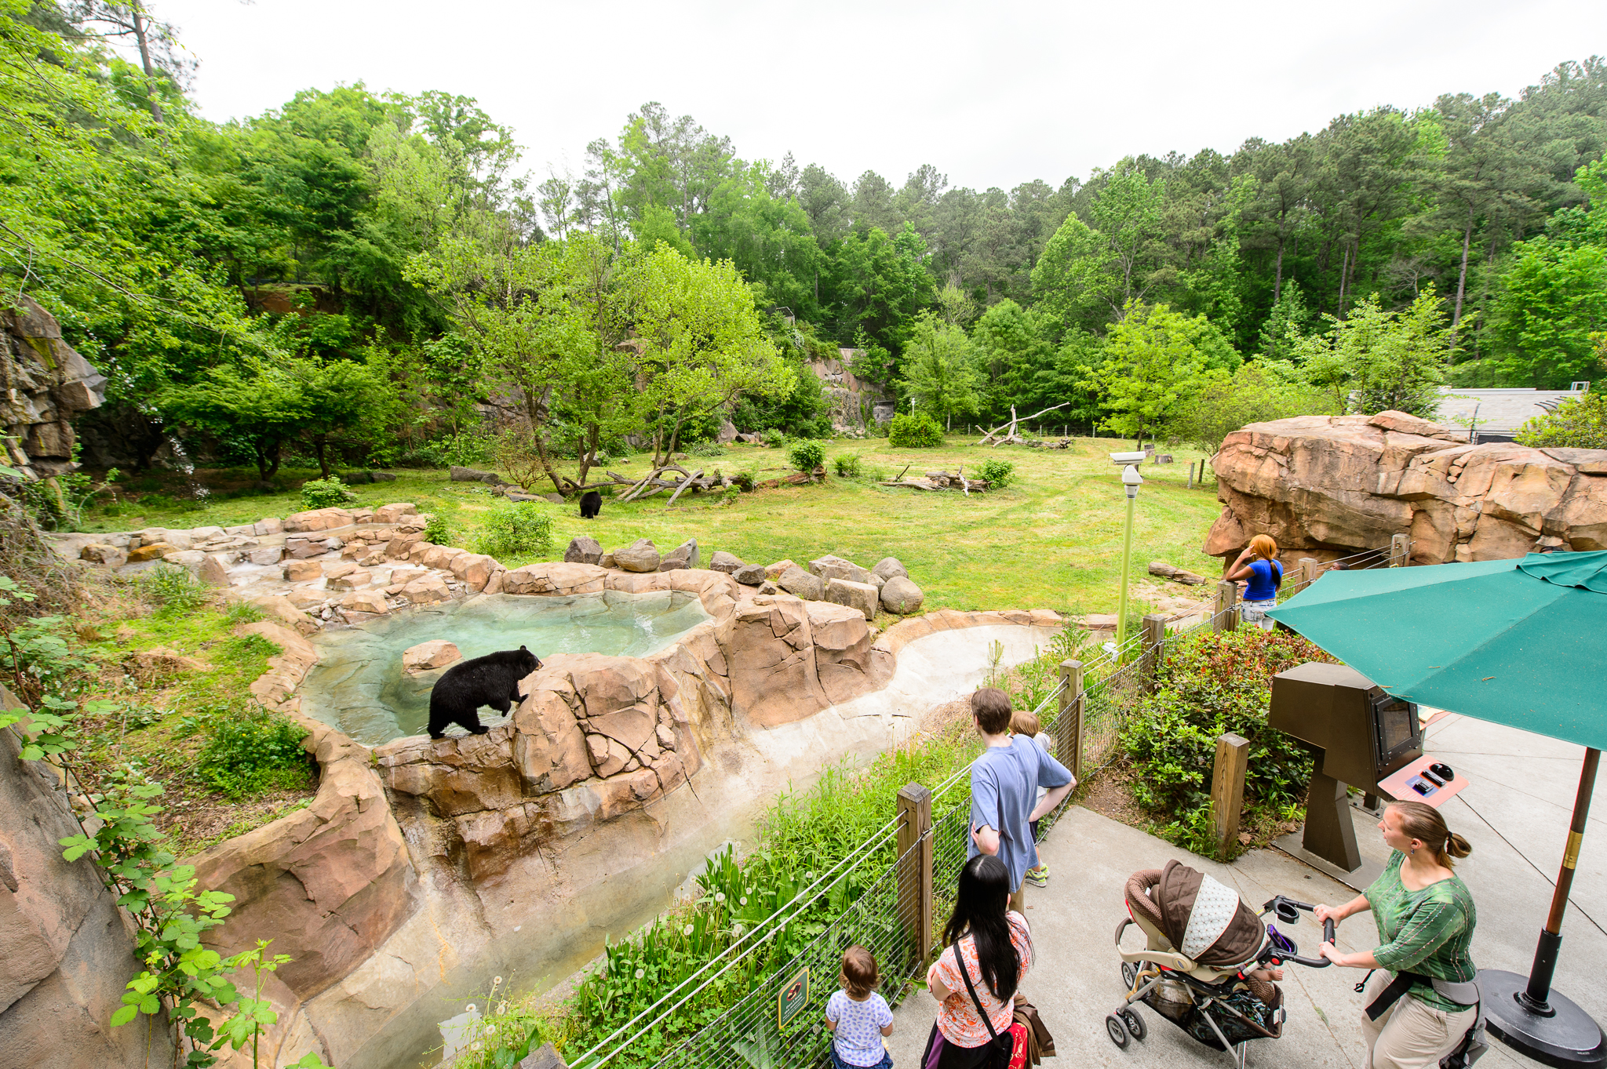
Museum of Life and Science – Know Wonder

Slide 30
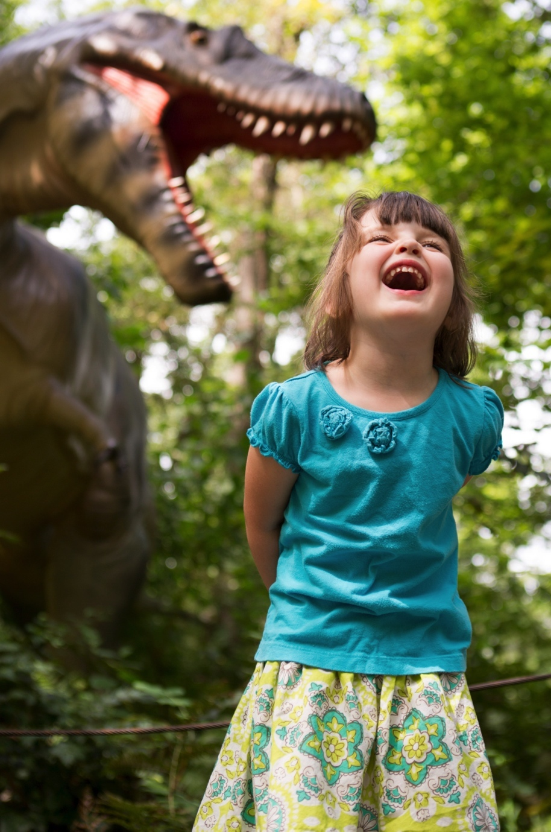
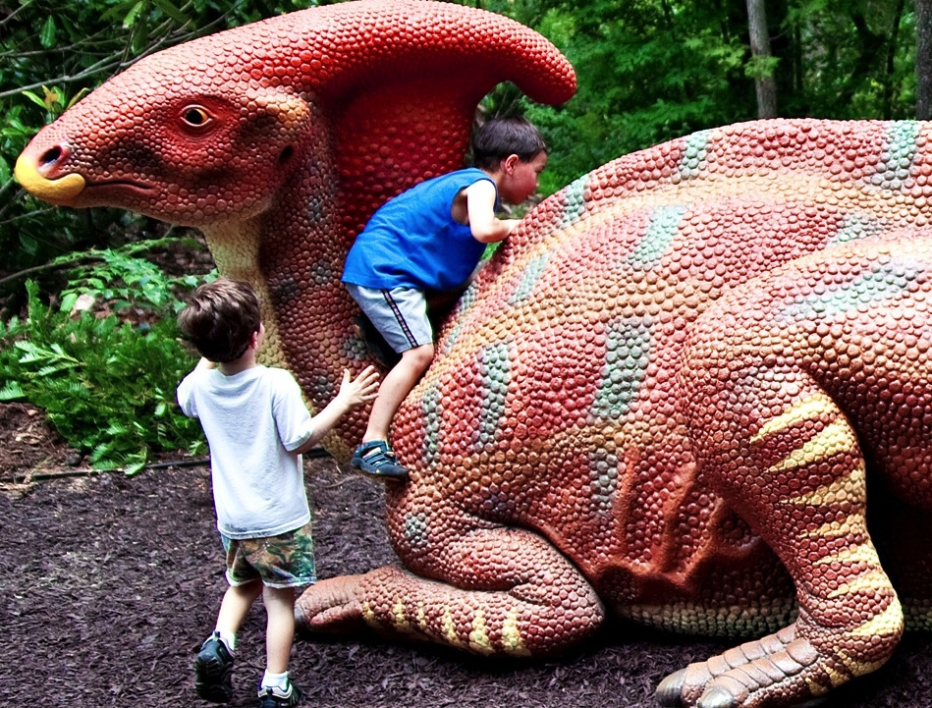
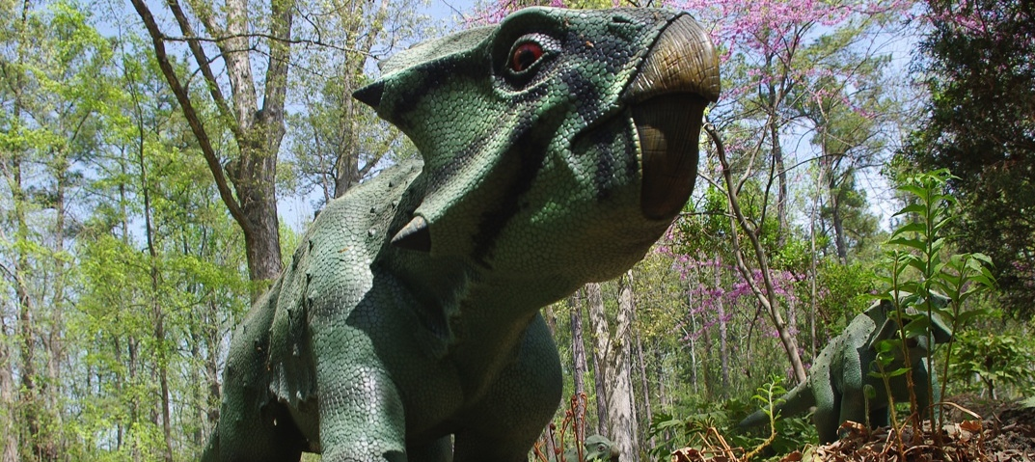
Museum of Life and Science – Know Wonder

Slide 31
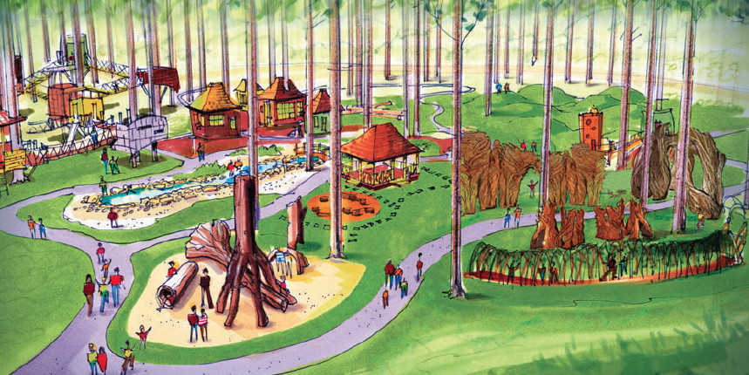
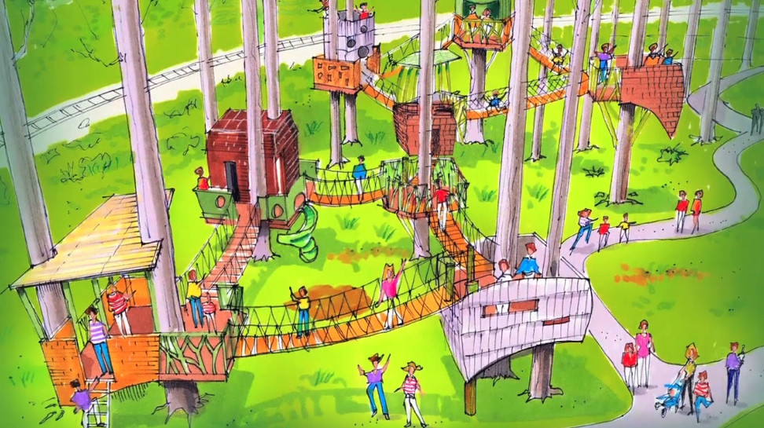
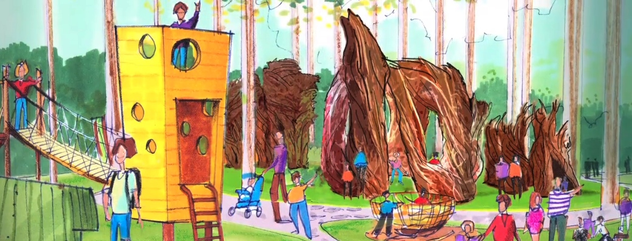
Museum of Life and Science – Know Wonder

Slide 32
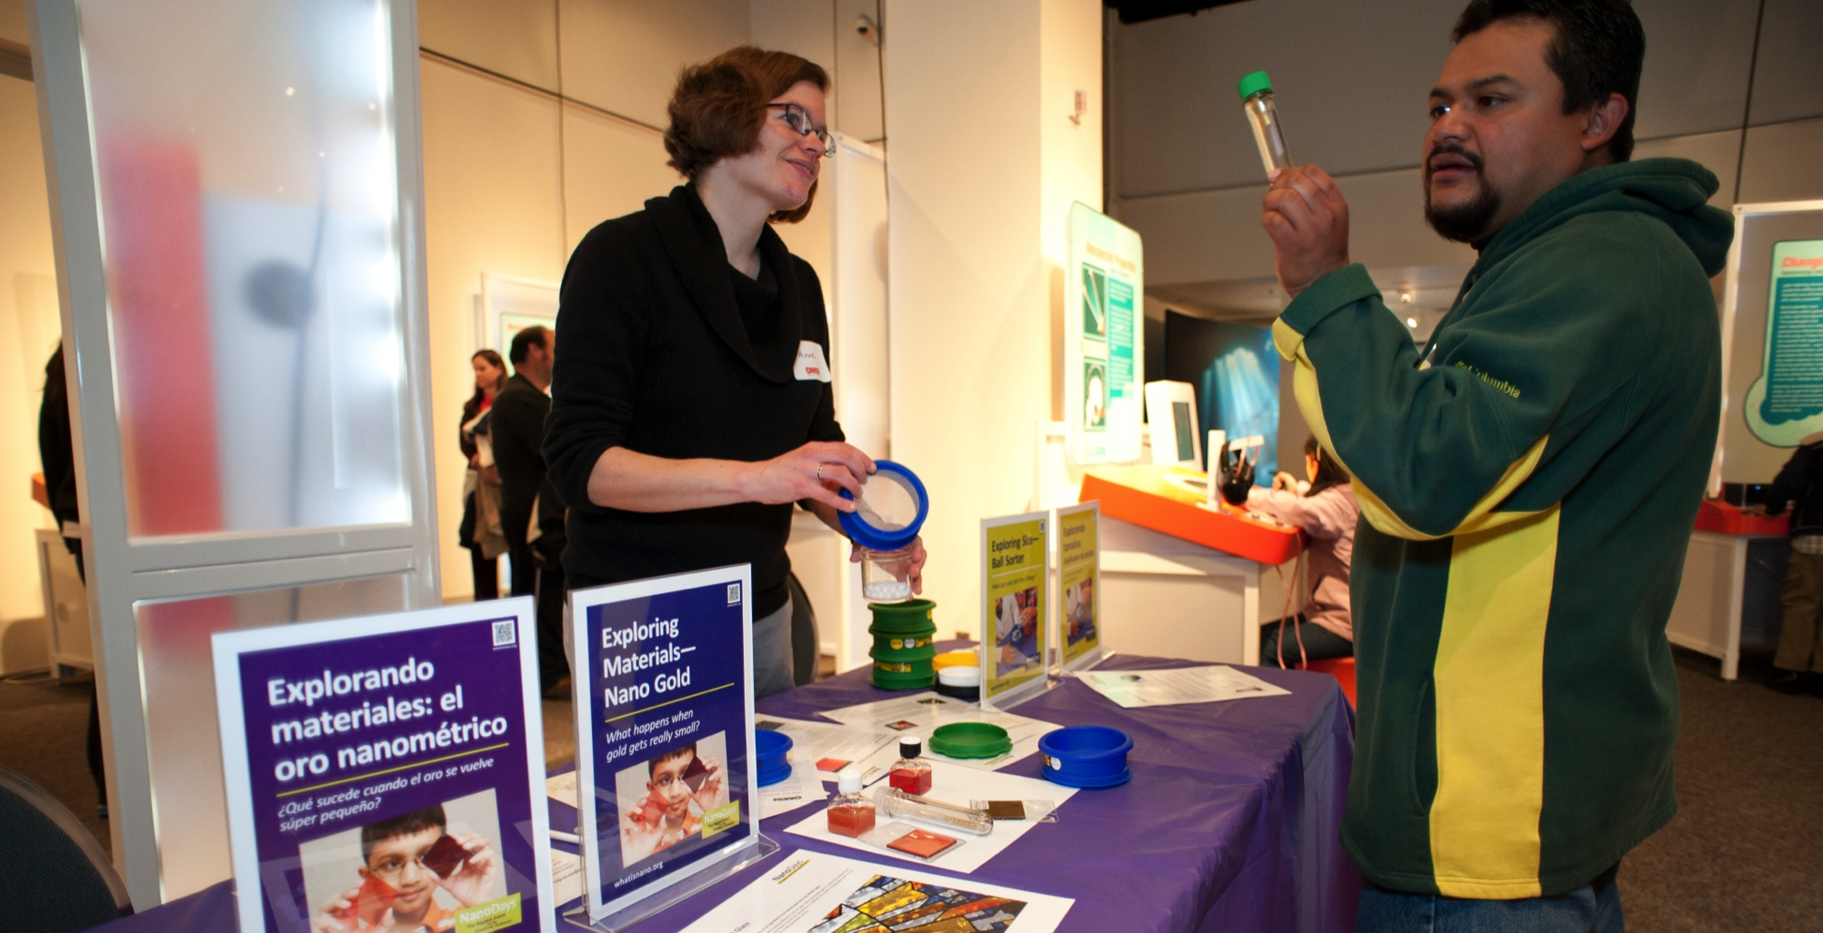
IGNITE Learning
A $5 membership program that provides low-income families in Durham year-round access to interactive science learning opportunities and Museum programs they otherwise would not be able to afford.

Slide 33
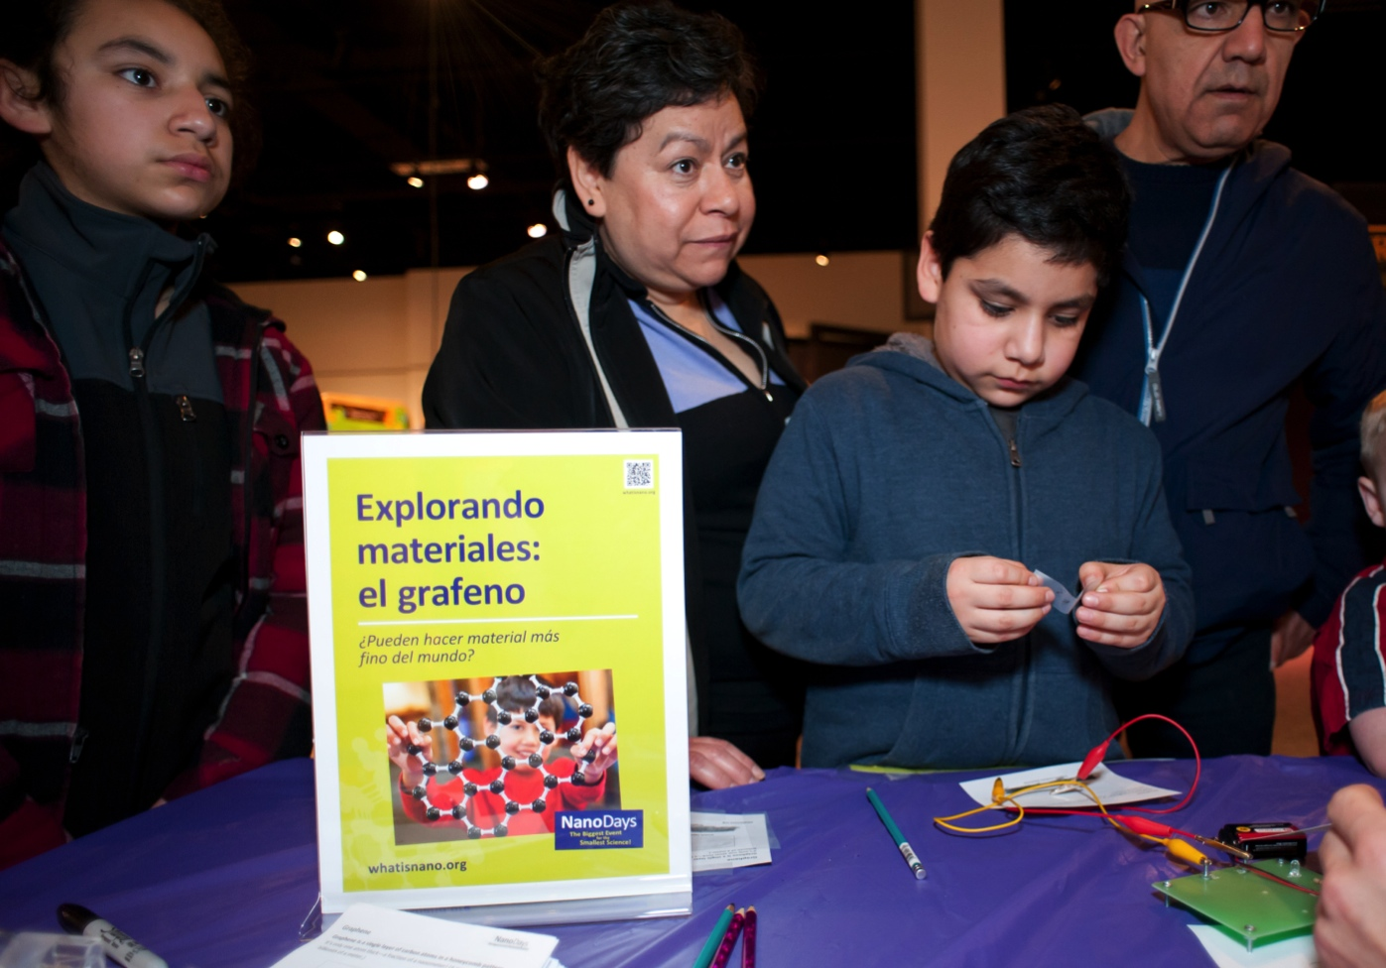
El centro hispano
A grassroots community based organization dedicated to strengthening the Hispanic/Latino community and improving the quality of life of Hispanic/Latino residents in Durham, Carrboro, Chapel Hill and surrounding areas.

Slide 34
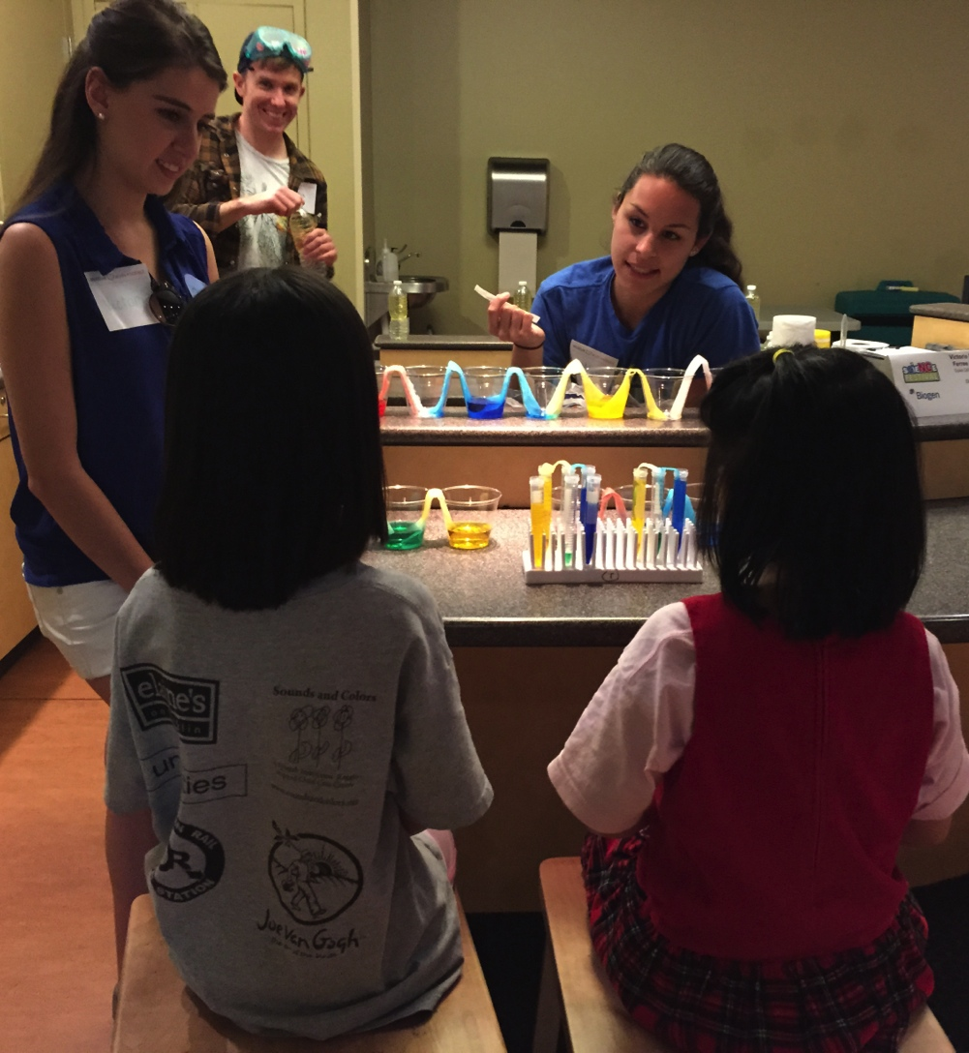
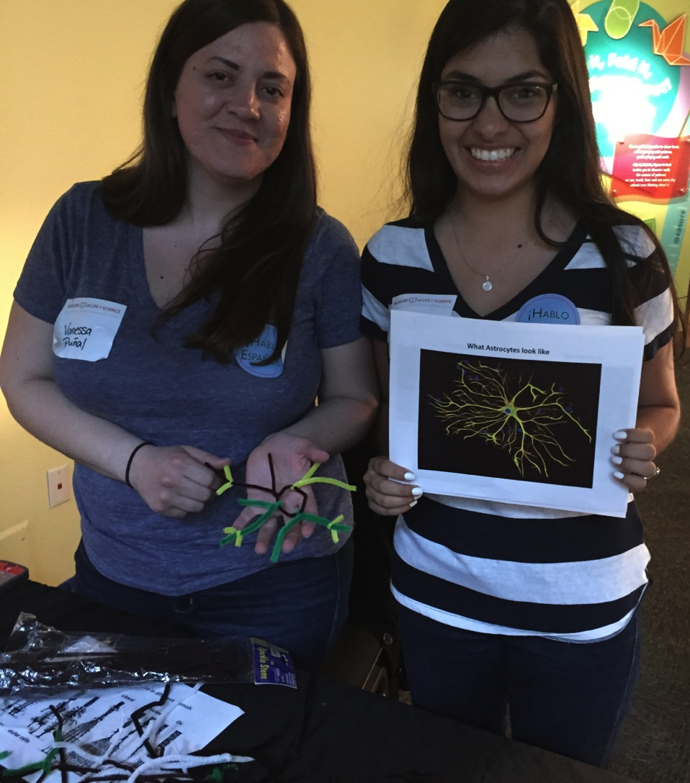
Bilingual Meet a scientist
A hands-on science event featuring bilingual scientists from around the Triangle.

Slide 35
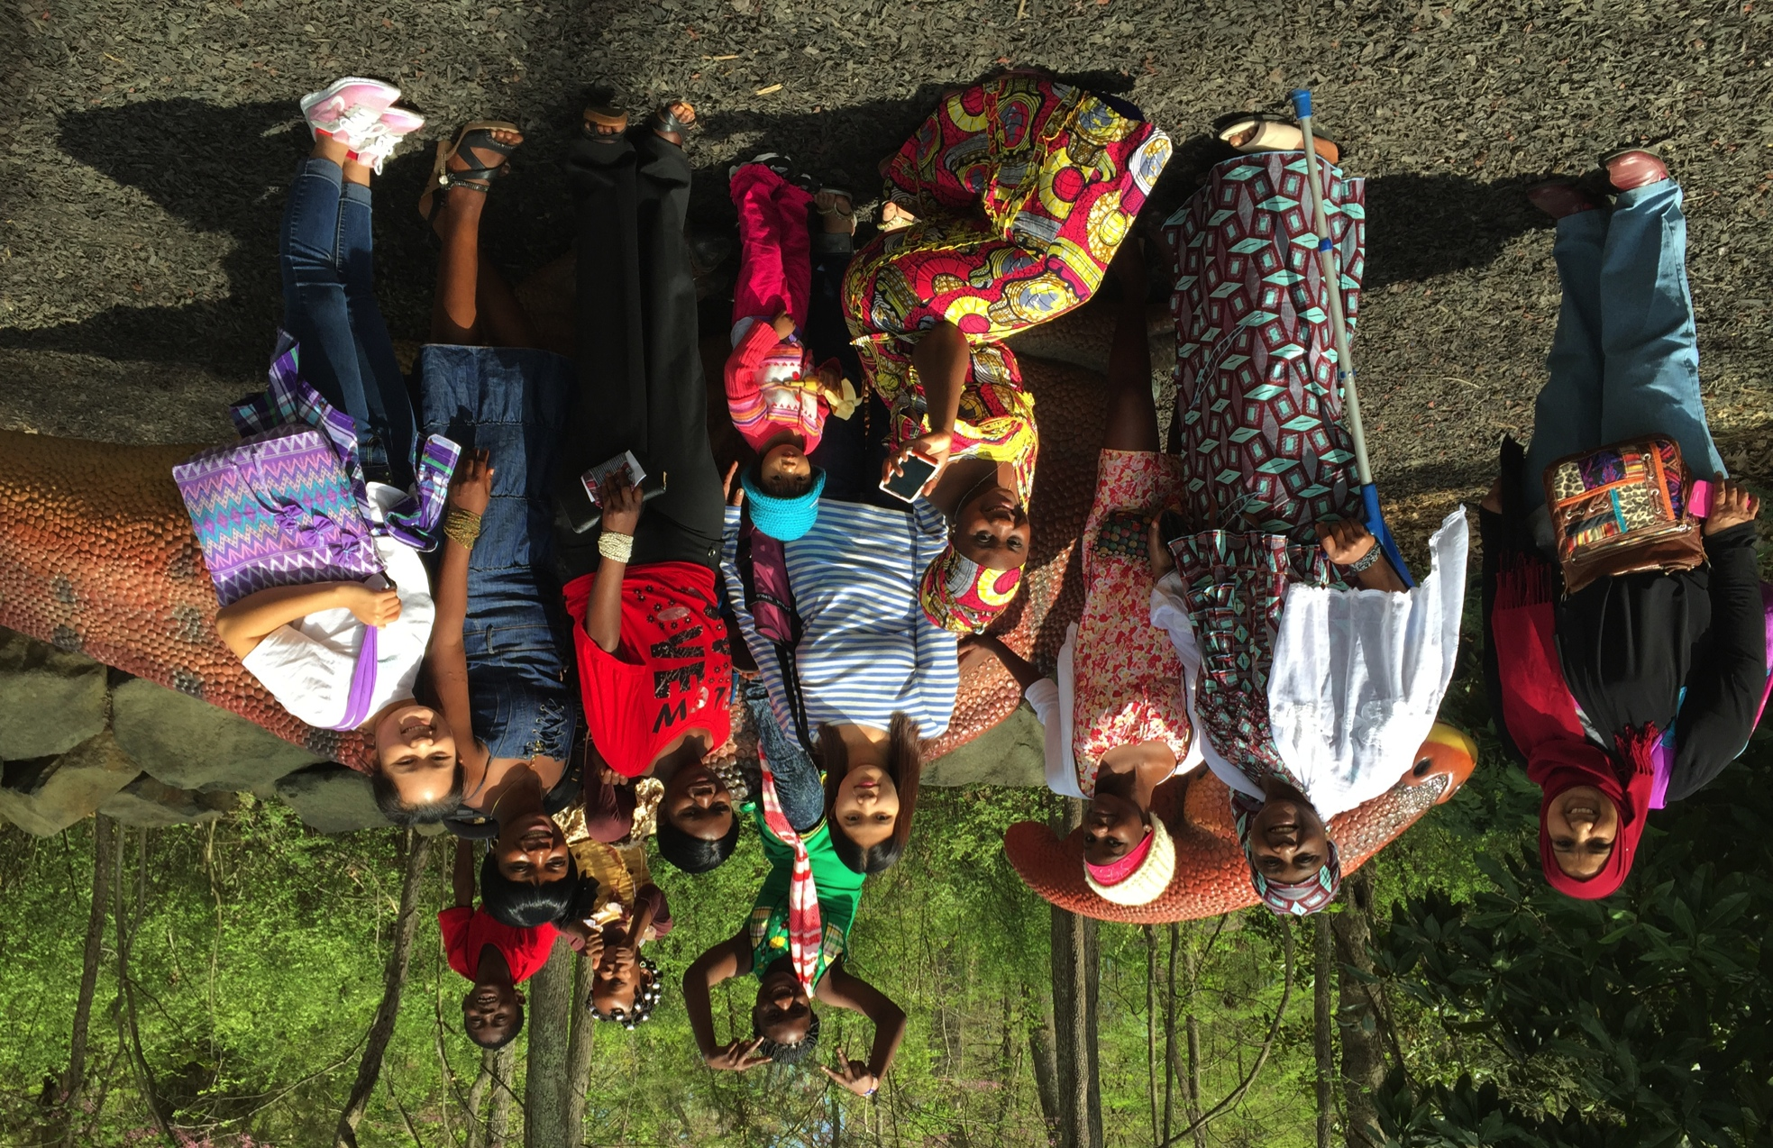
Bilingual Meet a scientist
Notes:
On April 12 we had the our Ignite Learning family day. Several of our partner organizations brought their members to experience the Museum.
Church World Services brought this group of ladies and children who were originally from Burma and Congo and had only been in the United States for less than 3 months. I gave them a tour of the campus. The woman in the teal and red dress with the white shawl was the grandmother to several of these ladies. During the tour she would frequently ask me questions about what animals we were seeing. We got up to the dinosaur trail and she turned to me and through her interpreter asked me "what animal is this?" I responded that it was a dinosaur. She asked "is it real?" And I responded "yes, they aren't alive anymore but they used to live here, in the Congo, everywhere." She then smiled and walked over and pet the dinosaur and then turned and told me to take a photo of her and her family. After I took the photo the interpreter told me that the grandmother had never been to school and this was her first time seeing a dinosaur.

Slide 36
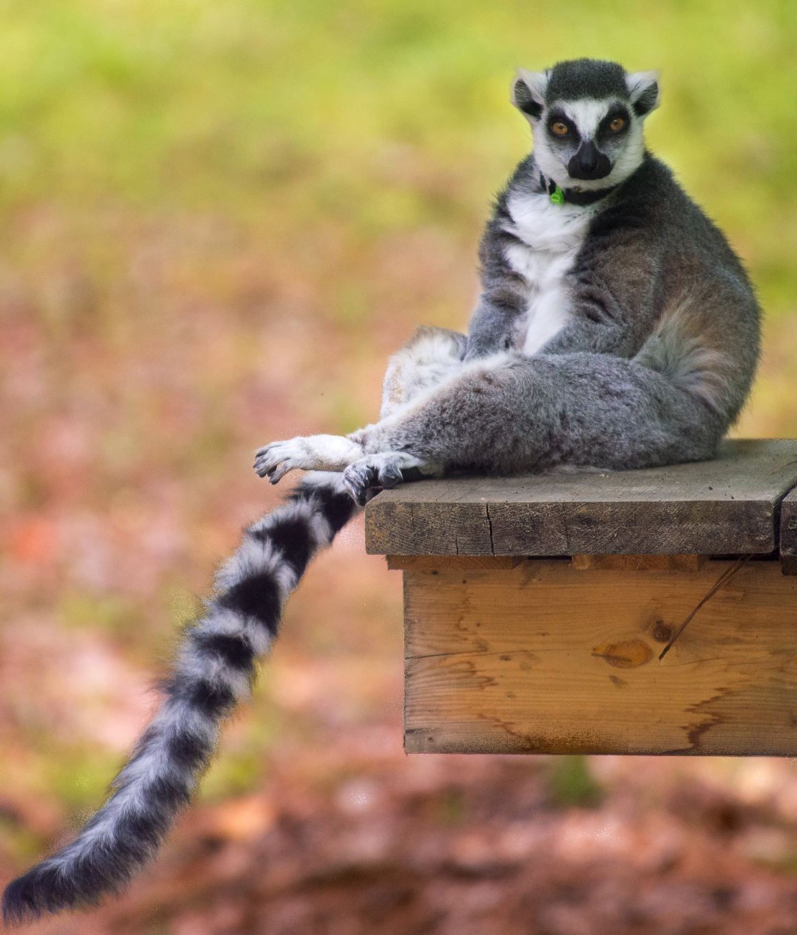
Thank you!
Brad Herring
bradh@ncmls.org
Lifeandscience.org

Slide 37
Great Ideas for Planning and Hosting Special Events
Michelle Kortenaar, Sciencenter, NY
Liz Leahy, The Discovery Museums, MA,
Becky Wolfe, The Children’s Museum of Indianapolis, IN
Juliet Gray-Moliere, Brooklyn Children's Museum, NY
Aaron Guerrero & Kevin Velasquez, Children's Museum of Houston, TX
Brad Herring, Museum of Life and Science, NC
Ali Jackson, Sciencenter, NY
Breakout into tables

Slide 38
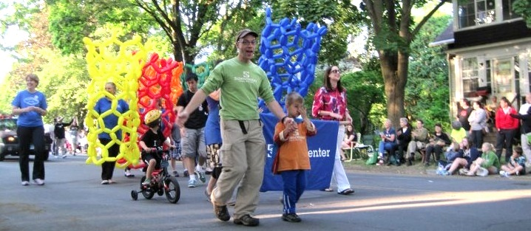
Ali Jackson
Director of National Collaborations
ajackson@sciencenter.org
www.sciencenter.org

Slide 39
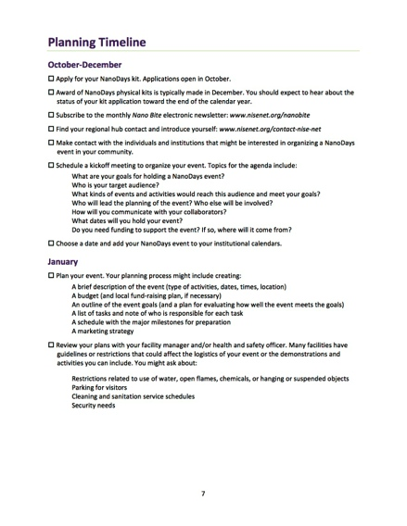
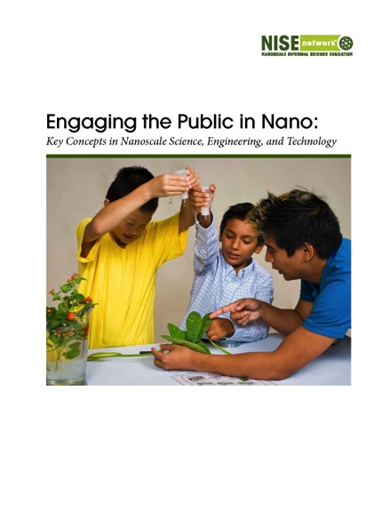
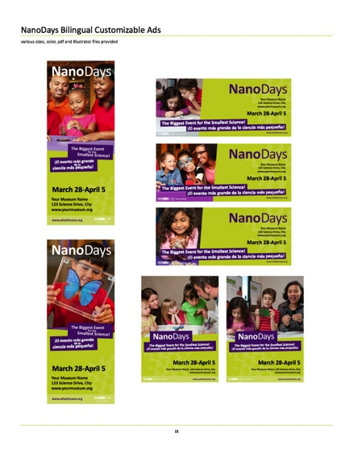
NanoDays Resources
Notes:
NISE Net resources:
Planning guide, detailed timeline, tips for working with partners (scientists, volunteers, training resources, ideas for making your event unique and special (including things like special presentations featuring a local scientist or student, science cafes, including additional longer programs, an open house at a local research center or lab), an illustrated document outlining four key big ideas for engaging the public nano related content (useful for PD), marketing and promotional materials(including ads, posters, banners, a sample press release and more)

Slide 40
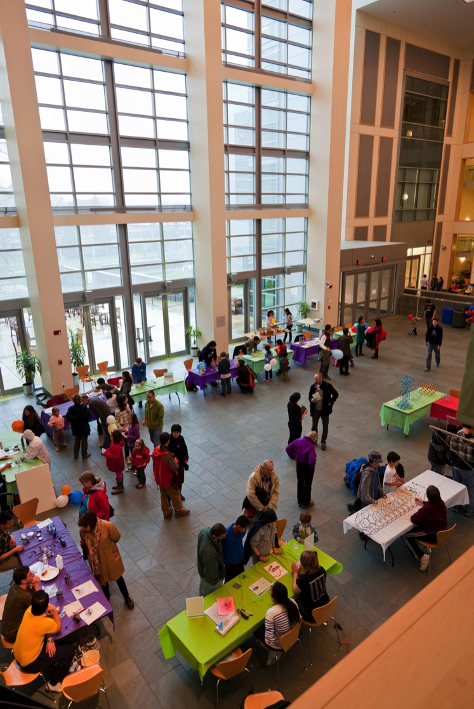
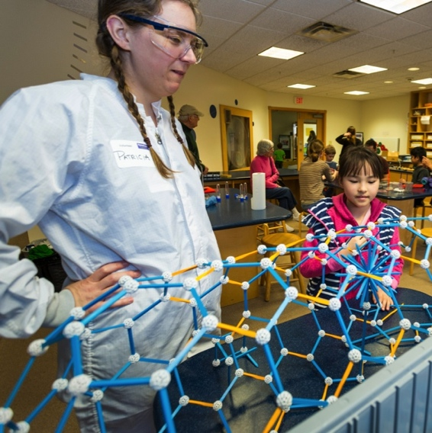
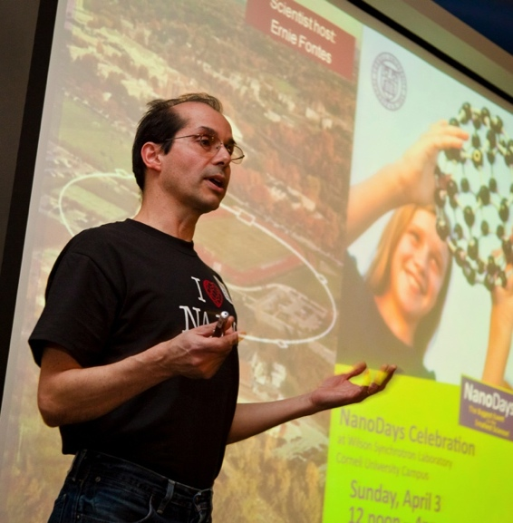
Local Collaborations
Notes:
We’ve been partnering with Cornell University to do Nano Education since even before NISE Net! They are wonderful science reviewers of new activities and programs, help us brainstorm new activities and training practices, and every year they provide student volunteers and scientists for our combined NanoDays in Ithaca.
Liz will talk more about how to specifically collaborate with research partners.
Often we partner with Cornell research centers who have their own outreach teams, ie.
Cornell Nanoscale Science & Technology Facility (an NNIN Fabriction Lab)
MRSEC, Cornell Center for Materials Research
Cornell Center for Accelerator-based Sciences and Education (Classe)
to host a weekend of nano fabulous fun for our community. Some years we do a two day event. One day at Sciencenter and one day up at Cornell. At the Sciencenter we’ll include upwards of 40+ hands-on activities, plus family friendly full length programs, such as a Story time reading of Horton Hears a Who, a Scientist presentation, and a full length program from the NISE Net.org library.
This year, we had over 100 volunteers engaging the public in nano activities. Michelle will elaborate more on how tor quickly train so many volunteers for big events.
For our museum, and we’re on the smaller size, NanoDays is one of only two museum wide, free public events (the other is our Halloween Night) for which the whole museum staff comes together and we have this many awesome activities spread out around the whole museum. We try really hard to tailor this national event to our local community by featuring local research happening at our area universities (Cornell and IC). Other NISE Net partners have found success partnering with local industry and making connections to nano science happening in their communities. You can also tailor by audience: our children’s museums partners have been able to tailor ND activities to work for younger audiences. Or by topic: natural history musuem partners focus on activities that relate to nano and nature.

Slide 41
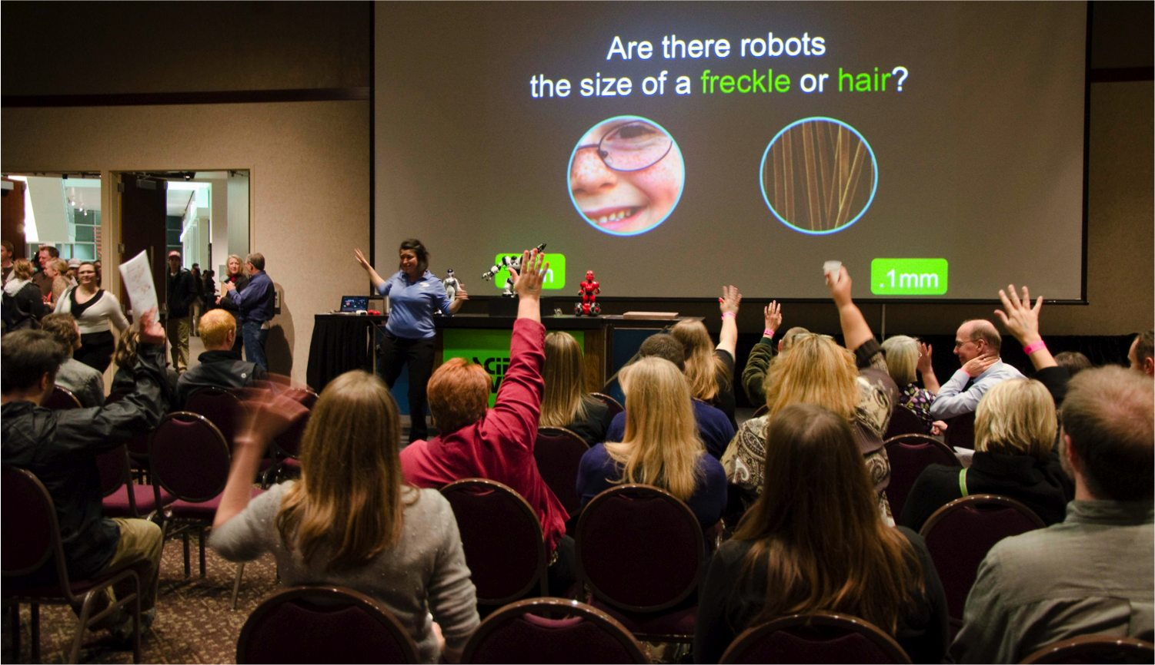
Questions & Discussion

Slide 42
Break out tables
Training volunteers fast: Michelle
Collaborating with scientists: Liz
Bringing in school audiences: Becky
Back to school: Juliet
Reaching special needs audiences: Aaron & Kevin
Community collaborations & sponsors: Brad
Making national events local: Ali

Slide 43
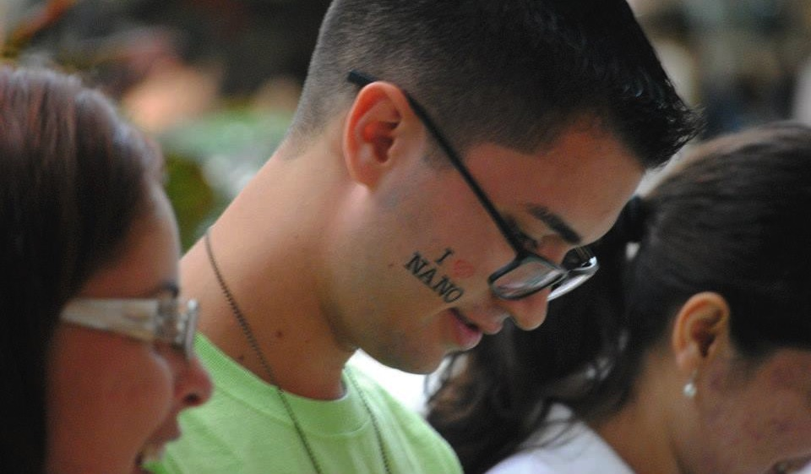
Thank You
Cynthia Needham, ICAN Productions
This presentation is based on work supported by the National Science Foundation under Grant No. 0940143. Any opinions, findings, and conclusions or recommendations expressed in this presentation are those of the authors and do not necessarily reflect the views of the Foundation.

