Slide 1
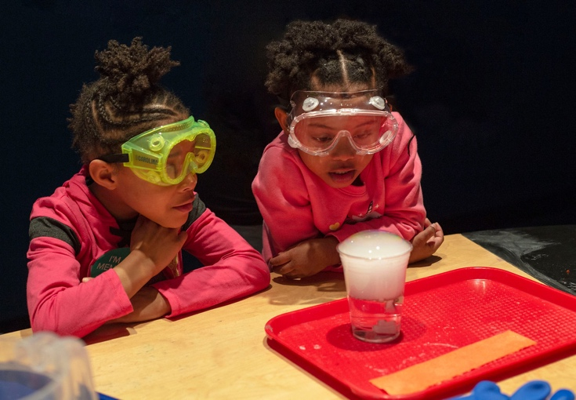

Bringing chemists and chemistry experiments into your museum and out into your community
Science Museum of Minnesota
ASTC Conference 2019
Notes:
Bringing chemistry into your museum is a great way to get visitors involved with hands-on science – it can be inspiring, fun, and messy allowing children and adults to actively participate together in the scientific process. But chemistry can also bring up lots of issues about safety, anxieties, negative feelings about chemicals, concerns about materials preparation storage and disposal, and the need for training and expertise.

Slide 2

Agenda
Catherine McCarthy, cmcarthy@smm.org
Science Museum of Minnesota, Saint Paul, MN
Patti Galvan, P_Galvan@acs.org
American Chemical Society, Washington, DC
Emily Belle, ebelle@sciencenter.org
Sciencenter, Ithaca, NY
Soma Chatterji, ChatterjiS@carnegiesciencecenter.org
Carnegie Science Center, Pittsburgh, PA
Darrell Porcello, porcello@gmail.com
Children’s Creativity Museum, San Francisco, CA
Discussion and Questions
Notes:
Presenters will share their experiences about their implementation of safe, fun, successful hands-on chemistry programs. Presenters will focus on a variety of programs including National Chemistry Week events both inside and outside museums, International Year of the Periodic Table, Explore Science: Let's Do Chemistry events, as well as ongoing hands-on programming and demonstrations.
You will learn about why they might want to engage visitors in chemistry
Collaboration opportunities with local chemists and chemistry students
Practical strategies to design activities and events so that they can have a fun safe successful event
Approaches and tips for overcoming barriers to chemistry events and programming

Slide 3
Catherine McCarthy
Science Museum of Minnesota
Saint Paul, MN

Slide 4
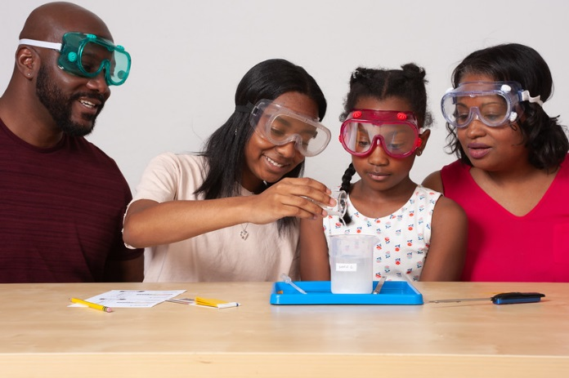
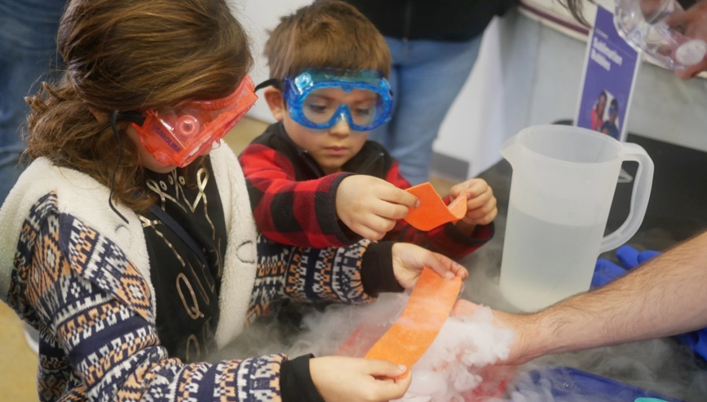


Project Overview
Explore Science: Let’s Do Chemistry
Children’s Creativity Museum, San Francisco
Catherine McCarthy
Science Museum of Minnesota
cmccarthy@smm.org
ASTC 2019

Slide 5
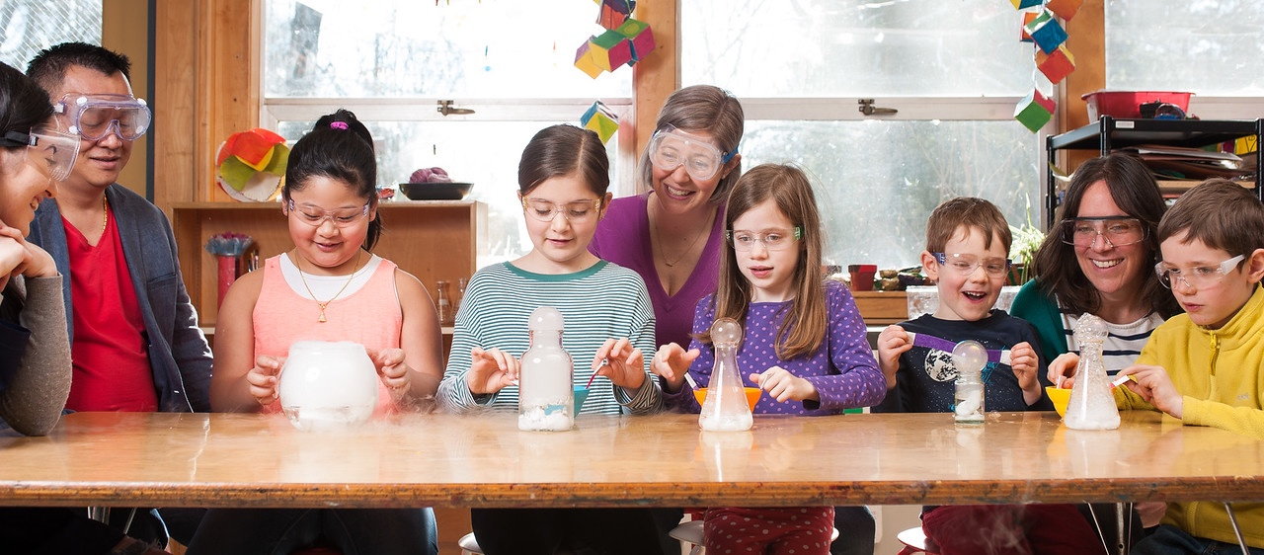
Project Goals
Putting research into practice
Hands-on activities that increase:
1. Interest,
2. Relevance
3. Self-efficacy
Notes:
This project came out of a need that we saw in the National Academies of Science report about Effective Chemistry Communication
In looking at this report and other literature about public perceptions of chemistry, the project team came to feel that it would be useful to create educational products that focus on changing the public’s attitudes towards chemistry
More particularly, our goals were to create hands-on activities that increase people’s
Interest in chemistry
Understanding of the relevance of chemistry to their lives, and
Feelings of self-efficacy towards chemistry

Slide 6
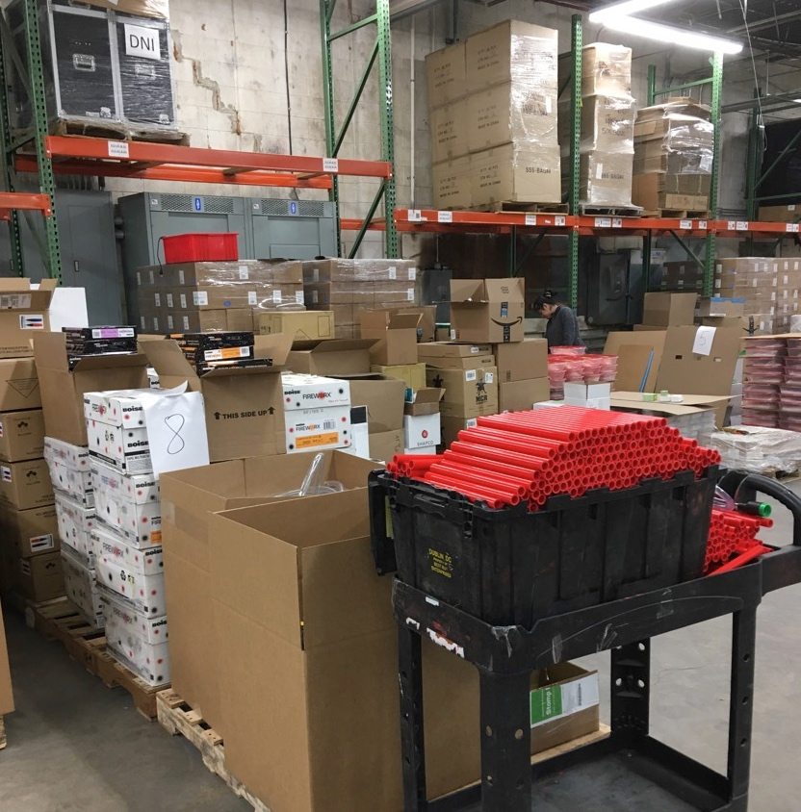
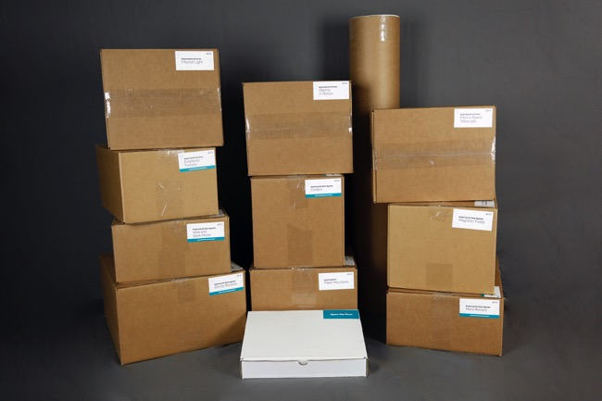
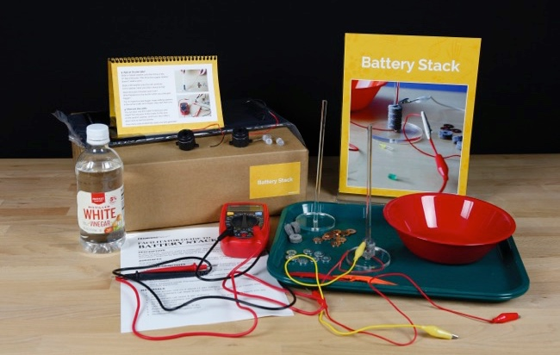
Explore Science: Let’s Do Chemistry kit contents

Slide 7
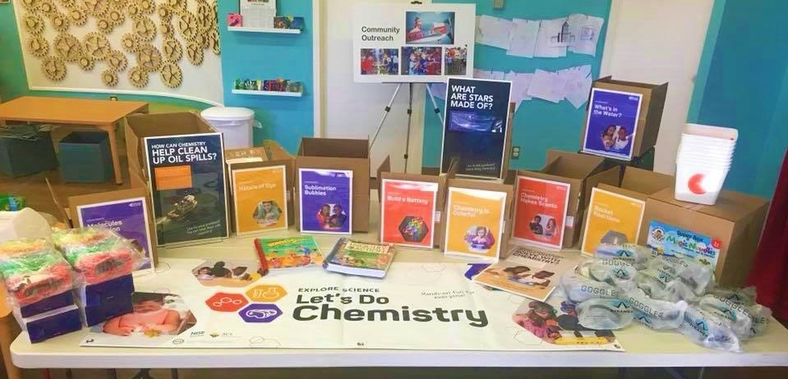
Explore Science: Let’s Do Chemistry kit contents
KidSTREAM
Science Museum of Minnesota
Sciencenter
Museum of Science

Slide 8
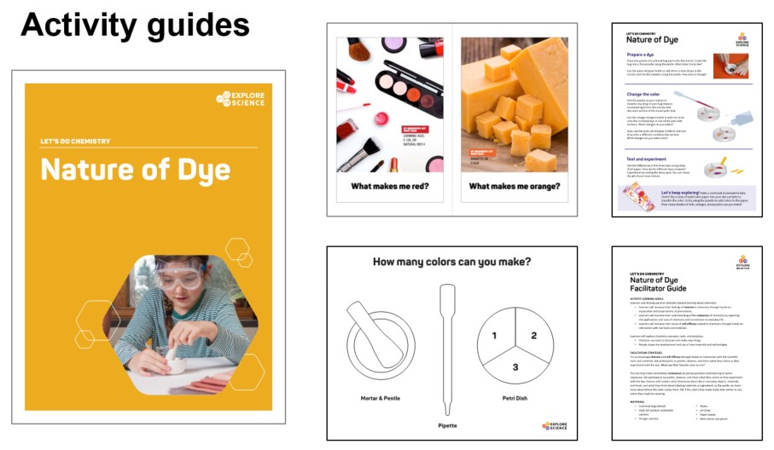
Activity Guides
KidSTREAM
Science Museum of Minnesota
Sciencenter
Museum of Science

Slide 9
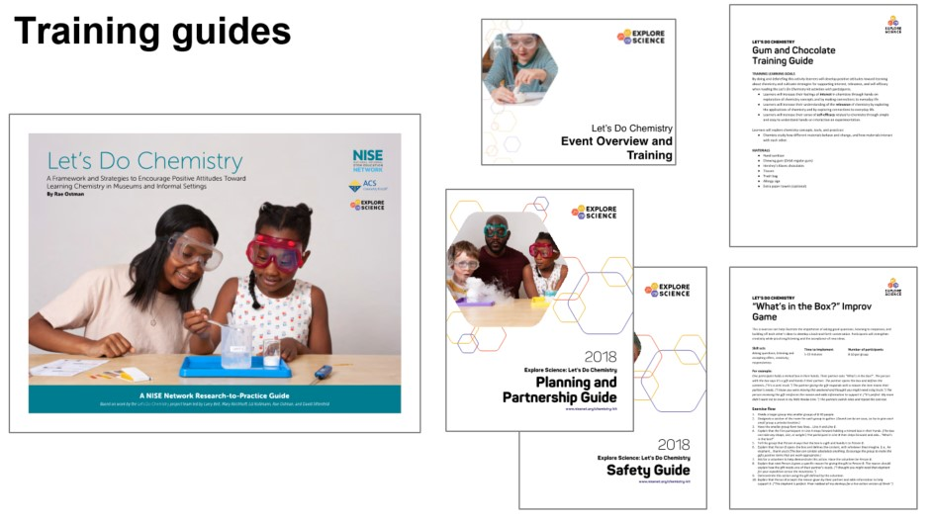
Training Guides
KidSTREAM
Science Museum of Minnesota
Sciencenter
Museum of Science

Slide 10
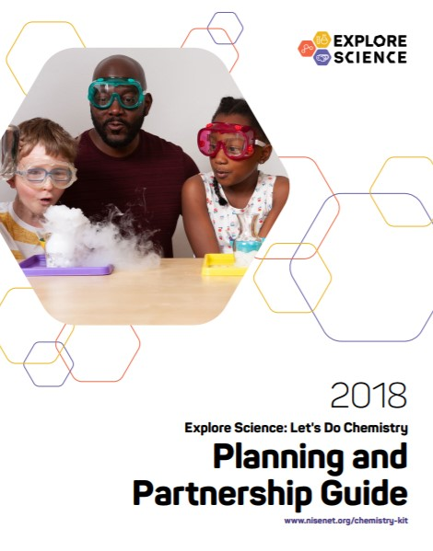

Event Planning an Partnerships Guide
  Event Planning and Partnership Guide
  This guide contains everything you will need to begin planning and promoting your Let's Do Chemistry event.
  Guide covers
  Planning timeline
  National Chemistry Week
  Collaborations and finding local experts
  Training staff and volunteers
  Additional resources
  Evaluating your event
  Promotional and marketing materials
Notes:
Explore Science: Let’s Do Chemistry Event Planning and Promotion Guide
http://nisenet.org/catalog/explore-science-lets-do-chemistry-event-planning-and-promotion-guide

Slide 11

Safety Guide
  Safety Guide
  Use this guide as you plan your Let’s Do Chemistry event and as a resource before training, demonstrating, or facilitating the activities.
  Guide covers
  Let’s Do Chemistry kit safety practices and protocols
  General chemistry safety guidelines, protocols, and precautions
  Additional safety tips
  Chemistry materials and supplies
  Additional resources
Notes:
Explore Science: Let’s Do Chemistry Safety Guide
http://nisenet.org/catalog/explore-science-lets-do-chemistry-safety-guide

Slide 12
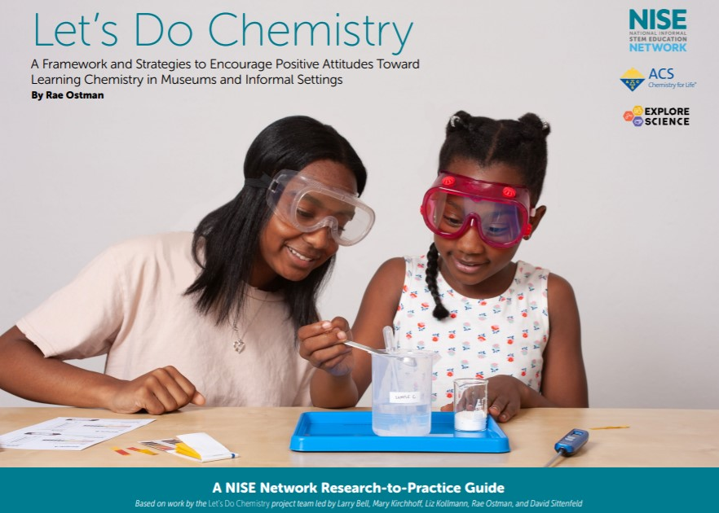
Framework and Strategies
  Framework and
  Strategies
  Research to Practice Guide
  This guide will help you and your facilitators run a fun, successful Let's Do Chemistry event and to encourage positive attitudes toward learning chemistry. Within the guide
  Guide covers
  Let’s Do Chemistry project overview
  Learning chemistry in museums
  Creating the framework
  Understanding the framework
  Using the framework
Notes:
Let’s Do Chemistry: A Framework and Strategies to Encourage Positive Attitudes Toward Learning Chemistry in Museums and Informal Settings Guide
http://nisenet.org/catalog/explore-science-lets-do-chemistry-professional-development-and-training-materials-framework

Slide 13
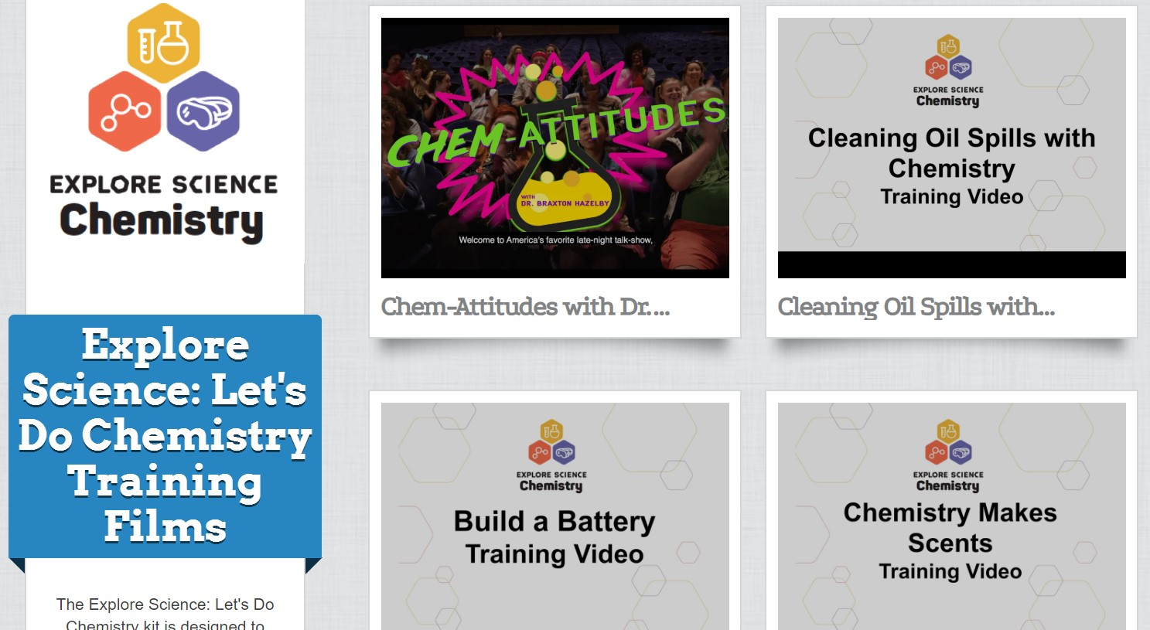
Professional Development Videos
  Training videos
  Training videos for each hands-on activity intended for staff and volunteer educators
  Facilitation video
  Chem-Attitudes with Dr. Braxton Hazelby facilitation training video This funny video will help you and your facilitators run activities in a way that encourages participation and positive attitudes towards learning about chemistry.
Notes:
Explore Science: Let’s Do Chemistry Training videos
https://vimeopro.com/nisenet/explore-science-lets-do-chemistry-training-films

Slide 14
Digital Materials
  Physical kits
  Include USB drive
  Digital Download
  www.nisenet.org/chemistry-kit

Slide 15
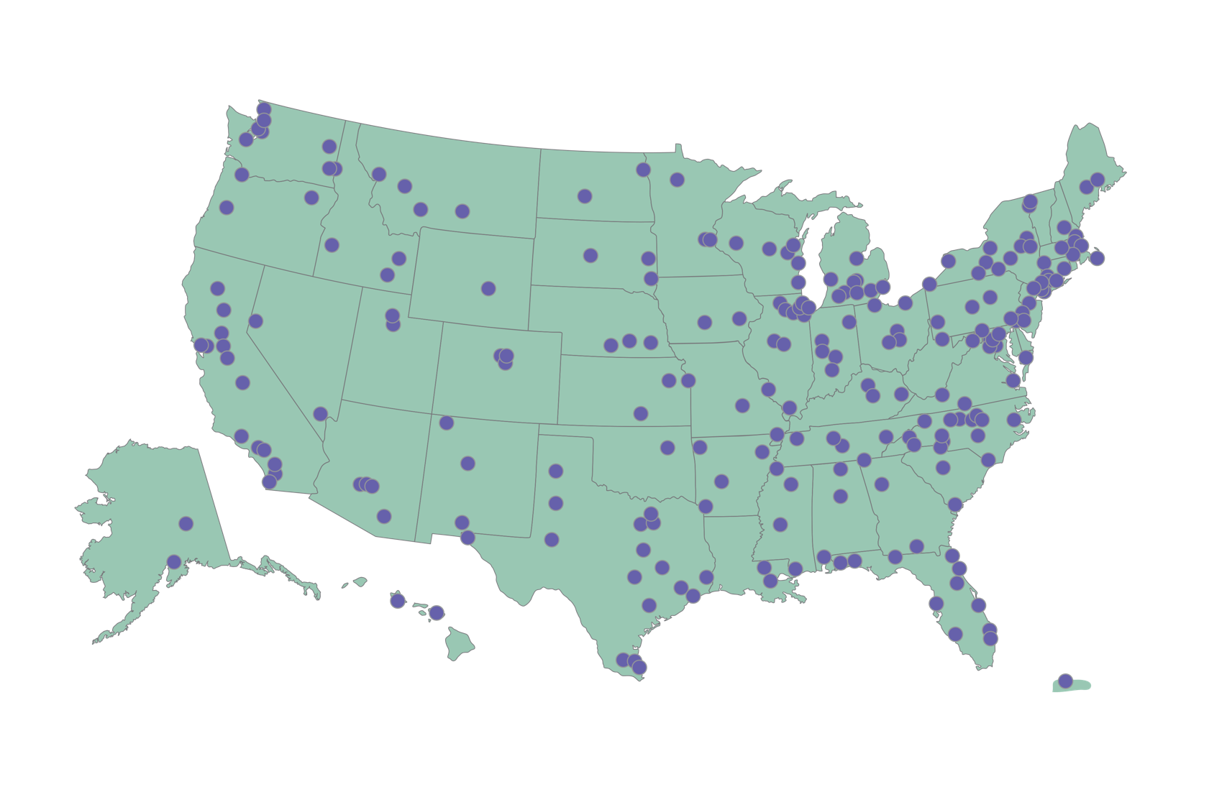

Explore Science: Let’s Do Chemistry kits
250 physical kits distributed across the US
museums, universities, ACS Local Sections & Student Chapters
Notes:
Last year, 250 Explore Science: Let’s Do Chemistry physical kits were developed and distributed to NISE Network partners such as museums, universities, ACS sections and chapters, and chemists all across the country to host a hands-on chemistry public event between October and December. Partners were encouraged to collaborate with their local museum or ACS section/chapter to host these activities during National Chemistry Week, which ran from October 21st-27th.
List:
http://www.nisenet.org/explore-science-lets-do-chemistry-kit-recipients

Slide 16
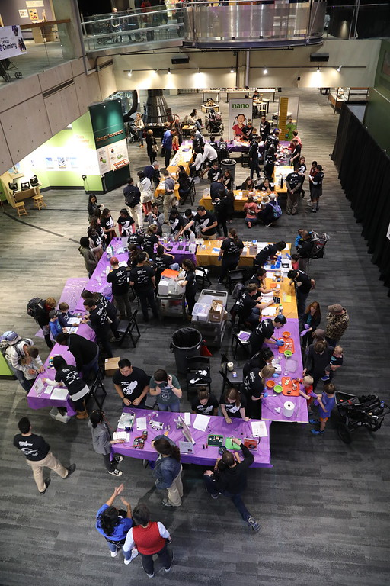
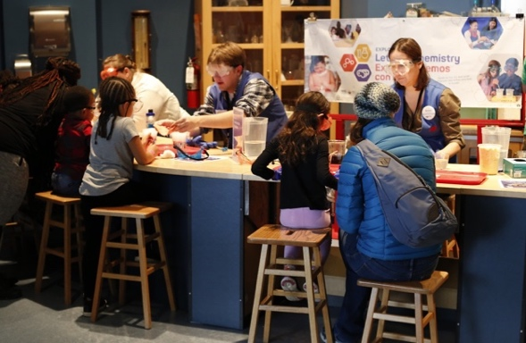

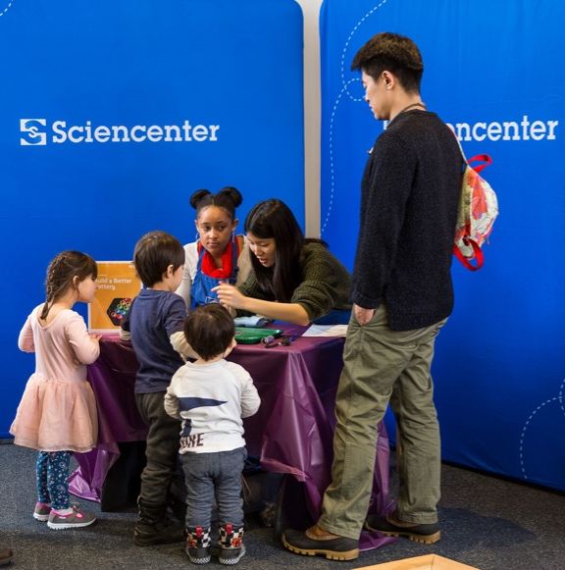
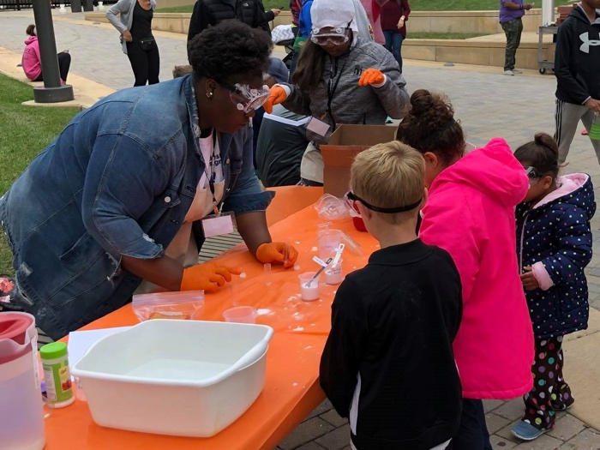
Events across the United States
Science Museum of Minnesota
Shared by Sciencenter
Shared by Discovery Station
Shared by Museum of Science
Notes:
44 ACS groups and 206 NISE Net members were awarded a physical kit that provided training resources and activities for hosting hands-on Let’s Do Chemistry events, which are all unique in location, format, and the audiences they reach. Here are just a few partner event examples.

Slide 17
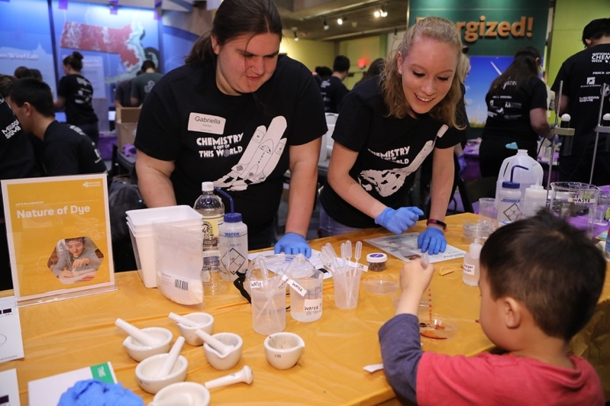
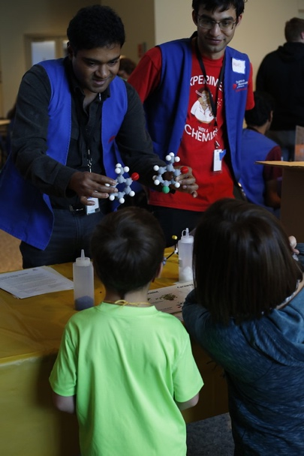
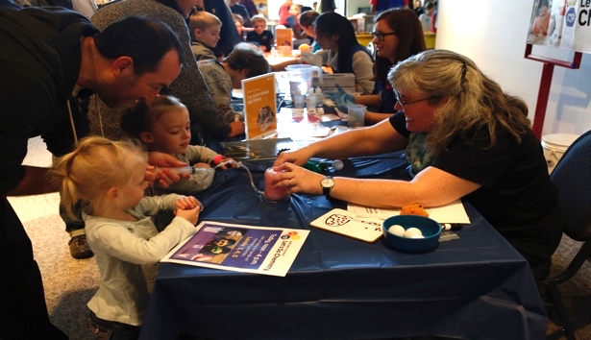
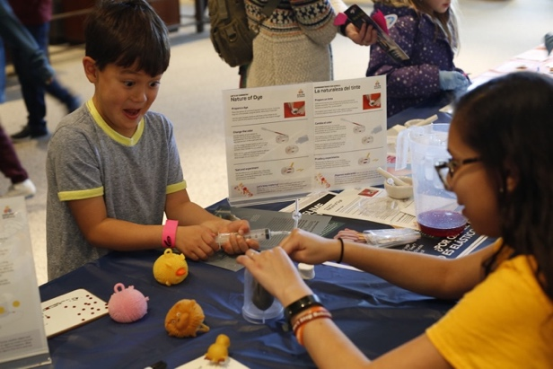
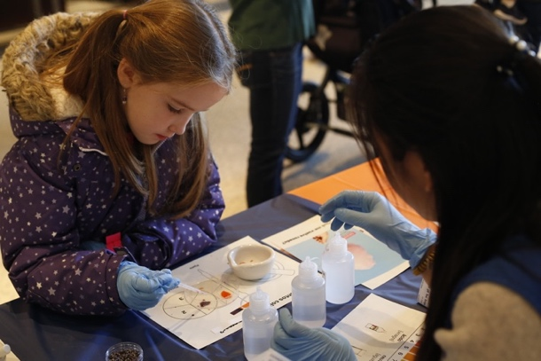
Science Museum of Minnesota, Saint Paul, MN
Events across the United States
Shared by Museum of Science
Museum of Science, Boston, MA

Slide 18
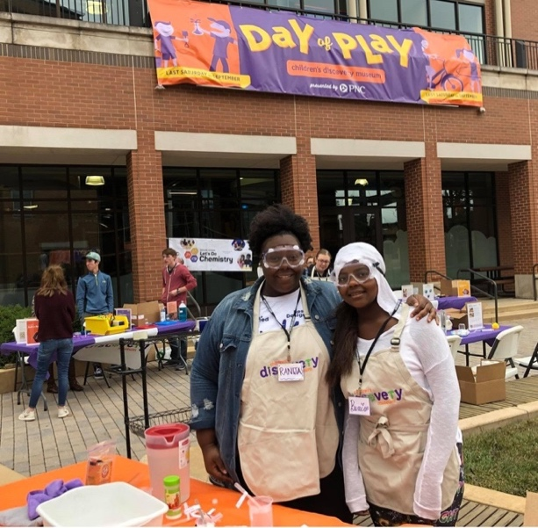

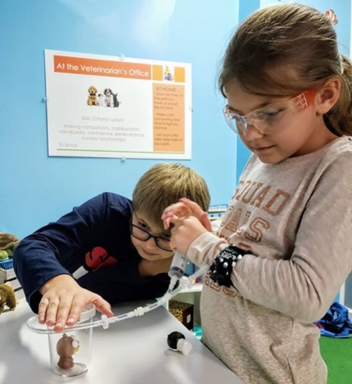
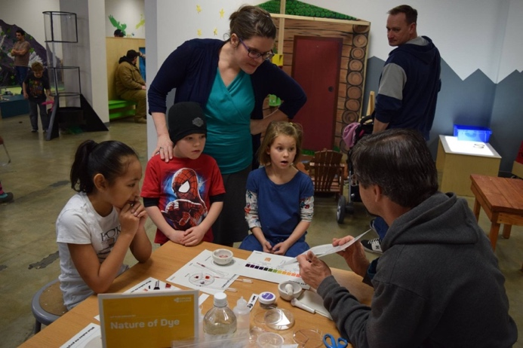
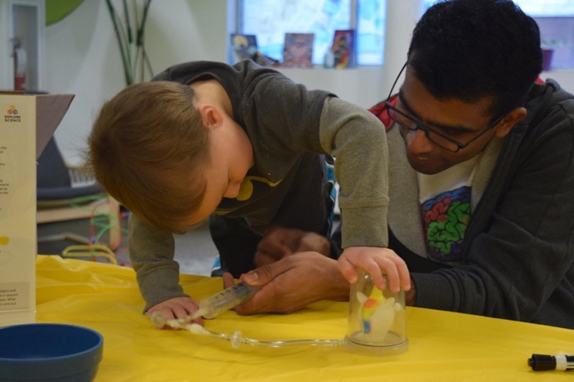
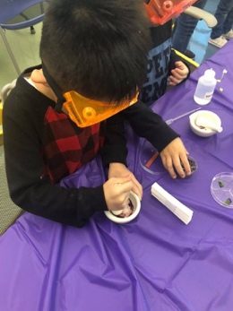
Children's Discovery Museum, Normal, Illinois
Events across the United States
Children's Discovery Museum, Normal, Illinois
Discovery Station, Hagerstown, Maryland
University of Arkansas Center for Mathematics and Science Education
Fairbanks Children’s Museum, Alaska
Fairbanks Children’s Museum

Slide 19
Who hosted Let’s Do Chemistry events?

Slide 20

Where were events hosted?
Other locations included:
Public library, K-12 schools, school district family science events
Day camps, afterschool programs, outdoor field classroom
Boys and Girls Clubs, Scouts
Church, church camp
Community organizations, community centers, local street markets, festivals, malls
Fair grounds
Hospital clinic
State park, National laboratory
Museum of Science
Shared by Keri Book @keribook, University of Arkansas Center for Mathematics and Science Education
Discovery Station
Notes:
Let’s Do Chemistry events were not confined to just within museum walls, partners hosted their public outreach events at many different locations and in many creative ways.

Slide 21
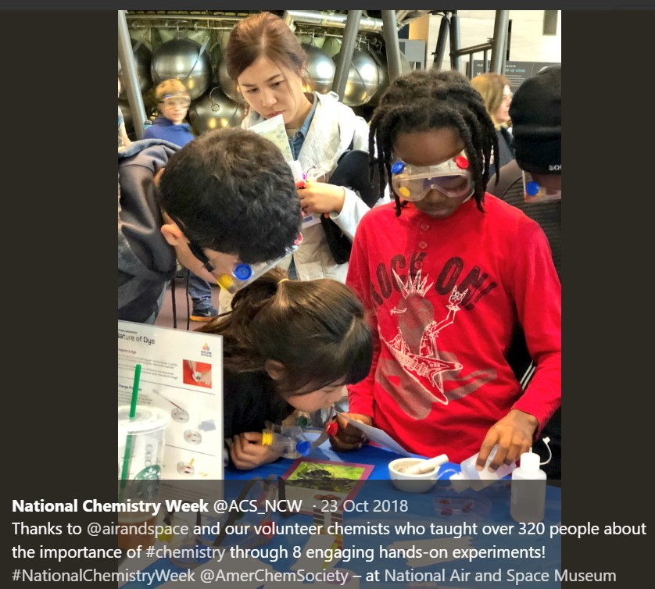
Public audiences reached through events
Museum of Science
Discovery Station

Slide 22
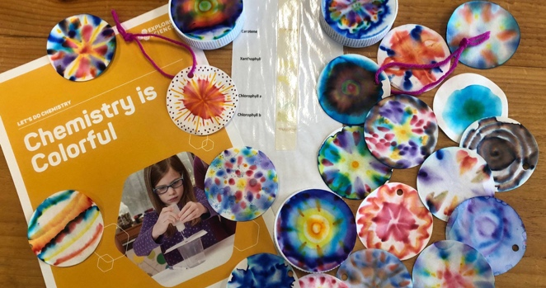
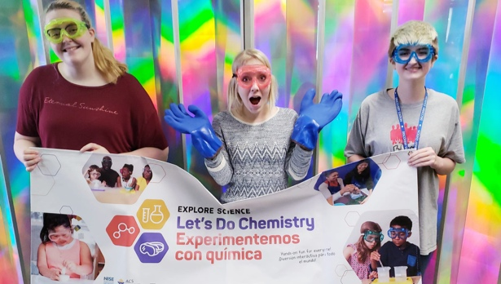
Public audiences reached through events
210,526 people reached
through October-November 2018 Let’s Do Chemistry events across the US
6,121 volunteers participated
in and facilitated hands-on activities
Many partners are already been using the materials in other ways following the Fall 2018 events
Shared by ECHO, Leahy Center for Lake Champlain, VT
Museum of Science
Discovery Station
Shared by Discovery Station, Hagerstown, Maryland

Slide 23
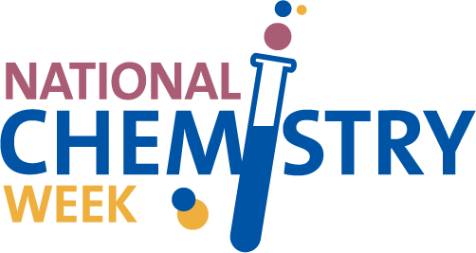
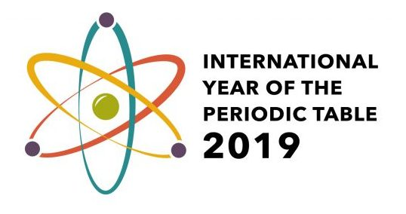

Shared by Museum of Science, Boston
More Opportunities for Special Events
nisenet.org/national-chemistry-week

Slide 24



National Chemistry Week and Let’s Do Chemistry events
“The kit provided an easy way for NISE Network partners and ACS groups to make new connections and learn about each other” - David Horwitz, Outreach Programs Manager, ACS
69% of Explore Science: Let’s Do Chemistry kit recipients reported using their activities during National Chemistry Week (October 21st-27th, 2018)
40% of kit recipients reported utilizing ACS volunteers (ACS Local Sections or Student Chapters) for their events
30% of kit recipients reported collaborating with either a museum or ACS group
Shared by Museum of Science
Discovery Station
ECHO, Leahy Center for Lake Champlain
Notes:
NCW thank you blog post by David Horwitz, ACS: http://nisenet.org/blog/post/thanks-participating-national-chemistry-week-2018

Slide 25
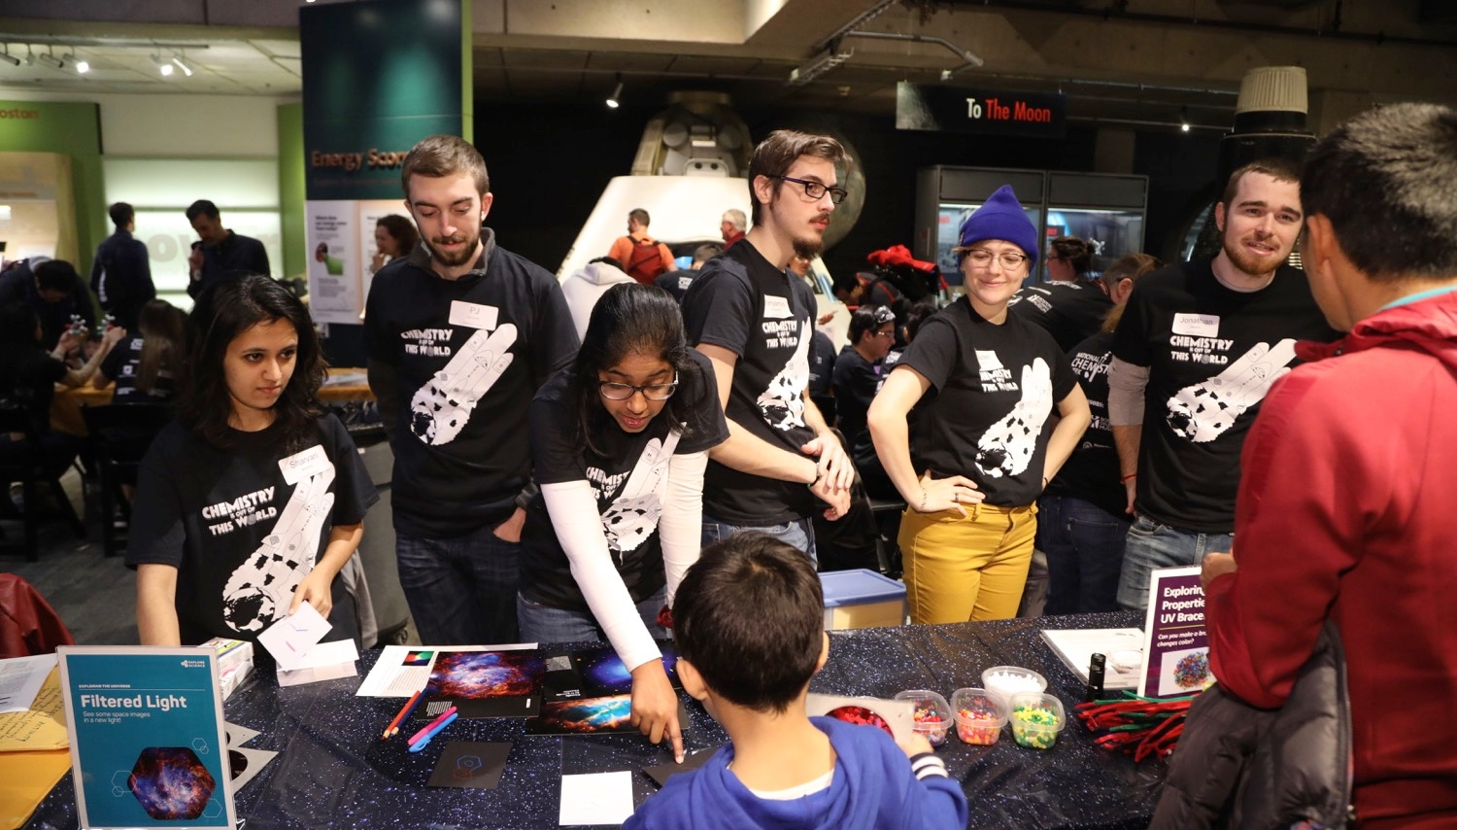
Shared by Museum of Science, Boston
Thank you to museum and chemist partners for hosting Explore Science: Let’s Do Chemistry events!

Slide 26
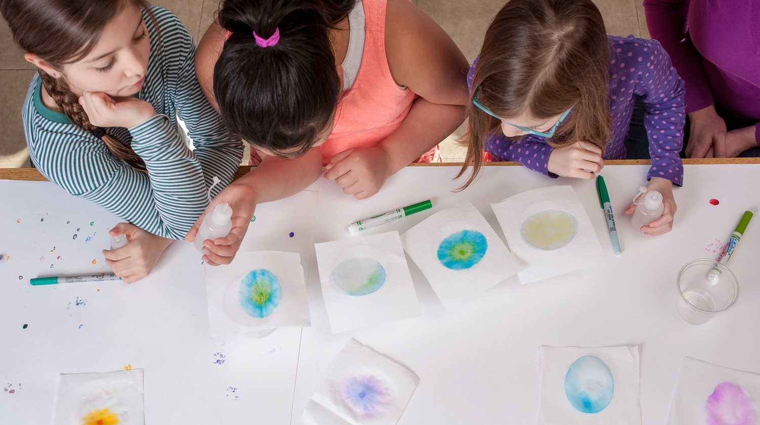

This work is supported by the National Science Foundation under award number 1612482.
Any opinions, findings, and conclusions or recommendations expressed in this presentation are those of the authors and do not necessarily reflect the views of the Foundation.

Slide 27
Patti Galvan
American Chemical Society Washington, DC

Slide 28

Leverage ACS resources and Let’s Do Chemistry for National Chemistry Week 2019
Patti Galvan
22 September 2019

Slide 29
Who We Are
A congressionally chartered professional society for chemists and related professionals, and the world’s largest scientific society.
Vision: To improve people’s lives through the transforming power of chemistry
Mission: To advance the broader chemistry enterprise and its practitioners for the benefit of Earth and its people

Slide 30
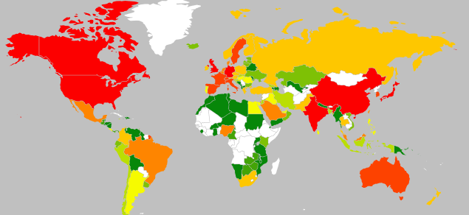
Who We Are
 | Over 1,000 Members
 | 500 – 999 Members
 | 200 – 499 Members
 | 100 – 199 Members
 | 50 – 99 Members
 | 20 – 49 Members
 | 10 – 19 Members
 | 5 – 9 Members
 | 1 – 4 Members
More than 2,500 ACS members in Canada
1 Student Chapter at the University of Toronto Mississauga
81% of membership is in the US

Slide 31
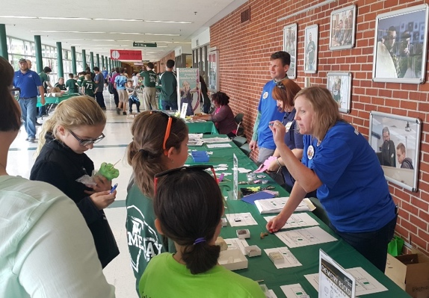
Why NCW?
National Chemistry Week (NCW) unites us in communicating the importance of chemistry to the public at the local, national, and global levels to make a positive change in the public's impression of chemistry.
Notes:
ACS local sections, student chapters, technical divisions, businesses, schools, and science enthusiasts

Slide 32
NCW Reach in the U.S.
NCW 2017
  81% of ACS local sections participated
  163K+ issues of the Celebrating Chemistry were distributed
NCW 2018
  91% of ACS local sections participated
  167K+ issues of the Celebrating Chemistry were distributed
  ACS local sections interacted with more than 75K+ people at in-person events
  NCW reached more than 25M+ online

Slide 33
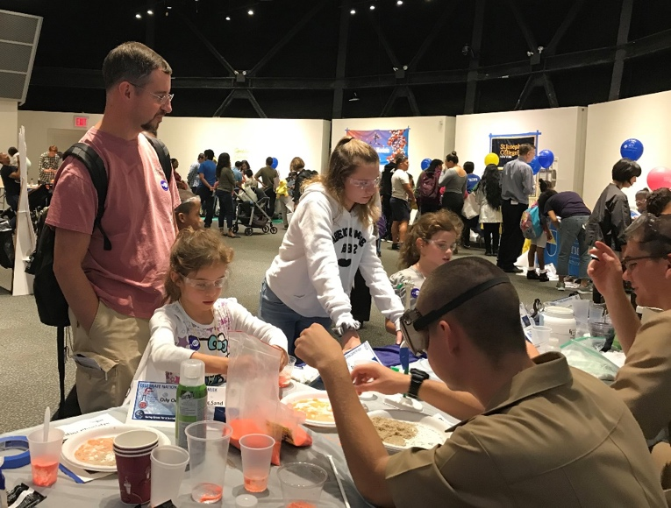
NCW Collaborations
The New York Local Section teams up with 19 universities and nonprofit organizations to host an annual NCW event at the New York Hall of Science for 1,200 attendees

Slide 34
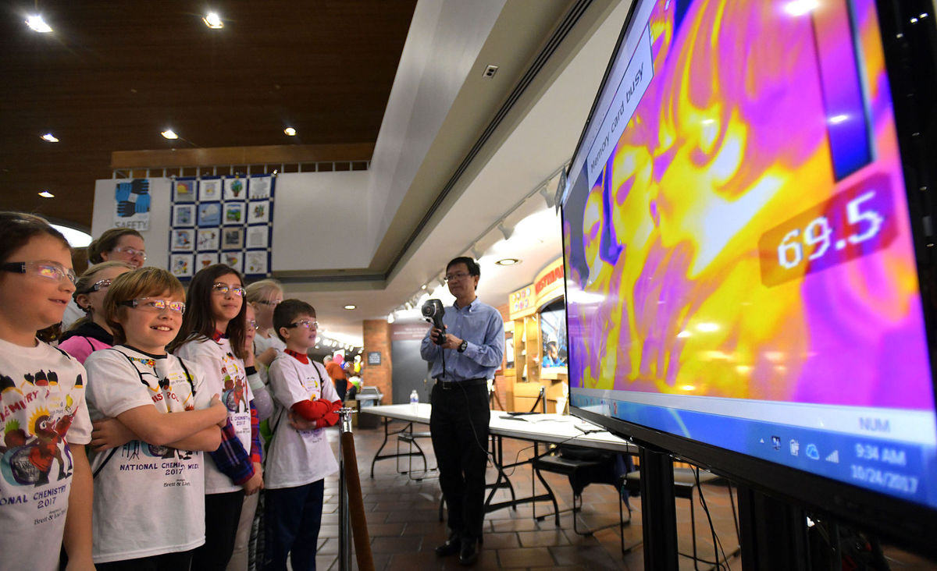
NCW Collaborations
The Northeast Tennessee Local Section works with Eastman Chemical to provide 1,400 students a day of chemistry

Slide 35
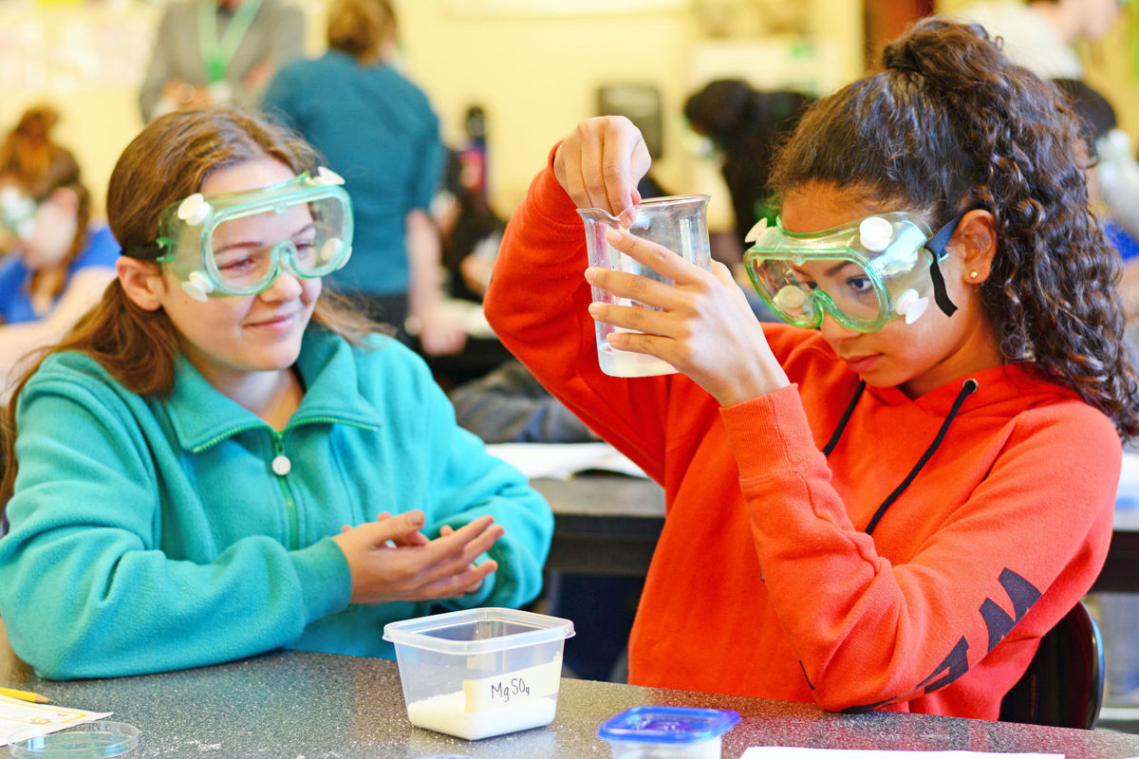
NCW Collaborations
The Puget Sound Local Section teams up a local student chapter to visit 23 middle school classrooms

Slide 36
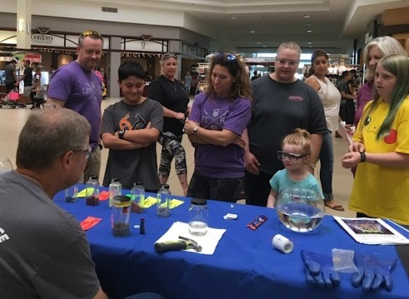
NCW Collaborations
The Permian Basin Local Section works with three high school ChemClubs to host tables of activities at the local mall and during the annual homecoming float parade

Slide 37
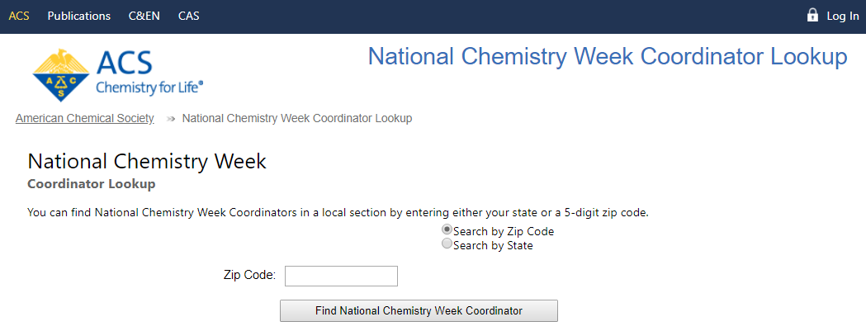
NCW Resources
NCW Coordinator Lookup Platform
www.ncwlookup.acs.org
Notes:
Your biggest resource is your ACS local section NCW Coordinator
If you would like a personal introduction, contact outreach@acs.org

Slide 38
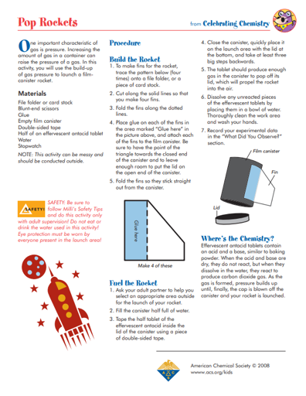
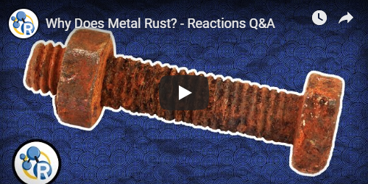
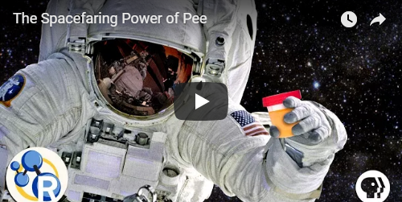
NCW Resources
Educational Resources
www.acs.org/ncw
Notes:
Science Safety Guidelines
Articles and activities (categorized by grade level)
Webinars
Videos

Slide 39
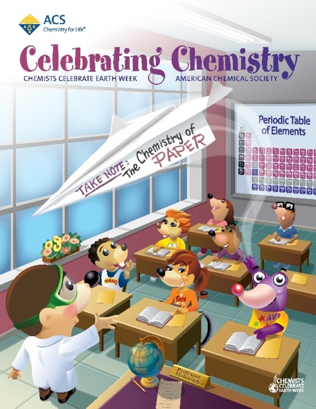
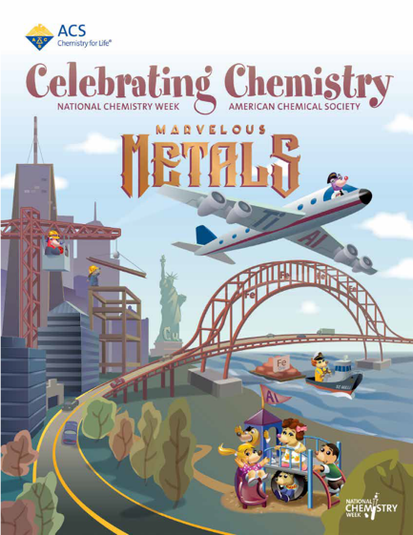
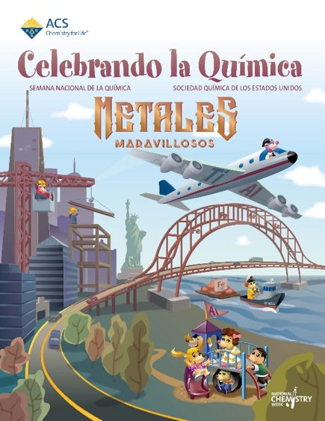
NCW Resources
Digital Celebrating Chemistry
www.acs.org/celebratingchemistry
Notes:
Available for download in English and Spanish
Past editions available

Slide 40
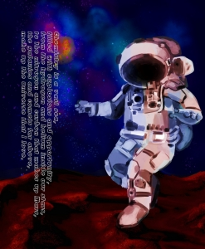
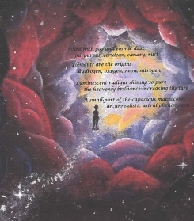

NCW Resources
Illustrated Poem Contest
www.acs.org/ncw
Notes:
Work with your ACS local section to host a contest
National prizes - $300 for first-place and $150 for second-place winners
Suggestion - use table at your NCW event for writing and illustrating poems

Slide 41

NCW Resources
Promotional Items
www.store.acs.org
Notes:
Resources may be purchased, but many are given to local sections for free or at discounted prices. We encourage you to reach out to your local section for stickers, tattoos, pencils, or bags for events.

Slide 42


NCW Resources
Design Toolkit
Social Media
  #NCW
  #NationalChemistryWeek
  Marvelous Metals
  Twitter - @ACS_NCW
  Facebook - National Chemistry Week
www.acs.org/ncw

Slide 43


Are you planning a chemistry event during National Chemistry Week 2019?

Slide 44



NCW Resources
Find an Event
www.acs.org/ncw
Notes:
If you’re planning to host a hands-on chemistry event for National Chemistry Week, make sure to advertise your event through the main NCW Facebook page, which has over 8,000 followers. First, create a Facebook event with all of your event’s info. Use the social media images from the NCW Design Toolkit for your event header. Then, visit the NCW “Plan an Event” web page and submit the URL of your Facebook event. Your event will be added to the NCW Facebook page and will be available on the main NCW website and the “Find an Event” web page.

Slide 45



Thank You!
NCW 2019 – October 20-26
Questions? Contact outreach@acs.org

Slide 46
Celebrating the International Year of the Periodic Table of Chemical Elements (IYPT 2019)
Patti Galvan
22 September 2019

Slide 47

IYPT 2019
2019 is the 150th anniversary of the publication of Mendeleev’s Periodic Table of Chemical Elements in 1869
IYPT is a celebratory year designated by the United Nations
IUPAC is the coordination hub for all IYPT events
ACS is working with IUPAC and other societies on international engagement

Slide 48
What’s So Special About the Periodic Table?
Mendeleev’s table predicted properties of undiscovered elements
Final row is complete
The table continues to evolve
Notes:
While not the first organization of the elements, Mendeleev’s successfully predicted the existence and some properties of gallium, germanium, scandium, and technetium
All spaces in the current periodic table are now filled by four newly named elements – muscovium, nihonium, tennesine, and oganesson
Chemical & Engineering News

Slide 49
What Tools are Available
IYPT Resources
  www.acs.org/iypt
    Register your event, get free press!
    Educational resources by age group
    Links to interactive tables from around the web
    Fun facts and videos
  Email: iypt@acs.org
    Send us your questions
    Get IYPT graphics

Slide 50
What’s Already Planned
IYPT Merchandise
  ACS Online Store: Periodic Table Goods, Element Pins
  IYPT Calendar
  IYPT Periodic Table Pins
  IYPT Periodic Table Wallet Cards
  IYPT Member-get-a-member blanket
  IYPT Cupcake Mix

Slide 51
What’s Already Planned
Recurring Events
  Tuesday Trivia Twitter posts
  Monthly history posts on ACS Axial
  Social Media graphics released by ACS Axial
  C&EN articles

Slide 52
What’s Already Happened
First Quarter
  Jan 29: ACS and IUPAC Opening Ceremony, Livestreamed from Paris
  Feb 11: IUPAC symposium “Women and the Periodic Table of Elements”
  Feb 12: ACS and IUPAC Global Women’s Breakfast
  Feb 16 -17: AAAS Family Science Days
  Feb 26 - 27: Special IYPT Program in a Box
  Feb 28: Capitol Hill Briefing and Reception

Slide 53
What’s Already Happened
Spring National Meeting
  #IYPT2019 Social Media Wall
  Periodic Table giveaways at the ACS Booth
  HIST Talks on IYPT
  Mar 30: CCA Presidential Outreach Event
  Mar 31: Celebratory IAC Reception
  Mar 31: Student Awards Ceremony theme
  Apr 1: CCA Outreach Workshop: IYPT and CCEW
  Apr 2: National Awards Ceremony/Banquet theme
  Apr 2: C&EN IYPT Trivia Night

Slide 54
What’s Already Happened
Fall National Meeting
  Periodic Table lanyard giveaways at the ACS Information Booths
  CCA Presidential Outreach Event
  Grady-Stack Award for Interpreting Chemistry for the Public awarded to Sir Martyn Poliakoff and the Periodic Table of Videos: From Test Tube to YouTube
  Symposium: 150 Years of the Periodic Table, HIST Division
  IAC Reception: Celebrating IYPT 2019
  C&EN and ACS on Campus present Periodic Table Bingo

Slide 55

What’s Already Happened
ACS and Government
  Capitol Hill receptions and briefings
  State resolutions from South Carolina, Massachusetts, and Puerto Rico
  July 24: Senate resolution unanimously passed!
  House resolution in the works, voting after August Recess
  ACS & Battelle Joint Congressional Briefing and
  Reception, Elements and National Labs, October 23, 2019
  ACS & NSF: IYPT Colloquium “Perspectives in Chemistry: 150 Years of the Periodic Table” at National Academies, November 2019

Slide 56



IYPT Resolutions:
U.S. Senate

Slide 57
What Are Others Doing?
HIST Division
  “The particular item I wanted to report is searchable online map of places associated with the developers of the periodic table and with the chemical elements. Each entry contains links to further information about the person, place, or event described. The map is called Places of the Periodic Table”
  https://www.google.com/maps/d/viewer?mid=1Xey19Nt9afpdL6wc1ysM_ZNhKQpQ5ilv&ll=28.563083397360725%2C-38.502264702109414&z=2
Western Michigan Local Section
  “Our local section of the ACS is organizing an event in October to make the World's Largest Periodic Table in honor of National Chemistry Week and IYPT2019. Details on the event can be found our local section website and Facebook page.”
  https://www.facebook.com/events/2261489874120479/
  https://westernmichigan.sites.acs.org/

Slide 58


What Are Others Doing?
California Local Section
  National Historic Chemical Landmark rededication in honor of the discovery of more than a dozen elements at Lawrence Berkeley National Lab (LBNL)
  150 guests attended ceremony and reception which included hands-on science experiments.
  Attendees included:
    Yumi Nakagawa, LHS Advisory Council Chair
    Korey Carter,LBNL
    David Seaborg (Son of the late Glenn Seaborg)
    Jim Postma, Chair of ACS CA Local Section
    Attila Pavlath, ACS Past President

Slide 59

What Can I Do?
Tweet or post about chemistry using #IYPT2019
Host social event(s) celebrating IYPT 2019
Connect your chemistry programming to the United Nations Sustainable Development Goals
Organize event(s) in your community specifically to improve public awareness of chemistry's contributions to sustainability
Organize hands-on science outreach event(s) in your community
Participate in National Chemistry Week

Slide 60
How Will YOU Celebrate IYPT 2019? www.acs.org/iypt
#IYPT2019 iypt@acs.org

Slide 61
Emily Belle
Sciencenter
Ithaca, NY

Slide 62



Ithaca, New York
Notes:
Quick facts to orient: square footage of exhibit space; 3,000+ members, over 100,000 on-site guests each year, reaching 1.5 million people annually through traveling exhibits & outreach programs, staff of 32, strong volunteer program
Location notes: Ithaca, NY - Finger lakes is a popular tourist region; we also share our community with two universities (Ithaca College & IC)
The Sciencenter relies on volunteers & community partnerships for depth, breadth, and reach of programming…and we do chemistry!
Today I’m going to tell you about two efforts to engage the public in chemistry: the first in our museum, and the second in surrounding rural areas serving audiences that may not make it to the museum proper

Slide 63


Chemsations!
Chemistry-based Partnerships

Slide 64



Notes:
Chemsations! Is a demo show that brings local high school students to the Sciencenter to present chemistry concepts to a public audience
Students are recommended by their science teacher
They are assisted by a graduate student volunteer who oversees the program
Promotes leadership, sense of ownership, communication skills

Slide 65


Program Sustainability
Notes:
Scripted, self-running; built-in partnership with IHS

Slide 66


Family Science Nights
Accessibility
Expanding the opportunities for everyone to engage with science by removing barriers
Chemistry-themed Outreach
Notes:
Locating chemistry programming as a key part of our strategic framework – in this case, bringing science activities to rural audiences
The Let’s Do Chemistry! Kit is perfect for this – it really feels like *doing science,* something special (goggle, indicators, test tubes and all!) while still be relevant and hands-on

Slide 67


Upstate New York: Tompkins, Schuyler and Tioga Counties
Notes:
We have other programs that serve additional surrounding counties

Slide 68

Partnering with Underserved Schools
Notes:
Family Science Nights bring volunteers (mostly groups of students from 2 local universities: Cornell and IC) to rural elementary schools
Enfield is actually within the Ithaca City District, but most volunteers reflect that…it feels like a different world.
Events from 6:30-7:30 at the schools; school-age children, their adults, younger and sometimes older siblings; coordinate with PTA and/or principal
Volunteers trained in activities and facilitation at the beginning of the semester

Slide 69




Notes:
Family Science Nights bring volunteers (mostly groups of students from 2 local universities: Cornell and IC) to rural elementary schools
Events from 6:30-7:30 at the schools; school-age children, their adults, younger and sometimes older siblings; coordinate with PTA and/or principal
Volunteers trained in activities and facilitation at the beginning of the semester

Slide 70





Slide 71
Soma Chatterji
Carnegie Science Center
Pittsburgh, PA

Slide 72


Slide 73



Slide 75


Slide 76


Slide 77


Slide 78


Slide 79


Slide 80


Slide 81


Slide 82


Slide 83


Slide 84
Darrell Porcello
Children’s Creativity Museu
San Francisco, CA

Slide 85



Darrell Porcello, PhD
Director of STEM
Networks and Partnerships
ASTC 2019 | Toronto, Canada

Slide 86







To nurture creativity and collaboration in
all children and families.

Slide 87






Slide 88




Boom-Fizz: Sounds of Chemistry workshop
Rocket Reactions

Slide 89



Boom-Fizz: Sounds of Chemistry workshop
Sublimation Bubbles

Slide 90
Boom-Fizz
Workshop
Boom-Fizz
Workshop

Slide 91

Boom-Fizz
Workshop
Boom-Fizz
Workshop
Color Explosion
Workshop

Slide 92



Boom-Fizz
Workshop
Boom-Fizz
Workshop
Color Explosion
Workshop
???
Workshop

Slide 93
This work is supported by the National Science Foundation under award number 1612482.
Any opinions, findings, and conclusions or recommendations expressed in this presentation are those of the authors and do not necessarily reflect the views of the Foundation.

Slide 94
Discussion
Sub headline here

Slide 95
Questions
Addressing fears about chemicals and chemistry ?
Sub headline here

Slide 96
Questions
Getting support from institution stakeholders and decision makers for chemistry ?
Sub headline here

Slide 97
Questions
Event Safety?
Sub headline here

Slide 98
Questions
Special Training?
Sub headline here

Slide 99
Questions
Materials handling and storage ?
Sub headline here

