Slide 1



Science Centers and Community Partners
Working Together for People and the Planet
ASTC 2020

Slide 2

WELCOME BACK
SUSTAINABLE FUTURES
Session 2

Slide 3

Workshop agenda
SESSION 1
Introduction to sustainability
Break
Sustainability and science centers
Sustainability @ OMSI
Homework
Final thoughts
SESSION 2
Brainstorming activity
Sustainability @ MOTE
Sustainability @ NC Museum of Natural Sciences
Break
Sustainability project ideas
Resources and future opportunities
Priorities, next steps, and reflections

Slide 4
Share – Looking back, looking forward
Share a reflection about yesterday or a hope for today

Slide 5
Breakout rooms – SDG brainstorming
Discuss the brainstorming activity
Here are some possible questions to consider:
Did you find examples of things your museum already does that support the SDGs?
Did you find new opportunities to connect your work to sustainability?
Is it easy to see how sustainability fits in with your work? Do you anticipate challenges?
Did your view of sustainability change as a result of this activity?

Slide 6
Ross Johnston,
Mote Marine Laboratory

Slide 7
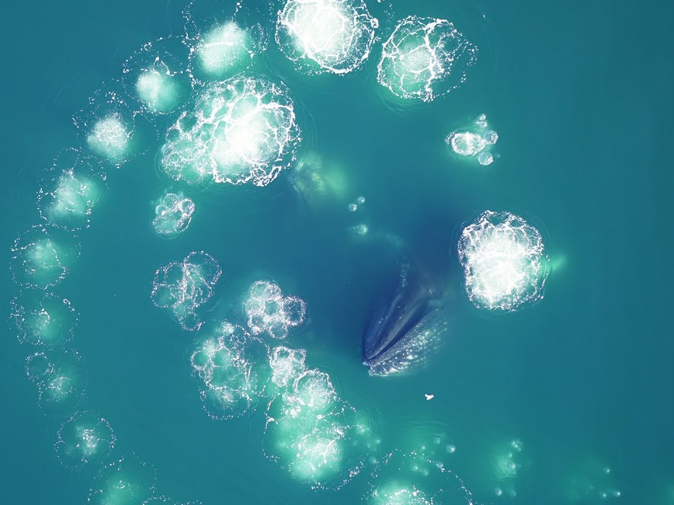
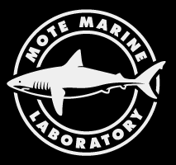
SEAing Sustainability Education Differently
Ross Johnston
Mote marine Lab, Sarasota, FL

Slide 8
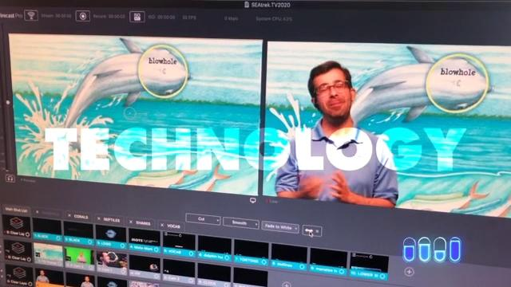
Welcome to SEATrek TV!

Slide 9
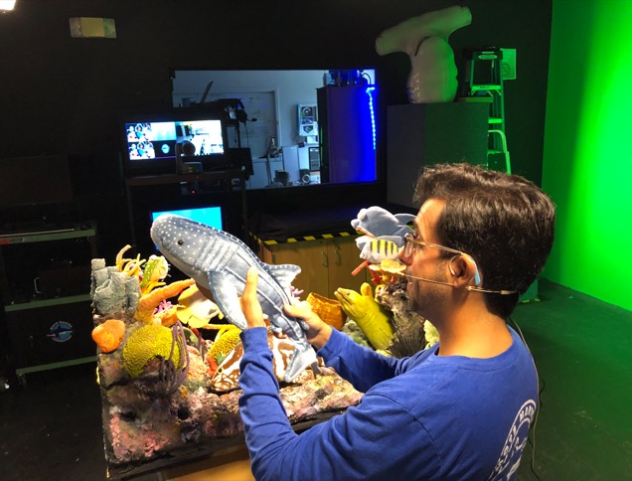
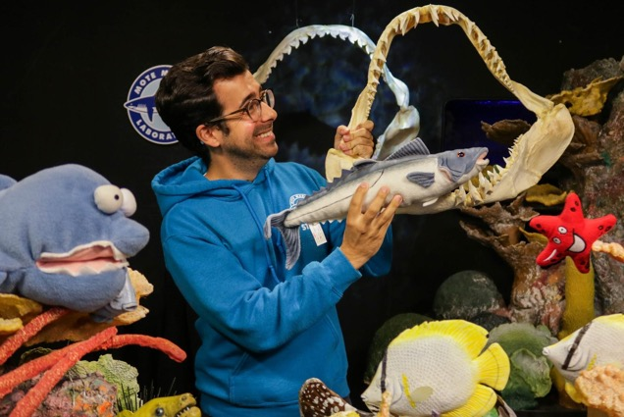
ReMote Learning Programs
Mote SEATrek TV
  Two decades of virtual learning programs
  International audience connections
  Over 6,000 yearly connections
  Youth and Adult programming
    Virtual storytimes, science demos, webinars
  Broadcasts Mote’s marine science, conservation, and sustainability research
Program Limitations
  Restricted to studio broadcasts
  Translating science to non-scientific audiences
  Limited work relationship with researchers
  Wired-in connections

Slide 10
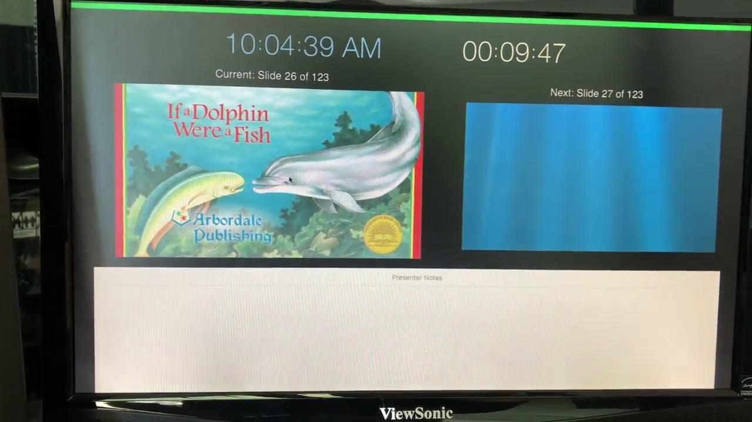
ReMote Learning Programs

Slide 11
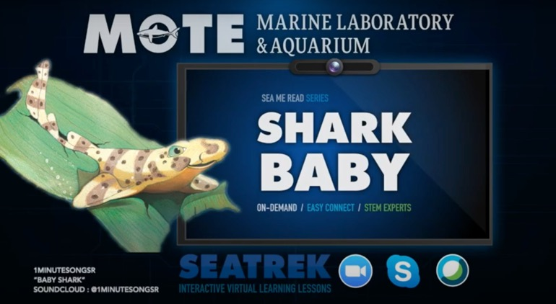
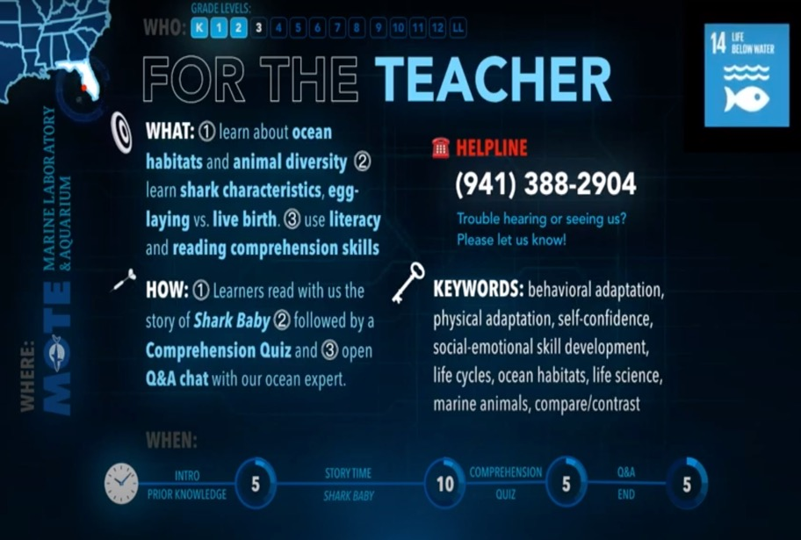
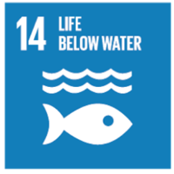



SEATrek’s SDG’s

Slide 12
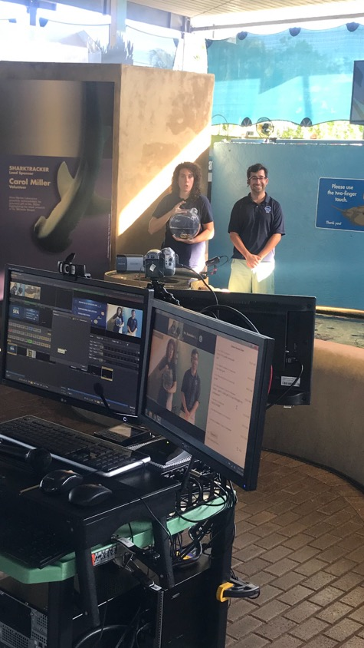
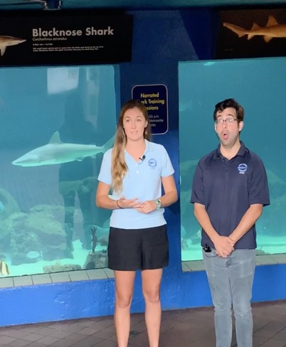
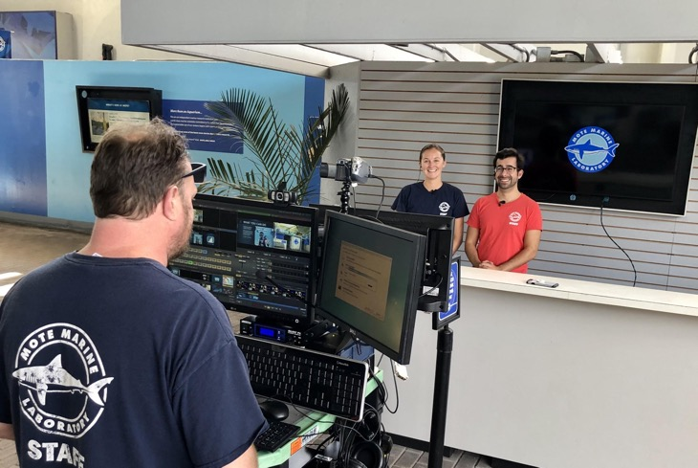
The Mote SEA Show
Science, Education, Aquarium (SEA) Goals:
  Free virtual behind-the-scenes tours using new technology
    “Lifting the curtain” on Mote’s laboratory science
  Direct interviews with scientists about their research
  ProMOTEing science literacy through transparency

Slide 13
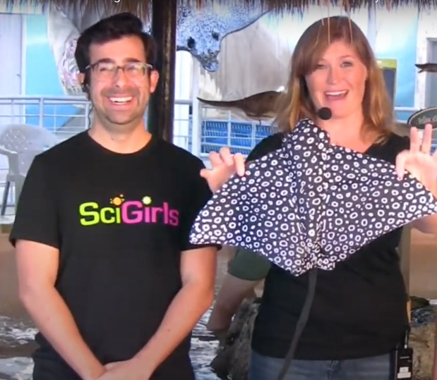
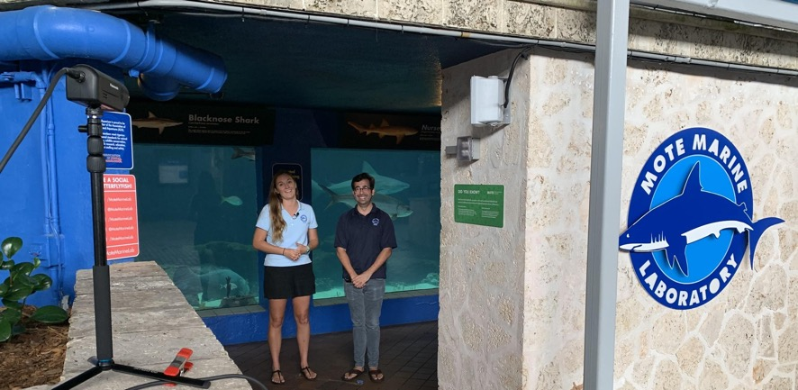
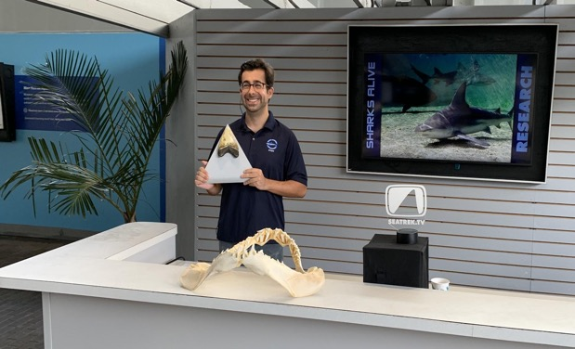
SEAson One, Done!
Blockbuster Success!
  4 months, 6 Mote scientists, 5 research topics
  1,606* participants reached!
    786* registered institutions + 820 informal viewers
  Requests from educators for more (free) content
  Requests from scientists to share their research
  Challenge: High viewership crashed Mote’s WiFi

Slide 14
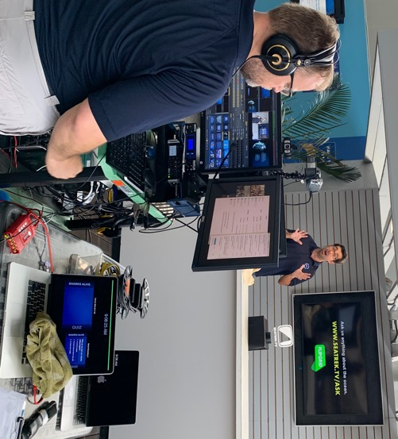
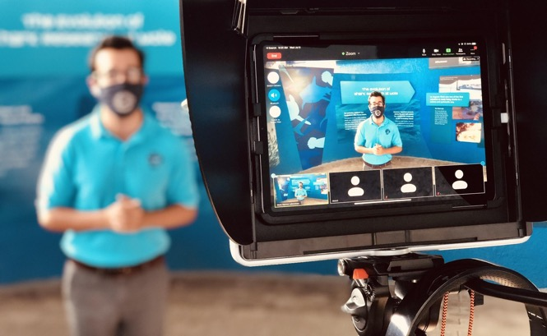

SEAson Two: Current Events
Wider Topics
  New Mote research = New guest experts
  TBD: Red tide, microplastics, blue holes, sea turtle hospital
  Completed: Ancient oceans, cephalopods, estuaries, ROV/AUV’s, manatees, sustainability strategies
Wider Area
  Padcaster’s cellular data = No WiFi restrictions
  Filming from the field!
Wider Audience
  Children’s hospitals & Pediatric care centers
  Summer camps & Libraries
  Scout programs & Senior homes
Flipgrid - “Ask us anything about the ocean!”
  https://flipgrid.com/seatrek
  http://mote.org/seatrek

Slide 15
Thank You ASTC & NISE!
Questions?
Ross Johnston
ross@mote.org

Slide 16
Kari Wouk, North Carolina Museum of Natural Sciences

Slide 17

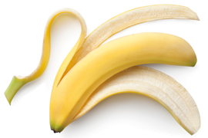
Compost at the NC Museum of Natural Sciences
Kari Wouk, Senior Manager of Educational Collaborations

Slide 18

Deciding
What Can We Do to Have the Greatest Positive Environmental Impact?
Organic items sent to the landfill break down VERY slowly, and when they do, they create methane, a greenhouse gas 84 times more potent than CO2
60% of waste stream is compostable
Composting saves 35% of usable land taken up by landfills
Creating one ton of compost is equivalent to removing 19 cars from the road for two weeks
Using compost reduces or replaces the need for herbicides and fertilizers

Slide 19

Implementing
How Do We Do It?
Worked with local commercial composter
Funded by our Friends of the Museum by Museum Store roundups
First implemented “back of house” at Café
Exhibits designed bins
Public launch with CompostCon event
Constant education

Slide 20
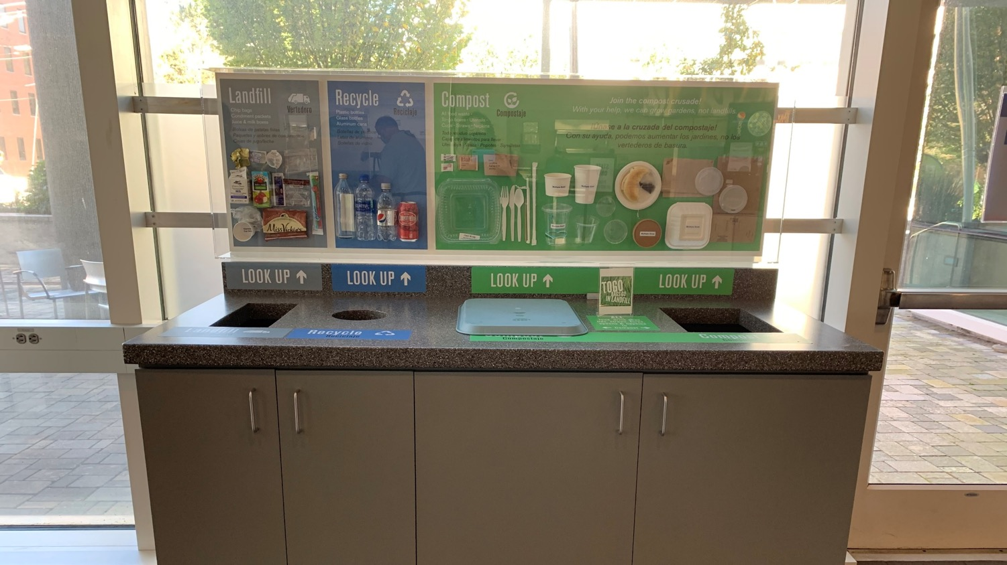

Slide 21
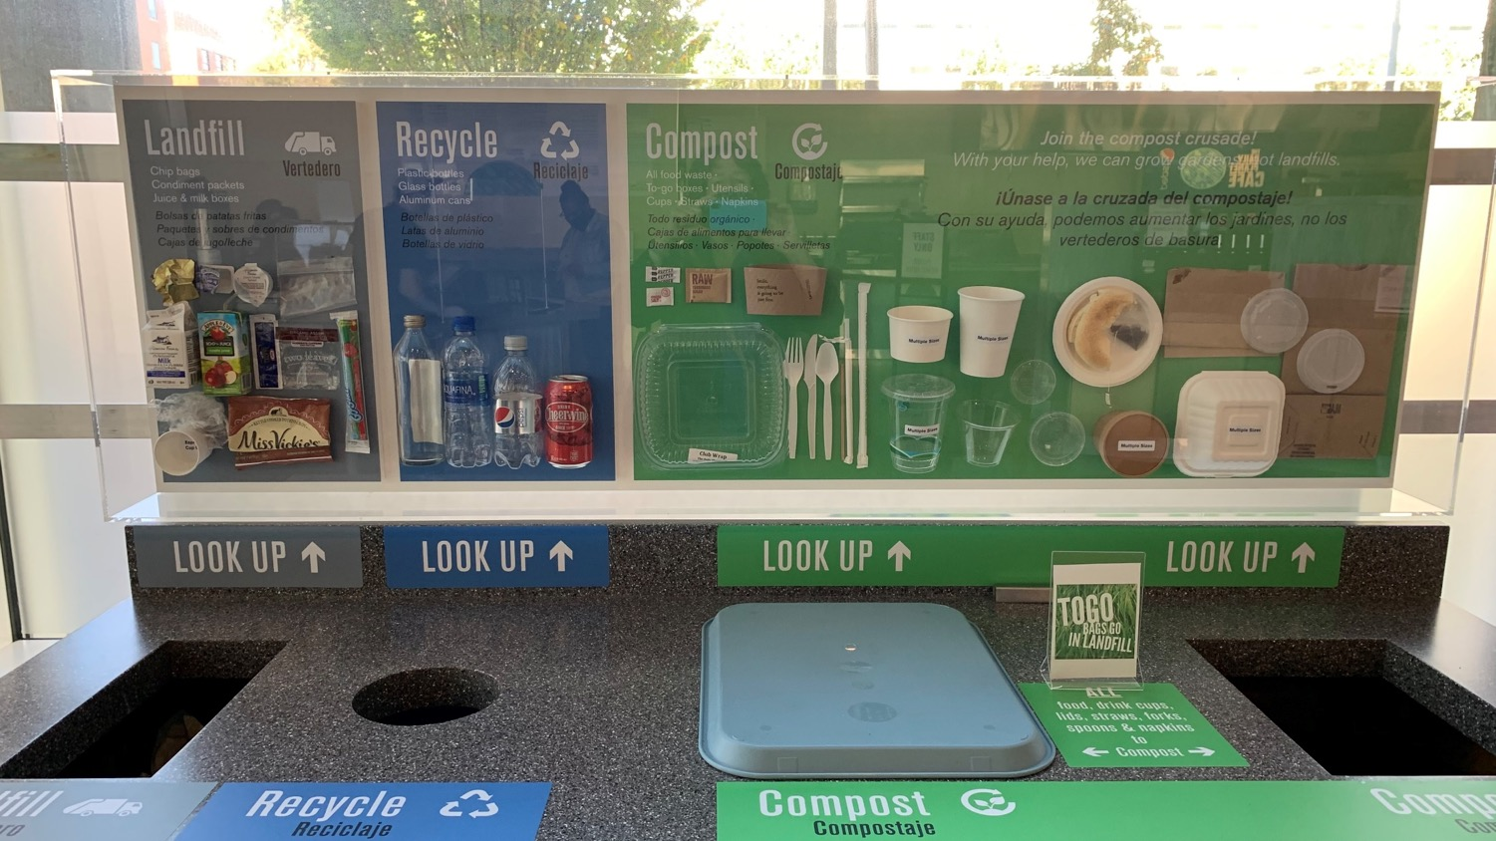

Slide 22
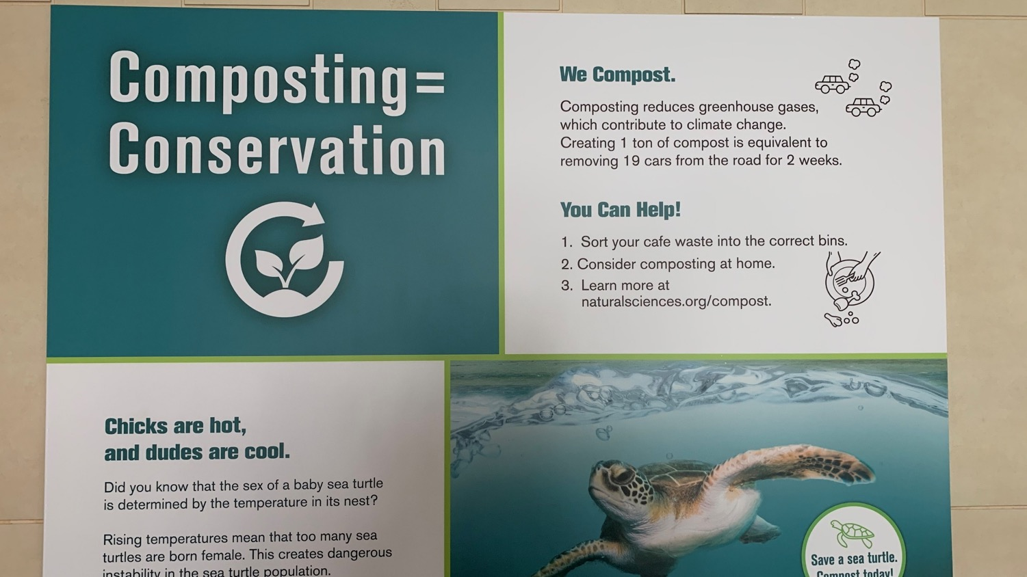

Slide 23
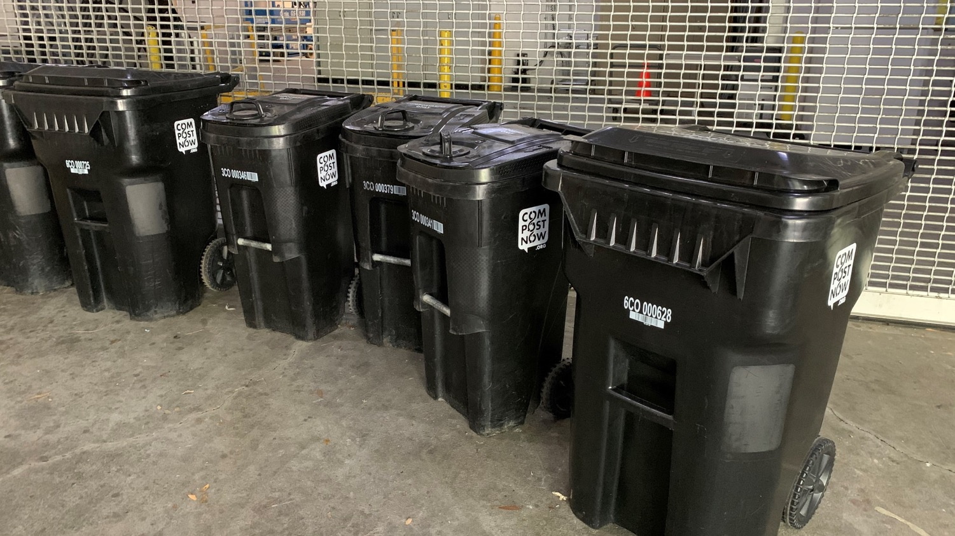

Slide 24
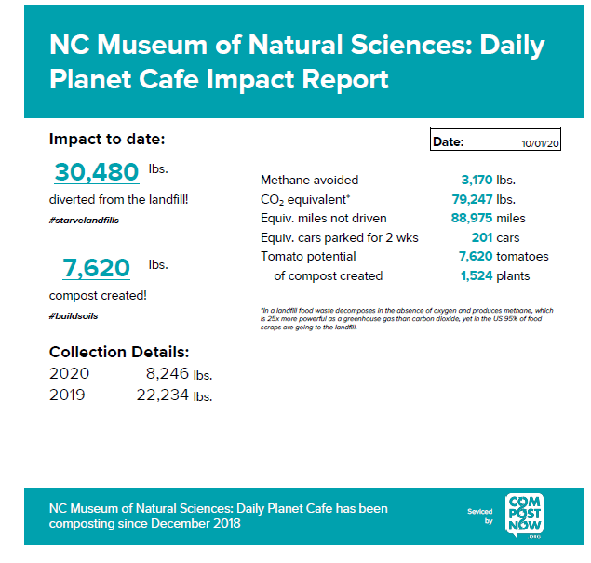
Impact

Slide 25
Lessons Learned
Education is Key
Visitors do not understand compost
Visitors do not understand compostable products
Visitors do not understand commercial compost
Visitors do not look up
Visitors want to do the right thing!

Slide 26
SUSTAINABILITY
PRIORITIES & PROJECTS

Slide 27

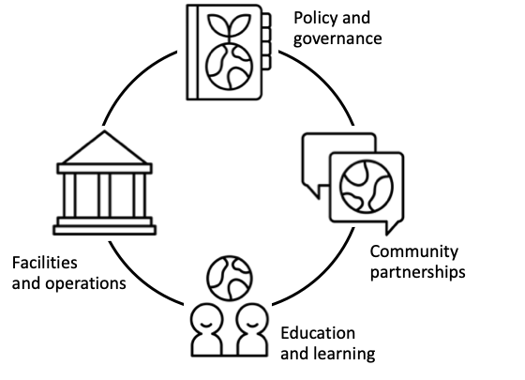
How does sustainability connect to your organization’s mission and priorities?

Slide 28
Sustainability projects
Identifying and solving problems in our community
What problem do you want to solve?
Creating the future we want to live in
What change do you want to see?
Doing things that are good for people and nature
What can you do?

Slide 29
Break + Reflection about sustainability
Think about ways that sustainability connects to your organization.
What are some sustainability projects or next steps that are feasible, meaningful, and aligned with your organization’s priorities?
Bring your ideas to share after break (15 minutes)

Slide 30
Share – Sustainability at your organization
What’s next for you and sustainability?
Share an idea for sustainability priorities, possible projects, or next steps at your organization
(One minute per person)

Slide 31
RESOURCES
& FUTURE OPPORTUNITIES
Notes:
These are all on the Google Classroom page

Slide 32
Resources
Available to download from https://www.nisenet.org/sustainability
Museums and sustainability
Sustainability project planning
Staff and community engagement
Public engagement and programming

Slide 33
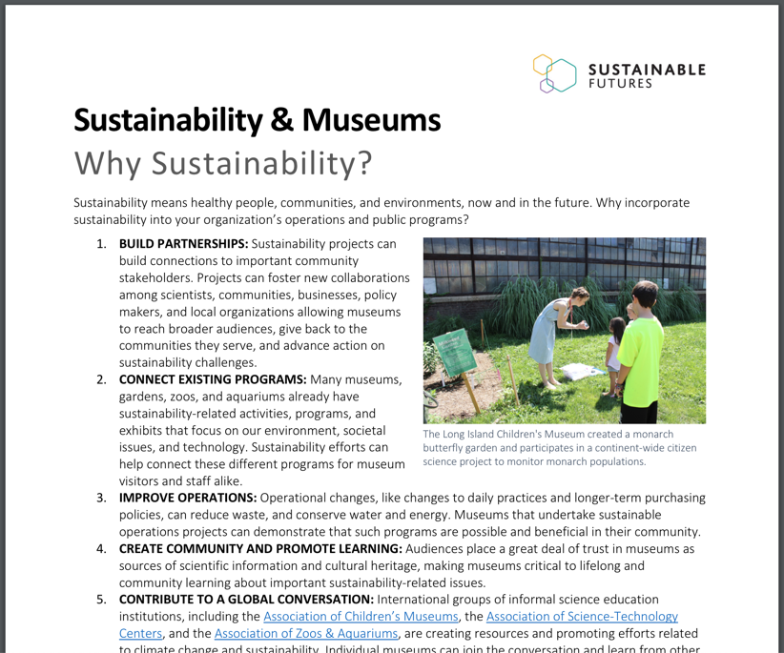
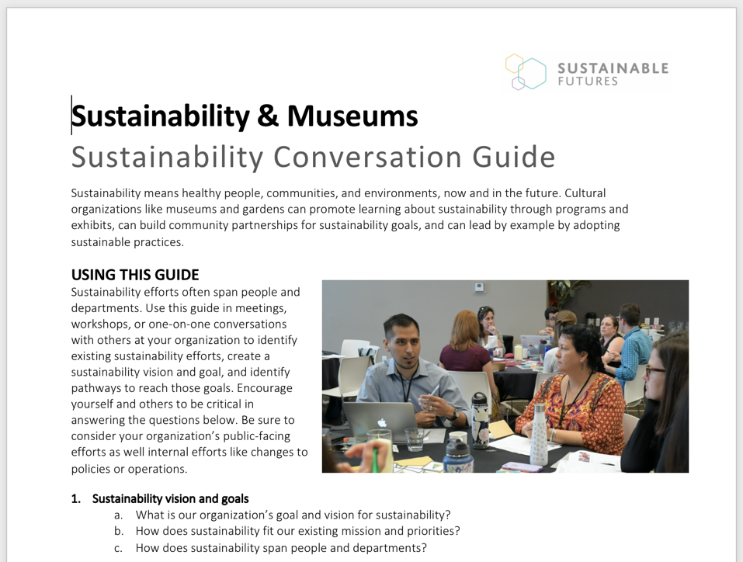
Why Sustainability + Conversation Guide
Decide how sustainability fits in at your organization

Slide 34
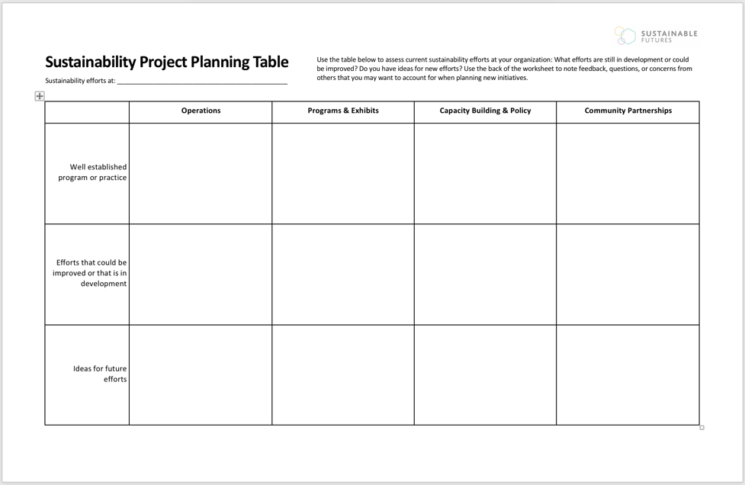
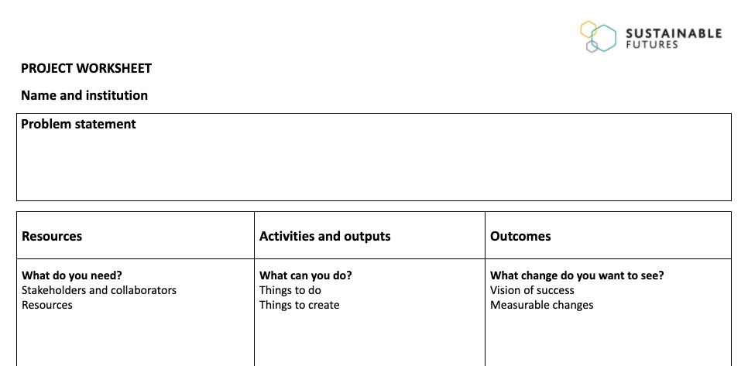
Project Planning Table + Worksheets
Identify opportunities for sustainability projects

Slide 35
NISE Network Sustainability Fellowships
Information will be available at https://www.nisenet.org/sustainability
Three cohorts in 2021-2022
Virtual professional development plus participant support funds
Applications will open in early January, 2021 and close March 1, 2021
Two informational online workshops, one in January and one in February, 2021

Slide 36
Raise your hand – Final reflections
One way I’ll approach my work differently as a result of this workshop
or
One thing I’m motivated and empowered to do as a result of this workshop

Slide 37
ADJOURN
Thank you!

Slide 38



The Rob and Melani Walton Sustainability in Science and Technology Museums program is supported through funding from The Rob and Melani Walton Foundation.
Sustainable Museums: Professional Development to Support Fieldwide Capacity in Practice, Partnerships, and Education for Sustainability is made possible in part by the Institute of Museum and Library Services
The Sustainable Development Goals (SDGs) logo, color wheel, and icons are used according to the United Nations guidelines: https://www.un.org/sustainabledevelopment/wp-content/uploads/2019/01/SDG_Guidelines_AUG_2019_Final.pdf

