Slide 2
Overview
Introduction to NISE Network
DEAI planning process and outcomes
Example of a project that aligns with the plan

Slide 3
NISE Network brings people together
to engage in STEM, understand our world,
and build a better future for everyone.

Slide 4
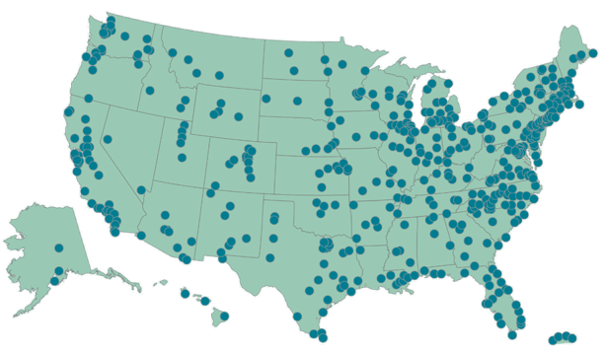
NISE Network
National Informal STEM Education Network
Characteristics:
We are a national network that connects local learning ecosystems.
We have hundreds of partner organizations in the US.
Project teams create resources “by and for” Network partners.
Partner organizations opt in to projects and activities that align with their priorities.
Network coordination and infrastructure is funded through projects and anchored by a core team at Arizona State University.

Slide 5
Key elements
A dedicated leadership team capable of learning, making decisions, and planning for change
An enduring set of values and practices that support ongoing improvement and fosters Network participation
Committed partner organizations that take part in activities and contribute to learning and impact
Network projects that align with funder and partner goals and further fieldwide priorities

Slide 6
Network goals and activities
1. Guide Network priorities and growth
Sharing and learning among Network partners
Participating in Network activities and using Network resources
2. Build capacity for the field, organizations, and individuals
Knowledge and strategies to tackle important issues
Professional development and resources
3. Develop and implement STEM engagement activities
Museum exhibits, programs, and media
Activities at other locations in a community
4. Encourage local partnerships with other organizations for Network activities
Experts in subject matter and approach
Community organizations
Notes:
Enduring values and practices:
Building the Network by working together
Learning together by doing and reflecting
Respecting organizational needs and priorities
Engaging professionals as partners rather than members
Co-creating and incorporating input, feedback, and data
Openly sharing products, practices, and knowledge (nisenet.org)
Designing and evaluating for adaptability and flexibility

Slide 7
Enduring values and practices
Building the Network by working together
Learning together by doing and reflecting
Respecting organizational needs and priorities
Engaging professionals as partners rather than members
Co-creating and incorporating input, feedback, and data
Openly sharing products, practices, and knowledge (nisenet.org)
Designing and evaluating for adaptability and flexibility

Slide 8
DEAI planning process

Slide 9
Plan for Diversity, Equity, Accessibility, and Inclusion (DEAI)
Participants: Network leaders, project team members, members of partner organizations, and “critical friends” from other national organizations
Consultant and partner: EDC conducted a landscape study, facilitated meetings, and created the final report document
Process: Over several months in 2020-2021
Regular meetings among leadership team and EDC
Iterations of landscape study and plan
Online meeting sessions with different groups of participants
Follow-up meetings with core Network team
Notes:
Critical friends: CAISE/ASTC, ACM, NGCP

Slide 10
DEAI strategies
Leadership: Prioritize DEAI in the projects we pursue, the partners we work with, and the goals we set
Partners: Build capacity for DEAI across the Network by creating community, resources, and opportunities for learning among Network partner organizations
Projects: Model and enact DEAI in our processes, practices, and products
Notes:
Align with how the Network works

Slide 11
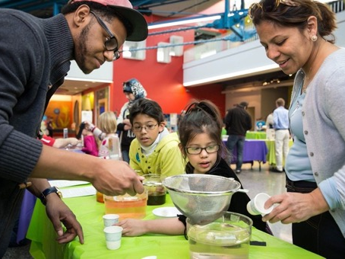
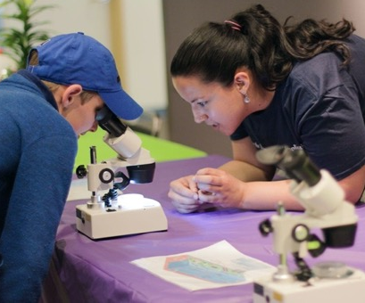
Planning for impact at different scales
The plan takes into account the need for change at network, organizational, and individual levels.
It aligns with our overall Network theory of change.

Slide 12
Systemic change
Organiza-
tional change
Individual learning

Slide 13
Progress with DEAI plan
Leadership: Prioritize DEAI in the projects we pursue, the partners we work with, and the goals we set.
The Network leadership team is committed to the goals and strategies
We regularly communicate that DEAI is a priority for the Network
We have been successful in receiving funding for new projects that advance the plan
Our new projects have allowed us to develop and strengthen some new partnerships to advance the plan
Our new projects allow us to diversify project leadership, but our core Network leadership group has not diversified (and is getting smaller)
Partners: Build capacity for DEAI across the Network by creating community, resources, and opportunities for learning among Network partner organizations,
Our new projects support Network partner organizations in defining and accomplishing DEAI goals
Network partners take the lead at their own organizations; the Network can provide resources and a supportive community
Projects: Model and enact DEAI in our processes, practices, and products.
Our new projects allow us to improve and model our DEAI processes, practices, and products
Because we are entirely project funded, change happens with project personnel through project activities
Notes:
Green: making good progress
Orange: making some/limited progress
Always more to be done!

Slide 14
Lessons learned
Participants: It was essential to have broad input and many perspectives. We were able to plan the process so that it wasn’t too burdensome for participants.
Consultant and partner: It was invaluable to have EDC as a partner, so that all participants could focus on contributing to the ideas in the plan (not coordinating the process).
Process: The conversations and understanding were the most valuable part; the plan provides a reference.
Outcomes: Our strategies are aligned with the Network’s overall theory of change, so DEIA is embedded in (not separate) from our ongoing planning.
Implementation: It takes time, commitment, and flexibility to implement the plan. It’s an ongoing process!

Slide 15
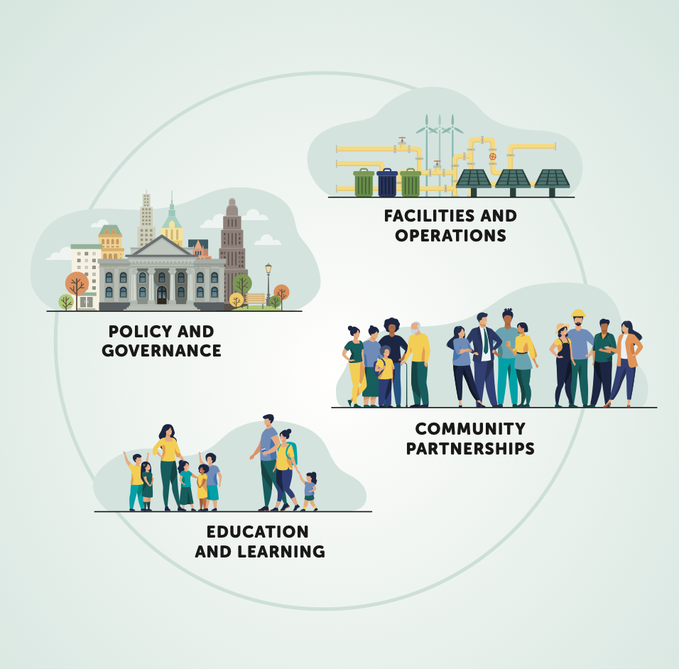
Whole institution model
Notes:
UNESCO – sustainability

Slide 16
Project example

Slide 17
NISE Network’s Earth & Space
Project-Based
Professional Learning Community
Focused on increasing the capacity of museums to make Earth & Space science more relevant and inclusive
Notes:
(Ali)

Slide 18
Examples of Project Inclusive and Relevance Themes
Collaborating with experts
Collaborating with community organizations
Intentionally working with specific audiences
Incorporating Indigenous ways of knowing & expertise
Deaf/Hard of Hearing communities
Blind/ Low Vision communities
Schools / Teachers/ @ home learning
Co-creation with minoritized and rural communities
Non-English speaking communities
And more!

Slide 19
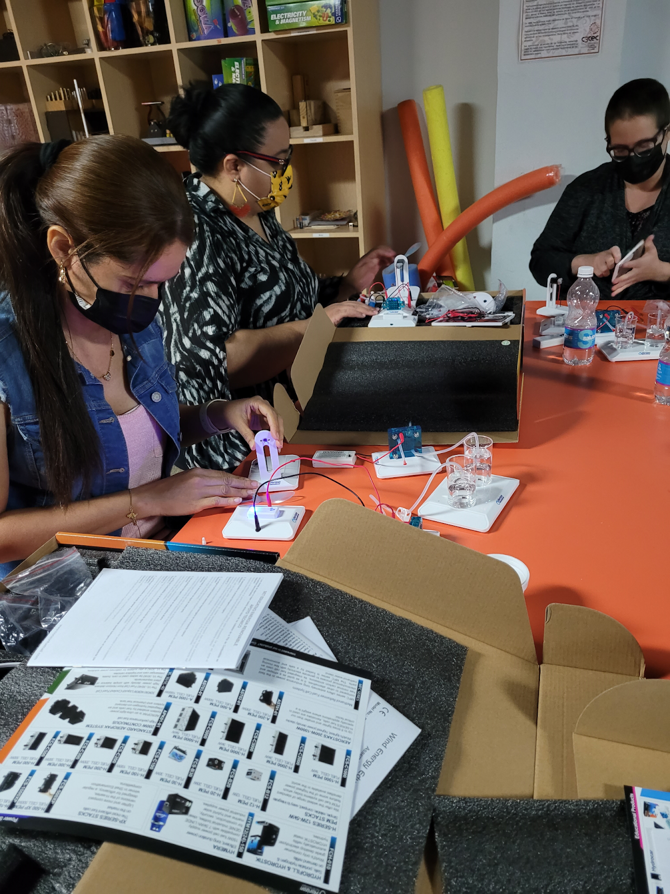
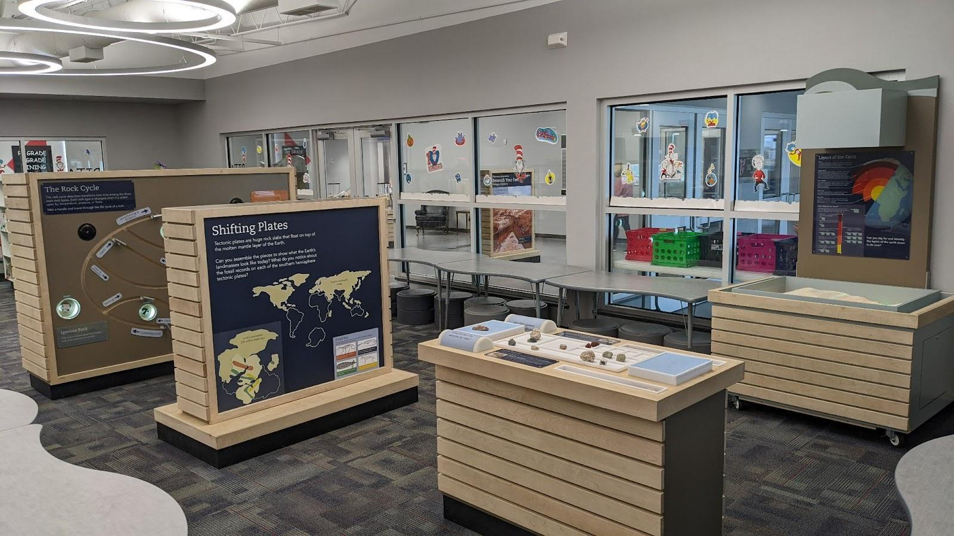
National Community and Conversion, Local Impact
Pauls Valley, Oklahoma
Discovery Lab, Tulsa, OK
Arecibo Observatory, Arecibo, PR
Explora, Albuquerque, NM

Slide 20
Notes:
https://www.nisenet.org/DEAI-tools

Slide 21
Diversity, Equity, Accessibility, and Inclusion (DEAI) Tools & Practices
Defining Diversity, Equity, Accessibility, & Inclusion in Your Project
Social Identity & Perspective
Building Inclusive Teams
Equity & Inclusion in Community Engagement
Partnership Approaches & Strategies
Culturally Responsive Programs
Collaborative Content Development
Multilingual Engagement
Working with Indigenous Communities
Inclusive Design

Slide 22
Diversity, Equity, Accessibility, and Inclusion (DEAI) Tools
Tools include:
Overview
Let’s Try This Activities
Case Studies
Discussion and Reflection Questions
Curated Resource Lists
Process approach
There is no one “right” answer

Slide 23
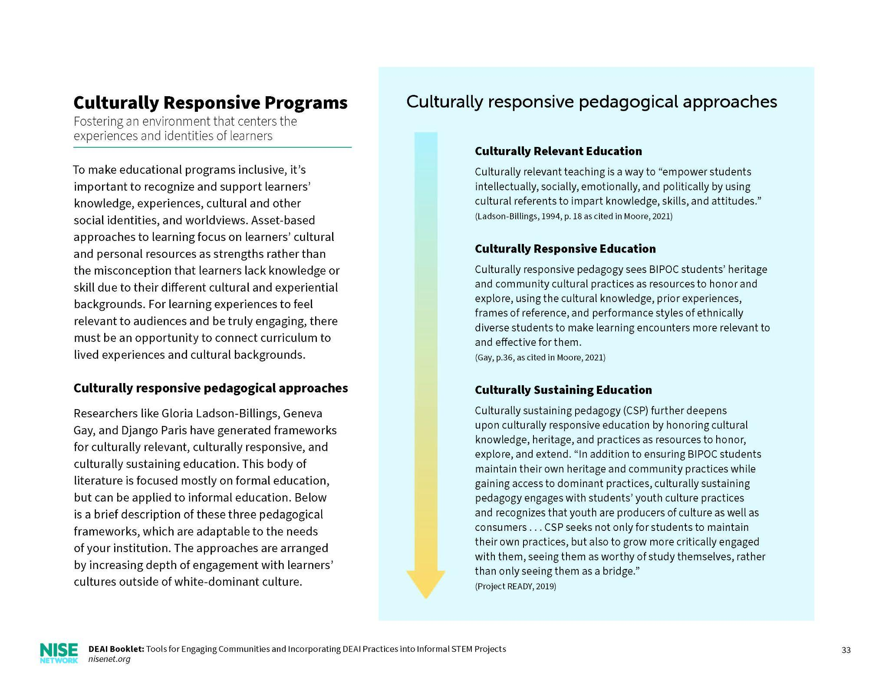
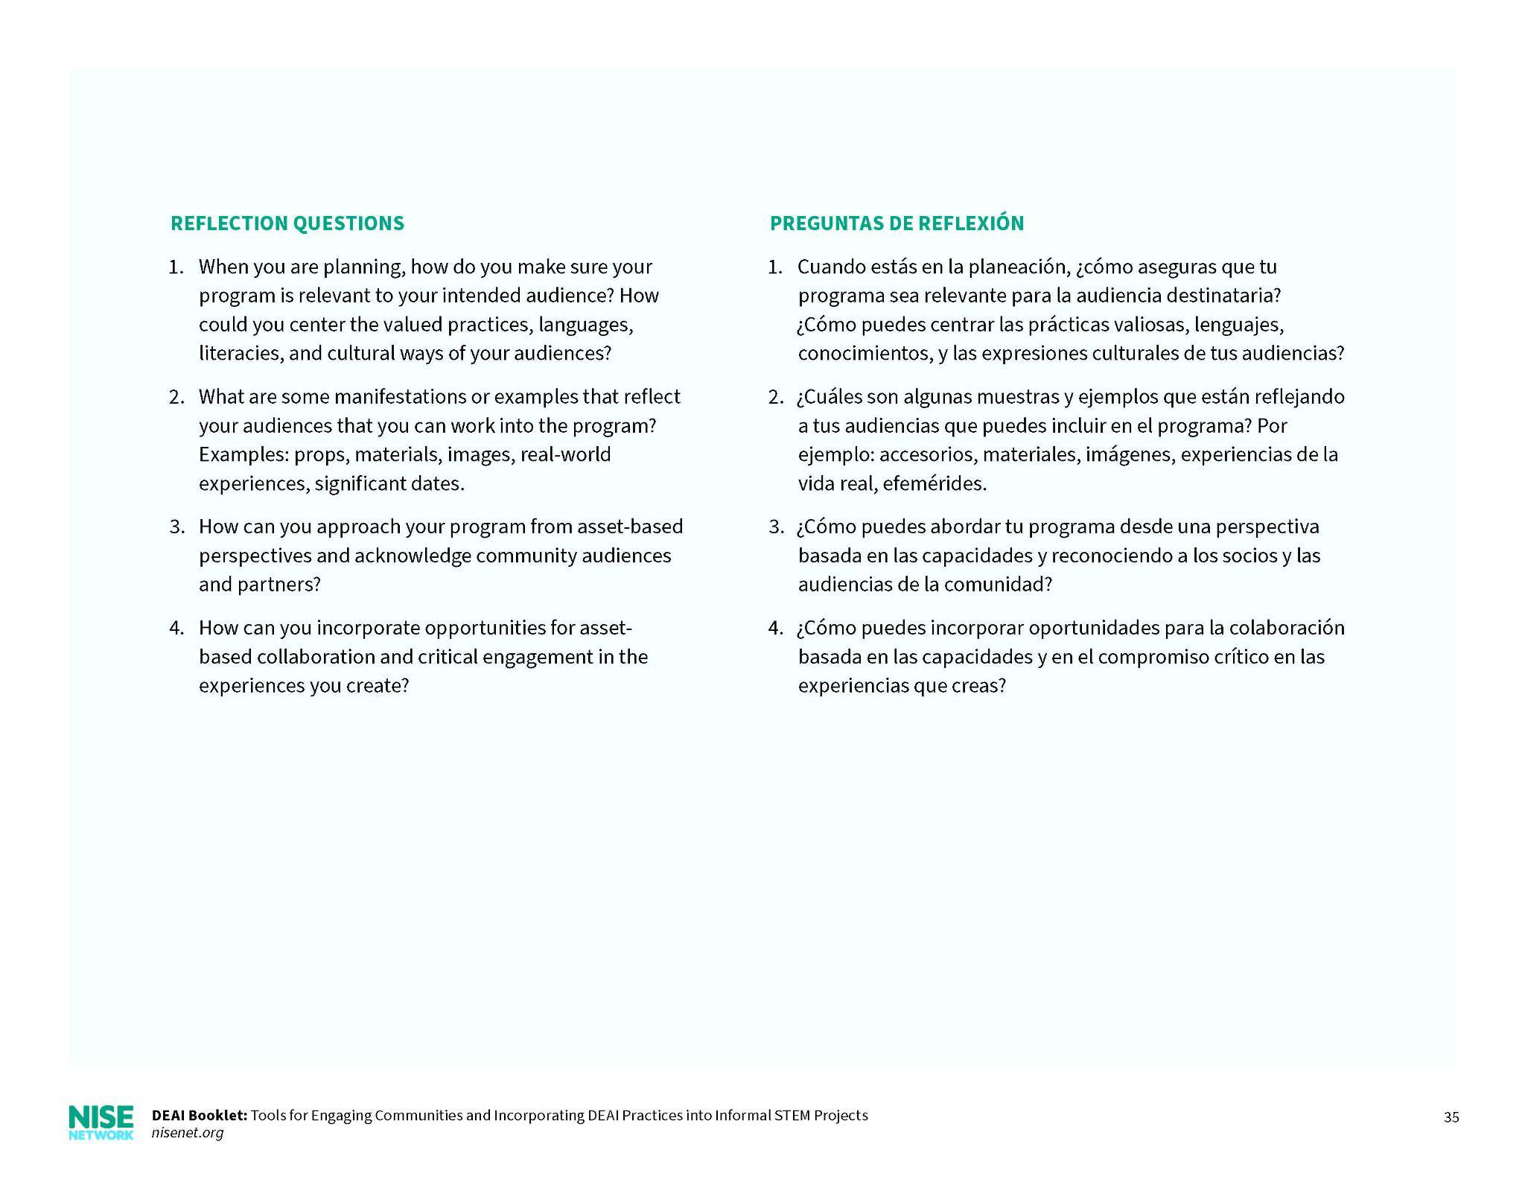
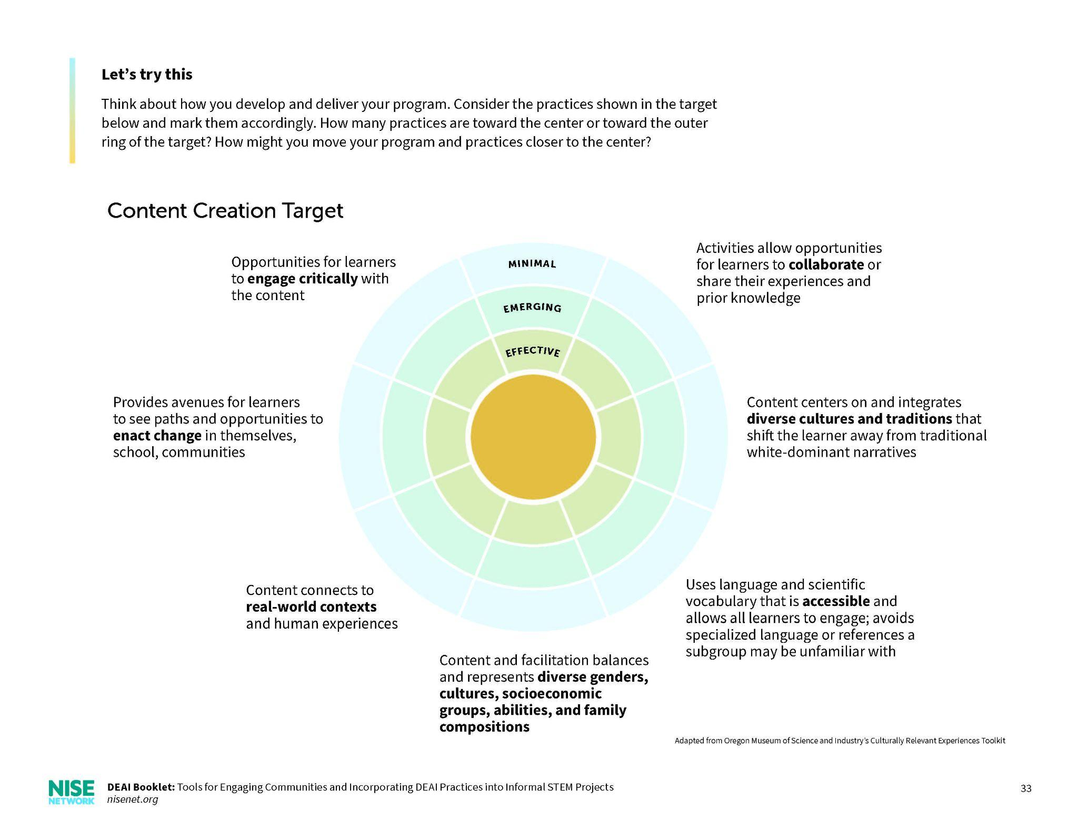
Example Tool: Culturally Responsive Programs
Reflection Questions
Resources
Overview
Let’s Try This

Slide 24
Equity & Inclusion in Community Engagement
Building trust, deepening relationships, and creating sustainable change
Example DEAI Tool:

Slide 25
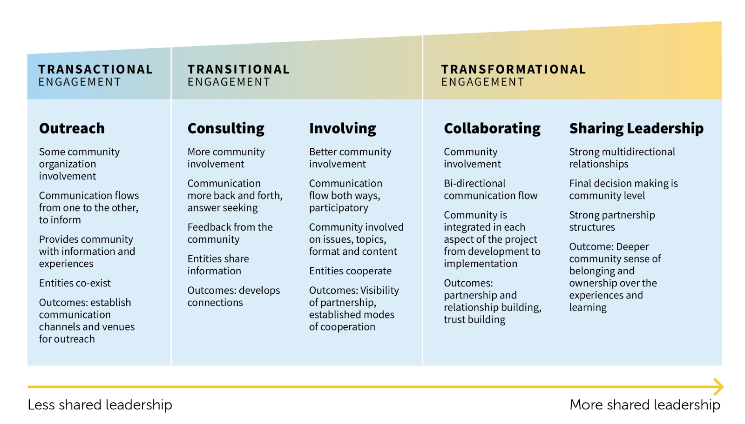
Equity & Inclusion in Community Engagement
Increasing Level of Community-Driven Involvement
*Adapted from the International Association for Public Participation
Notes:
Not set trajectory, shared leadership isn’t always best

Slide 26
Equity & Inclusion in Community Engagement
Examples of Community Engagement Work Activity
Think about where you most often fall on this spectrum and think about examples in your work and how this affects your DEAI practice.
Outreach Example: Family Science Events at Local Schools | Consulting Example: Getting student input on traveling exhibits | Involving Example: Prototyping with visitors and the community | Collaborating Example: Development team creating shared goals and funding with partner organizations | Sharing Leadership Example: Museum & Head Start Partnership: teacher training and family engagement events
Notes:
GIAC example of moving from outreach to collaboration and shared leadership

Slide 27
Equity & Inclusion in Community Engagement
Reflection Questions
How can you authentically involve community participants in planning, implementing, and sustaining the program?
What does your end product look like, and what strategies do you have in mind to make visible the voices of the community and program participants?
How would you make sure that the exchange between individuals and organizations are and feel fair and just?
How are you building trust with your partners and community members?

Slide 28
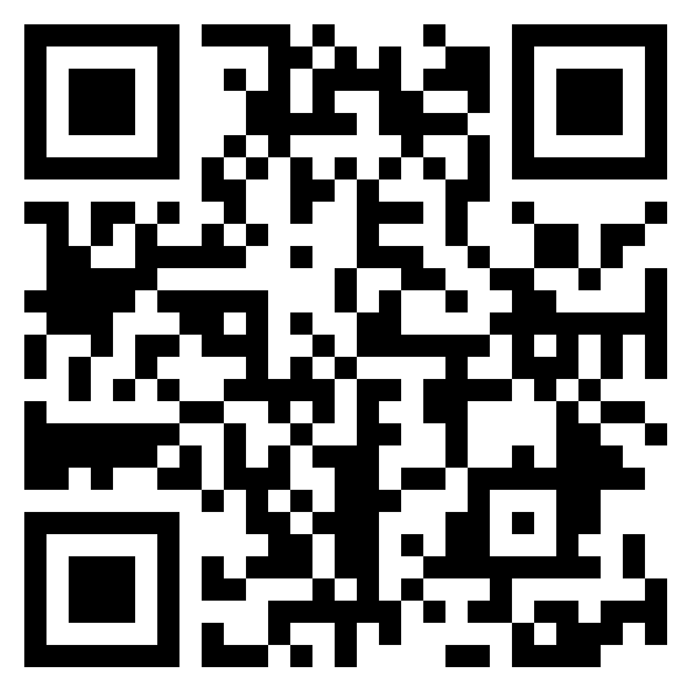
Padlet Resources
https://padlet.com/ajackson278/CAISENISENet
Notes:
(Ali)

Slide 29
Thank you
Support from the National Science Foundation: Nanoscale Informal Science Education Network (#0532536, #0940143), Multi-Site Public Engagement in Science (#1421179), Increasing Learning and Efficacy about Emerging Technologies (#1516684), ChemAttitudes (#1612482), Wireless Radio Communications (#2005784), STEM and Social Capital (#2045306). Any opinions, findings, and conclusions or recommendations expressed in this presentation are those of the authors and do not necessarily reflect the views of the Foundation.
Support from NASA: Space and Earth Informal STEM Education (#NNX16AC67A, #80NSSC18M0061), Moon and Beyond (#80NSSC18K1219), Build a Mars Habitat (#80NSSC20M0030), SciAct STEM Ecosystems (#), Destination Moon (#80NSSC21M0082), and Engaging Hispanic Communities. Any opinions, findings, and conclusions or recommendations expressed in this material are those of the author(s) and do not necessarily reflect the view of the National Aeronautics and Space Administration (NASA).
Support from NOAA: Citizen Science, Civics, and Resilient Communities (#NA18SEC0080008)
Support from IMLS: Sustainable Museums (#MG-245910-OMS-20).
Support from Rob and Melani Walton Foundation: Sustainability in Science and Technology Museums.
Support from The Kavli Foundation: Changing Brains.
Support from Dana Foundation: Barbara Gill Civic Science Fellowship.
Support from Templeton Foundation: Science and Religion.

