Slide 1

Playing with the Future: Creating exhibits and programs that immerse visitors in futures thinking
ASTC 2019
Preconference workshop

Slide 2
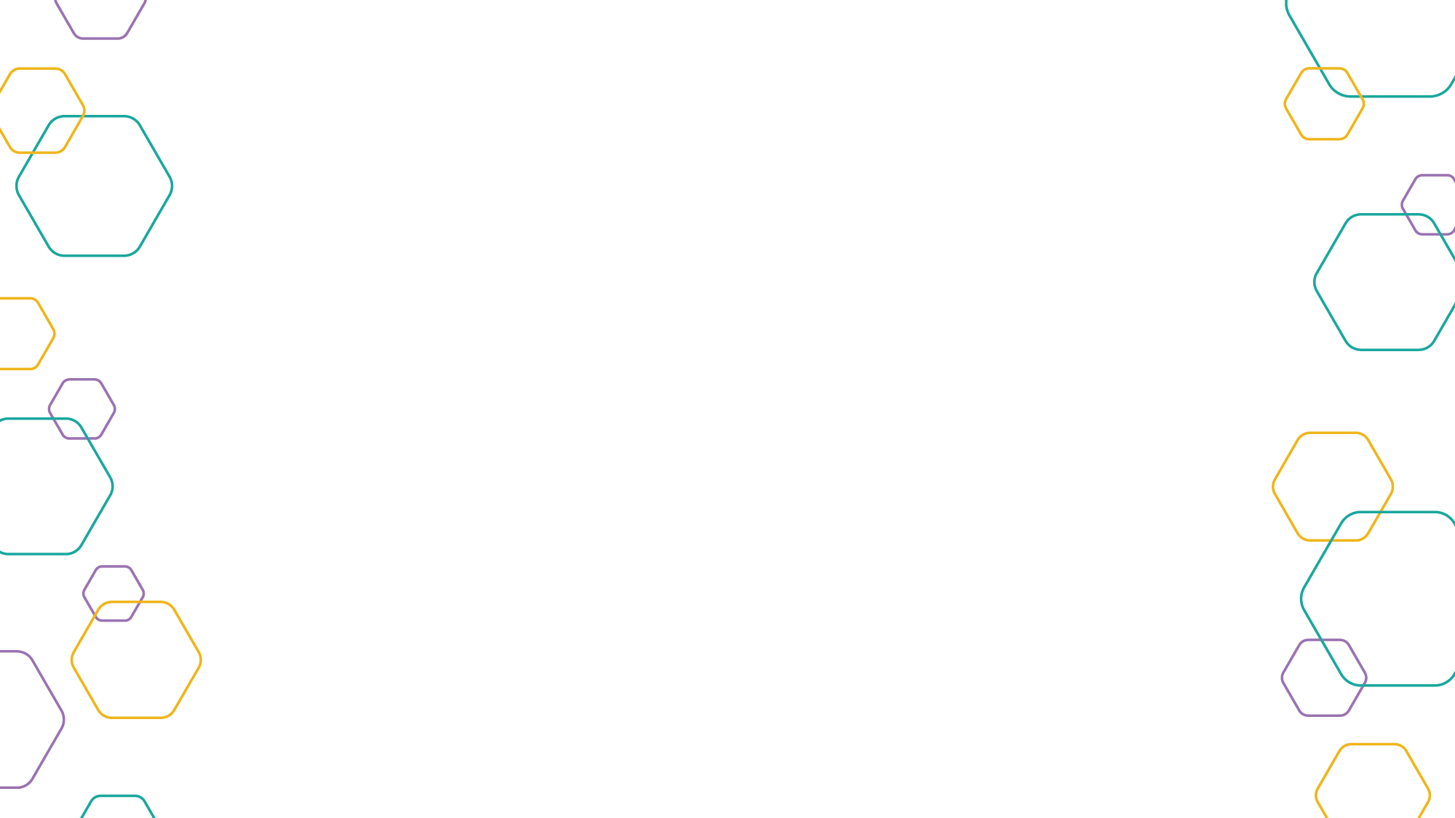
Presenters
Rae Ostman, ASU
Peter Bishop, Teach the Future
Joe Tankersley, Unique Visions
Meredith Doby, DoSeum

Slide 3
Workshop agenda
INTRO TO FUTURES THINKING IN MUSEUMS
1:30 Welcome and introductions
1:40 Joe: The Gift
2:00 Peter: Theory, ideas and practices
Joe: Immersive experiences and storytelling
2:30 Discussion
2:45 Meredith: Dream Tomorrow Today exhibition
Rae: Sustainable Futures programs
RAPID PROTOTYPING ACTIVITY
3:10 Brainstorm ideas in small groups
3:30 Check in: Sharing and feedback
4:00 Prototype ideas
4:45 Presentations
5:15 Wrap up and discussion
5:30 Adjourn
GOAL: Develop and share a concept for a futures-oriented museum experience.

Slide 4
Learning objectives for workshop
Familiarity with the goals, methods, and practices of futures studies and foresight.
Understanding of the ways science centers might apply these methods and practices in their STEM learning experiences.
Awareness of the rationale for and potential impact of integrating futures thinking into informal STEM learning.

Slide 5
JOE TANKERSLEY
Writer and futurist, Unique Visions
Former Imagineer, Walt Disney

Slide 6

Perfect Gift 2040
Select someone you know
Imagine it is their birthday in 2040
Create the perfect gift
object or experience
not currently available
4. Why is this the perfect gift for them?
#reimaginingourtomorrows

Slide 7
Perfect Gift 2040
X-lenses subscription for my daughter Allison, 44.
These mixed reality soft contacts are easy to wear and recyclable. Access AR or VR with a simple blink.
Perfect gift because: She hates the clunky look of her Facebook/Gucci AR glasses.
Uses: As a fundraiser for nonprofits she can instantly call up names and donor stats of everyone she meets.
Or access her favorite virtual worlds when she needs a little down time.
#reimaginingourtomorrows

Slide 8
PETER BISHOP
Founder and Executive Director, Teach the Future
Retired Associate Professor of Strategic Foresight and former Director of the graduate program in Futures Studies, University of Houston

Slide 9

Preparing Students
for the Future
by Actually
Teaching Them
about the Future!
Peter Bishop
Exec Director
Sacramento CA

Slide 10
Learning about the Future
Notes:
Goals
To highlight some of the attributes assigned to the Millennial generation
To look at how the world has changed in the past three generations- so that we might understand the interaction between generations that we find in schools/work.
To look at why this might be important to education
Generations are characterized by groups of people born within the same time period– and have a strikingly similar values and view of the world based on shared early life experiences. It is about passing through life stages together…
The theory is that b/c of our shared experiences- we might share beliefs towards science, technology, government, ‘progress’, national pride, gender, celebrity…
Story isn’t that young people have changed- or parents have changed– but that some things in our world have changed– and others have stayed the same…
We are all just responding and adapting as best we can…. It’s not about finding the best approach. Just recognizing how we might look at the world differently b/c we were born at a certain time– and passed thru the world changing at a different stage in life…

Slide 11
The Predictable Future
The future as a river or a road or even a roller coaster,
following one path and leading to a specific point
Notes:
The future is predictable in science class (within the limits of theory and measurement). As a result, we see the future as the deterministic extrapolation of known forces and trends culminating in one point for every time horizon in the future.

Slide 12
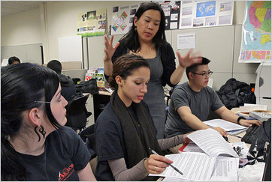
The Inevitable Future
History Class
History
The future as a sequence
of unchanging causes and effects
Notes:
Of course, that doesn’t work very well because human affairs are hardly deterministic. In good history classes, students realize that the past depended on the convergence of forces and trends but with a heavy dose of contingency. From that they conclude that future is more like a game of change than a river or a road. Anything could happen!

Slide 13
The Uncertain Future
History Class
Anthropology
Sociology
Economics
Political Science
The future as a foggy road,
largely unknowable and unpredictable.
Notes:
Of course, that doesn’t work very well because human affairs are hardly deterministic. In good history classes, students realize that the past depended on the convergence of forces and trends but with a heavy dose of contingency. From that they conclude that future is more like a game of change than a river or a road. Anything could happen!

Slide 14
The Contingent Future
History Class
Statistics Class
The future as a random process,
completely unknowable and unpredictable.
Notes:
Of course, that doesn’t work very well because human affairs are hardly deterministic. In good history classes, students realize that the past depended on the convergence of forces and trends but with a heavy dose of contingency. From that they conclude that future is more like a game of change than a river or a road. Anything could happen!

Slide 15
The Chosen Future
The future as a plan or a blueprint, the result of our own choices and efforts
Notes:
And finally, students are treated to all manner of people, their parents, teachers, ministers and every motivational speaker they ever hear, telling that they can be anything they want to be.
Now they are really confused. Is the future deterministic and predictable or chaotic and unpredictable? Is the future up to what the world does or do I/we have a role to play in creating the future?
It’s no wonder that teachers don’t want to get into this mess.

Slide 16
Confused?
Is the future…
  predictable and inevitable or
  unpredictable and random?
Is the future determined or chosen?
Is the future even understandable?

Slide 17
The future is many, not one.
  The Expected Future
    Where we are headed
    The future if everything continues as it has
    The result of conditions and trends (momentum)
  The Alternative Futures
    What might happen instead
    The set of plausible futures if something less likely or unexpected happens
    The result of events and issues (contingencies)
  The Preferred Future(s)
    What we want to happen
    Either the expected or any of the alternative futures that is preferable
    The result of our vision, goals, plans and actions (agency)
Notes:
But there is an alternative. Rather than choosing one of those as the “right” approach to the future, why not use all three.
There is clearly momentum in the world. It is heading somewhere. If it continues as it has, it will be somewhere, to a predicted future. We call that the Expected Future, the future we expect if everything we know and believe turns out to be true.
Will we get to the Expected Future. To some extent yes, but also not exactly as described. And in other cases to wildly different futures. Those are the Alternative Futures, plausible futures that could reasonably occur instead of the Expected Future. Alternative Futures are not the product of pure imagination. While we can’t prove that any Alternative Future is plausible (that’s the point!), we should be able to offer some reasonable foundation for why it could occur.
And finally, we also have a role in creating the future. We are not victims, completely powerless in the face of the mightly forces of the world. No, we can influence the future, albeit within limitations set by the world. Nevertheless, we identify our preferred future toward which we apply our time, talent and resources to achieve a better future than we would get absent our influence.

Slide 18
The Cone of Plausibility
The Future is many,
not one.
Vision
Implications
Limit of Plausibility
Alternatives
Expected
Present
Limit of Plausibility
Vision is the preferred future
Past
Source: Charles Taylor, Army War College
Notes:
As a result, we see the future as an expanding cone of plausible future. The farther out in the future ones goes, the more plausible alternative futures there are.
The cone, however, is bounded by the judgment of plausibility which does not include every single thing that could is possible.
Question: Is the past a cone as well?

Slide 19
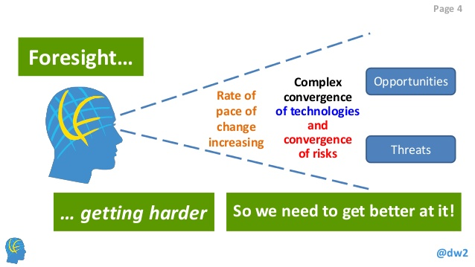
The Changing Conditions of Change
http://www.slideshare.net/DeltaWisdom/dw-wts-2015-augmented-reality

Slide 20
Is the Traditional Approach to the Future Adequate?
The traditional approach to the future is largely quantitative, extrapolative, causal, linear, and predictable.
Is that adequate in a rapidly
  changing, complex world?
What if the future is inherently uncertain and contingent?
What do we teach about the future then?

Slide 21
Change (the future) comes from the world and
from ourselves –
Inbound and Outbound.

Slide 22
It usually occurs slowly,
but sometimes disruptively,
opening and closing eras.

Slide 23
Trends occur within
the current era.
Disruptions end
the current era and
open the next one.

Slide 24
Scan broadly.
Connect the dots.

Slide 25
The Futures are many,
not one.
Think alternatives
and contingencies.

Slide 26
Tell stories and
dream dreams
that explore possibilities.

Slide 27
Anticipate!
Influence!

Slide 28
Design Questions
What is happening today? – Present
What happened to make it that way? – Past
What do you expect to happen? – Expected future
What might happen instead? – Alternative futures
What do you want to happen? – Preferred future(s)
What are you going to do about it? -- Plans
Notes:
And here is how – by asking three simple question in any class:
What do you think is going to happen? – Expected future
What might happen instead? – Alternative futures
What do you want to see happen? – Preferred future(s)
The image is an expanding cone of plausible futures. The center line of the cone is the Expected Future. The Alternatives make up the rest of the cross-section at the time horizon. The farther the time horizon, the more plausible futures there are. And some of those alternative futures are preferred toward which we try to bend the trajectory of change.

Slide 29

What do students learn or experience at a science center?
Science Centers…
Connect people with science
Provide first hand experience
Encourage curiosity
http://www.astc.org/about-astc/about-science-centers/

Slide 30
What do students learn or experience at a science center?
Science Centers…
Connect people with science and its future
Provide first hand experience of the future
Encourage curiosity about the future
http://www.astc.org/about-astc/about-science-centers/

Slide 31
We teach the future as well as the past.
www.TeachTheFuture.org
peter@teachthefuture.org
@teachfutures, #teachfutures
Prepare students for tomorrow.
Teach the Future today.
Notes:
So the last question, What is to be done next?
As you may know, I officially retired from my position at the University of Houston last August. All of what I have done, except the high school course, was on the side as a college professor. Now, and against my better judgment, I have moved foresight education to the top of my priority list. Everything that I have done before was inherited from someone else, including the UH futures program. Now I am starting something new. As I tell people in my seminars on leadership, I am committing to accomplish and to enroll others in the campaign to accomplish something of significance, namely to introduce students to the future.
To that end, I am announcing right here a new organization called Teach the Future. It’s just me and a website at the moment, but my hope is that it becomes a community of like-minded educators and partners who will commit to doing what we can to introduce futures thinking into the schools at all levels.
Our vision is that “We teach the future as we do the past.” We teach a lot about the past, as we should. That’s where our traditions are, that’s whence we’ve come. But we should also be teaching about the future.
I understand that this a monumental undertaking. I will not see the end of it, even if it succeeds. But that thousand mile journey beings with that one step, and this is my step.
Leaders ask themselves, “If not us, who? And if not now, when?” We can all be leaders in this movement, it’s that early. This is the ground floor, if not the basement. My hope is that we will look back at 2014 as the year that teachers and schools began to take the future seriously for the sake of their students.
You can go to TeachTheFuture.org right now and see what is there. Do it right now on your phone or device. It’s bare bones at the moment, but I assure you that it will grow over time. I will contribute what I have over the next month or so, but I hope that my contribution is insignificant compared to what teachers around the world will contribute. My hope is that a community, indeed a social movement forms around this vision – We teach the future as we do the past.
If you want to hear more or even get involved, send me an email to Peter@TeachTheFuture.org. Tell me about yourself, and more importantly, what you would like to do to introduce futures thinking to our students. I’ll create a mailing list. That will be the beginning of the community.
I do hope you join. It will mean a lot to our students.

Slide 32
JOE TANKERSLEY
Writer and futurist, Unique Visions
Former Imagineer, Walt Disney

Slide 33
From Flying Pigs to the Future of Work
Using Story to Entertain, Enlighten & Empower

Slide 34
Dessert Before Broccoli

Slide 35
Keep the Message Simple

Slide 36
Apply Learning Immediately

Slide 37
Encourage Creative Collaboration

Slide 38
The Future is About People

Slide 39
Guiding Principles for Creating Immersive Futures
Dessert Before Broccoli
Keep the Message Simple
Apply Learning Immediately
Encourage Creative Collaboration
The Future is About People
STORY IS YOUR MOST POWERFUL TOOL

Slide 40
MEREDITH DOBY
Vice President of Exhibits, The DoSeum

Slide 41

Meredith Doby
Vice President of Exhibits
The DoSeum

Slide 42
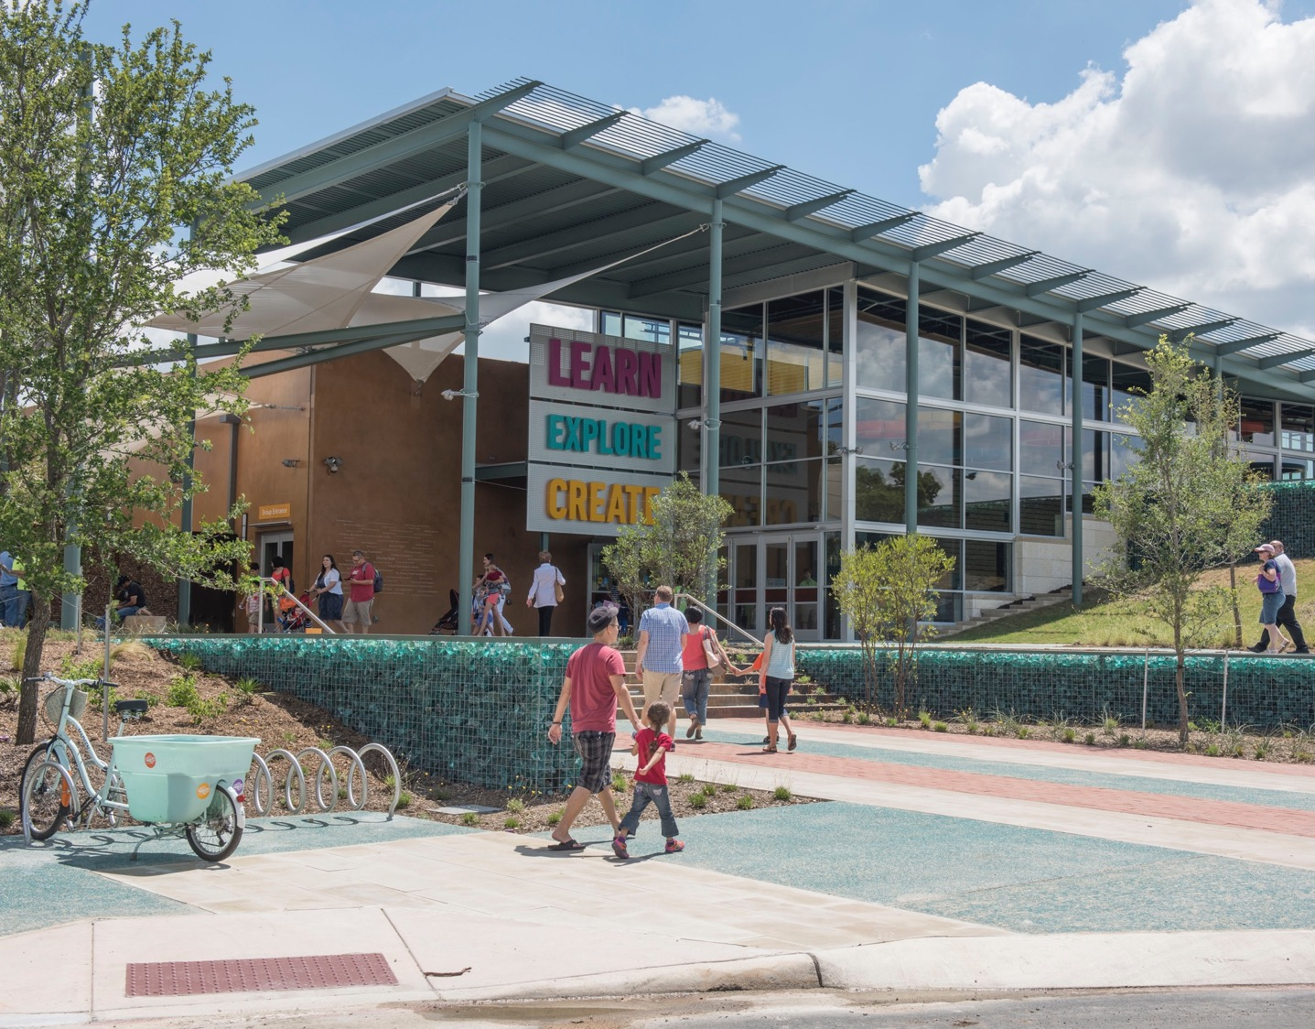

Notes:
SA300

Slide 43

Future Focus in Children’s Museums
Notes:
21st century learning skills
Training children to use the tools of the future for their creation
The jobs children in kindergarten will have don’t exist yet

Slide 44
Community Involvement
Brainstorming Session

Slide 45
Mission
In this exhibit visitors will be empowered to imagine a desired future, and then begin to practice the skills needed to achieve their future.
Big Idea
I can shape the future! And here’s how...
Primary Audience:
Children 5 - 11 years old + caregivers

Slide 46
Educational Goals
Feel their vision of the future is important and relevant.
Feel empowered
Develop future thinking skills:
  Collaboration
  Problem solving
  Maker-based learning
  Understanding actions and consequences
  Forecasting
  Empathy
Notes:
Will share results of some qualitative evaluation

Slide 47
Community Involvement
Community Conversations

Slide 48
Time Machine
What do you want your future to look like?
Let’s explore the past & present through the eyes of the future...
Designed by Artist in Residence Calder Kamin

Slide 49
Imagine the Possibilities!
Nature doesn’t waste.
Can we change as we grow?

Slide 50
Sliding Through a Fruit Field
By TeamLab
SLIDE YOUR WAY INTO THE FUTURE!

Slide 51
Sketch Town
KID colored FUTURE CITY!
From TeamLab

Slide 52
Be your Future Career
HUMANITARIAN INVENTOR
3D FLAVORIST
ROBOTIC ZOOLOGIST
ASTRO-CULINARY ARTIST

Slide 53
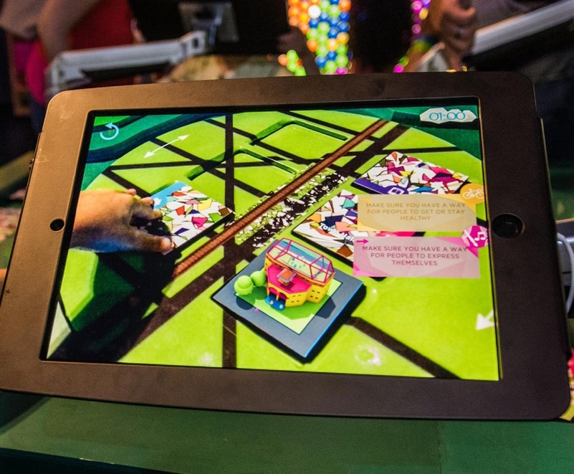
City Lab AR
will your city survive a flood? Do you have all the values?

Slide 54
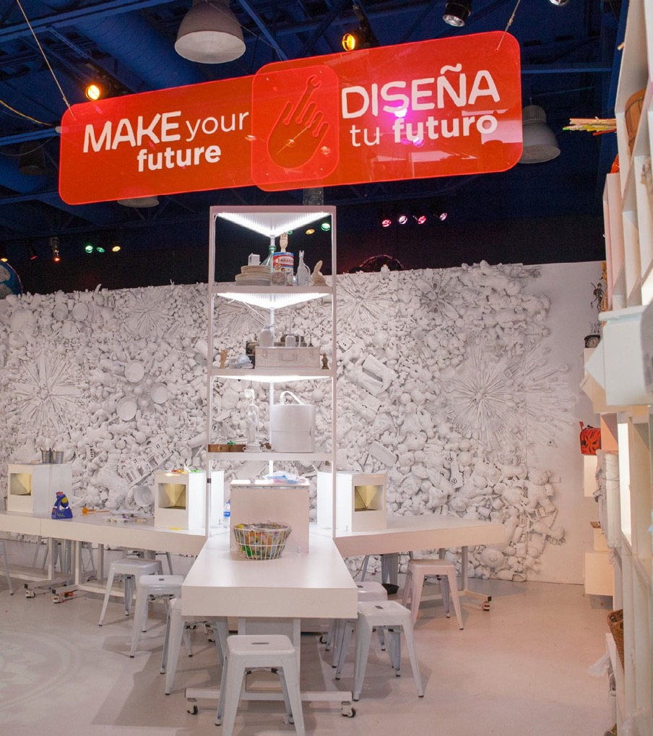
Design Lab
Designed by Artist in Residence Gregorio Mannino
What does the future need?
WHAT DO YOU WANT FOR THE FUTURE?
Notes:
developed out of comm convos

Slide 55
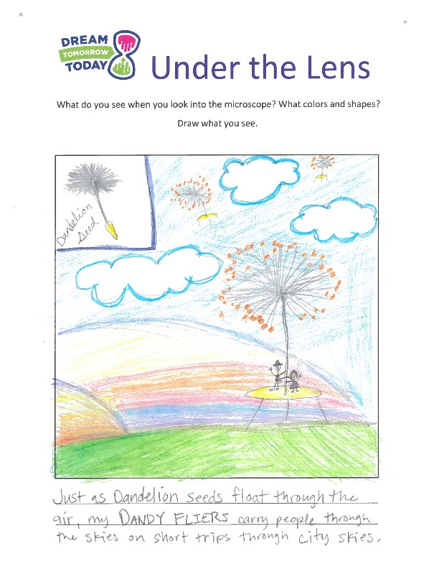
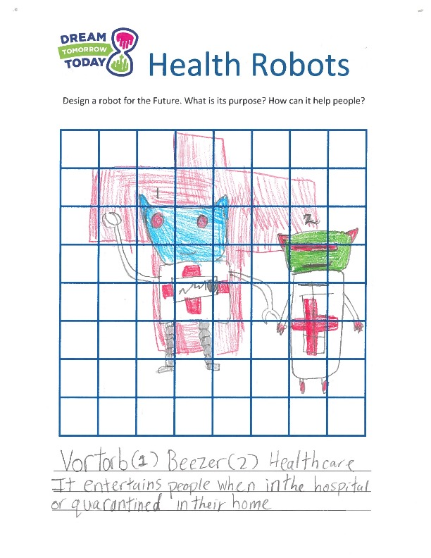

Slide 56


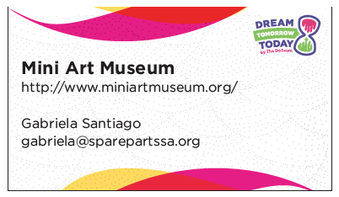
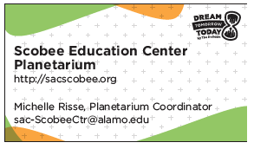
Call to Action
Cards connect kids to local community partners to make their first step towards their future!

Slide 57
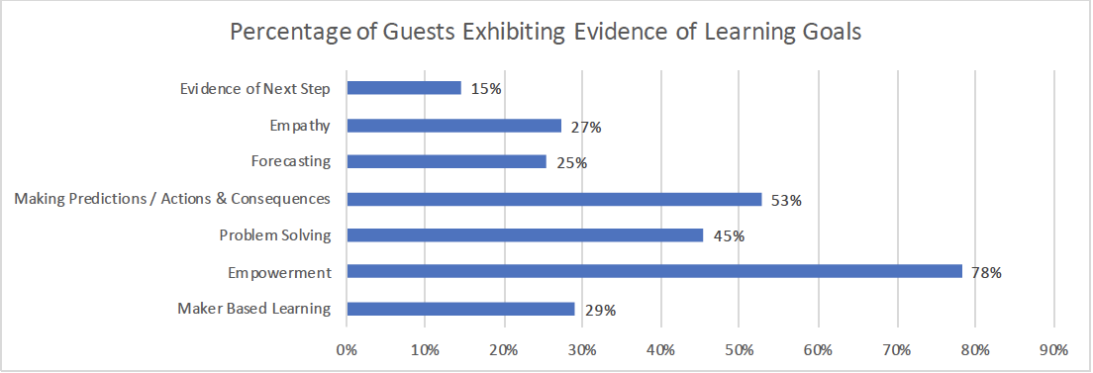
Did kids develop future thinking skills in the exhibition?
Notes:
180K visitors visited the exhibit
15 minute dwell time
Net promoter score of 81.6

Slide 58
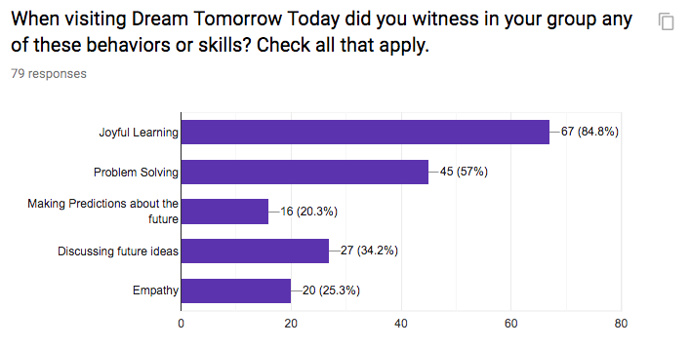
Did kids develop future thinking skills in the exhibition?
Notes:
180K visitors visited the exhibit
15 minute dwell time
Net promoter score of 81.6

Slide 59
RAE OSTMAN
Co-director, Center for Innovation in Informal STEM Learning, Arizona State University
Director, National Informal STEM Education Network

Slide 60

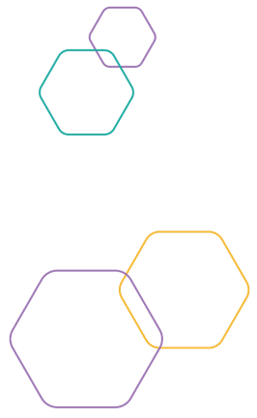

Purpose: Support museums and similar cultural organizations in their efforts to integrate sustainability into their program and operations.
Approach: Provide professional development and programmatic resources that share and develop sustainability science and practice.
Strategic outcome: Leverage the power of museums around the world to help millions of people understand the social, environmental, and economic impact of human behavior on the planet’s future.

Slide 61
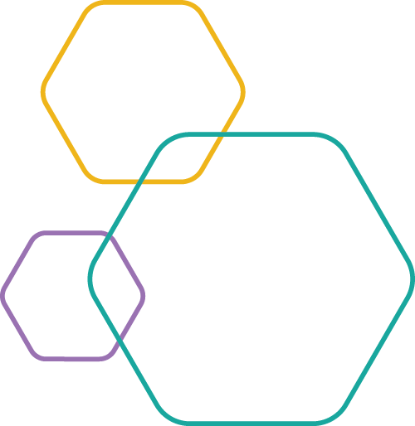
Public learning objectives
Participants will demonstrate an increased:
Understanding of big ideas related to sustainable futures and key concepts in sustainability science and practice (“sustainability”)
Awareness of the relevance of sustainability to their lives and issues they care about
Sense of self-efficacy related to sustainability, including the ability to take sustainable actions and participate in conversations about sustainable futures
Notes:
Welcome and introductions

Slide 62
Sustainability
“meets the needs of the present without compromising the ability of future generations to meet their own needs.”
United Nations. Our common future, Brundtland Report, (1987).
“cultivates individual and collective potential … to increase the possibility that humans and other life can flourish on Earth now and into the future.”
Education
for sustainability
J. Cloud, ed. Education for a sustainable future: Benchmarks for individual and social learning, Journal of Sustainability Education, (2017).

Slide 63
Sustainability
Economy
Society
Environment
Society
Economy
Environment
Notes:
Welcome and introductions

Slide 64

United Nations – Sustainable Development Goals

Slide 65


Mirakan, Japan
Future building workshop
Notes:
Project Description: 30-minute workshop including 2 games based on Future Builder game but with more emphasis on stakeholders communicating.

Slide 66

Museum of Life and Science, USA (in development)
Science and society forum
Notes:
Team met with Durham City Officials to identify various vital city systems which are serviced by non-local sources. Developed a thought exercise where participants identify what is needed to make the city self-sufficient/sustainable, when/if goods and services cannot be imported into the city. Over reaching goal is to have participants identify resources needed for certain goods/services.
Teams of 6: Think locally, think long term: What kind of resources do they have?
Break into groups with a sketch of city and list what they need and where to put those resources
What realistically can they produce given natural resources
What resources are required for city growth and prosperity
For institutions utilizing this program it will be important to connect with local city officials to identify what services/resources are available in their own city.

Slide 67

Walking Mountains Science Center, USA
Climate action plan
Notes:
Project Description: I worked with a group of local stakeholders to convene, facilitate, and create a long-term sustainable governance structure and funding source to fulfil the recommendations of the 2016 Climate Action Plan for the Eagle County Community (CAP). During my fellowship I convened and facilitated two large group meetings of the stakeholders who created the climate action plan the previous year. Now at the completion of the process the collaboration is moving ahead with implementation of projects. The education and outreach working group spearheaded a community-wide survey about climate action to benchmark community engagement and better understand the barriers and opportunities for action, and inform the brand and language for the collaborative's public communications. And a new project manager has been hired to focus on maintaining momentum and accomplishing annual GHG reduction goals through community engagement. WMSC is serving as the fiscal sponsor with new administrative and financial accounting systems in place to support the CAC.

Slide 68


TELUS Spark Science Centre, Canada
Energy transitions
Notes:
Project Description: Help define our City and Province as leaders in energy system innovation in Canada, by partnering with others to engage key audiences in ways which visibly reduce the polarity in public dialogue and measurably advance energy sustainability. Our particular challenge is to build a visitor experience road map that will help TELUS Spark achieve this goal.

Slide 69
Identifying and solving problems in our community
➔ What problem do you want to solve?
Creating the future we want to live in
➔ What change do you want to see?
Doing things that are good for people and nature
➔ What can you do?

Slide 70
Acknowledgements
The Rob and Melani Walton Sustainability in Science and Technology Museums program is supported through funding from The Rob and Melani Walton Foundation.

Slide 71
RESOURCES

Slide 72
American Alliance of Museums, Center for the Future of Museums: https://www.aam-us.org/programs/center-for-the-future-of-museums/
Teach the Future: http://www.teachthefuture.org/

Slide 73
PROJECT CONCEPTUALIZATION
& PROTOTYPING

Slide 74
Rapid prototyping
Work with others at your table to develop a concept for a futures-related experience:
Consider:
Your purpose or mission
Your participant learning objectives
The experience you imagine

Slide 75
Rapid prototyping
Work with others at your table to develop a storyboard, prototype, rich description…or some other way to engage us in an aspect of your concept.
At 4:45, each group will present their work. We’ll spend around five minutes total on each idea. Aim for:
3 minutes presenting
2 minutes to hear from the rest of us

Slide 76
Report back
Choose 2-3 people who are going to act as though they’ve just gone through your experience. What did they do? What were they excited about and what did they learn?
For our debrief, we’ll interview you as though you’re on FuturesTV.

Slide 77
Closing thoughts
Share final thoughts such as:
How you will take what you’ve learned back to your organization
How your ideas have changed or developed as a result of this workshop
What you now feel empowered or motivated to do
What are some challenges you can see? What barriers might you run into

Slide 78
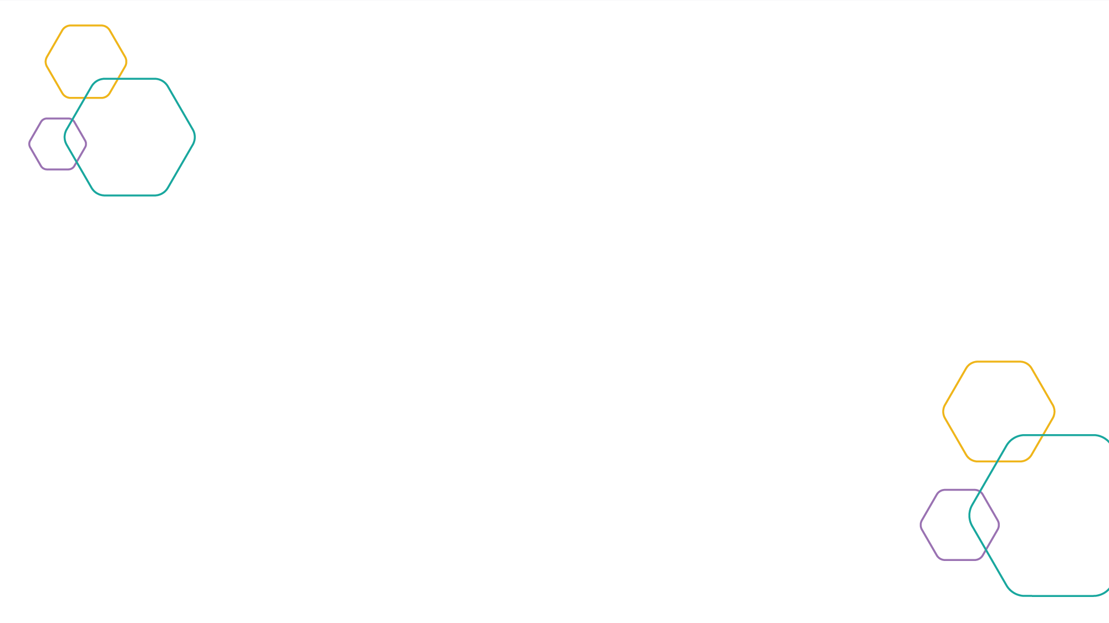
Thank you!

