Slide 1

PARTNER BREAKFAST
ASTC 2019

Slide 2

WELCOME!
Rae Ostman
Director
NISE Network
Co-Director, Center for Innovation in Informal STEM Learning
Arizona State University

Slide 3

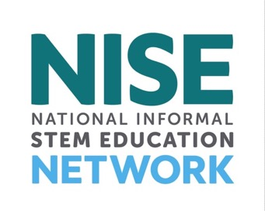
nisenet.org
Contents
Overview
Current projects +
opportunities
What’s next

Slide 4
NISE NETWORK

Slide 5
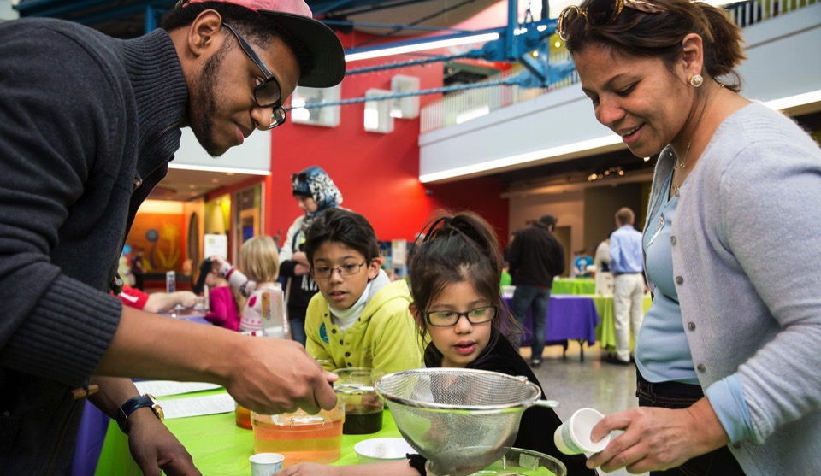
The National Informal STEM Education Network is dedicated to supporting learning about science, technology, engineering, and math (STEM).
Our activities
are fun and accessible
for everyone.

Slide 6
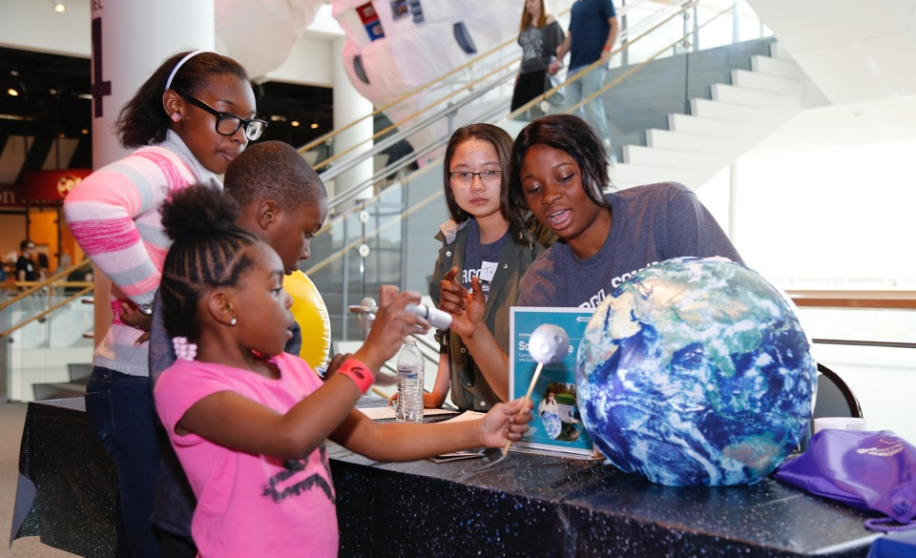
We create and share products and practices materials with partners around the world.
Our resources
are available to everyone for free download from nisenet.org

Slide 7
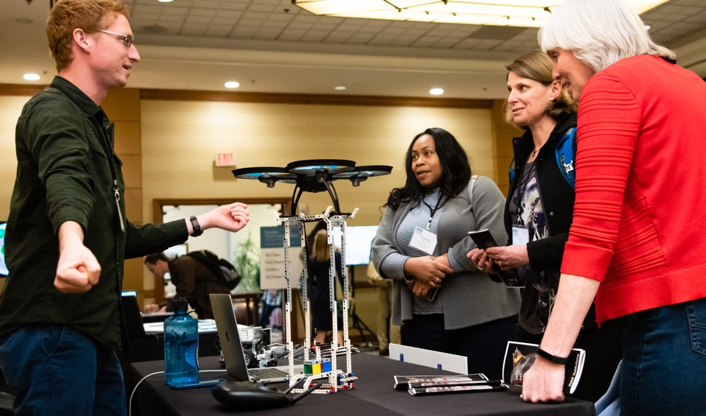
Hundreds of organizations participate in the NISE Network, including museums and universities.
Our community
includes educators, researcher/evaluators, and scientists
at museums
and universities.

Slide 8
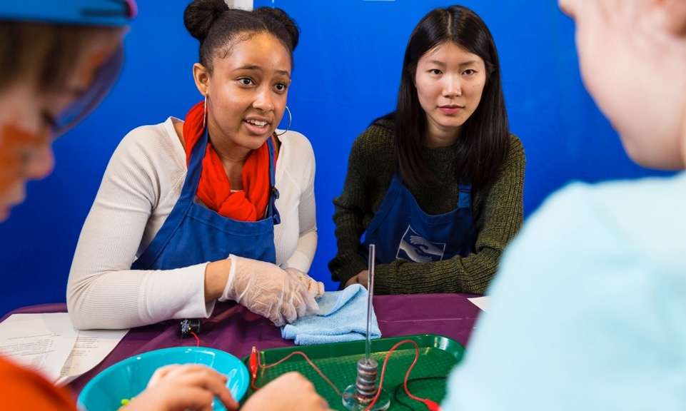
Partner organizations use Network resources to engage audiences in their communities.
Local implementation
brings people together to share and learn
from each other.

Slide 9
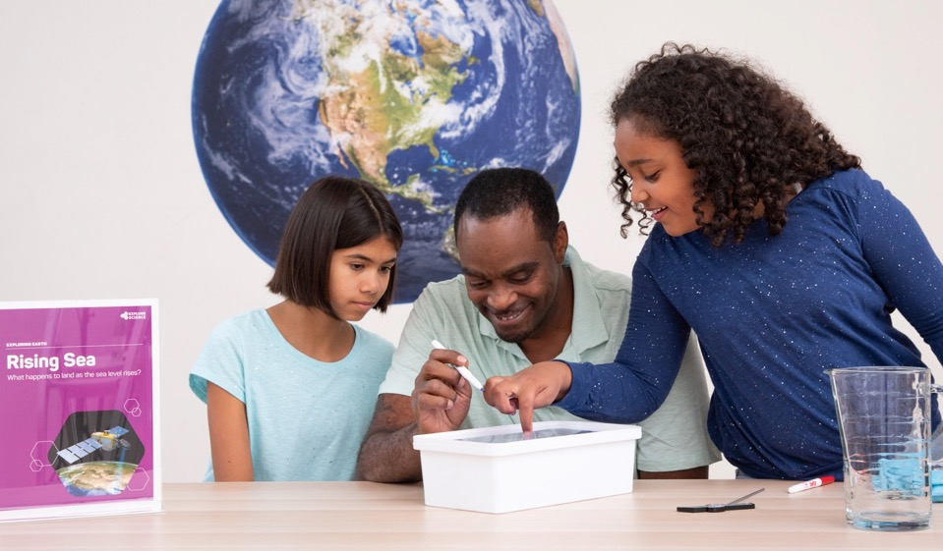
NISE Network projects tackle challenging problems and develop relevant knowledge, tools, and practices.
Network relationships,
knowledge, and infrastructure support a variety of projects.

Slide 10

Together we reach millions of people each year!
Our impact
grows each year through the efforts of our partner organizations.

Slide 11
CURRENT PROJECTS
&
NEW OPPORTUNITIES

Slide 12
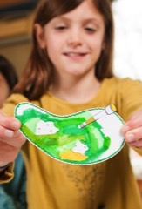
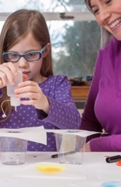
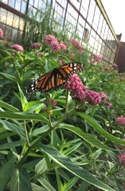
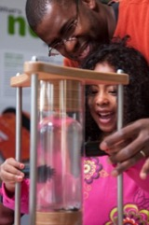
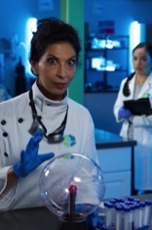
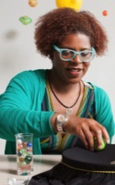
NISE Network projects explore many STEM topics!
Synthetic biology
2014-2018
Chemistry
2016-2019
Sustainability
2016-2020
2005
2020
Nanotechnology
2005-2017
Innovation
2015-2019
Earth + space
2016-2021
Climate 2019-2021

Slide 13
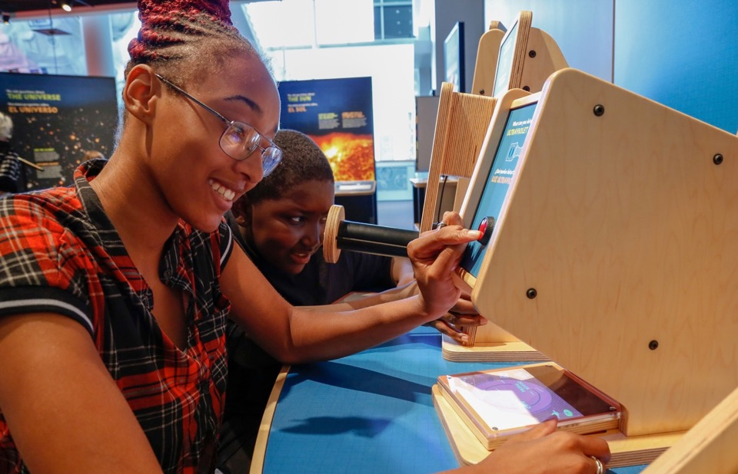
Space & Earth Informal STEM Education
Connecting learners
to authentic
Earth and space science and experts
Notes:
350 kits shipped in 2019!
52 exhibit copies being shipped 2018-2019

Slide 14
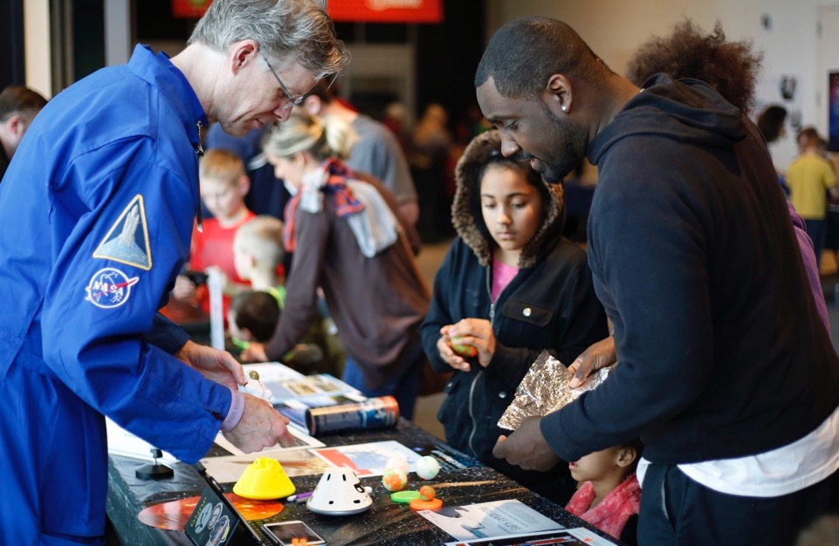
Space & Earth Informal STEM Education
6,300,000+
people have participated in events so far!
Notes:
250 toolkits in 2017 + 250 toolkits in 2018 + 350 toolkits in 2019
1.5 million people in 2017 + 1.9 million people in 2018 + 2.9 million people in 2019 with toolkits
52 exhibits
??? with exhibits
90% of partners reached underrepresented groups through Earth & Space events

Slide 15

Earth and Space toolkits – November 1, 2019
Applications for 2020 toolkit A and B
Application
information on
nisenet.org

Slide 16
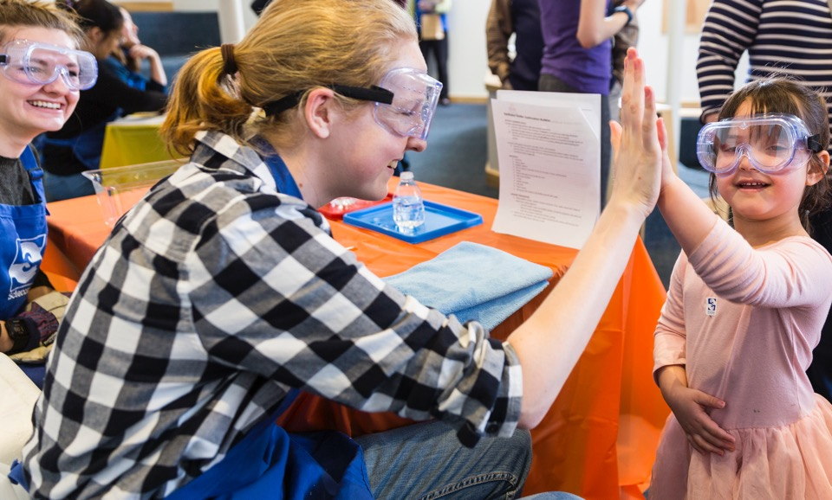
Explore Science: Let’s Do Chemistry
Promoting positive attitudes
toward learning chemistry
Notes:
250 kits shipped in 2018

Slide 17
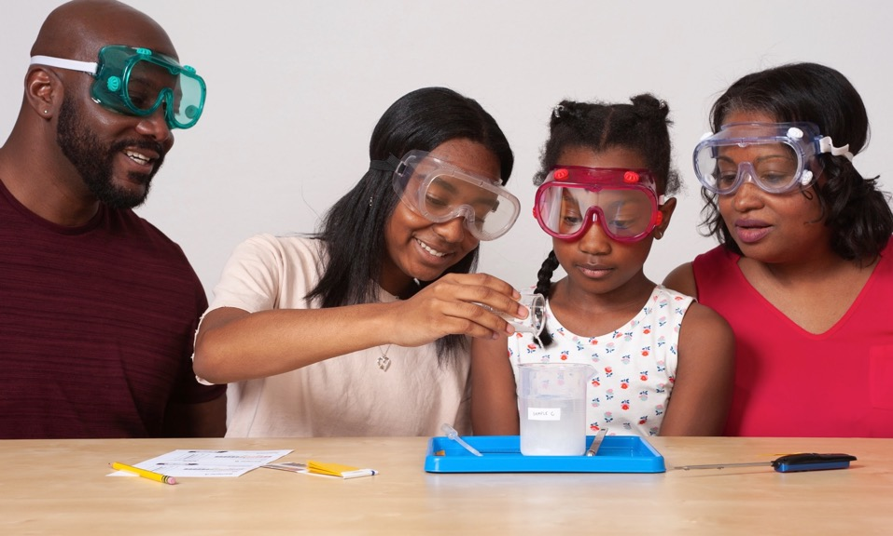
Explore Science: Let’s Do Chemistry
89%
of National Chemistry Week events engaged underserved
audiences
Notes:
including groups underrepresented in STEM fields, e.g.:
89% girls
87% low-income
84% racial and ethnic minorities

Slide 18

National Chemistry Week – October, 2020
International Year of the Periodic Table – 2020
Events
on nisenet.org

Slide 19
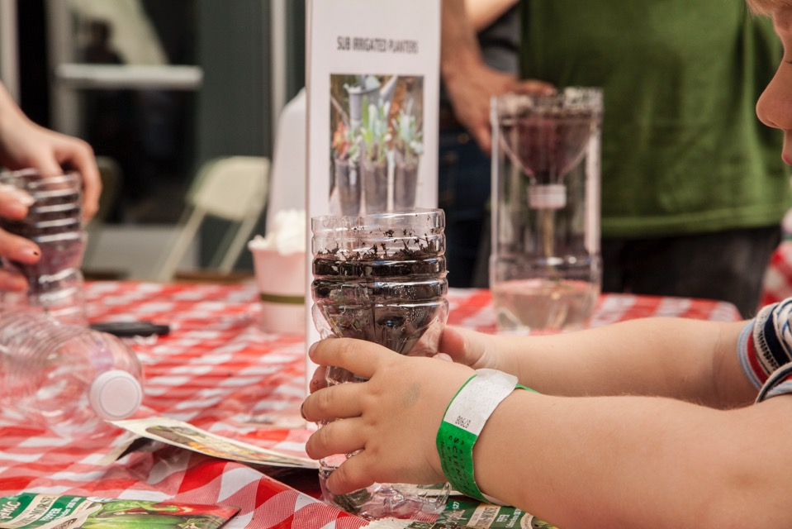
NEW! Sustainable Futures
Empowering
museums to create sustainability projects

Slide 20
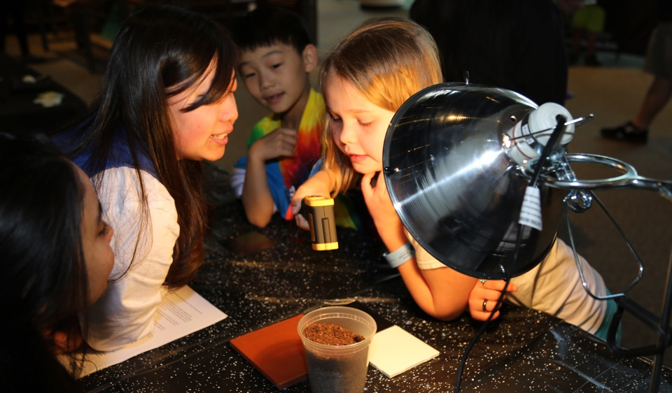
50th anniversary of Earth Day – April, 2020
New Sustainable Futures programs available to download in February, 2020
Digital library
of free resources on nisenet.org

Slide 21
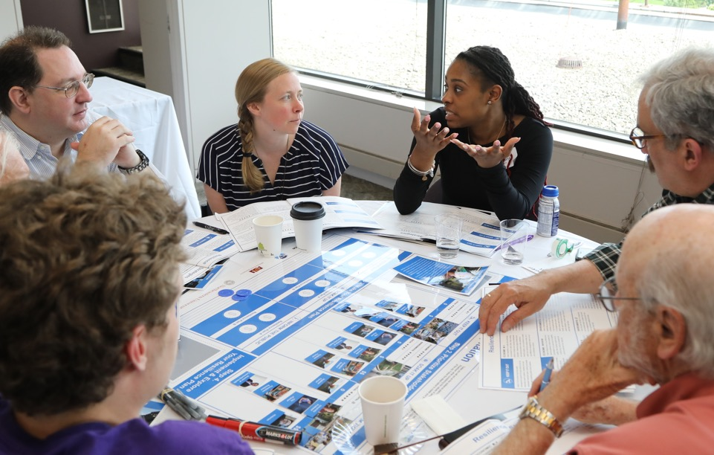
NEW! Resilient Communities
Supporting
extended engagement
through forums and citizen science
Notes:
Citizen Science, Civics, and Resilient Communities (CSCRC)

Slide 22
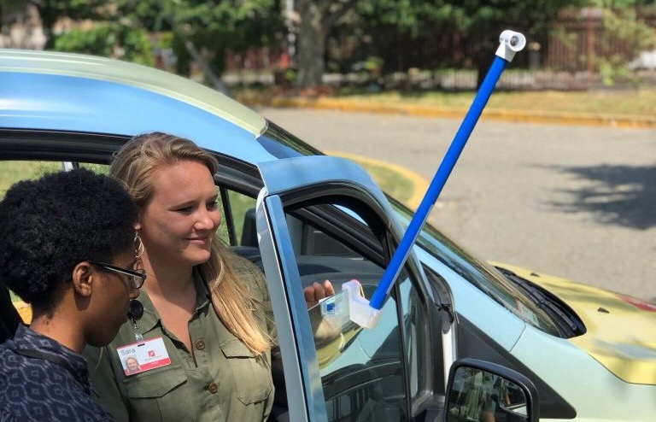
Resilient Communities
Local impacts
of heat waves,
sea level rise,
extreme precipitation, and drought

Slide 23
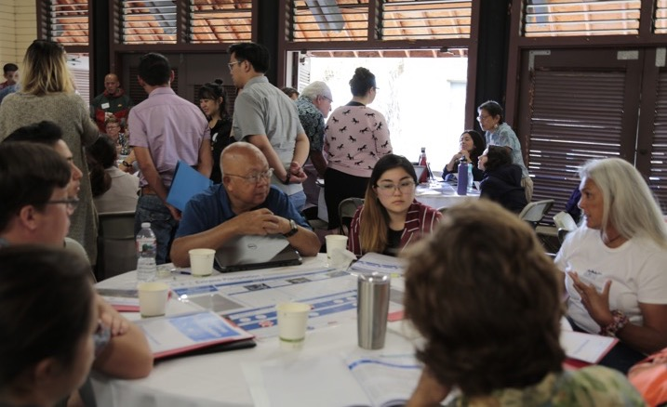
Resilient Communities applications – Fall, 2020
More information available summer 2020
Sign up for the newsletter
on nisenet.org

Slide 24




Stay connected, learn about Network activities, and download our free resources!
nisenet.org
Digital library
Sign in sheets
on the tables
Hub leaders nisenet.org/contact
Take a flyer!

Slide 25


Collaboration for Ongoing Visitor Experience Studies
$$=$$

Slide 26
COVES is designed to unite museums in systematically collecting audience-level data, with a focus on institutional and field-wide improvement.

Slide 27








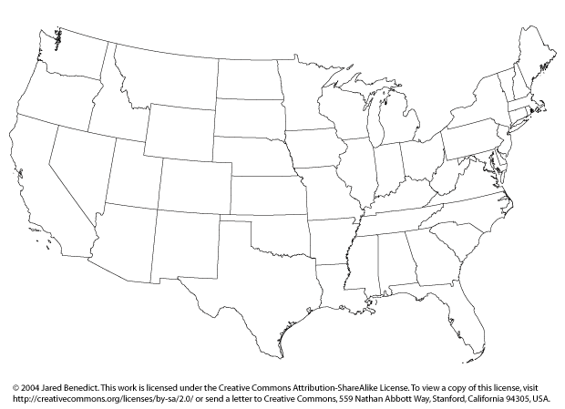






















http://www.understandingvisitors.org
Notes:
COVES currently has 30 participating institutions collecting, sharing, and comparing visitor data and is actively seeking new members. If you want to learn more about their work or how you can join, you can find more information on understandingvistiors.org or talk to Alex, Ryan, or Sarah. [Ask them to wave.]

Slide 28
WHAT’S NEXT

Slide 29
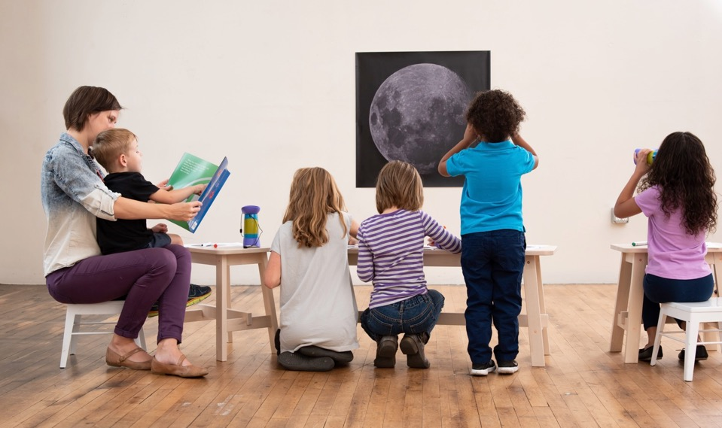
Earth and space science 2021–2025
Inclusion, diversity, equity, and access
Developing
and sharing
best practices and effective resources

Slide 30
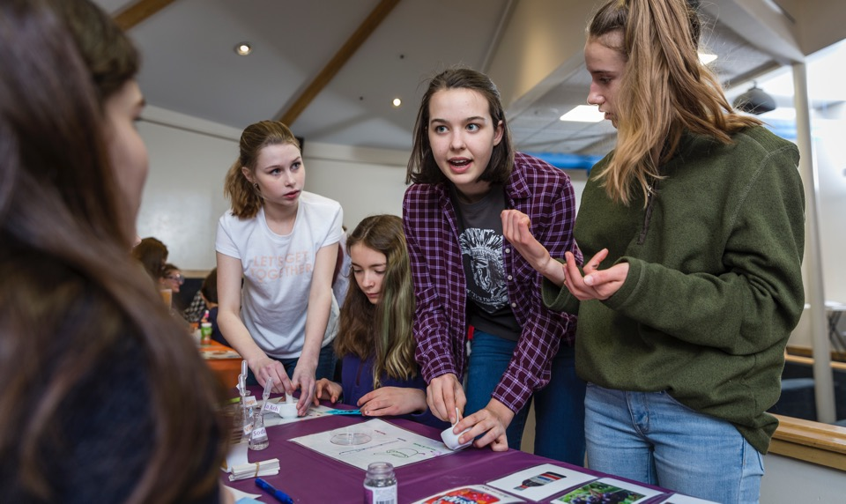
Chemistry
Interest, relevance, and self-efficacy
Professional development
for educators and chemists

Slide 31
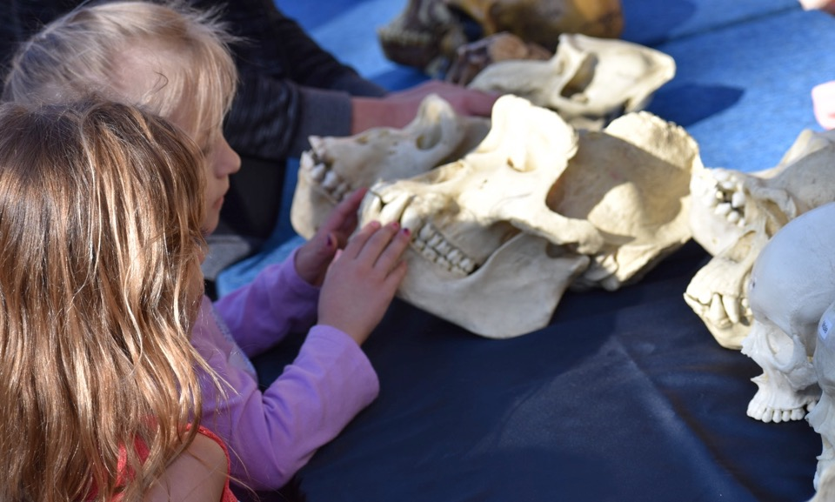
Human origins
Biological, cultural, and environmental change
Investigating what makes us human

Slide 32
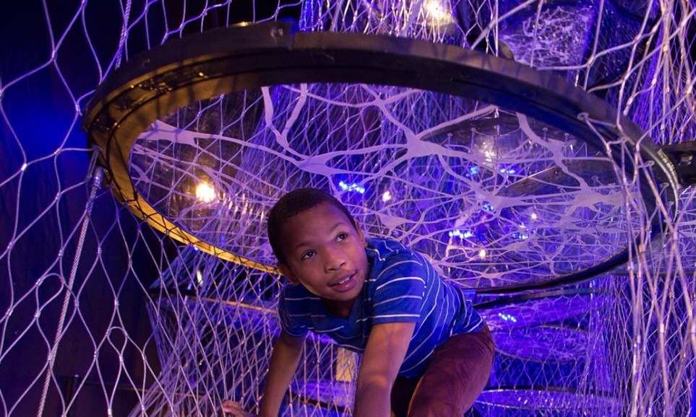
Brain science and technologies
Societal context and implications
Creating opportunities for
public engagement with science

Slide 33
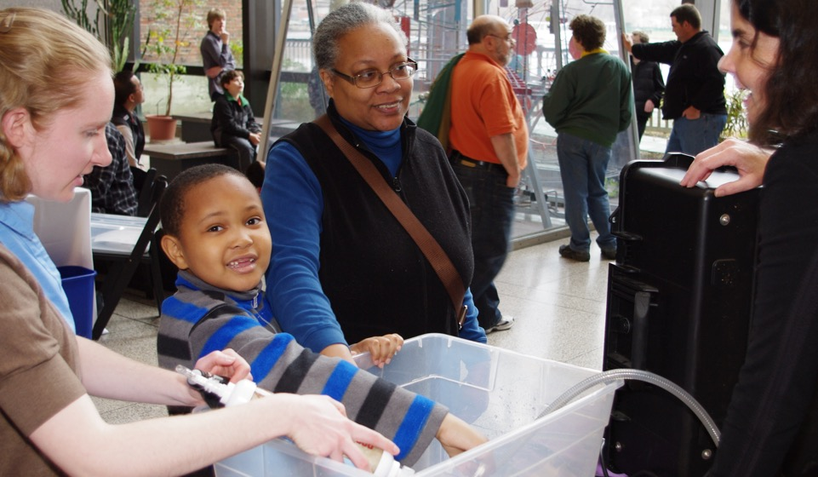
Energy transitions
Technological, social, political, economic change
Engaging communities in shaping innovation

Slide 34
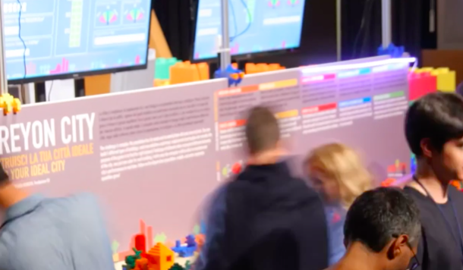
Sustainability
Global network for sustainable futures
Collaborating to build the future we want to live in

Slide 35
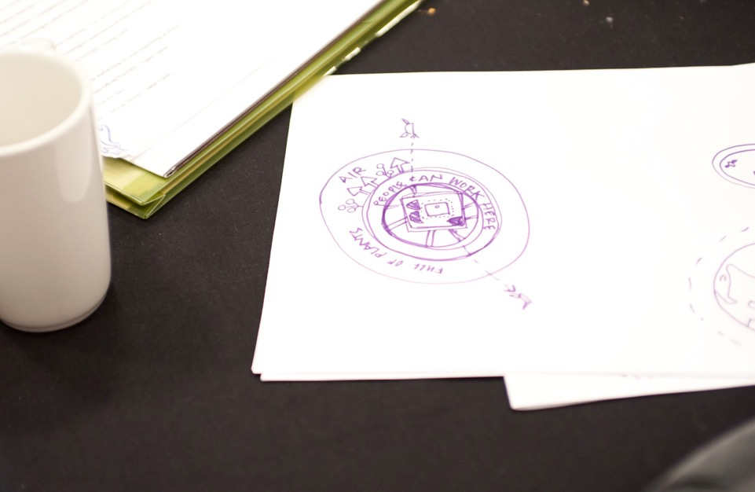
Let us know!
In early stages
Brain
Chemistry
Earth and space
Energy transitions
Human origins
Sustainable futures
How do these topics connect to your museum?
What do you need and want? What do you have to share?
Do you have other ideas for new projects we can work on together?

Slide 36
THANK YOU

Slide 37


Online digital library:
nisenet.org
Monthly newsletter
nisenet.org/newsletter
Social networking: nisenet.org/social

Slide 38



Acknowledgements
The Nanoscale Informal Science Education Network was supported by the National Science Foundation under award numbers 0532536 and 0940143. Multi-Site Public Engagement in Science is supported by the National Science Foundation under award number 1421179. Increasing Learning and Efficacy is supported by the National Science Foundation under award number 1516684. ChemAttitudes is supported by the National Science Foundation under award number 1612482. Any opinions, findings, and conclusions or recommendations expressed in this presentation are those of the authors and do not necessarily reflect the views of the Foundation.
Space and Earth Informal STEM Education is supported by NASA under cooperative agreement number NNX16AC67A and 80NSSC18M0061. Moon and Beyond is supported by NASA under grant number 80NSSC18K1219. Any opinions, findings, and conclusions or recommendations expressed in this material are those of the author(s) and do not necessarily reflect the view of the National Aeronautics and Space Administration (NASA).
Sustainability in Science & Technology Museums is supported by the Rob and Melani Walton Foundation.
Public Engagement with Neuroscience and Society conference and landscape study is supported by The Kavli Foundation.

