Slide 1
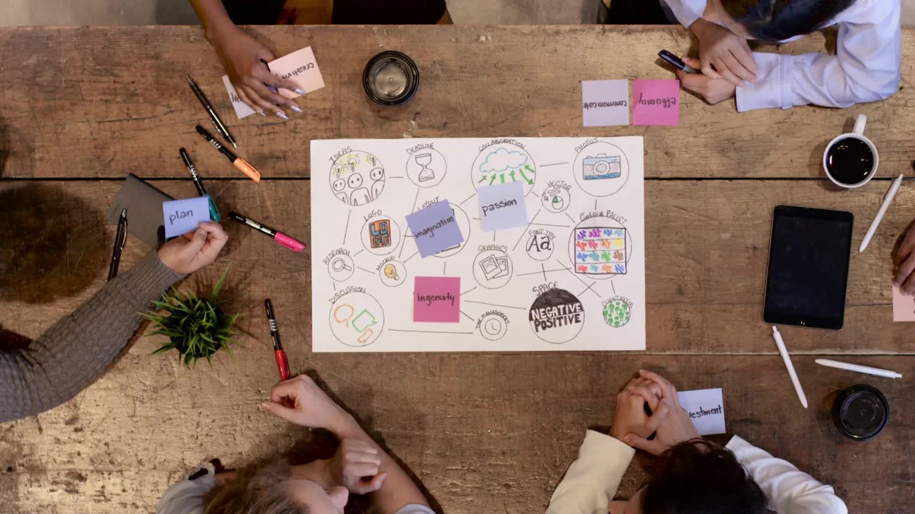
Advancing DEAI through
Process Evaluation and New Approaches for Evaluating Professional Impact
July 16, 2024
Visitor Studies Association Conference
Saint Paul, MN

Slide 2
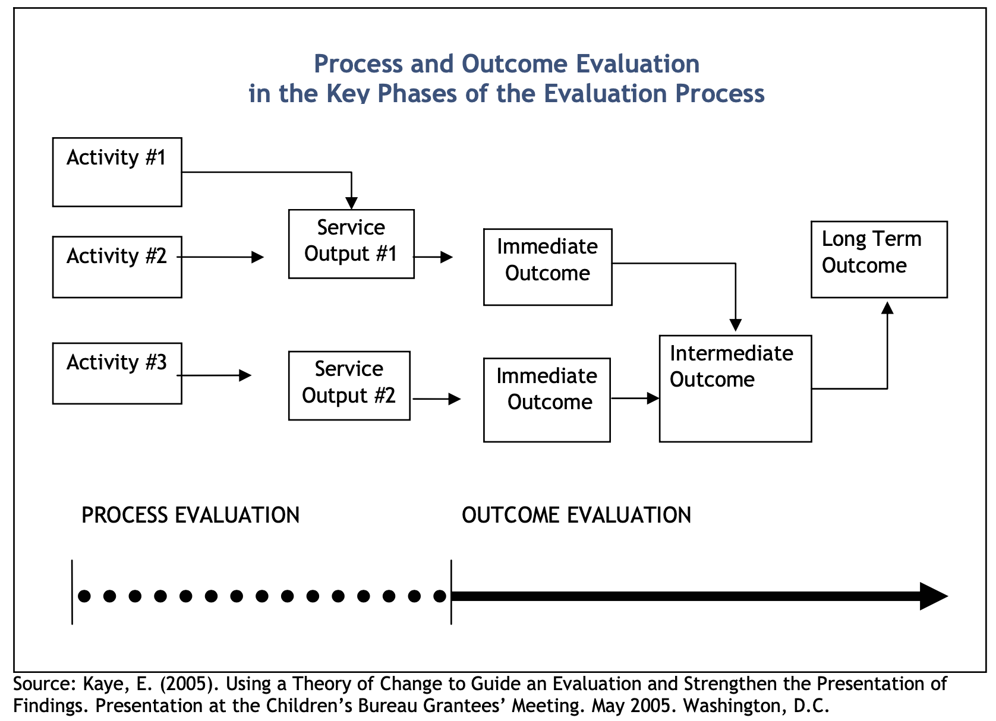
What is process evaluation?
Notes:
You may be more familiar with outcome or product evaluation, for example an exhibit or a program is developed and a front end, formative, remedial or summative evaluations is conducted that shares end-user outcomes. Process evaluation focuses on implementation.
What about the intersection of process evaluation and diversity, access, equity, and inclusion?
When you are conducting process evaluations you often find yourself focusing on the contexts in which core activities are happening
Some projects may have clearly defined DEAI values and goals, and monitoring how implementation unfolds allows us to check in with each other and stay accountable to those goals
At other times, groups may be interested in applying a DEAI lens to their work but not sure where to start. Process evaluation might support understanding gaps in the current implementation, as it happens
At a meta-level there is also a bit of a process within a process. As an evaluator you’re paying attention to and evaluating project implementation while also attuned to how your own choices of methods, analysis and reporting can uplift, or if we’re not careful, undermine the DEAI values infused within a project team.
That was just the quickest intro to Process Evaluation, and I think it’s interesting to think how some of us are trying this out in practice. So I’d like to talk about (switch slide)

Slide 3


Engaging Hispanic Communities in Authentic NASA Science: Broadening Participation in Science Activation through Local Partnerships and National Networks
Co-Creation /
Community Informed Design
Local Partners, National Network
Capacity
Building
This material is based upon work supported by NASA under cooperative agreement award number 80NSSC22M0122. Any opinions, findings, and conclusions or recommendations expressed in this material are those of the author(s) and do not necessarily reflect the view of the National Aeronautics and Space Administration (NASA).
Notes:
The Engaging Hispanic Communities in Authentic NASA Science project
The project has three pillars
Co-creation – working directly with community members and community based organizations to develop meaningful STEM experiences
Working locally but sharing nationally
Building leadership and STEM capacity, locally at the sites
Teams have a lot of flexibility to set up the project in a way that meet their needs at each of the six sites

Slide 4
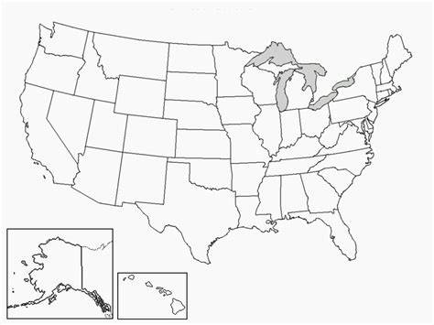
EHC Project
Partners and positionality
  External to project sites
  Working with museum leaders and community leaders
  Understanding shared values around diversity, equity and inclusion
  We meet in groups and 1:1 reflections
Notes:
I am located in Boston and the locations where the work in happening are in the Southwest United States. Those six sites are doing the day to day work of understanding how to authentically engage their communities in informal science learning and create culturally sustaining STEM activities. Each site has community based organizations engaged in the work with museum professionals. So far, the process evaluation has focused on reflections which are with the whole team and also 1:1. Project teams have gotten to choose a way to reflect – Miro board for a whiteboard like approach and Google Doc for a running notes style approach. We also meet as an evaluation team at least biweekly and with project leadership at least monthly.
Building relationships – at the sites, across sites, and with the evaluation and leadership teams.

Slide 5
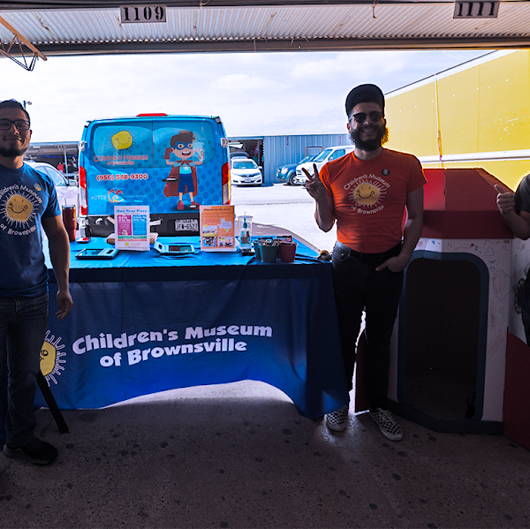
Goals of Process Evaluation
Understand in real-time how teams are working together; what voices are being uplifted?, what are the challenges?
Document the work of under-taking co-development or community informed work, as it happens
Evaluate the professional impact of being involved in co-creation work

Slide 6
Problem of Practice
Teams are navigating their own stories of community informed design and co-creation
As an evaluator, challenges in:
  Staying authentic to practitioner and community leader voice (e.g., Do we have to call it STEM capital?)
  Balancing confidentiality and just-in-time feedback for teams
Checking in with each other about what equity
(diversity, inclusion) means
in our work together
Intentionality in cycles of reflecting and planning

Slide 7
Breakout 1:
How have you used evaluation to increase accountability
to DEAI goals or frameworks
on projects?

Slide 8
Breakout 2:
What are methods
you have found helpful
in embedding evaluation
into ‘in-process’ projects?

