Slide 1
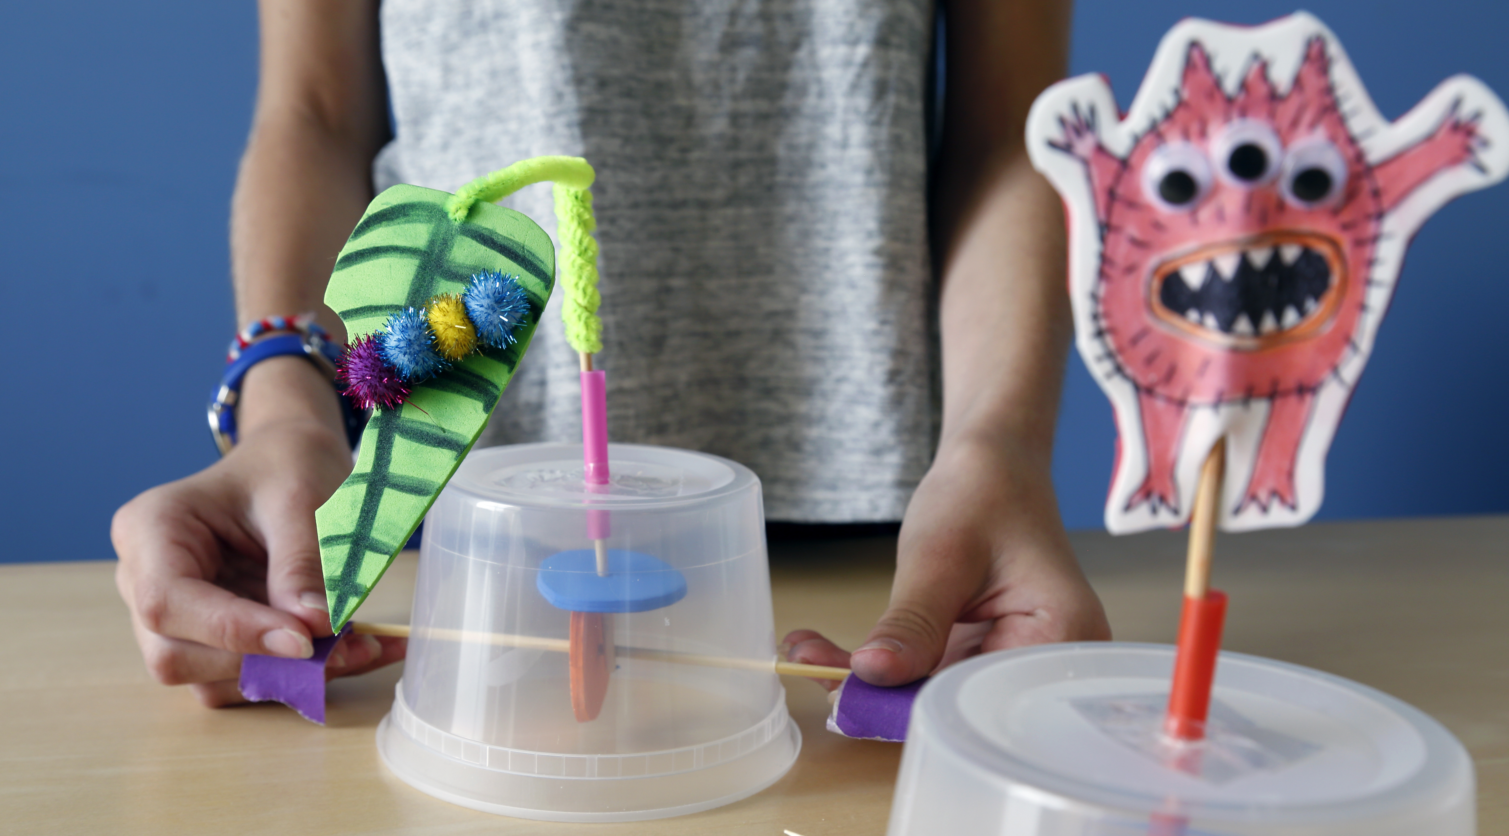
AUTOMATA
What happens when your creature comes to life?

Slide 2
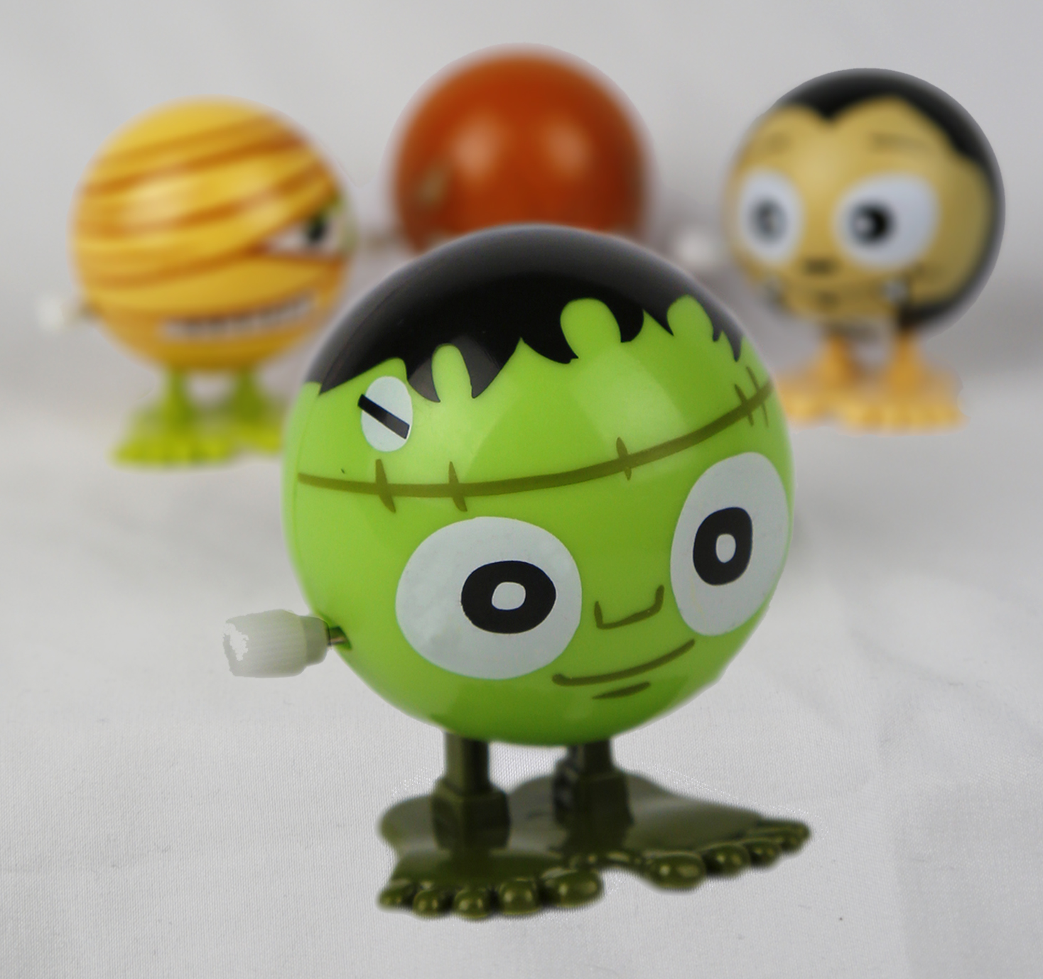
WHO WAS FRANKENSTEIN?
What do you know about Victor Frankenstein and his creature?
Victor Frankenstein and the “monster” he created first appeared 200 years ago in Mary Shelley’s novel Frankenstein. Since then, these characters have appeared in plays, movies, TV shows, comic books, and many other places.
You may recognize Frankenstein’s creature as a Halloween costume, a classic Hollywood monster, or the complex character in Shelley’s story.
Frankenstein’s creature inspired this wind-up toy. Many toys look like the character played by Boris Karloff in movies.

Slide 3
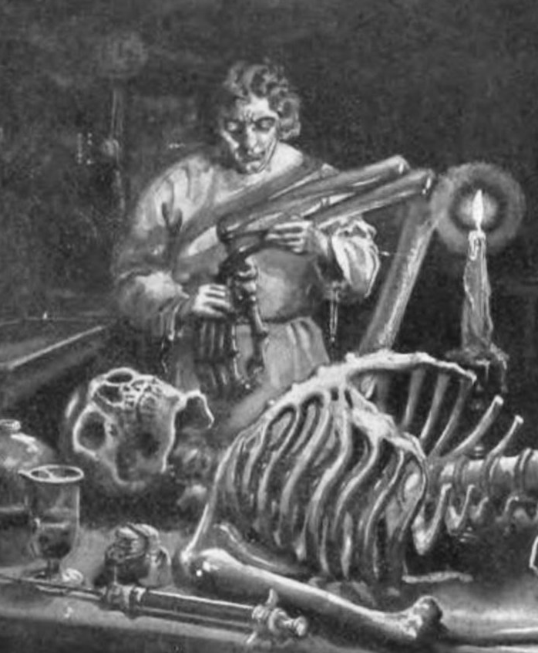
In Mary Shelley’s original story, Victor Frankenstein was a science student with a secret project. He built a person out of dead body parts and brought it to life.
When his creature began to move, Victor became scared of it. He thought his creature looked like a monster, and he let it run away.
In this activity, you will make an automaton—a machine that seems to be alive!
Victor Frankenstein used surgery, chemistry, electricity, and other methods to build his creature and bring it to life. This illustration is from an early edition of Mary Shelley’s 1818 novel.

Slide 4
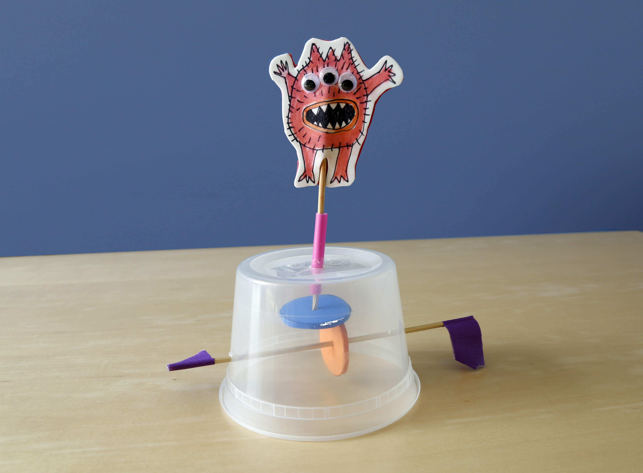
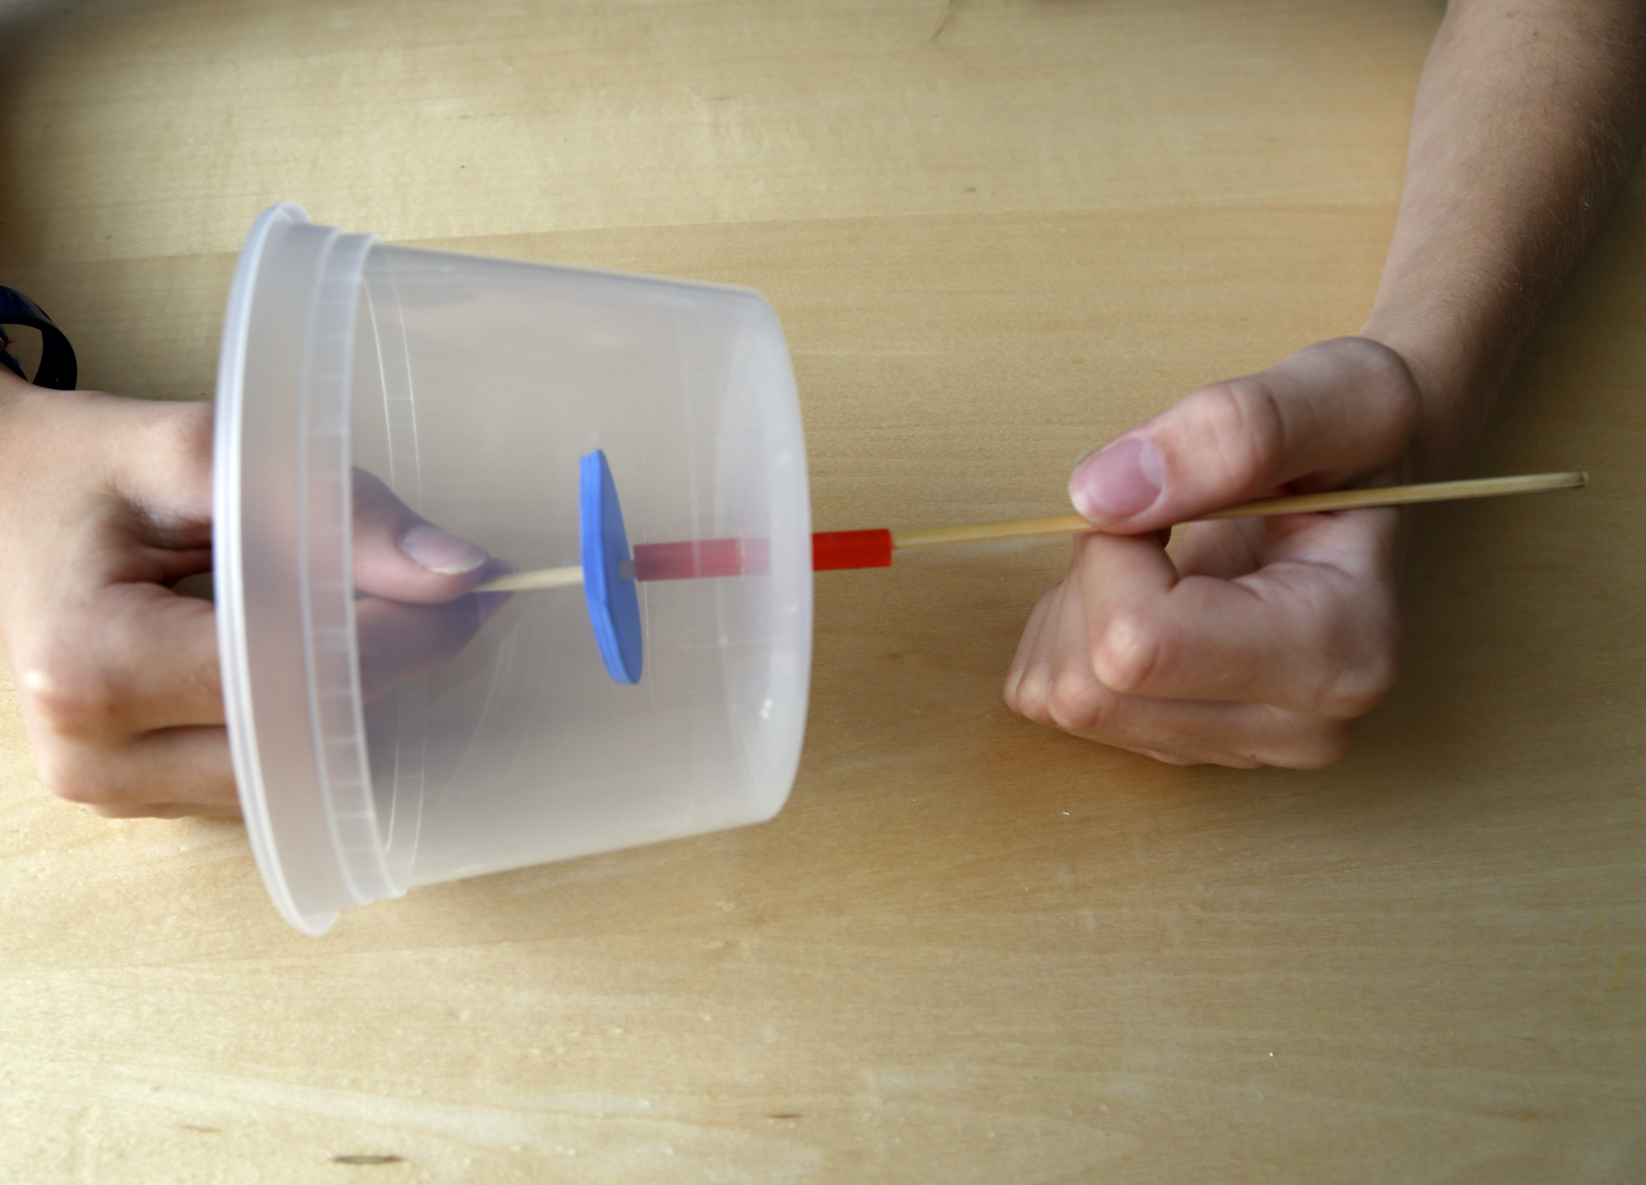
MAKE A CREATURE
1. Plan your automaton.
Play with the sample projects. When you turn the handle, look at how the foam circles work together to make the decoration on the top move. The foam circles are part of a cam system.
What will you put on top of your automaton?
Can you make something that looks like it’s alive?
2. Build a cam system.
Take a plastic container and turn it upside down. Insert a small piece of straw into the hole on the top. Tape it into place.
Thread a skewer through the straw, then push it through the middle of a foam circle. Adjust everything so the foam circle is inside the container, near the top.

Slide 5
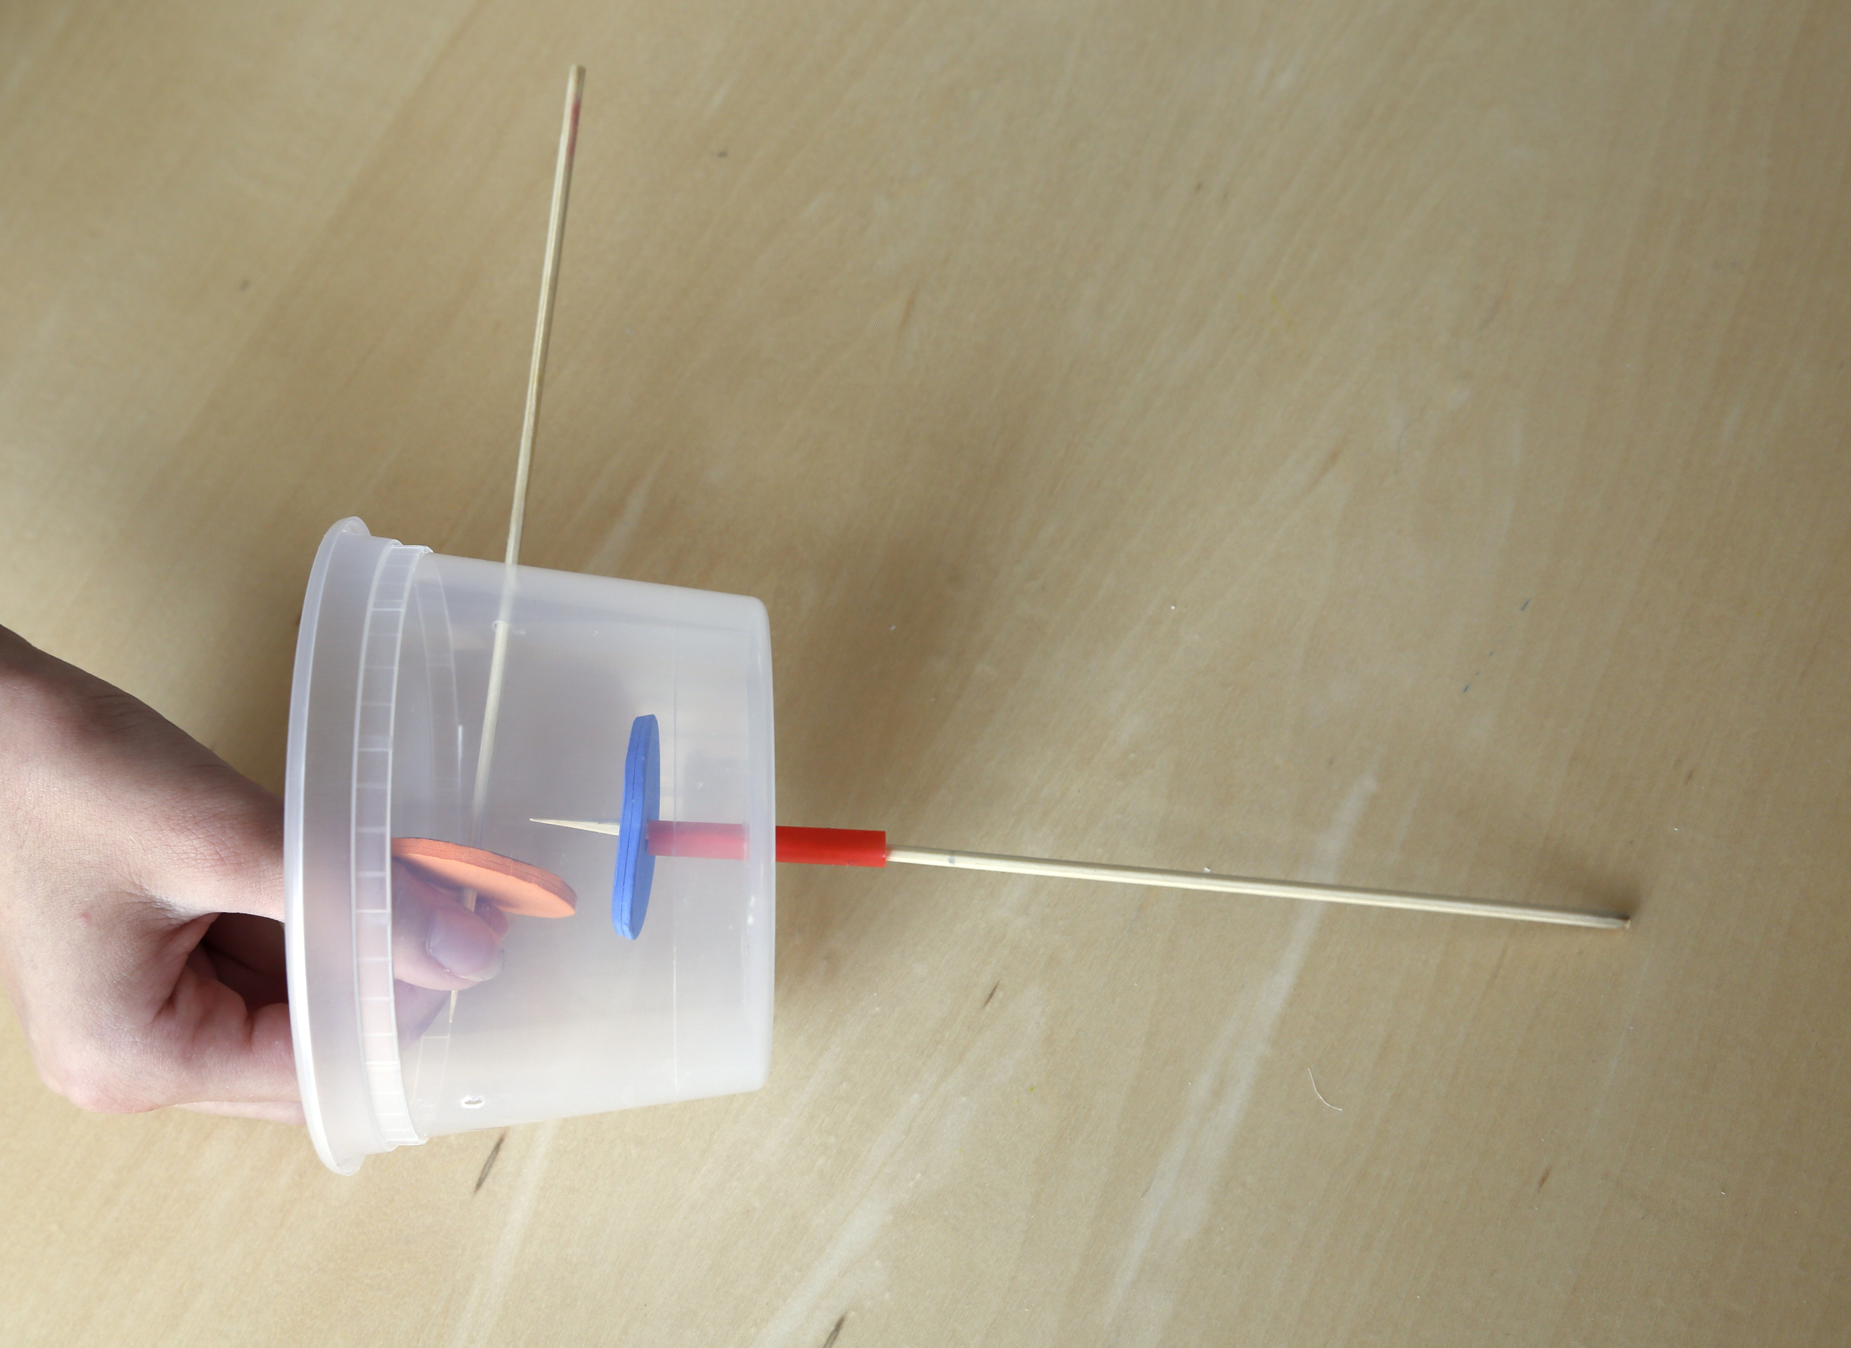
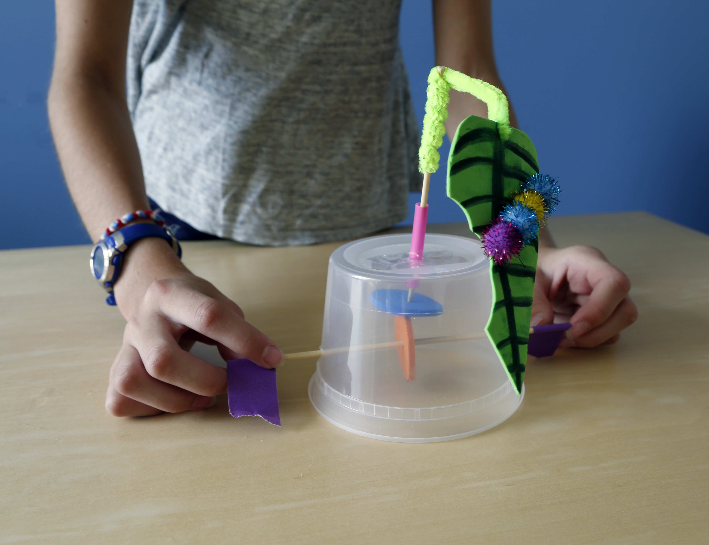
Insert a skewer through the hole in the side of the container. Push the skewer through the center of a second foam circle and out the hole in the other side of the container.
Adjust the foam circles so they are at right angles, with the flat surface of the top one resting on the edge of the bottom one.
3. Add handles.
Double a piece of tape over both ends of the side skewer. This will give you a handle on either side.
Turn the handle! What happens to the top skewer? How could you change the motion?
4. Bring it to life!
Now decorate your automaton. You can put whatever you want on top. Turn the handle.
Is it alive?
How can you tell the difference between a machine and a living creature?

Slide 6
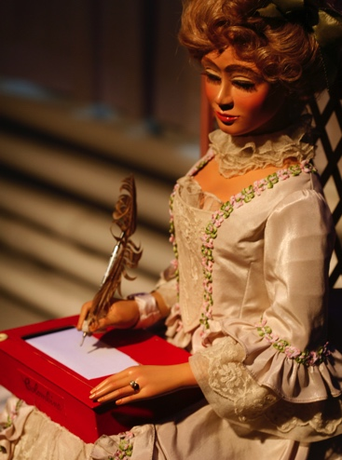
PEOPLE ARE CREATIVE
We’re always learning more about the world and inventing new things.
Automata are mechanical devices that imitate people, animals, or other living things. Sometimes they almost seem to be alive!
Automata aren’t new—they’ve been around for hundreds of years. Many different cultures have built them to provide entertainment and serve useful functions.
How do you feel about automata? Are they cool or creepy?
What is the difference between people and machines?
An eighteenth century Swiss automaton writes on its own. Mary Shelley may have seen similar automata when she was in Switzerland.

Slide 7
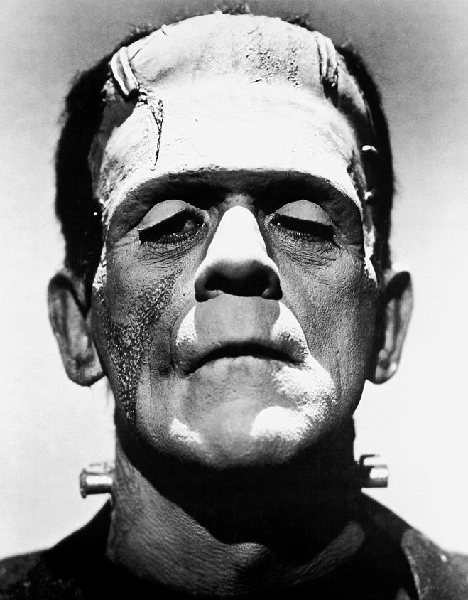
MONSTER OR MISTREATED?
Mary Shelley’s novel Frankenstein tells the story of a man who builds a creature and brings it to life—but doesn’t take responsibility for it.
The creature learns to survive on his own, but he has a difficult time. He blames his misery on his creator, Victor Frankenstein. He says Victor made him, but didn’t help him or take care of him.
The creature vows revenge, and kills Victor’s friend and then his bride. When Victor himself finally dies, the creature runs off and disappears forever.
Is the creature to blame for his crimes?
Should he blame Victor for his suffering?
Actor Boris Karloff tried to show the humanity of Frankenstein’s creature. Karloff played the character in many Hollywood movies.

Slide 8
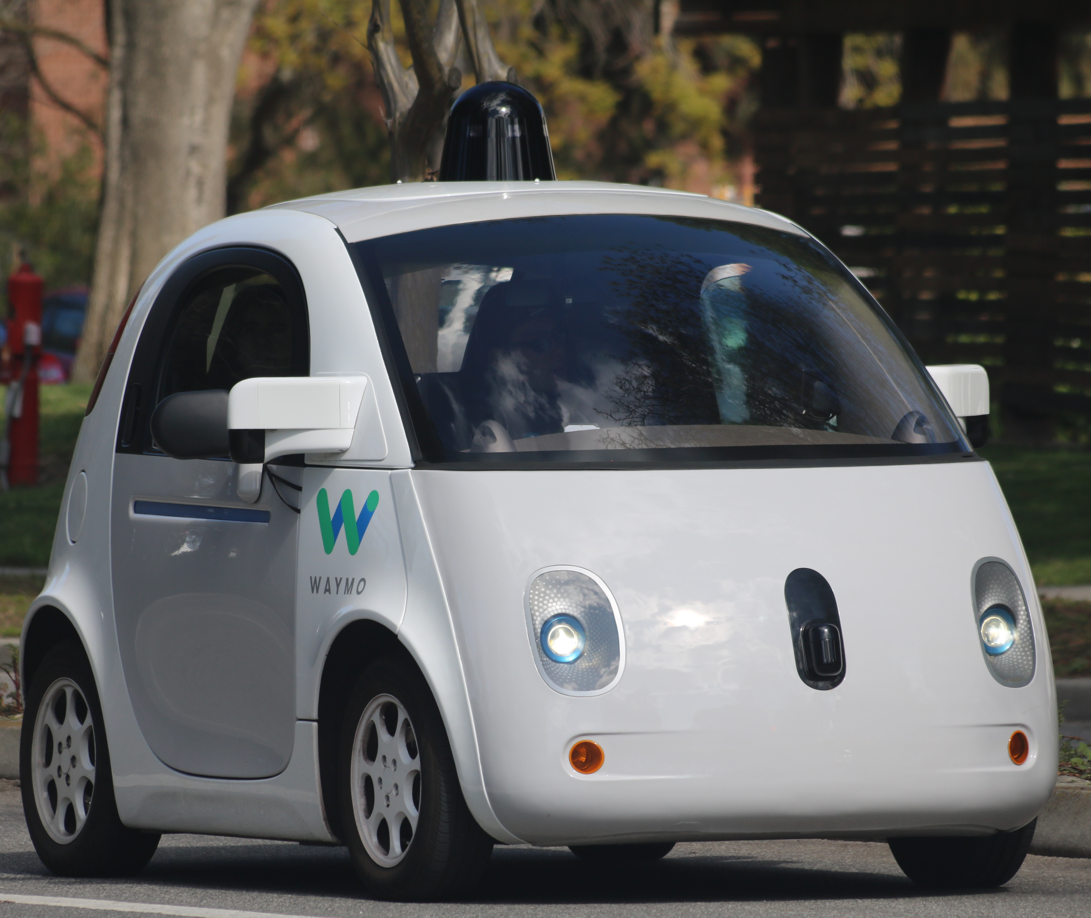
RESPONSIBLE INNOVATION
Frankenstein suggests that as we study science and make new technologies, it’s important to think ahead.
Researchers who study artificial intelligence make machines that can reason and learn over time. For example, self-driving cars navigate and drive on their own.
Manufacturers say self-driving cars are safer than human-driven vehicles, and provide mobility to people who are unable to operate a car. But some people are concerned that hackers could get into the cars’ computer systems, while others simply don’t like the idea of giving up control.
Would you ride in a car driven by a computer rather than a human?
Would you buy a driverless car?
Many companies are working on self-driving cars. The cars are being tested on streets all over the United States.

Slide 10


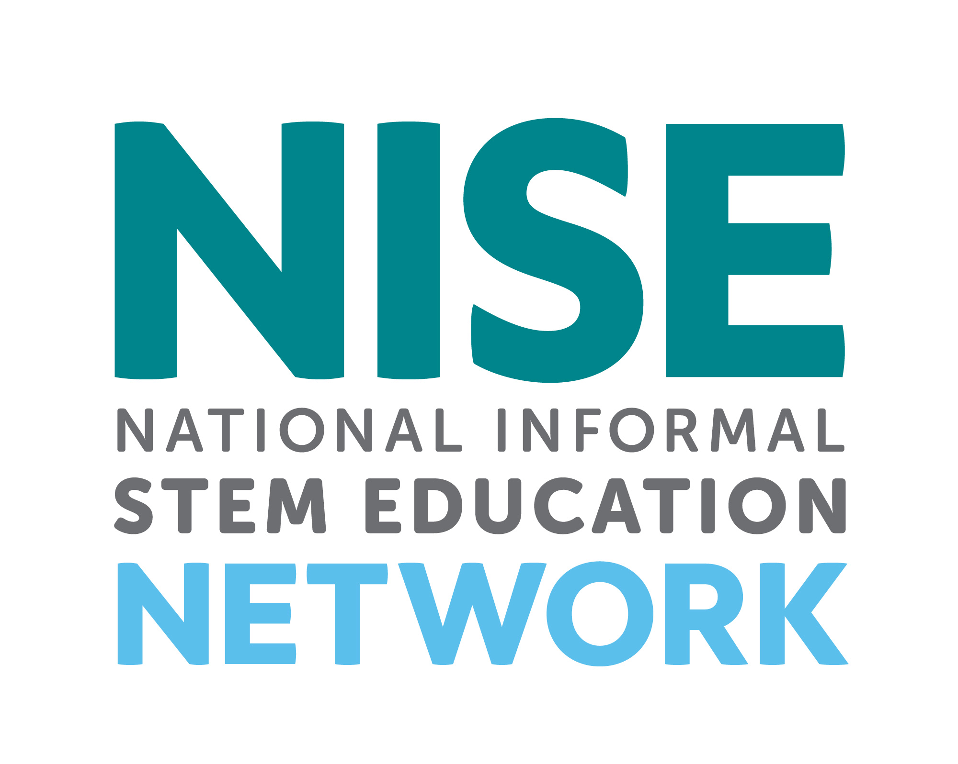

Mary Shelley’s novel Frankenstein is a 200-year-old science fiction story that explores themes of human creativity and scientific ethics. The Frankenstein200 project allows people across the United to States to exercise their creativity and consider responsible innovation in fields such as artificial intelligence and genetic engineering.
Frankenstein200 is a national project led by Arizona State University. In addition to hands-on activities, Frankenstein200 includes an alternate reality game that immerses players in a modern-day Laboratory for Innovation and Fantastic Explorations (L.I.F.E.). This fictional story imagines what might happen if a character named Dr. Tori Frankenstein picked up where her ancestor Victor Frankenstein left off.
Visit Frankenstein200.org to play the game!
Copyright 2017, Arizona State University. Published under a Creative Commons Attribution-Noncommercial-ShareAlike license: http://creativecommons.org/licenses/by-nc-sa/3.0/us/
Distributed in collaboration with the National Informal STEM Education Network: nisenet.org
This project was supported by the National Science Foundation under Grant Number 1516684. Any opinions, findings, conclusions, or recommendations expressed in this program are those of the authors and do not necessarily reflect the views of the Foundation.

