Slide 1
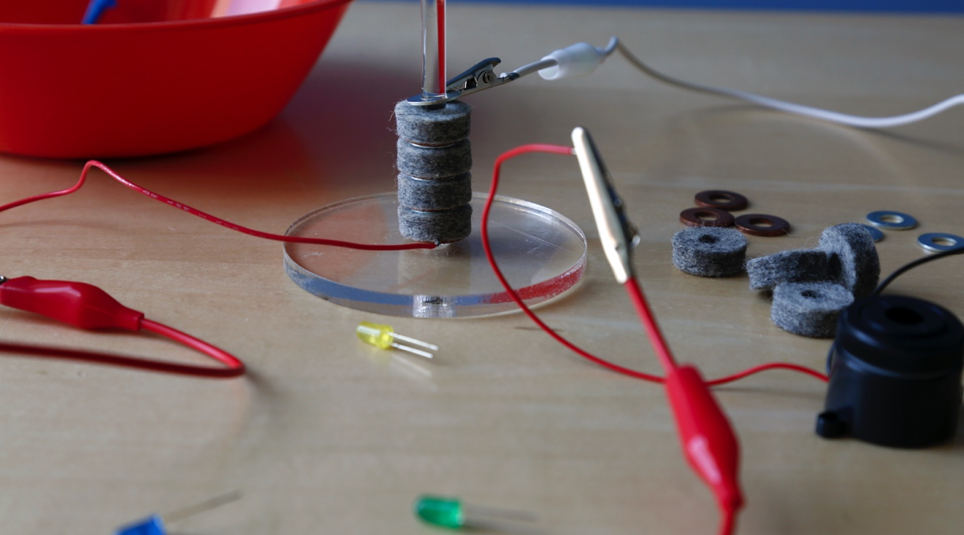
BATTERY STACK
Can an invention be both negative and positive?

Slide 2
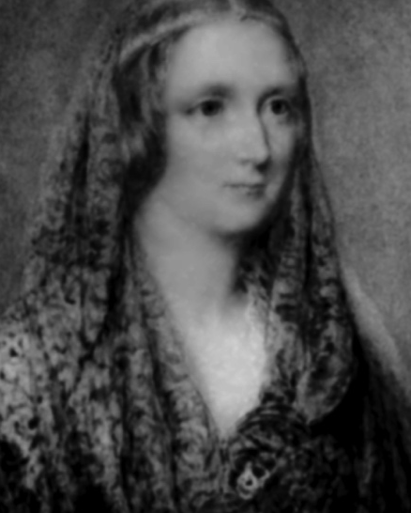
WHO WAS FRANKENSTEIN?
What do you know about Victor Frankenstein and his creature?
Victor Frankenstein and the “monster” he created first appeared 200 years ago in Mary Shelley’s novel Frankenstein. Since then, these characters have appeared in plays, movies, TV shows, comic books, and many other places.
You may recognize Frankenstein’s creature as a Halloween costume, a classic Hollywood monster, or the complex character in Shelley’s story.
Mary Shelley published Frankenstein in 1818.
She was only 20 years old.

Slide 3
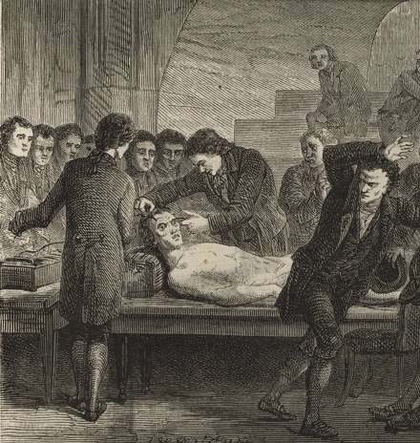
In Mary Shelley’s original story, Victor Frankenstein was a science student with a secret project. He built a person out of dead body parts and brought it to life.
Victor Frankenstein used surgery, chemistry, electricity, and other methods. In describing Victor’s research, Mary Shelley was inspired by scientific experiments taking place in England and Europe.
In this activity, you will replicate an early electrical experiment!
During Mary Shelley’s time, people could watch experiments that applied electricity to dead bodies. This image shows a scientist shocking the corpse of a condemned criminal to see what would happen.

Slide 4
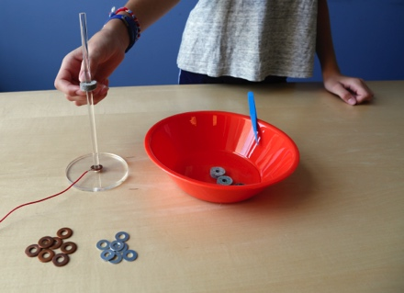
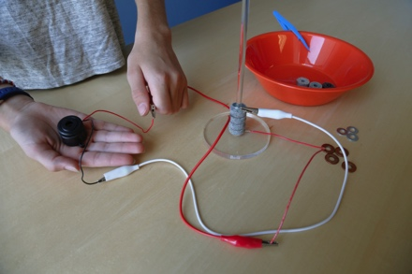
EXPLORE ELECTRICITY
1. Make a pile of washers.
Find a copper washer that has a wire attached. Slide it onto the clear acrylic rod.
Take a felt washer out of the bowl of vinegar and slide it onto the rod.
Finally, slide a zinc washer onto the rod. You’ve made a pile!
2. Test it.
Choose the buzzer or LED. Clip the red wire attached to the bottom washer to the buzzer’s red wire (or to the LED’s longer leg). Attach another clip to the buzzer’s black wire (or to the LED’s shorter leg), then touch the free end of the clip to the zinc washer at the top of the pile. What happens?
Tip: You’ll probably need to add more washers to get the buzzer or bulb to work!

Slide 5
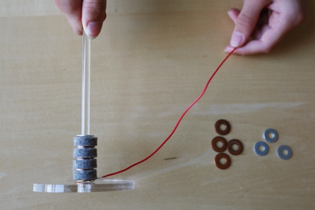
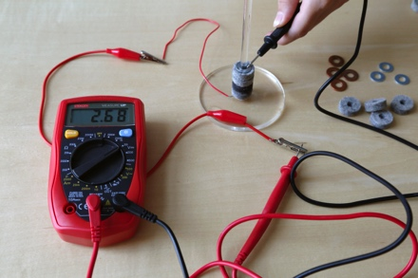
3. Add on to your pile!
Slide a copper washer onto the rod so it sits
on top of the pile. (This time, the copper washer doesn’t need a wire.) Slide a felt washer onto the rod, and then a zinc washer. Now your pile is twice as big!
Does the bulb or buzzer work now?
What happens to the buzzer when your pile gets bigger?
Tip: To make the pile bigger, keep adding washers in the same order: first copper, then felt, then zinc.
4. Measure the volts.
You can also use the meter to test your pile. Attach the red wire of the meter to the wire on the bottom washer, and touch the meter’s black wire to the top washer.
How many volts of electricity does your pile generate?

Slide 6
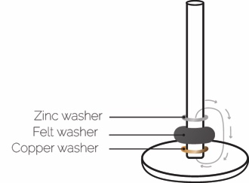
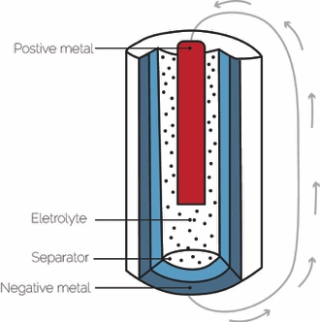
You made a battery that converts chemical energy to electrical energy!
The zinc loses electrons, which flow through the wire to the buzzer or light, and then back through the other wire to the copper washer. The copper gains electrons, which then join the acid in the vinegar to create hydrogen gas. This process will continue and produce energy until the vinegar dries up.
Commercial batteries work in a similar way. They use two different materials and an electrolyte solution to create an imbalance of charge and thus voltage. When the ends of the battery are connected with a wire, the voltage produces an electrical current. One AA battery produces around 1.5 volts, about the same amount as a pile made of three washers (one copper, one felt, and one zinc).
In a voltaic pile, electrons flow from zinc to copper.
In a modern battery, electrons flow from the negative terminal to the positive terminal.

Slide 7
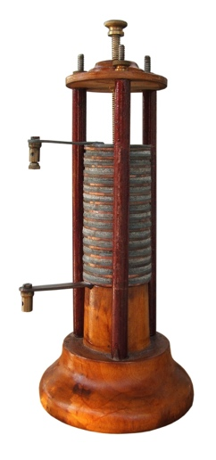
PEOPLE ARE CREATIVE
We’re always learning more about the world and inventing new things.
The first battery ever invented used a pile of metallic disks separated by salty cloth, similar to the one you made in this activity. This kind of battery is called a voltaic pile, after its inventor, Alessandro Volta.
Around 1800, Volta realized that electricity could be generated through a chemical reaction. At the time, many scientists thought that only animals produced electricity, and Volta proved them wrong. He invented the battery before there were light bulbs or anything else that ran on electricity!
Why do you think Volta may have wanted to investigate electricity?
The voltaic pile was the first kind of battery. It was invented by Alessandro Volta around 1800. The word volt comes from Volta’s name.

Slide 8
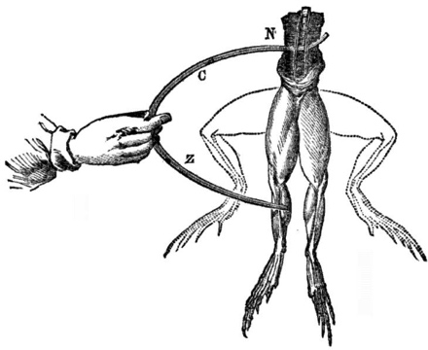
FRANKENSTEIN & ELECTRICITY
Mary Shelley’s novel Frankenstein was inspired by early scientists who studied electricity.
In 1803, a famous experiment took place in London, using the body of a hanged man. A scientist took a pair of conducting rods that were connected to a powerful battery and applied them to the dead man’s body. The electrical current made the corpse’s body move, and one eye opened!
Shelley wrote that this type of experiment made her think that one day it might be possible to reanimate a corpse.
How do you think Shelley may have felt about the electrical experiments going on during her lifetime?
How would you have felt about them?
Luigi Galvani discovered that a frog’s leg would twitch in response to an electrical spark. Mary Shelley thought “Galvanism” showed that it might be possible to bring a dead body back to life.

Slide 9
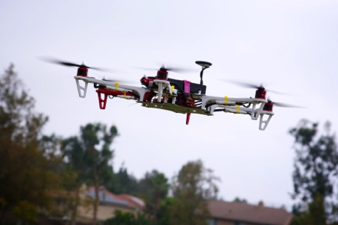
RESPONSIBLE INNOVATION
Frankenstein suggests that as we study science and make new technologies, it’s important to think ahead.
Volta’s invention has had a big impact on our lives. We use batteries every day! They provide electricity for our mobile phones, cars, and many other things.
But we might not like some of the ways people use batteries. For example, batteries can also be used to detonate explosives, for purposes that may be helpful or harmful.
Are inventors responsible for the ways people use their inventions?
Is an invention itself good or bad, or does it depend how people use it?
Batteries power many things. For example, many drones use small, high-capacity batteries.

Slide 10




Mary Shelley’s novel Frankenstein is a 200-year-old science fiction story that explores themes of human creativity and scientific ethics. The Frankenstein200 project allows people across the United to States to exercise their creativity and consider responsible innovation in fields such as artificial intelligence and genetic engineering.
Frankenstein200 is a national project led by Arizona State University. In addition to hands-on activities, Frankenstein200 includes an alternate reality game that immerses players in a modern-day Laboratory for Innovation and Fantastic Explorations (L.I.F.E.). This fictional story imagines what might happen if a character named Dr. Tori Frankenstein picked up where her ancestor Victor Frankenstein left off.
Visit Frankenstein200.org to play the game!
Copyright 2017, Arizona State University. Published under a Creative Commons Attribution-Noncommercial-ShareAlike license: http://creativecommons.org/licenses/by-nc-sa/3.0/us/
Distributed in collaboration with the National Informal STEM Education Network: nisenet.org
This project was supported by the National Science Foundation under Grant Number 1516684. Any opinions, findings, conclusions, or recommendations expressed in this program are those of the authors and do not necessarily reflect the views of the Foundation.

