Slide 1
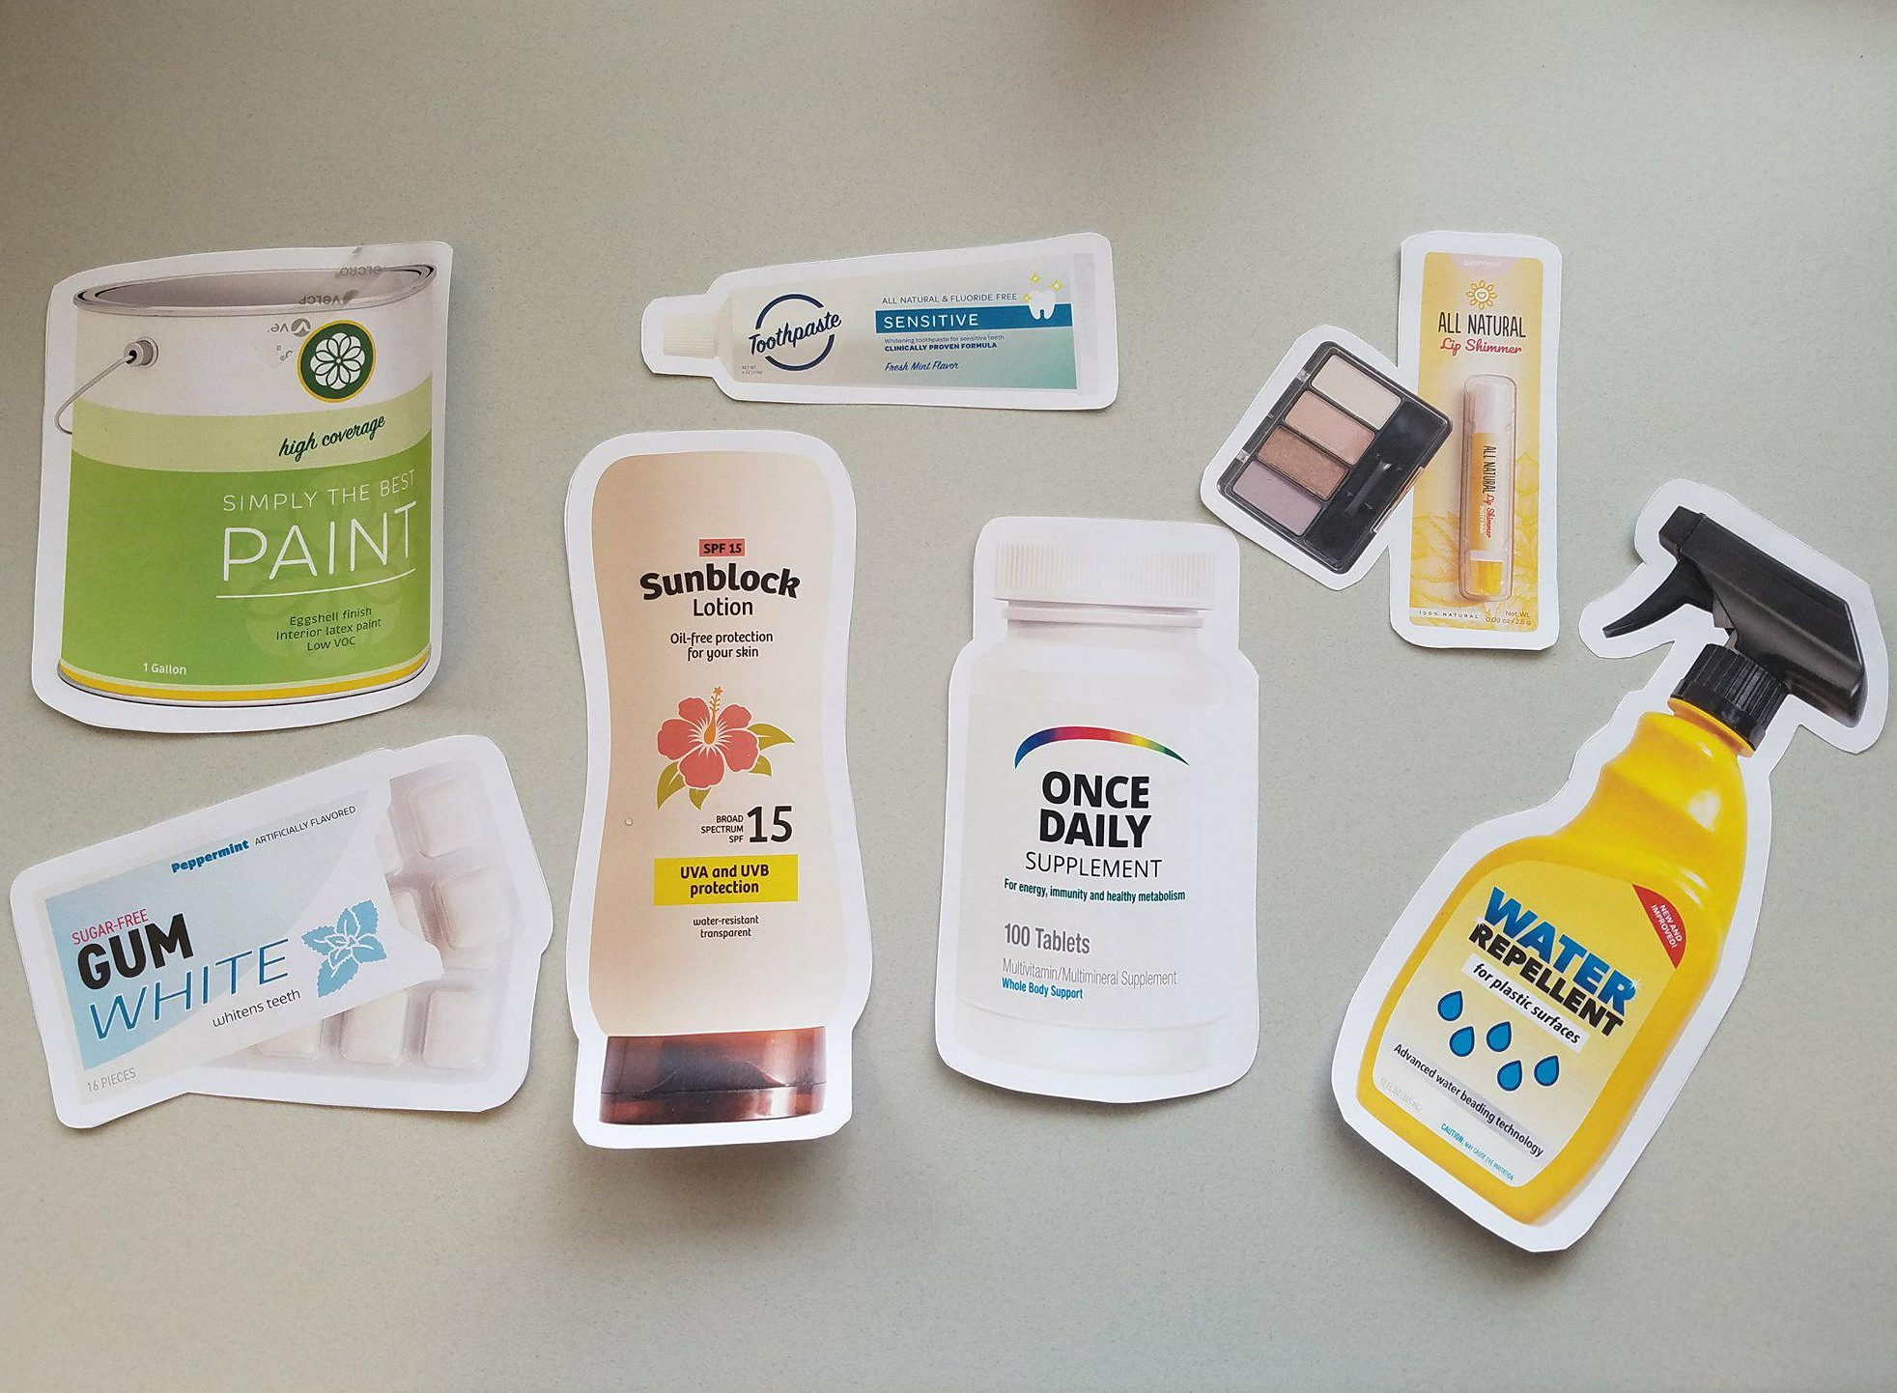
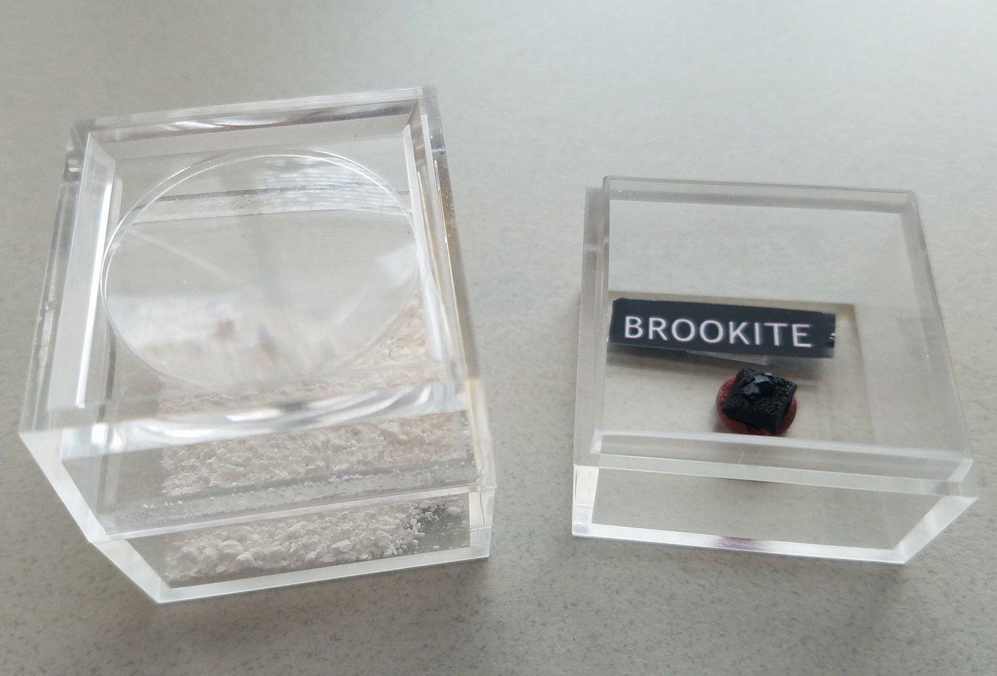
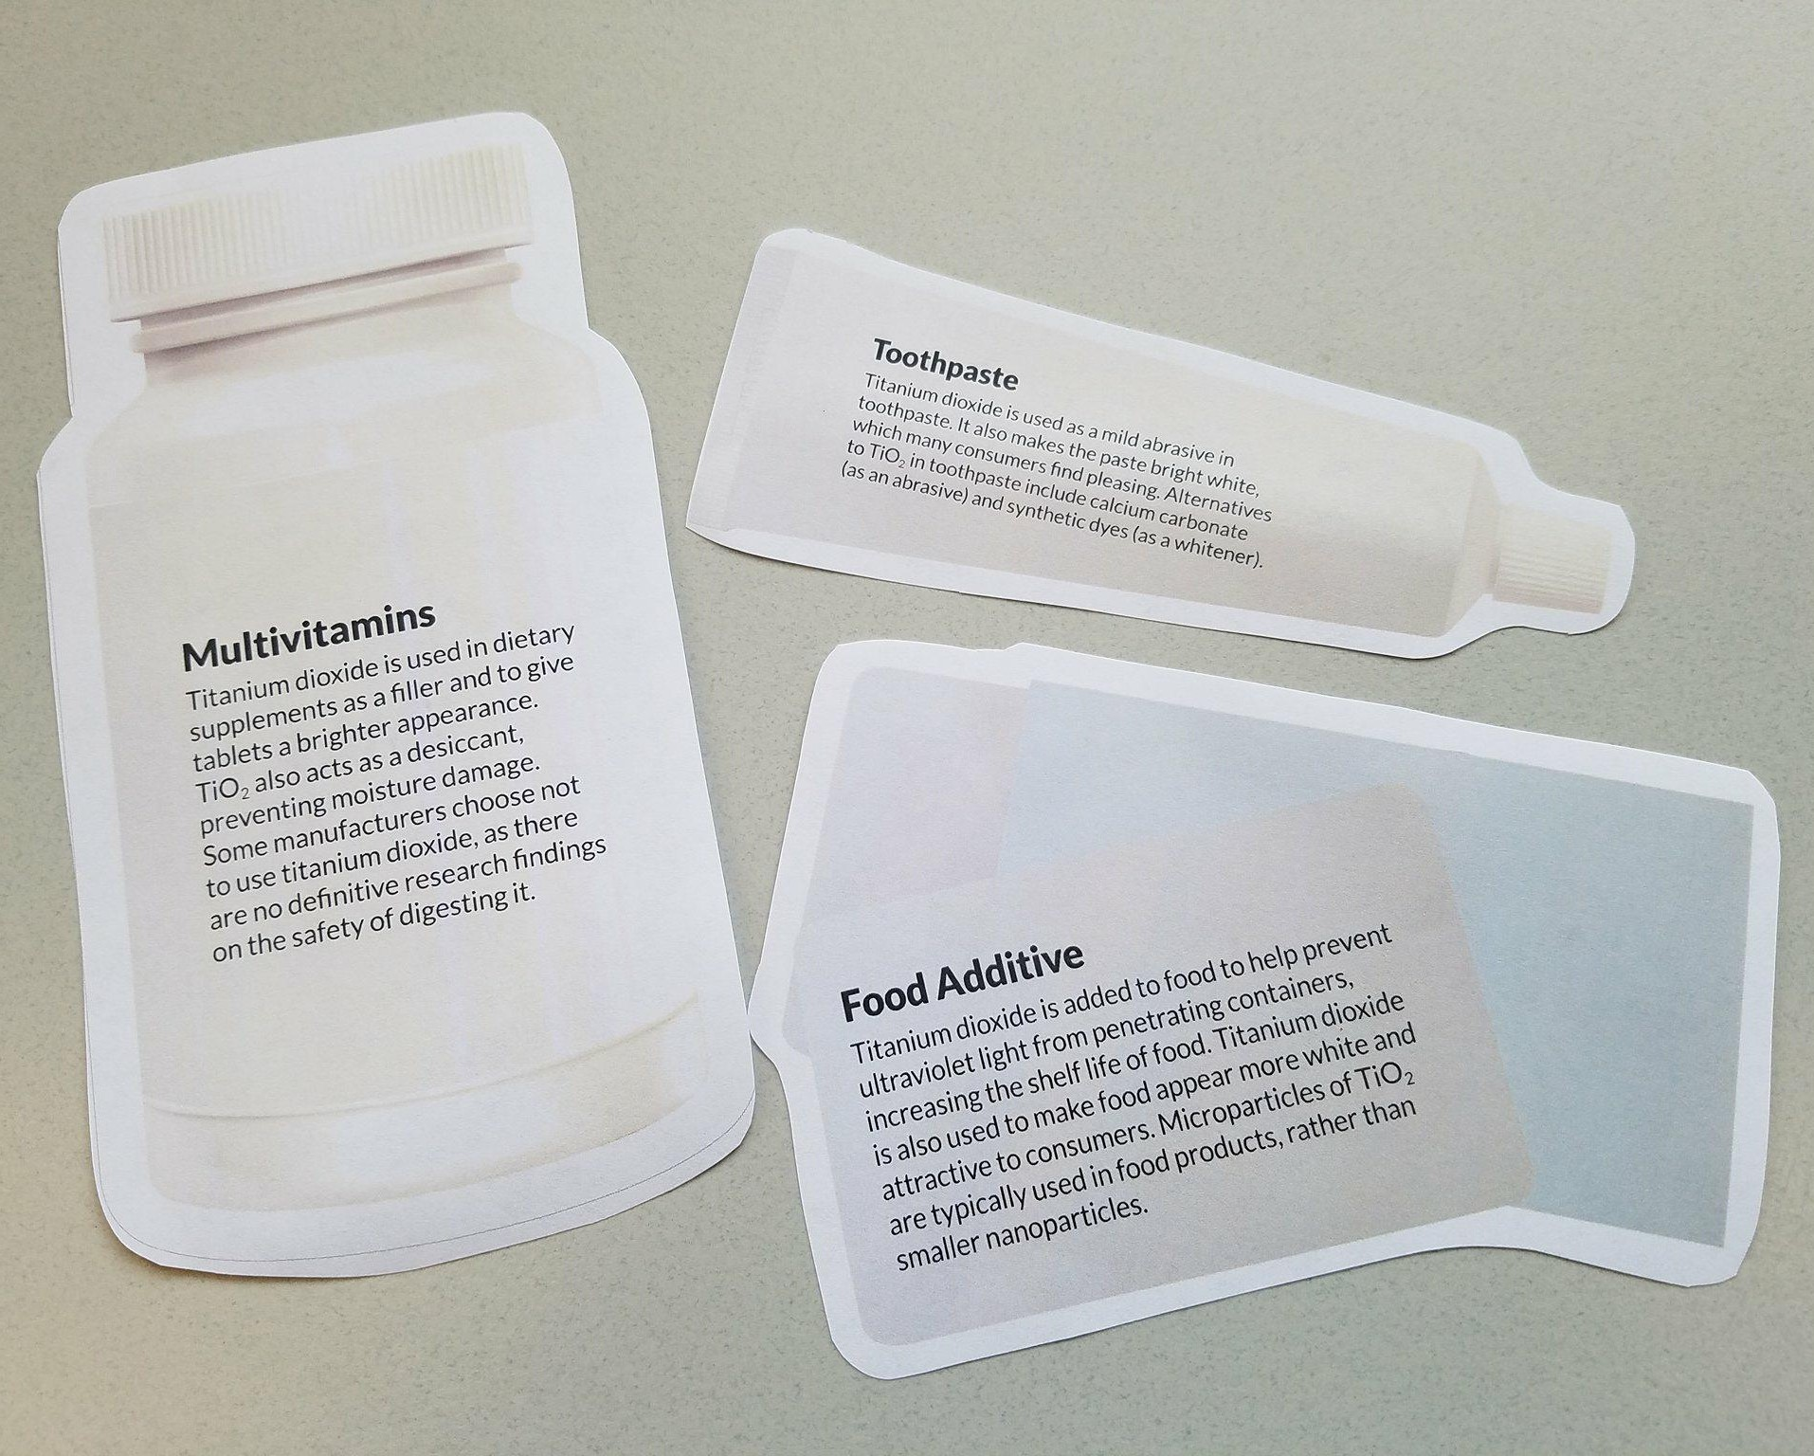
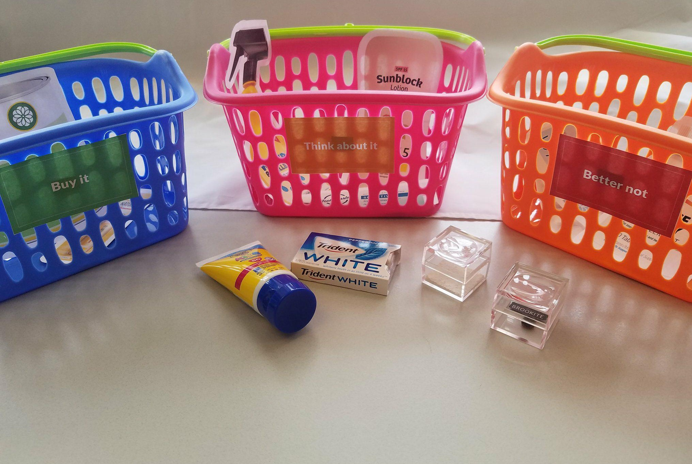

Buy it, or better not?
1
Look at the product cards and sort them into two piles: products you’ve used and products you haven’t used. Keep the cards for products you’ve used and set the others aside.
2
All of these products contain nano-sized titanium dioxide, a bright white powder that is derived from brookite and anatase minerals.
3
Read the back of the cards to learn more about how titanium dioxide is used in the products. Think about the potential risks and benefits of each product.
4
Based on your own values, place each card in the appropriate shopping basket. Will you BUY IT, THINK ABOUT IT, or decide you BETTER NOT?

Slide 2
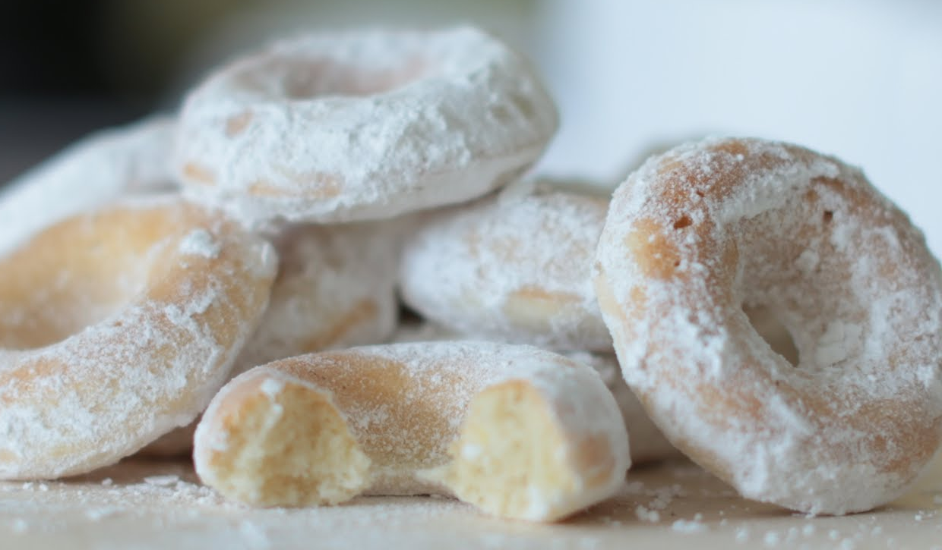

Nanoscale titanium dioxide is a common additive found in many products that we consume, rub into our skin, and use in our homes.
Materials can act differently when they’re nano-sized. For example, the titanium dioxide nanoparticles in sunblock are invisible to the human eye because they’re smaller than the wavelength of visible light. Some people are concerned that the particle size of ingredients like titanium dioxide may make a difference in how safe they are.
The powdered sugar used on many doughnuts contains titanium dioxide.
Nanotechnologies have costs, risks, and benefits that affect our lives in ways we cannot always predict. Not enough research has been performed for us to know the effects of nanoscale titanium dioxide on the environment. When titanium dioxide nanoparticles wash off skin, they enter the environment. The implications of nanoparticle pollution on plants and animals have not been fully assessed.
We also don’t know how nanoparticles affect consumers’ health. Once ingested, smaller particles can enter places in the body that larger ones can’t. This doesn’t necessarily mean they are harmful, but it does mean that we need to be careful about how we use nanoparticles in foods and other consumer products.
The effects of nanoscale titanium dioxide on human health or the environment are not yet known.
Notes:
-I had a lot more to say about human and chimp hands here, but I ran out of room! Also, I know the red text is probably too long which is why I had to shrink the font size. I’m happy to talk about phrasing and cutting down that ino there. (ALP)

Slide 3
Buy it, or Better not!

