Slide 1
How to Conduct an Interview
Ashley White
U.S. Green Building Council
Freelance Science Writer
ashley.ann.white@gmail.com
Emily Lewis,
2014-15 Congressional Fellow, ACS/AAAS
dr.emily.lewis@gmail.com
Alison Hatt,
User Program Director, Molecular Foundry,
Lawrence Berkeley National Laboratory

Slide 2
Why Conduct an Interview?
To better understand the science you’re writing about
Hear a description of the research in lay terms (it’s okay if you don’t understand it before the interview!)
Ask questions to clarify things you (still) don’t understand

Slide 3
Why Conduct an Interview?
To better understand the science you’re writing about
To find out information you can’t find on the web
Personal stories
Next steps in the research

Slide 4
Why Conduct an Interview?
To better understand the science you’re writing about
To find out information you can’t find on the web
Perspective and opinions
Why is the research important? Where will it lead next?
“What do you think about…?”

Slide 5
Why Conduct an Interview?
To better understand the science you’re writing about
To find out information you can’t find on the web
Perspective and opinions
Context
How do different pieces of the research fit together?
How does this research fit in the larger scheme of the field?

Slide 6
Why Conduct an Interview?
To better understand the science you’re writing about
To find out information you can’t find on the web
Perspective and opinions
Context
To get an outside opinion
Interview an expert not involved in the research to get more perspective
Interview a friend of your subject to get more stories and personal insight

Slide 7
Why Conduct an Interview?
To better understand the science you’re writing about
To find out information you can’t find on the web
Perspective and opinions
Context
To get an outside opinion
Conversations can give you ideas for storylines
Quotes!
Others?

Slide 8
Step 1: Your Assignment
Example Article Topics:
Profile of a researcher
Publicize recent award
Promote a significant research finding
General publicity
Update on particular research area/initiative
Explain what’s going on in X field
Special project/initiative
Covering an event
Publicize the event
Promote the outcomes

Slide 9
Step 2: Frame Your Article
General description of research
Info on particular research that led to award/pub
Why this area of research is important
Stories!
Profile of a researcher
General description of area/initiative
Specific examples of leading research
Importance of area/initiative in grand scheme
Future directions for area/initiative
Update on area/initiative
Purpose of event
What happened
Summaries/sound bites of important talks
Perspective on importance of event topic, future directions, etc.
Covering an event

Slide 10
Step 3: Choose Your Interviewees
Profile of a researcher
The researcher
Possibly a colleague of the researcher
Leading researcher in the field/working on the initiative
Administrator/program officer directing initiative
Colleagues they recommend
Recommendation of media relations officer
Update on area/initiative
Covering an event
Event organizer
Keynote speaker
Prominent attendee

Slide 11
Step 4: Set Up the Interview
Contact directly
Go through media relations officer
Dear Dr. Smith,
I’m writing an article for MRS Bulletin on future directions for the biomaterials field. I’d like to interview you for the article since you recently led a workshop and published a seminal report on this topic. Would you be available for a 30 minute call sometime later this week, perhaps on Wednesday or Friday afternoon?
Best regards,
Ashley White

Slide 12
Step 4: Set Up the Interview
Contact directly
Go through media relations officer
Dear Dr. Smith,
I’m writing an article for MRS Bulletin on future directions for the biomaterials field. I’d like to interview you for the article since you recently led a workshop and published a seminal report on this topic. Would you be available for a 30 minute call sometime later this week, perhaps on Wednesday or Friday afternoon?
Best regards,
Ashley White

Slide 13
Step 5: Preparing for the Interview
Background research
Website – personal, department, initiative, event
Google search
Previous news articles
Relevant research articles
Note: do enough research to ask good questions, but not to know most of the answers!
List of information you need (From Step 2. Example:)
Short description of research
A story
Why the research is important to fund (*quote*)
List of starting questions that will get at that information

Slide 14
Step 6: In the Interview - Overview
Opening the interview
Introduce yourself
Thank the interviewee
Remind interviewee of:
Article topic
Where it will be published
Audience

Slide 15
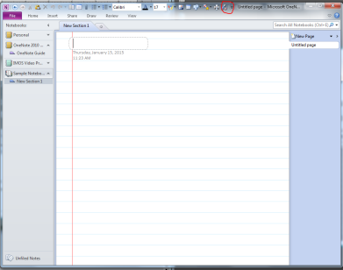
Step 6: In the Interview - Overview
Opening the interview
During the interview
Record
Ask permission
Tools
Microsoft OneNote
Evernote
Garageband (Mac)
Google Talk
Speaker phone + voice recorder
“Memo” function on smartphones
Tip: Save the document before you start recording.

Slide 16
Step 6: In the Interview - Overview
Opening the interview
During the interview
Record
Ask permission
Tools
Take notes
Just a few – recording will supplement
Good to refer to later in the interview
“Time stamp” critical items

Slide 17
Step 6: In the Interview - Overview
Opening the interview
During the interview
Ending the interview
“I want to be respectful of your time.”
“We’re coming up on our time box. Do you have a few extra minutes to stick around?”
“Is there anything important I didn’t ask that you think I should know?”
Ask for recommendations on others to talk to
Thank the interviewee again
Mention next steps

Slide 18
Step 6: In the Interview – Getting the Info you Need
Start broad, open-ended
Tell me a little bit about your research.
You just won the Nobel Prize for discovering the structure of DNA. Tell me – just what is DNA and why does it matter?
Can you describe some of the major components of the initiative?
What was the purpose of the event?

Slide 19
Step 6: In the Interview – Getting the Info you Need
Start broad, open-ended
Dig into some details
I was reading your Science article and I was really interested in your finding that some cats actually do get along with dogs. How did you find that out…how did you even think to pair the two species?
You mentioned that the Higgs boson had been theorized for decades but never experimentally observed. What key data did you collect that now makes you sure it’s real?
In your keynote talk, you mentioned a new project you’re developing that would track the physical activity levels of people inside buildings. How would that work?

Slide 20
Step 6: In the Interview – Getting the Info you Need
Start broad, open-ended
Dig into some details
Clarify things you don’t understand
Can we back up for a second? A minute ago you said that Yoda spoke of another. Who did he mean?
So that big peak in the graph – that’s the Higgs boson? What does the peak mean? How do you know it’s the Higgs?

Slide 21
Step 6: In the Interview – Getting the Info you Need
Start broad, open-ended
Dig into some details
Clarify things you don’t understand
Try to get stories
Was there a particular moment when you realized you wanted to be a scientist?
The day you made that discovery must have been pretty amazing – what was it like...can you walk me through it?
It sounds like you faced a lot of disappointments at the start of your career. What kept you motivated?

Slide 22
Step 6: In the Interview – Getting the Info you Need
Start broad, open-ended
Dig into some details
Clarify things you don’t understand
Try to get stories
Try to avoid:
Questions that lead to short or “yes” or “no” answers

Slide 23
Step 6: In the Interview – Getting the Info you Need
Start broad, open-ended
Dig into some details
Clarify things you don’t understand
Try to get stories
Try to avoid:
Bad Example: When did you start researching X? (answer: date)
Better: You published your first paper on X in 1992. How did it prepare you for studying Y?
Bad Example: Is the reaction really 100% selective towards Z? (answer: yes)
Better: I see that you show Z is the only product of the reaction. How did you optimize your system to produce that result?

Slide 24
Step 6: In the Interview – Getting the Info you Need
Start broad, open-ended
Dig into some details
Clarify things you don’t understand
Try to get stories
Try to avoid:
Questions that lead to short or “yes” or “no” answers
Jumping in too soon with your next question – embrace the awkward silence!
Sticking to the “script” – leave room for spontaneity

Slide 25
Step 6: In the Interview – Getting the Info you Need
Start broad, open-ended
Dig into some details
Clarify things you don’t understand
Try to get stories
Try to avoid:
Questions that lead to short or “yes” or “no” answers
Jumping in too soon with your next question – embrace the awkward silence!
Sticking to the “script” – leave room for spontaneity
Remember—it’s a conversation!

Slide 26
Step 7: Distill the Information
Transcribe interview
Only key pieces needed
(Can also self-evaluate during this process!)
Pick out must-keep quotes
Conveys emotion: “I had to look at the reading twice. I just couldn’t believe it!”
Superlative: “The most important thing we can invest in right now is better tools to interpret data.”
Choose other material that:
Tells a story (play around with narration vs. quotation)
Describes the topic better than you could in your own words
Supplements the flow of the text (intersperse quotes)

Slide 27
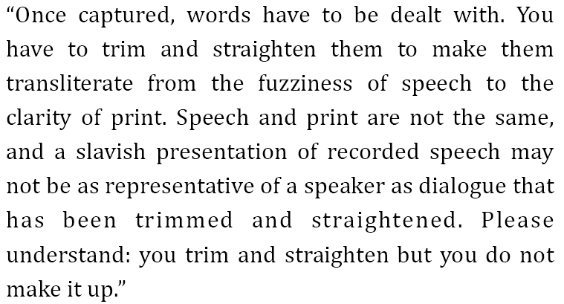
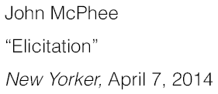
Turn transcription into quotes
Revising, rewording, correcting speech

Slide 28
Step 8: Follow Up and Finalize
Within 24 hours
Thank you note with next steps and timeframe
When article draft is complete
Check any quotes, particularly if you’ve tweaked them
Let interviewee know when article will be published
(Consider sharing copy of the entire article draft if time allows)
When article is published
Send link to final article
Share your Twitter handle
Ask if there’s a media relations officer you can inform

Slide 29
QUEstions?

Slide 30
My “Assignment”
The National Science Foundation’s Division of Materials Research (NSF-DMR) is assembling a brochure highlighting the outcomes of leading research it’s funded. The brochure will contain profiles of selected NSF-funded researchers. Each profile should include:
A description of research funded and key outcomes
Examples of outreach activities and their impact
Commentary on the value of NSF-DMR funding
The brochure will be distributed broadly, including to NSF leadership, other federal agencies, and Congressional offices to demonstrate the value of DMR’s research investment.

Slide 31
What information do I need (my “wish list”)?
Description of research and key outcomes
“Elevator pitch” version of research in lay terms
2-3 key outcomes – and what could they lead to in the long term?
Personal interest component
Examples of outreach activities and their impact
Short description of 1-2 contrasting outreach activities
How outreach may have tied back to research
How outreach has impacted general public
A specific story
Commentary on the value of DMR funding
Quotable material on the importance of supporting both materials research and materials outreach
Comparison of individual investigator awards vs. larger collaborations

Slide 32
The Format
Part 1: Dr. _______’s research
Critique
Part II: Dr. _______’s outreach + value of investment
Critique

Slide 33
Not all interviewees are great at being interviewed!
Character I: Too much jargon! How can I encourage Dr. ______ to describe his/her research in lay terms?
Character II: Not enough information! How can I encourage Dr. ______ to give more details?

Slide 34
This project was supported by the National Science Foundation under Award No. 0940143. Any opinions, findings, and conclusions or recommendations are those of the author and do not necessarily reflect the views of the Foundation.
Published under a Creative Commons Attribution-Noncommercial-ShareAlike license: http://creativecommons.org/licenses/by-nc-sa/3.0/us

