Slide 1
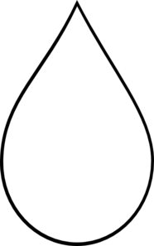
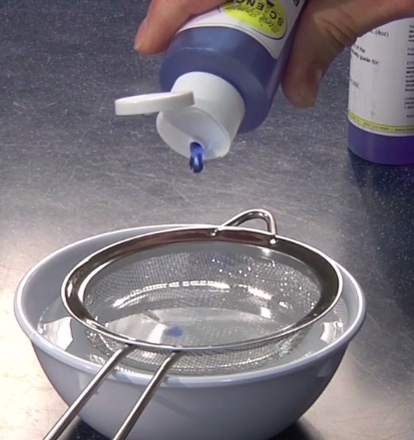
Gummy Capsules
Sodium alginate (a polymer) and blue dye dissolved in water
Calcium chloride
dissolved in water
When the two liquids combine, they form a gooey blob (a gel)
Notes:
8:17 for gummies, 8:18 for chromatography
→ Move gelatin stuff to another slide at the end
According to http://www.cmu.edu/gelfand/k12-teachers/polymers/polymer-architecture/gel-beads-and-worms.html, these capsules are 99% water

Slide 2
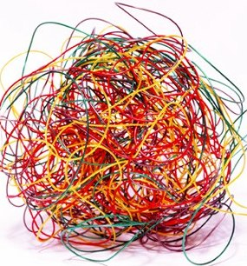
What’s a Polymer?
Polymers are made up of many, many molecules all strung together to form really long chains.
Polymer chains often get tangled up, like a mound of spaghetti.
http://pslc.ws/macrog/kidsmac/index.htm http://chemwiki.ucdavis.edu/Wikitexts/Simon_Fraser_Chem1%3A_Lower/States_of_Matter/Polymers_and_Plastics

Slide 3
What are Hydrogels?
polymer
Hydrogels are 3-dimensional polymer networks that are filled with water
Contain so much (>90%) water that they’re kind of like “solid” water
Have properties between those of solids and liquids
water
Schematic of a polymer gel
Notes:
Gelatin can gel >20 times its weight in water
Polymer in baby diapers (Hydrogel NISE activity can absorb 800-1000x its weight in water)
From Wikipedia: “By weight, gels are mostly liquid, yet they behave like solids due to a three-dimensional cross-linked network within the liquid.”

Slide 4
How do Gummy Capsules Form?
Add calcium ions
Gels form when the polymer networks are crosslinked
Crosslinks are bonds between different polymer chains
When you drop sodium alginate into the calcium solution:
Calcium replaces sodium
Calcium forms crosslinks
Why does this change matter? Unlike Na⁺ ions, Ca²⁺ ions can form two bonds
http://www.intechopen.com/source/html/37702/media/image2_w.jpg

Slide 5
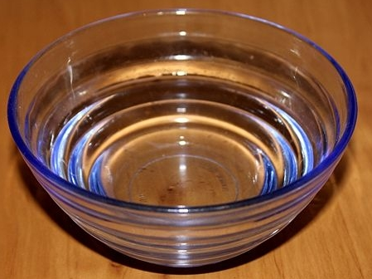
Spherification vs. Reverse Spherification
Spherification
Drop alginate into calcium chloride
Why does order matter?
Calcium ions are much smaller than strands of sodium alginate, so they can move (diffuse) much faster
Sodium
alginate
Calcium chloride
Sodium
alginate
Reverse Spherification
Drop calcium lactate into alginate
Calcium
lactate
Calcium
chloride
Sodium alginate

Slide 6
Spherification vs. Reverse Spherification
Calcium moves into the drop, so gelation occurs inside the sodium alginate drop
After rinsing, calcium keeps moving toward the center
Gummies become more solid over time
Sodium
alginate
Calcium chloride
Calcium moves into the alginate bath, so gelation occurs on the outside of the drop
After rinsing, the reaction stops, since rinsing removes the un-reacted alginate
Gummies are stable
Calcium
lactate
Sodium alginate

Slide 7
Factors that Affect the Gummies
Amount of calcium in the alginate solution
If the sodium alginate solution contains any calcium, gelation (cross-linking) can happen before you drop it into the calcium chloride
Preventing/fixing this problem:
If you’re dissolving the sodium alginate in a liquid other than water, make sure it doesn’t contain calcium (e.g., milk)
pH of the alginate solution
If the pH of the sodium alginate solution is too low, the hydrogen concentration will be too high and alginate won’t react with the calcium
Preventing/fixing this problem:
Measure the pH of your sodium alginate solution (shouldn’t be an issue if you’re just dissolving the sodium alginate in water)
If the pH is too low, add some sodium citrate

Slide 8
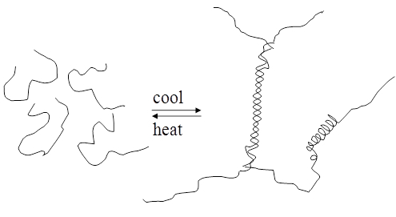
Another Tasty Hydrogel: Jello!
Cool
[Hot]
[Cold]
Jello/gelatin
Dissolve gelatin in hot water; let it cool
As the gelatin solution cools, the structure changes and crosslinks form
Candy connection: Jello!
http://www.intechopen.com/source/html/17237/media/image13.png

Slide 9
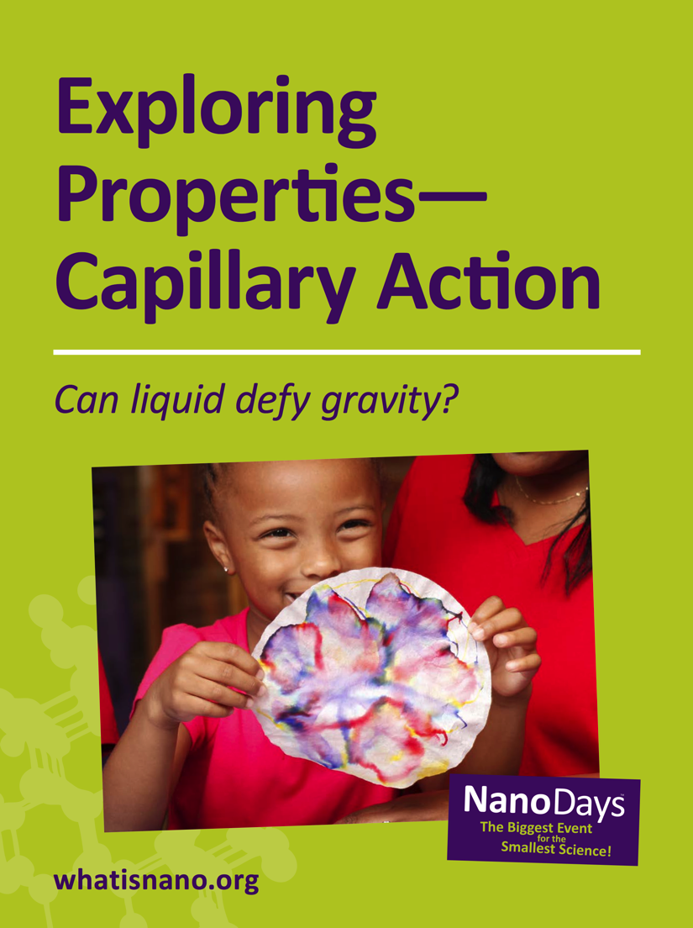
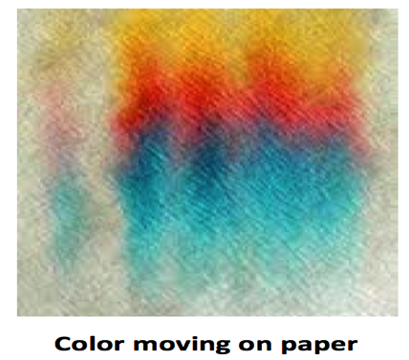
Capillary Action and Chromatography
Capillary action is the ability of a liquid to flow in narrow spaces— even against gravity.
Chromatography is a method for separating a mixture into different parts.
Some types of chromatography, like paper chromatography, rely on capillary action.
Notes:
Update images and text

Slide 10
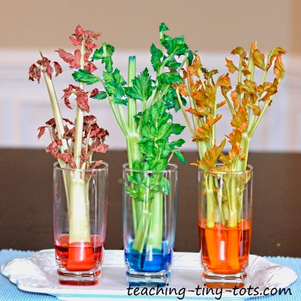
Capillary Action in Nature

Slide 11
Capillary Action
Liquid wets walls of tube, increasing surface area.
Surface tension acts to decrease surface area, pulling liquid up.
Wetting continues from a higher level, causing liquid to continue rising.
Eventually the liquid reaches a height at which its weight is balanced by surface tension. After this, the height stays constant.
For a more thorough discussion of Capillary Action, you can watch a recording of our brown-bag from March 17, 2014.
http://www.nisenet.org/search/product_category/online-workshops-31
http://chemwiki.ucdavis.edu/Under_Construction/chem1/States_of_Matter/Liquids_and_their_Interfaces
Notes:
The result is a membrane-like water surface having a tendency to contract and reduce the amount of its excess surface energy
The attraction of the water to the inner wall of the tube pulls the edges of the water up, creating a curved meniscus whose surface area is larger than the cross-section area of the tube. The surface tension of the water acts against this enlargement of its surface by attempting to reduce the curvature, stretching the surface into a ﬂatter shape by pulling the liquid farther up into the tube. This process continues until the weight of the liquid column becomes equal to the surface tension force, and the system reaches mechanical equilibrium.

Slide 12
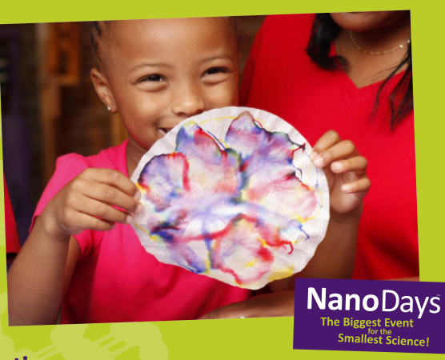
Paper Chromatography Activity
(1) Draw on paper
(2) Squirt a drop of water onto the paper
(3) Hold the paper vertically
Water and ink move up the paper, against gravity

Slide 13
Paper Chromatography
Water-soluble parts of the ink dissolve into the water
Dye moves with the water up the paper, due to capillary action
Different dyes travel different amounts
The distance each dye travels depends on how the dye dissolves in the water and how the dye interacts with the paper
Water and ink move up the paper, against gravity

Slide 14
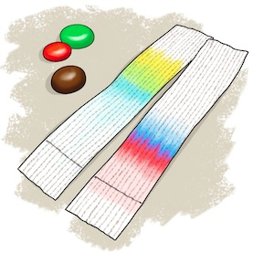
Candy Chromatography
Dampen candy slightly, then rub candy onto the filter paper
OR
Dissolve candy in water, then use a pipette or popsicle stick to transfer a small drop onto the filter paper
Let paper dry
Then suspend filter paper in a container of water
Many people think a 0.1% NaCl solution works better than pure water
Activity write-ups:
http://howtosmile.org/record/9665
http://www.scientificamerican.com/article/bring-science-home-candy-chromatography/
http://www.sciencebuddies.org/science-fair-projects/project_ideas/FoodSci_p006.shtml
Notes:
Instead of using a pipette, you can even just try picking up a small drop with a toothpick

Slide 15
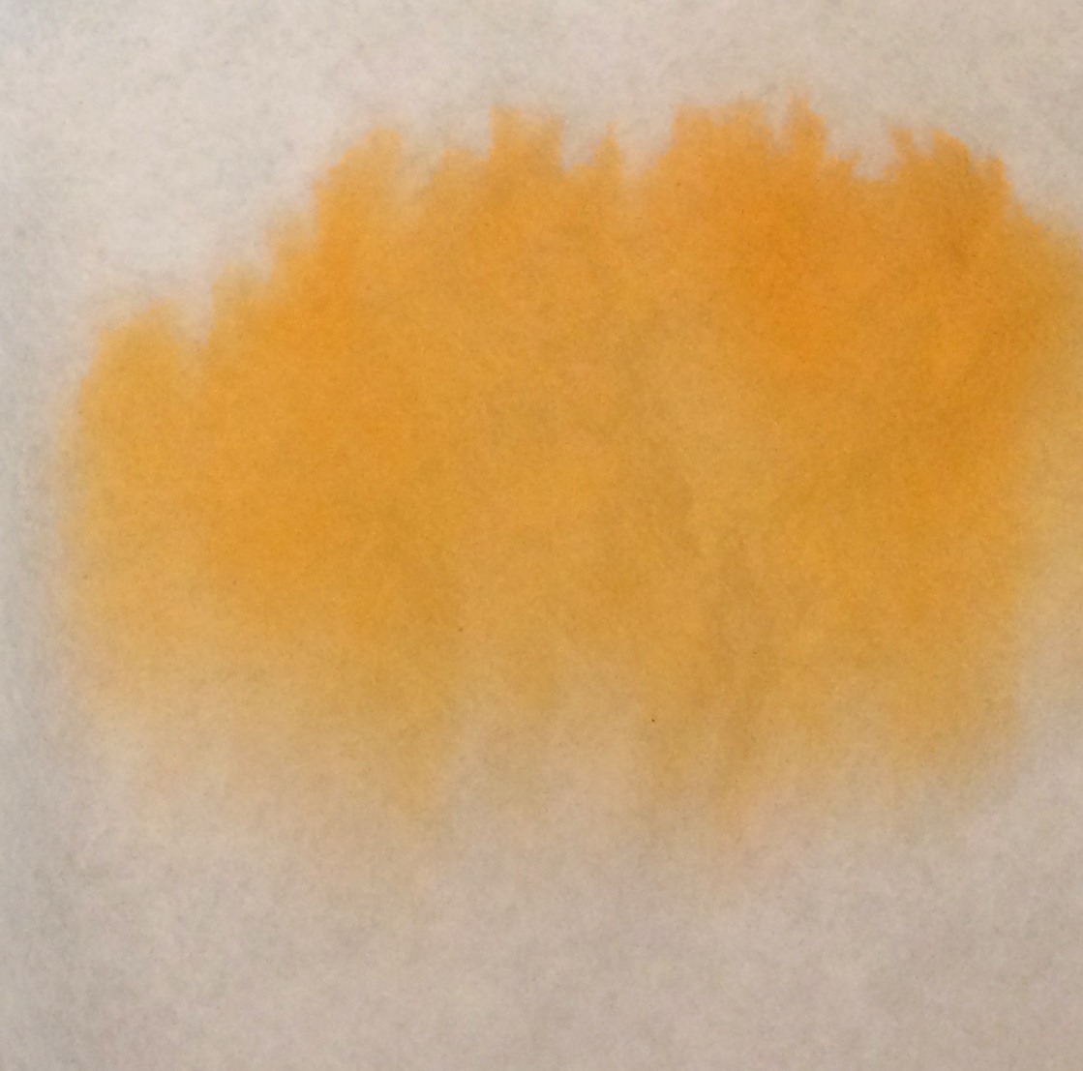
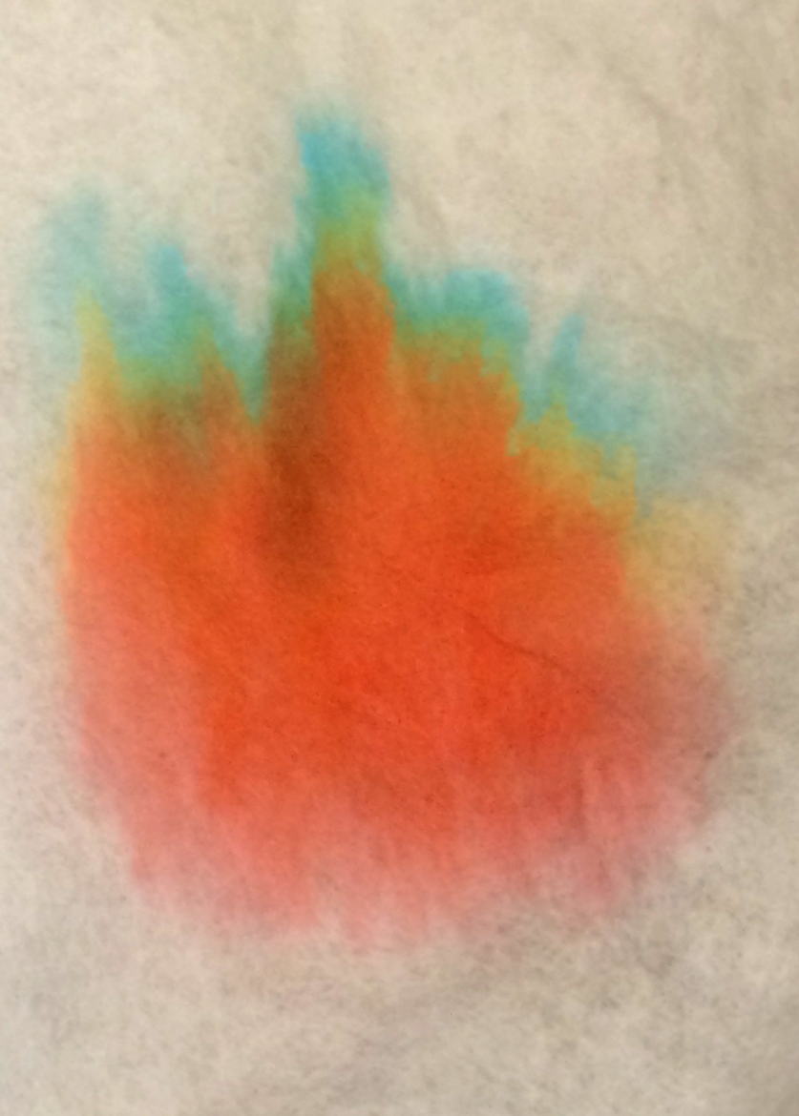
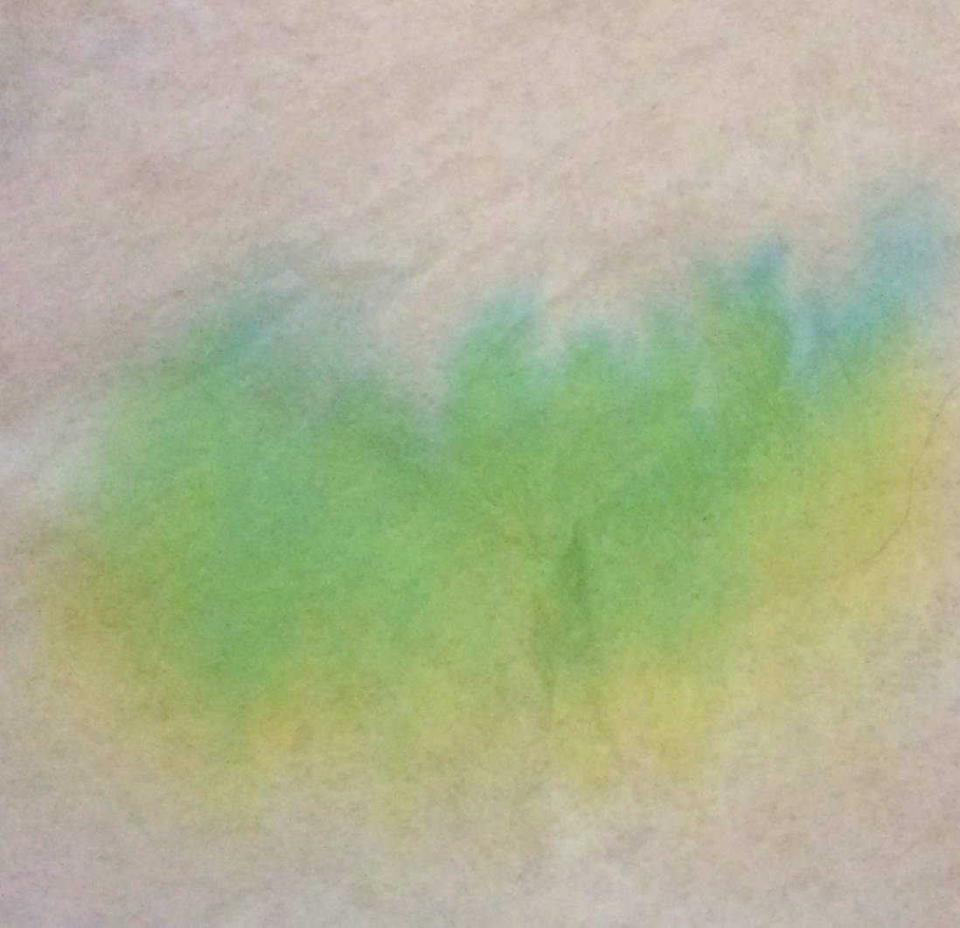
Will the Colors Separate?
Most of our foods can only use 7 synthetic colorants
Brown M&Ms worked the best for me (most separation)
I didn’t see color separation for orange Skittles or M&Ms; maybe the dye is just Yellow #6, instead of a combination of red and yellow dyes
Orange M&M
Name | Color
Blue #1 | Dark turquoise blue
Blue #2 | Dark navy blue
Red #3 | Red
Red #40 | Dark red
Yellow #5 | Yellow
Yellow #6 | Dark orange
Green #3 | Dark blue-green
Blue
Green(?)
Yellow
Red
Brown M&M
Green M&M
http://www.fda.gov/forindustry/coloradditives/coloradditiveinventories/ucm115641.htm
Notes:
Two other colorants, but only for specific things
Sample data from Flinn Scientific Publication NO. 11173

Slide 16
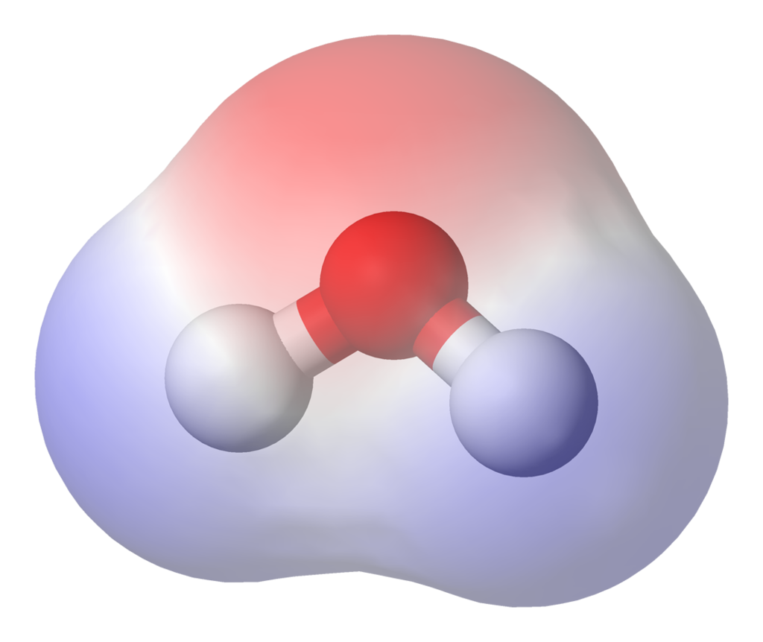
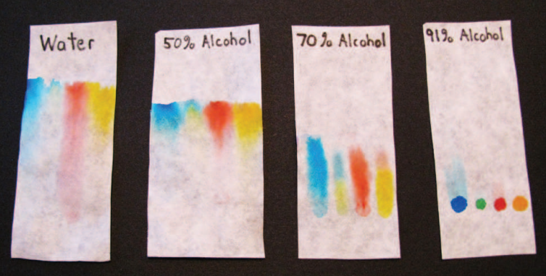
Why do the Colors Separate?
Why do some colors move further than others?
Like dissolves like
Water is polar (charges aren’t distributed evenly)
Red = more negative Blue = more positive
The most polar dyes dissolve in water the best, and move the farthest
So if we change the solvent, colors dissolve differently and move different amounts
From left: blue, green, red, yellow
To get more info on this experiment: http://www.rfwp.com/samples/dr-daves-chemistry.pdf#page=4
Notes:
Try repeating expt. using vinegar/isopropanol instead of water

Slide 17
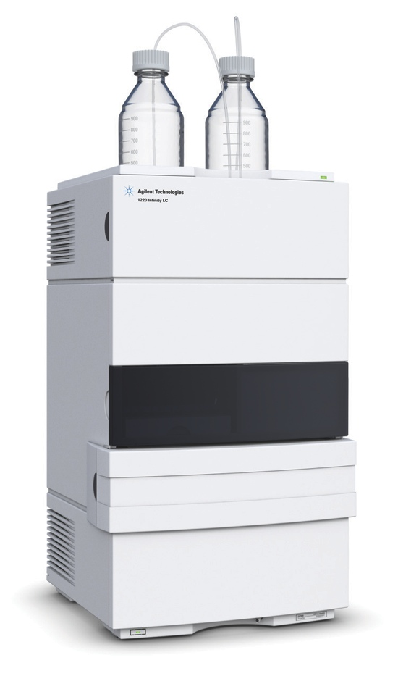
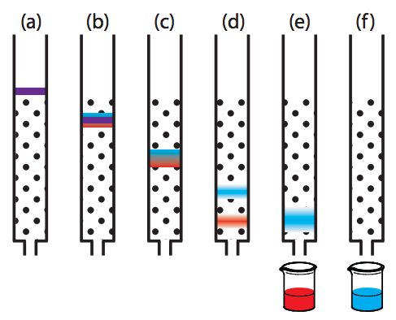
Other Chromatography Methods
Universal goal: for the different parts of a material to move at different speeds, so they can be separated and/or analyzed
One example: HPLC, where a pressurized liquid moves through a column filled with silica beads
Materials can be separated into parts based on different properties, such as
Charge, polarity
Hydrophobicity
Affinity
Size, shape
Liquid
chromatography
system from Agilent
http://www.saylor.org/site/wp-content/uploads/2012/07/Chapter121.pdf

Slide 18
More Resources
Descriptions of different spherification ingredients http://www.molecularrecipes.com/spherification/started-spherification/
Good description of science behind spherification http://itschemicallydelicious.wordpress.com/2013/02/07/the-science-behind-spherification/
“What is Jello-O?” (Scientific American) http://www.scientificamerican.com/article/what-is-jell-o-how-does-i/
“What’s that Stuff: Jell-O” (Chemical and Eng. News)http://pubs.acs.org/cen/whatstuff/stuff/8120jello.html
Good discussions of paper chromatography with food dyes (discusses the changes you get when you dip the paper into water versus other liquids) http://micro.sci-toys.com/node/45
Paper chromatography with markers, using water and alcohol http://www.kyantec.com/Tips/paperchromatography.htm

