Slide 3
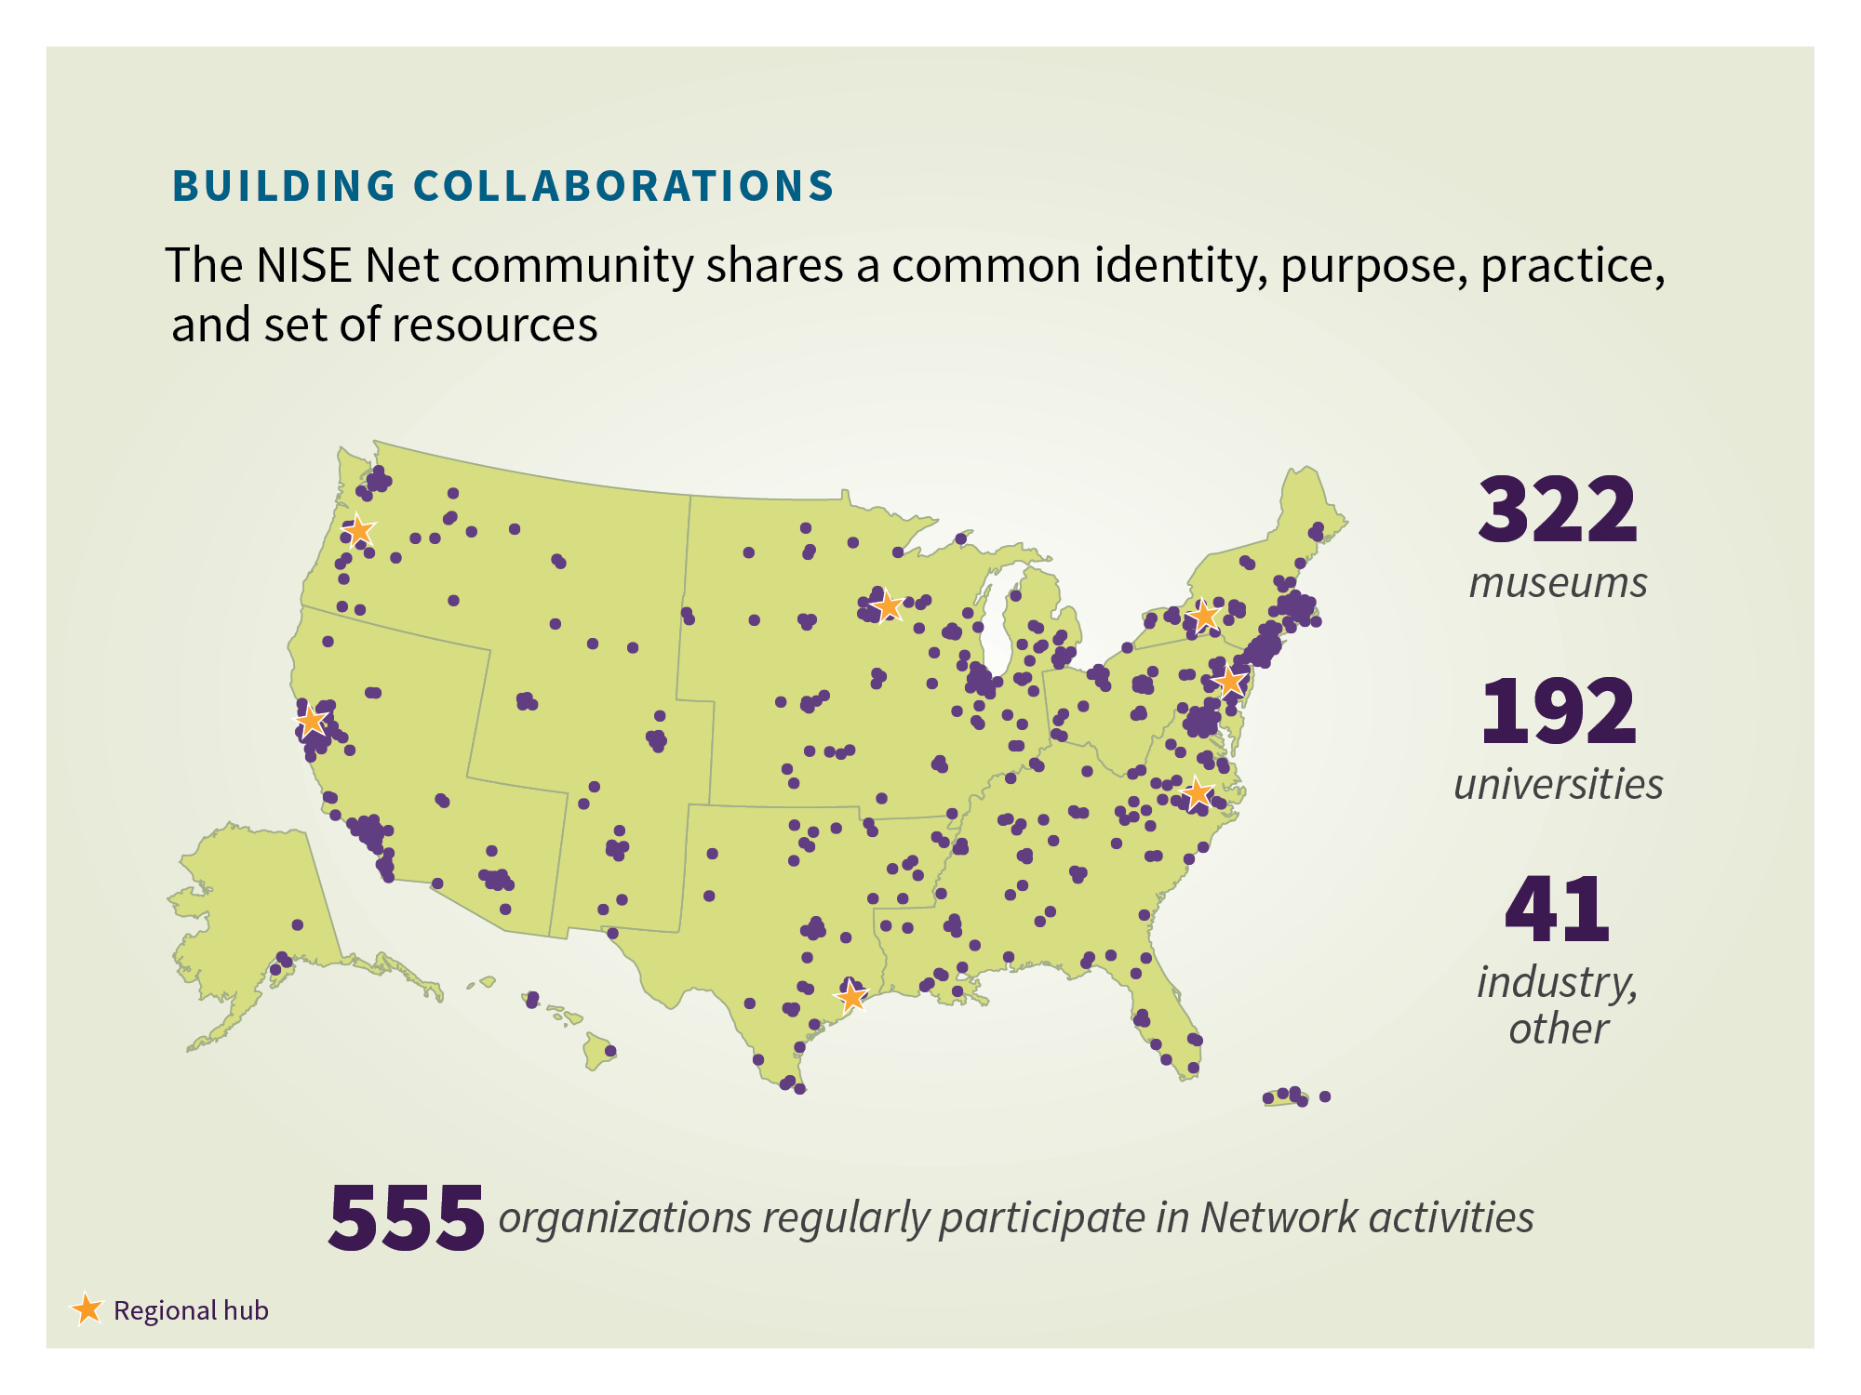

Slide 4
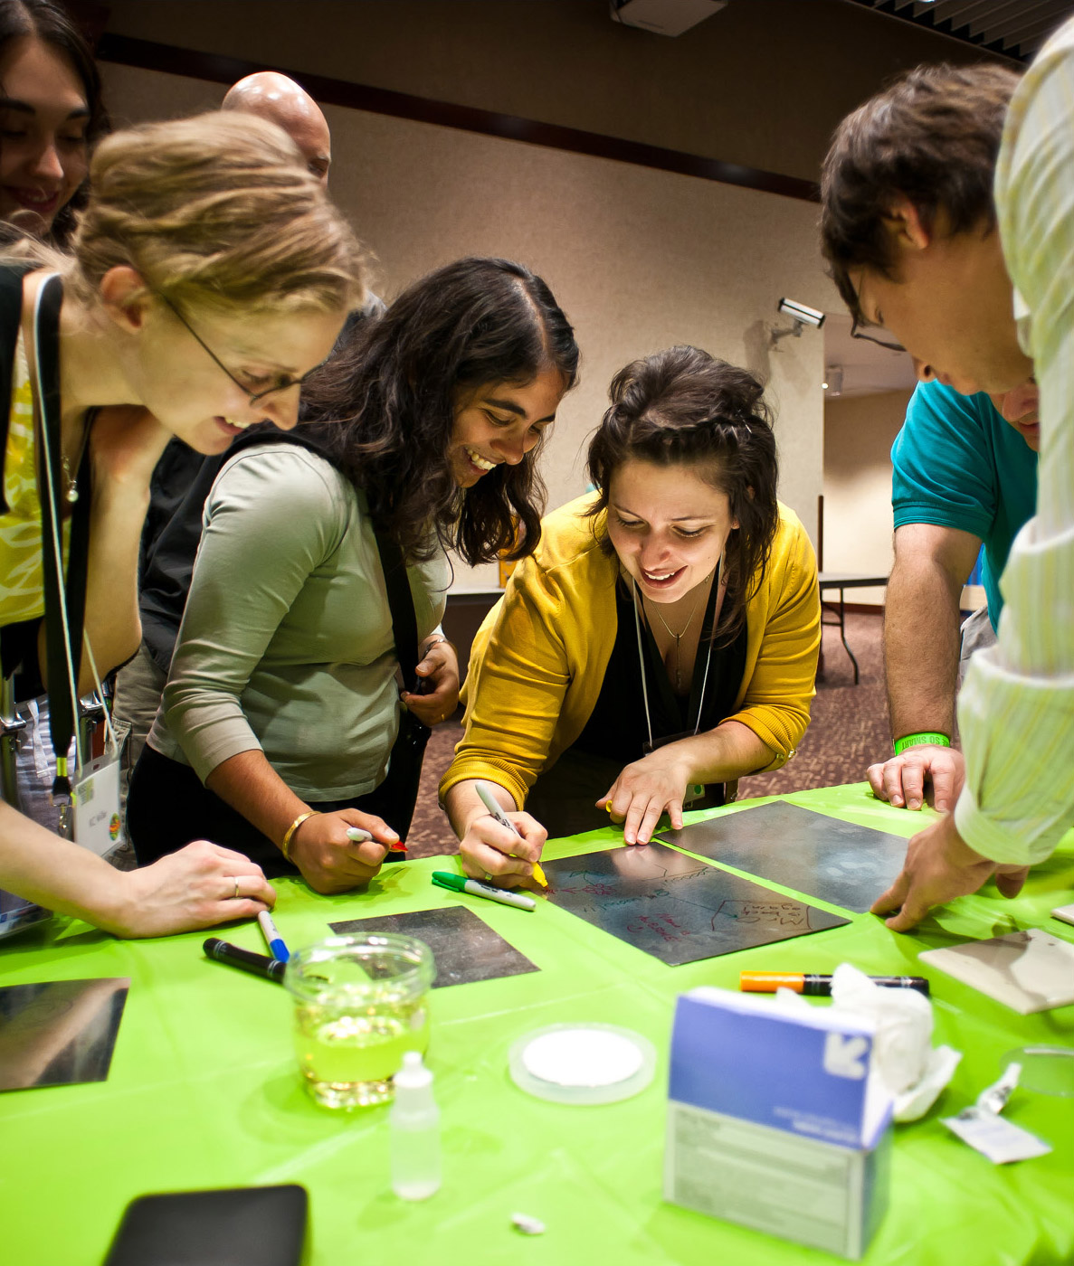
BUILDING COLLABORATIONS
Notes:
Note to presenter: You can customize this slide to report on your own activities by adding your own text and images. You can duplicate it if you need more than one, or delete it if you don’t need it.

Slide 5
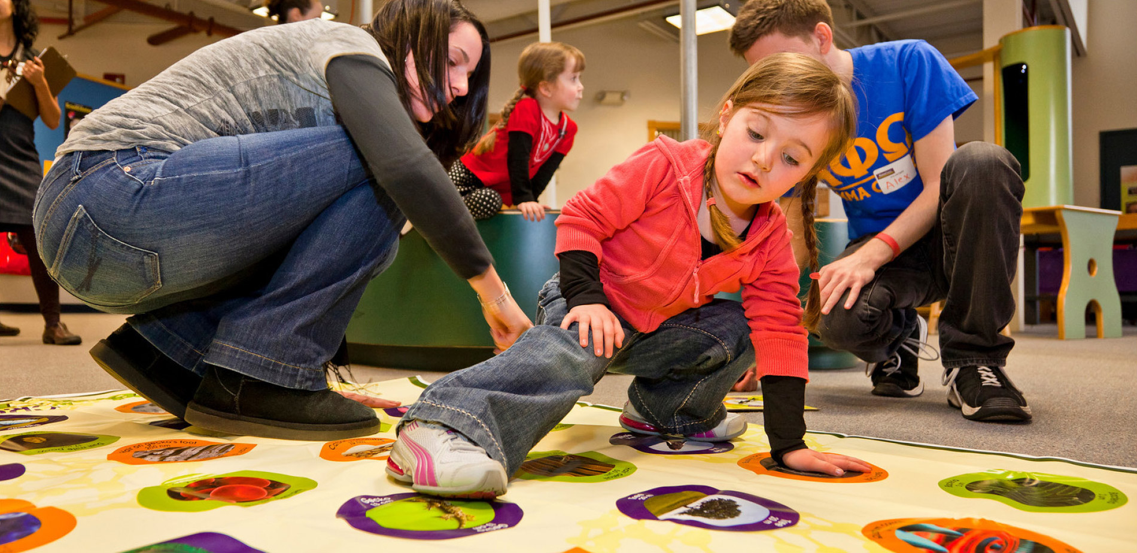
ENGAGING THE PUBLIC
NISE Net’s educational materials are designed to engage a wide range of audiences in learning about complex scientific content—in ways that are fun and easy to understand.

Slide 6
Notes:
Nano is a new interdisciplinary field of research. NISE Net developed a content map that identifies these four key concepts to introduce the public to nanotechnology.
The great potential of nano comes from its tiny size. Nano research and development happens at the scale of atoms and molecules. Many things have different properties at the nanoscale, which allows scientists and engineers to create new materials and devices. Some experts think that nanotechnology may transform our lives, similar to the way that the automobile and personal computer changed the way we live and work.

Slide 8
NANODAYS
NanoDays is the Network’s signature event—an annual celebration of nanoscale science, engineering and technology.

Slide 10
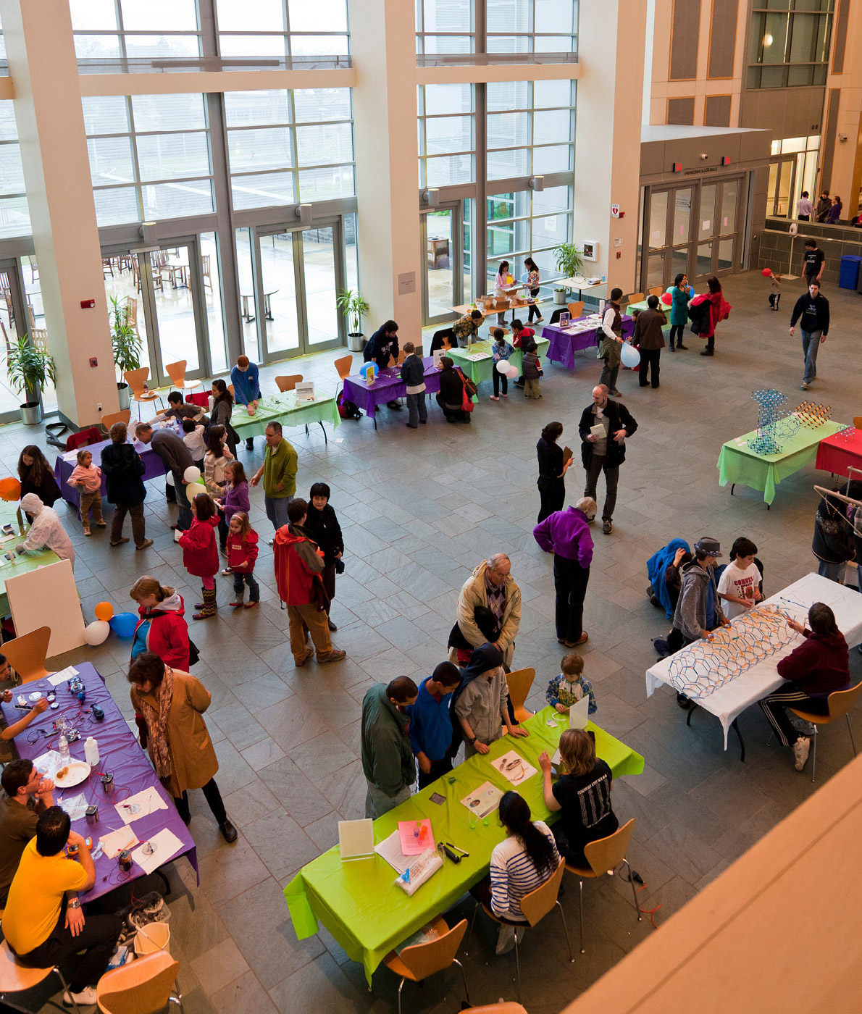
Notes:
Note to presenter: You can customize this slide to report on your own activities by adding your own text and images. You can duplicate it if you need more than one, or delete it if you don’t need it.

Slide 11
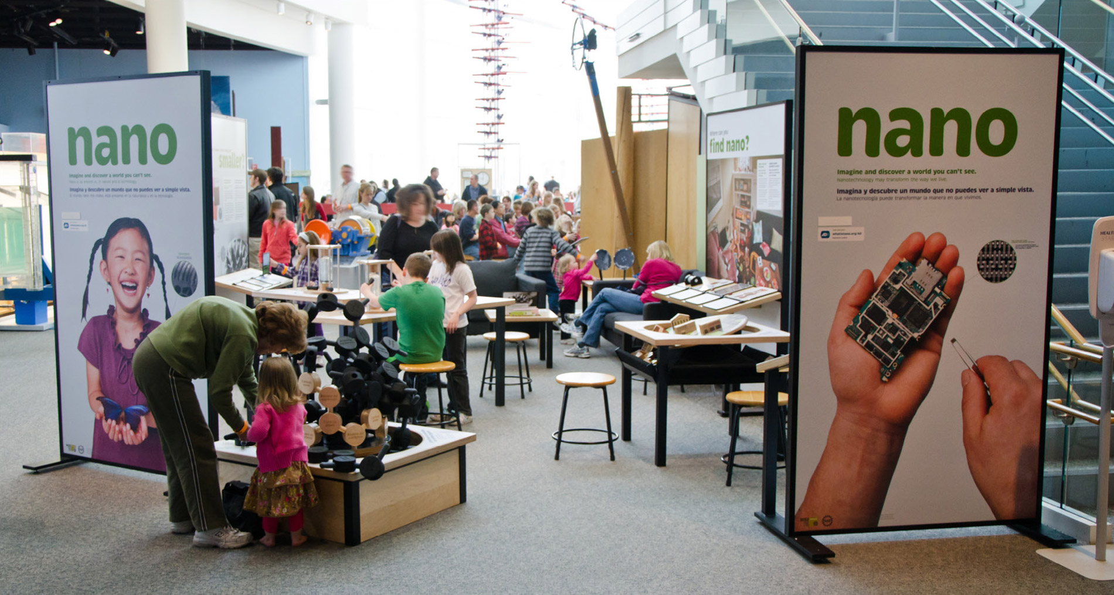
NANO EXHIBITION
Nano has a small footprint and a big impact!

Slide 12
Notes:
More information:
ENGAGING FOR VISITORS:
Both adults and children learn nano concepts
Almost all adults say they would come to NanoDays again
VALUABLE FOR PARTNERS:
Event volunteers learn nano concepts
Student volunteers become more interested in STEM careers

Slide 13
Notes:
Note to presenter: You can customize this slide to report on your own activities by adding your own text and images. You can duplicate it if you need more than one, or delete it if you don’t need it.

Slide 14
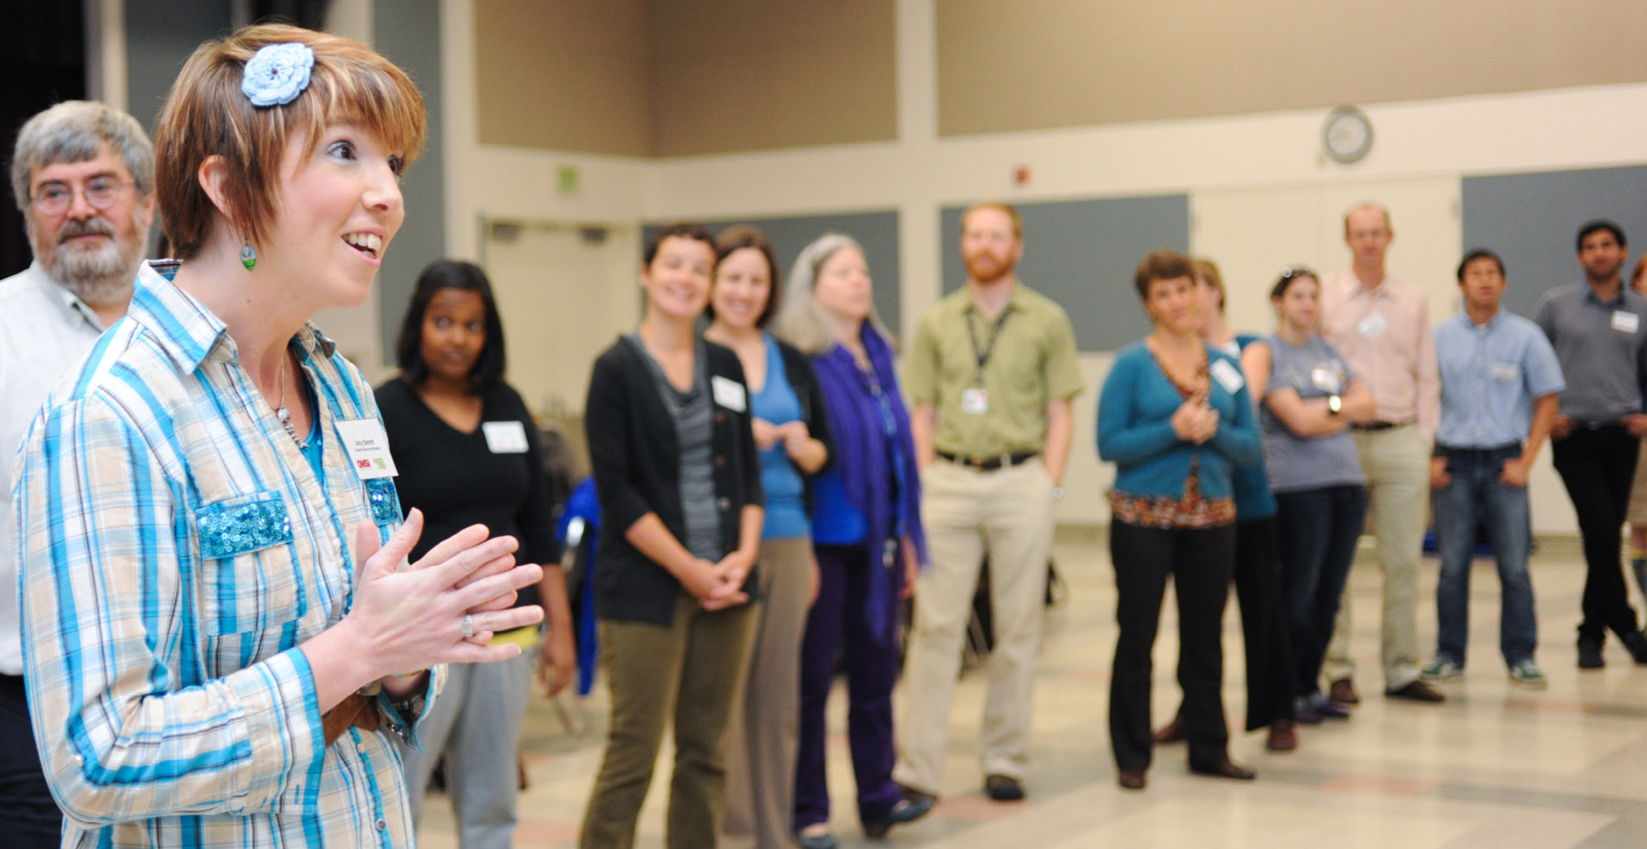
INCREASING CAPACITY
NISE Net has provided the rationale, resources, and support to transform informal STEM learning in museums.

Slide 15
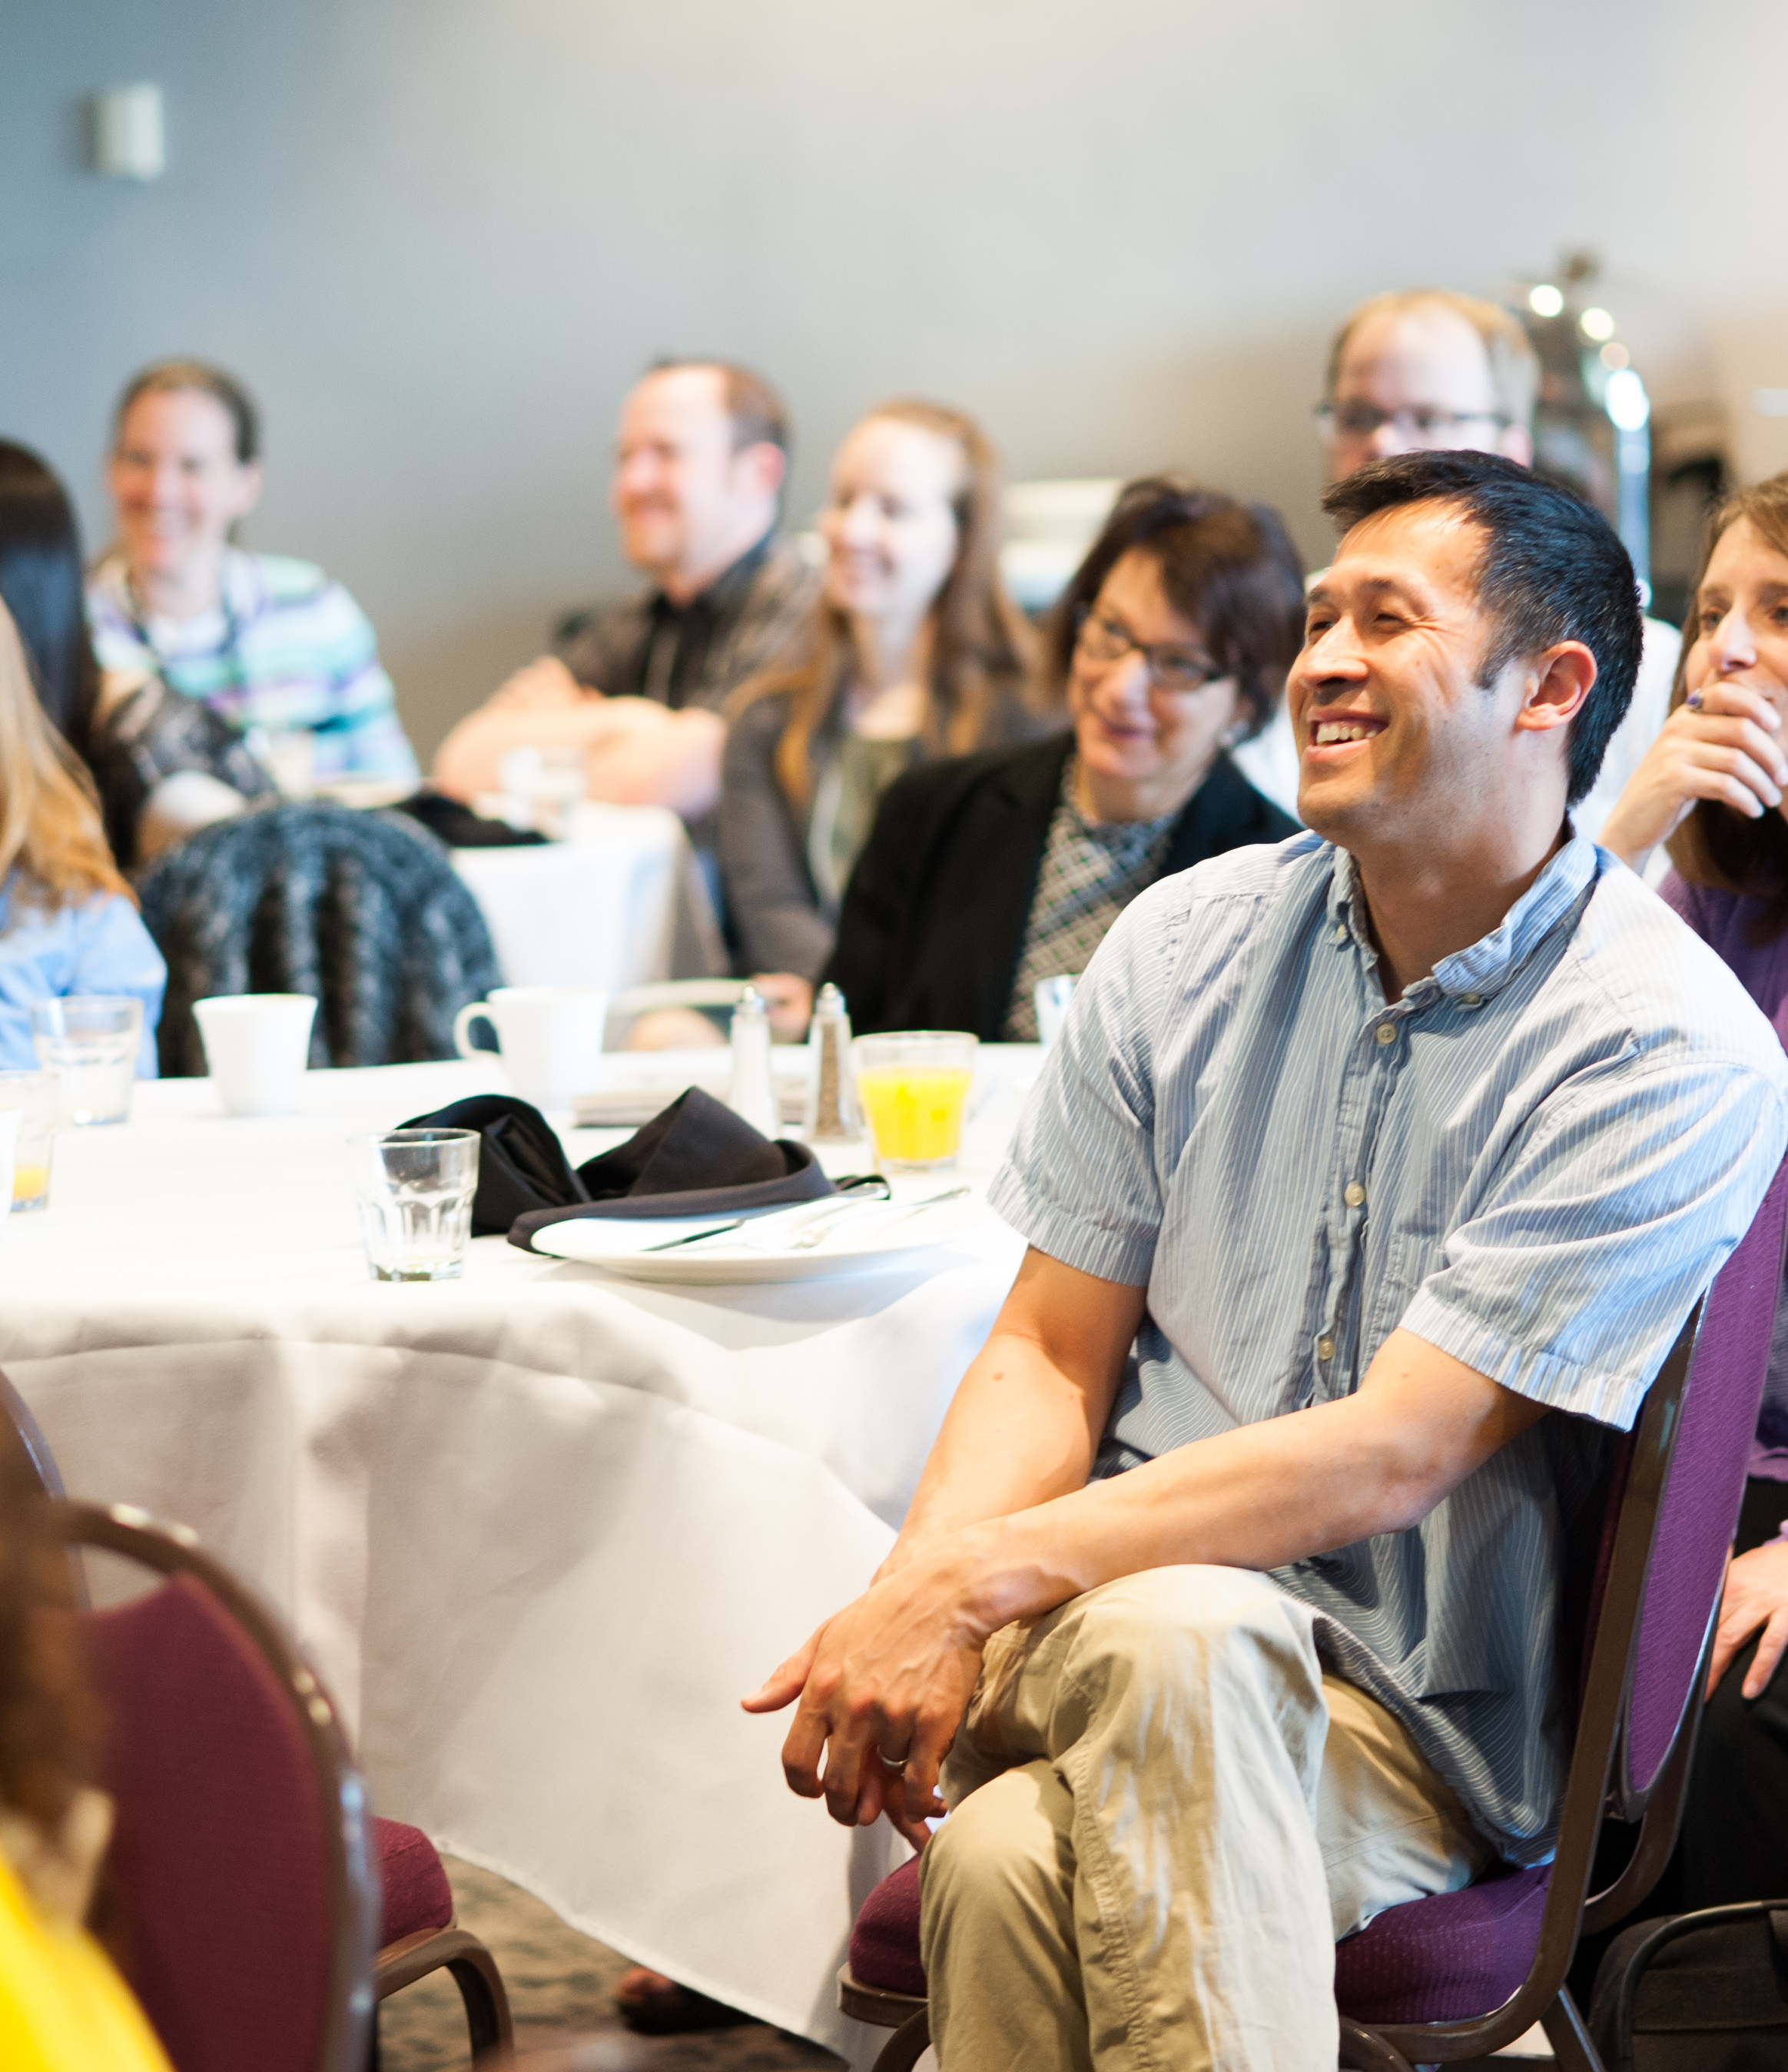
INCREASING
CAPACITY
Notes:
Note to presenter: This slide is an opportunity to discuss how staff and volunteers at your organization have benefited from participation in the Network. Perhaps they:
--Learned new knowledge, skills, and techniques
--Developed new partnerships through public engagement efforts
--Built new professional relationships at meetings and workshops
You can customize this slide by adding your own text and images. You can duplicate it if you need more than one, or delete it if you don’t need it.

Slide 16
Notes:
Note to presenter: This slide is an opportunity to discuss the impact and the sustainability of the Network at your organization. You might mention ongoing and future efforts related to NISE Network.

Slide 17
REFERENCES
Sciencenter. (2011). Engaging the Public in Nano: Key Concepts in Nanoscale Science, Engineering, and Technology. Ithaca, NY: NISE Network.
Svarovsky, G., Goss, J., Ostgaard, G., Reyes, N., Cahill, C., Auster, R., et al. (2013). Summative Study of the Nano Mini-Exhibition. Saint Paul, MN: NISE Network.
Svarovsky, G., Tranby, Z., Cardiel, C., Auster, R. & Bequette, M. (2014). Summative Study of the NanoDays 2014 Events. Saint Paul, MN: NISE Network.
Svarovsky, G., Goss, J., Bequette, M. & Kollmann, E.K. (forthcoming). NISE Net Public Reach Memo. Saint Paul, MN: NISE Network.
Available at www.nisenet.org

Slide 18
This report was based on work supported by the National Science Foundation under Award Numbers 0532536 and 0940143. Any opinions, findings, and conclusions or recommendations expressed in this report are those of the authors and do not necessarily reflect the views of the Foundation.
November, 2014

Slide 19
Notes:
Note to presenter: This is a blank, formatted slide (background, title and body text). You can use it to add your own content to the presentation.

Slide 20
Notes:
Note to presenter: This is a blank, formatted slide (background only). You can use it to add your own content to the presentation.

Slide 21
Notes:
Note to presenter: This is a blank, formatted slide (background only, with no white border around the edges). You can use it to add your own content to the presentation.

