Slide 1
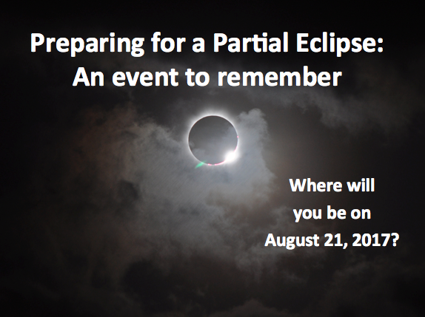
Notes:
Opening slide
Image Courtesy of Romeo Durscher

Slide 2
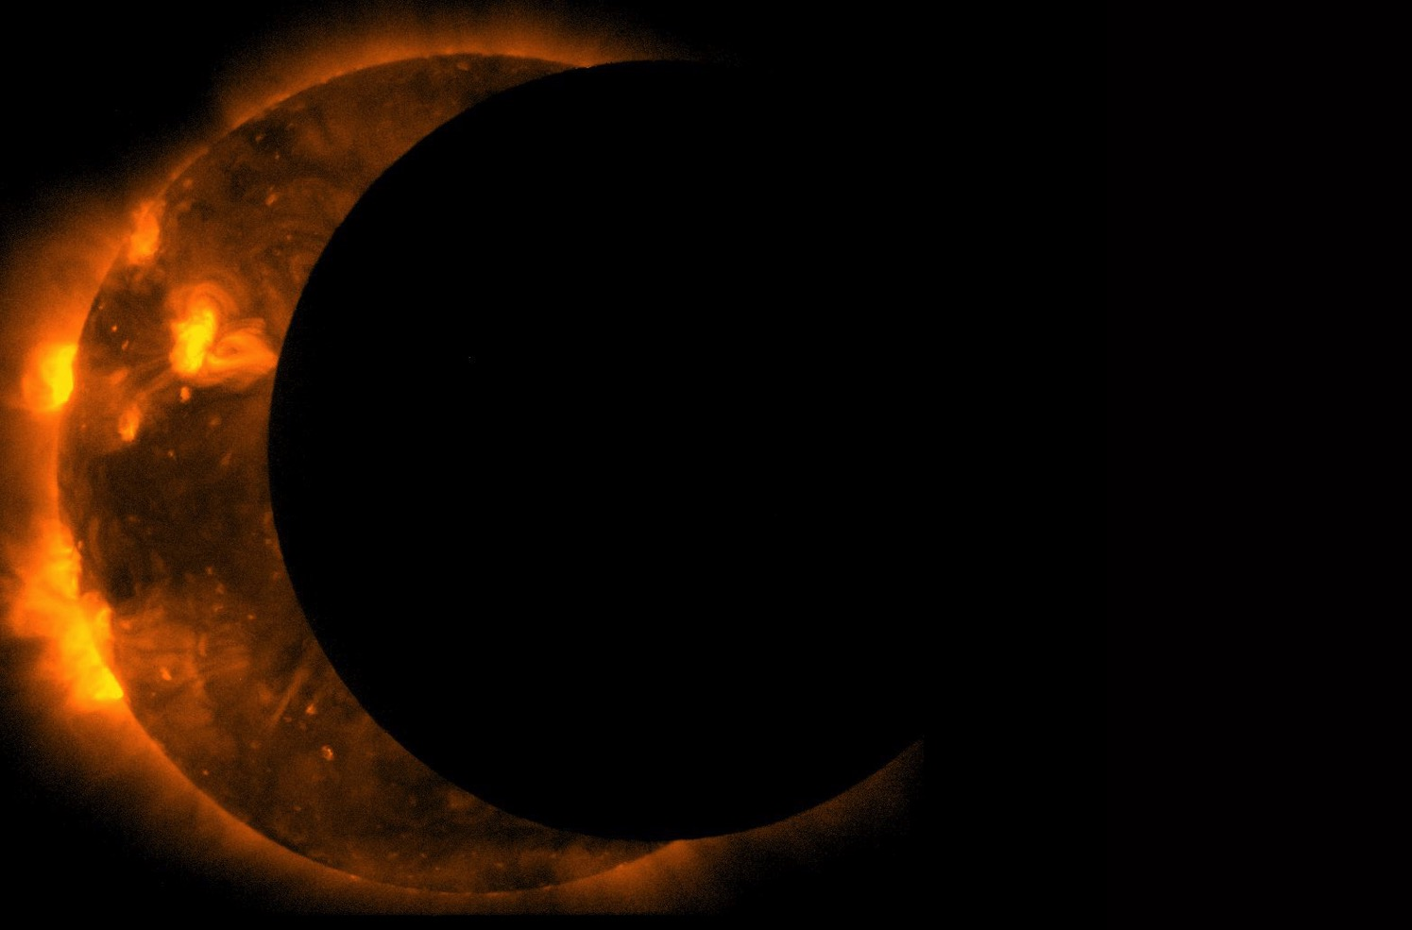
Presentation Overview
Eclipse 101
How to enjoy a partial eclipse
What’s the big deal about a total eclipse?
Resources for viewing, holding eclipse parties, and more
Notes:
Feel free to add your own information, use only parts of this presentation, or modify as you like.

Slide 3
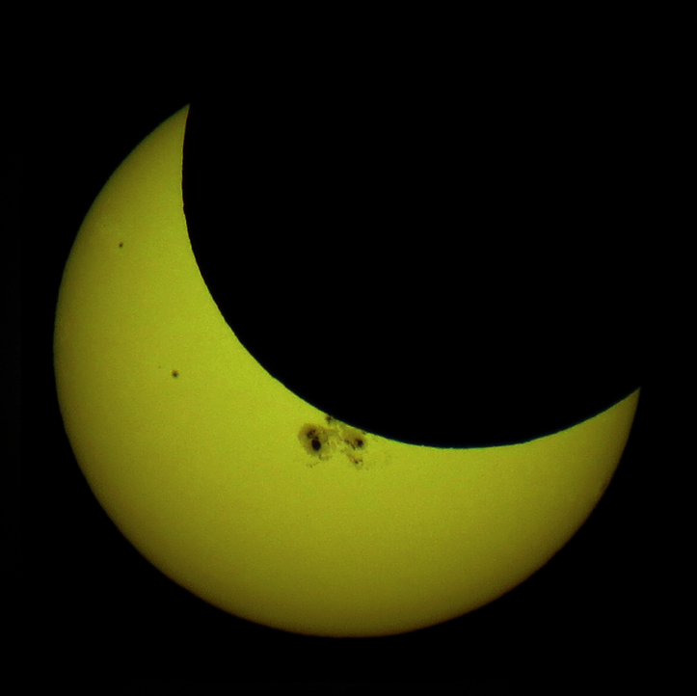
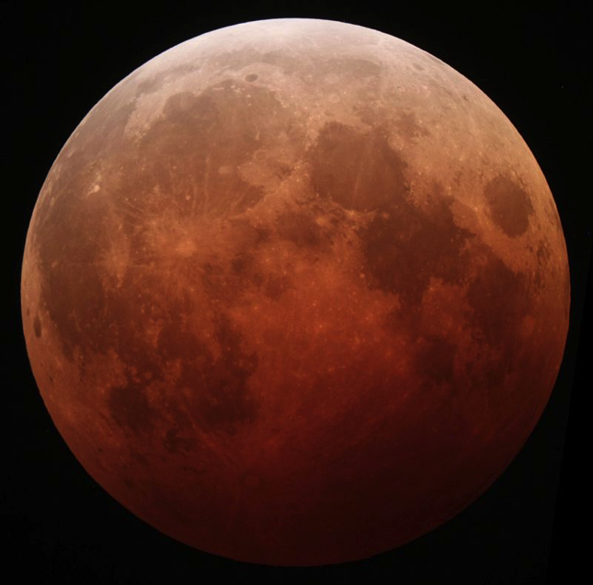
Have you seen an eclipse?
What’s going on?
Notes:
How many of you have seen an eclipse? (show of hands)
- Did it look like the one on the right or the left?
- Was it during the day or at night?
Eclipses happen all the time! There are an average of 2 solar eclipses (left image) and 2 lunar eclipses (right image) every year.
Solar and lunar eclipses both happen when the Sun, Moon, and Earth line up and a shadow is cast.
They look very different and your chance of seeing them is very different.
Let’s see why.
---------------------------------------
Optional Activity:
Have the audience create models of eclipses using the activity below before you go on to the next slide.
The Yardstick Eclipse activity allows the audience to figure this out themselves.
https://nightsky.jpl.nasa.gov/download-view.cfm?Doc_ID=327
-----------
Lunar eclipse image credit: October 8, 2014 California Alfredo Garcia Jr
Solar eclipse credit: Tomruen - Own work, CC BY-SA 4.0, https://commons.wikimedia.org/w/index.php?curid=36349192

Slide 4


Basic types of eclipses
Illustrations not to scale
Notes:
This is a very simplified diagram showing the difference between the two basic types of eclipses.
Let’s look at the solar eclipse on top. Here’s Earth. When are the people in the shadow seeing the eclipse? (daytime)
On Earth, we see the Moon pass in front of the Sun.
But does everyone on the daytime side see the eclipse? (no)
How about the lunar eclipse? What time is it for the people on Earth? What do we see? (point to Earth. Nighttime. Moon gets dark.)
Will all the people on the night side of Earth see the eclipse? (yes)
This makes lunar eclipses much more common because a whole half of the Earth can see each one (barring clouds!).
------------------------------
Additional visualization of geometry: https://svs.gsfc.nasa.gov/4324
Shadow cone on US: http://svs.gsfc.nasa.gov/cgi-bin/details.cgi?aid=4321
Find upcoming eclipses here: http://www.timeanddate.com/eclipse/
Credit: NASA Space Place

Slide 5
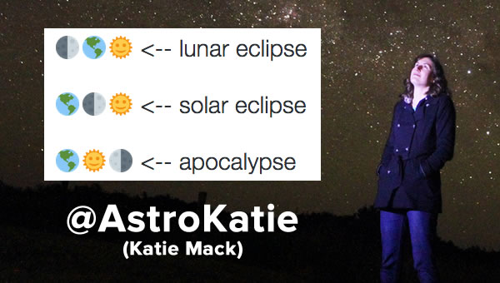
Remember: Which One Gets Darker?
Notes:
Pause for a moment to let the audience get this
Then <click the space bar/next> for the title to appear
An easy way to remember the difference between a lunar and a solar eclipse is in the name.
The name tells you what gets darker when the eclipse happens.
In a solar eclipse, the sun gets darker. In a lunar eclipse, the moon gets darker.
Great tweet by Dr. Katie Mack, astrophysicist and science writer

Slide 6
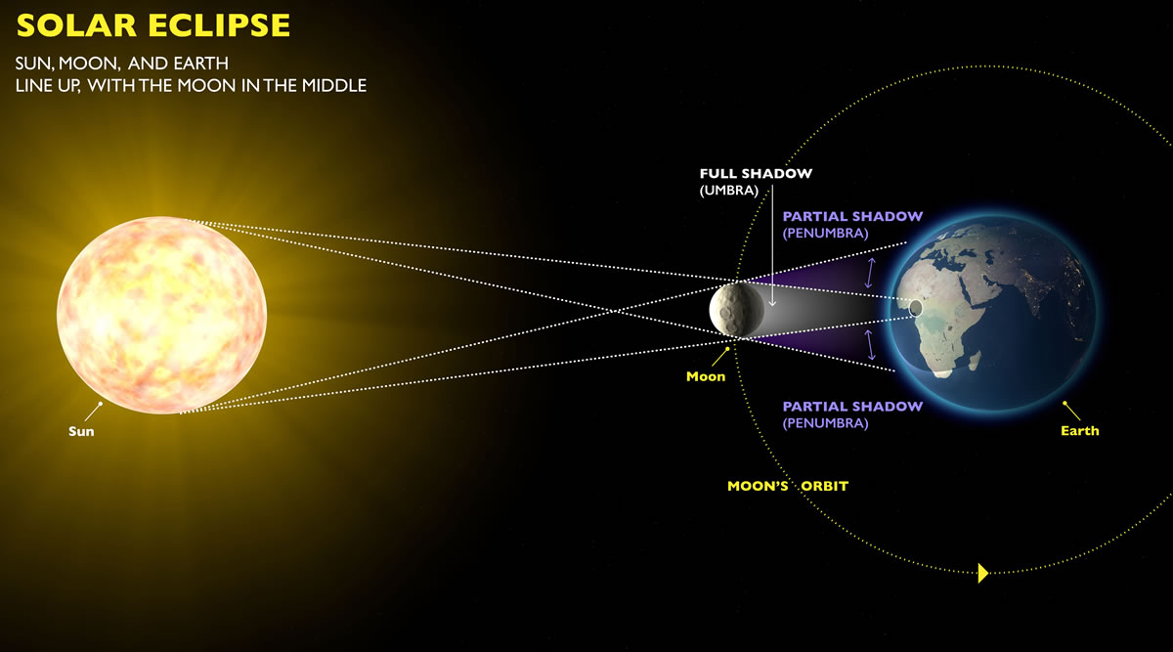
What is a Solar Eclipse?
Not to scale © exploratorium.edu
Notes:
Today we’re talking about Solar eclipses, for a very good reason. There’s one coming up.
How does a solar eclipse happen?
It’s simple geometry – the Sun, Moon, and Earth all line up.
The Moon creates a shadow that glides over the Earth as it moves past.
In the center of that shadow, the Sun is totally blocked by the Moon, creating a full shadow.
On the sides, only part of the sun is blocked, making a partial shadow.
------
The point of that shadow is called the umbra.
The larger shadow shown in blue here is the penumbra.
http://blogs.discovermagazine.com/imageo/2016/03/12/heres-what-the-shadow-of-a-total-eclipse-looks-like-from-space-as-it-crosses-earths-face/#.V31u42OQ2AZ

Slide 7
Notes:
I mentioned we’re talking about this because there’s one coming up. The good news is that everyone in North America (with clear skies) will be able to see this solar eclipse.
On the 21st of August, 2017 this total eclipse will cross the US.
It will take only about an hour and a half to get from the Pacific to the Atlantic Ocean so you can’t chase it.
But you can see a few minutes from many locations in the US.
The line through the center is where you’ll see a total eclipse – it’s called the Path of Totality and it’s about 60 miles wide.
Most Americans are within a 1-day drive of the path. How close are you?
If you can get to the path of totality, it’s an event that will be worth it.
-----
Map: Michael Zeiler, www.GreatAmericanEclipse.com

Slide 8
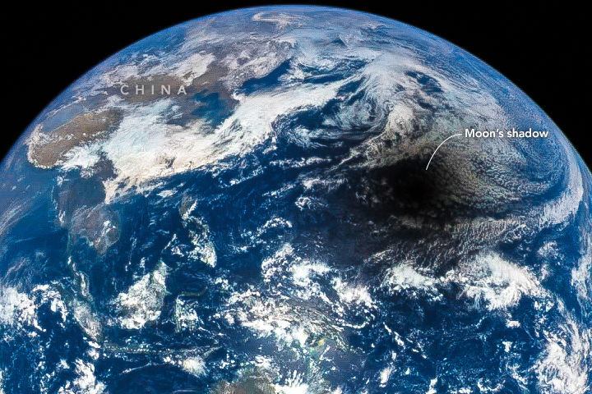
A Total Eclipse from Space
Notes:
This is an actual image from space, taken in 2016.
The central shadow of the eclipse will be moving more than twice as fast as the speed of sound – at about 2,000 mph
----
NASA image of March 9, 2016 eclipse courtesy of the DSCOVR EPIC team

Slide 9
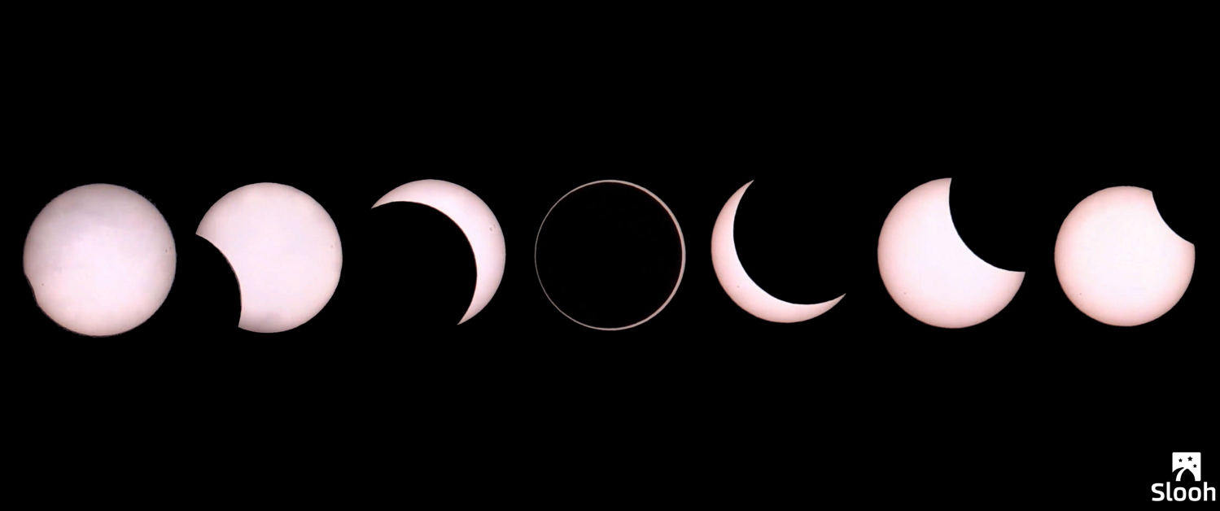
The View from Earth
Notes:
What does a solar eclipse look like from Earth?
Viewing an entire solar eclipse can take a good part of the afternoon.
From first contact, where the Moon begins to cover the Sun (left), to when the eclipse ends (right) can take about 2-3 hours.
Approximate timing across the US (Daylight Savings Time):
Pacific Time: 8:00am -10:45am
Mountain Time: 9:15 – 11:30am
Central Time: 10:45am – 2:00pm
Eastern Time: 12:15pm – 3pm
Find the exact timing for your location:
http://eclipse.gsfc.nasa.gov/SEgoogle/SEgoogle2001/SE2017Aug21Tgoogle.html

Slide 10
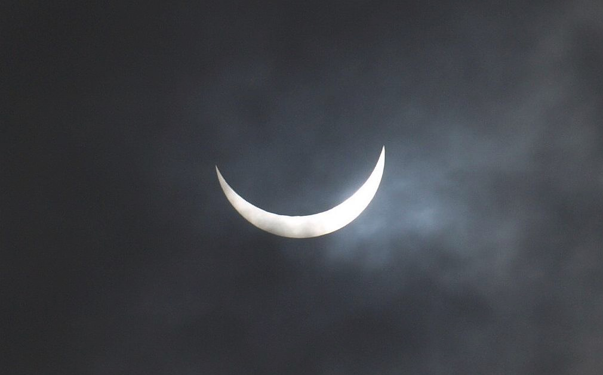
Everyone sees a partial eclipse
If it’s clear out…
Notes:
Everyone gets to see this spectacular event – if you know how to look!
While you won’t get the moments of night in the middle of the day, the entire country will still see a partial eclipse!
You will notice it get somewhat darker and shadows get very crisp.
The partial eclipse lasts much longer - just over 3 hours for everyone.
While you should never look directly at the Sun, I’ll show you various ways to observe this phenomenon.
This part is important even for people on the path of totality. They will be experiencing a partial eclipse for the hours before and after.
Image © Copyright Derek Harper
Visualization of path across US and sun they’ll see: http://svs.gsfc.nasa.gov/cgi-bin/details.cgi?aid=4314

Slide 11
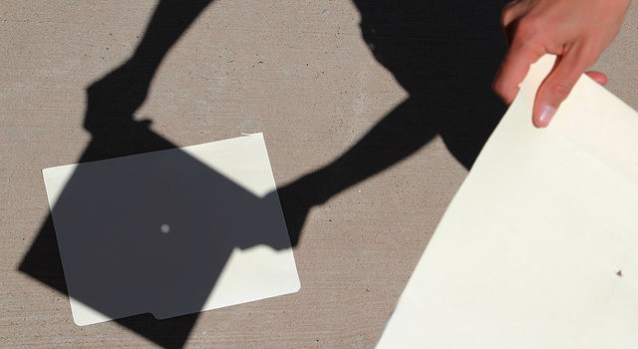
Viewing the partial eclipse
Do Not Look Directly at the Sun!
Projection of image
  Pinhole or using tools
Directly with filter
Live streaming the event
Notes:
During a partial eclipse, Do Not Look Directly At The Sun.
There are many ways to view a partial eclipse. Even those on the path of totality will observe a partial eclipse for all but a few minutes, so this applies to everyone.
We’re going to talk about 3 different ways to view a solar eclipse here.
Let’s start with the simplest way – Projection.

Slide 12
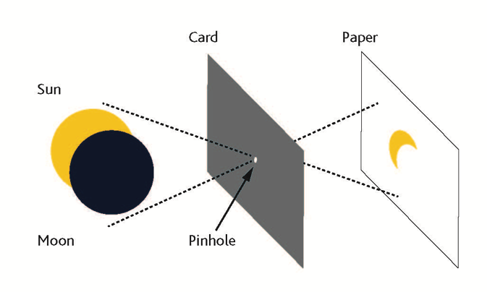
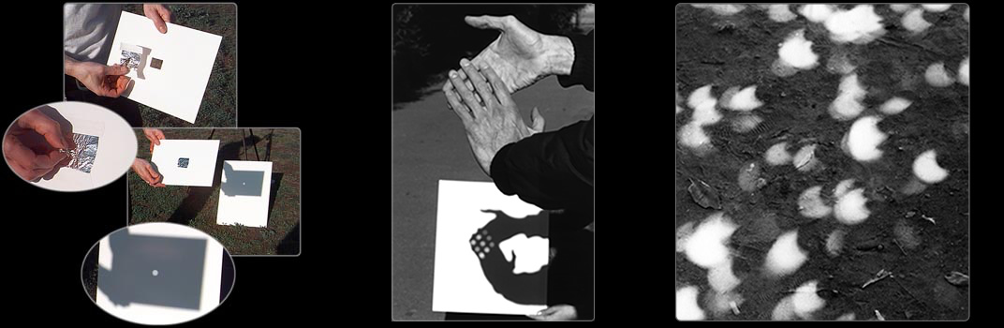
Watch the show safely!
Pinhole projection
Photo Credit: exploratorium.edu
Notes:
Pinhole projection can be done anywhere by making a small hole in a piece of cardboard or tinfoil and looking at the light that shines through it to a flat place a few feet away.
You might not know this, but the round lights you see everyday on the ground, between the leaves of trees are actually projections of the Sun!
You can use any number of small holes like the spaces between leaves, a colander, or even your hands.
Get creative and try it out before the eclipse. You can try different shaped holes, different sizes. See what works best.
Activity suggestion:
As you walk in the evening, you can try this at night with street lights through the leaves. Some lights are actually made up of many smaller LEDs and you will see those in the projections.

Slide 13
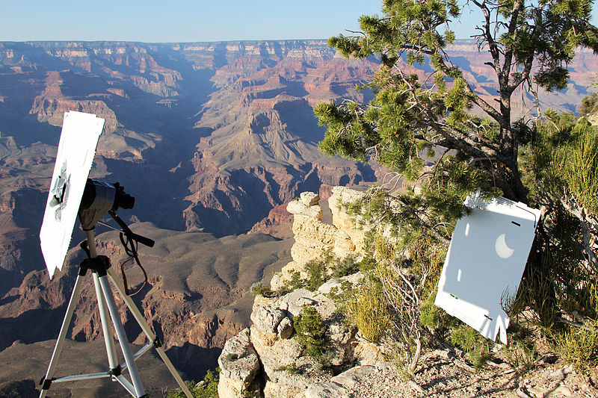
Project the sun with tools – and care
Notes:
Another method of projection involves binoculars or a small telescope.
Emphasize : This is not viewing the Sun directly! You never want to look through binoculars at the Sun. *
By carefully covering all but one lens, you can project an image of the Sun onto a flat surface.
This set-up needs careful monitoring so that no one accidentally looks through the eyepiece.
You will go blind.
Possible addition:
It can be useful to take an old pair of binoculars (or a magnifying glass) and shine them on a piece of thin plastic like old negatives or a plastic garbage bag. These will melt and give your visitors a visceral reminder not to look through binoculars at the Sun. Be careful – this projection can get very hot and you’ll need to give your instrument a break as it heats up.

Slide 14
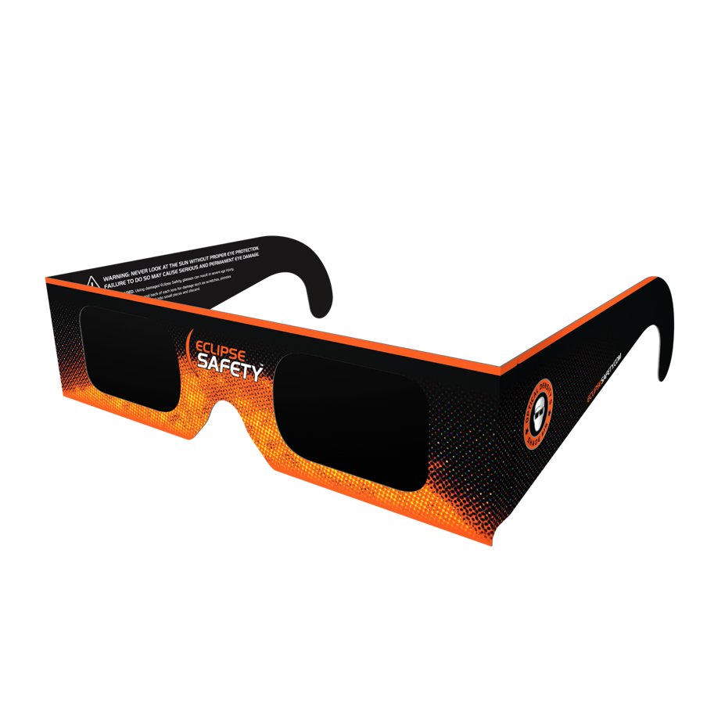
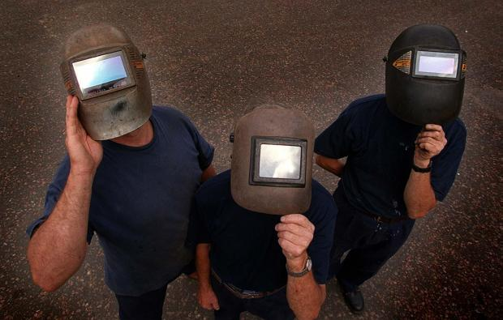
Observing directly with filters
Eclipse glasses
Not sunglasses!
#14 welders glasses
Notes:
There are ways to observe the eclipse directly, but it requires special filters
Use approved eclipse glasses – not sunglasses!
Also welders glass #14 is safe for viewing. Don’t combine two #7 glasses. That is not safe.

Slide 15
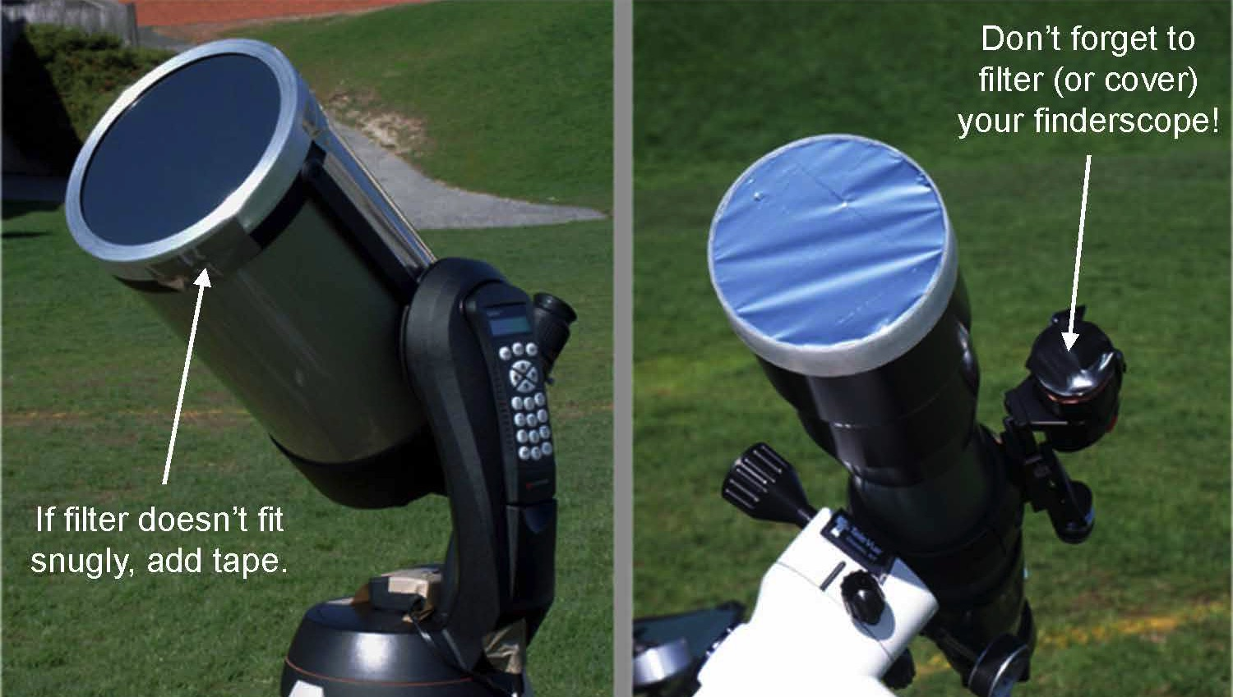
Use special care with filtered optics
Notes:
Telescopes and binoculars equipped with special solar filters are also useful if you have access.
Use only special-purpose solar filters on your precious optics!
These are usually made of metalized glass or special Mylar, not from a balloon.
Get these filters as far in advance as possible. See more information in the Resources page.
-----
Image credit: Rick Feinberg

Slide 16
Notes:
Now, although we’ll all see a partial eclipse, if you’re on the thick red line above, you will also have a completely different experience.
This is called the Path of Totality for a reason. These lucky people will see a total eclipse.
Some call it life-changing, others claim a spiritual experience. No one who sees one is disappointed.
Let’s see what all the fuss is about.

Slide 17
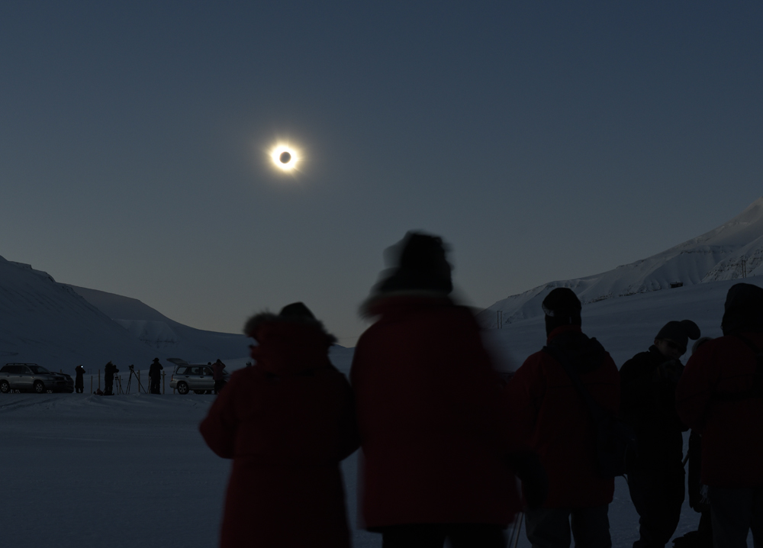

This is a total eclipse
Catch it if you can!
Notes:
A total eclipse is unlike any experience you’ll ever have.
People travel all over the world to see this phenomena.
This one will last around two minutes. Daylight turns to night and the environment responds in unusual ways.
Temperature drops, birds go home to roost, and insects start their evening rituals.
Let’s hear what this might look like from our perspective on Earth.
(Show one of the videos below or press the speaker on the bottom right to play audio only)
2015 eclipse in Norway https://youtu.be/dRAkhQ6CfmA
Good video talking about what you see: https://svs.gsfc.nasa.gov/12147
2016 Indonesia NASA: https://youtu.be/KWvPQBTvtfc
Alaska Airlines https://www.youtube.com/watch?v=YBoa81xEvNA
Australia 2012: https://youtu.be/mOXnnnR9PKk?t=6m8s
Fred Espenack on a boat: https://youtu.be/K4KnxE6yAuI?t=13m10s
-----
This is a picture of very cold observers braving the elements in Norway for a glimpse in 2015. Photo by Valerie Hwang

Slide 18
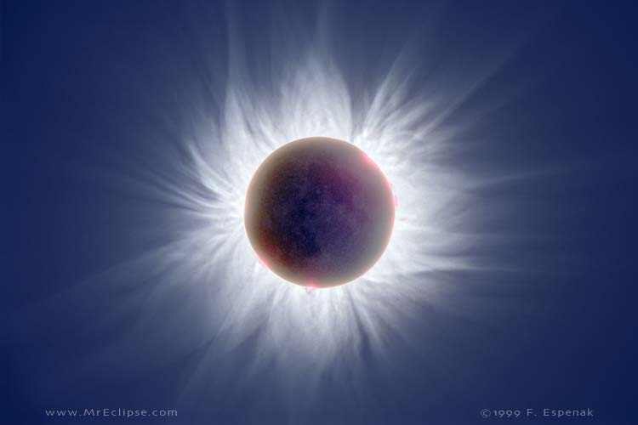
If this Is your 1st total eclipse
and you want to take photos or videos…
Our advice? don’t.
Notes:
The total eclipse lasts less than 3 minutes for this one.
You will notice many effects, such as changes in animal behavior, temperature, sound, of course it gets very dark.
You will see a sunset all around you on the horizon and the sky will be dark enough to see stars.
These few moments are the One And Only Time you may safely look directly at the Sun.
Very few people in the world have ever seen a total solar eclipse before.
Take the time to enjoy this. Eclipse chasers will tell you it seems to pass very quickly.
If you feel compelled to take images, set it up well ahead of time to take images automatically.

Slide 19
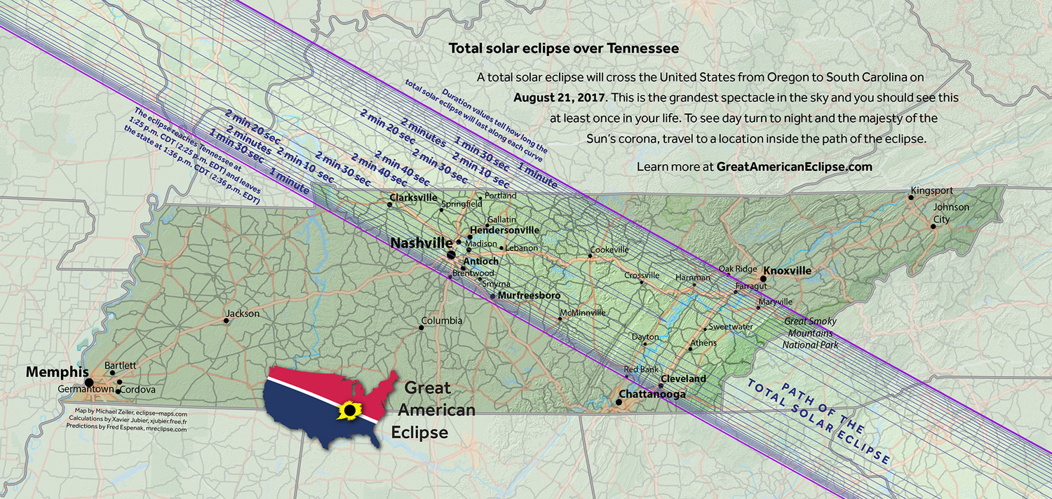
Plan ahead
Totality lasts about 2 minutes
In Tennessee this will happen at 2:30pm EDT
Notes:
If you’re able to get to the path of totality, you’ll likely need to plan ahead.
Many of the hotels on the path are already booked.
But you don’t have to be staying directly on the path of totality. As long as you wake up on August 21st within an hour of the path, you should be able to make it.
Practice your route the day before. Be prepared for traffic.
Bring snacks, sunscreen, and shade like an umbrella. Be sure to use the facilities ahead of time.
Be prepared with eclipse glasses/projection devices for the before and after! (more on that in a minute)
-----
Use images of a state close to you, found here:
http://www.greatamericaneclipse.com/nation/
**Timing info:
Pacific time zone: 10:15am – 10:30am-ish
Mountain time zone: 11:45 – noon-ish
Central time zone: 1:00 – 1:15-ish
Eastern time zone: 2:30 – 2:45-ish
(Daylight savings time)

Slide 20
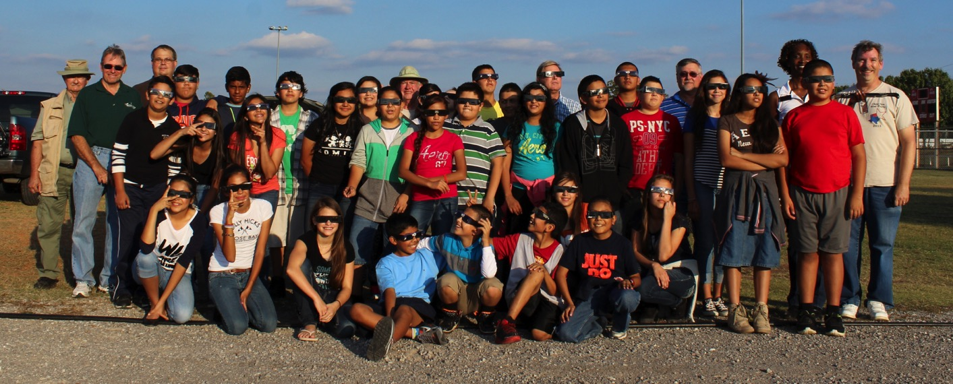
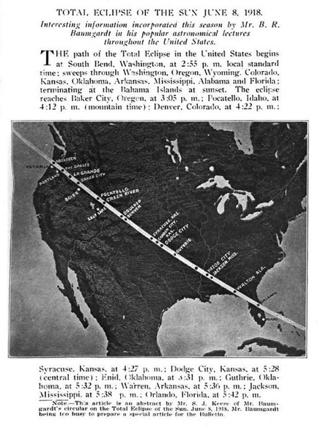
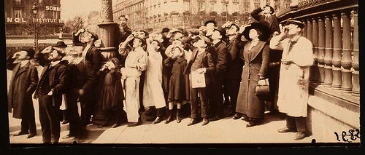
Bring friends and family
Notes:
Eclipses were exciting at the turn of the last century and it’s still exciting today.
Bring your friends and family to experience it with you.
Last time the whole country could see a total eclipse was in 1918! (next time in 2024!)
-----
Bottom left:1911 Paris by Eugn Atget
Newspaper article from 1918 US eclipse
Top image Oklahoma City Astronomy Club during the 2014 partial eclipse Credit: Dave Huntz

Slide 21
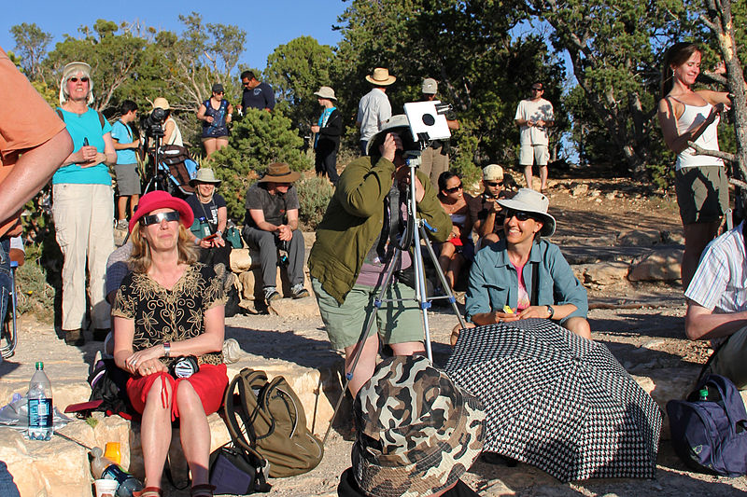
Involve your community
Notes:
Involve your community in the excitement!
Most people have never seen an eclipse before and this could be a very memorable event.
You don’t even need a telescope!
Order eclipse glasses now, in advance. Some places even sell glasses to raise money for the event.
Plan Sun and Moon themed music, food, and decorations- can anyone think of an an eclipse song? Sun or Moon food?
Set up some experiments! Experiments can be as simple as a thermometer and clock on time lapse all the way to a camera on a weather balloon and anything in between.
Watch online as the eclipse whizzes across the country. See eclipse2017.nasa/gov for more information.
Create a time capsule or a letter to your future self to open at the next eclipse (2024)
Grand Canyon National Park: Annular Eclipse Viewing 2012
More information about planning an event:
http://eclipse2017.nasa.gov/planning-your-eclipse-party

Slide 22
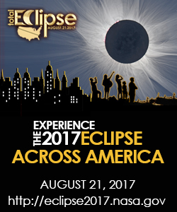
Viewing resources for every place
Notes:
NASA is preparing the country for this big event. (website bottom left)
The Night Sky Network connects you to your local amateur astronomy club.
You can also find lots of resources there.
As well as on the www.nisenet.org website.

Slide 23
Extensions
Types of eclipses
Why don’t eclipses happen every month?
Cosmic coincidence
Myths and stories

Slide 24
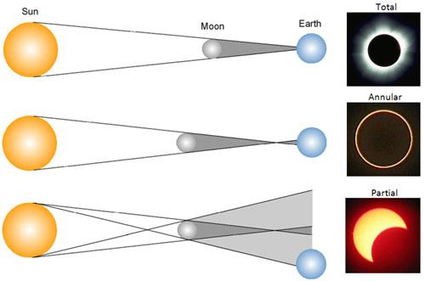
Types of eclipses

Slide 25
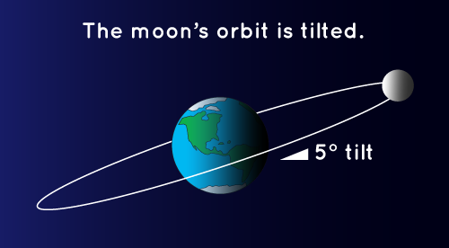
Why don’t eclipses happen every month?
Notes:
In this diagram, you can see that the Moon’s orbit around the Sun is at a tilt. This is why we don’t get a lunar eclipse every month. This diagram is not to scale: the Moon is much farther away from Earth than shown here.
----------
Try this activity with your audience using simple materials:
https://nightsky.jpl.nasa.gov/download-view.cfm?Doc_ID=326
Credit: NASA Space Place

Slide 26
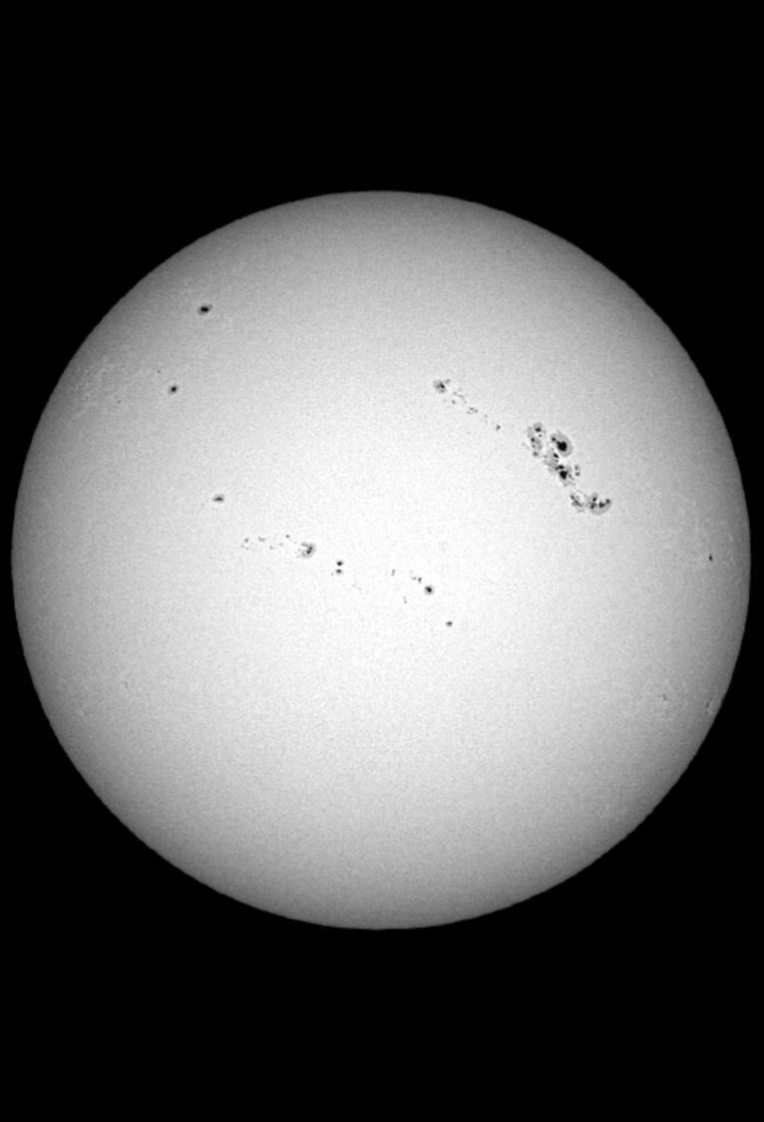
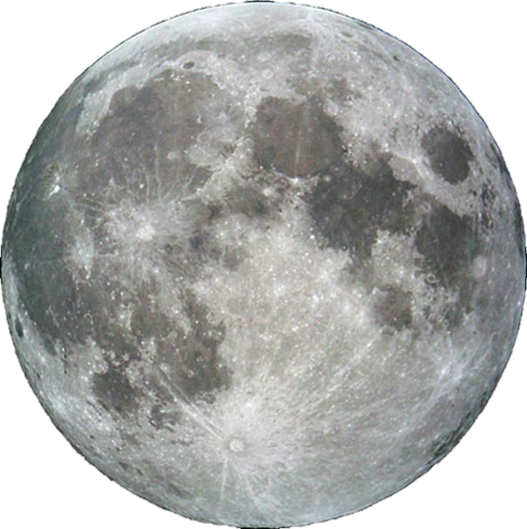
Cosmic coincidence
The Sun’s diameter is 400x the Moon’s diameter, but the Sun is also 400x farther away from Earth!
Notes:
We are alive during a special time in the history of the Earth.
The Moon is slowly moving away from the Earth* at the rate of about an inch a year. (About as fast as your fingernails grow!)
In another billion years or so, there will be no more solar eclipses because the Moon will be too far and appear too small to cover up the Sun.
* The Moon pulls on the water on Earth creating tide. Those tides pull back on the Moon, causing it to slow down ever so slightly.

Slide 27

Myths and stories
Notes:
"If you do a worldwide survey of eclipse lore, the theme that constantly appears, with few exceptions, is it's always a disruption of the established order," said E. C. Krupp, director of the Griffith Observatory in Los Angeles, California. as quoted in National Geographic
The image here shows an ancient Chinese myth. Tiangou was a black dog who ate the Sun.
Traditional Myths and Eclipse stories:
https://www.timeanddate.com/eclipse/solar-eclipse-myths.html
-----
"The New Year Painting of Zhang Xian"

Slide 28
Thank you
This presentation was made possible by:
  NASA Night Sky Network: nightskynetwork.org
  Astronomical Society of the Pacific: astrosociety.org
  Jet Propulsion Laboratory Exoplanet Exploration program: exoplanets.nasa.gov
  NASA Eclipse 2017: eclipse2017.nasa.gov

