Slide 1


Opportunities for Science Writing
NISE Network Catalog
Prepared by Aditi Risbud, Ph.D.
(aditi.risbud@moore.org)
Notes:
Introduce yourself and describe your own interest in science writing–depending on whether you are a scientist, involved in formal/informal science education, or are a science enthusiast

Slide 2
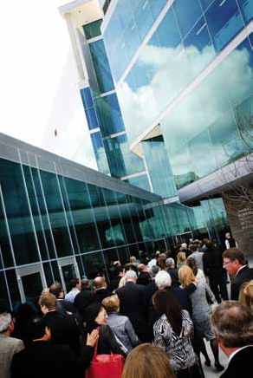
The Path Less Traveled….
Why science writing?
Pace and output
Socioeconomic and political aspects
Creativity
What can you do in this field?
Notes:
Pace and output: science writing allows you to dive deep into a topic for a short period of time and turn out a product quickly, whether that is a news article, press release, or profile of a scientist.
Socioeconomic and political aspect: science writing lets you tackle broader socioeconomic and political concepts, controversies, or outstanding questions that are caused by or benefit from scientific research.
Creativity: science writing lets you channel your own writing talents and voice while communicating something beyond your own activities.

Slide 3
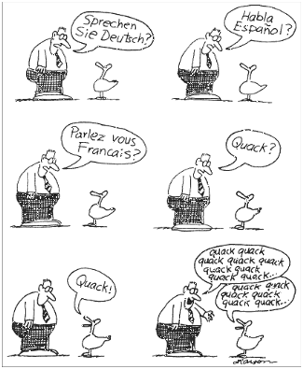
Audience and Purpose
Fellow students and mentors
Colleagues and leaders
The general public
Media
Funding agencies
Policymakers
http://engineerblogs.org/author/cherish-the-scientist/
Notes:
The techniques we use to communicate depend greatly on the audience—why are you saying what you are saying, and who are you saying it to? Are you trying to convince or persuade your colleagues or your family and friends? Pitch a business idea, or defend your actions? Are you trying to inspire or educate others? First determine your audience, and then start to write.

Slide 4
Perspective
Public’s Science Knowledge
Percent
Contemporary questions correct
Aspirin recommended %
to prevent heart attacks 91
GPS reliant on satellites 82
Undersea earthquakes
can cause tsunamis 77
Carbon dioxide is gas linked
to rising temperatures 65
Water recently discovered
on Mars 61
Pluto no longer a planet 60
Stem cells can develop into
many different types of cells 52
“Textbook” questions
Continents are/have been shifting 76
Not all radioactivity is man-made 63
Antibiotics do not kill viruses
as well as bacteria 54
Lasers do not work by
focusing sound waves 47
Electrons are smaller than atoms 46
Pew Research Center
Notes:
For perspective, here are the results from a recent (2011) Pew poll surveying the scientific literacy of American adults. Science writing is needed to help clarify topics of interest to most Americans, such as technology and healthcare.

Slide 5
Science Writing
What is it and who is it for?
  A compelling, usually short story about a breakthrough in science or engineering (500-800 words)
  Aimed at a 8th grade audience who may/may not have interest in science and engineering
  Must have a “hook”: why does this breakthrough matter in a person’s daily life?
Notes:
Describes most science writing pieces, along with the audience and purpose.

Slide 6

Science Writing
What it ISN’T:
Technical writing
  Journal articles, grant writing
Creative writing
  Science fiction, essays, poetry
http://betterbooktitles.com/
Notes:
Science writing lies between creative writing and technical writing. You want to be accurate about the details, but keep the reader entertained.

Slide 7
Training Programs
1 – 2 year graduate programs
  UC Santa Cruz
  Boston University
  MIT
  Imperial College
  Craft of writing news articles, features, essays
  Prepare for a career outside academia
  New media training
Notes:
If you are interested in formal science writing education, here are a few training programs you might consider, and what they (generally) offer.

Slide 8
Science Writing Career Options
Write for:
  Newspapers (online or print)
  Magazines
  Popular science journals
  Trade/specialty publications (MRS)
  Broadcast media (radio, TV)
  Blogs and online entities
  University press offices
  Corporate public relations
  Freelance
Notes:
Here are the places you might end up working as a science writer. Freelance writing is a very popular option, as you can live and work wherever you would like and work for a variety of editors.

Slide 9
Example 1
Include an example of science writing that you find particularly compelling or interesting
Reference
Notes:
Include additional examples (good or bad) depending on the time you have and the type of science writing you want to emphasize. Good sources are university or national laboratory press releases, popular science magazines (WIRED, MIT Technology Review).

Slide 10
Making it Work
Which is the right fit?
  Broader view of science
  Popularizing a specific niche
Career path
  Audience you want to impact
  Fame (seeing your byline) or fortune (getting a real paycheck)
Notes:
What is your interest in science writing, and what motivates you in a career? (this slide is meant to start a discussion with the audience/participants).

Slide 11


Thank You!
QUESTIONS?
This project was supported by the National Science Foundation under Award No. 0940143. Any opinions, findings, and conclusions or recommendations are those of the author and do not necessarily reflect the views of the Foundation.
Published under a Creative Commons Attribution-Noncommercial-ShareAlike license: http://creativecommons.org/licenses/by-nc-sa/3.0/us

