Slide 1
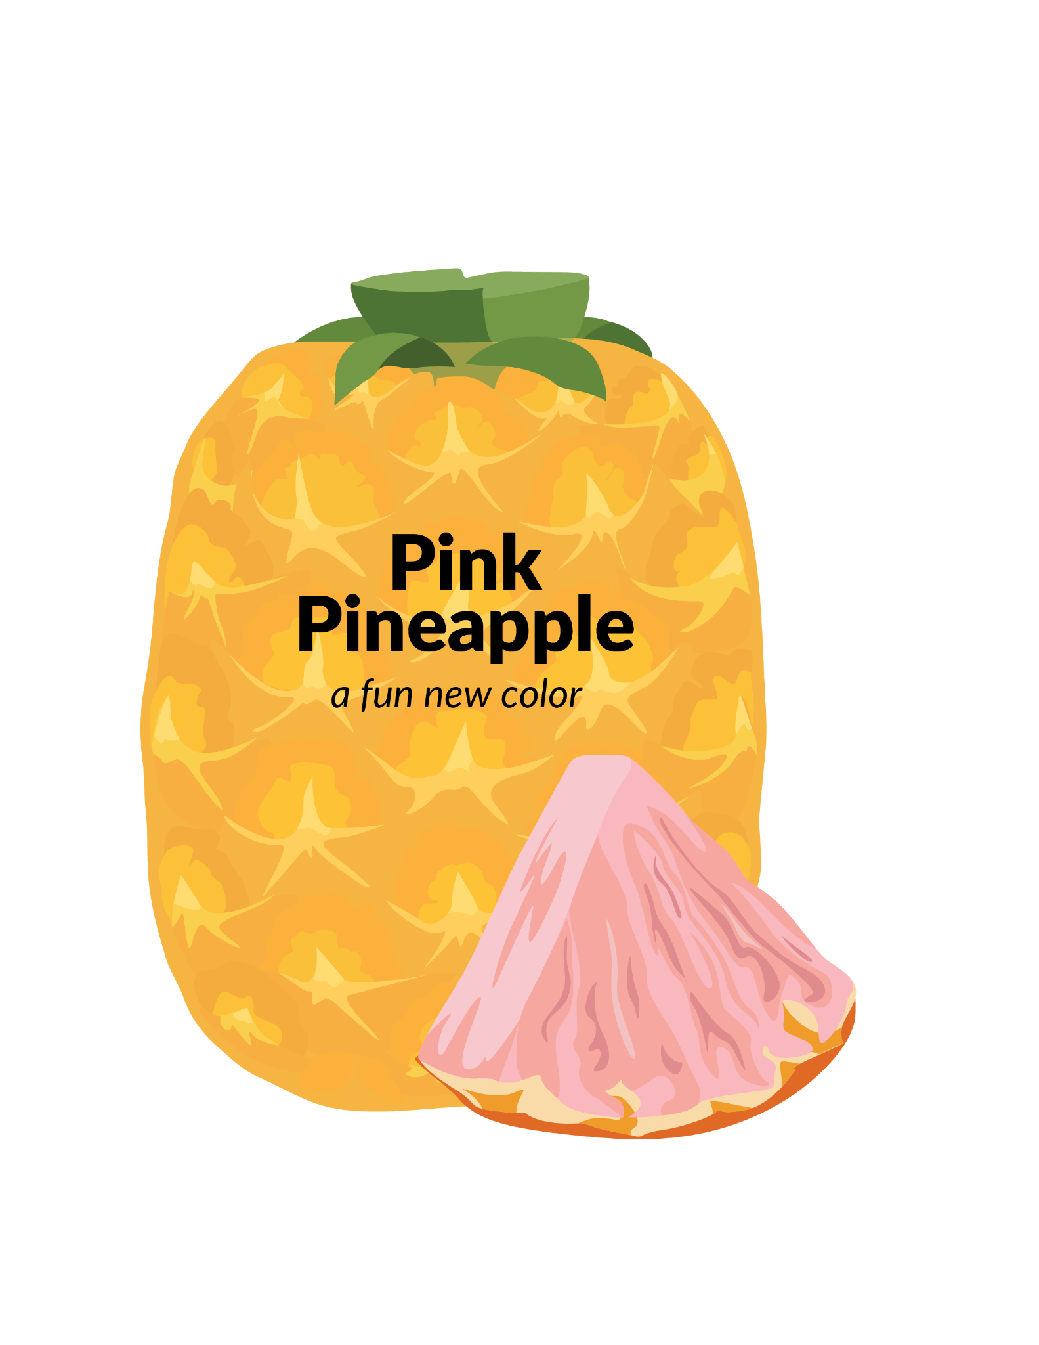
Pineapples are yellow because they contain neurosporene, a yellow pigment. It is one of many pigments found in foods. For example, carrots have an abundance of an orange pigment, beta-carotene, and lycopene is the red pigment in tomatoes. The amount and the color of the pigment in these foods determine their color. Recently, scientists intentionally changed the pigments in pineapples so the fruit inside is pink instead of yellow. These pink pineapples make more of the red pigment (lycopene) and less of the orange pigment (beta-carotene), but they taste the same as the standard yellow pineapples. Would you eat a pink pineapple?

Slide 2
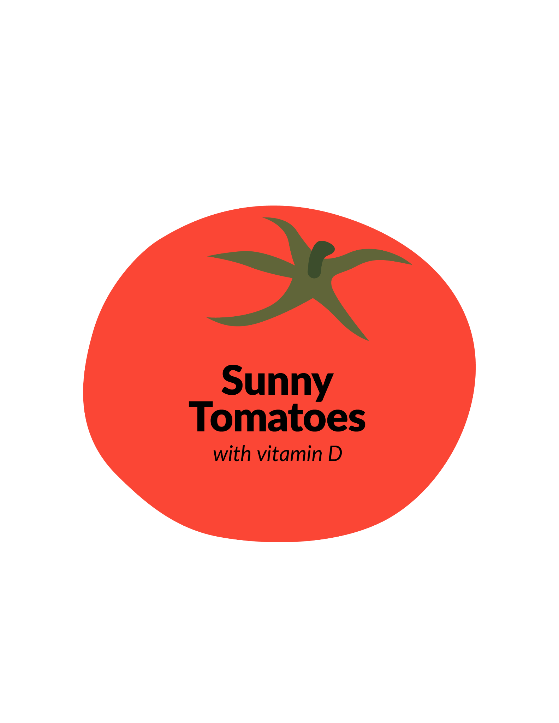
Humans can become vitamin D deficient when they don’t get enough sunshine or enriched foods, leading to fragile bones and serious diseases such as rickets in children and osteoporosis in adults. Sunlight turns the 7-dehydrocholesterol in cells into vitamin D. Using the CRISPR technique for gene editing, scientists have increased the amount of 7-dehydrocholesterol in tomatoes. Consuming these enriched tomatoes could help alleviate vitamin D deficiencies worldwide. Would you eat these sunny tomatoes to get your vitamin D?

Slide 3
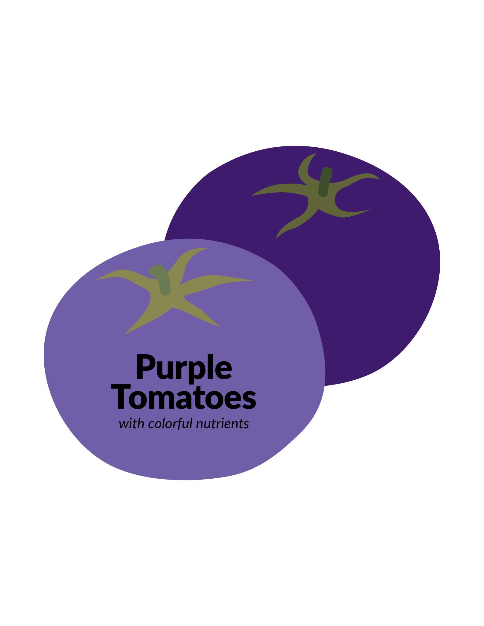
Blackberries and blueberries contain high levels of anthocyanins, a class of pigments that can protect against many human diseases. Scientists have developed a tomato that accumulates high levels of anthocyanins, giving them an intense purple color. When fed these tomatoes, mice susceptible to cancer showed a significant extension in life span. Would you eat these purple tomatoes?

Slide 4
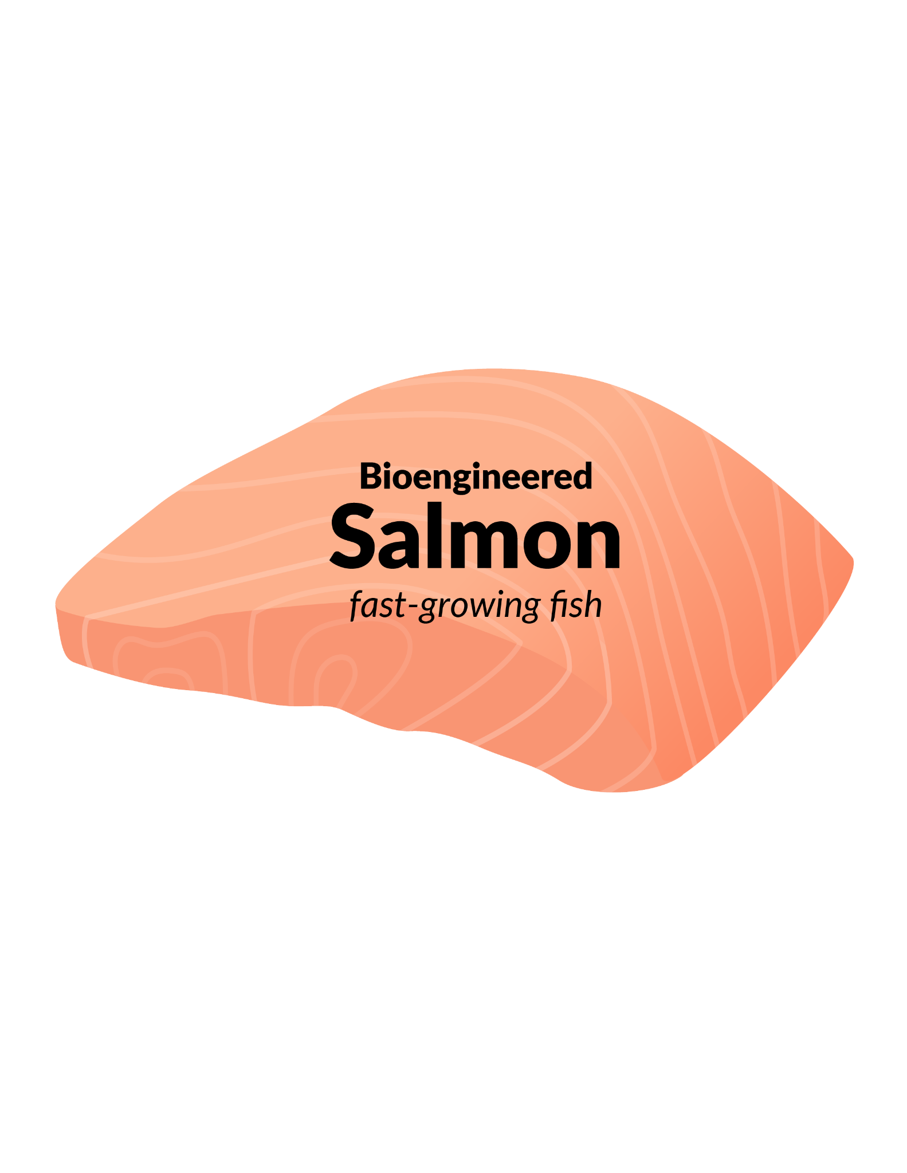
Salmon is one of the most popular fish we consume, and approximately 70% of the salmon we eat is farm-raised. A genetically engineered salmon was recently approved by the U.S. Food and Drug Administration. Modified with a gene from Chinook salmon and another gene from the cold-tolerant ocean pout, these fish grow twice as fast as their non-GMO counterparts. They require less feed and reach market size faster, but they can only be grown in tanks on land-based fish farms. Due to environmental concern over what might happen if the GMO fish escaped and bred with wild Atlantic salmon, the FDA has only approved production of sterile GMO salmon. Would you eat these fast-growing salmon?

Slide 5
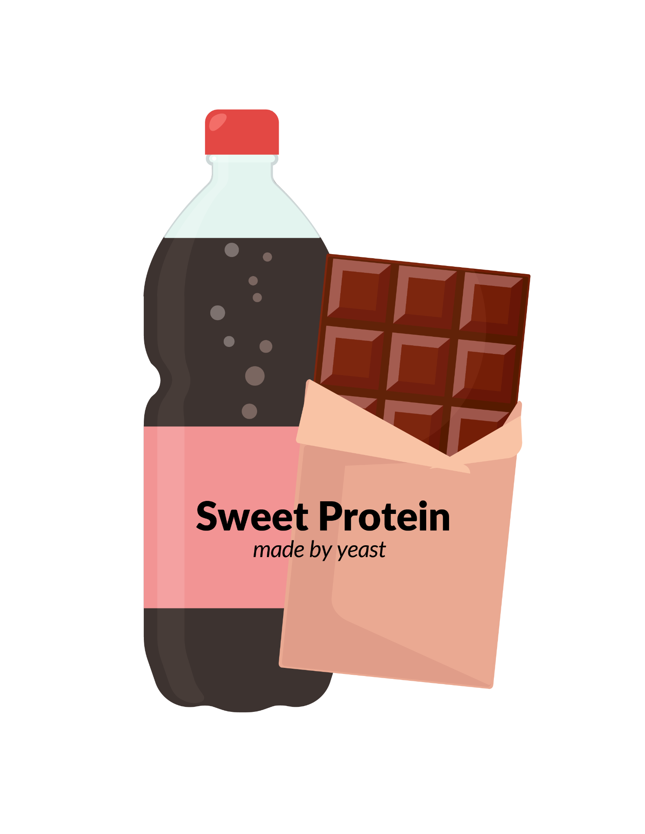
Individuals who consume too much sugar are prone to obesity and Type 2 diabetes. Low calorie sugar substitutes are popular, but research suggests they may also pose some health risks. Taking a new approach, scientists engineered yeast to make Brazzein, a protein that can be added to food as a sweetener. Brazzein is naturally found in Oubli, a West African fruit. Gram for gram, Brazzein is much sweeter than sugar. The manufacturers claim that since Brazzein is a protein, it should have no impact on blood sugar, insulin, or our gut microbiome. It is currently being used as a sweetener in iced tea and dark chocolate. Would you eat foods that contain this yeast-made protein-based sweetener?

Slide 6
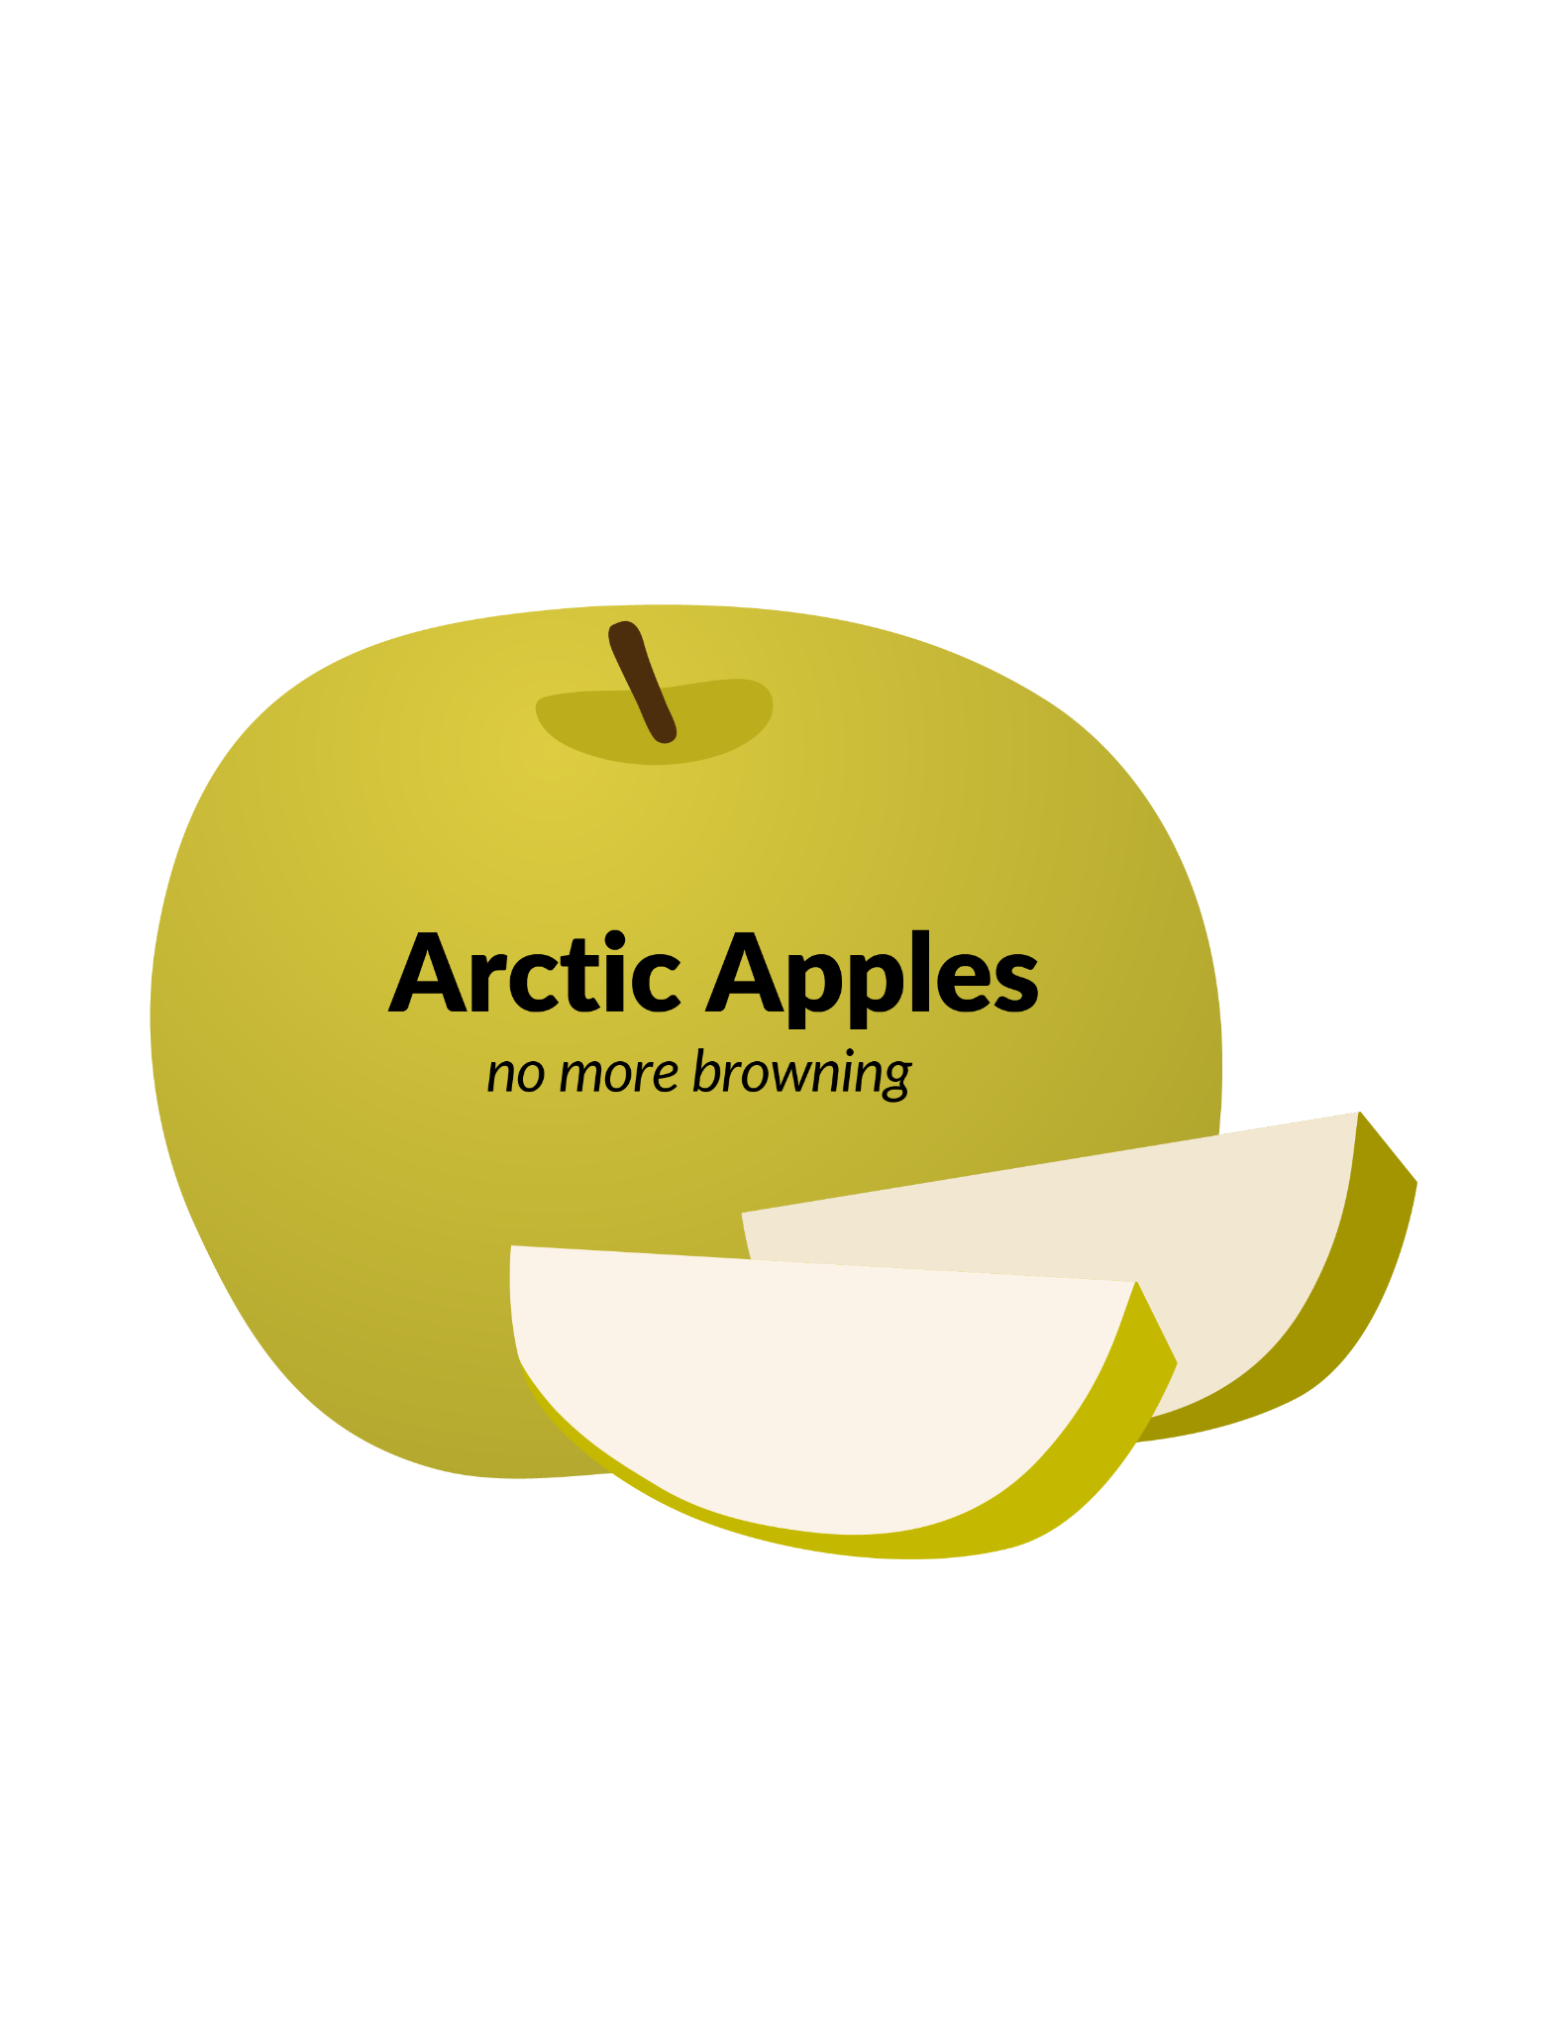
Could a bioengineered apple curb a major source of food waste? Many apples get thrown away when they turn brown after they are cut or bruised. Polyphenols are natural chemicals in apples which turn brown when they react with oxygen in the air. This reaction is catalyzed by polyphenol oxidase (PPO) enzymes. To limit the browning reaction, scientists decreased the amount of PPO enzymes in the apples which slowed the reaction of polyphenols with air. These apples don’t have any genes that come from different plants or animals, and they taste no different from apples that do turn brown. Would you eat this new kind of apple?

Slide 7
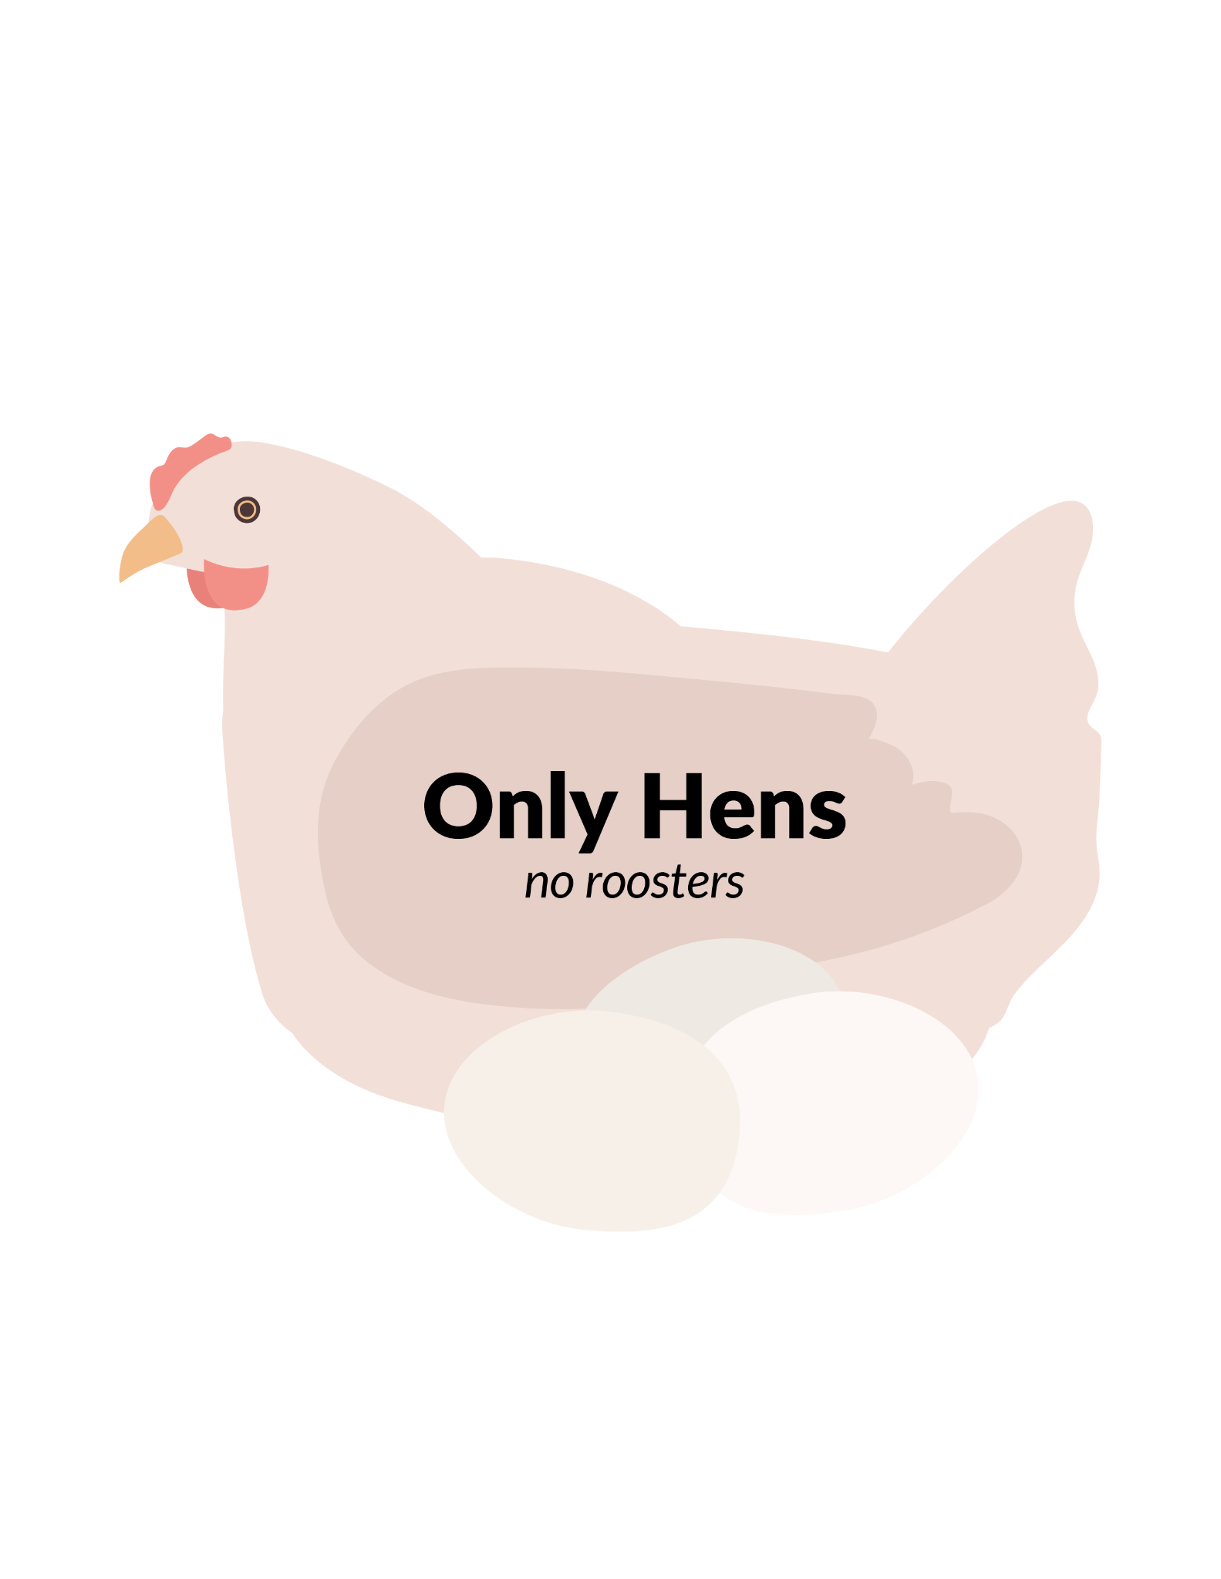
Approximately 7 billion unwanted male chicks are born each year. They are not needed in the egg-laying and meat industry so are culled from farmed flocks when they are one day old once their sex can be determined. Scientists have developed a process to sex-select chicks before they are born. Hens were genetically modified so that resulting eggs’ exposure to blue light activates a gene that stops the development of any male embryos. When the gene-edited hens lay eggs, only the exposed male eggs do not develop, leaving female table eggs and egg-layer hens identical to those currently used in the industry. Would you eat eggs and chicken that have been farmed this way?

Slide 8

Ice cream and many other sweet treats taste like vanilla. Pure vanilla extract comes from the beans of orchid plants, which are scarce and costly. Artificial (or imitation) vanillin is produced inexpensively using chemical processes, but many people think it doesn’t taste as good. An alternative, synthetic vanilla, is produced by engineered yeast. It’s cheap and can be labeled as “natural” since it’s produced through fermentation. Would you eat products containing yeast-made vanilla? Do you think products should have to indicate that they contain synthetic vanilla? If so, what should the label say?

Slide 9
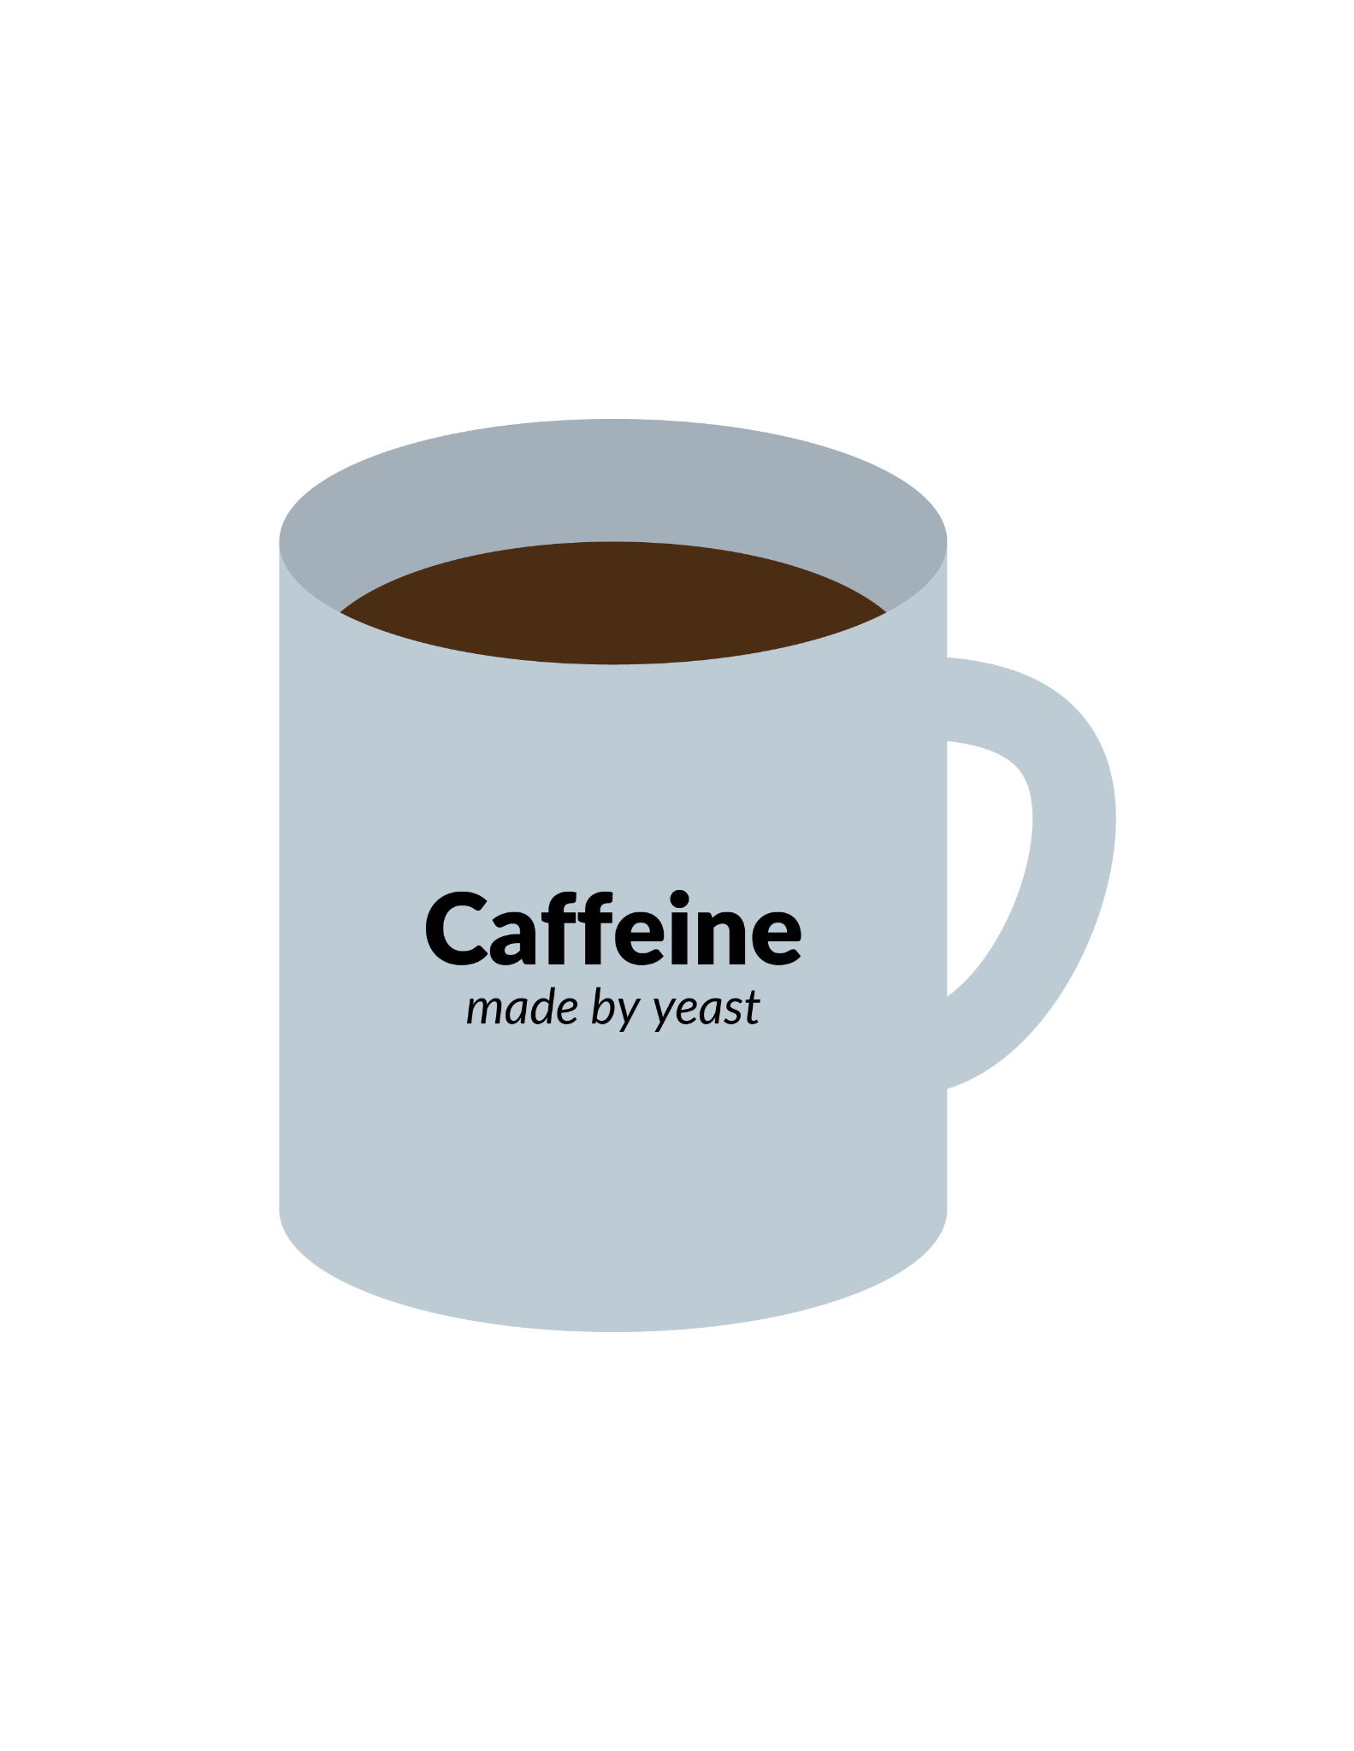
People drink caffeinated coffee, soda,
and energy drinks to wake them up, give them energy, and increase their ability to concentrate. Caffeine is naturally found
in plants from South America, including coffee plant seeds, cocoa beans, and kola nuts. By engineering yeast to produce caffeine, we could grow this ingredient
in the lab, which might be less expensive. Would you consume this form of caffeine? Do you think the reduced cost would be worth the potential threat to jobs on coffee and cocoa plantations?

Slide 10
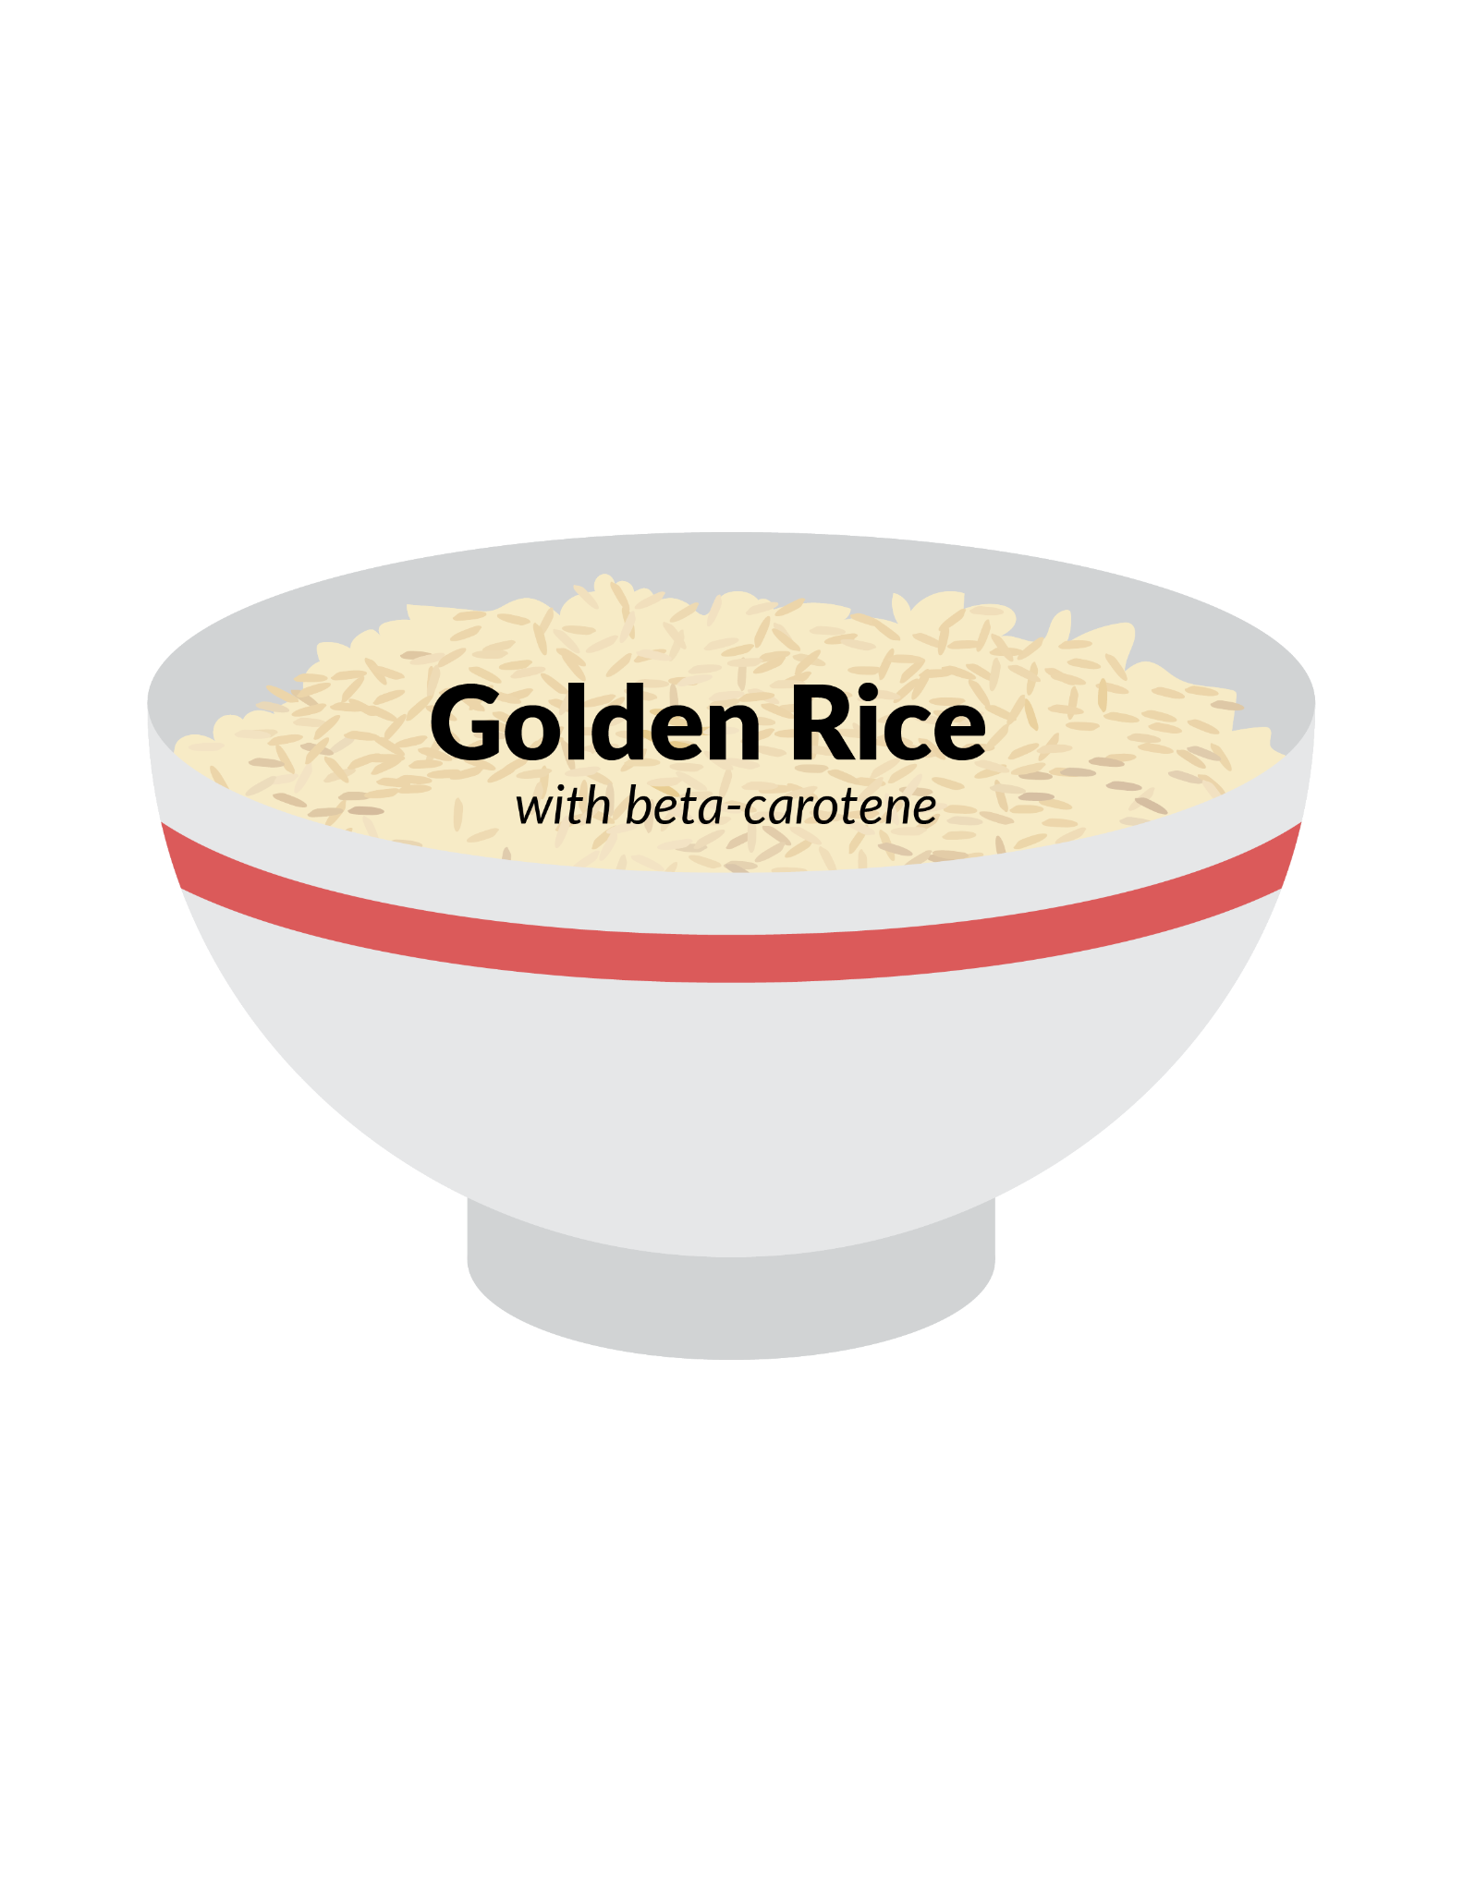
People drink caffeinated coffee, soda,
and energy drinks to wake them up, give them energy, and increase their ability to concentrate. Caffeine is naturally found
in plants from South America, including coffee plant seeds, cocoa beans, and kola nuts. By engineering yeast to produce caffeine, we could grow this ingredient
in the lab, which might be less expensive. Would you consume this form of caffeine?
Do you think the reduced cost would be worth the potential threat to jobs on coffee and cocoa plantations?

Slide 11
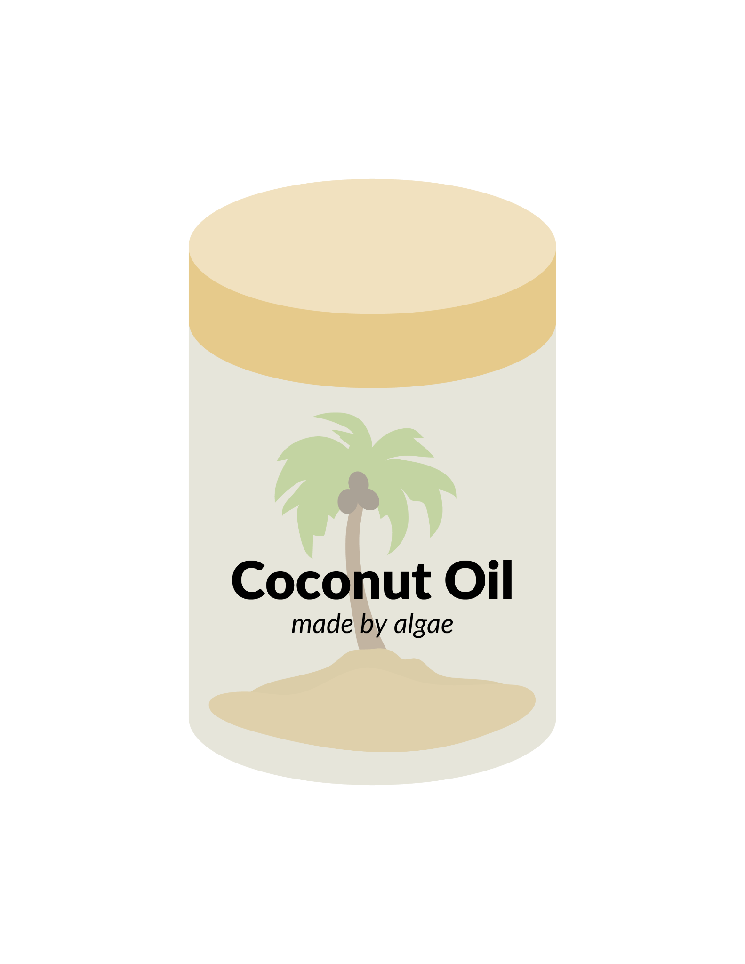
Coconut oil is extracted from coconut meat, and is used as an ingredient in baked goods, fried foods, soaps, and health and beauty products. Most coconut oil comes from trees grown in tropical areas. Researchers have engineered algae to produce lauric acid, which is the saturated fatty acid found in coconut oil (as well as palm kernel oil). This may be a more environmentally sustainable way to produce these products. Would you eat foods containing oil produced by algae?

Slide 12
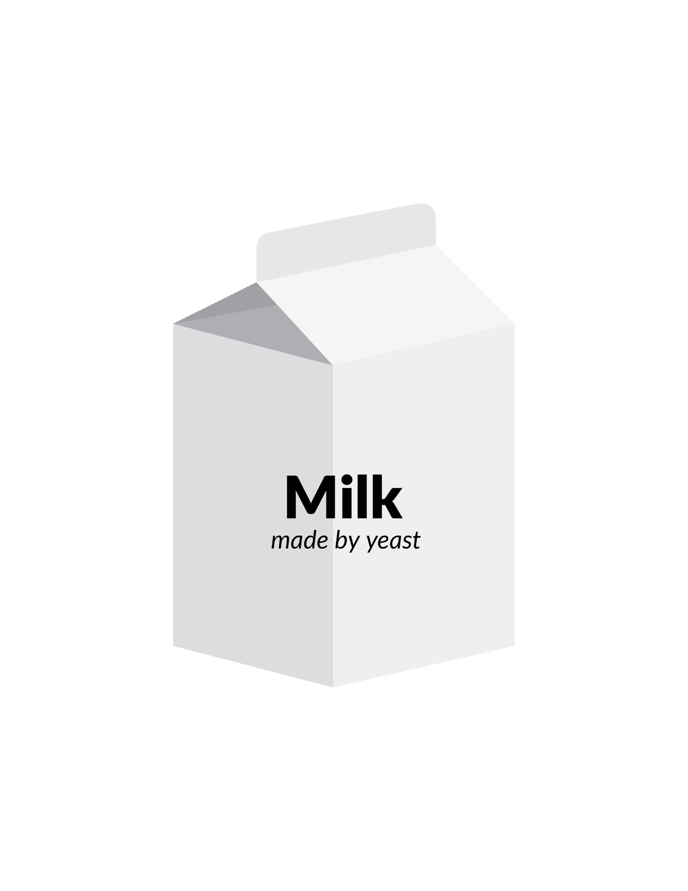
Synthetic milk has been developed by inserting DNA sequences from cows into yeast cells. The yeast cultures produce real milk proteins, such as casein and whey, which are combined with vegetable fats, calcium and other ingredients to boost the nutritional value and make the drink taste like cow milk. This animal-free approach might be greener and more sustainable than traditional milk production. Food companies can make ice cream, cream cheese, and protein powders using bioengineered milk proteins. Would you
eat foods containing this synthetic milk?

Slide 13
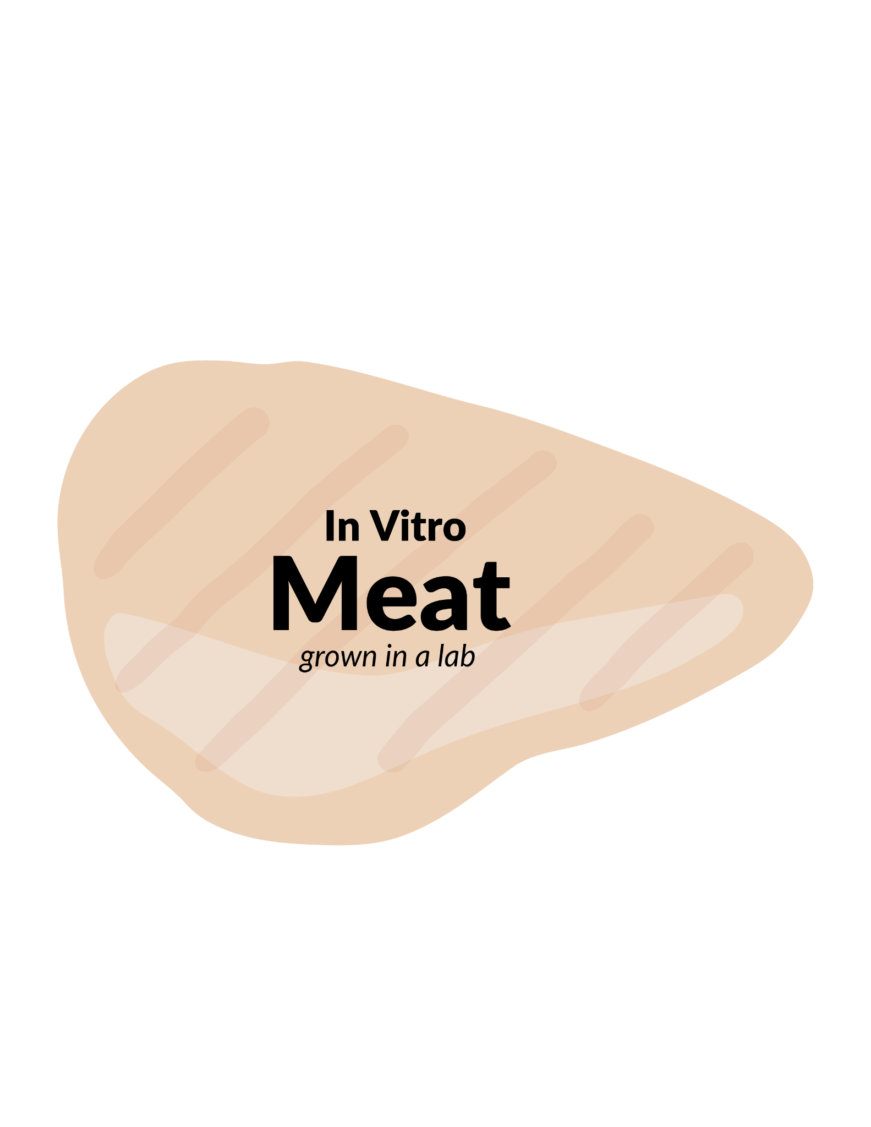
The USDA and FDA have approved production and sale of laboratory grown meat. This product uses cells taken from an animal to grow in a nutrient solution in the lab. The cells multiply in large tanks and become a dense slurry which is then formed into patties or filets. Cultivated chicken has been successfully produced, and the industry would like to develop other types of meat such as beef and fish. This technology could help feed a growing world population using less energy and land than livestock. Some animal rights advocates support this approach over raising animals for meat. Would you eat lab-grown meat?

Slide 14
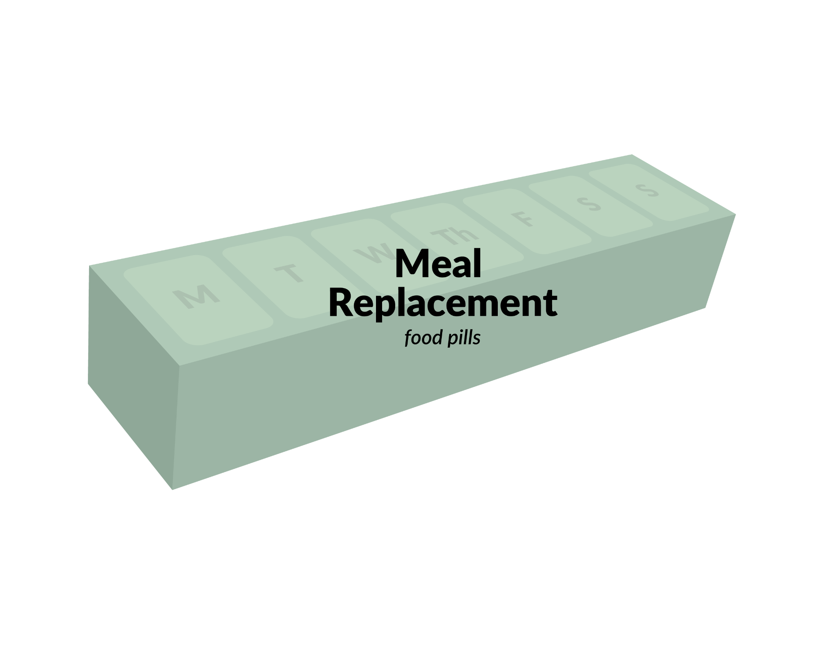
Imagine a collection of daily pills that could meet all your requirements for food and nutrition. You wouldn’t have to shop for food, cook, or even take time to eat–just pop pills and be good to go. That future is here! The science was developed at the NASA Ames Research base and food pill kits are commercially available. Almost all meals are replaced by food pills, keeping a traditional dinner. As you might imagine, many social, cultural, and economic systems would change if this technology were widely adopted. Would you consume food pills as part of your diet? What would happen to farmers and food production industries? What would you miss about food as we eat it now?

