Slide 1
Consider the following scenario:
Eric has read about researchers who are developing a non-invasive brain stimulation headset. This device can improve attention in people with a diagnosed condition like Attention Deficit Hyperactivity Disorder (ADHD). The headset has been thoroughly tested and shown to be effective as a therapy for ADHD with minimal side effects. It has also been shown to help sustain attention in people who do NOT have ADHD.
From previous medical tests, Eric knows that he does not have challenges in sustaining attention, and does not fulfill the medical criteria for ADHD. However, Eric concludes that the headset could help him improve his attention even more and decides to try it.
How acceptable do you think it is that people like Eric, who do not have an attention disorder, might use a device to improve their attention? (respond: 1 = not acceptable at all, 10 = very acceptable)
Would you prefer devices like this to be available in the marketplace with or without a doctor’s intervention? (respond: with/without/I am unsure)
Notes:
As a warm up exercise or conversation starter, consider setting up an online survey for attendees to read through this scenario and respond to the questions before the program begins. A QR code or URL on table signs can direct people to the survey.

Slide 2
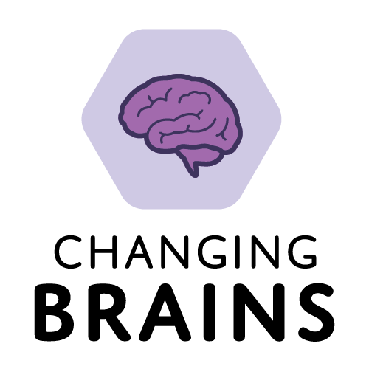
BETTER LIVING THROUGH
BRAIN STIMULATION?
(example slide deck)
Notes:
Update or replace the example slides with your information. Add guest presenter slides as appropriate. Consider whether you might want to have a few printed copies of the slides available as handouts, for reference and as accessibility aids.

Slide 3
Understand the science of brain stimulation technology and its potential impacts on human cognition and behavior.
Consider your individual values that would shape your personal decision to use a brain stimulation device.
Discuss community perspectives on the benefits and consequences of brain stimulation technology for different societal applications.
Program Goals

Slide 4
Agenda
Brain stimulation for cognitive enhancement – 15 minutes
Introduction to brain stimulation technologies
Evidence for cognitive impacts and ethical considerations
Individual values and decision making – 20 minutes
Consider your personal values and priorities about brain stimulation
Share your thoughts through a creative expression activity
Implementation in society – 20 minutes
Discover group attitudes towards different societal applications
Choose a scenario and discuss its ethical considerations
Notes:
Refer to the talking points and procedure section of the facilitator guide for more information on the agenda.

Slide 5
What’s our gut feeling about boosting brain power?
Display live survey results here
Notes:
Discuss any clear trends from results of survey to introduce the concept of brain stimulation technology and people’s attitudes towards using it for enhancement.

Slide 6
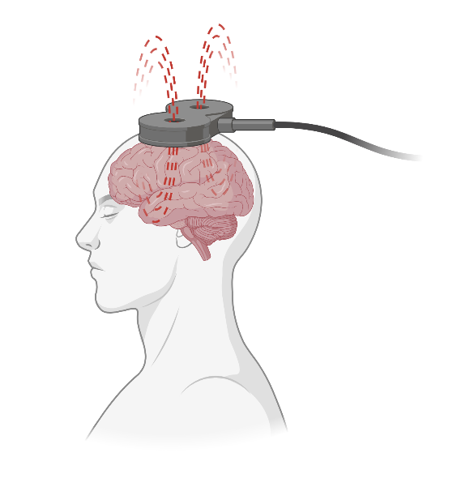
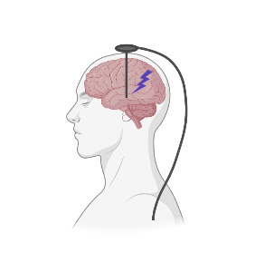
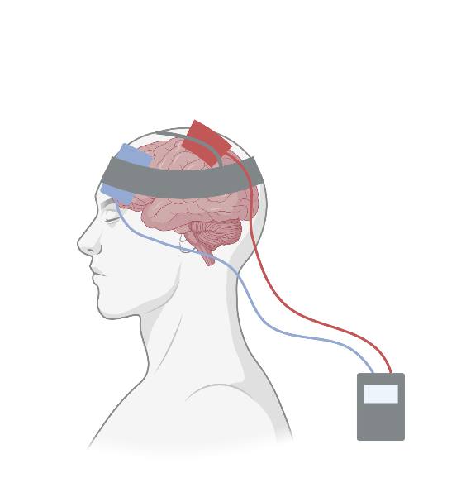
Technologies for Brain Stimulation
Transcranial
Magnetic
Stimulation
Transcranial
Electrical
Stimulation
Deep
Brain
Stimulation
Images created with BioRender.com
Notes:
Transcranial magnetic stimulation (TMS) involves the use of magnetic fields to stimulate specific regions of the brain. An electromagnetic coil is placed against the scalp, typically targeting the prefrontal cortex or other specific brain regions. The coil generates a rapidly changing magnetic field, which induces electrical currents in the underlying brain tissue. These currents can modulate the activity of neurons in the targeted area.
Transcranial electrical stimulation (TES) uses weak electrical currents to stimulate the brain. The basic principle behind TES is the application of a low-intensity electrical current to specific areas of the scalp, which then modulates the neural activity in the underlying brain regions.
Deep brain stimulation (DBS) is a surgical procedure used to treat various neurological conditions, primarily movement disorders, that involves the implantation of electrodes into specific deep brain structures to deliver electrical impulses that modulate abnormal brain activity.
Slide adapted from a presentation developed by:
Roy Hamilton, MD, MS, Professor of Neurology, University of Pennsylvania
Director, Laboratory for Cognition & Neural Stimulation
Director, Penn Brain Science, Translation, Innovation and Modulation (brainSTIM) Center

Slide 7
Transcranial Direct Current Stimulation (tDCS)
How does it work?
Subthreshold stimulation
Neurons alter firing rates
Excitatory or inhibitory
Why is it appealing?
Medically safe
Portable
Inexpensive
Easy to use
Image created with BioRender.com
Notes:
Transcranial Direct Current Stimulation (tDCS) is a type of transcranial electrical stimulation. In tDCS, two electrodes, an anode (positive electrode) and a cathode (negative electrode), are placed on the scalp. A low-amplitude direct current is passed between the electrodes, resulting in a steady flow of electrical current through the underlying brain tissue. The electrical current modulates the resting membrane potential of neurons, making them more or less likely to fire action potentials. This can lead to changes in neural excitability and activity. Direct-to-consumer tDCS products are widely available at relatively low cost but are not approved medical devices.
Slide adapted from a presentation developed by:
Roy Hamilton, MD, MS, Professor of Neurology, University of Pennsylvania
Director, Laboratory for Cognition & Neural Stimulation
Director, Penn Brain Science, Translation, Innovation and Modulation (brainSTIM) Center

Slide 8
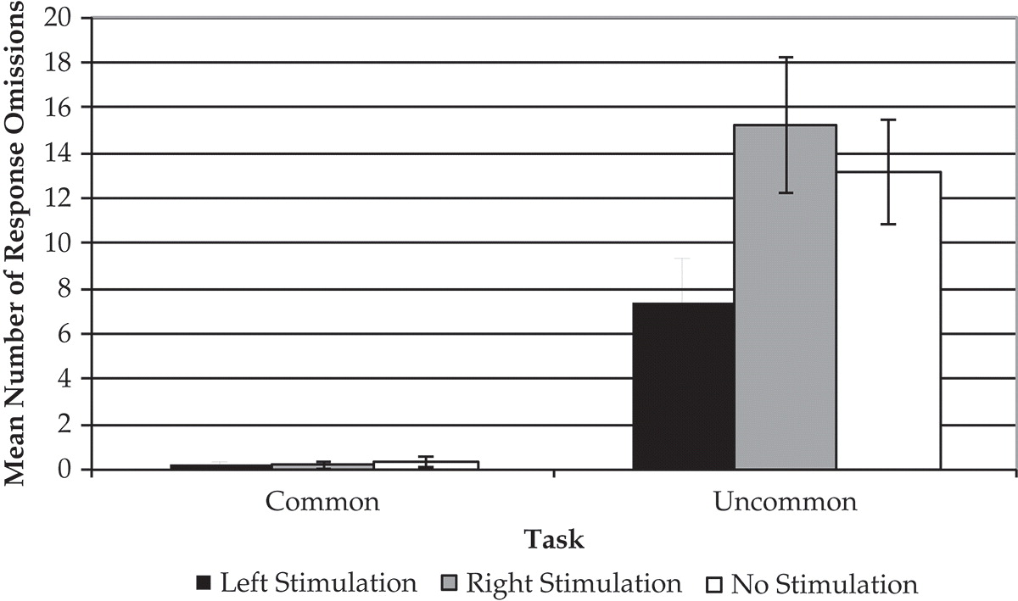
Creativity
Stimulating the left side of the brain with tDCS…
…helped people imagine more uncommon uses.
Imagine uncommon uses for everyday objects
Failed to Answer
Chrysikou et al. (2013) Cognitive Neuroscience
Notes:
Brain stimulation has been found to enhance creative thinking. In the study shown here, researchers gave participants pictures of everyday objects and had to come up with either the object’s common use or an uncommon use for it, like using tissues to blow your nose (common) or use as stuffing in a box (uncommon). Participants who received tDCS stimulation of their left prefrontal cortex were able to generate more uncommon uses (note that the graph at lower right shows the number of participants who were NOT able to answer).
Evangelia G. Chrysikou, Roy H. Hamilton, H. Branch Coslett, Abhishek Datta, Marom Bikson & Sharon L. Thompson-Schill (2013) Noninvasive transcranial direct current stimulation over the left prefrontal cortex facilitates cognitive flexibility in tool use, Cognitive Neuroscience, 4:2, 81-89, DOI: 10.1080/17588928.2013.768221
Slide adapted from a presentation developed by:
Roy Hamilton, MD, MS, Professor of Neurology, University of Pennsylvania
Director, Laboratory for Cognition & Neural Stimulation
Director, Penn Brain Science, Translation, Innovation and Modulation (brainSTIM) Center

Slide 9
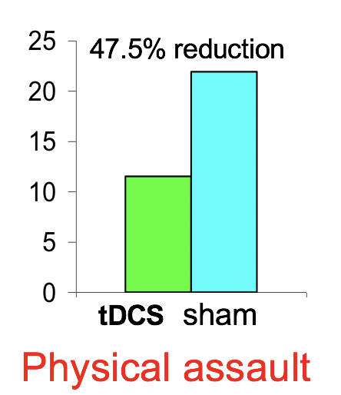
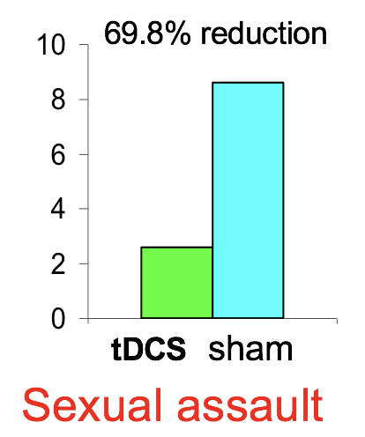
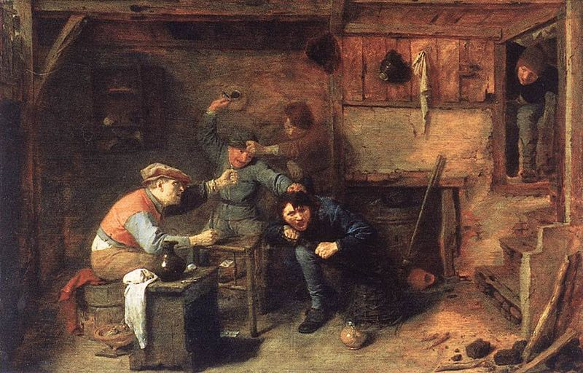
Given hypothetical scenarios of aggressive acts…
Violent Intent
% intention to commit crime
% intention to commit crime
…stimulating the prefrontal cortex with tDCS reduced the intention to commit violence.
Choy et al. (2018) Journal of Neuroscience
Notes:
Brain stimulation has been found to reduce violent intent. In the study shown here, researchers gave participants brief hypothetical vignettes of two scenarios depicting physical assault and sexual assault, and asked participants to respond with the likelihood that they would commit the aggressive act. Participants who received tDCS stimulation of their prefrontal cortex showed reduced likelihood of engaging in the aggressive acts.
Choy O, Raine A, Hamilton RH. Stimulation of the Prefrontal Cortex Reduces Intentions to Commit Aggression: A Randomized, Double-Blind, Placebo-Controlled, Stratified, Parallel-Group Trial. J Neurosci. 2018 Jul 18;38(29):6505-6512. doi: 10.1523/JNEUROSCI.3317-17.2018. Epub 2018 Jul 2. PMID: 29967006; PMCID: PMC6705949.
Image: Fighting card players in a tavern, Adriaen Brouwer, ca. 1632-33 (public domain); https://commons.wikimedia.org/wiki/File:Adriaen_Brower_-_Peasants_Fighting.jpg
Slide adapted from a presentation developed by:
Roy Hamilton, MD, MS, Professor of Neurology, University of Pennsylvania
Director, Laboratory for Cognition & Neural Stimulation
Director, Penn Brain Science, Translation, Innovation and Modulation (brainSTIM) Center

Slide 10
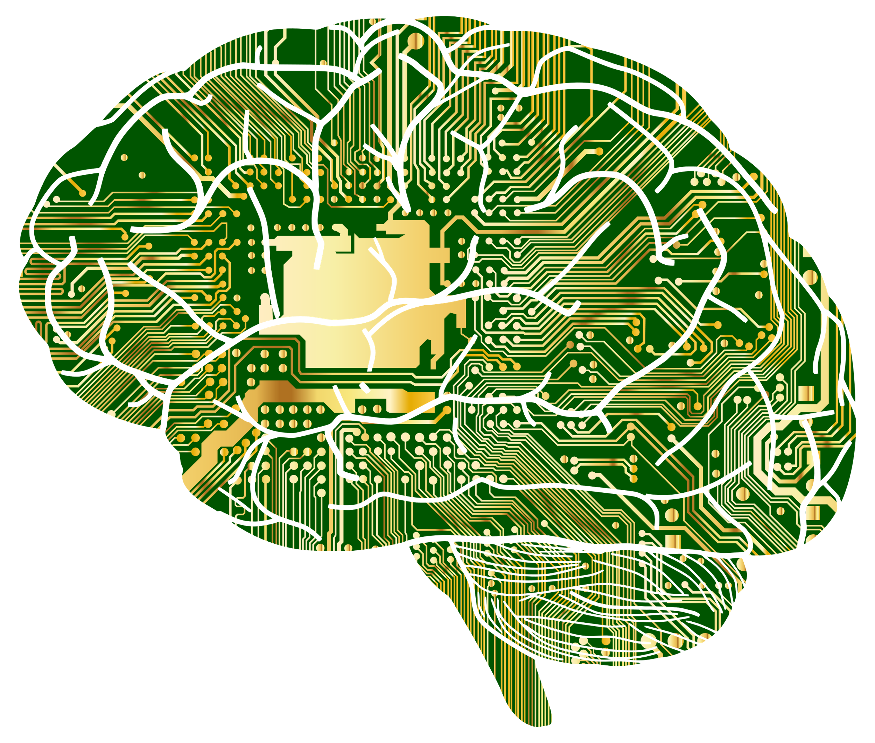
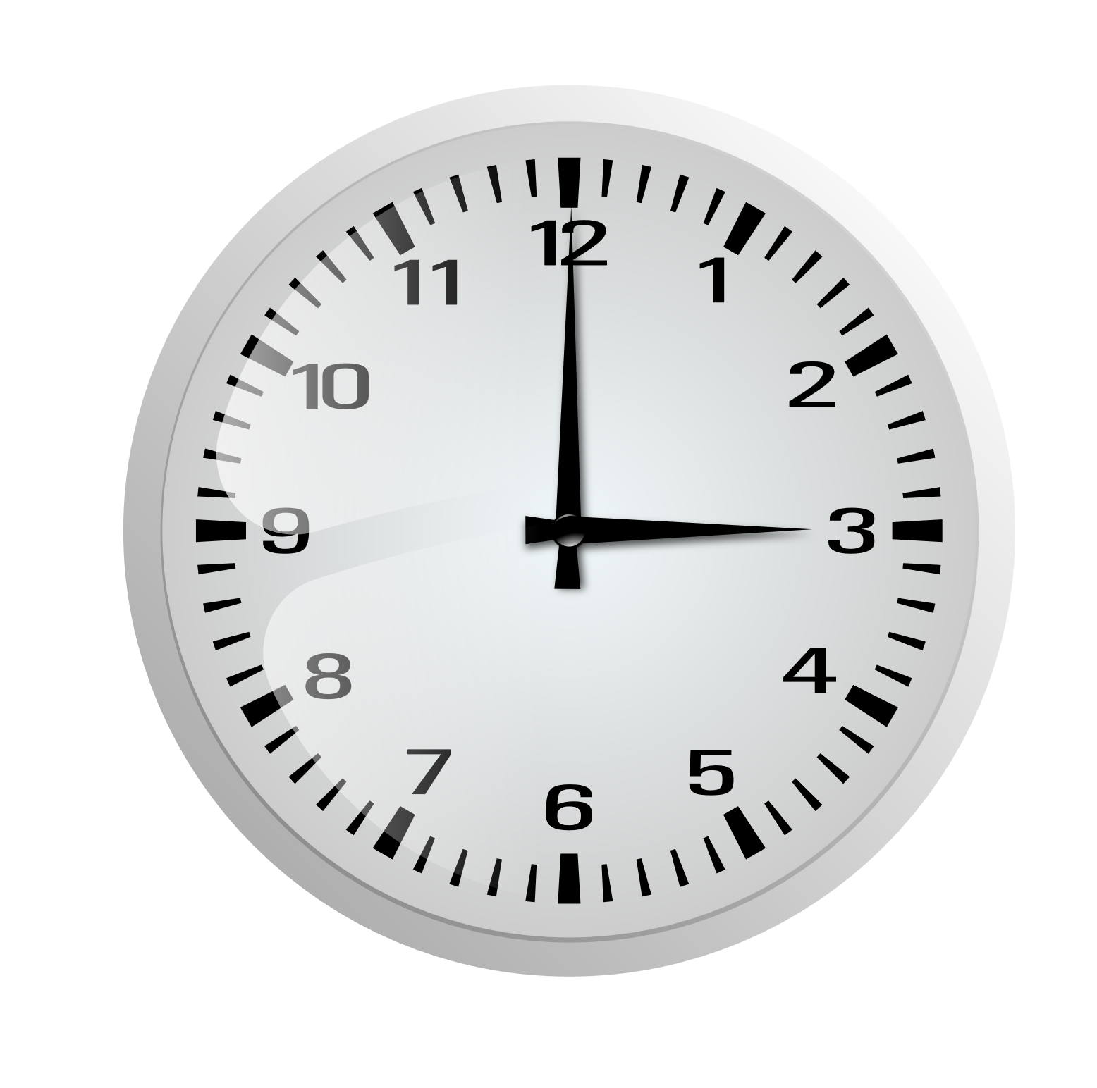
Brain stimulation can also influence…
Time perception
Language
Information processing
Addiction
Notes:
Other examples of how tDCS can affect brain function include:
Information processing - tDCS is likely to enhance working memory when applied during training, although effects vary between individuals.
(LE Mancuso, et al. J Cogn Neurosci 2016; 28 (8): 1063–1089. doi: https://doi.org/10.1162/jocn_a_00956)
Time perception - tDCS, when applied to the visual cortex, has been shown to disrupt the time perception of short intervals.
(G. Mioni, et al. Behavioural Brain Research, Volume 313, 2016, Pages 151-157, https://doi.org/10.1016/j.bbr.2016.07.019.)
Addiction – tDCS, particularly when delivered over multiple treatments, has shown effectiveness in reducing cravings for substances and food.
(Chen J, et al. Front. Psychiatry, 26 June 2020, Sec. Neuroimaging, Volume 11 - 2020. doi:10.3389/fpsyt.2020.00598)
Language – tDCS has been shown to enhance various language functions in healthy subjects, such as letter-cued word generation, verbal reaction time, picture naming, and verbal fluency.
(Monti A, et al. J Neurol Neurosurg Psychiatry 2013;84:832–842. doi:10.1136/jnnp-2012-302825)
Image credits
Brain computer - https://freesvg.org/brain-computer
Clock - https://publicdomainvectors.org/en/free-clipart/Clock-without-frame-vector-drawing/12696.html
Addiction – Jose Luis Navarro/RVAHub, CC BY-SA 4.0
Speech bubbles - Vectorportal.com, CC BY-SA 4.0
Slide adapted from a presentation developed by:
Roy Hamilton, MD, MS, Professor of Neurology, University of Pennsylvania
Director, Laboratory for Cognition & Neural Stimulation
Director, Penn Brain Science, Translation, Innovation and Modulation (brainSTIM) Center

Slide 11
Interest in brain stimulation is growing
Among researchers…
Research papers
Year
Notes:
Research into brain stimulation has grown rapidly in the last 15 years.
Slide adapted from a presentation developed by:
Roy Hamilton, MD, MS, Professor of Neurology, University of Pennsylvania
Director, Laboratory for Cognition & Neural Stimulation
Director, Penn Brain Science, Translation, Innovation and Modulation (brainSTIM) Center

Slide 12
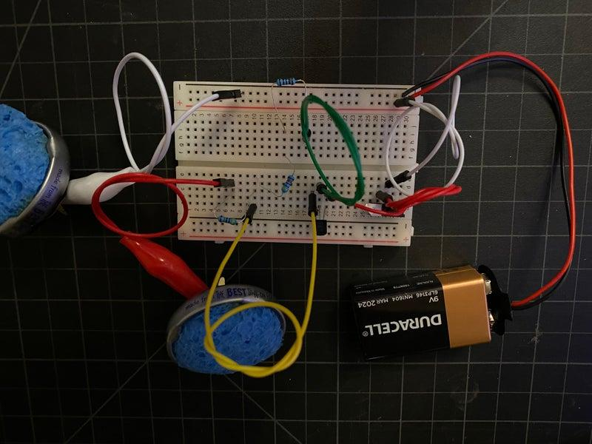
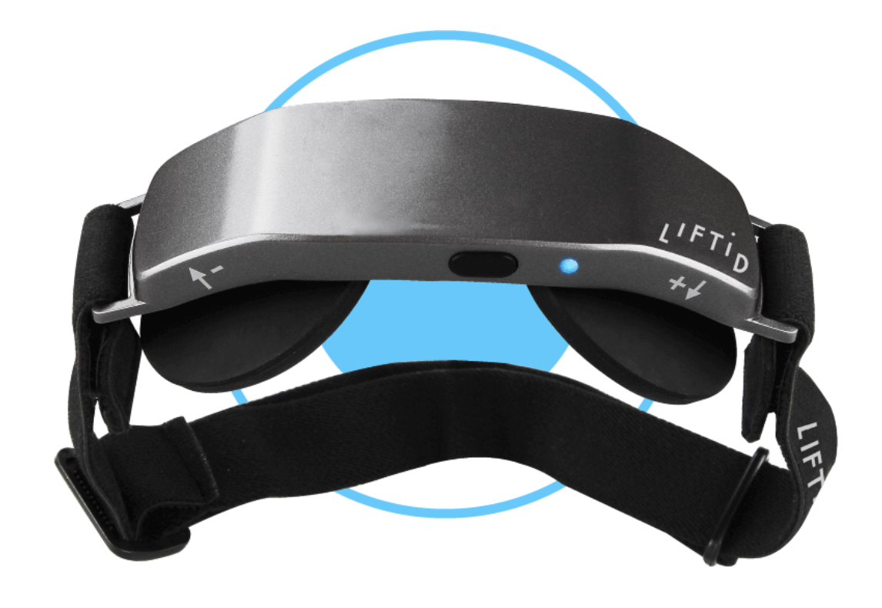
Interest in brain stimulation is growing
…and in the public eye.
getliftid.com
Notes:
At the same time, there is increased public awareness of and access to brain stimulation technology. LIFTiD is a direct-to-consumer tDCS device that has been featured on popular television shows. There are also online tutorials for building your own DIY tDCS device.
Images:
LIFTiD: https://www.getliftid.com/
DIY tDCS device: tylerpridemilligan, CC BY-NC-SA 4.0, https://www.instructables.com/DIY-Wearable-TDCS-Device/
Slide adapted from a presentation developed by:
Roy Hamilton, MD, MS, Professor of Neurology, University of Pennsylvania
Director, Laboratory for Cognition & Neural Stimulation
Director, Penn Brain Science, Translation, Innovation and Modulation (brainSTIM) Center

Slide 13
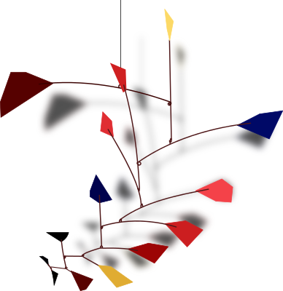
What might be unintended consequences & tradeoffs?
Questions to consider
What do pain and struggle mean for character?
Notes:
As brain stimulation technology becomes more widespread, there are many questions to consider about its ethical and societal impacts. For example…
How might the use of brain stimulation for one purpose lead to unintended consequences and tradeoffs?
What do pain and struggle mean for character? If brain stimulation reduces effort, does it change the value of our accomplishments? Will it affect how we develop persistence and resilience?
Images:
Donchico, Openclipart, https://openclipart.org/detail/249413/calder-style
Mohamed_hassan, Pixabay, https://pixabay.com/vectors/challenge-difficulty-struggle-hill-6689107/
Slide adapted from a presentation developed by:
Roy Hamilton, MD, MS, Professor of Neurology, University of Pennsylvania
Director, Laboratory for Cognition & Neural Stimulation
Director, Penn Brain Science, Translation, Innovation and Modulation (brainSTIM) Center

Slide 14
Will the technology be available and accessible to all?
Questions to consider
Will people feel forced to keep up with a “new normal”?
Notes:
Who will have access to the technology? How can we ensure fairness and equity?
Will people feel as though they have free choice, or will they feel coerced to use it if the technology becomes widespread?
Images:
Perhelion, Wikimedia Commons, https://commons.wikimedia.org/wiki/File:Balanced_scale_of_Justice.svg
Slide adapted from a presentation developed by:
Roy Hamilton, MD, MS, Professor of Neurology, University of Pennsylvania
Director, Laboratory for Cognition & Neural Stimulation
Director, Penn Brain Science, Translation, Innovation and Modulation (brainSTIM) Center

Slide 15
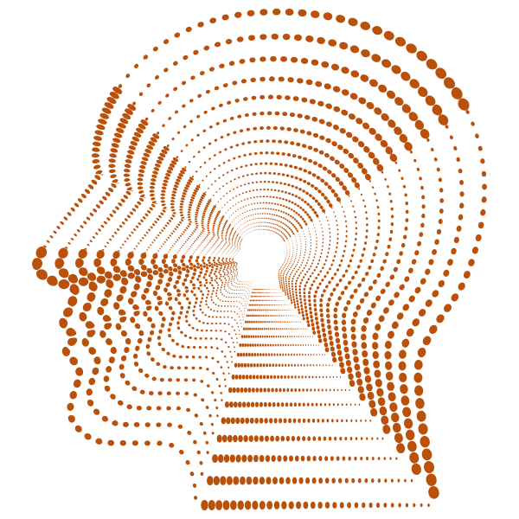
What uses do we think are morally acceptable?
Questions to consider
Traits that are core vs. peripheral to identity?
Self vs. others?
Medaglia et al. (2019) Brain Stimulation
Notes:
What uses do we think are morally acceptable? Scientists have studied public perceptions of a) whether it is more acceptable to enhance traits that are core to identity (e.g., empathy or kindness) vs. more peripheral (e.g., rote memory or concentration) and b) whether it is more acceptable to enhance traits in others vs. yourself. Interestingly, results of one study suggest that for core traits, people would more readily use enhancement in others than for themselves.
Medaglia JD, Yaden DB, Helion C, Haslam M. Moral attitudes and willingness to enhance and repair cognition with brain stimulation. Brain Stimul. 2019 Jan-Feb;12(1):44-53. doi: 10.1016/j.brs.2018.09.014.
Slide adapted from a presentation developed by:
Roy Hamilton, MD, MS, Professor of Neurology, University of Pennsylvania
Director, Laboratory for Cognition & Neural Stimulation
Director, Penn Brain Science, Translation, Innovation and Modulation (brainSTIM) Center

Slide 16
What comes next?
We need many perspectives to inform:
What is possible and what is likely
What to look out for
What we can learn from history
How to balance autonomy with public safety
How to create specific and effective policies
Notes:
The future of brain stimulation requires scientists to be in dialogue with experts in different fields, people with lived experience, and diverse public audiences to bring together different perspectives. Conversations such as this program are a great way to start discussions about the values, priorities, and choices we all bring to the table.
Images:
Karen Arnold, https://www.publicdomainpictures.net/en/view-image.php?image=191239&picture=statue-of-liberty-logo
Slide adapted from a presentation developed by:
Roy Hamilton, MD, MS, Professor of Neurology, University of Pennsylvania
Director, Laboratory for Cognition & Neural Stimulation
Director, Penn Brain Science, Translation, Innovation and Modulation (brainSTIM) Center

Slide 17
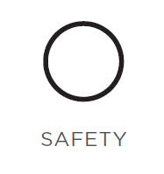
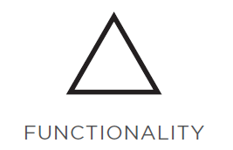
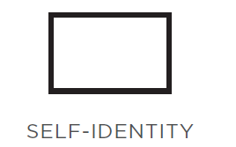
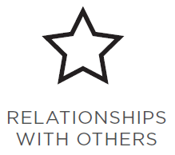
Using only these symbols (no words), draw a picture that represents how your values would shape your decision to use a brain stimulation device.
Notes:
Instructions for Personal Values drawing exercise. Explain that the goal of this exercise is to think about how different factors would shape your personal decision to use a brain stimulation device, or not. There are no right or wrong answers – you can use each symbol once or as many times as you like. Each symbol represents a general concept as indicated. It is NOT recommended to show examples of drawings before the activity so that participants can apply their own imagination and interpretation. Invite people to make their own meaning of each concept, but some broad guidance might be:
safety - how would it impact your health?
functionality - is it effective? does it actually work?
self-identity - how might it change how you see yourself?
relationships with others - how would it affect the way you interact with your family/friends/community?
fairness – who has access? do people have equal outcomes?
This activity was adapted from the “Drawing Together” activity from Liberating Structures developed by Henri Lipmanowicz and Keith McCandless (https://www.liberatingstructures.com/20-drawing-together/).

Slide 18
A new brain stimulation headset comes out that gives a small boost to attention and focus. Stand up for uses you agree with.
A person reading for pleasure uses the device to help them focus after a long day at work.

Slide 19
A new brain stimulation headset comes out that gives a small boost to attention and focus. Stand up for uses you agree with.
City bus drivers are issued the device to help stay attentive during long routes.

Slide 20
A new brain stimulation headset comes out that gives a small boost to attention and focus. Stand up for uses you agree with.
Students studying for finals ask their parents to buy the headset to get ahead in their studies.

Slide 21
A new brain stimulation headset comes out that gives a small boost to attention and focus. Stand up for uses you agree with.
Surgeons opt to use the headset to enhance attention and precision during long procedures.

Slide 22
A new brain stimulation headset comes out that gives a small boost to attention and focus. Stand up for uses you agree with.
Gamers use the headset to maintain their lead in an online competition.

Slide 23
With your group, choose a scenario:
Everyday consumers
Bus drivers
Students
Surgeons
Gamers
Discuss:
Who would benefit from widespread implementation?
What might be some unexpected consequences?
What information would you want to know to decide?
Who should be involved in the decision?

