Slide 1
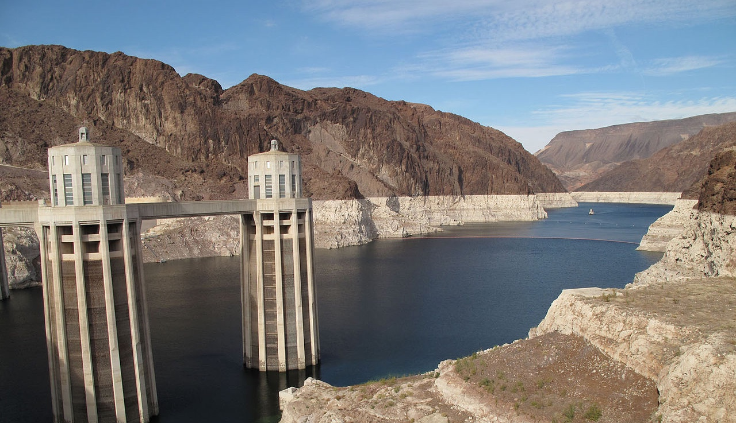
DROUGHT
Notes:
Kamlynn:
With that, I’ll turn it over to Nich Weller to get us started on our first deliberation event on drought

Slide 2
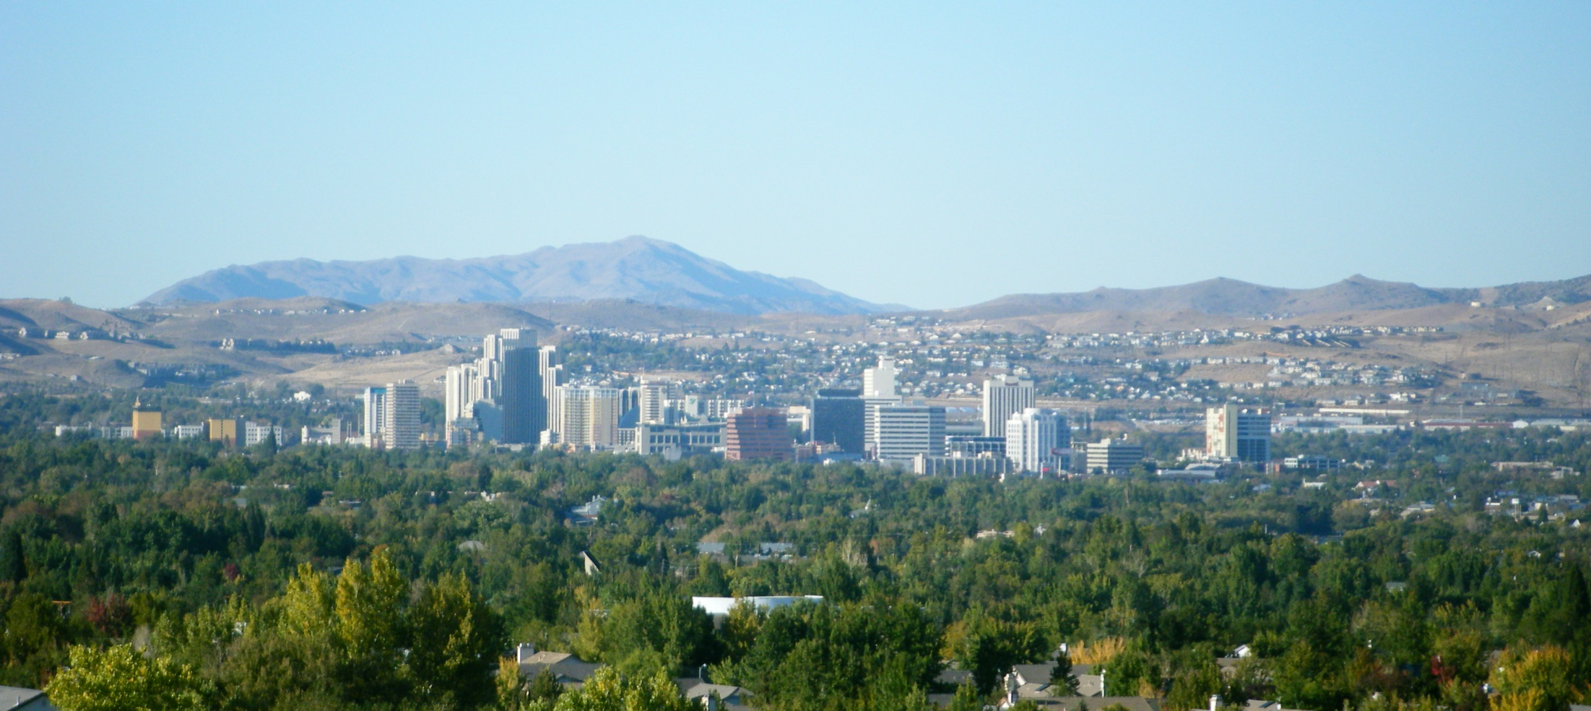
Welcome to Ottawatta
Drought
Notes:
Today we will be making a resilience plan for drought here in Ottawatta. Before you can make a plan, however, you should learn a little bit about the city and who lives there. Also, I can’t take credit for the name. A wonderfully clever friend suggested it.

Slide 3
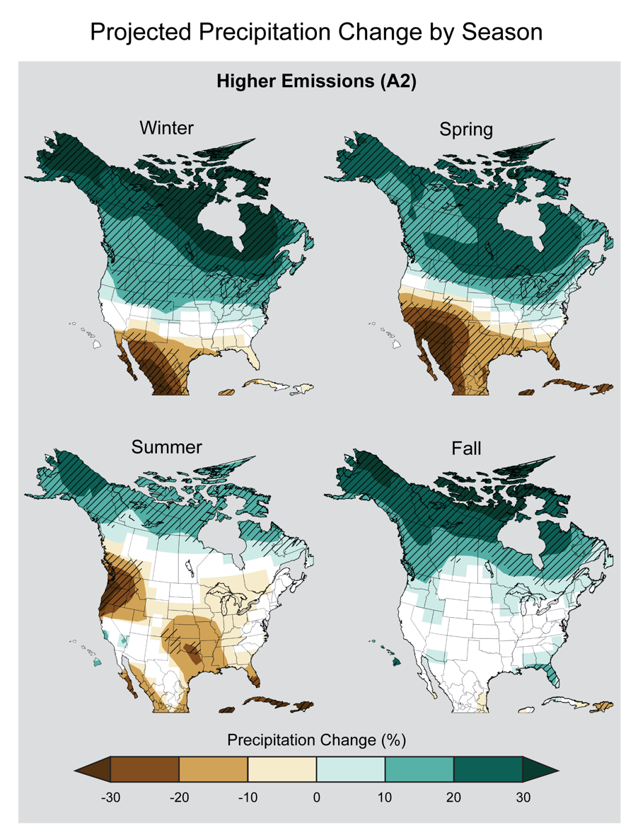
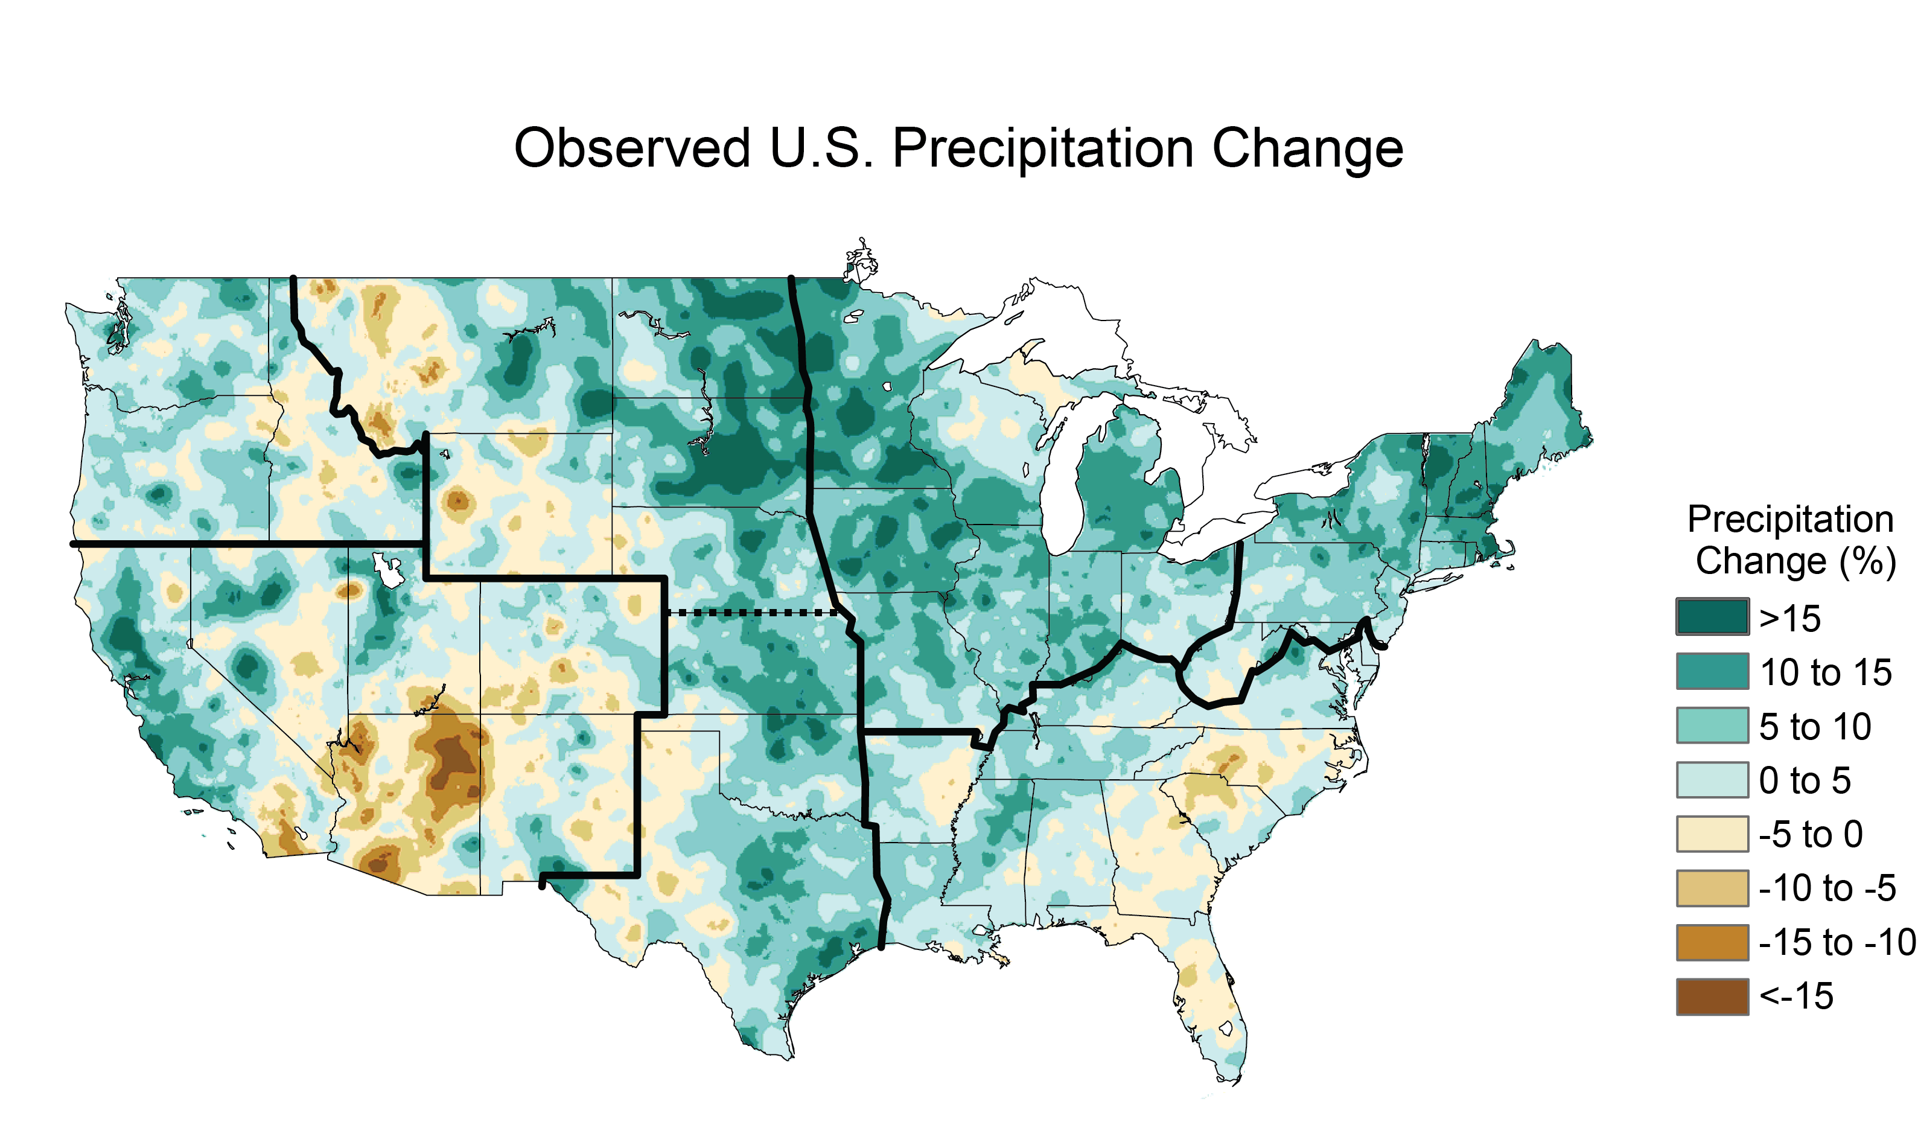
Droughts occur regularly across the U.S. but may become more common and severe in the future
Notes:
Welcome to Ottawatta! Ottawatta, like other parts of the country has seen a decline in rainfall over the last 40 years and may face longer, more severe droughts in the future.
LEFT: The colors on the map show annual total precipitation changes for 1991-2012 compared to the 1901-1960 average. You can see places across the west and southeast have experienced drier than normal conditions.
RIGHT: Projected change in seasonal precipitation for 2071-2099 (compared to 1970-1999) under an emissions scenario that assumes continued increases in emissions (A2).Hatched areas indicate that the projected changes are significant and consistent among models. White areas indicate that the changes are not projected to be larger than could be expected from natural variability. In general, the northern part of the U.S. is projected to see more winter and spring precipitation, while the southwestern U.S. is projected to experience less precipitation in the spring. (Figure source: NOAA NCDC / CICS-NC).

Slide 4

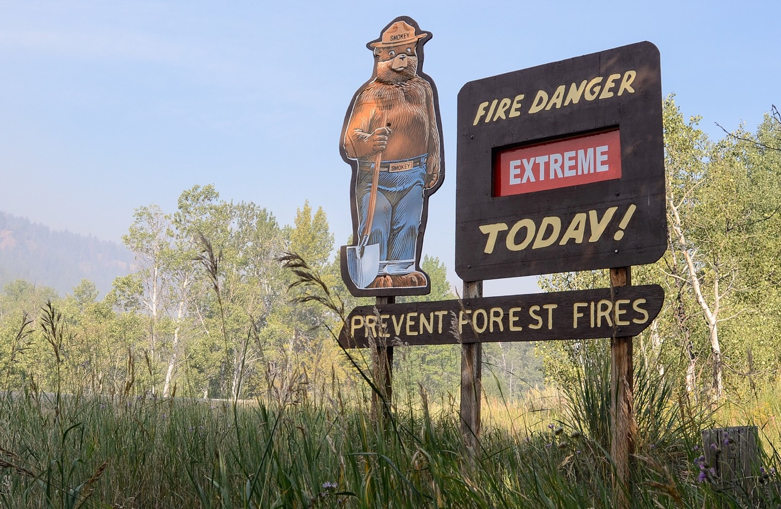
Droughts threaten human well-being
Notes:
Drought increases risk of wildfires and dust storms, which both reduce air quality affecting human health.
Of course, drought can also lead to water shortages which poses a threat to health and economic well-being of an area.

Slide 5
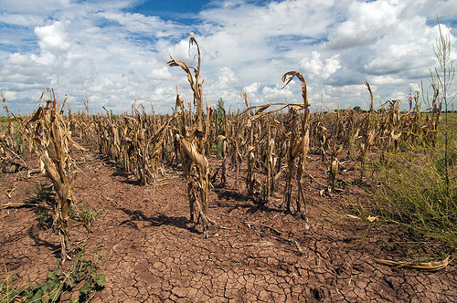
Droughts impact the economy
Notes:
“The historic Texas drought has led to a record $5.2 billion in agricultural losses, making it the most costly drought on record, according to Texas AgriLife Extension Service economists.”

Slide 6
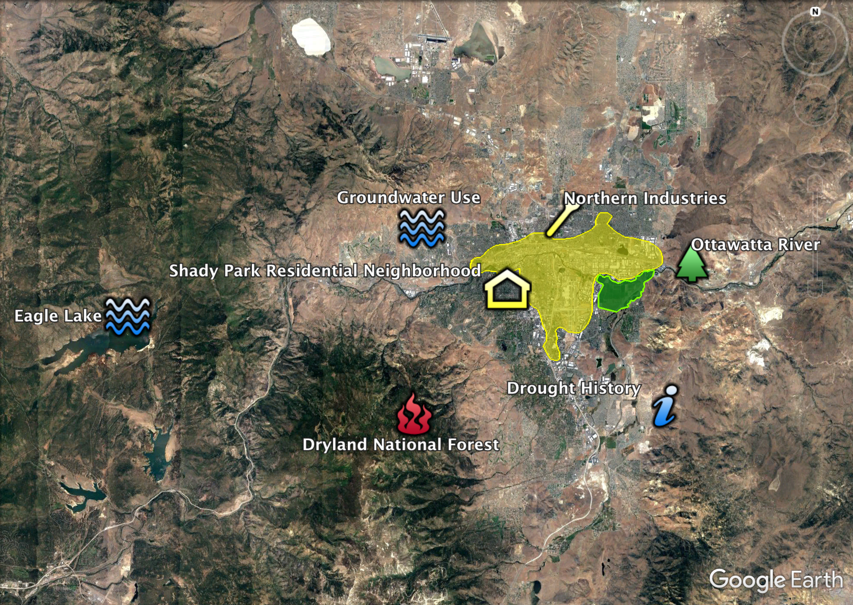
What makes Ottawatta vulnerable?
Notes:
So let’s learn a little more about Ottawatta. This map shows some important ways ottawatta might be affected by drought. The facilitators at each of your tables’ can pull this map up on their computer later if you want more details. First, let’s explore how Ottawatta has been affected by droughts in the past.

Slide 7
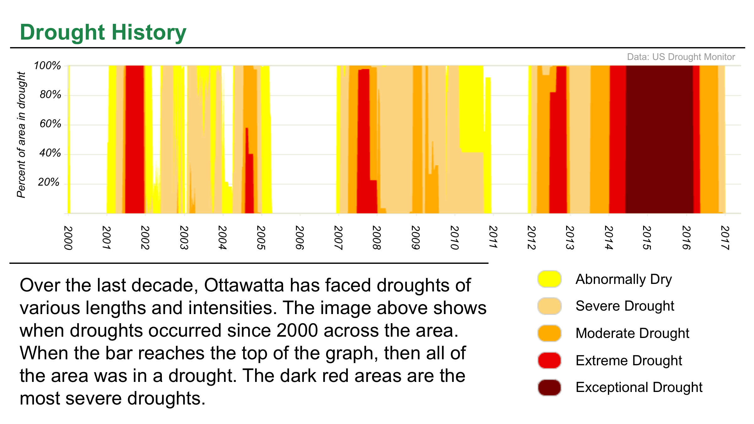
Notes:
This graph shows when Ottawatta has experienced drought over the last decade. The darker colors indicate the entire region experienced a severe drought from 2014-2016.

Slide 8
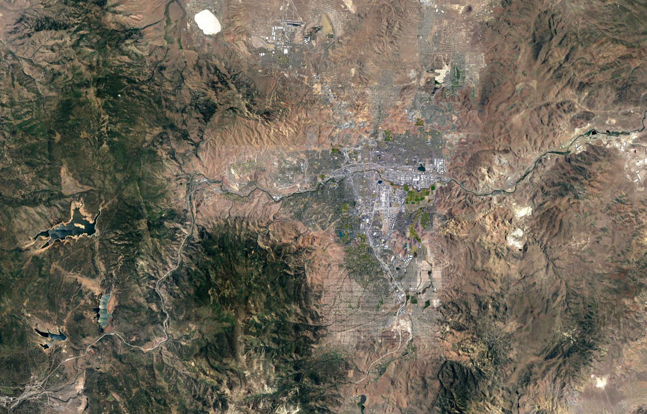
Notes:
And this drought had impacts on the environment around ottawatta. This is an areal image of ottawatta, you can see the core of the city here in the middle of the image and some mountains surrounding it to the west and south.

Slide 9
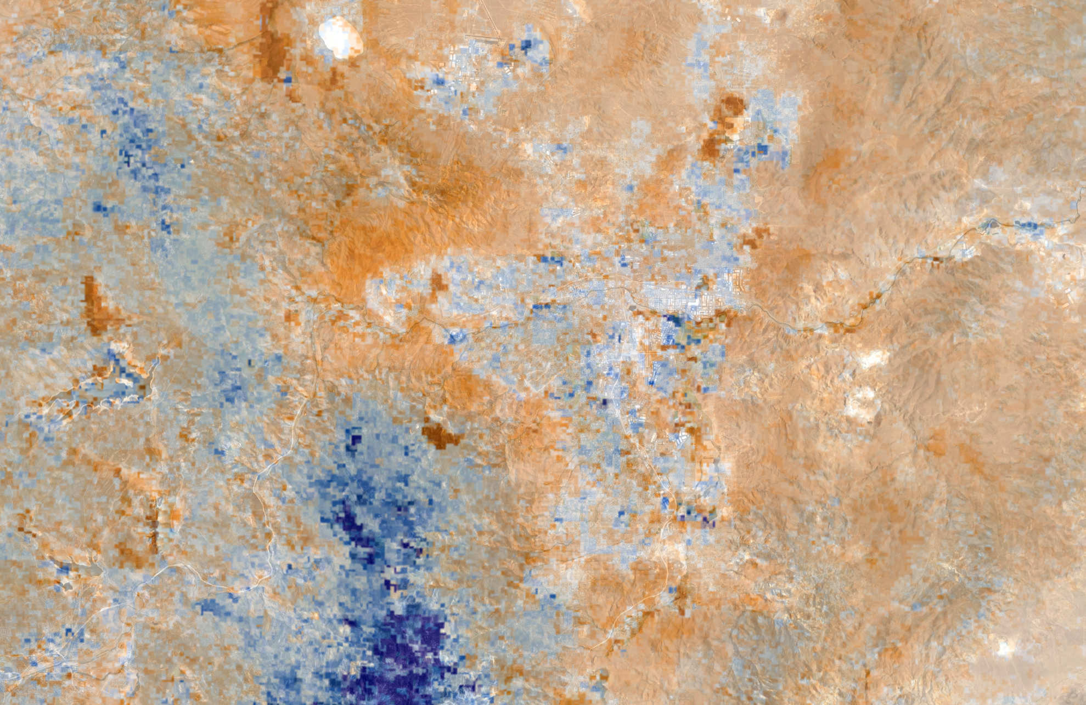
Notes:
This map shows areas that were less green, as measured by satellites, than usual during that severe drought in 2014. The red areas are less green and the blue areas are more green. You can see that drought doesn’t affect all ottawatta evenly.

Slide 10
Notes:
But how might this drought impact the people that live in Ottawatta?
About 600,000 people live here. And all of those people get their water from either groundwater or the reservoir that’s nearby.

Slide 11
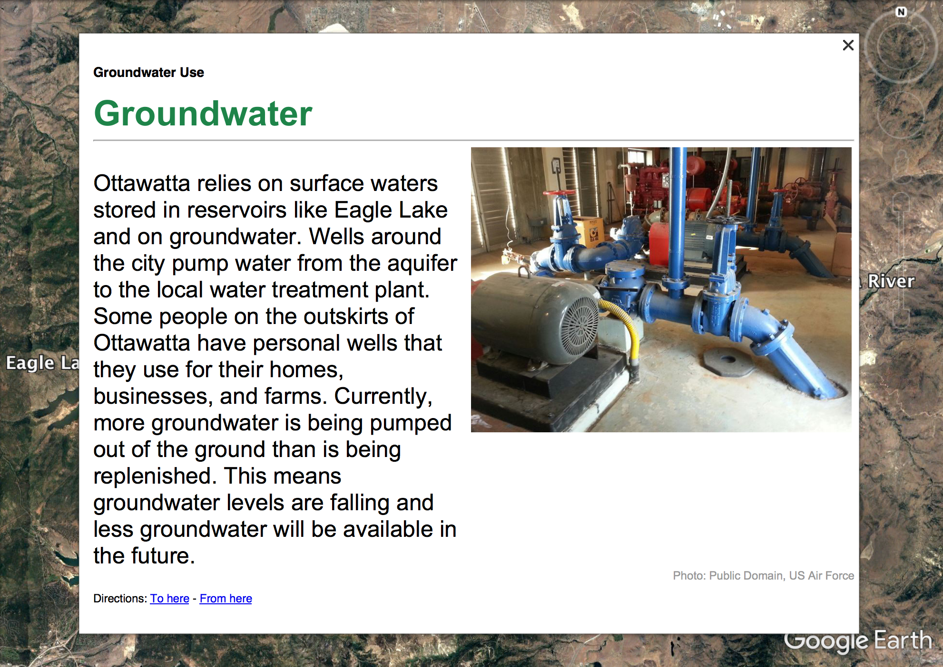
Notes:
So let’s look at Ottawatta’s water supply. Ottawatta gets about 1/3 of it’s water from groundwater. But excessive groundwater pumping can lead to falling groundwater levels.

Slide 12
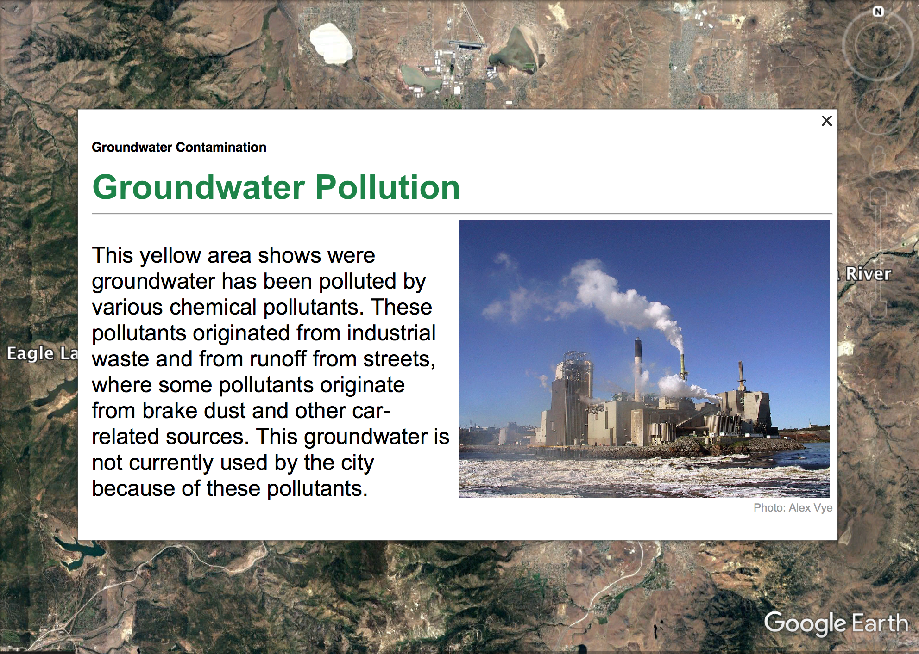
Notes:
[change map] But not all of that water is usuable. Pollution from runoff and from industrial sources has left a large portion of the groundwater unusable.

Slide 13
Notes:
This yellow patch in the middle of the city shows where that polluted groundwater lies

Slide 14
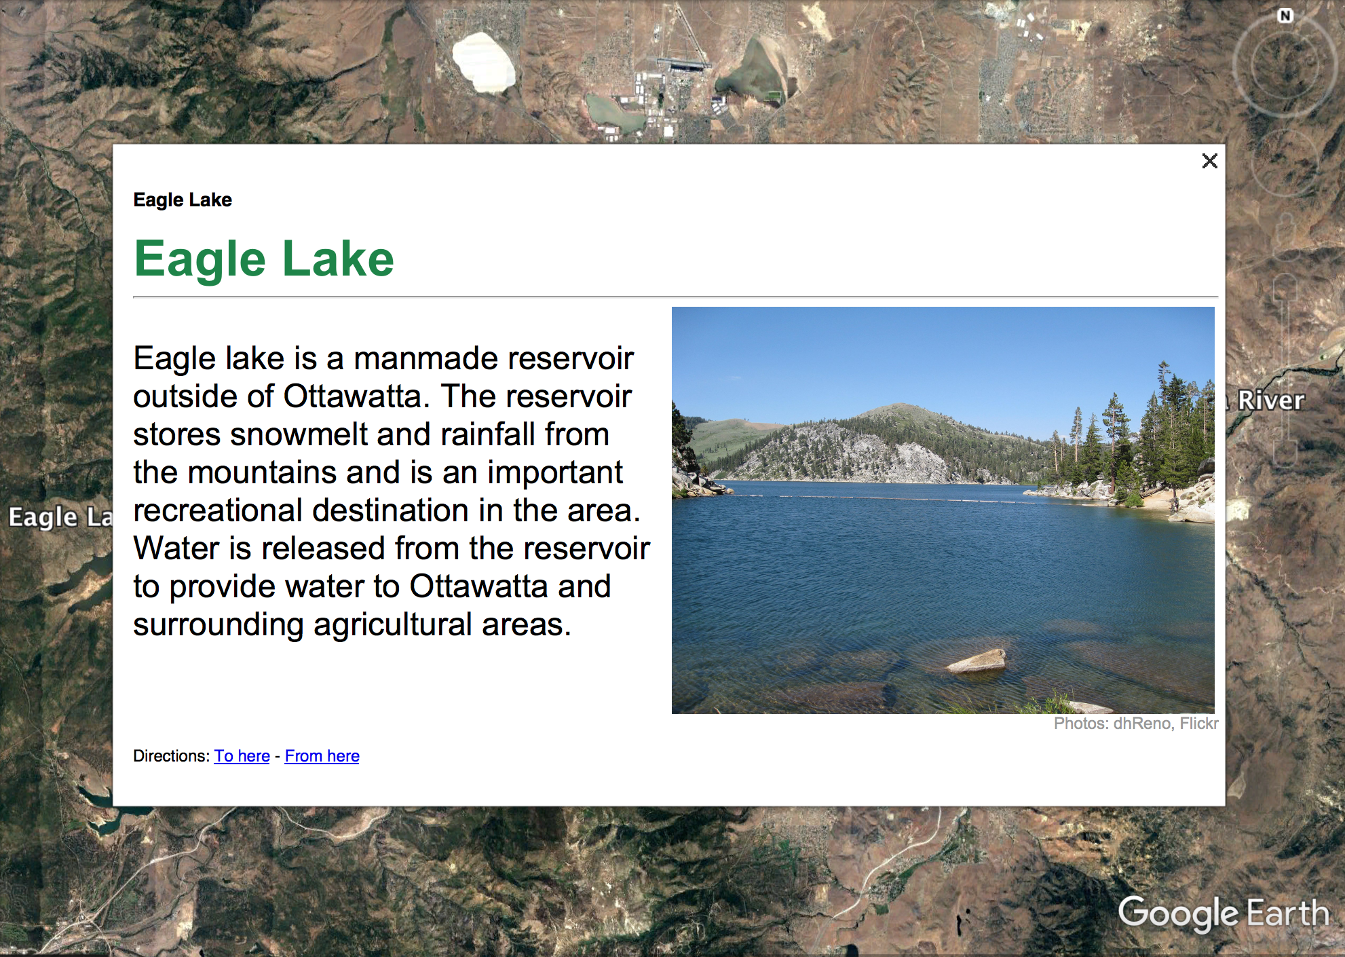
Notes:
Ottawatta also uses surface water from a nearby lake, which is dammed and used to store water for Ottawatta.

Slide 15
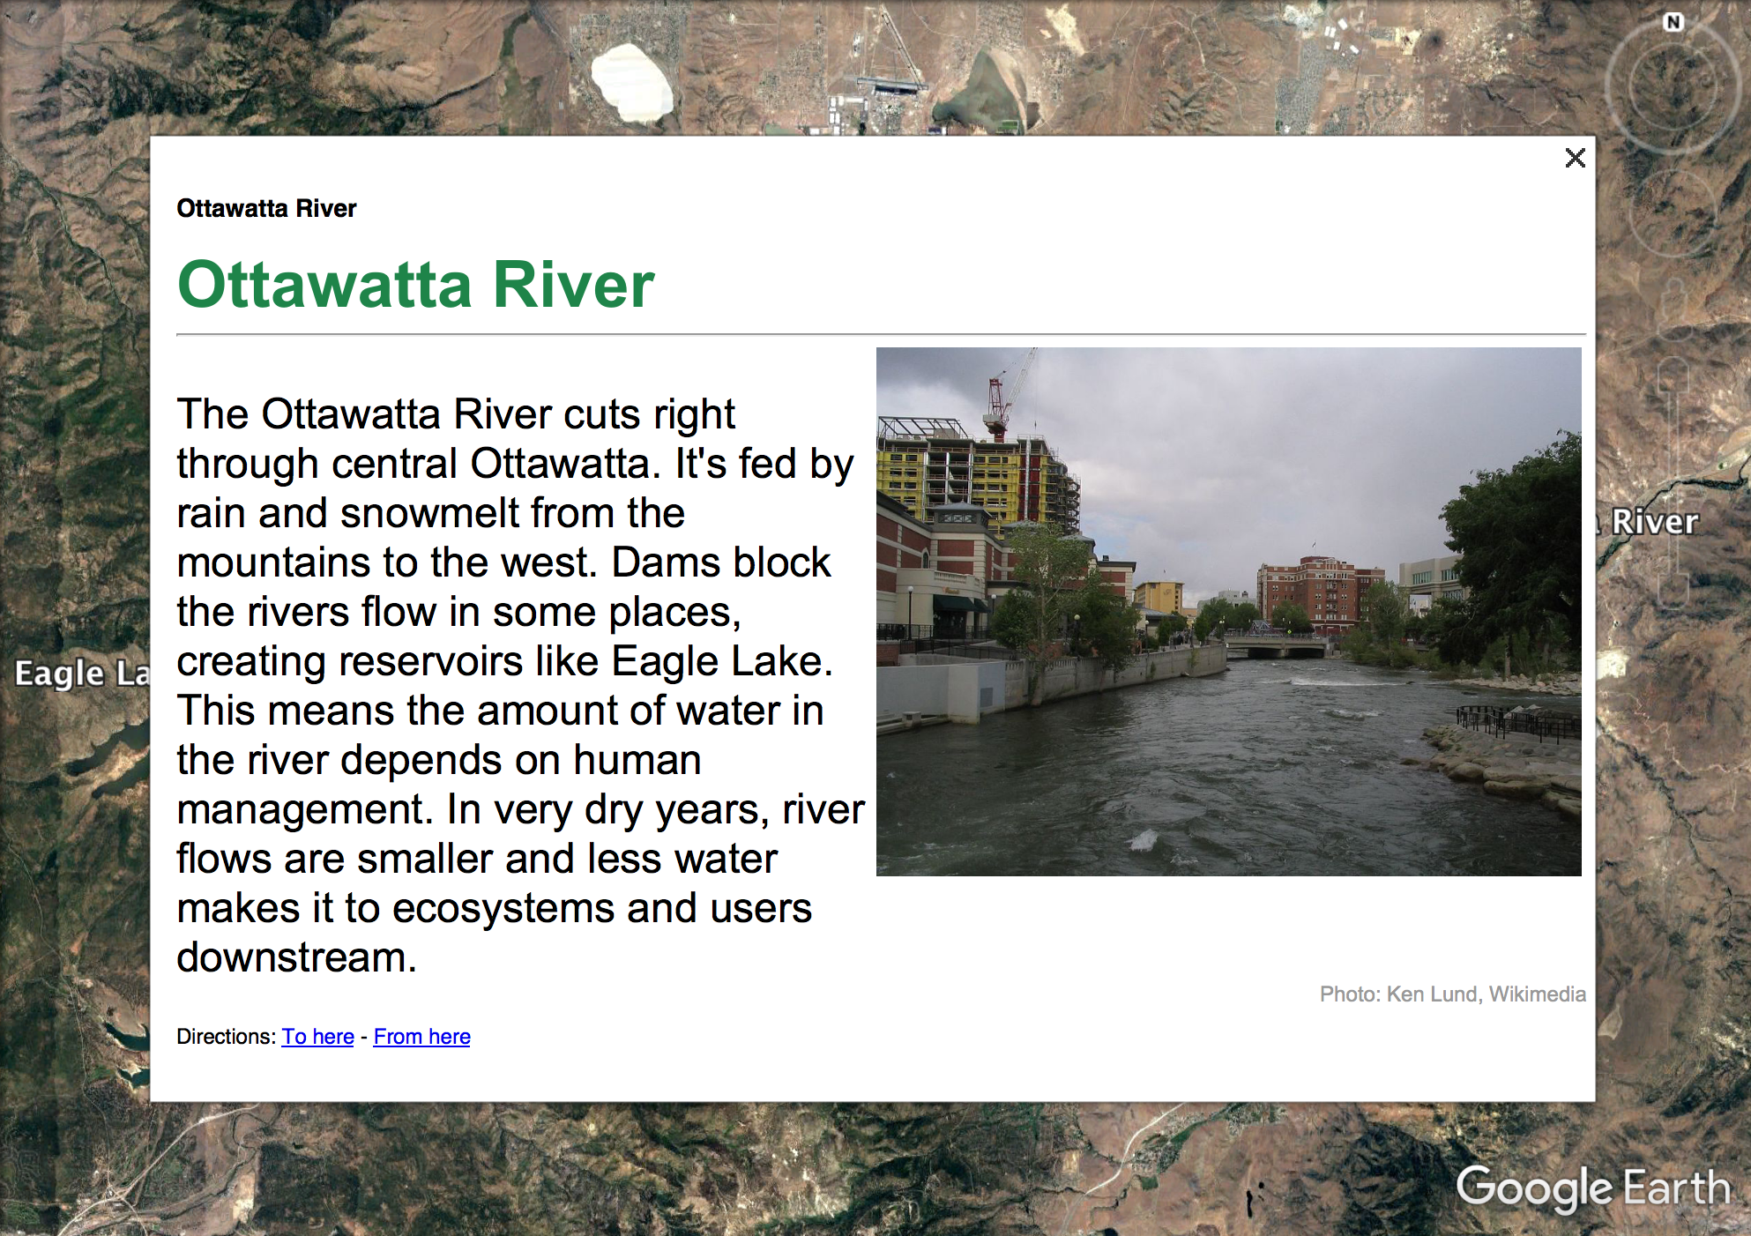
Notes:
Water released from that lake flows through Ottawatta where some of it is used and some goes to farms downstream.

Slide 16
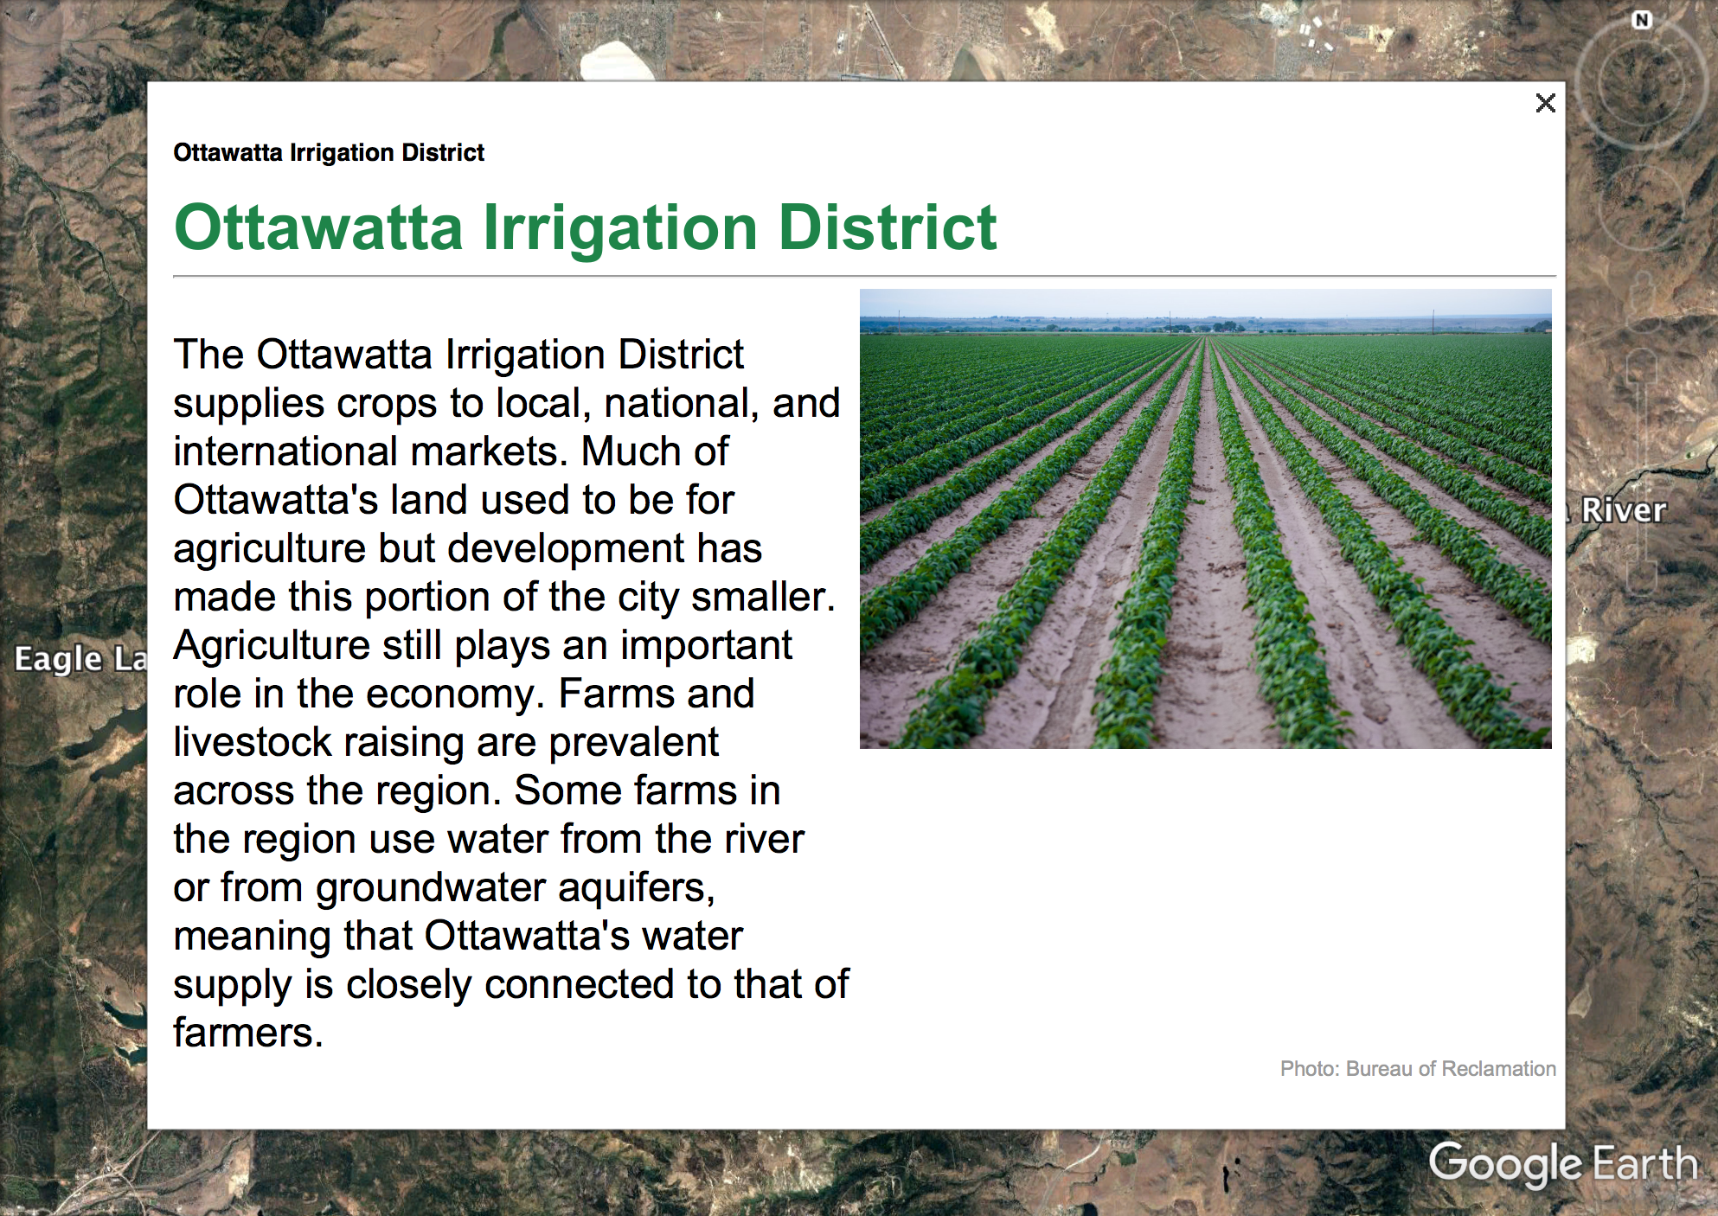
Notes:
The green area on the map shows on such farm area that receives water from the river.

Slide 17
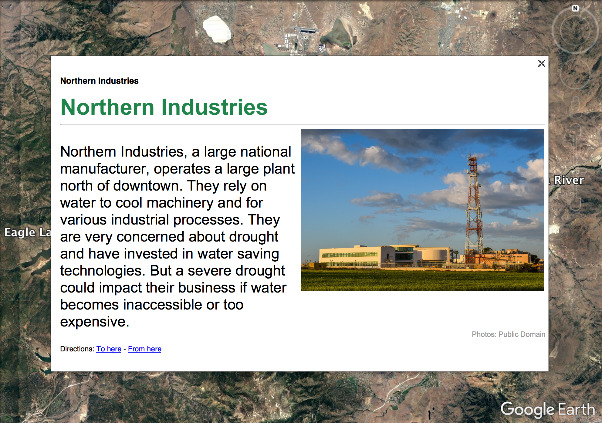
Notes:
While farming and ranching are important to ottawatta’s economy, so is manufacturing. There’s a major manufacturing plant in the city that uses a lot of water.

Slide 18
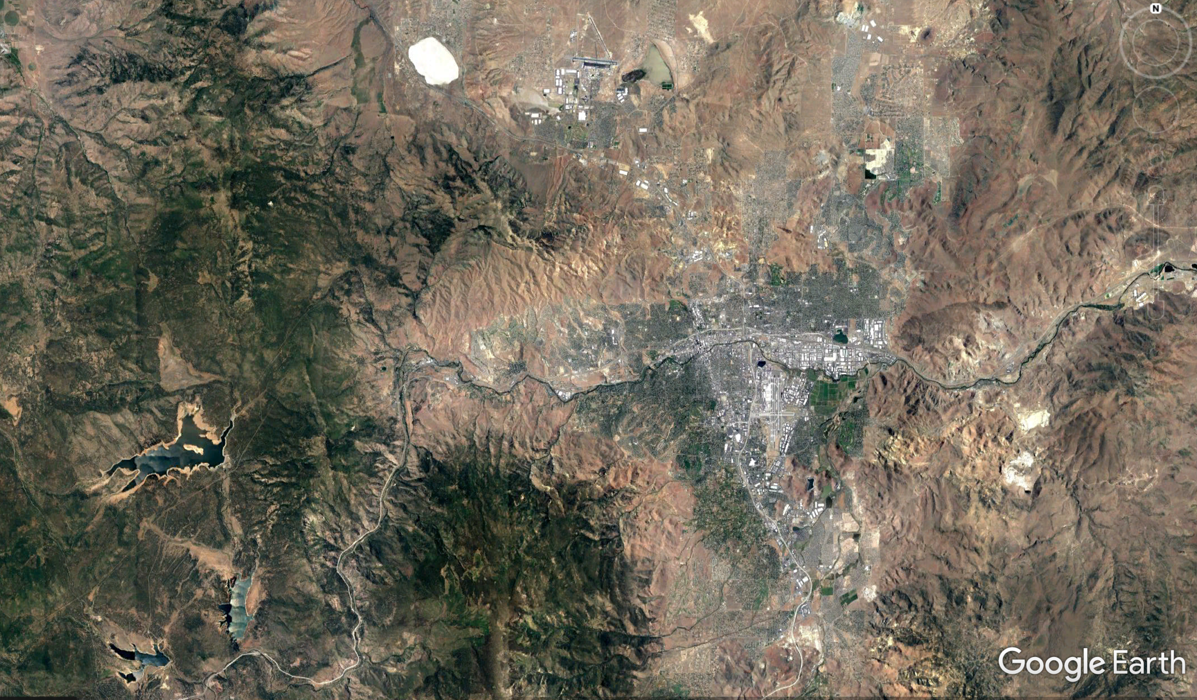
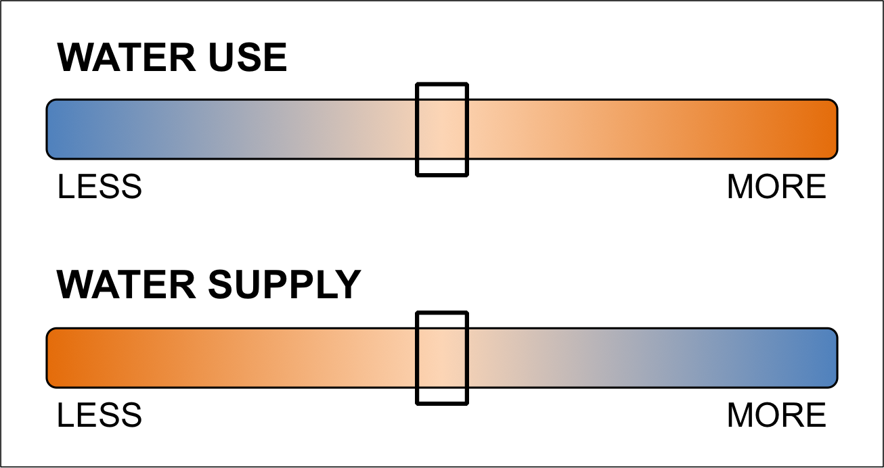
What makes Ottawatta vulnerable?
Notes:
As you work through your resilience plans for Ottawatta, you’ll see this little diagram. This diagram shows how much water Ottawatta uses and how much water supply is available based on the different decisions you all make. Generally, Ottawatta will be more resilient if it can increase water supply and decrease water use. But remember that this diagram does not predict future drought, it just shows the impacts of the decisions you all make today.

Slide 19
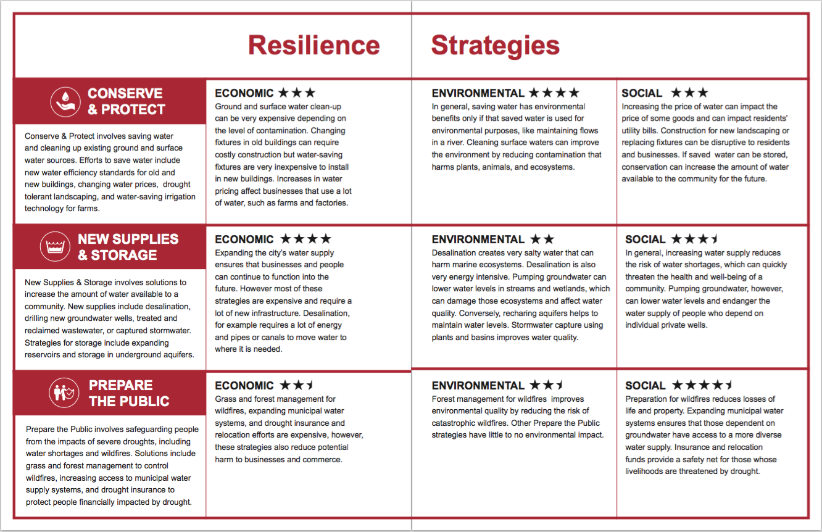
Notes:
So how do we make Ottawatta more prepared and resilient to drought? Well that’s what you’ll all be discussing this morning. In your background information packets, which I’m sure you all read very thoroughly, are 3 strategies for dealing with drought. These are conserving and protecting existing water sources, finding new supplies and storing more water for the future, or preparing the public for the human impacts of drought.

Slide 20
Resilience for Ottawatta
Step 1: Consider Stakeholder Perspectives
Step 2: Prioritize Stakeholder Values
Step 3: Make your Resilience Plan
Step 4: Implement and Explore Your Resilience Plan
Notes:
So let’s get started!! Today you will act as the resilience planning team for the city of Ottawatta. Your team’s task is to create a plan that makes Ottawatta more resilient to drought while considering the values of people who live there, the impacts on the economy and the effects on the environment of the city. Follow the steps below to create your plan, then implement and explore your plan using digital visualizations.

Slide 21
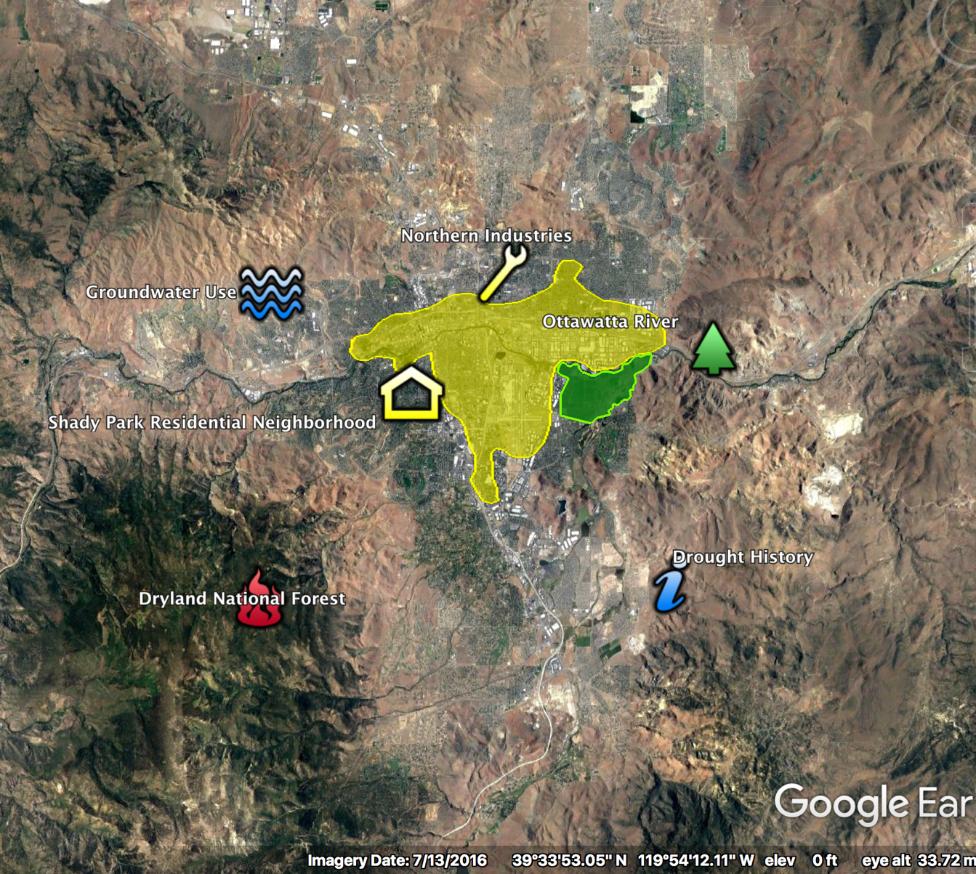
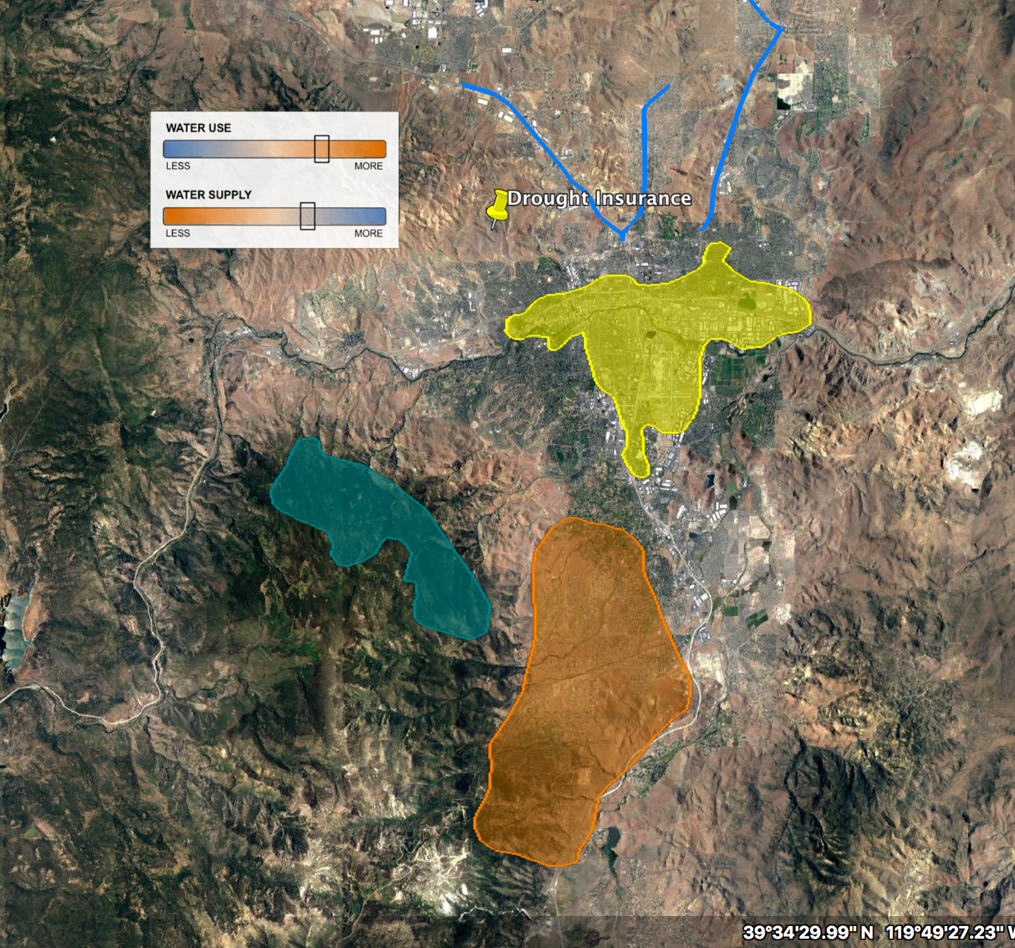
Resilience for Ottawatta
Notes:
Let’s start planning! You will begin by learning about the stakeholders, or people who will be affected by extreme precipitation and the resilience plans you will put in place, then you will discuss some options for a plan, and then finally visualize them (hit next).
Now, your facilitators will begin section 1. You will have two minutes for table introductions then 15 minutes for section 1. Please keep track of time!
Participants, please remove the Red Drought Workbooks from your folders.
Facilitators please turn to page 1 of your facilitation guide and take out the stakeholder cards.
You may now begin.
Good luck and have fun!

Slide 22
Table introductions
2
MINUTES
112 minutes total

Slide 23
Section 1: consider stakeholder perspectives
15
minutes
110 minutes total

Slide 24
Section 1: consider stakeholder perspectives
10
minutes
105 minutes total

Slide 25
Section 1: consider stakeholder perspectives
5
minutes
100 minutes total

Slide 26
Section 2: prioritize Stakeholder values
25
minutes
95 minutes total
Notes:
Facilitators, we are now on Section 2. You will need the stakeholder icons located in a white envelope in your folder. There are three sets of all six of the stakeholders. You will use one set per strategy on the board. Please remember to tape these down at the end of the section.

Slide 27
Section 2: prioritize Stakeholder values
20
minutes
90 minutes total

Slide 28
Section 2: prioritize Stakeholder values
15
minutes
85 minutes total

Slide 29
Section 2: prioritize Stakeholder values
10
minutes
80 minutes total

Slide 30
Section 2: prioritize Stakeholder values
5
minutes
75 minutes total

Slide 31
Section 3: Make your resilience plan
25
minutes
70 minutes total
Notes:
Facilitators, we are now on Section 3. You will need the A & B cards and three coin chips. Participants can turn to the section in their workbooks that says Resilience Plans to follow along. Remember, only individual opinions are recorded in the workbooks. Table results are recorded on the board! What is in your workbook and on the board do not need to match!

Slide 32
Section 3: Make your resilience plan
20
minutes
65 minutes total

Slide 33
Section 3: Make your resilience plan
15
minutes
60 minutes total

Slide 34
Section 3: Make your resilience plan
10
minutes
55 minutes total

Slide 35
Section 3: Make your resilience plan
5
minutes
50 minutes total

Slide 36
Section 4: Implement and explore your resilience plan
15
minutes
45 minutes total
Notes:
Facilitators, you will now be using google earth and the final resilience plan cards. Remember to use the card to alert us if you need help using google earth. Explore google earth first, then read the final plan card out loud. If this is your final plan please remember to tape down the coins with what you choose.

Slide 37
Section 4: Implement and explore your resilience plan
10
minutes
40 minutes total

Slide 38
Section 4: Implement and explore your resilience plan
5
minutes
35 minutes total

Slide 39
Section 5: Re-evaluate your plan
10
minutes
30 minutes total

Slide 40
Section 5: Re-evaluate your plan
5
minutes
25 minutes total

Slide 41
Section 6: Visualize new plan
10
minutes
20 minutes total

Slide 42
Section 6: Visualize new plan
5
minutes
115 minutes total

Slide 43
Time’s up!

Slide 44
Share your plan
60 seconds each

