Slide 1
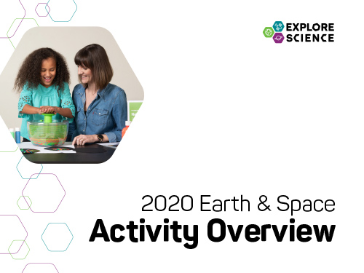
Notes:
[This slide presentation provides an overview of the Explore Science: Earth and Space Toolkit, and can be used to introduce staff and volunteers to the project and its educational materials. You can customize this training presentation to fit your organization and programming.]

Slide 2

Presentation
Explore Science: Earth & Space
Our Event
Toolkit of Activities
Leading the Activities
Questions?
Notes:
Welcome to the Explore Science: Earth & Space event training! In this presentation, we’re going to go through quite a bit of information related to our local event and the national Explore Science: Earth & Space project.
This training has three parts:
1. Quick introduction to the Explore Science: Earth & Space project and toolkit
2. Overview of the toolkit and the individual activities
3. Tips and training resources to help you lead the activities successfully
We’ll have time at the end for questions, but feel free to ask for clarification throughout.

Slide 3

Explore Science: Earth & Space
Notes:
The Explore Science: Earth & Space project represents an effort by the National Informal STEM Education Network (NISE Network) in collaboration with NASA to engage museum visitors in Earth and space science hands-on activities and experiences with connections to science, technology, and society.

Slide 4
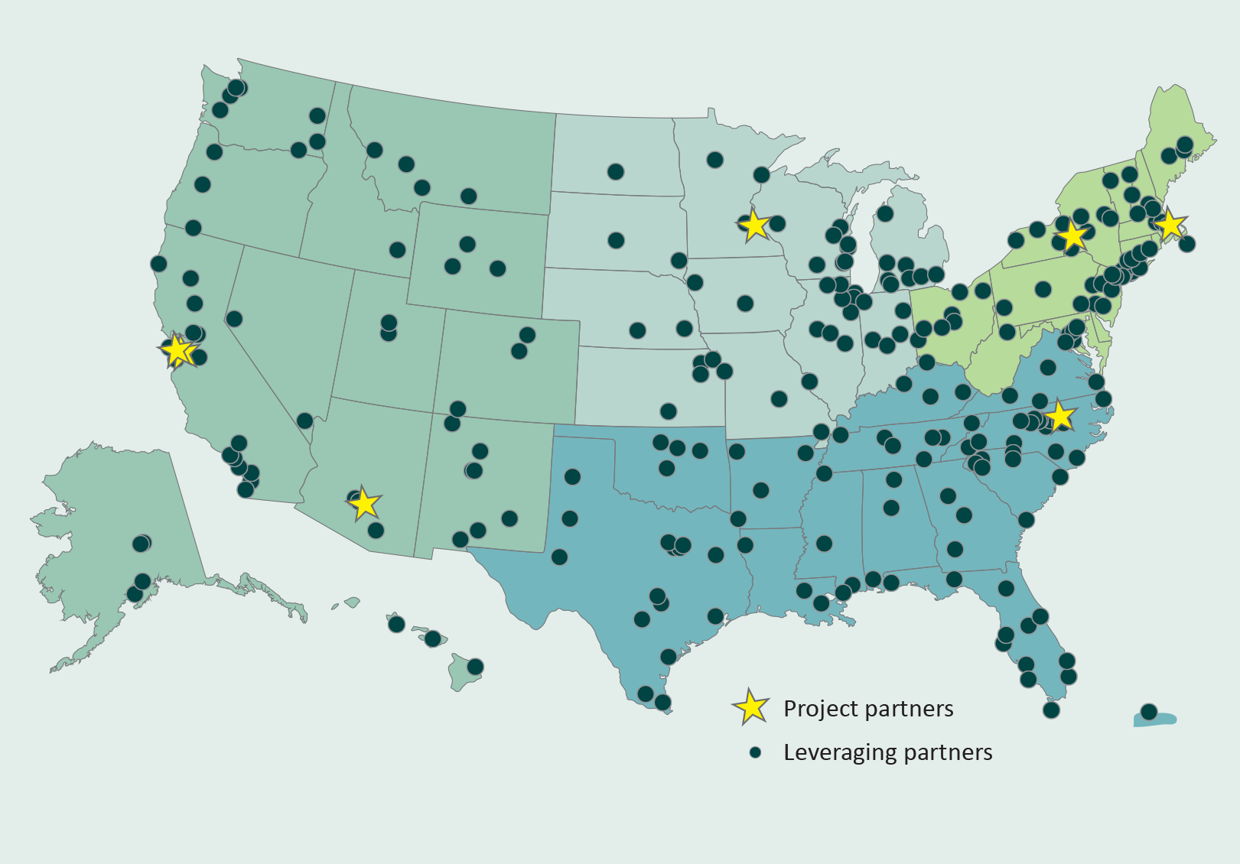
Notes:
This year, the NISE Network shared 350 physical Explore Science: Earth & Space toolkits. Institutions (including, children’s museums, science centers, NASA Visitor Centers, nature centers, natural history museums, and more!) all across the country are hosting events and engaging visitors through year-round programming!

Slide 5
Our Event
Notes:
Here are a few details about our event, today.

Slide 6


Our Event
Background
Who’s here
Orientation
Safety
Policies
Schedule
Future events
Notes:
[This is for information specifically about your institution
Background
(Your institution’s) mission and goals for this event
Who’s here
Introduce collaborators, guest speakers, volunteer groups, and other educators and facilitators.
Orientation, Safety, and Policies
Where are restrooms, lunchrooms, and other places?
Where are the emergency exits?
Who should be contacted in case of emergency?
What do volunteers do if they have a problem? Who should be contacted?
Does your institution have procedures for fire alarms, lost children, and other emergencies?
Schedule
Highlight the schedule for the day.
Are there special presentations? If so, where will they be held and at what time?
When does the event begin and end?
NASA current events
Add in a few notes about upcoming or related celestial or earth science related events. For example, “We’re celebrating Earth Day!” or “It’s Astronomy Day!”
Future events
What opportunities are there to participate in future events and stay in touch?]

Slide 7
Toolkit of Activities
Notes:
Now, we’ll quickly review the Explore Science: Earth & Space Toolkit.

Slide 8

Explore Science kits
Designed for hands-on learning
Adaptable to different settings and learners
Everything you need is in the kit!
Notes:
The Explore Science: Earth & Space toolkit materials have been designed to engage visitors in Earth and space phenomena, to help visitors reflect on science as a way of knowing, and to encourage them to identify as science learners.
The toolkits focus on hands-on space and earth science activities. They are adaptable to different settings and different kinds of learners.
Each toolkit includes everything you need for all the activities, with supplies for about 100 people.

Slide 9

Learning Framework
Experience Earth and space PHENOMENA and explore science findings.
Use the scientific PROCESS and reflect on science as a way of knowing.
PARTICIPATE in the scientific community and identify as a science learner.
Notes:
The Toolkit activities were developed around a learning framework that has three main parts: PHENOMENA, PROCESS, and PARTICIPATE.
Experience Earth and space PHENOMENA and explore science findings.
Use the scientific PROCESS and reflect on science as a way of knowing.
PARTICIPATE in the scientific community and identify as a science learner.

Slide 10
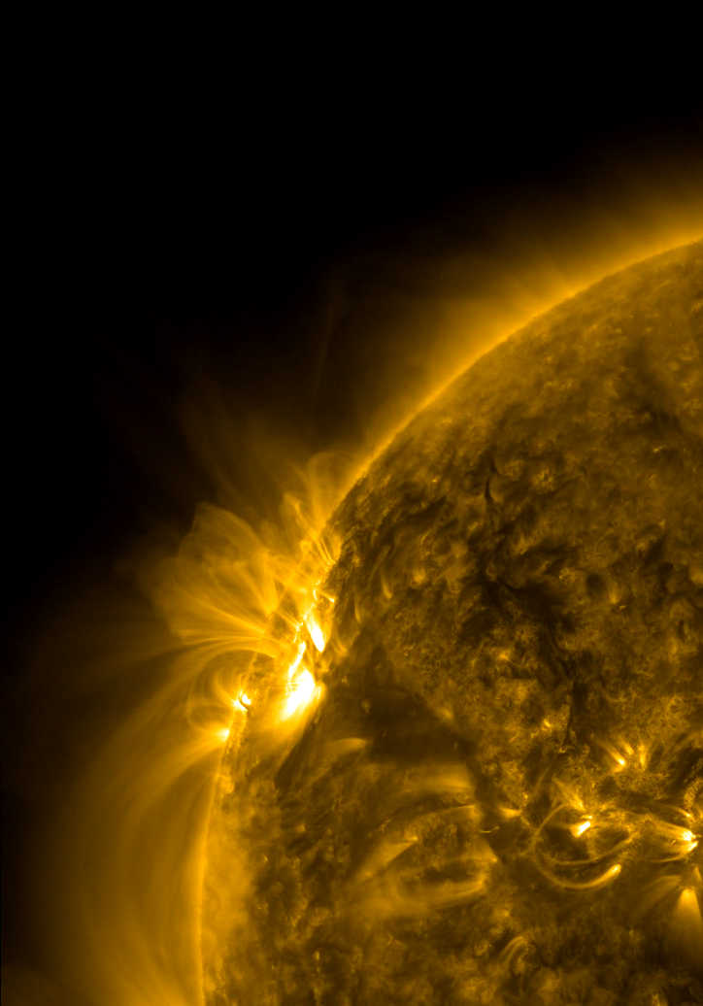
The Sun powers Earth and our solar system.
Notes:
Some of the BIG questions NASA scientists are asking about the Sun include:
What causes features on the Sun—like sunspots—to vary?
How do Earth and our solar system respond to the dynamic Sun?
Image
Active Region Conga Line
A series of active regions on the Sun were all lined up one after the other as they rotated into view over three days (Sept. 22-24, 2012)
https://sdo.gsfc.nasa.gov/gallery/ultrahd/
Image credit: NASA/SDO

Slide 11
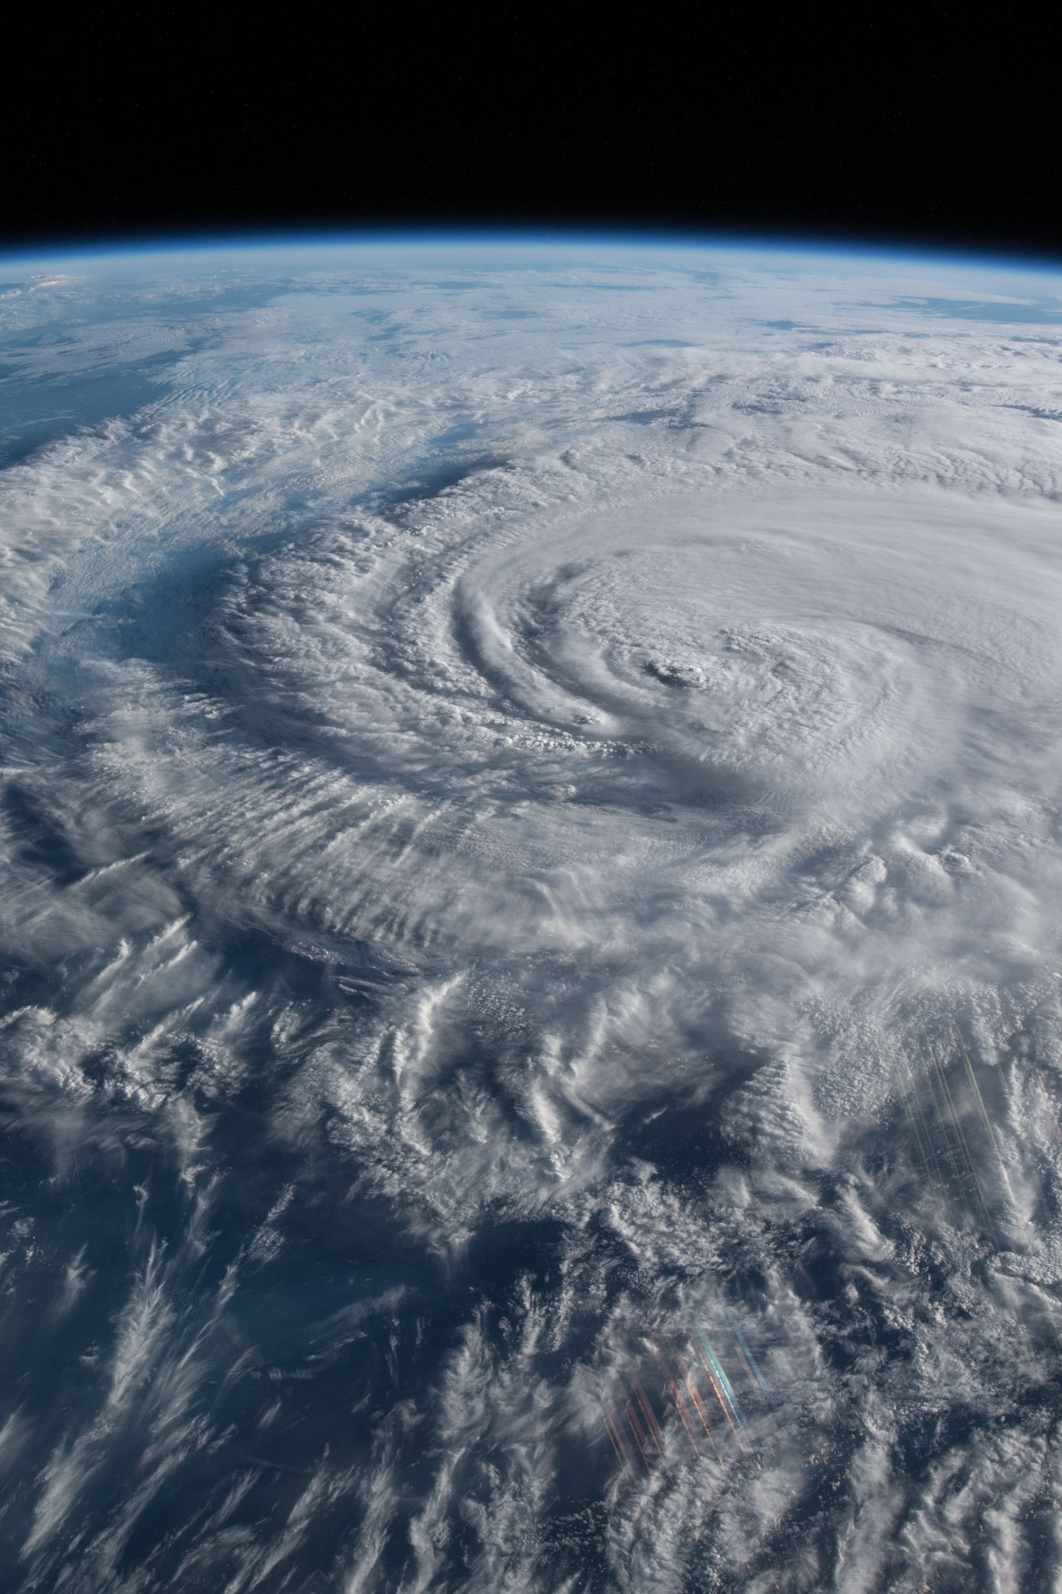
Earth is a changing planet of air, water, rock, and life.
Notes:
Some of the BIG questions NASA scientists are asking about the Earth include:
How is the Earth changing?
What cause changes on Earth?
How will the Earth change in the future?
Image
Hurricane Florence as it was making landfall
Hurricane Florence is pictured from the International Space Station as a category 1 storm as it was making landfall near Wrightsville Beach, North Carolina.
https://www.nasa.gov/image-feature/hurricane-florence-as-it-was-making-landfall-0
Image credit: NASA

Slide 12
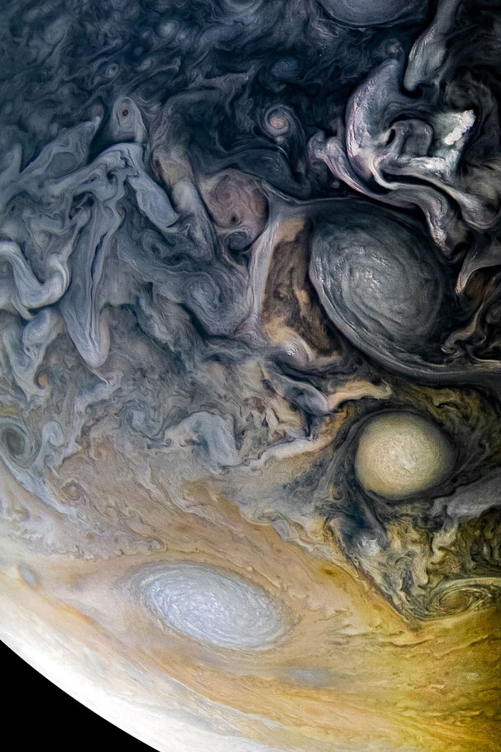
Planetary systems like ours may contain water and life.
Notes:
Some of the BIG questions NASA scientists are asking about our solar system and other planetary systems include:
How did our solar system form?
How did life begin on Earth?
Could life exist elsewhere?
Image
Intricate Clouds of Jupiter
See intricate cloud patterns in the northern hemisphere of Jupiter in this new view taken by NASA's Juno spacecraft.
https://www.jpl.nasa.gov/spaceimages/details.php?id=PIA21984
Image credit: NASA/JPL-Caltech/SwRI/MSSS/Kevin M. Gill

Slide 13
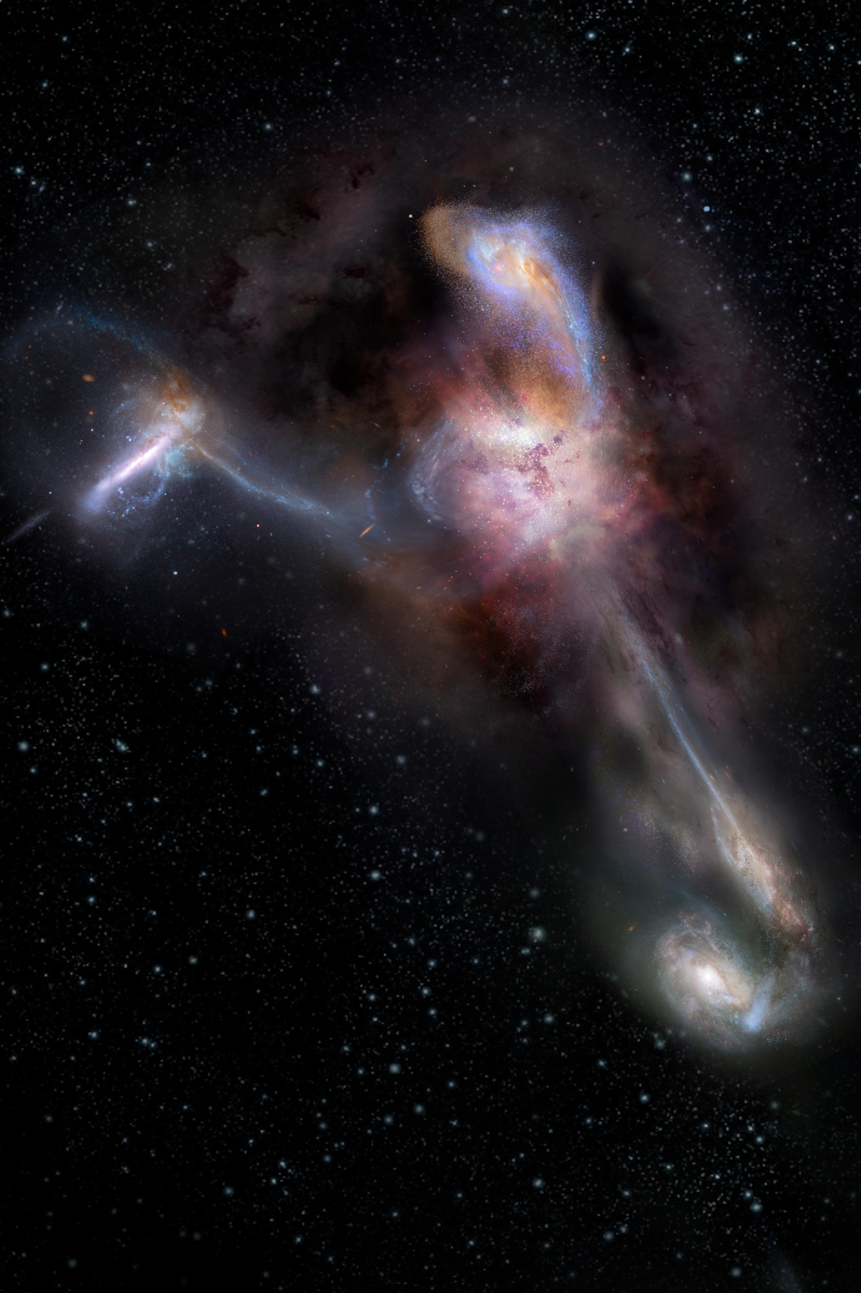
The universe is very large, old, and mysterious.
Notes:
Some of the BIG questions NASA scientists are asking about astrophysics include:
How did the universe begin?
How is the universe changing?
Are we alone in the universe?
Image
The Most Luminous Known Galaxy
Artist impression of W2246-0526, the most luminous known galaxy, and three companion galaxies. https://astropix.ipac.caltech.edu/image/nrao/NRAO_Gallery_nrao18ch26_artimp_Final
Image credit: NRAO/AUI/NSF, S. Dagnello

Slide 14
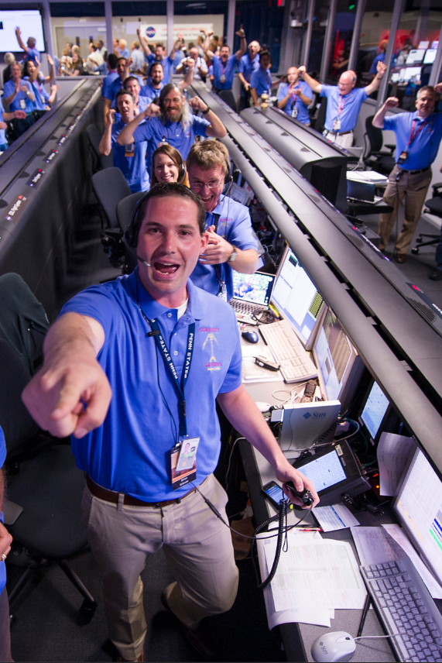
Our society chooses to explore Earth and space.
Notes:
The relationship between Earth & space science and our society is a cross-cutting topic to all NASA science research and missions. Some questions include:
How do our values influence science questions about Earth and space?
What inspiration does society draw from new NASA technology and discoveries?
How do teamwork and specialized tools contribute to NASA research?
What impacts do the dynamic processes of the Sun, Earth, and universe have on human society?
Image
The Mars Science Laboratory Team
The Mars Science Laboratory (MSL) team in the MSL Mission Support Area react after learning the the Curiosity rove has landed safely on Mars and images start coming in at the Jet Propulsion Laboratory on Mars, Sunday, Aug. 5, 2012 in Pasadena, Calif
https://mars.nasa.gov/resources/4208/the-mars-science-laboratory-team/
Image credit: NASA/Bill Ingalls

Slide 15
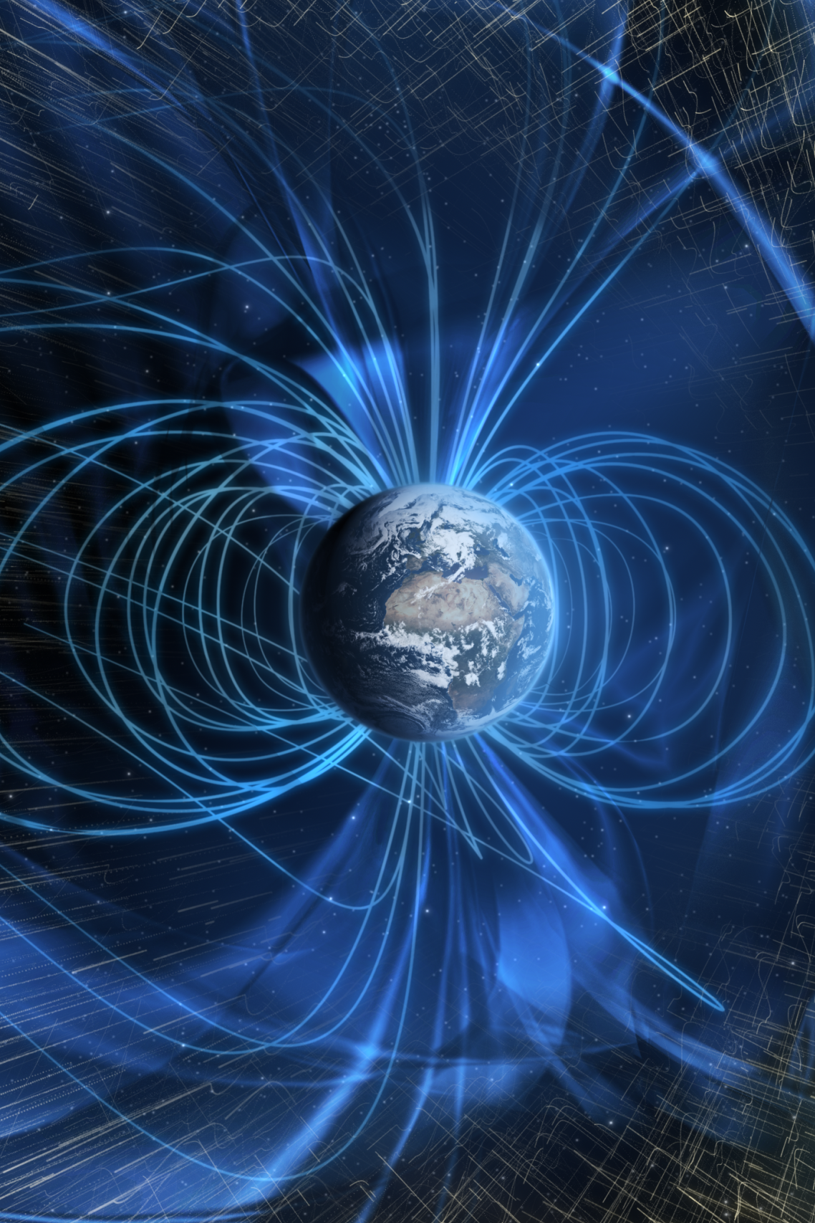
Forces and energy connect everything in the universe.
Notes:
Force and energy are common threads of the universe and how NASA scientists learn about nearby and far-away space objects. Some topics include:
The Electromagnetic spectrum
Gravity
Magnetism
Image
Earth’s Magnetic Field
The solar wind is deflected past Earth by a global magnetic field (artist's concept).
https://svs.gsfc.nasa.gov/4370
Image credit: NASA/GSFC

Slide 16
Hands-on Activities
Notes:
The Explore Science: Earth & Space toolkit includes 10 hands-on activities. Each activity comes in a box and includes all the physical materials you’ll need plus the activity and facilitator guides and additional information sheets.
[The following slides include the activities from the Explore Science: Earth & Space 2020 toolkit Part A. You may choose to augment your kit with additional activities from the 2017, 2018 & 2019 toolkits or other educational resources. The 2017, 2018 & 2019 digital toolkits are available for download from nisenet.org. The NISE Network also has a curated list of programs, media, and professional development that directly relate to the toolkits. These resources can be viewed and downloaded from http://www.nisenet.org/earthspacekitextensions.]

Slide 17
Notes:
The Bear’s Shadow and Investigating Clouds activities help participants Explore Earth.
Bear’s Shadow appeals to preschool-aged visitors, as well as accompanying adults and older children. It explores the following ideas:
A shadow is created when an object blocks light from falling on a surface.
An object’s shadow always appears on the opposite side from the light source.
Shadow’s change when the relative positions of the light source and the object change.
Investigating Clouds explores the following ideas:
Clouds influence Earth’s weather and climate.
Clouds form when individual water molecules combine into droplets.
NASA researchers study clouds in order to better understand and predict how Earth’s climate is changing.
Particular to the information sheet, worksheet, and Globe postcard that come in the activity: Citizen science programs collect and share the data with researchers that collaborate with NASA.

Slide 18
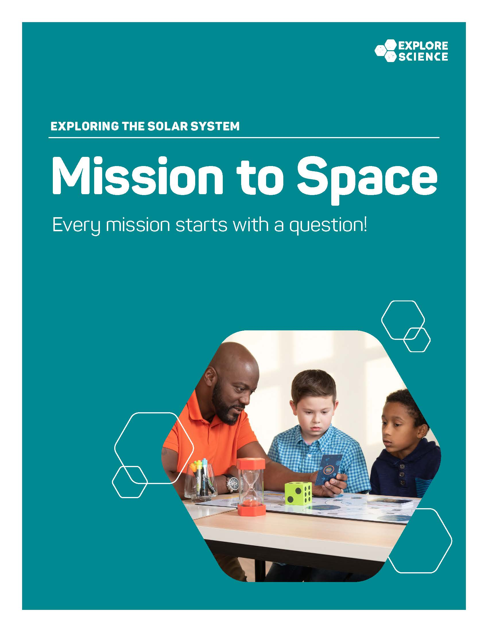
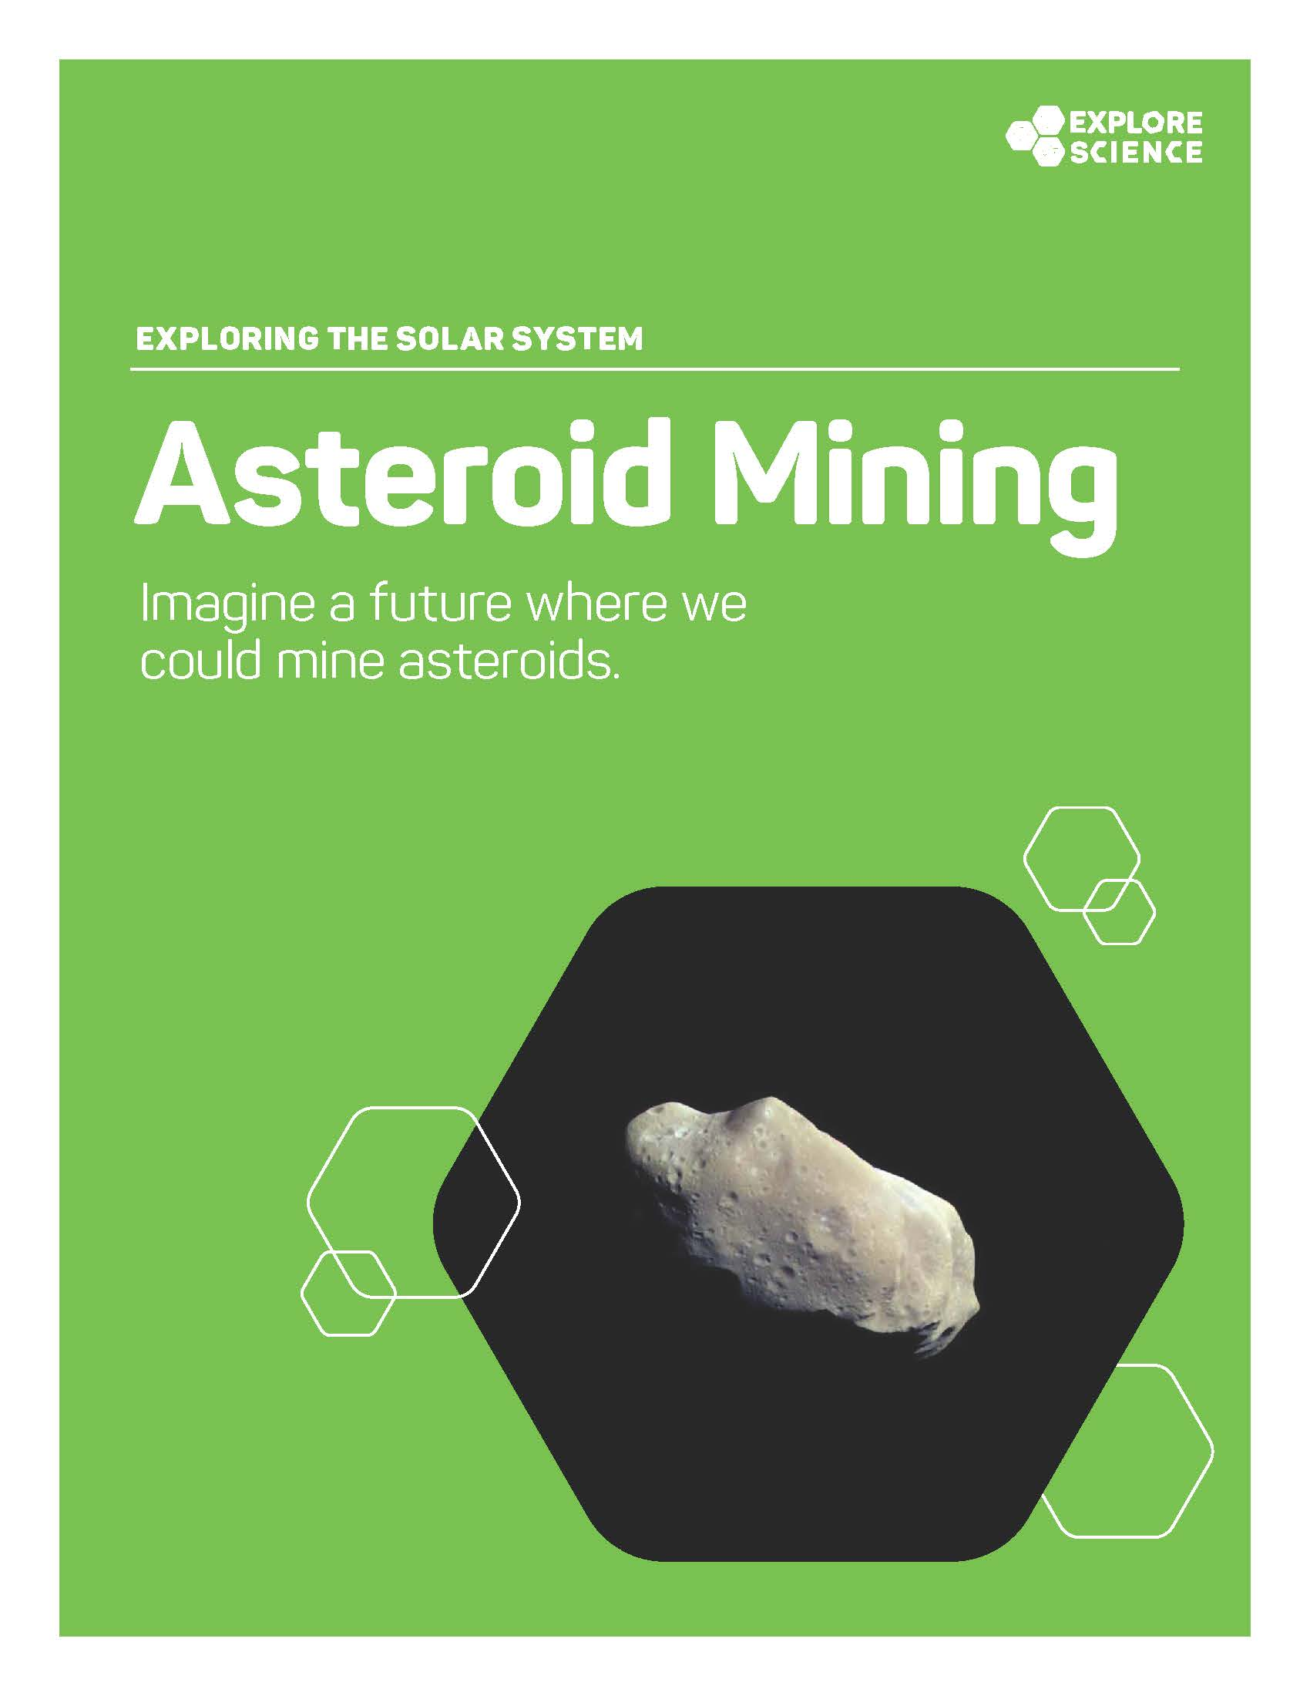
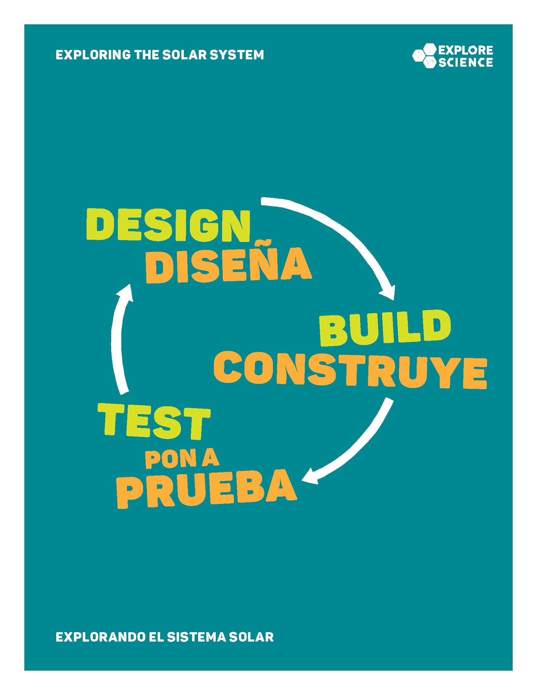
Notes:
Asteroid Mining, Mission to Space, and Design, Build, Test all help participants Explore the Solar System.
The Mission to Space board game explores the following ideas:
A successful mission to space take a lot of planning, research, and curiosity.
Developing, planning, and completing a mission to space is a complex process with many steps.
Missions to space are full of surprises and challenges.
The Asteroid Mining activity explores three main ideas:
Asteroids are small, rocky objects—some contain previous metals or water ice.
It’s exciting to imagine what our lives might be like in a future filled with more space exploration—and it’s also important.
NASA missions are helping researchers learn more about asteroids and the resources they might contain.
The Design, Build, Test engineering activity explores the following ideas:
Scientists use spacecraft to explore Earth and space.
Missions to space require large teams to design, build, and test spacecraft.
Preparing to launch a spacecraft into space take a lot of time.

Slide 19
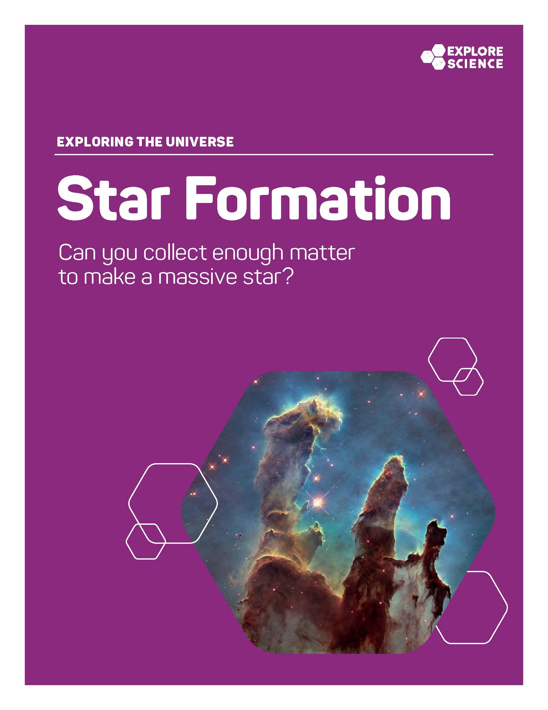
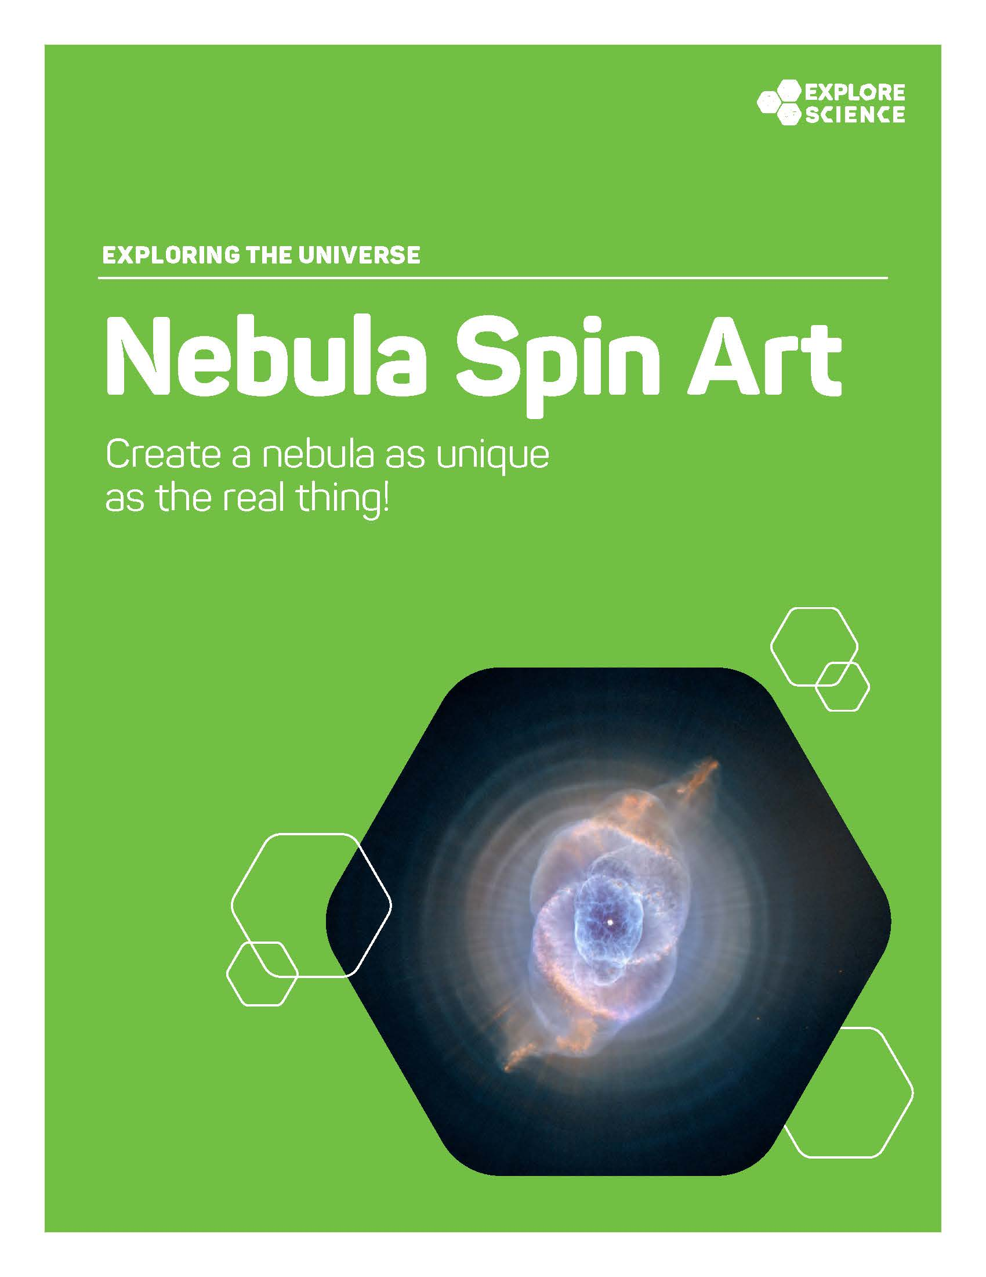
Notes:
These activities are about Exploring the Universe.
The Star Formation challenge explores the following ideas:
The space between stars, planets, and other large objects is not empty—it contains gas and dust.
Stars are born when huge amounts of gas and dust clump together.
The more gas and dust that clump together, the higher the new star’s mass.
NASA scientists use telescopes to learn more about how stars form.
The Nebula Spin Art activity explores the following ideas:
A nebula is a large cloud of gas and dust in space that can be created by a dying star.
Nebulas are responsible for mixing up and spreading out elements in space.
NASA scientists can assign colors in nebula images to represent different elements and other characteristics we can’t see with our eyes.
The Space Guess Quest game explore the following main ideas:
Humans are exploring a wide variety of objects, like nebulas, galaxies, stars, and worlds throughout the universe (and now the universe even includes human-made spacecraft!)
Scientists often use visual clues to identify objects in space.
Scientists rely on a variety of tools as they explore our universe.
The Orbiting Objects activity explores the following ideas:
The force of gravity influences everything (with mass) in space.
Every object in space exerts a gravitational pull on every other object.
Gravity keeps objects orbiting other objects, and prevents them from flying off into space.

Slide 20

Notes:
And this year, we have added an additional toolkit category: Exploring Science Practices.
The Early Explorations activity is designed to engage early learners (ages 0-4) and their caregivers in the development of science process skills. Through doing this activity with their young child, caregivers will explore 3 main ideas:
Exploring materials, using tools, and making observations are important skills for doing science.
Very young children (ages 0-4) use science process skills (like exploring, categorizing, measuring, observing, predicting, problem-solving, and using tools) to learn about the world around them.
Practicing science process skills early and often is important for children’s brain development.
Throughout this exploration, the facilitator should model strategies for fostering, guiding, and building on basic science practices. The activity has the following goals:
To help adults understand that doing science looks different at different developmental stages;
To model facilitation strategies that encourage the use of science process skills by early learners;
And to thereby increase caregivers’ ability and confidence to engage the very young children in their lives in science activities.

Slide 21
Leading the Activities
Notes:
Now, we’ll review some tips for leading these activities with participants

Slide 22
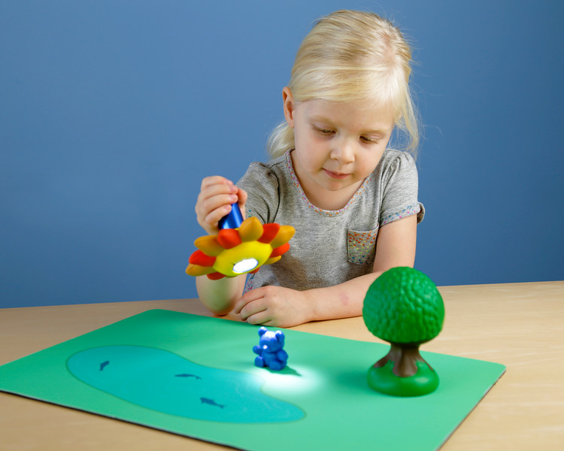
Activity materials
Notes:
We’ve just taken a very quick look at all 10 activities in the Explore Science: Earth & Space toolkit.
Here is an example of just one activity, Bear’s Shadow. Each activity box includes all the physical materials needed to do the activity.
Some of these materials are intended for the learners to use. These include the supplies they need to do the activity—like the flashlight “sun,” toy bear, toy tree, and landscape mat with pond and fish—shown in this image. You’ll also want to share the colorful activity guide and sign, and any additional information sheets, worksheets, or other graphics. These things should all be out and accessible for learners.
The box also includes some materials for you, the facilitator, to use. These include the more plain-looking facilitator guide with some notes about things like set-up and safety, and some tips to help you do a great job leading the activity, as well as any materials you’ll need for advance preparation. These are just for you and are not meant to be shared with participants.
Finally, please note that there are both activity and content training videos for each activity, which you can watch to help you learn the activity before you do it with participants.

Slide 23
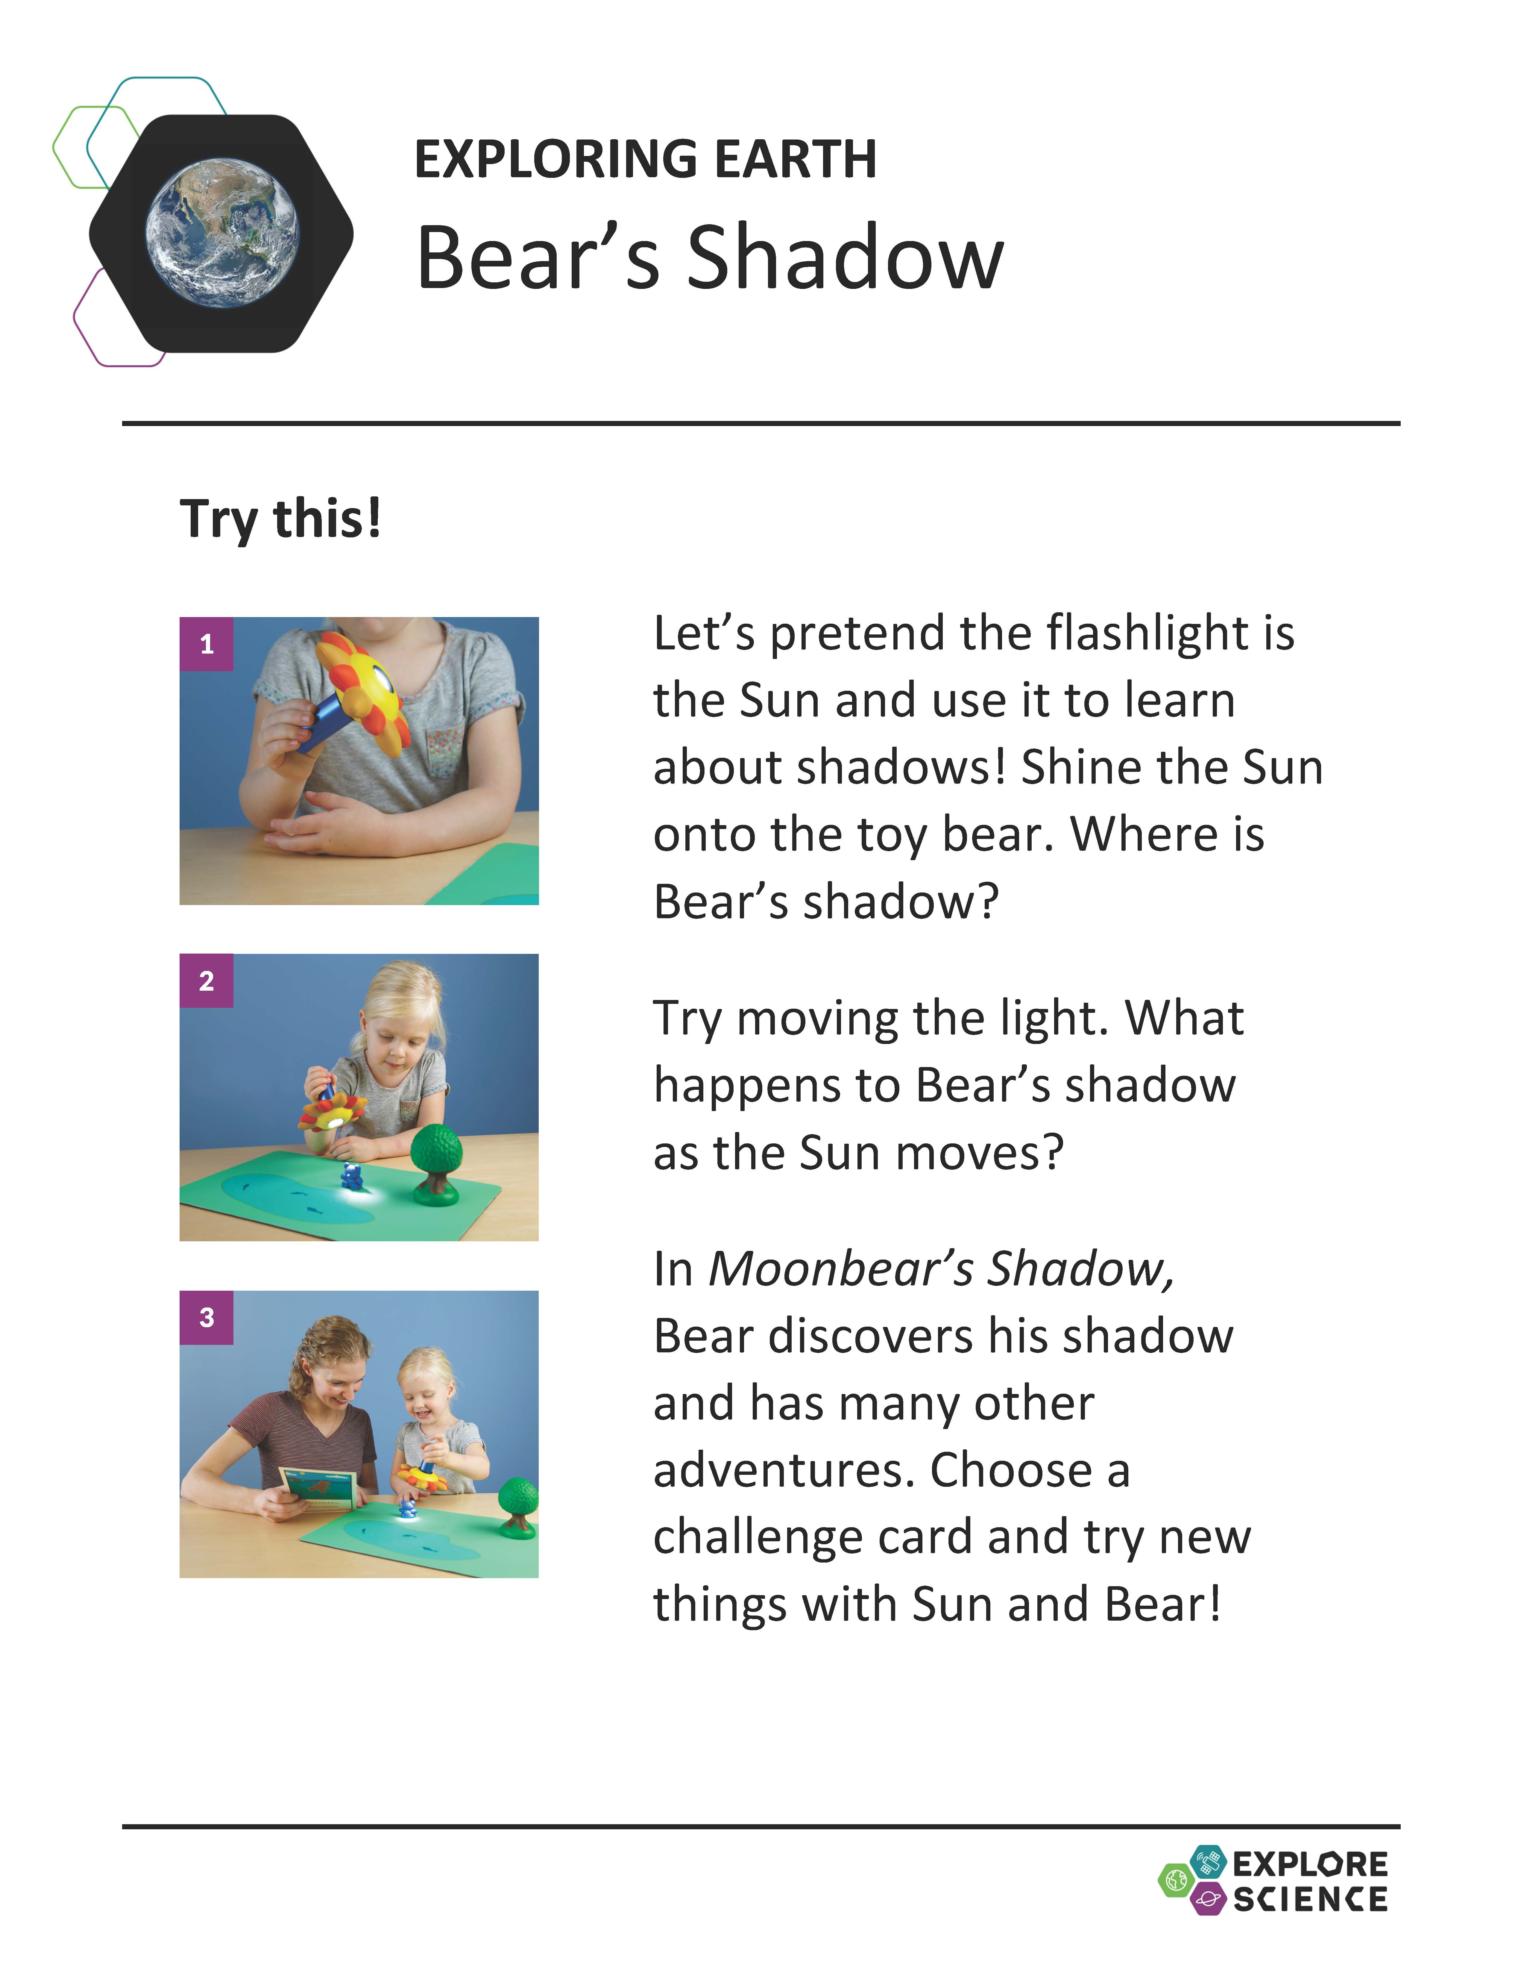
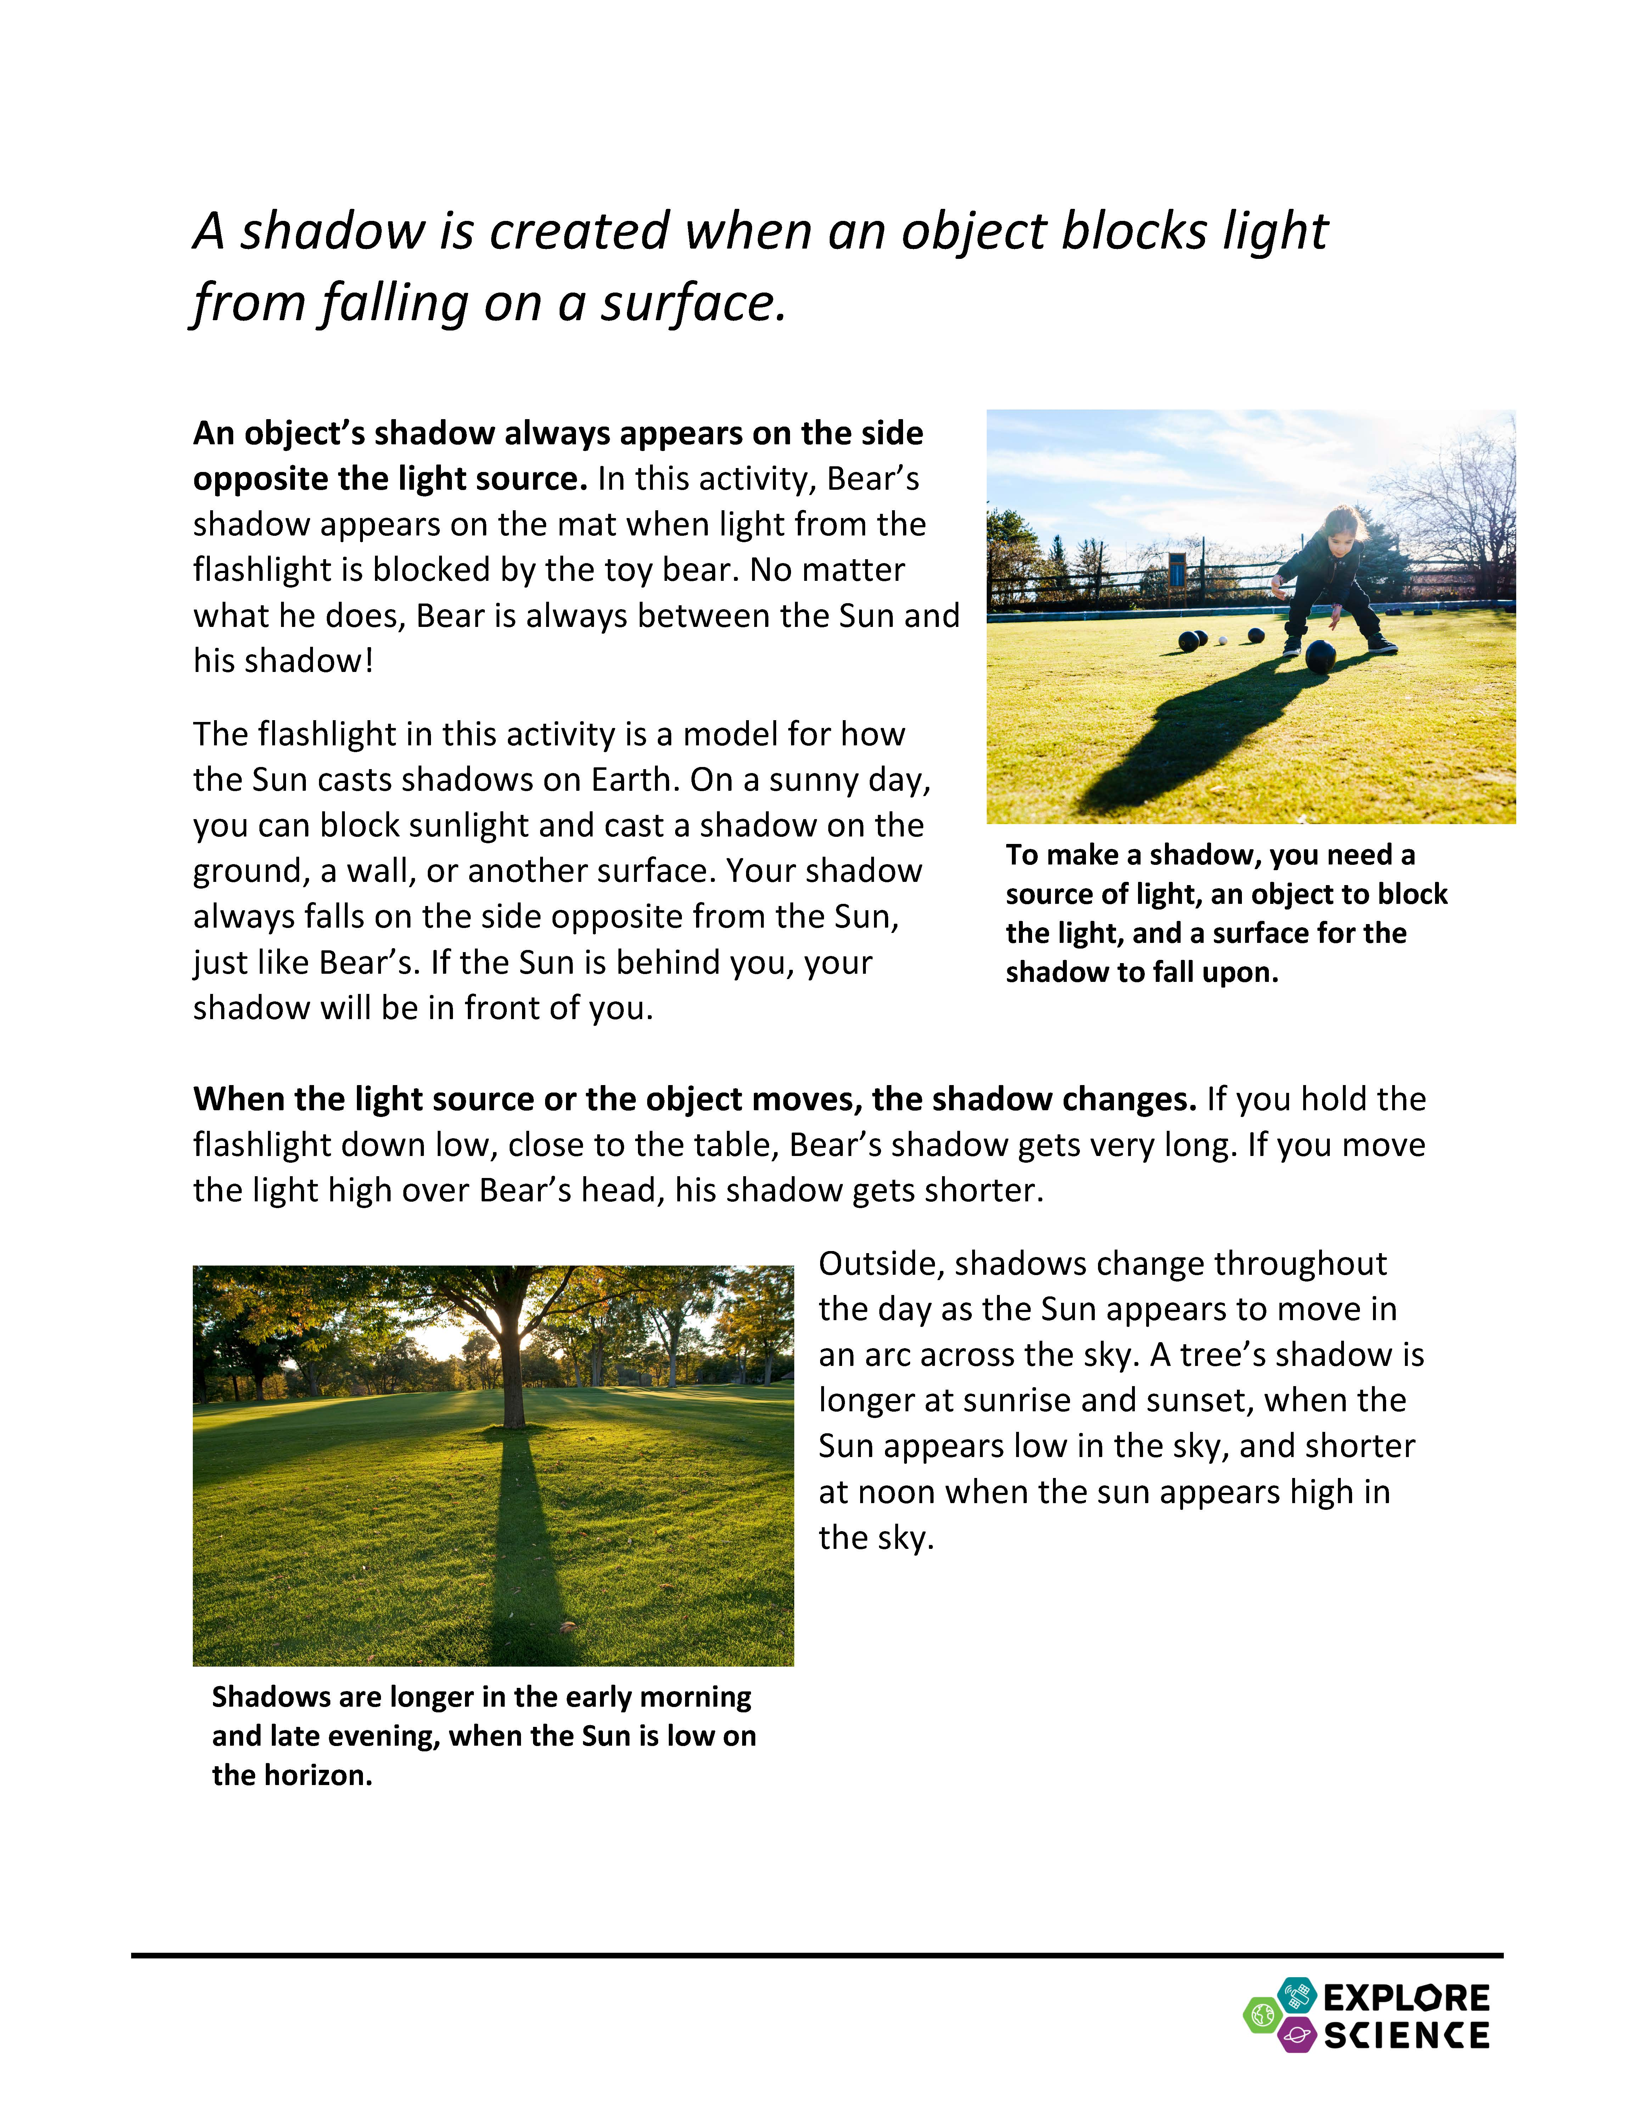
Activity instructions
Notes:
UPDATE
Now let’s look at some of these materials a bit more closely. Here is an example of an activity guide, for the Bear’s Shadow activity.
The activity guides are structured to help you lead learners through hands-on science activities.
The front side includes step-by-step instructions in the section called “Try this!”
The back side describes what learners observe—and explains why it happens. Finally, the guide relates the activity to current space or Earth related science, NASA research, or information on childhood development.
You can leave these guides out on the table both to help you explain the activity and so that learners can read them and look at the pictures.
(They’re available in both English and Spanish versions.)

Slide 24
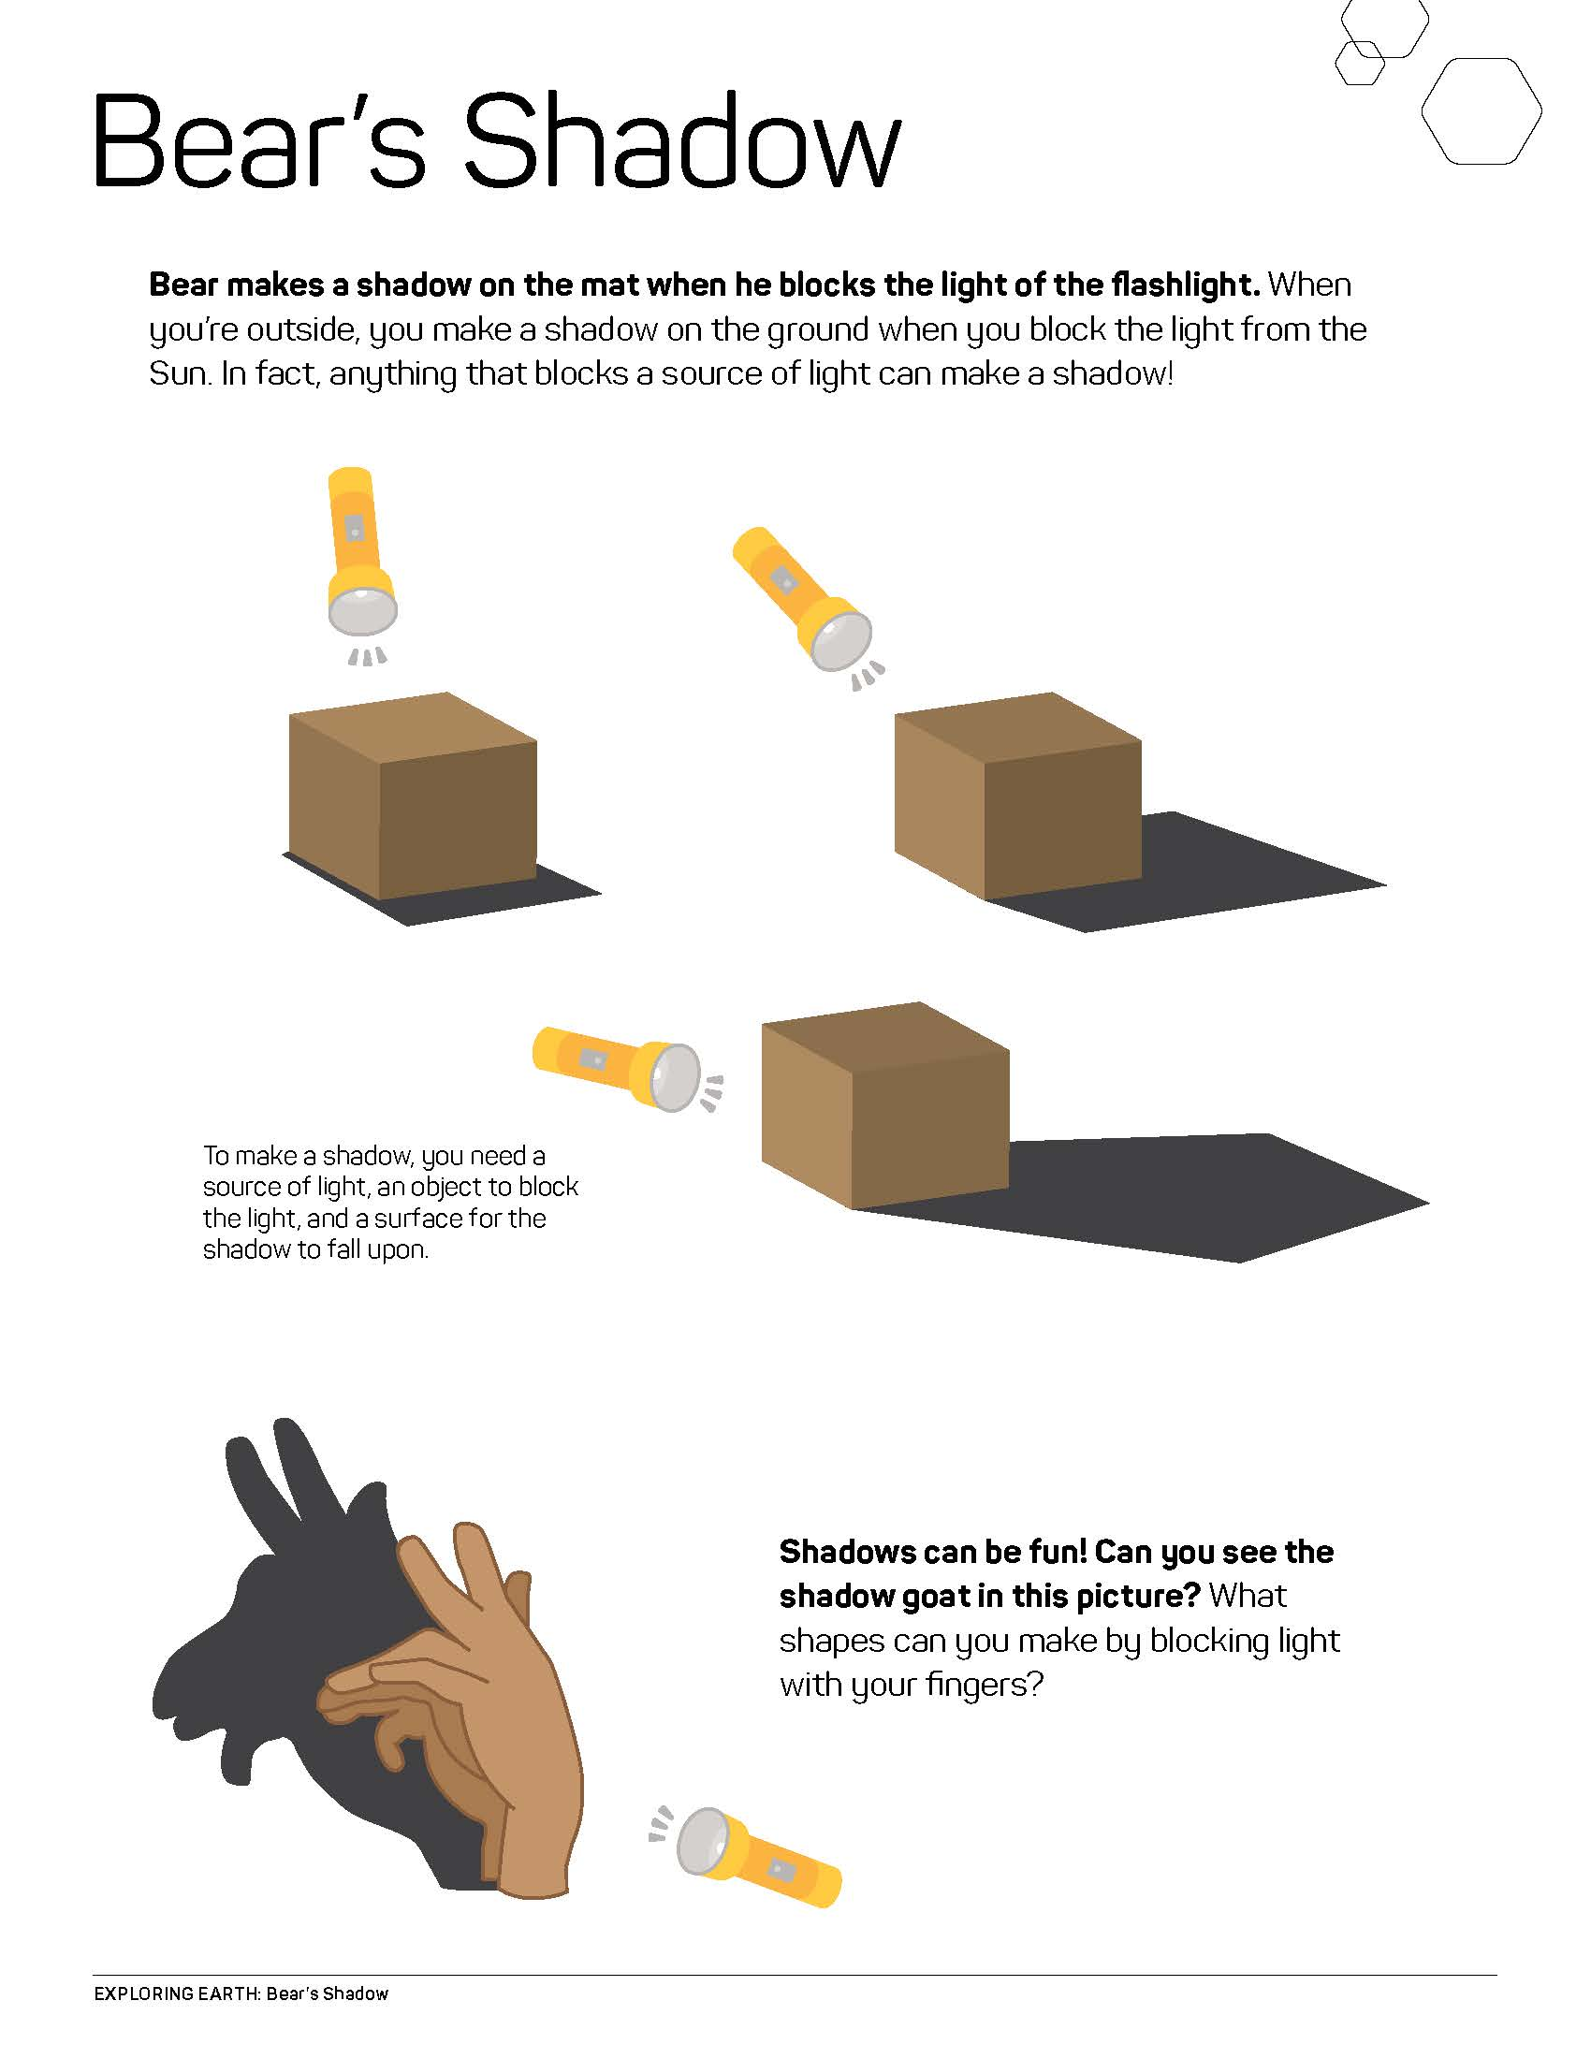
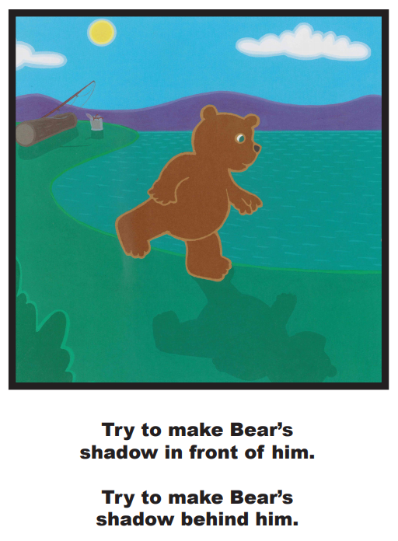
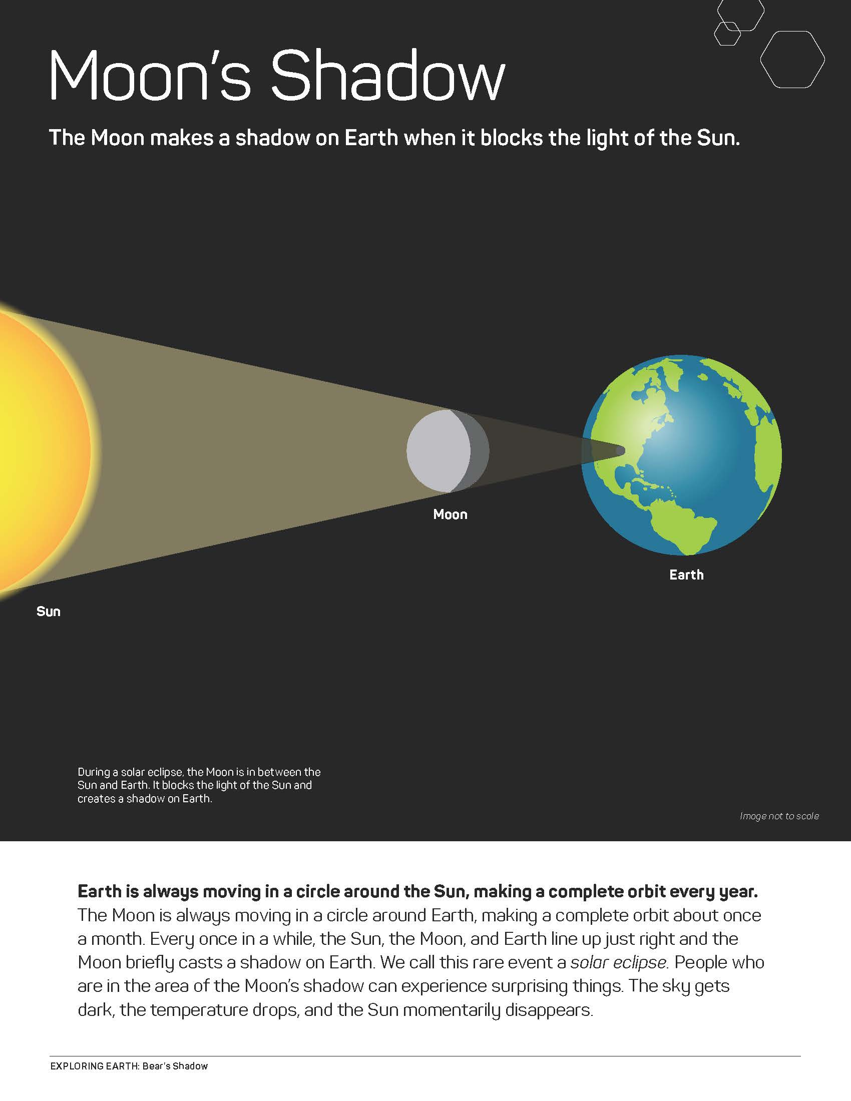
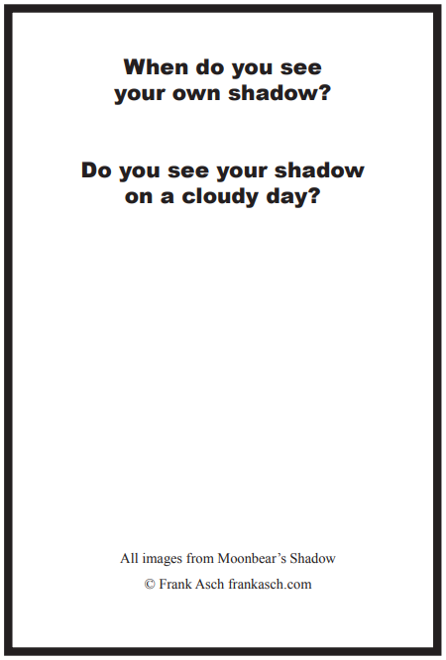
Info sheets and worksheets
Notes:
Many activities include additional information sheets or other graphic assets (in this case, challenge cards). Depending on your event or setting you may choose to use these more or less. They provide additional related content about the hands-on activity for participants and facilitators alike.

Slide 25
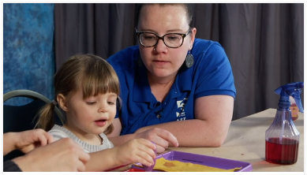
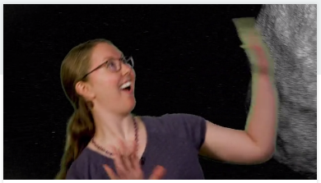
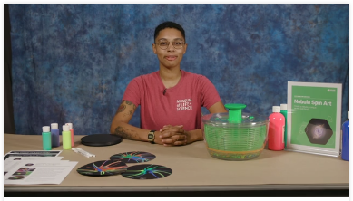
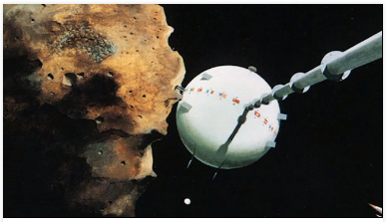
Training Videos
Notes:
Each activity in the toolkit comes with an activity training video and a science content training: https://vimeopro.com/nisenet/explore-science-earth-space. Facilitators can watch these before the event (or even last minute, online!)
[This year, we have also included a a training video about facilitation techniques titled Educathalon and a set of training videos on Strategies for Approaching Difficult Scientific Concepts in space and Earth science. Part one describes various strategies you can use and provides an annotated example. Part two provides a scripted example of a visitor interaction and invites you to notice which strategies are employed. You can watch these videos together as a group and discuss what you see and notice and how this might change the ways you interact with visitors.]

Slide 26
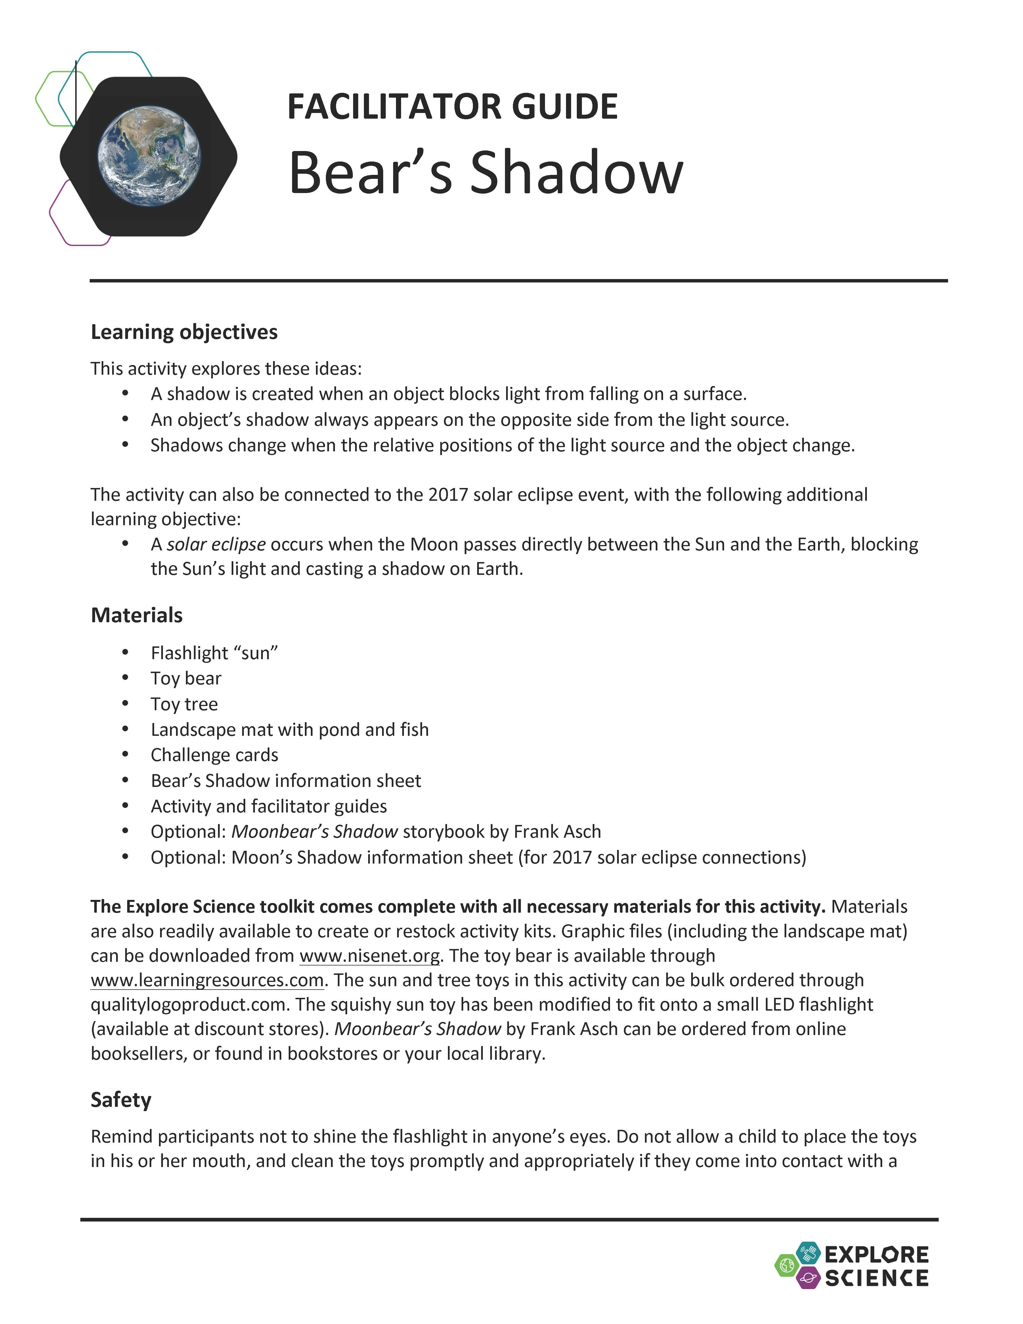
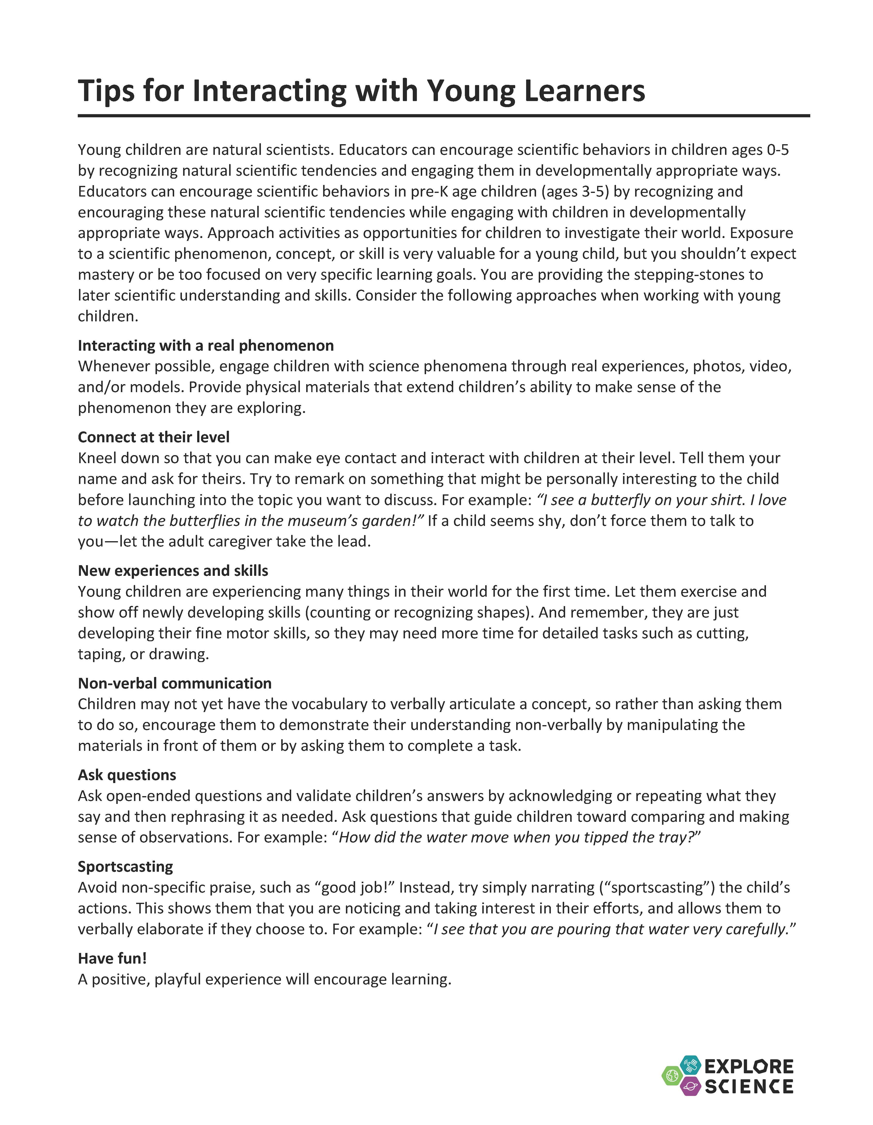
Notes and tips
Notes:
The facilitator guide is for you, the activity leader.
The first few pages list the learning objectives, activity materials, and includes important notes related to set-up, safety, presentation, difficult concepts and other aspects of the activity.
Additionally, each activity contains a useful reference sheet with tips for leading hands–on science activities or tips for interacting with young learners, as well as notes about how to talk to visitors about misconceptions and other difficult concepts.

Slide 27
Tips for Leading Hands-on Activities
Greet your guests
Encourage exploration
Ask open-ended questions
Be a good listener
Share what you know
Offer positive responses
Share accurate information
Remain positive
Thank your guests
& HAVE FUN!
Notes:
Tips for leading hands-on activities include:
Greet your guests
Encourage exploration
Ask open-ended questions
Be a good listener
Share what you know
Offer positive responses
Share accurate information
Remain positive
Thank your guests
& HAVE FUN!

Slide 28
Tips for Interacting with Young Learners
Interact around real science phenomena
Connect at their level
Support new experiences and skill development
Embrace repetition
Make opportunities for non-verbal communication
Ask open-ended questions
“Sportscast” (narrate) the child’s actions
& HAVE FUN!
Notes:
These tips are especially useful for facilitators leading the “Early Explorations” activity. However, they can be used with young participants for any of the toolkit activities.

Slide 29
Questions?
Notes:
Questions?

Slide 30


Thank you
Space and Earth Informal STEM Education is supported by NASA under cooperative agreement numbers NNX16AC67A and 80NSSC18M0061. Any opinions, findings, and conclusions or recommendations expressed in this material are those of the author(s) and do not necessarily reflect the view of the National Aeronautics and Space Administration (NASA).
Copyright 2020 Sciencenter
Activity photos by Emily Maletz and Dave Burbank for the NISE Network. Training video screen capture by Museum of Life and Science. Living with the Sun image: composite image of 25 separate images of the Sun from the Solar Dynamics Observatory (SDO) spanning the period of April 16, 2012, to April 15, 2013, courtesy NASA Goddard Space Flight Center/SDO/AIA/S. Wiessinger. The Changing Earth image: Late winter storms dropped a fresh coating of snow across the Alps in mid-March 2016, courtesy NASA image by Jeff Schmaltz, LANCE/EOSDIS Rapid Response. Our Solar System and Planets Around Other Stars image: Artistic concept of water plumes on Jupiter’s moon Europa courtesy NASA/ESA/K. Retherford/SWRI. Galaxies and Beyond image: Eagle Nebula's “Pillars of Creation” courtesy NASA.
Notes:
THANK YOU!

