Slide 1
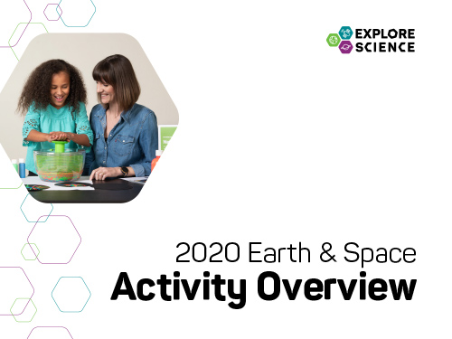
Notes:
[This slide presentation provides an overview of the Explore Science: Earth and Space Toolkit, and can be used to introduce event staff and volunteers to the project and its educational materials. You can customize this training presentation to fit your organization and programming.]

Slide 2

Presentation
Explore Science: Earth & Space
Our Event
Toolkit of Activities
Leading the Activities
Questions?
Notes:
Welcome to the Explore Science: Earth & Space event training! In this presentation, we’re going to go through quite a bit of information related to our local event and the national Explore Science: Earth & Space project.
This training has three parts:
1. Quick introduction to the Explore Science: Earth & Space project and toolkit
2. Overview of the toolkit and the individual activities, including the immersive Moon Adventure Game
3. Tips and training resources to help you lead the activities successfully
We’ll have time at the end for questions, but feel free to ask for clarification throughout.

Slide 3

Explore Science: Earth & Space
Notes:
The Explore Science: Earth & Space project represents an effort by the National Informal STEM Education Network (NISE Network) in collaboration with NASA to engage museum visitors in Earth and space science hands-on activities and experiences with connections to science, technology, and society.

Slide 4
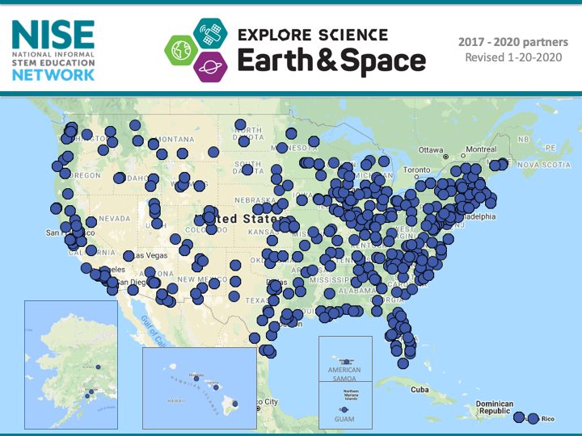
Notes:
This year, the NISE Network shared 350 physical Explore Science: Earth & Space toolkits. Institutions (including, children’s museums, science centers, NASA Visitor Centers, nature centers, natural history museums, and more!) all across the country are engaging visitors using toolkit activities!

Slide 5
Our Event
Notes:
Here are a few details about our event, today.

Slide 6


Our Event
Background
Who’s here
Orientation
Safety
Policies
Schedule
Future events
Notes:
[This is for information specifically about your institution
Background
(Your institution’s) mission and goals for this event
Who’s here
Introduce collaborators, guest speakers, volunteer groups, and other educators and facilitators.
Orientation, Safety, and Policies
What policies are in place to minimize risk of exposure to the COVID-19 virus?
Where are restrooms, lunchrooms, and other places?
Where are the emergency exits?
Who should be contacted in case of emergency?
What do volunteers do if they have a problem? Who should be contacted?
Does your institution have procedures for fire alarms, lost children, and other emergencies?
Schedule
Highlight the schedule for the day.
Are there special presentations? If so, where will they be held and at what time?
When does the event begin and end?
NASA current events
Add in a few notes about upcoming or related celestial or earth science related events. For example, “We’re celebrating Earth Day!” or “It’s Astronomy Day!”
Future events
What opportunities are there to participate in future events and stay in touch?]

Slide 7
Toolkit of Activities
Notes:
Now, we’ll quickly review the Explore Science: Earth & Space Toolkit.

Slide 8

Explore Science kits
Designed for hands-on learning
Adaptable to different settings and learners
Everything you need is in the kit!
Notes:
The Explore Science: Earth & Space toolkit materials have been designed to engage visitors in Earth and space phenomena, to help visitors reflect on science as a way of knowing, and to encourage them to identify as science learners.
The toolkits focus on hands-on space and earth science activities. They are adaptable to different settings and different kinds of learners.
Each toolkit includes everything you need for all the activities, with supplies for about 100 people.

Slide 9

Learning Framework
Experience Earth and space PHENOMENA and explore science findings.
Use the scientific PROCESS and reflect on science as a way of knowing.
PARTICIPATE in the scientific community and identify as a science learner.
Notes:
The Toolkit activities were developed around a learning framework that has three main parts: PHENOMENA, PROCESS, and PARTICIPATE.
Experience Earth and space PHENOMENA and explore science findings.
Use the scientific PROCESS and reflect on science as a way of knowing.
PARTICIPATE in the scientific community and identify as a science learner.

Slide 10
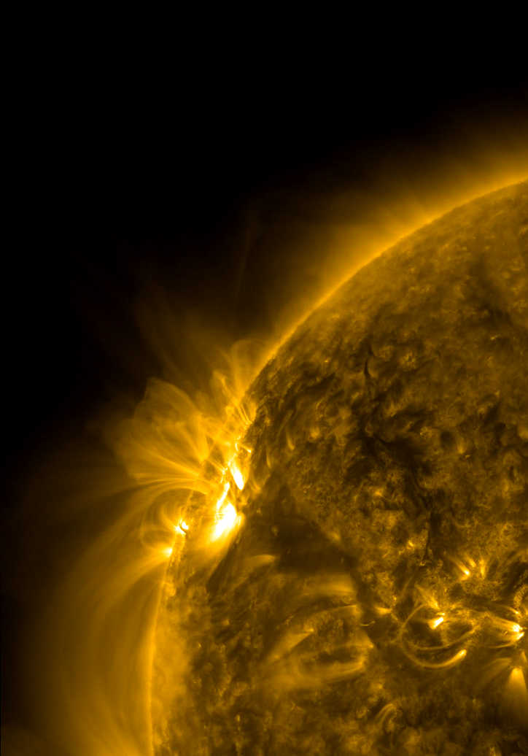
The Sun powers Earth and our solar system.
Notes:
Some of the BIG questions NASA scientists are asking about the Sun include:
What causes features on the Sun—like sunspots—to vary?
How do Earth and our solar system respond to the dynamic Sun?
Image
Active Region Conga Line
A series of active regions on the Sun were all lined up one after the other as they rotated into view over three days (Sept. 22-24, 2012)
https://sdo.gsfc.nasa.gov/gallery/ultrahd/
Image credit: NASA/SDO

Slide 11
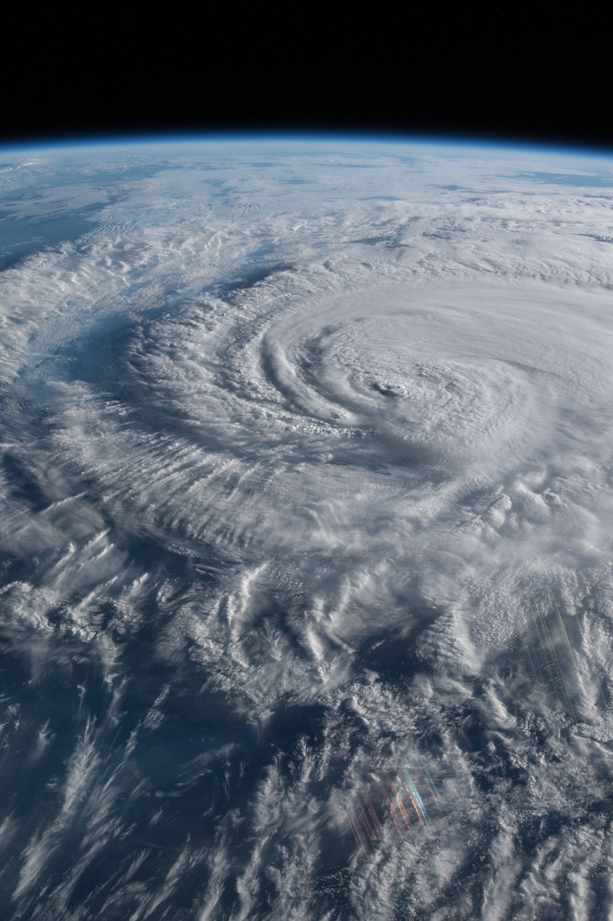
Earth is a changing planet of air, water, rock, and life.
Notes:
Some of the BIG questions NASA scientists are asking about the Earth include:
How is the Earth changing?
What cause changes on Earth?
How will the Earth change in the future?
Image
Hurricane Florence as it was making landfall
Hurricane Florence is pictured from the International Space Station as a category 1 storm as it was making landfall near Wrightsville Beach, North Carolina.
https://www.nasa.gov/image-feature/hurricane-florence-as-it-was-making-landfall-0
Image credit: NASA

Slide 12
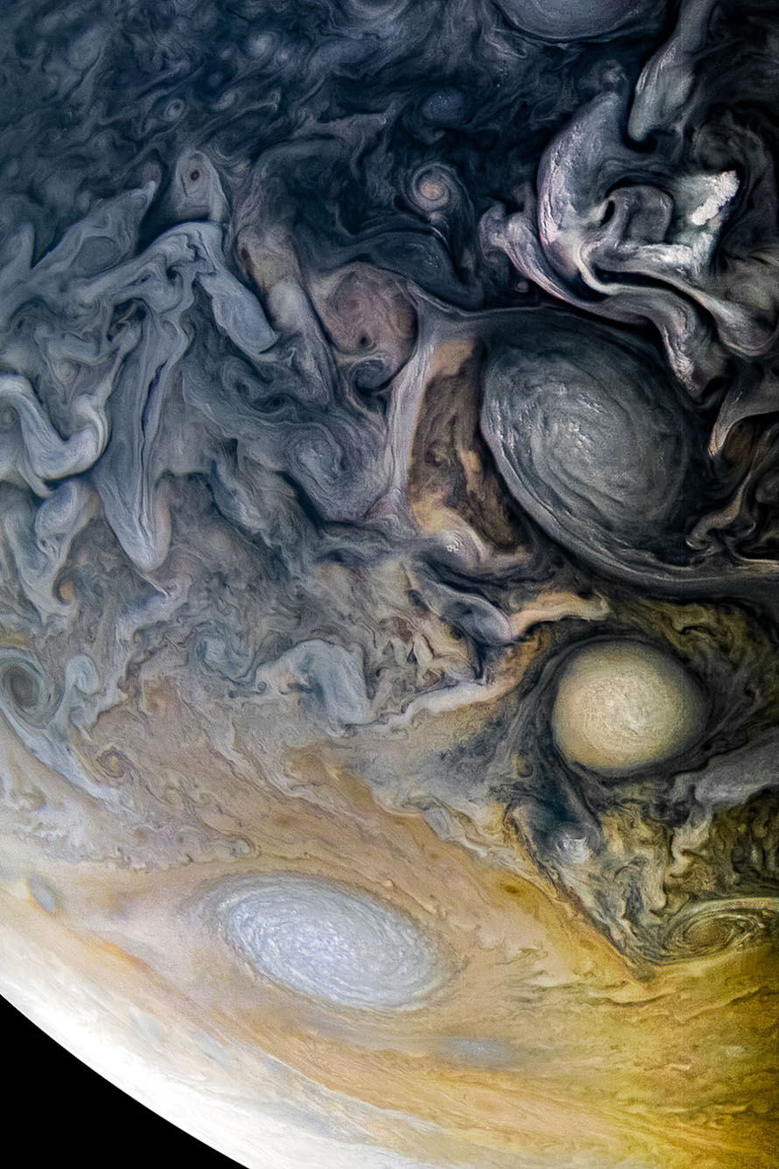
Planetary systems like ours may contain water and life.
Notes:
Some of the BIG questions NASA scientists are asking about our solar system and other planetary systems include:
How did our solar system form?
How did life begin on Earth?
Could life exist elsewhere?
Image
Intricate Clouds of Jupiter
See intricate cloud patterns in the northern hemisphere of Jupiter in this new view taken by NASA's Juno spacecraft.
https://www.jpl.nasa.gov/spaceimages/details.php?id=PIA21984
Image credit: NASA/JPL-Caltech/SwRI/MSSS/Kevin M. Gill

Slide 13
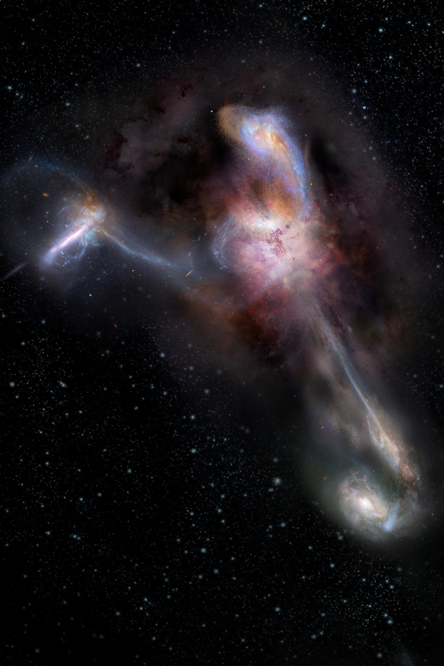
The universe is very large, old, and mysterious.
Notes:
Some of the BIG questions NASA scientists are asking about astrophysics include:
How did the universe begin?
How is the universe changing?
Are we alone in the universe?
Image
The Most Luminous Known Galaxy
Artist impression of W2246-0526, the most luminous known galaxy, and three companion galaxies. https://astropix.ipac.caltech.edu/image/nrao/NRAO_Gallery_nrao18ch26_artimp_Final
Image credit: NRAO/AUI/NSF, S. Dagnello

Slide 14
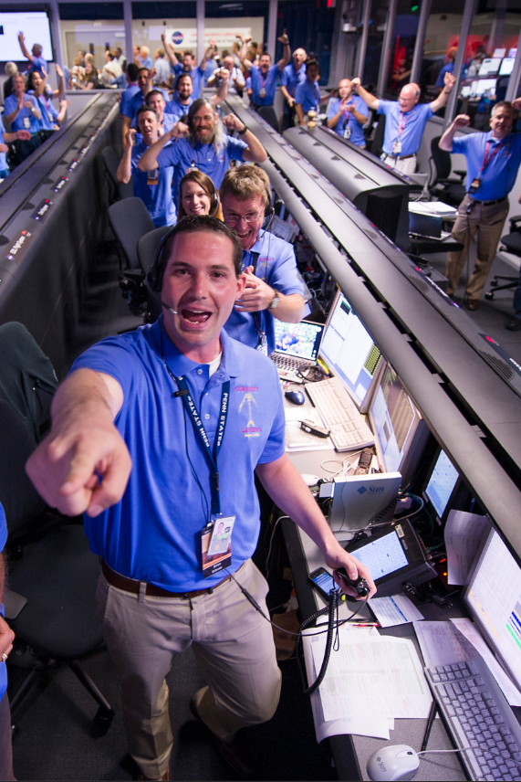
Our society chooses to explore Earth and space.
Notes:
The relationship between Earth & space science and our society is a cross-cutting topic to all NASA science research and missions. Some questions include:
How do our values influence science questions about Earth and space?
What inspiration does society draw from new NASA technology and discoveries?
How do teamwork and specialized tools contribute to NASA research?
What impacts do the dynamic processes of the Sun, Earth, and universe have on human society?
Image
The Mars Science Laboratory Team
The Mars Science Laboratory (MSL) team in the MSL Mission Support Area react after learning the the Curiosity rove has landed safely on Mars and images start coming in at the Jet Propulsion Laboratory on Mars, Sunday, Aug. 5, 2012 in Pasadena, Calif
https://mars.nasa.gov/resources/4208/the-mars-science-laboratory-team/
Image credit: NASA/Bill Ingalls

Slide 15
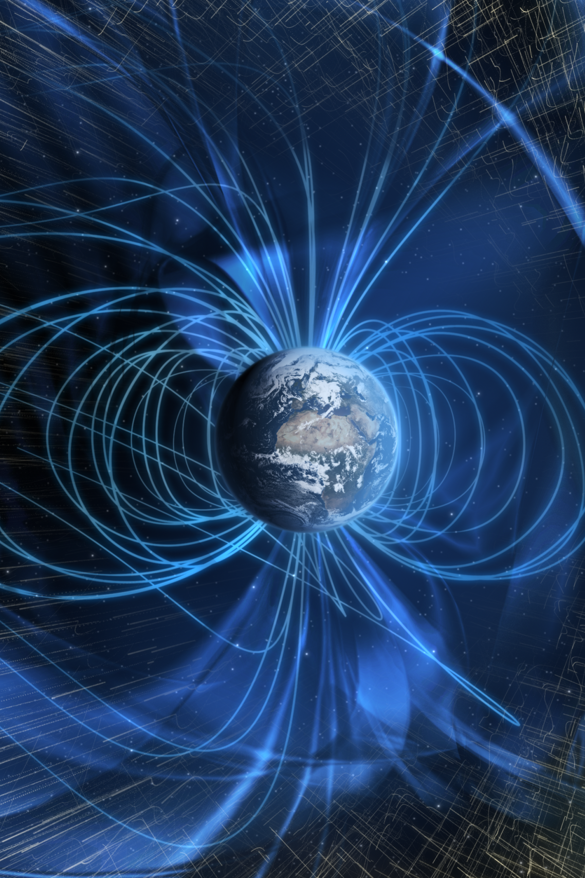
Forces and energy connect everything in the universe.
Notes:
Force and energy are common threads of the universe and how NASA scientists learn about nearby and far-away space objects. Some topics include:
The Electromagnetic spectrum
Gravity
Magnetism
Image
Earth’s Magnetic Field
The solar wind is deflected past Earth by a global magnetic field (artist's concept).
https://svs.gsfc.nasa.gov/4370
Image credit: NASA/GSFC

Slide 16
Hands-on Activities
Notes:
The Explore Science: Earth & Space toolkit includes 10 hands-on activities. Each activity comes in a box and includes all the physical materials you’ll need plus the activity and facilitator guides and additional information sheets.
[The following slides include the activities from the Explore Science: Earth & Space 2020 toolkit Part A. You may choose to augment your kit with additional activities from the 2017, 2018 & 2019 toolkits or other educational resources. The 2017, 2018 & 2019 digital toolkits are available for download from nisenet.org. The NISE Network also has a curated list of programs, media, and professional development that directly relate to the toolkits. These resources can be viewed and downloaded from http://www.nisenet.org/earthspacekitextensions. Many activities may be adapted to no-contact, socially distant or virtual settings.]

Slide 17
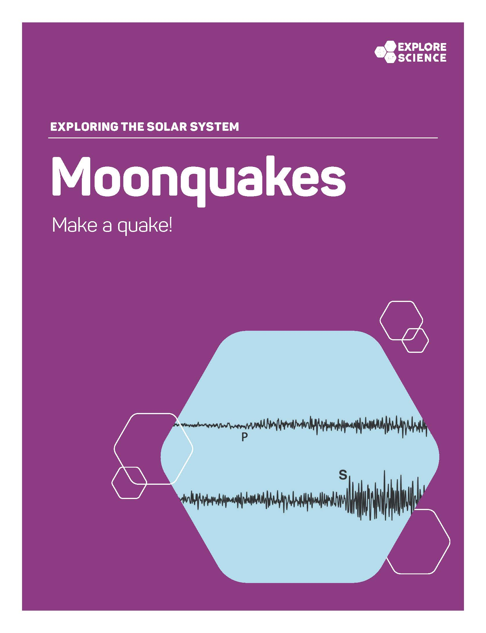
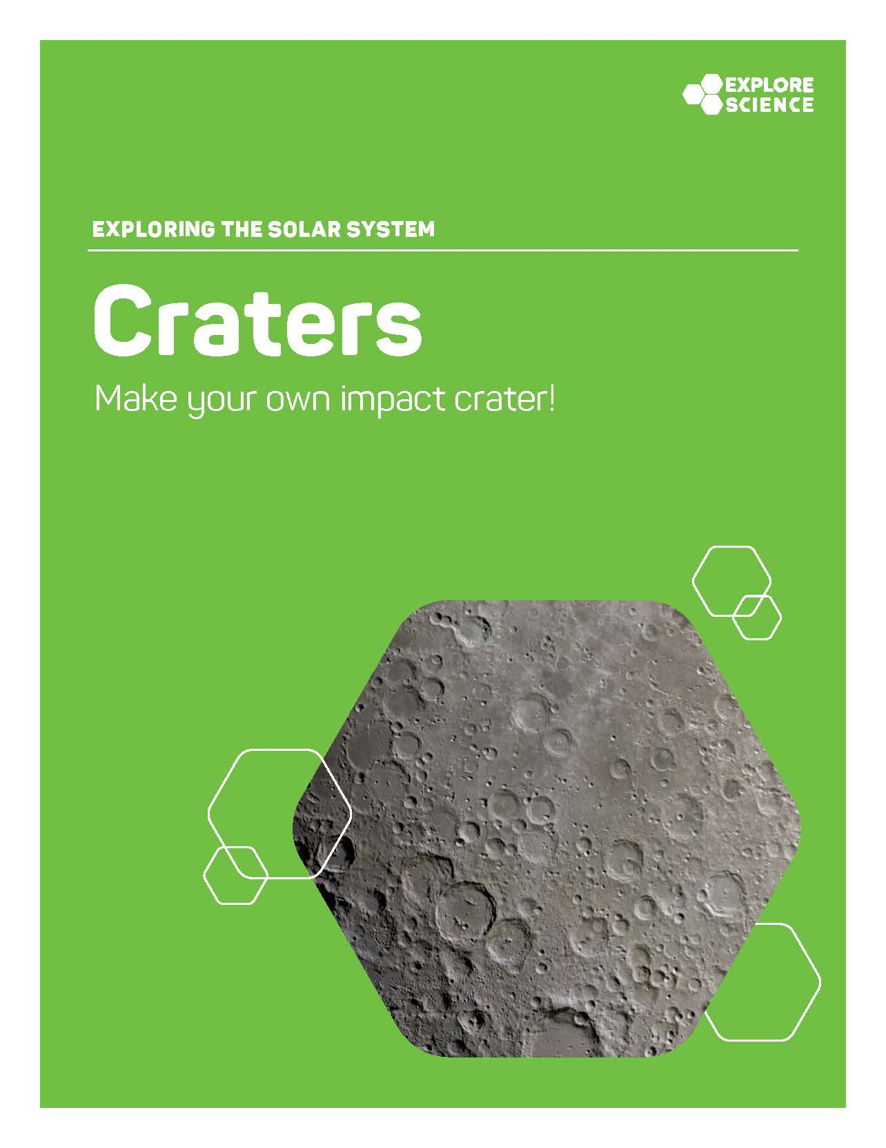
Notes:
The Moon Story Blocks, Moonquakes and Craters activities all help participants Explore the Solar System, with a focus on the Moon.
Moon Story Blocks engages learners in exploring the following ideas:
We imagine and tell stories—using images, characters, and emotions—to communicate our ideas and dreams;
Just like you, scientists, engineers, and artists use their creativity and imagination to tell stories about space missions that might happen in the future;
Future NASA missions will continue to explore the Moon in preparation for the return of humans to its surface.
The Moonquakes activity explores the following ideas:
The Moon is a very different place from our home planet, but there are similarities;
Both earthquakes and moonquakes result from a sudden release of energy and cause the ground to move and shake;
NASA missions study moonquakes and other processes on the Moon’s surface to learn more about the Moon itself and to prepare for the return of humans.
Craters explores the following main ideas:
Studying the surface of a planet or moon can reveal its history and composition;
Impact craters form when a meteorite collides with the surface of a moon or planet (or other body in space);
Scientists use tools to find and observe craters and learn more about the geologic processes on planets, moons, asteroids, and other worlds.
In addition, the Observe the Moon bundle includes tools, resources, and exercises for participants to further explore the Moon. Through these facilitated experiences, learners will zoom in on three key takeaways:
From Earth, we can look up and see the Moon with our own eyes;
We can observe the Moon in even greater detail by using tools, like binoculars, telescopes, and NASA spacecraft;
We all have personal and cultural connections to the Moon.

Slide 18

Notes:
The Measure Up! activity falls into the Exploring Science Practices toolkit category.
It is designed to engage early learners (ages 0-4) and their caregivers in the development of science process skills. Through doing this activity with their young child, caregivers will explore 3 main ideas:
Measuring, using tools, and counting are important skills for doing science;
Very young children can use measuring tools to investigate foundational science concepts like distance, mass, and volume;
Scientists develop and use measuring tools to gather information about the physical world, including faraway objects in space.
Throughout this exploration, the facilitator should model strategies for fostering, guiding, and building on basic science practices. The activity has the following goals:
To help adults understand that doing science looks different at different developmental stages;
To model facilitation strategies that encourage the use of science process skills by early learners;
And to thereby increase caregivers’ ability and confidence to engage the very young children in their lives in science activities.

Slide 19

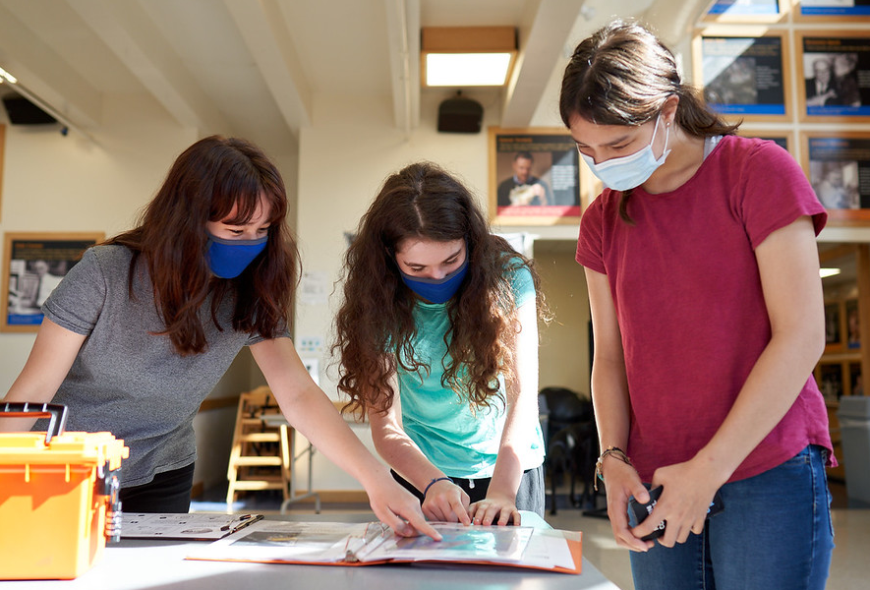
Notes:
[Include this slide if participants will also have the chance to play the Moon Adventure Game at your event.]
These toolkit activities complement the Moon Adventure Game, a hands-on collaborative experience for STEM learning. In the game, players work together to solve a series of challenges grounded in actual NASA science and research about what people might need in the future to live and work on the Moon. Players assume the role of astronauts living and doing research in an outpost on the Moon. As players conduct research, a moonquake causes significant damage to the life-support systems on the outpost, leading to a series of immersive challenges in which players must work together to quickly restore the necessary systems to survive.
Unlike the other activities, which are designed as drop-in experiences, the Moon Adventure Game requires a designated space away from commotion and about thirty minutes for each group of 3-6 play through. [Here, you may provide details about the location and schedule for the Moon Adventure game play during the event.]
As a result of participating in the game, learners will:
Strengthen 21st century skills related to collaboration, innovation, critical thinking, and problem-solving;
Increase their interest in Moon and space exploration;
Develop a sense of science identity and confidence related to learning about the Moon and space science;
Learn new content knowledge about the Moon and/or space exploration.

Slide 20
Leading the Activities
Notes:
Now, we’ll review some tips for leading these activities with participants.

Slide 21
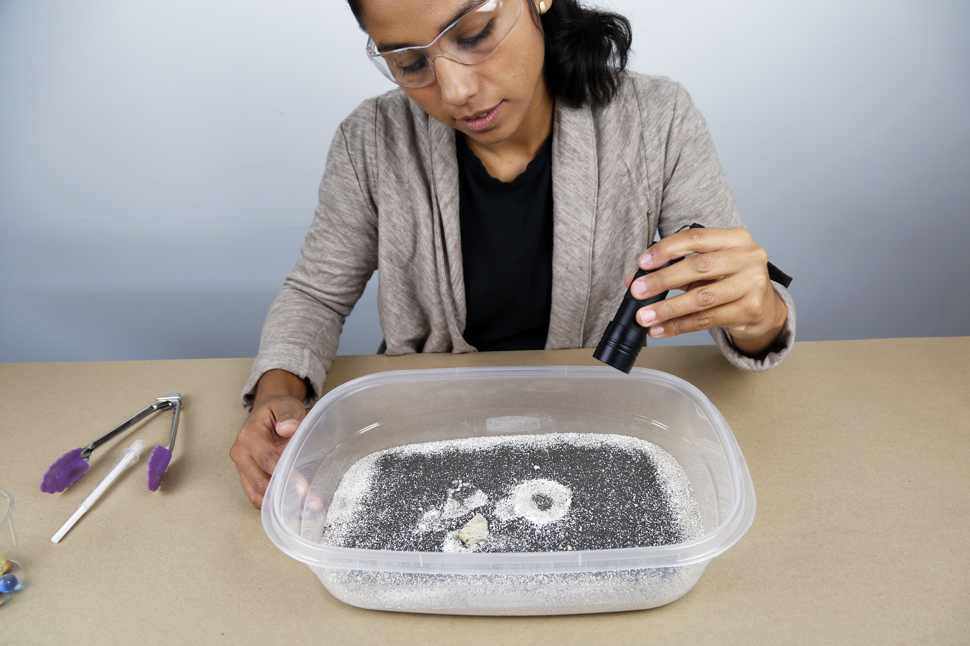
Activity materials
Notes:
We’ve just taken a very quick look at the contents of the Explore Science: Earth & Space toolkit, and the accompanying Moon Adventure Game.
Here is an example of just one activity, Craters. Each activity box includes all the physical materials needed to do the activity.
Some of these materials are intended for the learners to use. These include the supplies they need to do the activity—like the container of sand with iron filings, marbles, gravel pieces and Ultraviolet flashlight—shown in this image. You’ll also want to share the colorful activity guide and sign, and any additional information sheets, worksheets, or other graphics. These things should all be out and accessible for learners.
The box also includes some materials for you, the facilitator, to use. These include the more plain-looking facilitator guide with some notes about things like set-up and safety, and some tips to help you do a great job leading the activity, as well as any materials you’ll need for advance preparation. These are just for you and are not meant to be shared with participants.
Finally, please note that there are both activity and content training videos for each activity, which you can watch to help you learn the activity before you do it with participants.

Slide 22
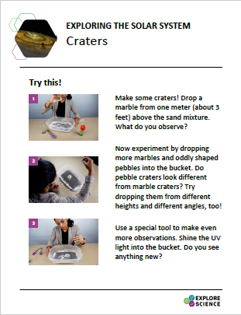
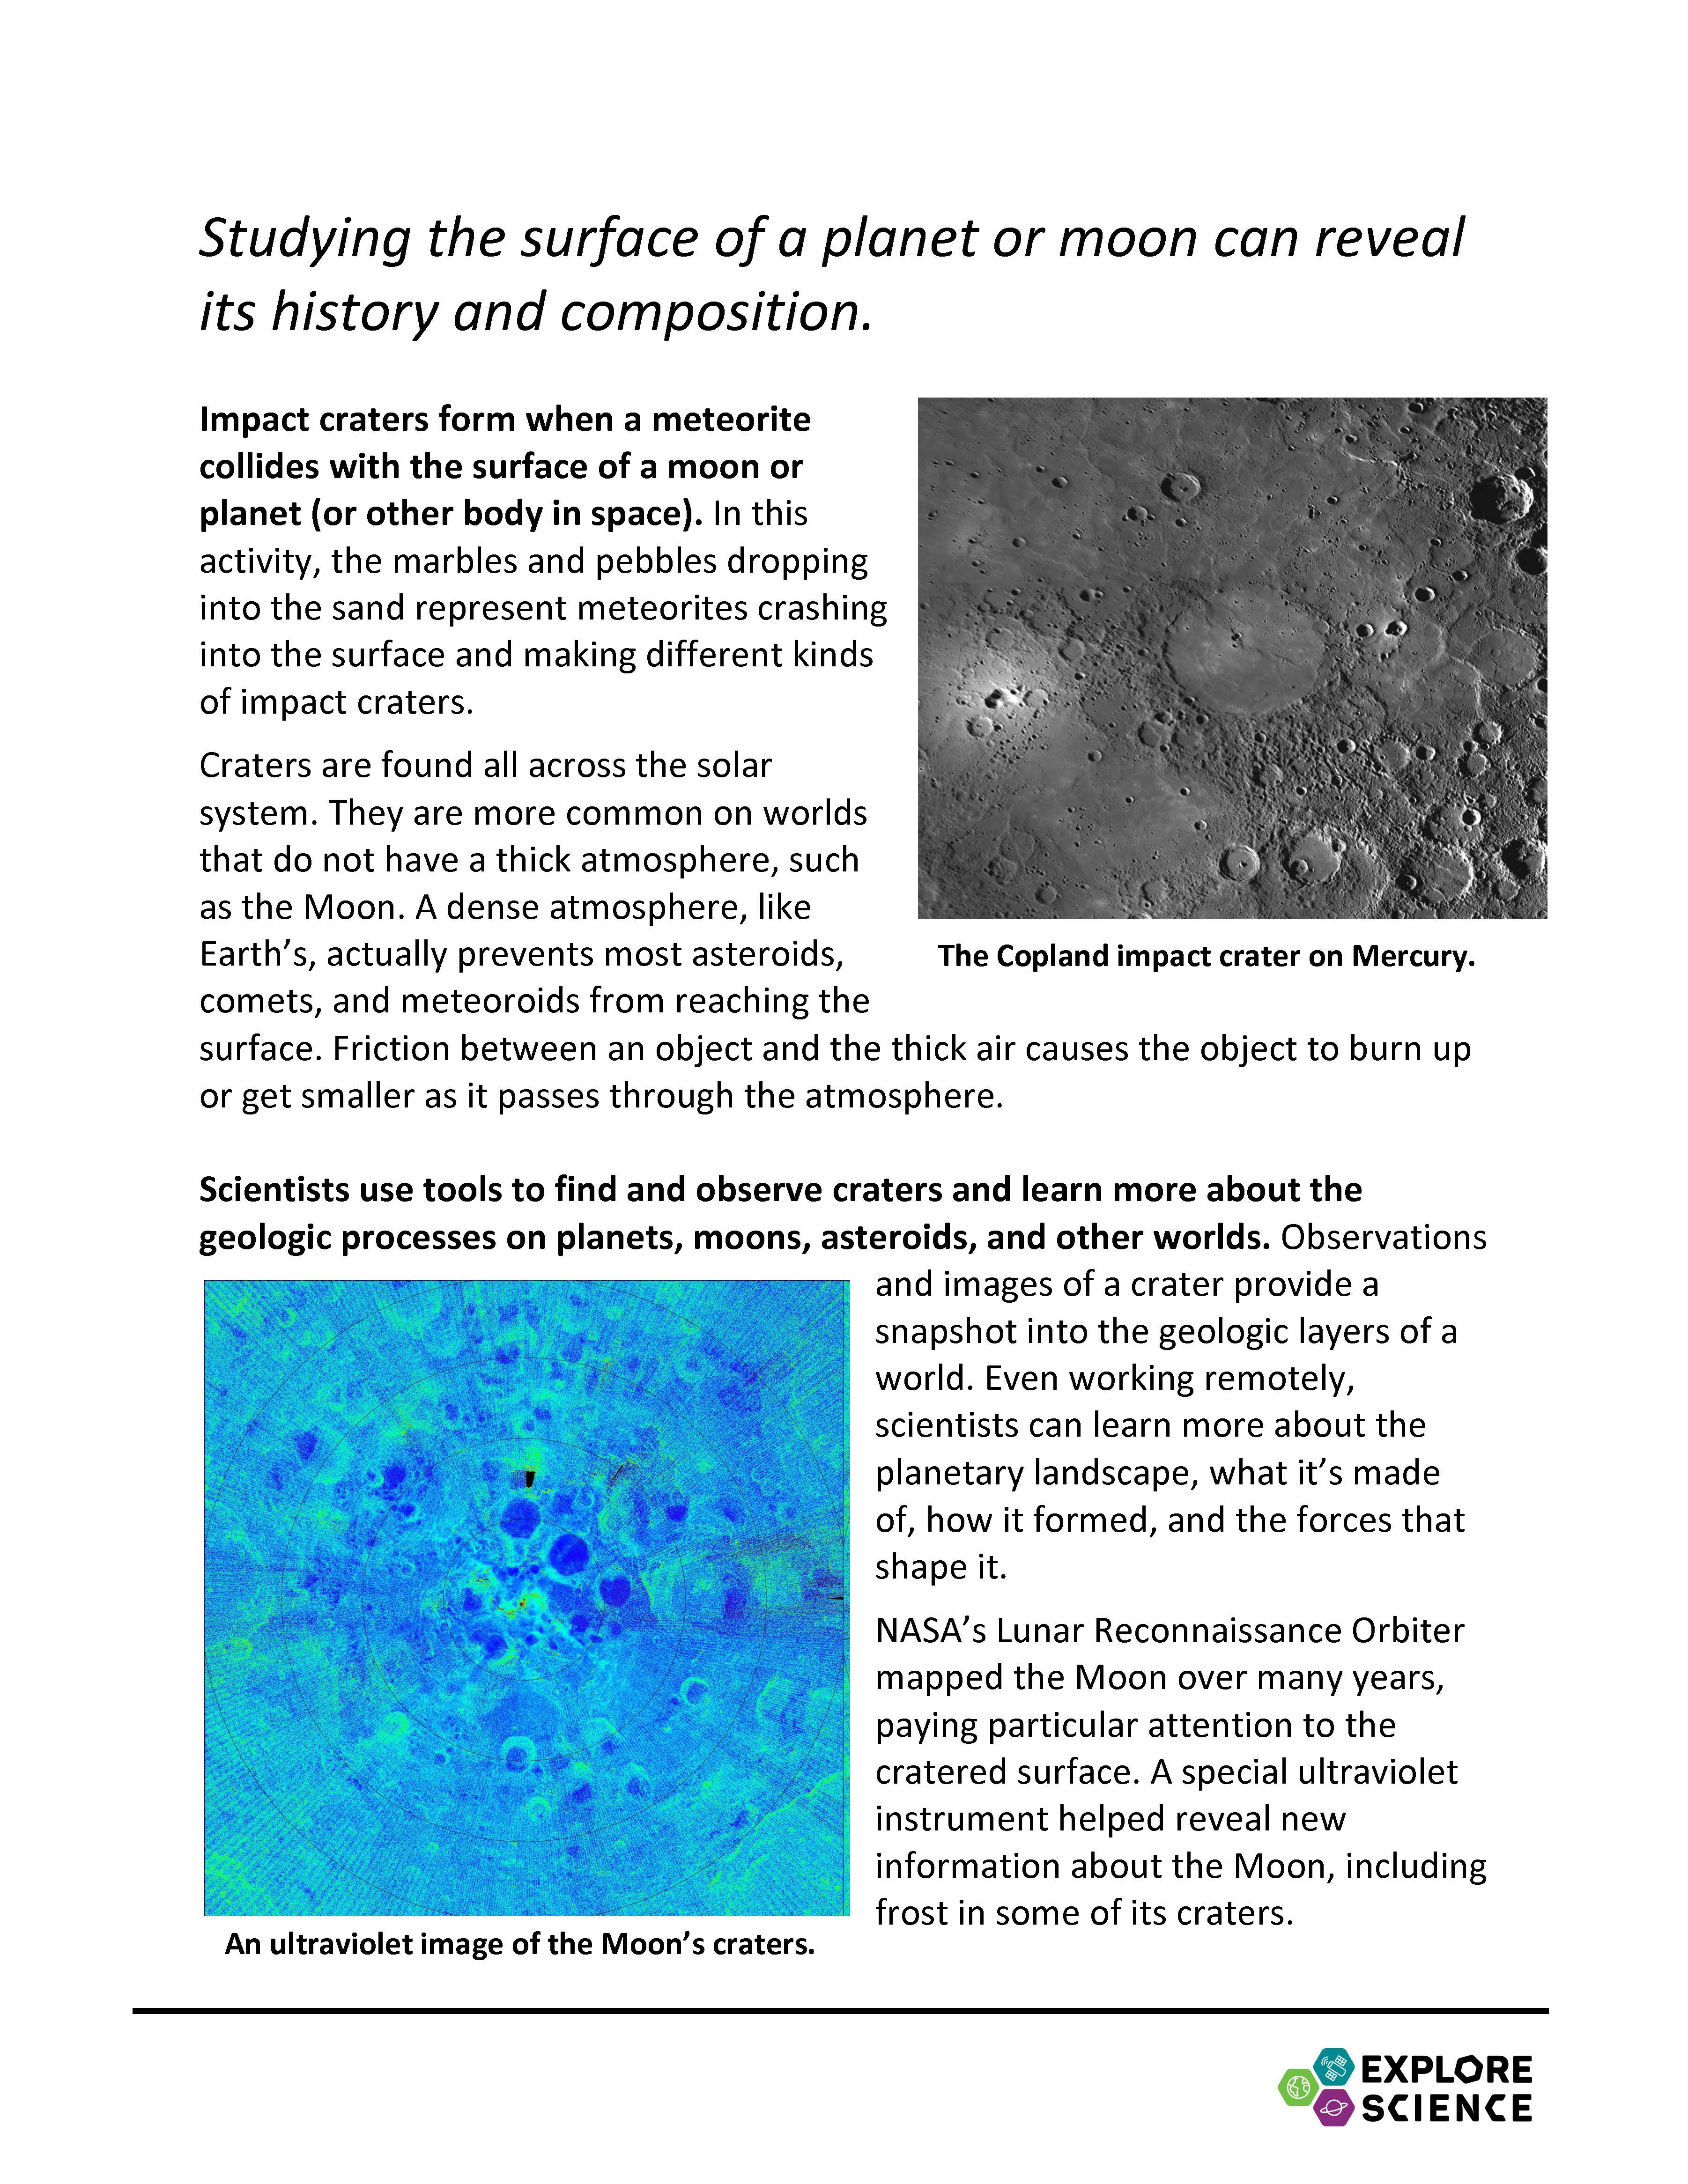
Activity instructions
Notes:
Now let’s look at some of these materials a bit more closely. Here is an example of an activity guide, for the Craters activity.
The activity guides are structured to help you lead learners through hands-on science activities.
The front side includes step-by-step instructions in the section called “Try this!”
The back side describes what learners observe—and explains why it happens. Finally, the guide relates the activity to current space or Earth related science, NASA research, or information on childhood development.
You can leave these guides out on the table both to help you explain the activity and so that learners can read them and look at the pictures.
(They’re available in both English and Spanish versions.)

Slide 23
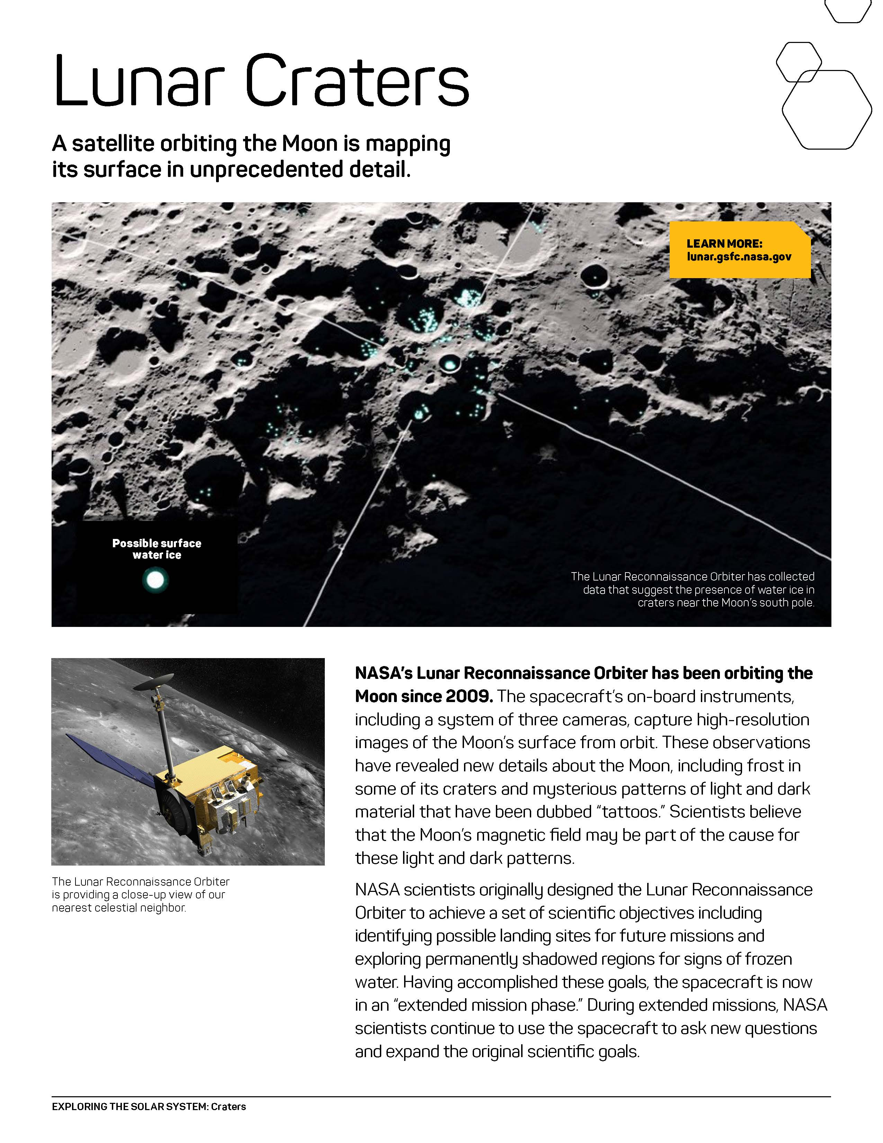
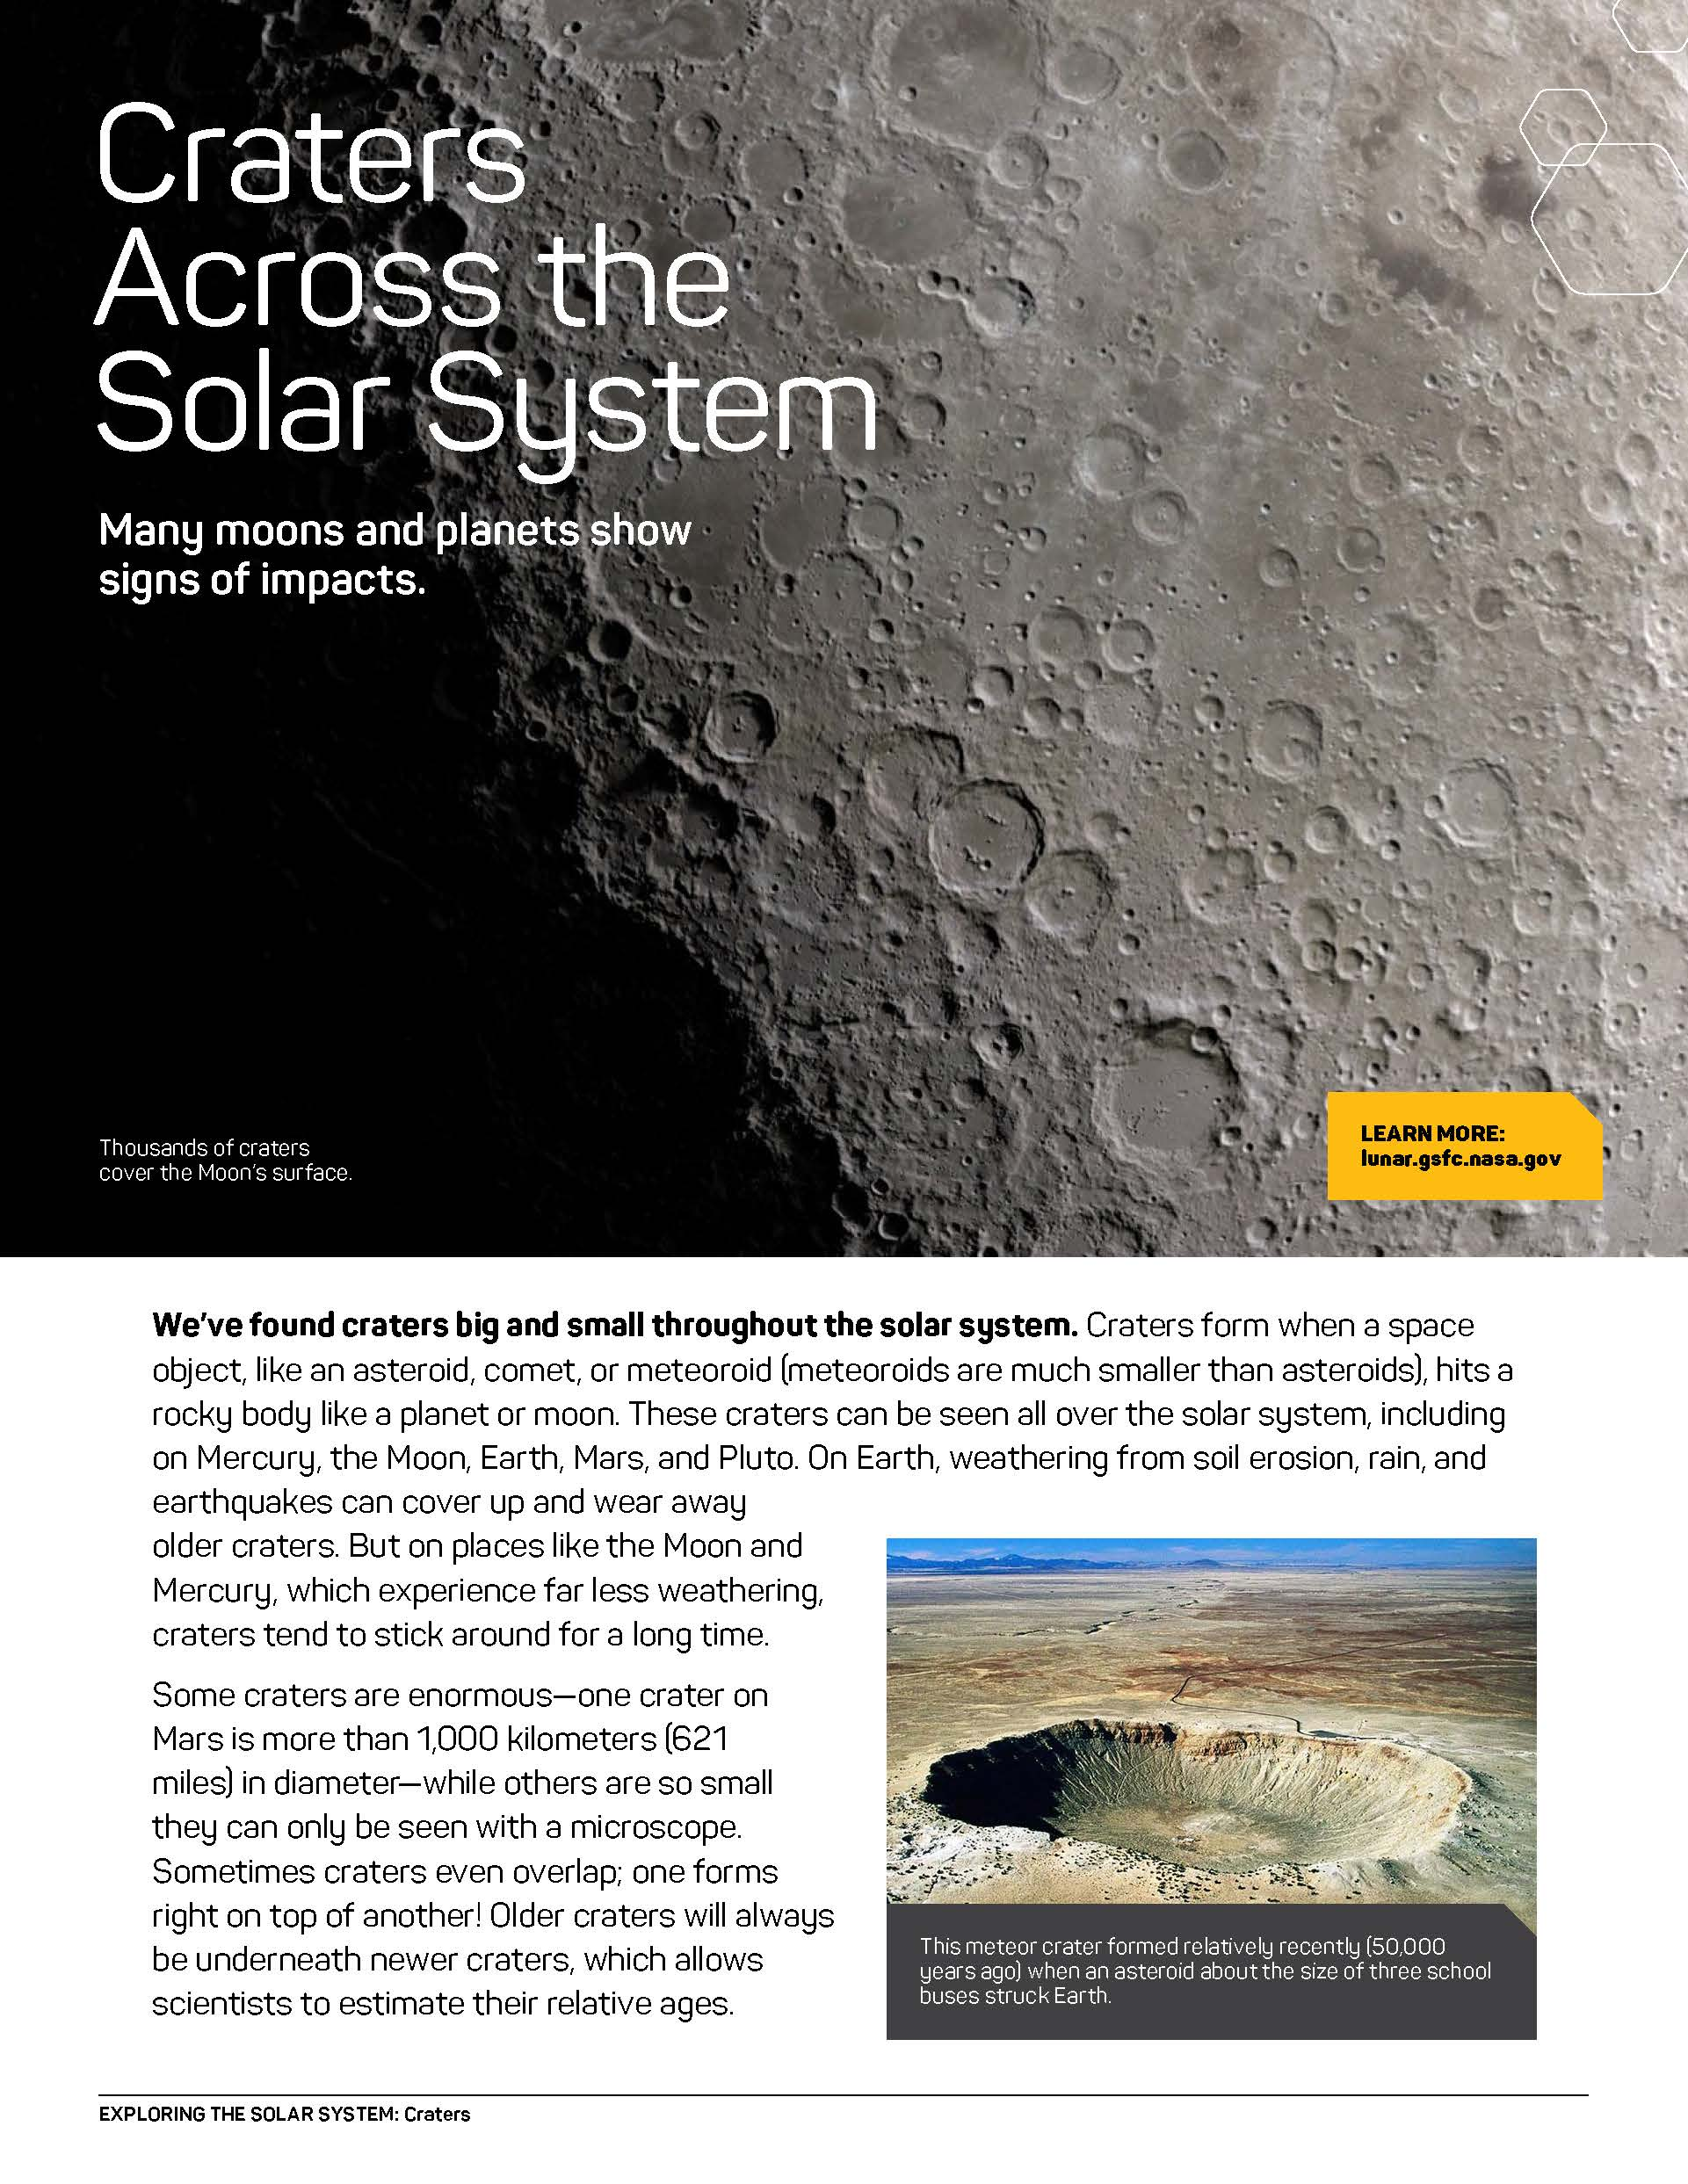
Info sheets and worksheets
Notes:
Many activities include additional information sheets or other graphic assets (like prompt cards or visual instruction sheets). Depending on your event or setting you may choose to use these more or less. They provide additional related content about the hands-on activity for participants and facilitators alike.

Slide 24
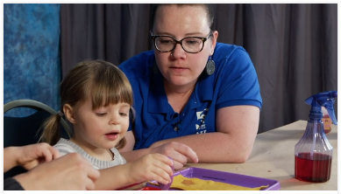
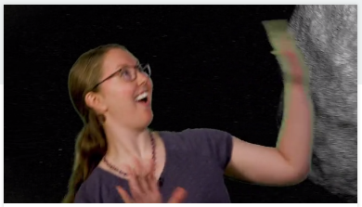
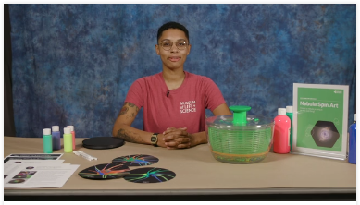
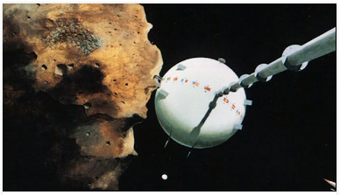
Training Videos
Notes:
Each activity in the toolkit comes with an activity training video and a science content training: https://vimeopro.com/nisenet/explore-science-earth-space. Facilitators can watch these before the event (or even last minute, online!)
[This year, we have also included a a training video about facilitation techniques titled Educathalon and a set of training videos on Strategies for Approaching Difficult Scientific Concepts in space and Earth science. Part one describes various strategies you can use and provides an annotated example. Part two provides a scripted example of a visitor interaction and invites you to notice which strategies are employed. You can watch these videos together as a group and discuss what you see and notice and how this might change the ways you interact with visitors.]

Slide 25
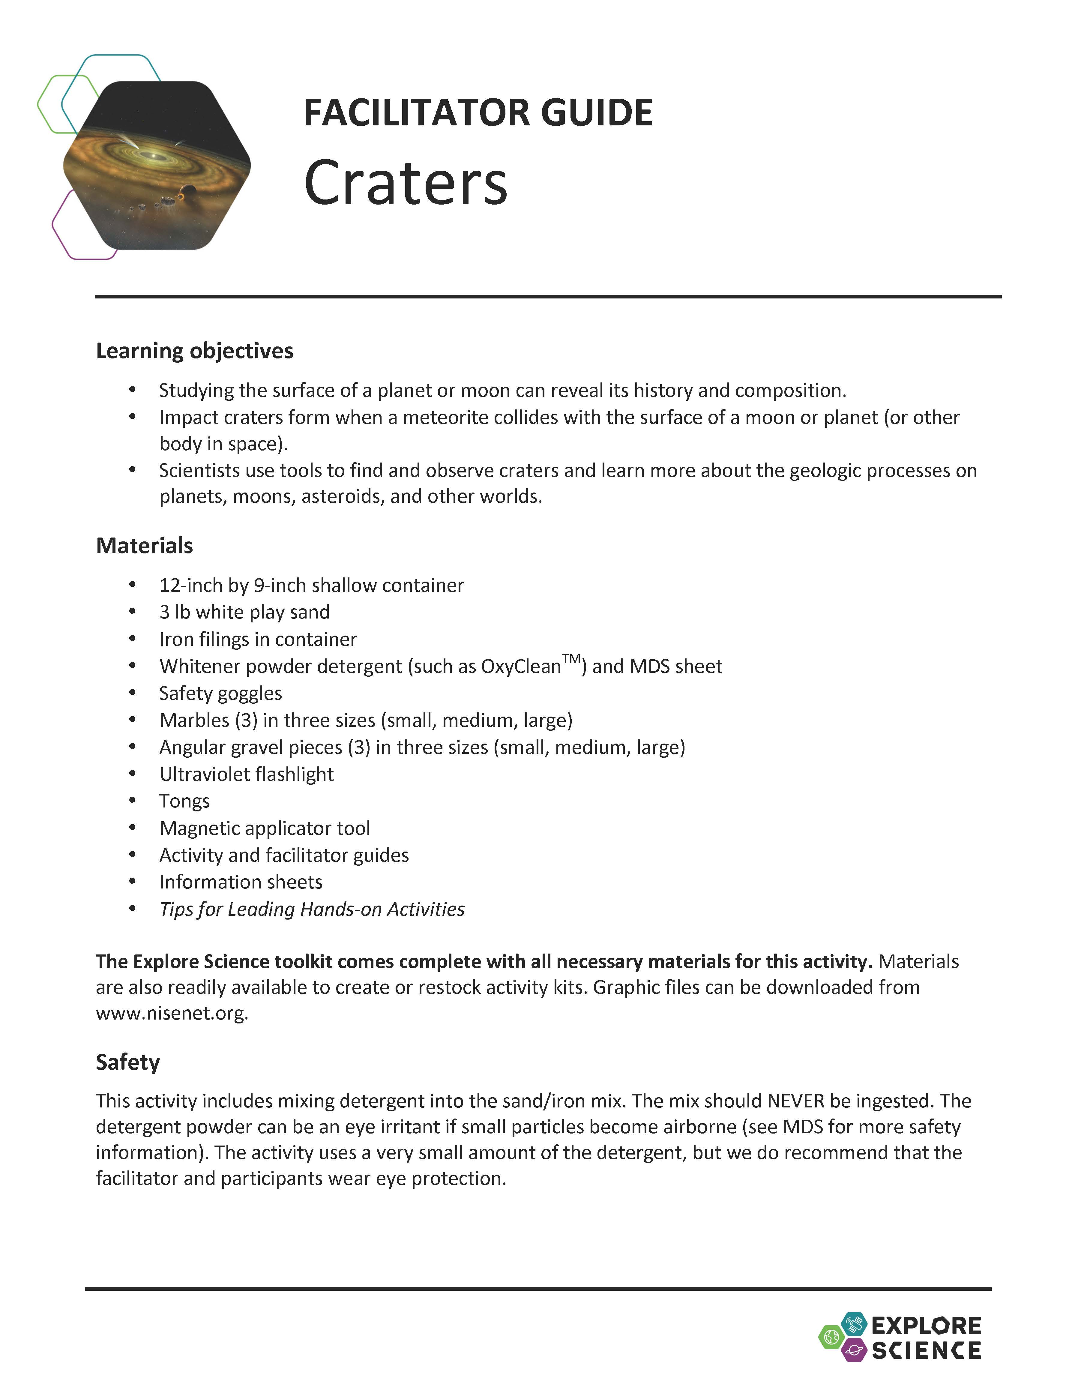
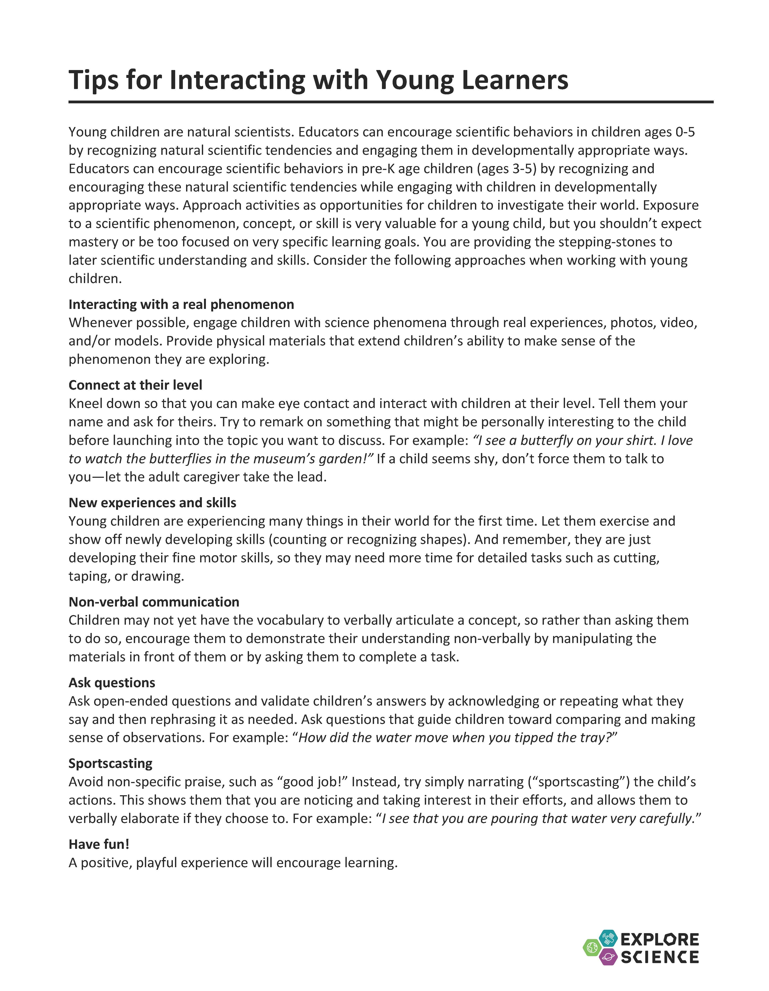
Notes and tips
Notes:
The facilitator guide is for you, the activity leader.
The first few pages list the learning objectives, activity materials, and includes important notes related to set-up, safety, presentation, difficult concepts and other aspects of the activity.
Additionally, each activity contains a useful reference sheet with tips for leading hands–on science activities or tips for interacting with young learners, as well as notes about how to talk to visitors about misconceptions and other difficult concepts.

Slide 26
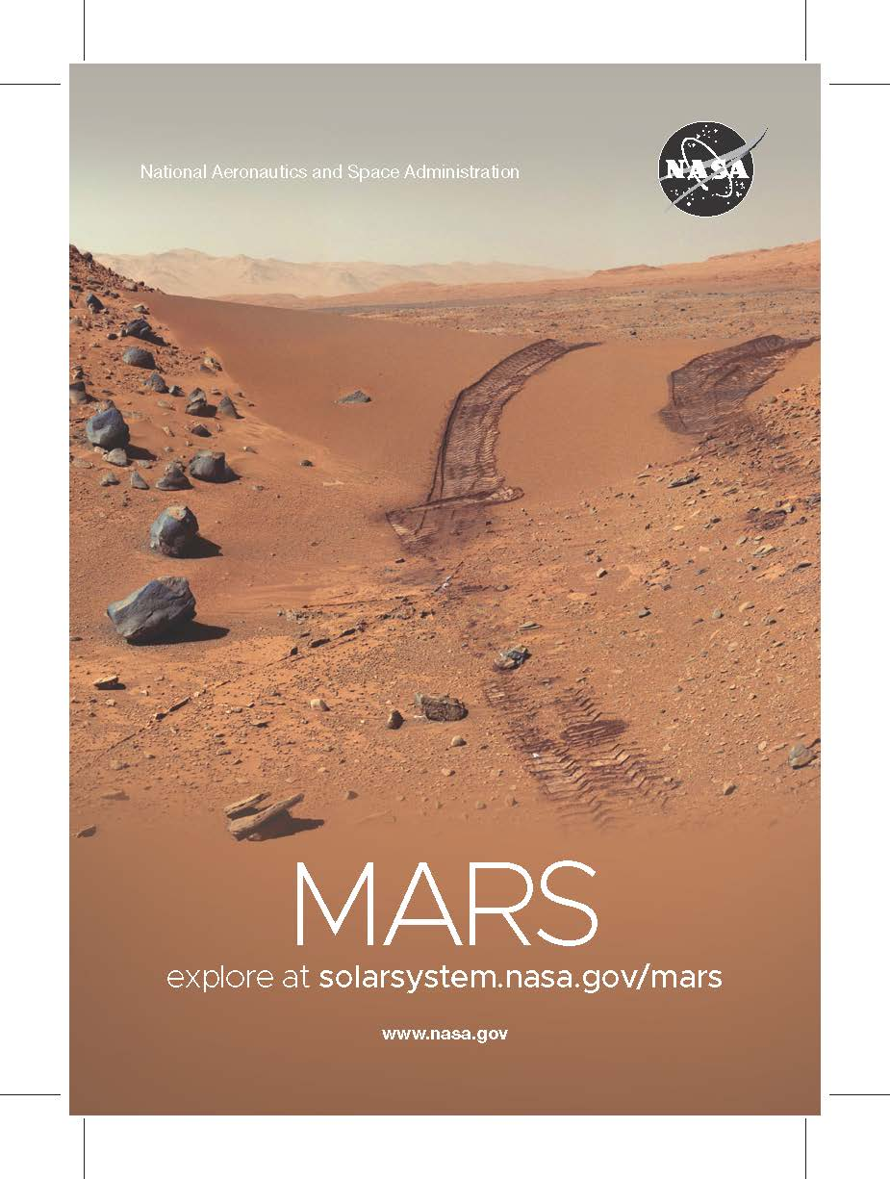
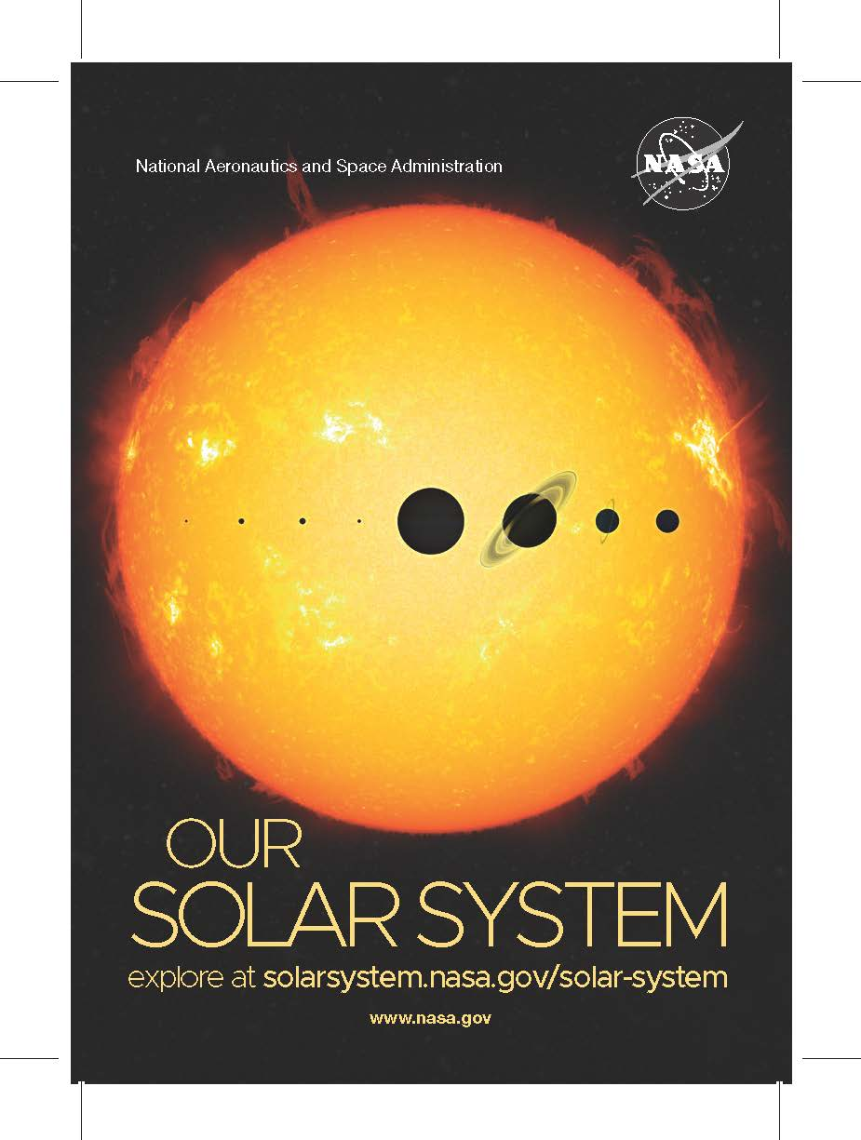
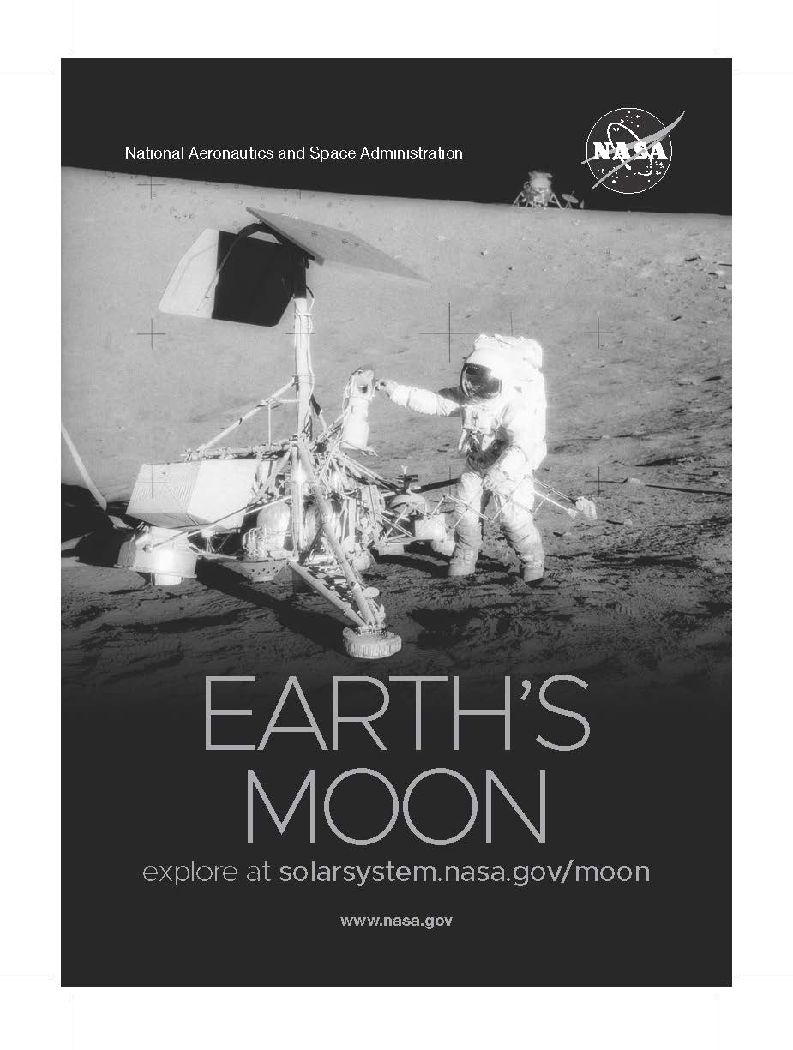
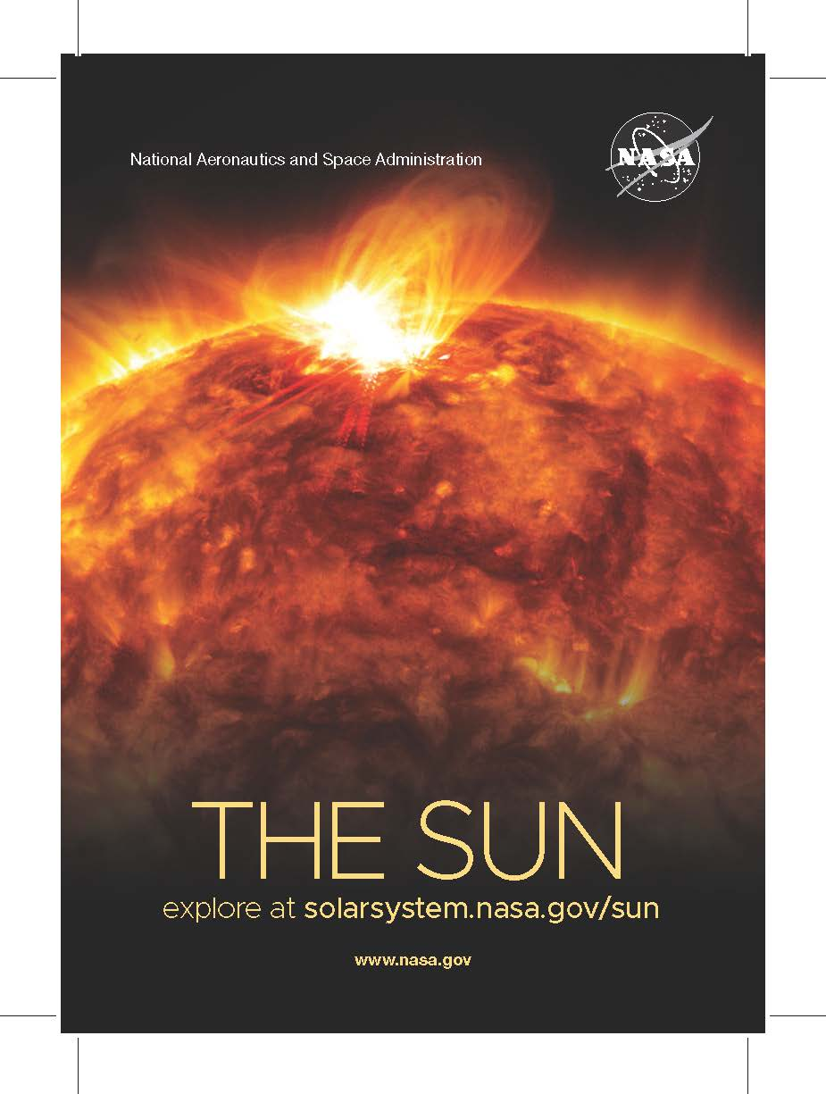
Training Game
Notes:
Now, we’ll play a game to familiarize ourselves with some Earth & space science content while exploring various facilitation techniques and strategies for engaging learners.
[Choose one of three Training Games offered as part of this toolkit: “Sort it Out,” “Spacelebrity,” or “Great Minds Think Alike,” and follow the instructions in the Explore Science: Earth & Space Training Games guide to play and debrief the game with trainees. A slide for each game is included at the end of this presentation – you may choose replace this generic slide with one for the specific game that you intend to play.]

Slide 27
Tips for Leading Hands-on Activities
Greet your guests
Encourage exploration
Ask open-ended questions
Be a good listener
Share what you know
Offer positive responses
Share accurate information
Remain positive
Thank your guests
& HAVE FUN!
Notes:
Tips for leading hands-on activities include:
Greet your guests
Encourage exploration
Ask open-ended questions
Be a good listener
Share what you know
Offer positive responses
Share accurate information
Remain positive
Thank your guests
& HAVE FUN!

Slide 28
Tips for Interacting with Young Learners
Interact around real science phenomena
Connect at their level
Support new experiences and skill development
Embrace repetition
Make opportunities for non-verbal communication
Ask open-ended questions
“Sportscast” (narrate) the child’s actions
& HAVE FUN!
Notes:
These tips are especially useful for facilitators leading the “Early Explorations” activity. However, they can be used with young participants for any of the toolkit activities.

Slide 29
Questions?
Notes:
Questions?

Slide 30


Thank you
Space and Earth Informal STEM Education is supported by NASA under cooperative agreement numbers NNX16AC67A and 80NSSC18M0061. Any opinions, findings, and conclusions or recommendations expressed in this material are those of the author(s) and do not necessarily reflect the view of the National Aeronautics and Space Administration (NASA).
Copyright 2020 Sciencenter
Activity photos by Emily Maletz and Dave Burbank for the NISE Network. Training video screen capture by Museum of Life and Science. Living with the Sun image: composite image of 25 separate images of the Sun from the Solar Dynamics Observatory (SDO) spanning the period of April 16, 2012, to April 15, 2013, courtesy NASA Goddard Space Flight Center/SDO/AIA/S. Wiessinger. The Changing Earth image: Late winter storms dropped a fresh coating of snow across the Alps in mid-March 2016, courtesy NASA image by Jeff Schmaltz, LANCE/EOSDIS Rapid Response. Our Solar System and Planets Around Other Stars image: Artistic concept of water plumes on Jupiter’s moon Europa courtesy NASA/ESA/K. Retherford/SWRI. Galaxies and Beyond image: Eagle Nebula's “Pillars of Creation” courtesy NASA.
Notes:
THANK YOU!

Slide 31
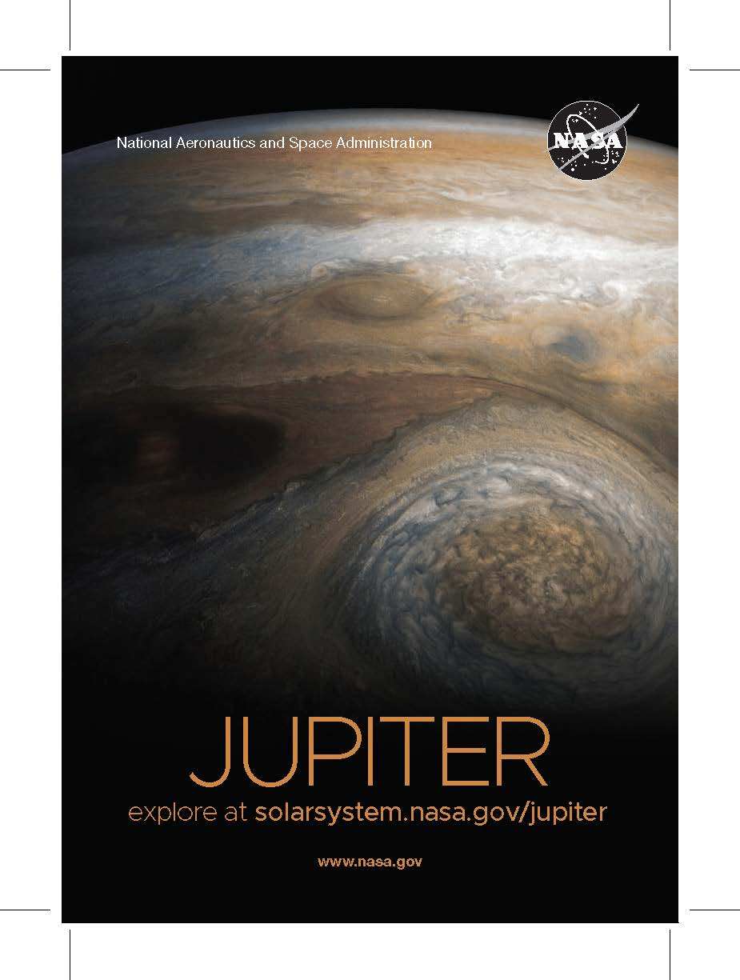
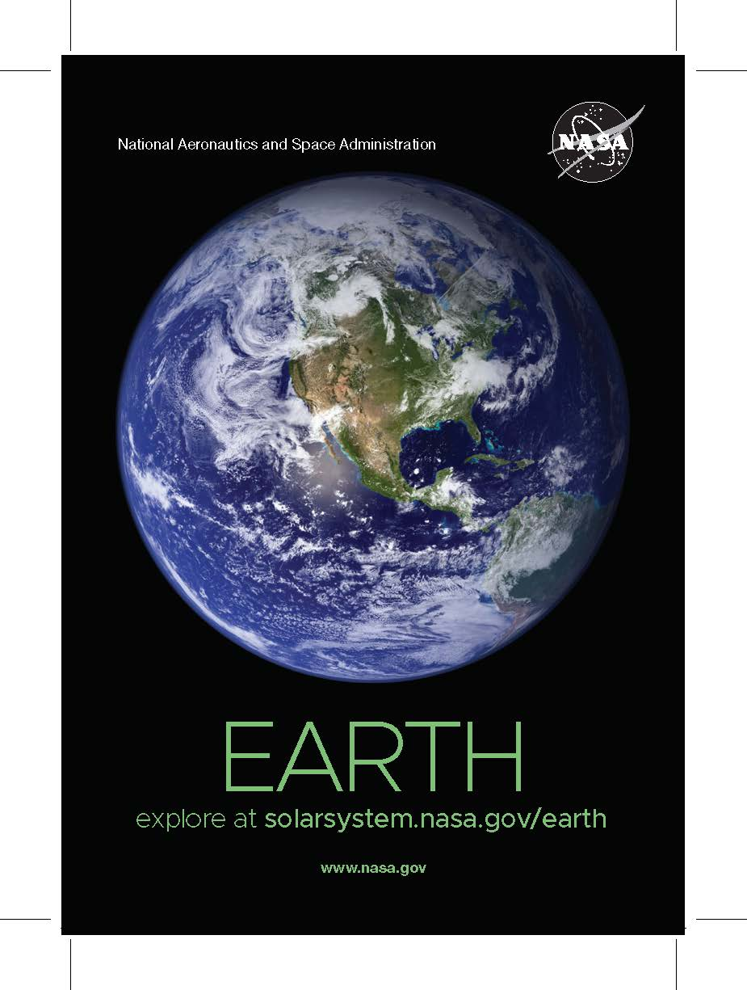
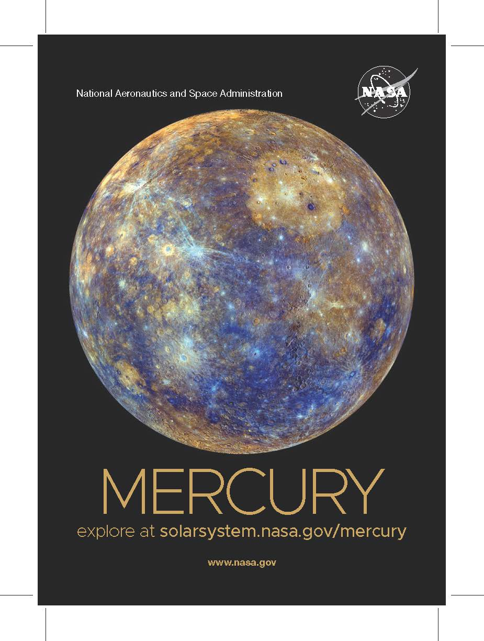
Training Game – Sort it Out
NASA JPL, “Solar System Size and Distance”
Notes:
Now, we’ll play a game to familiarize ourselves with some Earth & space science content while exploring various facilitation techniques and strategies for engaging learners.
[Follow the instructions in the Explore Science: Earth & Space Training Games guide to play and debrief “Sort it Out” with trainees. Prior to playing, you may choose to watch this “Solar System Size and Distance” video from NASA JPL to review relevant solar system science content: https://www.jpl.nasa.gov/edu/learn/video/solar-system-size-and-distance/]

Slide 32
Training Game – Spacelebrity
National Geographic, “Science 101: The Solar System”
Notes:
Now, we’ll play a game to familiarize ourselves with some Earth & space science content while exploring various facilitation techniques and strategies for engaging learners.
[Follow the instructions in the Explore Science: Earth & Space Training Games guide to play and debrief “Spacelebrity” with trainees. Prior to playing, you may choose to watch this “Science 101: The Solar System” video from National Geographic to review relevant solar system science content: https://www.nationalgeographic.org/video/space-101-solar-system/]

Slide 33
Training Game – Great Minds Think Alike
National Geographic, “Science 101: The Solar System”
Notes:
Now, we’ll play a game to familiarize ourselves with some Earth & space science content while exploring various facilitation techniques and strategies for engaging learners.
[Follow the instructions in the Explore Science: Earth & Space Training Games guide to play and debrief “Great Minds Think Alike” with trainees. Prior to playing, you may choose to watch this “Science 101: The Solar System” video from National Geographic to review relevant solar system science content: https://www.nationalgeographic.org/video/space-101-solar-system/]

