Slide 1
Extreme Precipitation
Notes:
Welcome back everyone! I hope you enjoyed your planetarium show. Thank you for returning to the room in a timely manner.
We are now going to begin with session one. We will start with a brief introduction to Rivertown.

Slide 2
Welcome to Rivertown
Session 1: Extreme Precipitation
Notes:
Today we will be making a resilience plan against Extreme Precipitation for Rivertown. Before you can make a plan, however, you should learn a little bit about the city and who lives there.

Slide 3
The U.S. is experiencing more heavy rainfalls than ever before
Notes:
Welcome to Rivertown! According to the National Climate Assessment, Rivertown has had more extreme precipitation events from 1958 to 2012 than most other places in the united states. Because we are seeing significant changes in the frequency and intensity of these downpours across the US, Rivertown is planning ways to protect the city against more future extreme precipitation events.
LEFT: One measure of heavy precipitation events is a two-day precipitation total that is exceeded on average only once in a 5-year period, also known as the once-in-five-year event. As this extreme precipitation index for 1901-2012 shows, the occurrence of such events has become much more common in recent decades. Changes are compared to the period 1901-1960, and do not include Alaska or Hawai‘i. (Figure source: adapted from Kunkel et al. 2013).
RIGHT: Figure 2.18: The map shows percent increases in the amount of precipitation falling in very heavy events (defined as the heaviest 1% of all daily events) from 1958 to 2012 for each region of the continental United States. These trends are larger than natural variations for the Northeast, Midwest, Puerto Rico, Southeast, Great Plains, and Alaska. The trends are not larger than natural variations for the Southwest, Hawai‘i, and the Northwest. The changes shown in this figure are calculated from the beginning and end points of the trends for 1958 to 2012. (Figure source: updated from Karl et al. 2009).

Slide 4
Extreme Precipitation can Lead to Flooding
EXPLORE RIVERTOWN
Notes:
Flooding may intensify in many U.S. regions, even in areas where total precipitation is projected to decline. A flood is defined as any high flow, overflow, or inundation by water that causes or threatens damage. Floods are caused or amplified by both weather- and human-related factors. Major weather factors include heavy or prolonged precipitation, snowmelt, thunderstorms, storm surges from hurricanes, and ice or debris jams. Human factors include structural failures of dams and levees, altered drainage, and land-cover alterations (such as pavement).
Flash floods occur in small and steep watersheds and waterways and can be caused by short-duration intense precipitation, dam or levee failure, or collapse of debris and ice jams. Most flood-related deaths in the U.S. are associated with flash floods.
Urban flooding can be caused by short-duration very heavy precipitation. Urbanization creates large areas of impervious surfaces (such as roads, pavement, parking lots, and buildings) that increased immediate runoff, and heavy downpours can exceed the capacity of storm drains and cause urban flooding.
Flash floods and urban flooding are directly linked to heavy precipitation and are expected to increase as a result of increases in heavy precipitation events.
River flooding occurs when surface water drained from a watershed into a stream or a river exceeds channel capacity, overflows the banks, and inundates adjacent low lying areas. Riverine flooding depends on precipitation as well as many other factors, such as existing soil moisture conditions and snowmelt.
https://commons.wikimedia.org/wiki/File:FEMA_-_32096_-_Cars_drives_though_flooded_street_in_an_Oklahoma_neighborhood.jpg
https://commons.wikimedia.org/wiki/File:Trapped_woman_on_a_car_roof_during_flash_flooding_in_Toowoomba_2.jpg

Slide 5
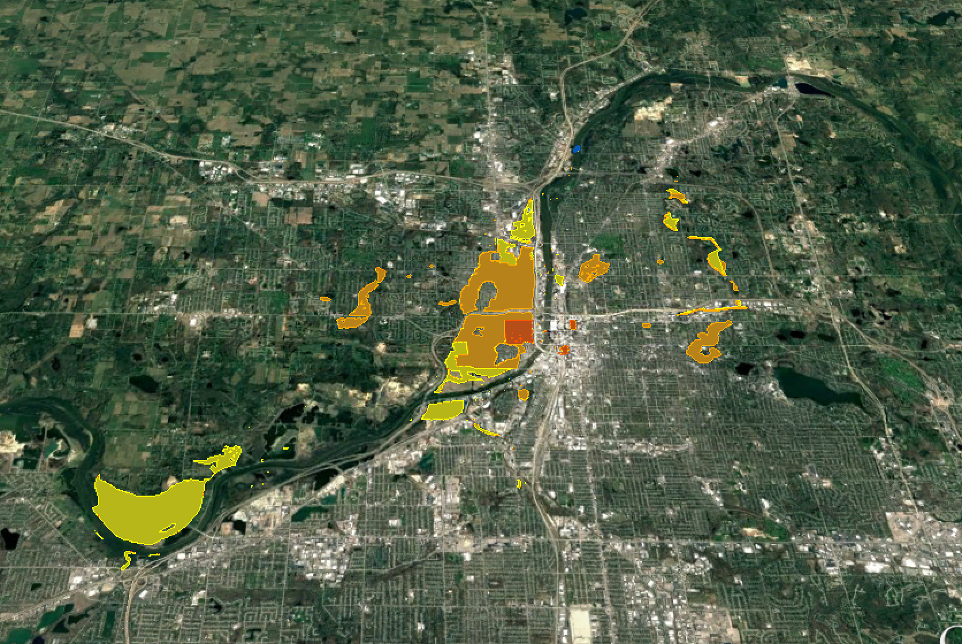
Who lives in Rivertown?
Yellow 100 - 1000 people
Orange 1,000 - 10,000 people
Red 10,000 - 100,000 people
Notes:
So now that you know a little bit about how extreme precipitation affects Rivertown, let's learn about who lives in the town. I'm going to take you through some screen shots from the google earth platform you'll be using later to visualize your resilience plans.
POPULATION - THIS IS IN THE BACK OF THE WORKBOOK

Slide 6
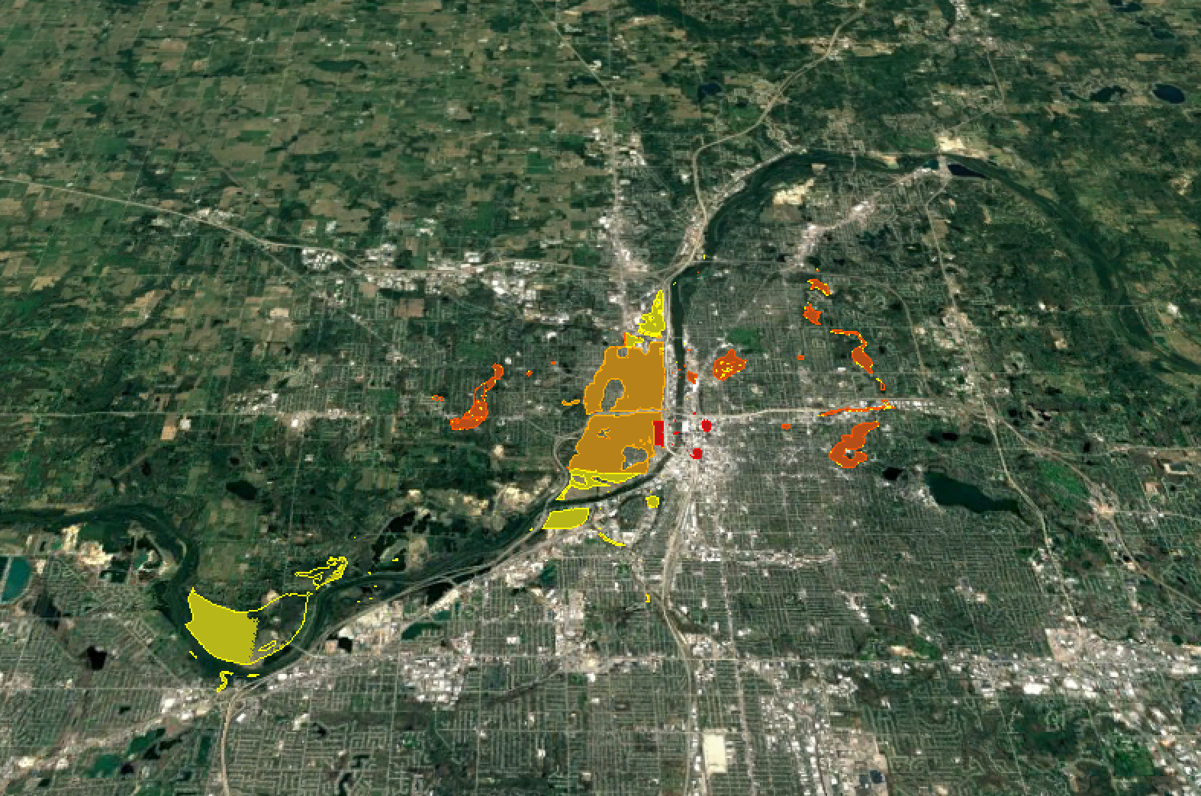
Who lives in Rivertown?
Yellow $100,000 - $1 million
Orange $1 million - $10 million
Dk. Orange $10 million - $100 million
Red $100 million +
Notes:
PROPERTY VALUE - THIS IS IN THE BACK OF THE WORKBOOKS

Slide 7
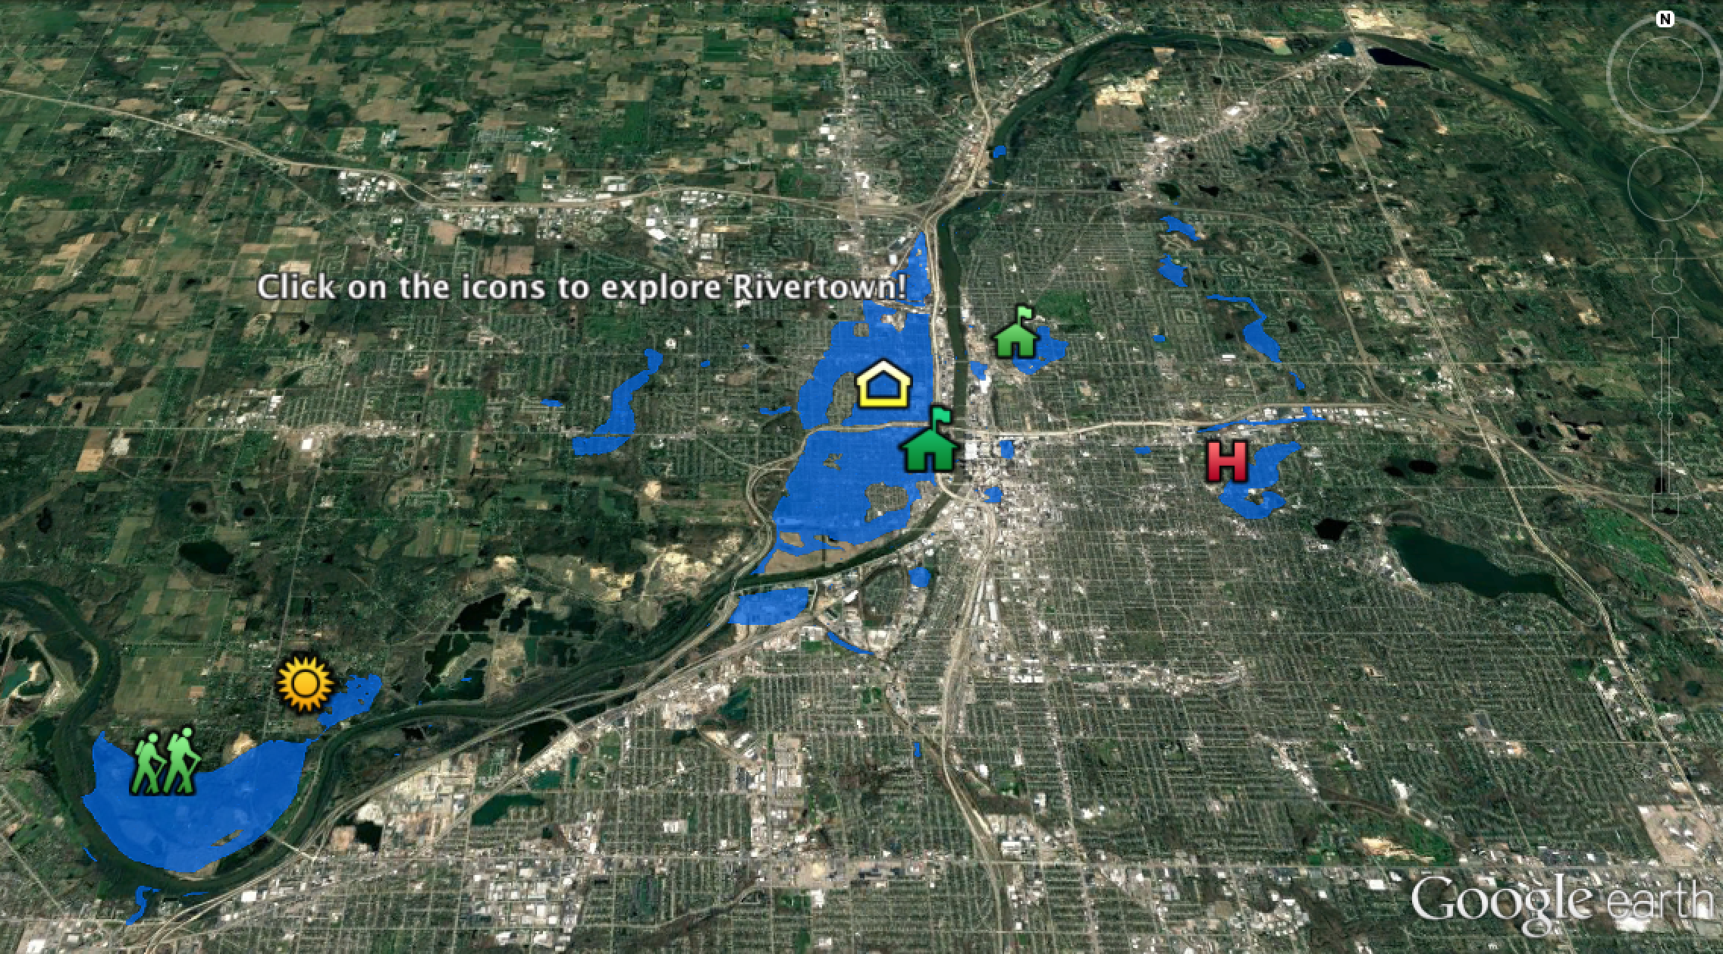
What makes Rivertown vulnerable?
Notes:
This is also on the back of your workbooks if you want to refer to it later.

Slide 8
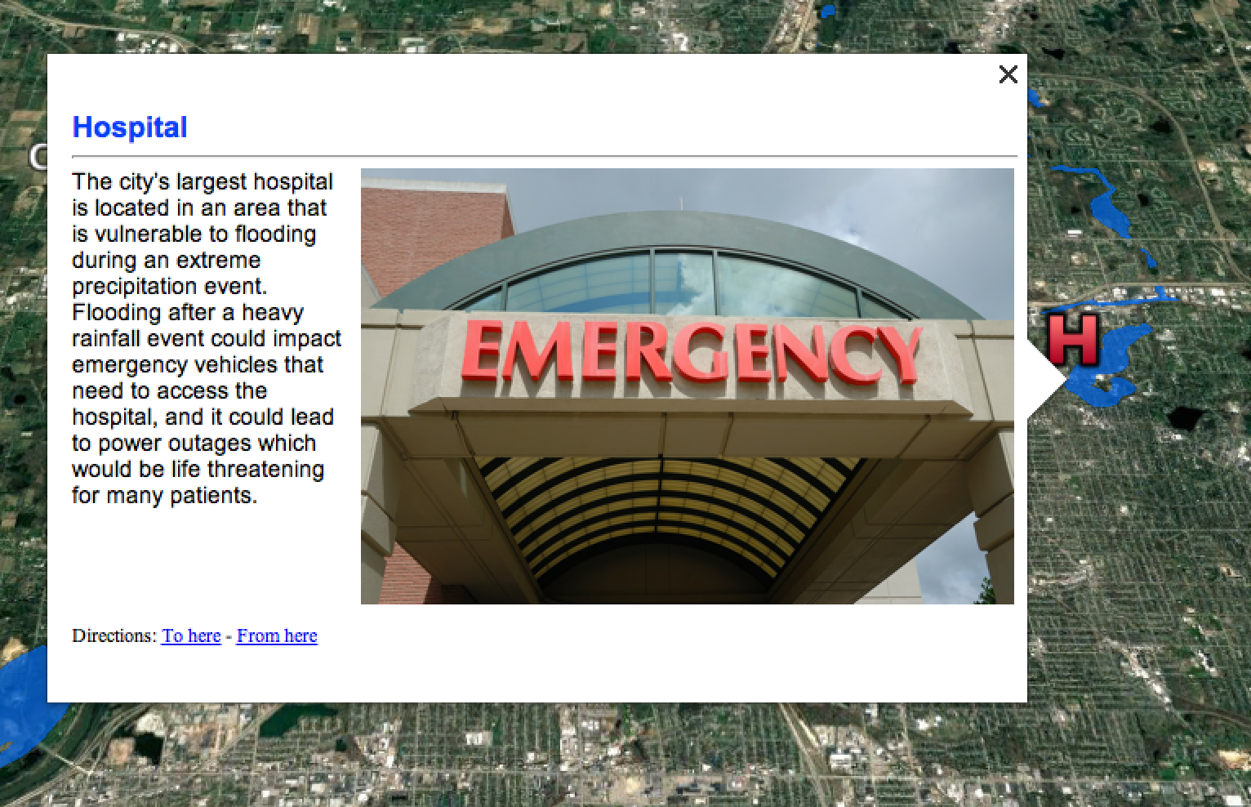
What makes Rivertown vulnerable?
Notes:
The city’s largest hospital is located in an area that is vulnerable to flooding during an extreme precipitation event. Flooding after a heavy rainfall event could impact emergency vehicles that need to access the hospital, and it could lead to power outages which would be life threatening for many patients.

Slide 9
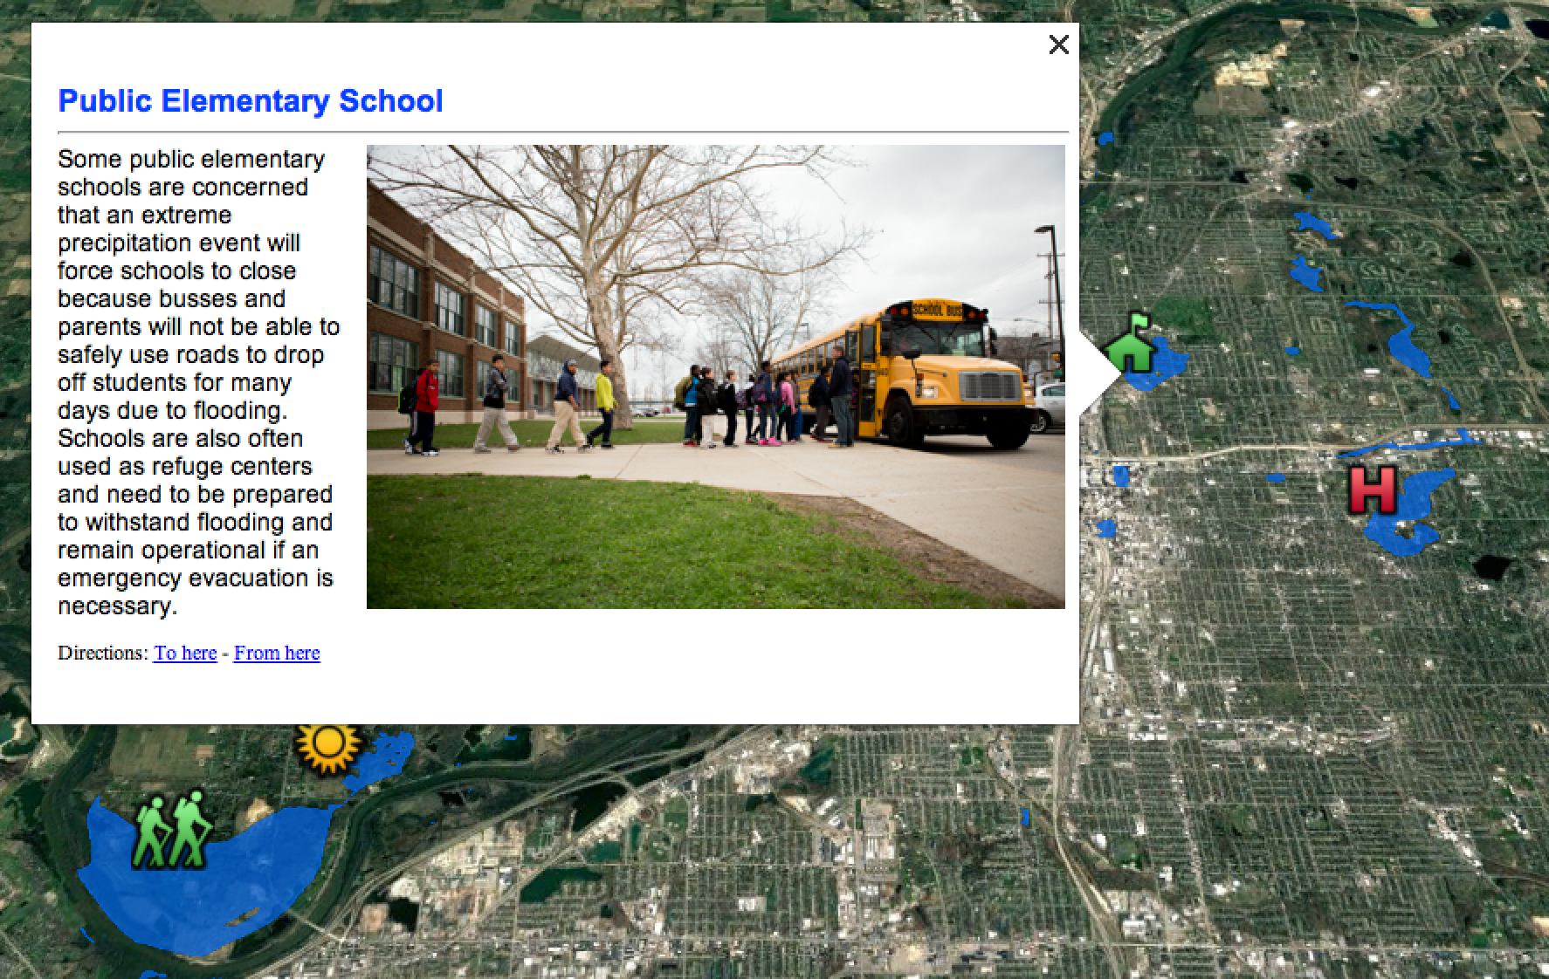
What makes Rivertown vulnerable?
Notes:
Some public elementary schools are concerned that an extreme precipitation event will force schools to close because busses and parents will not be able to safely use roads to drop off students for many days due to flooding. Schools are also often used as refuge centers and need to be prepared to withstand flooding and remain operational if an emergency evacuation is necessary.

Slide 10
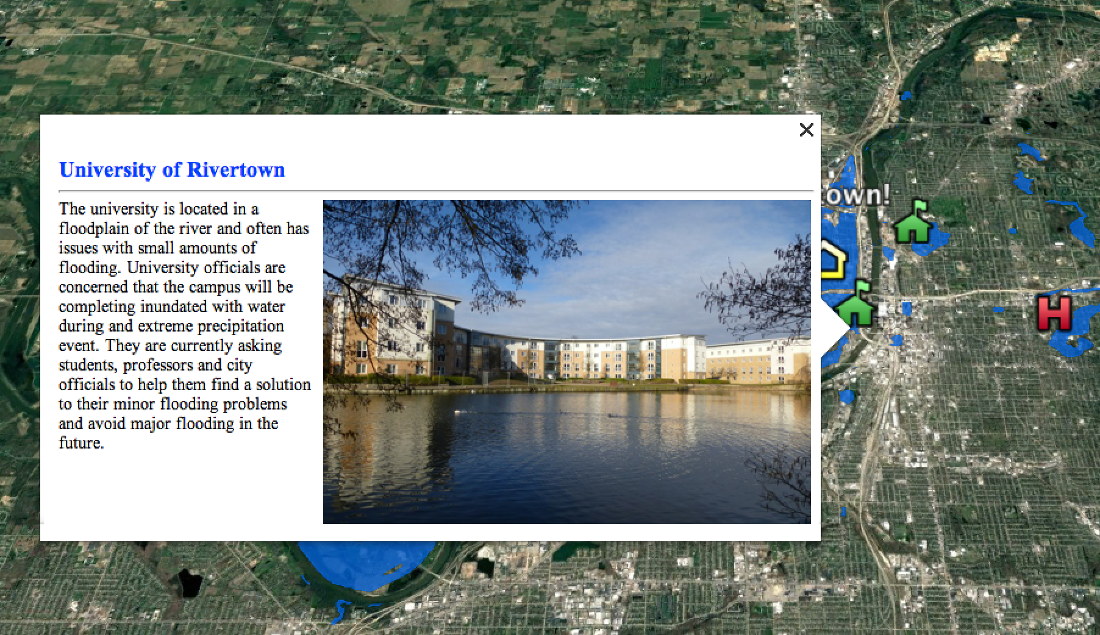
What makes Rivertown vulnerable?
Notes:
The university is located in a floodplain of the river and often has issues with small amounts of flooding. University officials are concerned that the campus will be completing inundated with water during and extreme precipitation event. They are currently asking students, professors and city officials to help them find a solution to their minor flooding problems and avoid major flooding in the future.

Slide 11
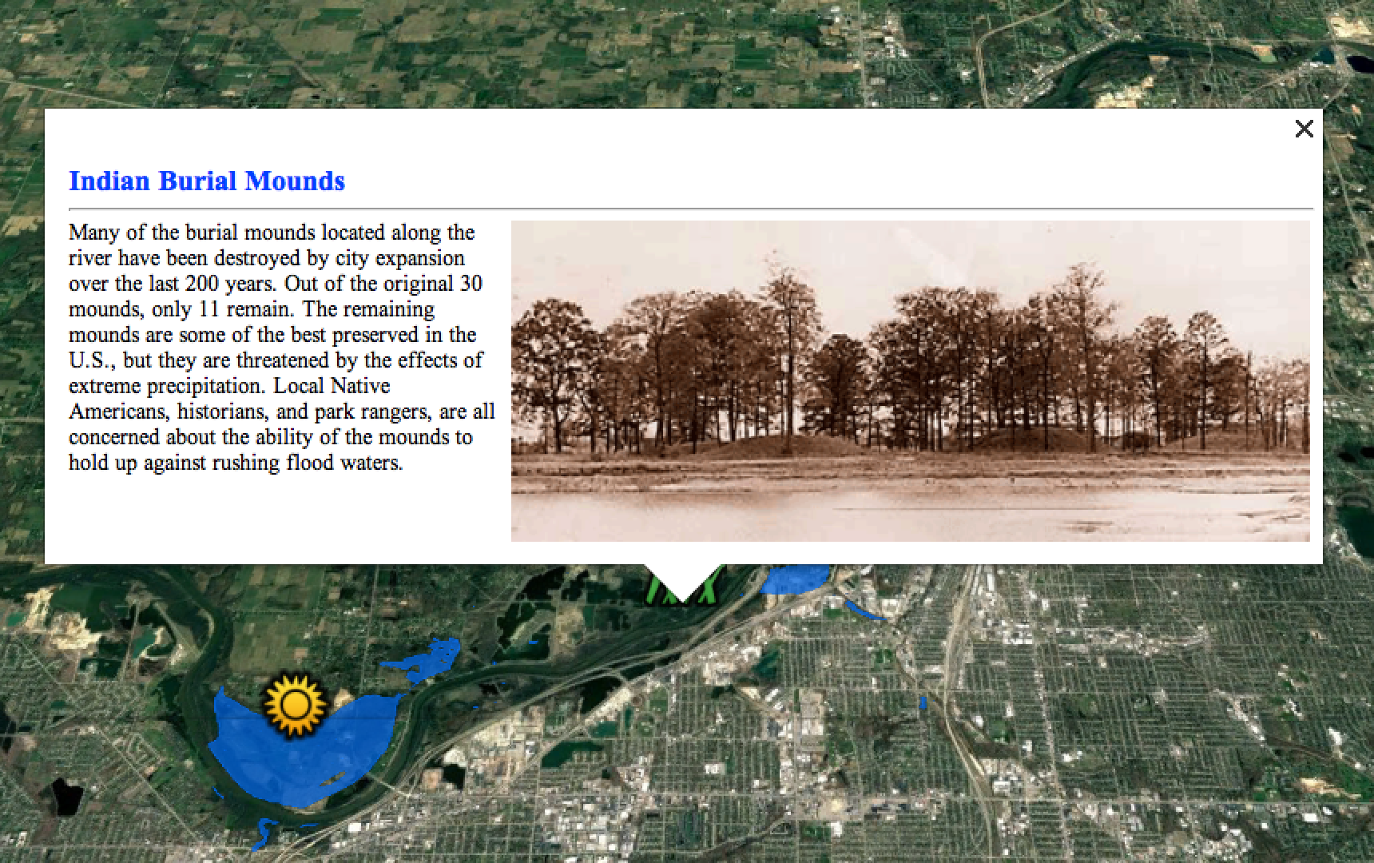
What makes Rivertown vulnerable?
Notes:
Many of the burial mounds located along the river have been destroyed by city expansion over the last 200 years. Out of the original 30 mounds, only 11 remain. The remaining mounds are some of the best preserved in the U.S., but they are threatened by the effects of extreme precipitation. Local Native Americans, historians, and park rangers, are all concerned about the ability of the mounds to hold up against rushing flood waters.

Slide 12
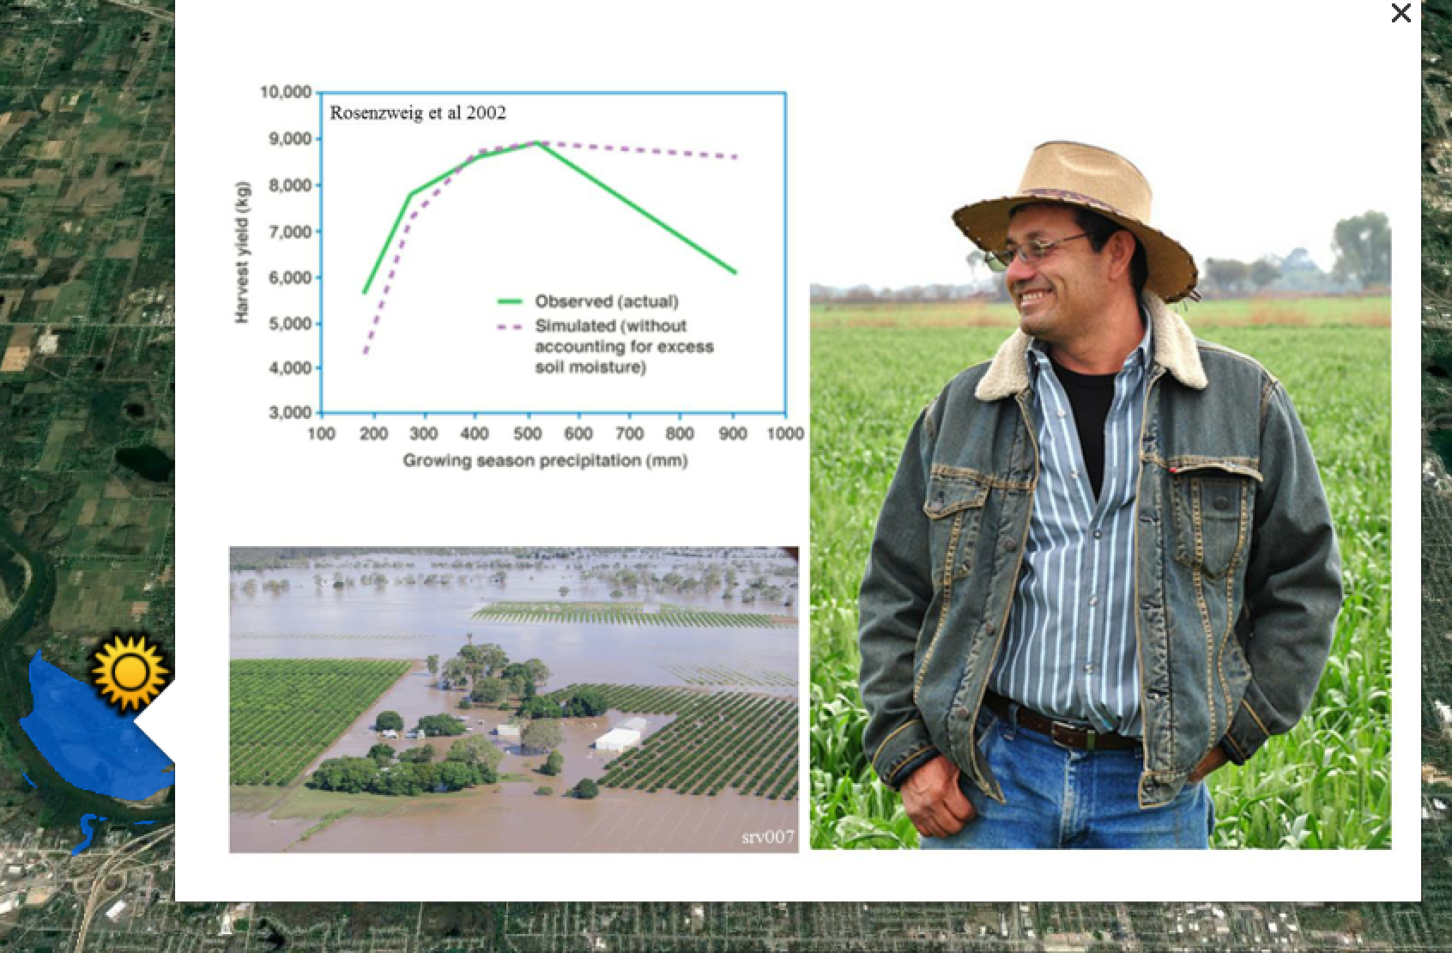
What makes Rivertown vulnerable?
Notes:
When there is heavy rainfall that leads to flooding, farming yields can be affected. You'll see here that after a flood, his crop yield decreased significantly.

Slide 13
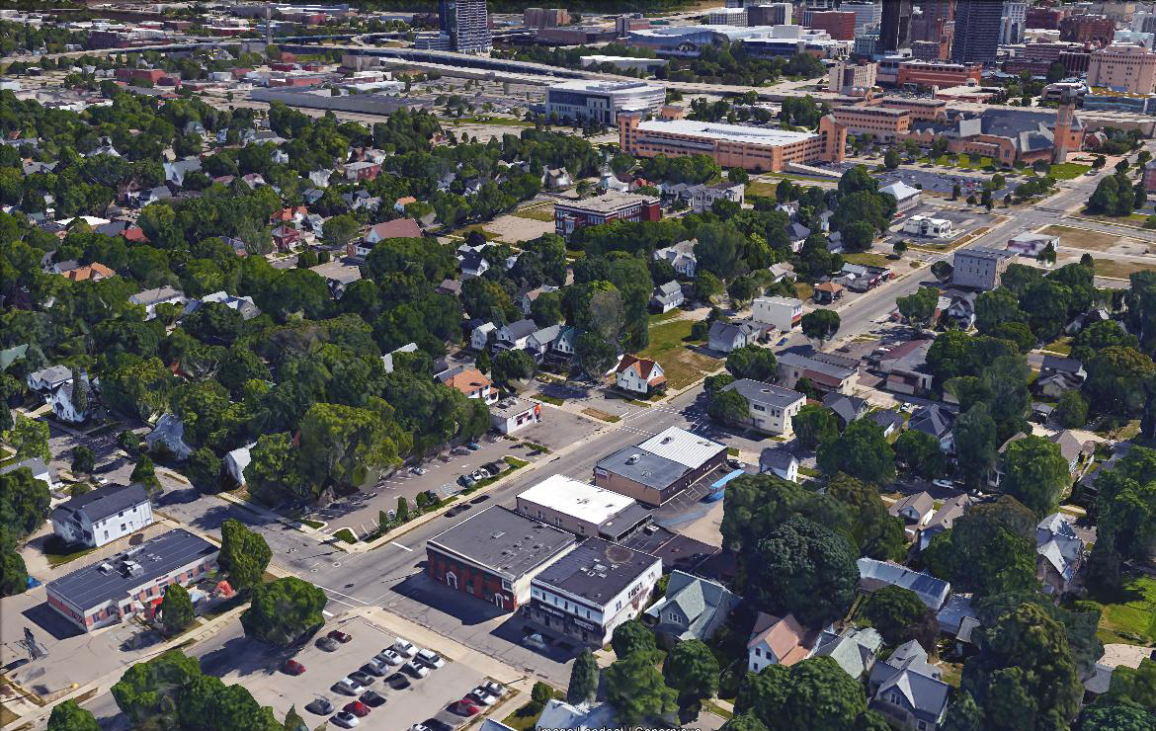
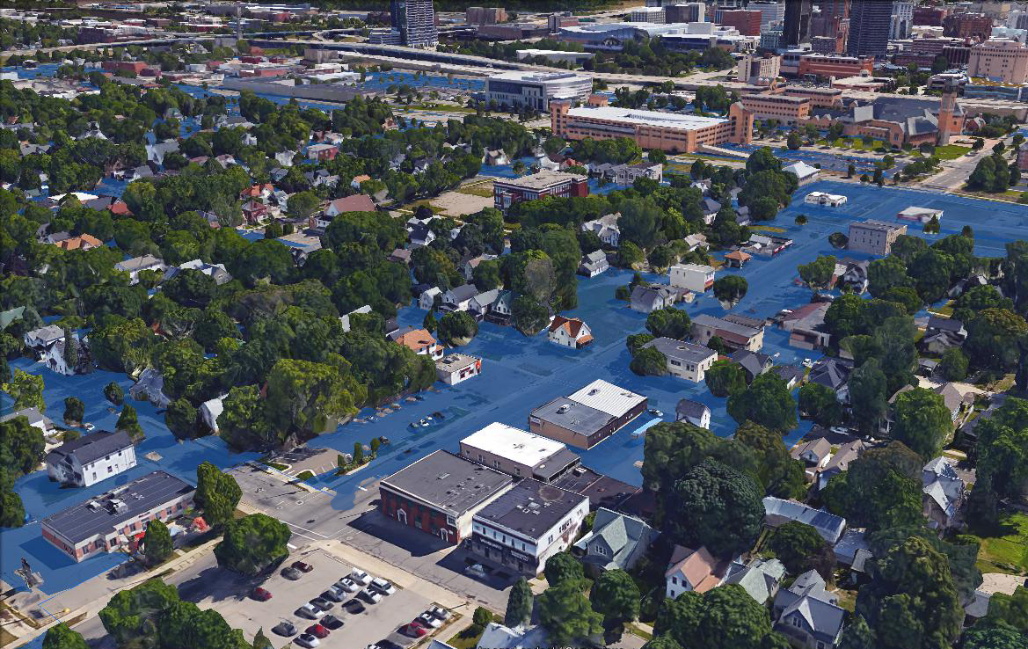
What makes Rivertown vulnerable?
Before extreme precipitation event
After extreme precipitation event
Notes:
suburban neighborhood

Slide 14
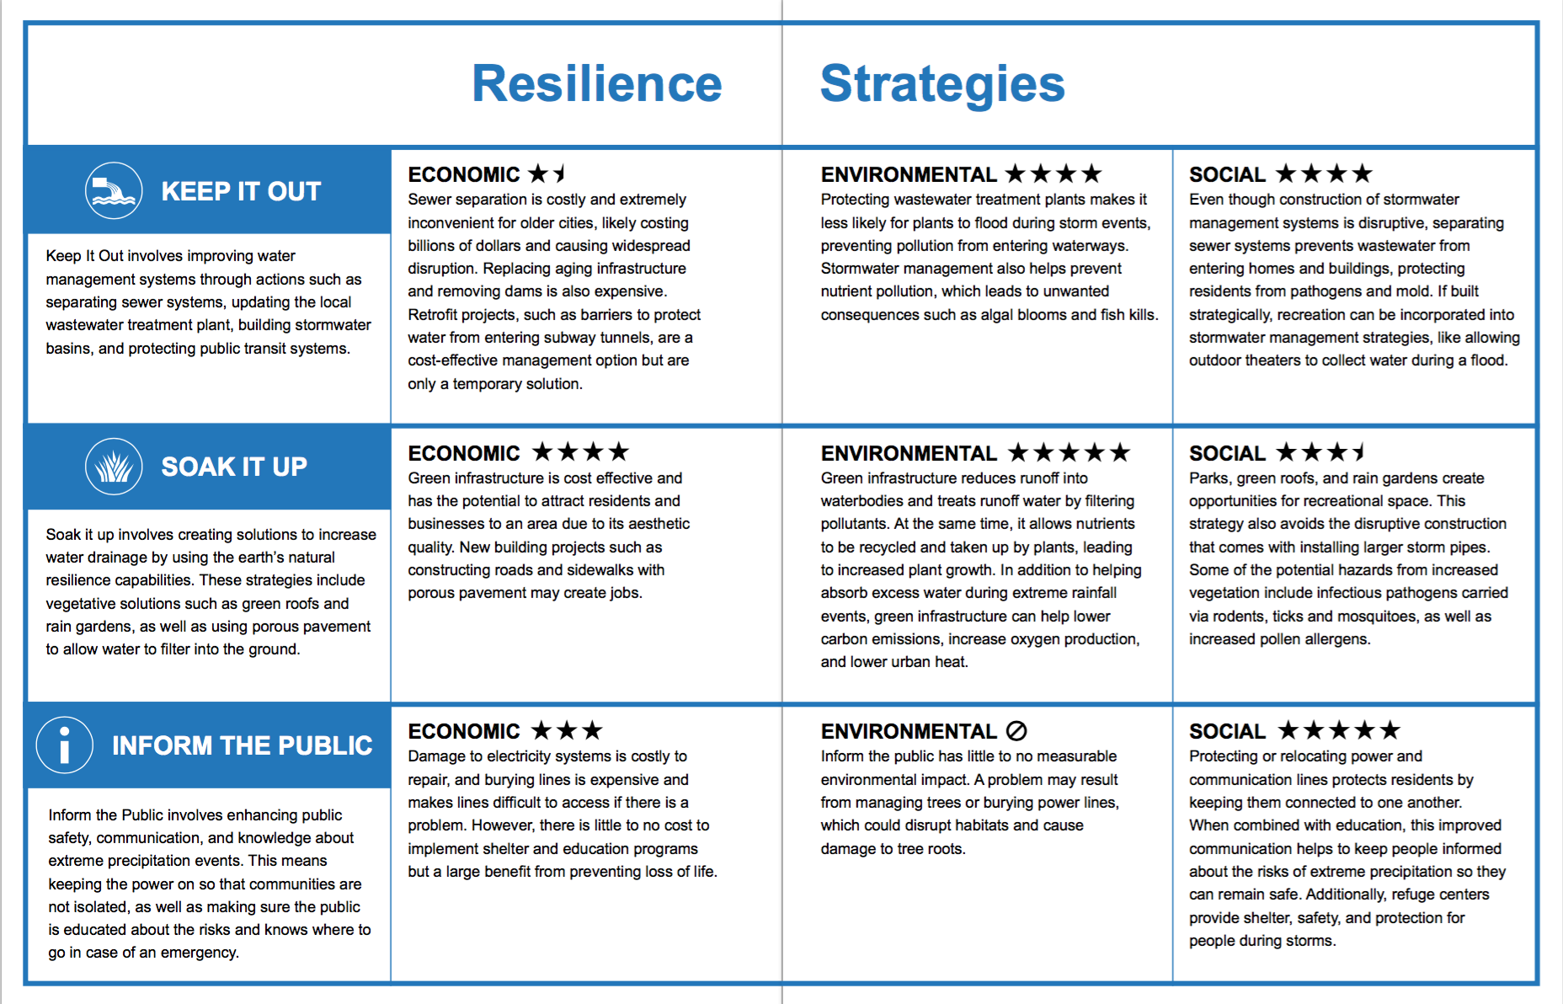
Possible Resilience Strategies for Rivertown
Notes:
Rivertown has assembled a team of city planners planners, scientists, and engineers to come up with options for resilience. They’ve chosen three options, or resilience strategies, and have ranked them based on the economic, environmental, and social values of each strategy. The star rankings are a way to help you understand what the strategy does a bit better. You learned about these in your background packet and can refresh your memories on what these mean by looking in your workbooks for the section labeled "resilience strategies"

Slide 15
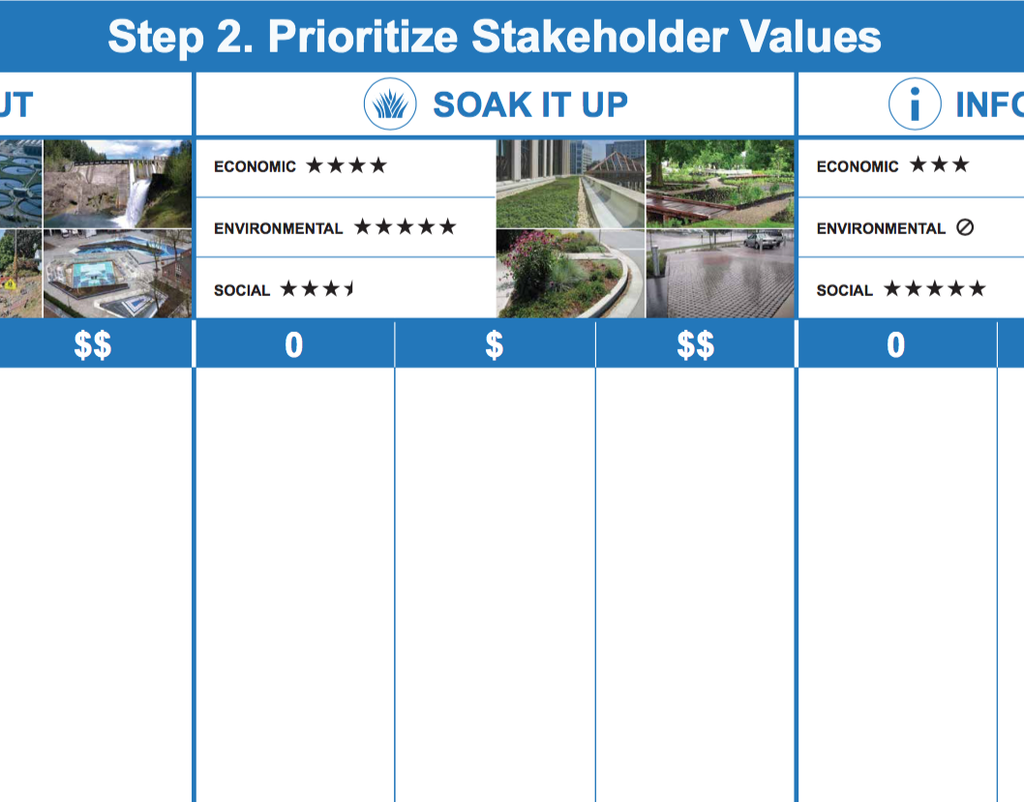
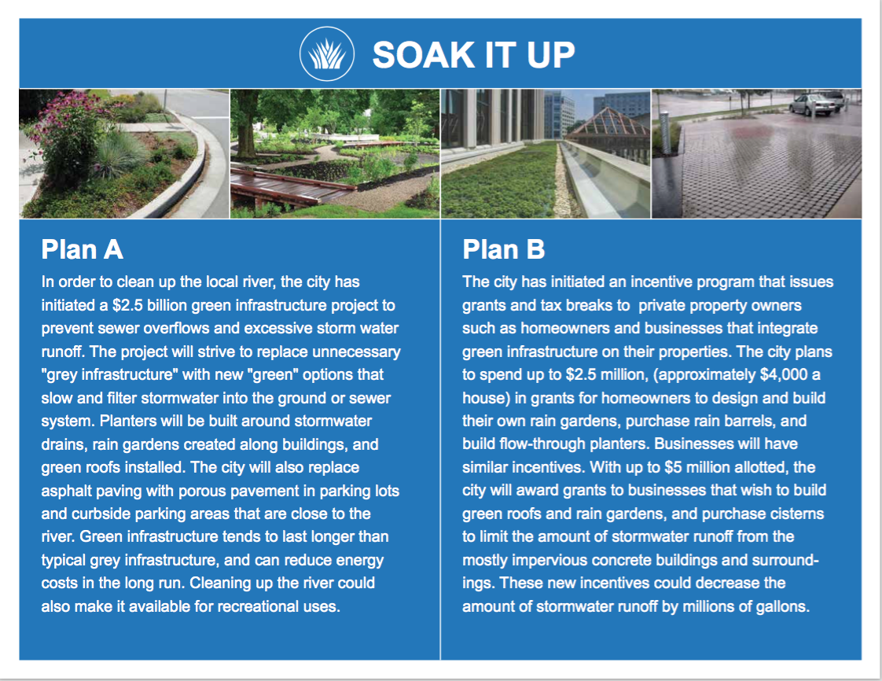
Resilience for Rivertown
Step 1: Consider Stakeholder Perspectives
Step 2: Prioritize Stakeholder Values
Step 3: Make your Resilience Plan
Step 4: Implement and Explore Your Resilience Plan
Notes:
Today you will act as the resilience planning team for the city of Rivertown. Your team’s task is to create a plan that protects Rivertown while considering the values of people who live there, the impacts on the economy and the effects on the environment of the city. Follow the steps below to create your plan, then implement and explore your plan using digital visualizations.

Slide 16
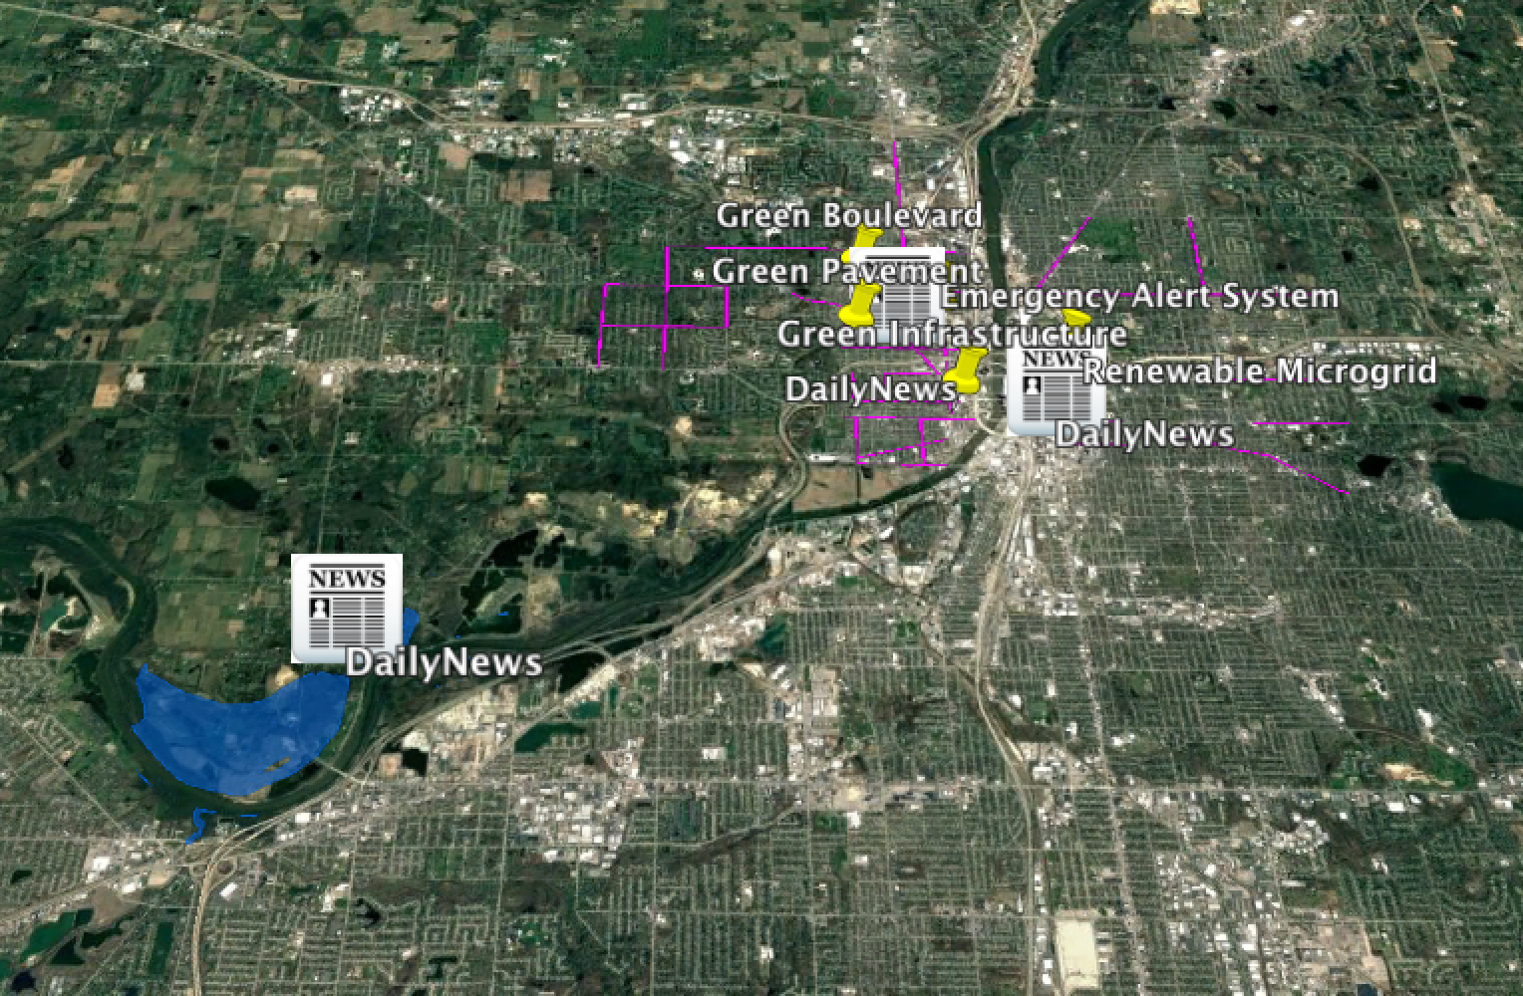
Resilience for Rivertown
Notes:
Now that you know a little bit about Rivertown, let’s start planning! You will begin by learning about the stakeholders, or people who will be affected by extreme precipitation and the resilience plans you will put in place, then you will discuss some options for a plan, and then finally visualize them (hit next).

Slide 17
Ground Rules for Discussion
Respect others’ opinions and ideas
No interruptions – one person talks at a time
Listen carefully to what others have to say
It’s ok to disagree with others
Take part in the discussion
Give everyone a chance to speak
Keep comments brief and to the point
Notes:
Before we get started, let’s go over our ground rules for the discussion tonight. Please keep these in mind during your conversations.
Now, your facilitators will begin section 1. You will have two minutes for table introductions then 13 minutes for section 1. Please keep track of time!
Participants, please remember your Blue Extreme Precipitation Workbooks. Use these to follow along and take notes. We will collect the last page at the end of the night.
Facilitators please turn to page 1 of your facilitation guide and take out the stakeholder cards.
You may now begin.
Good luck!

Slide 18
Table Introductions & Overview
2
minutes
102 minutes remaining

Slide 19
Step 1: Consider Stakeholder Perspectives
15
minutes
100 minutes remaining

Slide 20
Step 1: Consider Stakeholder Perspectives
5
minutes
90 minutes remaining

Slide 21
Step 2: Prioritize Stakeholder Values
25
minutes
85 minutes remaining
Notes:
Facilitators, we are now on Section 2. You will need the stakeholder icons located in a white envelope in your folder. There are three sets of all six of the stakeholders. You will use one set per strategy on the board. Please remember to tape these down at the end of the section.

Slide 22
Step 2: Prioritize Stakeholder Values
20
minutes
80 minutes remaining

Slide 23
Step 2: Prioritize Stakeholder Values
15
minutes
75 minutes remaining

Slide 24
Step 2: Prioritize Stakeholder Values
10
minutes
70 minutes remaining

Slide 25
Step 2: Prioritize Stakeholder Values
5
minutes
65 minutes remaining

Slide 26
Step 3: Make Your Resilience Plan
20
minutes
60 minutes remaining
Notes:
Facilitators, we are now on Section 3. You will need the A & B cards and three coin chips. Participants can turn to the section in their workbooks that says Resilience Plans to follow along. Remember, only individual opinions are recorded in the workbooks. Table results are recorded on the board! What is in your workbook and on the board do not need to match!

Slide 27
Step 3: Make Your Resilience Plan
15
minutes
55 minutes remaining

Slide 28
Step 3: Make Your Resilience Plan
10
minutes
50 minutes remaining

Slide 29
Step 3: Make Your Resilience Plan
5
minutes
45 minutes remaining

Slide 30
Step 4: Implement and Explore Your Resilience Plan
10
minutes
40 minutes remaining
Notes:
Facilitators, you will now be using google earth videos and the final resilience plan cards. Remember to use the card to alert us if you need help using the google earth videos. If this is your final plan please remember to tape down the coins with what you choose.

Slide 31
Step 4: Implement and Explore Your Resilience Plan
5
minutes
35 minutes remaining

Slide 32
Step 5: Re-Evaluate Your Resilience Plan
10
minutes
30 minutes remaining
Notes:
Remember, only individual opinions are recorded in the workbooks. Table results are recorded on the board! What is in your workbook and on the board do not need to match!

Slide 33
Step 5: Re-Evaluate Your Resilience Plan
5
minutes
25 minutes remaining

Slide 34
Step 6: Explore Your New Resilience Plan
10
minutes
20 minutes remaining

Slide 35
Step 6: Explore Your New Resilience Plan
5
minutes
15 minutes remaining

Slide 36
Time’s up!
Please make sure all of your pieces are taped down on your board and that you write down your final plan in the space provided on the board.

Slide 37
Step 7: Share Your Resilience Plan
10
minutes
10 minutes remaining

Slide 38
Step 7: Share Your Resilience Plan
5
minutes
5 minutes remaining

