Slide 1
Extreme Precipitation
This resource was prepared by support of award NA18SEC0080008 from the Environmental Literacy Program of the National Oceanic and Atmospheric Administration (NOAA), U.S. Department of Commerce. The statements, findings, conclusions, and recommendations are those of the author(s) and do not necessarily reflect the views of NOAA or the U.S. Department of Commerce.

Slide 2
Consider Stakeholder Perspectives
15 minutes

Slide 3
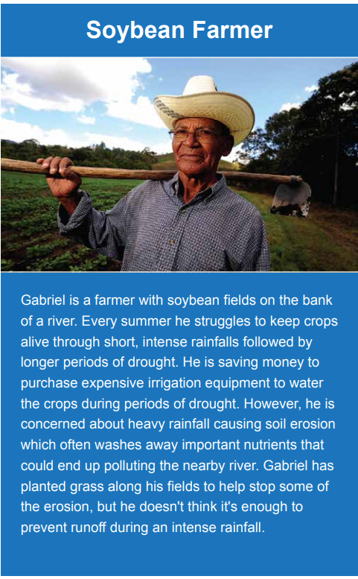
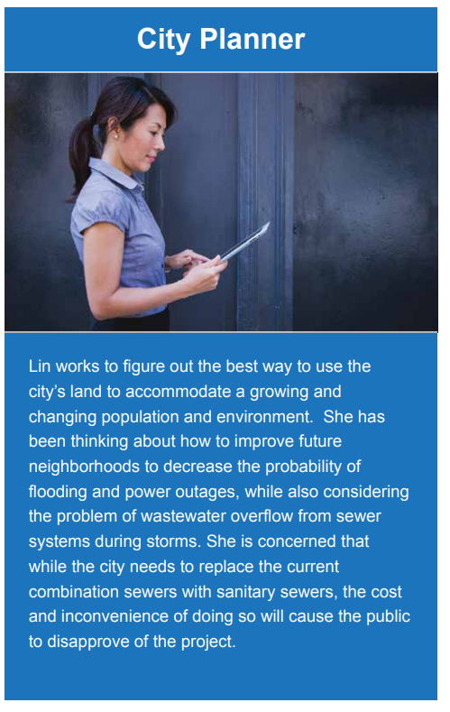

Slide 4
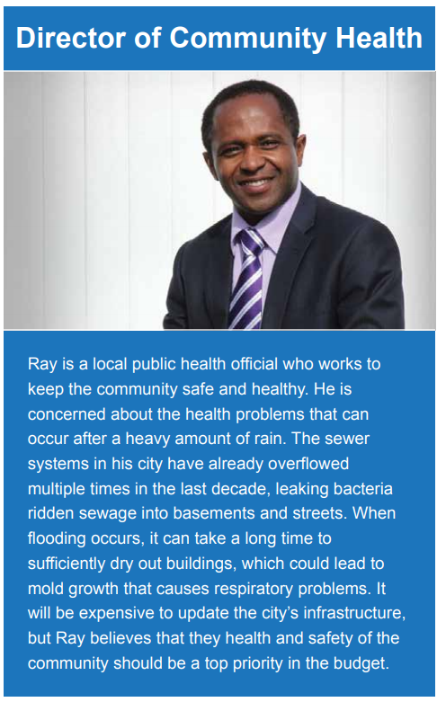
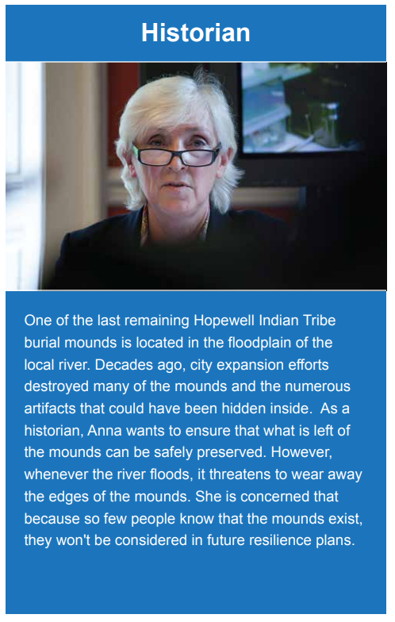

Slide 5
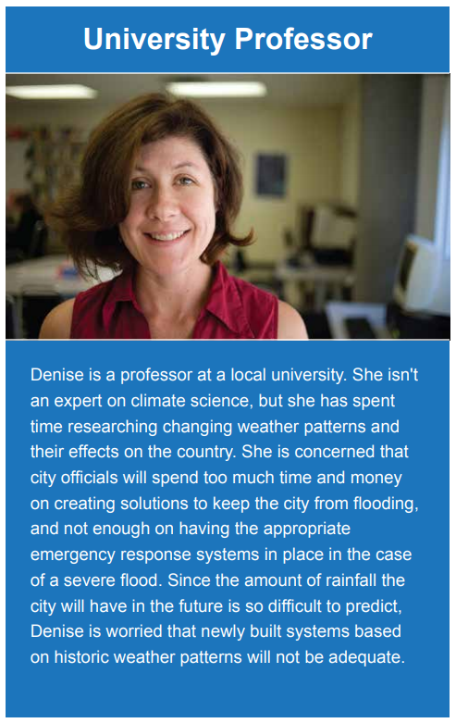
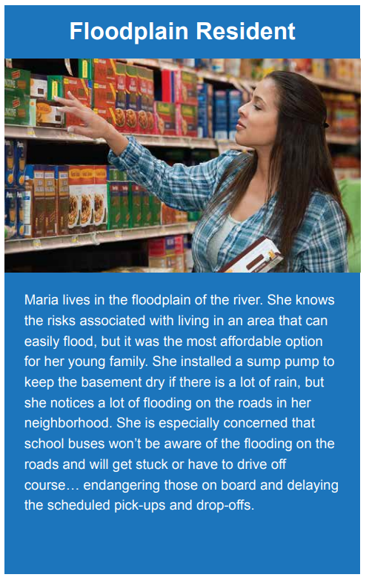

Slide 6
Prioritize Stakeholder Values
25 minutes

Slide 7
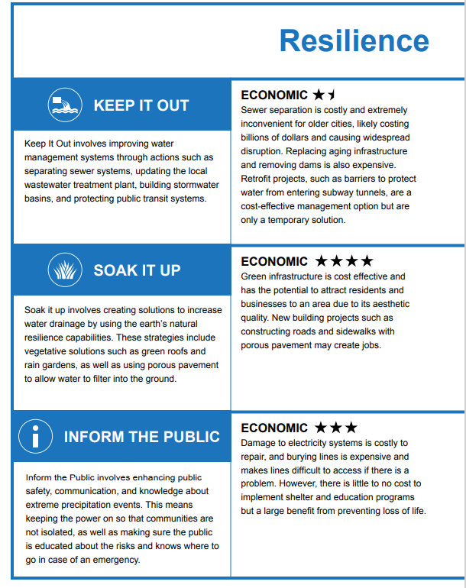
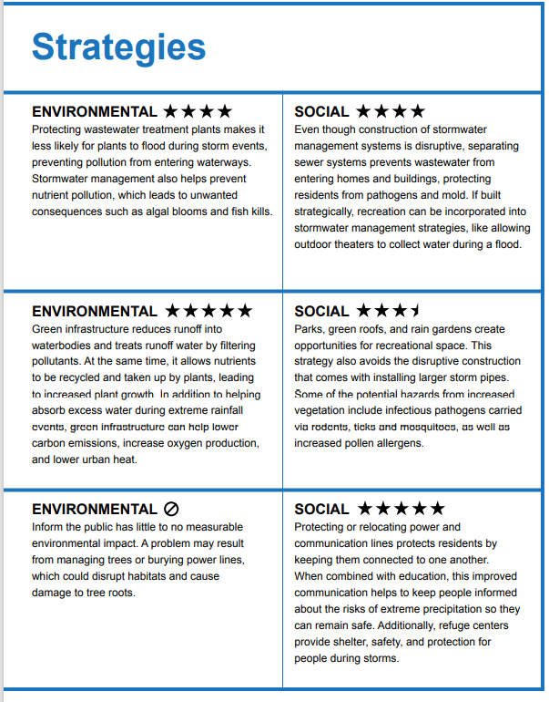

Slide 8

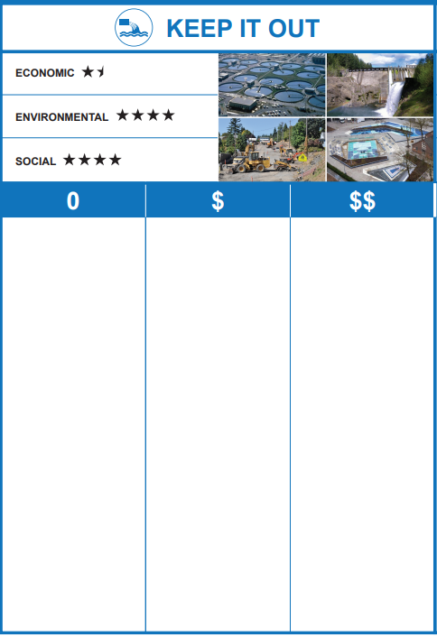







Slide 9
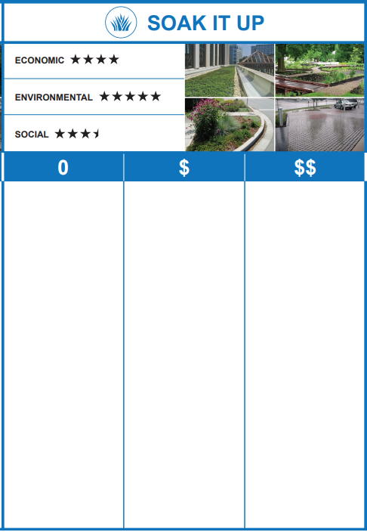

Slide 10
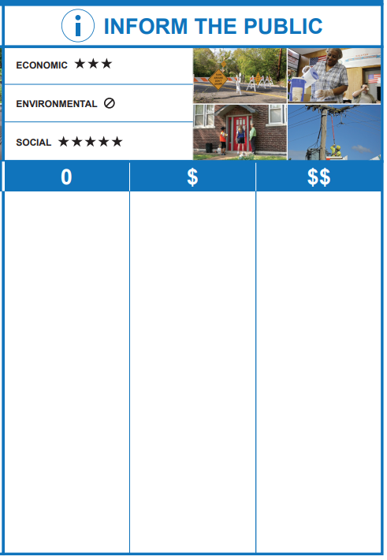

Slide 11
Make Your Resilience Plan
20 minutes

Slide 12
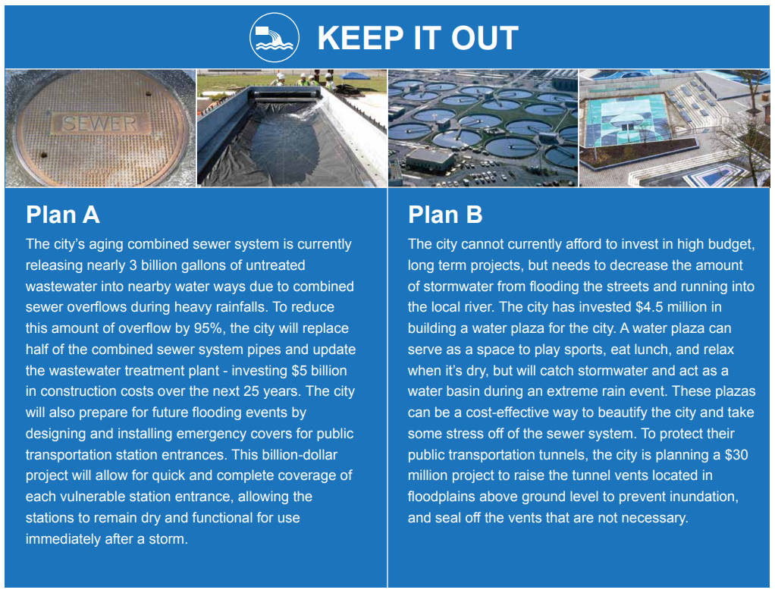

Slide 13
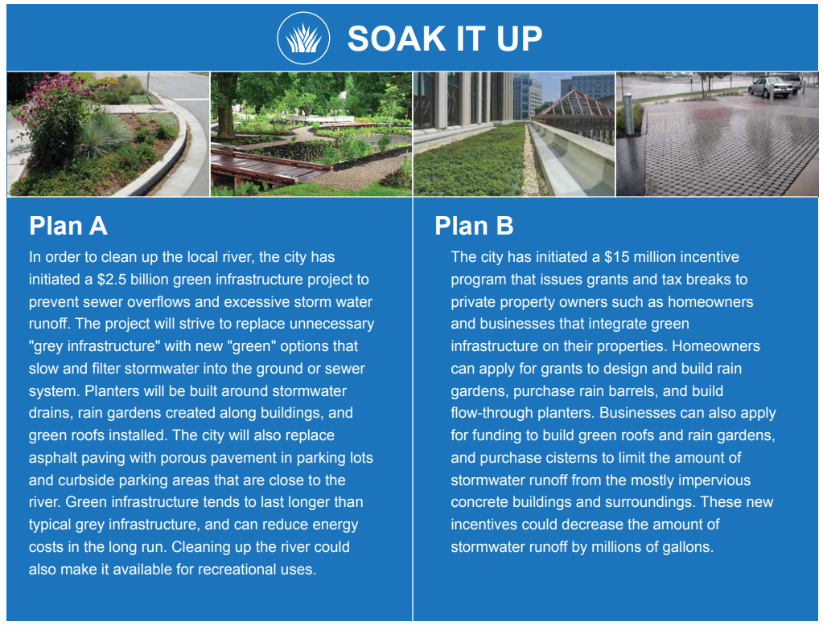

Slide 14
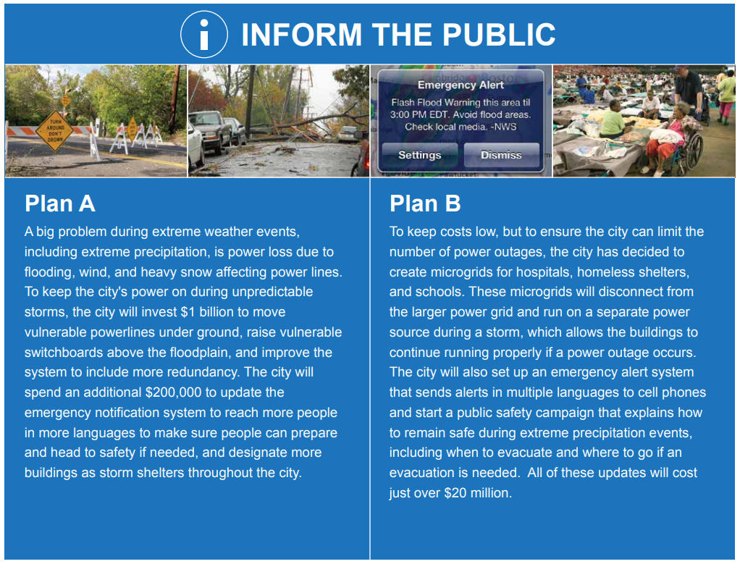

Slide 15
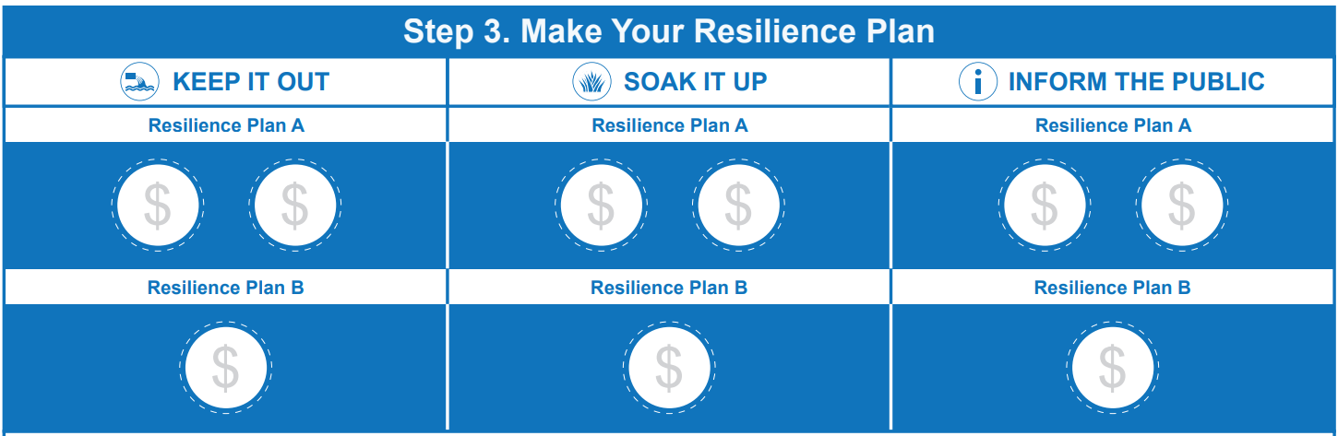

Slide 16
Implement and Explore Your Resilience Plan
OPEN LINK: StoryMap
10 minutes
Notes:
https://nu.maps.arcgis.com/apps/MapSeries/index.html?appid=8de74983b341405eaf2692dbde81c9bf

