Slide 1
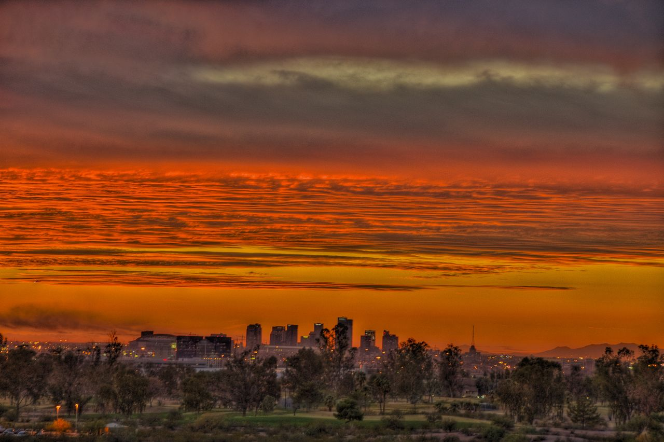
Extreme Heat
Notes:
Welcome back everyone! I hope you enjoyed your lunch ad our wonderful guest presentations. Thank you for returning to the room in a timely manner.
We are now going to begin with session two. We will start with a brief introduction to Heattown.

Slide 2
Welcome to Heattown
Extreme Heat
Notes:
Today we will be making a resilience plan against Extreme Heat for Heattown. Before you can make a plan, however, you should learn a little bit about the city and who lives there.

Slide 3
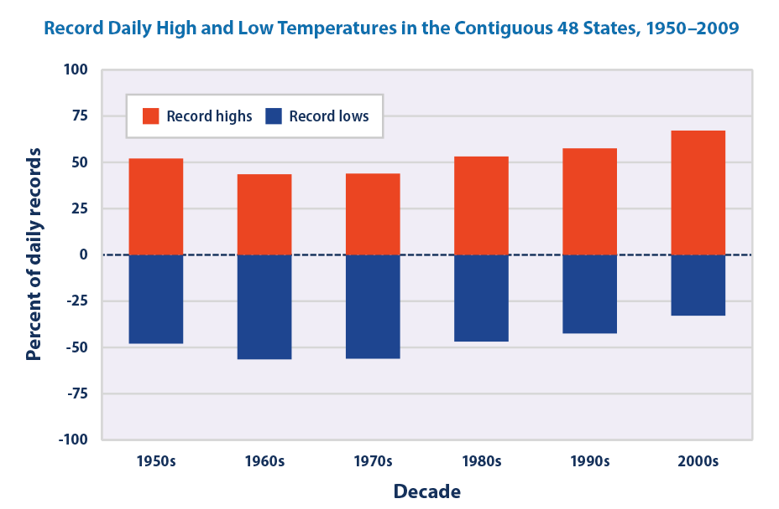
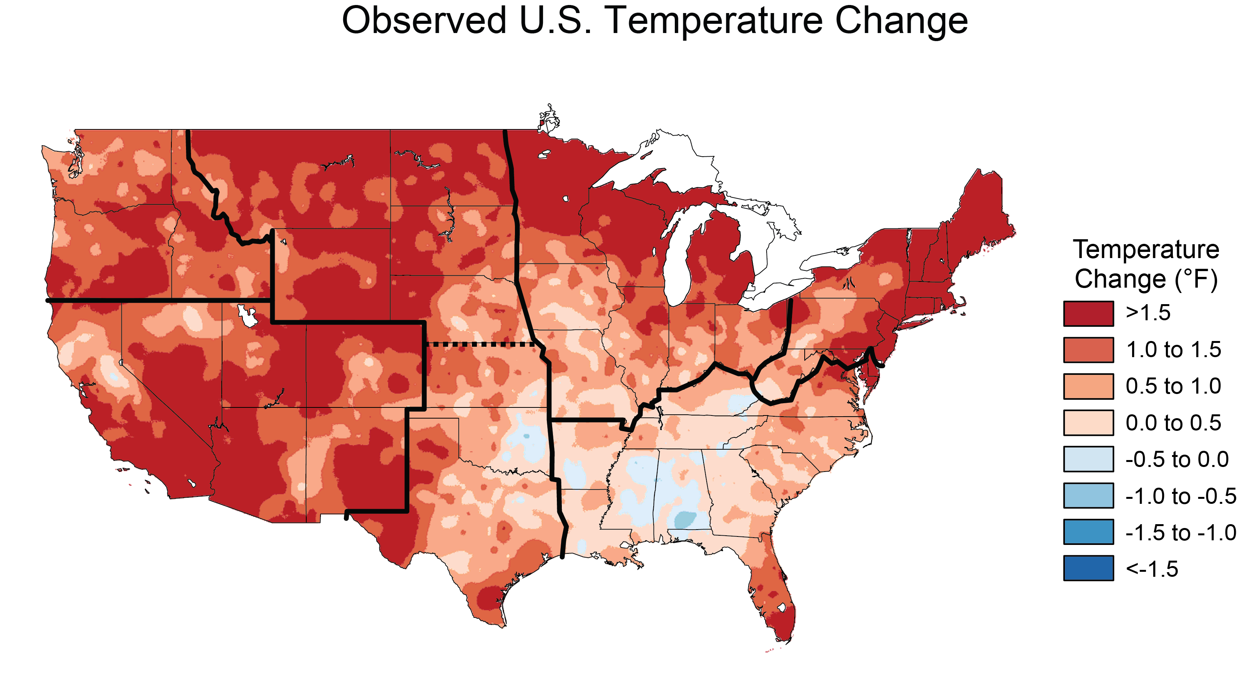
The U.S. is experiencing more heat waves and they are becoming more intense and longer
1991-2012 average compared to 1901-1960 average
Notes:
In the U.S., the number of extreme heat events has increased in recent years and these events have become hotter and longer. Scientists predict that heat waves will become more common and more intense in the coming decades.
Scientists attribute the increase in heat waves to both an increasing in overall temperature, shown on the map on the LEFT, and to increased variable in temperature. The graph on the right shows that more high temperature records are being broken, suggesting extreme heat is becoming more common and hotter.
LEFT: The colors on the map show temperature changes over the past 22 years (1991-2012) compared to the 1901-1960 average (Figure source: Russell S. Vose, National Oceanic and Atmospheric Administration National Climatic Data Center)
RIGHT: This figure shows the annual values of the U.S. Heat Wave Index from 1895 to 2015. These data cover the contiguous 48 states. Interpretation: An index value of 0.2 (for example) could mean that 20 percent of the country experienced one heat wave, 10 percent of the country experienced two heat waves, or some other combination of frequency and area resulted in this value.
Data source: Kunkel, 2016. From: https://www.epa.gov/climate-indicators/climate-change-indicators-high-and-low-temperatures

Slide 4
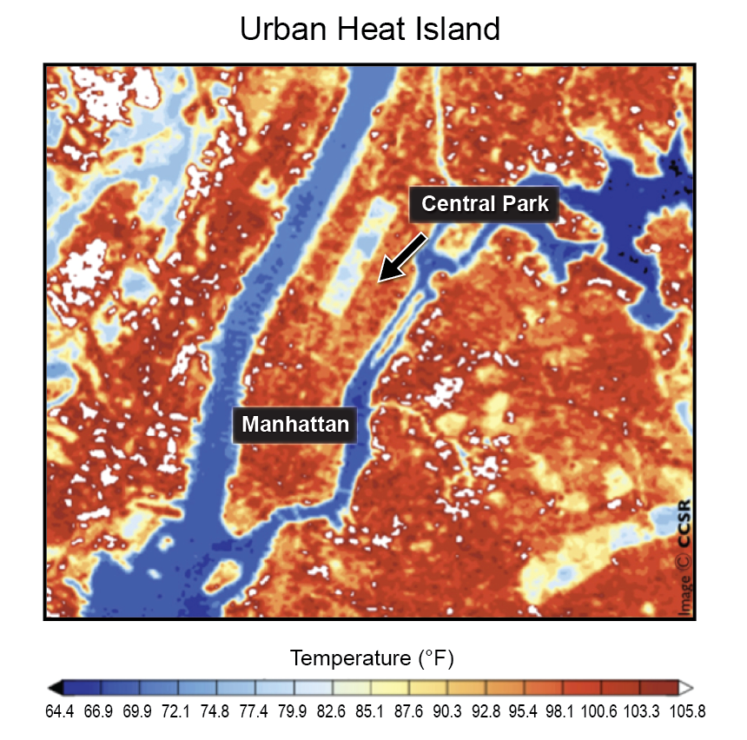
The Urban Heat Island effect makes heat waves worse
Notes:
In cities, extreme heat is made worse by the urban heat island effect. Asphalt, concrete, and buildings absorb heat from the sun more than soil, grass, or trees, as you can see in thermal image on the left. That heat warms the air at night, keeping the city warmer at night. In many cities, poorer neighborhoods are often warmer because they lack trees and have more concrete and asphalt surfaces.
FROM NCA: Surface temperatures in New York City on a summer’s day show the “urban heat island,” with temperatures in populous urban areas being approximately 10°F higher than the forested parts of Central Park. Dark blue reflects the colder waters of the Hudson and East Rivers. (Figure source: Center for Climate Systems Research, Columbia University).

Slide 5
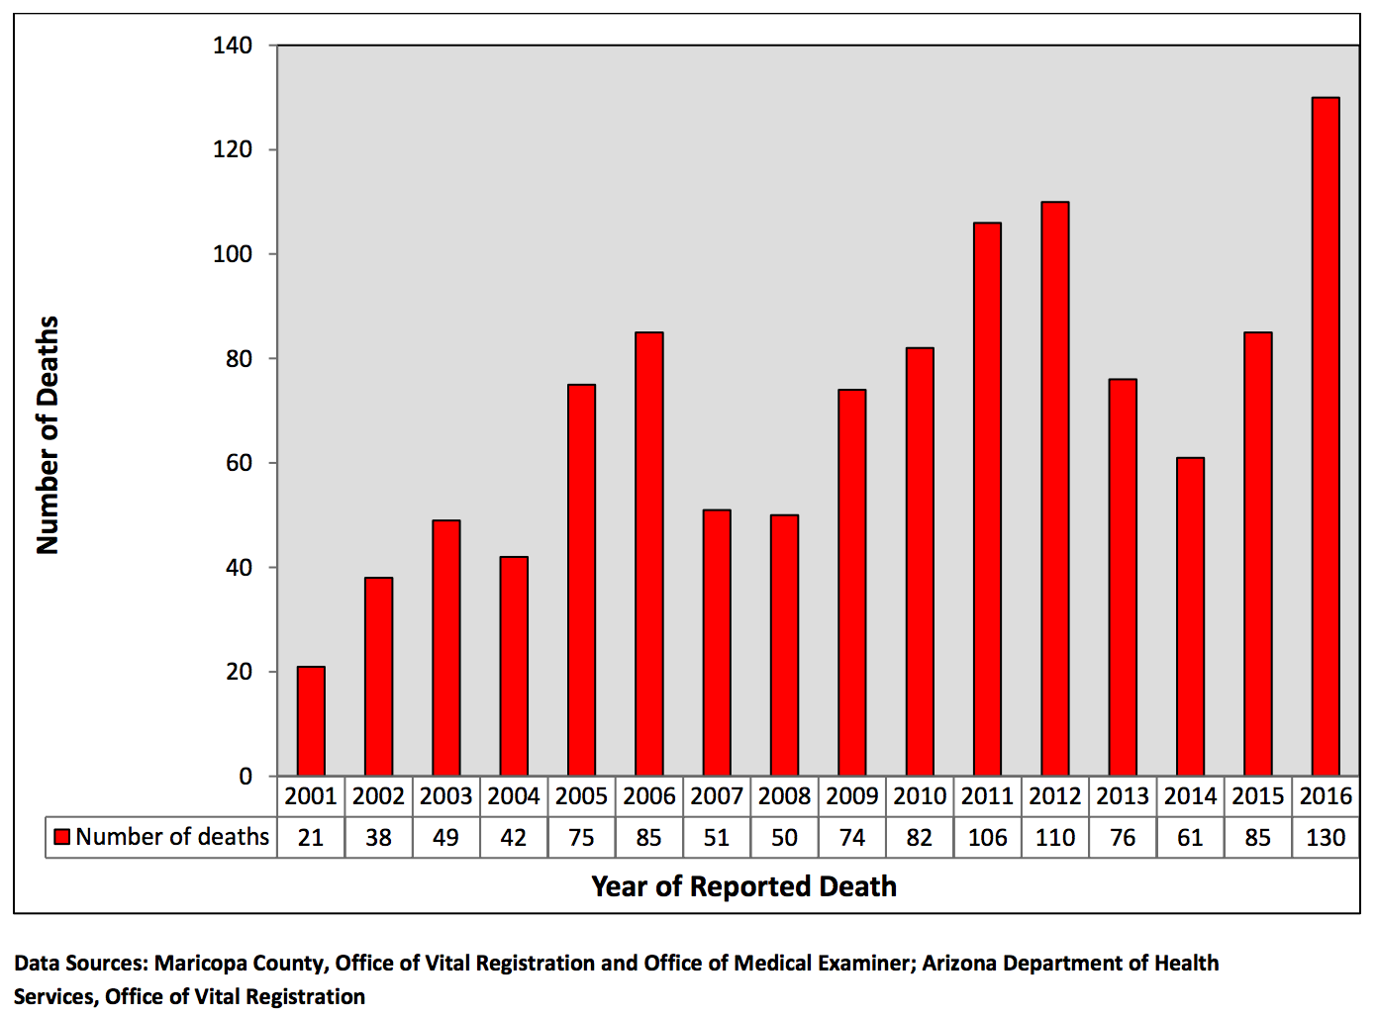
Heat waves threaten human health
Notes:
Heat directly threatens human health, particularly those without air conditioning, that work outside, and the elderly.
This graph shows the number of confirmed heat-associated deaths in Maricopa County, which include Phoenix and Mesa, Arizona.
Across the country, heat kills more people than tornadoes, floods, extreme cold, and hurricanes.
From Maricopa County Heat Deaths Report 2016. https://www.maricopa.gov/ArchiveCenter/ViewFile/Item/3084

Slide 6
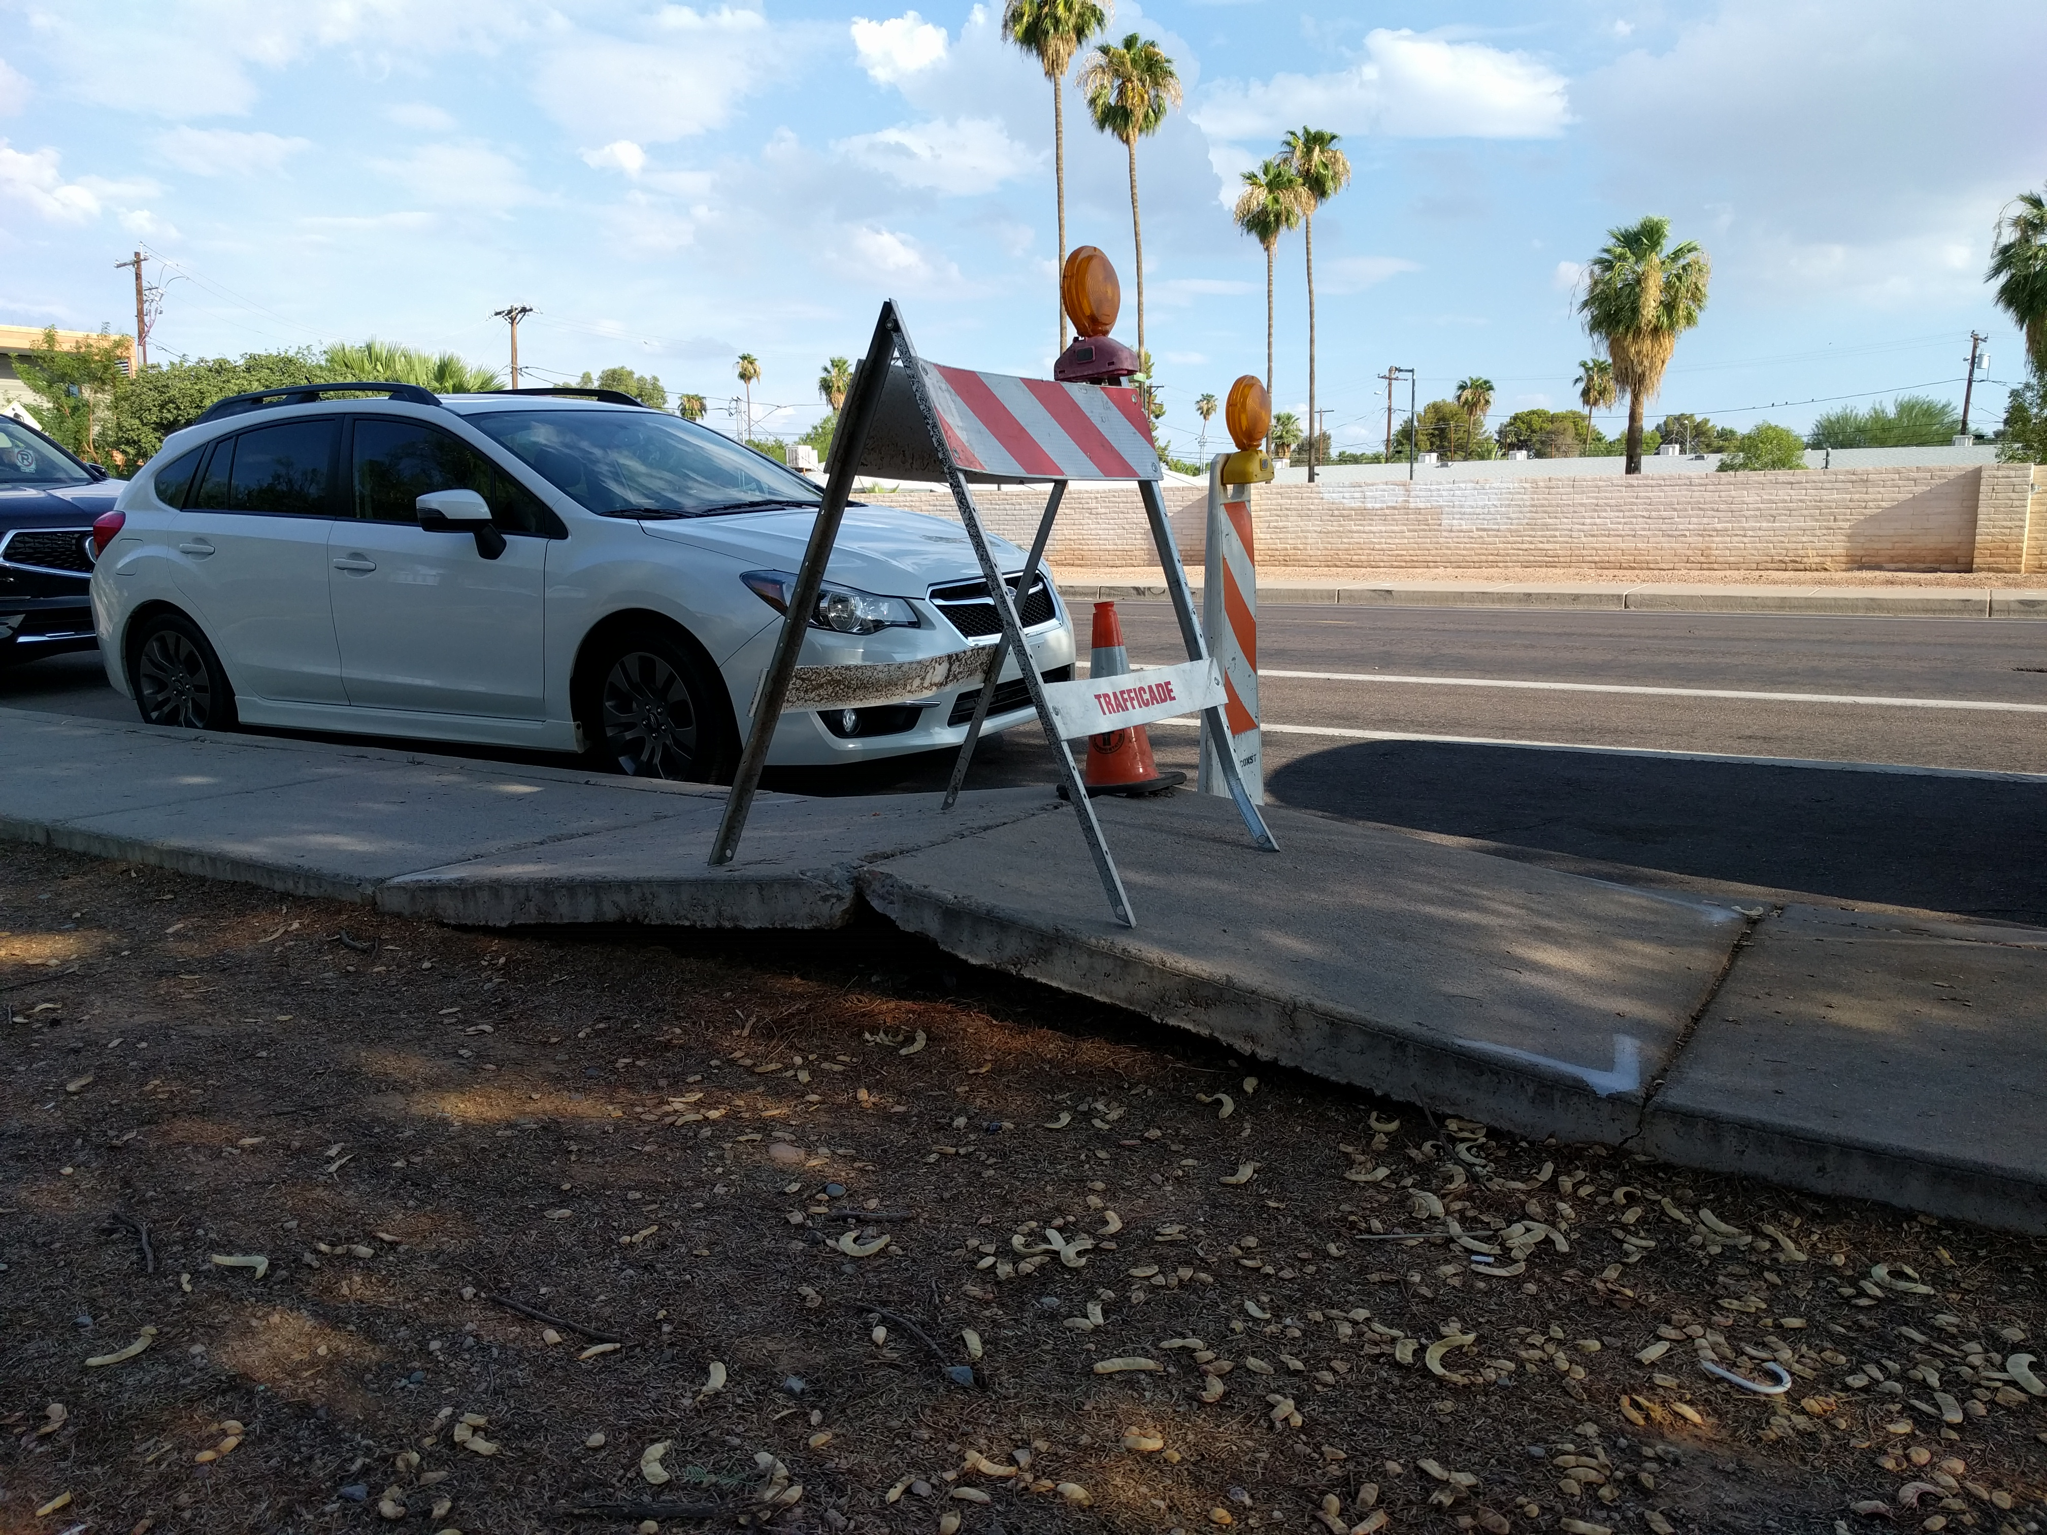
Heat can damage infrastructure
Notes:
Heat also stresses the electricity grid. Many people turn on their AC and the electrical grid is less efficient in high temperatures. This can lead to blackouts which jeopardize more lives.
It also damages roads, highways, and bridges… and sidewalks, a common site here in Phoenix.

Slide 7
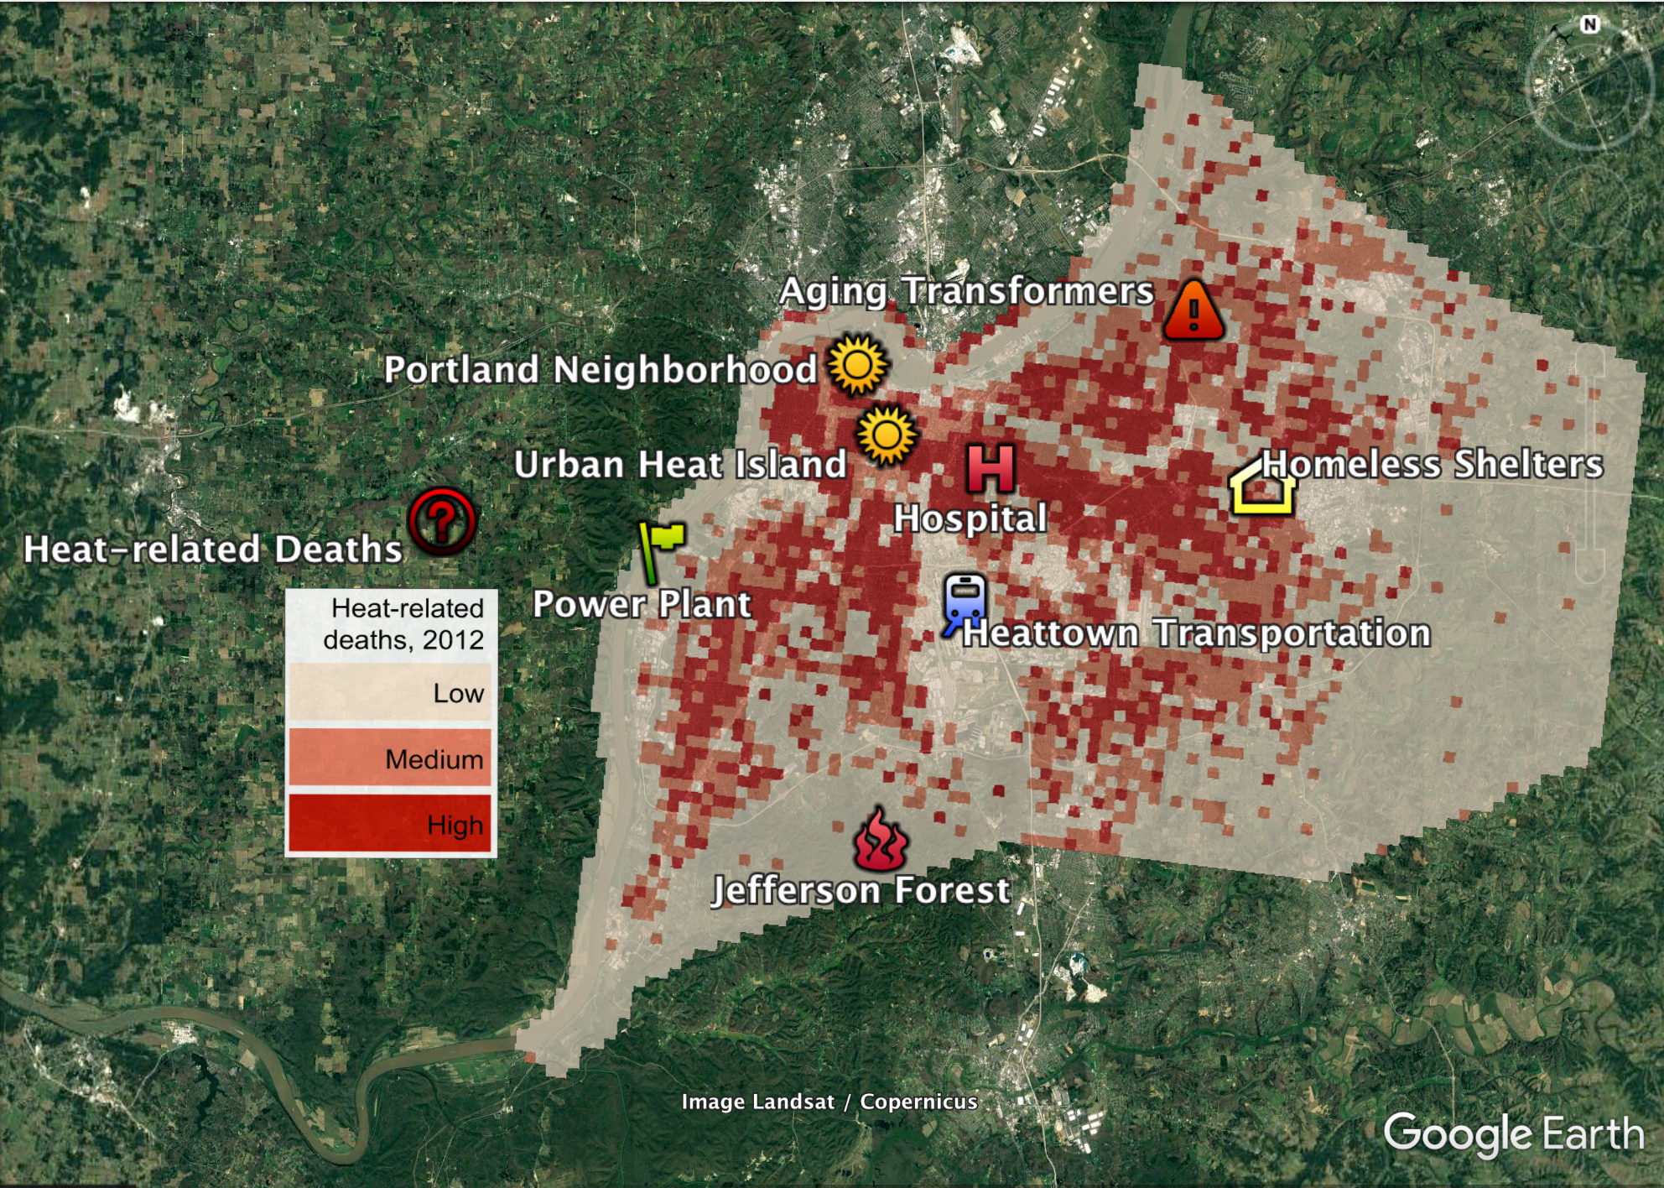
What makes Heattown vulnerable?
Notes:
So let’s look at how Heattown and learn more about it! This map is also on the back of your workbooks. Let’s talk about the kinds of temperatures that heattown will be facing. Currently, Heattown experiences between 0 and 15 days above 95 degrees, which of course sounds cool to us! But heattown is not used to that kind of heat like we are. And they really won’t be used to what it might be like by 2050. The national climate assessment projects that Heattown will face between 30-60 days above 95 degrees. That’s a lot for place that rarely experiences those hots days now.

Slide 8
Notes:
So let’s look at how Heattown and learn more about it! This map is also on the back of your workbooks

Slide 9
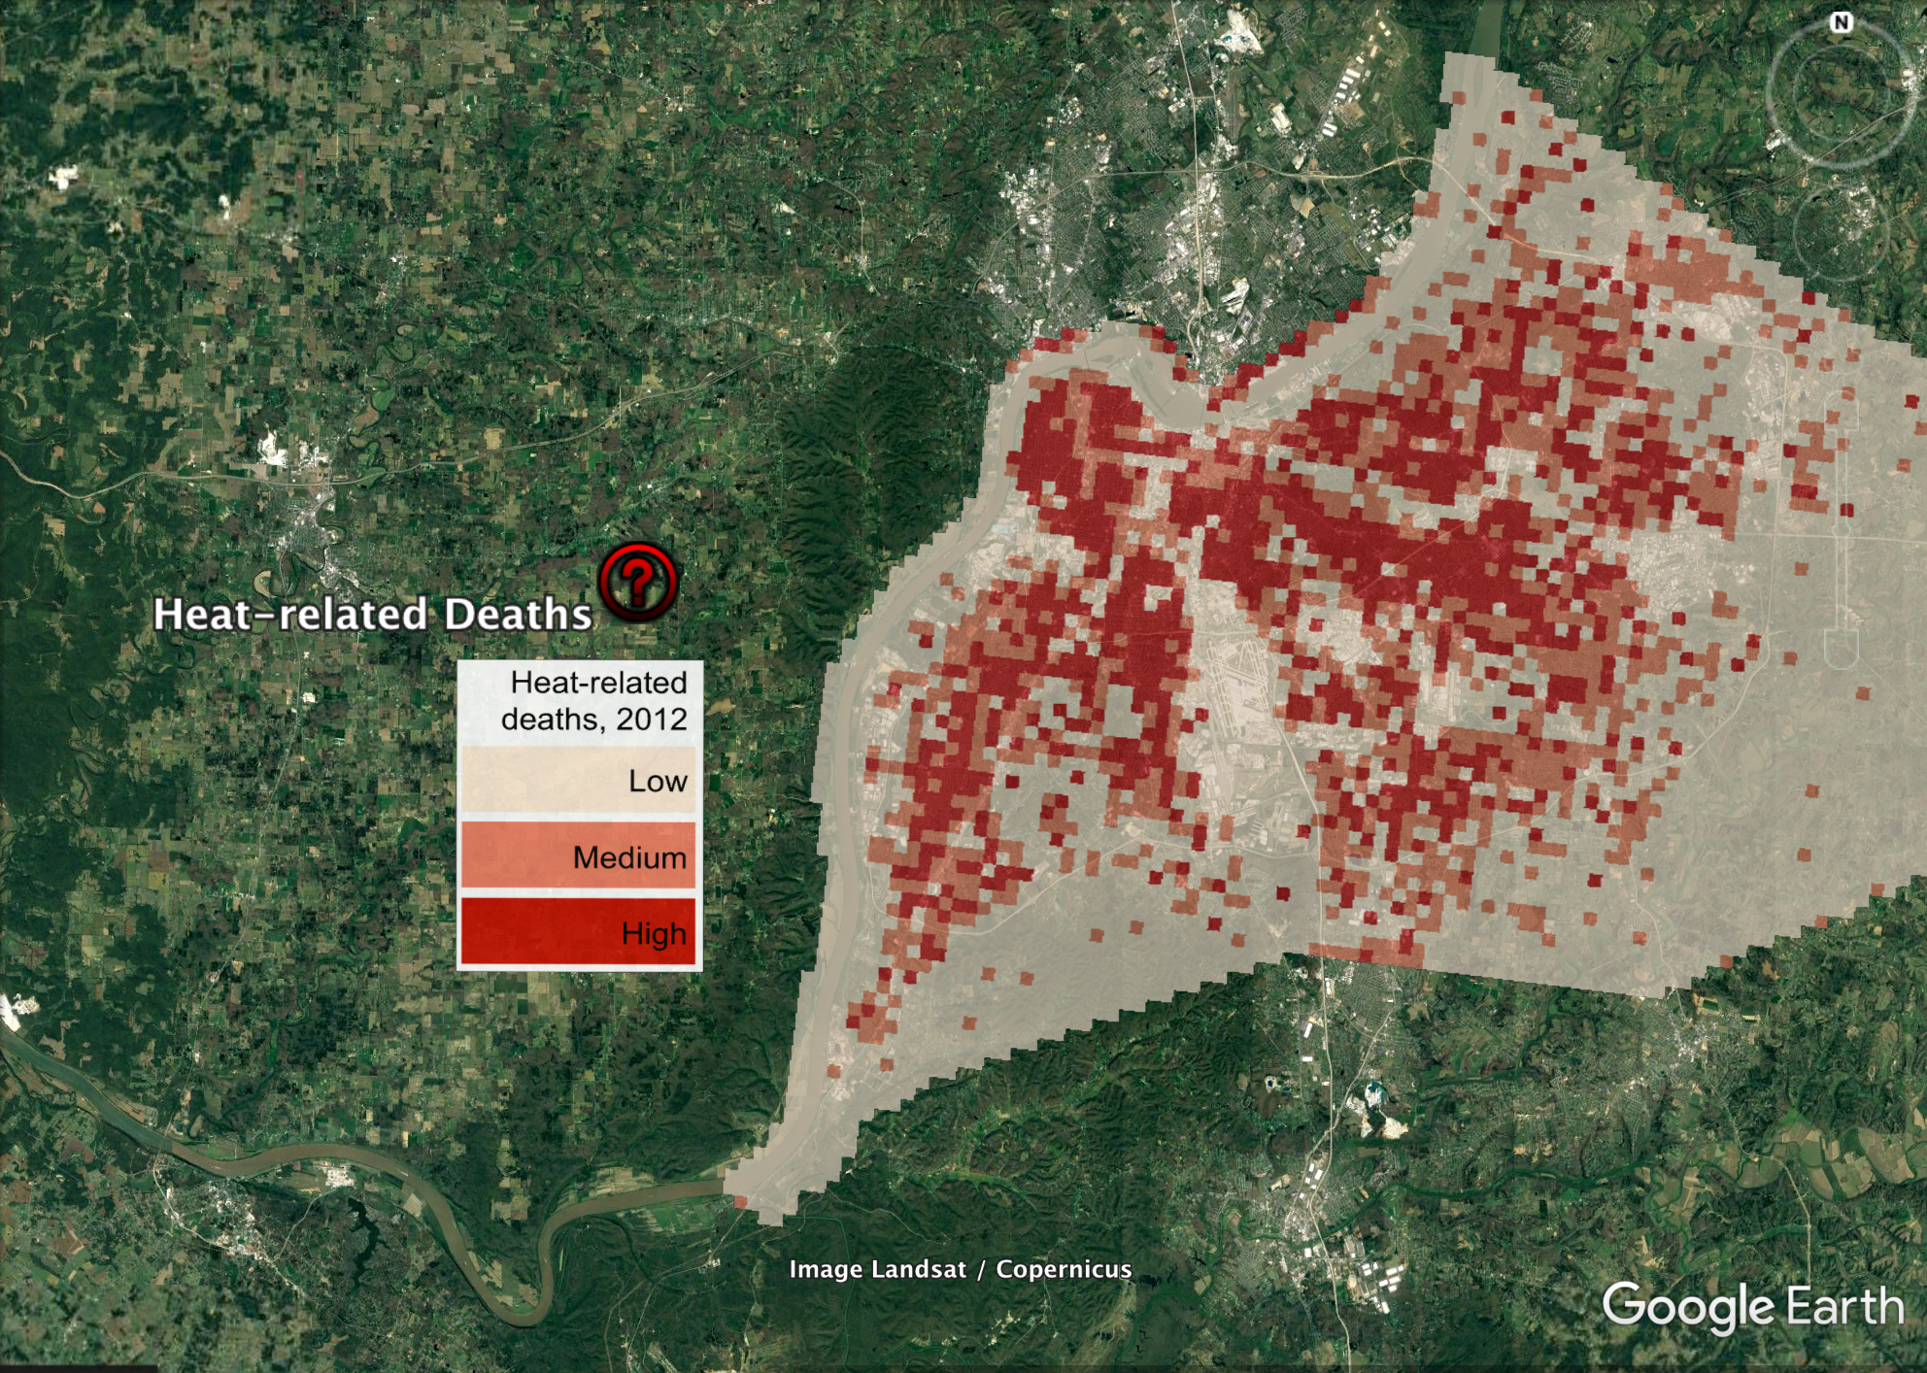
Notes:
First let’s take a look at related deaths across the city. In 2012, 86 people died from the heat. This map shows where in the city those deaths occurred. The dark red areas show where the most deaths took place. The number of deaths due to heat is a product of many factors including local temperatures, population density, and social factors like access to air conditioning.
So let’s look at who lives in Heattown.

Slide 10
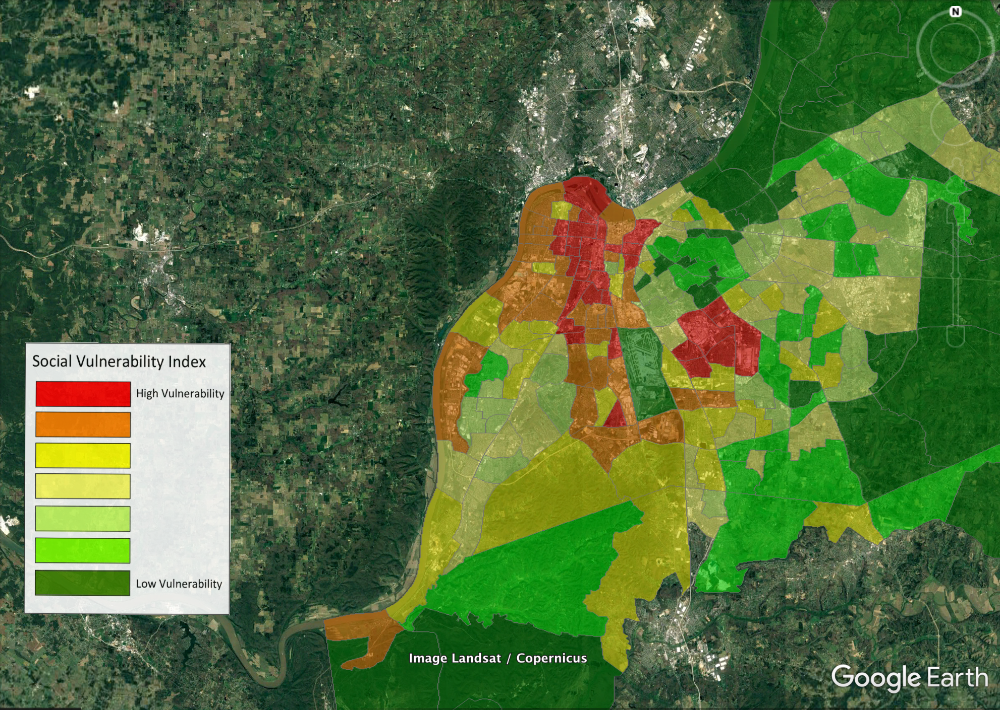
Notes:
Heattown’s population is around 600,000 if you include the surrounding areas. This map shows the areas with highest vulnerability. Vulnerability in this map is based on income, age, access to transportation, and whether or not people live a lone. You’ll notice that some of the same areas that had high heat deaths also are home to people who are highly vulnerable in the city. [feel free to flip back to previous slide to show overlap

Slide 11
Notes:
So heat doesn’t impact everyone in the city equally, and not everyone in the city is equally impacted by heat. Here is one neighborhood in heattown that doesn’t have much shade along pedestrian and transit routes.

Slide 12
Notes:
Social services are also affected by heat. Homeless shelters and community centers could be overwhelmed during an extreme heat wave as people seek relief.

Slide 13
Notes:
As could the local hospital, which sees more ER visitors during heat waves and is susceptible to potential power outages due to heat.

Slide 14
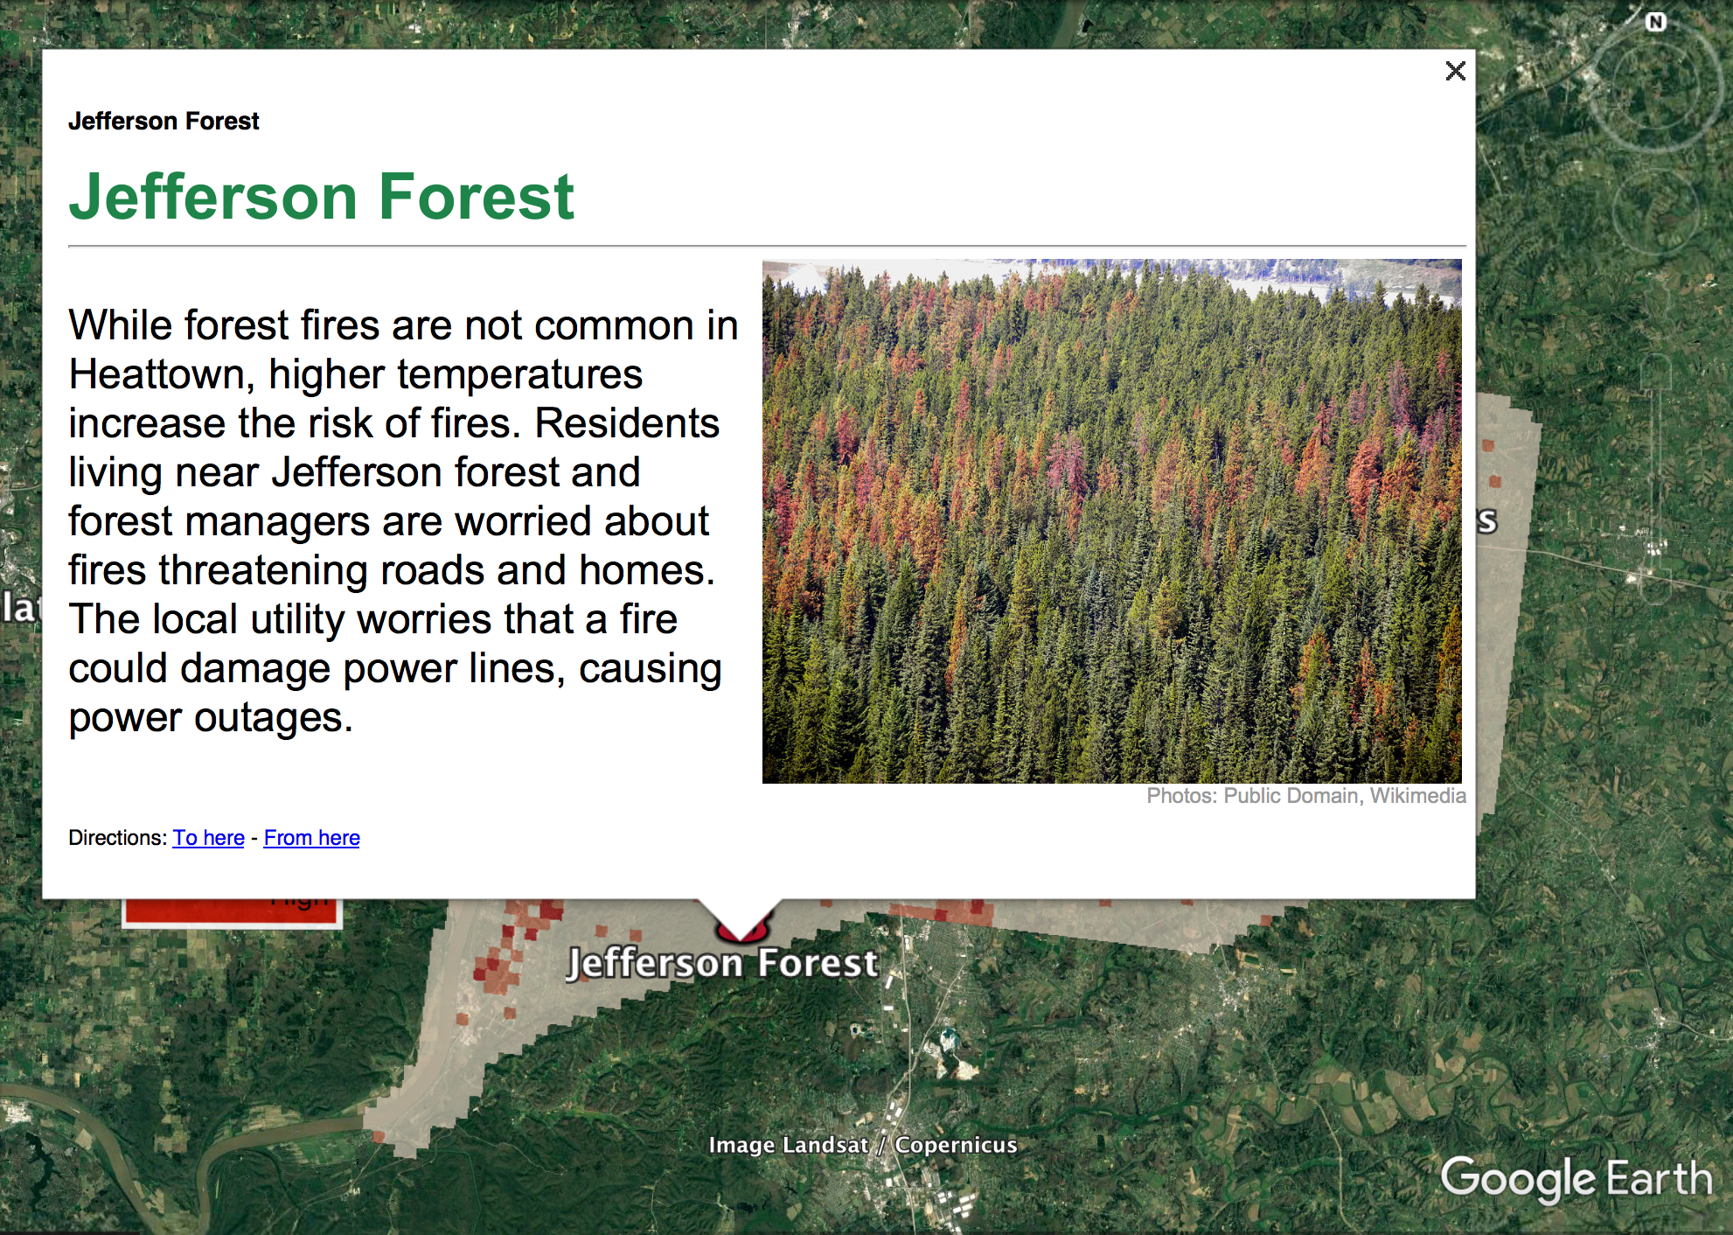
Notes:
But heat is affecting the natural ecosystems in Heattown too. The Forest here to the south of the city is seeing a lot of dead trees, stressed due to heat and pests and at risk of a severe wildfire.

Slide 15
Notes:
Finally, heat impacts the infrastructure in the city. Heattown’s power grid, like many across the U.S., is aging and could fail during an extreme heat event when demand for electricity is highest (to run AC). The bridges, roads, and runways of Heattown are also at risk to buckling or failing, especially the older infrastructure that wasn’t designed with extreme temperatures in mind.

Slide 16
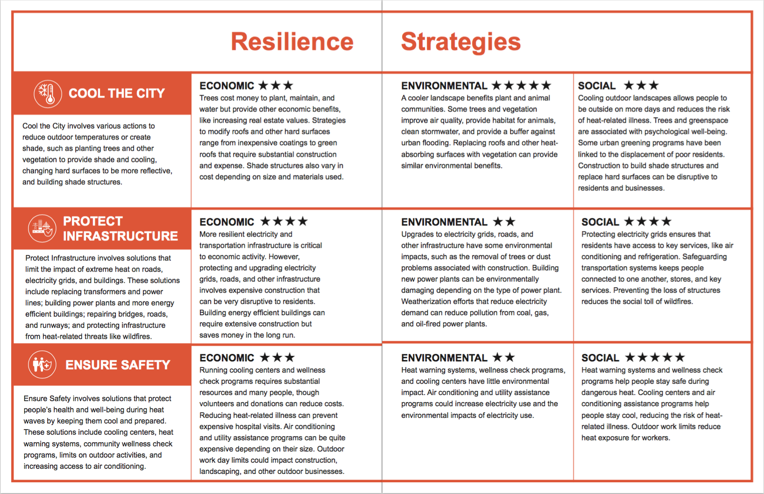
Notes:
So what should we do in heattown? Well this is what you all at each of your tables is going to figure out! You’ve read about 3 strategies to deal with the impacts of heat. These are to cool the city down with shade and plants, protect key infrastructure, and ensure that people are safe during heat waves.

Slide 17
Resilience for Heattown
Step 1: Consider Stakeholder Perspectives
Step 2: Prioritize Stakeholder Values
Step 3: Make your Resilience Plan
Step 4: Implement and Explore Your Resilience Plan
Notes:
Today you will act as the resilience planning team for the city of Heattown. Your team’s task is to create a plan that protects Heattown while considering the values of people who live there, the impacts on the economy and the effects on the environment of the city. Follow the steps below to create your plan, then implement and explore your plan using digital visualizations.

Slide 18
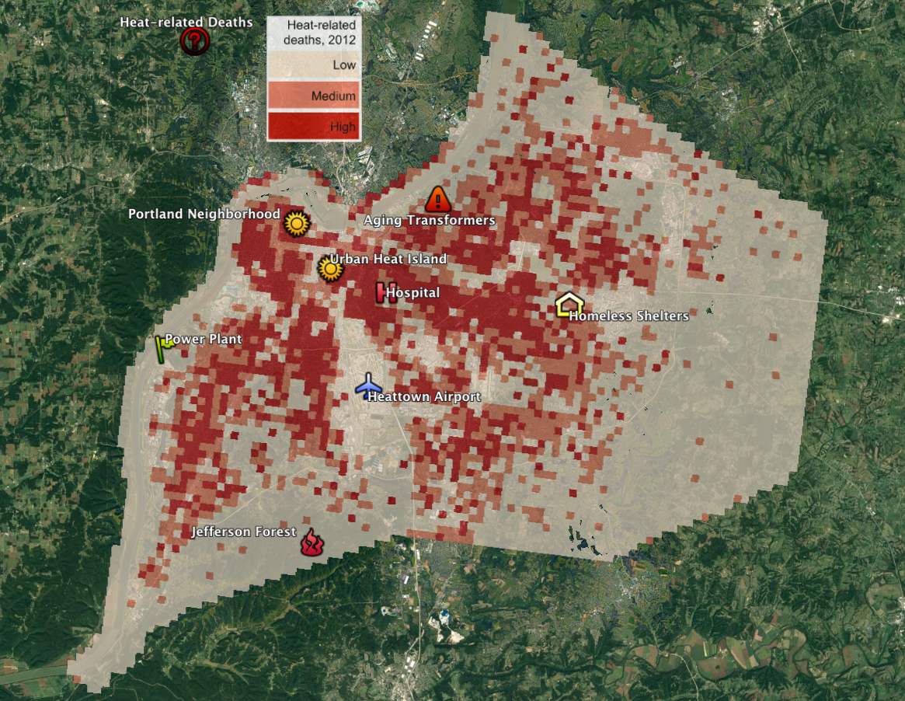
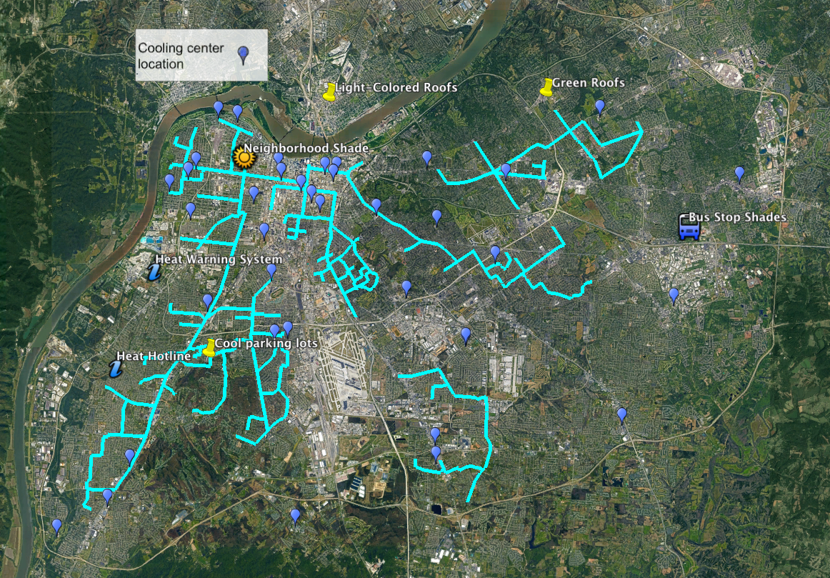
Resilience for Heattown
Notes:
Now that you know a little bit about Heattown, let’s start planning! You will begin by learning about the stakeholders, or people who will be affected by extreme precipitation and the resilience plans you will put in place, then you will discuss some options for a plan, and then finally visualize them (hit next).
Now, your facilitators will begin section 1. You will have two minutes for table introductions then 15 minutes for section 1. Please keep track of time!
Participants, please remove the Orange Heat Workbooks from your folders.
Facilitators please turn to page 1 of your facilitation guide and take out the stakeholder cards.
You may now begin.
Good luck!

Slide 19
Section 1: consider stakeholder perspectives
15
minutes
110 minutes total

Slide 20
Section 1: consider stakeholder perspectives
10
minutes
105 minutes total

Slide 21
Section 1: consider stakeholder perspectives
5
minutes
100 minutes total

Slide 22
Section 2: prioritize Stakeholder values
25
minutes
95 minutes total
Notes:
Facilitators, we are now on Section 2. You will need the stakeholder icons located in a white envelope in your folder. There are three sets of all six of the stakeholders. You will use one set per strategy on the board. Please remember to tape these down at the end of the section.

Slide 23
Section 2: prioritize Stakeholder values
20
minutes
90 minutes total

Slide 24
Section 2: prioritize Stakeholder values
15
minutes
85 minutes total

Slide 25
Section 2: prioritize Stakeholder values
10
minutes
80 minutes total

Slide 26
Section 2: prioritize Stakeholder values
5
minutes
75 minutes total

Slide 27
Section 3: Make your resilience plan
25
minutes
70 minutes total
Notes:
Facilitators, we are now on Section 3. You will need the A & B cards and three coin chips. Participants can turn to the section in their workbooks that says Resilience Plans to follow along. Remember, only individual opinions are recorded in the workbooks. Table results are recorded on the board! What is in your workbook and on the board do not need to match!

Slide 28
Section 3: Make your resilience plan
20
minutes
65 minutes total

Slide 29
Section 3: Make your resilience plan
15
minutes
60 minutes total

Slide 30
Section 3: Make your resilience plan
10
minutes
55 minutes total

Slide 31
Section 3: Make your resilience plan
5
minutes
50 minutes total

Slide 32
Section 4: Implement and explore your resilience plan
15
minutes
45 minutes total
Notes:
Facilitators, you will now be using google earth and the final resilience plan cards. Remember to use the card to alert us if you need help using google earth. Explore google earth first, then read the final plan card out loud. If this is your final plan please remember to tape down the coins with what you choose.

Slide 33
Section 4: Implement and explore your resilience plan
10
minutes
40 minutes total

Slide 34
Section 4: Implement and explore your resilience plan
5
minutes
35 minutes total

Slide 35
Section 5: Re-evaluate your plan
10
minutes
30 minutes total

Slide 36
Section 5: Re-evaluate your plan
5
minutes
25 minutes total

Slide 37
Section 6: Visualize new plan
10
minutes
20 minutes total

Slide 38
Section 6: Visualize new plan
5
minutes
115 minutes total

Slide 39
Time’s up!

