Slide 1
IMAGINE OUR COMMUNITY 2100
(example slide deck)
Notes:
Update or replace the example slides with your information. Add guest presenter slides as appropriate. Consider whether you might want to have a few printed copies of the slides available as handouts, for reference and as accessibility aids.

Slide 2

Notes:
Sample graphic artwork

Slide 3
Program Goals
Understand how the United Nation’s Goals can be used in our community.
Work together to envision what our community can be like in the future.
Learn ways to get involved in our community to further sustainability.

Slide 4
Agenda
Sustainability and our community – 15 minutes
Introduction to United Nations Sustainable Development Goals (“SDGs”)
Introduction to local statistics and community sustainability goals
Imagining our future – 35 minutes
Review the SDGs given to your group
Draw your future community
When prompted, open the disruptor scenario envelope and incorporate a solution or adjustment
Share and discuss – 25 minutes
Group share out
What can we do to help?
Notes:
Refer to the talking points and procedure section of the facilitator guide for more information on the forum agenda.

Slide 5

Notes:
Review the UN’s Sustainable Development Goals and explain that each table has 2-3 SDGs placed on their table at random. Each table will have time to read and discuss their goals as a group.

Slide 6
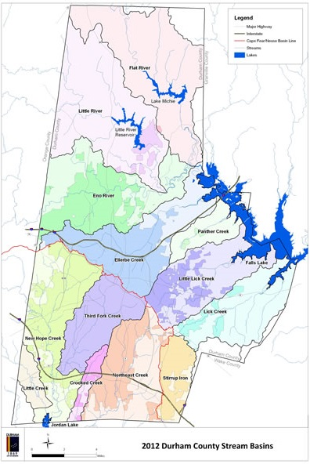
County Statistics (example)
Year: 2016
Population: 295,373 in 2016
Job growth: about 2.5%
Median household income: $53,495
Housing units:
  Single-Family, Detached: 72,254
  Townhouses: 8,297
  Condominiums: 1,987
  Apartments and Multiplexes: 45,573
  Mobile Homes: 1,126
Notes:
This slide is an example of the kind of county statistics and information you might present. You should replace it with data from your community. You also might find it helpful to include a map or outline of your community (county/city) for participants to view prior to beginning the drawing activity. The example map included in this slide is a map of Durham County showing both an outline of the county and Durham’s watersheds.
This example map is found here: https://durhamnc.gov/705/Durhams-Watersheds

Slide 7
Community Future Goals (example)
Shared economic prosperity
Creating a safer community together
Connected, engaged, and diverse communities
Innovative and high performing organization
Sustainable, natural, and built environment
  Waste stream diversion rate: below target
  Number of trees planted: on target
  Stream water quality index: below target
Notes:
This slide presents examples of future goals your community may have identified. You can replace these examples with goals from your community. You might consider conducting basic research within your own community on any current or future sustainability projects or initiatives. These may include community rain garden building, funding for installing rain barrels, grants for homeowners to install solar panels, or initiatives to increase recycling. In addition, check to see if your community has a sustainability roadmap to address any long-term goals and targets around planning for a more sustainable future? These could include goals around climate and energy, the economy and jobs, resilient infrastructure, equity and empowerment and innovation.
You can reach out to an expert to advise you on what your community may be already doing or planning for the future and invite them to serve as a guest speaker to present this information.

Slide 8
Ground Rules for Table Discussions
Respect others’ opinions and ideas
No interruptions – one person talks at a time
Listen carefully to what others have to say
It’s ok to disagree with others
Take part in the discussion
Give everyone a chance to speak
Focus on the subject
Keep comments brief and to the point
Take a break when you need to
Notes:
The kind of group conversations that naturally take place regularly in life may or may not lead to a productive learning experience outcome. Often those conversations take place among people who all think about things in the same way and share the same values, and so new perspectives never arise. At other times differences of opinion lead to debate rather than dialogue, with participants focused on winning the argument rather than listening to the views of others. Arguments easily get sidetracked and no progress is made. Small group conversations in forum programs, therefore, require some type of facilitation strategy. One strategy for ensuring that everyone gets a chance to speak is to put a facilitator at each table. Another way is to use materials that facilitate the process, along with the host helping people to stay on track. In this second strategy, it is useful to put a copy of these ground rules for table discussions on each table.

Slide 9
Disruptor Scenarios
The disruptor scenarios are examples of problems or emergencies that can hurt, or disrupt, an otherwise stable society, and therefore should cause you to rethink parts of their future city.
Use this opportunity to discuss within your groups ways to mitigate or adapt to your disruptor and adjust your drawings accordingly.
Notes:
Use this slide to explain the use of the disruptor scenarios.
Ask each group to open the sealed envelope containing their disruptor scenario during the Imagine our future section of the forum. Explain to the entire group that these disruptor scenarios are examples of problems or emergencies that can hurt, or disrupt an otherwise utopian society, and therefore should cause each group to rethink parts of their future city. Invite them read the scenario aloud to their group and discuss how this new scenario might disrupt their future city. Allow an additional 10 to 15 minutes for each group to brainstorm ways their community will mitigate or adapt to their disruptor and adjust their drawings accordingly.

Slide 10
Group Share Out
What were your SDGs and how did you incorporate them into your drawing?
What was the disruptor scenario for your group and how did you try to solve that problem?
What was one take away from this activity that you found interesting?
What would change about any of these plans if you were planning for 10 years into the future? Or 200?
Notes:
After each small group has completed their future community drawing, ask them to designate one or more members to share their ideal future community with the entire group. Provide 3 to 5 minutes per group to share. You can adjust this time depending on how many small groups need to share. This slide has a few discussion prompts to ask each group to consider discussing during their report out:

Slide 11
What can you do to help?
What steps can we take now to help ensure that our actual future looks more like these imagined futures?
What policy changes should we strive for?
What can we as individuals do to improve our communities now and in the future?
Notes:
After each group has shared, you may decide to have a whole group discussion and wrap up. This slide contains a few discussion prompts to start this discussion. If you had a guest speaker you might encourage them to help facilitate this portion.

Slide 12
Community Resources (example)
Sustainability Events:
  https://www.eventbrite.com/d/nc--durham/sustainability/
Workplace Opportunities:
  http://bullcityworkplacechallenge.com/
Volunteer for Keep Durham Beautiful:
  https://keepdurhambeautiful.org/volunteer
Good Life Goal Challenge sheet:
  https://www.nisenet.org/catalog/ecosystem-engineers
Good Life Goals Pack of Actions:
  https://docs.wbcsd.org/2018/09/Good_Life_Goals/Pack_of_Actions.pdf
Notes:
Encourage participants to follow up by exploring any relevant sustainability-based exhibits in the museum before they leave. Here are some additional suggestions and resources you can share with program participants.
Your city/county planning department will have additional resources and information on local efforts to plan for the future.

