Slide 1
STEM Learning Ecosystems
Generalized Example Illustration
All Variations
Illustration variations include with and without: natural context, learner pathway, and “Culture, Society, Place”
Published under a Creative Commons Attribution Noncommercial-ShareAlike license Copyright Arizona State University, November 2023
https://nisenet.org/stem-learning-ecosystems
This material is based upon work supported by NASA under cooperative agreement award number 80NSSC21M0007. Any opinions, findings, and conclusions or recommendations expressed in this material are those of the author(s) and do not necessarily reflect the view of the National Aeronautics and Space Administration (NASA).

Slide 2
STEM Learning Ecosystems
Generalized Example Illustration
Variations Available as PDF, JPG, and PNG
Illustration
with text labels
without text labels
“Culture, Society, Place” with text labels
“Culture, Society, Place” without text labels
learner pathway with text labels
learner pathway without text labels
Illustration set in a natural context
with text labels
without text labels
“Culture, Society, Place” with text labels
“Culture, Society, Place” without text labels
learner pathway with text labels
learner pathway without text labels
Also available as slides with editable text labels in a separate document https://nisenet.org/stem-learning-ecosystems

Slide 5
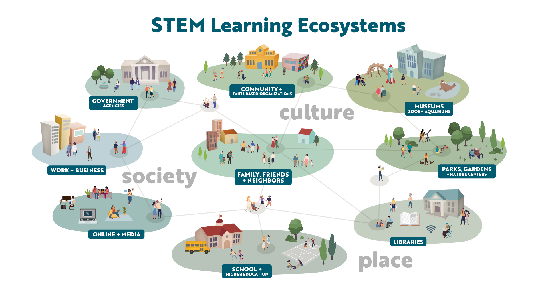

Slide 7
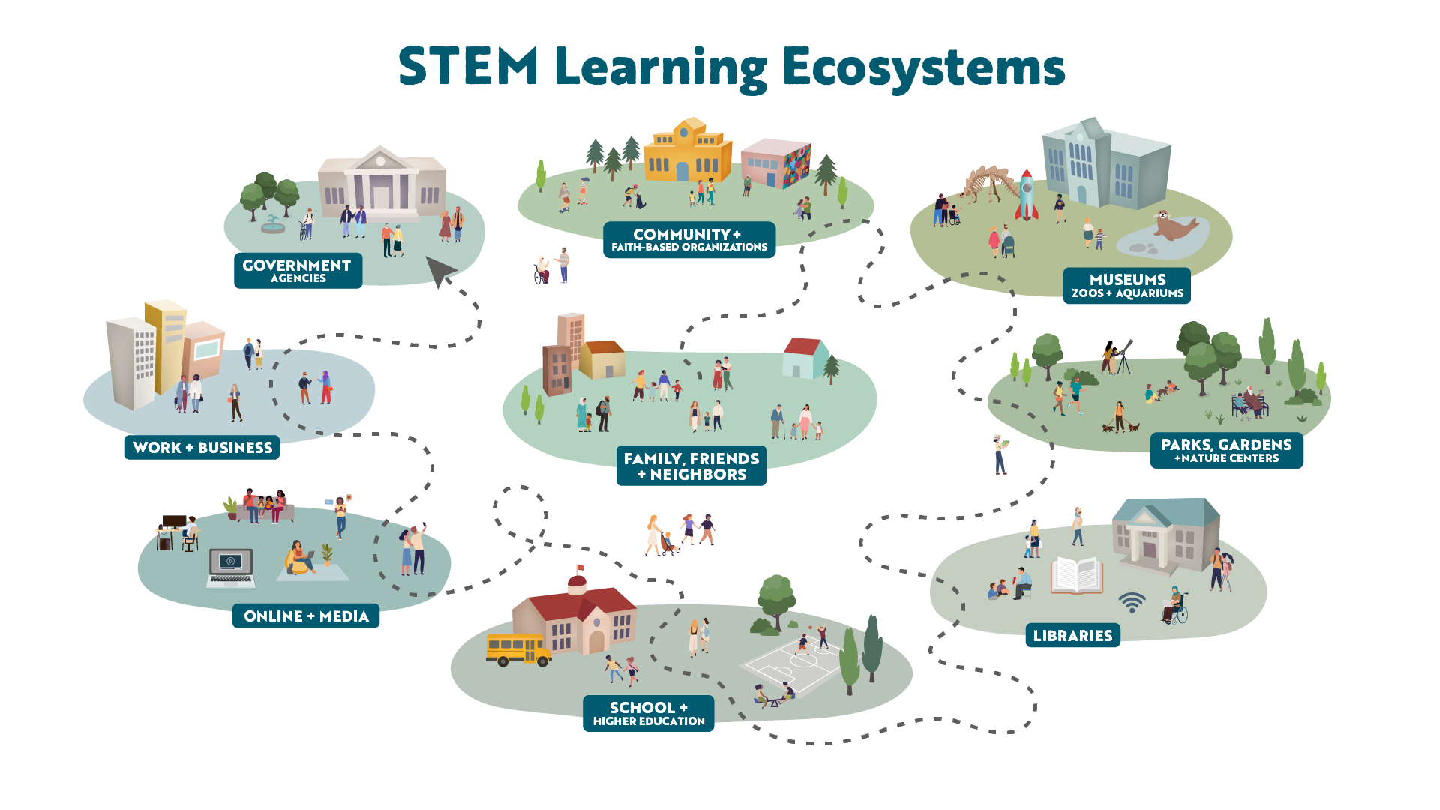

Slide 8
