Slide 1
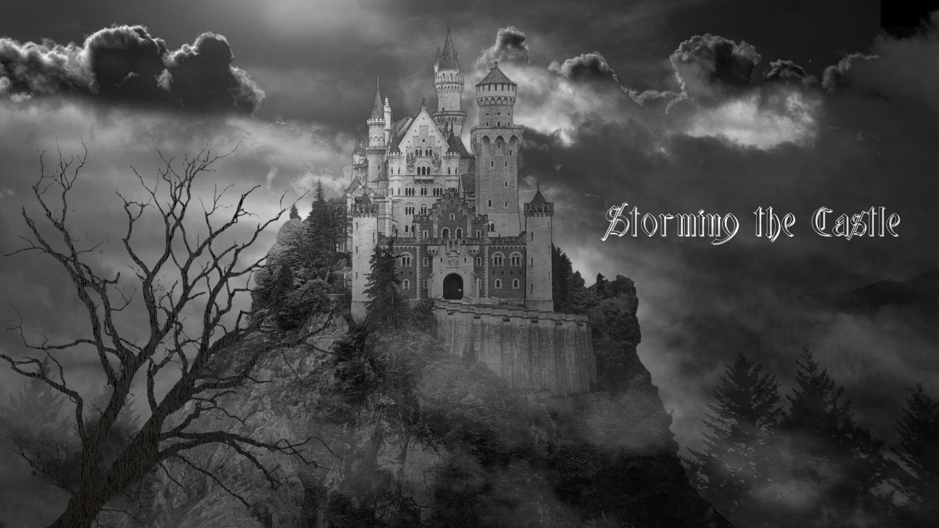

Title card
Spooky clouds and lightning
thunder sfx

Slide 2
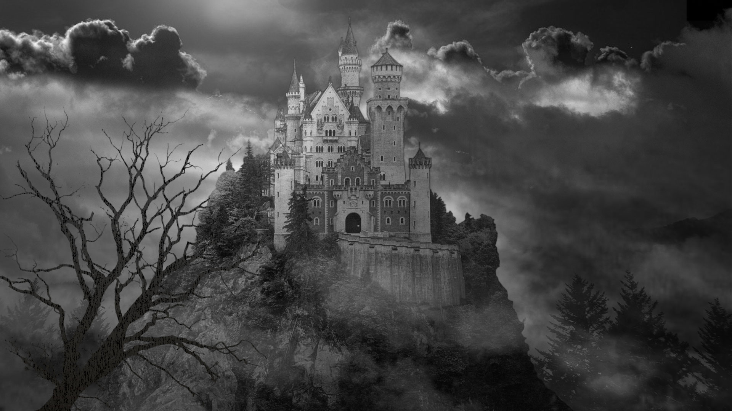
Notes:
Spooky clouds and lightning
thunder sfx

Slide 3
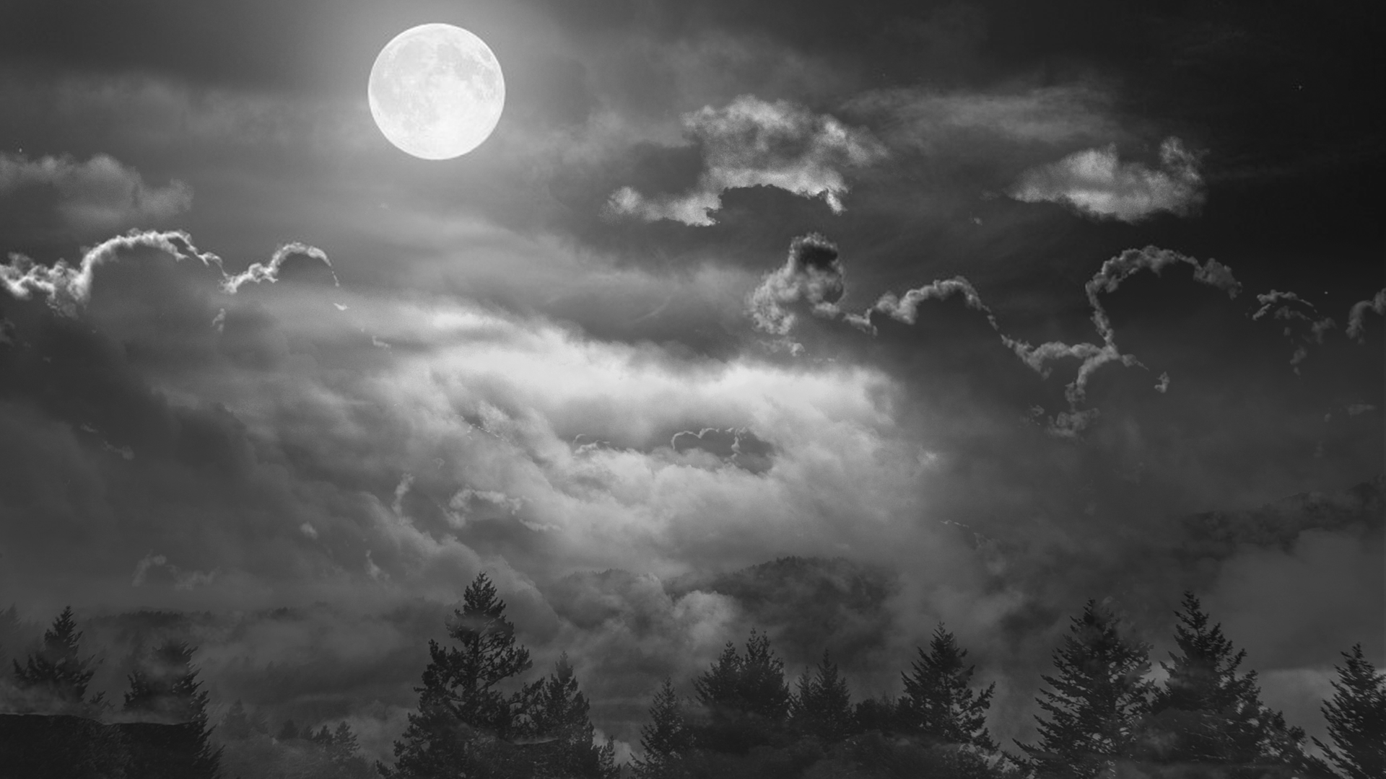
Notes:
Spooky clouds and lightning
Door bell sfx on click

Slide 4

Notes:
Answer door
Spooky clouds and lightning
Angry Mob sfx on click

Slide 5
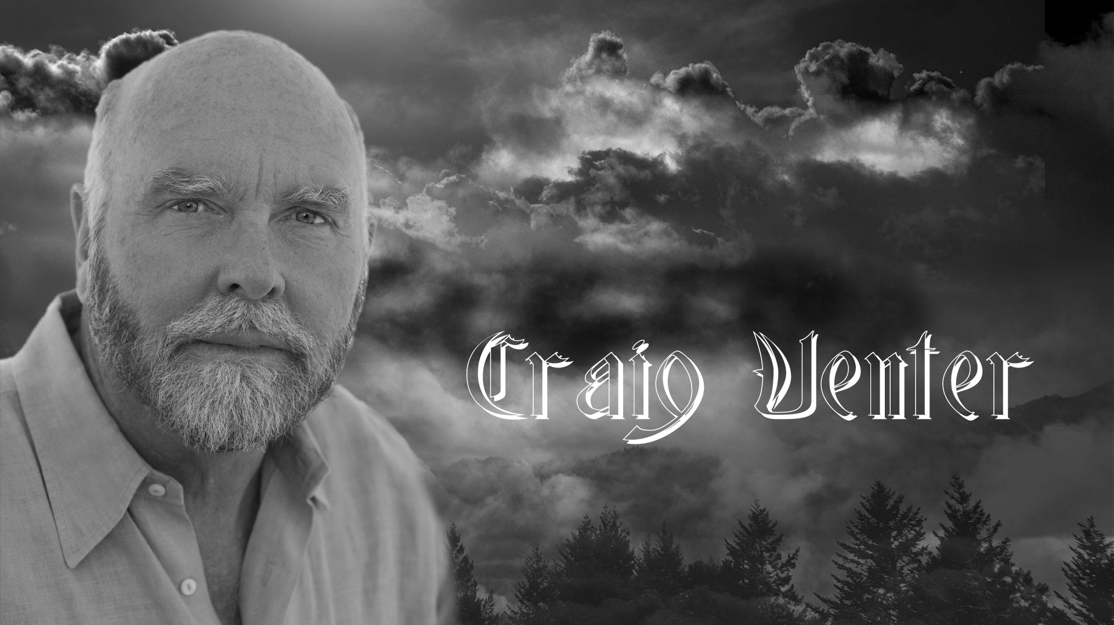
Notes:
Doorbell sfx on click

Slide 6
Notes:
Doorbell sfx on click

Slide 7
Notes:
Whinnying horses sfx on click

Slide 8
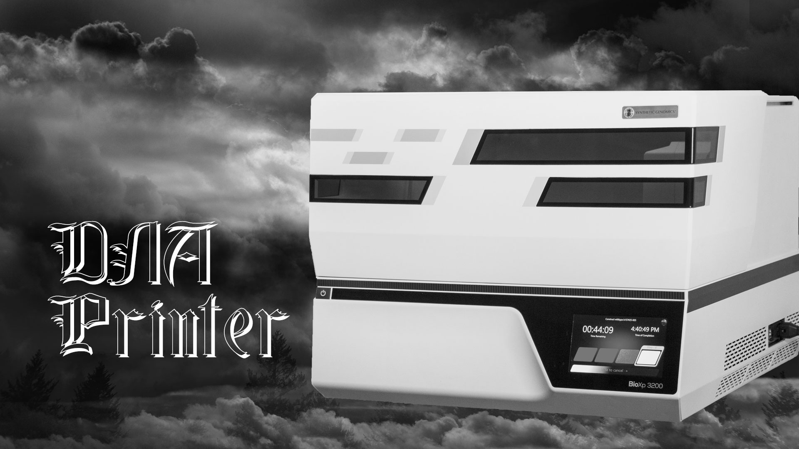

Slide 9
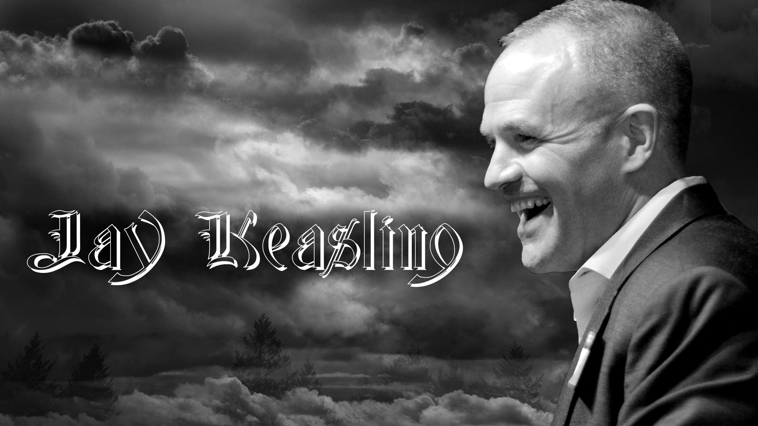

Slide 10
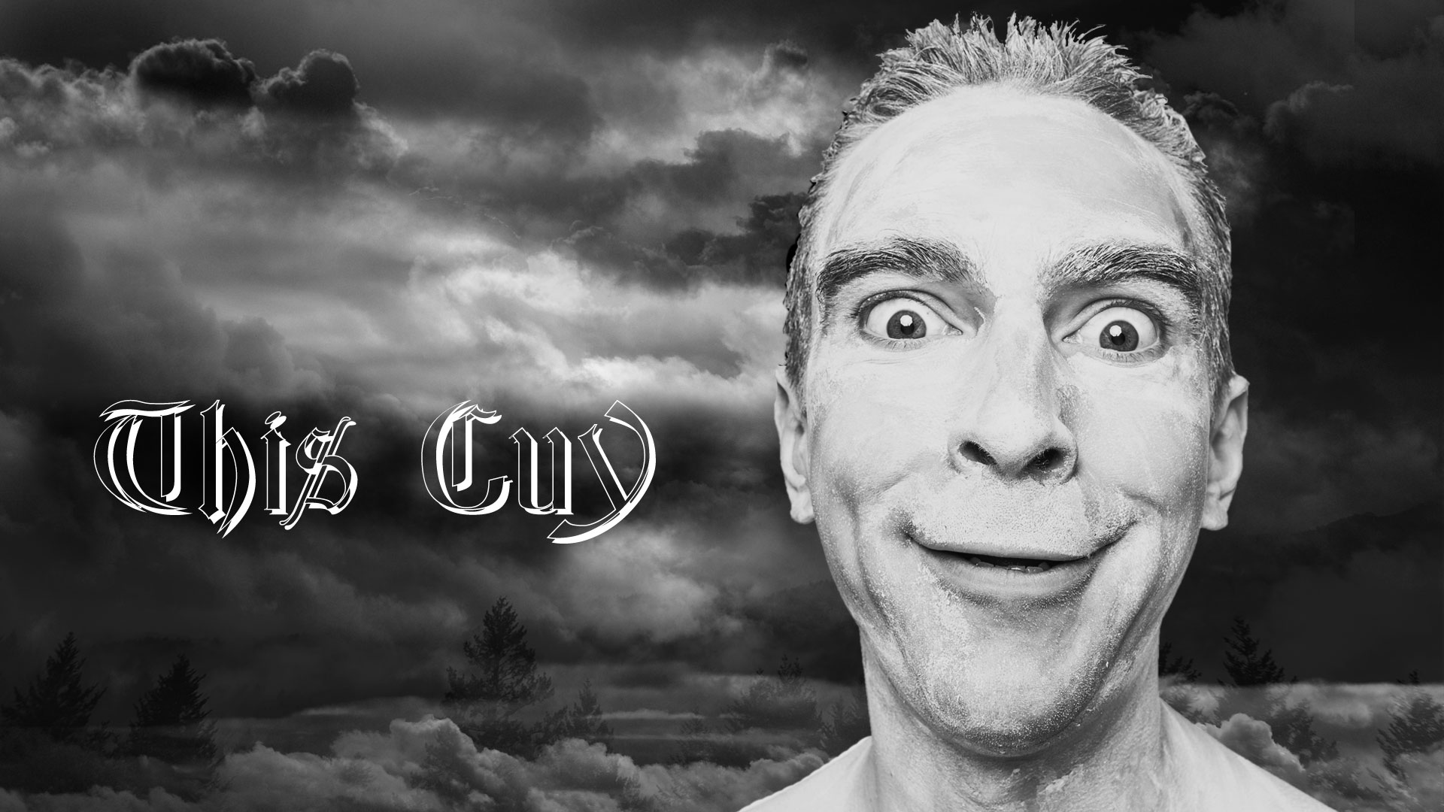

Slide 13
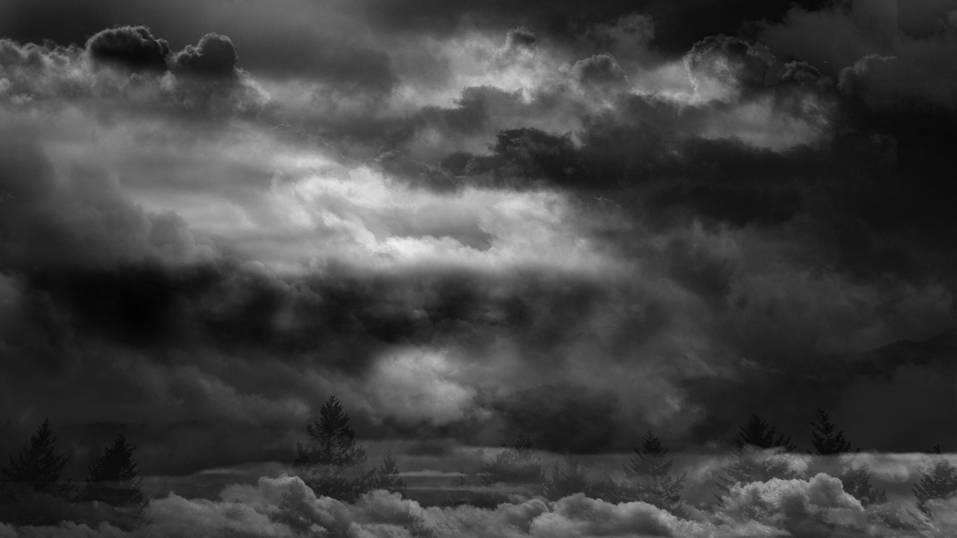
Notes:
Time to go home
Disappointed crowd sfx on slide change

Slide 14
Notes:
Goodnight people
Castle door closing sfx on slide change
Elephant sfx on click

Slide 15
Notes:
Goodnight people
Castle door closing sfx on slide change
Elephant sfx on click

Slide 16
