Slide 1


Sustainability and Museums

Slide 2

SUSTAINABILITY

Slide 3

Sustainability
needs
“meets the needs of the present without compromising the ability of future generations to meet their own needs”
present
future
Needs – include food, water, shelter, work, happiness, and respect.
Future – people in the future will also have needs. How will our actions affect them?
Present – people all over the world have needs that are equally important and must be met.
United Nations. (1987). Our common future. (Commonly known as the Brundtland Report).
https://sustainabledevelopment.un.org/content/documents/5987our-common-future.pdf

Slide 4
Sustainability
Economy
Society
Environment
Society
Economy
Environment
Notes:
Welcome and introductions

Slide 5
Sustainability means healthy people, communities, and environments, now and in the future.

Slide 6
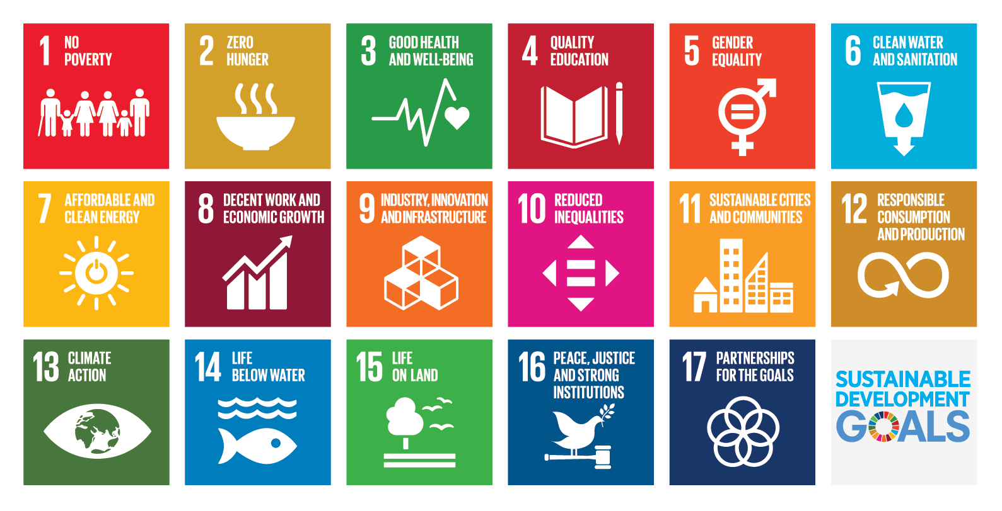
United Nations

Slide 7
Education for sustainability
“cultivates individual and collective potential … to increase the possibility that humans and other life can flourish on Earth now and into the future ”
individual
collective
future.
Individual – empowering learners
Future – making a difference as an organization
Collective – connecting with our communities
Cloud, ed. (2017). Education for a sustainable future: Benchmarks for individual and social learning. Journal of Sustainability Education.
https://cloudinstitute.org/efs-benchmarks

Slide 8
SUSTAINABILITY & MUSEUMS

Slide 9
Museums and sustainability
What role can museums play?
Museums are trusted organizations
Museums support lifelong learning
Museums foster social learning
Museums engage diverse public audiences
Museums can serve as conveners in a community
Museums can model sustainable practices

Slide 10

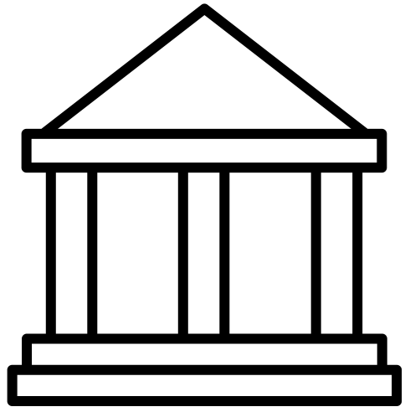
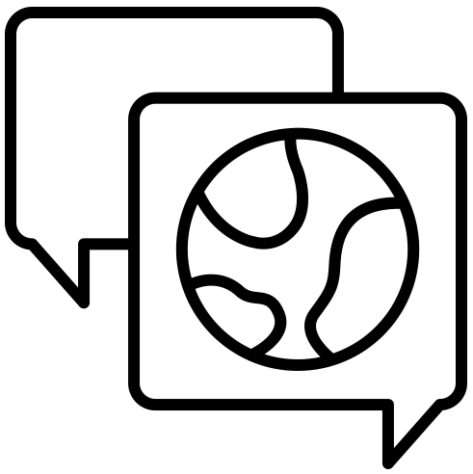
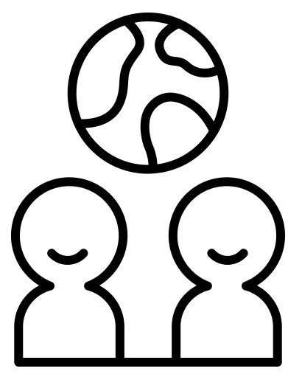
Whole institution
approach
Policy and governance
Community partnerships
Facilities
and operations
Education and learning
Adapted from UNESCO. (2017). Education for Sustainable Development Goals: Learning objectives.
https://unesdoc.unesco.org/ark:/48223/pf0000247444
Icons: Made by Made, Noun Project

Slide 11
Resources
Available to download from https://www.nisenet.org/sustainability
Museums and sustainability
Sustainability project planning
Staff and community engagement
Public engagement and programming

Slide 12
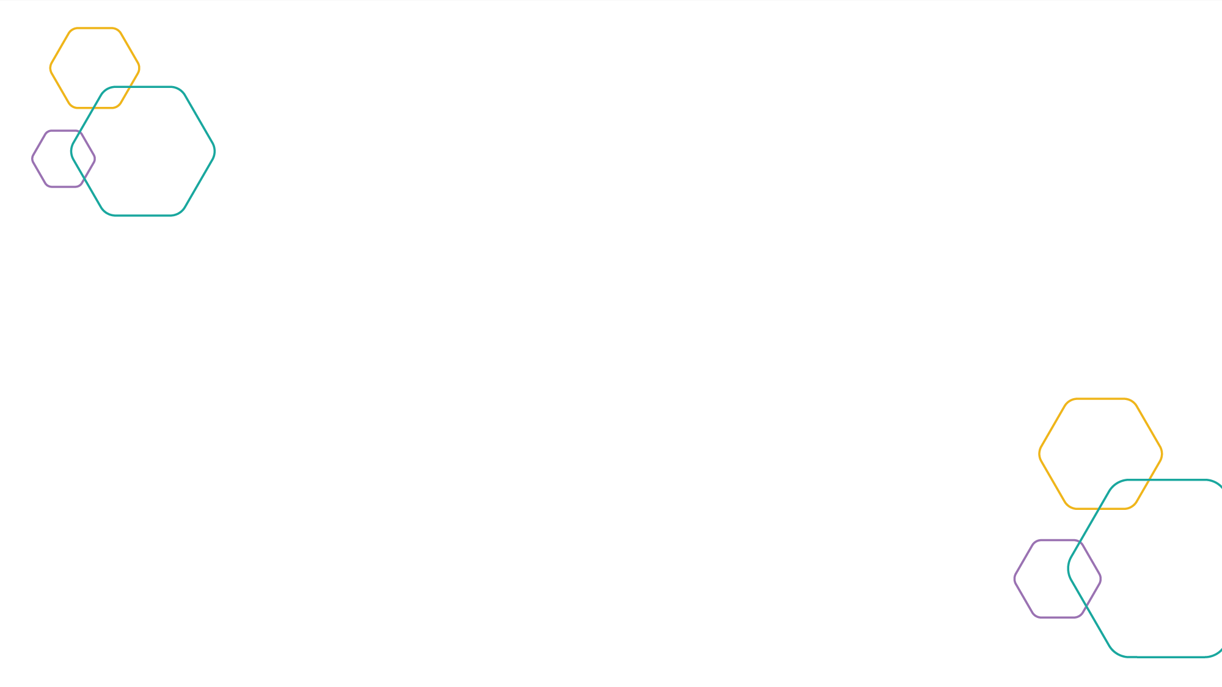

Created by Arizona State University for the NISE Network. Copyright 2019, Arizona State University. Published under a Creative Commons Attribution-Noncommercial-ShareAlike license: http://creativecommons.org/licenses/by-nc-sa/3.0/us/
The Sustainable Development Goals (SDGs) logo, color wheel, and icons are used according to the United Nations guidelines: https://www.un.org/sustainabledevelopment/wp-content/uploads/2019/01/SDG_Guidelines_AUG_2019_Final.pdf
The Rob and Melani Walton Sustainability in Science and Technology Museums program is supported through funding from The Rob and Melani Walton Foundation.

