Slide 1

Notes:
Welcome to Module 5: Build Your Training. My name is Emily and I am one of the educators for the Let’s Do Chemistry project. ​
​
If you have not already done so, please review the welcome module, which provides background on the project and our research. ​
​
In this video we will talk about ways you can create your own training for your colleagues, volunteers, and activity facilitators based on what you have learned from the Let’s Do Chemistry framework.

Slide 2

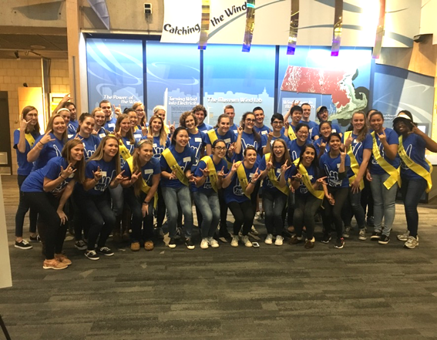
MODULE FIVE
Build Your Training
Virtual Outreach
Volunteers
National Chemistry Week
How can you pass on your knowledge of the framework to others?
Scientists
Colleagues
Chemists Celebrate Earth Week
Notes:
You have learned so much over the course of this workshop, do how can you pass that off to the people who will be facilitating activities? Think about who your audience might be for your training. Will is be college students facilitating activities for national chemistry week? Scientists? Volunteers? Your coworkers? Maybe this will even be a virtual training for a virtual event!
Consider who your audience will likely be, and think about how you can summarize what you have learned, to best fit their needs as learners.
Photo copyright: Museum of Science, Boston 2017

Slide 3

MODULE FIVE
Build Your Training
What will we cover today?
Good Training Practices
  Active Participation
  Facilitation
  Safety
Training Resources
Use the Frameworks
Evaluation
Notes:
In this video we will review some standard good training processes and resources or outreach, how to use the design and facilitation frameworks in your future work, and how to incorporate evaluation into your training and activity development.
As a reminder, this training you are creating should work for your trainees. Think about how much time you have with them, and what the most important things are for them to learn. It is likely that a training for outreach volunteers will look very different from a training session with your peers. Consider how you can adapt what you have learned over the last few weeks and share that knowledge to help others become better science communicators and activity facilitators.
Photo copyright: Science Museum of Minnesota for NISE Network

Slide 4
Good Training Practices
Notes:
Good training practices. This section will lead you through a variety of ways you can engage participants in a training. These are simply guidelines that we have had success with for our audiences. We encourage you to take these guidelines, apply them, and innovate new ways to adapt them for your audience.

Slide 5
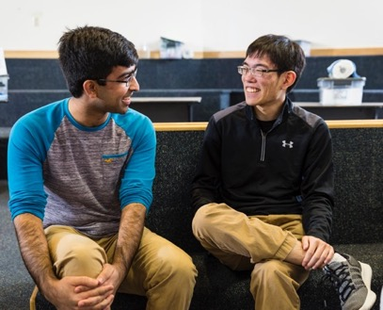
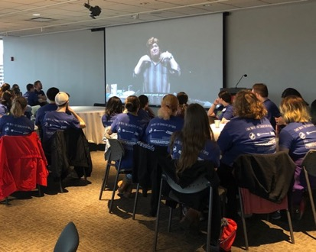
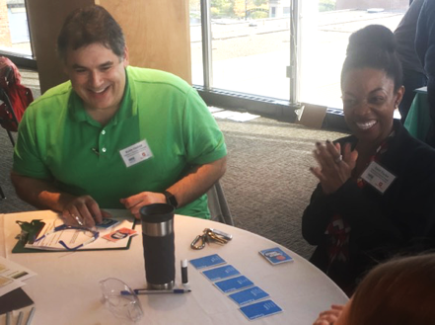
Good Training Practices
Active Participation
How can you make your training engaging and experiential?
IMPROV GAMES
SHORT VIDEOS
HANDS-ON ACTIVTIES
Notes:
How can you make your training engaging and experiential? Incorporating active participation into your training can increase engagement and learning potential in your participants. In the past we have used improv games to help participants get used to asking and answering questions, short and fun videos to help demonstrate ideas rather than or in addition to using PowerPoint presentations, and hands-on activities for participants to try and to practice facilitating with. How can you adapt some of these strategies to work in a virtual world?
Photo copyright: Gary Hodges (left); Emily Hostetler, Museum of Science, Boston, 2018 (center); David Sittenfeld, Museum of Science, Boston, 2017 (right)

Slide 6
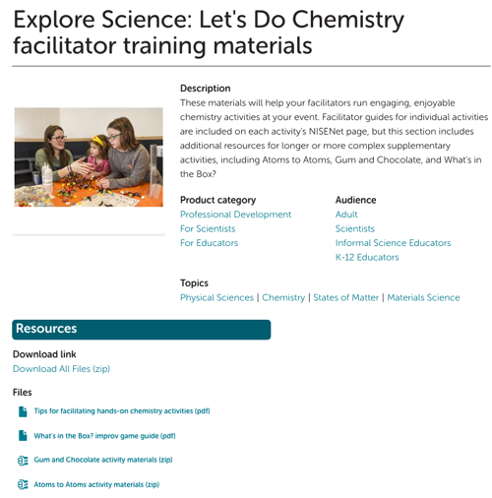
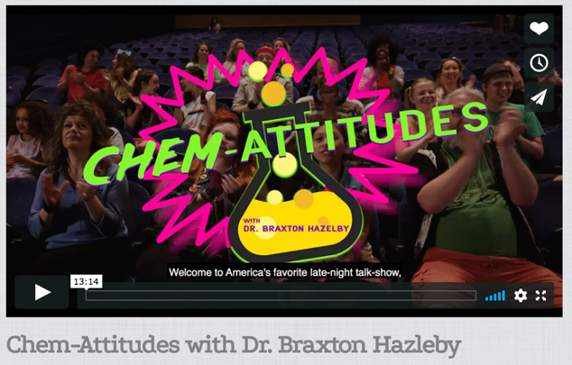
Good Training Practices
Active Participation
https://www.nisenet.org/chemistry-kit -> Training Videos
https://www.nisenet.org/chemistry-kit -> Activity Facilitator Training Materials
Notes:
You have all already brought forward some excellent ideas of how to communicate the importance of the design strategies and facilitation techniques in your online sessions, however if you are looking for additional resources to support your training, we encourage you to visit the Let’s Do Chemistry kit site and take a look at some of our training and facilitation resources where we have short videos and facilitator training activities available to download and share.

Slide 7
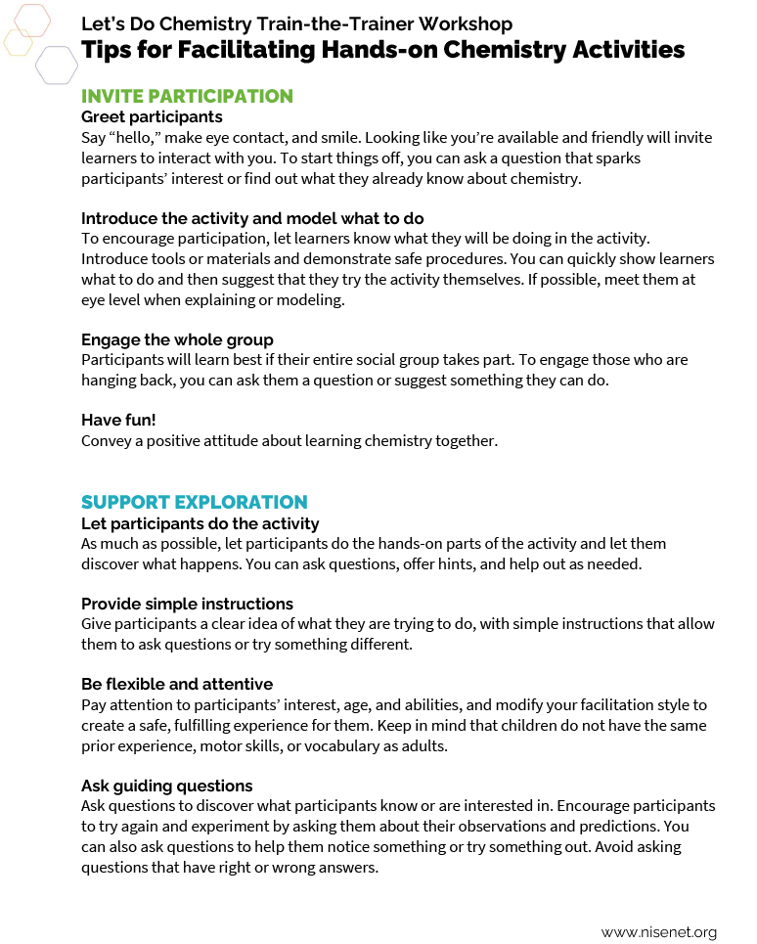
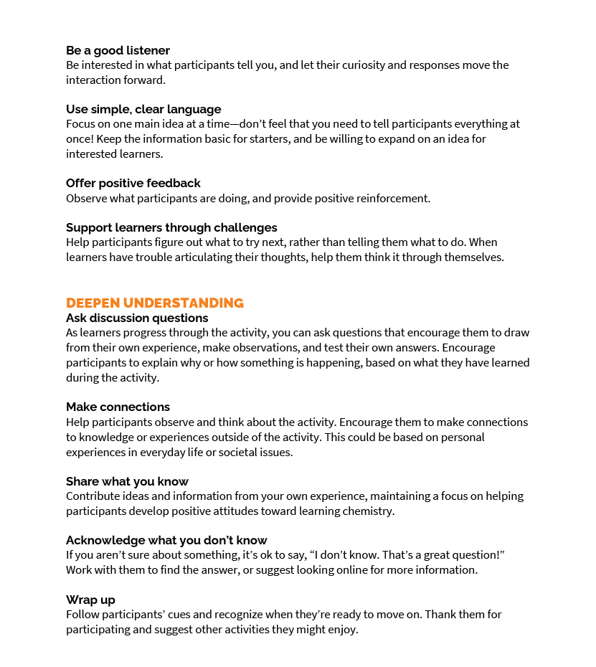
Good Training Practices
Facilitation
Review tips for facilitating hands-on activities
  Invite Participation
  Support Exploration
  Deepen Understanding
Demonstrate and/or practice “good” facilitation techniques
Notes:
In our last module we discussed how to incorporate facilitation techniques into activities to increase interest, relevance, and self efficacy. So how do you communicate these good facilitation techniques to others?
Facilitation is a huge part of the hands-on activity experience for both the facilitator and the participant. A confident facilitator is someone who understands their role and the goal of the interaction.
To help facilitators feel more confident in their abilities, make sure they review the facilitator tip guide that reviews how to invite participation, support exploration, and deepen understanding.
Demonstrating and practicing good facilitation techniques is another way to boost their confidence! Have facilitators a practice these skills with peers before an event so they have time to ask for clarification and questions before interacting with the public.

Slide 8
Good Training Practices
Facilitation
Review participant goals for hands-on activities
  For example: “the activity is more about confidence and less about comprehensive knowledge”
Review facilitator goals for hands-on activities
  For example: "the activity is more about exploring together and less about explaining the details"
nisenet.org/chemistry-kit -> professional development and training materials
Notes:
Facilitators with a strong science background might feel compelled to overshare with the public. It’s important to convey clear goals for both the participants and the facilitators.
Remind facilitators who their audience will be and what their goals are for engaging in the activity. It can also be a good practice to remind facilitators we are all learning! Set goals for the facilitators as well. Perhaps they will focus on exploring together more than explaining while engaging with the public.

Slide 9
Good Training Practices
Facilitation and IRS Framework
How can you encourage facilitators to support IRS?
Notes:
Your activity facilitators will not need the deep knowledge of IRS you all now have. However, a brief overview of how these attitudes can improve the participant experience could deepen their understanding of the activity and positively affect their interactions.
To do this, you could
Include IRS goals in facilitator materials such as activity write ups, and
Use real examples of what it means for facilitators to support IRS goals

Slide 10
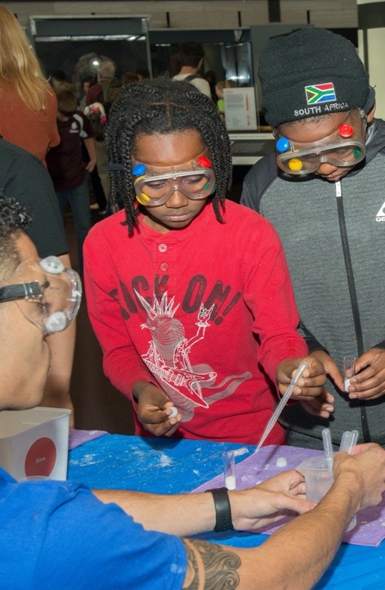
Good Training Practices
Define Chemistry
Chemists study:
  The elements and how they combine to make up everything
  The ways substances behave and change
  How compounds combine to become different compounds
Chemistry helps us:
  Understand the world around us
  Solve problems
  Answer questions
Notes:
Your training participants may be coming from a wide variety of backgrounds. Build a common definition of chemistry that everyone feels comfortable with and facilitators can share with participants as appropriate.
For example, you can have a conversation about what chemists do and how chemistry can help us understand the world around us, solve problems, and answer questions.
Everyone can learn, use, and talk about chemistry! Encourage your training participants to think about how they are chemists in their every day lives, and how to talk with participants about chemistry in their daily lives too.
Photo copyright: Christine Brennan Schmidt, 2018, Washington DC

Slide 11
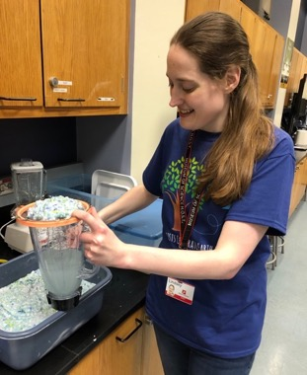
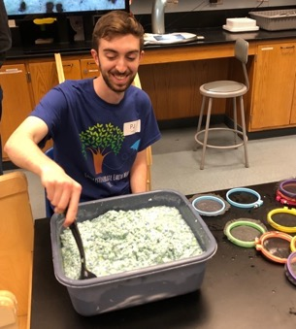
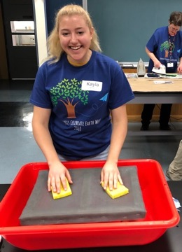
Good Training Practices
Practice
Review and practice the steps and procedures for specific chemistry activities
Notes:
This step in the training process is materials-intensive, noisy, messy, and takes quite a bit of time. However, it is important that activity facilitators become familiar with the steps, procedures, actual materials used, expected results, and possible errors In so that they can effectively facilitate the activities. This may be the facilitator's favorite part of the training!
Photo copyright: Emily Hostetler, Museum of Science, Boston, 2018

Slide 12
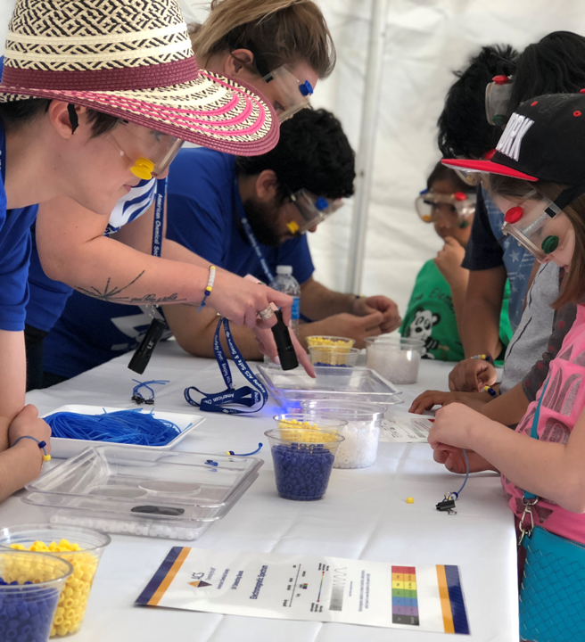
Good Training Practices
Safety
Introduction to RAMP from ACS:
R - Recognize the hazards
A - Assess the risks
M - Minimize the risks
P - Prepare for emergencies
“Safety for Outreach Settings” www.acs.org/outreach
Notes:
One of the most crucial parts of planning an outreach event is safety. Safety must be communicated to everyone who plans on developing activities, facilitating activities, and participating in an outreach event.
ACS developed a safety system called RAMP helps you select low risk hands-on activities and eliminate high risk ones. RAMP is an acronym for the four-part risk management system designed to guide the process of information gathering, critical thinking, decision-making, and creative problem solving required to do chemistry safely. It will also allow you to make adjustments, bring supplies, and educate your facilitators and presenters to increase the chances that everyone has a positive experience with chemistry
Photo copyright: David Horwitz, 2018, Washington DC

Slide 13
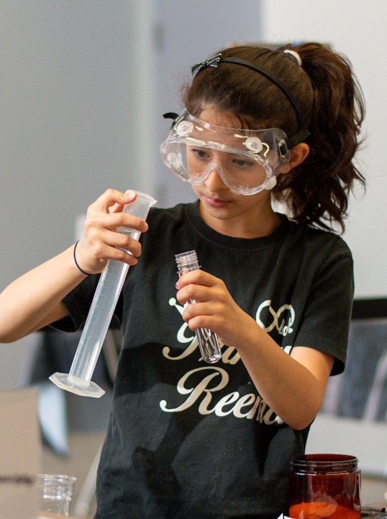
Good Training Practices
Safety
Common Safety Considerations & Best Practices
Age - Appropriate Safety
  motor coordination, misunderstanding, misbehavior, materials management, crowd control
Transporting Chemicals & Equipment
  Separate acids & bases
  Properly seal & store containers
  Use proper containers & driving practices for liquid nitrogen & dry ice.
  Replace glassware with plastic when possible.
Take-Home Items
  Provide information to help adults/families minimize risk
“Safety for Outreach Settings” www.acs.org/outreach
Notes:
Let’s review some of the key components of RAMP, and what you should be sure to clearly communicate in your trainings and incorporate into your activity development.
Consider the age of your audience. Younger learners might be more prone to wanting to touch all of the materials, and older participants might become especially excited and could use help focusing on the task. Think about ways to help make everyone’s experience better and integrate those practices into your training and activity guides.
Be sure to consult the SDS for each of the chemicals you are using, and include those with the activity guides and training. Follow all safety procedures for transporting chemicals both within and outside of a building, and be sure the person who is in charge of this task is aware of the risks and appropriate procedures for doing so.
Take home items can be a high risk situation. Be sure the item that is being taken home is given to an adult, not child, and that the adult is given a list of what the item is composed of, and the risks associated with it. For example, a take home item of strawberry DNA extracted in alcohol could be a high risk take home as it could be swallowed by a child. However, a watercolor chromatography bookmark could be a fun low risk take home.
Photo copyright: Children's Creativity Museum for NISE Network

Slide 14
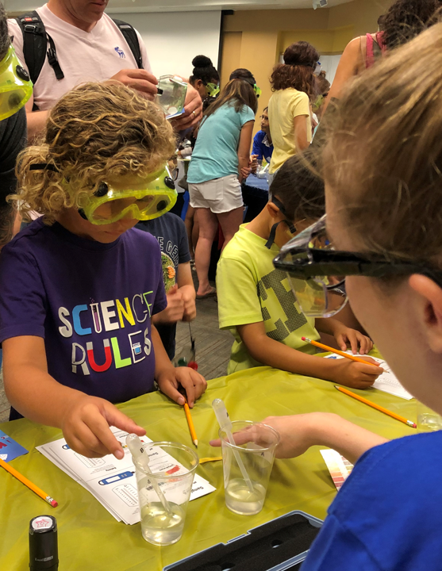
Good Training Practices
Safety
Common Safety Considerations & Best Practices
Splash Goggles or Safety Glasses?
  Safety glasses: no risks from liquid splashes or dust.
  Splash goggles: a chance that a splash, droplet, or airborne particle could get in someone’s eye and cause irritation or harm.
Waste
  Play it safe - take it with you!
  Dispose of it properly
“Safety for Outreach Settings” www.acs.org/outreach
Notes:
Splash Goggles or Safety Glasses is a common discussion and debate! Basically,
Safety glasses: no risks from liquid splashes or dust.
Splash goggles: a chance that a splash, droplet, or airborne particle could get in someone’s eye and cause irritation or harm.
Be sure there are enough goggles or glasses provided to everyone who may be interacting with the activity - including adults and facilitators! And, be sure to check in often to make sure facilitators and participants are using them correctly.
Be sure that you have a plan of how to dispose of liquid and solid waste. If you are traveling and don’t know if they will have the proper place for disposal - plan to bring it back with you where you know you can dispose of it. Be sure to include in the facilitator guide how to properly dispose of the waste produced by the activity as well.
Photo copyright: Linda Wang, 2019, San Diego CA

Slide 15
Good Training Practices
Safety
How can you communicate and enforce safety standards?
Make safety a priority in training
Make safety a priority in activity write-ups
  Personal Protective Equipment (PPE)
  Clean-up procedures & material disposal
Provide enough PPE for each activity
  Activity Facilitators & Participants
  Don’t forget to include adults who may be helping children
Create visible signage to indicate what PPE is necessary to participate in the activity
Include how to properly label all materials
Notes:
While these tips will be mostly used while you are planning events and activities, it’s imperative to communicate the importance if safety to your activity facilitators.
Think about ways you can communicate these safety standards.
- Make safety a priority in activity write-ups that are provided to activity facilitators,
- Provide enough PPE for each activity,
- Create visible signage to indicate what PPE is necessary to participate in the activity, and
- Review how to properly label all materials
To learn more about safety, see “Safety for outreach settings” by ACS or look at our Let’s do chemistry kit safety guide.

Slide 16
Training Resources
Notes:
Let’s review some training resources

Slide 17
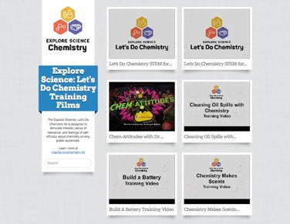
Training Resources
What is available to make it your own?
Notes:
Here are just a few examples of the resources available to you to use to inform your training. The following are all available on nisenet’s lets do chemistry kit page.
Let’s Do Chemistry Research to Practice Guide
Planning and Partnership Guide
Safety Guide
Event Overview and Training presentation
Training Videos
You will also find many helpful resources at the American Chemical Society’s outreach web page.

Slide 18
Use the Frameworks
Notes:
My name is Patti and I am a practitioner with the Let's Do Chemistry project. I hope that as you learned about the Design and Facilitation Frameworks you felt validated. After all, you use many of these strategies in your practice and have done so for years. Perhaps you even identified a few strategies that you would like to utilize more intentionally, so that the hands-on offerings you provide for the public make more of an impact.
The benefit to having these strategies and techniques identified is now you can tell educators, chemists, and students specifically what to practice so that they can be successful.

Slide 19



Use the Frameworks
Promote positive attitudes
...toward learning chemistry!
Notes:
As part of your training workshop, have participants list their motivations for sharing chemistry with the public.
Chemists have told me that they hope to:
Show kids that chemistry is fun.
Help people realize that chemistry is an important part of their lives.
Serve as a role model so students realize they can become chemists, too.
Chemists and educators can all agree that their goals for students and the general public are encompassed by the broader goal of promoting positive attitudes toward learning chemistry. I suggest you take it a little further. Define interest, relevance, and self-efficacy and ask your team to sort their motivations in to these categories. This exercise establishes the common goals for the group and helps trainees realize that the time spent with you in training will help them do what they have always wanted to do when sharing hands-on chemistry activities with the public!
Image copyright: ACS Chemoji, Chemical & Engineering News

Slide 20
Evaluation
Notes:
Hi, I'm Marta, a researcher with the Let's Do Chemistry project. In previous modules, we have focused on sharing findings from what we learned through the research in this project.
Since this module is all about how you could use the frameworks developed in the Let’s Do Chemistry project, today we are going to share some information and tools with you for testing activities after they had been modified and for evaluating your own training workshops!

Slide 21
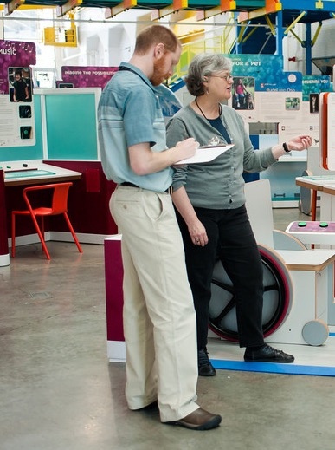
Evaluation
Overview
Purpose of evaluation
Test activities or workshops with your target audience(s)
Gather feedback directly from participants
Make informed changes to activities and training workshops
Determine whether project goals are being met
Notes:
In case you are not already familiar, we wanted to introduce you to why you might want to include evaluation when you are developing an activity or conducting a training workshop of your own.
Just as an overview, evaluation provides an opportunity
To test what you have created with your target audience
Gather feedback directly from participants
Make informed changes
And determine whether project goals are being met
Feedback can be really helpful in determining if any changes you are making are working as you hoped, or in helping understand how you are affecting people’s attitudes around interest, relevance, and self-efficacy or any other outcomes you were hoping for.
Although evaluation will likely look different than it would have before the pandemic, there are evaluation strategies that can be adapted to current circumstances.
We have some tools from the ChemAttitudes project to share with you, that could help you collect data about your activities and trainings, particularly in regard to the framework we have been talking about over the last few weeks.
Photo copyright: Emily Maletz for the NISE Network, 2013

Slide 22
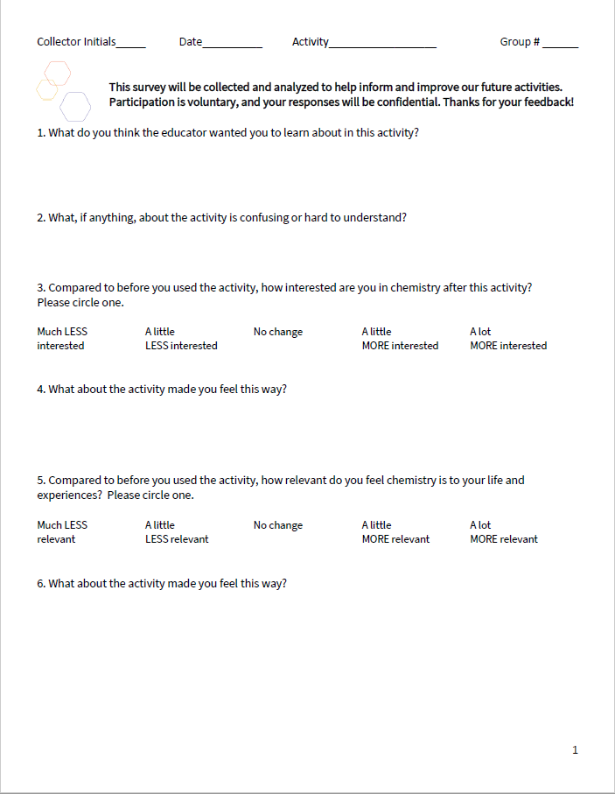
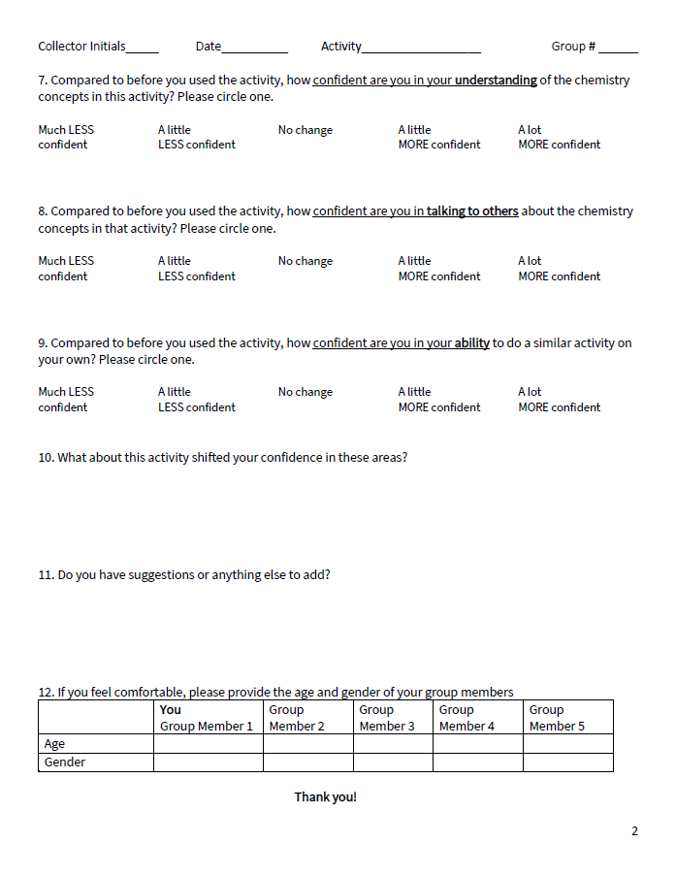
Evaluation
Instruments
Interview for public audiences
Activity feedback
Interest, relevance, self-efficacy goals
Survey for staff and volunteers
Ages 18+
Workshop feedback
Interest, relevance, self-efficacy goals
Notes:
For activity development, we have an interview you can use with participants. This was based off of the instrument that we used to understand if and how the activities tested for the Let’s Do Chemistry kit met the project goals.
We are also sharing a survey that could be used to help you improve your training workshops, similar to what we will be asking you to fill out after this workshop. All of these documents will be shared on the workshop’s website under additional resources.
Both instruments include a mix of rating and open-ended questions to help you learn about how the activities and/or the training met your goals related to interest, relevance, and self-efficacy, as well as help you gather information on any areas of confusion, and some general feedback about the experience.
[Public: content learning questions; Staff: questions about the workshop]
Of, course, it is important to remember that when interviewing children make sure you get their parent or guardian’s consent, in addition to agreement from the child!

Slide 23

Evaluation
Team-Based Inquiry
The NISE Network has a variety of resources to support evaluation for activity development, including:
Team-Based Inquiry Guide
Training Videos
https://www.nisenet.org/catalog/team-based-inquiry-guide
https://www.nisenet.org/catalog/team-based-inquiry-training-videos
Notes:
We can’t cover everything that is helpful to know in doing evaluation for activity development or gathering feedback from trainees.
However, the NISE Network has more evaluation resources you can access to help you do your own activity and workshop testing.
In particular, we’d like to direct you towards the Team-Based Inquiry guide and training videos, which cover all the stages of evaluation as well as a crash course in evaluation ethics. These links are included on this slide and also on the additional resources section of the workshop's website.
A Team-Based Inquiry guide and other resources can be downloaded from: https://www.nisenet.org/catalog/team-based-inquiry-guide
Training videos are available here: https://www.nisenet.org/catalog/team-based-inquiry-training-videos

Slide 24
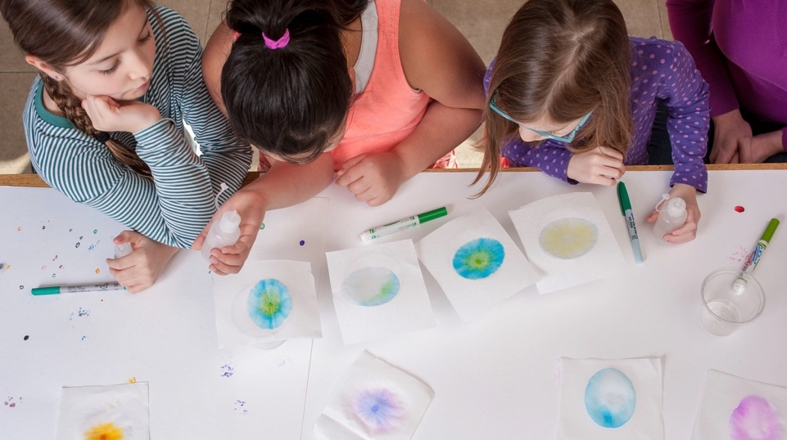


This work is supported by the National Science Foundation under award number 1612482.
Any opinions, findings, and conclusions or recommendations expressed in this presentation are those of the authors and do not necessarily reflect the views of the Foundation.
Copyright 2020, Museum of Science, Boston
Edited by Allison Anderson, Marta Beyer, Patti Galvan, and Emily Hostetler
Published under a Creative Commons Attribution-Noncommercial-Share Alike license:
http://creativecommons.org/licenses/by-nc-sa/3.0
Notes:
This work is supported by the National Science Foundation under award number 1612482. Any opinions, findings, and conclusions or recommendations expressed in this presentation are those of the authors and do not necessarily reflect the views of the Foundation.
Copyright 2020, Museum of Science, Boston
Edited by Allison Anderson, Marta Beyer, Patti Galvan, and Emily Hostetler
Published under a Creative Commons Attribution-Noncommercial-Share Alike license:
CC BY-NC-SA 3.0 creativecommons.org/licenses/by-nc-sa/3.0/us/
You are free to copy, adapt, or distribute this presentation and/or the text and images contained in it for educational, nonprofit purposes. When making copies or excerpts, please include the copyright and credit information above. If adapting the contents, the following citation is recommended:
APA 7 style: Anderson, A., Beyer, M., Galvan, P., & Hostetler, E. (2020). Let’s Do Chemistry Train-the-Trainer Workshop Module 1: Welcome [PowerPoint slides]. Museum of Science, Boston for the NISE Network.
Photo copyright: Emily Maletz for the NISE Network, 2018

Slide 25
Credits
Let’s Do Chemistry framework graphics, activity photos, and activity guide graphics by Emily Maletz for the NISE Network, 2018.
Citations and image credits are included in the notes for each slide.

Slide 26

Section Header
Slide Title
Text
Text
Text
Notes:
You can use this blank, formatted slide to add content to the presentation.

Slide 27
Section Header
Slide Title
Text
Text
Text
Notes:
You can use this blank, formatted slide to add content to the presentation.

