Slide 1

Notes:
Welcome to Module 4: Facilitation strategies. My name is [name], and I am one of the researchers for the Let’s Do Chemistry project.
If you have not already done so, please review the welcome module, which provides background on the project and our research.
In this video we will talk about the research findings related to facilitation based off of what we learned about how facilitators interacted with visitors while using the Let’s Do Chemistry kit activities.
We will also talk about how to apply the research findings to your own practice of facilitating activities as well as training others for outreach.

Slide 2
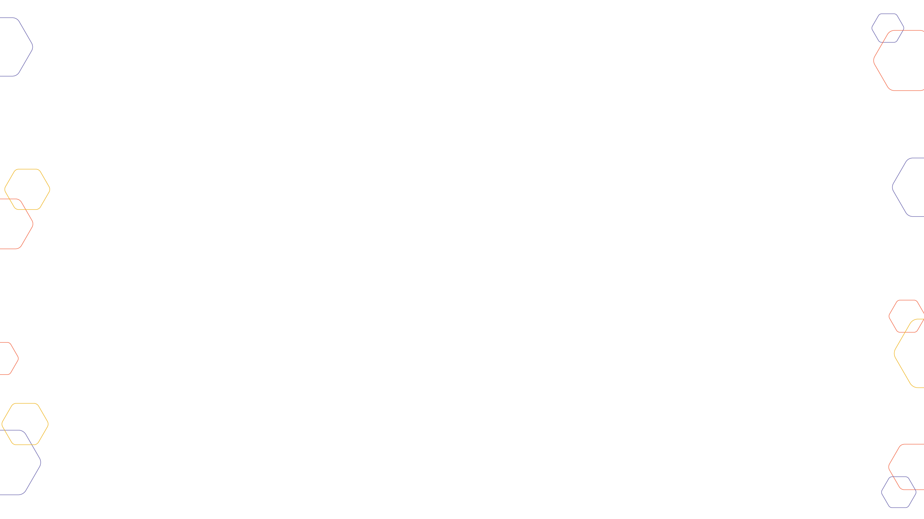
Research Findings
Notes:
Let’s start with the research findings!
In this section we will
discuss what the facilitation techniques are,
Share broadly how facilitators used them, and then
Take a look closer look at some of the specific techniques in relation to our research findings.

Slide 3
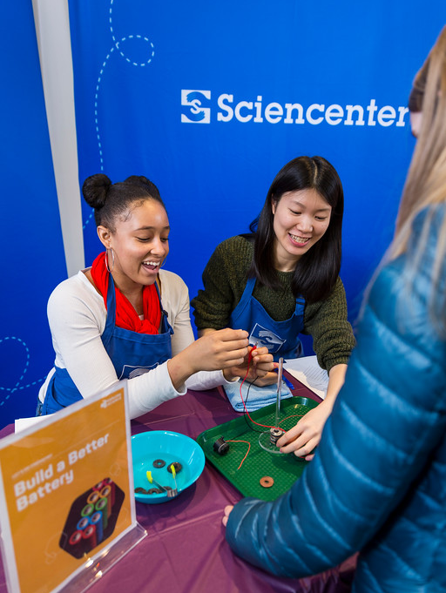
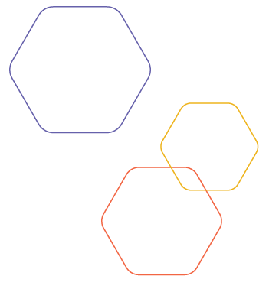
Facilitation Findings
Developing a
Framework
Discussed and refined educator-described facilitation techniques
Reviewed relevant existing informal and formal facilitation frameworks
Adapted the Exploratorium’s Facilitation Field Guide
Analyzed video recordings of facilitator interactions with visitors
Notes:
Before we talk about what we learned about facilitation, we want to share how we developed this facilitation framework.
We took a multi-step approach to understanding and sharing the facilitation techniques that led to successful interactions with visitors.
[ANIMATE – Appear] 1.) Initially, we had conversations with the educators about the facilitation techniques they were using and why, and then further refined these as a project team.
[ANIMATE – Appear] 2.) The research team reviewed relevant literature, looking for facilitation frameworks in both formal and informal education settings. This led us to a framework from the Exploratorium which described facilitation of tinkering or maker activities.
[ANIMATE – Appear] 3.) We modified their framework to fit the facilitated hands-on activities in the Let’s Do Chemistry kit, and primarily, we adapted the three major phases of facilitation they identified and then refined specific strategies.
[ANIMATE – Appear] 4.) To understand the facilitation techniques that educators were using as a part of the activities, we analyzed the 44 videos that we collected, focusing on what the educators said. In almost all of the video cases we looked at, visitors said that they increased in at least one of the three attitudes of interest, relevance, or self efficacy, so we feel that what we saw in our data represents successful interactions.
Exploratorium Facilitation Field Guide available here:
https://www.exploratorium.edu/sites/default/files/files/facilitation_field_guide.pdf
Photo copyright: Gary Hodges, 2018

Slide 4
Facilitation Findings
Facilitation Techniques
Invite participation includes techniques that initiate visitor engagement or participation.
Support exploration includes techniques that maintain visitor engagement in the process of participating in or “moving through” the activity.
Deepen understanding includes techniques that encourage and support meaning-making.
Notes:
From adapting the framework, we identified three main types of facilitation used by educators. These were:
[Tentative ANIMATE – Appear] Invite participation which includes those techniques that initiate visitor engagement or participation.
[Tentative ANIMATE – Appear] Support exploration which include those techniques that maintain visitor engagement in the process of participating in or “moving through” the activity.
[Tentative ANIMATE – Appear] Deepen understanding which include those techniques that encourage and support meaning-making.
Throughout this video we will use shorthand to refer to these facilitation areas by calling them Invite, Support, or Deepen.

Slide 5
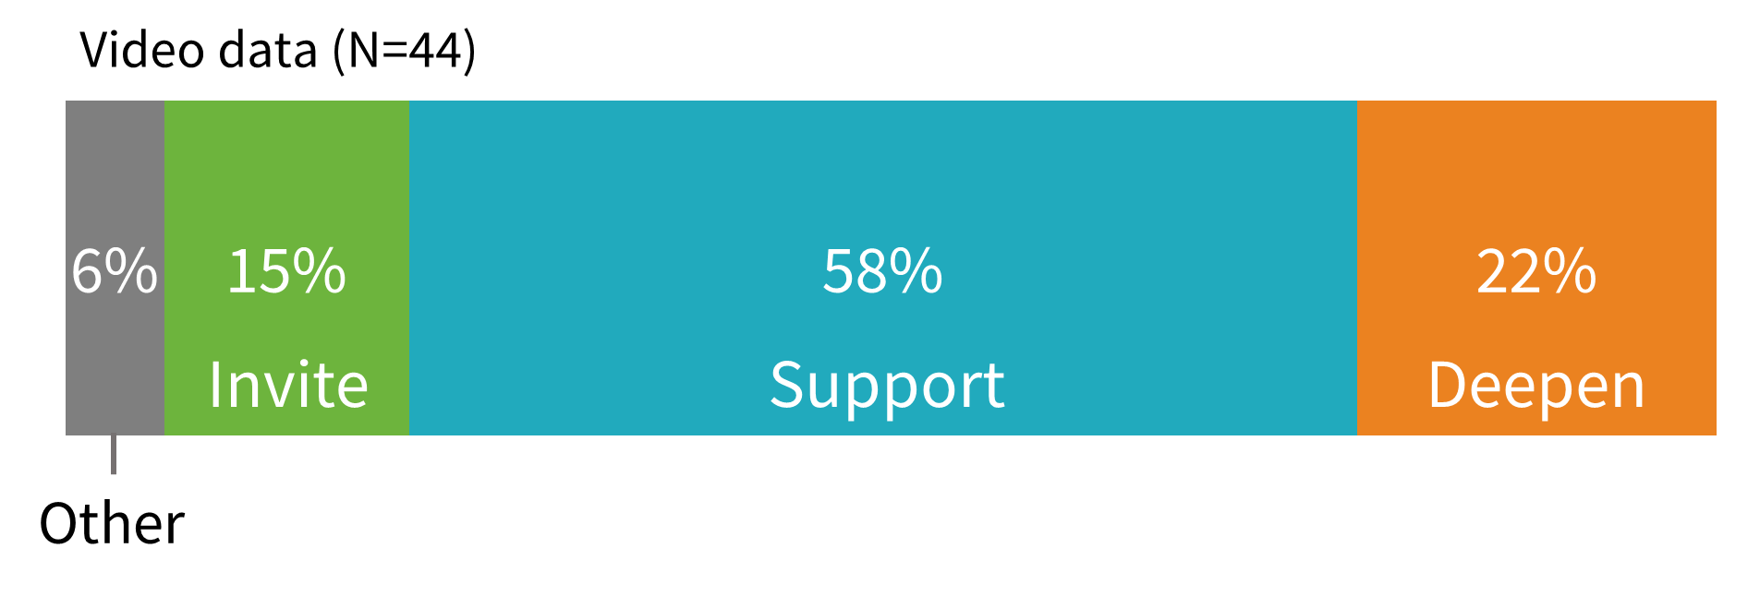
Facilitation Techniques
Frequency of Facilitation Moves
Notes:
Here we are looking at how often educators used each facilitation technique, as a percentage across an interaction.
Looking across all the video data where we observed facilitators interacting with visitors using the Let’s Do Chemistry activities, we saw that facilitators spent 15% of their total interaction inviting participation, 58% of their interaction supporting exploration, and 22% deepening understanding.
Note: “other” facilitation primarily included interactions unrelated to the activity, such as managing microphones during data collection or interacting with other visitors. This category occasionally also included something that couldn’t be defined as Invite, Support, or Deepen.
However, just seeing how frequently the facilitation moves were being used doesn’t show us the whole picture, and one might have assumed that they were being used in a linear fashion with a facilitator starting with invite, moving to support, and ending with deepen.

Slide 6

Facilitation Techniques
Distribution of Facilitation Moves
 | Invite participation
 | Support exploration
 | Deepen understanding
 | Other
Notes:
But, facilitator interactions were not linear, as we have represented in this graphic.
Here we are looking at an overview of all the cases we looked at, don’t worry about picking apart each column, this is a big picture view of the facilitation across all of the videos
Ultimately we coded 44 cases for the three facilitation techniques, as well as allowing for an “other” category.
Each column in this graphic represents an educator interacting with a visitor group during an activity, and each row represents a different facilitator move during an activity.
For each activity we tested, all of our data comes from the same educator, and are represented here by clusters of 3 to 4 columns.
For example, columns 4-6 are from the same activity Build a Battery and the three columns furthest to the right are from What’s in the Water. And
As you can see, even for the same activities with the same educators, the columns still show a lot of variety in how they were facilitated.
This graphic, as we mentioned when introducing it, indicates that facilitator interactions were not linear. You can see this because inviting participation—pictured in green--did not always occur at the beginning of the activity
Rather, it occurred at multiple points in the activity in most cases
The same is true for supporting exploration and deepening understanding
These facilitation moves also occurred throughout the activity
Although they often occurred around each other
Not only was there a lot of variation for when and how facilitators were using the techniques, we also saw variation around how long an interaction might be or how much a facilitator talked during an experience.
These data indicate that facilitators are moving through these techniques continuously during an experience to support visitors’ needs and extend their learning and experiences.
Note: 43 videos were coded, which represented 44 visitor groups/cases. In one video, the facilitator interacted with two groups, both of whom completed an interview after using the activity.

Slide 7
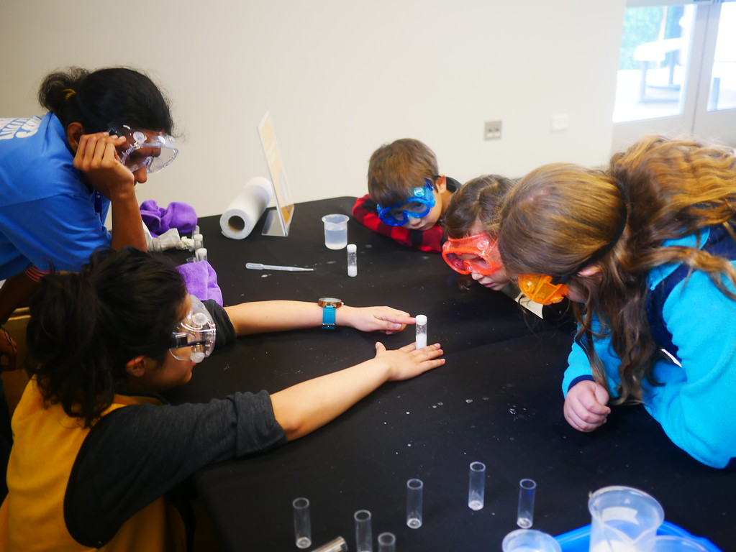
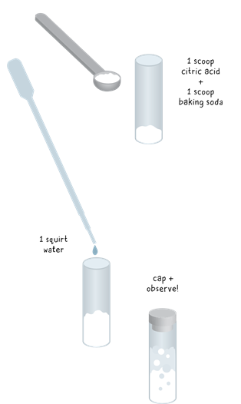
Facilitation Techniques
Research Example: Rocket Reactions
Notes:
To understand how a facilitator might combine the techniques that we have just discussed, we are going to share a short interaction from our research. This example from Rocket Reactions emphasizes the non-linear aspect of facilitation and represents a portion of the activity experience.
Rocket Reactions is an activity that invites visitors to explore the reaction between an acid and base. They test different ways of mixing baking soda, citric acid, and water in a capsule, trying to get the reaction to build enough pressure in the capsule for the cap to pop off.
Photo copyright: Children’s Creativity Museum, 2018
Image copyright: Emily Maletz for the NISE Network, 2018

Slide 8
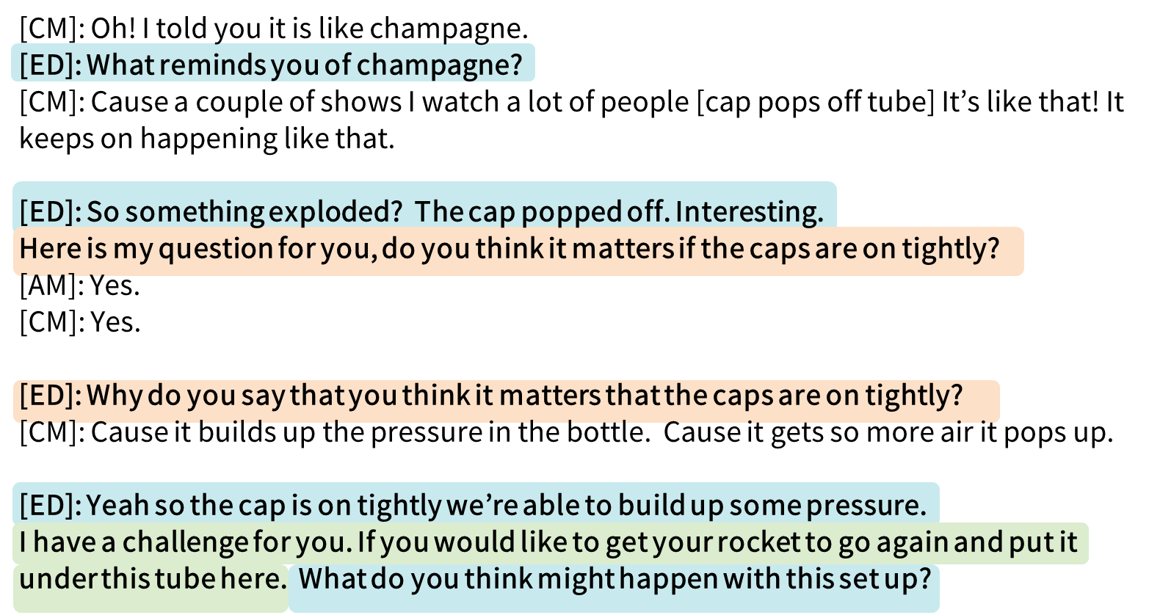
Facilitation Techniques
Research Example: Rocket Reactions
Notes:
We’re jumping into this activity after the visitors have been experimenting with the reaction for a little while. This is just a tiny portion of the activity, the whole interaction is displayed in the bar on the left and we're looking at the little section in the black box.
Here the educator is using Support techniques while they are responding to the visitors comments and asking about their observations saying "what reminds you of champagne?" And "so something exploded? the cap popped off, interesting"
The educator prompts the visitor to explain what they think is happening, to deepen understanding, by saying "here is my question for you, do you think it matters if the caps are on tightly?" And then "Why do you say that you think it matters that the caps are on tightly?"
After confirming what the visitor said by repeating it back, saying "yeah, so the cap is on tightly we're able to build some pressure", the educator invites them to pursue another challenge ("I have a challenge for you. If you would like to get your rocket to go again and put it under this tube here") and then uses a support technique in asking them to start making predictions, "what do you think might happen with this setup?"
As you can see, there is a lot of moving back and forth between the techniques, not only in this particular moment but in the whole interaction that is vizualized on the left.
Keep in mind that facilitators need to be flexible to the particulars needs of the participants they are interacting with, so there is variation between interactions even with the same facilitator and activity and this is just one example that we saw during our research!

Slide 9
Facilitation Techniques
General Facilitation Findings
Facilitators will use techniques from all three areas - inviting participation, supporting exploration, and deepening understanding - but will most often be supporting exploration
Facilitation during these activities is non-linear, and facilitators often flip back and forth between support exploration and deepen understanding techniques
Facilitators should be prepared to adjust how they interact and be flexible with each group
Notes:
To summarize, we saw that during an interaction, facilitators will use techniques from all three areas - inviting participation, supporting exploration, and deepening understanding - but will most often be supporting exploration
We also saw that facilitation is a non-linear experience, and that facilitators often flipped back and forth between support and deepen techniques.
Based on what we saw, facilitators should be prepared to adjust what they are doing at an activity with each visitor and be flexible with each group.
Note: All but one group had an increase in at least one area (I/R/S), with the vast majority having in increase in two or more areas.

Slide 10
Facilitation Descriptions
Notes:
Now that you have a sense of what facilitation might look like across an activity, we will look more closely at some of the techniques in each of the three overarching facilitation areas of invite, support, and deepen.
In our research, we studied what facilitators said during interactions with visitors. We dove deeper by focusing on the video data from visitors who reported increased interest, relevance, or self-efficacy in order to refine our understanding of what educators said when facilitating successful interactions
Since the techniques are used in a variety of combinations and rely on many factors related to the facilitator, participant, and the activity, these data do not always allow us to directly connect the techniques to a specific attitude. However, the research indicates that these techniques generally support the three attitudes because they were present or prevalent in the cases with increased interest, relevant, and/or self-efficacy.

Slide 11
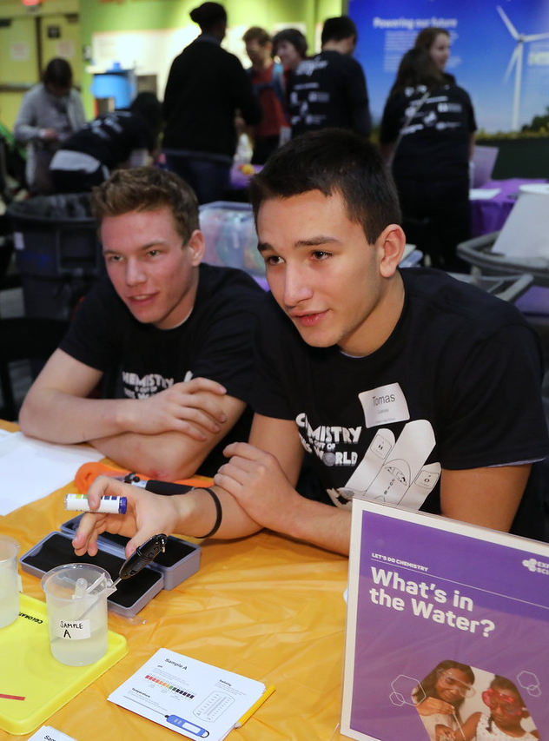
Facilitation Findings
Facilitation
Descriptions
In this section
Facilitation technique descriptions
Findings related to specific techniques
Example quotes
Notes:
In this section, we will show the range of facilitation techniques we saw in each area. But we are going to spend time highlighting the patterns and findings related to the main ones used by educators, and illustrate these findings with example quotes.
Because we don't have time to review every facilitation technique in detail during the video, we wanted to remind you that you can read about all of them in the Appendix of your participant packet. The packet includes the complete list with example quotes from real interactions between educators and visitors.
Photo copyright: Eric Workman, 2018

Slide 12
Facilitation Techniques
Invite Participation
Invite Participation Facilitation Techniques
Provide an introduction or activity overview
Introduce and model tools
Build rapport with participants
Learn what people have experienced or know about chemistry
Encourage everyone to participate
Aid in transitions between different portions of an activity
Encourage visitors to stay, but give them the option to stop
Techniques that initiate visitor engagement or participation
Notes:
Invite participation includes techniques that initiate visitor engagement or participation.
Among the specific techniques that were used to invite participation, we saw facilitators
Providing an introduction or broad instructions to the activity
Introducing and modeling tools
Building rapport
Learning about visitors' prior knowledge and experience
Encouraging engagement of all group members
Transitioning between sections of the activity
And encouragin particpants to keep exploring as well as the option to stop
Across the many interactions where visitors reported increased interest, relevance, or self-efficacy, we saw that the invite participation techniques used by facilitators varied widely,
Overall, we saw that facilitators were using Invite moves for about 15% of their total interaction, so they used any individual technique at most a few times.

Slide 13
Facilitation Techniques
Invite Participation
Facilitators should always provide an introduction or activity overview
Invite Participation Facilitation Techniques
Provide an introduction or activity overview
Introduce and model tools
Build rapport with participants
Learn what people have experienced or know about chemistry
Encourage everyone to participate
Aid in transitions between different portions of an activity
Encourage visitors to stay, but give them the option to stop
“So what we are doing today, we are thinking about water quality and some of the ways that we can test water quality. And we have a bunch of different chemical tests that we can perform. So we have four different options for you today.” – What’s in the Water
Notes:
While we found that the invite techniques varied by educator and visitor group, the educators always provided an introduction or activity overview.
One example of this is from the What’s in the Water activity and is up on the screen
Here the facilitator is introducing the main topics in the activity, when she says “what we are doing today, we are thinking about water quality and some of the ways that we can test water quality.“
Then she indicates what they will be doing by saying “And we have a bunch of different chemical tests that we can perform.”
And she introduces the options they have for the activity.

Slide 14
Facilitation Techniques
Invite Participation
Discussion about visitors’ prior experiences and knowledge may be helpful to increasing relevance and self-efficacy in visitors
Invite Participation Facilitation Techniques
Provide an introduction or activity overview
Introduce and model tools
Build rapport with participants
Learn what people have experienced or know about chemistry
Encourage everyone to participate
Aid in transitions between different portions of an activity
Encourage visitors to stay, but give them the option to stop
“When you think about chemistry, what kind of things come to mind?” – Molecules in Motion
Notes:
In cases where visitors reported having increased feelings of relevance or self-efficacy,
we saw that it may be helpful for facilitators to find out what visitors already know about chemistry or what kinds of chemistry experiences they have had in the past.
Like this example, where the facilitator asks “When you think about chemistry what kind of things come to mind?”

Slide 15
Facilitation Techniques
Support Exploration
Support Exploration Facilitation Techniques
Offer positive feedback
Provide basic information and vocabulary
Give step-by-step instructions
Ask participants to make observations and predictions
Encourage iteration and continued experimentation
Techniques that maintain visitor engagement in the process of participating in or “moving through” the activity
Notes:
Supporting exploration strategies are those that help guide a visitor through the activity.
Thinking back to that first graph, we saw that facilitators were most often supporting exploration, with 58% of moves falling in the support area during an interaction
So they used all of these individual techniques a fair amount.
This includes specific strategies such as
Offering positive reinforcement to visitors
Giving them basic information or vocabulary
Providing explicit instruction for aspects of the activity
Asking visitors to make observations and predictions
And encouraging iteration or experimentation

Slide 16
Facilitation Techniques
Support Exploration
Support Exploration Facilitation Techniques
Offer positive feedback
Provide basic information and vocabulary
Give step-by-step instructions
Ask participants to make observations and predictions
Encourage iteration and continued experimentation
The most common facilitation technique was offering positive feedback
“You’re right, let’s keep going” – Build a Battery
Notes:
Overall, we found that all of the techniques were used pretty regularly by facilitators, but that providing positive reinforcement was the most common.
This ranged from simple positive feedback, such as “alright,” “nice,” “good job,” to a facilitator more directly saying something like what is seen in the example, where the educator says, “You’re right, let’s keep going”

Slide 17
Facilitation Techniques
Support Exploration
Support Exploration Facilitation Techniques
Offer positive feedback
Provide basic information and vocabulary
Give step-by-step instructions
Ask participants to make observations and predictions
Encourage iteration and continued experimentation
Generally using supporting exploration moves may increase visitor self-efficacy
Notes:
We found a positive relationship between how frequently a facilitator used supporting exploration techniques and visitor ratings of self-efficacy,
although we did not see any specific techniques that seemed to support self-efficacy better than others
Rather we saw that a facilitator using an overall higher proportion of these strategies during an interaction likely contributed to increased feelings of self-efficacy on the part of the visitor.

Slide 18
Facilitation Techniques
Deepen Understanding
Deepen Understanding Facilitation Techniques
Describe why or how something is happening
Provide information and support making connections outside the activity
Encourage participants to apply something they learned during the activity
Encourage participants to explain why or how something is happening
Techniques that encourage and support meaning making
Notes:
Finally, deepening understanding occurs when educators encourage and support meaning-making for visitors.
This included using specific techniques like
Providing information to explain why or how something is happening or
giving supplemental information to support making connections outside of the activity
Encouraging visitors to apply something they learned
Encouraging visitors to explain why or how something is happening

Slide 19
Facilitation Techniques
Deepen Understanding
Facilitators frequently provided information and supported making connections outside the activity
Deepen Understanding Facilitation Techniques
Describe why or how something is happening
Provide information and support making connections outside the activity
Encourage participants to apply something they learned during the activity
Encourage participants to explain why or how something is happening
“Artists can use this if they're gonna take an old painting and [try] to recreate it, they can take little pieces of the paint and do chromatography to them to figure out exactly what mixture they were.” – Chemistry is Colorful
Notes:
What we saw in this area was that educators most commonly used the technique of providing supplemental information and supporting connections outside the activity,
as is seen here in the Chemistry is Colorful activity where the facilitator shared an example from a real-work application of chromatography in art – saying "“artists can use this if they're gonna take an old painting and [try] to recreate it, they can take little pieces of the paint and do chromatography to them to figure out exactly what mixture they were.”

Slide 20
Facilitation Techniques
Deepen Understanding
Deepening understanding techniques of either describing why or how something is happening or providing information that supports making connections outside the activity may be especially helpful for relevance
Deepen Understanding Facilitation Techniques
Describe why or how something is happening
Provide information and support making connections outside the activity
Encourage participants to apply something they learned during the activity
Encourage participants to explain why or how something is happening
"The air actually has a volume and because it has a volume and takes up space - if you push it on something it actually pushes on things. You can’t see the air, but we can see some of the things that it’s doing.” - Molecules in Motion
Notes:
When looking more closely at the chemistry attitudes, we saw that providing supplemental information in some form seems to particularly support visitors' increased feelings of relevance.
We saw that either of the deepen categories highlighted on the screen were helpful, so that could be either describing why or how something is happening, or providing additional information and supporting making connections
As in this example, where a facilitator says "The air actually has a volume and because it has a volume and takes up space - if you push it on something it actually pushes on things. You can’t see the air, but we can see some of the things that it’s doing.”

Slide 21
Facilitation Techniques
Deepen Understanding
Deepen Understanding Facilitation Techniques
Describe why or how something is happening
Provide information and support making connections outside the activity
Encourage participants to apply something they learned during the activity
Encourage participants to explain why or how something is happening
Encouraging participants to explain why or how something is happening may increase visitor self-efficacy
“So you used the words pressure before. What do you think could be happening in your tube right now?” – Rocket Reactions
Notes:
We also learned that having the visitor explain why or how something is happening may increase visitors’ feelings of self efficacy,
Like in this example where the facilitator asks, “What do you think could be happening in your tube right now?” to prompt the visitor to try and explain what they are seeing.

Slide 22
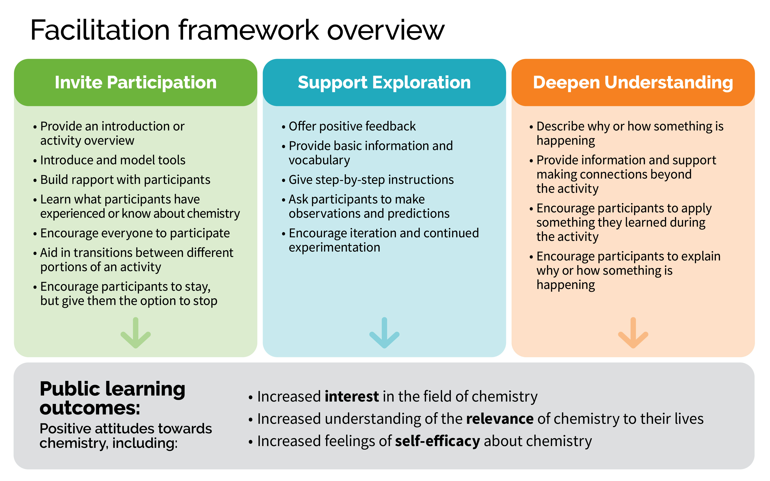
Notes:
As we previewed in the welcome video, this is our final theoretical framework for facilitation.
Overall, we saw that facilitation was complicated and while there are some pieces that might better support interest, relevance, or self-efficacy than others, generally using these techniques supported positive attitudes towards chemistry

Slide 23
Facilitation Findings
Important Strategies
Facilitators always provided an introduction or activity overview as one of their invite participation techniques
The most common support engagement technique was offering positive feedback
As part of deepen engagement, facilitators frequently provided information and supported making connections outside the activity
Notes:
Before we end, I want to review the big pieces that you should take away from all of this information.
These are the strategies that occurred consistently throughout all the cases and are probably good to consider or include with any experience
As you can see on the screen, these important strategies were
Always including an introduction or activity overview
Frequently using positive feedback
And making sure to provide information and support making connections outside the activity.

Slide 24
Facilitation Findings
Connections to Relevance and Self-efficacy
Deepening understanding techniques of either describing why or how something is happening or providing information that supports making connections outside the activity may be especially helpful for relevance
Generally using supporting exploration moves may increase visitor self-efficacy. This attitude may also be supported by the deepening understanding technique of encouraging participants to explain why or how something is happening
Discussion about visitors’ prior experiences and knowledge may also be helpful to increasing relevance and self-efficacy
Notes:
And as we have shown, some of our data allowed us to make connections to two of our attitudes around chemistry, specifically relevance and self-efficacy.
Our data suggest that deepen moves may increase feelings that chemistry is relevant, and that providing supplemental information is especially helpful.
In terms of self-efficacy, we saw that generally using any of the support moves may increase visitors feelings of self-efficacy, but also the specific deepen technique of encouraging participants to explain why or how something is happening.
For both relevance and self-efficacy, having discussions about visitors’ prior experiences may be helpful for increasing these attitudes, possibly because that helps the facilitator better tailor the activity to the visitor.
While we saw that visitors had an increased interest in chemistry in many cases, there were not clear patterns about what might have supported these increases. Interest didn’t seem as directly connected to facilitation, and may be more dependent on design strategies that we discussed in Modules 2 and 3 related to content and format.

Slide 25
Applying the Research
Notes:
My name is Patti and I am a practitioner with the Let’s Do Chemistry project. I have been incorporating the design and facilitation frameworks into the hands-on activities that I develop for chemists to use in schools, science centers, and public spaces.
In my mind, the format strategies look like the doing part of an activity, while the content strategies sound like the saying part of an activity. The facilitation techniques provide a structure for me to weave the format and content through to create a conversation that is responsive to each group of participants. I encourage you to think about the strategies and techniques and how they work together in a way that makes sense for you.

Slide 26
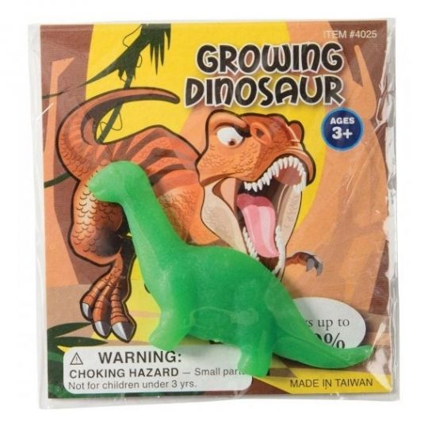
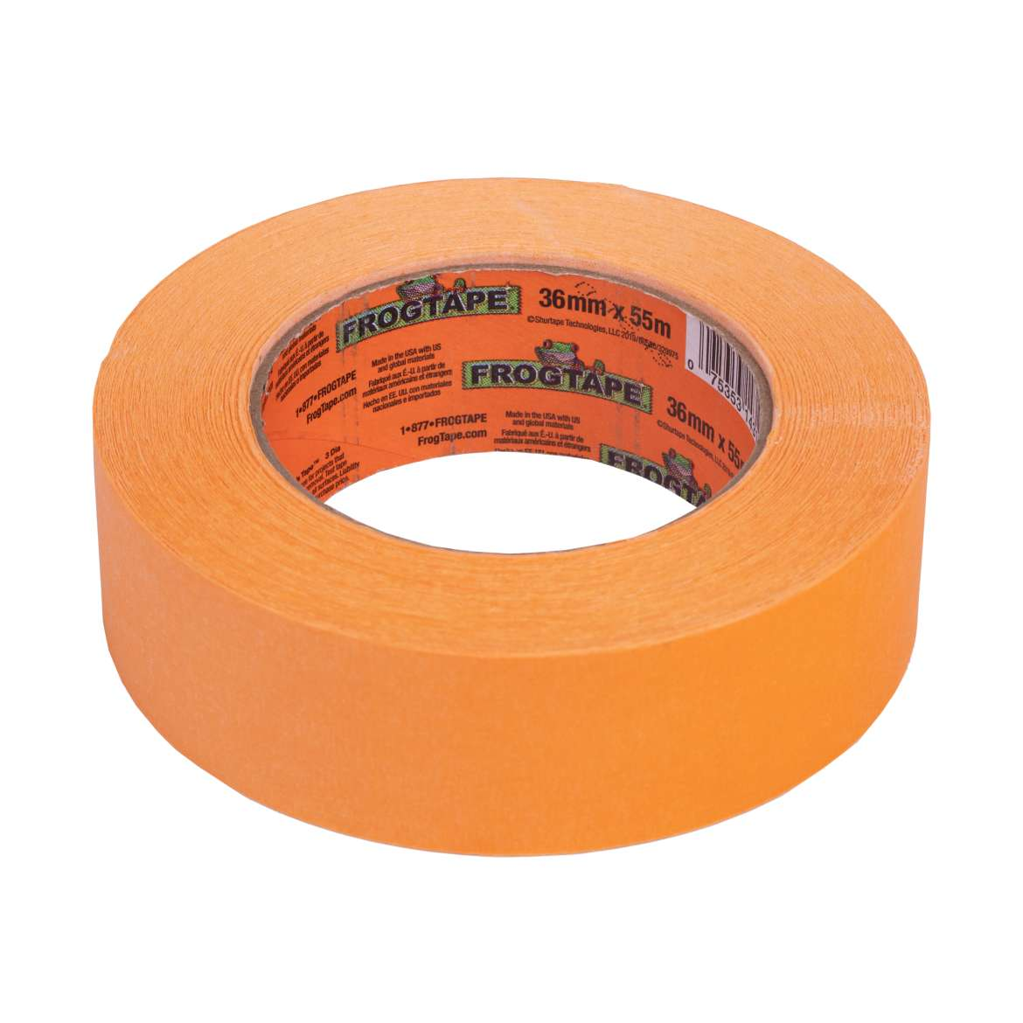
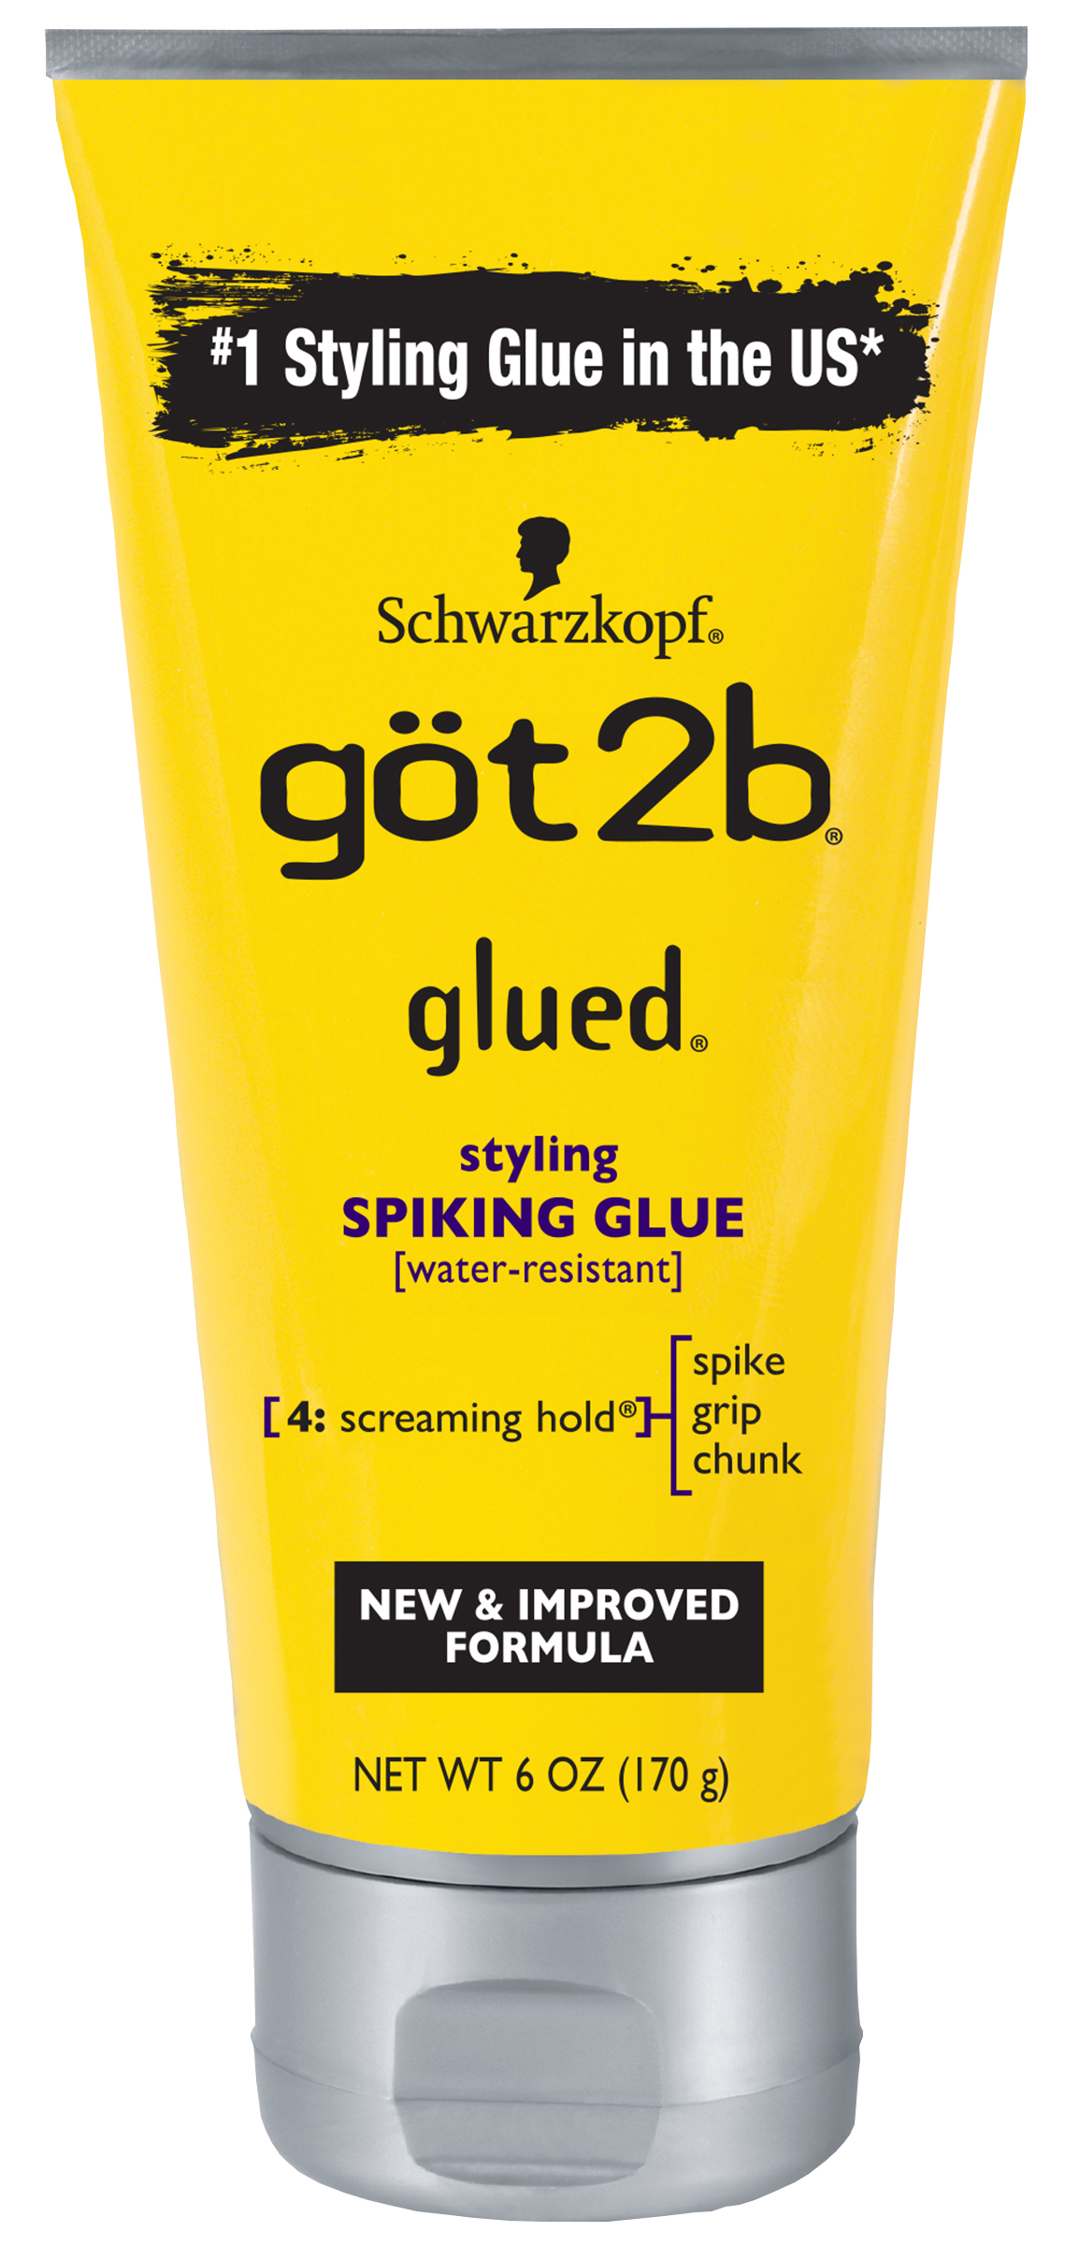
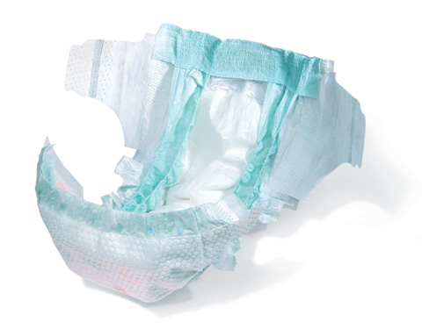
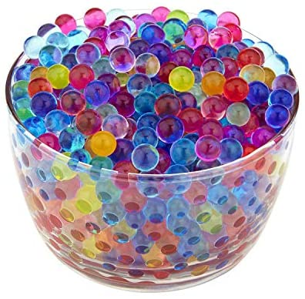
Facilitation Techniques
Invite Participation
Notes:
Let’s look at the sodium polyacrylate activity one last time.
The facilitation techniques grouped under Invite Participation help answer the question, “How will I encourage people to stop what they are doing, choose to participate in this hands-on activity, and stick with it?”
In the activity write-ups, I started providing guidance about setting the table so that it’s visually appealing and is easy to manage the materials. For the sodium polyacrylate activity, we have a few diapers and many colorful Growing Dinosaurs on the table along with “hands-on stations” defined by separate trays. I make it clear that there is something to do here. Just like plates on a table, each tray signals that there is space for one person to work.
I also give facilitators an idea of what they can say to introduce the activity. For example, “Discover the secret science inside baby diapers!” “Find out what diapers, gel beads, and hair gel have in common!” Or “Learn the secret behind a popular magic trick!”
Image copyright: Water beads, Growing Dinosaur, Frog Tape, Hair Gel, Disposable Diaper

Slide 27
Facilitation Techniques
Invite Participation
Invite Participation Facilitation Techniques
Provide an introduction or activity overview
Introduce and model tools
Build rapport with participants
Learn what people have experienced or know about chemistry
Encourage everyone to participate
Aid in transitions between different portions of an activity
Encourage visitors to stay, but give them the option to stop
Notes:
The sodium polyacrylate activity has different sections. Use the Invite Participation techniques to help participants transition through the different sections. Participants might be inclined to leave during these shifts in focus. Always encourage them to stay, but if they are finished with the activity, allow them to leave. Participants should not feel trapped. It is ok if they want to do something else before you get to the end of what you want to say to them.
The research team found that activity facilitators always provided an introduction or activity overview. This could be something like, “All of these items contain a super absorbing polymer like this one right here. Find out what happens to this special polymer when you add water!”
Practice something to say for each of the invite participation strategies. There is no need to use all of these during every single presentation. Practicing will help get the right words on the tip of your tongue so that they are ready when the time is right. Practice makes BETTER!
Image copyright: Water beads, Growing Dinosaur, Frog Tape, Hair Gel, Disposable Diaper

Slide 28
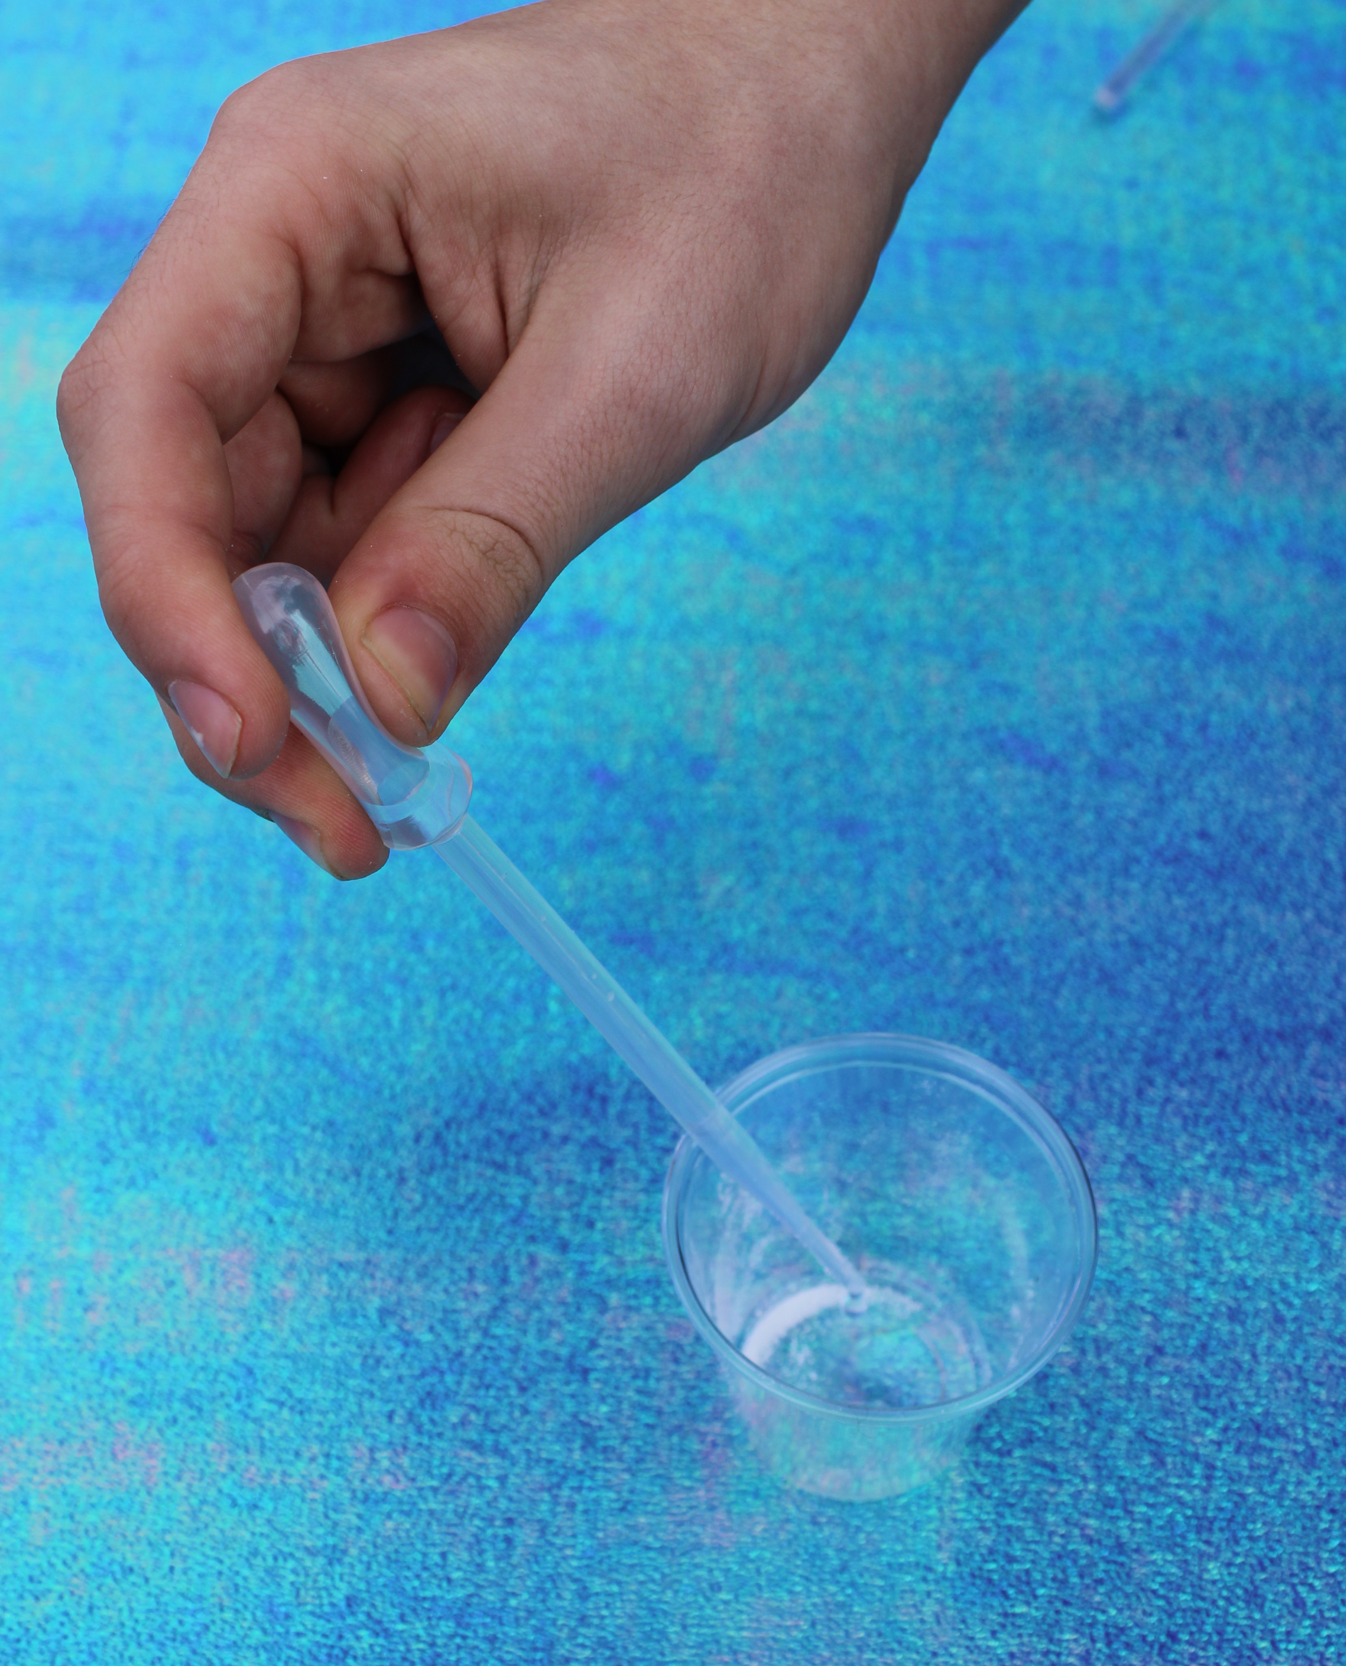
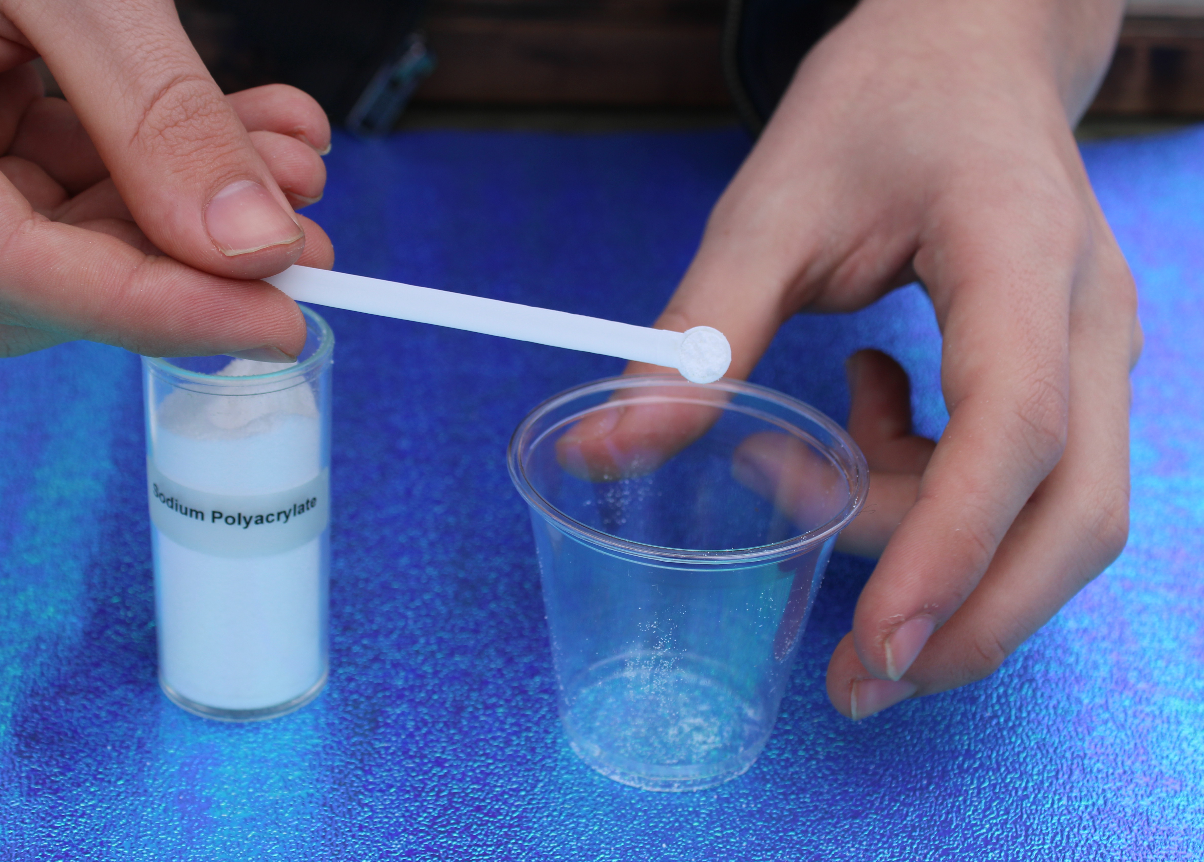
Facilitation Techniques
Support Exploration
Support Exploration Facilitation Techniques
Offer positive feedback
Provide basic information and vocabulary
Give step-by-step instructions
Ask participants to make observations and predictions
Encourage iteration and continued experimentation
Notes:
The role of the facilitator is to support learners as they take on the role of scientist. Help participants know when they are on the right track! People are more likely to take on a new role or try something new if they feel that they can be successful. Saying “Good job,” is validating. Even more validating is specific praise. For example, “You really know how to use a dropper. You must have done chemistry before!” Praise good ideas, keen observation skills, insights, and understandings.
The basic information and vocabulary you choose depends on the individual participants and what you choose to emphasize with them. Participants have different life experiences, so follow their lead and build on their ideas as you support their exploration.
Also, prepare questions you can ask to encourage thinking and steer the conversation in the direction you intend. For example, “I wonder if this polymer could absorb another pipet full of water. What do you think?” What do you notice about the polymer now? What do you think might happen if you turn the cup upside down?
Photo copyright: Patti Galvan, 2020, Falls Church VA

Slide 29
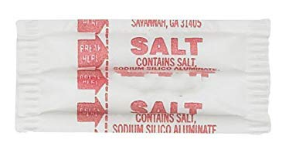
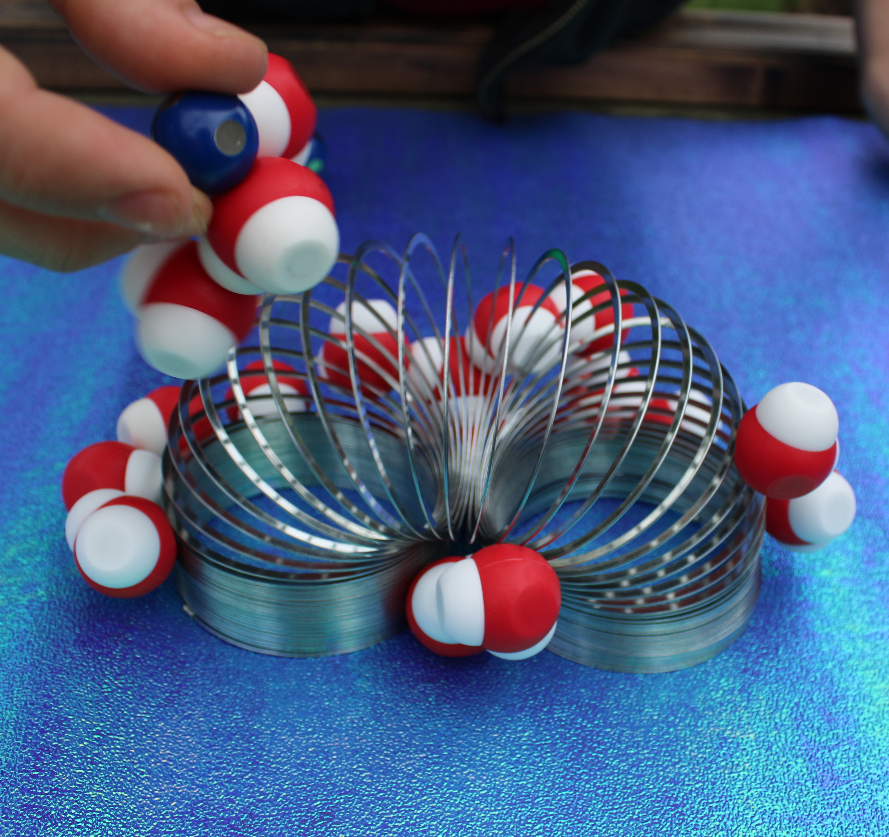
Facilitation Techniques
Deepen Understanding
Deepen Understanding Facilitation Techniques
Describe why or how something is happening
Provide information and support making connections outside the activity
Encourage participants to apply something they learned during the activity
Encourage participants to explain why or how something is happening
Notes:
In the Deepen Understanding phase of a facilitated hands-on activity, you may provide information and support making connections outside the activity. You may also encourage participants to apply the information or explain it.
For example, you could explain that the slinky is like the baby diaper polymer. “It is made of many very long and coiled molecules. These red and white pieces represent water molecules. What do you notice about them? (They stick together in clumps.) What do you think will happen when you put these water molecules near the slinky? How is this like the water and polymer in your cup? “
The thing that I like best about this part of the activity is that participants gain enough information to make an informed prediction about what might happen when they add salt. They can explain that water molecules are pulled away from the sodium polyacrylate by the salt pieces. I admit that sometimes I get over-excited about the chemistry happening and can’t stop talking about it, but this doesn’t do anything to promote positive attitudes about chemistry. I have noticed that participants politely wait for a time when they can escape. Participants will feel more successful doing chemistry if they can explain it.
Photo copyright: Patti Galvan, 2020, Falls Church VA

Slide 30
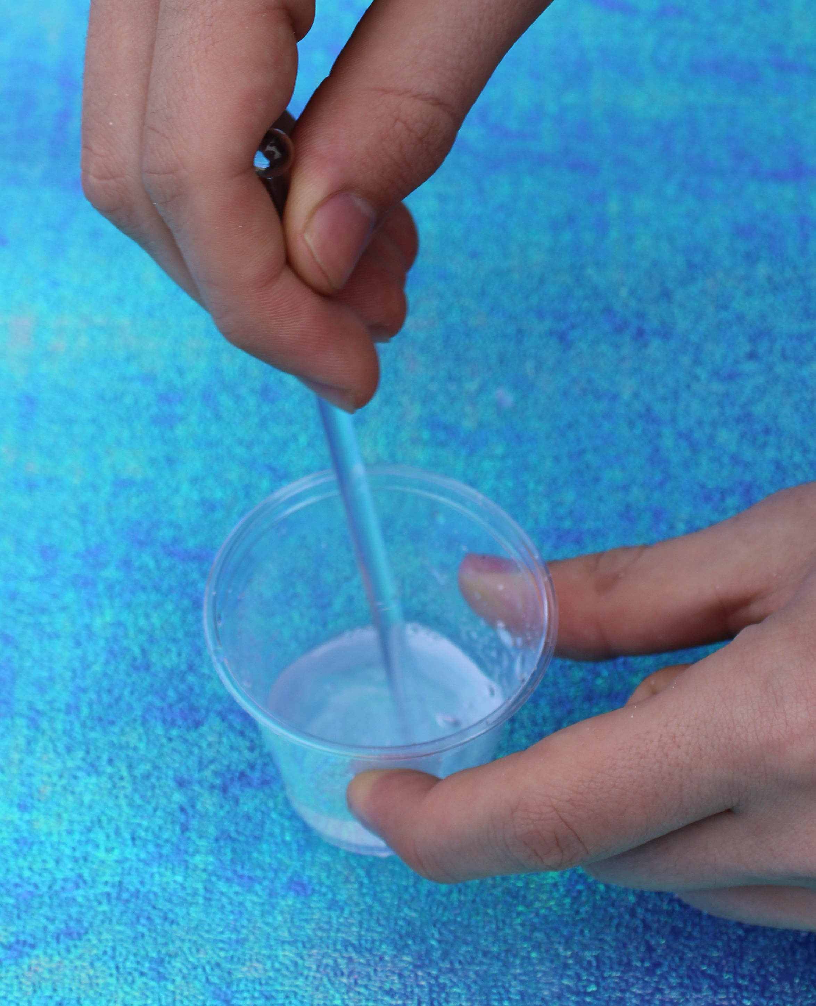

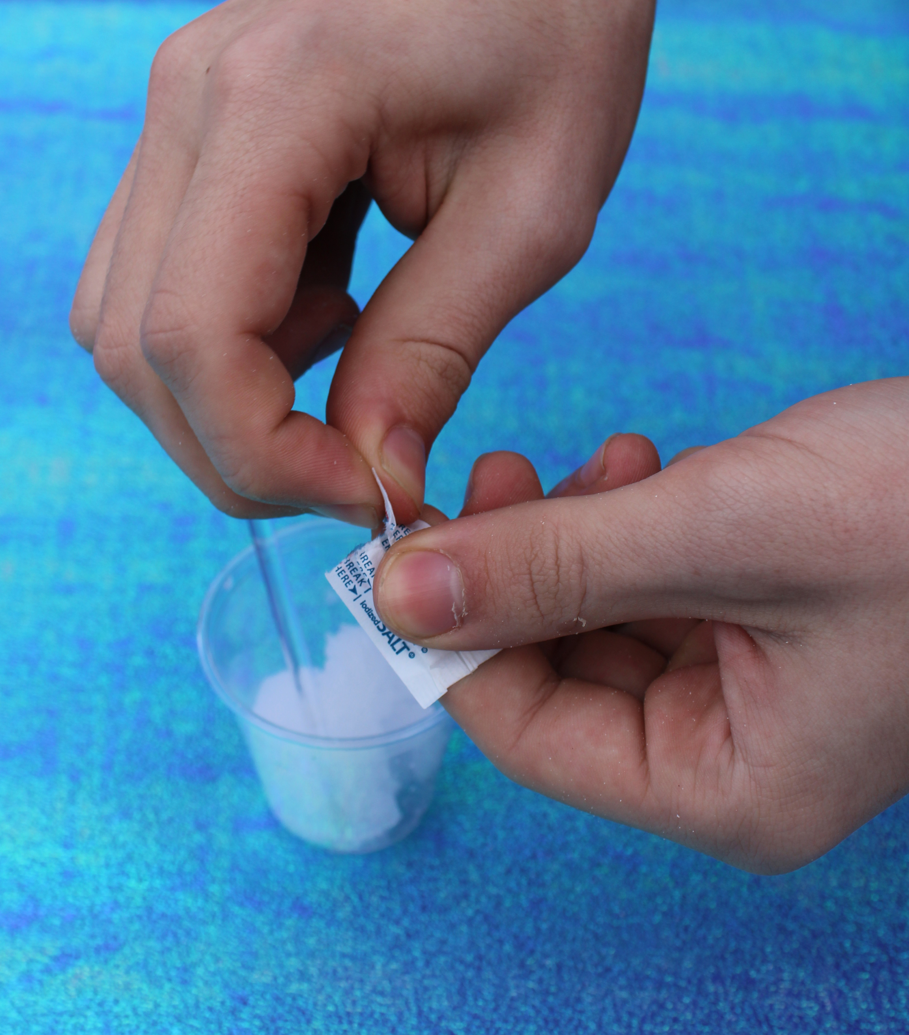
Facilitation Techniques
Support Exploration
Support Exploration Facilitation Techniques
Offer positive feedback
Provide basic information and vocabulary
Give step-by-step instructions
Ask participants to make observations and predictions
Encourage iteration and continued experimentation
Notes:
Interestingly, this activity does not end by deepening understanding, it ends with more exploration. Invite participation again to help with this transition in the activity. If participants choose to continue, the facilitator can draw on the different supporting moves again. Participants add salt, and confirm that their prediction is correct. The water pulls away from the polymer and the mixture becomes a liquid again. To extend the exploration at home, we have paired this activity with a Growing Dinosaur and one-page activity write-up. We explain that there is a similar super absorbing polymer inside the dinosaur and a material similar to a kitchen sponge. To make the dinosaur grow as large as possible, should participants soak the dinosaur in water or saltwater? The choice is theirs! When sending items home, it is very important to include a write-up of what to do along with safety information.
Image copyright: Jim Wisniewski, 2010, Chicago Illinois

Slide 31
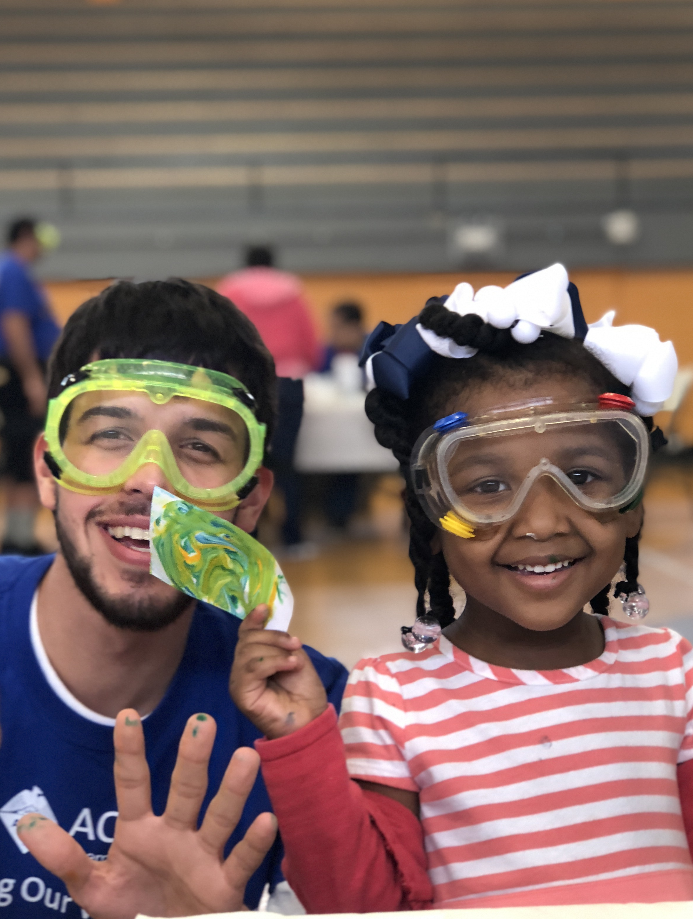
Applying the Research
Training Others
Create a positive
learning environment!
  Foster a fun experience
  Build confidence
  Share excitement
  Explore together
  Model curiosity
  Find connections
  Offer guidance
  Ask questions
Notes:
Activity facilitators may feel pressure to provide many facts and hope that something sticks. Help them realize that their role is to create a positive learning environment. This will have the best staying power. Here are good practices that activity facilitators should focus on:
Foster a fun experience
Build confidence
Share excitement
Explore alongside someone
Model scientific curiosity
Find concrete connections
Offer guidance and suggestions
Ask questions
Photo copyright: David Horwitz, 2018, New Orleans LA

Slide 32
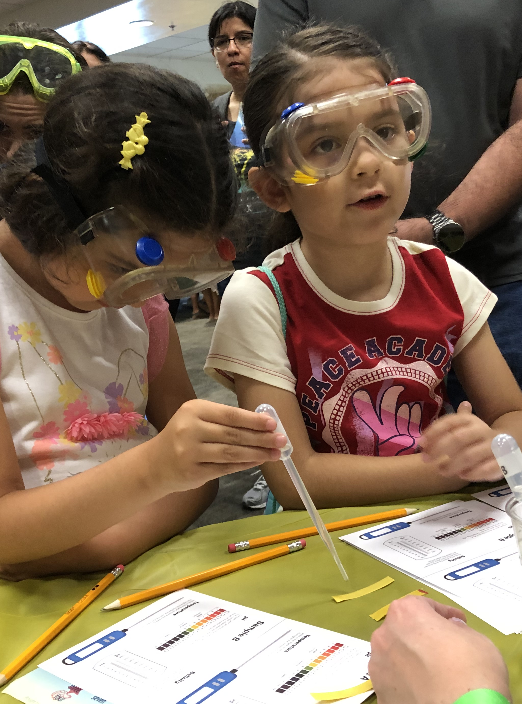
Applying the Research
Training Others
If an activity is interesting,
participants will:
  Try things out
  Observe carefully
  Experiment with variables
  Do more
Notes:
While facilitating be sure to watch for certain behaviors in participants. This is how you will know that your activity is increasing interest, relevance and self-efficacy. If participants are interested in the activity, they will
Try things out
Observe carefully
Experiment with variables
And simply want to do more
When you see these behaviors, offer positive feedback!
Photo copyright: Linda Wang, 2019, San Diego CA

Slide 33
Applying the Research
Training Others
Adjust how you…
  Present chemistry concepts
  Engage participants in hands-on
Notes:
If you do not see these behaviors, make changes immediately! You might:
Adjust how you present chemistry concepts
Adjust how you engage participants in hands-on
The more you practice, the easier it will be to go with the flow and make slight changes to optimize an activity and how you facilitate it.
Photo copyright: Linda Wang, 2019, San Diego CA

Slide 34
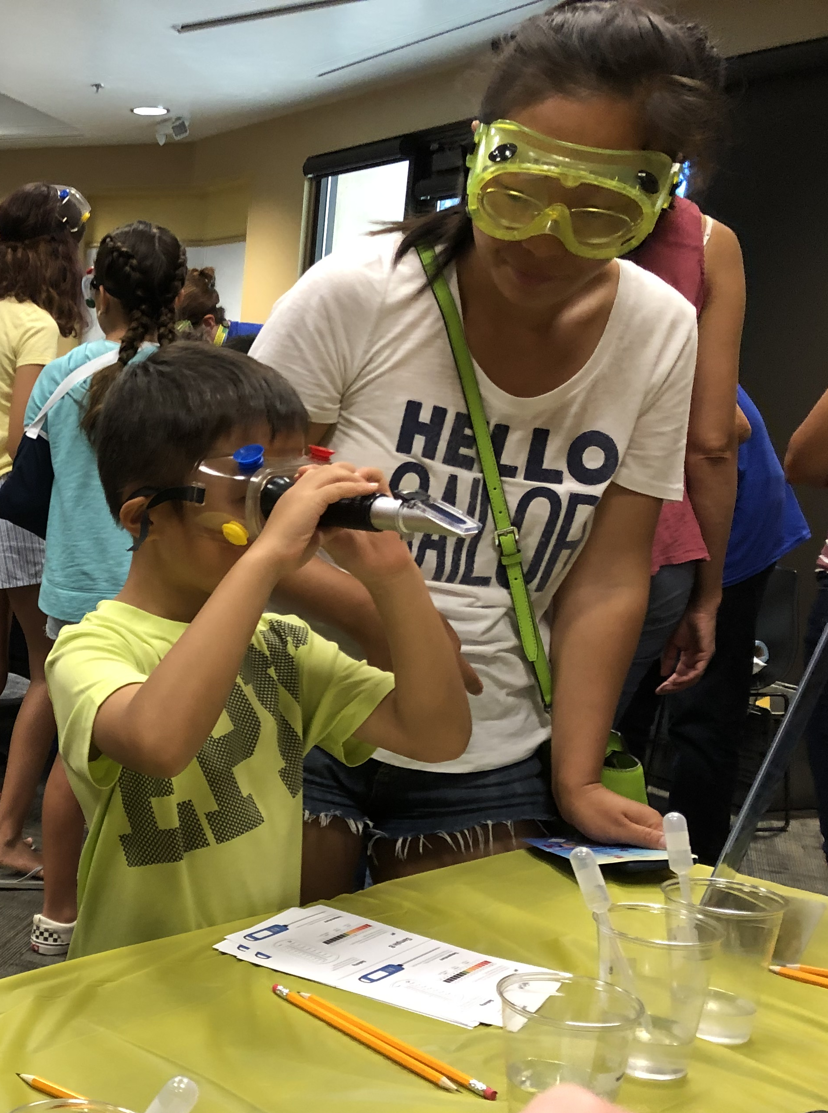
Applying the Research
Training Others
If an activity is relevant, participants will:
  Notice applications of chemistry
  Make connections to everyday life
  Talk about issues they value
  Remember familiar experiences
Notes:
If an activity is increasing feelings of relevance, participants will:
Notice applications and uses of chemistry
Make connections to everyday life
Talk about how chemistry relates to issues that are important to them
Remember familiar experiences
Photo copyright: Linda Wang, 2019, San Diego CA

Slide 35
Applying the Research
Training Others
Make changes like the following:
  Ask questions
  Make connections to everyday life
  Include familiar applications
Notes:
If you do not see these behaviors:
Ask questions to help participants recall prior experiences;
Provide examples of connections to everyday life that might resonate with the participants better; OR
Include chemistry applications to familiar items or issues that are important to participants.
Photo copyright: Linda Wang, 2019, San Diego CA

Slide 36
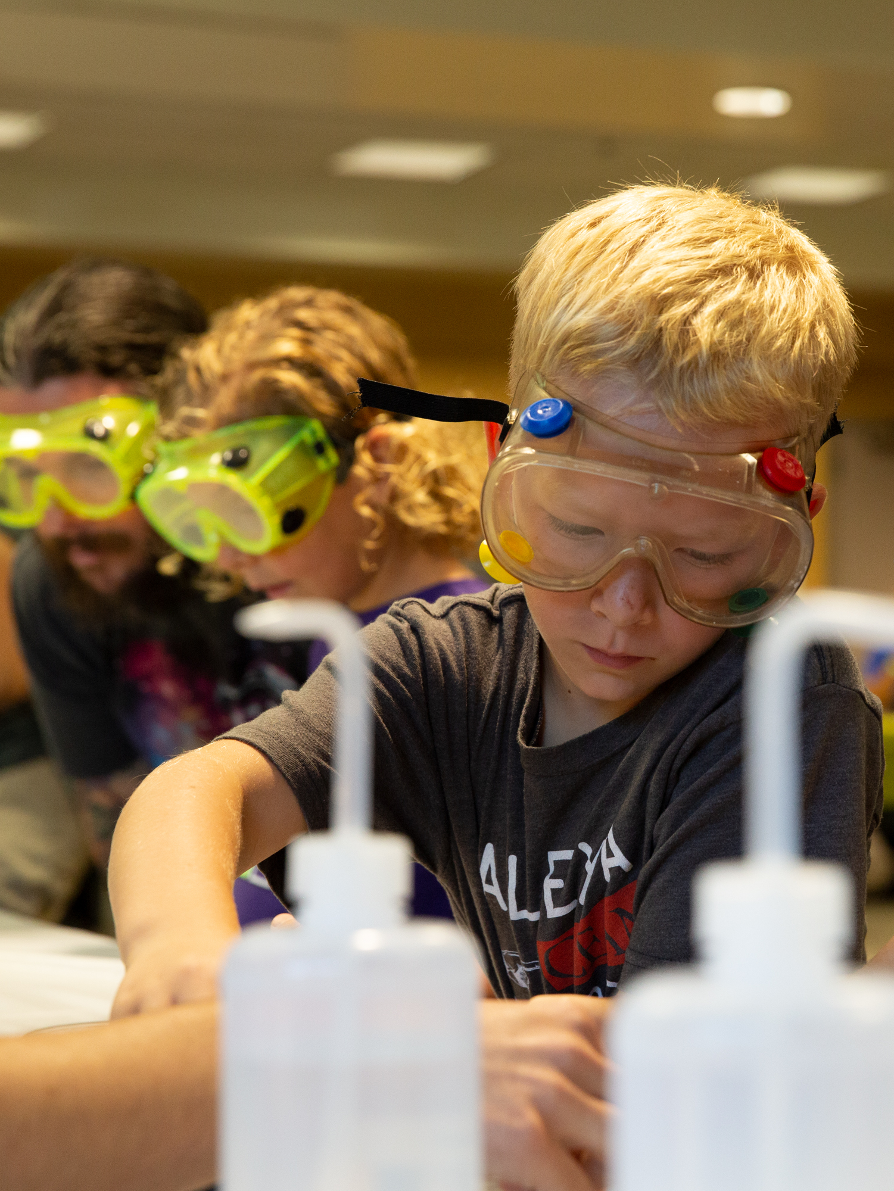
Applying the Research
Training Others
If an activity is helping learners
develop feelings of self-efficacy, participants will:
  Understand what to do
  Appear confident
  Ask questions
  Suggest things to try
  Figure things out
  Identify as someone who
  can do chemistry
Notes:
As participants develop feelings of self-efficacy, you see the following behaviors:
Participants understand what to do
They appear confident as they do the activity
They come up with their own questions or ideas of things to try
They figure things out on their own AND perhaps best of all,
They view themselves as someone who can do chemistry!
Photo copyright: Loris Guzzeta, 2019, San Diego CA

Slide 37
Applying the Research
Training Others
Ways to adjust:
  Make the activity more hands-on
  Revise instructions
  Connect what participants
  do to the content
Notes:
If you do not see these behaviors:
Make the activity more hands-on and interactive
Revise instructions so that it is easy for participants to figure out what to do
Improve the connection between what participants are doing and the main point of the activity.
Facilitators improve their own techniques and practices as they do the activities with participants. Needing to make adjustments while facilitating does not mean that you have made a mistake. It means that you are responsive to the needs of participants!
Photo copyright: Loris Guzzeta, 2019, San Diego CA

Slide 38

Applying the Research
Training Others
Positive attitudes are key to all chemistry learning!
Notes:
Keep in mind that developing positive attitudes toward learning chemistry will help participants learn concepts, practices, and other dimensions of chemistry. Positive attitudes are key to all chemistry learning!
Image copyright: ACS Chemoji, Chemical & Engineering News

Slide 39
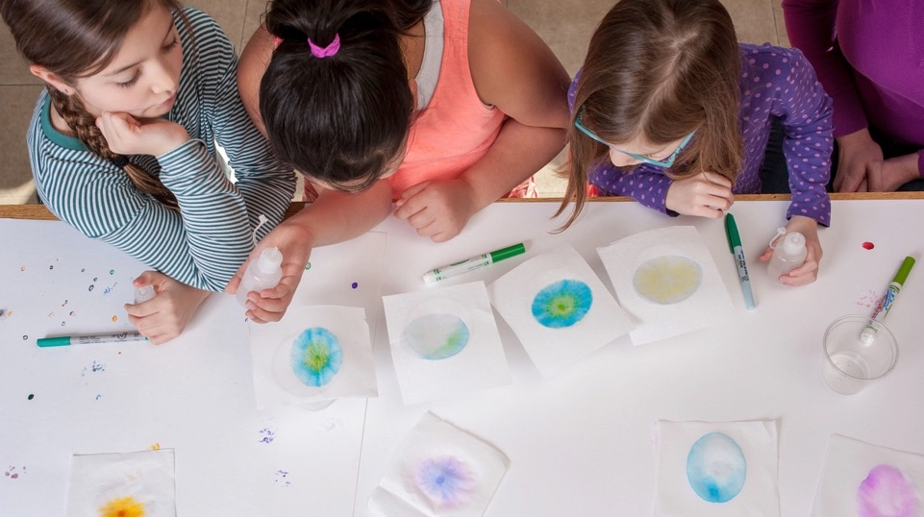


This work is supported by the National Science Foundation under award number 1612482.
Any opinions, findings, and conclusions or recommendations expressed in this presentation are those of the authors and do not necessarily reflect the views of the Foundation.
Copyright 2020, Museum of Science, Boston
Edited by Allison Anderson, Marta Beyer, Patti Galvan, and Emily Hostetler
Published under a Creative Commons Attribution-Noncommercial-Share Alike license:
http://creativecommons.org/licenses/by-nc-sa/3.0
Notes:
This work is supported by the National Science Foundation under award number 1612482. Any opinions, findings, and conclusions or recommendations expressed in this presentation are those of the authors and do not necessarily reflect the views of the Foundation.
Copyright 2020, Museum of Science, Boston
Edited by Allison Anderson, Marta Beyer, Patti Galvan, and Emily Hostetler
Published under a Creative Commons Attribution-Noncommercial-Share Alike license:
CC BY-NC-SA 3.0 creativecommons.org/licenses/by-nc-sa/3.0/us/
You are free to copy, adapt, or distribute this presentation and/or the text and images contained in it for educational, nonprofit purposes. When making copies or excerpts, please include the copyright and credit information above. If adapting the contents, the following citation is recommended:
APA 7 style: Anderson, A., Beyer, M., Galvan, P., & Hostetler, E. (2020). Let’s Do Chemistry Train-the-Trainer Workshop Module 1: Welcome [PowerPoint slides]. Museum of Science, Boston for the NISE Network.
Photo copyright: Emily Maletz for the NISE Network, 2018

Slide 40
Credits
Let’s Do Chemistry framework graphics, activity photos, and activity guide graphics by Emily Maletz for the NISE Network, 2018.
Sciencenter event photo by Gary Hodges, 2018; Rocket Reactions event photo Children’s Creativity Museum, 2018; What’s in the Water facilitator photo by Eric Workman, 2018;
Citations and image credits are included in the notes for each slide.

Slide 41
Section Header
Slide Title
Text
Text
Text
Notes:
You can use this blank, formatted slide to add content to the presentation.

Slide 42
Section Header
Slide Title
Text
Text
Text
Notes:
You can use this blank, formatted slide to add content to the presentation.

