Slide 1
Women’s Rights and Sustainability

Slide 2
What does sustainability mean to you?
Notes:
What is sustainability?

Slide 3

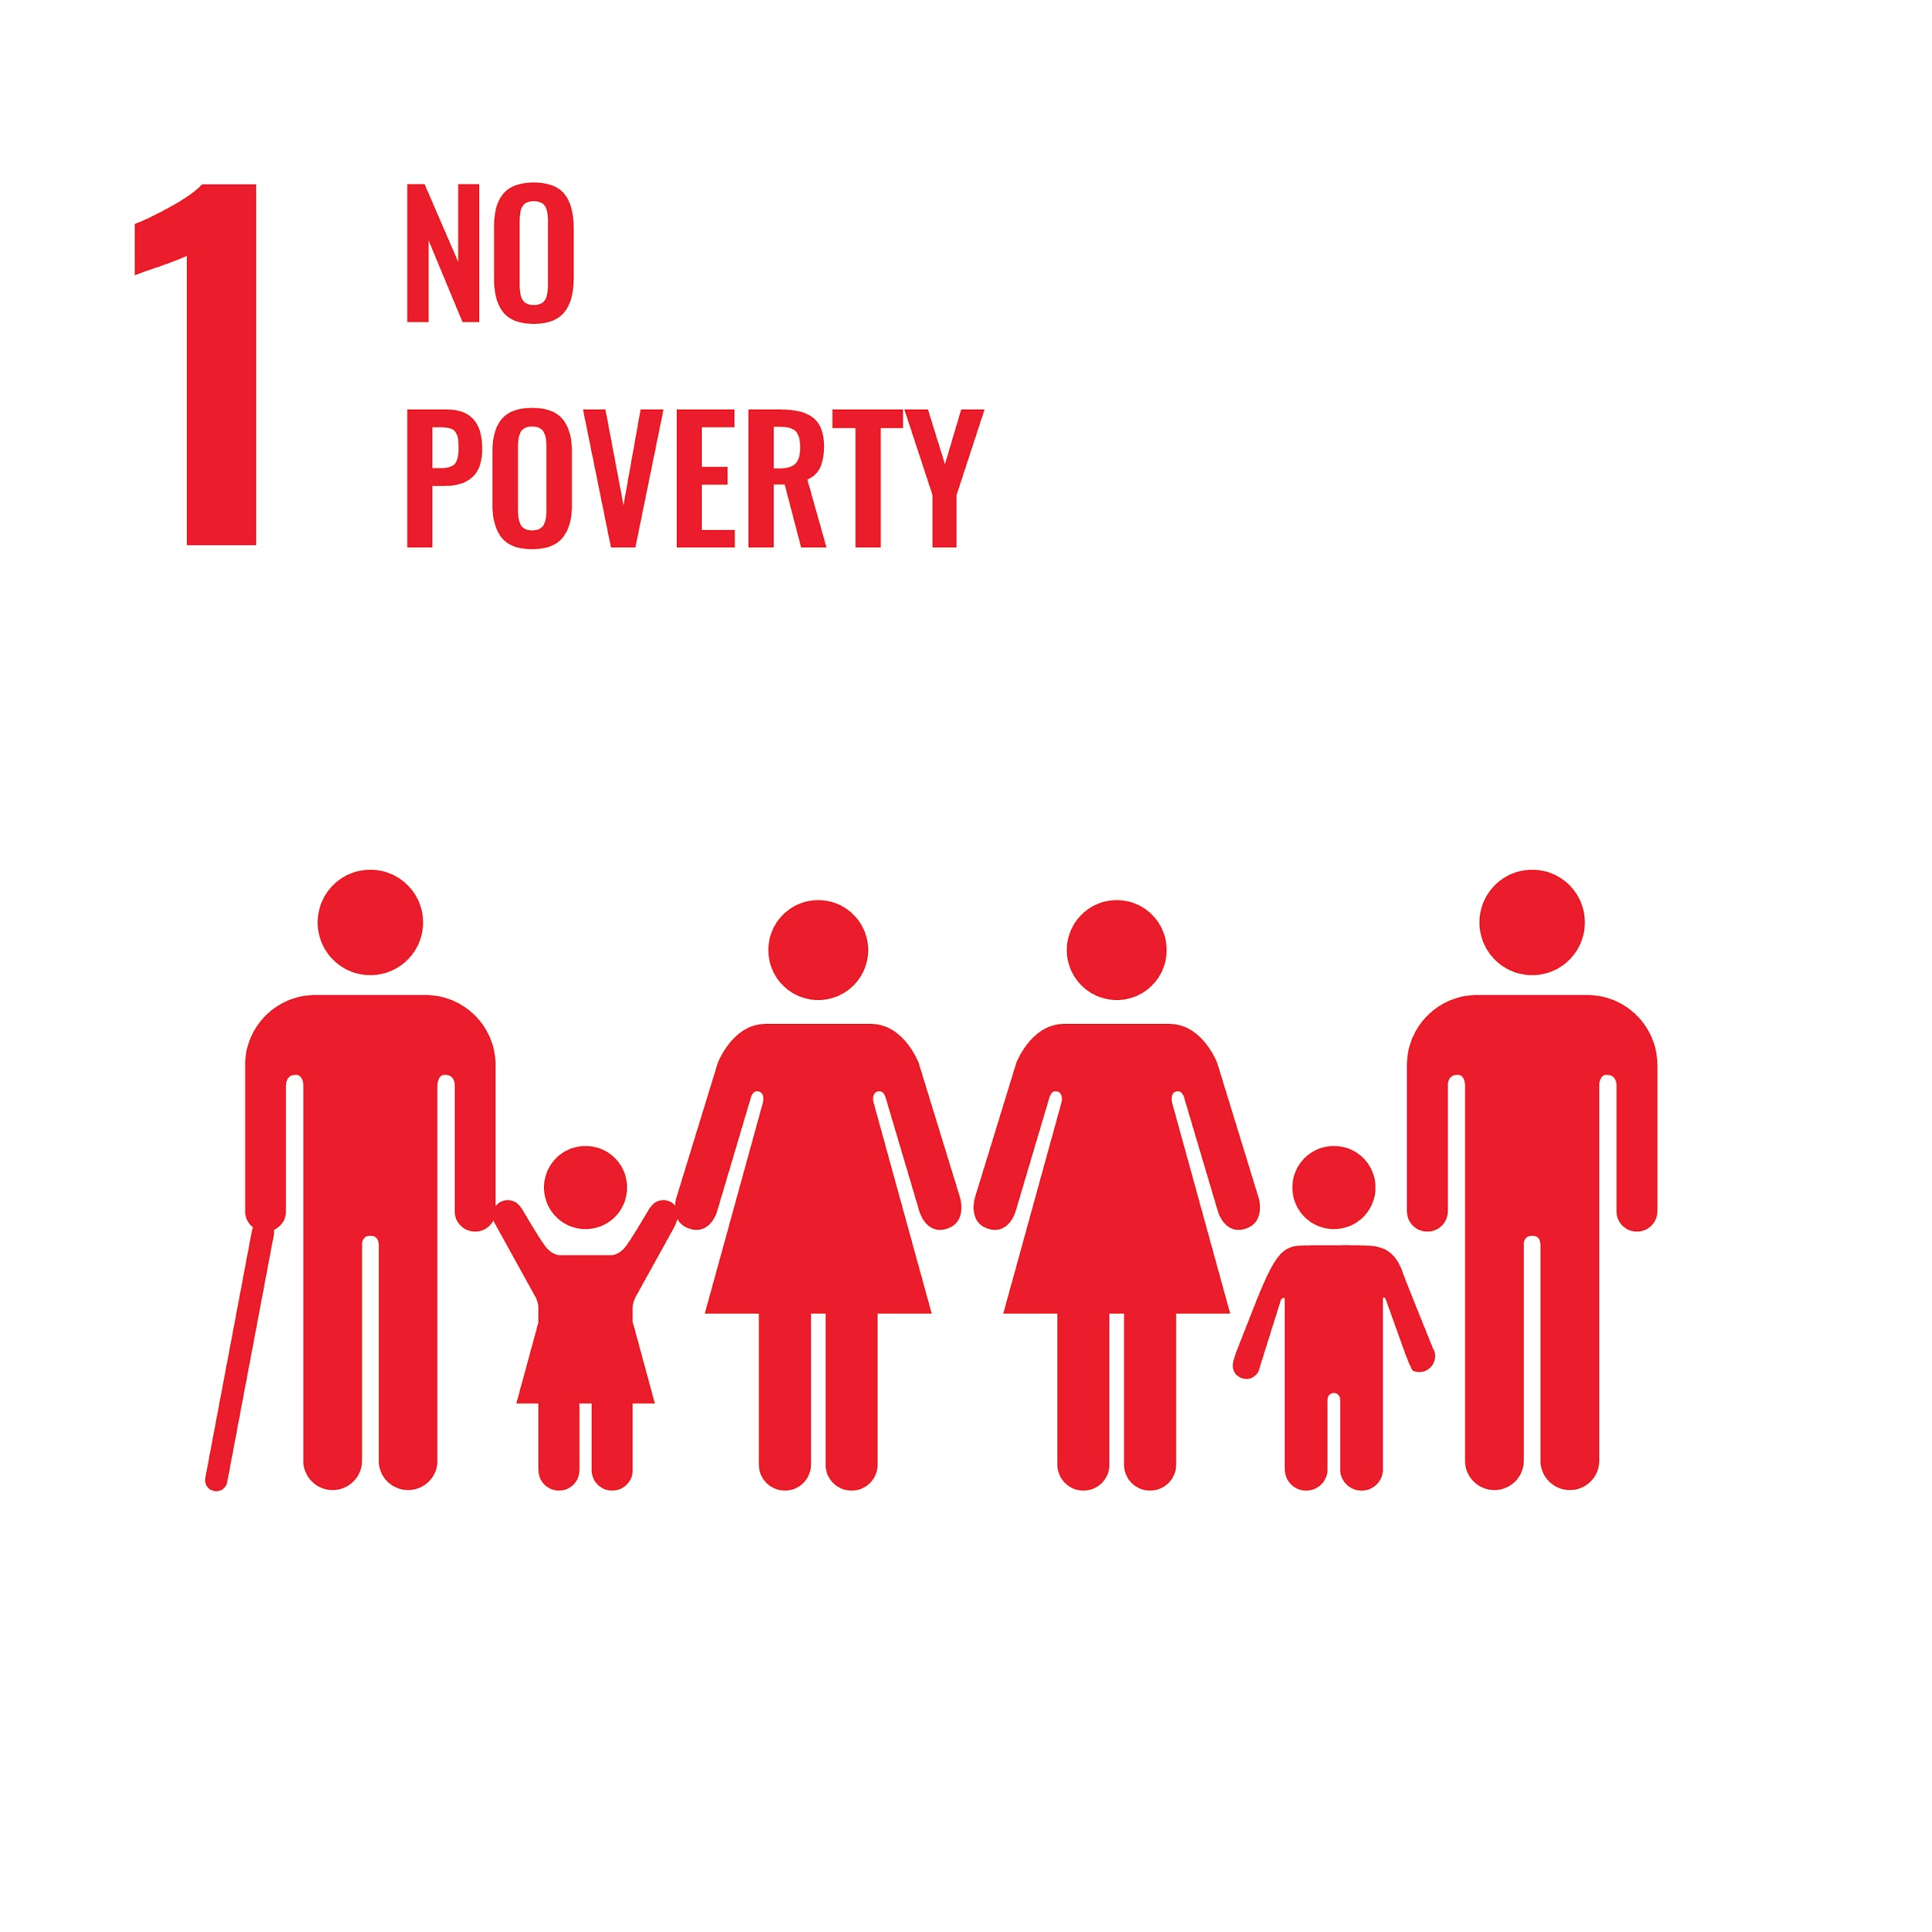
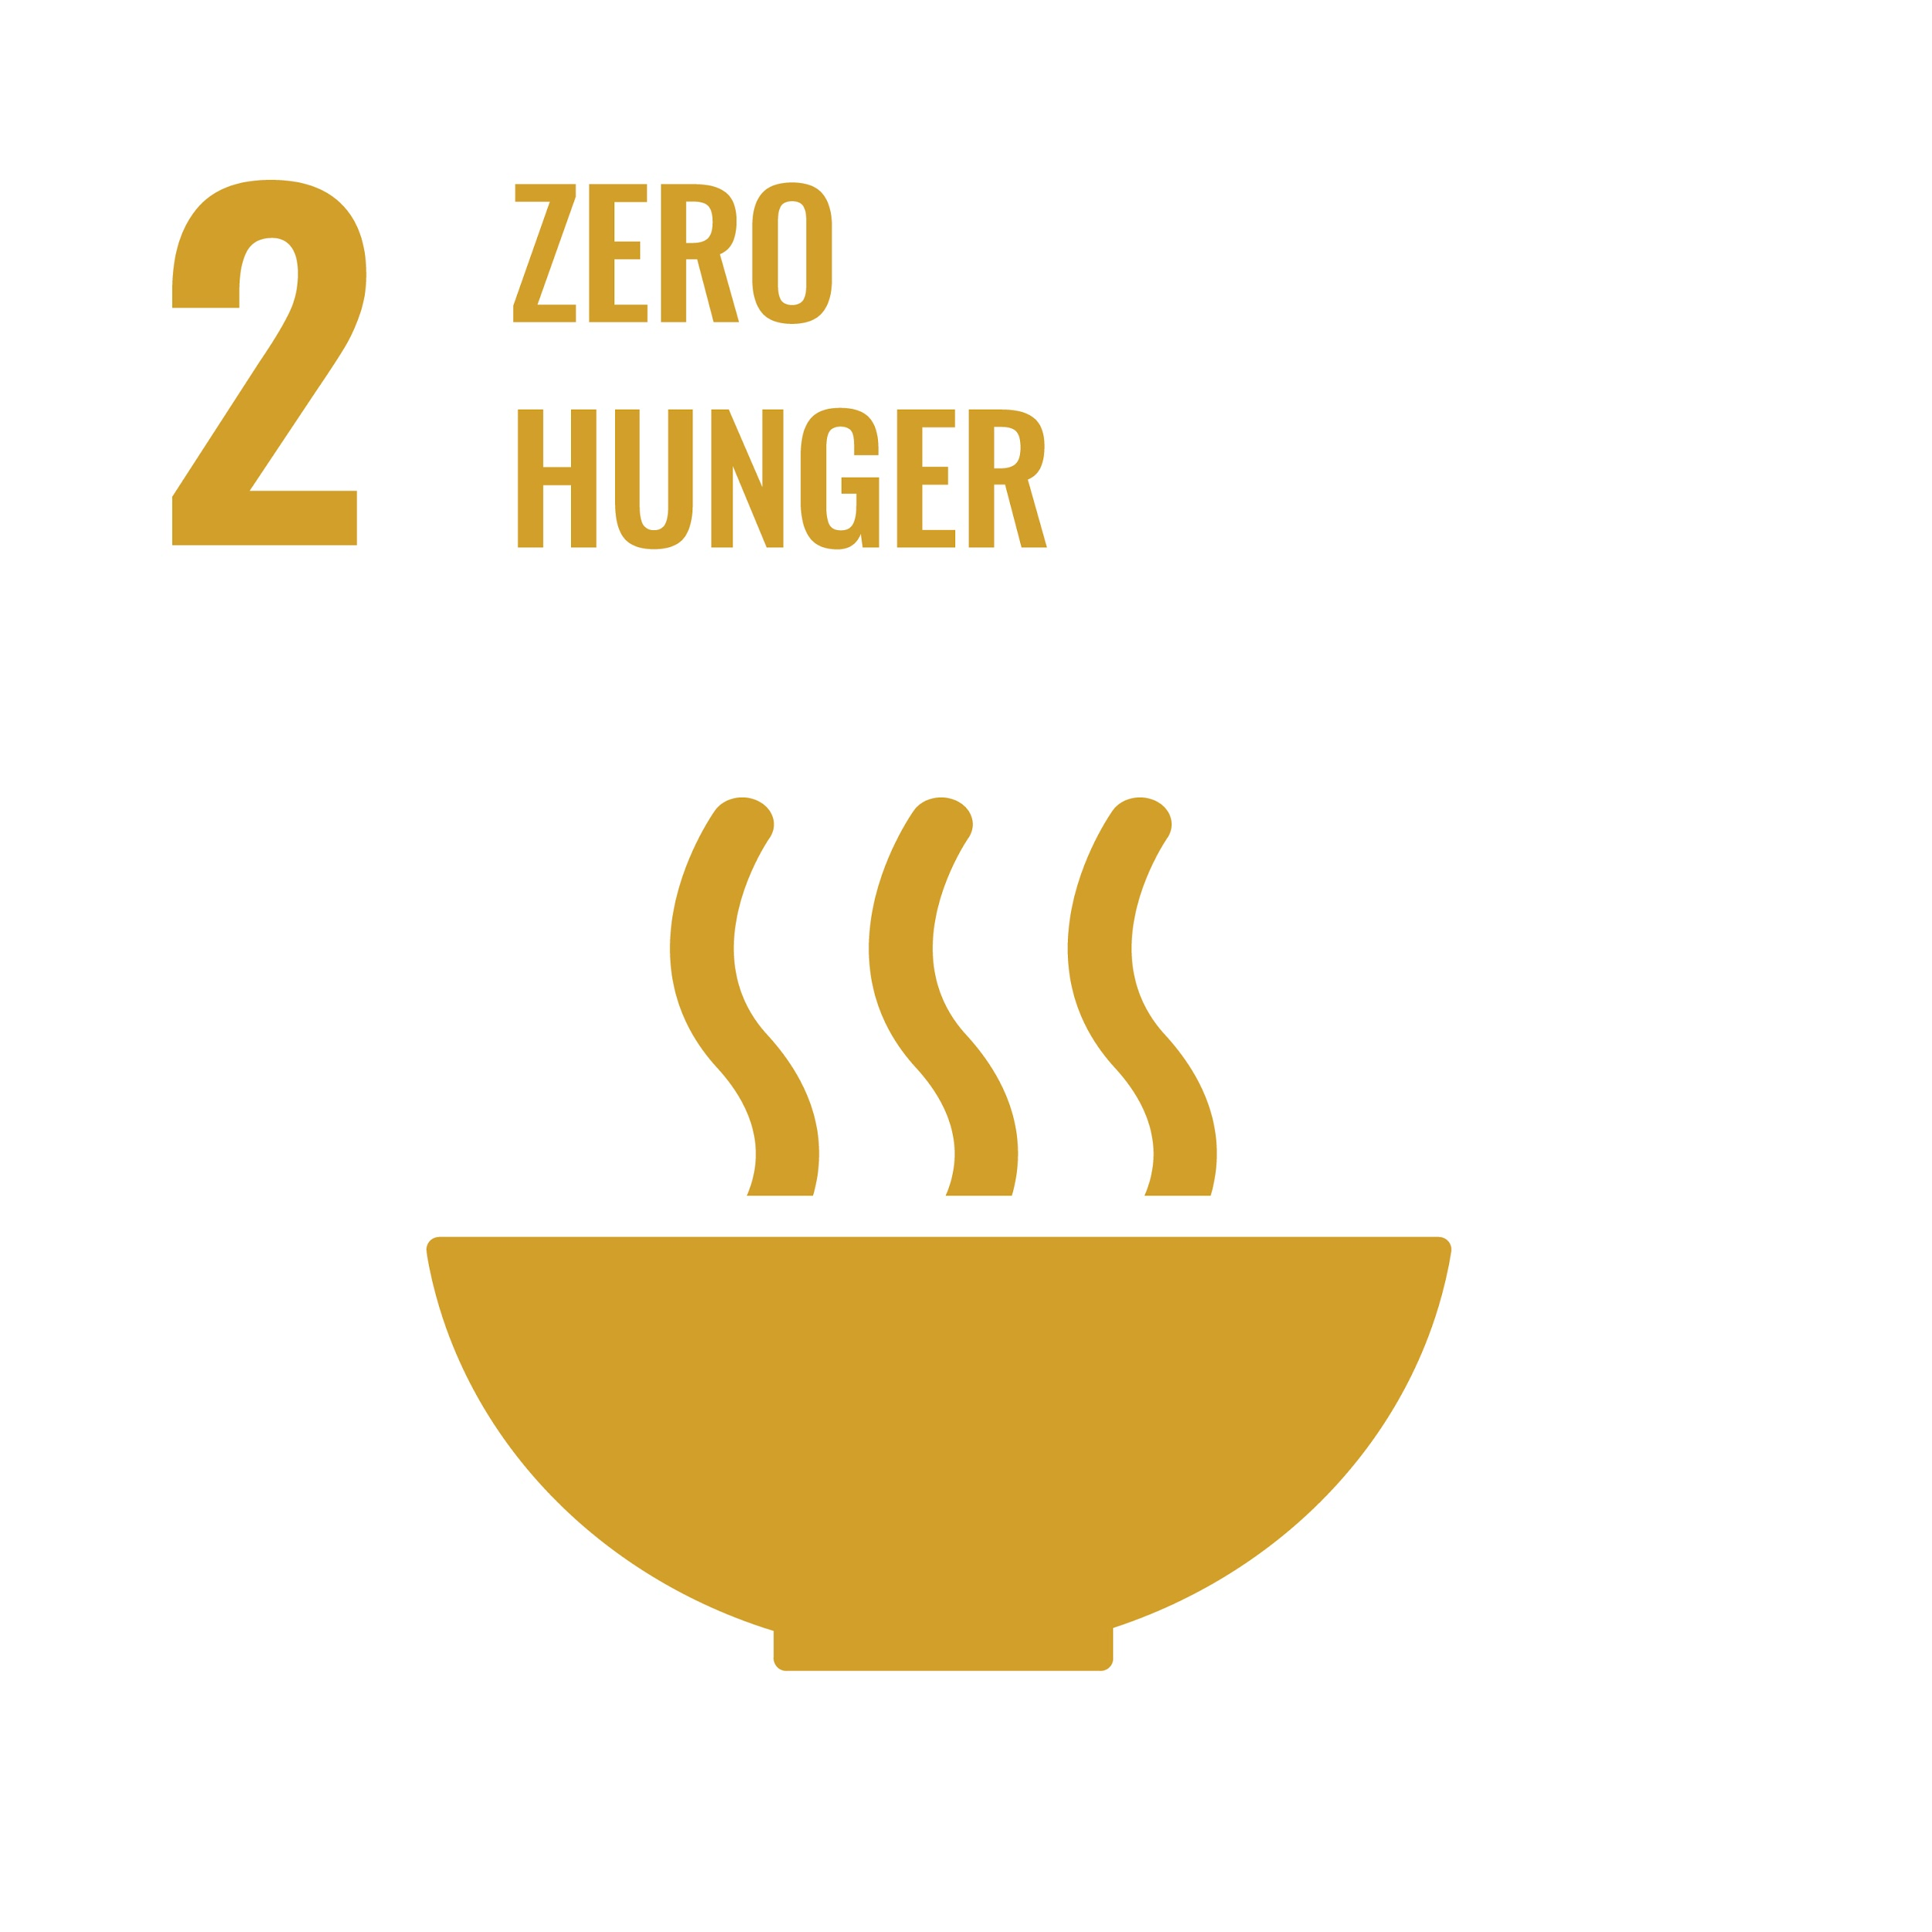
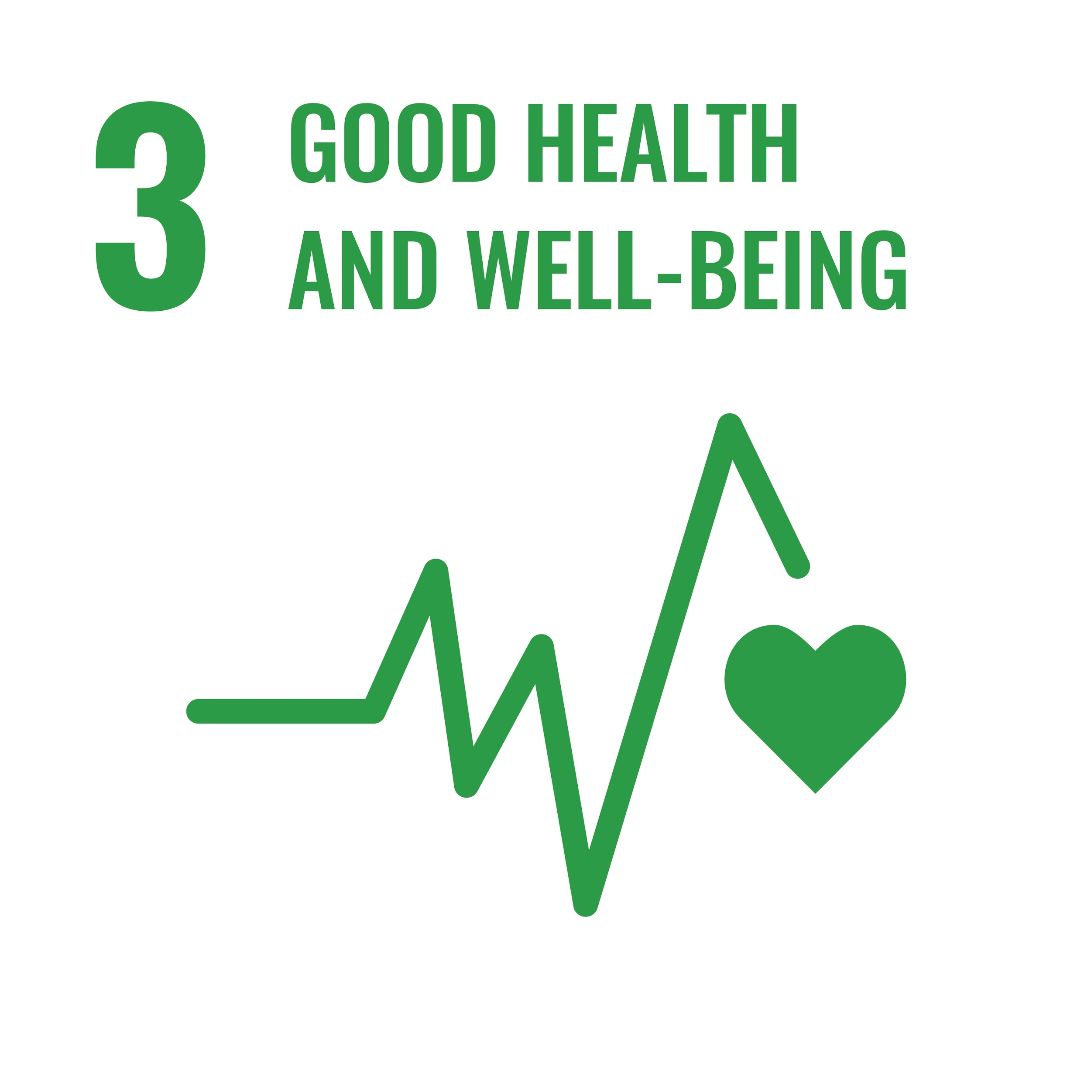
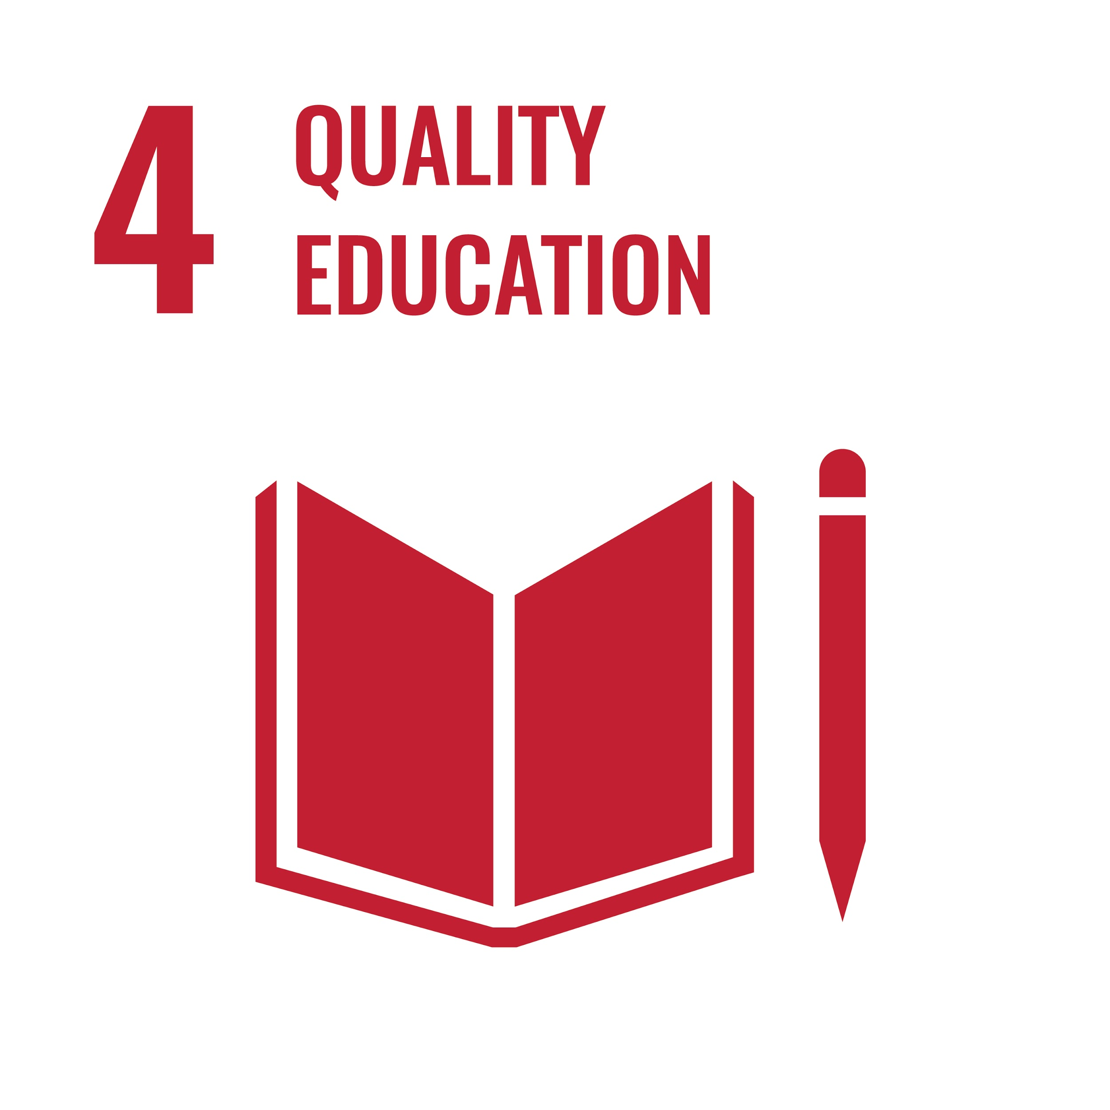
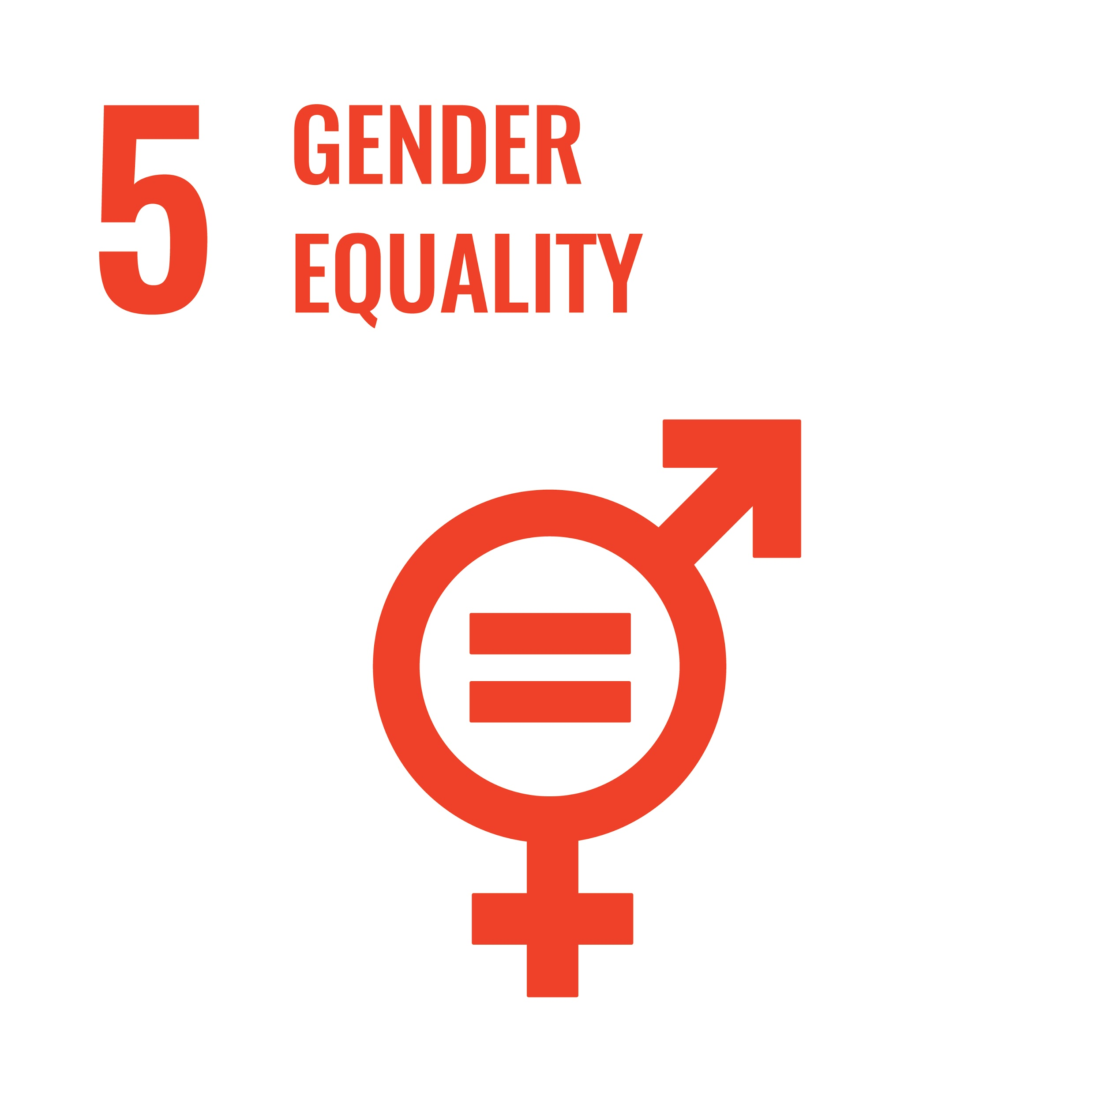
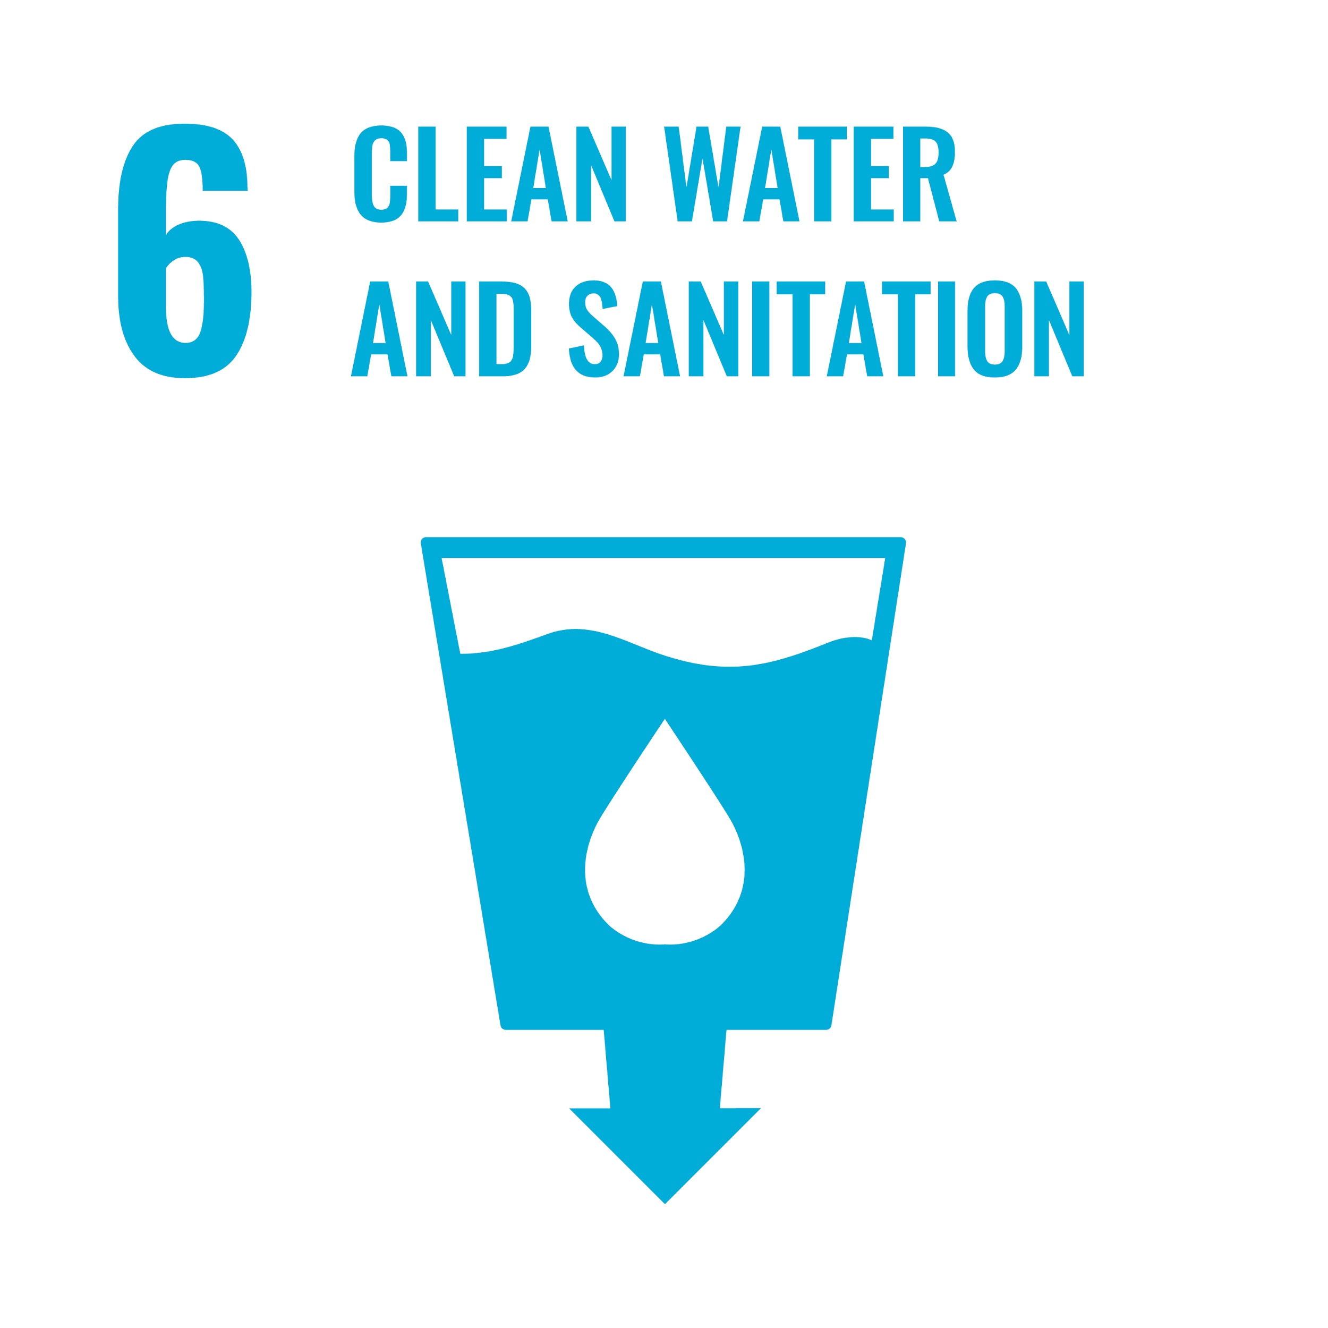
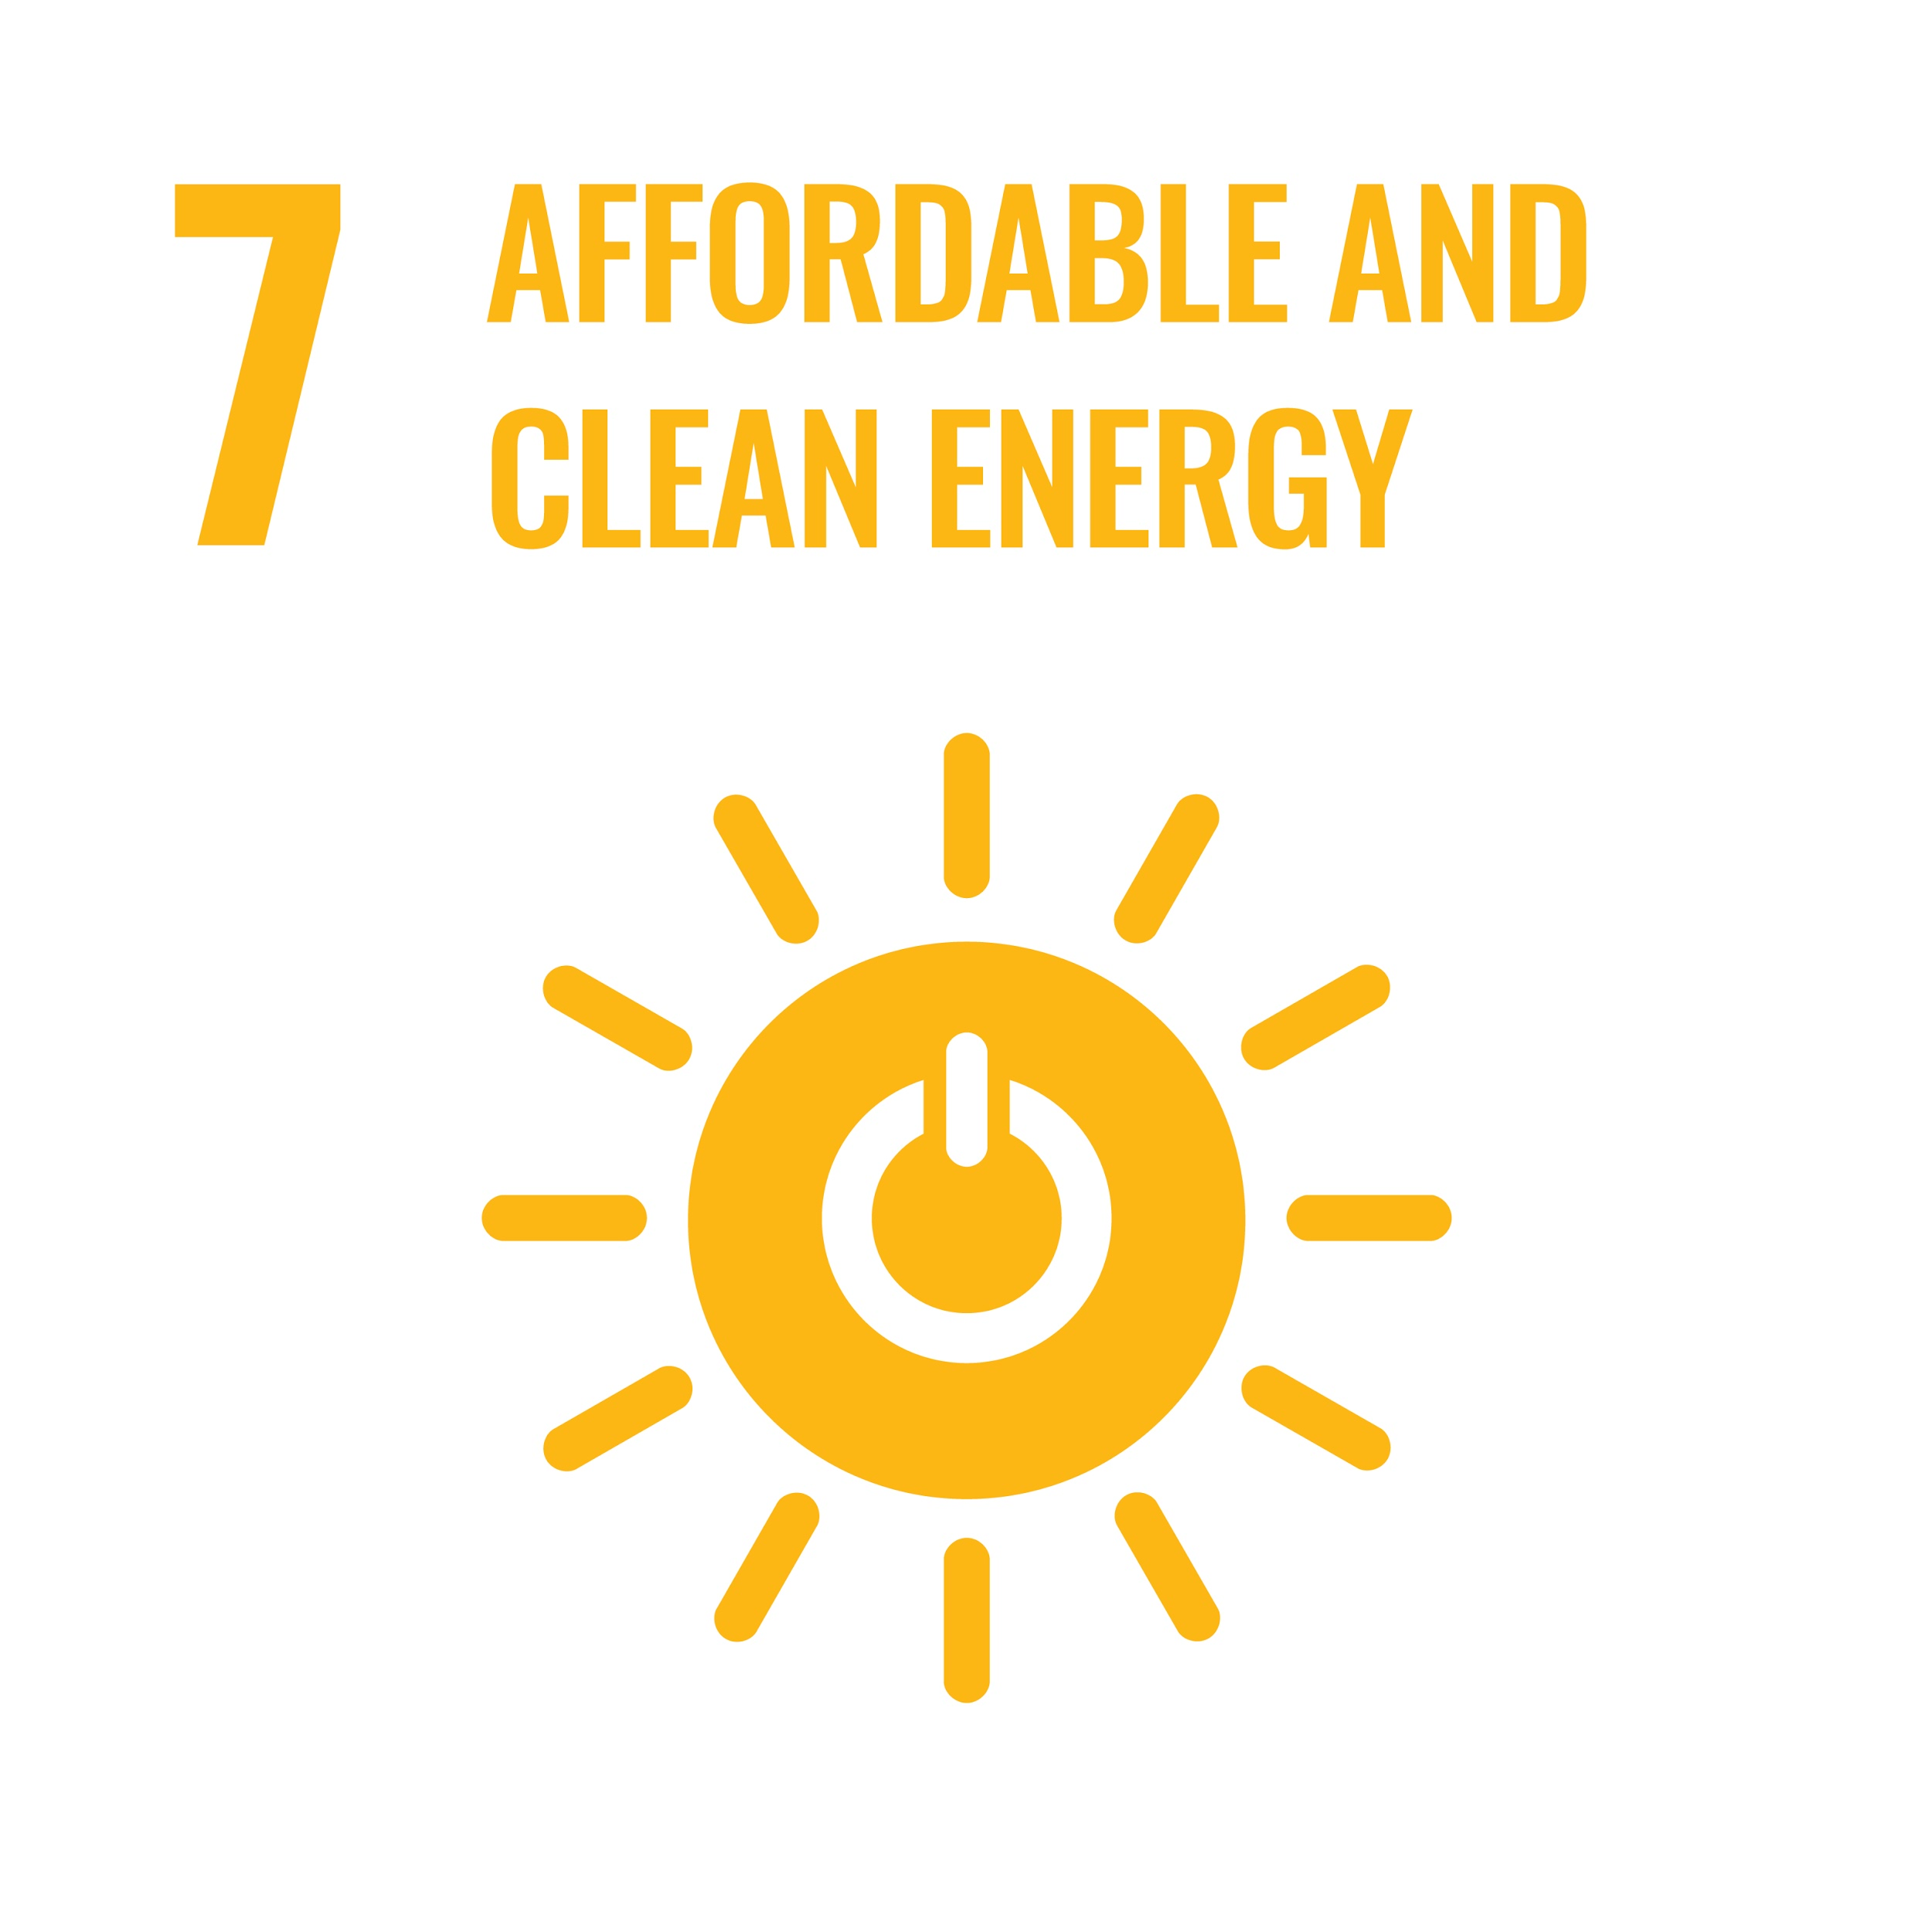
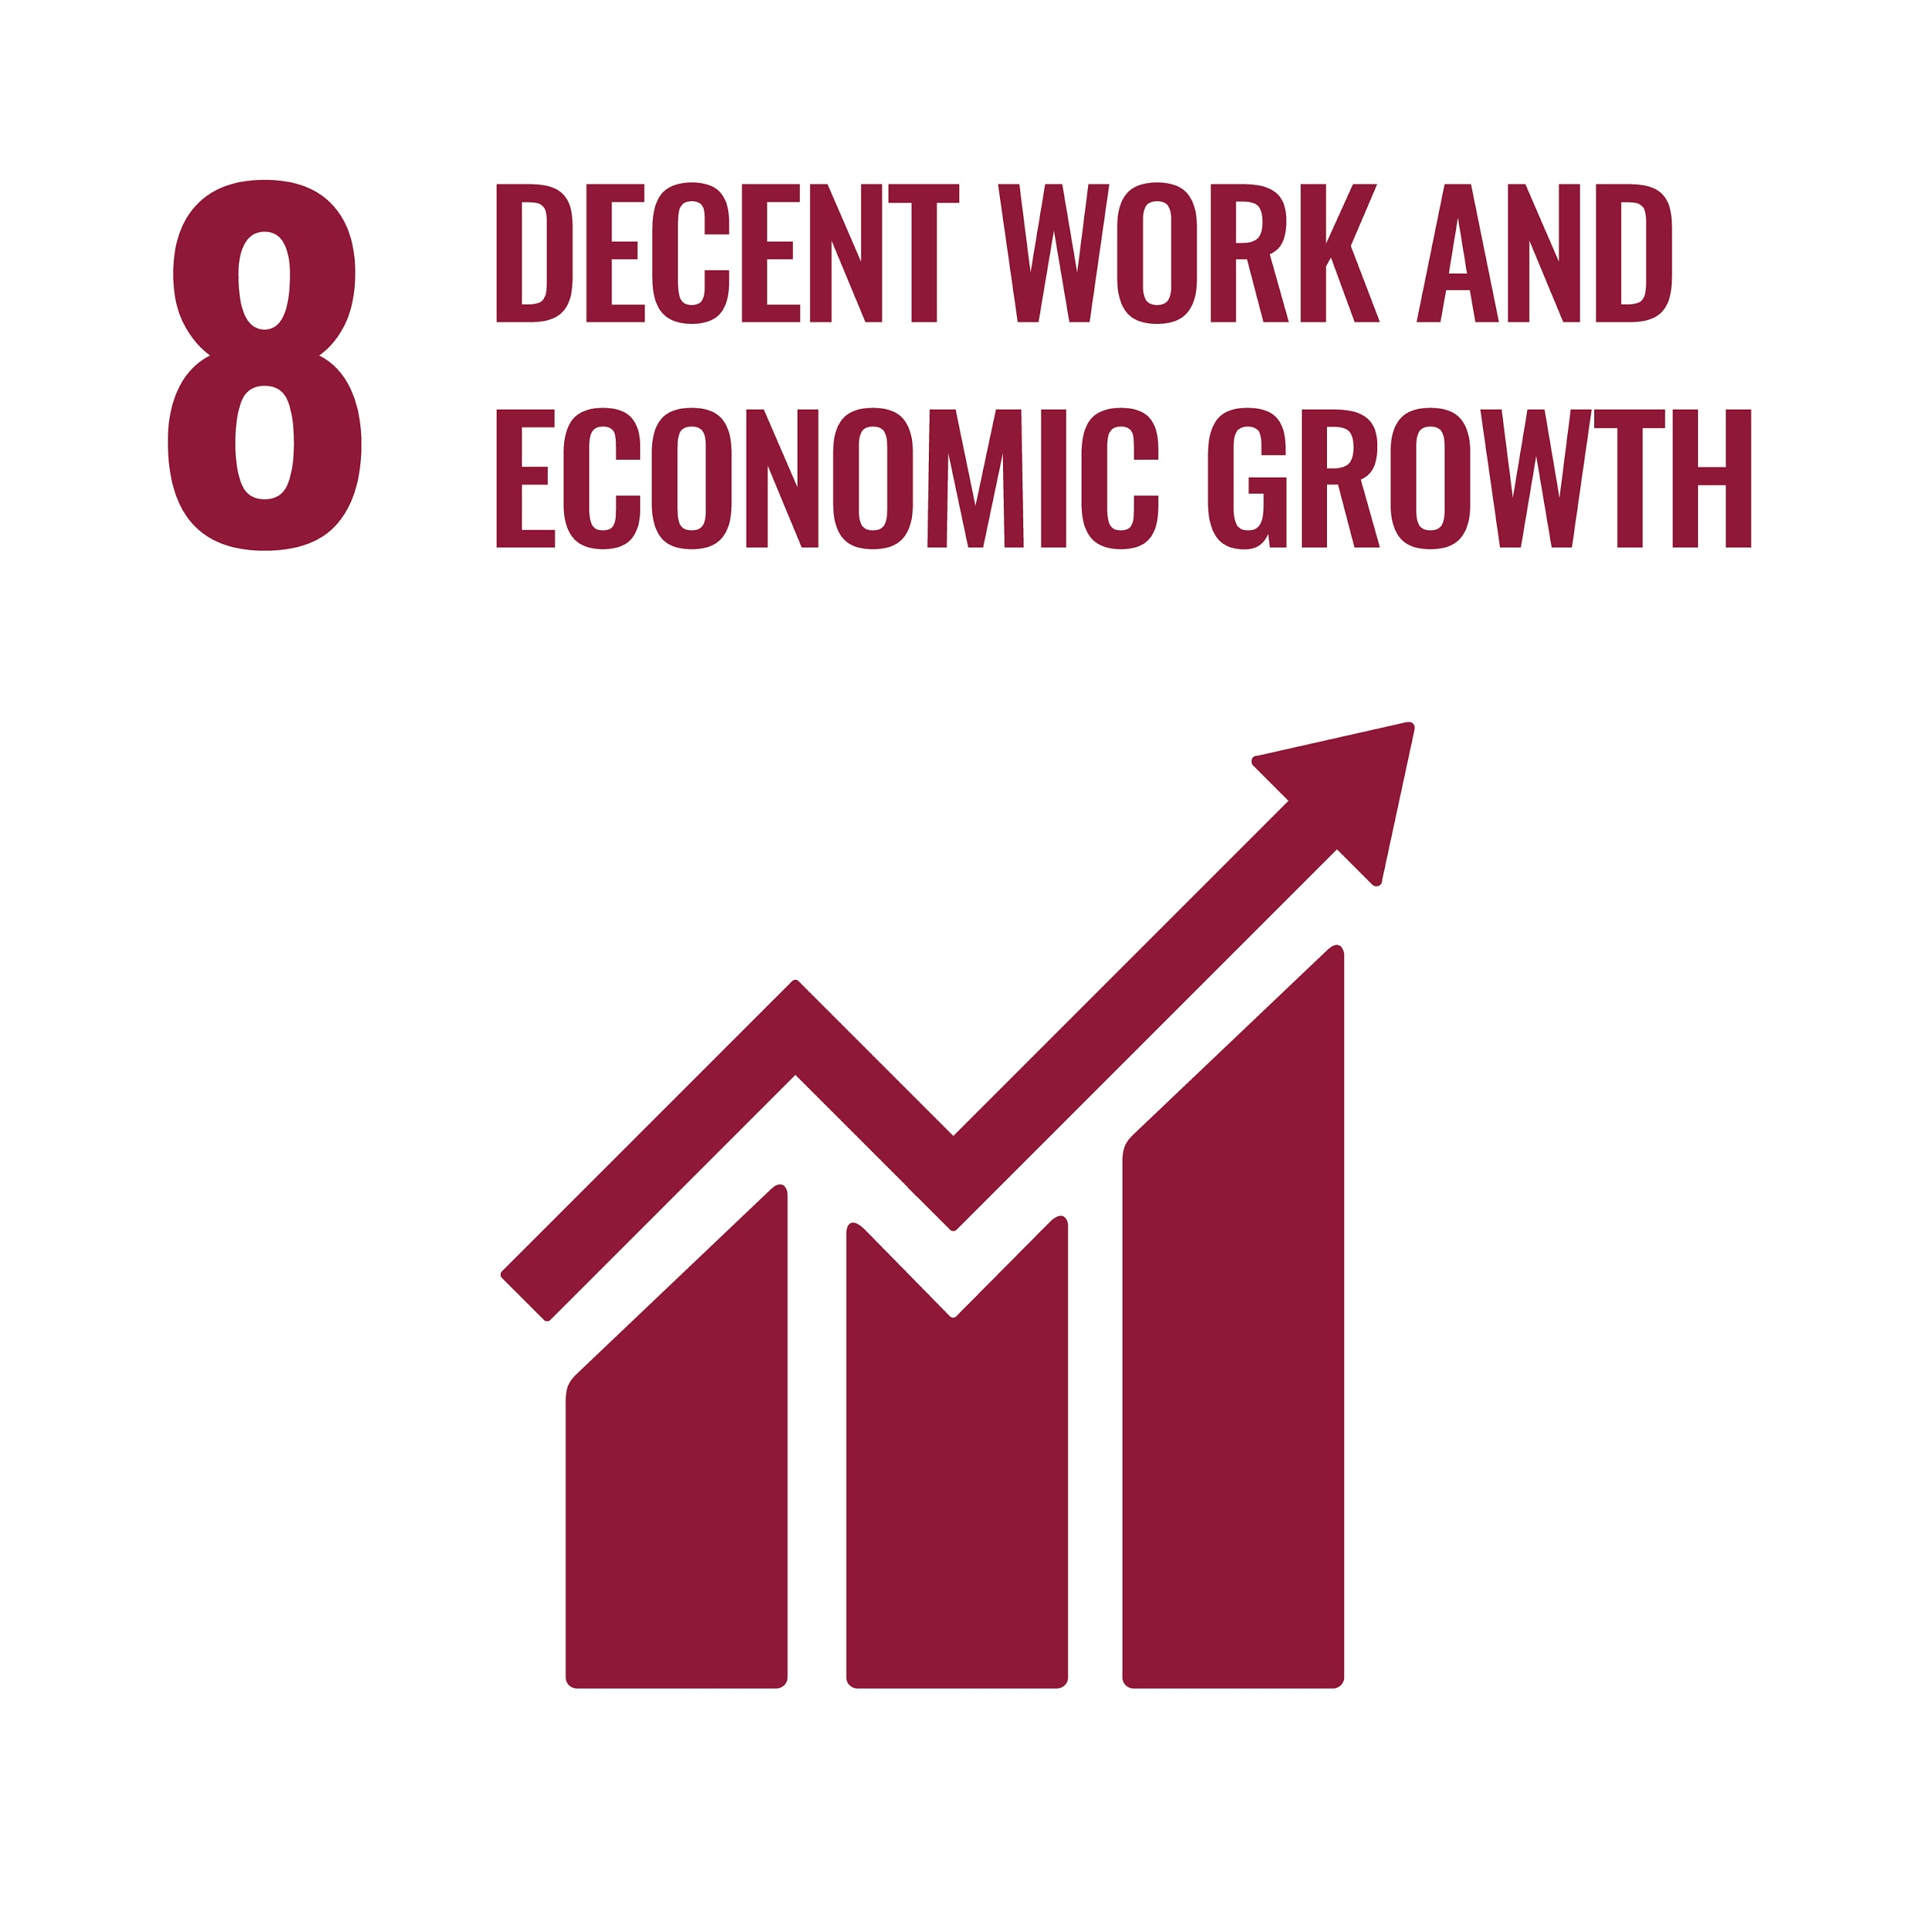
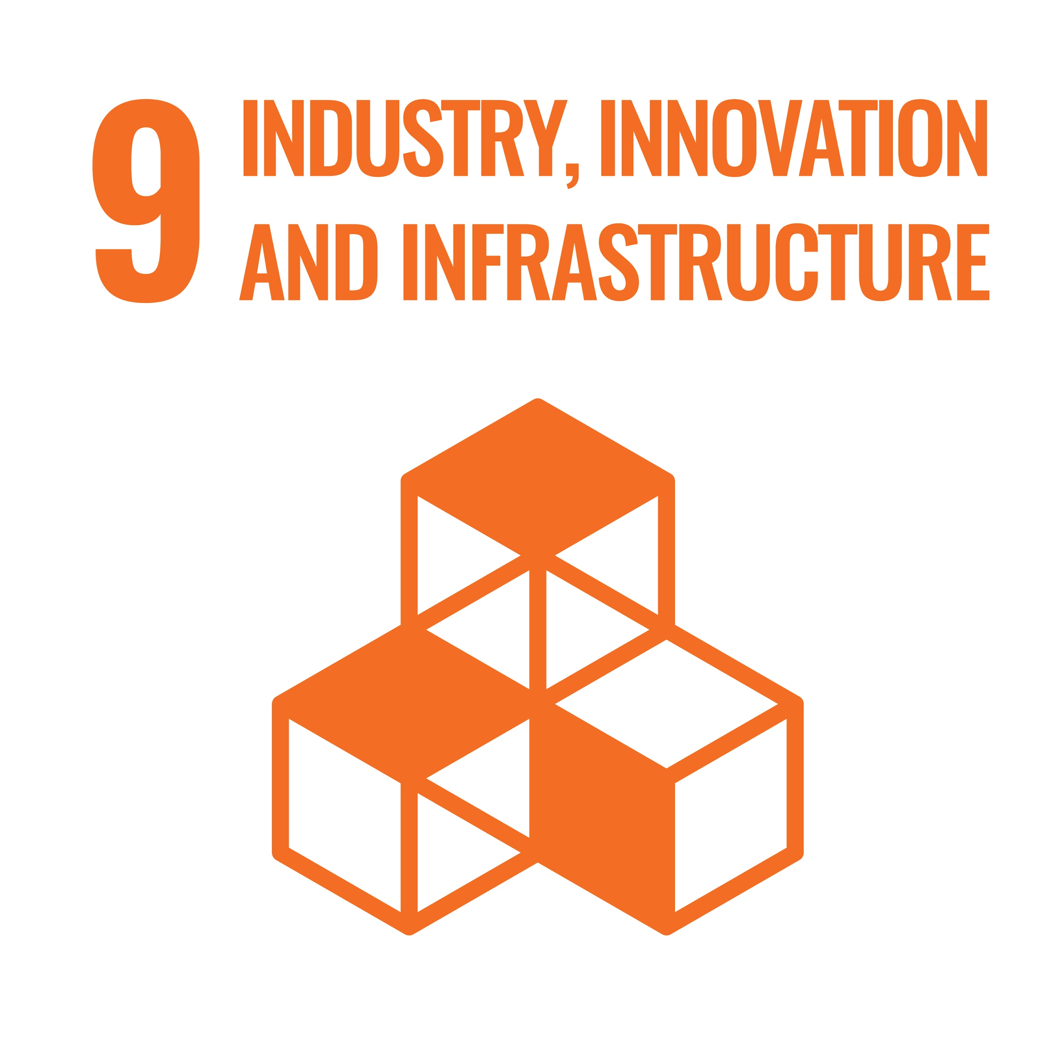
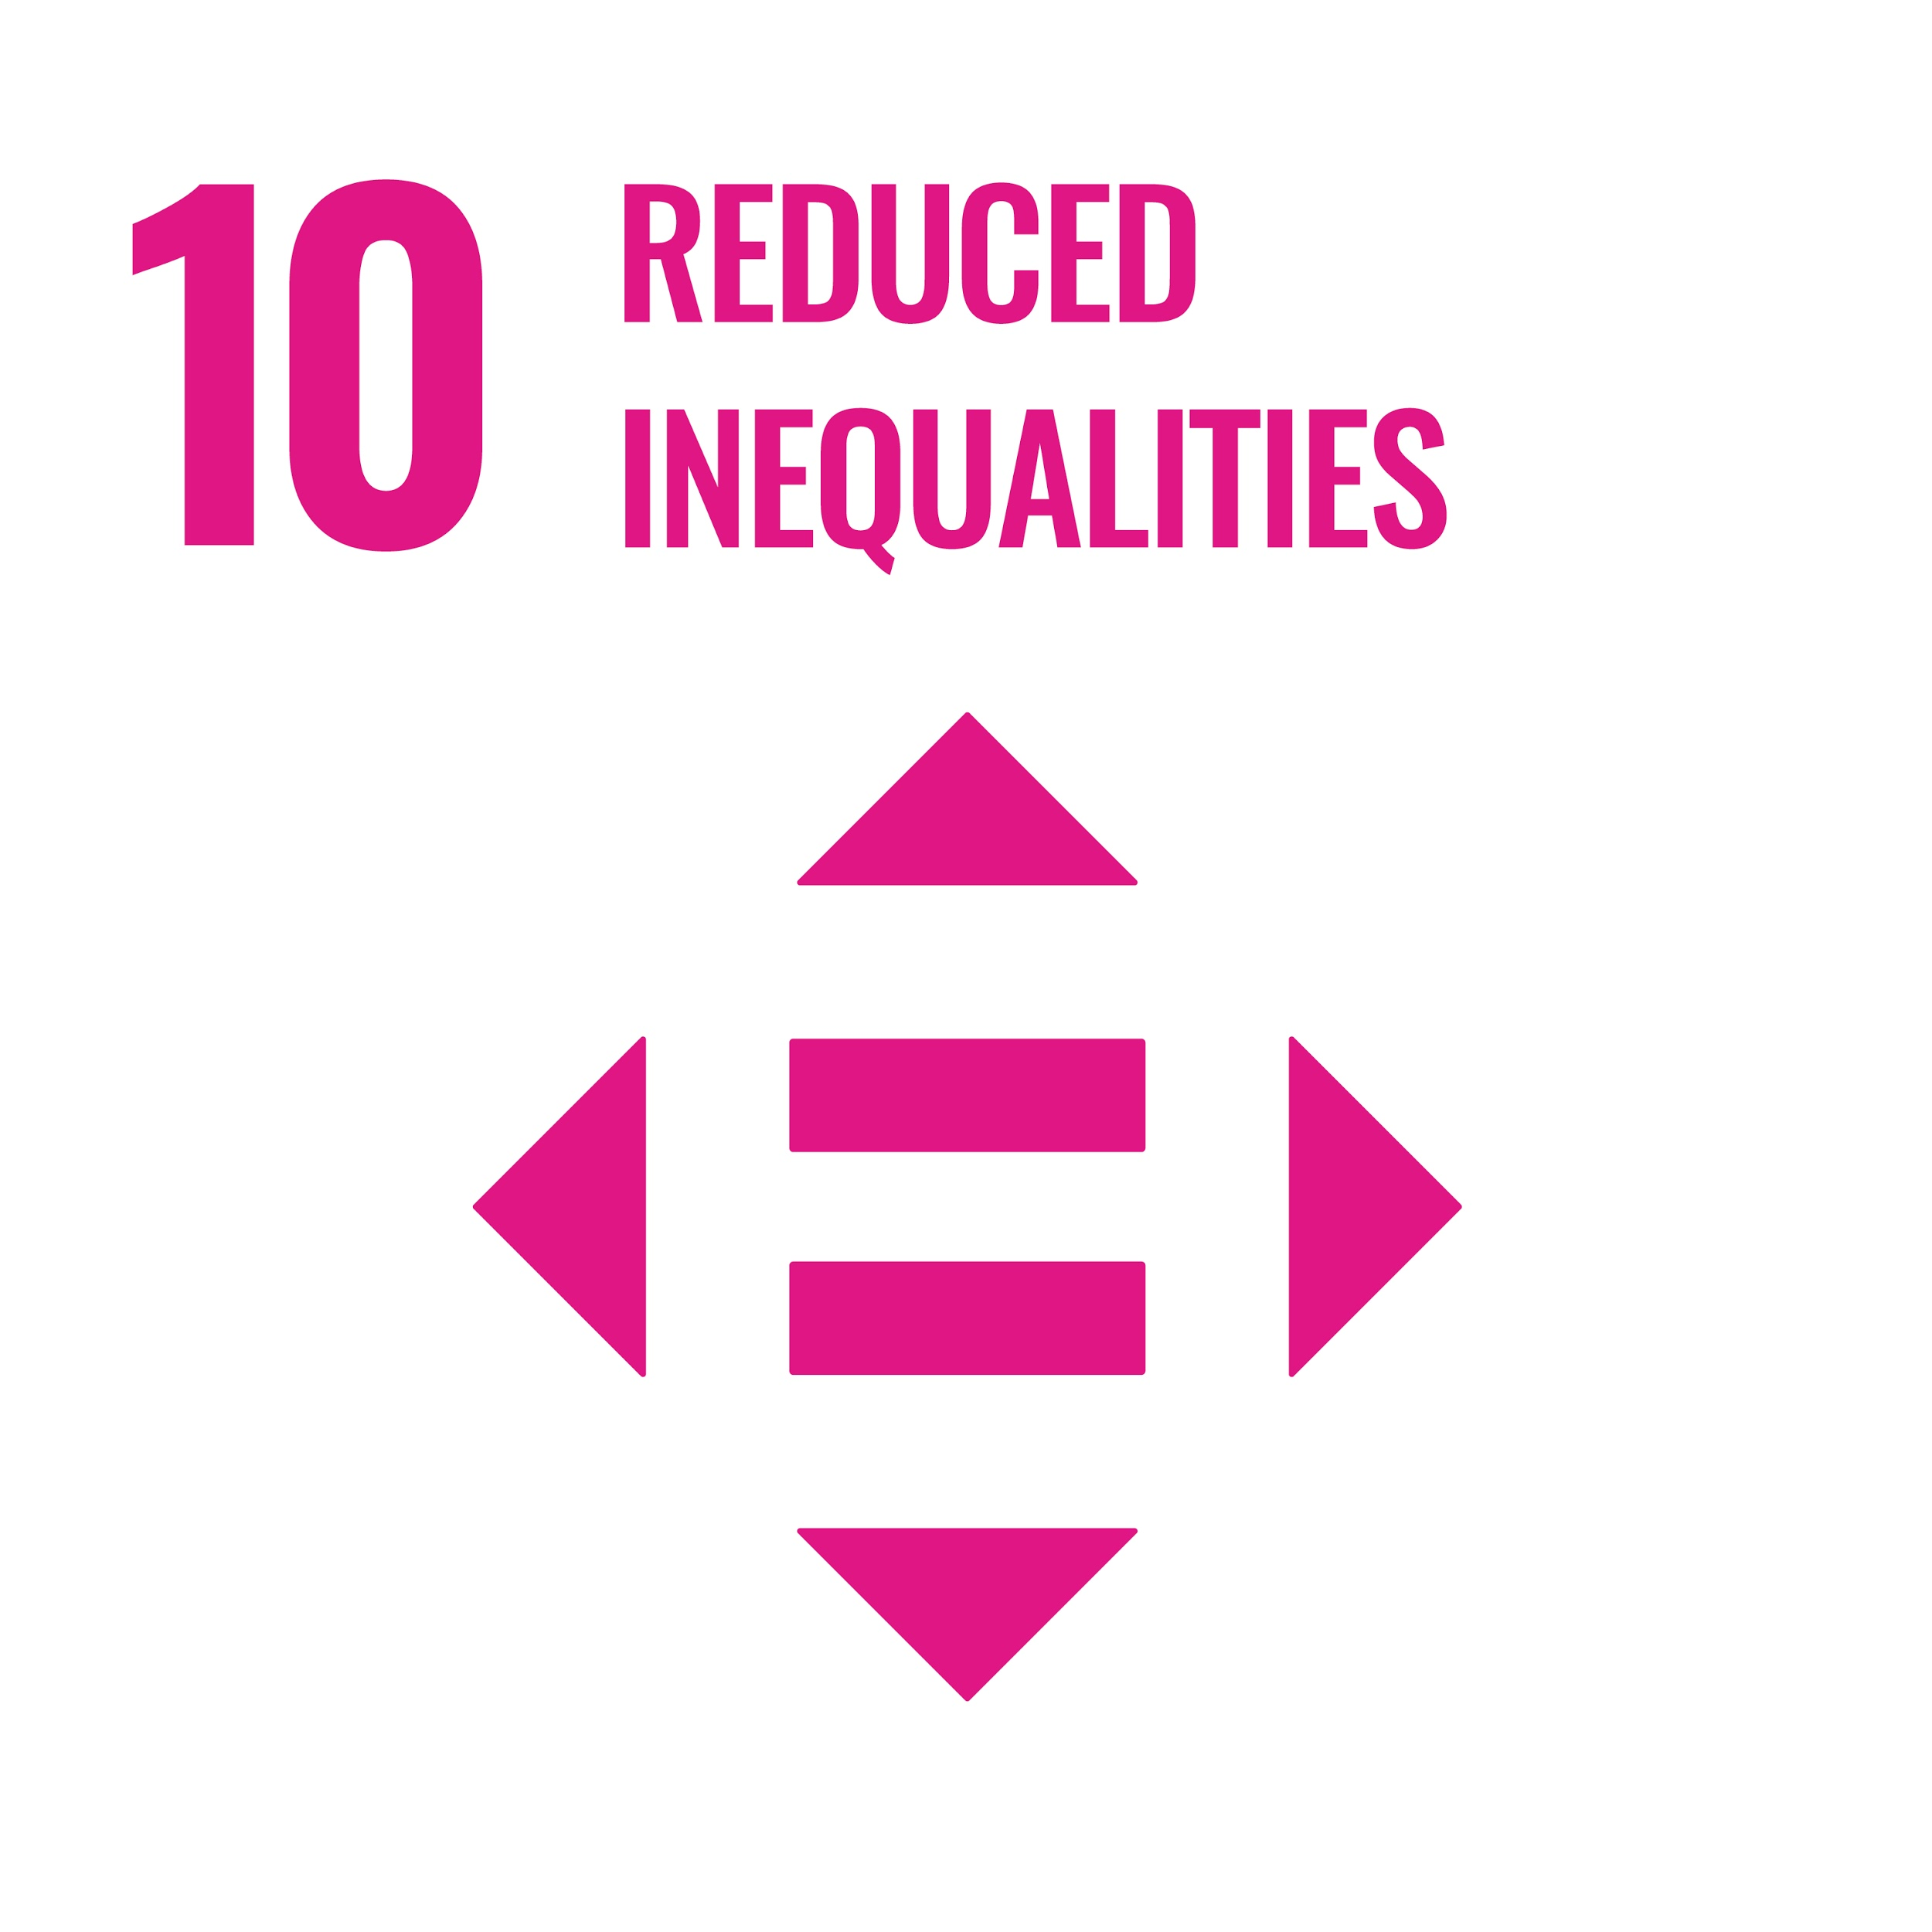
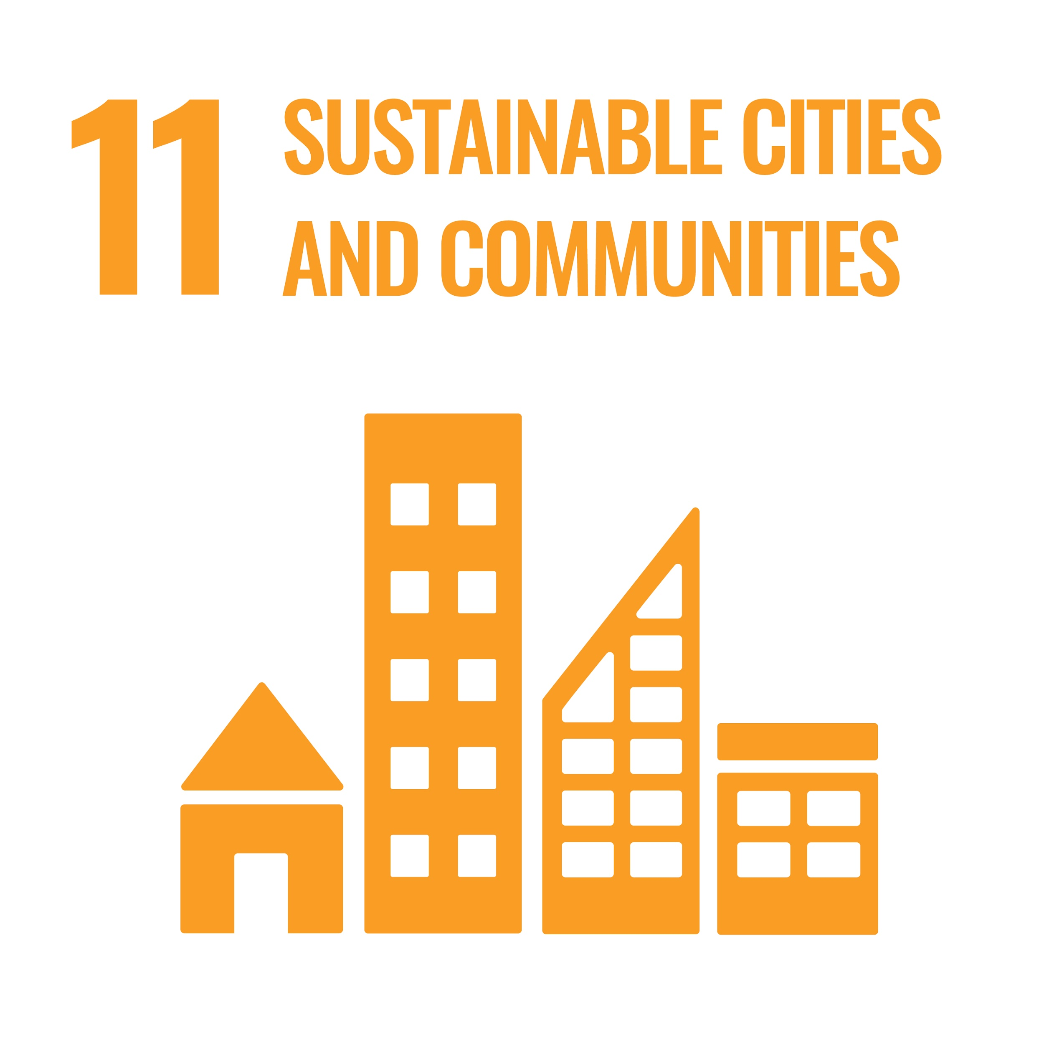
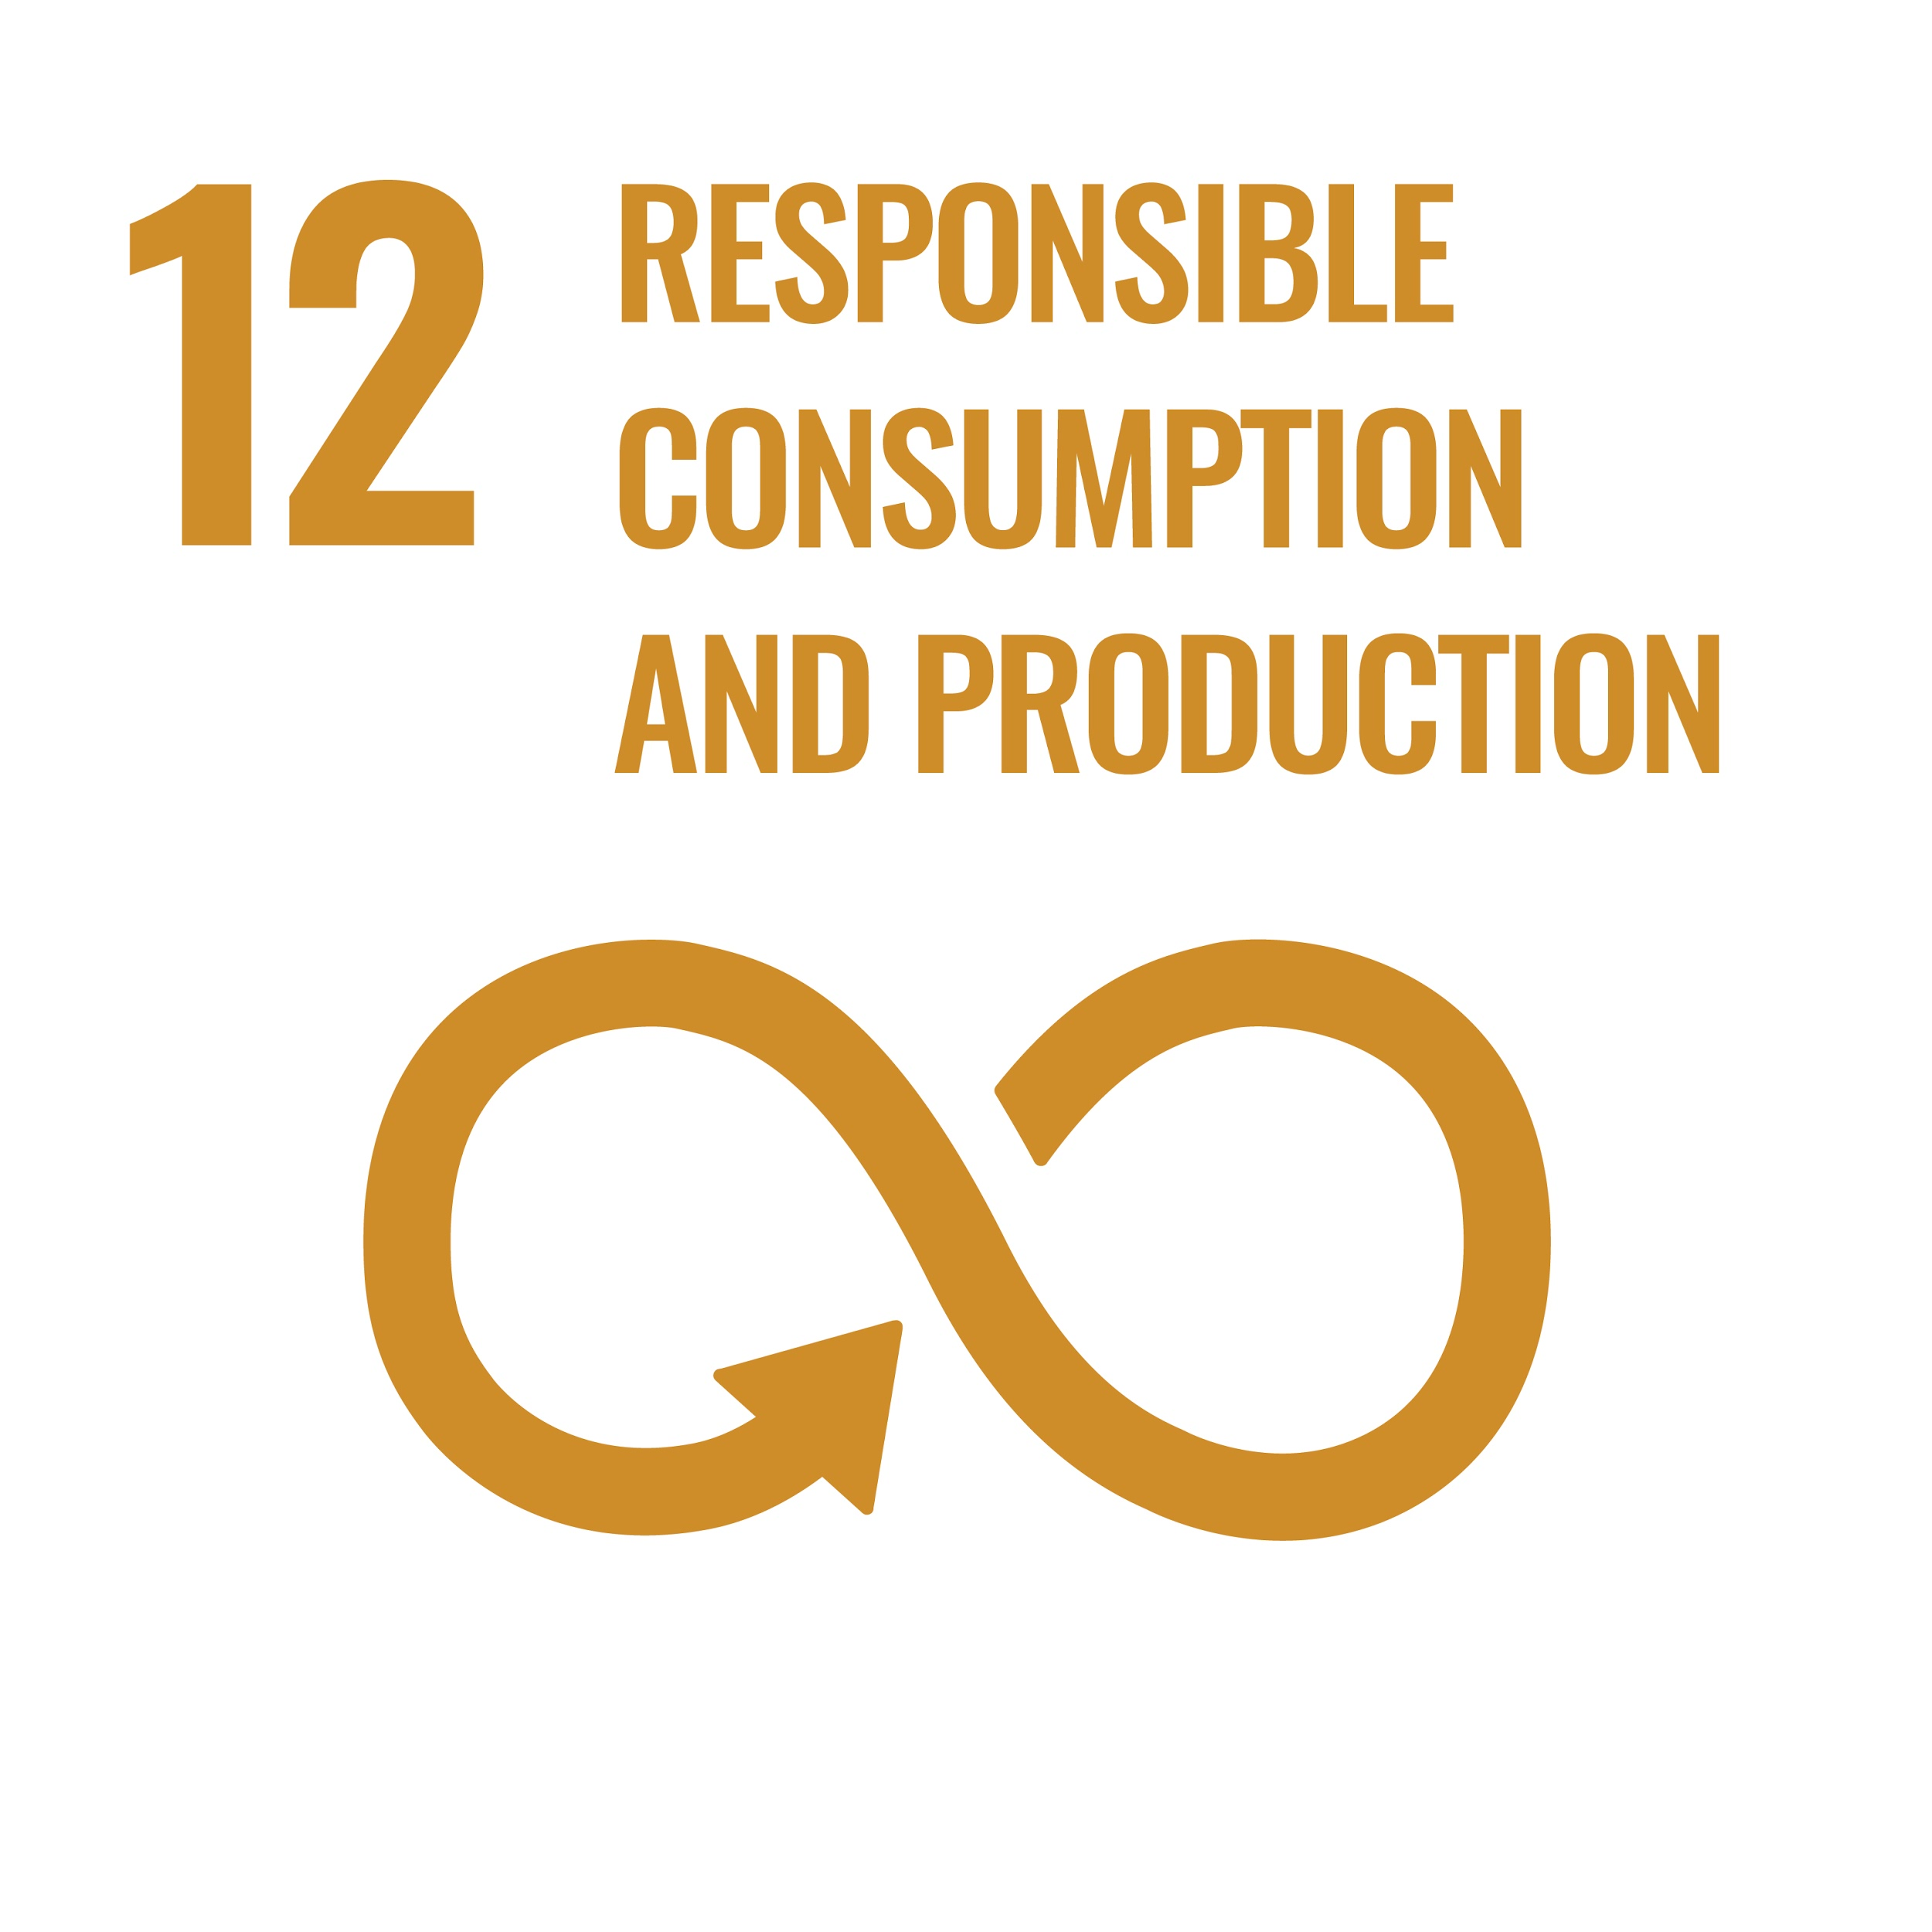
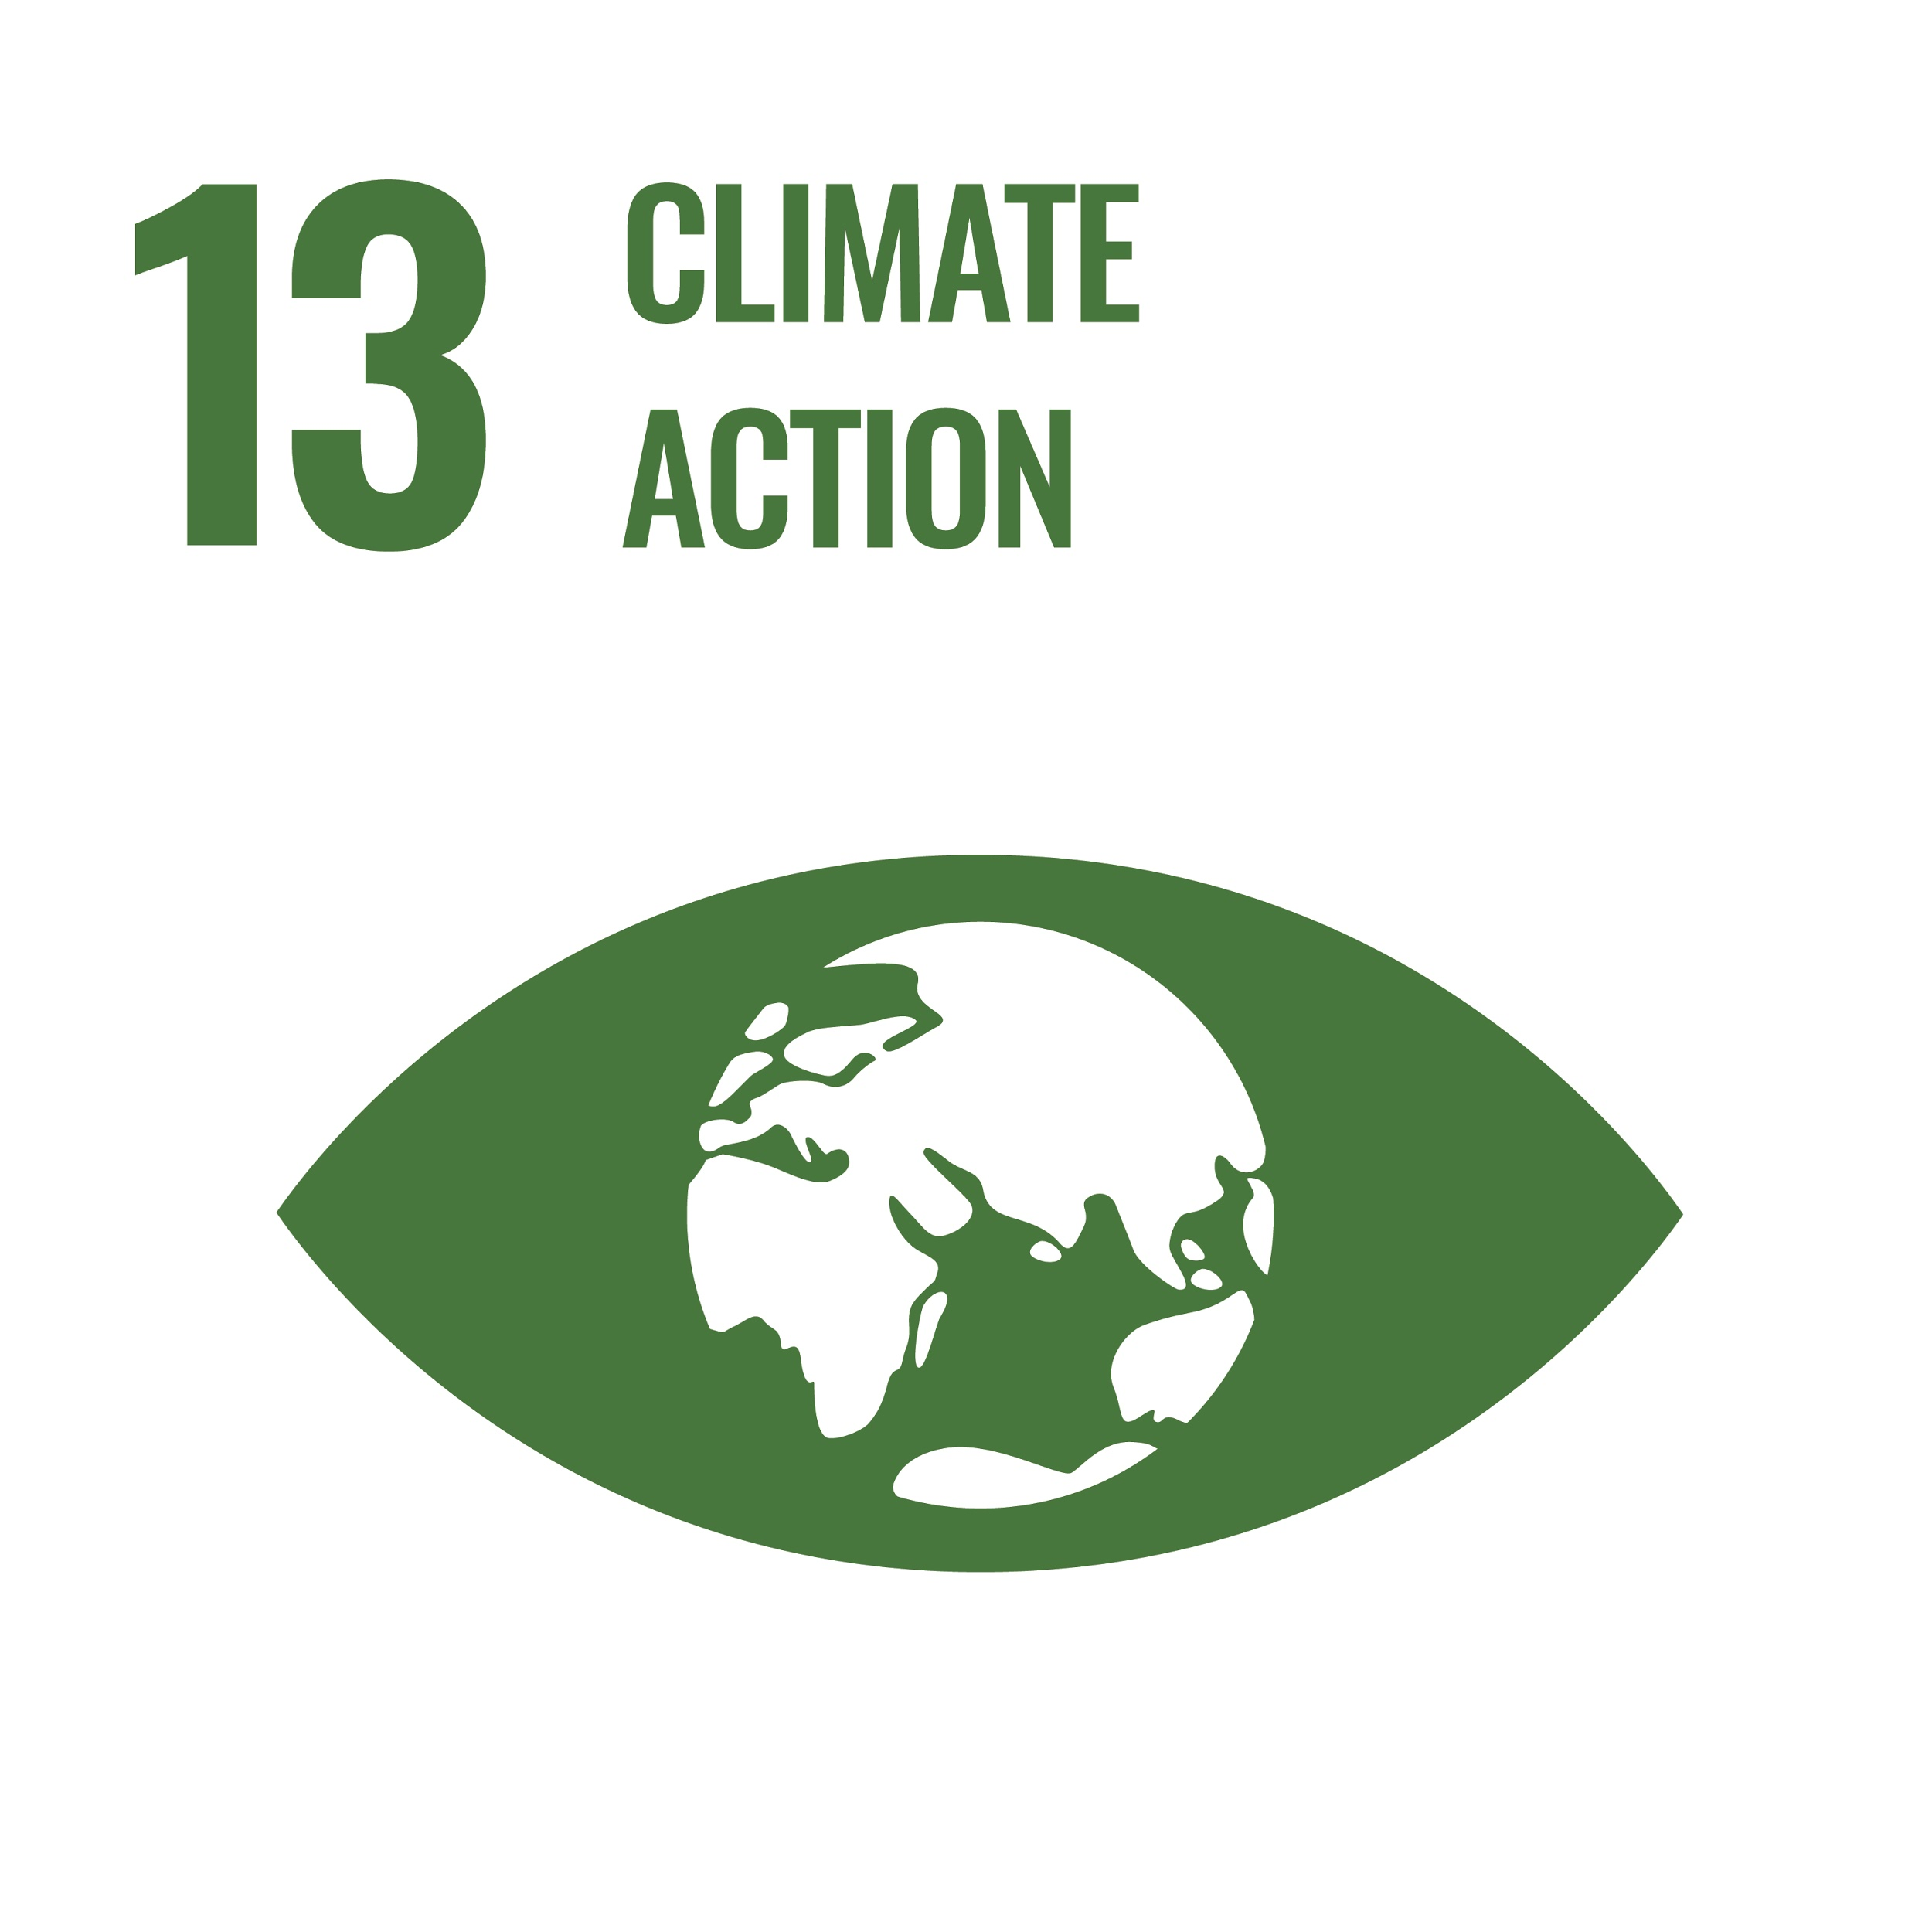
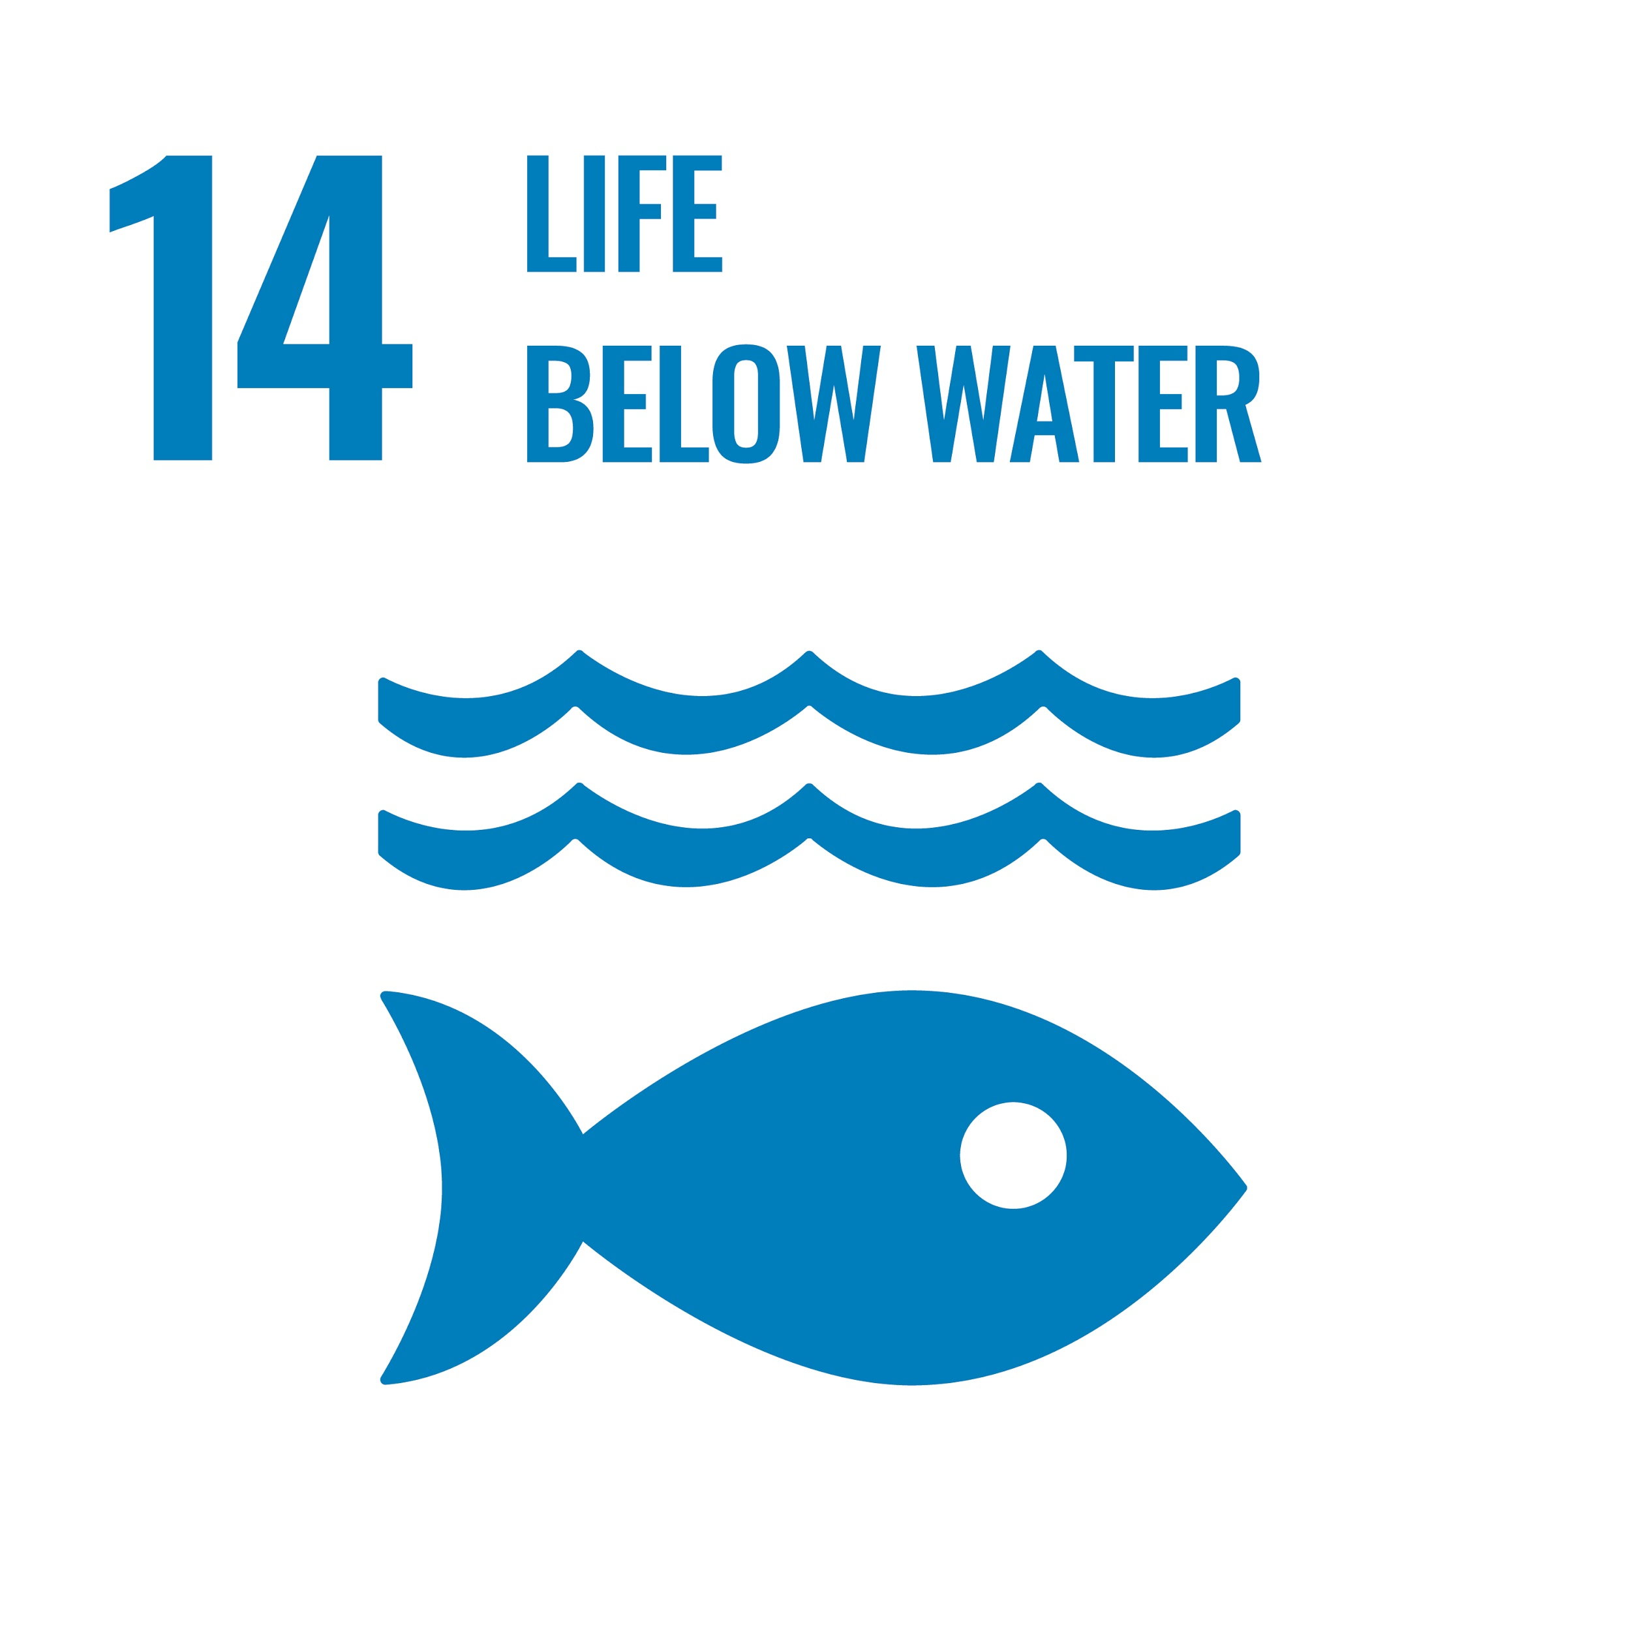
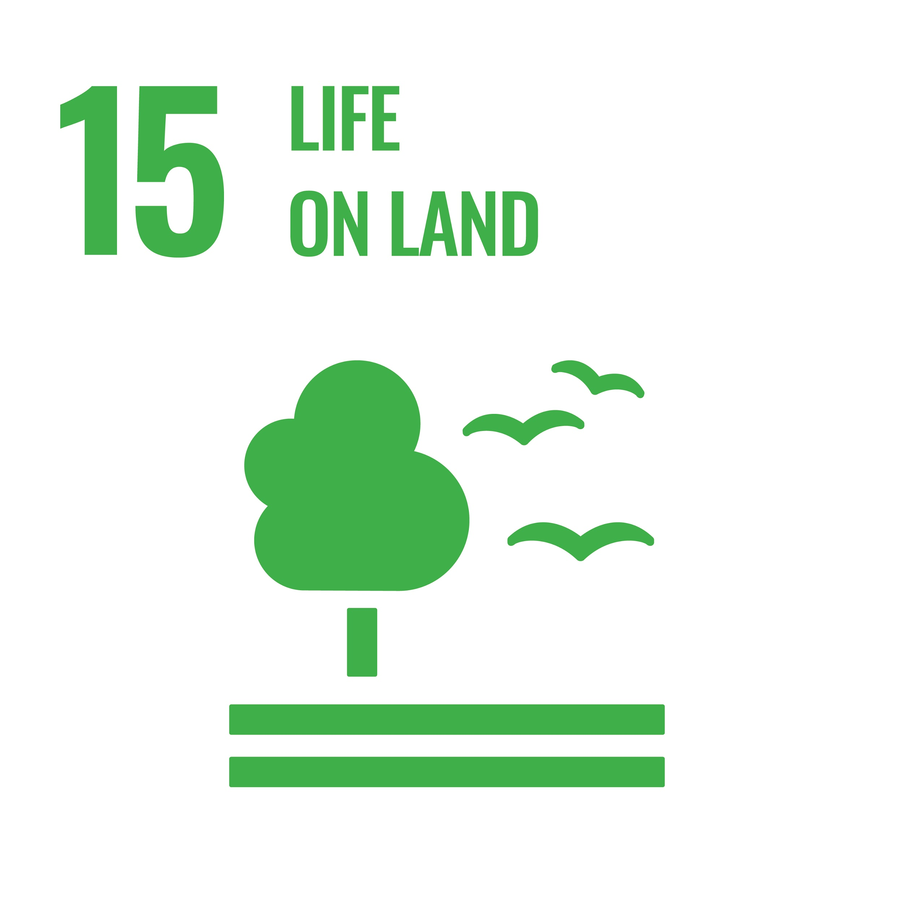

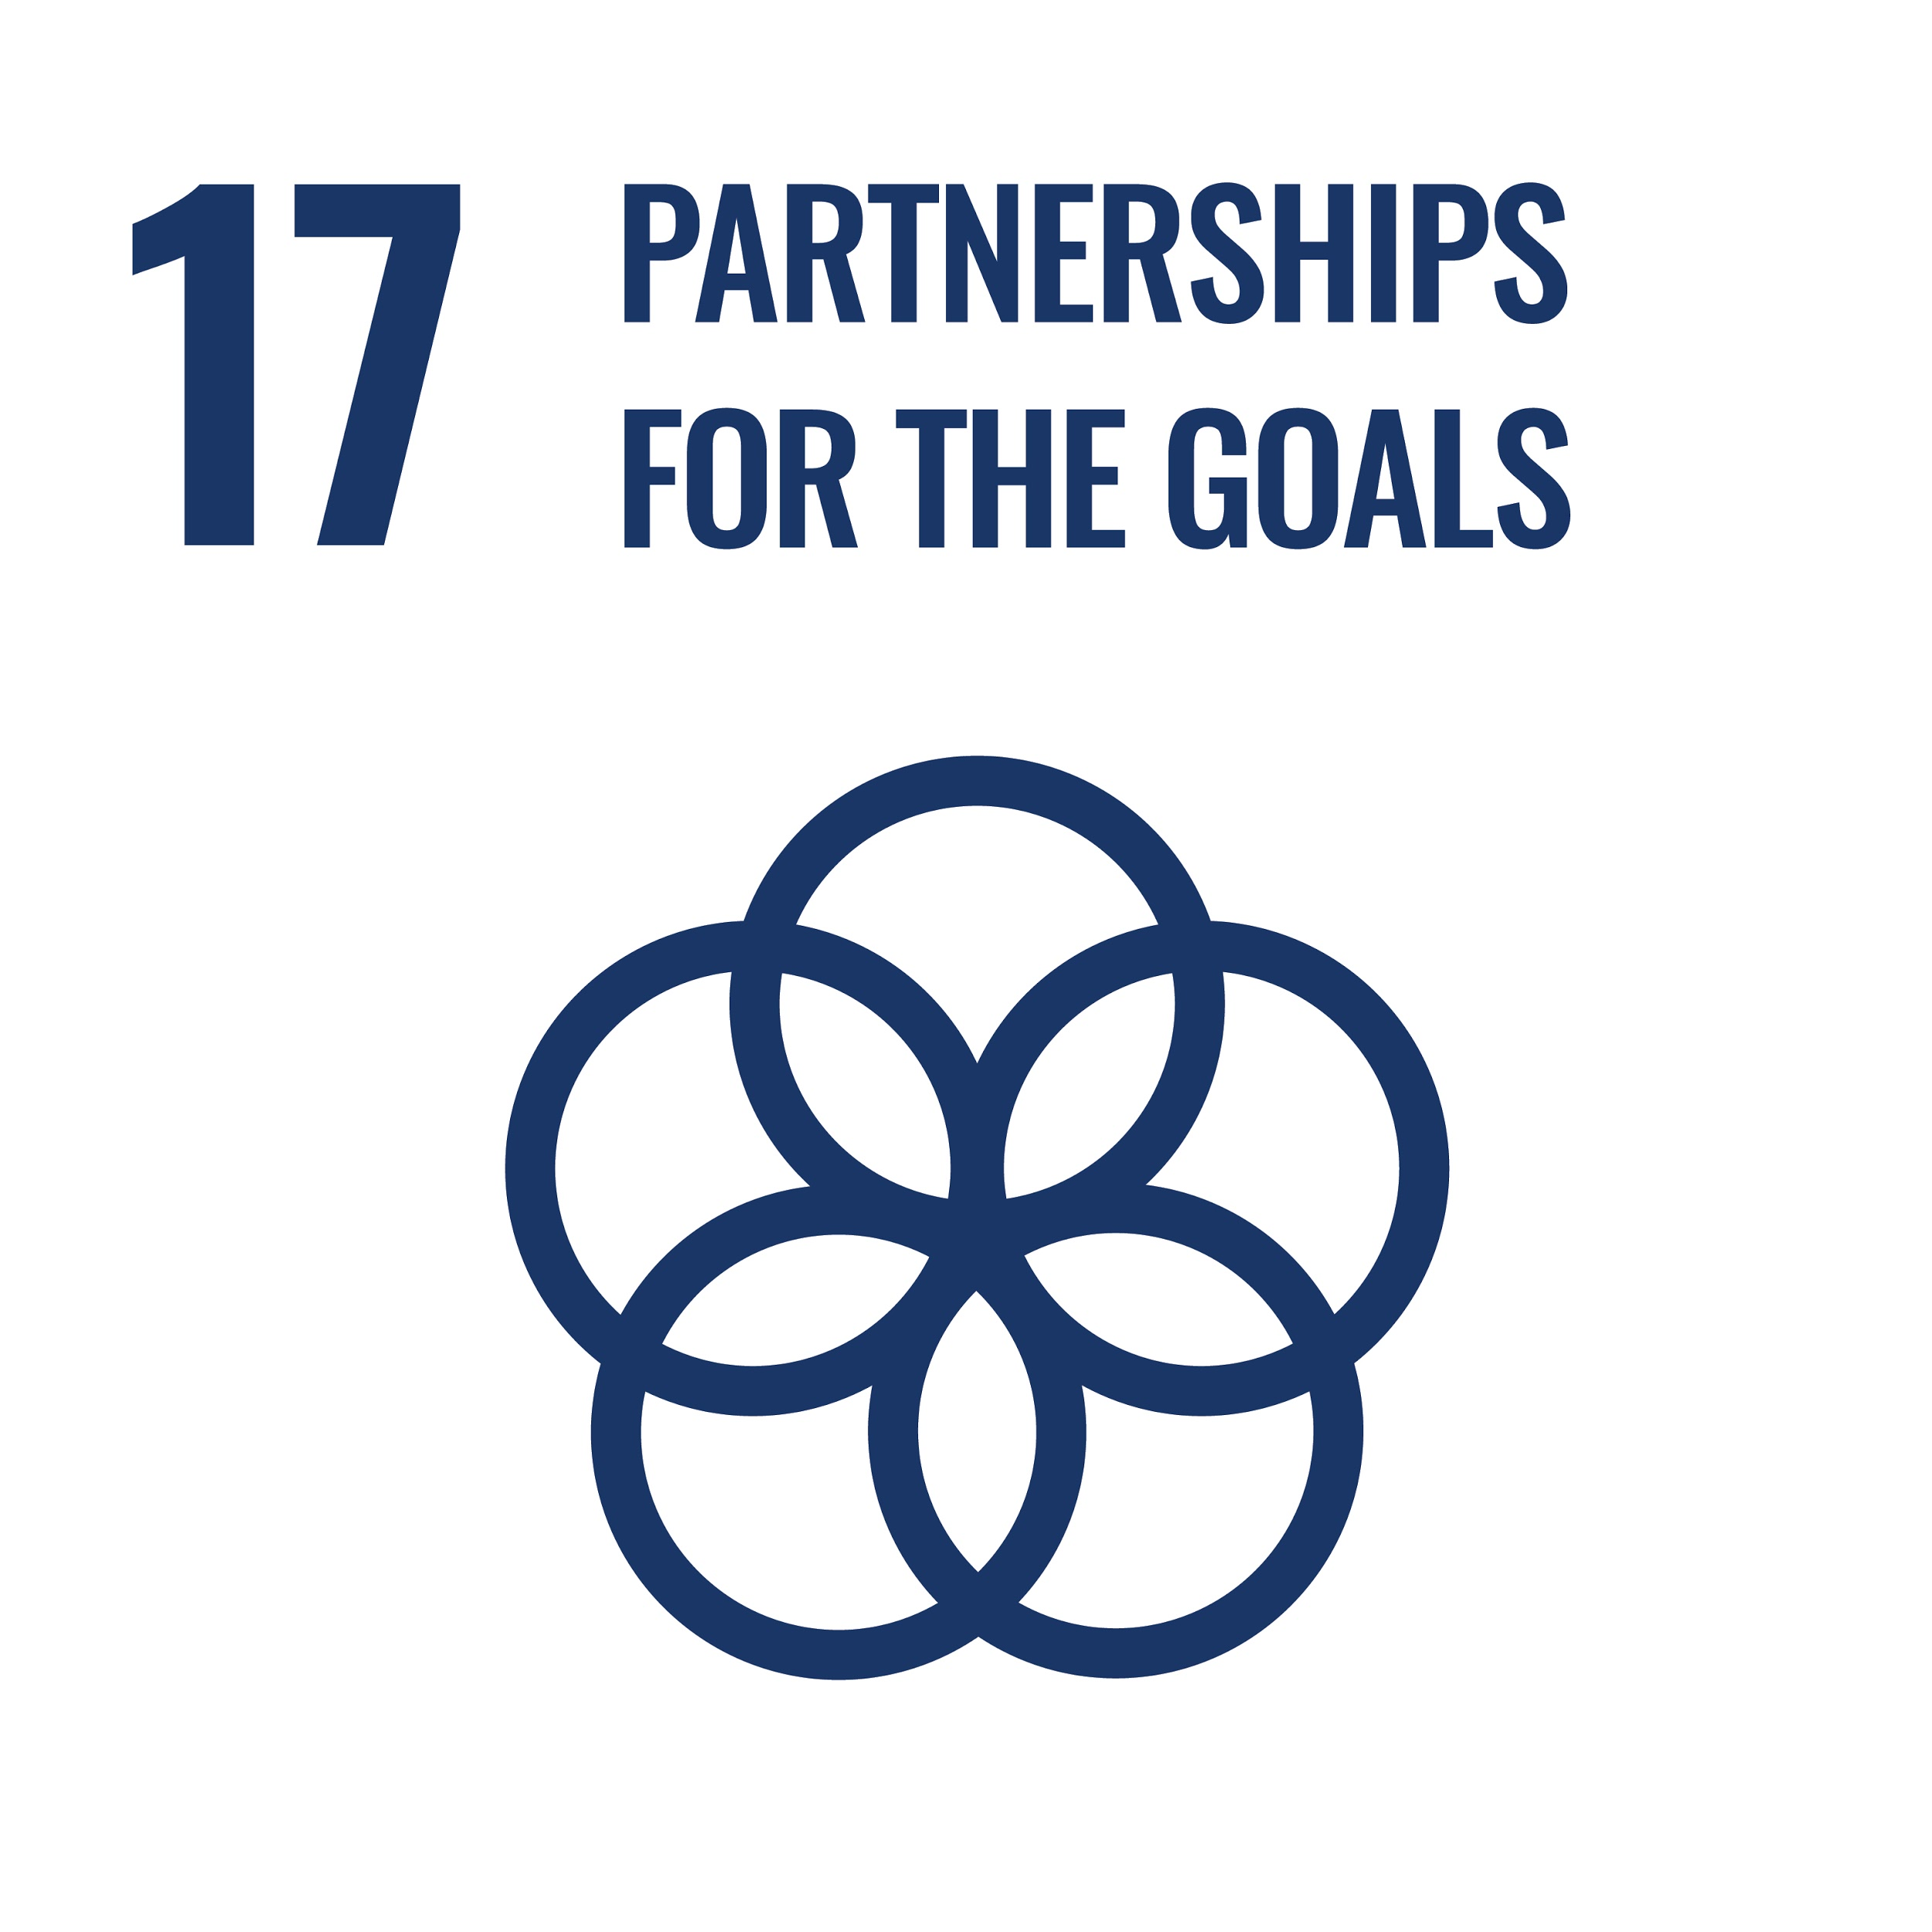
Notes:
What are the UN sustainability goals?
“The Sustainable Development Goals are the blueprint to achieve a better and more sustainable future for all. They address the global challenges we face, including those related to poverty, inequality, climate change, environmental degradation, peace and justice.”
Note: Some of these are associated with green technology and behaviors (7, 11,12,13-15) but other are more about creating equitable and stable communities.
Which of these in particular are most important to you? Do your answers differ from your peers? Why do you think that is?
How are women included in these goals?

Slide 4
What does it mean to be sustainable?
The UN has defined sustainability as: “meeting the needs of the present without compromising the ability of future generations to meet their own needs.”
For sustainable development to be achieved, it is crucial to harmonize three core elements: economic growth, social inclusion and environmental protection.
Source: Brundtland, G.H. (1987). Our common future: Report of the World Commission on Environment and Development. Geneva, UN-Dokument A/42/427. http://www.un-documents.net/ocf-ov.htm
Notes:
[VERY IMPORTANT POINT TO MAKE] The ultimate goal (or most influential measure of success) in terms of global sustainability is the reduction or limiting the amount of carbon dioxide in our atmosphere.
Why? CO2 is a measure of human activity, human energy output, and human impact on a global scale. By using CO2, we have a measurable goal with predictable outcomes. An example of this is global temperature. We know that if CO2 levels in our atmosphere reaches X part per million, worldwide temperature will reach Y degrees celsius.
What does it mean for our world to foster sustainability in regards to women’s rights?

Slide 5
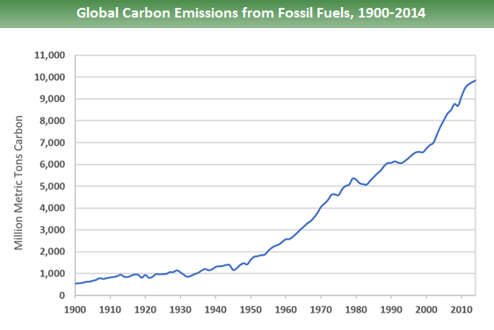
How do we measure the success of the
Sustainable Development Goals?
Source: Boden, T.A., Marland, G., and Andres, R.J. (2017). Global, Regional, and National Fossil-Fuel CO2Emissions. Carbon Dioxide Information Analysis Center, Oak Ridge National Laboratory, U.S. Department of Energy, Oak Ridge, Tenn., U.S.A. doi 10.3334/CDIAC/00001_V2017. Public domain.
Notes:
Global carbon emissions from fossil fuels have significantly increased since 1900. Since 1970, CO2 emissions have increased by about 90%, with emissions from fossil fuel combustion and industrial processes contributing about 78% of the total greenhouse gas emissions increase from 1970 to 2011. Agriculture, deforestation, and other land-use changes have been the second-largest contributors.

Slide 6
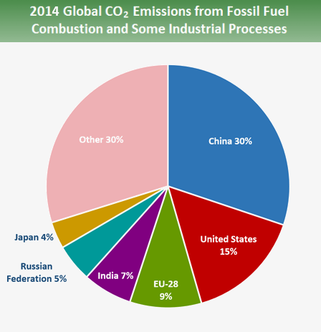
How do we measure the success of the
Sustainable Development Goals?
“The effects of climate change are worse among poor and low-income communities, in part because many live on the margins of society, in unstable structures, and in areas more susceptible to flooding, landslides, earthquakes, but also because of inadequate capacities, inadequate resources and reduced access to emergency response systems.”
Source: https://www.un.org/en/climatechange/cities-pollution.shtml
Source: Boden, T.A., Marland, G., and Andres, R.J. (2017). Global, Regional, and National Fossil-Fuel CO2Emissions. Carbon Dioxide Information Analysis Center, Oak Ridge National Laboratory, U.S. Department of Energy, Oak Ridge, Tenn., U.S.A. doi 10.3334/CDIAC/00001_V2017. Public domain.
Notes:
In 2014, the top carbon dioxide (CO2) emitters were China, the United States, the European Union, India, the Russian Federation, and Japan. These data include CO2 emissions from fossil fuel combustion, as well as cement manufacturing and gas flaring. Together, these sources represent a large proportion of total global CO2 emissions.
Emissions and sinks related to changes in land use are not included in these estimates.

Slide 7

Health and education
“When levels of education rise (in particular for girls and young women), access to reproductive health-care improves, and women’s political, social, and economic empowerment expand, fertility typically falls.”
“It is critical that human rights are always centered, that gender equality is the aim, and that benefits to the planet are understood.”
Photo: Zack Clark, public domain.
Source: Project Drawdown. (2020). The Drawdown Review. Used with permission.
Notes:
Population interacts with the primary drivers of emissions: production and consumption, largely fossil-fueled.
It’s critical to note the vast disparities in emissions from high-income countries compared to low, and between the wealthiest individuals and those of lesser financial means. For example, almost half of consumption-related emissions are generated by just 10% of people globally.
According to Project Drawdown: “The topic of population also raises the troubling, often racist, classist, and coercive history of population control. People’s choices about how many children to have should be theirs and theirs alone. And those children should inherit a livable planet. It is critical that human rights are always centered, that gender equality is the aim, and that benefits to the planet are understood.”

Slide 8

Family planning
Currently, only 1% of all overseas development assistance goes to family planning.
“The world faces a $5.3 billion dollar funding shortfall for providing the access to reproductive healthcare that women say they want to have.”
“When family planning focuses on healthcare provisions and meeting women’s expressed needs, empowerment, equality, and well-being are the result; the benefits to the planet are side effects.”
Photo: Thiago Cerqueira on Unsplash, CC 0.
Source: Project Drawdown. (2020). The Drawdown Review. Used with permission.

Slide 9
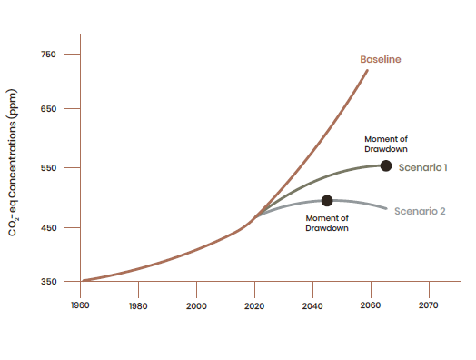
What does this mean for the environment?
“Drawdown is the future point in time when levels of greenhouse gases in the atmosphere stop climbing and steadily decline.”
Source: Project Drawdown. (2020). The Drawdown Review. Used with permission.
Notes:
“Drawdown is the future point in time when levels of greenhouse gases in the atmosphere stop climbing and steadily decline.”
Below is an excellent explanation of the graph above taken from the Drawdown Review 2020:
As of early 2020, atmospheric carbon dioxide alone is over 410ppm; with other greenhouse gases, we approach 460ppm CO2-eq. Under Drawdown Scenario 1, CO2-eq concentrations would rise to ~540ppm in 2050. The resulting global mean temperature would be 1.74˚C above pre-industrial levels in 2050 and rise to 1.85˚C in 2060—on a path to warm by 2˚C by century’s end. Under the more ambitious Drawdown Scenario 2, CO2-eq concentrations would peak at ~490 ppm in the mid-2040s and fall slightly by 2050 to ~485 ppm. Because there is a time lag between emissions and planetary warming, global mean temperature would continue to rise after the point of Drawdown, with peak warming around 1.52˚C through the 2050s.
Interestingly, the Drawdown Scenarios align, respectively, with meeting a minimum goal of 2°C and a more ambitious goal of 1.5°C. Drawdown Scenario 1 is roughly in-line with 2˚C temperature rise by 2100, while Drawdown Scenario 2 is roughly in-line with 1.5˚C temperature rise at century’s end. In other words, we can avoid catastrophic warming with climate solutions in hand today. What’s more, our analysis does not include all possible climate solutions already available. With other potential solutions, such as those focused on reducing industrial emissions or capping fugitive methane, the world might reach Drawdown even more quickly.
(From Drawdown Review 2020)

Slide 10
What does this mean for the environment?
According to Project Drawdown, access to educational opportunities for women and family planning would save 85.42 Gigatons of CO2 equivalent from 2020-2050
Source: Project Drawdown. (2020). The Drawdown Review. Used with permission.
Notes:
Of the categories Project Drawdown identified, these two combined would have the second largest impact on CO2 reduction.

Slide 11
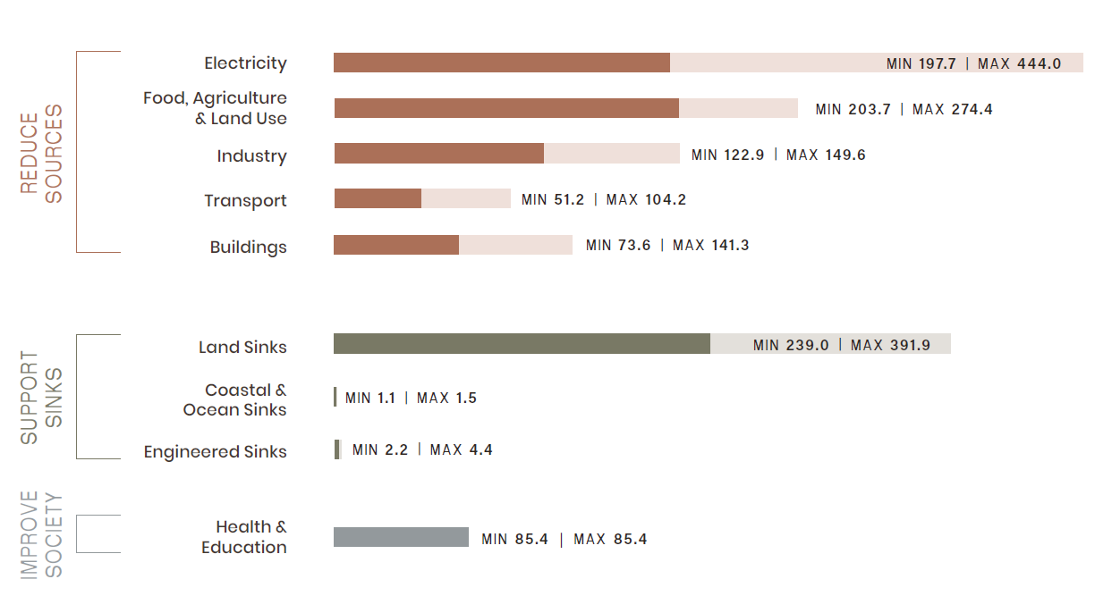
What does this mean for society?
Beyond addressing greenhouse gases, climate solutions can have “co-benefits” that contribute to a more equitable world.
Source: Project Drawdown. (2020). The Drawdown Review. Used with permission.
Notes:
From Drawdown 2020 Review: The Drawdown Solutions Framework organizes climate solutions by sector and by subgroup, within three overarching areas of action. Here, you see the potential emissions impact of each sector, as well as the solution subgroups therein. Using two different scenarios of solution implementation, we derived the minimum and maximum impact shown here. (X / Y = Min / Max CO2-eq (Gt) reduced/sequestered (2020-2050)
Definition of “Sinks” according to Drawdown 2020 Review: “Land is a critical component of the climate system, actively engaged in the flows of carbon, nitrogen, water, and oxygen—essential building blocks for life. Carbon is the core of trees and grasses, mammals and birds, lichens and microbes. Linking one atom to the next, and to other elements, it’s the fundamental material of all living organisms. Plants and healthy ecosystems have an unparalleled capacity to absorb carbon through photosynthesis and store it in living biomass.”

Slide 12
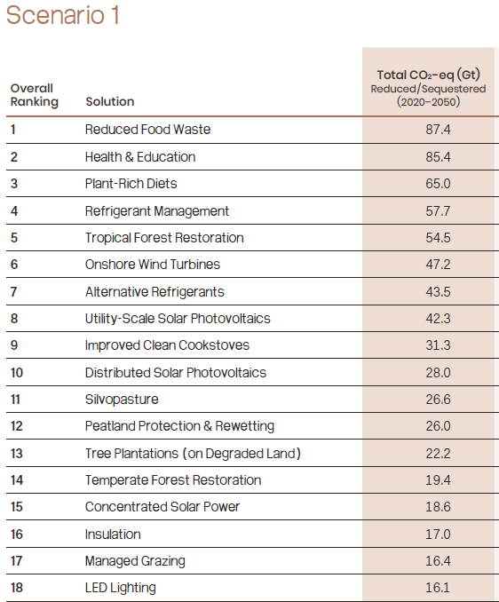
What does this mean for the environment?
Source: Project Drawdown. (2020). The Drawdown Review. Used with permission.
Notes:
These are all current technologies and techniques we can do to achieve scenario #1. Education and healthcare is #2. Overall there are 76 individual solutions (not shown). Many are behavior changes, some are technological, some are technique improvements. (Silvopasture is the intentional combination of trees, forage plants and livestock together as an integrated, intensively-managed system. From aftaweb.org)
(This is also an optional slide.)

Slide 13
Thank you!

Slide 14

Created by Lawrence Hall of Science for the NISE Network. Copyright 2020, University of California, Berkeley. Published under a Creative Commons Attribution-Noncommercial-ShareAlike license: http://creativecommons.org/licenses/by-nc-sa/3.0/us/
The Rob and Melani Walton Sustainability in Science and Technology Museums program is supported through funding from The Rob and Melani Walton Foundation.
Slide 3: The Sustainable Development Goals (SDGs) logo, color wheel, and icons are used according to the United Nations guidelines: https://www.un.org/sustainabledevelopment/wp-content/uploads/2019/01/SDG_Guidelines_AUG_2019_Final.pdf
All other image and content credits as cited on slides.

