Slide 1
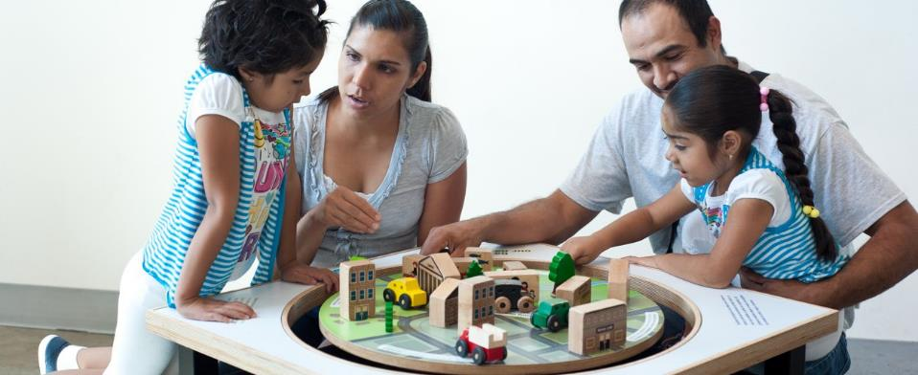


Developing Programs to Reach Bilingual Audiences

Slide 2
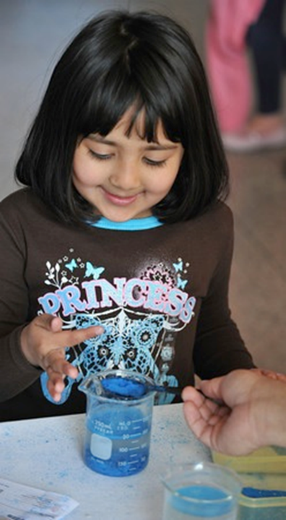
Overview
Welcome and Introductions
Presentations
Q&A
Presenters:
Aaron Guerrero, Children’s Museum of Houston
Veronika Nunez, Oregon Museum of Science and Industry
Treloar Tredennick Bower, Fort Collins Museum of Discovery
Nick Spicher, The Science Factory
Veronica Garcia-Luis, Exploratorium
Aaron Hunt, West Texas A&M University

Slide 3
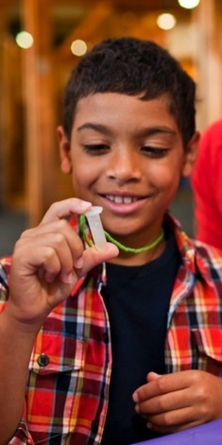

NISE Network
Nanoscale Informal Science Education Network
The NISE Network is a national community of researchers and informal science educators dedicated to fostering public awareness, engagement, and understanding of nanoscale science, engineering, and technology.

Slide 4
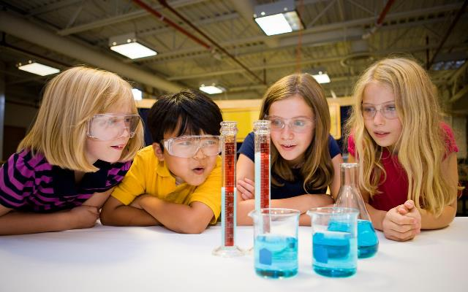

NISE Net Bilingual Resources
Aaron Guerrero
Project Manager for XCL and 21-Tech
aguerrero@cmhouston.org

Slide 5
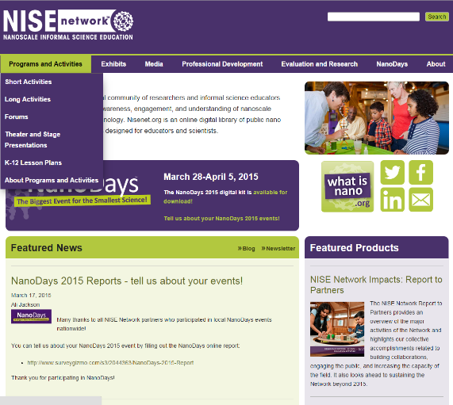
Website for Educators - nisenet.org
  Finding Spanish Resources
  Programs
  Exhibits
  Tools and guides
  Media
  Graphics

Slide 6
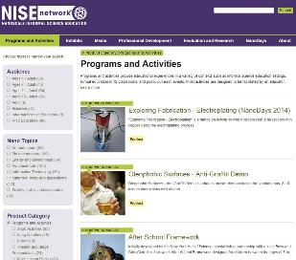
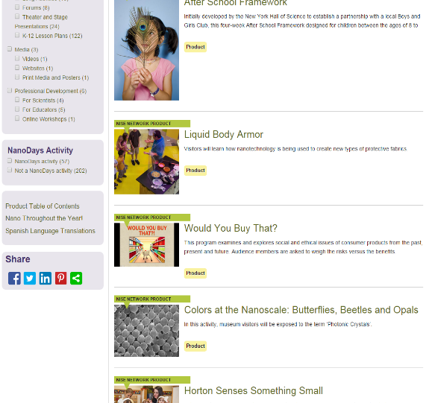
Spanish Language Translations
Spanish Language Translations

Slide 7
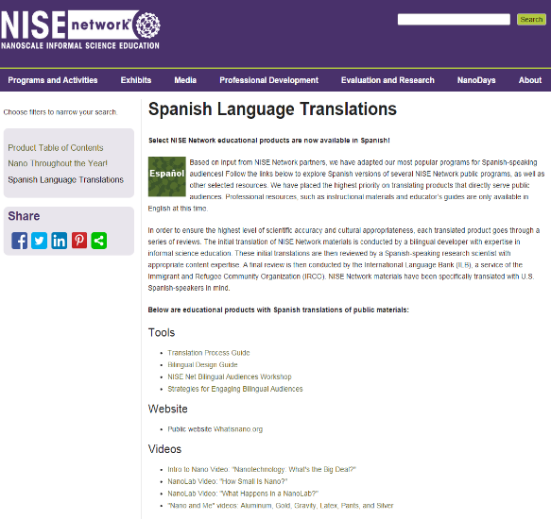
Spanish Resources

Slide 8
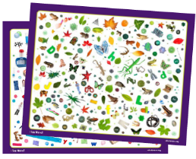
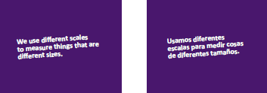
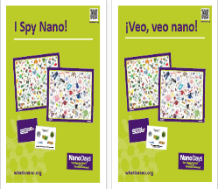
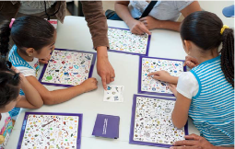
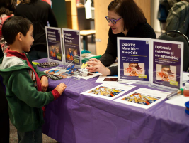
Bilingual Programs

Slide 9
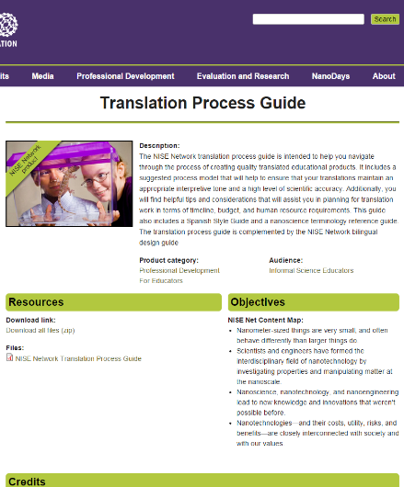
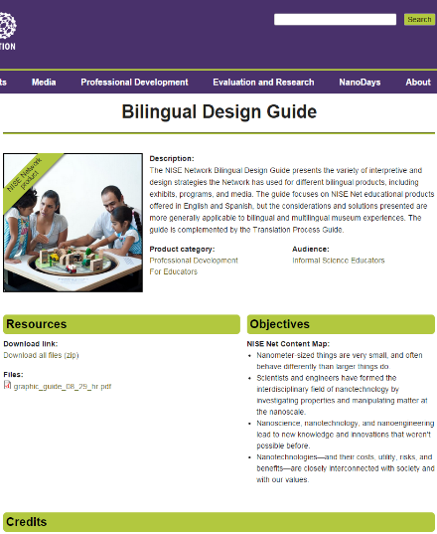
Bilingual Guides

Slide 10
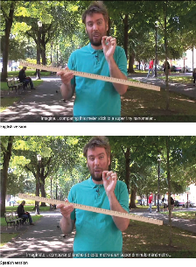
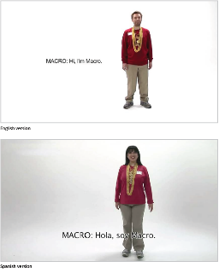
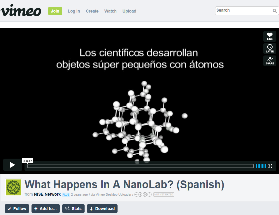
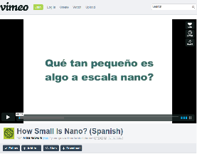
Bilingual Videos
Intro to Nano
Nano and Me
What Happens In A Nano Lab?
How Small Is Nano?

Slide 11
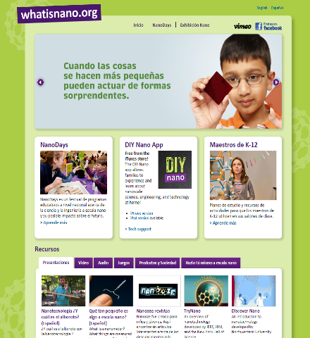

Website for the Public
  Videos, podcasts, activities, links
  List of mini-exhibition locations
  Audio Description in English and Spanish

Slide 12
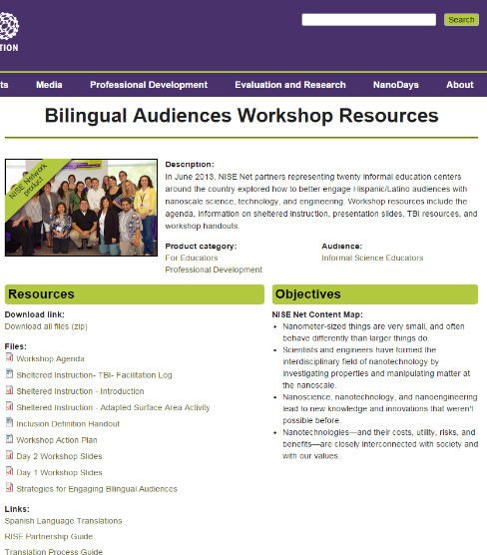
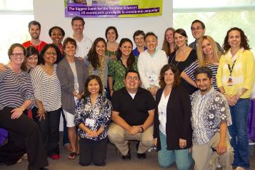
NISE Network- Bilingual Audiences Workshop
20 informal education centers attended
Attendees received strategies and tips
Also received resources including Translation Process Guides, Bilingual Design Guides, and Team- Based Inquiry Guides.

Slide 13
Workshop Goals
Overarching Goal:
To inspire confidence and build capacity for partners to engage bilingual audiences in nanoscale science, engineering, and technology (nano).
As a result of participating in the workshop, professionals will:
1. Develop a rationale for engaging bilingual audiences in nano, and see bilingual work as an emerging practice.
2. Build awareness of and facility with educational and professional tools and strategies (both NISE Net and outside resources), to better engage bilingual audiences.
3. Connect with other professionals engaged in bilingual work by sharing personal experiences and learning together.
4. Identify opportunities for action by problem solving challenges and articulating next steps.

Slide 14
Collaborating with organizations that serve Hispanic communities
Verónika Núñez
OREGON MUSEUM OF SCIENCE AND INDUSTRY

Slide 15
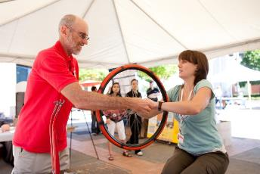
Identify 3 organizations that already work with the Hispanic community
These organizations include schools, non-profits, theaters, wellness centers, libraries, community groups, etc.
Look for leaders within these communities that are trusted and know the population you are working with/for.
Look for Spanish newspapers to know what’s happening in the community: events, openings, celebrations.

Slide 16
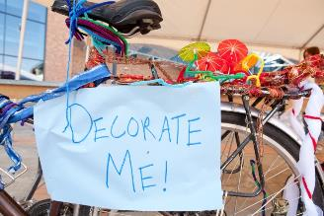
Collaboration and partnerships take time
Be aware of that when planning events, classes, or any other activities with partner organizations. Ask yourself these questions:
    Where’s is this organization located (geographically)?
    Who’s your contact? Has this person organized similar events?
    What’s the preferred language of the community you are serving? Do you have bilingual volunteers? Do the organization you are partnering with have bilingual volunteers?
    Do you need bilingual materials? What kind of materials? (Libraries are fantastic resources and often have bilingual materials, books, activities.)

Slide 17
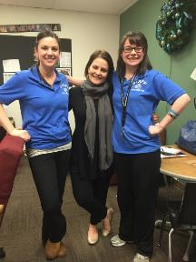
Relationships are at the heart of collaboration
Nourishing and sustaining the relationship should be a priority.
    Listen to the needs of the community, respond to their requests, understand their challenges, find ways to include their voices in the programming.
    Define clear roles and responsibilities.
    Have realistic expectations.
    Record the progress of the collaboration: what worked, what didn’t work, resources, etc. It will be a valuable reference.

Slide 18
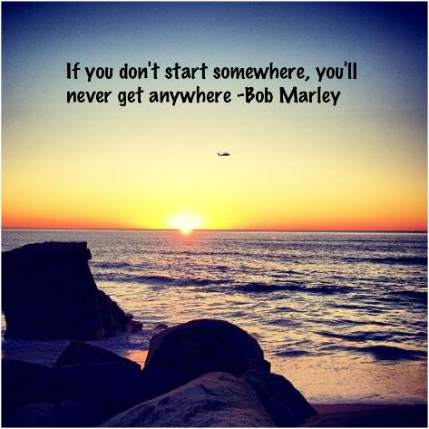
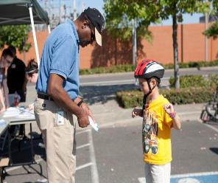
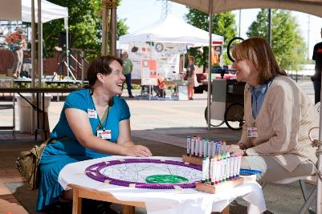
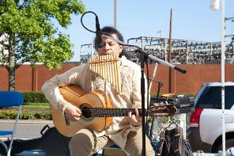
Start small, gain confidence

