Slide 1
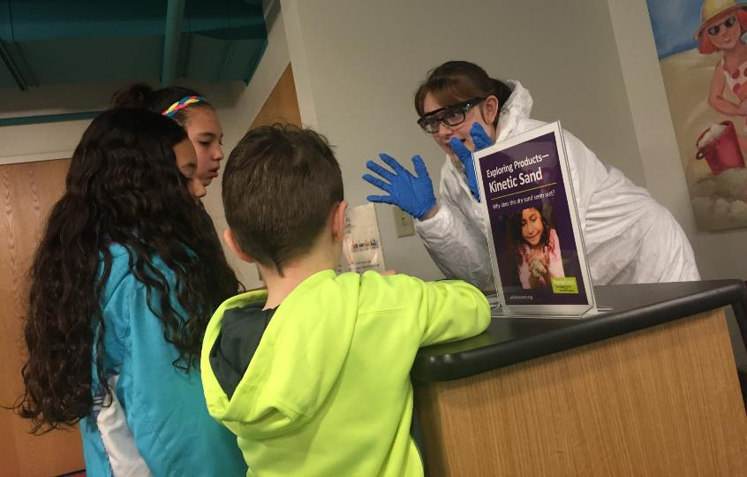
Jacqueline Gardner
Programming Director
Children’s Museum of Eau Claire
NANO-LAB-ORATION

Slide 2
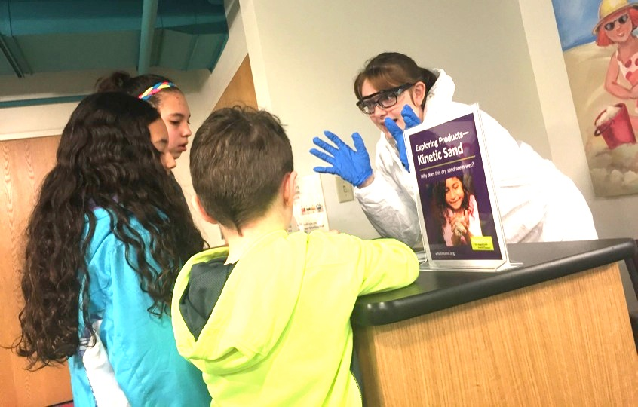
Leveraging community collaboration to bring the smallest of sciences to the smallest of visitors.
NANO-LAB-ORATION

Slide 3
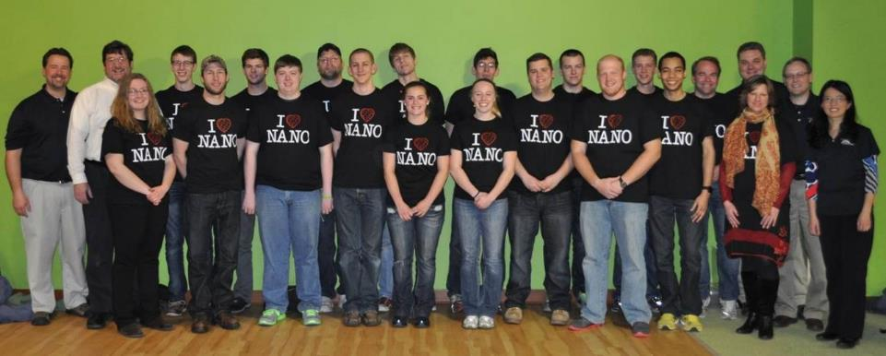
Material Sciences Department

Slide 4
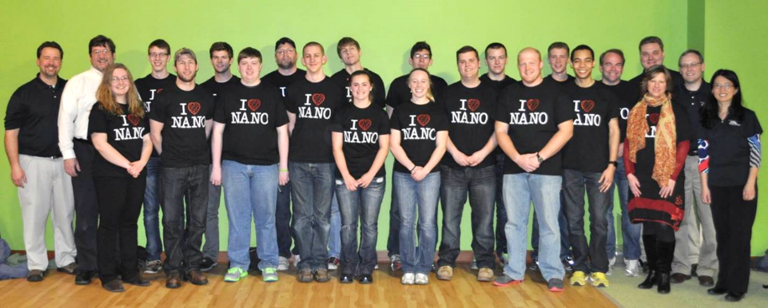
Material Sciences Department

Slide 5
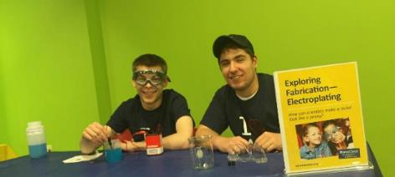
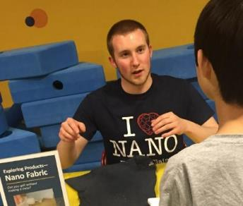
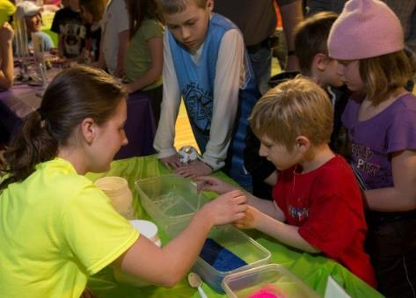
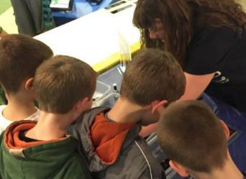
CMEC & UWEC

Slide 6
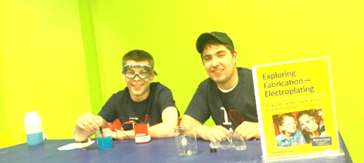
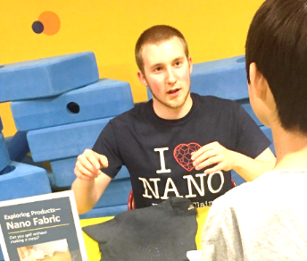
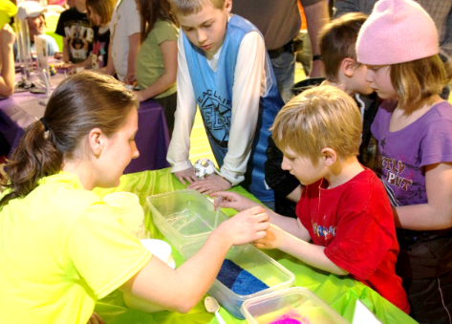
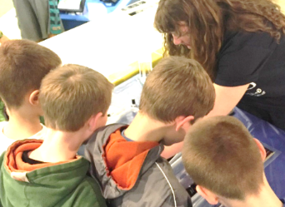
CMEC & UWEC
Mutual Mentoring
Appreciation for Community
Relatability
Better Resources
Leverages Time (aka, work less)
Everyone wins

Slide 7
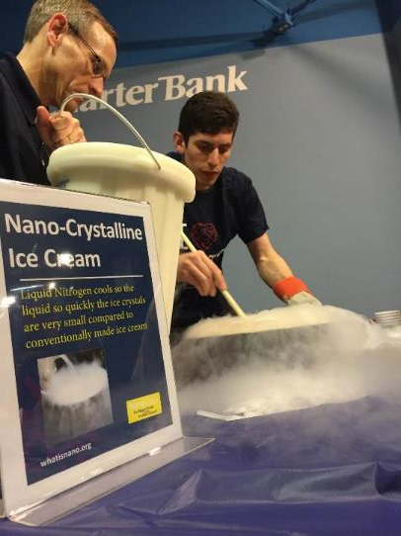
NANO ICE CREAM!

Slide 8
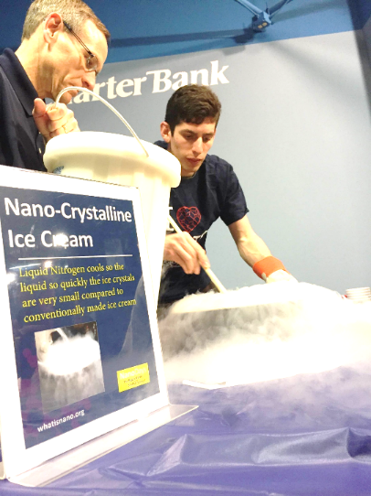
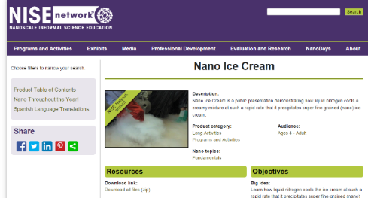
NANO ICE CREAM!
Liquid nitrogen
Rapid cooling creates superfine grained (nano) ice cream
Kids LOVED it
Adults loved it, too

Slide 9
Meeting a Young Audience’s Needs
John McCollum
Biotechnology Learning Center Supervisor

Slide 10
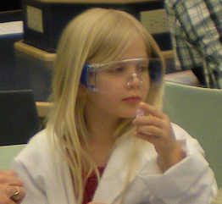
Questions to ask yourself as you design a new Nano program:
How young is your expected audience?
What can you anticipate them already knowing about your subject?

Slide 11
If you know the age group you are working with…
Ask the teachers in your community directly if you can, and look at national standards and state standards. For Nano programs, pay particularly close attention to national standards sections with this header: Physical Science- Structure and Properties of Matter

Slide 12
If you don’t know the age group you are working with or are anticipating mixed groups…
Build extra time into your program to allow you to ask your audience questions. This will allow you to determine their level of knowledge :
“What do you think nanotechnology is?”
“Do you know what an atom is?”

Slide 13
If you find your audience is working from an elementary level…
Be prepared to define every new term you introduce. Break complex terms down into simpler ones that include concepts at the appropriate level.
The term nanotechnology, for example:
Nano can be equated with something small.
Technology involves something used as a tool.

Slide 14
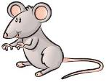
If you find your audience is working from an elementary level…
Ask participants to provide examples for a new definition. Use what they give you to construct analogies and comparisons:
“A mouse is really small, but a molecule is even smaller. One hair on that mouse’s back might be 100,000 nanometers across. A DNA molecule is only two nanometers across.”

Slide 15
Other considerations for working with a young audience include…
Time:
Young audiences want to be active and discover new things. If possible, plan for you activity to take no more than 15 or 20 minutes, even if it is very engaging.
Provide frequent breaks if a program must go longer. Shift focus and program style every twenty minutes.

Slide 16
Other considerations for working with a young audience include…
Safety:
Have traditional lab safety measures in place, but have mobile alternatives.
Use safety equipment that fits.
Replace glass with plastic where you can.
Anticipate hazards such as allergies, small items that are easily swallowed or placed in mouth, sharp items, poisons, and magnets.

Slide 17
Summer of Learning Sponsored by United Way
Kevin Velasquez
Exhibits Project Manager
kvelasquez@cmhouston.org
(713) 535-7239

Slide 18
Technology

Slide 19
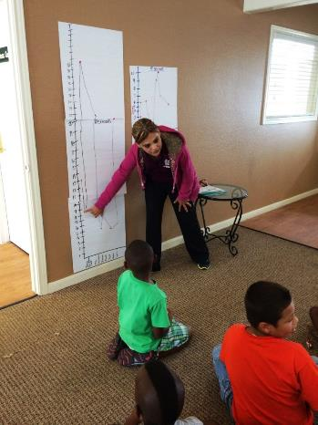
Math

Slide 20
Science

Slide 21
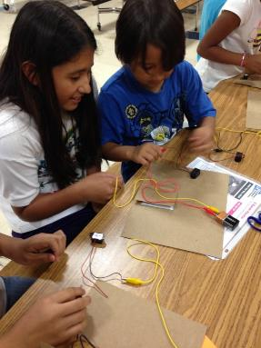
Engineering

Slide 22
Activating Prior Knowledge

Slide 23
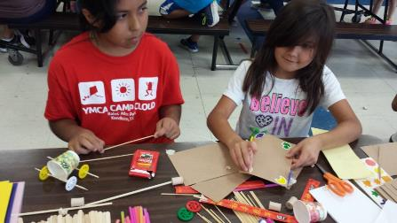
Art

Slide 24
Summer retention program Emphasis on STEAM and Literacy 10 weeks - 720 kids - 8 sites 2015 Courses: Chemistry, Geology, Astronomy, Engineering Pre- and post-evaluation

Slide 25
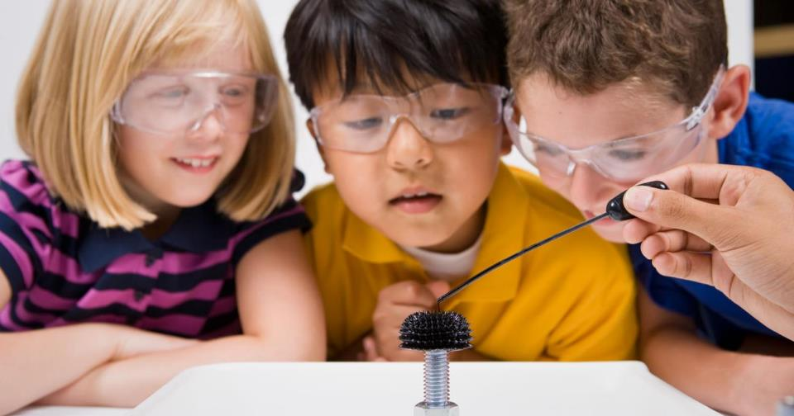
This presentation is based on work supported by the National Science Foundation under Grant No. 0940143.
Any opinions, findings, and conclusions or recommendations expressed in this presentation are those of the author(s) and do not necessarily reflect the views of the Foundation.
Notes:
And as always, thank you to NSF for supporting this project!

Slide 26
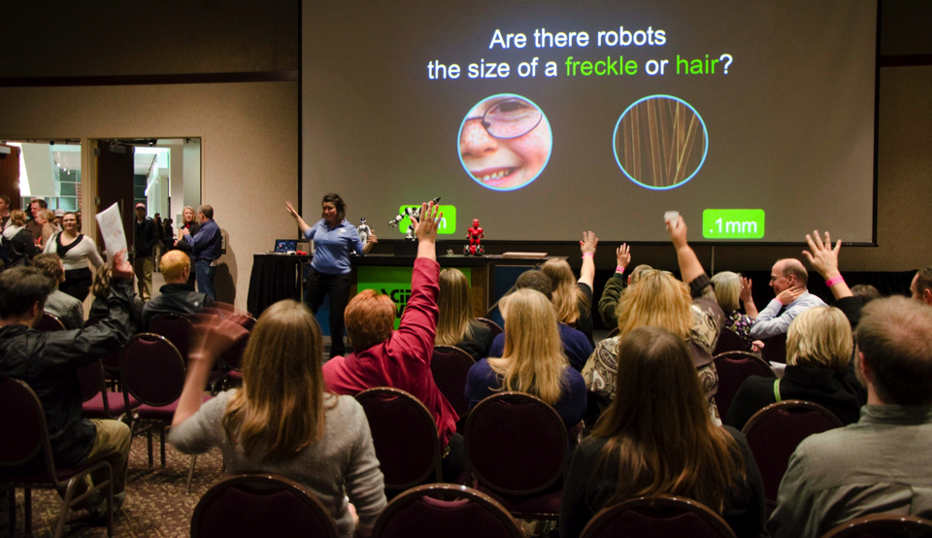
Questions and Answers

Slide 27
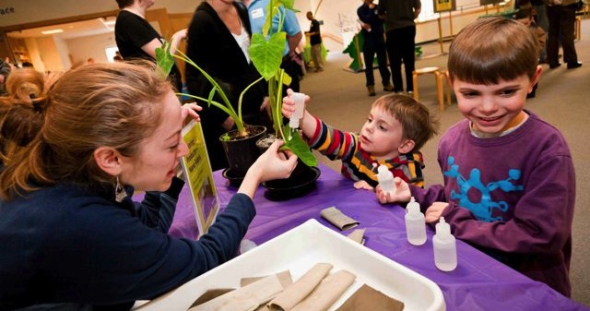
THANK YOU!!!
To all our partners, we could not do this work without you!

