Slide 1
Designing and Implementing
K-12 Teacher Professional Development
Michelle Kortenaar, Sciencenter
Joyce Allen, Georgia Institute of Technology
Becky Wolfe, Children’s Museum of Indianapolis
Bob Decker, Mohawk Valley Community College
Mary Breen, Fernbank Science Center
Carolyn Nichol, Rice University
Matt Johnson, Penn State University
Lynne Hehr, University of Arkansas
Tanya Faltens, nanoHub

Slide 2
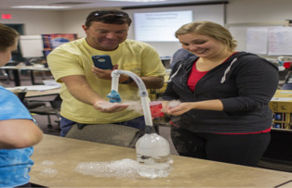

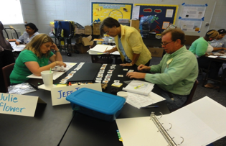

Teacher Professional Development at Georgia Tech
Summer 2014 and Fall 2014 Workshop:
Nanoscale Science and Engineering as an Avenue to STEM in Elementary and Middle Schools
Funded by the Teacher Quality State Grant
Teacher Recruitment Six Schools committed to sending a team of teachers-Science, Math, ELA
Requirements of Teams
Read two books before workshop.
Attend a 4 day workshop at GaTech
Plan and carry out a design challenge based on students’ learning of NSE.
Return for Follow-up with students to share design challenge results.
Notes:
Joyce Allen

Slide 3
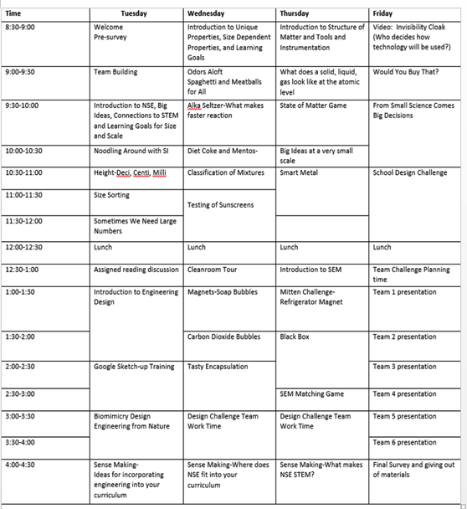
Selection of Activities
Where NSE Fits into Curriculum
Available Resources
www.nnin.org
http://www.nnin.org/sites/default/files/files/Joyce_Resource%20List.pdf

Slide 4
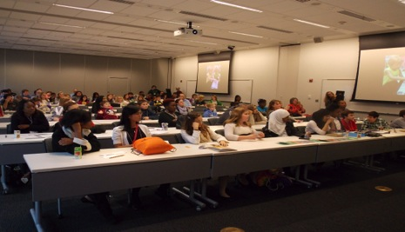
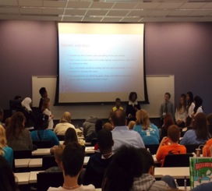
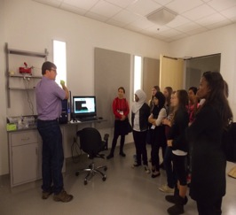
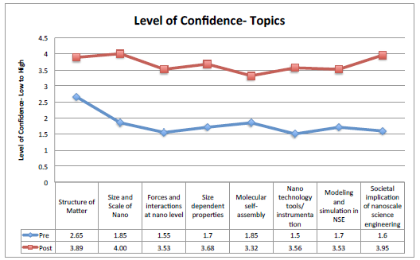
Results
Follow-up Meeting December 2014
External Evaluation
http://www.ien.gatech.edu/georgia-tech-nnin-education-and-outreach

Slide 5
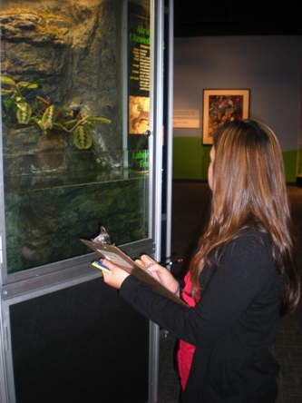
What does PD “look like” at TCM?
One Day Workshops:
Related Gallery Investigation
Guest Speaker
Nano specific and nano “infused”
Summer Institutes:
3-5 days
Includes guest speakers on field trips
Long term projects
Notes:
Becky Wolfe

Slide 6
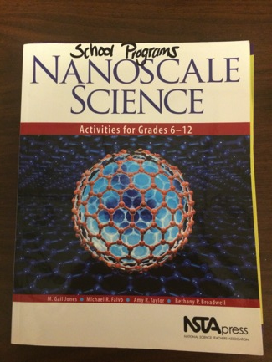
Curriculum and Resources
“You can’t eat just one”
Use a primary curriculum book
Supplementary resources - provided via handouts or dropbox
Specifically looking for connections to standards
Nano Specific:
Allign NISEnet materials with standards; added supports for notebooks
NSTA Nano book

Slide 7
Nano and the Classroom
Teachers as learners
Teacher pre-survey – low familiarity with nano
Workshop was content heavy; used NISE materials for this section
Foundation was NISEnet “Big Ideas”
Teachers as educators
Modeled inquiry teaching practices
Used tools, materials, etc. that would be suitable for a middle school classroom
Content tied to chemistry standards (Indiana)

Slide 8
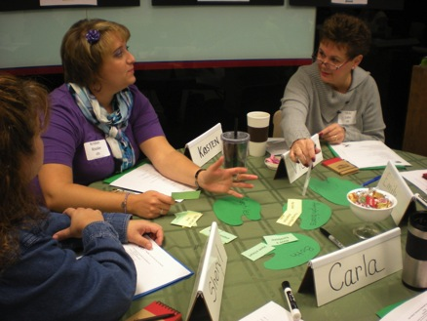
Sneaking in Nano
What is Nano?
In 2012, teachers unfamiliar with nano; reluctant to sign up for workshop
Sneaking in Nano:
Success with including nano in other topics
Workshops included: geckos, biotechnology, chemistry, natural history, mathematics

Slide 9
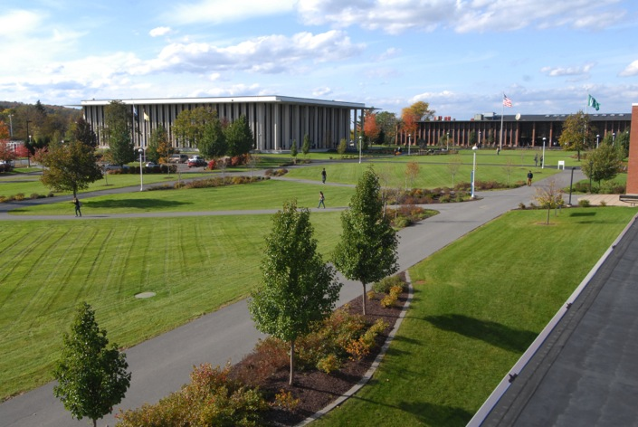


Mohawk Valley Community College
JUNE 2015
NETWORK-WIDE MEETING
NISENET.ORG
Notes:
Good morning. My name is Bob Decker and I’m from Mohawk Valley Community College in Utica, NY. I’m here to discuss our recent NiseNet Mini-Grant funded Teachers’ Workshop that was held at MVCC in March, 2015

Slide 10
Teachers Workshop - Scheduling
Identifying Time Constraints – Past Experiences
5 Day Sessions were not well-subscribed – Summer
2 Day Fri PM/Sat all Day were better – One afternoon release
Single Day/4 hour sessions were popular – 4 PM – 8 PM with dinner and presentation plus one hands-on activity
Issues Most Frequently Encountered:
Release Time/Substitutes (for some school districts)
Length of Program .vs. ability to integrate long activities
Places to include content in defined courses
Notes:
Past experiences in grant-funded activities that included teacher workshops indicated challenges with enrollment in multi-day workshops. A “half-day school” Friday and full-day Saturday session had greater interest with teachers investing one day and the districts supporting a half-day substitute. Release time and program length vs. content are issues as are questions regarding the space in existing curriculum for added activities.

Slide 11
Half-Day Saturday Session (March)
3 teacher groups were included in this workshop. The Nano 101 presentation and “Nanotechnology – What’s the Big Deal?” video was provided for all participants. Following this, groups broke up into 3 concurrent sessions. Two activities were presented for each
K-5 : Oobleck (NanoDays) and Electroplating (various sources)
6-9 : Ferrofluids (NNIN) and Nanotechnology Consumer Products (NACK Center and MRSEC)
HS : Dye-Sensitized Solar Cells (MRSEC) and LCD Thermometer (NNIN)
Participants included two K-5 teachers, 5 MS teachers, 6 HS teachers
MVCC Facilitators included three faculty members and three student assistants (Science/Engineering Majors)
Notes:
In this format, 3 different groups of teachers were convened for a 4 hour activity. All participated in the Nano 101 presentation and “Nanotechnology – What’s the Big Deal” video screening and then were separated into groups. 2 activities per group were explained and presented. NiseNet, MRSEC, NACK, and NNIN activities were performed and the teachers were provided with materials to complete the session activities back at their home school districts.

Slide 12

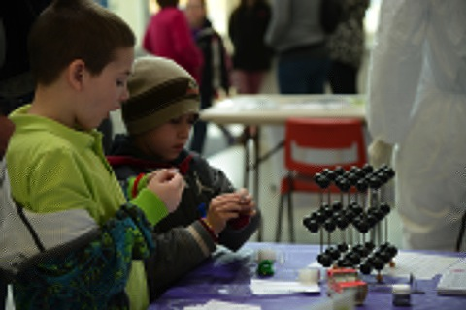
Workshop Logistics
Teachers were provided with
Lesson Plans for activities (NiseNet), standards, and links for further study
Major Materials for use in classroom upon return
Technical Support from Facilitators
Possible uses:
One to two day activities
Supplemental for AP Class use following May Exams
Notes:
Teachers were provided with links to supporting materials and information on sources for materials and supplies to augment what was provided. Lesson plans, links to existing sites and related sites, and information on applicable educational standards, where available, were also provided.

Slide 13
Results and Feedback
Additional Support/Outcomes:
Pre/Post surveys indicated significant improvement in understanding topics in nanotechnology
Instructors/Facilitators were invited to school districts for visits and further activities
Participants indicated interest in further activities
NiseNet funding for materials and facilitators through the Mini-Grant made this activity possible!
Contact info: rdecker@MVCC.edu
THANK YOU!!!
Notes:
Pre and post workshop surveys indicated that the participants felt that they had improved their knowledge and understanding of Nanotechnology. Participating teachers invited the workshop facilitators to visit their home districts and follow-on discussions on materials and implementation have taken place. Visits to one school district have already taken place since the workshop. NiseNet funding of this activity provided the support needed to carry this out!

Slide 14
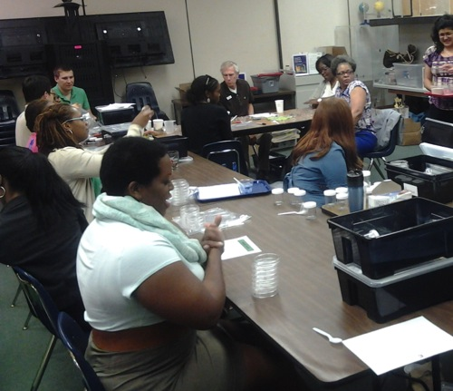
Use teachers’ time wisely
Provide enough materials for them to do the lesson in stations or groups (find out your state’s maximum class size, provide materials for that many students).
Include time in the workshop to prepare materials.
Think of your workshop like a Nisenet NanoDays activity box. When you open it up, EVERYTHING is there!
Text:
Text
Notes:
Mary Breen

Slide 15

For a teacher time is...
$$money$$
If you can’t give a teacher money, then give them time. Find a way to provide money for substitute teachers.

Slide 16

Customize your workshop
Provide a survey in advance to find out areas of strengths and weaknesses

Slide 17
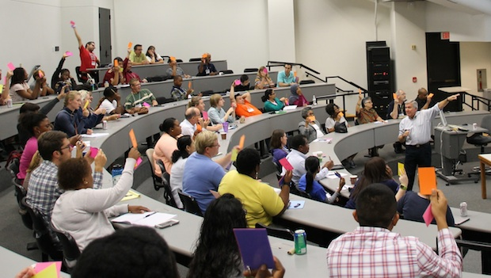
Rice University Office of STEM Engagement
JUNE 2015
NETWORK-WIDE MEETING
NISENET.ORG
Notes:
Carolyn Nichol
Good morning

Slide 18
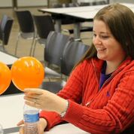
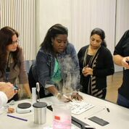
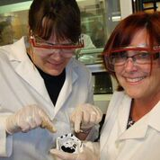
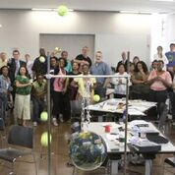
Rice University Office of STEM Engagement, Carolyn Nichol
Agenda for typical PD session
One week in the summer
Followed by 2 semesters during academic year (total 110-160 hours)
Lessons:
Example for high school biology:
  Potential Effects of Nano-silver on a Bacteria Population

Slide 19
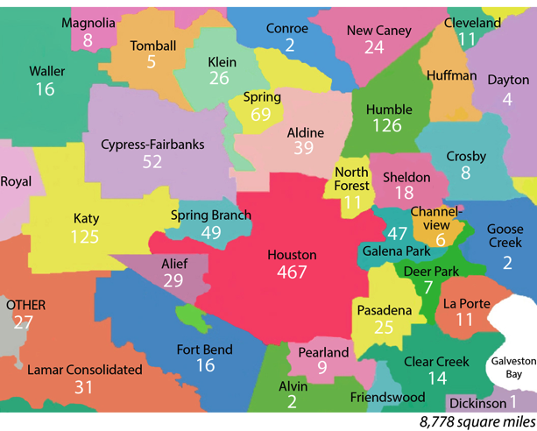
Teacher recruitment
Districts served:
Over 26 districts
Houston ISD
Partnerships
  Schools contribute
    Space
    Funding
    Substitutes

Slide 20
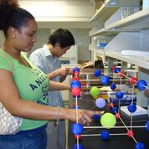
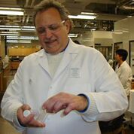
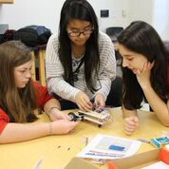
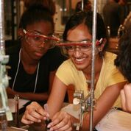
How do we fund the programs?
Federal Grants:
NSF REU site in nanotech
NSF RET site in nanotech
NISE mini-grant
Corporate Foundations:
ConocoPhillips
Schlumberger
Toshiba
School District Contracts:
HISD, YWCPN

Slide 21
What are the Barriers to Implementation?
Alignment with the standards
Teachers’ content knowledge
Administrators’ buy in
Proof
Use nanoscience as an example in standards aligned lessons
Provide intensive PD
Have conversations, meet their needs
Assessment, Data on student outcomes
More info: RSTEM.RICE.EDU

Slide 22
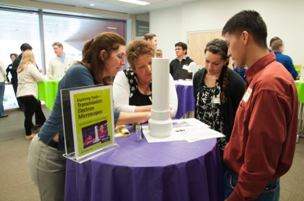
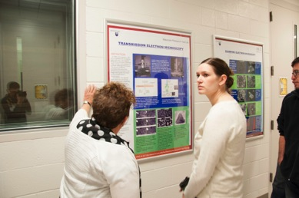
Nanodays Penn State
NanoDays at the Discovery Space of Central PA – 3/28/15
Hands-on activities for children and adults of all ages
NanoDays at the Millennium Science Café – 4/21/15
Professional Meeting promoting education and outreach experiences for researchers
NanoDays Nanotechnology Teacher workshop -4/28/15
Resources, research and careers for grade 6-12 STEM teachers
Notes:
Matt Johnson
Graduate students in nanoscale science/technology fields and TESLA students work with Kristin Dreyer (MRSEC) or me (ASSIST) to prepare for presenting the NISENet kits at the various events. We view this as an important professional development for the graduate students and teacher candidates as well as for the teachers that learn about nanoscale science/technology – communication with non-technical audience.
Agenda of teacher PD: overview of Nanoscale S/T, tour of Millennium science complex, millennium café, my lesson, taking nano concepts to the classroom (NISENet kits), taking nano concepts to the marketplace, workforce development, resources and reflections.
Stress importance of:
making cohesive story between all aspects
tour looked at TEM, NISENet TEM kit presented by grad student that uses TEM and could bring his research into it.
lesson used remote access AFM (would have), model AFM, grad student that uses AFM
Recruitment comes from multiple sources, but largely through the Center for Science and the Schools’ listserv/newsletter
Funding comes from multiple sources – MRSEC, ASSIST, CNEU, MSC

Slide 23
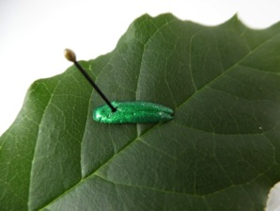
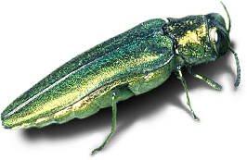
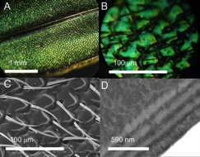
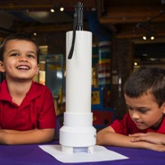
Teacher PD Strategy
Two hour lesson
Based on authentic PSU research
Uses the practices of researchers to learn content (as per NGSS)
Uses NISENet kit(s) as a phenomenon or as part of the learning
Examples:
How nanotechnology helped catch the emerald ash borer
Lotus leaf/ superhydrophobicity
Gecko feet

Slide 24
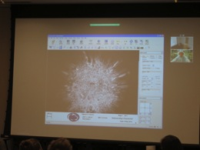
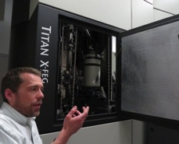
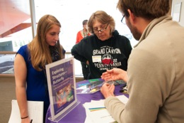
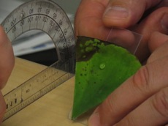
Collaborations
Penn State MRSEC
Center for Science and the Schools
Center for Nanotechnology Education and Utilization
Discovery Space Center Children’s Museum

Slide 25
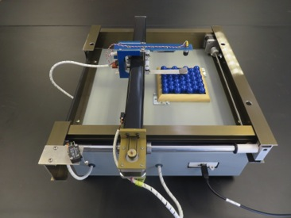
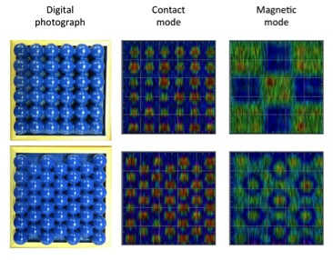
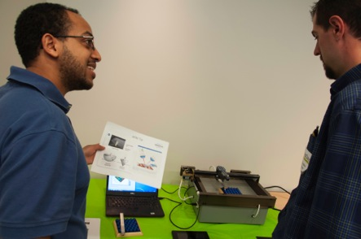
Teaching Model AFM – The Physics Teacher (in press)
Laser Diode
Photodiode &
Graded Filter
Electronics
Mirror
XY Translator

Slide 26
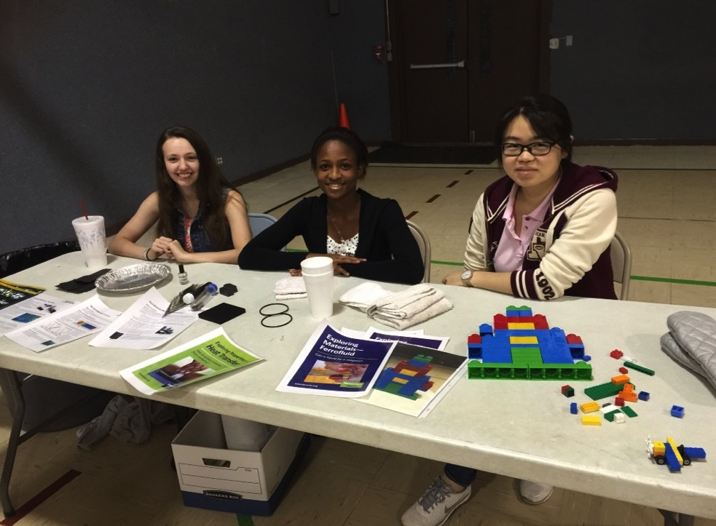
Agendas
One and one half public event
Three hour public event
Three hour teacher workshop
Six hour teacher workshop
JUNE 2015
NETWORK-WIDE MEETING
NISENET.ORG
Notes:
Lynne Hehr
Depends on time, teacher/student/public need, and outcome wanted:
Science Café
Public event
Family Math and Science Night: teacher and/or student led
Teacher Training – content, table setup to explore various stations, materials handout
Pre and post video test

Slide 27
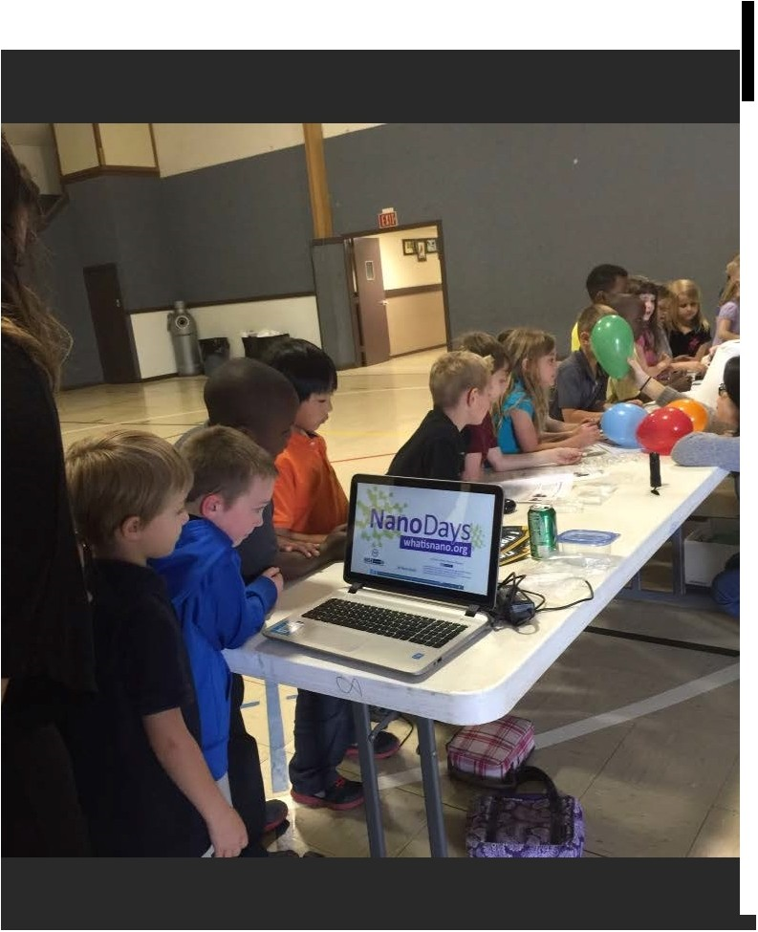
Materials
Nano 101, How Small Is Nano videos
I Spy Nano
Nano Future Tellers
Exploring Forces
  Static Electricity
Exploring Materials
  Ferrofluid
  Graphene
  Memory Metal
  Stained Glass Windows
Exploring Products
  Nano Fabric
  Nano Sand
  Sunblock
Exploring Properties
  Invisibility
  Surface Area
  UV Bracelets
Exploring Size
  Measure Yourself
  Memory Game
  Powers of 10 Game
  Scented Balloons
Exploring Tools
  3D Imaging
  Dress like a Nanoscientist
  Mitten Challenge
  Transmission Electron Microscopes
JUNE 2015
NETWORK-WIDE MEETING
NISENET.ORG
Notes:
Discuss what we did, what we gave them, materials that we provide them on loan, putting all liquid stations in the same area

Slide 28

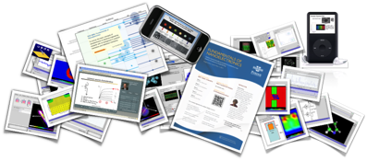

nanoHUB Education
Over 4000 Resources
nanohub.org/groups/u
www.nanohub.org
First
Year
Engineering
Nano Model Eliciting Activities
Problem Solving, Mathematical Modeling, Design, Teaming, and Computation Tools
8-Week Nano Design Project
K12 Engineering
Research Institute
Connecting Engineering with
People and Communities
Notes:
Education Research allows us to drive content and improve student learning

Slide 29
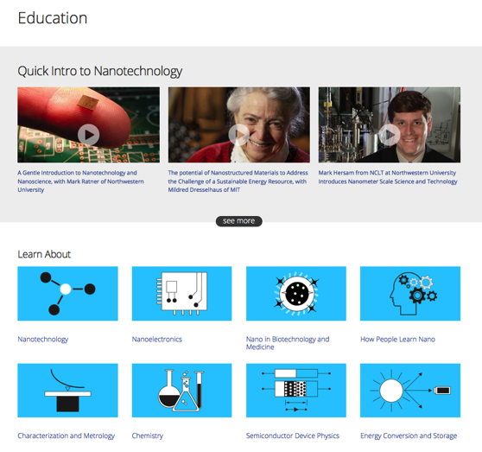
nanoHUB Education Page
nanohub.org/education

Slide 30
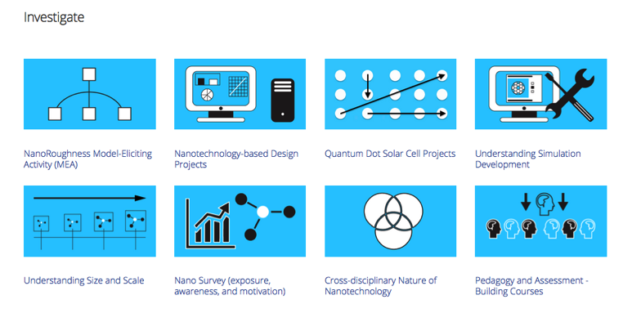
Nano Education Research
Contact Krishna Madhavan cm@purdue.edu
https://nanohub.org/groups/edresearch

Slide 31
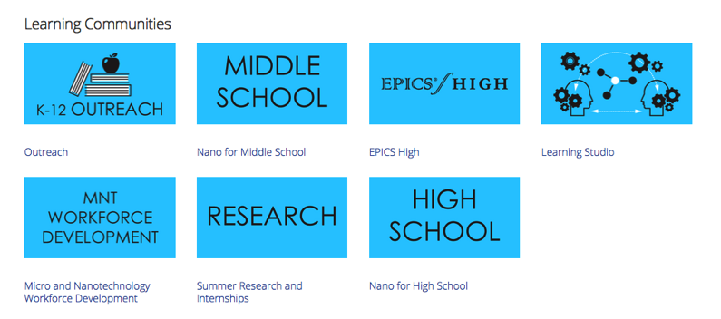
nanoHUB Learning Communities
nanohub.org/education

Slide 32
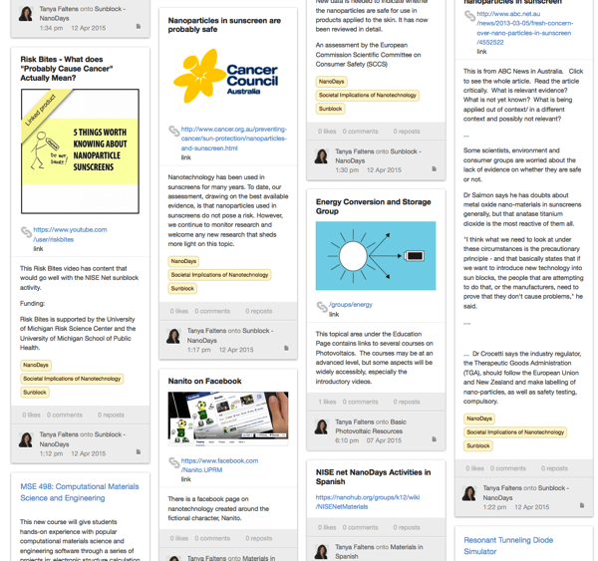
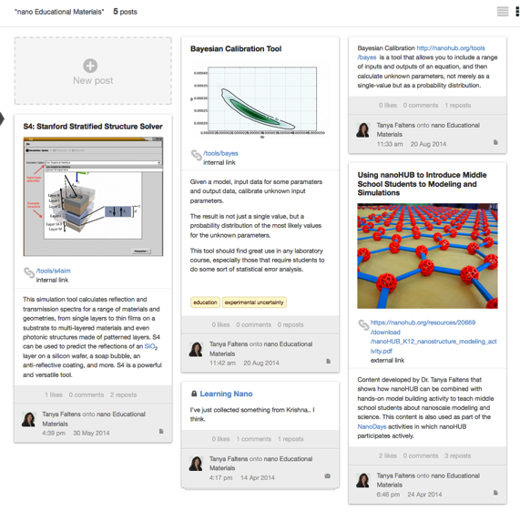
Collections allow nanoHUB users to collect, assemble, rearrange and share any content

Slide 33
Designing and Implementing
K-12 Teacher Professional Development
Michelle Kortenaar, mkortenaar@sciencenter.org
Joyce Allen, joyce.allen@ien.gatech.edu
Becky Wolfe, BeckyW@childrensmuseum.org
Bob Decker, Robert.Decker@mvcc.edu
Mary Breen, mary_breen@dekalbschoolsga.org
Carolyn Nichol, cnichol@rice.edu
Matt Johnson, mmj125@psu.edu
Lynne Hehr, lhehr@uark.edu
Tanya Faltens, tfaltens@purdue.edu

