Slide 1
Designing and Implementing Nanoscience Summer Camps
Michelle Kortenaar, Sciencenter
Meghan Schiedel, Terry Lee Wells Nevada Discovery Museum
Michele Laverty, National Ag Science Center
Andrew McGarrahan, St. Louis Science Center
Messaoud Bahoura, Norfolk State University
Alan Brown, SciPort: Louisiana’s Science Center
Paola Ferrari, Nanopiccola

Slide 2
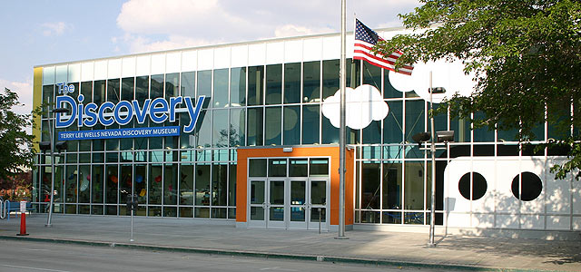
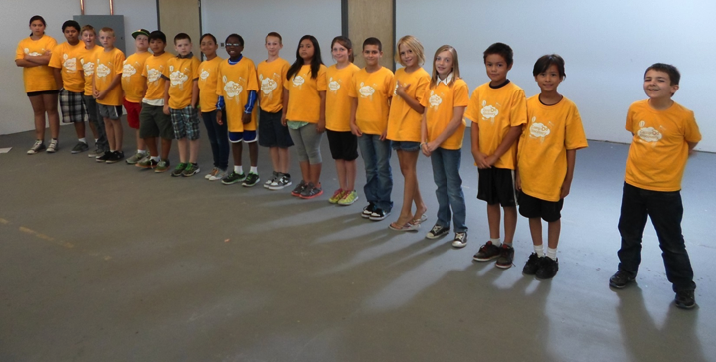
The Museum and The Camp
Text:
text
text
Notes:
Meghan Schiedel

Slide 3
Themed Days Based on Learning Objectives
5 Learning objectives:
Nano is studying and making tiny things
Nano- often behave differently than larger things do.
Nano is new technologies
Nano is in nature and technology
Nanotechnologies are closely interconnected with society and with our values

Slide 4
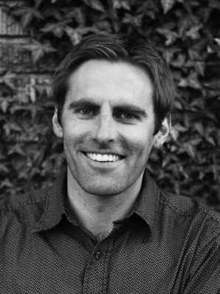
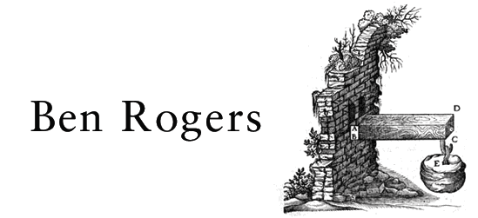
Guest Nano Scientist
Text:
text
text

Slide 5
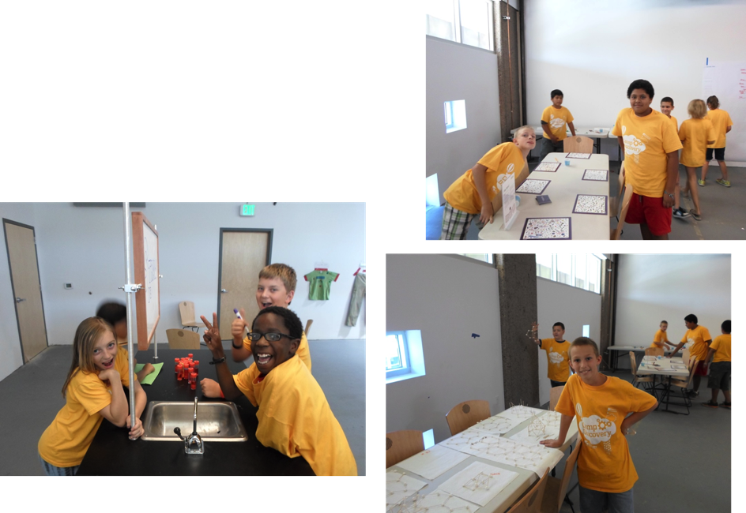
Nano Learning Celebration
Student lead NanoDay activities
Presentation of student work and learning throughout the week

Slide 6
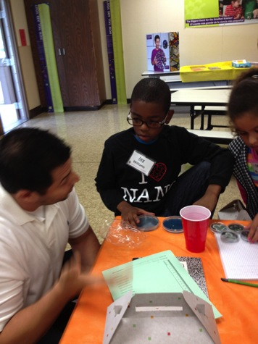
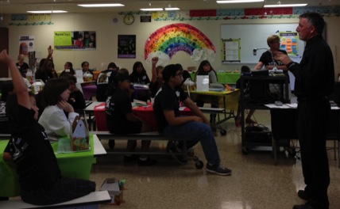
Ag and Nano Summer Camp
How is Nano Ag or Ag Nano?
Brought in scientists –
Daily experiments using Nano Days kits
Daily homework to extend
Michele@agsciencecenter.org
Notes:
Michele Laverty

Slide 7
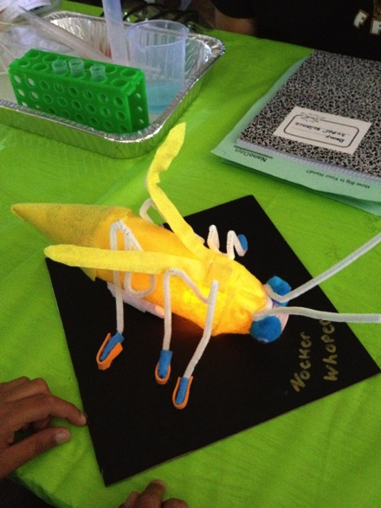
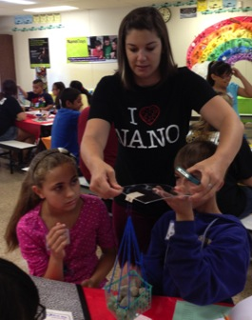
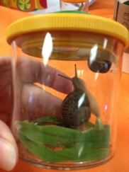
Ag and Nano Summer Camp
Connected to nature
Insect Safari
Build a bug homework
Gecko tape

Slide 8
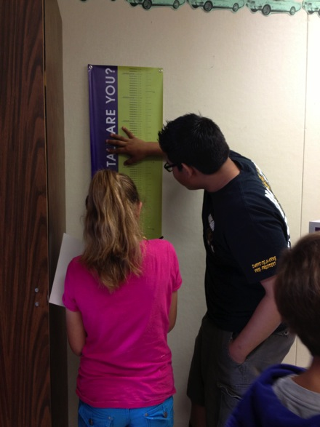
Ag and Nano Summer Camp
We partner with FFA as camp staff.
FFA members act as team leaders 3-1 ratio
They can share about FFA but they also learn the science with the campers…
“Nano science is pretty neat”
“The overall experience with the kids and the extra knowledge the FFA members learned as well.”
“#1 Favorite Part, Experiments!”

Slide 9
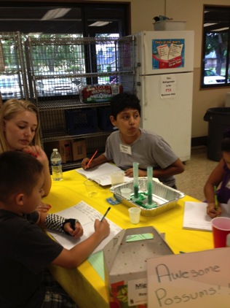
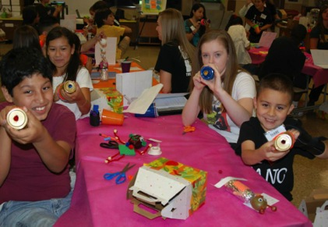
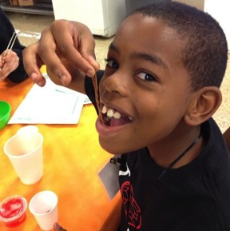
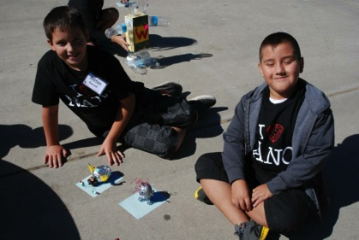
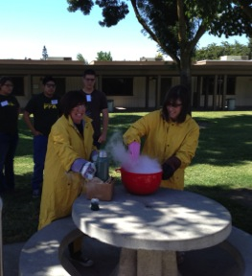
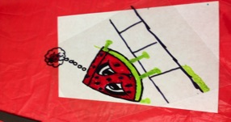
Ag and Nano Summer Camp
Ag an

Slide 10
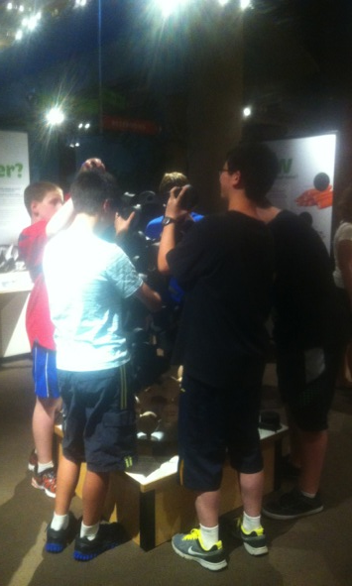
Camp Layout
Full day camps for High School Students
Morning spent as introduction to Nano concepts
Afternoon doing Lab work
Camp was taught by myself and another high school chemistry teacher using experiments from the University of Illinois and the University of Wisconsin MRSEC.
Notes:
Andrew

Slide 11
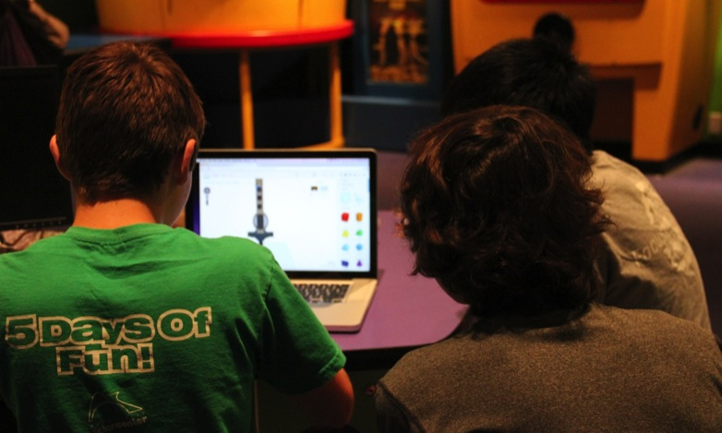
3D Design/Printing

Slide 12
3D Models

Slide 13
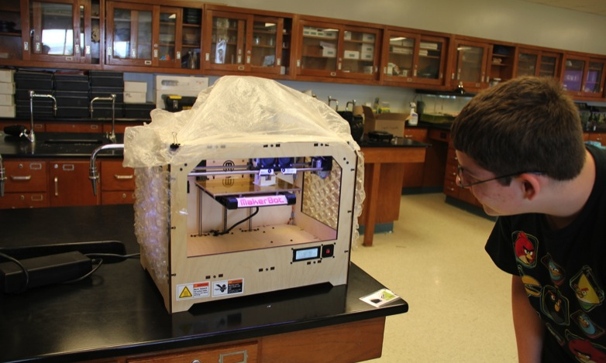
3D Printing

Slide 14
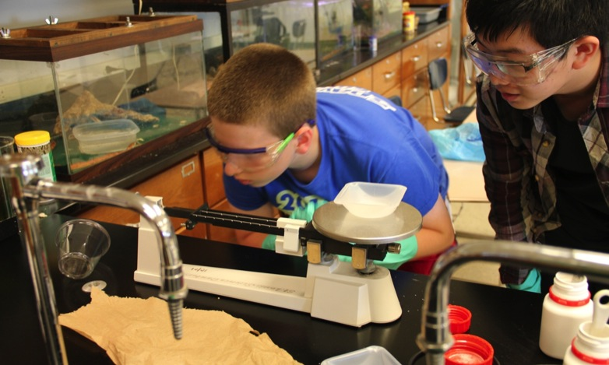
Liquid Crystals

Slide 15
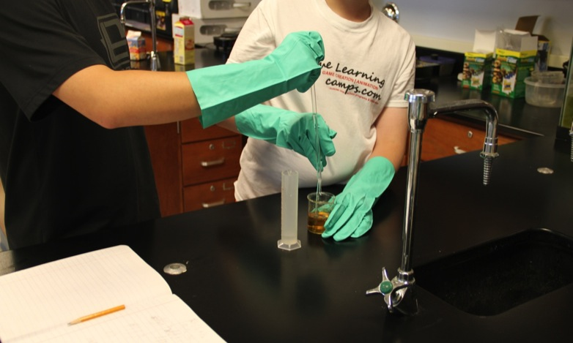
Ferrofluid

Slide 16
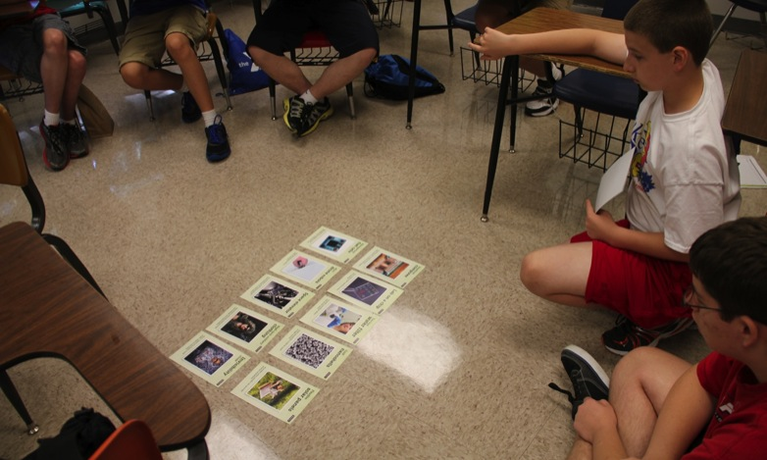
Nano and Society

Slide 17
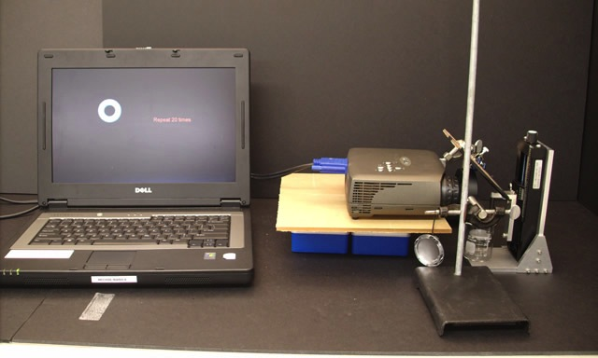
Nano 3D Printing

Slide 18
Nano and Society

Slide 19
Evaluations
Knowledge – 3.86
Enjoyment – 3.43
Interest – 3.57
Attitude – 3.57

Slide 20
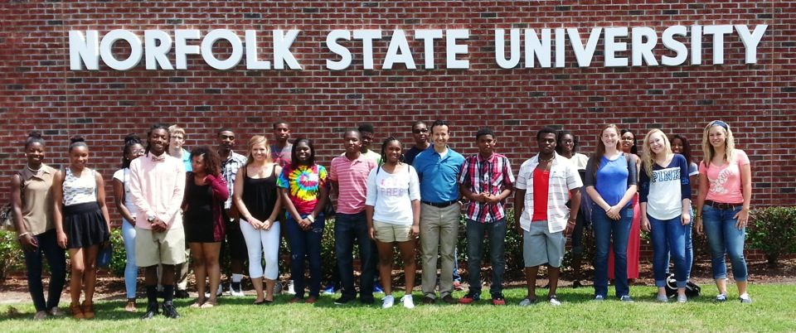
High School Summer Research at NSU
Dr. Messaoud J. Bahoura, Norfolk State University, mbahoura@nsu.edu
JUNE 2015
NETWORK-WIDE MEETING
NISENET.ORG
Notes:
Messaoud Bahoura
Good morning

Slide 21
High School Summer Research Overview
22 High School Students from 17 local high schools in the Hampton Roads area.
13 females.
9 males.
Number of students
17 minorities including African American and Asians. 4 Caucasian females, 1 Caucasian male.
Gender
Two faculty and 2 African American undergrads
Ethnicity
Mentors
$1,500.
Stipend
Research Topic
Building “Macro” Atomic Force Microscopy
Program Goals
Program Outcomes
Broaden the student’s experimental experience.
Develop critical thinking through reasoning, inquiring, and problem solving.
Gain independence and confidence in performing lab work.
Work in a team environment.
Learn by doing.
Perform lab work in a safe and organized manner.
Keep a legible and accurate description of procedure, observations, and results in a lab note book.
Manage time efficiently in lab.
Maintain a positive attitude toward lab work.
Be ethically and effectively prepared for college and research.

Slide 22
High School Summer Research Schedule
Week | Hands on activities
1 | Mandatory Center’s laboratory safety training and quiz. Groups’ formation with group captain’s election. Introduction nanotechnology: (NanoDays kits)
2 | Presentation: How the atomic force microscope works with questions and answer session. Reading material “Visualizing the Nanoscale” and quiz. Each of the three groups was assigned, randomly, the construction of one of three modes of the AFM. In groups, the students assembling AFM parts & components: getting familiar with the purpose of each part.
3 | Mid-program power point students’ presentation of their project in groups: Assembling and constructing the AFM Each group worked on how to make the cantilever reflect more of the laser light with minimum diffusion. They used different types of polishing materials and came up with few ideas. High school students used tools such as electrical drill, saw, and Dremel tool set to assembled the AFM frame; installed the HeNe laser, the cantilever and the probing tip.
4 | Seminar: “Professional ethics and responsible research conduct” by Dr. Jon Skuza (CMR) followed by a quiz. Taking measurements and plotting data. Seminar: “How to present their results in public for both oral and poster formats” Dr. Ashley Haines (Biology Department), followed by a quiz.
5 | Real AFM Training: micro and nano scale objects scanning for poster presentation. Preparing posters Public presentation of posters Public closing ceremony and distribution of certificates of participation.

Slide 23
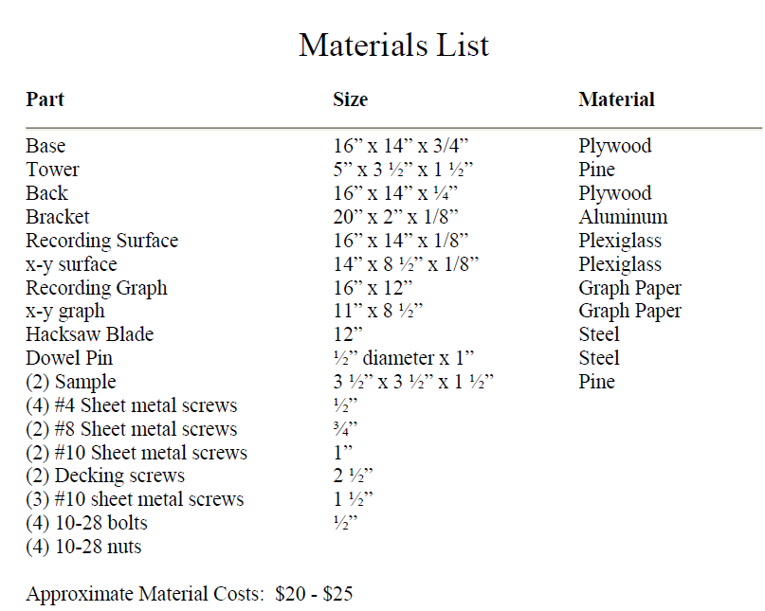
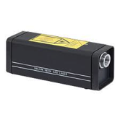
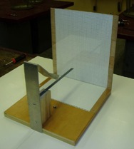
Resources
Adaptation: “Building “Macro” Atomic Force Microscopy For High School Classrooms by Paul Fedoroff et al.
Source: http://community.nsee.us/lessons/Macro_AFM_Simulator/Building%20and%20Using%20Tapping%20Mode%20AFM.pdf
Thorlabs:
Laser: HeNe Laser system, 0.8 mW
Model: HNLS008R
Cost: $772.92 each

Slide 24
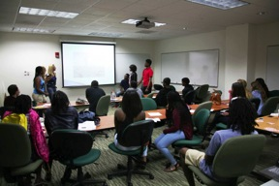
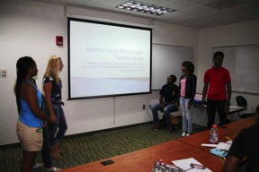
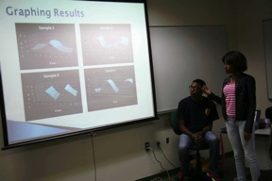
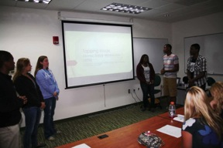
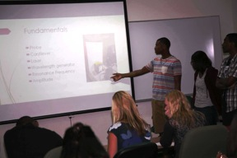
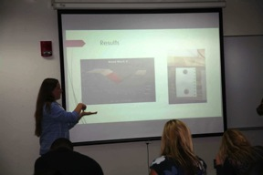
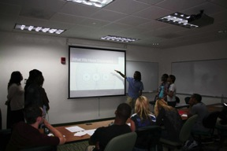
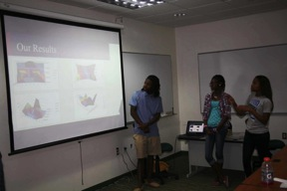
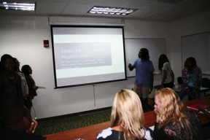
HS Students Presenting
HS students presenting their literature search about how the Atomic Force Microscope works and how it is used to scan objects.

Slide 25
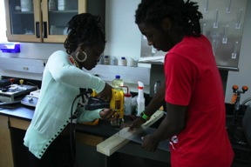
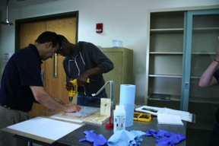
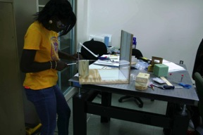
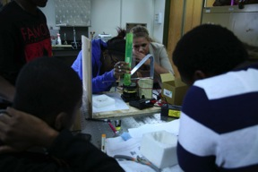
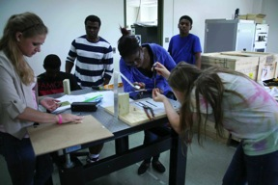
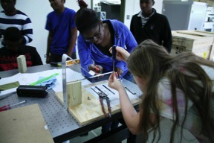
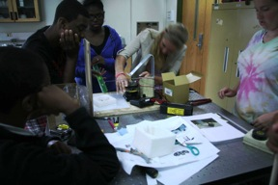
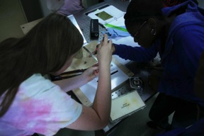
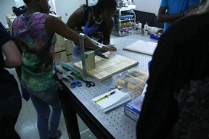
HS Students Building their AFM
High school using electrical power tools to assemble their AFM.

Slide 26
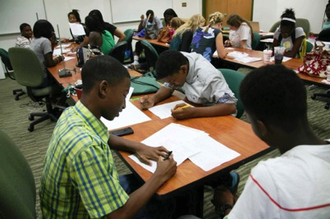
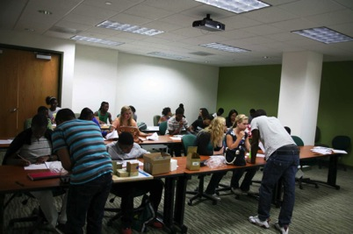
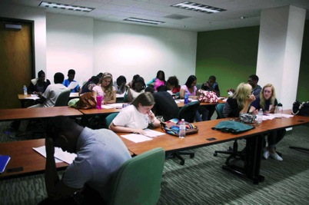
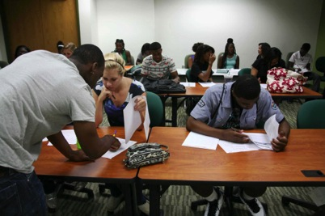
HS Students Taking Quizzes

Slide 27
Seminar: Professional Ethics & Responsible Research Conduct
Seminar: “Professional Ethics and Responsible Research Conduct“ followed by a quiz, Dr. Skuza (CMR).

Slide 28
Wave and Resonance Frequency
In class explanation of waves and resonance frequency. High school students finding the resonant frequency for their AFM setup in tapping mode.

Slide 29
Seminar: How to Present
Seminar: “ How to present your work” followed by a quiz, Dr. Haines (Biology Department)

Slide 30
HS Students Training on Laboratory AFM
HS student being trained on Vecco Atomic Force Microscope by graduate student Mundle. The students took real scans at the micro and nano levels for few objects that they included in their posters.

Slide 31
HS Students’ Experimental Results: Macro AFM
 | Contact Mode |  | Tapping Mode |  | Magnetic Mode
Group A
Group B
Group C
HS students’ experimental results using the Macro Atomic Force Microscopy system they built.

Slide 32
HS Students’ Experimental Results: Lab AFM
 | Object | AFM Scan
Group A
Group B
Group C
HS students’ experimental results using a Vecco Atomic Force Microscope.

Slide 33
Poster Session

Slide 34
Closing Ceremony: Certificates of Participation

Slide 35
Closing Ceremony

Slide 36
Using and adapting NISE Net Summer Camp frameworks
Sci-Port: Louisiana’s Science Center
92,000 sq. feet; 290 permanent exhibits, travelling exhibits
Space Dome Planetarium
Outreach (afterschool enrichment; travelling exhibits throughout Louisiana)
250,000 annual visitors
demonstrations and labs for public and schools (standards-based, age-appropriate)
IMAX Dome theater
Power of Play Children’s Museum
Birthdays, private events, camps (holiday, professional day camps, summer)

Slide 37
Sci-Port: What we do and how we do it
Mid-sized market (440,000 people in our 4-parish area) in Northwest corner of Louisiana.
Memberships and private donations
Corporate memberships and special event sponsorships
Grants
Local and state funding.
Small but multi-talented staff.
Summer camp staffed by certified teachers (rather than seasonal staff)
Partnerships and cheap/free resources (camps)
Animal Care camps (service dogs, comfort dogs, raptor center, K-9 unit, pet rescue organizations, Pig in the City, entomologists)
NASA, NISENet framework
Notes:
Alan

Slide 38
Using and adapting NISE Net Summer Camp frameworks
Offered different half-day, week-long sessions for K-1, 2-3, 4-5, 6-10
Frameworks designed for ages 8-10, high school
Framework is designed to fill 1.5-2 hours daily, less than a “full half-day.” But, open-ended nature of several investigations allows for extension.
Training resources available on-line (videos, scripts).
Materials (physical kits, other materials listed along with links for purchasing, part numbers, etc.)
What is Nano? (cutting-edge science in an age of Pinterest-inspired summer “craft” camps)
Nano is everywhere!
Notes:
Alan Brown

Slide 39
Designing and Implementing Nanoscience Summer Camps
Michelle Kortenaar, mkortenaar@sciencenter.org
Meghan Schiedel, mschiedel@nvdm.org
Michele Laverty, michele@agsciencecenter.org
Andrew McGarrahan, Andrew.McGarrahan@slsc.org
Messaoud Bahoura, mbahoura@nsu.edu
Alan Brown, abrown@sciport.org
Paola Ferrari, pmferrari@sbcglobal.net

