Slide 1
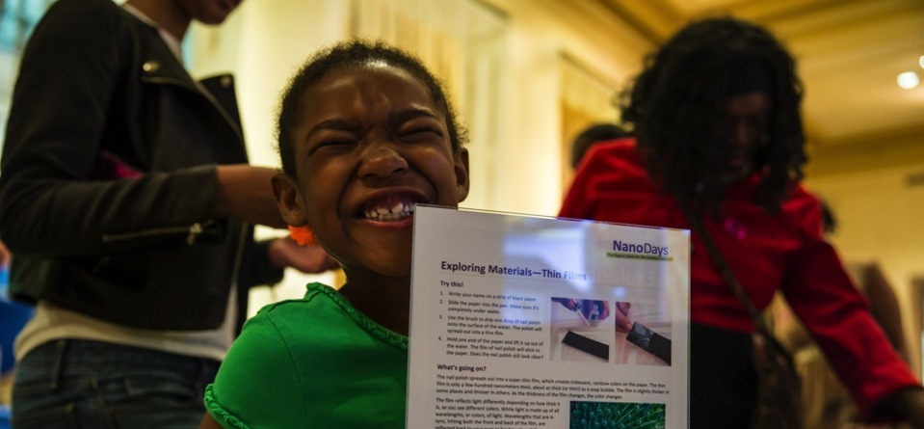



NanoDays!
JUNE 2015
NETWORK-WIDE MEETING
NISENET.ORG
Notes:
Welcome! Hope the meeting has gone well for everyone. It’s really just so inspiring to see the varied ways that you all have taken NISE Net and NanoDays materials and truly made them your own.

Slide 2
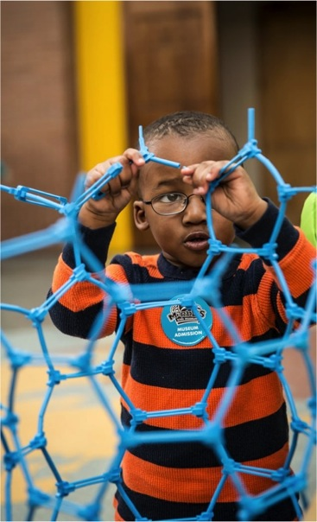
Session Overview
Introductions
Planning and Development
Team-Based Inquiry
Fabrication
NanoDays Report Data and Summative Evaluation

Slide 3
Learn how NanoDays activities are developed, reviewed, and fabricated
Ali Jackson, Sciencenter
Sarah Cohn, Science Museum of Minnesota
KC Miller, Science Museum of Minnesota
JUNE 2015
NETWORK-WIDE MEETING
NISENET.ORG
Notes:
NanoDays is a complex effort that includes multiple NISE Network teams working together to create resources and coordinate the participation of hundreds of partners.
This presentation focuses on the tools, ideas, and processes that are specific to creating a nationwide event such as NanoDays, which is supported by a physical and digital kit that includes professional resources and educational products. I’ll start by describing the planning and development of NanoDays resources by a cross-organizational team,. Sarah Cohn will share our visitor testing process and some in depth information about TBI. And KC Miller also from SMM will share some stories about fabrication and distribution of the physical kits, and
of course NanoDays requires the the implementation by hundreds of partners across the country through annual NanoDays events,
And we’ll wrap up with a quick debrief of the impact of the initiative on public audiences.

Slide 4
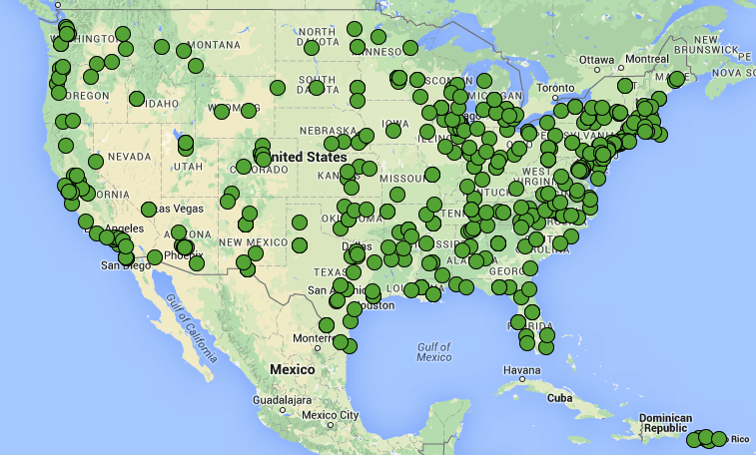
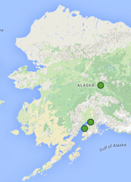

NanoDays
2008-2015
Notes:
Eight years of kits
468 partners received 1650 kits
100+ educational products
hands-on activities
stage presentations
Games
Plus videos, books, training materials, and more

Slide 5
THANK YOU!
Notes:
First, and foremost, thank you to all our partners for taking ownership of these activities and events!

Slide 6
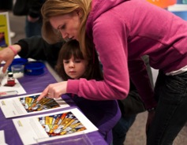
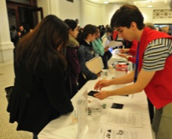
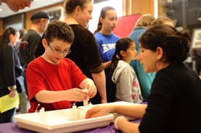
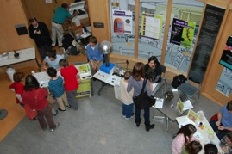
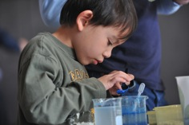

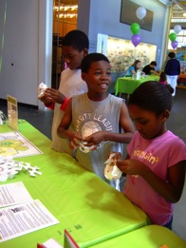
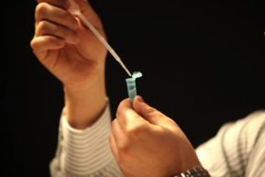
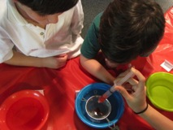
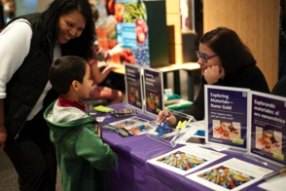
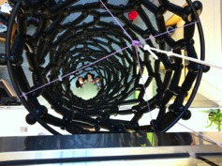
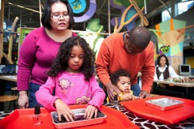
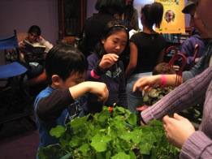
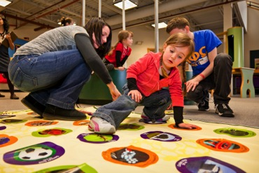
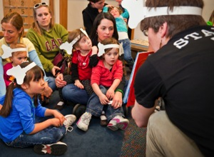
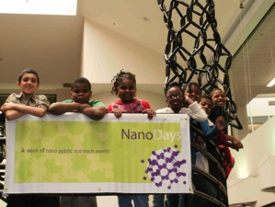

Notes:
NanoDays is both an annual event celebrating nanoscale science, engineering, and technology and a suite of programming resources that NISE Network partners use year-round to provide hands-on activities for multiple and diverse audiences, from families and school groups who visit the museum to outreach to underserved communities.

Slide 7
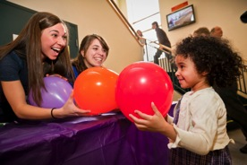
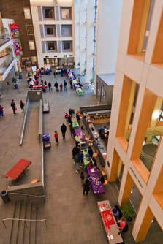
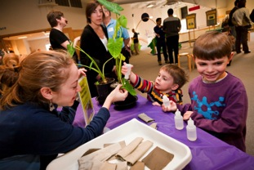
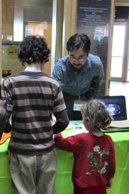
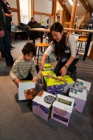
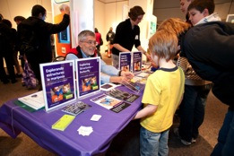
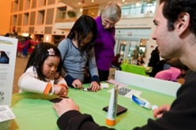
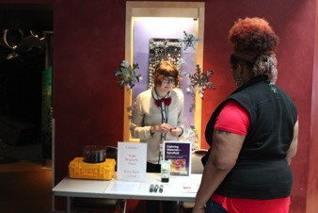
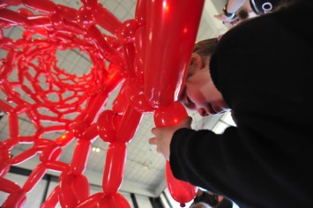
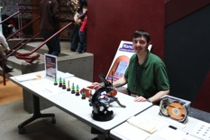
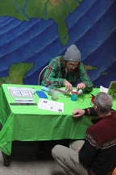
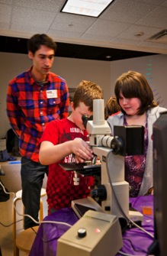
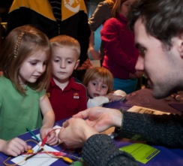
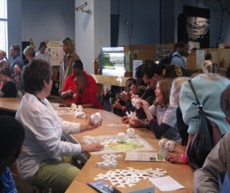
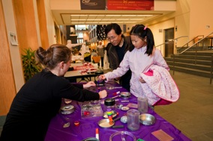
Notes:
As you can see, there is great variation in local NanoDays events, as partners participate in ways that work best for their organization and community!

Slide 8



Product Development Process
Iterative, collaborative development process:
Peer review
Expert review
Visitor testing
Audiences and Content
Content Map as a guide
Inclusive audience approach
Designed for sharing
Easily edited and adapted
Creative Commons license
  More info: /nisenet.org/programs
Notes:
Quickly review the NISE Network Product Development Process
NISE Network products are created through an iterative, collaborative process that involves researchers in the field of nanoscale science, professionals in the field of ISE, and our targeted public audience. This process helps to ensure that our programs, exhibits, and other products are scientifically accurate, represent best practices in educational product development, and are effective experiences for our visitors.
The Tools and Guides section of the website provides resources to help all museum professionals use a similar approach to developing educational experiences related to nanoscale science and other topics.
• Peer review NISE Network development teams include educators, exhibit developers, and other professionals from museums across the country. We work together to make sure our educational products achieve their educational goals, are well-crafted, and represent best practices. Our collaborative development process also helps to create new knowledge to advance the field of informal science education and builds capacity at partner organizations. NISE Net products all go through extensive peer review during development.
• Expert review Scientists are involved throughout the creation of NISE Net products, from the early conceptual development through prototyping and final review. Scientists help us to find interesting ideas and present them accurately and effectively. They also help us to communicate the excitement of this field of emerging science, and give it a human face. We also rely on experts in an an inclusive approach to audience engagement—including universal design, and cultural sensitivities.
• Visitor testing NISE Network products for the museum visitors are prototyped and evaluated with their target audience as an integral part of the development process. Evaluation helps us to ensure that our programs, exhibits, and other visitor experiences are accessible, engaging, and educationally effective. Many products go through several rounds of evaluation and improvement before they are distributed. Sarah will share more about the specific process we’ve developed—TBI—to rapidly and effectively test our products.
Audiences and Content:
• NISE Network Content Map: The NISE Network Content Map articulates the key ideas for our educational products, including programs, exhibits, and media experiences. It presents the content knowledge the network has identified as the most important for engaging the public in learning about nanoscale science, engineering, and technology. Content map resources include the full written text document, a powerpoint presentation outlining the map, and a one-page graphic summary of the map.
• Products are designed with an inclusive audiences approach
Educational Products are designed for sharing:
• Products are designed to be easily edited and adapted for different audiences under a Creative Commons Attribution Non-Commercial Share Alike license

Slide 9
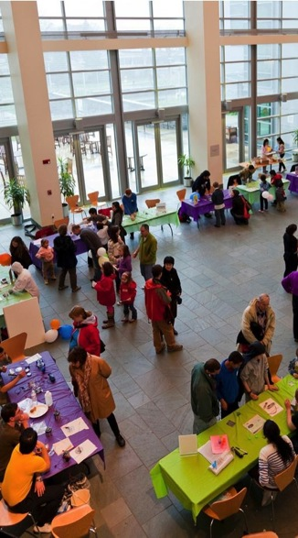
NanoDays Goals
Cultivate a national network of museums and research institutions working together to engage the public, through common participation in a national event related to nanoscale science, engineering, and technology (“nano”).
Provide a tangible opportunity for NISE Net partners to develop and strengthen local partnerships between museums and scientists or research centers.
Increase capacity in the informal science field to engage the public in nano content, building on and contributing to best practices in informal education.
Engage diverse public audiences in learning related to nano at NanoDays events.
Notes:
The goals of NanoDays are directly related to and aligned with overall NISE Network goals to build a national network, increase capacity in the field to engage the public in nano, and reach large and broad public audiences across the country. NanoDays goals include:
Cultivate a national network of museums and research institutions working together to engage the public, through common participation in a national event related to nanoscale science, engineering, and technology (“nano”).
Provide a tangible opportunity for NISE Net partners to develop and strengthen local partnerships between museums and scientists or research centers.
Increase capacity in the informal science field to engage the public in nano content, building on and contributing to best practices in informal education.
Engage diverse public audiences in learning related to nano at NanoDays events.
NanoDays activities and other educational products and resources are planned, developed, and disseminated by a team that includes members from museums and universities across the country. The NanoDays team works closely with other NISE Net development teams, including the program group, the Network community group (including the regional hub leaders), and the evaluation team.

Slide 10
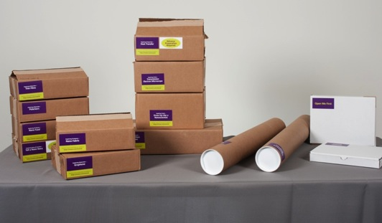
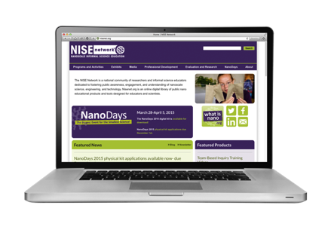
NanoDays Kits
Notes:
All NanoDays events have in common a core set of educational materials with hands-on activities produced by the NISE Net NanoDays team.
These are distributed as both physical kits and digital kits (available for download from nisenet.org)
NanoDays kits contain all the necessary materials to plan and host a successful event: a host guide for planning; marketing and promotional materials; a set of individually-boxed activities that include all needed supplies; posters, media, and other kinds of programming; staff and volunteer training materials; tablecloths and signage to give the event a unified look and feel…and more!

Slide 11
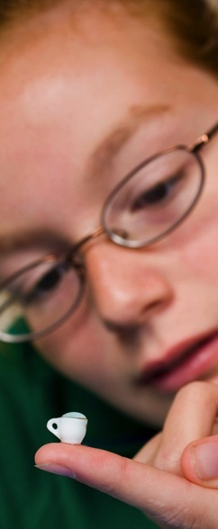
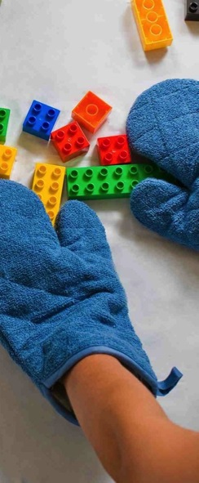
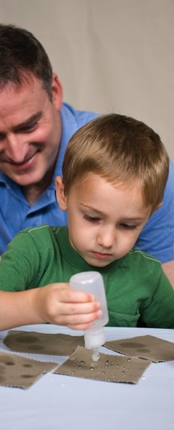
NanoDays Activities
Notes:
The most essential part of the NanoDays kits—and events—are the branded NanoDays learning experiences.
NanoDays activities are simple yet powerful. Many allow visitors to explore the unusual properties of nanoscale materials and technologies, such as a tiny teacup that won’t spill water, a mysterious magnetic fluid, red-colored gold, and glass objects that seem invisible.
We’ve worked hard to include a variety of experiences!
Very young visitors enjoy experiences such as whole-body games, extra-large puzzle blocks, and giant models of carbon nanotubes made from balloons.
Adults appreciate contextual information such as posters that provide information on the societal and ethical implications of nanotechnology and videos that “zoom” in to provide a nanoscale view of natural and human-made objects such as computer chips and butterfly wings.

Slide 12
Annual Cycle
Winter
Partners receive kits
Planning for the next kit begins
Fall
Applications and awards for new kit
Fabrication and shipping of new kit
Spring
NanoDays events across the country
Prototyping for the next kit
Summer
Reports from spring events
Intensive development for the next kit
Notes:
NanoDays kits are developed following an annual cycle
Winter Planning for a new kit begins immediately after the last kit has shipped. NanoDays kits are distributed to partners in January, and the event occurs a few months later. But the development team is already looking ahead to the event 15 months down the road, because we prototype next year’s activities at this year’s event.
Spring NanoDays events are held over an 11-day period in the spring (two weekends and the weekdays in between). The official NanoDays event period is typically at the end of March/beginning of April. NISE Net partners are free to schedule their events (and use their kits) at other time of the year, but it is exciting to have a common activity that almost the entire Network participates in at the same time.
Summer Each partner receiving a NanoDays kit is required to fill out a report, explaining how they used the kit. The reports also provide an opportunity for partners to share feedback on the resources and suggestions for the next kit (and sometimes also information to help shape other Network initiatives). The NanoDays team uses the reports to make decisions about what to include in the next kit, and the Network community team uses this information to make decisions about how the next kits will be awarded. Meanwhile, the development—activity, staff, and volunteer testing— for next year’s NanoDays is most intensive during the summer.
Fall NanoDays development wraps up in early Fall, and the fabrication team goes to work ordering supplies, putting together the kits, and shipping them out.
NanoDays public engagement products are informed by front-end research performed at the beginning of the NISE Net project (Flagg, 2005), which indicated that public audiences were likely to have little familiarity with nano and its potential applications. As a result, NanoDays activities focus on providing foundational knowledge, creating links to everyday life and to other STEM topics, and explaining the potential of nanotechnologies to address major societal issues that are interesting and relevant for broad public audiences.

Slide 13
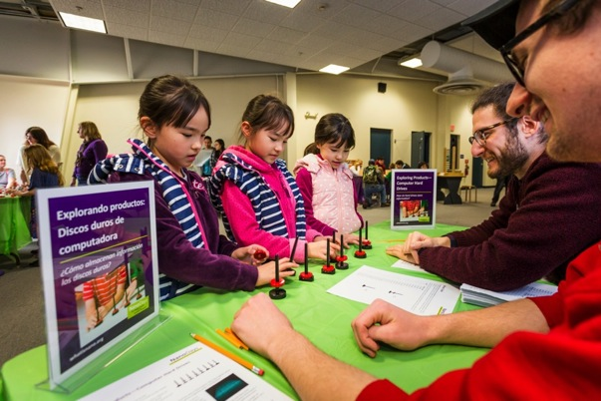
Front-End Research
Notes:
NanoDays public engagement products are informed by front-end research performed at the beginning of the NISE Net project (Flagg, 2005), which indicated that public audiences were likely to have little familiarity with nano and its potential applications. As a result, NanoDays activities focus on providing foundational knowledge, creating links to everyday life and to other STEM topics, and explaining the potential of nanotechnologies to address major societal issues that are interesting and relevant for broad public audiences.

Slide 14

Content Map
1. Nano is small and different
Nanometer-sized things are very small, and often behave differently than larger things do.
2. Nano is studying and making tiny things
Scientists and engineers have formed the interdisciplinary field of nanotechnology by investigating properties and manipulating matter at the nanoscale.
3. Nano is new technologies
Nanoscience, nanotechnology, and nanoengineering lead to new knowledge and innovations that weren’t possible before.
4. Nano is part of our society and our future
Nanotechnologies—and their costs, utility, risks, and benefits—are closely interconnected with society
and with our values.
More info: /nisenet.org/catalog/tools_guides/content_map
Notes:
The development of NanoDays public engagement products is also shaped by the NISE Network content map. This tool was created through an extensive process of consultation with experts in informal education and in nanoscale science, engineering, and technology (Bequette et al., 2012).
***
The NISE Net content map identifies four key concepts for engaging the public in nano:
Nano is small and different: Nanometer-sized things are very small, and often behave differently than larger things do.
Nano is studying and making tiny things: Scientists and engineers have formed the interdisciplinary field of nanotechnology by investigating properties and manipulating matter at the nanoscale.
Nano is new technologies: Nanoscience, nanotechnology, and nanoengineering lead to new knowledge and innovations that weren’t possible before.
Nano is part of our society and our future: Nanotechnologies—and their costs, utility, risks, and benefits—are closely interconnected with society and with our values.

Slide 15
Tips: Learning Materials
If your kit is intended for an event, it should include a critical mass of things to do. NISE Net usually includes around 10 hands-on activities, plus full-length programs, videos, posters, books, and other learning opportunities.
Messy activities can be especially fun and memorable, but don’t include too many. Some sites are unable to use them or have limited areas where they can do them, and some audiences will avoid them.
At least one activity should have a take-home product. People also like inexpensive, promotional giveaways like temporary tattoos.
A big, showy display of some kind can help make audiences aware of your event and create excitement for it. (NanoDays events often use a large model of a carbon nanotube made of balloons.)
Decide on a reasonable number of consumable supplies. For NanoDays kits, we include supplies for at least 100 uses of each activity.
Notes:
In a kit that offers multiple public engagement activities, balance different content and types of activities, and offer things for all ages:
Focus on a few clear main concepts, and provide more than one way to explore each one.
If your kit is intended for an event, it should include a critical mass of things to do. NISE Net usually includes around 10 hands-on activities, plus full-length programs, videos, posters, books, and other learning opportunities.
At least one activity should have a take-home product. People also like inexpensive, promotional giveaways like temporary tattoos.
Messy activities can be especially fun and memorable, but don’t include too many. Some sites are unable to use them or have limited areas where they can do them, and some audiences will avoid them.
A big, showy display of some kind can help make audiences aware of your event and create excitement for it. (NanoDays events often use a large model of a carbon nanotube made of balloons.)
Decide on a reasonable number of consumable supplies. For NanoDays kits, we include supplies for at least 100 uses of each activity.

Slide 16
Tips: Professional Resources & Training Materials
Provide a planning guide that walks host sites through the process of planning and implementing their event.
A timeline checklist is very useful, indicating what to do when. Links to other resources are also helpful.
Providing ready-to-use marketing and promotional materials makes a big difference for organizations with limited resources.
Simple supplies can help create the impression of an exciting event. For example, brightly-colored, disposable tablecloths are practical, inexpensive, and help signal that a set of activities form a unified event.
Training should include an overview of the event and its goals; top-level learning objectives for public audiences; and the listing and schedule of activities.
Each activity should be fully-documented, so that new volunteers can figure out how to use it on their own.
Even for very simple activities, staff and volunteer educators appreciate video training tools in addition to written guides.
Simple, fun activities make good use of volunteers. Events often rely on one-time volunteers, and they will be happier and do a better job if they are deployed in activities that require relatively little training.
Notes:
Professional resources help partners plan and implement a successful event:
Provide a planning guide that walks host sites through the process of planning and implementing their event. A timeline checklist is very useful, indicating what to do when. Links to other resources are also helpful.
Providing ready-to-use marketing and promotional materials makes a big difference for organizations with limited resources.
Simple supplies can help create the impression of an exciting event. For example, brightly-colored, disposable tablecloths are practical, inexpensive, and help signal that a set of activities form a unified event.
Staff and volunteer training materials are essential:
Ideally, training materials should be included in physical kits (for on-site use) and online (for advance use).
Volunteers will be best able to do their individual task and provide general visitor services if your training includes an overview of the event and its goals; top-level learning objectives for public audiences; and the listing and schedule of activities.
Each activity should be fully-documented, so that new volunteers can figure out how to use it on their own, if necessary. Even for very simple activities, staff and volunteer educators appreciate video training tools in addition to written guides.
Simple, fun activities make good use of volunteers. Events often rely on one-time volunteers, and they will be happier and do a better job if they are deployed in activities that require relatively little training.

Slide 17
Product Development Process
Iterative, collaborative development process:
Peer review
Expert review
Visitor testing
Notes:
Quick review the NISE Network Product Development Process

Slide 18
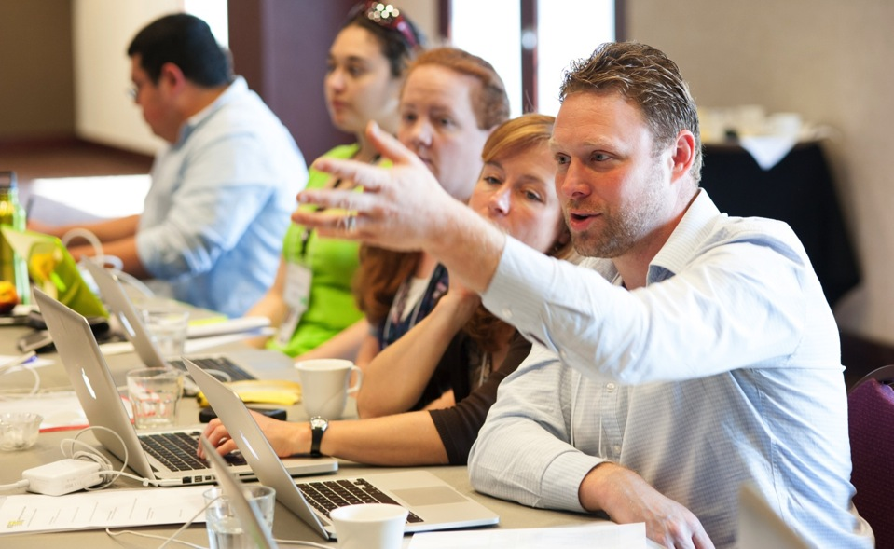
Peer Review
Notes:
Development and fabrication
To develop our educational materials, the Network consistently uses a rigorous process that includes peer review, expert review, visitor testing, and partner feedback .
NISE Net program team members and Network partners offer suggestions on content, audience, and design of NanoDays materials

Slide 19

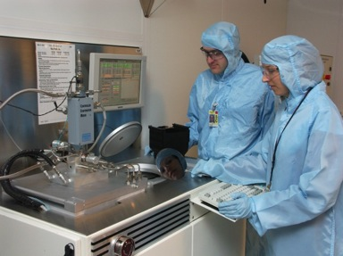

Expert Review
Notes:
Experts review NanoDays materials to ensure the content is accurate and to provide feedback on pedagogy, universal design, cultural relevancy, and other aspects of their design

Slide 20
Visitor Testing
Question
Improve
Investigate
Reflect
Notes:
NanoDays activities are tested with visitors at more than one site to ensure that they work in different settings and can be implemented easily by staff and volunteers

Slide 21
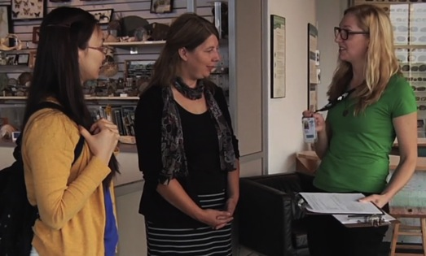
Visitor Testing… Team-Based Inquiry
Improve
Question
Investigate
Reflect

Slide 22
Team-Based Inquiry
Why TBI? Video
https://vimeo.com/album/3104606/video/107705737
Notes:
https://vimeo.com/album/3104606/video/107705737

Slide 23
Team-Based Inquiry
An approach to empowering professionals to get the data they need, when they need it, in order to improve their products and practices and create successful educational experiences
Question
Reflect
Improve
Investigate
Systematic
Led by non-evaluation professionals
Collaborative and team based
Small scale and focused
Embedded in work
Notes:
The NISE Network Network, as it has grown over time, needed to give ISE professionals across the country the skills and tools to incorporate evaluation and data-based decision making into their work, motivated the development of team-based inquiry.
NISE Net members and evaluators came up with this definition that highlighted the core of TBI: team-based inquiry is an approach to empowering professionals to get the data they need, when they need it, in order to improve their products and practices and create successful educational experiences
The diagram shows the ongoing professional inquiry process used in TBI, based on research from a variety of fields, such as participatory evaluation, professional inquiry, reflective practice, evaluation capacity building, action research, and organizational change.
Professional inquiry in general, and TBI specifically, involves asking questions related to your work or practice, collecting data to answer those questions, analyzing and reflecting on the data, and identifying concrete ways to improve based on your findings. In many ways, this is a formalization of the prototyping process most museum practitioners use when developing floor activities or exhibits. It is making it more transparent, systematic, and concrete.
TBI has been designed to be highly flexible, to work to help ILE professionals make decisions about all types of questions they may have. However, to be most successful we often highlight several characteristics of TBI: systematic; led by non-evaluation professionals; collaborative and team based; small scale and focused; embedded in work.

Slide 24
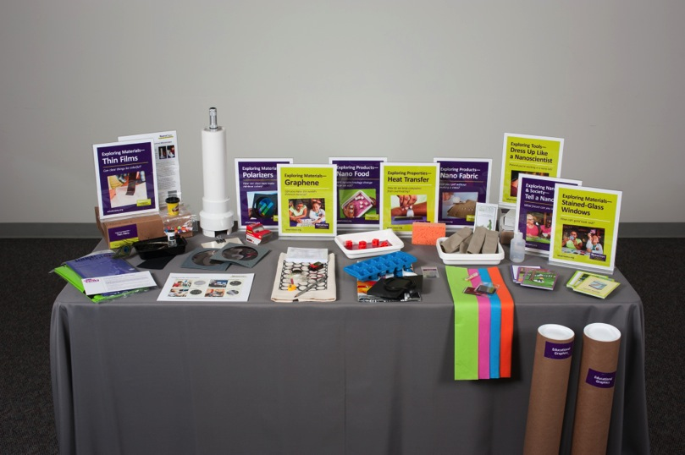
Team-Based Inquiry
Notes:
NanoDays was one of the strongest adopters of integrating TBI into the development process. Ali is going to present some examples of how TBI has shaped what is in the kits and what is NOT, but I want to make sure you all know that everything in the kit has been tested and reviewed by the appropriate the audience – training documents have been reviewed and tested with volunteers and staff, and all of the activities have been tested with novice volunteers and visitors.

Slide 25
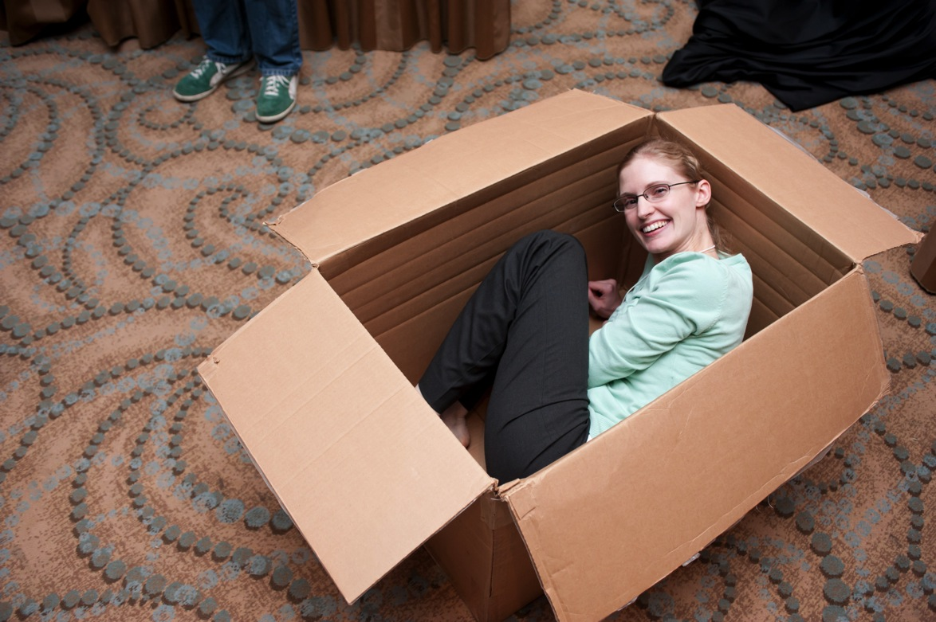
Notes:
Including KC!

Slide 26

Horton Senses Something Small
Improve
Question
Investigate
Reflect
Does the program engage young children?
How could it be improved?
Data collection
Observations of participating children
Caregiver surveys
Example lessons learned
Shortened the story
Identified more ways to prompt participation
Notes:
To make this more concrete, here are some examples of TBI projects the NanoDays team has done.
In each case, the team identified a question they needed to answer in order to move forward effectively with their work. In this case, the team was developing a new program and wanted to know how young children would respond to it.
Data collection can include both traditional evaluation techniques, as well as more creative data collection that leverages the types of information we deal with every day as part of our work (e.g., meeting notes, e-mails, informal observations, etc.). In this case, the program facilitator worked with an evaluator to create forms to more systematically document their reflections and input from participants.
In TBI, project teams identify specific lessons learned and ways to improve. In this case, the developer was able to identify the appropriate age group for the program, as well as a particularly effective facilitation strategy.

Slide 27
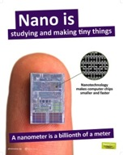
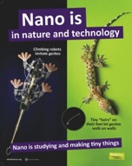
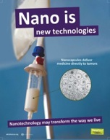
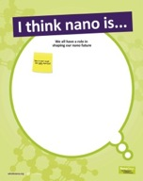

NanoDays 2012 Posters
Improve
Question
Investigate
Reflect
Are educational posters worth including in the NanoDays 2012 kit?
Data collection
Interviews with 30 visitors at three museums
Informal observations by team
Debrief with educators
Lessons learned
Visitors liked the graphics and suggested improvements
Educators felt graphics attracted attention and defined space
Notes:
Another example…
The nature of the data collection and analysis process will be different for each study. With every new project or question, your work is different, your questions are different, and who you need to hear from and work with need to reflect those tings.

