Slide 1
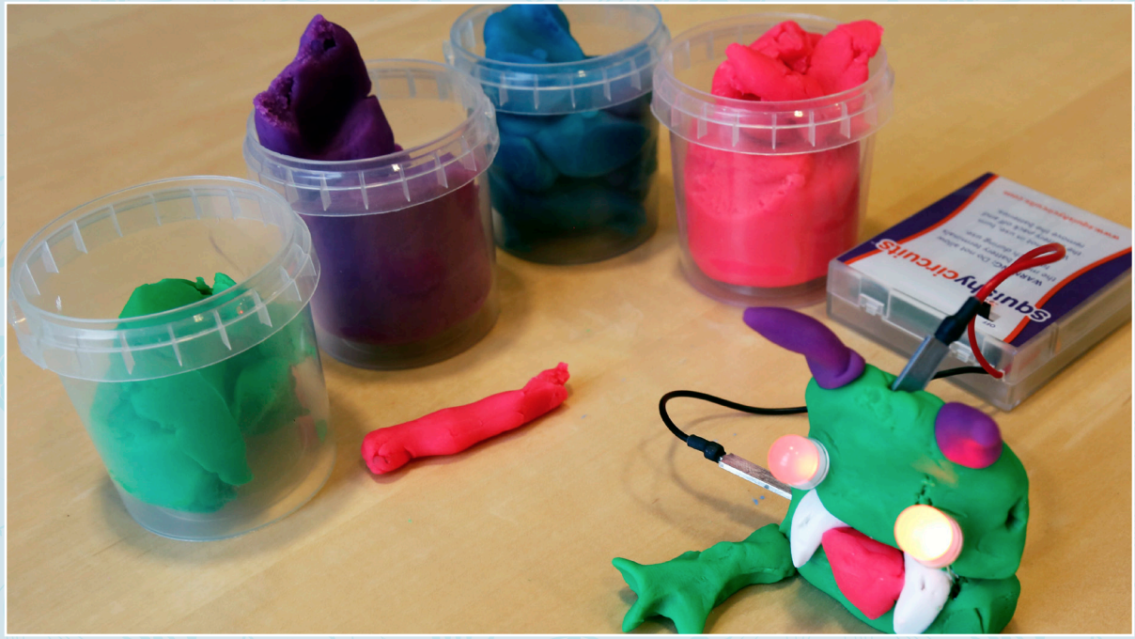
DOUGH CREATURE
Can you build a creature from scratch?

Slide 2
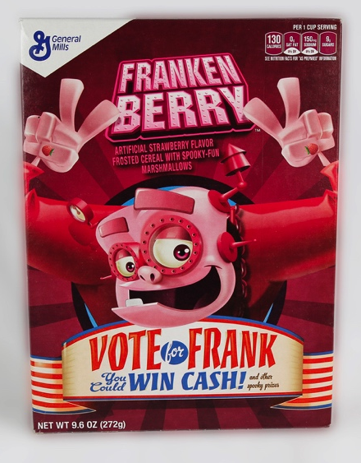
WHO WAS FRANKENSTEIN?
What do you know about Victor Frankenstein and his creature?
Victor Frankenstein and the “monster” he created first appeared 200 years ago in Mary Shelley’s novel Frankenstein. Since then, these characters have appeared in plays, movies, TV shows, comic books, and many other places.
You may recognize Frankenstein’s creature as a Halloween costume, a classic Hollywood monster, or the complex character in Shelley’s story.
Franken Berry is part of a line of monster-themed breakfast cereals. In popular culture, Frankenstein’s creature has become associated with other monster characters, such as Count Dracula.

Slide 3
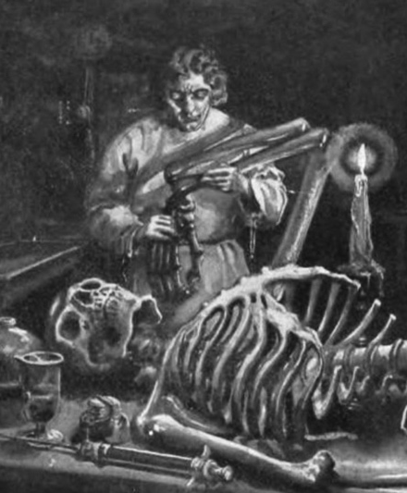
In Mary Shelley’s original story, Victor Frankenstein was a science student with a secret project. He built a person out of dead body parts and brought it to life.
Victor used the biggest body parts he could find because they were easier to work with. He used electricity to jolt the creature back to life. Could that possibly work?
In this activity, you will make a creature out of dough that conducts electricity!
Victor Frankenstein used surgery, chemistry, electricity, and other methods to build his creature and bring it to life. This illustration is from an early edition of Mary Shelley’s 1818 novel.

Slide 4
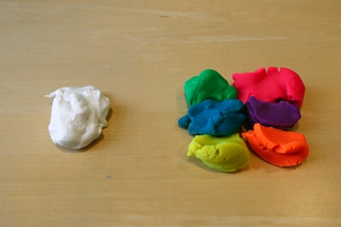
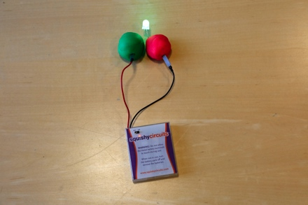
LEARN THE BASICS
1. Learn the difference between conductive and insulating materials.
The colored dough is conductive. Electricity can flow through it. The white clay is insulating. Electricity can’t move through it.
2. Make a simple circuit.
Take two balls of colored dough and put a wire from the battery pack into each ball. Set the balls near each other, but don’t let them touch.
Find an LED bulb. Separate the metal legs (terminals). Put the longer leg into the dough with the red wire and the shorter leg into the dough with the black wire.
Tip: Make sure the battery pack is turned on!
Safety: Never allow the metal ends of the red and black wires to touch each other.

Slide 5
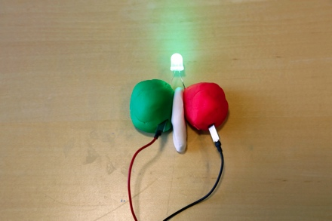
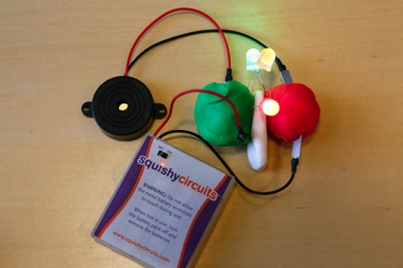
3. Prevent short circuits.
Push the two balls of conductive colored dough together, and notice that the LED dims or goes out.
To avoid short circuits, put insulating white clay between the two colored balls.
4. Try more things!
Attach multiple bulbs, a buzzer, or a motor.
Now that you’ve got the hang of it, you can make lots of things!

Slide 6
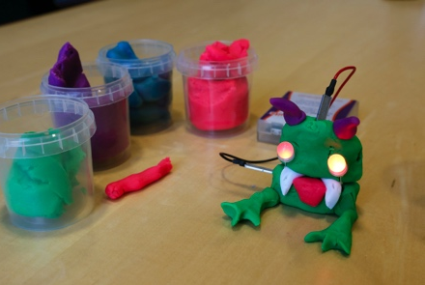
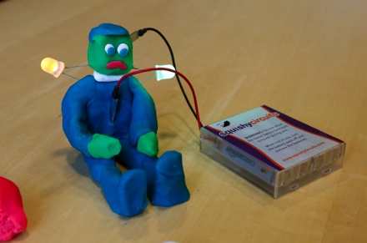
MAKE A CREATURE
5. Build a creature that conducts electricity.
Use colored dough to make a creature. Use white clay to prevent short circuits.
What kind of creature do you want to make?
6. Bring it to life!
Add a bulb, buzzer, or motor to make your creature seem alive.
What is your creature like? Is it kind, silly, or naughty?
Does it get along with others?

Slide 7
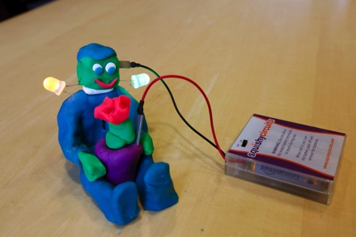
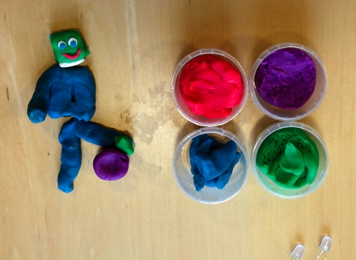
7. Tell a story.
Imagine what might happen if your dough creature lived in our world.
What does your creature do?
Where does it live? Who takes care of it?
8. Take it apart.
When you’re done, take your creature apart so other people can use the dough.

Slide 8
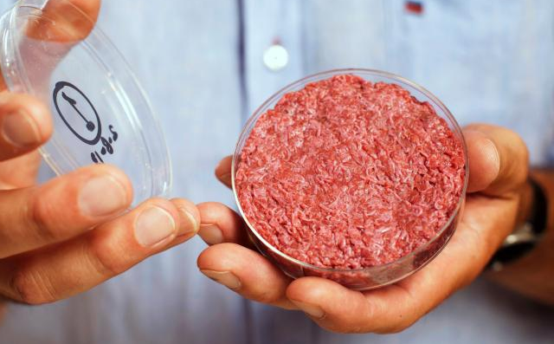
PEOPLE ARE CREATIVE
We’re always learning more about the world and inventing new things.
People have used selective breeding to improve plants and animals for thousands of years. More recently, researchers in the field of cellular agriculture have begun combining knowledge from farming and medicine to produce agricultural products from cell cultures.
For example, researchers can now grow meat in a Petri dish by culturing muscle tissues. They can also get yeast to make cow’s milk. Some people think these methods might be more ethical and environmentally friendly than raising farm animals to produce meat or milk.
Would you try cultured meat? Or drink milk produced by yeast?
Researchers can grow beef and chicken meat in a lab without genetic modification. Combining techniques from biology and engineering, they culture the animals’ cells to form tissues.

Slide 9
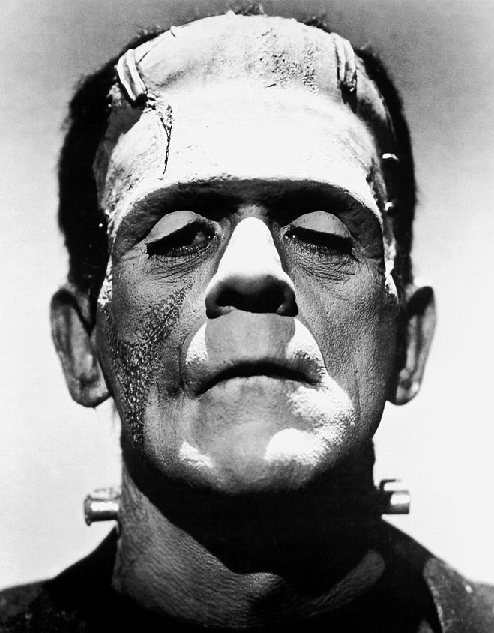
MONSTER OR MISTREATED?
Mary Shelley’s novel Frankenstein tells the story of a man who builds a creature and brings it to life—but isn’t prepared for what happens next.
Victor Frankenstein expects to feel proud of himself when he discovers the secret of life. Instead, he is disgusted by his creature. He lets it run away and fend for itself. He doesn’t take care of it or teach it right from wrong.
Did Frankenstein spend too much time working on his experiments, and not enough time thinking about what might happen if he succeeded?
Actor Boris Karloff tried to show the humanity of Frankenstein’s creature. Karloff played the character in many Hollywood movies.

Slide 10
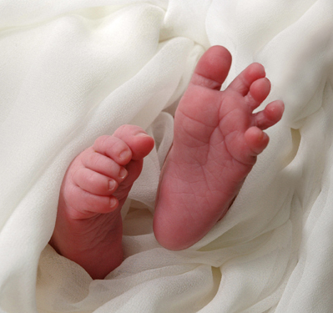
RESPONSIBLE INNOVATION
Frankenstein suggests that as we study science and make new technologies, it’s important to think ahead.
For example, genetic treatments can cure diseases, but they also raise questions about whether people will begin creating “designer babies.”
Mitochondrial replacement is a special kind of in vitro fertilization where the embryo has nuclear DNA from two parents and mitochondrial DNA from a third. This treatment can be used to prevent a baby from inheriting a genetic disease.
Would you try a new genetic treatment if it would ensure a healthy baby?
Would you use it to select a trait like eye color?
In 2016, a baby was born that has three genetic parents. A treatment called mitochondrial replacement prevented the baby from inheriting a genetic disease..

Slide 12




Mary Shelley’s novel Frankenstein is a 200-year-old science fiction story that explores themes of human creativity and scientific ethics. The Frankenstein200 project allows people across the United to States to exercise their creativity and consider responsible innovation in fields such as artificial intelligence and genetic engineering.
Frankenstein200 is a national project led by Arizona State University. In addition to hands-on activities, Frankenstein200 includes an alternate reality game that immerses players in a modern-day Laboratory for Innovation and Fantastic Explorations (L.I.F.E.). This fictional story imagines what might happen if a character named Dr. Tori Frankenstein picked up where her ancestor Victor Frankenstein left off.
Visit Frankenstein200.org to play the game!
Copyright 2017, Arizona State University. Published under a Creative Commons Attribution-Noncommercial-ShareAlike license: http://creativecommons.org/licenses/by-nc-sa/3.0/us/
Distributed in collaboration with the National Informal STEM Education Network: nisenet.org
This project was supported by the National Science Foundation under Grant Number 1516684. Any opinions, findings, conclusions, or recommendations expressed in this program are those of the authors and do not necessarily reflect the views of the Foundation.

