Slide 1

Editing Our Evolution:
Rewriting the Human Genome
[Date]
[Location]
Notes:
Hello and welcome to our ‘Editing Our Evolution’ forum at ____. My name is ____ and I’m excited that you’re here today. We’re going to be talking today about an interesting topic, human genome editing, and hopefully we’ll have some fun, too. For those who aren’t familiar with the format, a forum is a guided conversation that is informed by some scientific background information. At the end, we’ll be asking for your opinions! We’ll take your recommendations, combine them with those from other sites holding this same conversation, and share them with scientists who are working on this technology.

Slide 2

Agenda
Welcome 5 minutes
[First Speaker] 15 minutes
[Second Speaker] 15 minutes
Instructions 5 minutes
Scenario 1 25 minutes
Scenario 2 20 minutes
Scenario 3 15 minutes
Share Out 10 minutes
Survey 5 minutes
Notes:
Our agenda for the evening is pretty exciting. We’ll be here for about two hours. [Recommended] First, we’ll [watch a video/hear from (speaker’s name(s))] to get an introduction to the topic, and then we’ll dive into group discussions where you will be considering three hypothetical scenarios about human genome editing. [Otherwise]We’ll be having group discussions about three hypothetical scenarios about human genome editing.
[If applicable, introduce first speaker or video]

Slide 3
Agenda
Welcome 5 minutes
[First Speaker] 15 minutes
[Second Speaker] 15 minutes
Instructions 5 minutes
Scenario 1 25 minutes
Scenario 2 20 minutes
Scenario 3 15 minutes
Share Out 10 minutes
Survey 5 minutes
Notes:
[If applicable] Thanks [speaker’s name] for an informative presentation.
[If applicable, introduce second speaker or video to follow up first speaker]
[If applicable] Thanks [second speaker’s name] for that great talk. Both [first speaker’s name] and [second speaker’s name] will be around during our conversations to answer any questions you might have. If you have any questions for them, please write them down and the speakers can answer them when they get to your table. We also welcome people to stick around after the program to talk about anything else that’s on your mind related to this topic.

Slide 4
Editing Our Evolution:
Rewriting the Human Genome
Notes:
Now I’ll explain the process for our conversation. This forum is part of a conversation happening at more than 20 other institutions around the US this year, and it’s designed to encourage conversations about the important societal issues arising from advances in human genome editing.
This forum is based on the report on human genome editing written by the National Academy of Science committee on human genome editing. We’ve put together three hypothetical scenarios representing some of the most critical ethical and societal questions raised by human genome editing. You’ll discuss the line between therapy and enhancement, issues of equity and access, and the difference between editing your own genome and editing the genome of an embryo that could pass the changes down through generations. The treatments described in the scenarios don’t currently exist on the market. Some of them are likely to be available soon, while others are farther off. We hope that by working through these scenarios with your groups, you’ll have a chance to share your thoughts about issues you haven’t considered before.
[Optional] If you’re sitting with people you came with, I’d like to invite you to mix up your tables so that you’re sitting with people you don’t know. But you’re welcome to stay with your friends if you prefer .
[If people are unevenly distributed between tables] If you’re sitting at a table with more than 8 people or fewer than 4, I suggest you take this opportunity to move to a table where you’ll have four to eight people . This way you’ll have the best chance for a good conversation.
I’d also like to have anyone who identifies as a synthetic biologist raise their hand. Because part of the point of this forum is to have scientists and members of the public learn from each other, I’d like to encourage you all to spread out so that you’re evenly distributed among the tables. To everyone else, please keep in mind that synthetic biologists are also people! Their role is not to facilitate the discussion, but just to participate like everyone else.

Slide 5
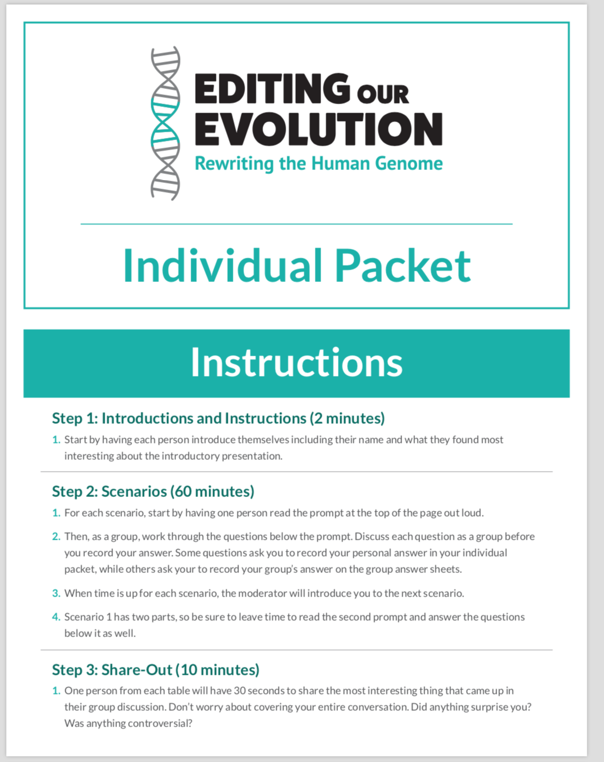
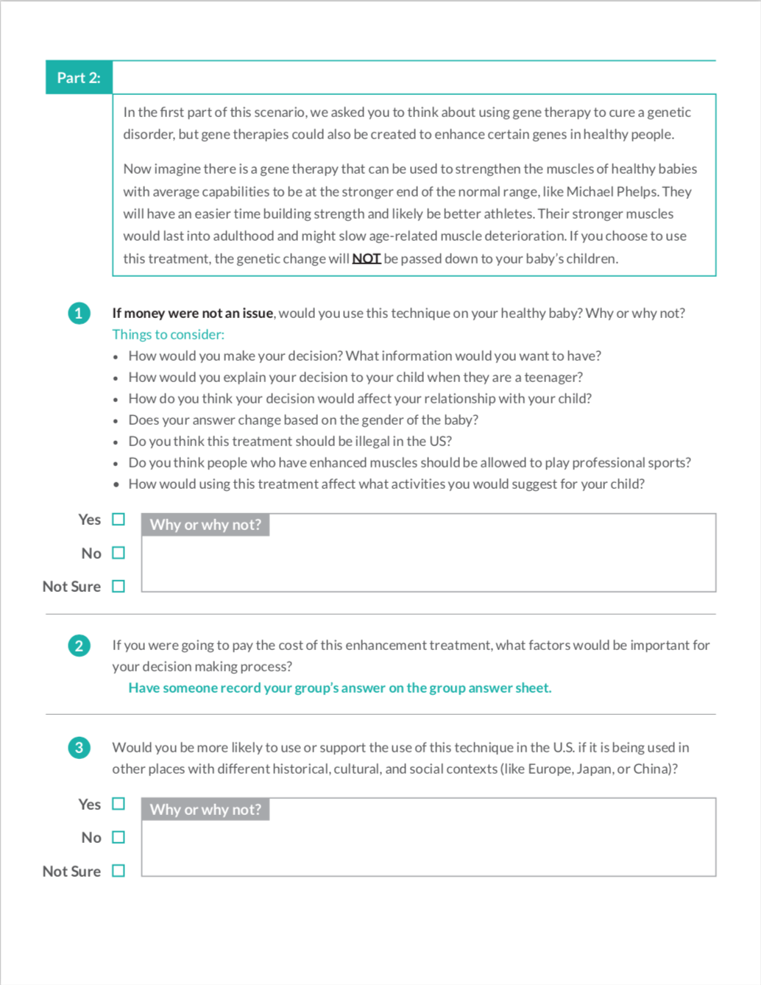
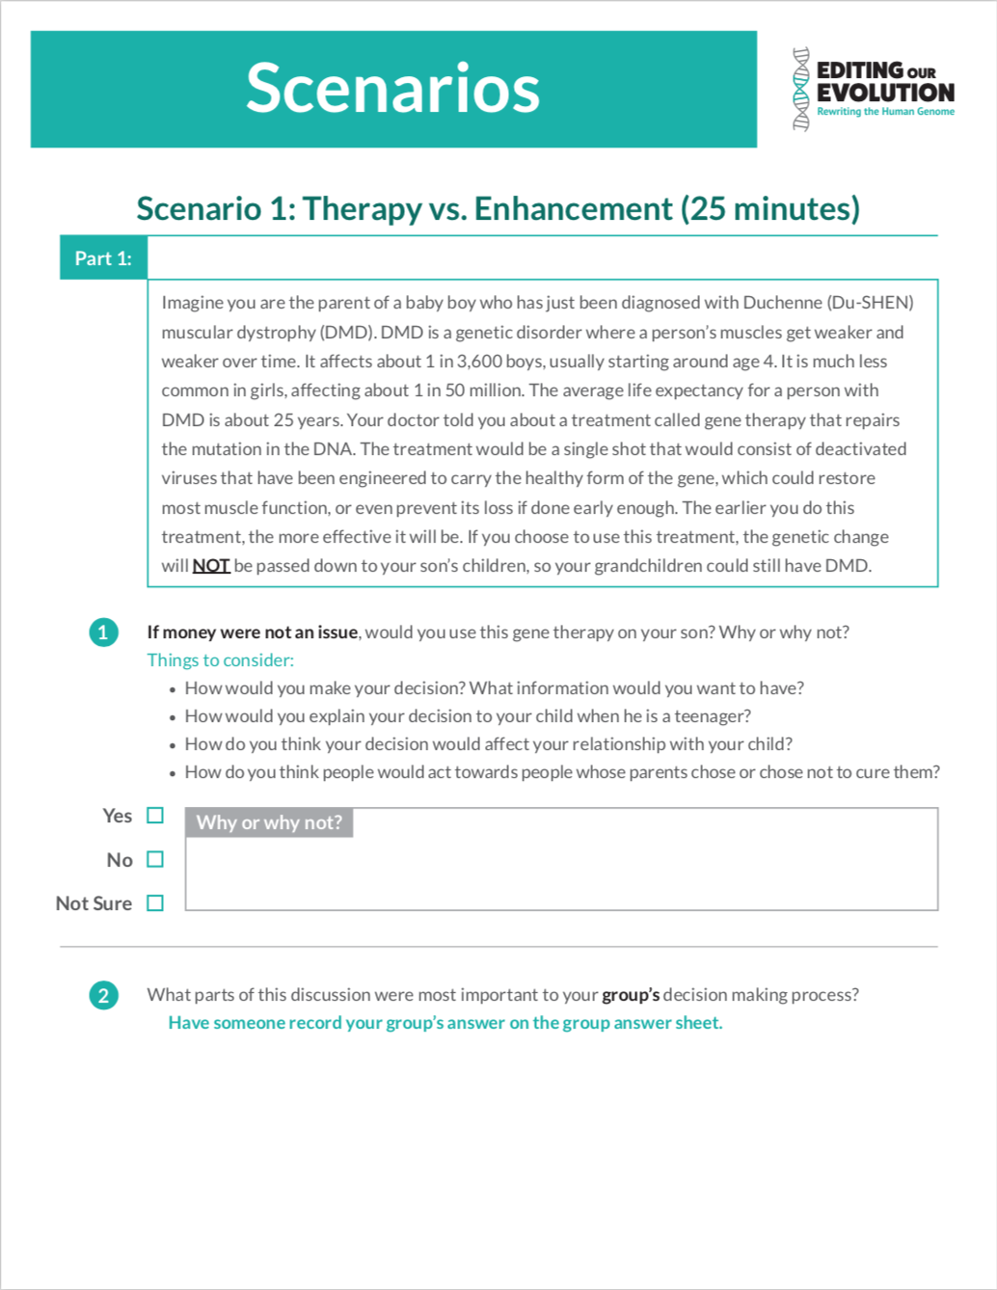
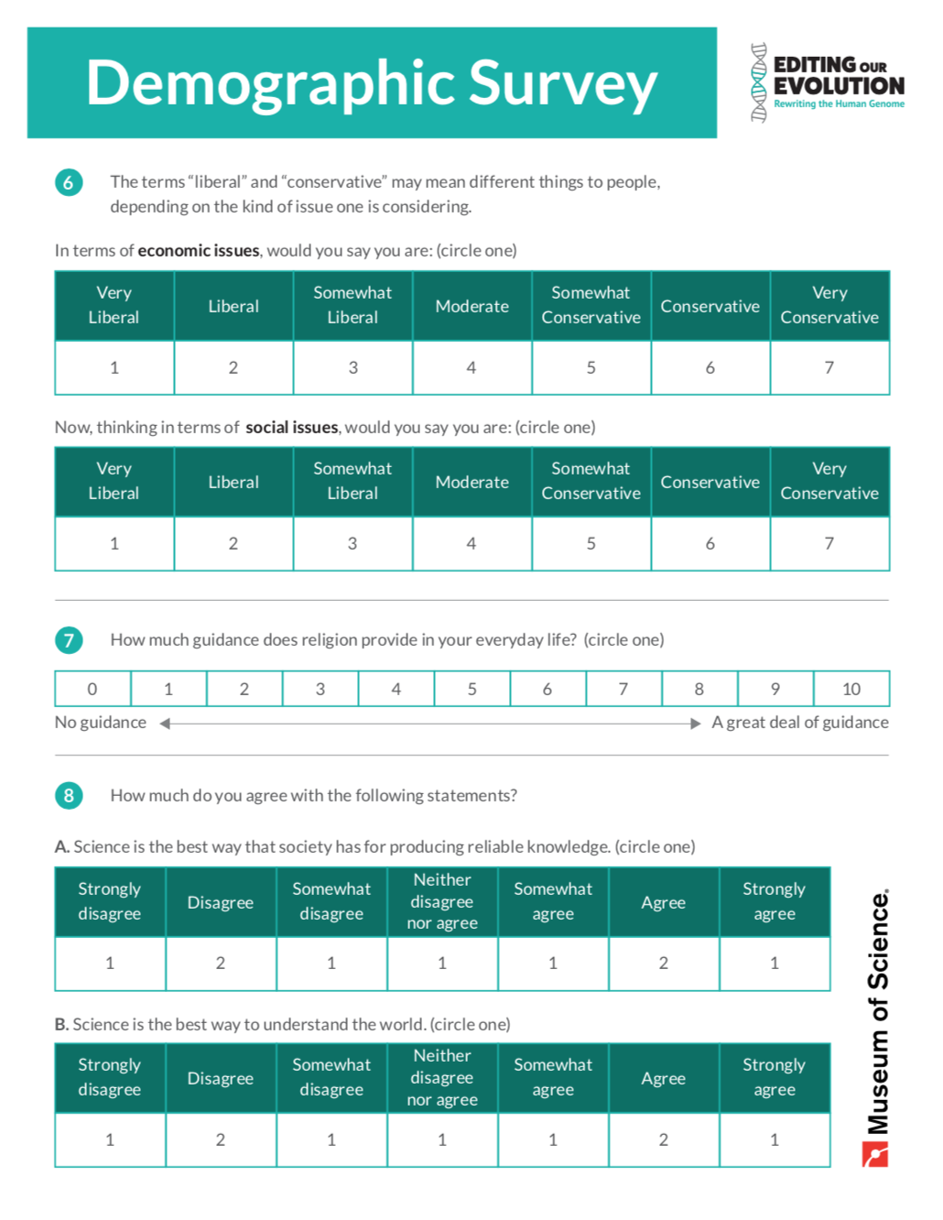
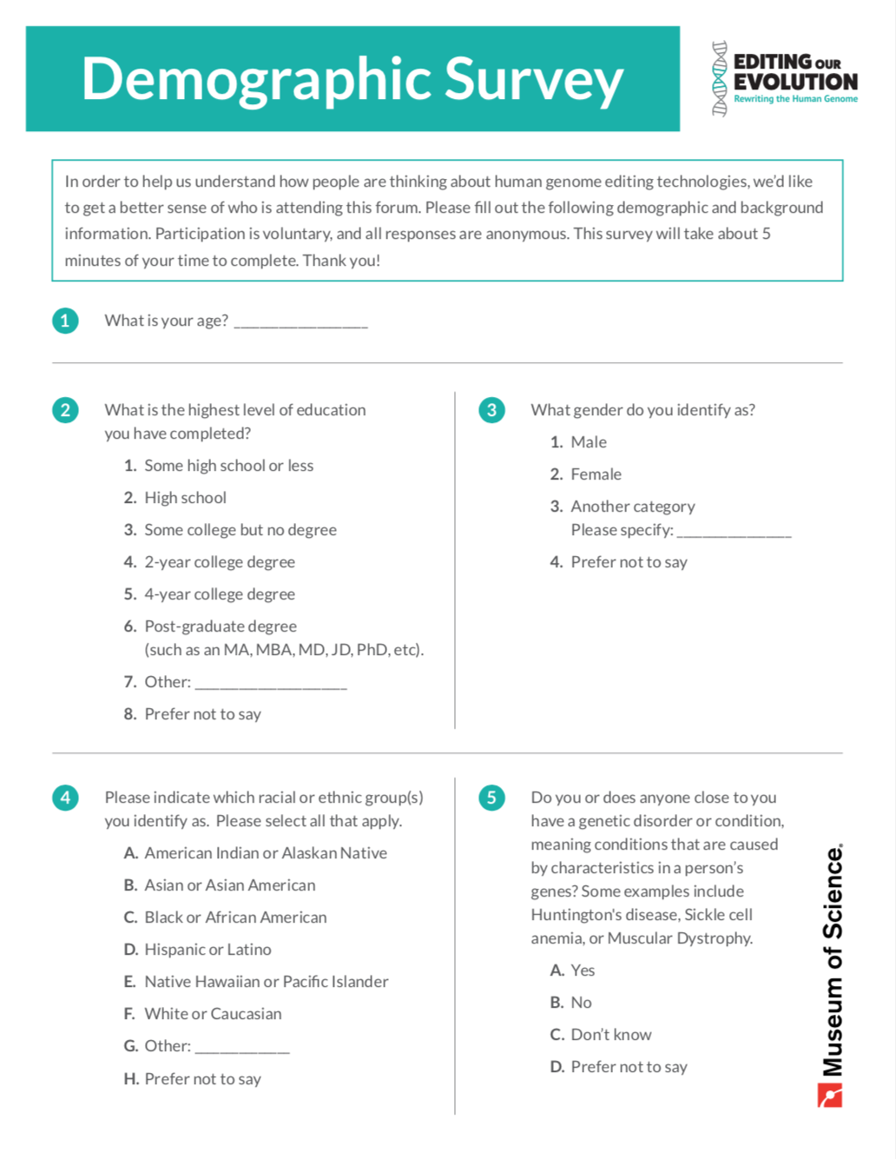
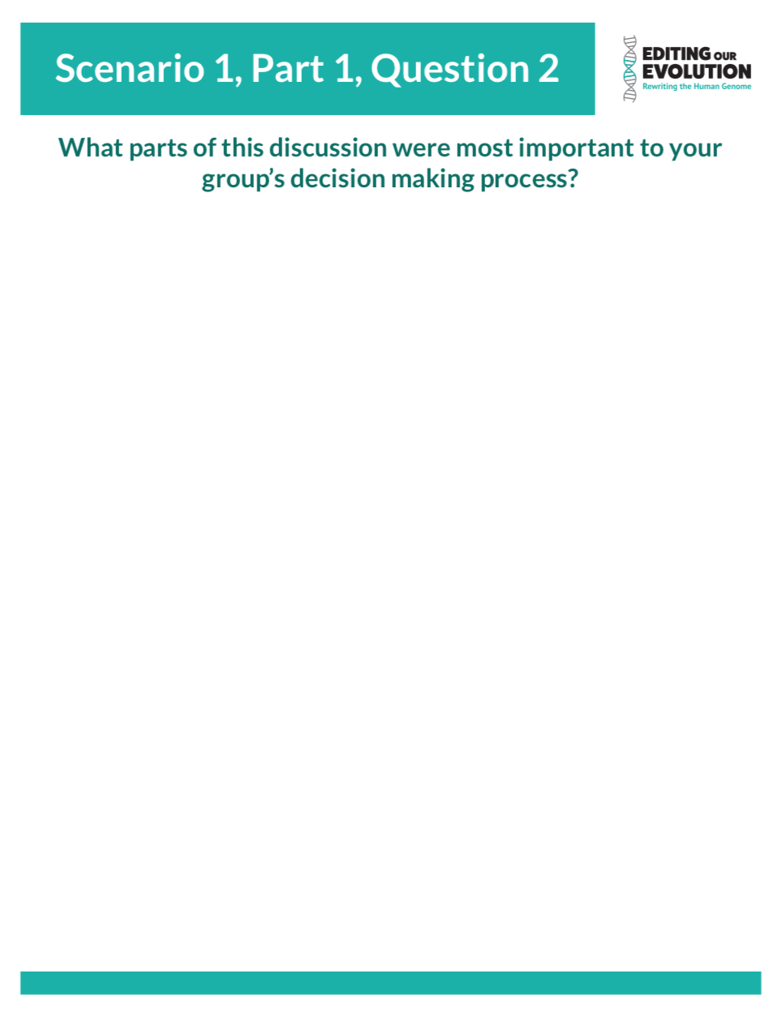
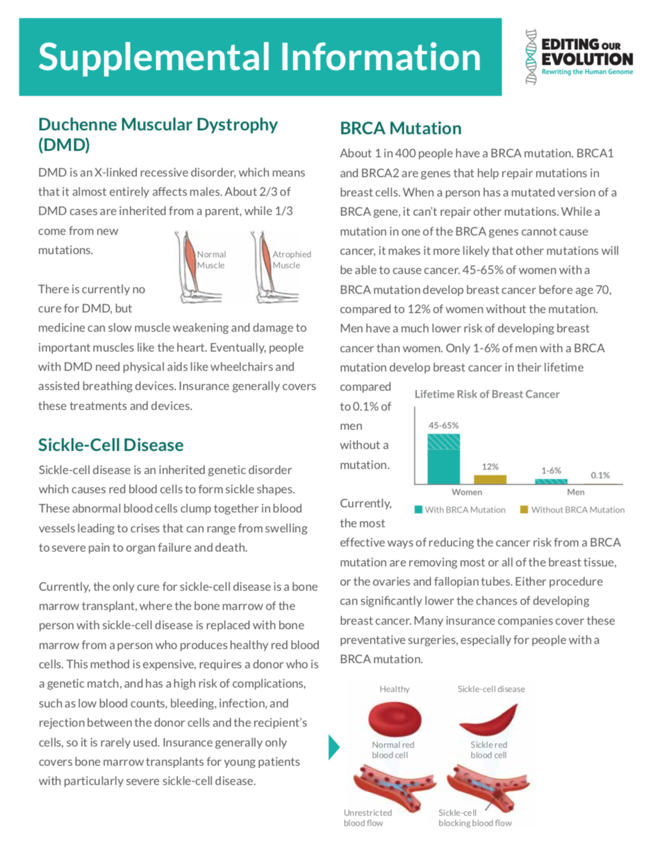
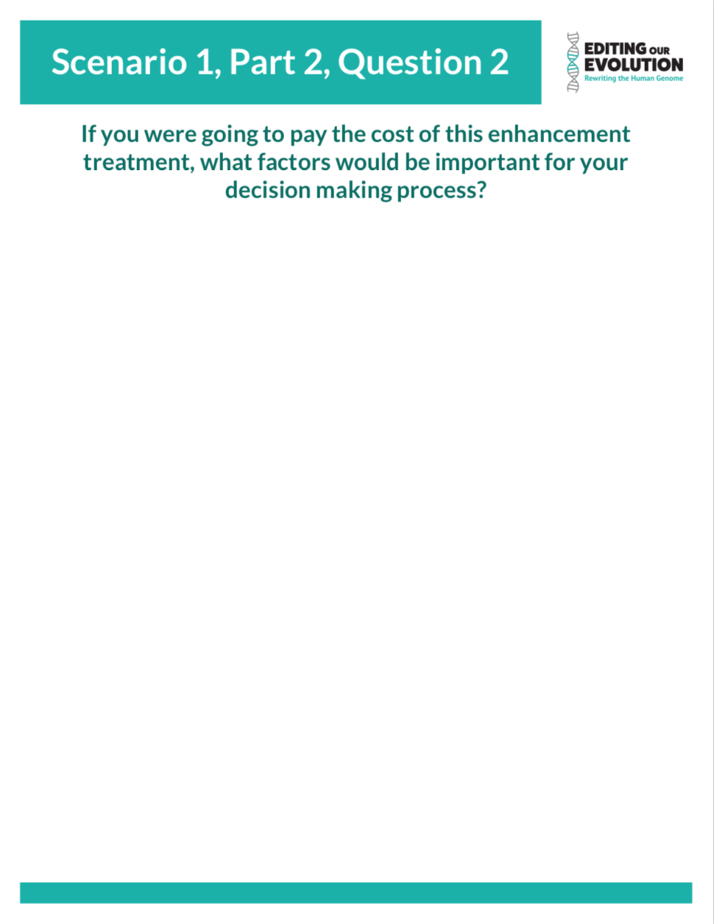
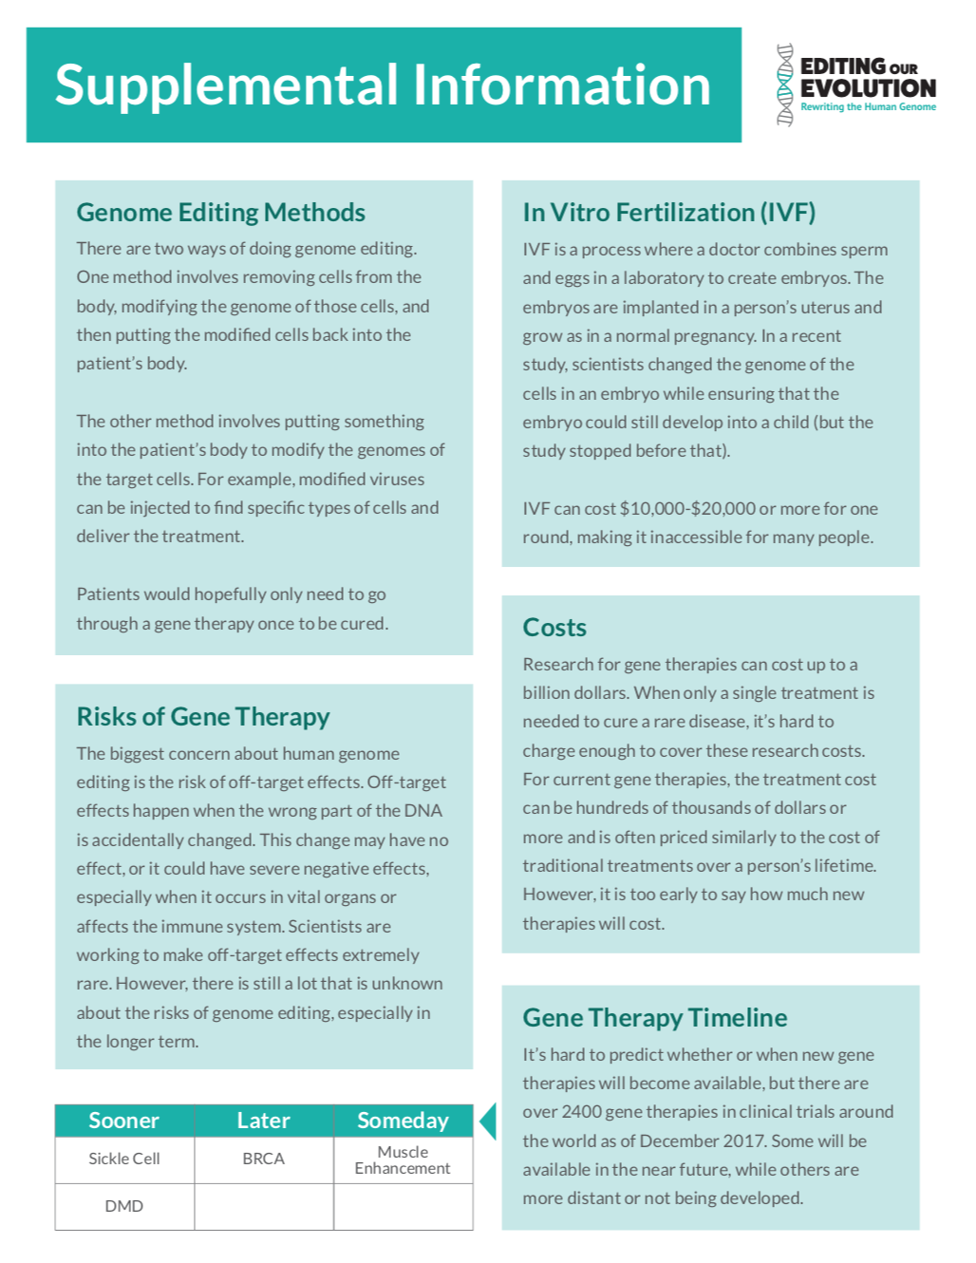
Materials
Notes:
Looking on your table, each person should have an individual packet in front of them.
On the front page is the instructions sheet, which we will all go over together in a moment.
The next few pages have the scenarios that you will be reading and discussing tonight as well as the questions that we’d like you to talk about and answer. Please fill out these sheets, as we’ll be using your answers and the answers from all of the other locations that are hosting this event to help give scientists a better sense of how people feel about issues surrounding human genome editing.
The second to last page of the packet has an optional demographic survey that we ask that you fill out at the end of the forum. We’ll talk more about this after you go through the scenarios, but this survey will help us understand how people are thinking about human genome editing.
And the last page in your packet has supplemental information, which you can look at if you want more information about any of the diseases, treatments, or other issues described in the scenarios.
Finally, your table should also have a set of group answer sheets. Some of the questions tonight ask you to come up with an answer as a group and write that answer on one of these sheets instead of your individual packet.

Slide 6
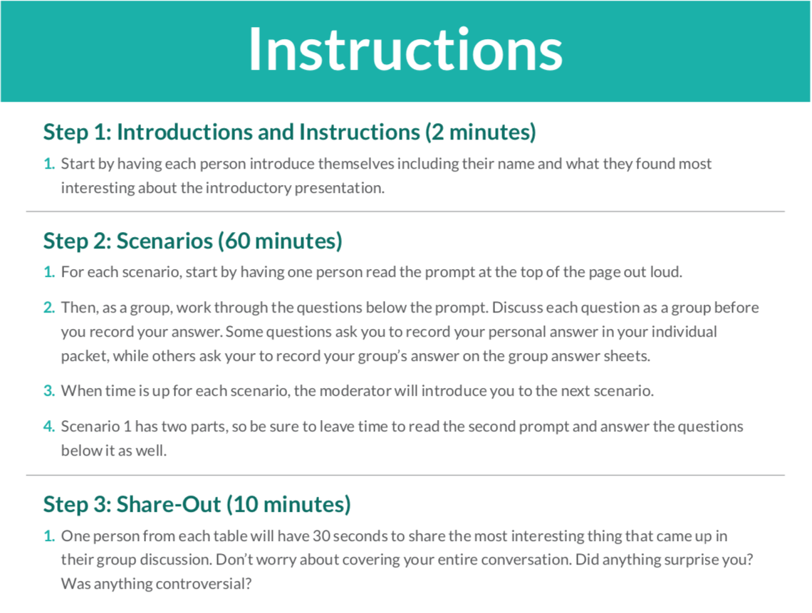
Instructions
Notes:
Okay, now let’s look through the instructions on the first page of the packet together.
Step 1: Introductions
We’ll start by having each person introduce themselves including their name and what they found most interesting about the conversation you all just watched.
Step 2: Scenarios
For each scenario, start by having one person read the prompt at the top of the page out loud.
Then, as a group, work through the questions below the prompt. Discuss each question as a group before you record your answer. Some questions ask you to record your personal answer in your individual packet, while others ask your to record your group’s answer on the group answer sheets. You can choose one person to be the scribe for your group, or change who writes the answer to each group question.
When time is up for each scenario, the moderator will introduce you to the next scenario.
Keep in mind, scenario 1 has two parts, so be sure to leave time to read the second prompt and answer the questions below it as well.
Step 3: Share Out
One person from each table will have 30 seconds to share the most interesting thing that came up in their group discussion. Don’t worry about covering your entire conversation. Did anything surprise you? Was anything controversial?

Slide 7
Ground Rules for Discussion
Respect others’ opinions and ideas
No interruptions – one person talks at a time
Listen carefully to what others have to say
It’s ok to disagree with others
Respect others’ experiences and backgrounds
Take part in the discussion
Give everyone a chance to speak
Keep comments brief and to the point
Notes:
Before we get started with our first group discussion, I also want to establish some ground rules. This topic might feel controversial for some people, whether because of their faith or a personal connection, so we want to encourage respectful conversation as our top priority. There are no right or wrong answers and everyone’s opinion is important, even if you haven’t thought about this topic before.
Please:
Respect others’ opinions and ideas
No interruptions – one person talks at a time
Listen carefully to what others have to say
It’s ok to disagree with others
Respect others’ experiences and backgrounds
Take part in the discussion
Give everyone a chance to speak
Keep comments brief and to the point

Slide 8
Scenario 1
Notes:
This first scenario has two parts. The first part will ask you to put yourself into the position of a parent in the not-too-distant future, where human genome editing has allowed for a cure to Duchenne Muscular Dystrophy . In the second part of the scenario, you’ll consider a more distant future where technology allows us to enhance physical abilities. For this and the rest of the scenarios you’ll be discussing tonight, because the treatments don’t exist yet, we don’t know exactly how severe or how frequent the risks will be. However, for the purposes of this discussion, we ask that you assume that these treatments have been approved by the FDA and that the known risks and side effects are in the same range as traditional treatments. Nobody can know for sure when treatments like this may exist or reach that level of safety, but if you want to get a rough sense of how far in the future these treatments may be, you can look at the timeline on the back of your supplemental information sheets.
We’ll have slides up keeping track of the time as we go through the discussion. If your table runs into any issues, you can raise your hand and one of us will come over to help. Our speakers will also be available to answer questions. Are there any questions before we begin? Let’s get started with reading the instructions and introducing yourselves at your table!

Slide 9
Scenario 1:
Therapy vs. Enhancement
25
minutes remaining
60 minutes until share out

Slide 10
Scenario 1:
Therapy vs. Enhancement
20
minutes remaining
60 minutes until share out

Slide 11
Scenario 1:
Therapy vs. Enhancement
15
minutes remaining
55 minutes until share out
Notes:
We’re about halfway through this scenario, so make sure you have time to move on to the second part of the scenario. In the first part of this scenario, we asked you to think about using gene therapy to cure a genetic disorder, but the second part is about how gene therapies could also be created to enhance certain genes in healthy people.

Slide 12
Scenario 1:
Therapy vs. Enhancement
10
minutes remaining
50 minutes until share out

Slide 13
Scenario 1:
Therapy vs. Enhancement
5
minutes remaining
45 minutes until share out
Notes:
We’ve only got a few minutes left in this scenario. Start wrapping up your discussion and writing down your answers.

Slide 14
Scenario 1:
Therapy vs. Enhancement
Time’s Up
45 minutes until share out
Notes:
Time’s up! Take a second to write down any final thoughts you have about this scenario before we move on.
In the next scenario, we’ll be asking you to think about issues of equity and access that may come up as more gene therapies are developed. To start out the scenario, you’ll be putting yourselves into the shoes of a person living with sickle-cell disease and thinking about whether you would even want to use a gene therapy if you had access to it. Then you’ll be discussing who should be responsible for providing access to life-saving gene therapies for people who want them. You can have someone start reading scenario 2 now.

Slide 15
Scenario 2:
Equity and Access
20
minutes remaining
40 minutes until share out

Slide 16
Scenario 2:
Equity and Access
15
minutes remaining
35 minutes until share out

Slide 17
Scenario 2:
Equity and Access
10
minutes remaining
30 minutes until share out

Slide 18
Scenario 2:
Equity and Access
5
minutes remaining
25 minutes until share out
Notes:
We’ve only got a few minutes left in this scenario. Start wrapping up your discussion and writing down your answers.

Slide 19
Scenario 2:
Equity and Access
Time’s Up
30 minutes until share out
Notes:
Time’s up! Finish writing down your last thoughts before we move on to our final scenario for the night.
This next scenario brings up an important consideration when we talk about editing the human genome. Many potential gene therapies will cure a person’s disease within their own body, but genome editing also offers the potential for changes that can be passed down from generation to generation. This means it could be possible to completely eliminate certain genetic diseases and mutations, but it also brings up practical and ethical concerns about what it means to change genes in a way that could have impacts across generations. You’ll be considering these questions by looking at BRCA mutations, which are major risk factors for developing breast cancer. Have someone read scenario 3 now.

Slide 20
Scenario 3:
Heritable Editing
15
minutes remaining
15 minutes until share out

Slide 21
Scenario 3:
Heritable Editing
10
minutes remaining
10 minutes until share out
Notes:
We’re about halfway through this scenario, so make sure your table is staying on track with your discussion.

Slide 22
Scenario 3:
Personal vs. Heritable Editing
5
minutes remaining
5 minutes until share out
Notes:
We’ve only got a few minutes left in this scenario. Start wrapping up your discussion and writing down your answers.
Don’t forget to choose someone to report out for your group. We’ll all share our plans once we’ve finished our conversation.

Slide 23
Scenario 3:
Personal vs. Heritable Editing
Time’s Up
0 minutes until share out
Notes:
And that’s all the time we have for scenario 3. Finish recording your thoughts and then we’ll go around and give each table 30 seconds to share the most interesting thing that came up in their group discussion. Does anyone want to go first?”
While each group is sharing out, we also would like to ask each of you to fill out a short, 2-page survey on the second to last page of your individual packet. This survey is designed to give us a better sense of who came to this forum and how different people feel about the topic of human genome editing. Your participation is voluntary, all your answers are confidential, and all the questions are optional. Please leave the survey attached to your packet when you’re done.
[if applicable] If you want to take a copy of the materials home with you, we’ve placed some blank copies by the exit.
[After all groups have shared] Thanks to each of our reporters, and thanks to all of you for coming and putting so much thought into your plans.
[If applicable] “Do our speakers have any thoughts they want to share after hearing all of these plans?”

Slide 24
Thank you!
Please complete the survey if you want to help us improve the program
Notes:
“Thank you for participating in today’s forum! As part of this forum, the Museum of Science, Boston is collecting information on your answers to these questions and some demographic information to get a better idea of how people are thinking about the issue of human genome editing. To do so we’ll be collecting the data from your individual packets, and we would also like you to complete a the 3-5 minute demographic survey on the second-to-last page in your packet. Your participation is voluntary, all your answers are confidential, and all the questions are optional. If you don’t wish to participate, you may take your packet with you or throw it away.
Once you’ve completed this, you may leave the surveys on the table or hand them to myself or other staff in room as you leave. Please let me know if you have any questions and we greatly appreciate your help.”
Thanks again for coming!

