Slide 1
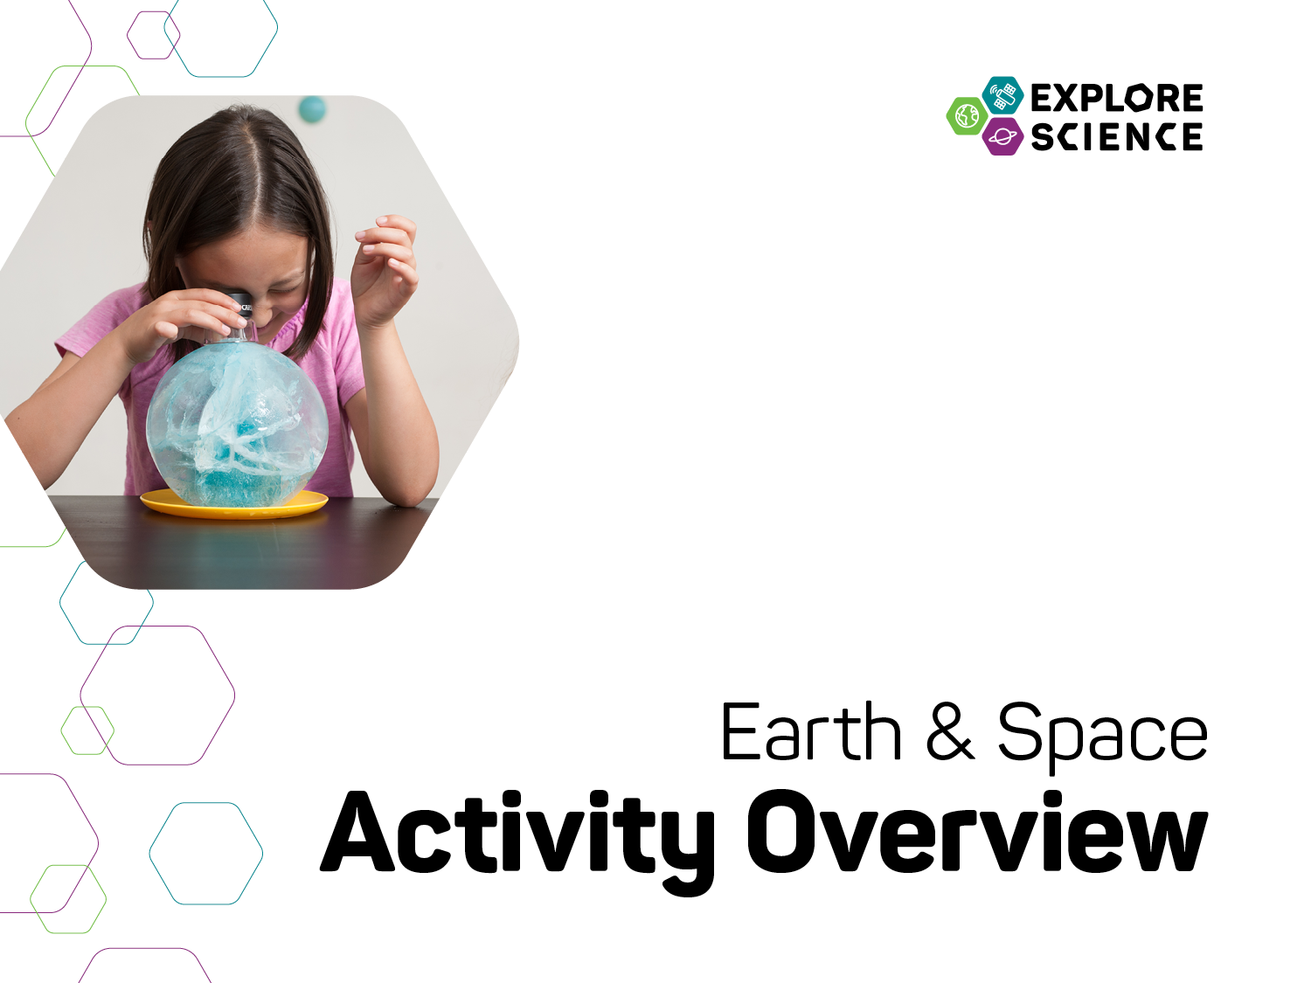

Slide 2

Presentation
Explore Science: Earth & Space
Our Event
Toolkit of activities
Leading the activities
Notes:
Welcome to the Explore Science: Earth & Space toolkit training!
This training has three parts:
1. Quick introduction to the Explore Science: Earth & Space project and toolkit
2. Overview of the toolkit and the individual activities
3. Tips to help you lead the activities successfully

Slide 3

Explore Science: Earth & Space
Notes:
The Explore Science: Earth & Space project represents an effort by the National Informal STEM Education Network (NISE Net) in collaboration with NASA to engage museum visitors in Earth and space science experiences with connections to science, technology, and society through engaging, hands-on activities.
This year, 2017, the NISE Net has sent out 250 physical Explore Science: Earth & Space toolkits. Museums all across the country hosting events and engaging their visitors through year-round programming.

Slide 4
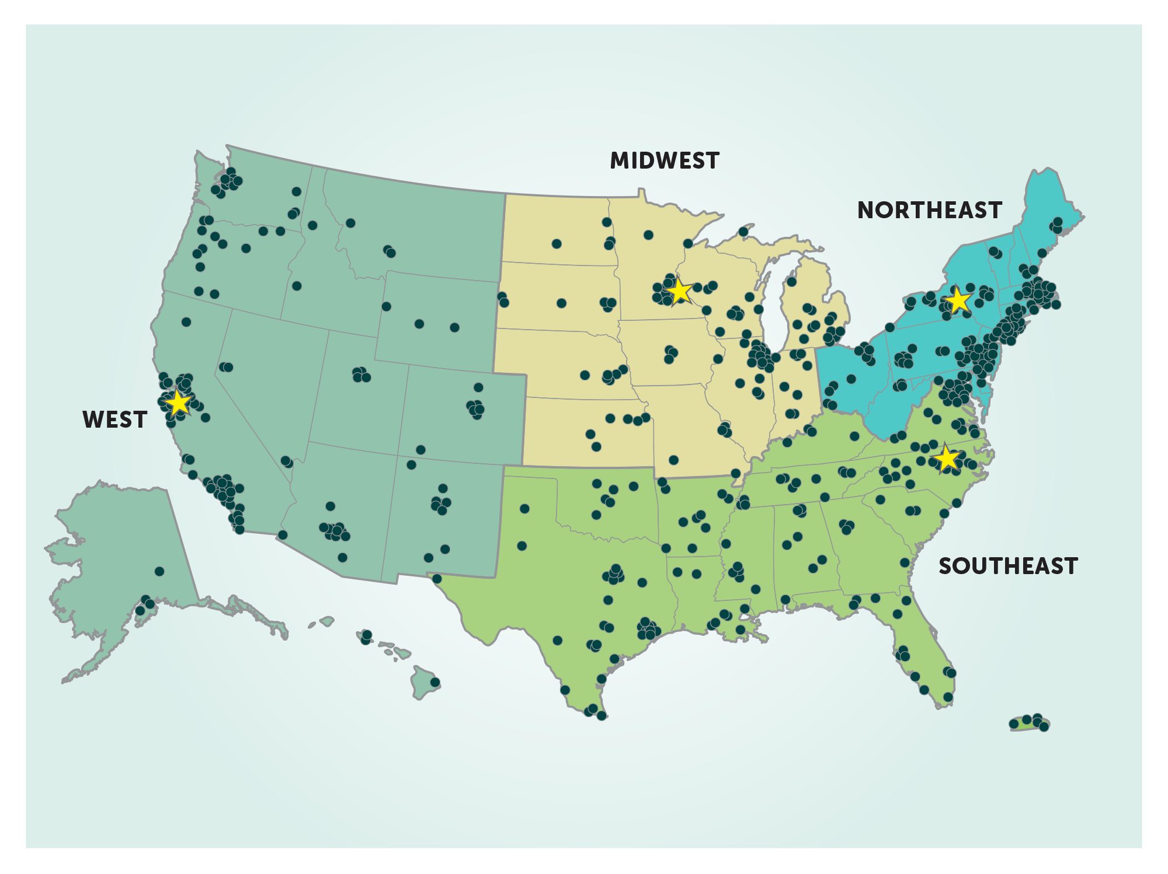
Notes:
This year, 2017, the NISE Net has sent out 250 physical Explore Science: Earth & Space toolkits. Museums all across the country are hosting events and engaging their visitors through year-round programming.

Slide 5
Our Event
Notes:
Here are a few details about our event, today.

Slide 6

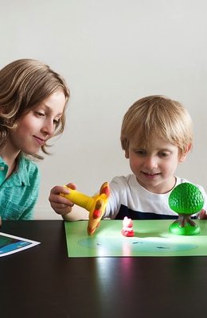
Our Event
Background
Who’s here
Orientation
Safety
Policies
Schedule
Future events
Notes:
This is for information specifically about your institution
Background
(Your institution’s) mission and goals for this event
Who’s here
Introduce collaborators, guest speakers, volunteer groups, and other educators and facilitators.
Orientation, Safety, and Policies
Where are restrooms, lunchrooms, and other places?
Where are the emergency exits?
Who should be contacted in case of emergency?
What do volunteers do if they have a problem? Who should be contacted?
Does your institution have procedures for fire alarms, lost children, and other emergencies?
Schedule
Highlight the schedule for the day.
Are there special presentations? If so, where will they be held and at what time?
When does the event begin and end?
NASA current events
Add in a few notes about upcoming or related celestial or earth science related events. For example, “We’re celebrating Earth Day!” or “A total solar eclipse is happening next month!” or “Juno just arrived at Jupiter!”
Future events
What opportunities are there to participate in future events and stay in touch?

Slide 7
Toolkit of Activities
Notes:
Now, we’ll quickly review the Explore Science: Earth & Space Toolkit.

Slide 8
Explore Science kits
Designed for hands-on learning
Adaptable to different settings and learners
Everything you need is in the kit!
Notes:
The Explore Science: Earth & Space toolkit materials have been designed to engage visitors in Earth and space phenomena, to help visitors reflect on science as a way of knowing, and to encourage them to identify as science learners.
The toolkits focus on hands-on space and earth science activities. They are adaptable to different settings and different kinds of learners.
Each toolkit includes everything you need for all the activities, with supplies for about 100 people.

Slide 9

Learning Framework
Experience Earth and space PHENOMENA and explore science findings.
Use the scientific PROCESS and reflect on science as a way of knowing.
PARTICIPATE in the scientific community and identify as a science learner.
Notes:
The Toolkit activities were developed around a learning framework that has three main parts: PHENOMENA, PROCESS, and PARTICIPATE.
Experience Earth and space PHENOMENA and explore science findings.
Use the scientific PROCESS and reflect on science as a way of knowing.
PARTICIPATE in the scientific community and identify as a science learner.

Slide 10
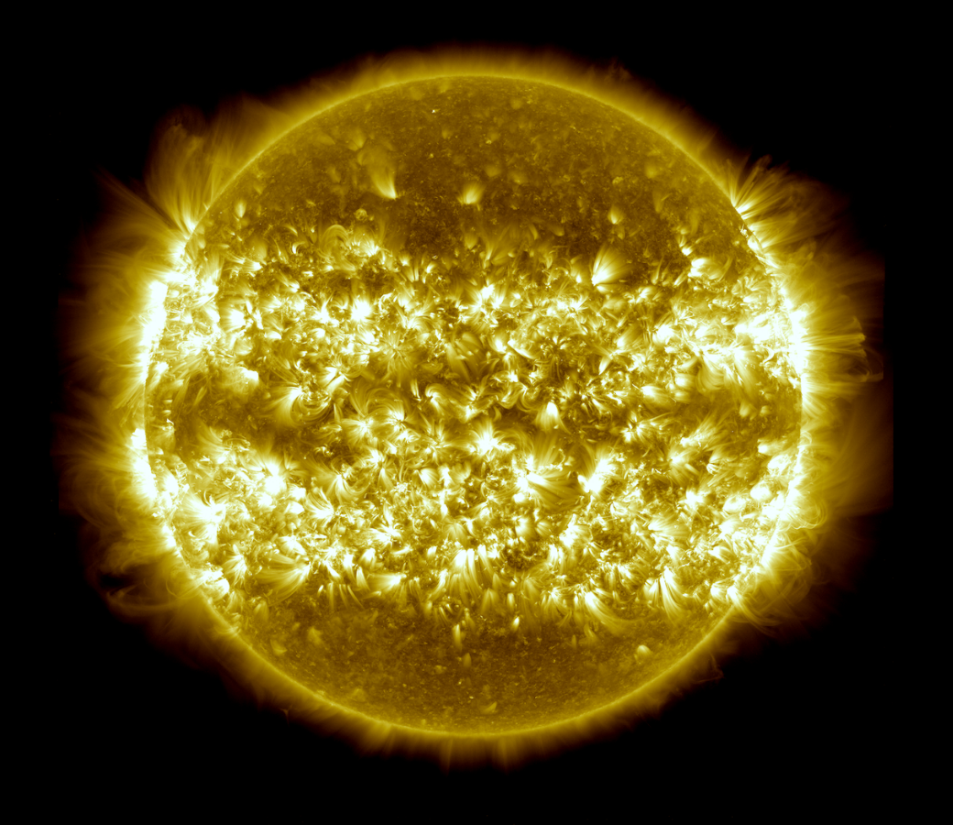
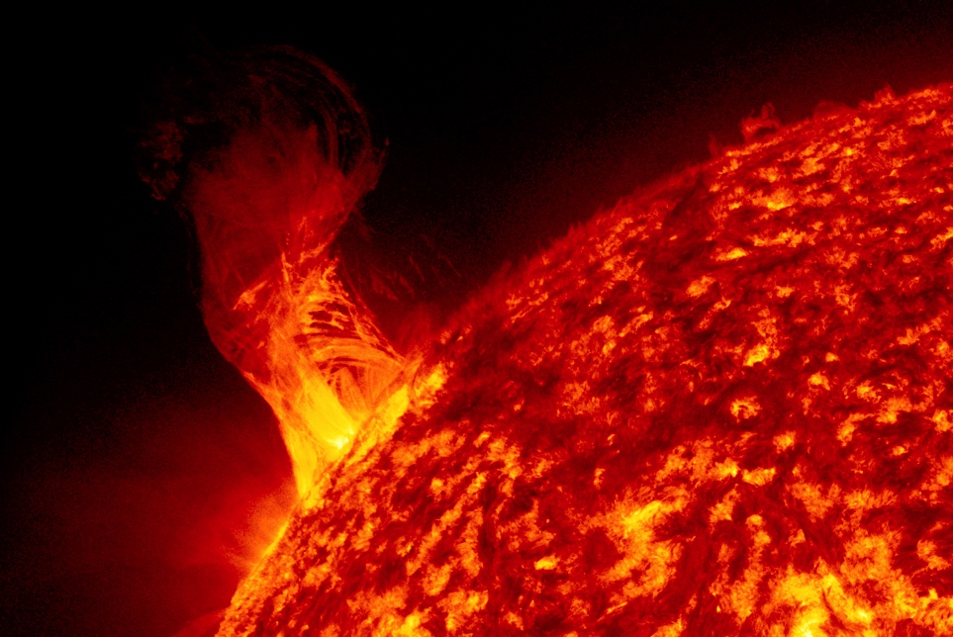
Living with the Sun
Notes:
The toolkit also covers a range of content covered by NASA’s Science Mission Directorate, including:
Living with the Sun
Some of the BIG questions NASA scientists are asking are:
What causes the Sun to vary?
How do Earth and the solar system respond?
What are the impacts on humanity?
BIG Stories about the Sun:
1. The Sun radiates a massive amount of energy across the entire electromagnetic spectrum from its surface.
2. The Sun is the source of all life on Earth, but can also harm human society and technology.
3. The Sun is at the center of our solar system, and plays a role in regular patterns observed on Earth including eclipses, phases of the moon, and seasons.

Slide 11
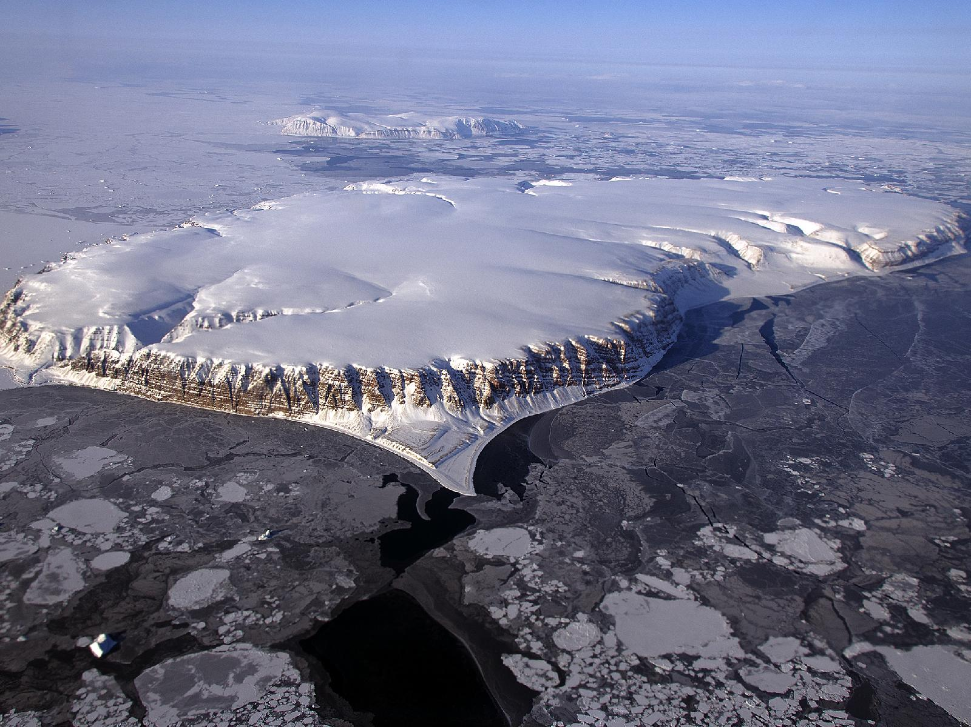
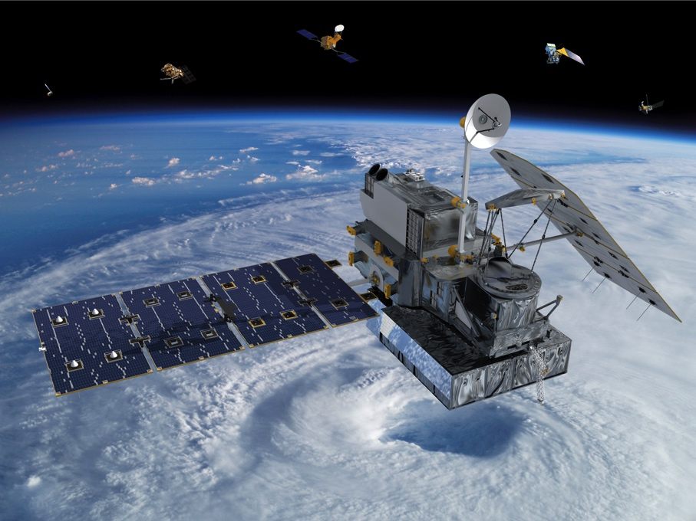
The Changing Earth
Notes:
The Changing Earth
Some of the BIG questions NASA scientists are asking are:
How is the Earth changing?
What cause changes on Earth?
How will the Earth change in the future?
BIG Stories about Earth:
1. Earth is a continuous changing and complex system of interacting rock, water, air, and lifeforms; its energy comes from the Sun and Earth’s hot interior.
2. Earth is a water planet with icecaps and glaciers, lakes, rivers, groundwater, water in the atmosphere, and one big ocean; all influence weather, climate, and life. While the majority of water on Earth is in the ocean, most of the freshwater is locked up in ice and underground.
3. Human activities have changed the Earth's land, oceans, and atmosphere. Some of these measurable changes have decreased the capacity of the environment to support some lifeforms.

Slide 12
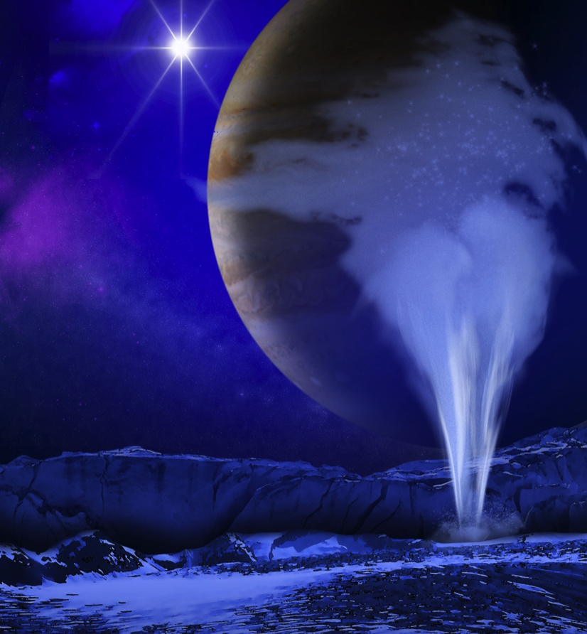
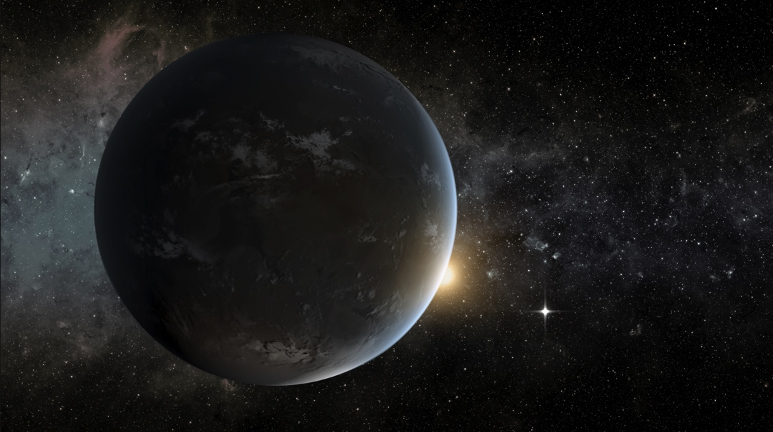
Our Solar System and
Planets around
other Stars
Notes:
Our Solar System and Planets around other Stars
Some of the BIG questions NASA scientists are asking are:
How did the solar system form and evolve?
Why did life evolve on Earth?
Could life exist elsewhere?
BIG Stories about the solar system and other planets:
1. The solar system began as a rotating disk of hot dust and gas around the Sun almost 5 billion years ago, and evolved into 4 small and rocky inner planets, 4 large and gaseous outer planets, many moons, asteroids, dwarf planets, and comets. These solar system objects are separated by vast distances of empty space and are held together in orbits around the Sun by gravity.
2. There are other sources of water in the solar system, potentially locked in ice or under-the-surface oceans of moons and other smaller objects that may support life.
3. Spacecraft and ground-based observations have identified many planets outside of our solar system called exoplanets that share similarities with nearby planets and may even support life.

Slide 13
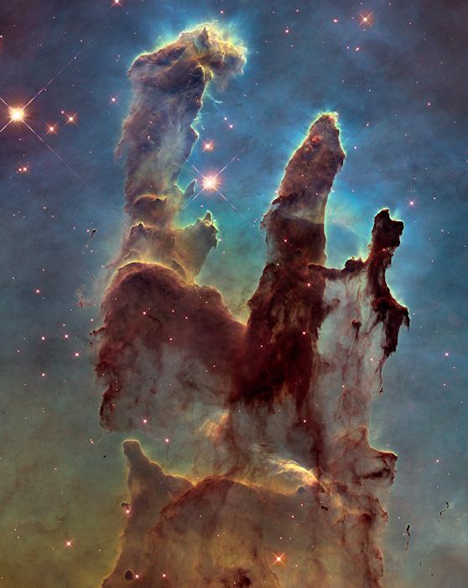
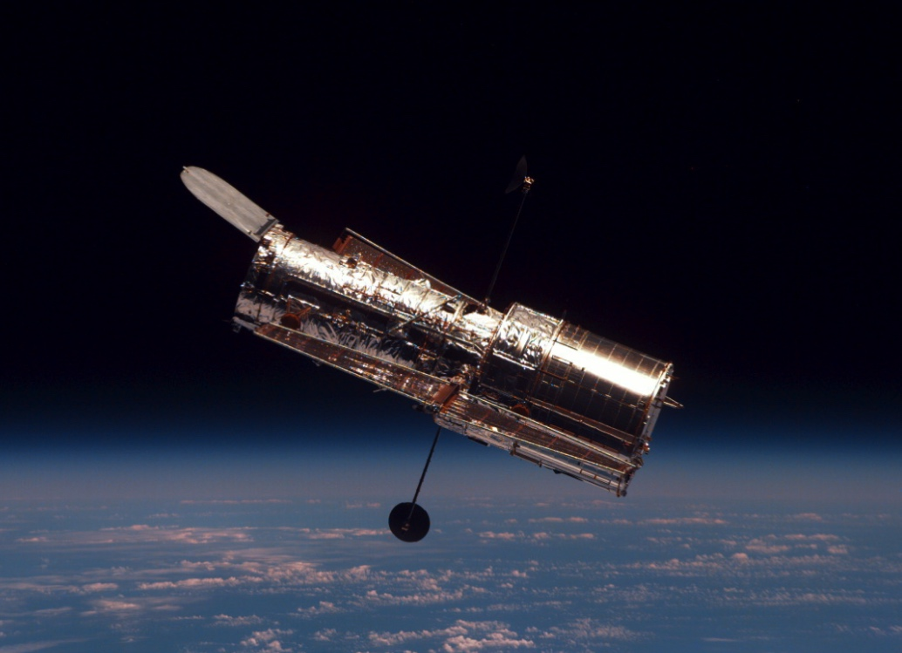
Galaxies and
Beyond
Notes:
Galaxies and Beyond
Some of the BIG questions NASA scientists are asking are:
How does the universe work?
How did we get here?
Are we alone?
BIG Stories about space beyond our solar system:
1. Our Sun is a medium-sized star located near the edge of a disc-shaped galaxy of stars, the Milky Way. The universe contains many billions of galaxies, and each galaxy contains many billions of stars.
2. The “Big Bang” is the name given to the beginning of the universe - the moment when all matter was created about 14 billion years ago.
3. Black holes are objects whose gravity is so strong that nothing can escape from them, not even light.

Slide 14
Hands-on Activities
Notes:
The Explore Science: Earth & Space toolkit includes 9 hands-on activities. Each activity comes in a box and includes all the physical materials you’ll need plus the activity and facilitator guides and additional information sheets.

Slide 15

Notes:
These three activities all relate to light and shadows. Your can use them to connect to the 2017 solar eclipse, or eclipses more generally.
The Solar Eclipse activity explores the following ideas:
A solar eclipse occurs when the Moon moves between the Sun and Earth, casting a shadow on Earth.
A solar eclipse is a rare and beautiful event.
People have observed and tried to explain solar eclipses for thousands of years.
The Big Sun, Small Moon activity explores the following ideas:
We can see a solar eclipse from Earth because the Sun and Moon appear to be the same size in the sky.
The further away an object is, the smaller it appears.
NASA researchers learn new things by studying the Sun during a total solar eclipse.
Both of these are great outdoor activities (but they also work inside).
Bear’s Shadow works especially well for younger visitors and their families, and explores the following ideas:
A shadow is created when an object blocks light from falling on a surface.
An object’s shadow always appears on the opposite side from the light source.
Shadows change when the relative positions of the light source and the object change.
When connected to the 2017 solar eclipse event, it has the following additional learning objective:
A solar eclipse occurs when the Moon passes directly between the Sun and the Earth, blocking the Sun’s light and casting a shadow on Earth.

Slide 16
Notes:
These two activities are about Explore Earth, and the way that NASA studies Earth from above and below.
The Rising Sea activity explores the following ideas:
Earth’s sea levels are rising, submerging land and causing coastlines to recede.
Rising sea levels will have major consequences for people all around the world.
Scientists are monitoring the sea level, providing information that can help us prepare for and adapt to the changing ocean.
The Investigating Clouds activity explores the following ideas:
Clouds influence Earth’s weather and climate.
Clouds form when individual water molecules combine into droplets.
NASA researchers study clouds in order to better understand and predict how Earth’s climate is changing.
Particular to the information sheet, worksheet, and Globe postcard that come in the activity: Citizen science programs collect and share the data with researchers that collaborate with NASA.

Slide 17
Notes:
The Pocket Solar System activity helps participants create a scale model of our Solar System.
The activity explores the following ideas:
There’s a lot of empty space in our solar system—distances between planets are vast!
The solar system is made up of eight planets and many other objects orbiting the Sun.
NASA’s science missions are exploring our solar system, and beyond.

Slide 18
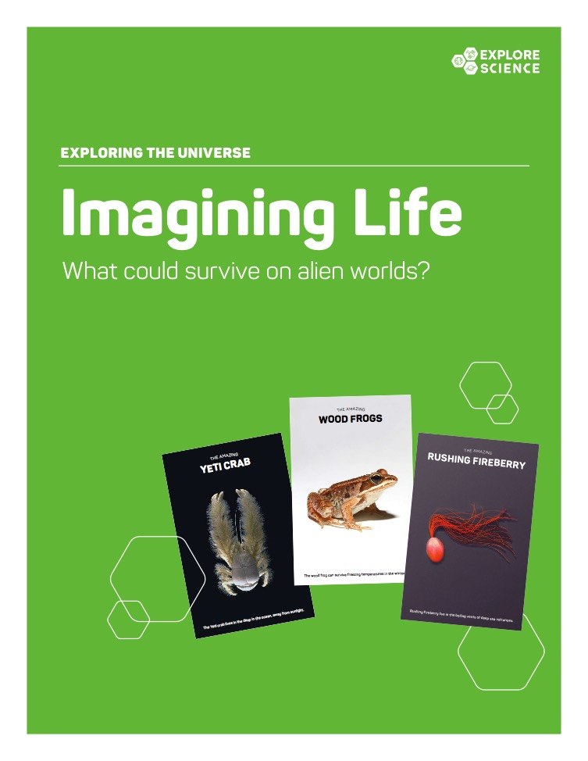
Notes:
These activities are about Exploring The Universe.
The Ice Orbs activity explores the following ideas:
Ocean worlds may be the most likely places to discover life beyond Earth.
Scientists think that ocean worlds have icy cold, frozen exteriors and warmer, liquid interiors.
Some astrobiologists are studying ocean worlds for evidence and signs of life.
The Orbiting Objects activity explores the following ideas:
The force of gravity influences everything (with mass) in space.
Every object in space exerts a gravitational pull on every other object.
Gravity keeps objects orbiting other objects, and prevents them from flying off into space.
The Imagining Life activity explores the following ideas:
If life exists elsewhere in the universe, it could look very different from life on Earth.
Life on Earth comes in an amazing variety of forms.
Astrobiologists use our knowledge about life on Earth to make predictions about what life might be like elsewhere in the universe.

Slide 19
Leading the Activities
Notes:
Now, we’ll review some tips for leading these activities with participants

Slide 20
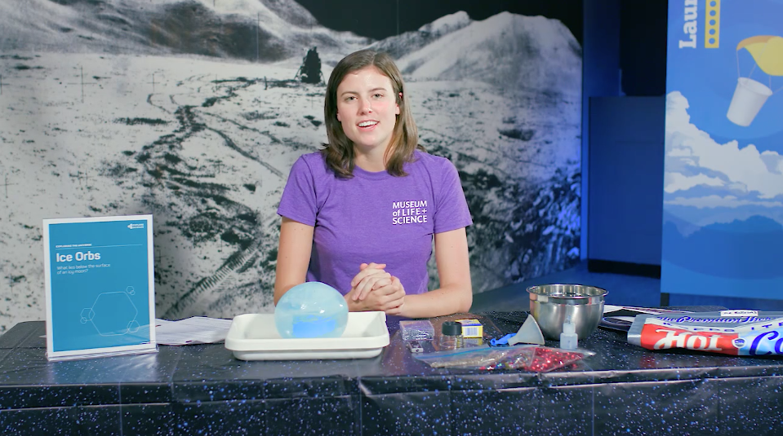
Activity materials
Notes:
We’ve just taken a very quick look at all 9 activities in the Explore Science: Earth & Space toolkit.
Here is an example of just one activity, Ice Orbs. The image shows all the physical materials needed to do the activity.
Some of these materials are intended for the learners to use. These include the supplies they need to do the activity (like the ice orb, tray, magnifying glass) and the activity guide and sign, and additional information sheets or other graphics. These things should all be out and accessible for learners.
It also includes some materials for you, the facilitator, to use. These include the materials you’d need for any advance preparation as well as the facilitator guide with some notes about things like setup and safety, and some tips to help you do a great job leading the activity. You can set these somewhere handy for you only.

Slide 21
Activity instructions
Notes:
Now let’s look at some of these materials a bit more closely. Here is an example of an activity guide, for the Ice Orbs activity.
The activity guides are structured to help you lead learners through hands-on science activities.
The front side includes step-by-step instructions in the section called “Try this!”
The back side describes what learners observe—and explains why it happens. Finally, the guide relates the activity to current space or Earth related science or NASA research.
You can leave these guides out on the table both to help you explain the activity and so that learners can read them and look at the pictures.
(They’re available in both English and Spanish versions.)

Slide 22
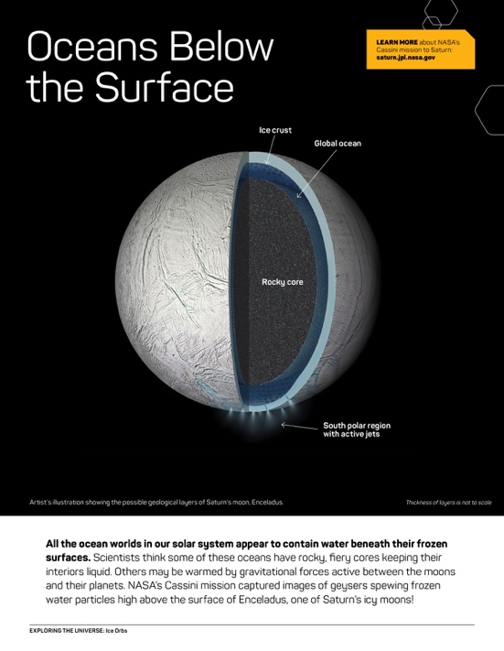
Info sheets and worksheets
Notes:
Many activities include additional information sheets or other graphic assets. Depending on your event or setting you may choose to use these more or less. They provide additional related content about the hands-on activity for participants and facilitators alike.

Slide 23
Notes and tips
Notes:
The facilitator guide is for you, the activity leader.
The first few pages list the learning objectives, activity materials, and includes important notes related to setup, safety, presentation, difficult concepts and other aspects of the activity.
Additionally, each activity contains a useful reference sheet with tips about leading hands–on science activities and notes about how to talk to visitors about misconceptions and other difficult concepts.

Slide 24


Thank you
Space and Earth Informal STEM Education is supported by NASA under cooperative agreement number NNX16AC67A. Any opinions, findings, and conclusions or recommendations expressed in this material are those of the author(s) and do not necessarily reflect the view of the National Aeronautics and Space Administration (NASA).
Copyright 2016 Science Museum of Minnesota
Activity photos by Emily Maletz for the NISE Network. Activity materials screen capture by Museum of Life and Science. Living with the Sun images: December 31, 2012 solar prominence courtesy NASA Goddard Space Flight Center/SDO/SVS, composite image of 25 separate images of the Sun from the Solar Dynamics Observatory (SDO) spanning the period of April 16, 2012, to April 15, 2013 courtesy NASA Goddard Space Flight Center/SDO/AIA/S. Wiessinger. The Changing Earth images: Global Precipitation Measurement (GPM) Core Observatory courtesy NASA, Saunders Island and Wolstenholme Fjord with Kap Atholl in the background photographed during a NASA Ice Bridge flight over Greenland courtesy NASA/Michael Studinger. Our Solar System and Planets Around Other Stars images: Artistic concept of exoplanet Kepler-62f courtesy NASA Ames/JPL-Caltech/Tim Pyle, Artistic concept of water plumes on Jupiter’s moon Europa courtesy NASA/ESA/K. Retherford/SWRI. Galaxies and Beyond images: View of Hubble from space shuttle Atlantis courtesy NASA/ESA/Hubble Heritage Team (STScI/AURA)/J. Hester, P. Scowen (Arizona State U.), Eagle Nebula's “Pillars of Creation” courtesy NASA.
Notes:
THANK YOU!

