Slide 1
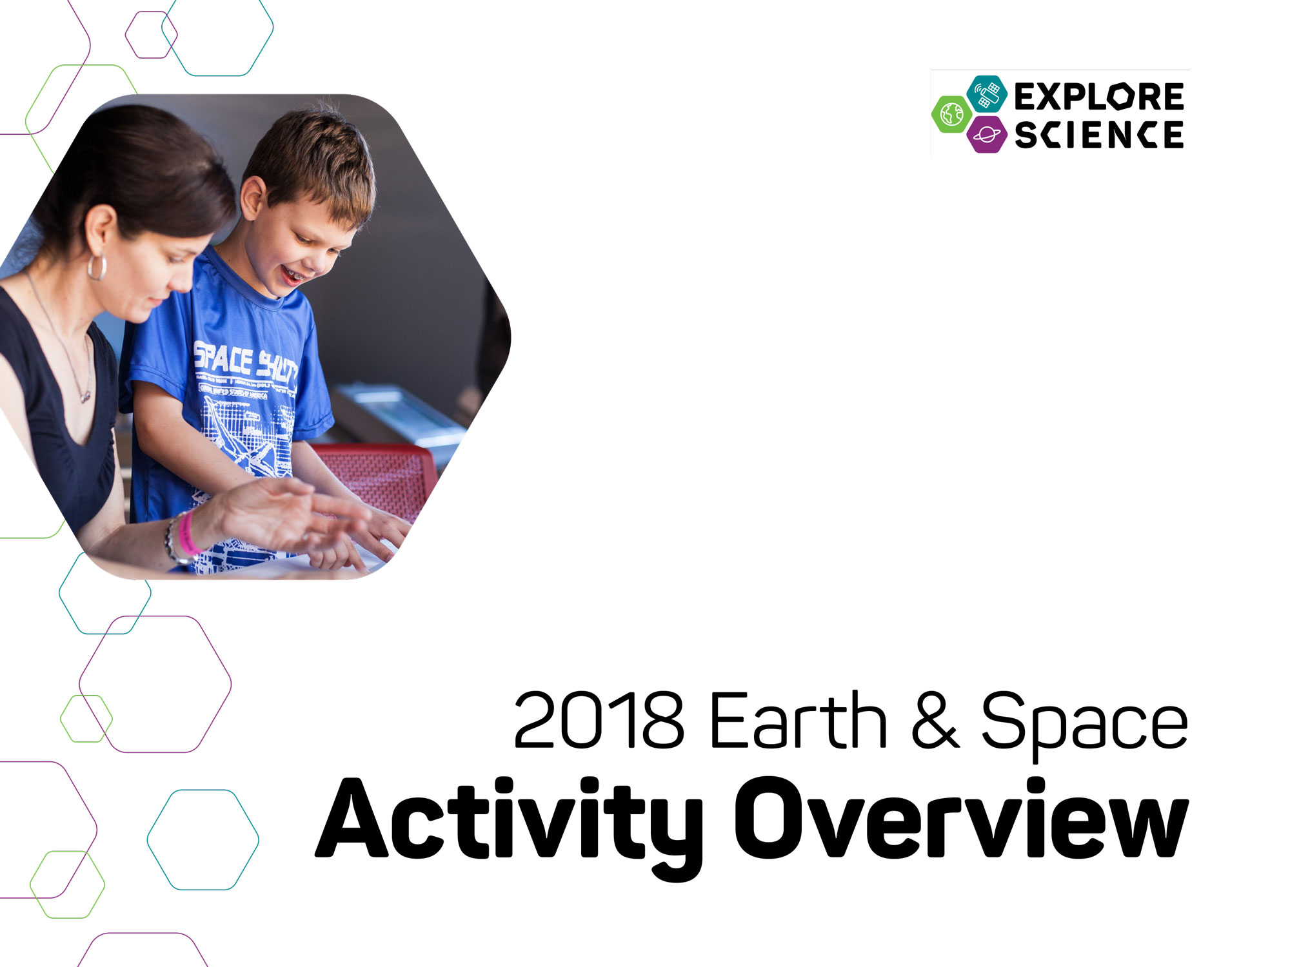
Notes:
[This slide presentation provides an overview of the Explore Science: Earth and Space Toolkit, and can be used to introduce staff and volunteers to the project and its educational materials. You can customize this training presentation to fit your organization and programming.]

Slide 2

Presentation
Explore Science: Earth & Space
Our Event
Toolkit of Activities
Leading the Activities
Questions?
Notes:
Welcome to the Explore Science: Earth & Space event training! In this presentation, we’re going to go through quite a bit of information related to our local event and the national Explore Science: Earth & Space project.
This training has three parts:
1. Quick introduction to the Explore Science: Earth & Space project and toolkit
2. Overview of the toolkit and the individual activities
3. Tips and training resources to help you lead the activities successfully
We’ll have time at the end for questions, but feel free to ask for clarification throughout.

Slide 3

Explore Science: Earth & Space
Notes:
The Explore Science: Earth & Space project represents an effort by the National Informal STEM Education Network (NISE Network) in collaboration with NASA to engage museum visitors in Earth and space science hands-on activities and experiences with connections to science, technology, and society.

Slide 4
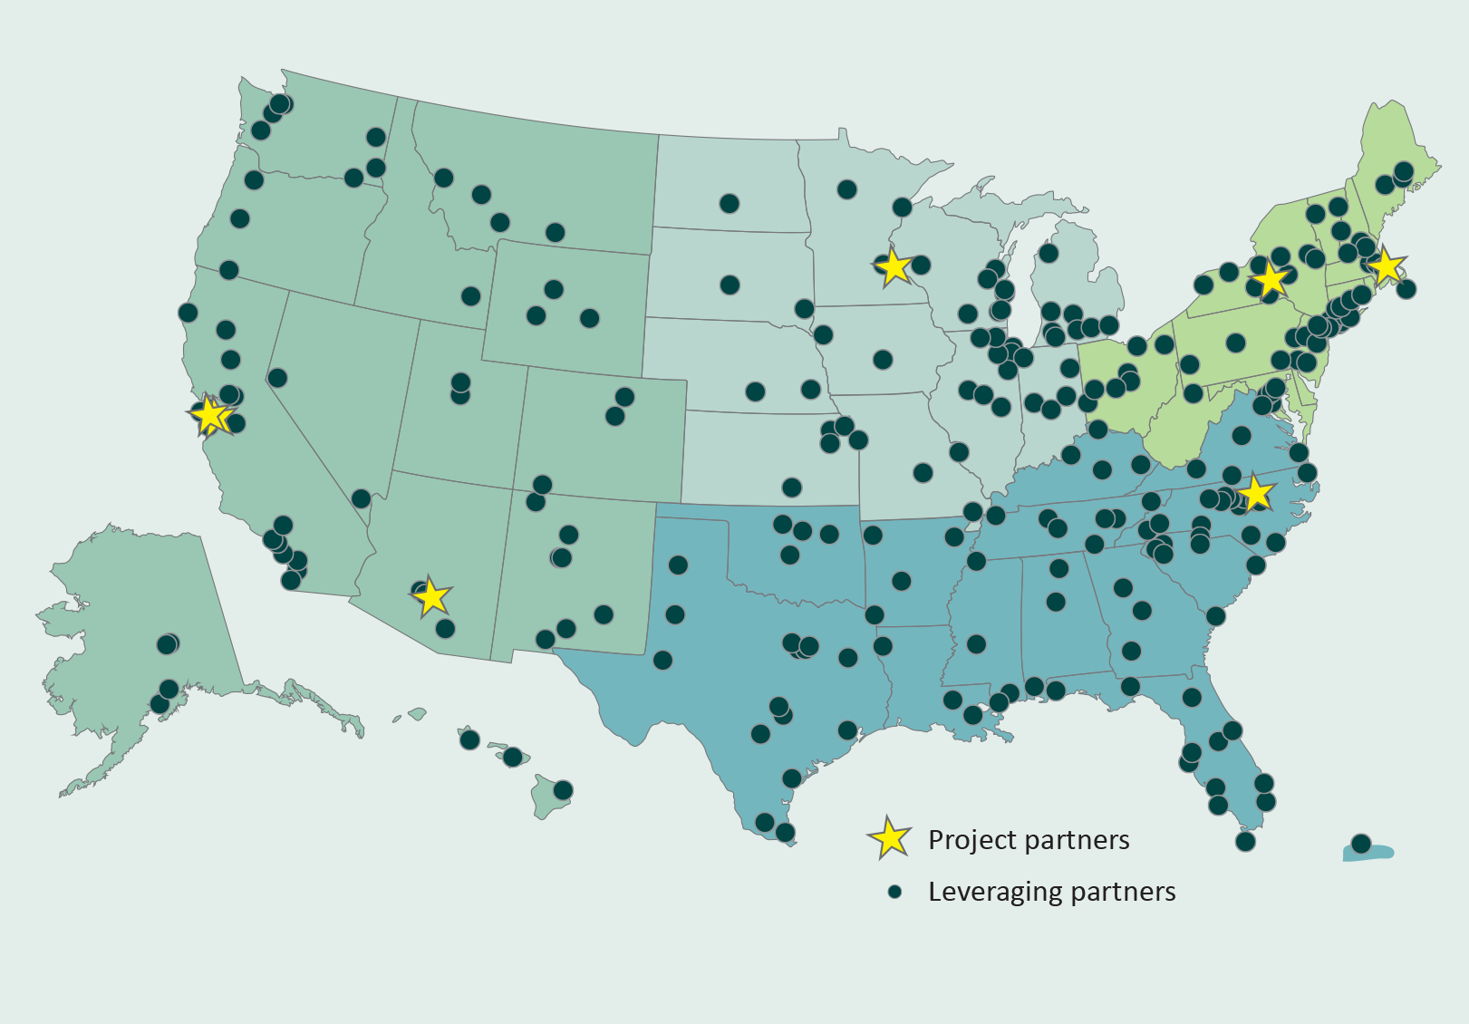
Notes:
This year, the NISE Network shared 250 physical Explore Science: Earth & Space toolkits. Institutions (including, children’s museums, science centers, NASA Visitor Centers, nature centers, natural history museums, and more!) all across the country are hosting events and engaging visitors through year-round programming!

Slide 5
Our Event
Notes:
Here are a few details about our event, today.

Slide 6
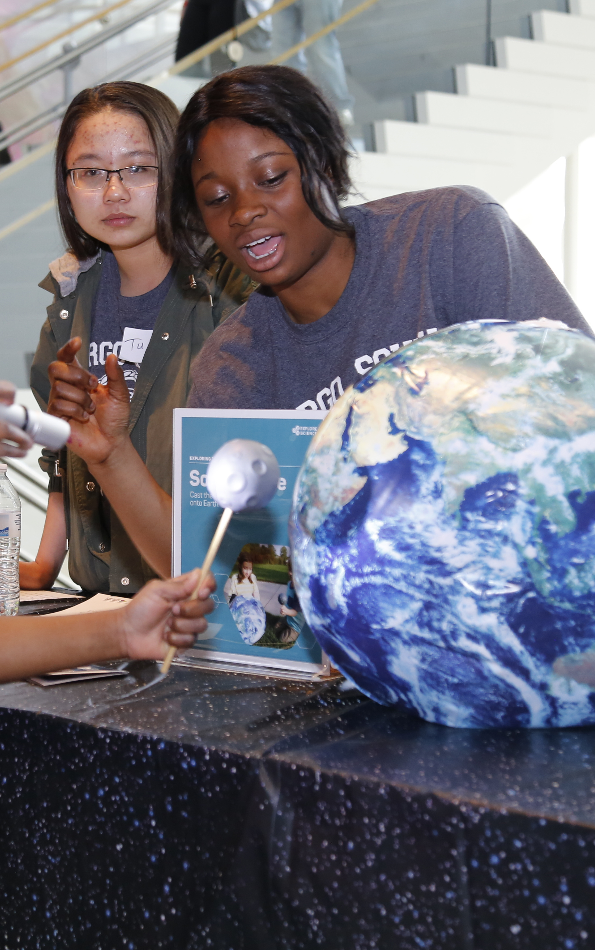

Our Event
Background
Who’s here
Orientation
Safety
Policies
Schedule
Future events
Notes:
[This is for information specifically about your institution
Background
(Your institution’s) mission and goals for this event
Who’s here
Introduce collaborators, guest speakers, volunteer groups, and other educators and facilitators.
Orientation, Safety, and Policies
Where are restrooms, lunchrooms, and other places?
Where are the emergency exits?
Who should be contacted in case of emergency?
What do volunteers do if they have a problem? Who should be contacted?
Does your institution have procedures for fire alarms, lost children, and other emergencies?
Schedule
Highlight the schedule for the day.
Are there special presentations? If so, where will they be held and at what time?
When does the event begin and end?
NASA current events
Add in a few notes about upcoming or related celestial or earth science related events. For example, “We’re celebrating Earth Day!” or “It’s Astronomy Day!”
Future events
What opportunities are there to participate in future events and stay in touch?]

Slide 7
Toolkit of Activities
Notes:
Now, we’ll quickly review the Explore Science: Earth & Space Toolkit.

Slide 8

Explore Science kits
Designed for hands-on learning
Adaptable to different settings and learners
Everything you need is in the kit!
Notes:
The Explore Science: Earth & Space toolkit materials have been designed to engage visitors in Earth and space phenomena, to help visitors reflect on science as a way of knowing, and to encourage them to identify as science learners.
The toolkits focus on hands-on space and earth science activities. They are adaptable to different settings and different kinds of learners.
Each toolkit includes everything you need for all the activities, with supplies for about 100 people.

Slide 9

Learning Framework
Experience Earth and space PHENOMENA and explore science findings.
Use the scientific PROCESS and reflect on science as a way of knowing.
PARTICIPATE in the scientific community and identify as a science learner.
Notes:
The Toolkit activities were developed around a learning framework that has three main parts: PHENOMENA, PROCESS, and PARTICIPATE.
Experience Earth and space PHENOMENA and explore science findings.
Use the scientific PROCESS and reflect on science as a way of knowing.
PARTICIPATE in the scientific community and identify as a science learner.

Slide 10
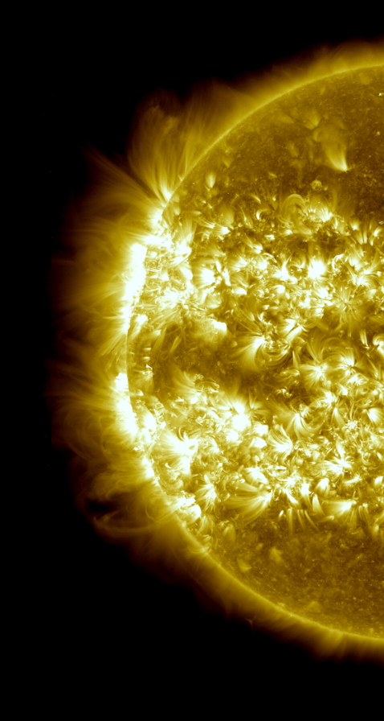
Living with the Sun
Notes:
The toolkit also covers a range of content from NASA’s Science Mission Directorate, including:
Living with the Sun
Some of the BIG questions NASA scientists are asking include:
What causes the Sun to vary?
How do Earth and the solar system respond?
What are the impacts on humanity?

Slide 11
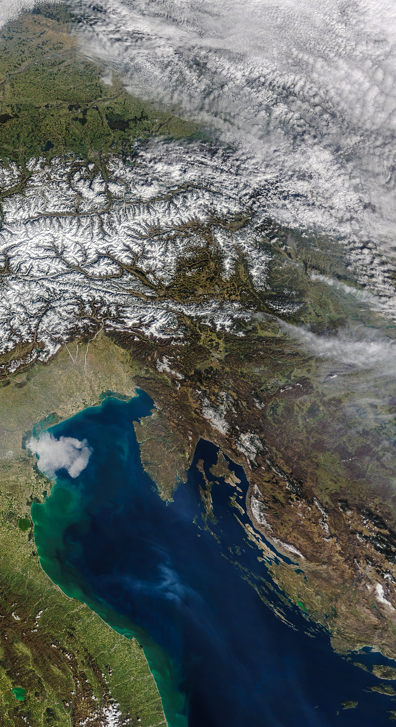
The Changing Earth
Notes:
The Changing Earth
Some of the BIG questions NASA scientists are asking include:
How is the Earth changing?
What cause changes on Earth?
How will the Earth change in the future?

Slide 12
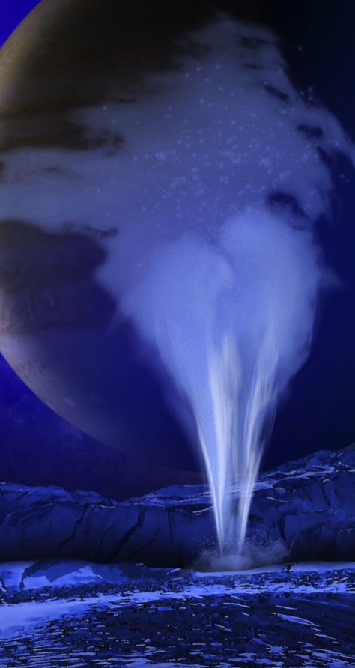
Our Solar System
and planets
around other
stars
Notes:
Our Solar System and Planets around other Stars
Some of the BIG questions NASA scientists are asking include:
How did the solar system form and evolve?
Why did life evolve on Earth?
Could life exist elsewhere?

Slide 13
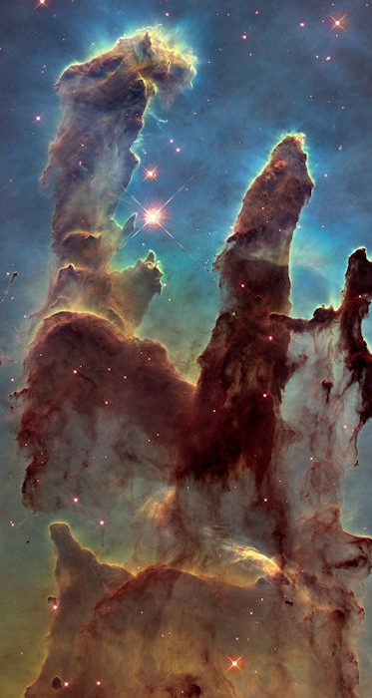
Galaxies and
Beyond
Notes:
Galaxies and Beyond
Some of the BIG questions NASA scientists are asking include:
How does the universe work?
How did we get here?
Are we alone?

Slide 14
Hands-on Activities
Notes:
The Explore Science: Earth & Space toolkit includes 10 hands-on activities. Each activity comes in a box and includes all the physical materials you’ll need plus the activity and facilitator guides and additional information sheets.
[The following slides include the activities from the Explore Science: Earth & Space 2018 toolkit. You may choose to augment your kit with additional activities from the 2017 toolkit or other educational resources. The 2017 digital toolkit is available for download: http://www.nisenet.org/earthspacekit-2017. The NISE Network has a curated list of programs, media, and professional development resources in the NASA Wavelength Digital Library that directly relate to the toolkits. These resources can be viewed and downloaded from nasawavelength.org/users/nisenet.]

Slide 15
Notes:
The Paper Mountains activity helps participants Explore Earth.
The activity explores the following ideas:
Earth is a constantly changing and dynamic system.
The shape of the land and the pull of gravity both influence how water moves over Earth.
NASA scientists use observations to make predictions about the future of our planet.

Slide 16
Notes:
These activities are about Exploring The Universe.
The Pack a Space Telescope activity explores the following ideas:
Engineers design, build, and test new technologies to study the universe.
Careful planning and design help us make new discoveries and better understand Earth and space.
NASA teams work together to launch, guide into orbit, and operate a space telescope.
The Exoplanet Transits activity explores the following ideas:
Scientists are searching the universe for planets orbiting distant stars.
When a planet, or other object, moves between its star and Earth, some light from that star gets blocked from view.
The transit method is one of the ways NASA scientists search for distant planets.
The Objects in Motion activity explores the following ideas:
Objects in the universe interact in complex but predictable ways.
Stars, planets, moons, and other objects in space orbit around each other because of gravity.
NASA scientists use what we know about the laws of physics to make new predictions and discoveries.
The Filtered Light activity explores the following ideas:
Astronomers use light from distant objects to make observations about the universe
Filters block certain energy levels of light while allowing others to pass through.
NASA scientists use telescopes and other instruments to capture and filter different energies of light.

Slide 17
Notes:
The other five activities help participants Explore the Solar System.
The Stomp Rockets activity explores the following ideas:
Some rockets carry science tools—not scientists—into space!
Sounding rockets take quick, low-flying trips into space.
Scientists use many different kinds of spacecraft to make new discoveries.
The Magnetic Fields activity explores the following ideas:
Scientists have observed active magnetic fields throughout the solar system.
Earth has a strong, protective magnetic field.
The Sun’s magnetic field extends out into space and sends powerful bursts of magnetic energy into the solar system.
The Mars Rovers activity explores the following ideas:
Teams of scientists and engineers use rovers and other robotic vehicles to explore distant worlds.
Rover missions, like those to Mars, are carefully planned here on Earth
NASA missions require large teams of people working together.

Slide 18
Notes:
The other five activities help participants Explore the Solar System.
The Craters activity explores the following ideas:
Studying the surface of a planet or moon can reveal its history and composition.
Impact craters form when a meteorite collides with the surface of a moon or planet (or other body in space).
Scientists use tools to find and observe craters and learn more about the geologic processes on planets, moons, asteroids, and other worlds.
The Hide and Seek Moon activity, specifically designed for early childhood, explores the following ideas:
Tools help scientists study objects that are very far away.
Binoculars make distant objects appear closer and brighter.
NASA scientists use powerful telescopes to study objects in space.

Slide 19
Leading the Activities
Notes:
Now, we’ll review some tips for leading these activities with participants

Slide 20
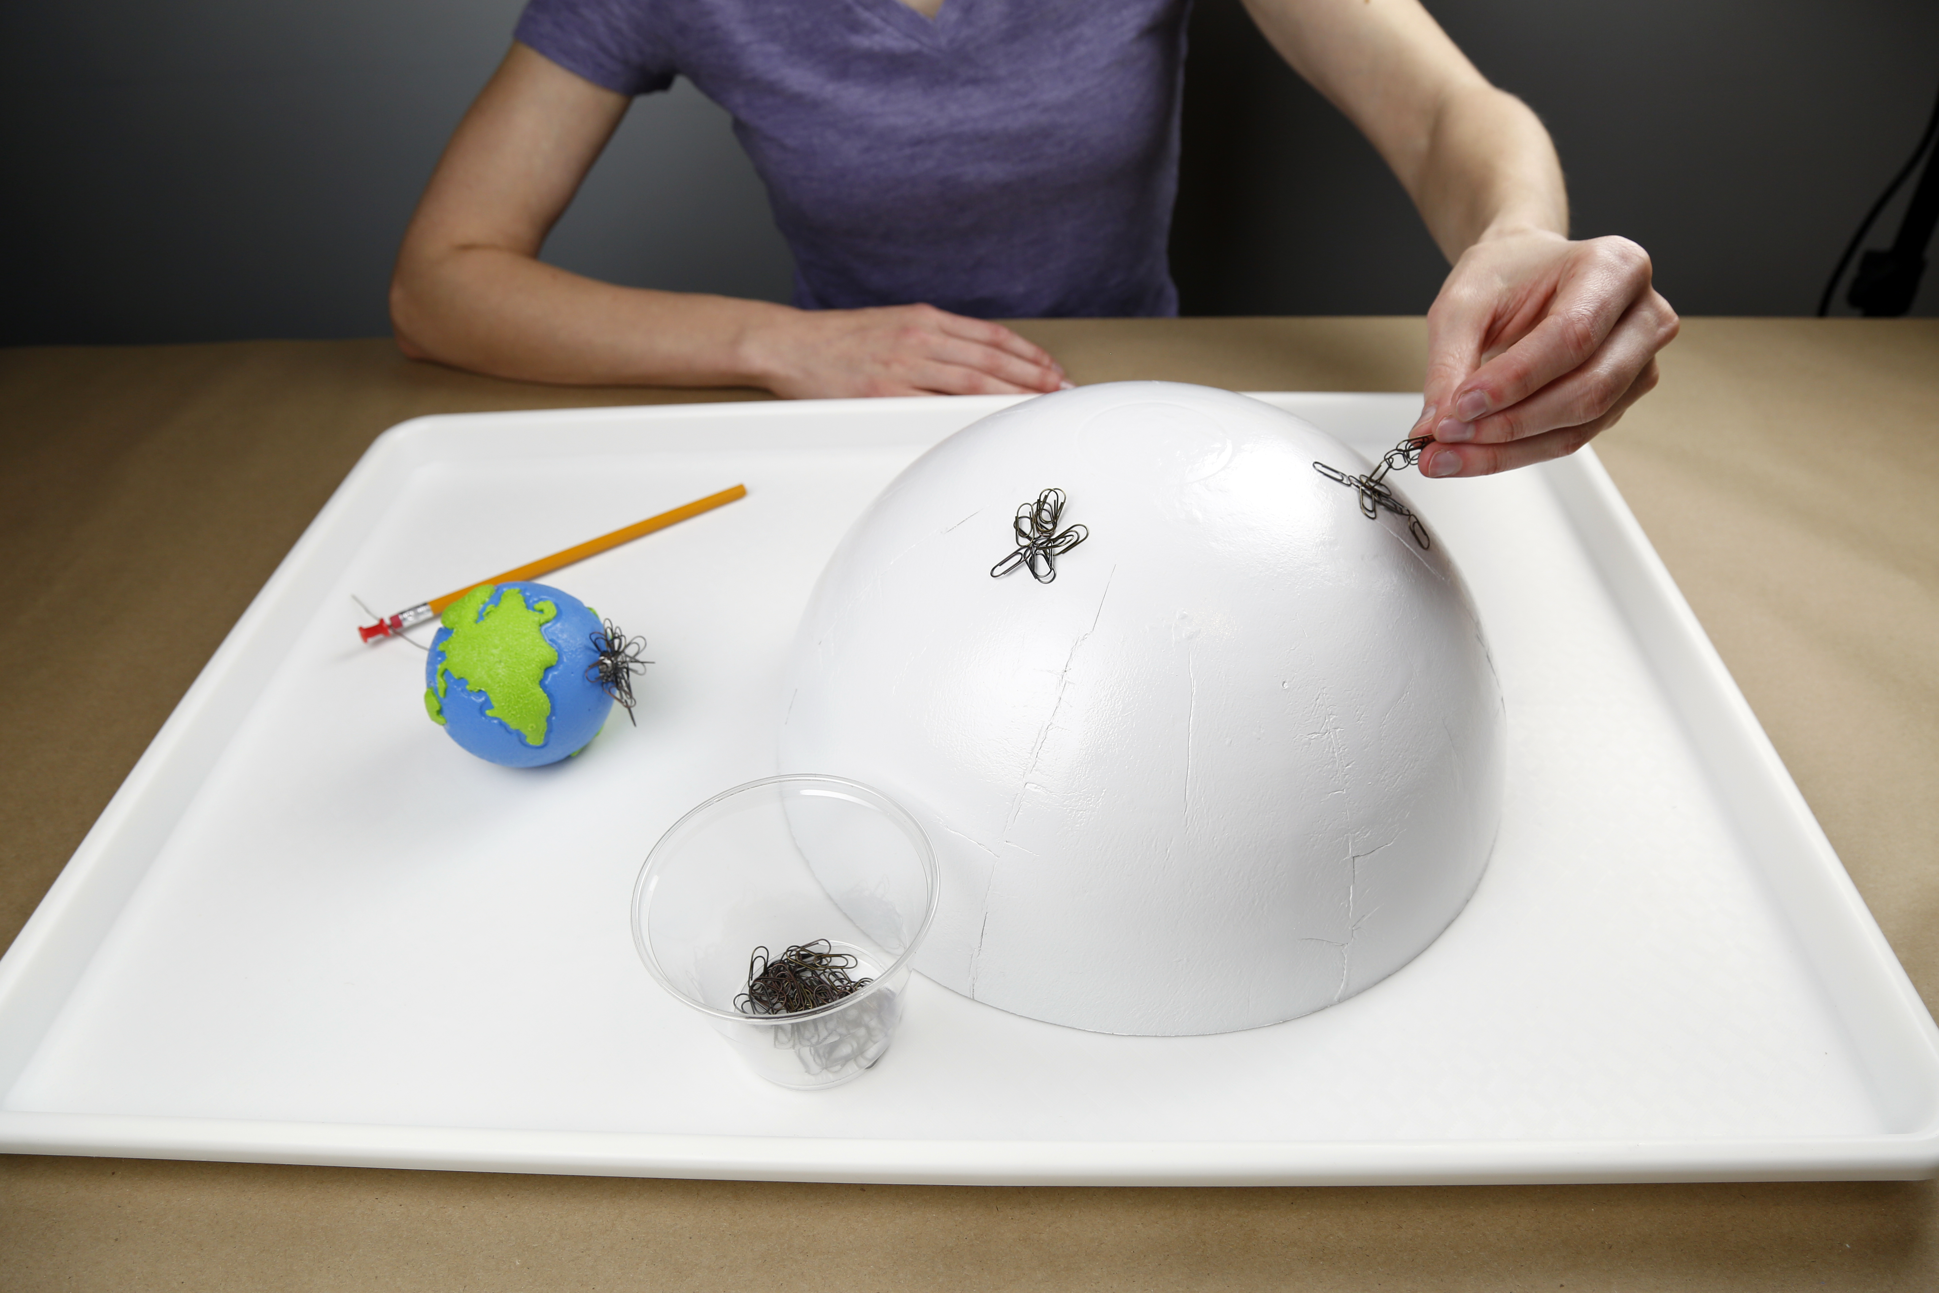
Activity materials
Notes:
We’ve just taken a very quick look at all 10 activities in the Explore Science: Earth & Space toolkit.
Here is an example of just one activity, Magnetic Fields. The image shows all the physical materials needed to do the activity.
Some of these materials are intended for the learners to use. These include the supplies they need to do the activity (like the Sun and Earth models, tray, and paperclips) and the colorful activity guide and sign, and any additional information sheets or other graphics. These things should all be out and accessible for learners.
It also includes some materials for you, the facilitator, to use. These include the more plain-looking facilitator guide with some notes about things like set-up and safety, and some tips to help you do a great job leading the activity, as well as any materials you’ll need for advance preparation. These are just for you and are not meant to be shared with participants.
Finally, please note that there are both activity and content training videos for each activity, which you can watch to help you learn the activity before you do it with participants.

Slide 21
Activity instructions
Notes:
Now let’s look at some of these materials a bit more closely. Here is an example of an activity guide, for the Magnetic Fields activity.
The activity guides are structured to help you lead learners through hands-on science activities.
The front side includes step-by-step instructions in the section called “Try this!”
The back side describes what learners observe—and explains why it happens. Finally, the guide relates the activity to current space or Earth related science or NASA research.
You can leave these guides out on the table both to help you explain the activity and so that learners can read them and look at the pictures.
(They’re available in both English and Spanish versions.)

Slide 22
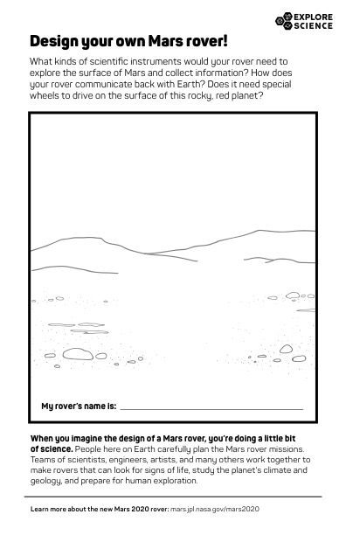
Info sheets and worksheets
Notes:
Many activities include additional information sheets or other graphic assets. Depending on your event or setting you may choose to use these more or less. They provide additional related content about the hands-on activity for participants and facilitators alike.

Slide 23
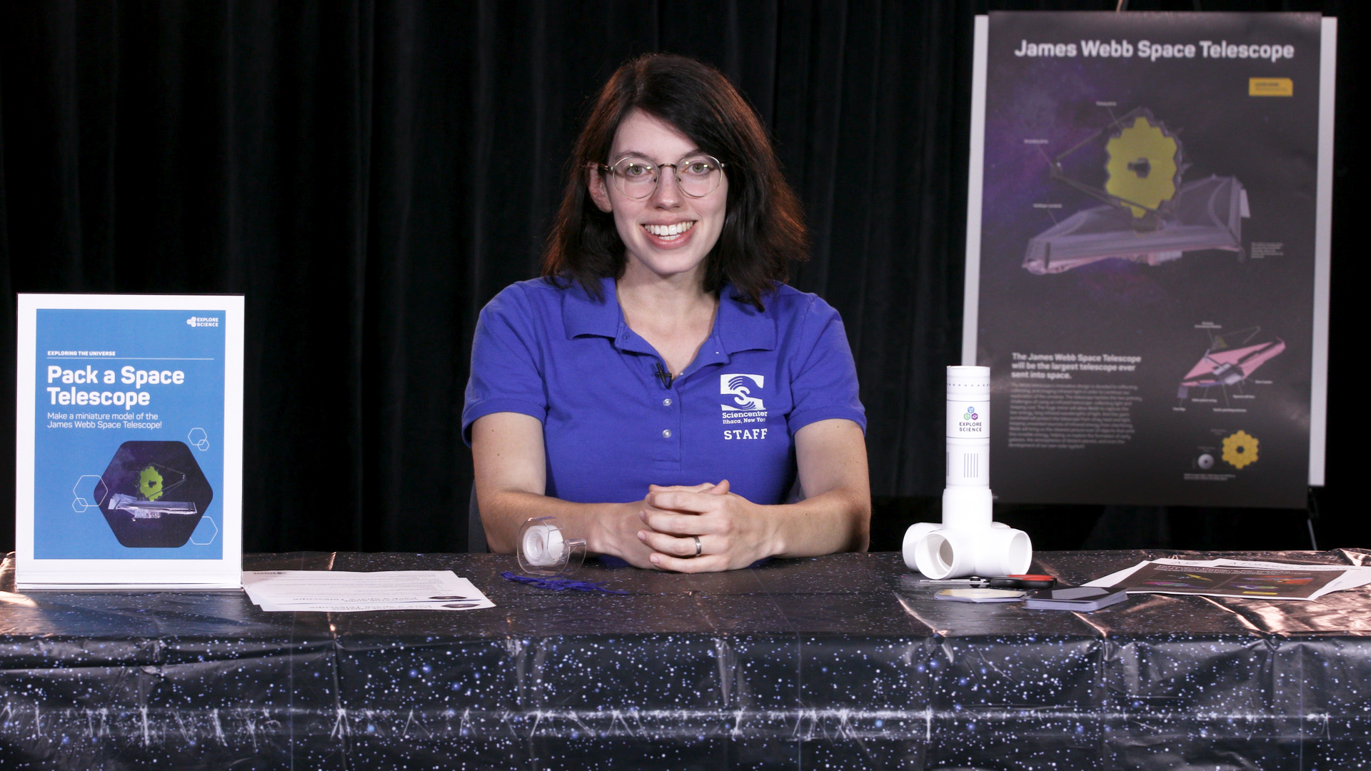
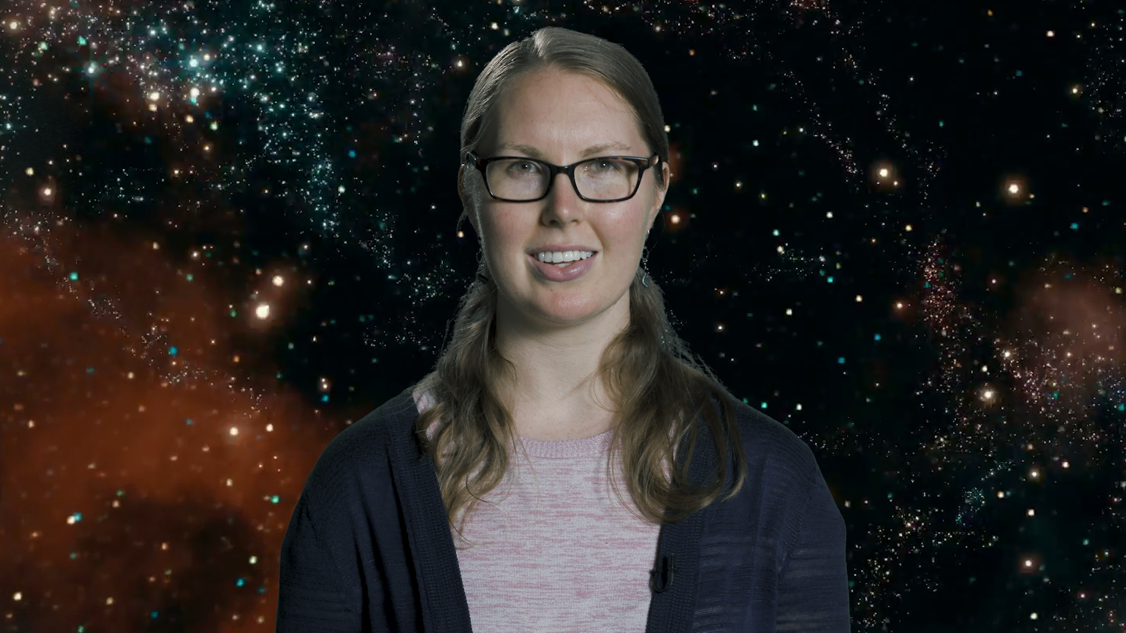
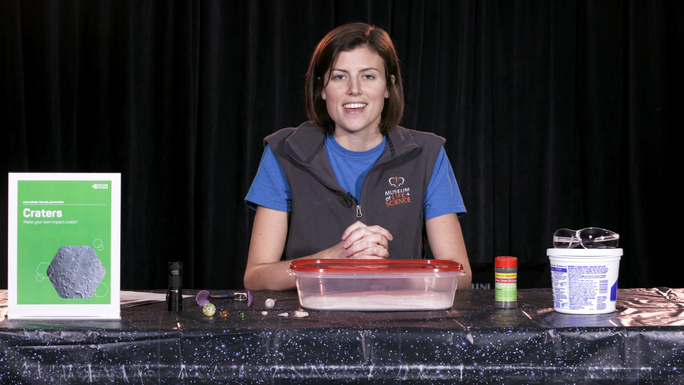
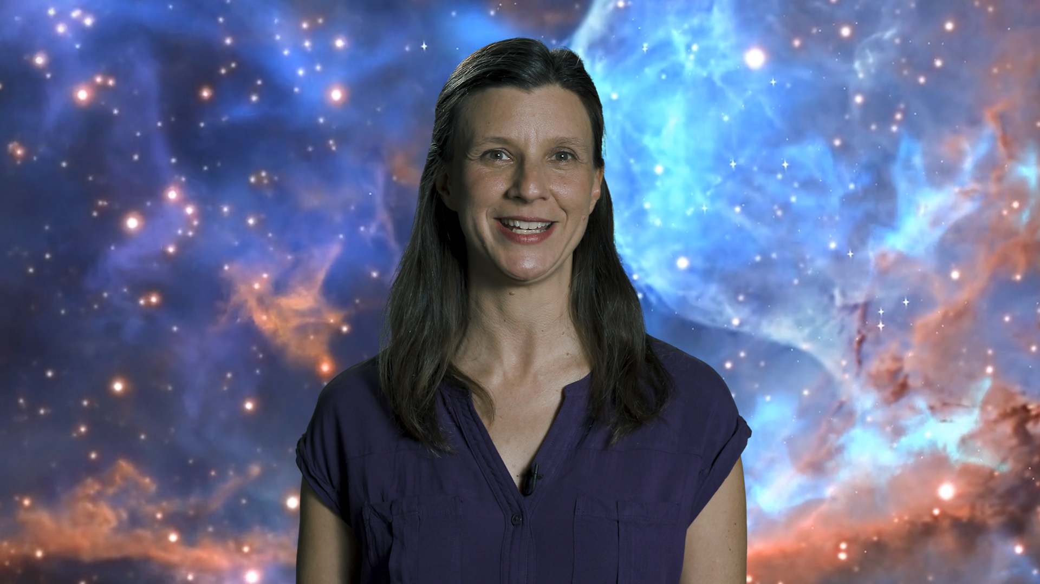
Training Videos
Notes:
Each activity in the toolkit comes with an activity training video and a science content training: https://vimeopro.com/nisenet/explore-science-earth-space. Facilitators can watch these before the event (or even last minute online!)
[This year, we have also included a set of training videos on Strategies for Approaching Difficult Scientific Concepts in space and Earth science. Part one describes various strategies you can use and provides an annotated example. Part two provides a scripted example of a visitor interaction and invites you to notice which strategies are employed. Watch this as a group and discuss what you see together.
Part 1: https://vimeo.com/243358295
Part 2: https://vimeo.com/243361942]

Slide 24
Notes and tips
Notes:
The facilitator guide is for you, the activity leader.
The first few pages list the learning objectives, activity materials, and includes important notes related to set-up, safety, presentation, difficult concepts and other aspects of the activity.
Additionally, each activity contains a useful reference sheet with tips about leading hands–on science activities and notes about how to talk to visitors about misconceptions and other difficult concepts.

Slide 25
Tips for Leading Hands-on Activities
Greet your guests
Encourage exploration
Ask open-ended questions
Be a good listener
Share what you know
Offer positive responses
Share accurate information
Remain positive
Thank your guests
& HAVE FUN!
Notes:
Tips for leading hands-on activities include:
Greet your guests
Encourage exploration
Ask open-ended questions
Be a good listener
Share what you know
Offer positive responses
Share accurate information
Remain positive
Thank your guests
& HAVE FUN!

Slide 26
Questions?
Notes:
Questions?

Slide 27
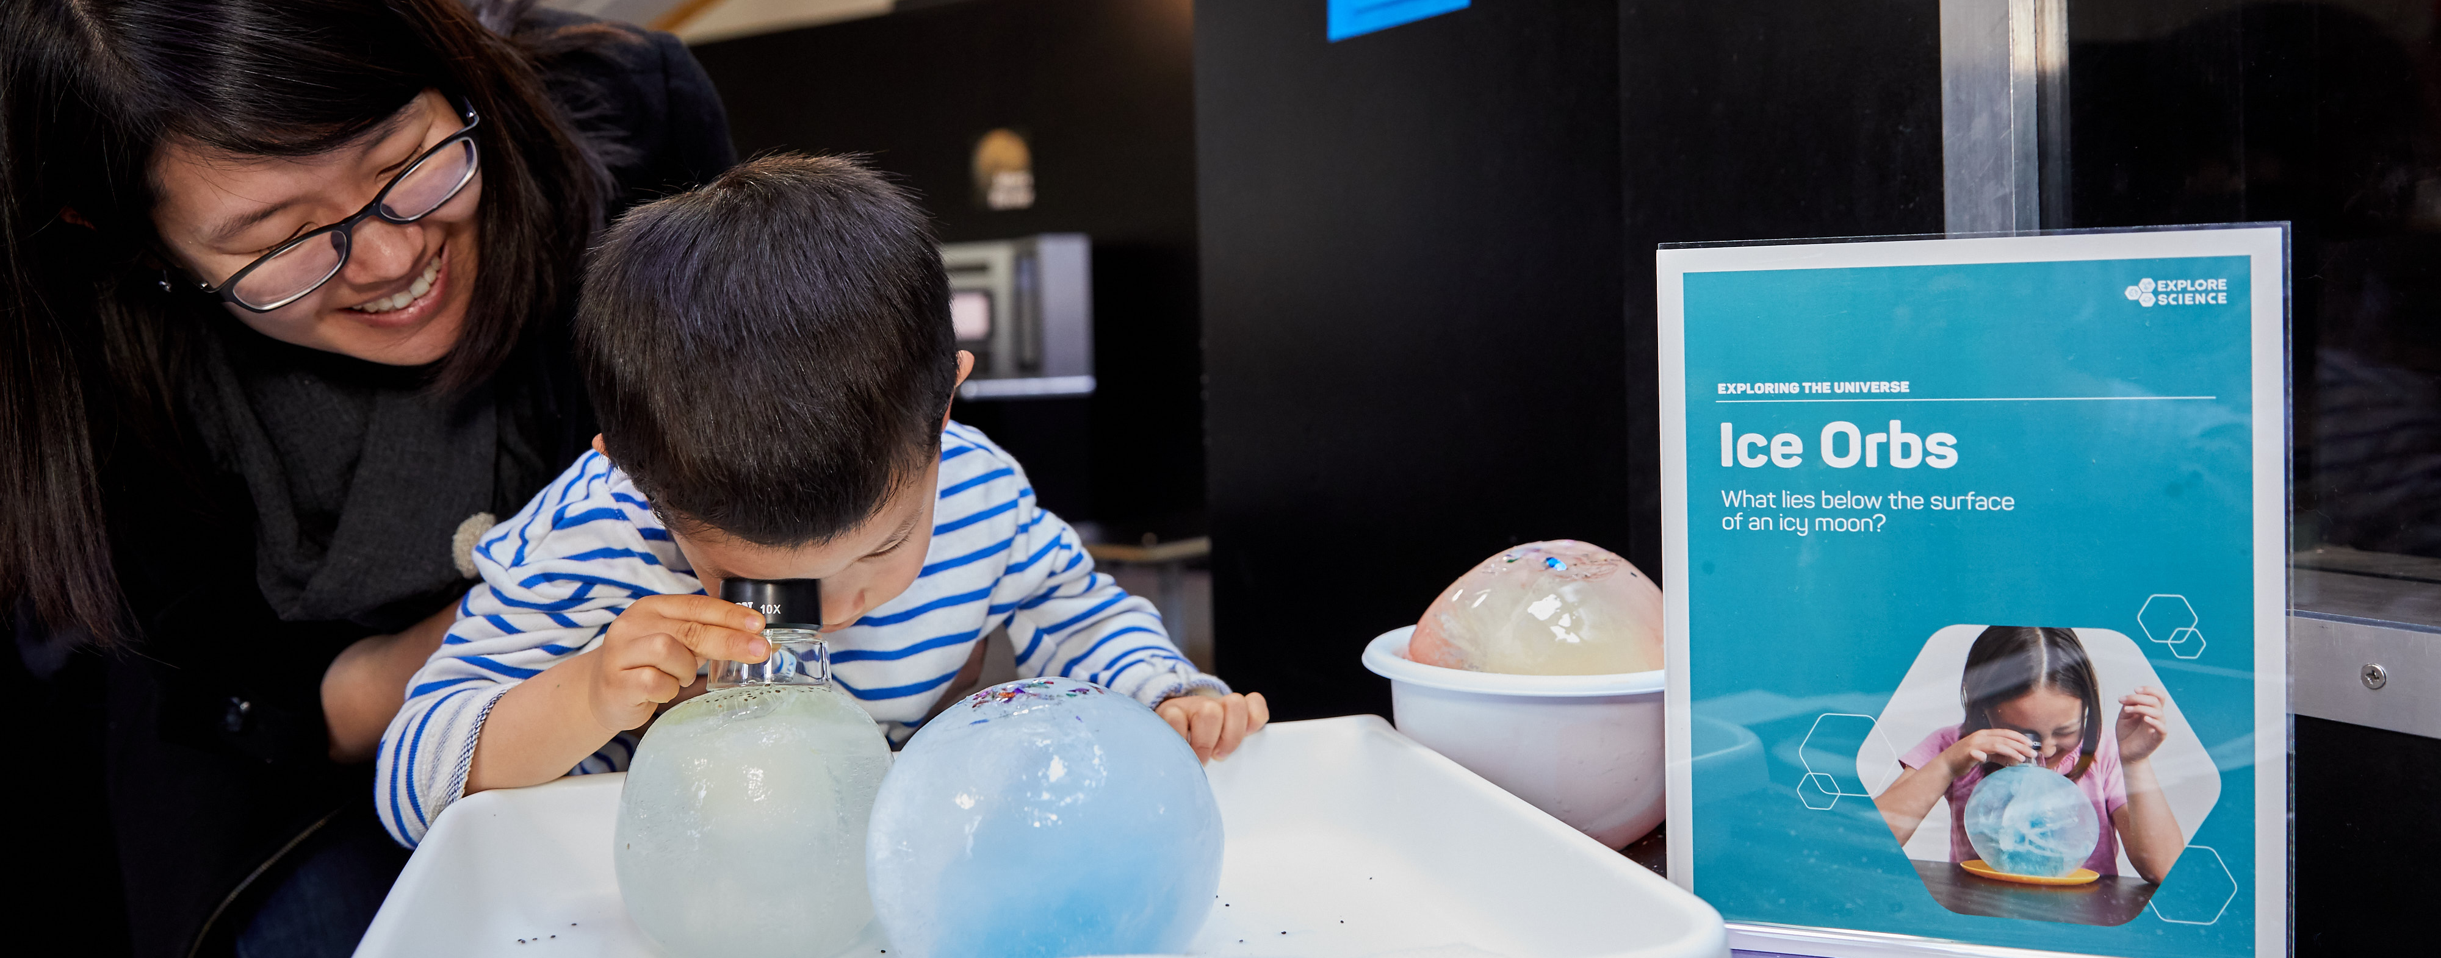

Thank you
Space and Earth Informal STEM Education is supported by NASA under cooperative agreement number NNX16AC67A. Any opinions, findings, and conclusions or recommendations expressed in this material are those of the author(s) and do not necessarily reflect the view of the National Aeronautics and Space Administration (NASA).
Copyright 2017 Science Museum of Minnesota
Activity photos by Emily Maletz and Dave Burbank for the NISE Network. Activity materials screen capture by Museum of Life and Science. Living with the Sun image: composite image of 25 separate images of the Sun from the Solar Dynamics Observatory (SDO) spanning the period of April 16, 2012, to April 15, 2013, courtesy NASA Goddard Space Flight Center/SDO/AIA/S. Wiessinger. The Changing Earth image: Late winter storms dropped a fresh coating of snow across the Alps in mid-March 2016, courtesy NASA image by Jeff Schmaltz, LANCE/EOSDIS Rapid Response. Our Solar System and Planets Around Other Stars image: Artistic concept of water plumes on Jupiter’s moon Europa courtesy NASA/ESA/K. Retherford/SWRI. Galaxies and Beyond image: Eagle Nebula's “Pillars of Creation” courtesy NASA.
Notes:
THANK YOU!

