Slide 1
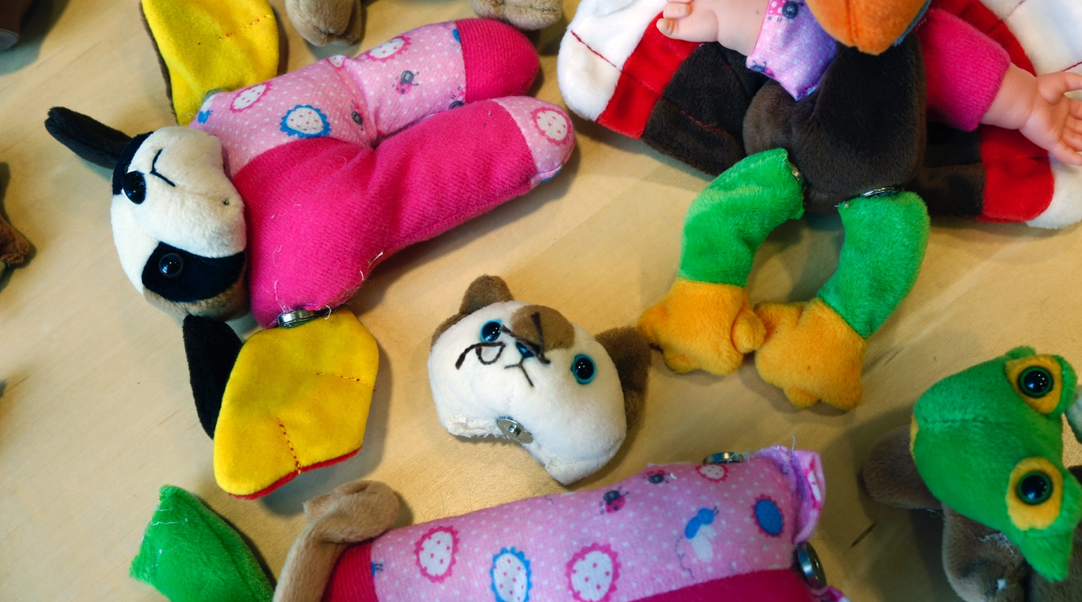
FRANKENTOY
What do you get when you mix and match animal parts?

Slide 2
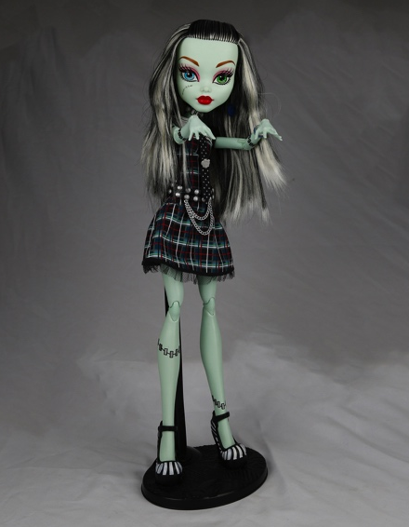
WHO WAS FRANKENSTEIN?
What do you know about Victor Frankenstein and his creature?
Victor Frankenstein and the “monster” he created first appeared 200 years ago in Mary Shelley’s novel Frankenstein. Since then, these characters have appeared in plays, movies, TV shows, comic books, and many other places.
You may recognize Frankenstein’s creature as a Halloween costume, a classic Hollywood monster, or the complex character in Shelley’s story.
Frankie Stein is a character from Monster High. She was created in her father’s lab. She says she is 115 days old, “but some parts of me are older than others.”

Slide 3
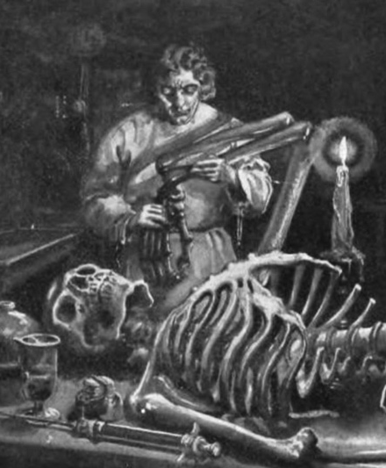
In Mary Shelley’s original story, Victor Frankenstein was a science student with a secret project. He built a person out of dead body parts and brought it to life.
Victor used the biggest body parts he could find because they were easier to work with. He used electricity to jolt the creature back to life. Could that possibly work?
In this activity, you will make a creature out of toy parts!
Victor Frankenstein used surgery, chemistry, electricity, and other methods to build his creature and bring it to life. This illustration is from an early edition of Mary Shelley’s 1818 novel.

Slide 4
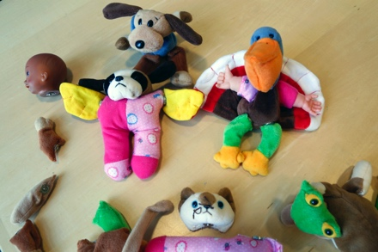
MAKE A CREATURE
1. Create a new animal.
Mix and match parts from different toys. What kind of creature is it?
Is it a pet or a wild animal?

Slide 5
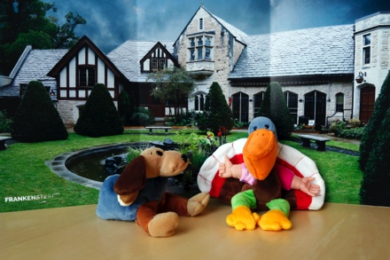
2. Pretend it’s alive!
Act out a story with your creature. You can also take a picture of it against the folding backdrop.
What does your creature say and do?
Where does it live?
Can it make friends with another creature?

Slide 6
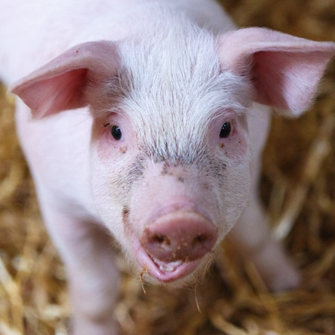
PEOPLE ARE CREATIVE
We’re always learning more about the world and inventing new things.
People have used selective breeding to improve plants and animals for thousands of years. More recently, we have begun using genetic engineering and synthetic biology to create modified and entirely new organisms.
For example, we can make creatures called chimeras that combine genetic material from two different animals. Human-pig hybrids may be able to grow donor organs for people who need them.
Is it ethical to raise hybrid animals to save the lives of people?
If a chimera is mostly pig but part human, should it have the rights of an animal or a person?
Scientists have injected human cells into pig embryos. They have also made chimeras from two different species of mice.

Slide 7
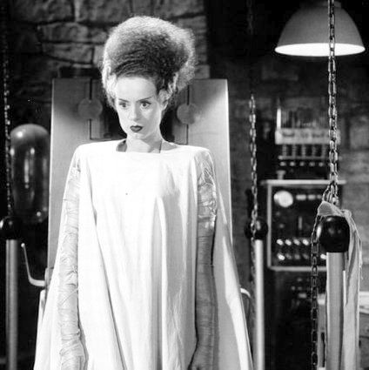
MONSTER OR MISTREATED?
Mary Shelley’s novel Frankenstein tells the story of a man who builds a creature and brings it to life—but isn’t prepared for what happens next.
Victor Frankenstein is horrified by his creature. The creature runs away, but then comes back and tells Victor that he is miserable and lonely. Victor starts to make him a female companion, then thinks better of it and destroys her.
Does the creature deserve a mate, so he isn’t all alone?
What might happen if there were two creatures?
Victor Frankenstein must decide whether or not to create a companion for his creature.
In Shelley’s novel, Victor doesn’t complete his female creature. In a movie adaptation, he does bring her to life.

Slide 8
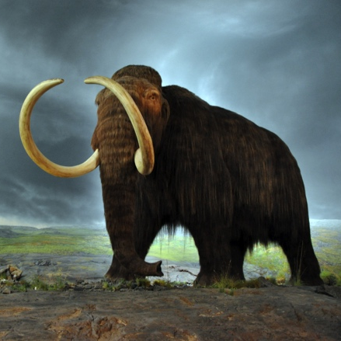
RESPONSIBLE INNOVATION
Frankenstein suggests that as we study science and make new technologies, it’s important to think ahead.
For example, genetic engineering could save animals from extinction, but reintroducing these animals could also cause environmental disruptions.
Scientists are editing the genes of a modern Asian elephant to give it some of the characteristics of a woolly mammoth. This “de-extinction” research won’t bring back real woolly mammoths—but perhaps future research could.
What might happen if an ancient creature like a woolly mammoth came back to life today?
How would it survive?
Scientists are editing the genes of a modern elephant to be more like a woolly mammoth. If they succeed, the new creature will have characteristics of a long-extinct relation.

Slide 9


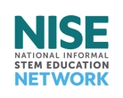
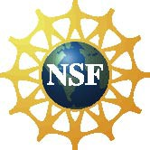
Mary Shelley’s novel Frankenstein is a 200-year-old science fiction story that explores themes of human creativity and scientific ethics. The Frankenstein200 project allows people across the United to States to exercise their creativity and consider responsible innovation in fields such as artificial intelligence and genetic engineering.
Frankenstein200 is a national project led by Arizona State University. In addition to hands-on activities, Frankenstein200 includes an alternate reality game that immerses players in a modern-day Laboratory for Innovation and Fantastic Explorations (L.I.F.E.). This fictional story imagines what might happen if a character named Dr. Tori Frankenstein picked up where her ancestor Victor Frankenstein left off.
Visit Frankenstein200.org to play the game!
Copyright 2017, Arizona State University. Published under a Creative Commons Attribution-Noncommercial-ShareAlike license: http://creativecommons.org/licenses/by-nc-sa/3.0/us/
Distributed in collaboration with the National Informal STEM Education Network: nisenet.org
This project was supported by the National Science Foundation under Grant Number 1516684. Any opinions, findings, conclusions, or recommendations expressed in this program are those of the authors and do not necessarily reflect the views of the Foundation.

