Slide 1
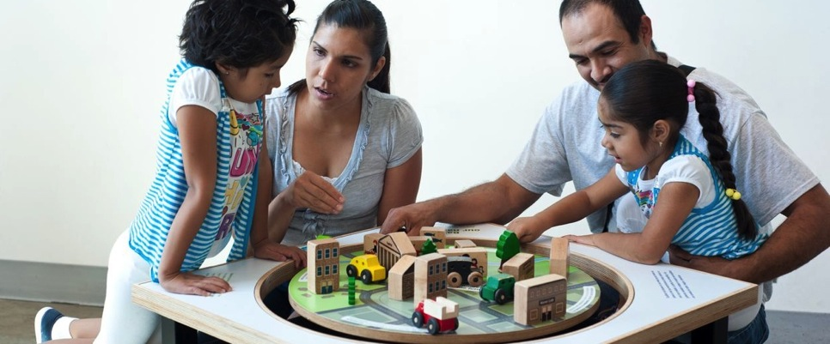


Engaging young children in emerging science – sharing our experiences with nanoscience
Association of Children’s Museums
Interactivity Conference
May 2013 - Pittsburgh

Slide 2
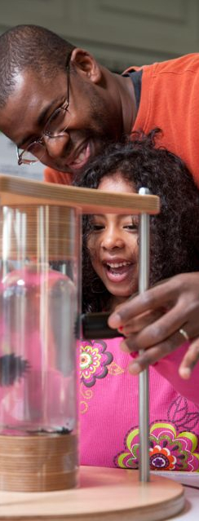

Lightning Round Overview
Introduction to the NISE Network
Catherine McCarthy, Science Museum of Minnesota
Lightning Speed Sharing
Children’s Museum of Houston, TX- Aaron Guerrero
Creative Discovery Museum, TN- Shannon Johnson
McWane Science Center, AL- Kathy Fournier
Children’s Museum of Tucson, AZ- CoCo Tarantal
The Discovery Museums, MA- Denise LeBlanc
Marbles Kids Museum, NC- Hardin Engelhardt
Sciencenter, NY- Ali Jackson
Port Discovery Children’s Museum, MD- Nora Moynihan
Science Museum of Minnesota, MN- Paul Martin
Discussion

Slide 3
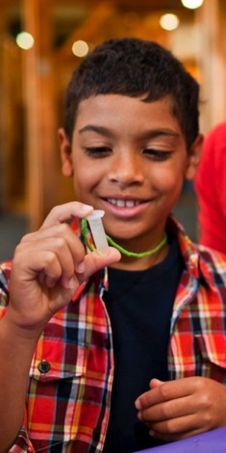

NISE
Network
Nanoscale Informal Science Education Network
The NISE Network is a national community of researchers and informal science educators dedicated to fostering public awareness, engagement, and understanding of nanoscale science, engineering, and technology.
Notes:
Years 1-5: (2005-2010)
Building the network
Years 6-10: (2010-2015)
Engaging the public through the network

Slide 4
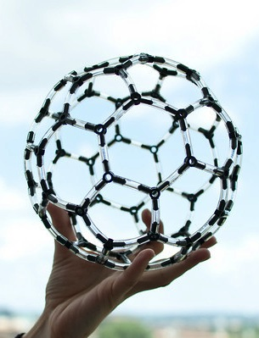
What is Nano?
Nano:
  Small: 1 billion nanometers in a meter
  Matter behaves differently at this scale
Nanotechnology: manipulating matter in different ways at this scale can lead to exciting breakthroughs in
  Medicine
  Computing
  Energy
  Materials technologies
Notes:
Nano is a prefix meaning one billionth

Slide 5
NISE Network: Strategy
Inputs
Outputs
Outcomes
NISE Network
ISE organizations
Research centers
Network community
partnerships
practices and knowledge
resources and materials
workshops and training
Increase capacity
in the field to engage
the public in nano
Educational products
programs
exhibits
media
tools and guides
Engage the public,
increasing awareness and understanding of nano
Notes:
Inputs - informal science education organizations (science and children’s museums) and scientists
Outputs - Build a community,
create educational products that partners want to use and can adapt to meet their need
Ultimately increase our capacity to engage the public

Slide 6
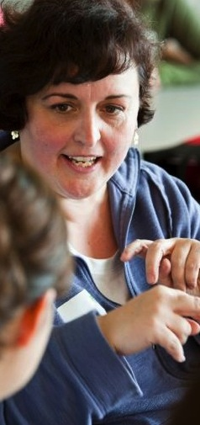
Network
Community
Notes:
----- Meeting Notes (5/1/13 15:15) -----
Network Community - people and organiztions

Slide 7
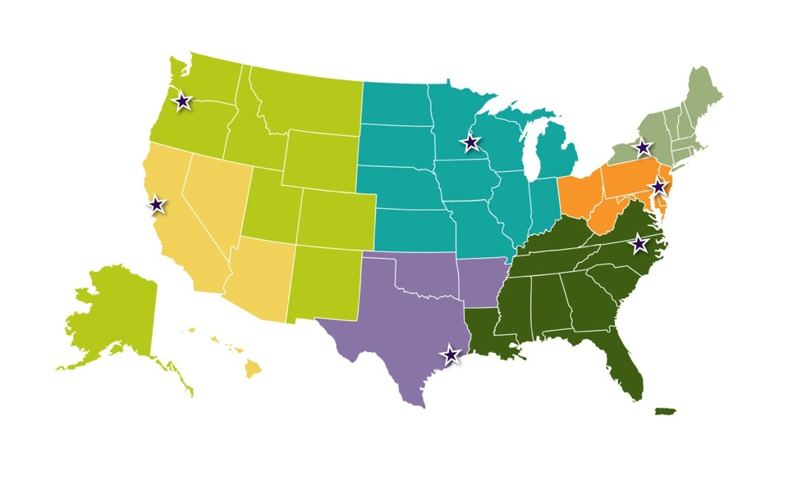
NISE Net Regional Hub Structure
West
Northeast
Midwest
Mid-Atlantic
Southwest
South
Southeast
Notes:
To build the network and raise the capacities of its members, we have 7 regional hubs that
Share NISE Network resources with partners
Support the infusion of nano content into partner museum institutions—increasing public impact
Encourage further involvement in the network
Connect informal science educators and local researchers

Slide 8
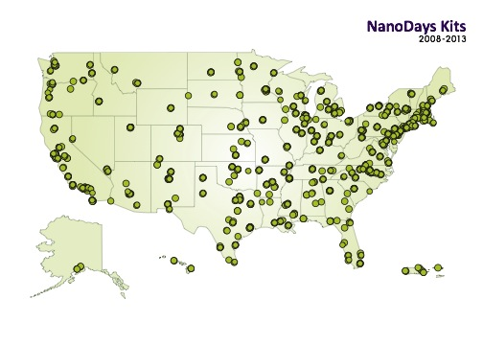
NanoDays Participants
Notes:
The Network is made up of museums and scientists all over the country.
This slide includes 225 partners who received NanoDays kits

Slide 9
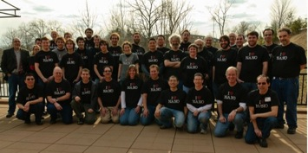
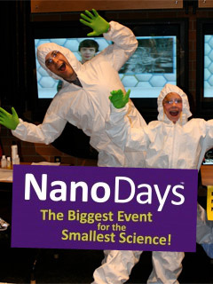
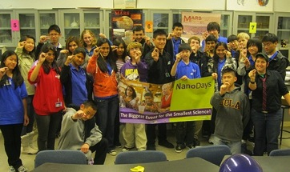
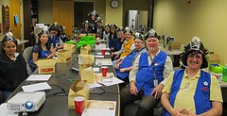
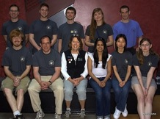
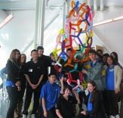
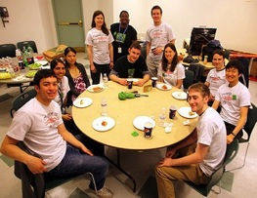
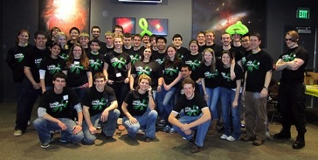
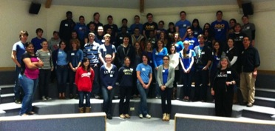
NanoDays Volunteers
Notes:
We asked partners to send us photos of their NanoDays events –here are just a few

Slide 10
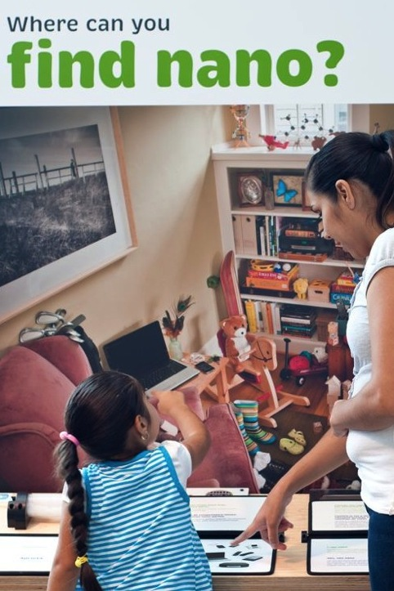
Educational
Products
Notes:
I wanted to mention some of our public engagement materials, particularly some of the newest ones.

Slide 11
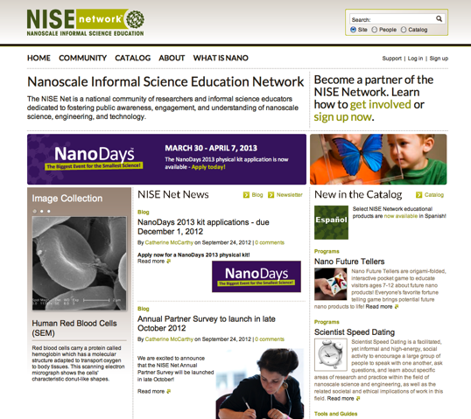
Website for educators - nisenet.org
r
  Catalog
  Programs
  Exhibits
  Tools and guides
  Media
  Image Gallery
  Evaluation & Research
Notes:
All of the resources I’ll be talking about are on nisenet.org

Slide 12
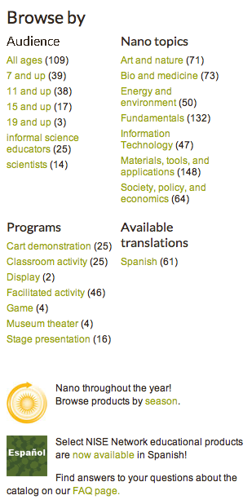
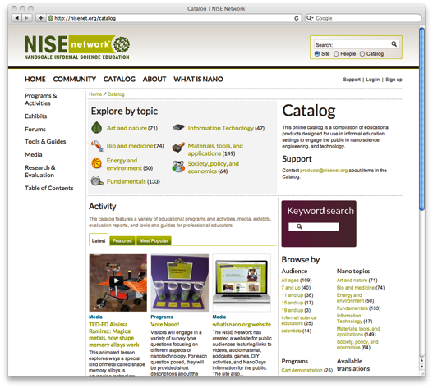
Search the Catalog
r
Search the catalog by
audience, topic, or season.

Slide 13

Products in Catalog
NISE Net Products
    Created with NISE Network funding
    Development process:
scientist review, peer review, & evaluation
    Standards and templates
    Encourage free sharing and adaption
Linked resources
    Created with other funding
    Vetting process
    Different rights ownership/attribution
Creative Commons license clarifies use
Notes:
2 types of products
----- Meeting Notes (5/1/13 15:15) -----

Slide 14
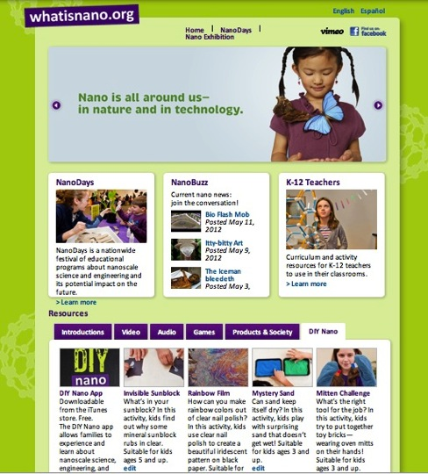

Website for the Public
r
  Videos, podcasts, activities, links
  List of mini-exhibition locations
  Audio Description in English and Spanish
Notes:
Way to extend the experience for visitors
The public website (whatisnano.org) includes links to many new videos and materials.
It is now available in Spanish
We also have DIY activities for people to try at home

Slide 15
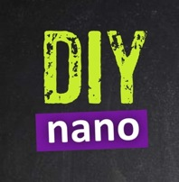
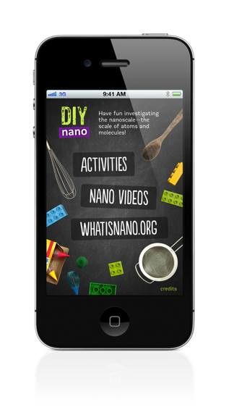
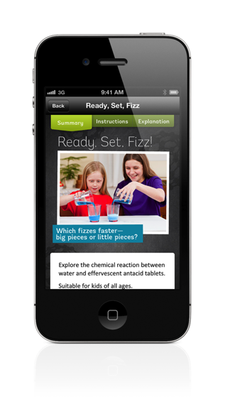


DIY Nano App for iPhones and iPads
r
  Activities to try at home
Notes:
Way to extend the experience for visitors
The iPhone and iPad apps are one more way we can reach public audiences.
Features activities in recipe-style format for at-home activities plus links to videos and whatisnano.org
Winner of the Parent’s Choice silver honor award – Fall 2012.
Featured in Wired magazine.

Slide 16
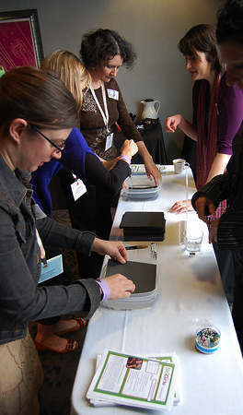
Professional
Development Tools
  Training materials and guides
  Museum-Scientist Collaborations
  Reaching Diverse Audiences
  Nano and Society
  Team-Based Inquiry
  Online Brown-Bags
More info: nisenet.org/category/catalog/tools_guides

Slide 17
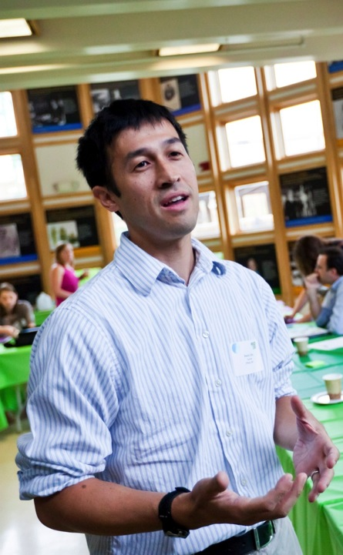
Upcoming Opportunities
    Online Brown-Bag
      www.nisenet.org/community/events
    NanoDays
    Mini-Grants

Slide 18
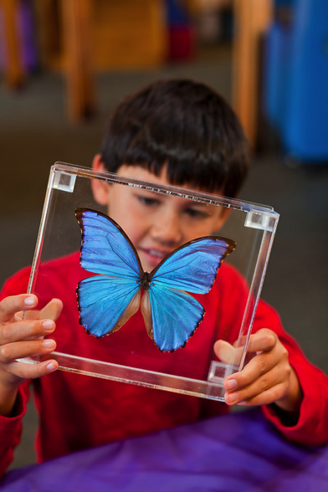
NanoDays
  Host a NanoDays Event:
  March 29 – April 6, 2014
  New Hands-on Activities
  Physical kit application deadline: December 1
  Digital kit materials available online: ~January 15th:
  Continue to use your NanoDays materials throughout the year!
More info: nisenet.org/nanodays

Slide 19
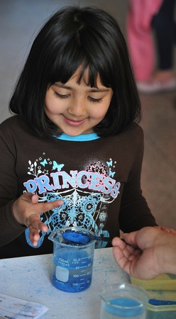
Mini-Grants
Awards:
  plan to award 40 in 2014
Application deadline: November 1
$3,000 maximum
Eligible activities:
  New efforts to integrate nano into existing programming
  New efforts to reach new audiences
  New partnerships and collaborations
More info: nisenet.org/community/mini-grants
Notes:
Awards:
27 mini-grants awarded in 2011
40 mini-grants awarded in 2012
40 mini-grants awarded in 2013
Eligible Activities
New efforts to integrate nano into existing programming
New efforts to reach new audiences with nano programming (including traditionally under-served or under-represented audiences)
New partnerships between museums and nano researchers, community-‐based organizations, or diversity serving organizations

Slide 20




Stay in Touch
Website
networking tools
  Update your profile on the website nisenet.org/faq
  Sign up for the monthly
  NanoBite newsletter
  nisenet.org/community/nanobite
  Join our social networking sites
  nisenet.org/community
Notes:
Please stay in touch.
We have a monthly electronic newsletter – NanoBite.
We also regularly post on social networking sites and if you use those, it is another way to communicate across the network.

Slide 21
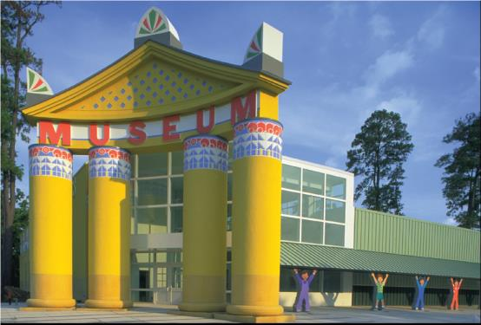

Children’s Museum of Houston
Aaron Guerrero
NISE Net South Hub/ Children’s Museum Hub Leader
aguerrero@cmhouston.org
www.cmhouston.org

Slide 22
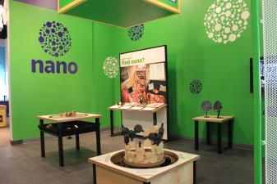
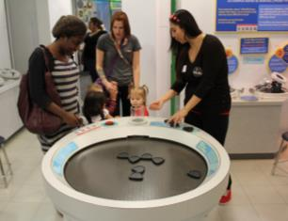
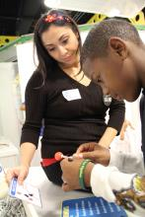
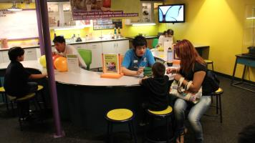
Nano in Exhibit Spaces
Matter Factory
Permanent 1,350 square-foot exhibit
Nano Mini-Exhibit
Incorporated into Matter Factory exhibit
Science Station
Facilitated area focused on a variety of different science topics throughout the year
Notes:
Matter Factory
Long term 1,350 square foot exhibition including Super Small Matter Lab
Introduce children 8 & up with activities and hands-on interactives to introduce concepts of materials science
Increase awareness of materials and technologies developed at the nano-level.
Interact with materials at the micro- and nano-level, to discover their basic building blocks.
Science Station
Science Station incorporates a variety of nano activities throughout the year
Nano mini exhibit
Incorporated as a permanent addition to the Matter Factory exhibit space
Will have a little less than an estimated 7,000 students visit exhibit through school tour program for the 2012-13 school year
Will have an estimated 10,500 visitors visit through the Family Adventures program for the 2012-13 school year

Slide 23
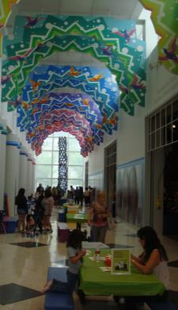
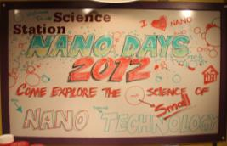
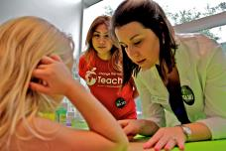
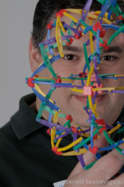
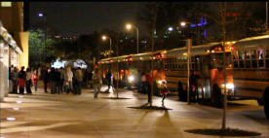

Nano in Programming
Incorporate nano programming into:
After-school Family Adventures program
Mr. O video episodes
21-tech facilitation
Annual NanoDays week-long event
Notes:
Nano activities facilitated in the fall for Family Adventures program
Mr. O video episodes focused on nano themes and based on NISE Net activities
Training for staff as part of 21 tech project to use ipads and nano apps to faciliate exbiit components and engage visitors in nano conversations.
Last but not least
-Hosting annual week-long event for NanoDays

Slide 24
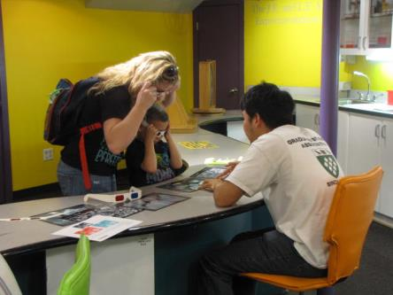
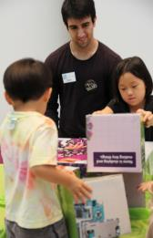


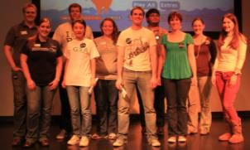
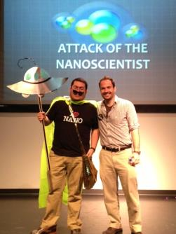

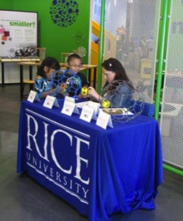

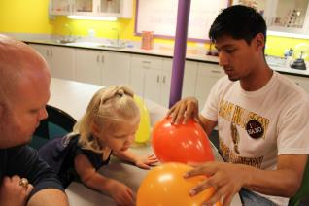
Nano Partnerships
Notes:
Rice University
Yearly NanoDays partner
Volunteers staff activities throughout the year
Help with nano exhibit spaces and engage visitors in components
Rice Center for Biological and Environmental Nanotechnology
Scientific review with programs
Coordinate field trips to nano labratories
University Houston
Scientific review for nano programs
NanoDays support

Slide 25
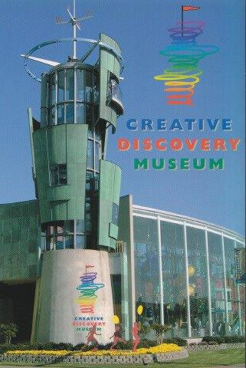
Creative Discovery Museum
Chattanooga, Tennessee
Shannon Johnson, Exhibit Development Manager
srj@cdmfun.org
www.cdmfun.org

Slide 26
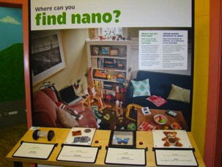
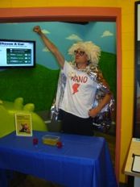
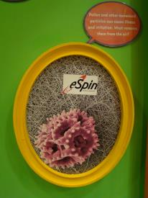
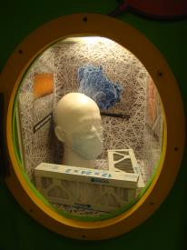
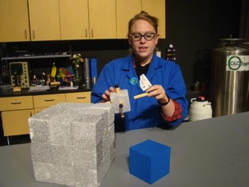
Nano within the Museum expands target audience
Nano mini-exhibition within the Inventor’s Clubhouse gallery
Nano Night free night
Chemistry Day with nano focus and collaboration with local high school and college students
Inventor’s window highlighting eSpin Technologies
Walk-ups using Nano Days kits
Science demonstration for general admission guests– surface area
Science Theater experience – 1 hour show + 1 hour hands-on workshop

Slide 27





Nano in the Community
After-school education enriches elementary and middle school students
Science & Math Family nights brings cutting edge science to adults and children
Distance learning “Would You Buy That” and hands-on activities reaches rural TN communities and middle school audience

Slide 28

Kathy Fournier
Vice President of Education
Birmingham, Alabama
205-714-8254
kfournier@mcwane.org
www.mcwane.org

Slide 29



NANO at McWane

Slide 30



NANO PROGRAMMING
Nano Days 2008-2013 and going….
2 Reserved School Programs
6th -8th Weighing In on Scale: The Science of Nanotechnology 9th -12th Nanotechnology: BIG Science…Small Scale
Home School Curriculum
Camps
Family Science Nights
GRANTS AND PARTNERSHIPS
NSF/MSP with Tuskegee University
NISEnet Mini Grant with UAB

Slide 31






EXHIBIT
INTERNAL PROMOTION
Nano in the bathrooms
Nano on our digital signs
MEDIA
Nano at the elevator
Nano in the Cafe

Slide 32


Children’s Museum Tucson
Coppelia “Coco” Tarantal
Early Childhood Education
Specialist
CoCo@ChildrensMuseumTucson.org
www.ChildrensMuseumTucson.org

Slide 33




Nano Exhibit
Installed in September 2012
Over 85,000 visitors have interacted with the exhibit since it was installed
Versatility of the Exhibit
Most popular NANO component

Slide 34




Roll Out Science
Nano Activity Bins
Science Cart
Nano Days
Staff Trainings

Slide 35




Events & Outreaches
Museum Events:
Science in the City: Annual Family SciFest
Science Sundays
Community Outreaches:
Festival of Books
Future Innovators Night
Be Safe Saturday

Slide 36




Nano in ECE
Importance of STEM in ECE
Wee Play
Wee Science
Adventure Learning Programs
Professional Development

Slide 37



Acton, Massachusetts
Denise LeBlanc
Director of Learning Experiences
dleblanc@discoverymuseums.org
www.discoverymuseums.org

Slide 38






Nano@Night Family Nights led by Youth Volunteers
NISE Network mini-grant
Trainings for teen volunteers
Teens planned and led two Nano@Night Free Family Nights
Free admission was funded by community organizations
Teens continue to lead monthly Nano programs

Slide 39







Programming
Nano integrated into existing programs
Reaction Station:
Adventures for Young Chemists
  Funded by The Camille & Henry Dreyfus Foundation
  Collaboration with Brandeis University Chemistry professor Dr. Christine Thomas
  http://tinyurl.com/RxnStation
Geodesic Domes, Buckyballs
Offsite STEM Career Fairs

Slide 40








Nano Partnerships
Partnership begun in 2010
Faculty and researchers from MRSEC and Biology Department lead activities that highlight their interdisciplinary research at the interface of biology and nanoscale materials science.

Slide 41







Nano Partnerships
NanoDays 2013
Dr. Gareth McKinley shared
activities related to nanocomposite technology:
water repellant coatings
moisturizing polymers on razors
ferrofluid suspension systems for high performance cars.

Slide 42

Marbles Kids Museum
Hardin Engelhardt
Education and Evaluation Specialist
hengelhardt@marbleskidsmuseum.org
www.marbleskidsmuseum.org

Slide 43



Nano Days
Annual event
An introduction to nanoscience and technology
Draws 300 guests
Partners facilitate activities from the Nano Days physical kits or their own activities
Marbles staff and volunteers facilitate additional activities

Slide 44

Nano Dailies
Deliver activities and materials from Nano Days physical kits and NISENet resources as part of ongoing facilitated science programming
Kit activities and NISENet resources serve as a model for development of other content and for partner content development

Slide 45






Nano Play
NISENet Mini-Grant funded initiative
Lunch time nano exploration sessions integrated into regular summer camp program
One 45 minute session per week
~75 campers, 10-15 staff and volunteer participants, and 6-8 partners each week

Slide 46



What’s next?
Nano-focused learning lab for students in grades 4-8 in conjunction with the documentary Mysteries of the Unseen World.
Creation of a STEM Corps of middle school students to deliver STEM Play at Marbles and outreach events

Slide 47






Partnerships

Slide 48




Ali Jackson
Manager of National Collaborations
ajackson@sciencenter.org
www.sciencenter.org

Slide 49



NanoDays with Cornell University
Notes:
We’ve been partnering with Cornell University to do Nano Education since even before NISE Net! They are wonderful science reviewers of new activities and programs, help us brainstorm new activities and training practices, and every year they provide student volunteers and scientists for our combined NanoDays in Ithaca.
Often we partner with a Cornell Research center, in particular,
Cornell Nanoscale Science & Technology Facility (NNIN Fab Lab)
MRSEC, Cornell Center for Materials Research
Cornell Center for Accelerator-based Sciences and Education (Classe)
to host a weekend of nano fabulous fun for our community. This year, we just had a one day event at the Sciencenter with over 40 hands-on activities, three family friendly full length programs (Story time reading of Horton Hears a Who, Scientist presentation on nano fabrics and the fashion of the future, and a program on Oobleck and liquid body armor. We had over 100 Cornell volunteers engaging the public in nano activities.
For our museum, and we’re on the smaller size, NanoDays is one of only two museum wide, free public events (the other is our Halloween Night) for which the whole museum staff comes together and we have this many awesome activities spread out around the whole museum.
At NanoDays we sometimes pair activities (like fine wine and cheese) that have similar learning goals or content to help both our volunteers and visitors get the message (for example the Blue Morpho butterfly about structural color—nano spacing—with the Thin-films activity, also about the thin spacing of a film causing light to bounce back and reflect different colors).

Slide 50

Nano at Camp
Notes:
On that theme of pairing or scaffolding, we’ve offered two different models of Nano at camp. We’re a children’s science museum so our campers range in age from 7-11
Version 1: Five days of nano programming, drawing from the nisenet.org catalog
Session 1: Intro to Nano
A nanometer is one-billionth of a meter. Nanometer-sized things are very small.
Nanometer-sized things often behave differently than larger things do.
Session 2: Nanoscale in nature
Nanometer sized things exist in nature
Nanotechnology and materials can be inspired by nature
Session 3: Manipulating and building things at the Nanoscale
Matter is made of atoms
Molecules can be built from atoms using self-assembly
Nanoscale materials can be built by a “top down” approach of lithography
Session 4: Scientists use special tools to work on the nanoscale
Specialized microscopes allow scientists to observe nanoscale structures
Session 5: Nanotechnology leads to new knowledge and innovations
Some products already have nanoscale materials in them
Researchers and engineers are using nanoscale science to produce new and/or improved materials
There are costs, risks and benefits of nanoscale science and engineering
Our choices as consumers and citizens affect the development of nanotechnologies
Version 2: two morning of Nano activities per two week session
The first morning is a general introduction and on the second week we choose from one of the following modules.
We also use a similar model of combing activities from NanoDays kits and form the catalog to create a field trip program that allows kids to get hands on with nano activities and get more comfortable with the content and material before exploring the nano mini-exhibtion. (framwork for camp and for the field trip can be found on nisenet.org, in addition to the exhibit field trip worksheet.)

Slide 51

NISE Net Content Map
Engaging the Public in Nano
1. Nano is small and different.
2. Nano is studying and making tiny things.
3. Nano is new technologies.
4. Nano is part of our society and our future.
Notes:
NISE Net has identified four key concepts for engaging the public in nano.
Nano is small and different.
Nano is studying and making tiny things
Nano is new technologies
Nano is part of our society and our future
(If you want to learn more about these four ideas, you can look at a guide called “engaging the public in nano”. It was in the NanoDays kit from last year, or you can find it in the online catalog.)
In thinking about pairing activities and building programs from activity components, we’ve gotten really comfortable with the NISE Net content map. This is a great resource for educators working to create their own nano programming.

Slide 52




Nano mini-exhibition
  Invisibility Cloak
  Public program
  You Decide
  Public program
Notes:
The mini-exhibition also follows the four areas of the content map. We’ve had good success pairing activities directly with components of the mini-exhibition. One of the component, small, smaller, nano, looks how ferrous materials—particles of iron—behave as they get smaller. Ferrofluid—nano particles of iron suspended—acts like a magnetic liquid and is visually surprising and cool! This year at NanoDays we added a demo to the ferrofluid exhibit. US currency contains a minute quantity of ferrofluid. It’s a anti counterfeit measure and helps vending machines know if you’ve put in a one or a fifty. This little demo got conversation going and helped people think about the ways that nanotech intersects with their everyday lives.
We’ve found that area 4 of the content map—that nano is part of our lives and our future—works especially well under educator facilitation. We’ve implemented conversational activities about nano and society right into the exhibit space.
These conversational activities are often based on questions facilitators pose about personal values and opinions. Having these conversations in the context of the mini-exhibition makes them more relevant and meaningful.
Example: What do we want the world to be like in the future? This is not something you can research and uncover the correct answer. Each visitor will have a different response and no response is wrong.
Scientists are not the experts in this topic, and neither are you or your visitors. Everyone has their own values and makes their own decisions about how a technology impacts their lives. This means you’re not on the spot to be the expert to know everything about nanotechnology and how it might affect our lives. You’re just there as a facilitator trying to get the visitor to explore and express their opinions and values. There is no right or wrong answer. There will always be things we don’t know. Science can only inform us and help us make our own decisions based on the facts.
For some educators, this might be a big change. The center of expertise shifts when you’re talking about how nano will affect individuals and society as a whole. Visitors have important expertise here: they have the best idea of how something will impact their lives. They have an equal place in the conversation, alongside educators and scientists.

Slide 53

Port Discovery Children’s Museum
Nora Moynihan
nmoynihan@portdiscovery.org
Baltimore, Maryland
www.portdiscovery.org

Slide 54




Alice in Nanoland
Utilizes the book “Alice in Nanoland” by Horton and Long
Immerses children in the world of nano by building of a story they already know
Allows for simplification and categorization of topics and sessions to provide programs perfect for young audiences
Used to enrich the nano experience of Port Discovery’s:
  After school program
  Summer Camp
  Family programs
  General visitor experience

Slide 55




Rule #1:
Nano is very, very, small
Rule #2:
Unexpected things can happen
Notes:
Rule #1: Nano is very, very, small
Children learn just how tiny nano is by measuring objects in nanometers.
Then they learn that molecules are nanosized. During the smelly balloon experiment they test their noses as “nanosensors” that can smell scent molecules that their eyes cannot see.
Using marshmallows and toothpicks, children build their own molecules.
Rule #2: Unexpected things can happen
Children participate in various experiments to discover the unexpected properties of things that are nano-sized. They learn that smaller pieces of a reactant will react faster than larger pieces due to the increased surface area.
Children learn about how nanogold is used to create stained glass because it turns red and green. They create their own “stained glass” sun catchers with paint.

Slide 56





Rule #3:
Scientists can make and study tiny things
Rule #4:
Nano is found in nature
Rule #5:
Nano inspires new technologies
Notes:
Rule #3: Scientists can make and study tiny things.
Children discover that scientists must use special microscopes that “feel” surfaces to learn about nano-sized things.
Through a self-assembling activity, children learn that some molecules self assemble and that scientists use self-assembly to create new things.
Children extract DNA, a nano-molecule, from a strawberry.
Rule #4: Nano is found in nature
Children view images of examples of nano structures in nature; such as hairs on a geckos feet and the dermal denticles of a shark.
Using nail polish, children learn that a blue morpho butterfly get its color from colorless nanostrucutres.
Rule #5: Nano inspires new technology
Children learn about the nanotechnology, liquid body armor. The test how a suspension can change from a liquid to a solid by using a cornstarch and water mixture, “liquid body armor” to protect an egg from cracking.
Then children are able to make and feel their own liquid body armor.

Slide 57



Interactive Storytelling
Children act out the story of Alice in Nanoland
Reiterates the Rules of Nanoland
Notes:
For the final day of our after school and summer camp presentation, a special guest performer leads the students in a reenactment of the book, Alice in Nanoland. The entire audience participates in this interactive retelling which reviews all 5 rules of Nanoland in a fun an engaging way.

Slide 58

In the beginning
Notes:
Quotes from Nora Moynihan:
“The NISE Net is the best thing that ever happened to Port Discovery”
“Nano is the best exhibition we have on our floor”

Slide 59

Nano Mini-exhibition
400 sq. ft
Modular
Neutral look
Low maintenance
Replicable
Interactive
Informative
Welcoming and inclusive
Notes:
The Nano mini-exhibition, which was originally designed to have a 400 sq. ft footprint.
It is comprised of seven core components (4 panels, the Balance Our Nano Future tippy table, Small/Smaller/Nano, and Build a Giant Carbon Nanotube) and the seating area, which has reading material and is often next to the static beads table.
Originally, the plan was to exact replicas distribute it to 50 sites. Sites would be bound by contract to have it displayed on their floor for 1 year.
In their conversations about the mini-exhibition, the Nano design team wanted it to be interactive, informative, and welcoming and inclusive for a broad range of visitors. The design team articulated their goals in a more formal manner in January 2012… [ and they had three that were specifically focused on the public]

Slide 61


Nano Mini-exhibition
Notes:
81 applications
6 early copies, 43 in Batch 1 (Years 7/8), 21 in Batch 2 (Year 9/10) = 70 total
Hoping to award more copies
Small footprint: 400 square feet
Flexible configurations and modular components
Inexpensive replication
Intimate visitor experience
Long visitor dwell times
Strong content learning and visitor conversations

Slide 62




Small, Smaller, Nano
Notes:
81 applications
6 early copies, 43 in Batch 1 (Years 7/8), 21 in Batch 2 (Year 9/10) = 70 total
Hoping to award more copies
Small footprint: 400 square feet
Flexible configurations and modular components
Inexpensive replication
Intimate visitor experience
Long visitor dwell times
Strong content learning and visitor conversations

Slide 63




Nano and us
Notes:
Quotes from Nora Moynihan:
“The NISE Net is the best thing that ever happened to Port Discovery”
“Nano is the best exhibition we have on our floor”

Slide 64
Indicators of Success
Notes:
[walk through this] - indicators of success from goals document. And our evidence.

Slide 65

Everybody loves to sit
Notes:
Quotes from Nora Moynihan:
“The NISE Net is the best thing that ever happened to Port Discovery”
“Nano is the best exhibition we have on our floor”

Slide 66

This presentation is based on work supported by the National Science Foundation under Grant No. 0940143.
Any opinions, findings, and conclusions or recommendations expressed in this presentation are those of the author(s) and do not necessarily reflect the views of the Foundation.
Notes:
And as always, thank you to NSF for supporting this project!

Slide 67

THANK YOU!
To all our partners - we could not do this work without you!

Slide 68


Discussion

