Slide 1
WELCOME
NISE Network Partner Breakfast
ACM 2018

Slide 2
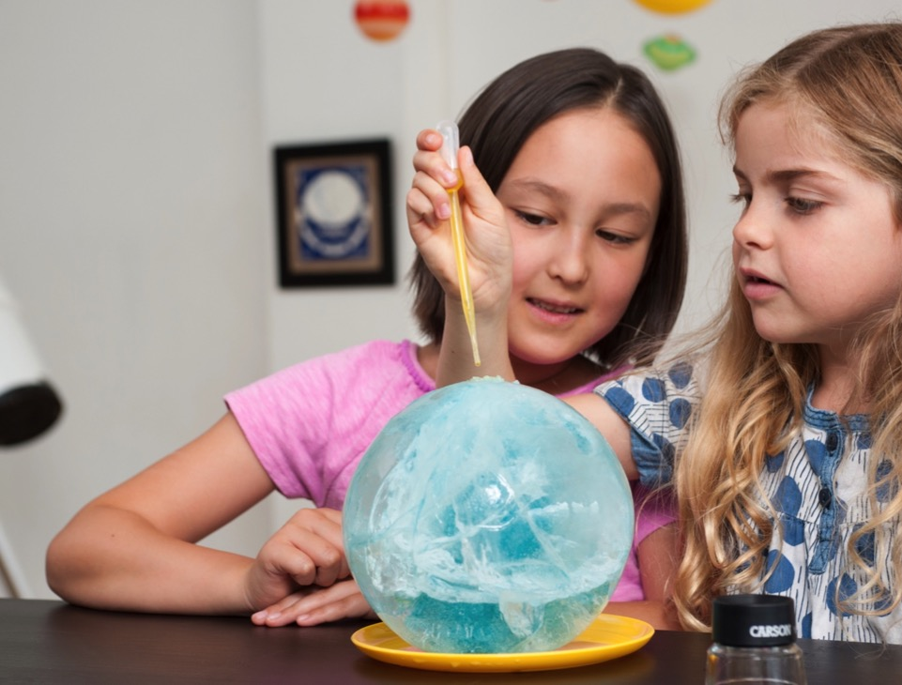
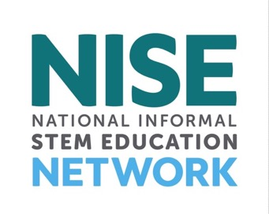
www.nisenet.org
Presentation
Overview
Projects
Impact
Discussion
Future directions
nisenet.org

Slide 3
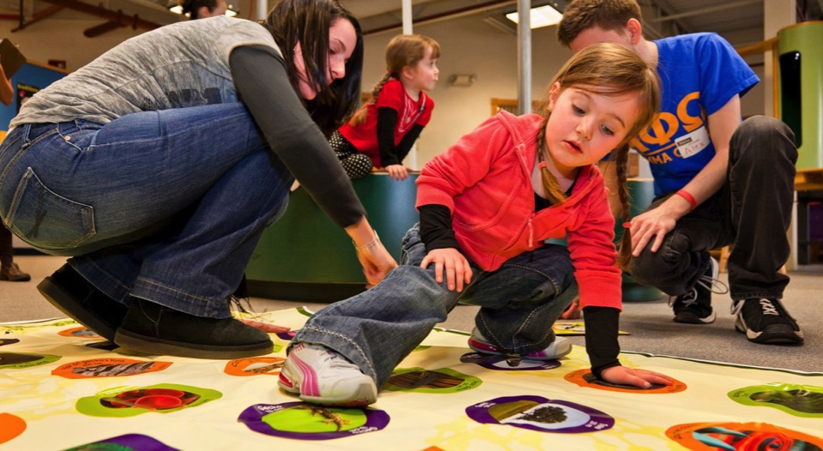
NISE Net supports informal learning about STEM in communities across the United States.
Our activities are
fun and accessible
for everyone.

Slide 4
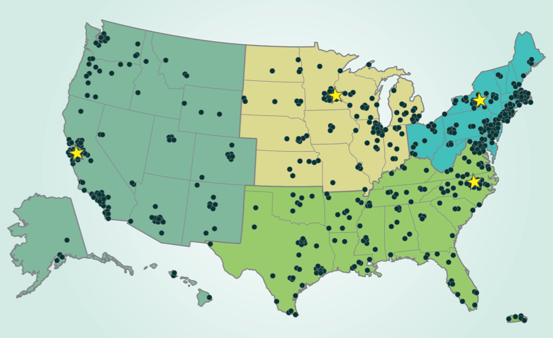
Hundreds of organizations participate in NISE Net.
Network partners
include museums
and universities.
Regional hubs

Slide 5
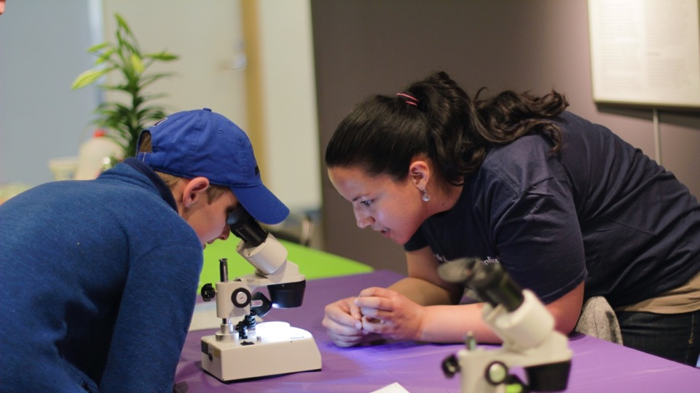
Partner organizations use Network resources to engage audiences in their communities.
Local collaborations
increase our reach
and impact.

Slide 6
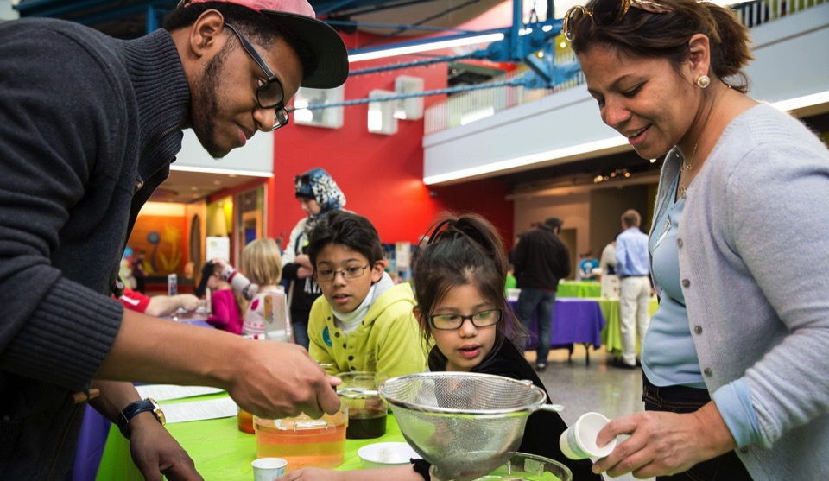
Together we reach millions of people each year!
NISE Net
brings together diverse people to share and learn from each other.

Slide 7
PROJECTS

Slide 8

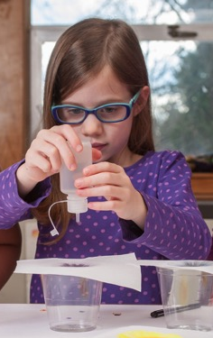
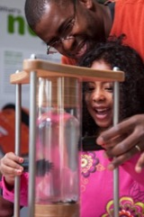
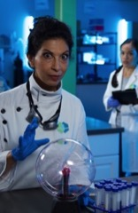

NISE Net has projects in many areas of STEM.
Synthetic biology
2014-2018
Chemistry
2016-2019
2005
2020
Nanotechnology
2005-2017
Frankenstein
2015-2019
Earth & Space
2016-2020

Slide 9
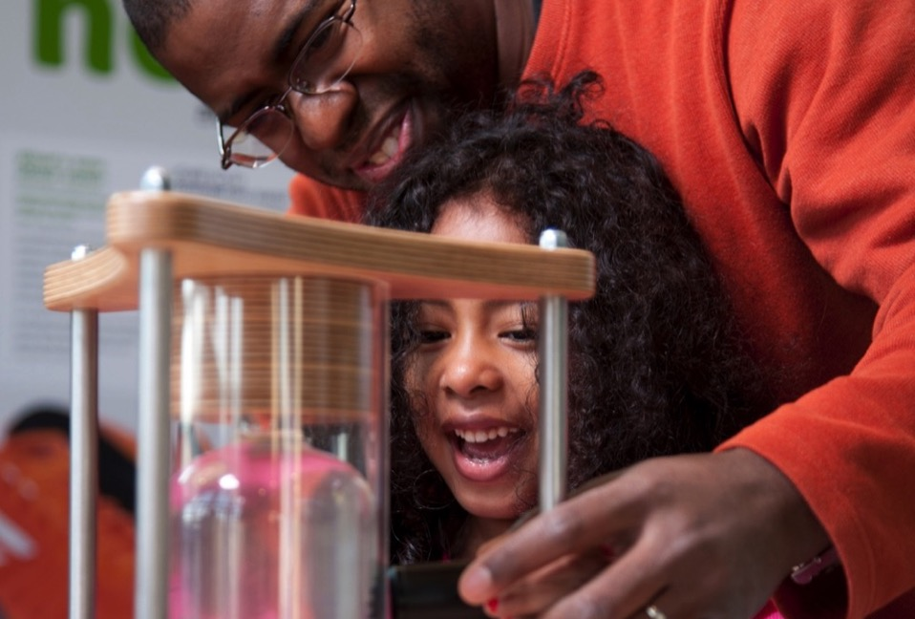
Nanoscale Informal Science Education Network
Building a national Network
to engage audiences
in learning about current STEM research

Slide 10
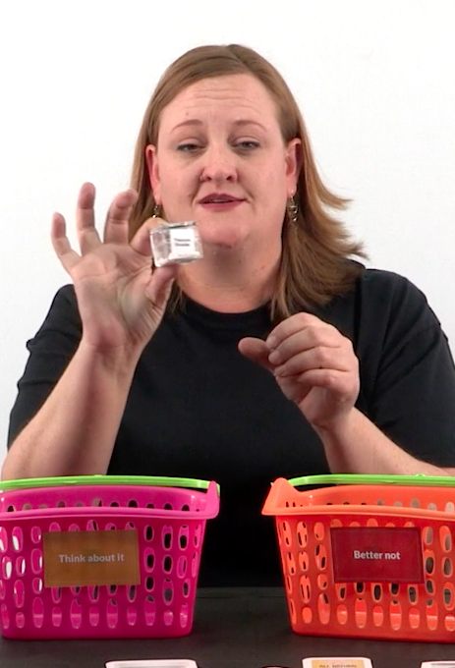
NanoDays
“Buy it—or better not?”
New NanoDays program available on nisenet.org

Slide 11
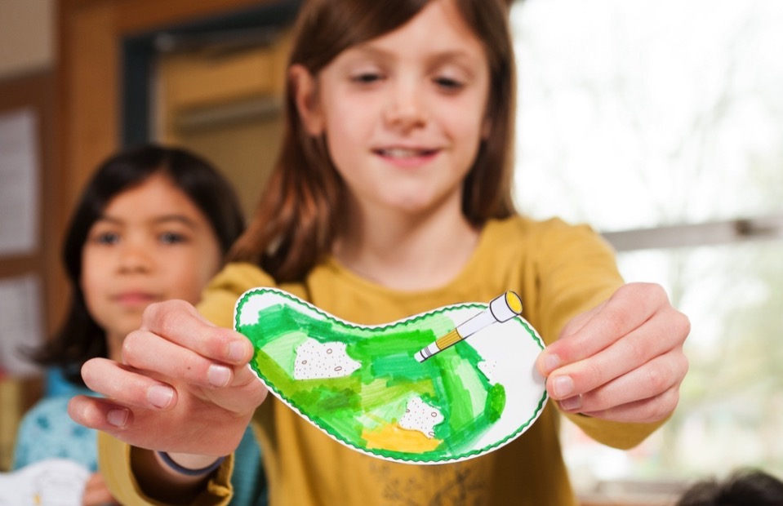
Building with Biology
Creating dialogue
among researchers, educators, and public audiences about STEM and society

Slide 12
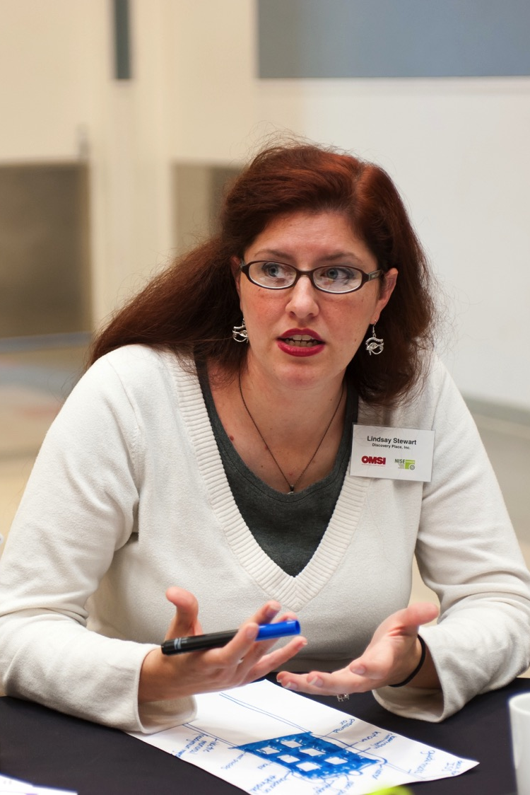
Building with Biology
“Editing Our Evolution: Rewriting the Human Genome” public forum available on nisenet.org

Slide 13
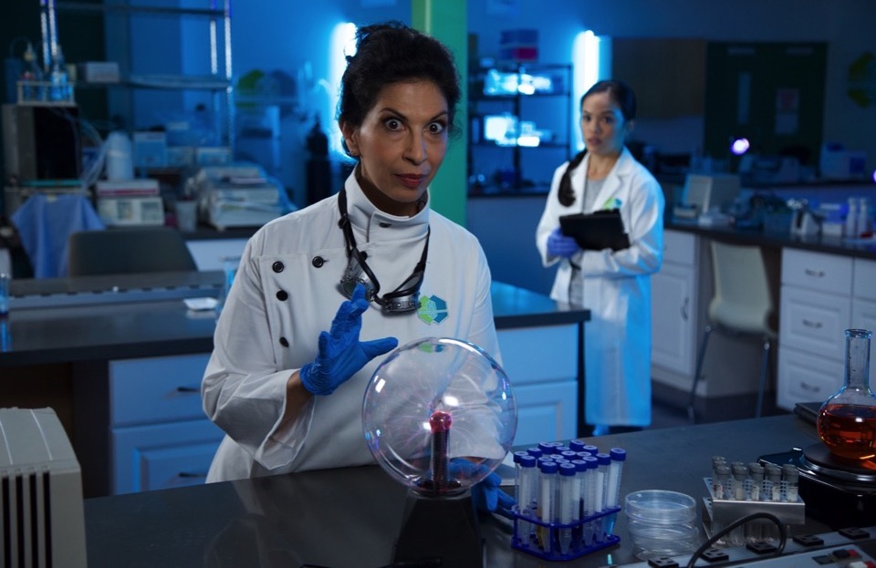
Frankenstein200
Exploring creativity
and responsible innovation in a transmedia environment

Slide 14
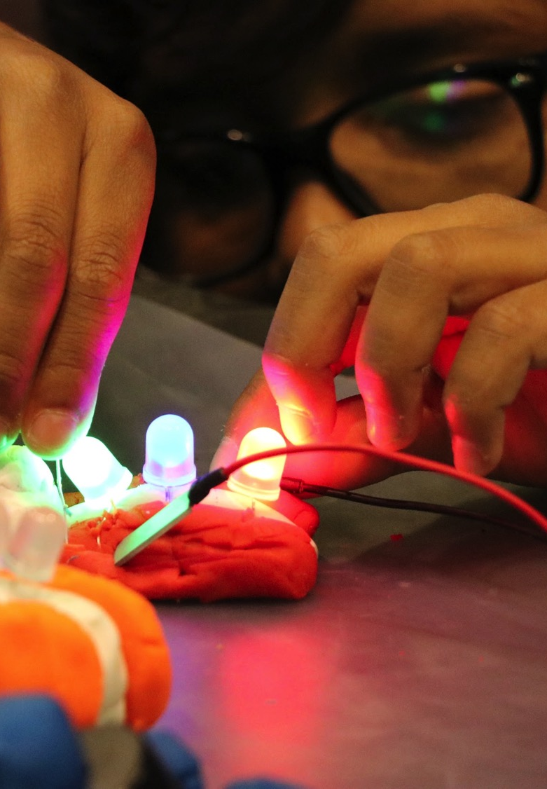
Frankenstein200
Digital kit available on nisenet.org
Alternate reality game available at frankenstein200.org

Slide 15

Explore Science: Let’s Do Chemistry
Promoting positive attitudes
toward learning chemistry

Slide 16

Explore Science:
Let’s Do Chemistry
Applications due June 1 for a free physical kit of hands-on activities

Slide 17

Space & Earth Informal STEM Education
Connecting learners
to Earth and space
science and experts

Slide 18

Explore Science:
Earth & Space
350 toolkits with hands-on activities and professional resources in 2019 and 2020
2019 toolkit applications due November 1, 2018
2017 and 2018 digital toolkits available on nisenet.org

Slide 19
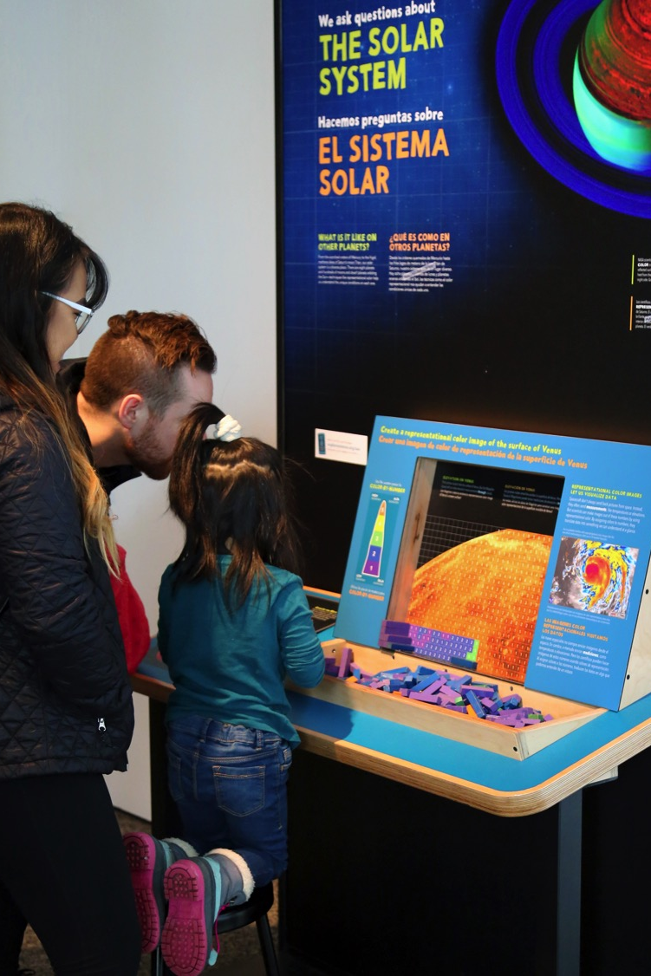
Sun, Earth, Universe
50 small-footprint exhibitions
Applications were due May 1, 2018. Applications completed after this date will be added to the wait list.

Slide 20
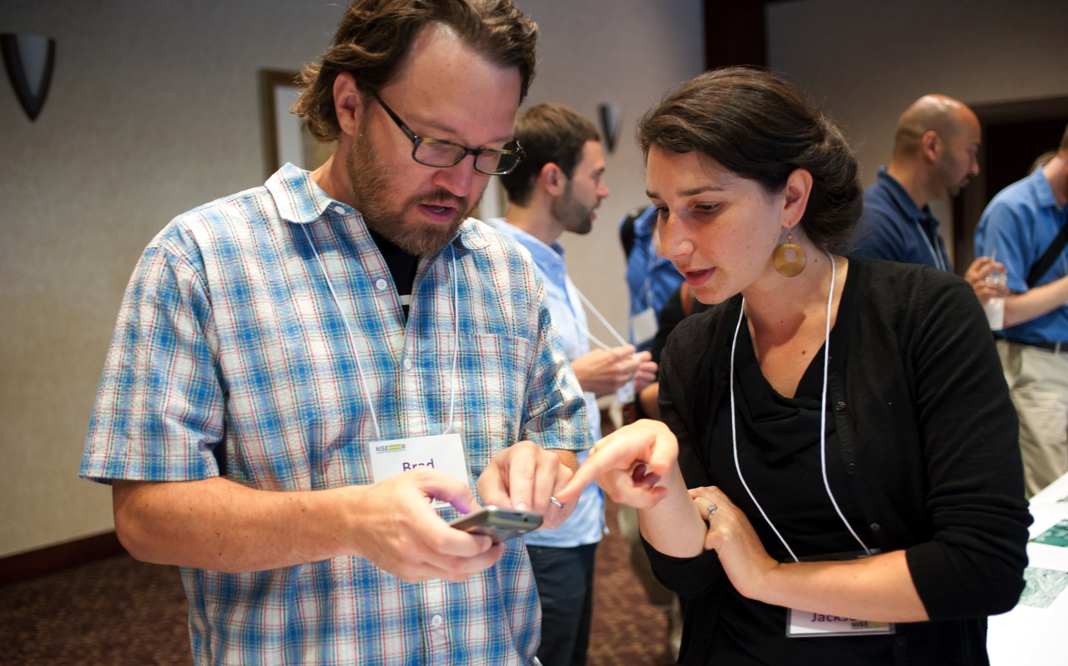
For these and other opportunities, regional hub leaders are your connection to the Network!
Keep in touch!
Hub leaders: nisenet.org/contact
Newsletter: nisenet.org/newsletter
Social networking: nisenet.org/social

Slide 21
IMPACT

Slide 22
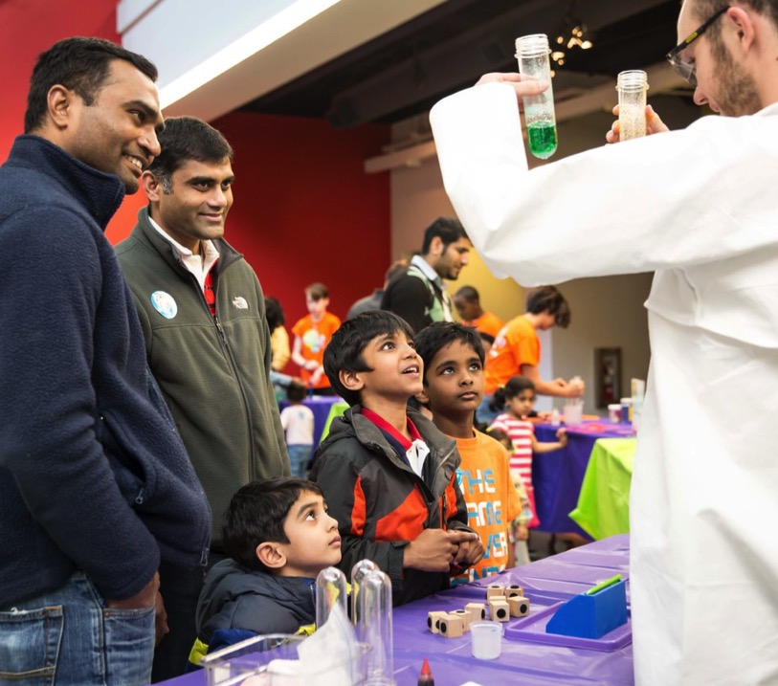
50,000,000+
people have been reached through Network projects

Slide 23
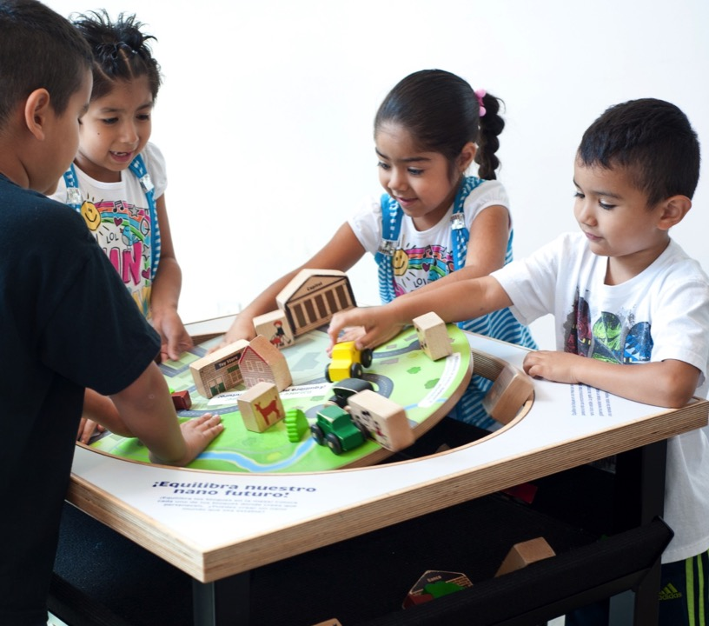
95%
of visitors reported high levels of enjoyment at the Nano mini-exhibition

Slide 24
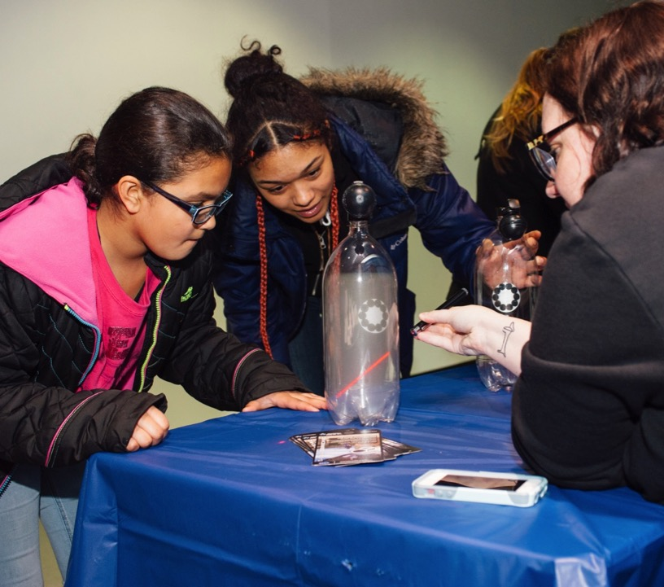
85%
of Network partners reached underserved audiences through Space & Earth events

Slide 25
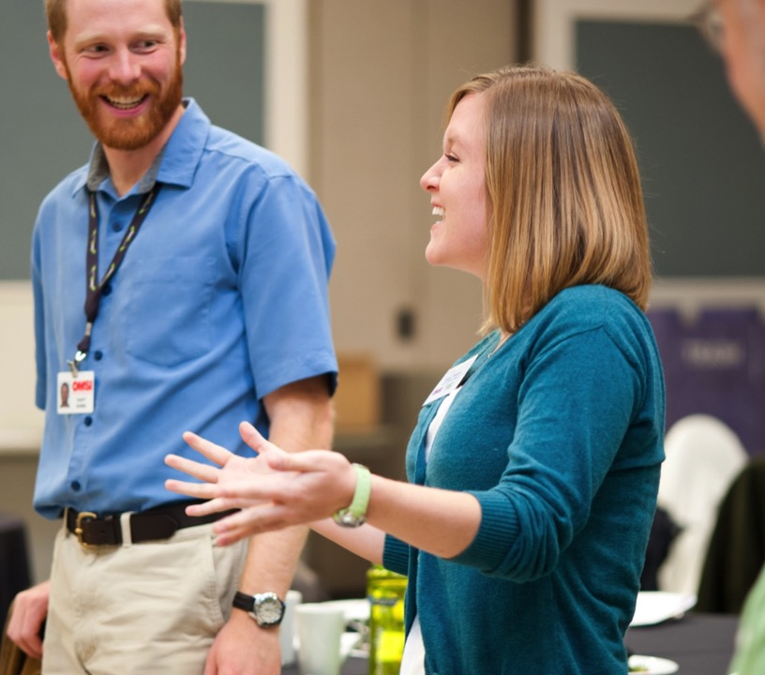
2,700+
professionals have participated in Network projects

Slide 26

97%
of professionals applied things they learned from the Nano project
to other work

Slide 27
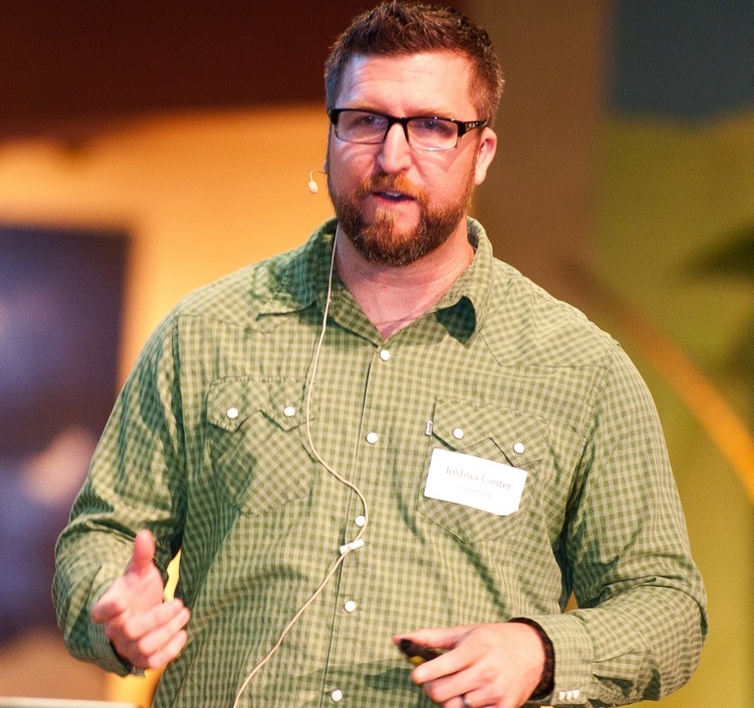
92%
of scientists increased their public engagement skills by participating in
Building with Biology

Slide 28

600+
organizations have participated in Network projects

Slide 29
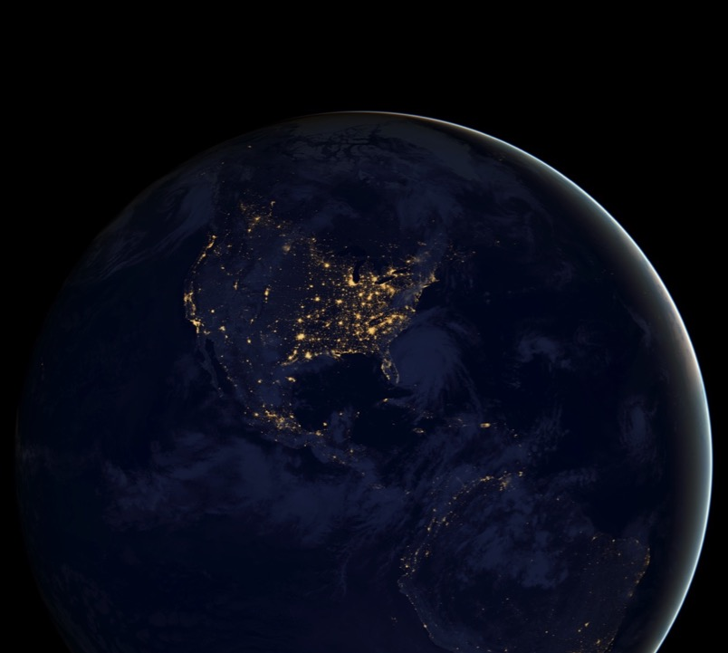
50
states have active
Network partners

Slide 30
DISCUSSION

Slide 31
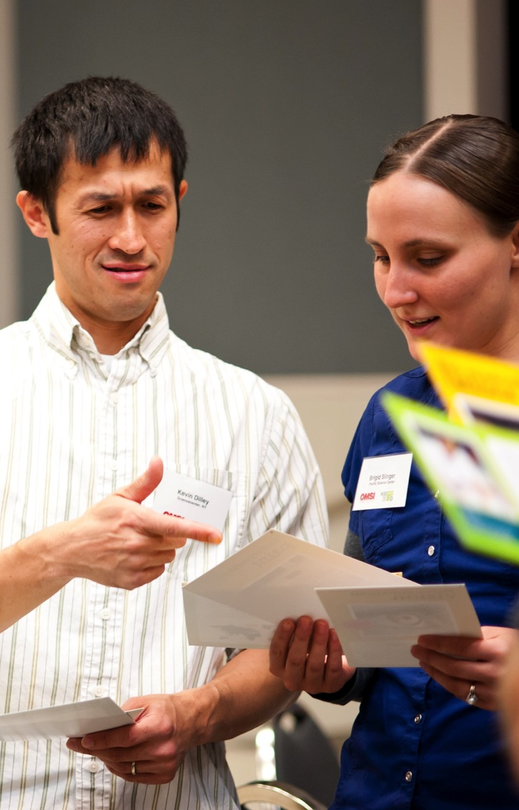
Possible
future projects
Brain and neuroscience
Human origins
Families and early learners
Rural audiences
Facilitation techniques
What else can the Network do?
Discuss at your table!
Please jot notes on the cards and leave them for us.

Slide 32
THANK YOU!

Slide 33

Leadership
Arizona State University
Children’s Creativity Museum
Children’s Museum of Houston
Museum of Life and Science
Museum of Science
Oregon Museum of Science & Industry
Science Museum of Minnesota
Sciencenter
The Franklin Institute
Tulsa Children’s Museum
University of California Berkeley
Advisors
Afterschool Alliance
Association of Children’s Museums
Center for the Advancement of Informal STEM Learning, Association of Science-Technology centers
National Girls Collaborative Project

Slide 34


Acknowledgements
The Nanoscale Informal Science Education Network was supported by the National Science Foundation under award numbers 0532536 and 0940143. Multi-Site Public Engagement in Science is supported by the National Science Foundation under award number 1421179. Increasing Learning and Efficacy is supported by the National Science Foundation under award number 1516684. ChemAttitudes is supported by the National Science Foundation under award number 1612482. Any opinions, findings, and conclusions or recommendations expressed in this presentation are those of the authors and do not necessarily reflect the views of the Foundation.
Space and Earth Informal STEM Education is supported by NASA under cooperative agreement number NNX16AC67A. Any opinions, findings, and conclusions or recommendations expressed in this material are those of the author(s) and do not necessarily reflect the view of the National Aeronautics and Space Administration (NASA).

