Slide 1
WELCOME! NISE NETWORK PARTNER BREAKFAST | ASTC 2018

Slide 2
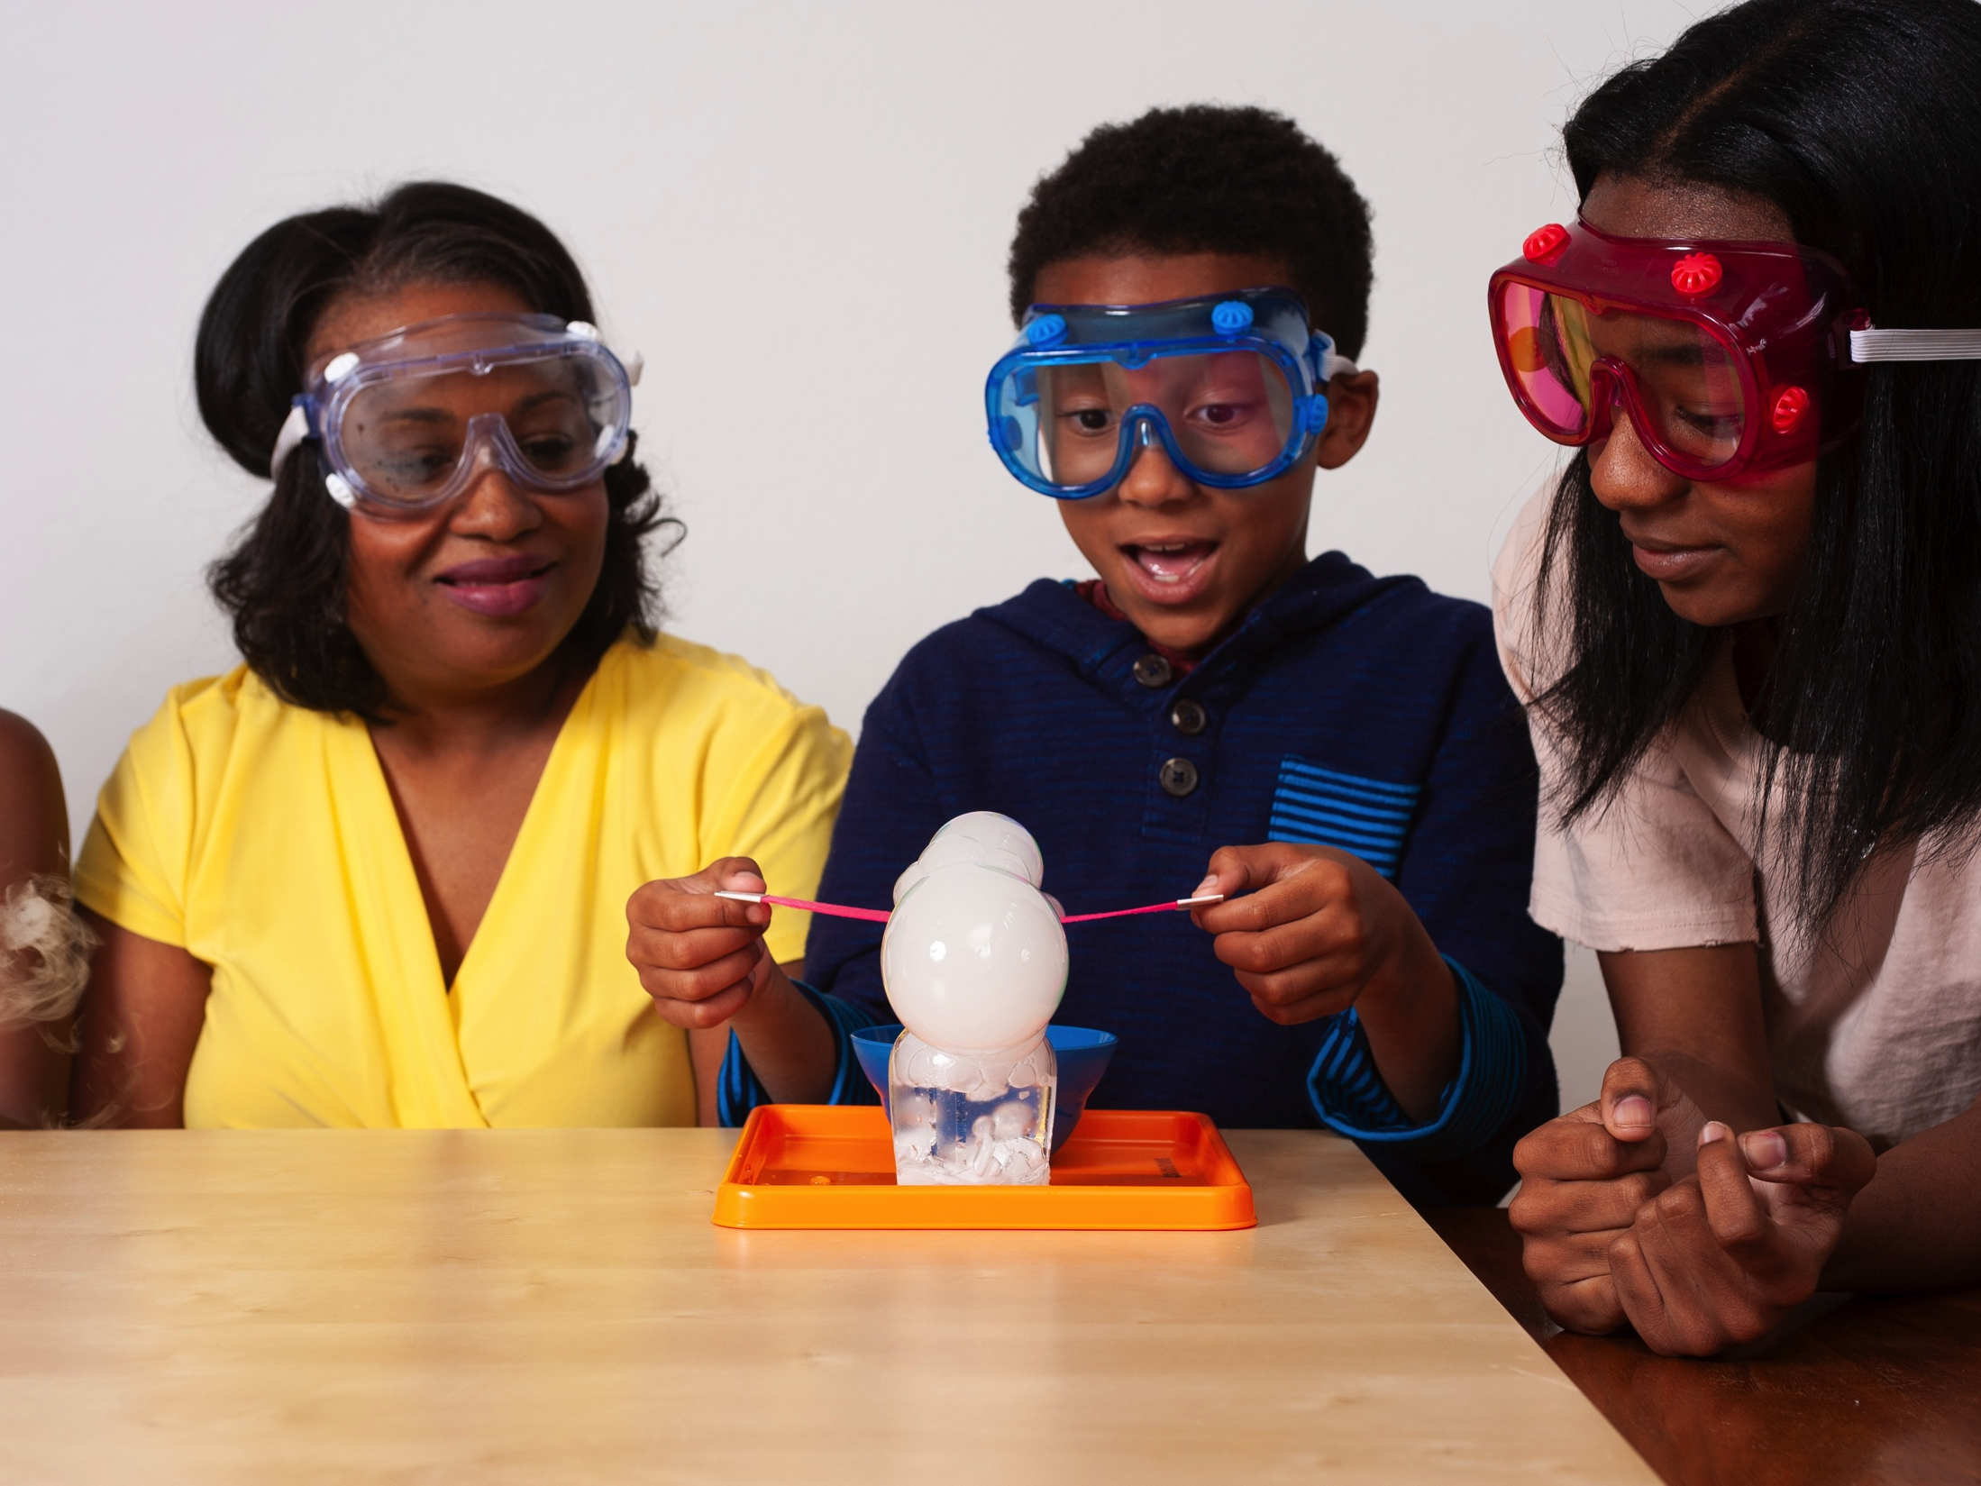
nisenet.org
Contents
Overview
Projects
Highlights from 2018
Discussion

Slide 3
NISE NETWORK

Slide 4
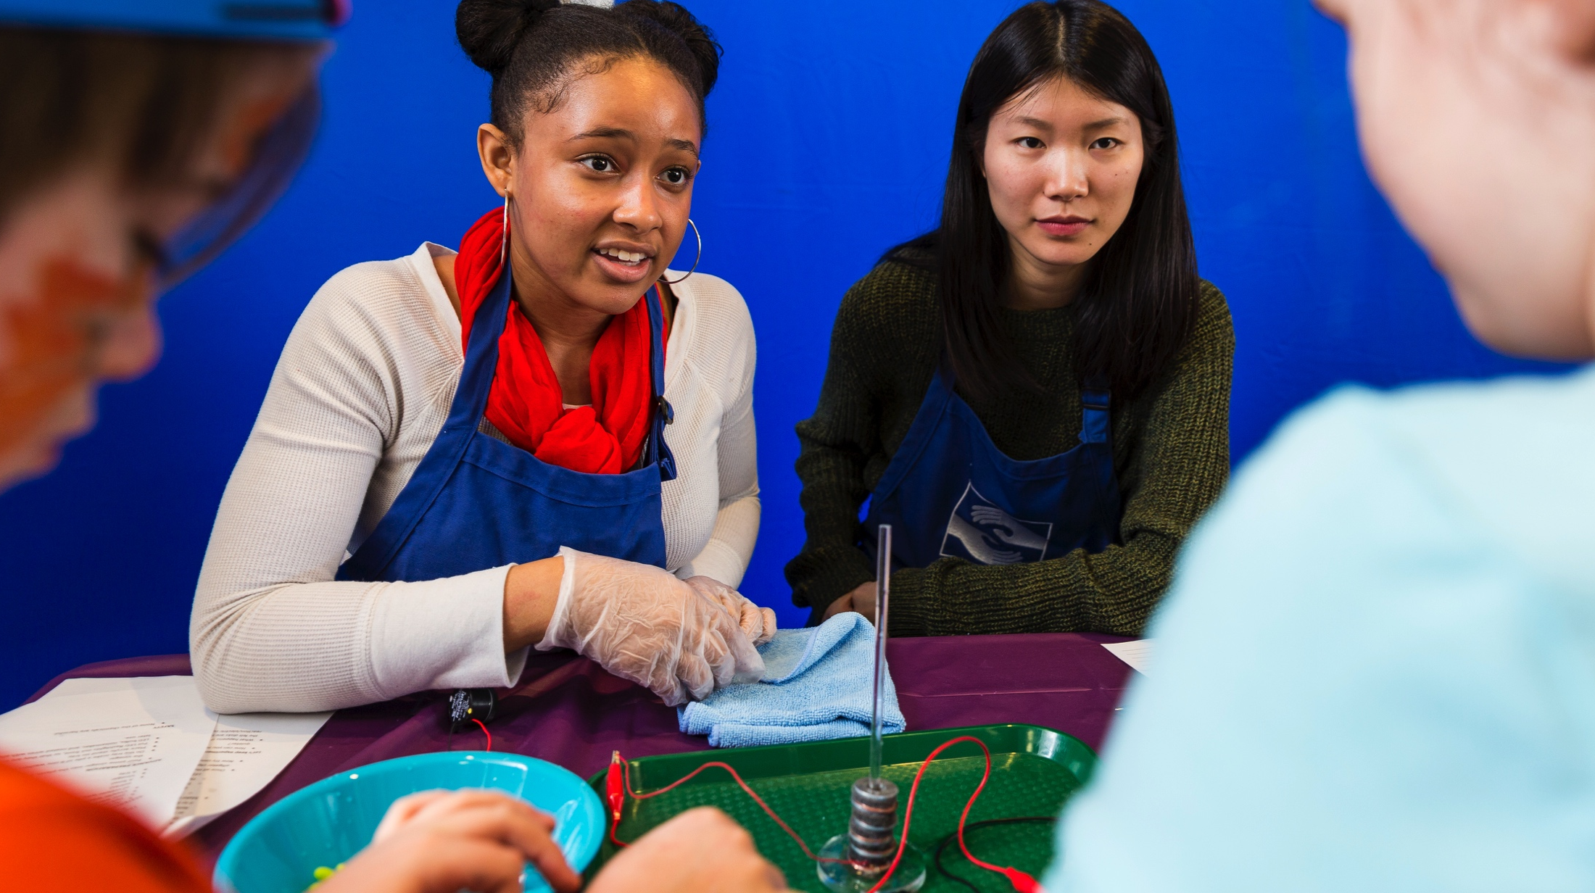
The National Informal STEM Education Network is dedicated to supporting learning about science, technology, engineering, and math (STEM).
Our community
includes educators, researcher/evaluators, and scientists.

Slide 5
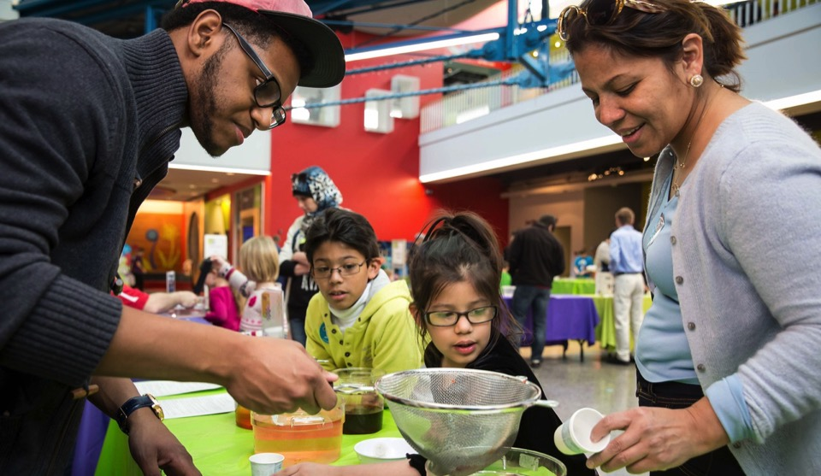
NISE Net supports informal learning about STEM in communities across the United States.
Our activities
are fun and accessible
for everyone.

Slide 6
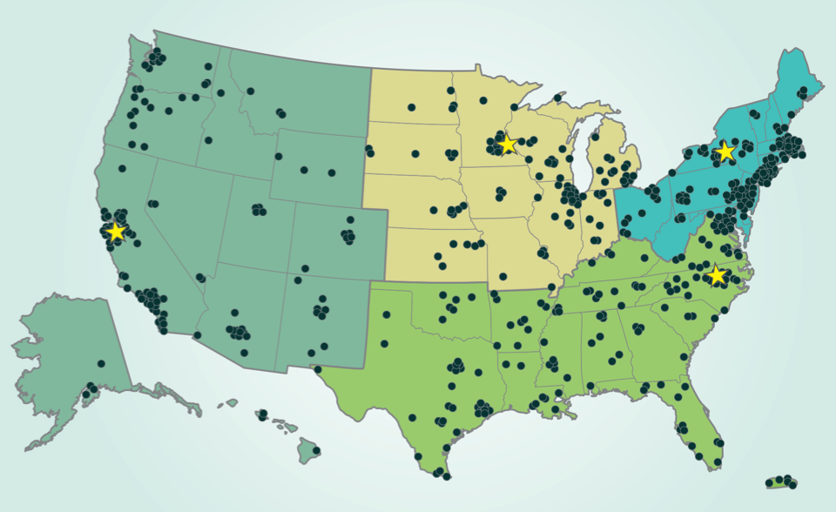
Hundreds of organizations participate in the NISE Network.
Network partners
include museums
and universities.
Regional hubs

Slide 7
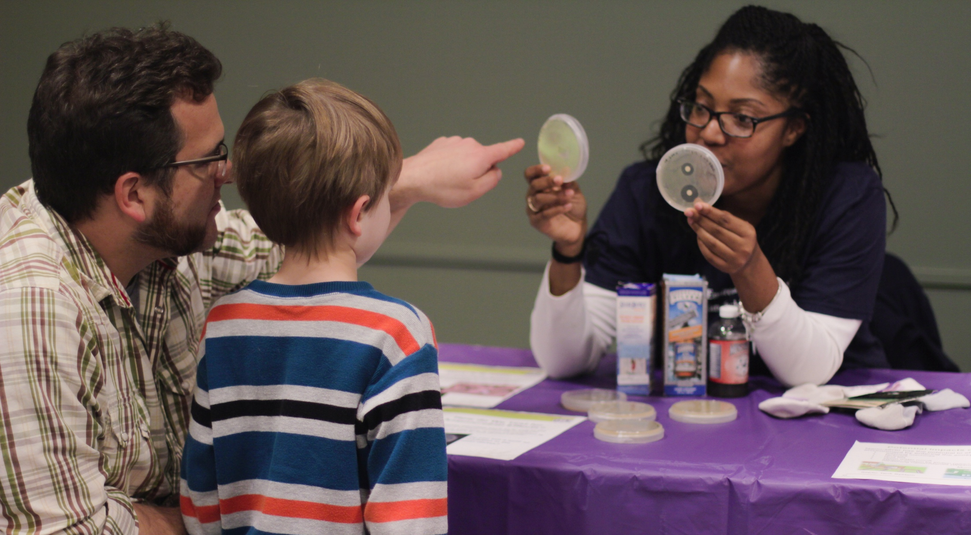
Partner organizations use Network resources to engage audiences in their communities.
Our projects
bring together diverse people to share and learn from each other.

Slide 8
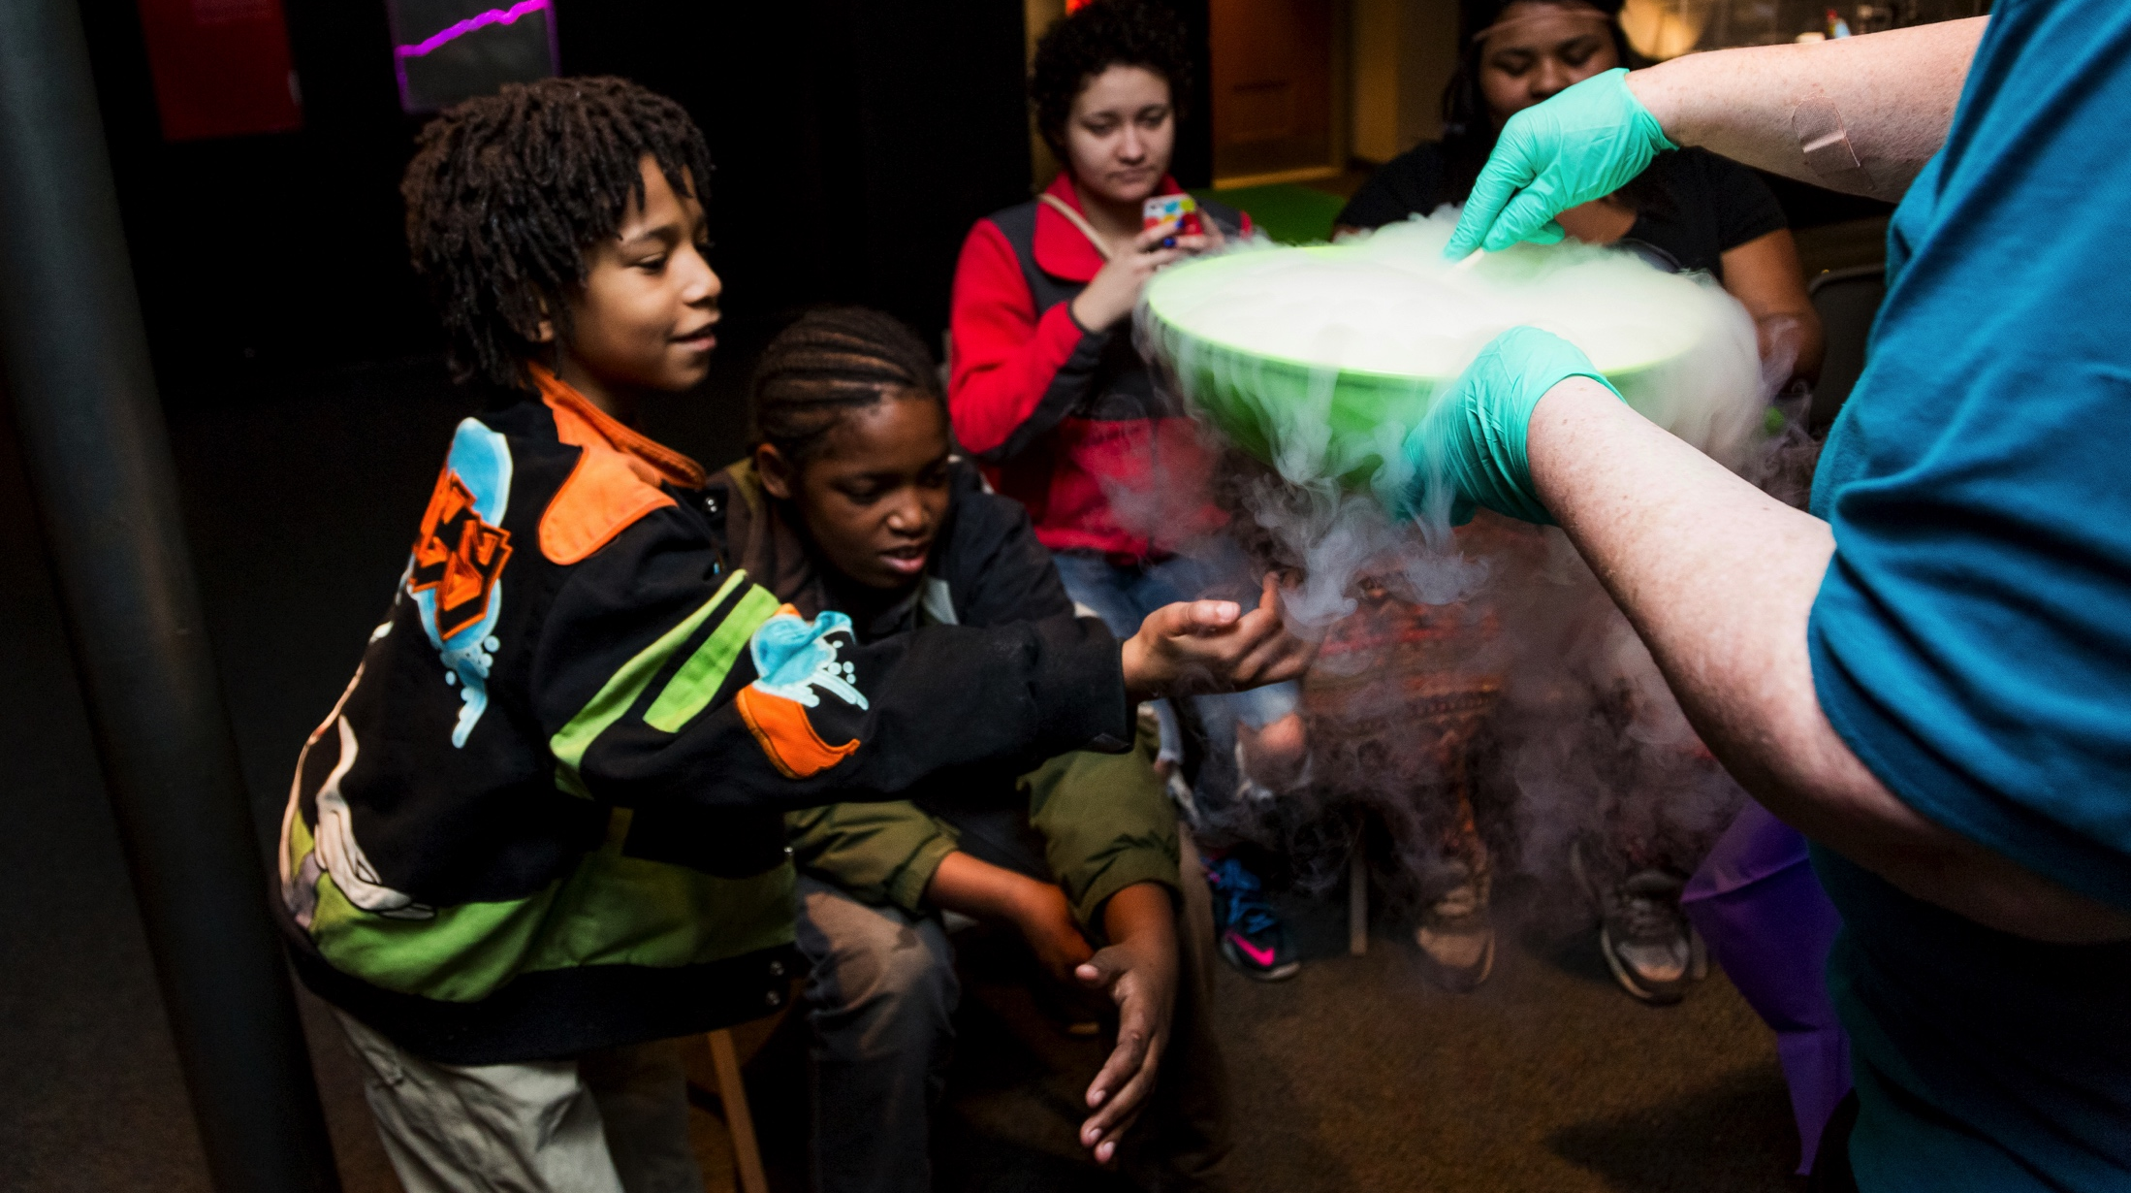
Together we reach millions of people each year!
Our impact
extends across the country and grows each year.

Slide 9
PROJECTS

Slide 10
NISE Net projects tackle challenging problems and develop relevant knowledge, tools, and practices.
Our Network
relationships, knowledge, and infrastructure support a variety of projects.

Slide 11
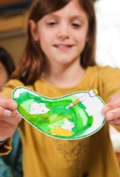
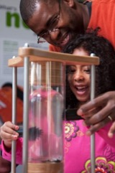
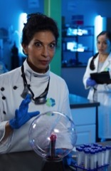
NISE Net has projects in many areas of STEM.
Synthetic biology
2014-2018
Chemistry
2016-2019
2005
2021
Nanotechnology
2005-2017
Frankenstein
2015-2019
Earth & Space
2016-2021

Slide 12
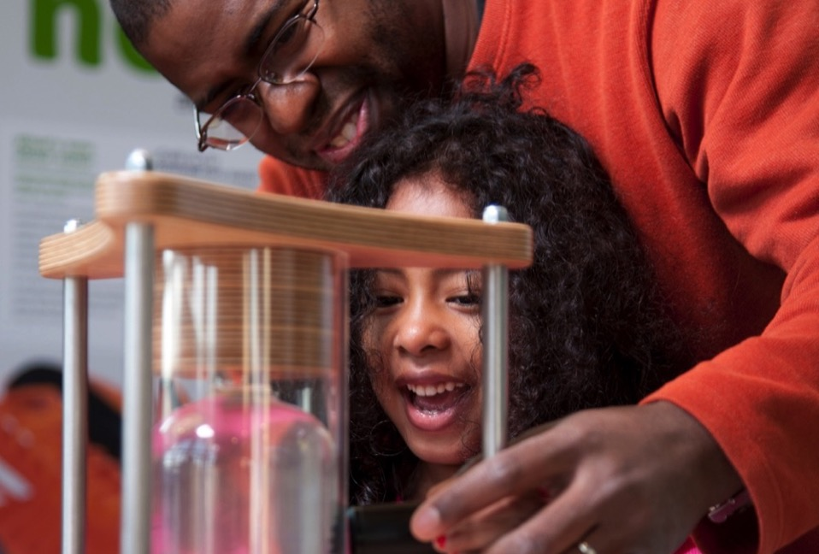
Nanoscale Informal Science Education Network
Building a national Network
to engage audiences
in learning about current STEM research

Slide 13
NanoDays
“Buy it—or better not?”
New NanoDays program available on nisenet.org

Slide 14
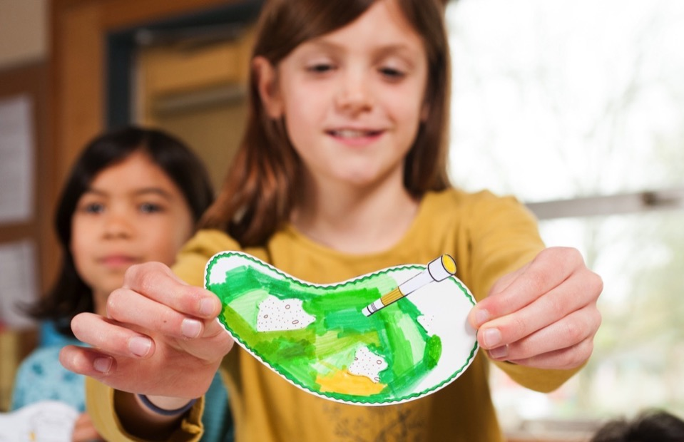
Building with Biology
Creating dialogue
among researchers, educators, and public audiences about STEM and society

Slide 15
Building with Biology
Hands-on activity kits and NEW public forum available on nisenet.org
New guide on public engagement with science on nisenet.org

Slide 16
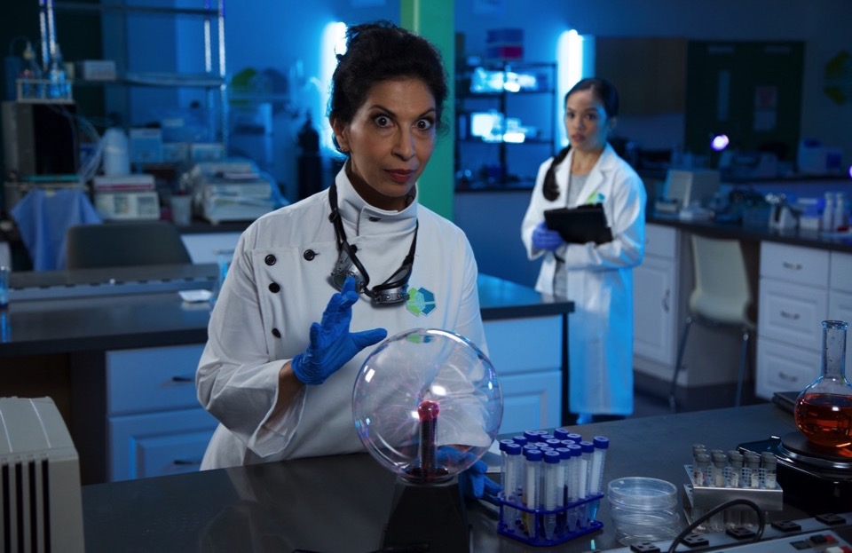
Frankenstein200
Exploring creativity
and responsible innovation in a transmedia environment

Slide 17
Frankenstein200
Digital kit available at nisenet.org/frankensteinkit
Alternate reality game available at frankenstein200.org

Slide 18
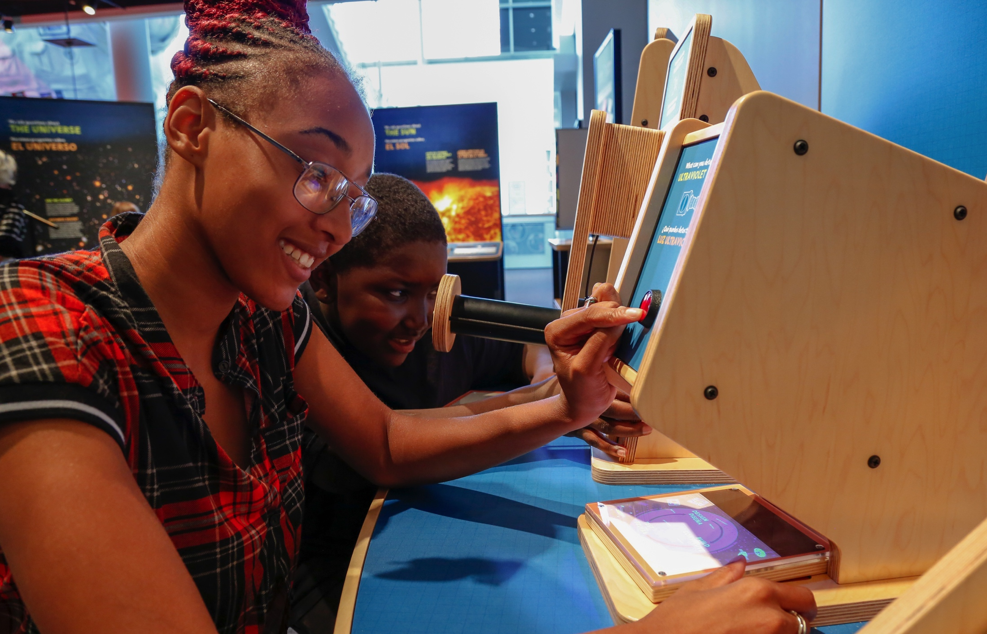
Space & Earth Informal STEM Education
Connecting learners
to authentic
Earth and space science and experts

Slide 19
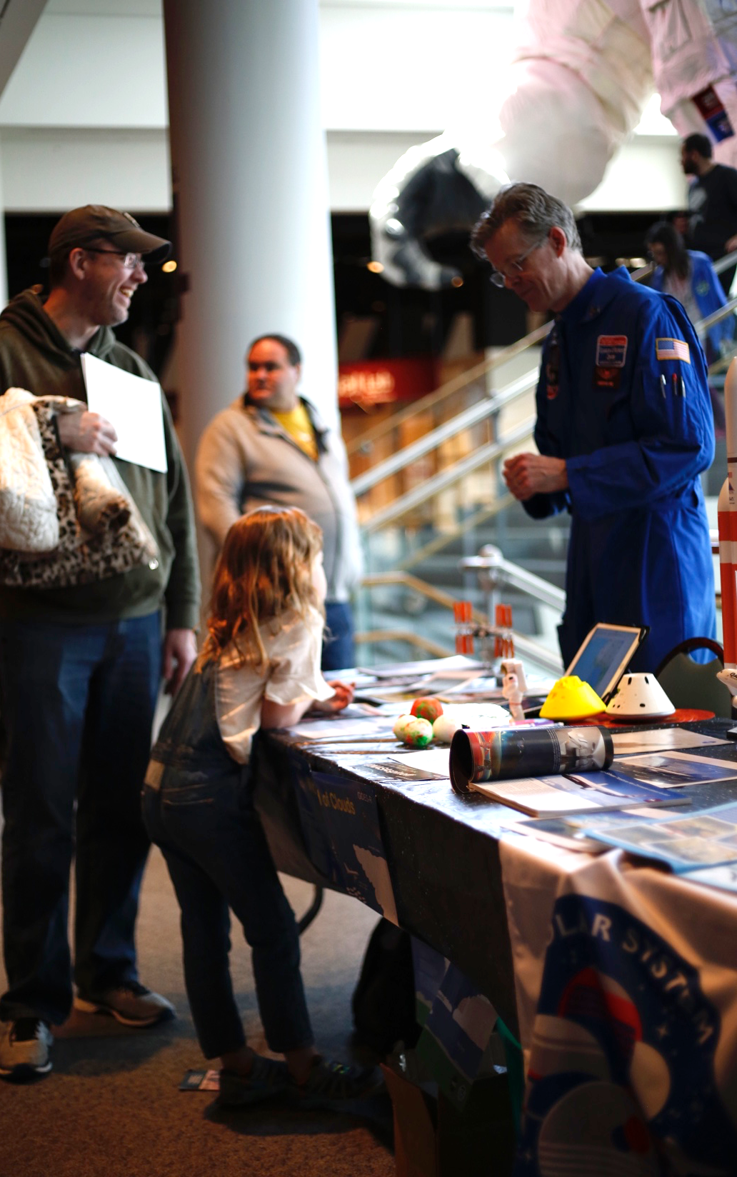
Space & Earth
350 Earth & Space toolkits – applications due Nov. 1, 2018
52 copies of the Sun, Earth, Universe exhibition distributed 2018–2019
Earth & Space toolkit (2020) and Moon & Beyond game (2021)
Previous digital toolkits available at http://www.nisenet.org/earthspacekit

Slide 20
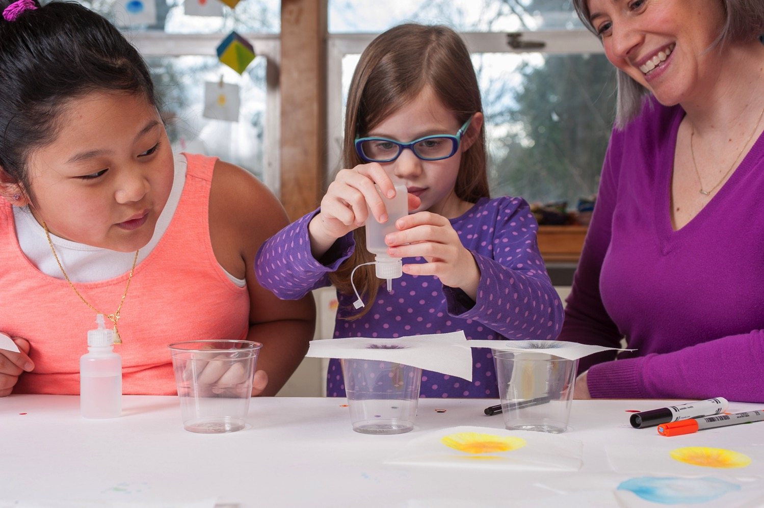
Explore Science: Let’s Do Chemistry
Promoting positive attitudes
toward learning chemistry

Slide 21
ChemAttitudes
National Chemistry Week events October 21-27
Digital kit available at nisenet.org/chemistry-kit

Slide 22
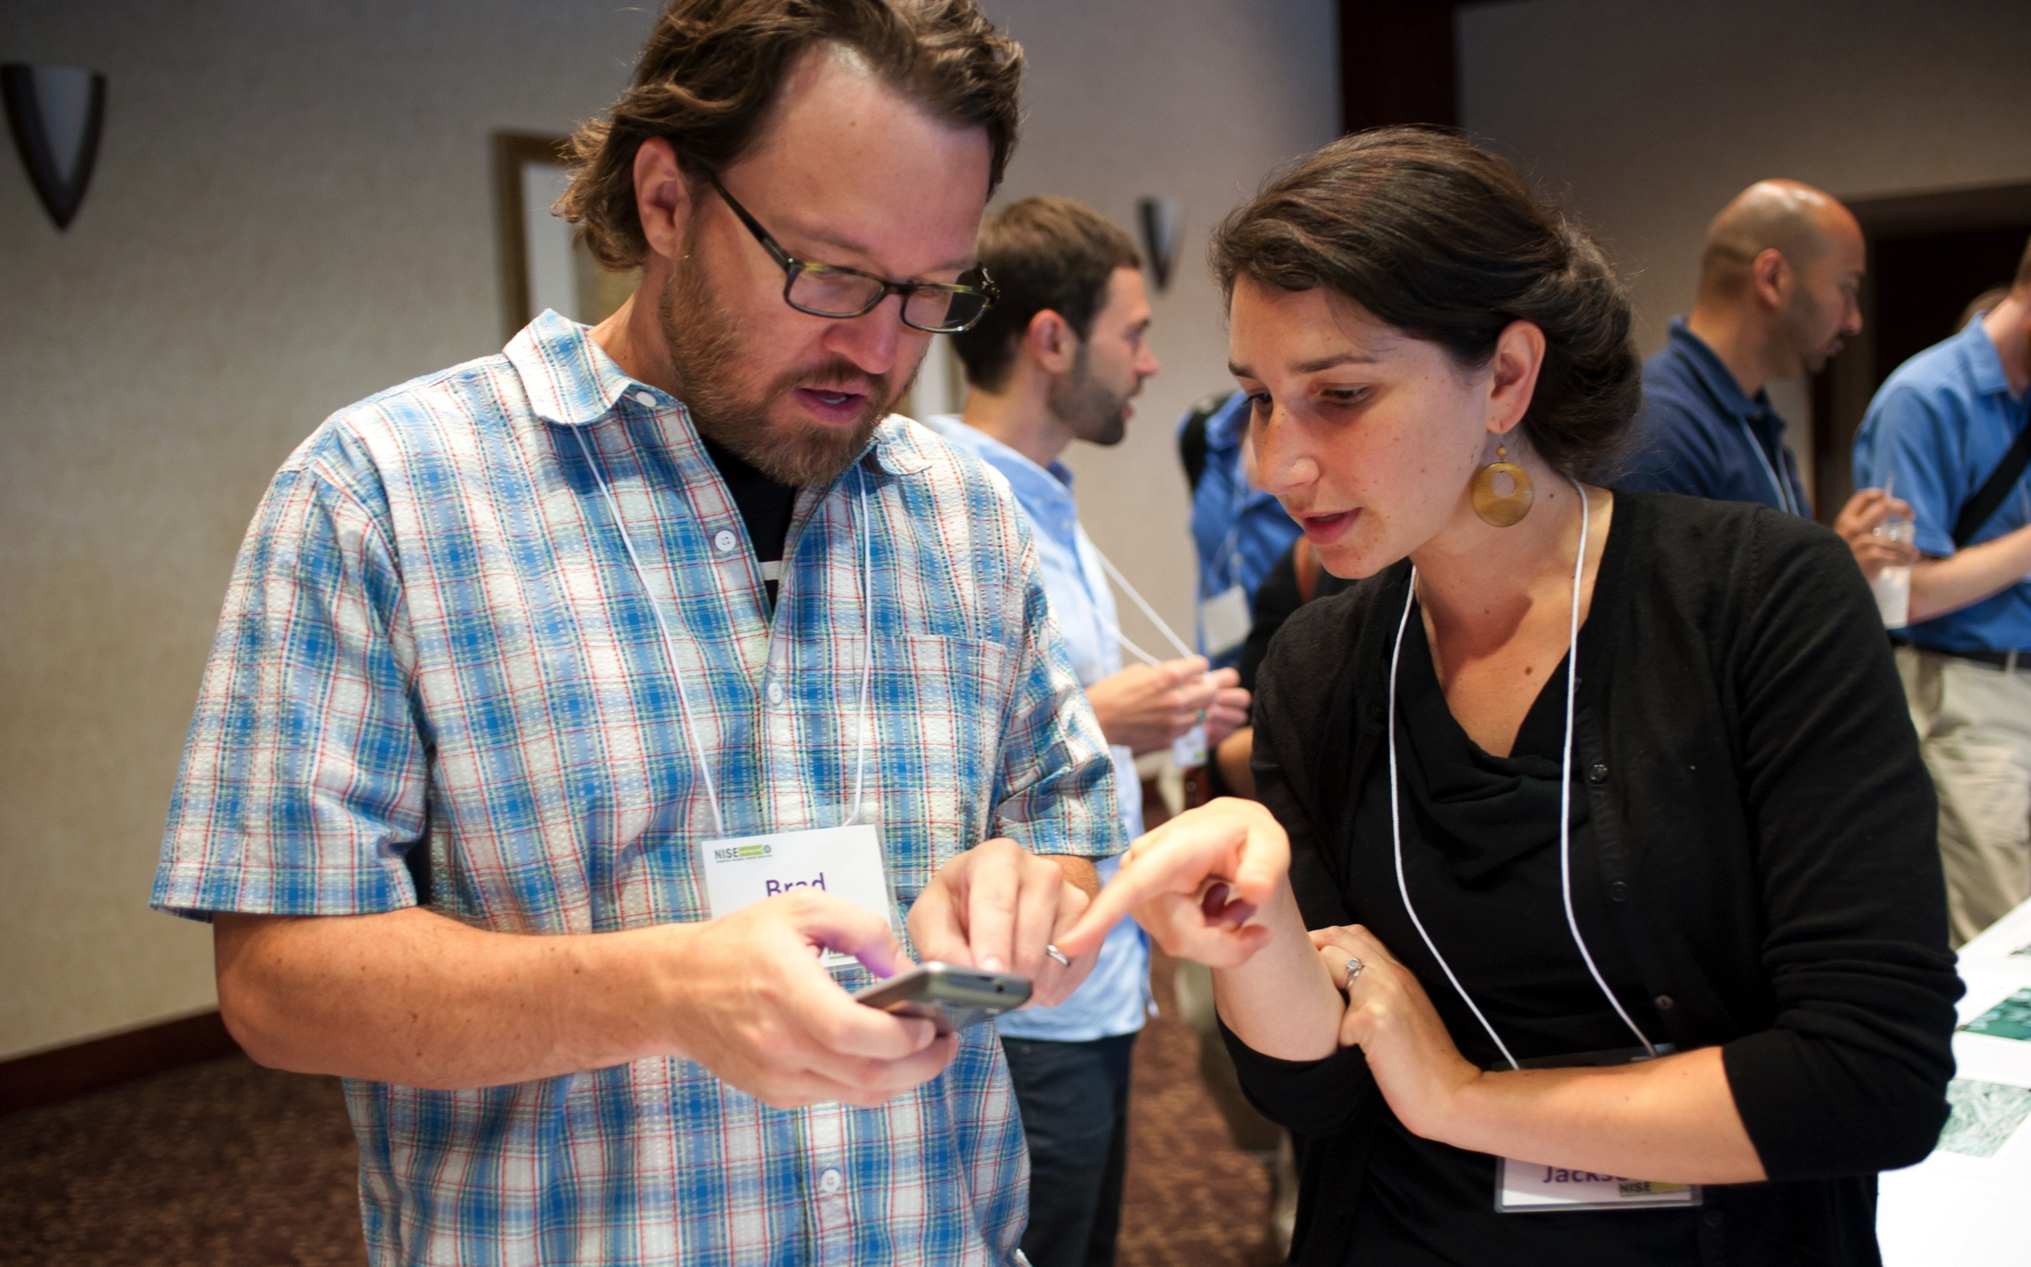
For these and other opportunities, regional hub leaders are your connection to the Network!
Keep in touch!
Hub leaders: nisenet.org/contact
Newsletter: nisenet.org/newsletter
Social networking: nisenet.org/social

Slide 23
2018 HIGHLIGHTS

Slide 24
400+
organizations
participating in
Network projects

Slide 25
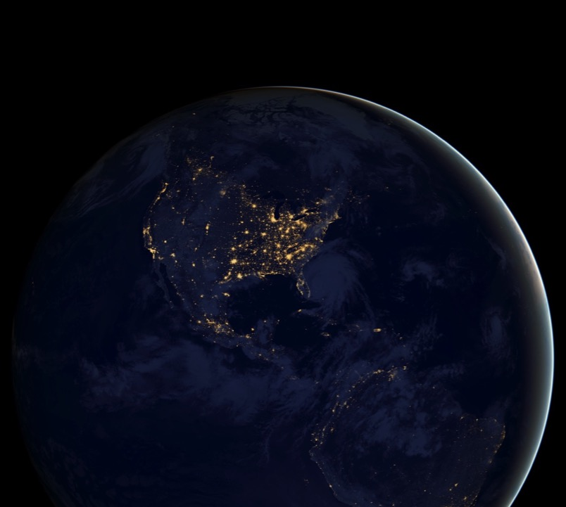
50
states with active
Network partners

Slide 26
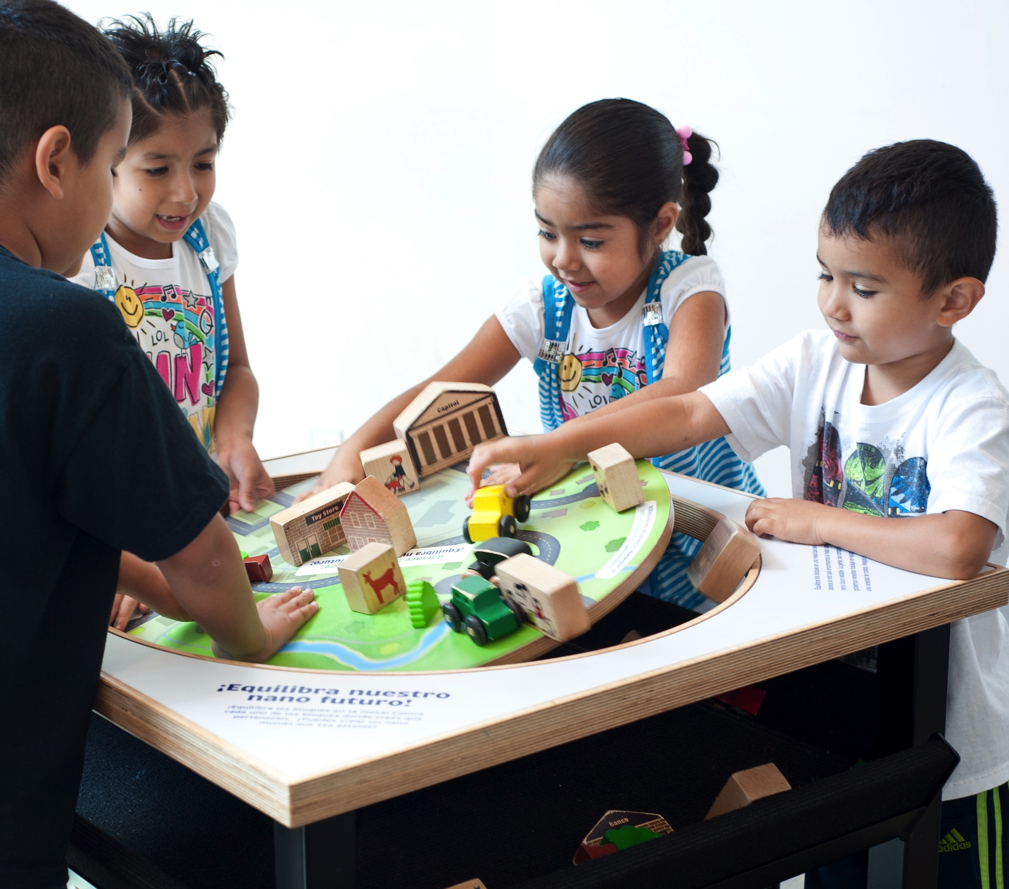
10,000,000
people reached through the Nano project

Slide 27
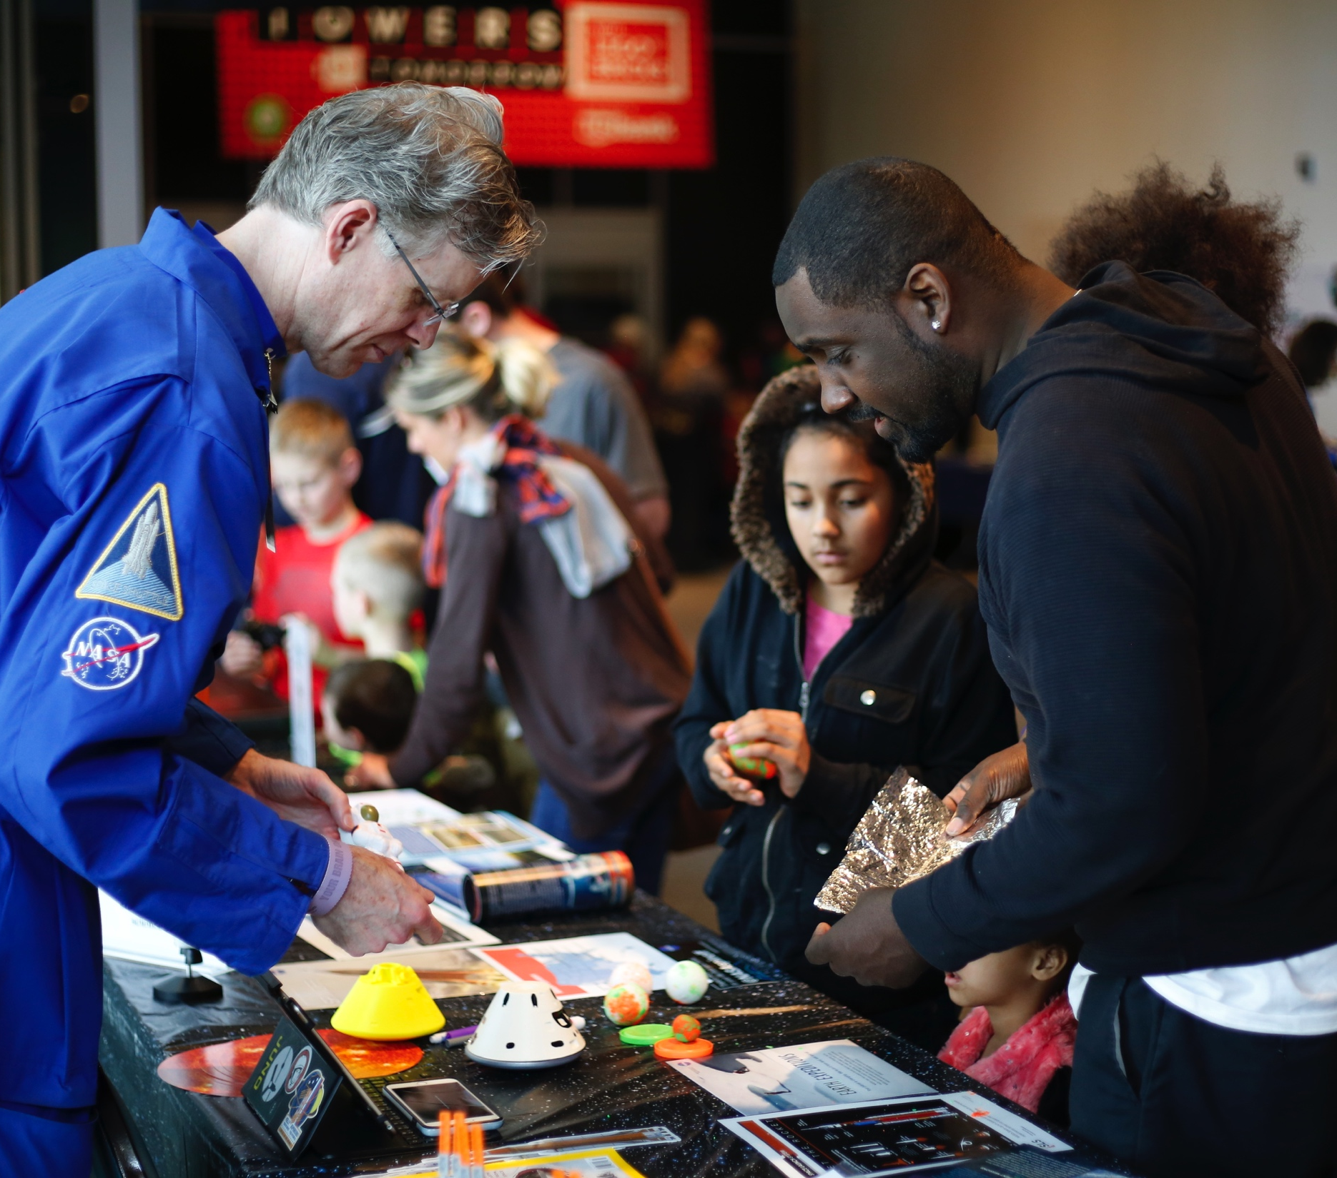
1,300,000
people reached through the
Earth & Space project

Slide 28
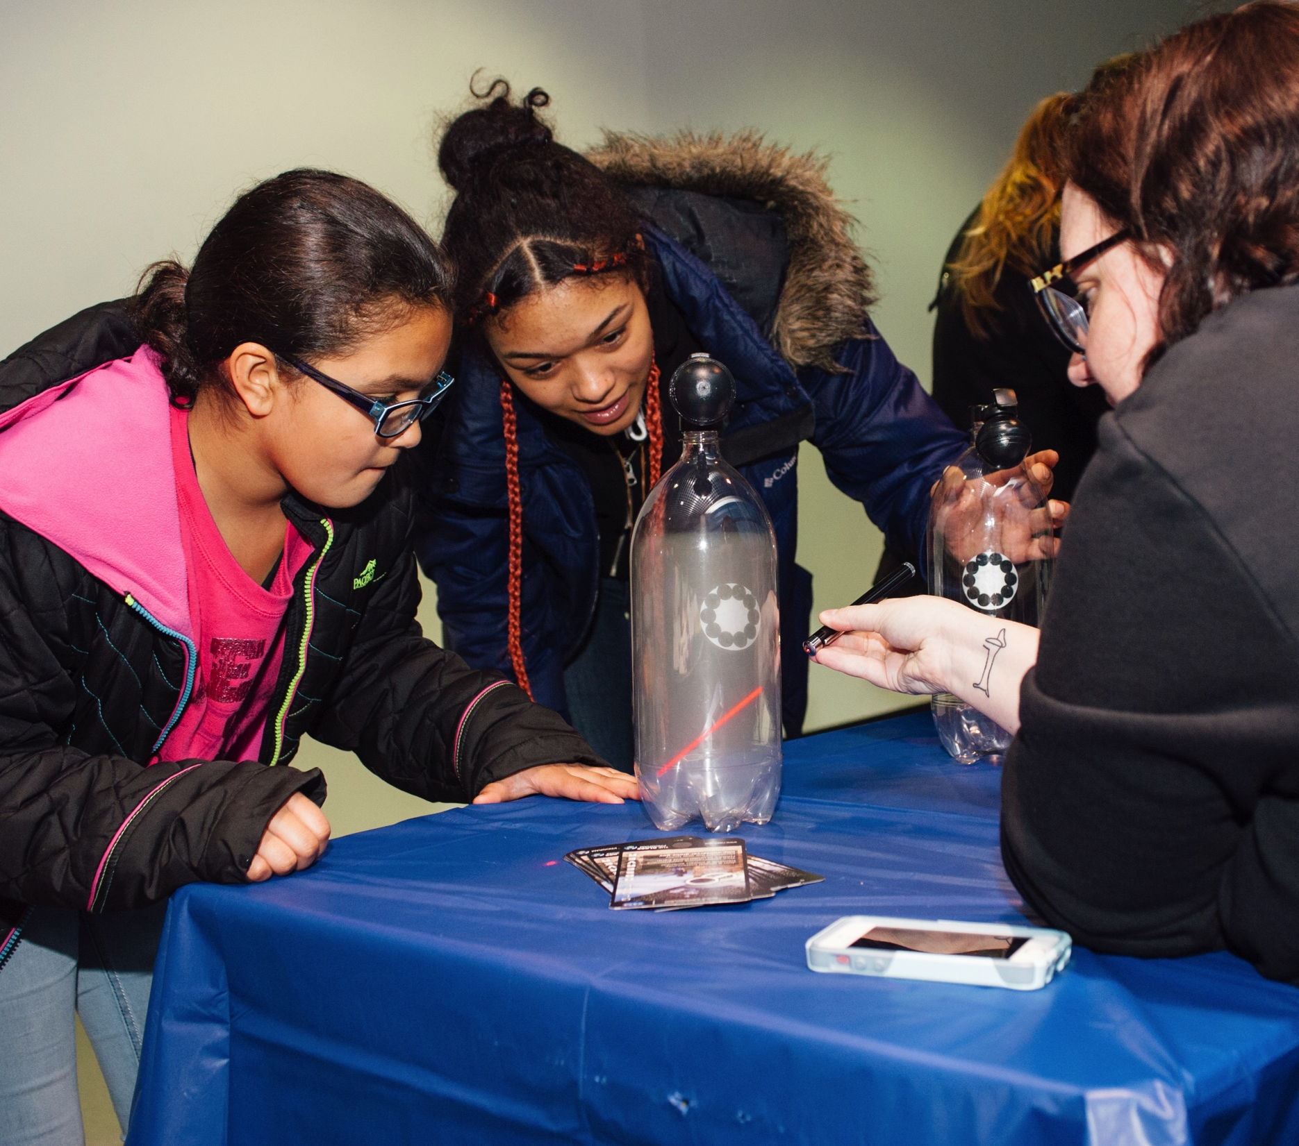
86%
of partners reached underserved audiences through Earth & Space events

Slide 29
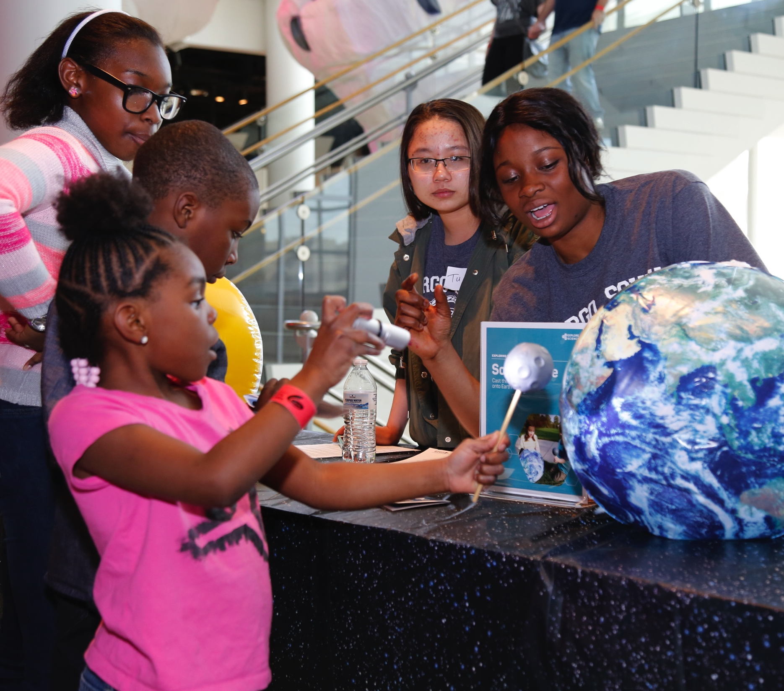
91%
of families learned something new at
Earth & Space activities
Notes:
Preliminary finding

Slide 30
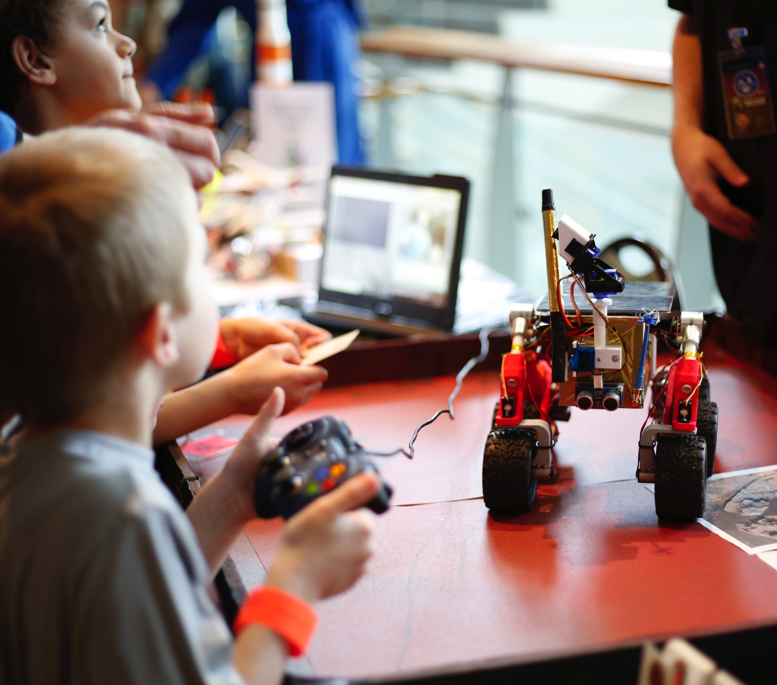
85%
of Earth & Space events featured partnerships with scientists and other organizations

Slide 31
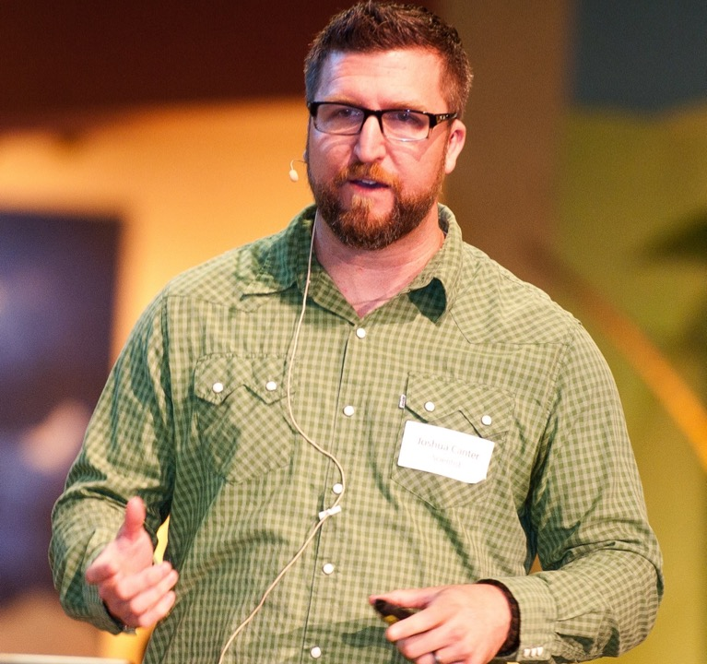
90%
of scientists increased their public engagement skills by participating in
Building with Biology
Notes:
According to facilitator reports

Slide 32
91%
Building with Biology events addressed societal and/or ethical implications of science
Notes:
According to facilitator reports

Slide 33
DISCUSSION PUBLIC ENGAGEMENT WITH NEUROSCIENCE & SOCIETY

Slide 34
We’d like to know…
What types of programs are you already doing around brain science?
Who are you partnering with?
What types of activities or products would you want from a NISE Net project related to brain science?
Please write your responses on a card, and include your name and organization. Thanks!

Slide 35
THANK YOU

Slide 36
Leadership
Arizona State University
Children’s Creativity Museum
Children’s Museum of Houston
Museum of Life and Science
Museum of Science
Oregon Museum of Science & Industry
Science Museum of Minnesota
Sciencenter
The Franklin Institute
Tulsa Children’s Museum
University of California Berkeley
Advisors
Association of Children’s Museums
Center for the Advancement of Informal STEM Learning, Association of Science-Technology centers
National Girls Collaborative Project

Slide 37
Acknowledgements
The Nanoscale Informal Science Education Network was supported by the National Science Foundation under award numbers 0532536 and 0940143. Multi-Site Public Engagement in Science is supported by the National Science Foundation under award number 1421179. Increasing Learning and Efficacy is supported by the National Science Foundation under award number 1516684. ChemAttitudes is supported by the National Science Foundation under award number 1612482. Any opinions, findings, and conclusions or recommendations expressed in this presentation are those of the authors and do not necessarily reflect the views of the Foundation.
Space and Earth Informal STEM Education is supported by NASA under cooperative agreement number NNX16AC67A and 80NSSC18M0061. Any opinions, findings, and conclusions or recommendations expressed in this material are those of the author(s) and do not necessarily reflect the view of the National Aeronautics and Space Administration (NASA).
LCnano received partial funding from the US Environmental Protection Agency through the STAR program (RD83558001). Any opinions, findings, conclusions, or recommendations expressed in this presentation are those of the authors and do not necessarily reflect the views of the LCnano project.
The Public Engagement with Neuroscience and Society conference was funded by The Kavli Foundation.

