Slide 1
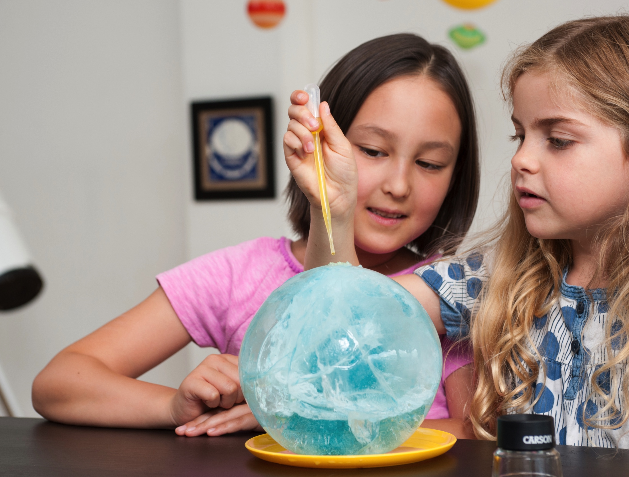
www.nisenet.org
nisenet.org

Slide 2
WELCOME NISE Network Partner Breakfast ASTC 2017

Slide 3
Agenda
Presentation
Network overview
Current projects
Year in review
Discussion
Future directions

Slide 4
NISE NETWORK

Slide 5
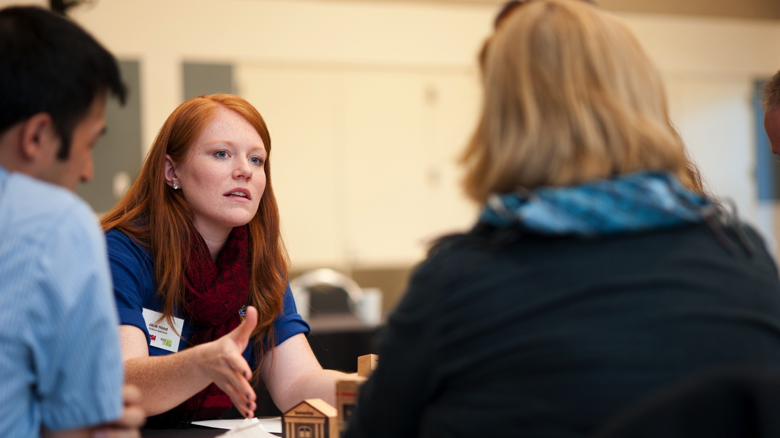
NISE Net is the National Informal STEM Education Network.

Slide 6
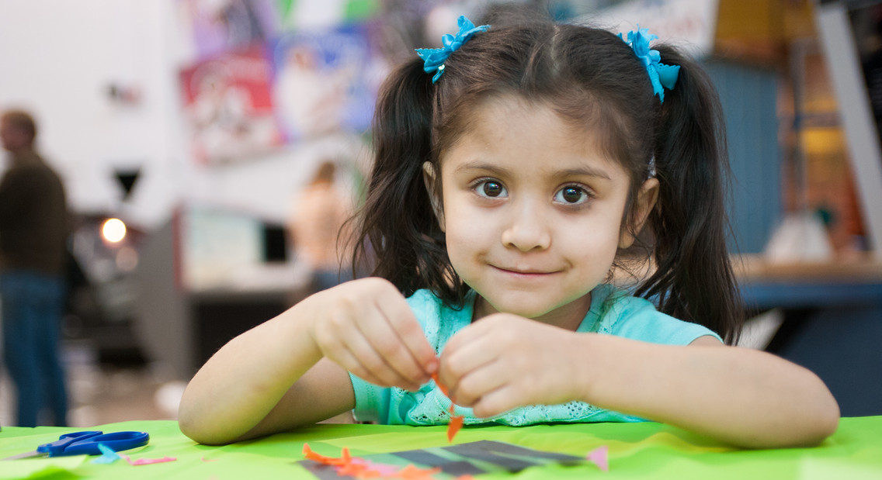
NISE Net supports informal learning about STEM in communities across the United States.

Slide 7
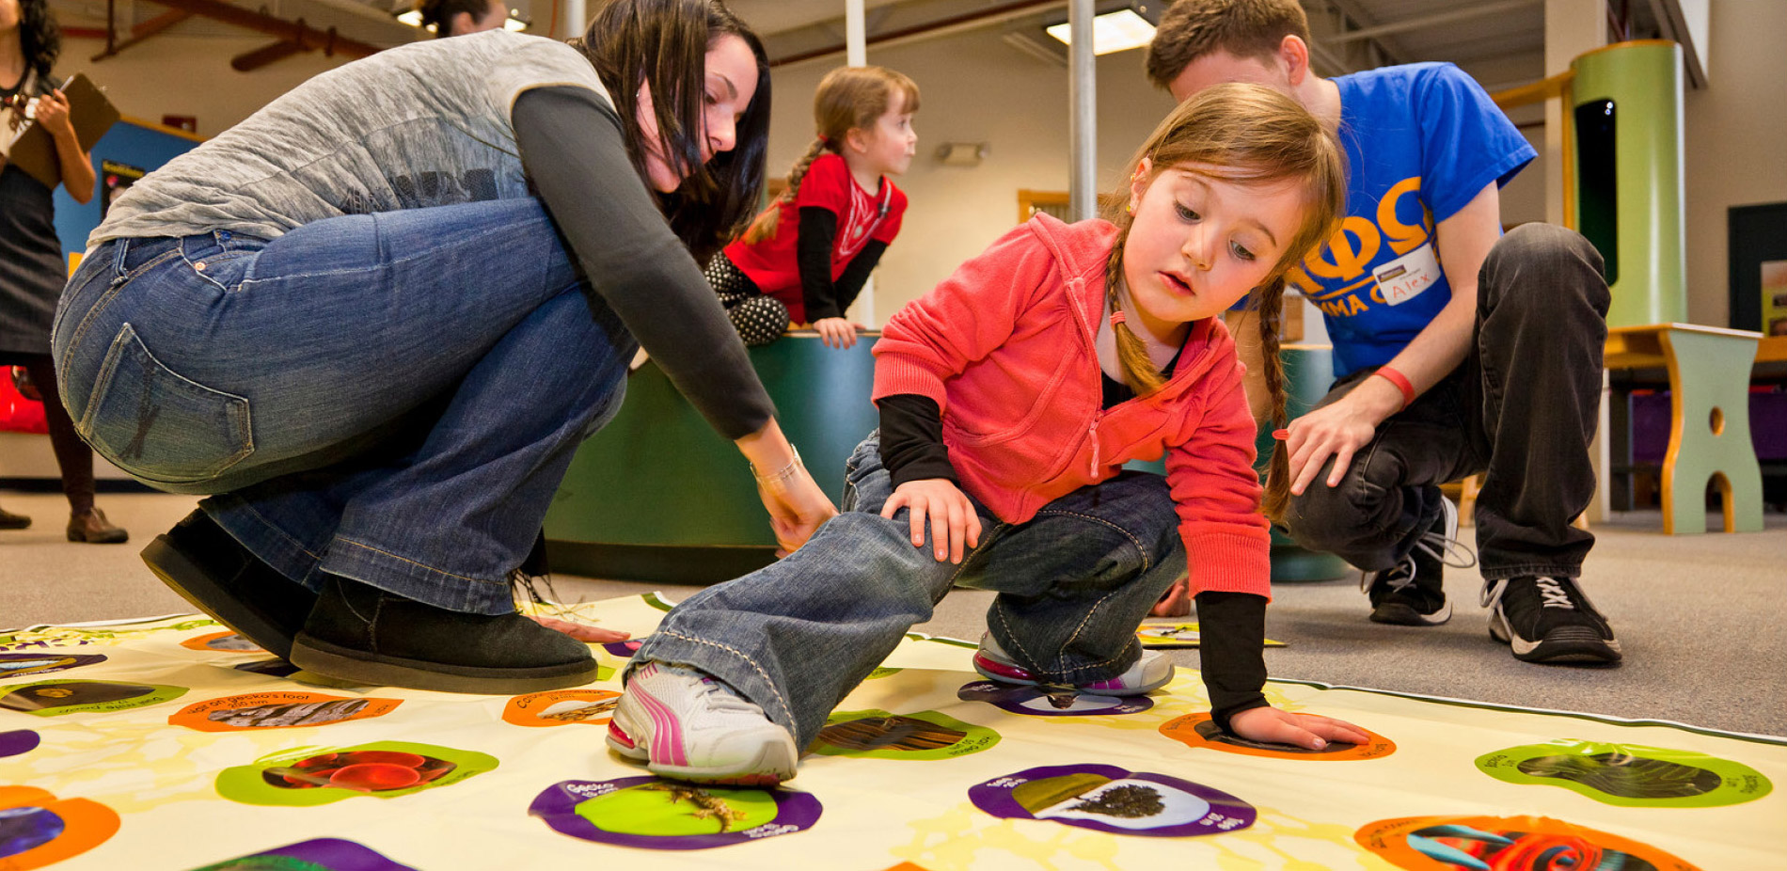
The Network engages all audiences in learning about STEM in ways that are fun and accessible.

Slide 8
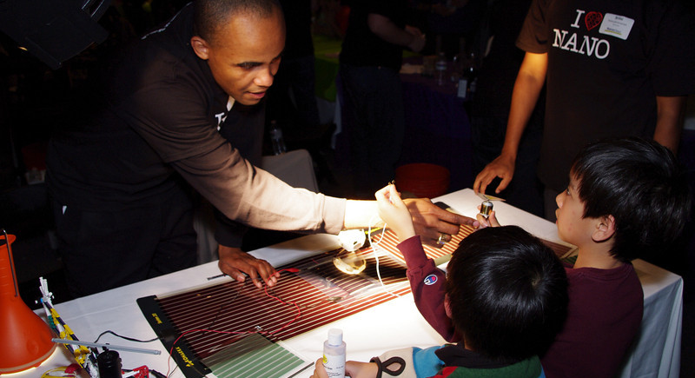
NISE Net improves the practices and skills of educators and scientists.

Slide 9
NISE Net seeks to broaden participation in STEM learning—at home, at school, and in the community.

Slide 10
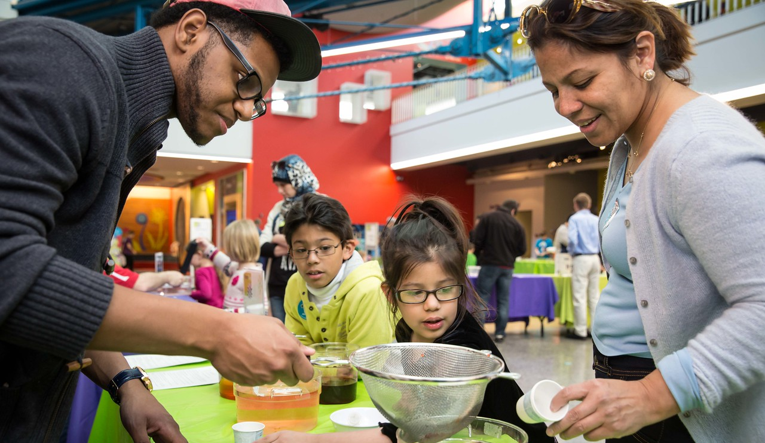
Together we reach millions of people each year!

Slide 11
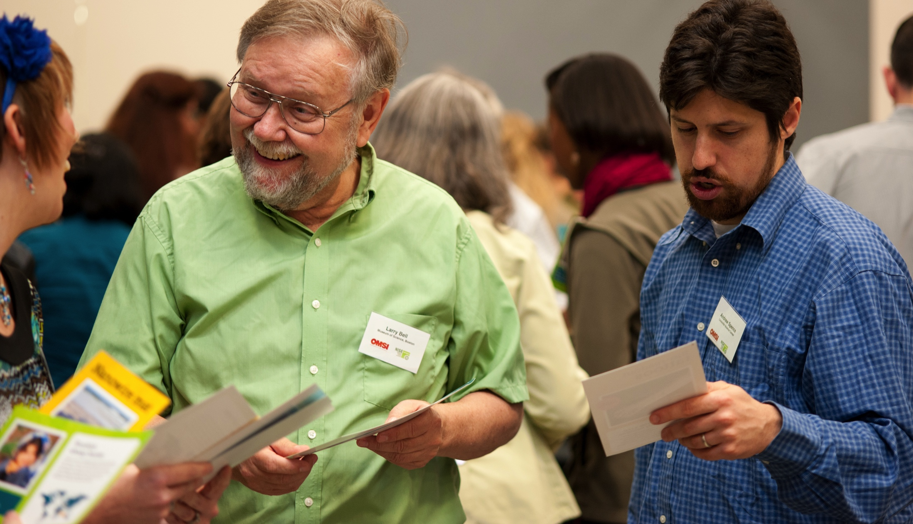
Network projects leverage the relationships and infrastructure we have built.

Slide 12
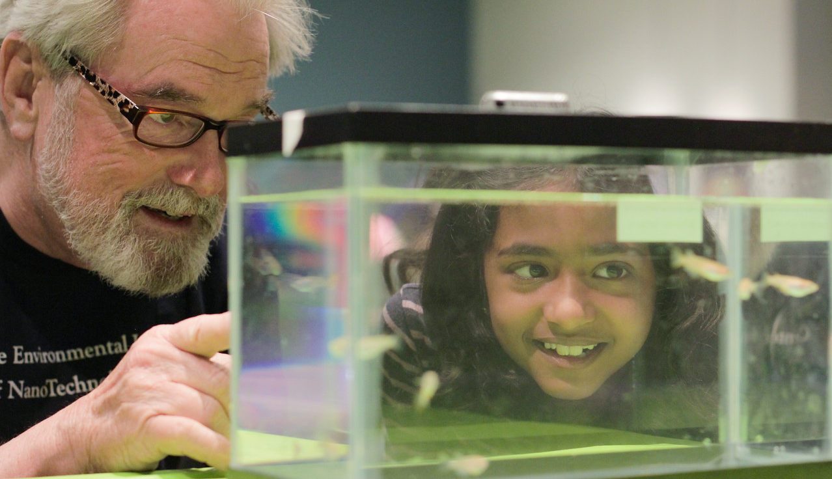
Our projects tackle challenging problems and develop relevant knowledge, tools, and practices.

Slide 13
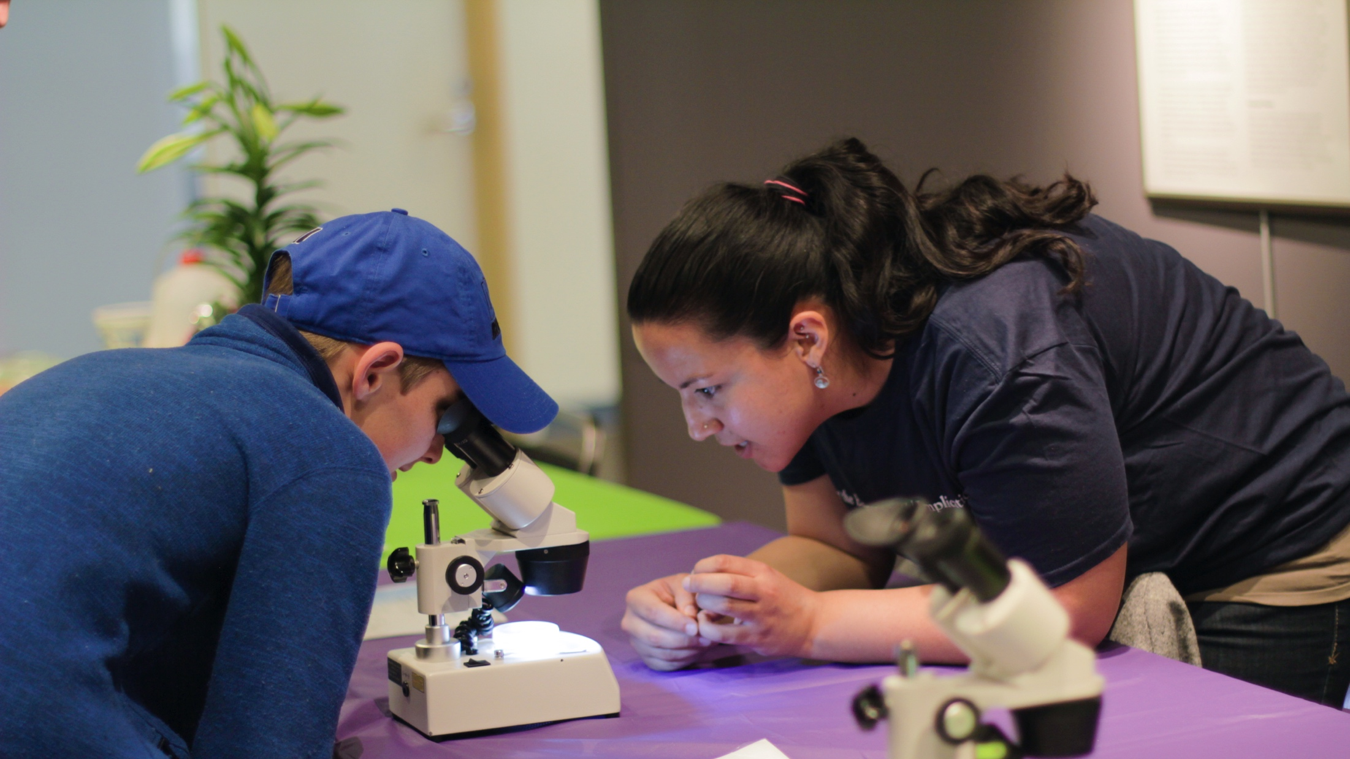
Network partners use project resources to engage local audiences in many different ways.

Slide 14
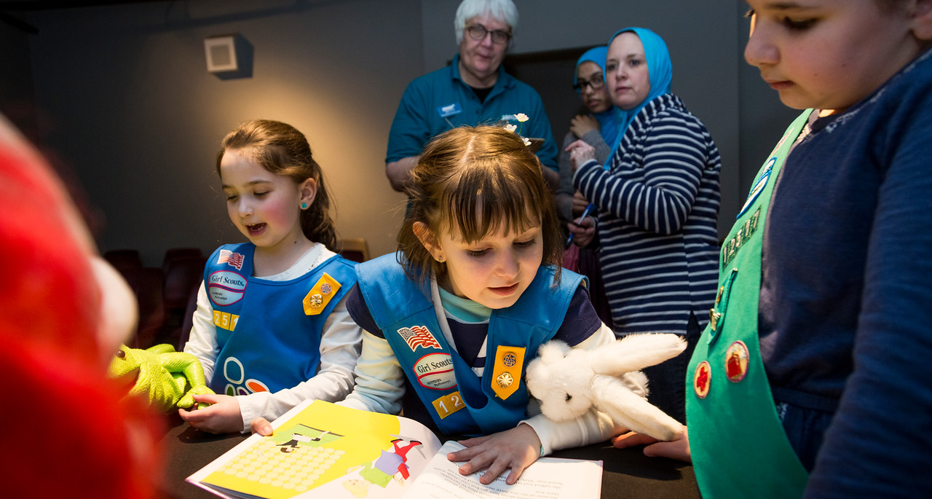
Partners adapt and improve our resources, creating new ideas, learning, and models.

Slide 15
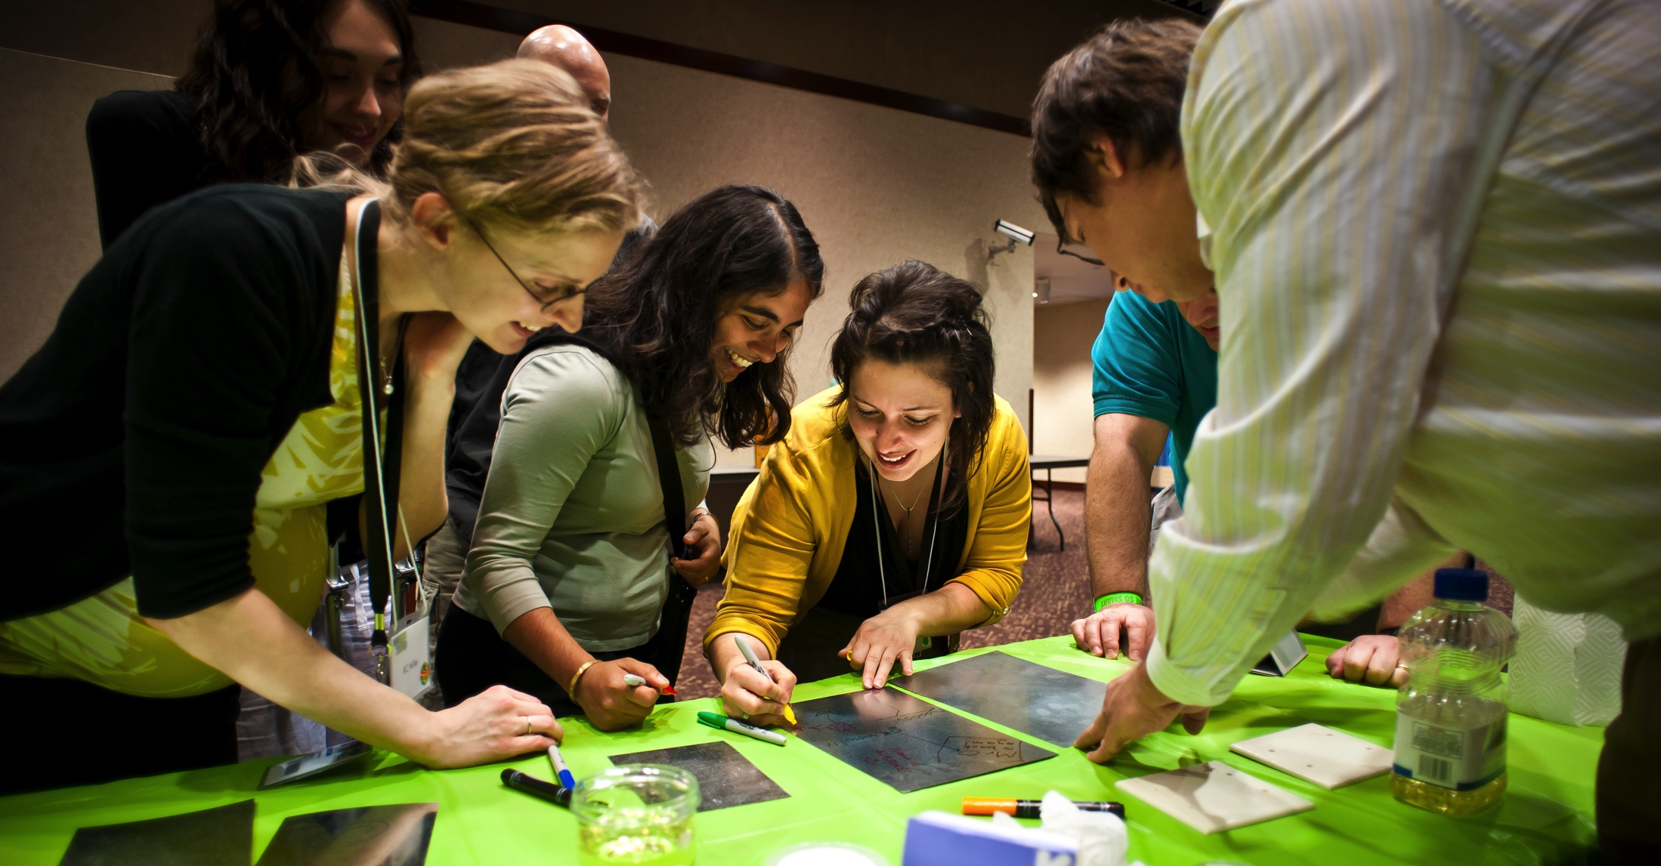
Partners share their innovations across the Network through in-person and online gatherings.

Slide 16
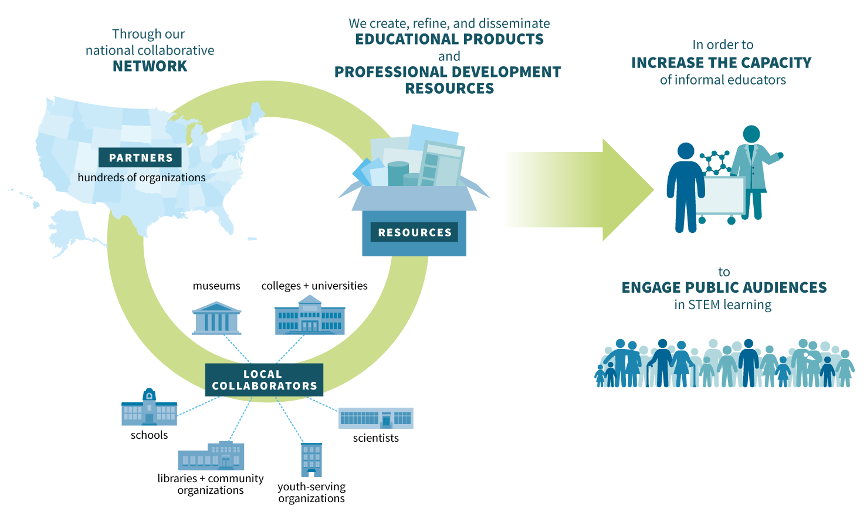
NISE Net advances the field of informal learning and empowers communities across the country.

Slide 17
Professionals from diverse organizations lead the Network.
LEADERSHIP
REGIONAL HUBS
R. Ostman, Arizona State University (Director)
L. Bell, Museum of Science
P. Martin, Arizona State University
M. Benne, Oregon Museum of Science & Industry
I. Bennett, Arizona State University
M. Dahlager, Science Museum of Minnesota
J. Das, The Franklin Institute
E. Kollmann, Museum of Science
M. Kortenaar, Sciencenter
C. McCarthy, Science Museum of Minnesota
K. Ostfeld, Children’s Museum of Houston
C. McCallum, Children’s Museum of Houston
D. Porcello, University of California Berkeley
D. Sittenfeld, Museum of Science
R. Vandiver, Tulsa Children’s Museum
J. Wetmore, Arizona State University
B. Herring, Museum of Life + Science
A. Jackson, Sciencenter
F. Kusiak, University of California Berkeley
C. Leavell, Science Museum of Minnesota
ADVISORS
M. Ballard, Afterschool Alliance
J. Bell, CAISE
L. Huerta Migus, Association of Children’s Museums
K. Peterson, National Girls Collaborative Project

Slide 18
PROJECTS

Slide 19
Space & Earth Informal STEM Education (SEISE)
Creating authentic STEM learning experiences that connect learners to NASA content and experts

Slide 20
Space & Earth Informal STEM Education (SEISE)
250 toolkits with hands-on activities and professional resources
Toolkit applications due on November 1, 2017

Slide 21
Space & Earth
Informal STEM Education (SEISE)
50 small-footprint exhibitions
More information and applications in early 2018

Slide 22
Building with Biology
Bringing researchers and public audiences together to talk about synthetic biology through hands-on activities and public forums

Slide 23
Building with Biology
Public forum on editing the human genome available fall 2018 on nisenet.org

Slide 24
Frankenstein200
Studying transmedia learning that occurs across hands-on activities, immersive digital games, and online challenges

Slide 25
Frankenstein200
Digital kit available at nisenet.org/frankensteinkit
Alternate reality game and more activities January, 2018 at frankenstein200.org
Instructables contest May, 2018 at instructables.com/contest

Slide 26
ChemAttitudes
Investigating design principles and facilitation techniques that support learners’ interest, relevance, and self-efficacy in chemistry

Slide 27
ChemAttitudes
250 kits with hands-on activities and professional resources
Applications due around June 1, 2018

Slide 28
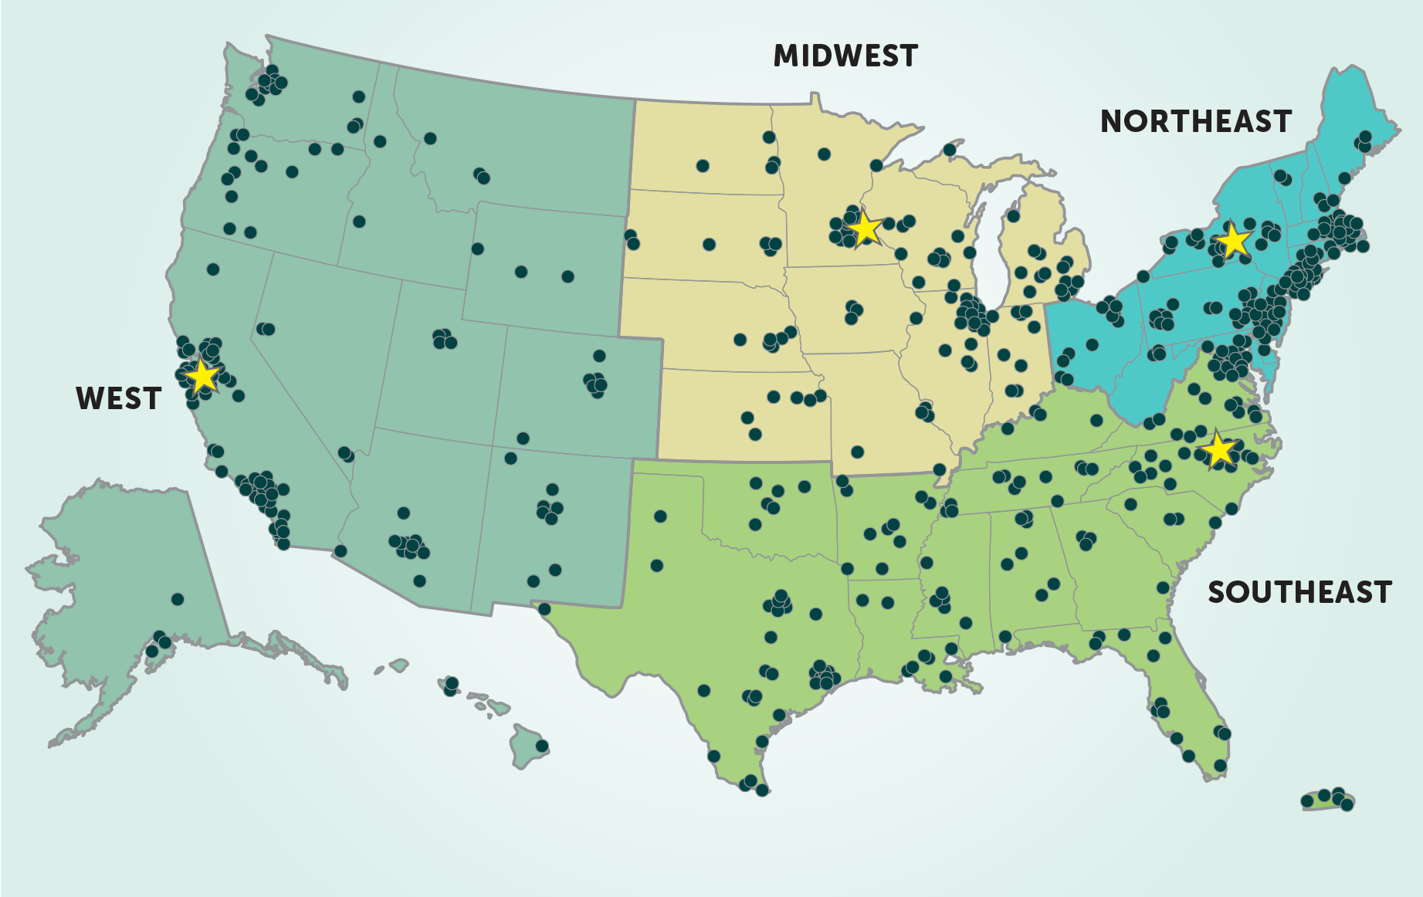
For these and other opportunities, regional hub leaders are your connection to the Network!
nisenet.org/contact

Slide 29
YEAR IN REVIEW

Slide 30
5
active Network projects and dissemination partnerships

Slide 31
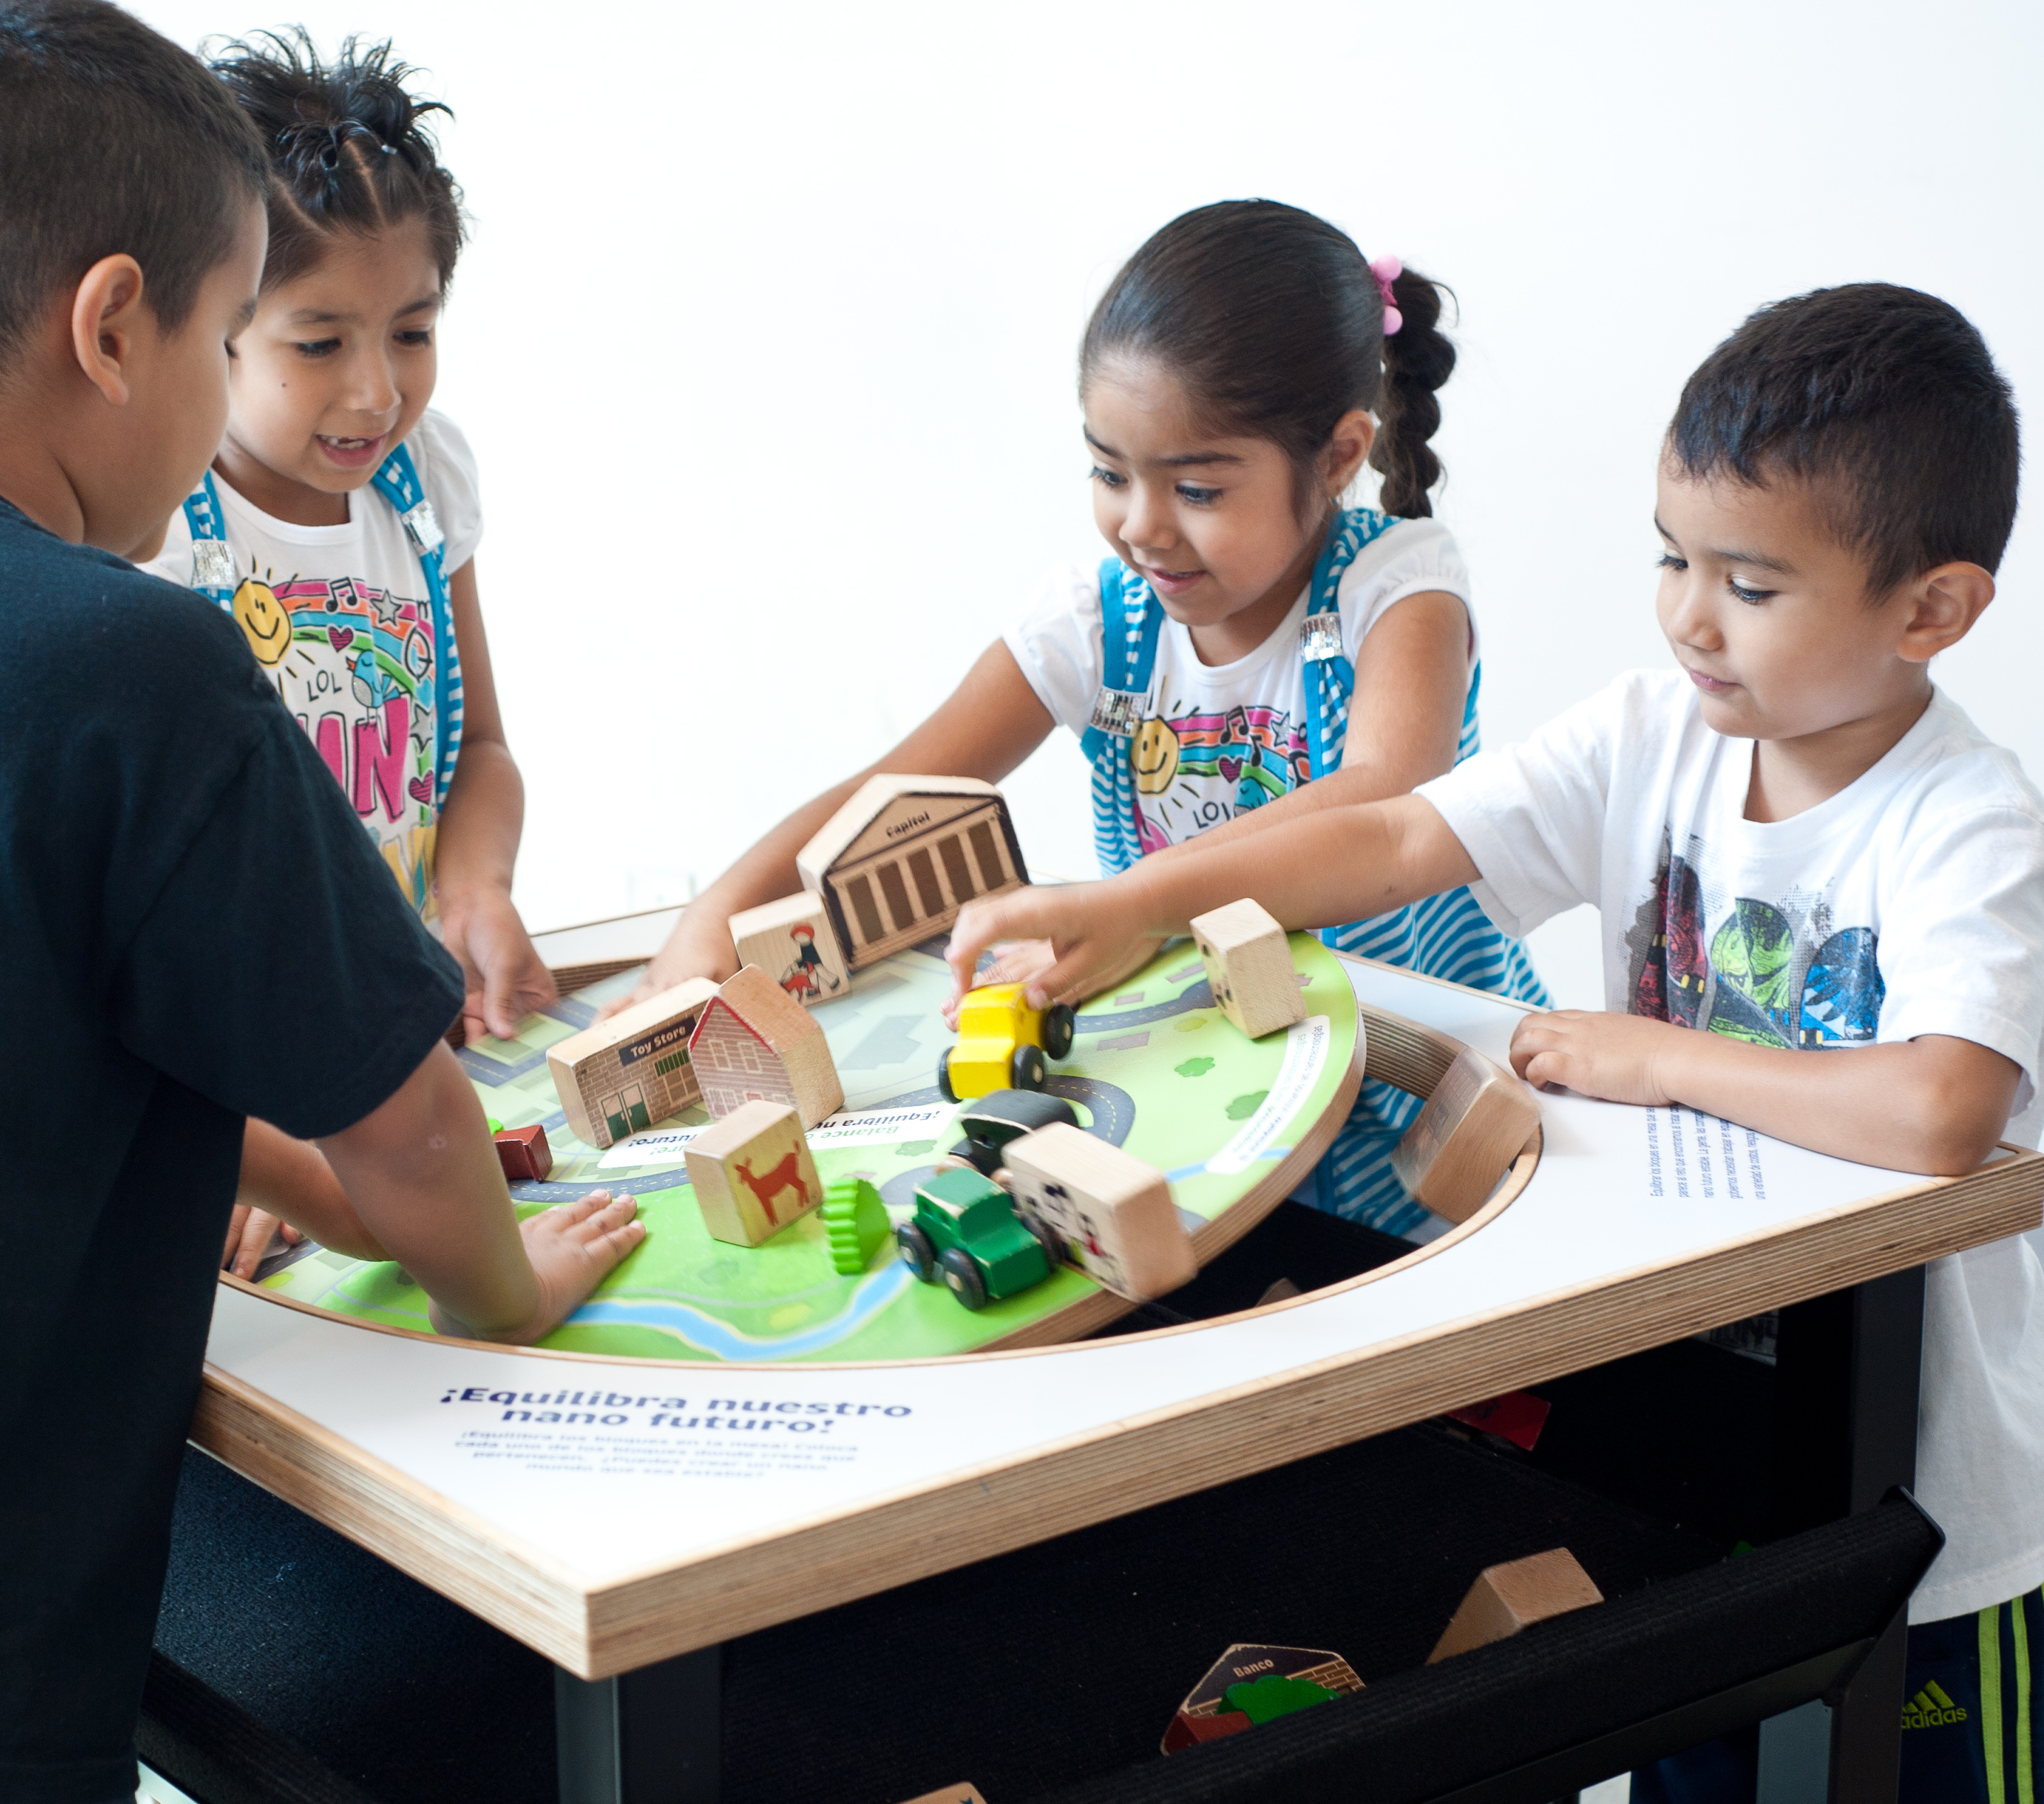
50,000,000+
people reached through the Nano project

Slide 32
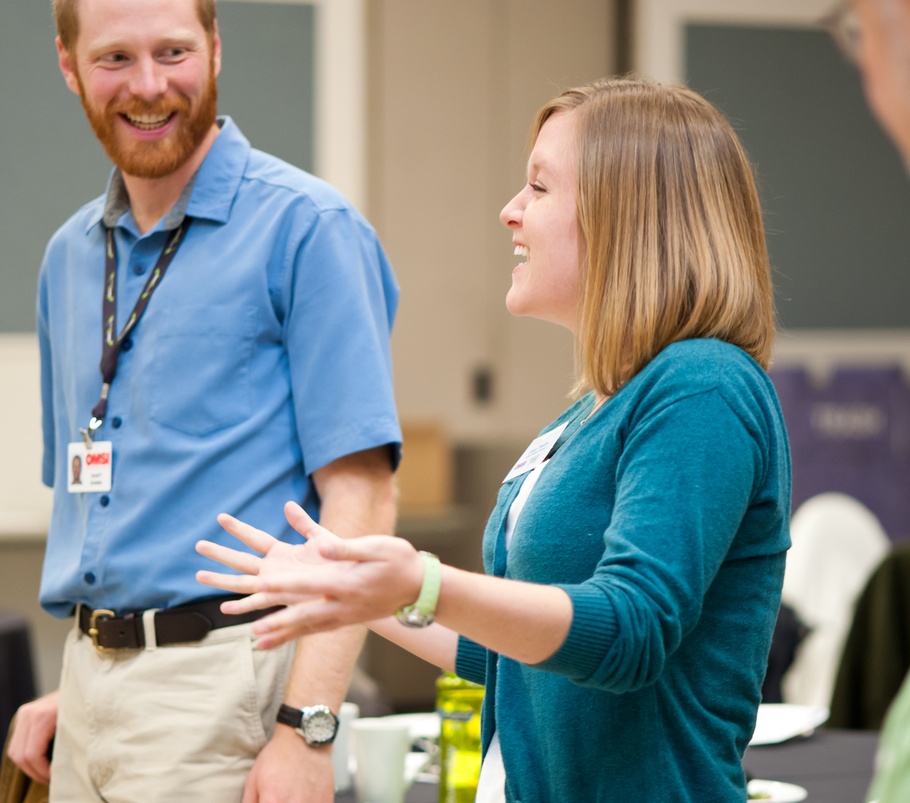
2,700+
professionals participated in the Nano project

Slide 33
350
organizations participated in new Network projects

Slide 34
50
states with active
Network partners

Slide 35
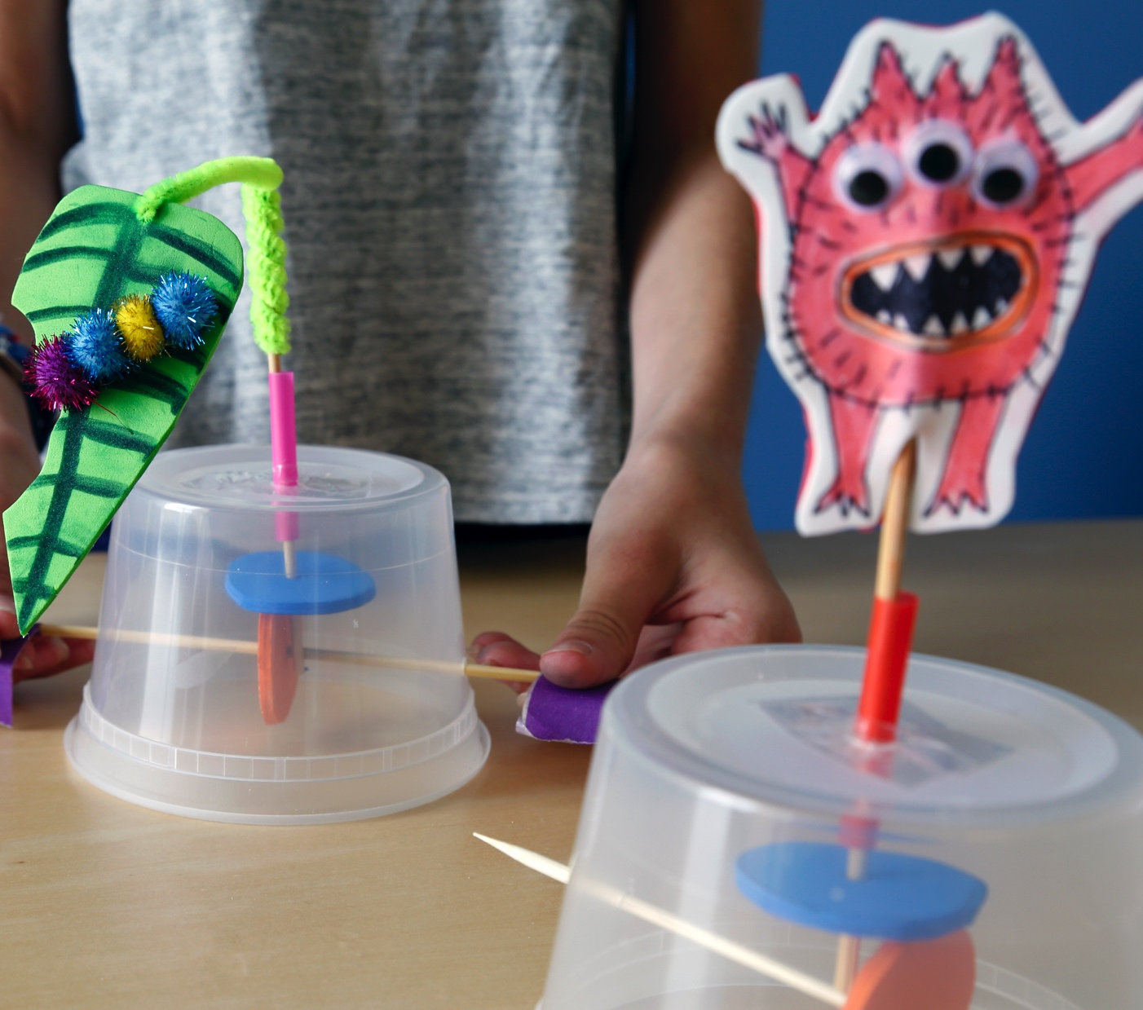
2
new kits produced
containing 16 activities

Slide 36
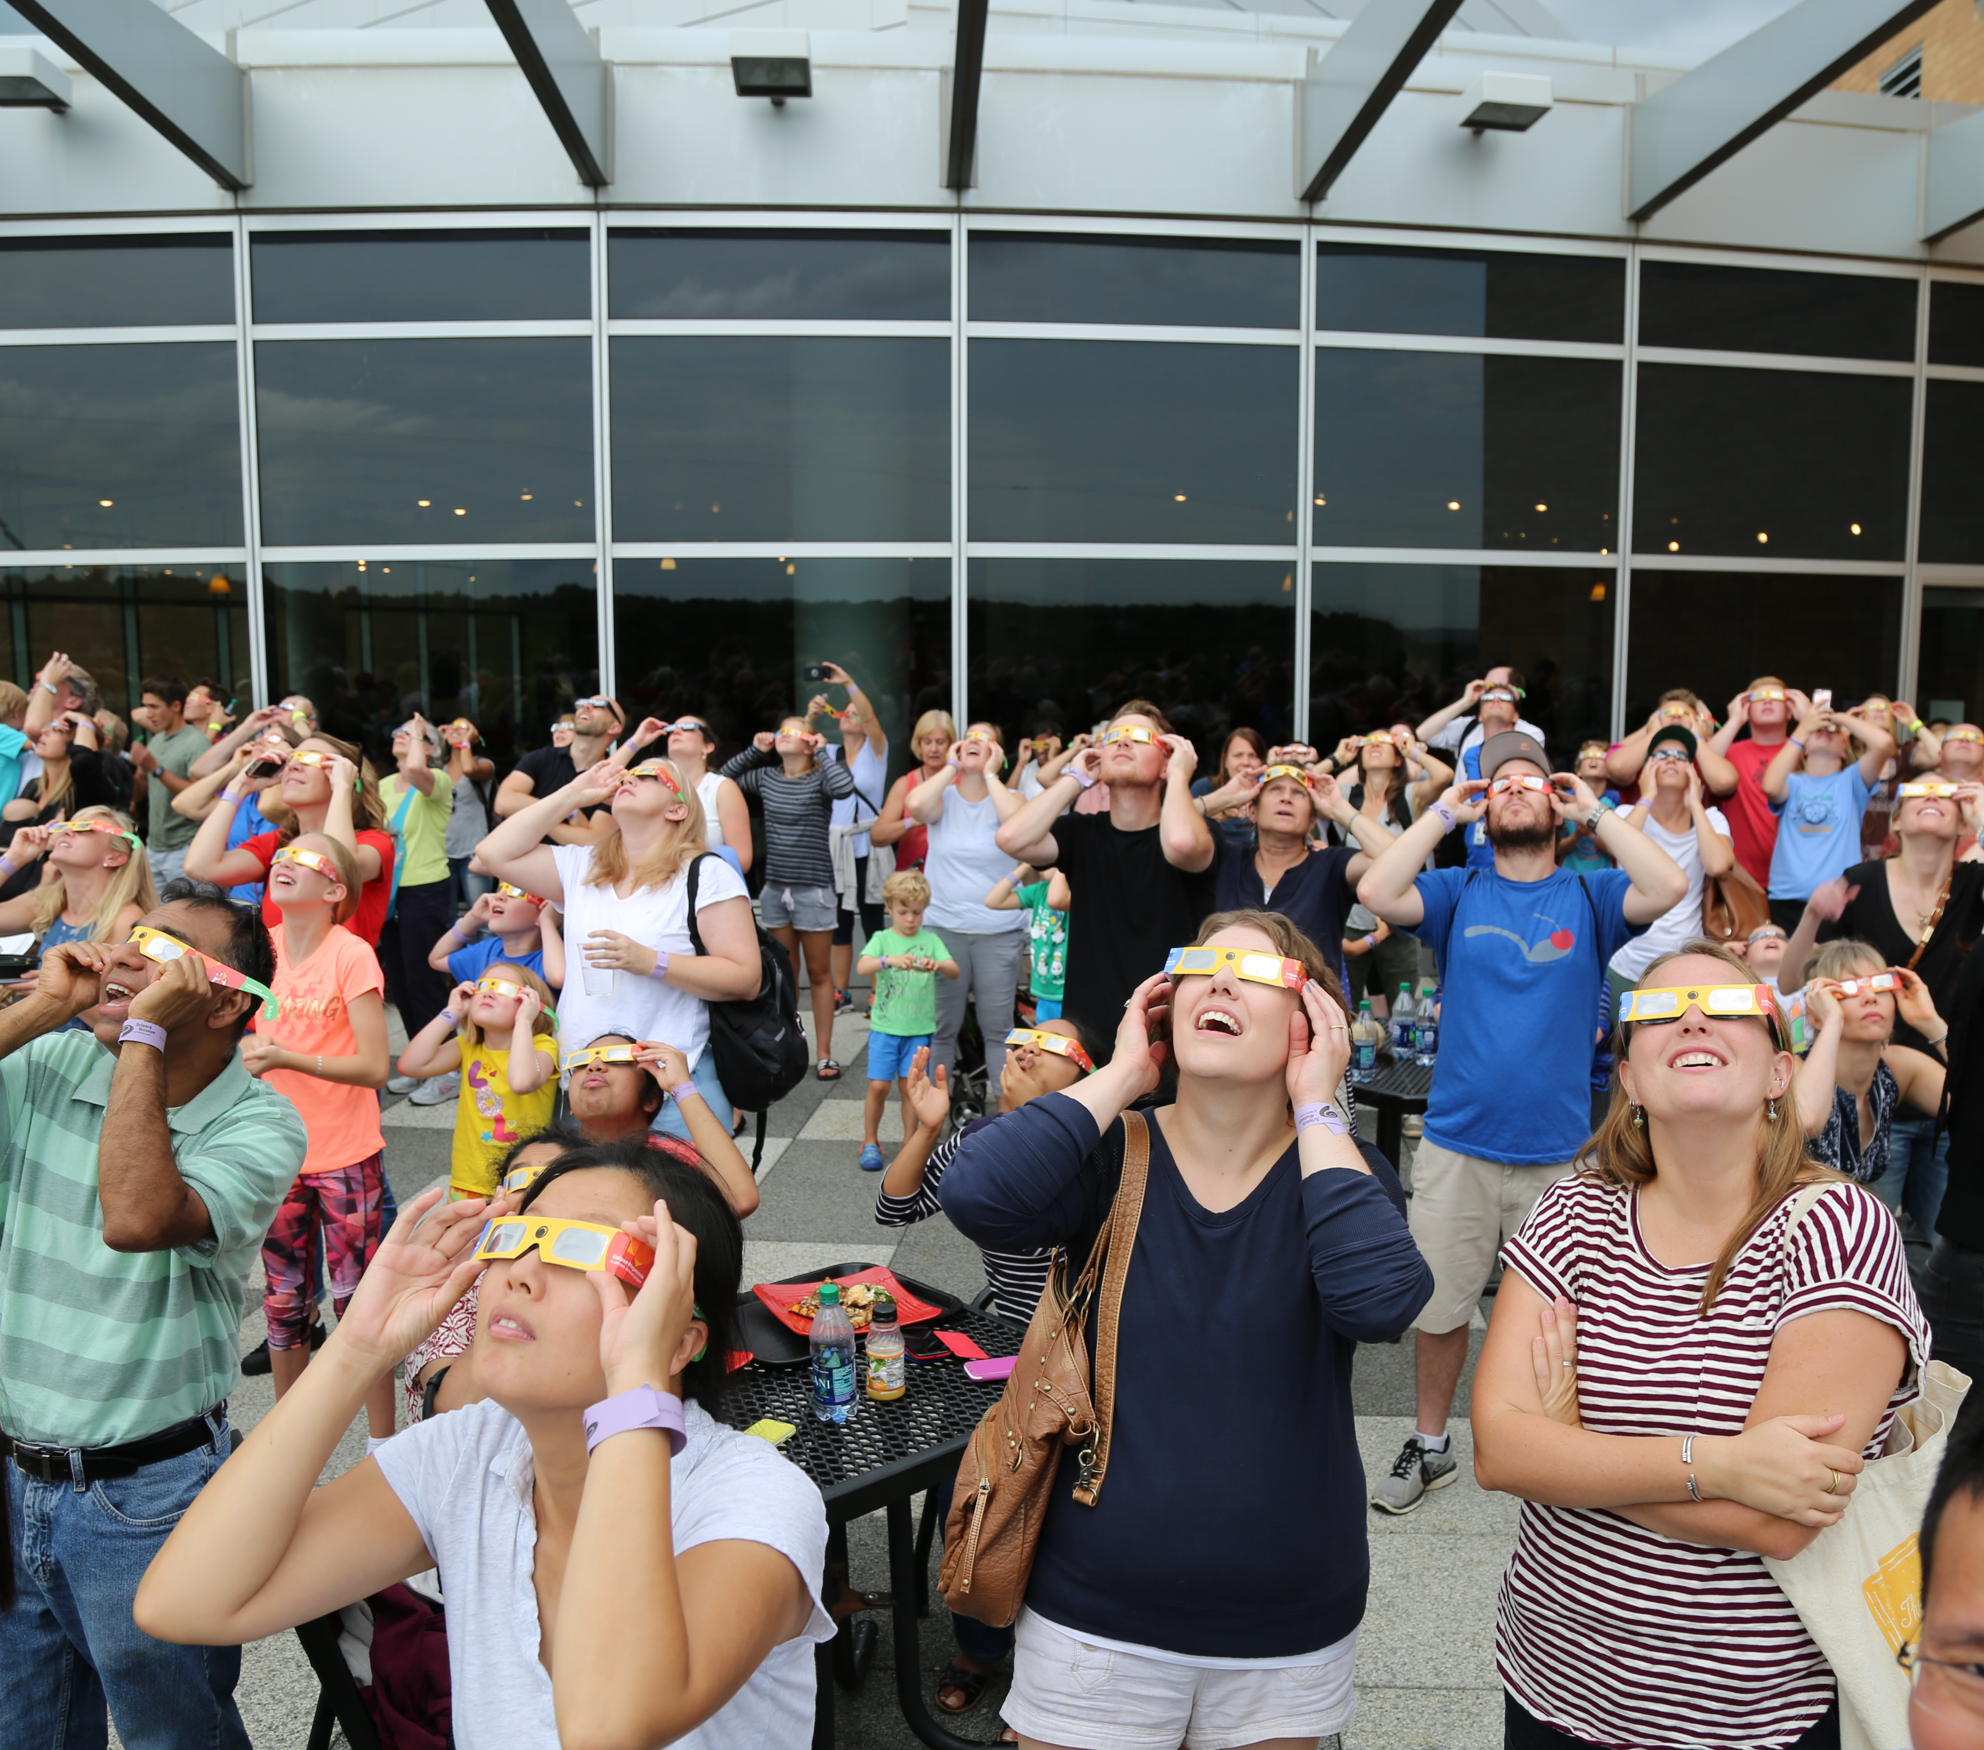
54,602,768
people visited Space & Earth partner organizations

Slide 37
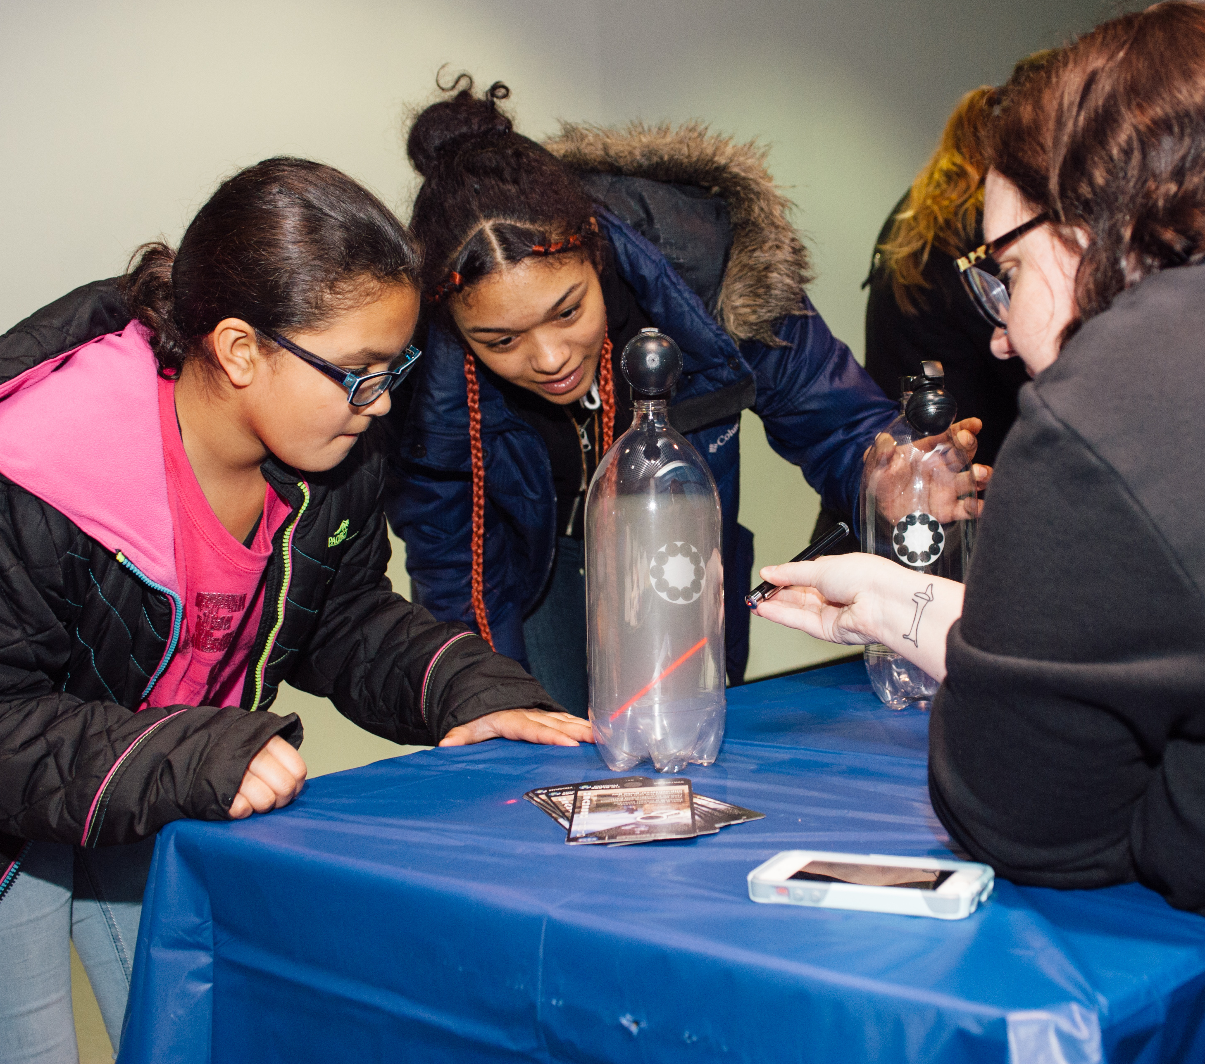
85%
of partners reached underserved audiences through Space & Earth events

Slide 38
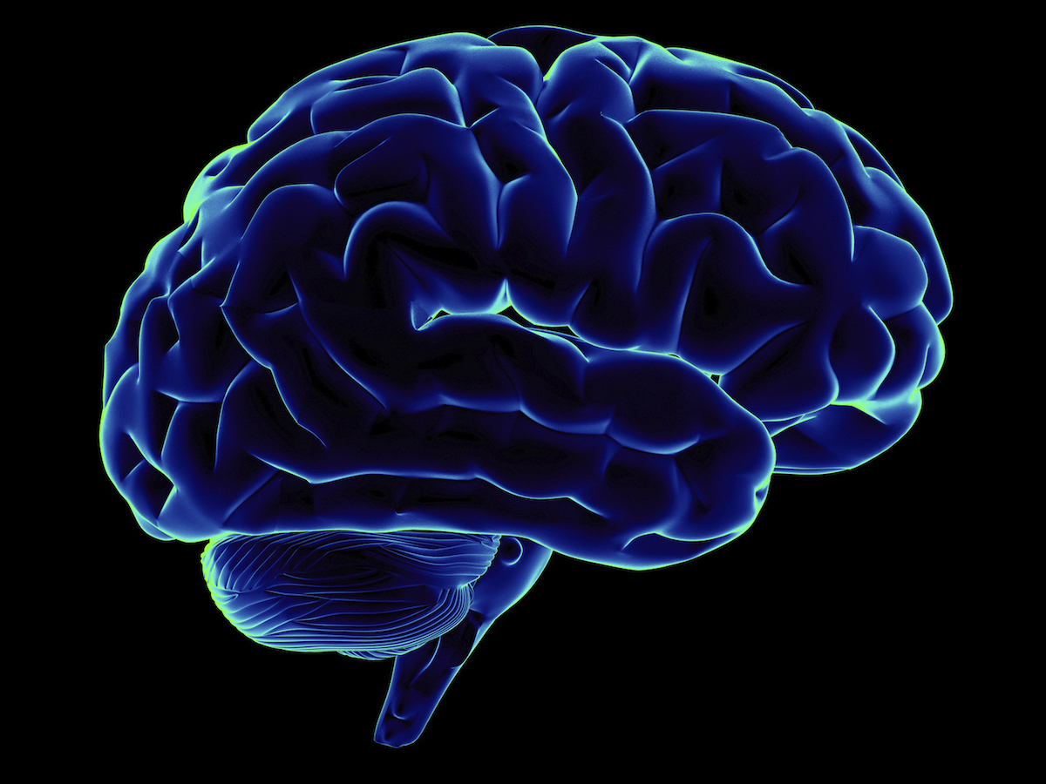
5+
new project ideas
under development

Slide 39
DISCUSSION

Slide 40
Possible
future directions
Brain and neuroscience
Civic engagement
Climate resilience
Engaging rural audiences
What else are you interested in doing through the Network?
Discuss at your table!
Please jot notes on the cards and leave them for us.

Slide 41
Thank you
The Nanoscale Informal Science Education Network is supported by the National Science Foundation under award numbers 0532536 and 0940143. Multi-Site Public Engagement in Science is supported by the National Science Foundation under award number 1421179. Increasing Learning and Efficacy is supported by the National Science Foundation under award number 1516684. ChemAttitudes is supported by the National Science Foundation under award number 1612482. Any opinions, findings, and conclusions or recommendations expressed in this presentation are those of the authors and do not necessarily reflect the views of the Foundation.
Space and Earth Informal STEM Education is supported by NASA under cooperative agreement number NNX16AC67A. Any opinions, findings, and conclusions or recommendations expressed in this material are those of the author(s) and do not necessarily reflect the view of the National Aeronautics and Space Administration (NASA).

