Slide 1
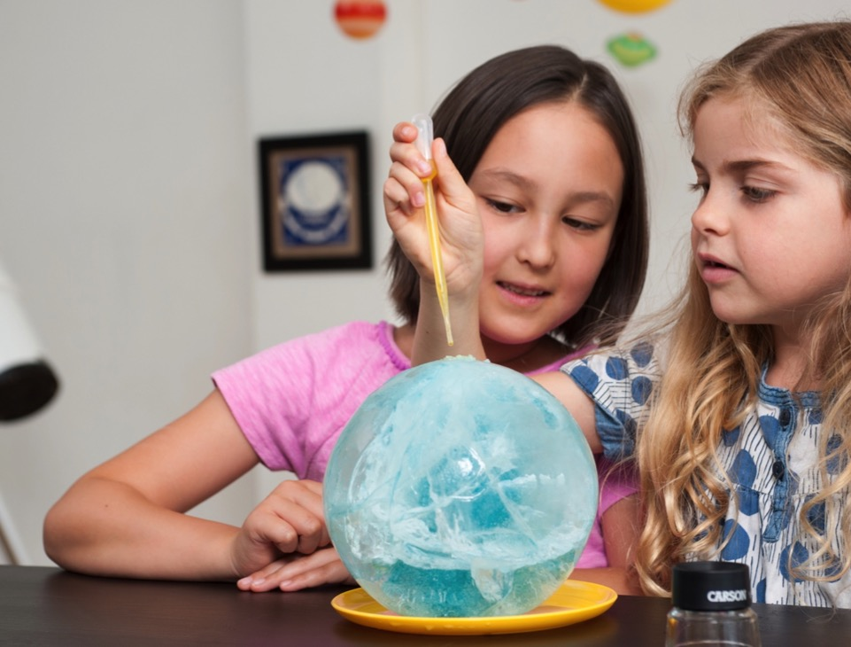
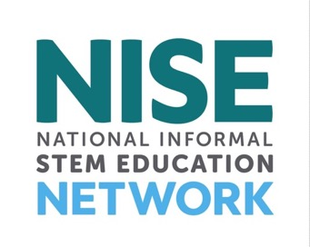
www.nisenet.org
Contents
Overview
Partners
Projects
Products
Impact
nisenet.org

Slide 2
NISE NETWORK

Slide 3

The National Informal STEM Education Network is dedicated to supporting learning about science, technology, engineering, and math (STEM).
NISE Net
includes
informal educators and scientists.

Slide 4
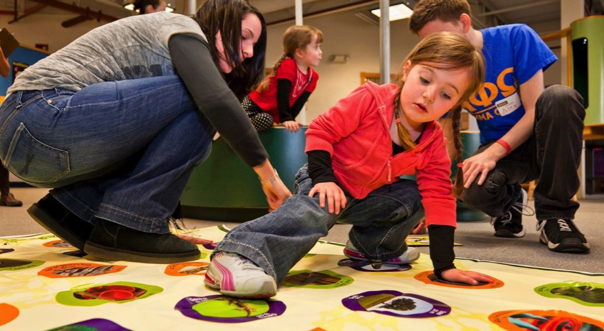
NISE Net supports informal learning about STEM in communities across the United States.
Our activities are
fun and accessible
for everyone.

Slide 5
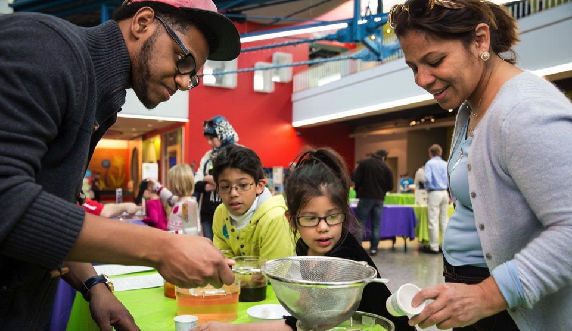
Together we reach millions of people each year!
NISE Net
brings together diverse people to share and learn from each other.

Slide 6
PARTNERS

Slide 7
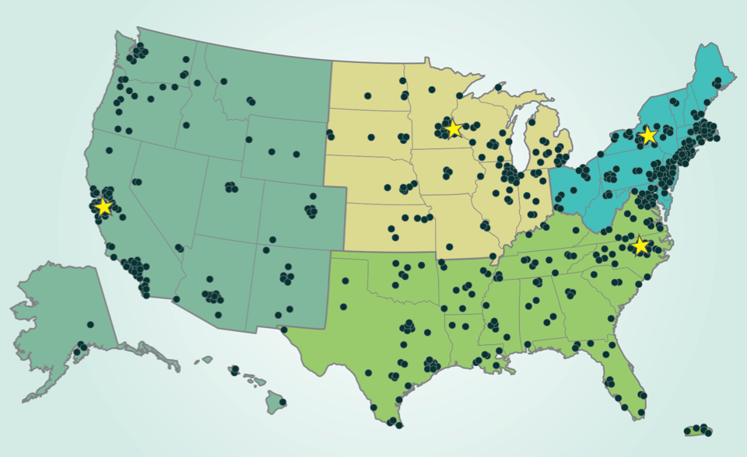
Hundreds of organizations participate in NISE Net.
Network partners
include museums
and universities.
Regional hubs

Slide 8
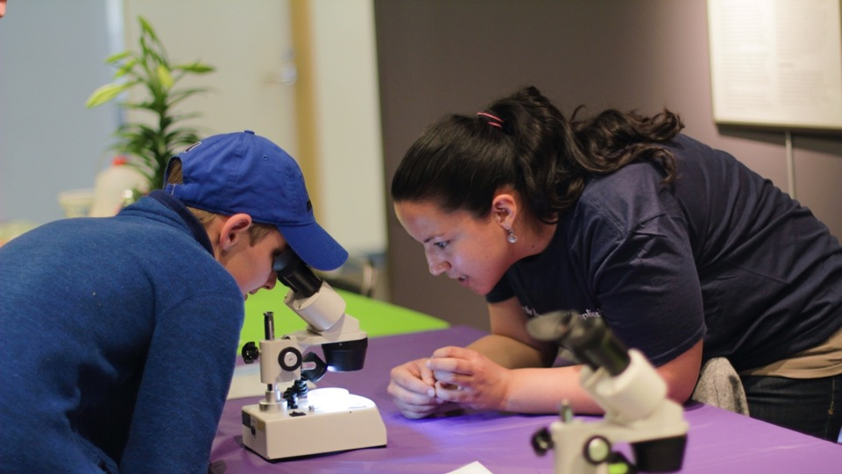
Partner organizations use Network resources to engage audiences in their communities.
Local collaborations
increase our reach
and impact.

Slide 9
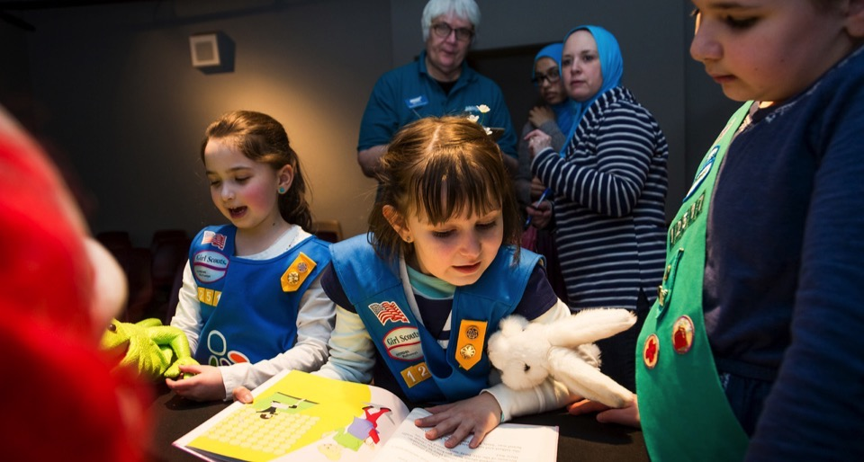
Partners adapt and improve Network resources, creating new ideas, learning, and models.
Innovations
are shared across
the Network.

Slide 10
PROJECTS

Slide 11
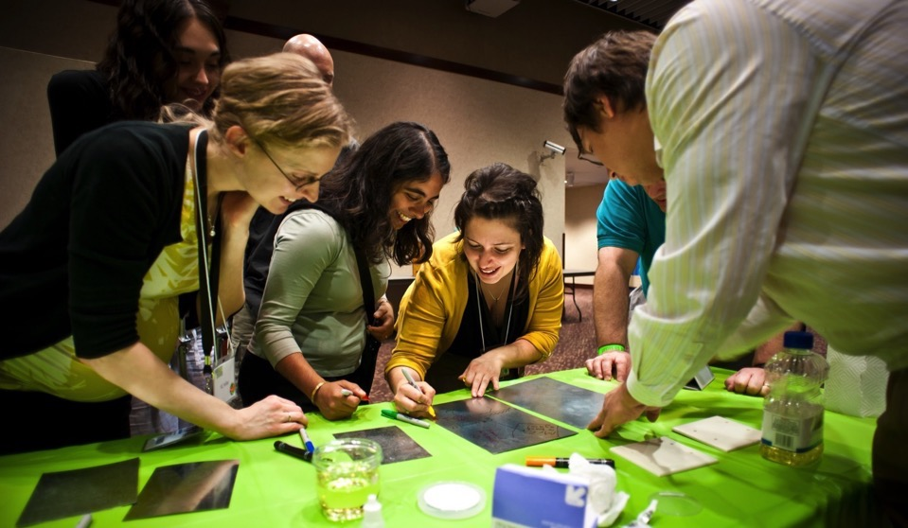
NISE Net projects tackle challenging problems and develop relevant knowledge, tools, and practices.
Our projects
leverage
Network relationships, knowledge, and infrastructure.

Slide 12
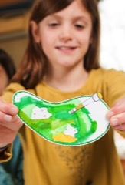
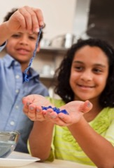
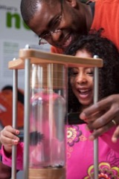
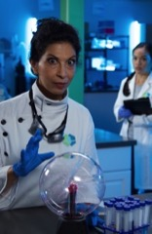

NISE Net has projects in many areas of STEM.
Synthetic biology
2014-2018
Chemistry
2016-2019
2005
2020
Nanotechnology
2005-2017
Frankenstein
2015-2019
Earth & Space
2016-2020

Slide 13
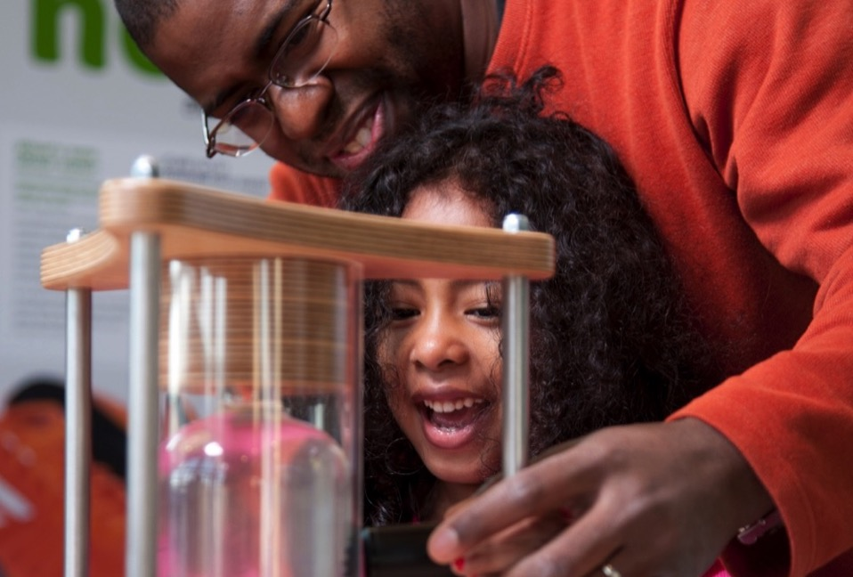
Nanoscale Informal Science Education Network
Building a national Network
to engage audiences
in learning about current STEM research

Slide 14
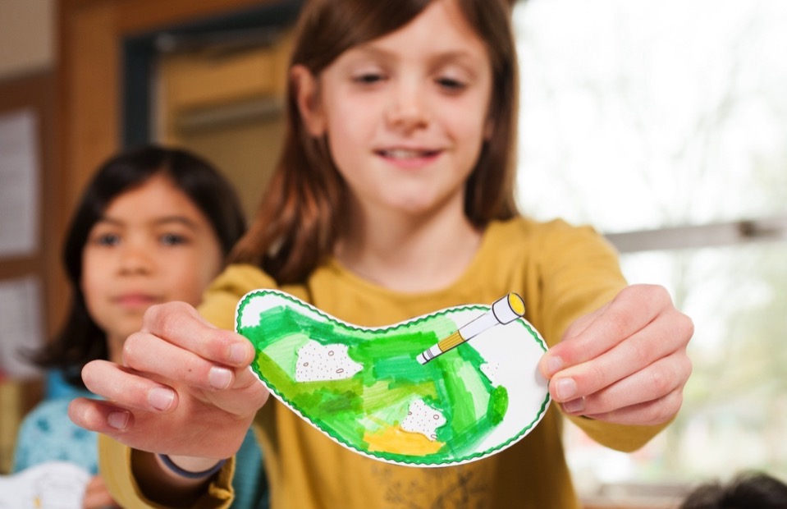
Building with Biology
Creating dialogue
among researchers, educators, and public audiences about STEM and society

Slide 15
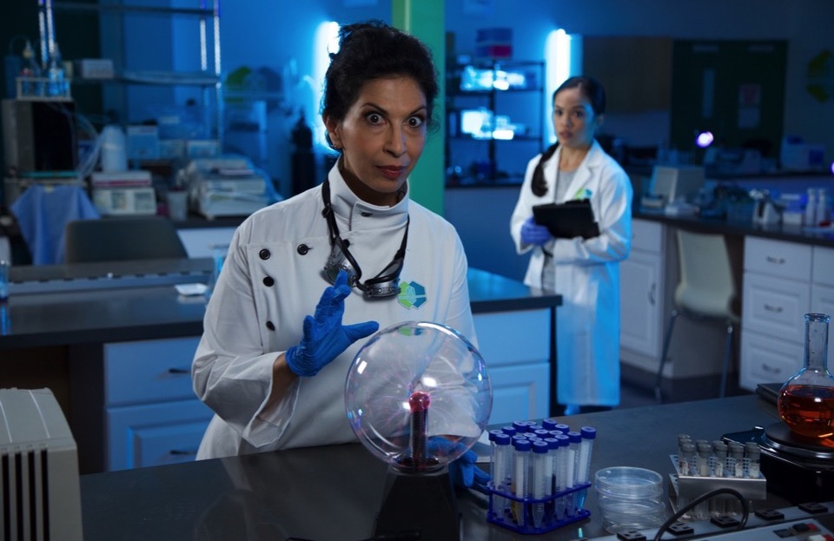
Frankenstein200
Exploring creativity
and responsible innovation in a transmedia environment

Slide 16
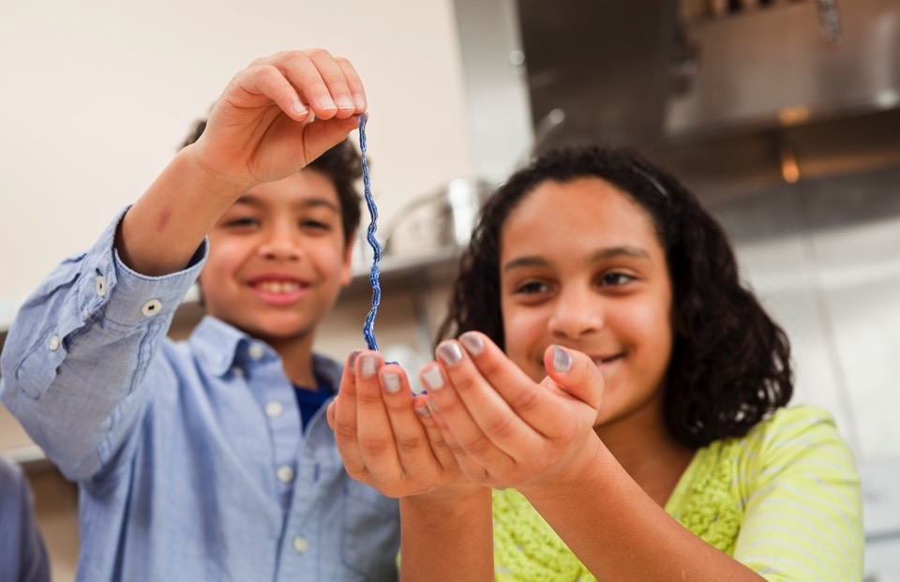
Explore Science: Chemistry
Promoting positive attitudes
toward learning chemistry

Slide 17
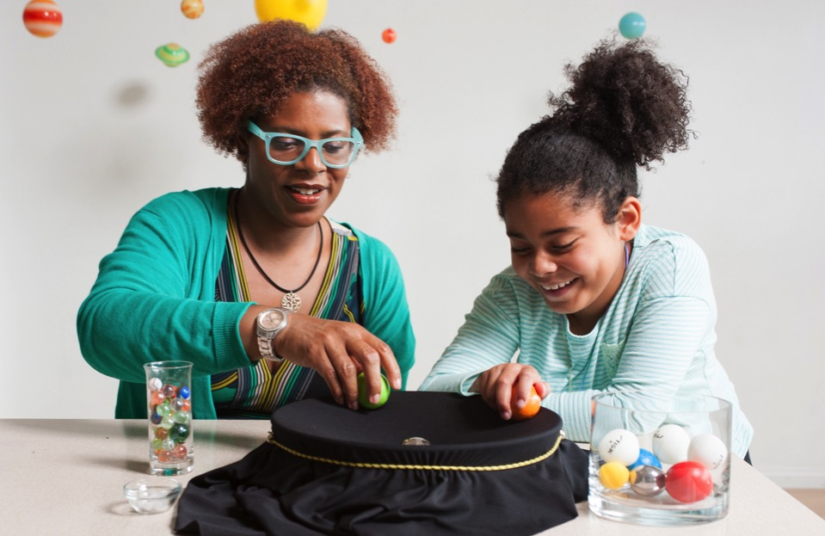
Explore Science: Earth & Space
Connecting learners
to Earth and space
science and experts

Slide 18
PRODUCTS

Slide 19
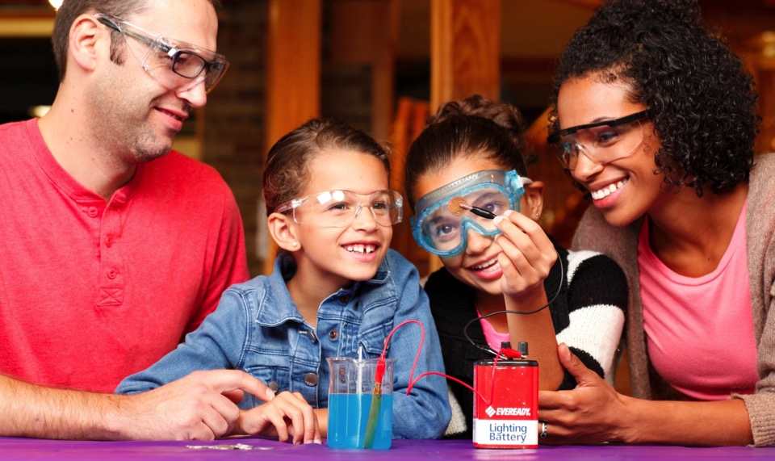
NISE Net creates educational materials for a variety of audiences and settings.
Educational resources
include hands-on activities, public programs, exhibits, and media.

Slide 20
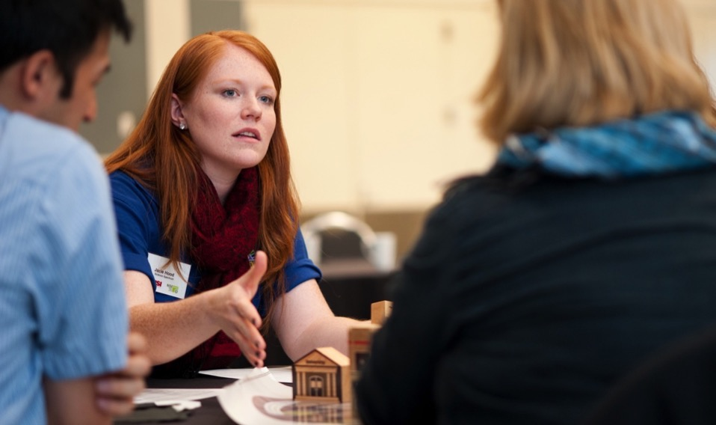
The Network provides professional development for educators and scientists.
Professional resources
include meetings, guides, videos, and online workshops.

Slide 21
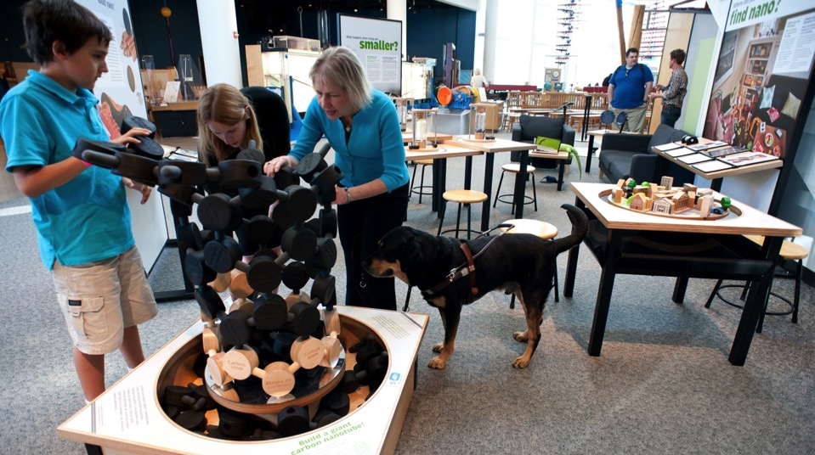
Our development process takes advantage of the deep expertise of our Network and project partners.
Iterative testing
involves educators, scientists, evaluators, partner organizations, and target audiences.

Slide 22
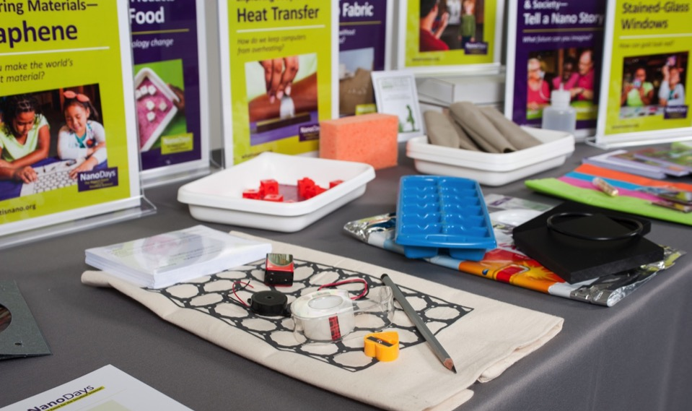
Network resources are open source and freely available to use and adapt.
nisenet.org
provides access to our online digital library, monthly newsletter, and social networking.

Slide 23
IMPACT

Slide 24
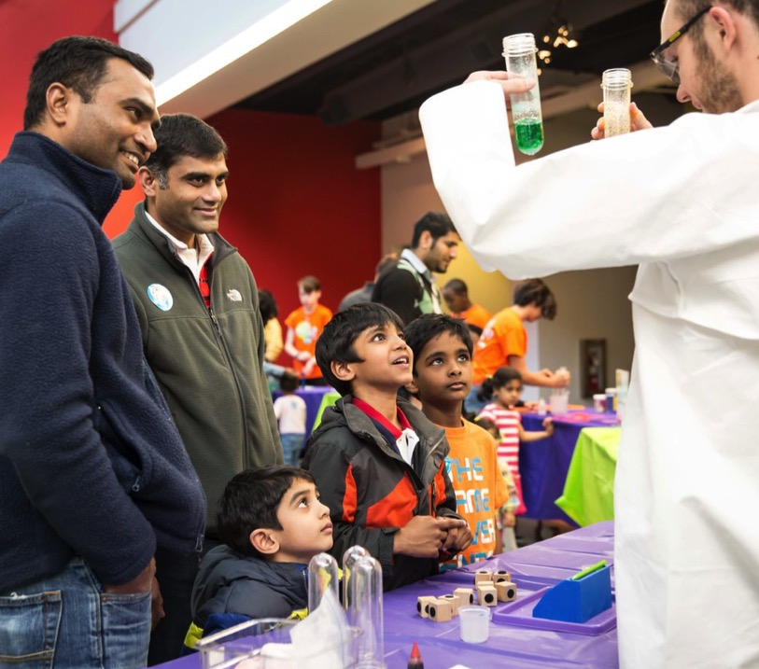
50,000,000+
people have been reached through Network projects

Slide 25
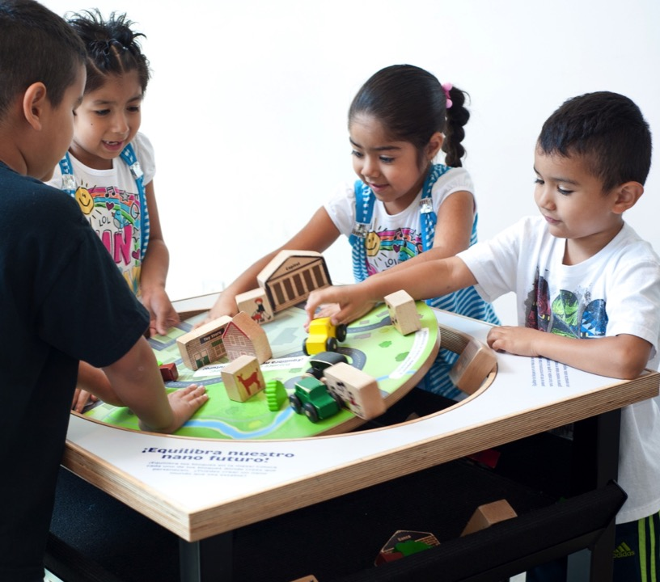
95%
of visitors reported high levels of enjoyment at the Nano mini-exhibition

Slide 26
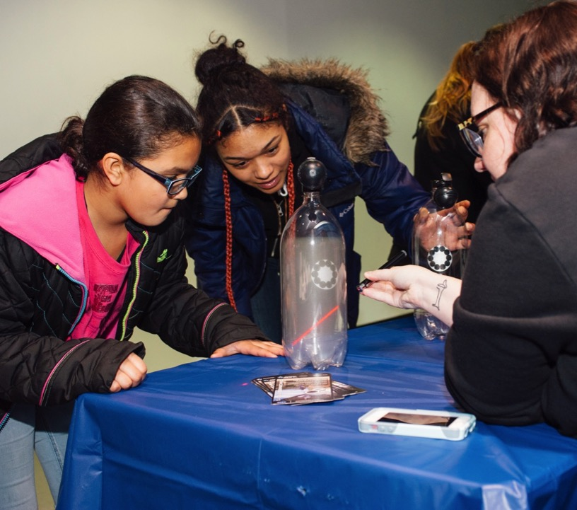
85%
of Network partners reached underserved audiences through Space & Earth events

Slide 27
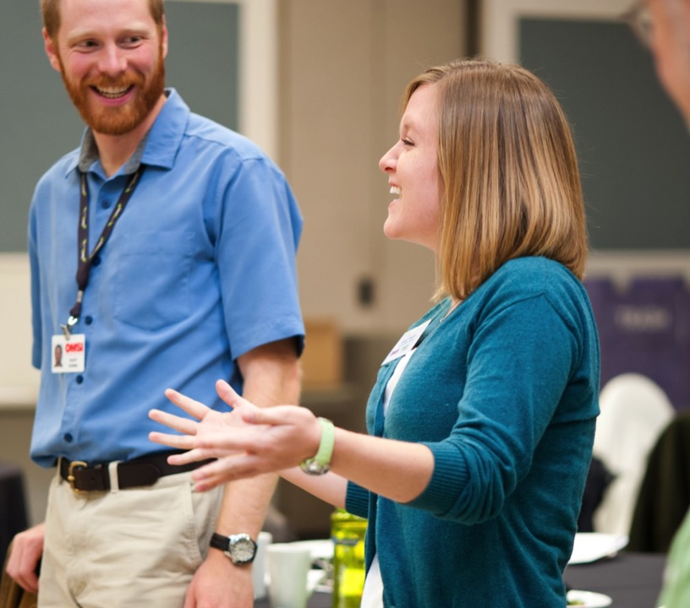
2,700+
professionals have participated in Network projects

Slide 28

97%
of professionals applied things they learned from the Nano project
to other work

Slide 29
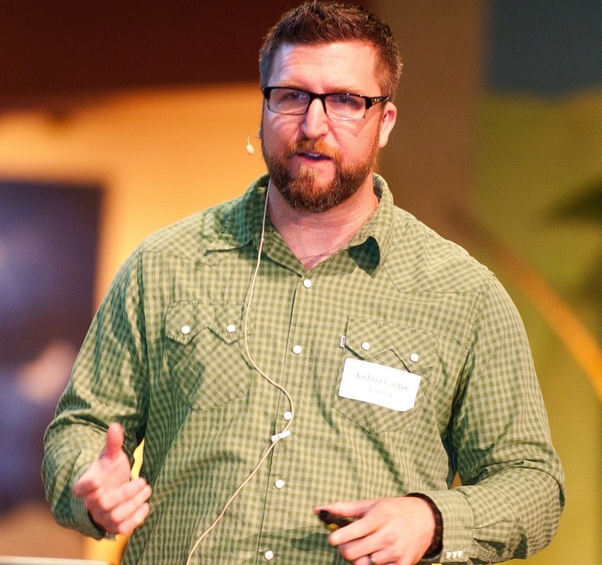
92%
of scientists increased their public engagement skills by participating in
Building with Biology

Slide 30
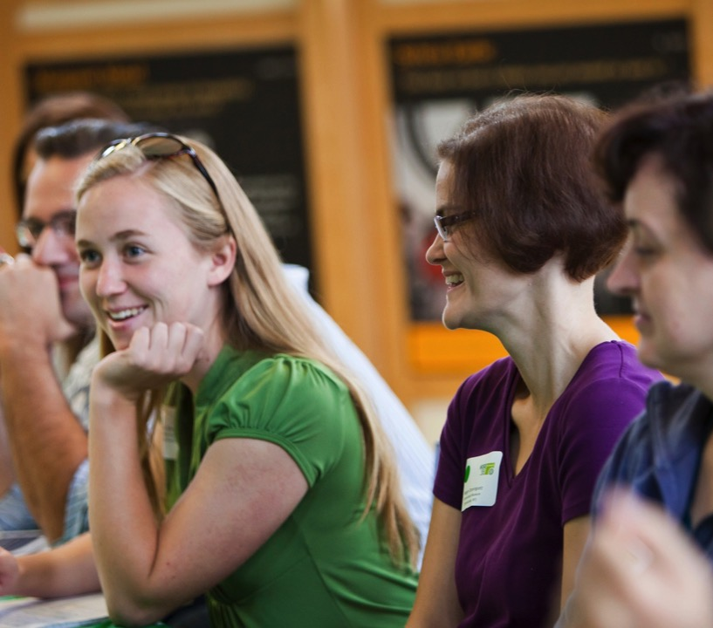
600+
organizations have participated in Network projects

Slide 31
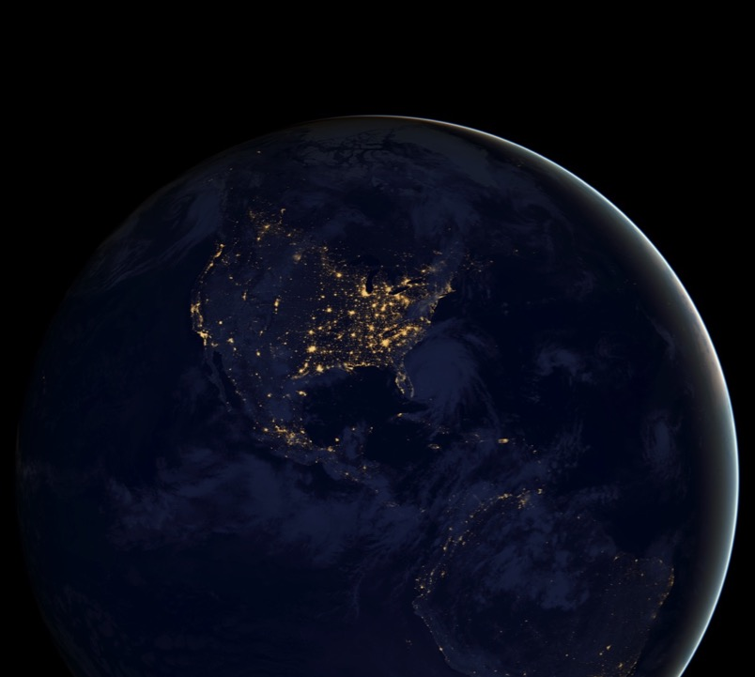
50
states have active
Network partners

Slide 32
THANK YOU

Slide 33

Leadership
Arizona State University
Children’s Creativity Museum
Children’s Museum of Houston
Museum of Life and Science
Museum of Science
Oregon Museum of Science & Industry
Science Museum of Minnesota
Sciencenter
The Franklin Institute
Tulsa Children’s Museum
University of California Berkeley
Advisors
Afterschool Alliance
Association of Children’s Museums
Center for the Advancement of Informal STEM Learning, Association of Science-Technology centers
National Girls Collaborative Project

Slide 34


Acknowledgements
The Nanoscale Informal Science Education Network was supported by the National Science Foundation under award numbers 0532536 and 0940143. Multi-Site Public Engagement in Science is supported by the National Science Foundation under award number 1421179. Increasing Learning and Efficacy is supported by the National Science Foundation under award number 1516684. ChemAttitudes is supported by the National Science Foundation under award number 1612482. Any opinions, findings, and conclusions or recommendations expressed in this presentation are those of the authors and do not necessarily reflect the views of the Foundation.
Space and Earth Informal STEM Education is supported by NASA under cooperative agreement number NNX16AC67A. Any opinions, findings, and conclusions or recommendations expressed in this material are those of the author(s) and do not necessarily reflect the view of the National Aeronautics and Space Administration (NASA).
Image credits
Slides 1, 3, 7, 11, 14, 17, 20, 21, 22, 25, 26, 27, 28: Emily Maletz for the NISE Network
Slides 4, 9, 16, 19, 30: Gary Hodges for the NISE Network
Slides 5, 24: Tierney Ferrell for the NISE Network
Slide 8: Brad Herring for the NISE Network
Slide 13: Ken Stanek for the NISE Network
Slide 15: Rose Abdoo as Tori Frankenstein in Frankenstein200. Arizona State University/No Mimes Media.
Slide 29: Ashley McCabe for the NISE Network
Slide 31: NASA Earth Observatory images by Joshua Stevens, using Suomi NPP VIIRS data from Miguel Román, NASA's Goddard Space Flight Center

