Slide 1
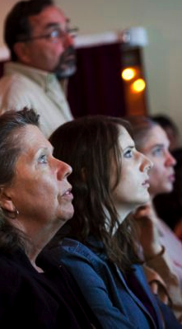
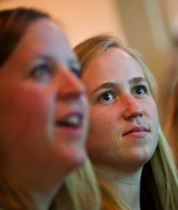
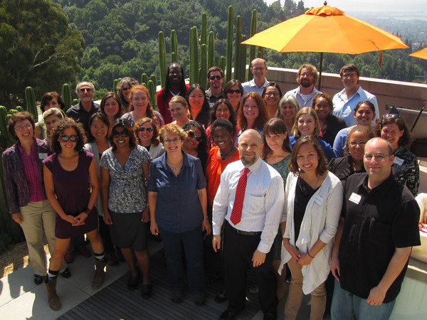
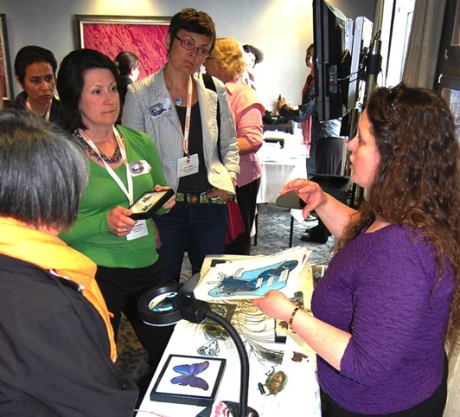
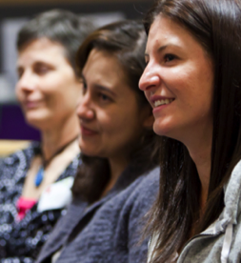
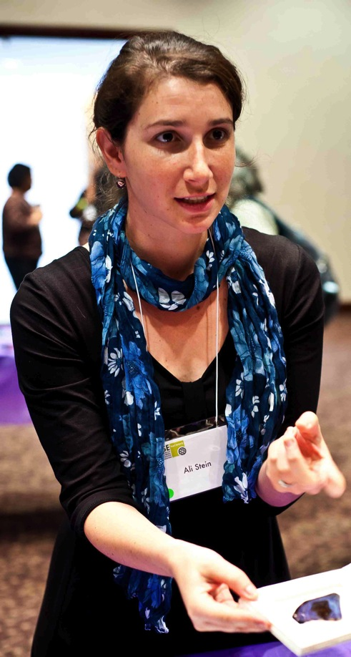
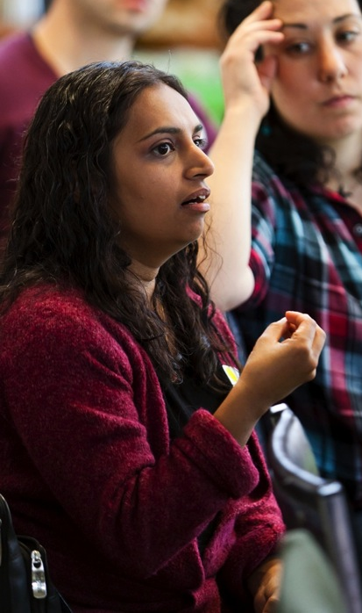
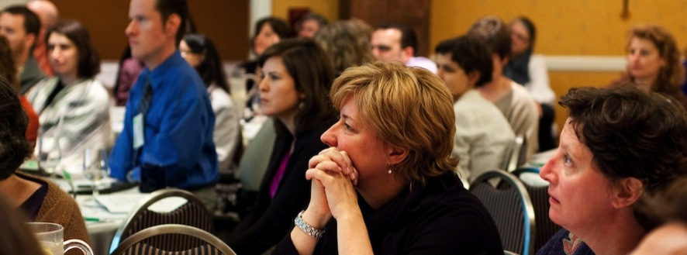
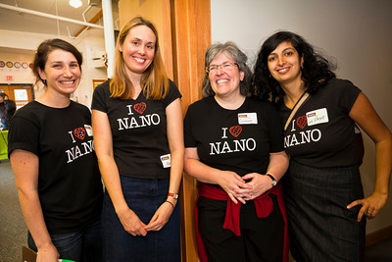
Welcome
NISE Network Partners !
Network-Wide Meeting, Boston, 2012
Notes:
The Network includes all of YOU!
Here are about 50 people - out of 2600 in our QuickBase files
1300 have profiles on nisenet.org, and 1000 subscribe to the NanoBite newsletter

Slide 2
Anchorage Kenai Jonesboro Little Rock Little Rock Phoenix Tempe Tucson Berkeley Los Angeles Menlo Park Modesto Oakland Pomona Redding San Diego San Francisco San Jose San Luis Obispo Santa Barbara Sausalito Stanford Durango Fort Collins Lafayette New Haven Norwalk Washington Dover Wilmington Fort Myers Miami West Palm Beach Atlanta Hilo Des Moines Boise Champaign Chicago Normal Rockford Fort Wayne Indianapolis West Lafayette Wichita Louisville Baton Rouge Acton Boston Brookline Cambridge Lowell Baltimore Bethesda College Bangor Portland Ann Arbor Traverse City Bemidji Duluth Minneapolis St. Paul Malden St. Louis Jackson Bozeman Missoula Charlotte Durham Raleigh Winston-Salem Bismarck Fargo Lincoln Omaha Jersey City Newark Princeton Albuquerque Las Cruces Los Alamos Las Vegas Reno Buffalo Corona Elmira Garden City Ithaca New York Oneonta Port Jefferson Queens Rochester Schenectady Syracuse Troy Upton Cincinnati Columbus Dayton Enid Stillwater Ashland Eugene Portland Allentown Philadelphia Pittsburgh University Park Humacao Chattanooga Memphis Austin Fort Worth Houston Laredo Lubbock Tyler Salt Lake City Alexandria Arlington Danville Bellevue Mukilteo Pullman Seattle Beloit Madison Morgantown Casper

Slide 3
Evolution of the NISE Net

Slide 4
Nanoscale Informal Science Education Network
10/2005 -
2006 -
2007 -
2008 -
2009 -
2010 -
2011 -
2012 -
2013 -
2014 -
10/2015 -

Slide 5
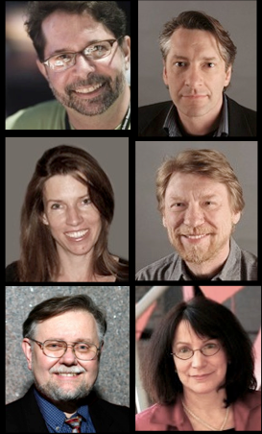
Nanoscale Informal Science Education Network
3
10/2005 -
2006 -
2007 -
2008 -
2009 -
2010 -
2011 -
2012 -
2013 -
2014 -
10/2015 -

Slide 6
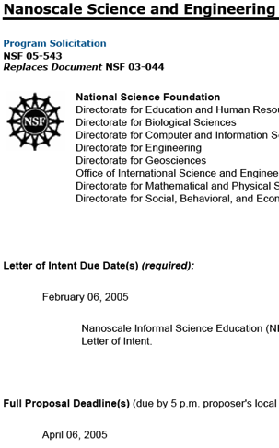
foster public awareness, engagement, and understanding of nanoscale science, engineering, and technology
Create a network to build capacity in the field
Develop and disseminate educational deliverables of all kinds
Stimulate educational research & evaluation

Slide 7
Nanoscale Informal Science Education Network
3
10/2005 -
2006 -
2007 -
2008 -
2009 -
2010 -
2011 -
2012 -
2013 -
2014 -
10/2015 -

Slide 8
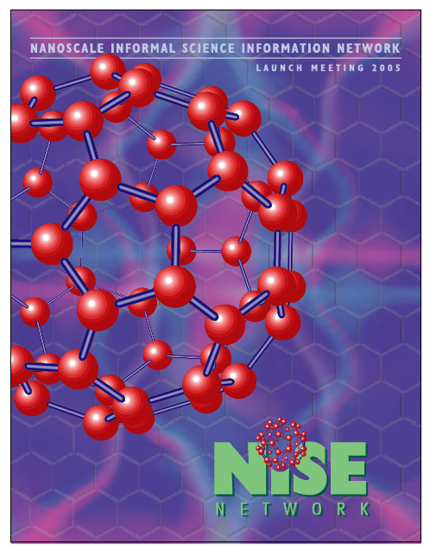
Nanoscale Informal Science Education Network
3
10/2005 -
2006 -
2007 -
2008 -
2009 -
2010 -
2011 -
2012 -
2013 -
2014 -
10/2015 -

Slide 9
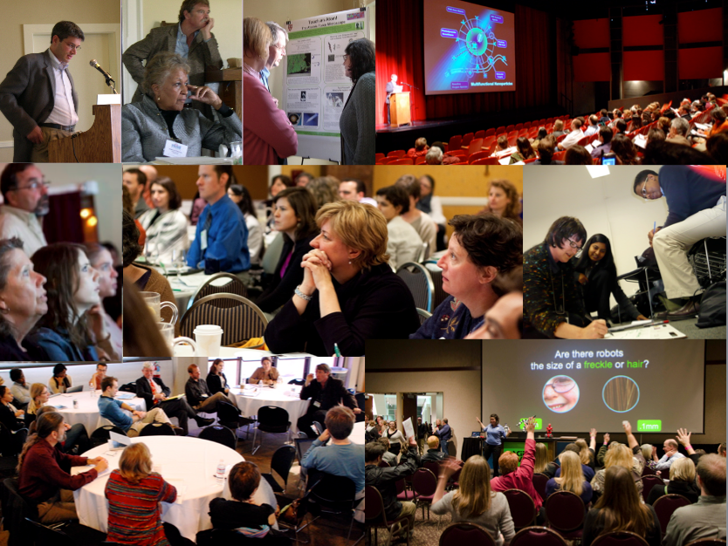
Create a common sense of purpose
Develop shared understanding
Build connections with other professionals
Next Year: Regional Meetings
Year 10: Network Wide Meeting

Slide 10
Nanoscale Informal Science Education Network
3
3
10
10/2005 -
2006 -
2007 -
2008 -
2009 -
2010 -
2011 -
2012 -
2013 -
2014 -
10/2015 -

Slide 11
Nanoscale Informal Science Education Network
3
10
10/2005 -
2006 -
2007 -
2008 -
2009 -
2010 -
2011 -
2012 -
2013 -
2014 -
10/2015 -

Slide 12
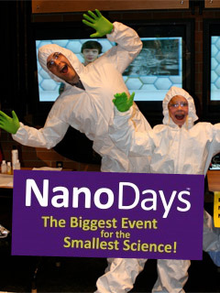
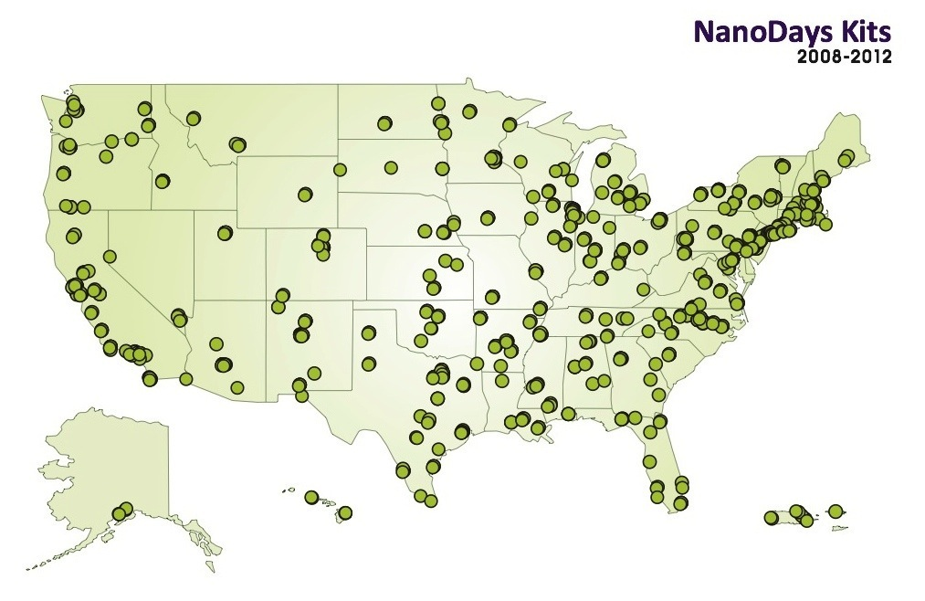
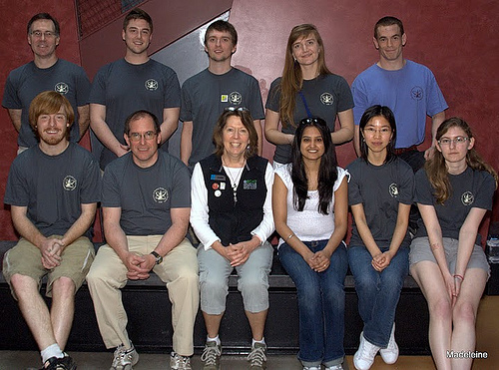
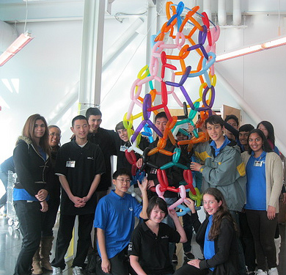
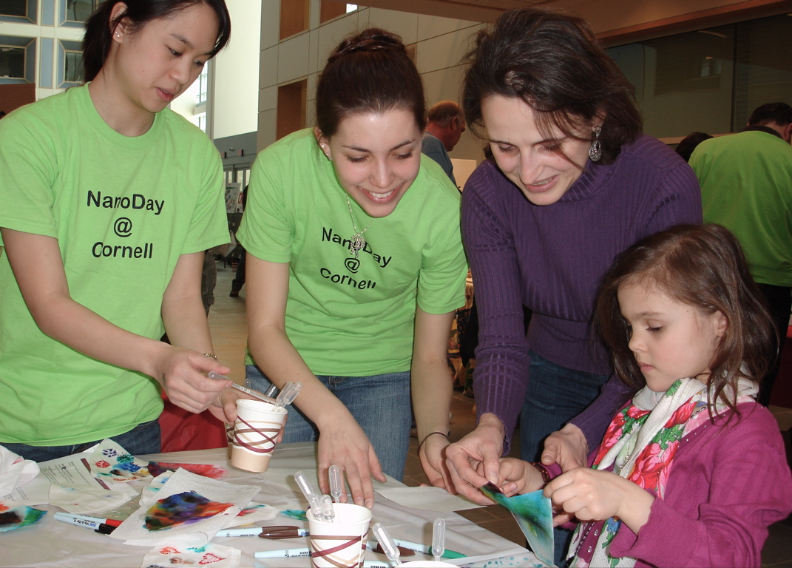
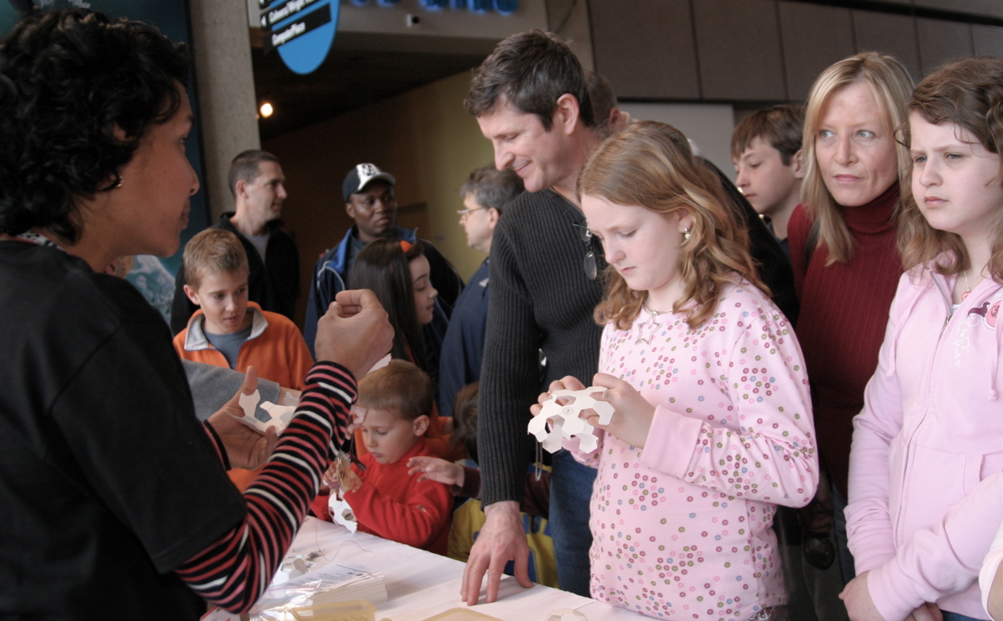
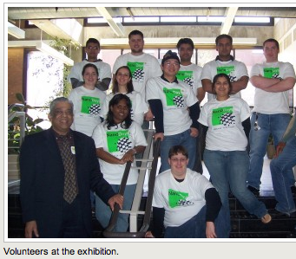
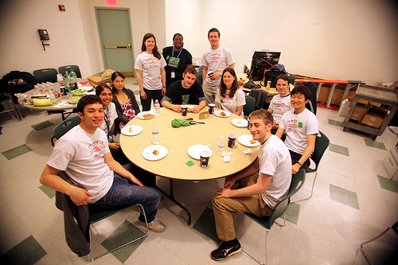
March 30- April 7, 2013 (321 applications for kits)
Makes nano content seem doable

Slide 13
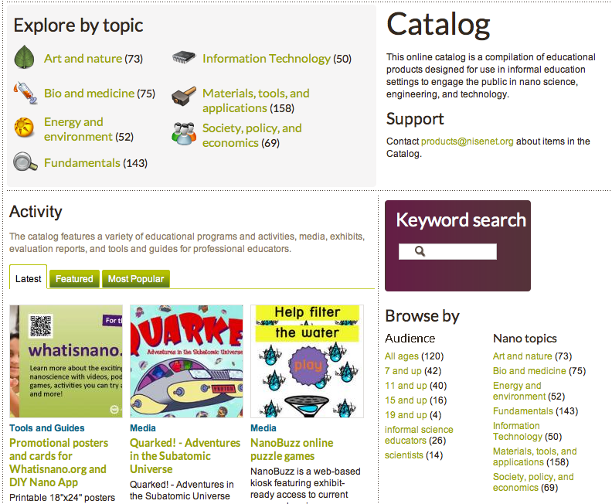
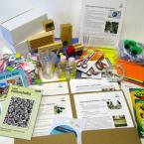
280 entries and 118 evaluation reports

Slide 14
Nanoscale Informal Science Education Network
3
10
10/2005 -
2006 -
2007 -
2008 -
2009 -
2010 -
2011 -
2012 -
2013 -
2014 -
10/2015 -

Slide 15
Nanoscale Informal Science Education Network
3
10
100
3
10
10/2005 -
2006 -
2007 -
2008 -
2009 -
2010 -
2011 -
2012 -
2013 -
2014 -
10/2015 -

Slide 16
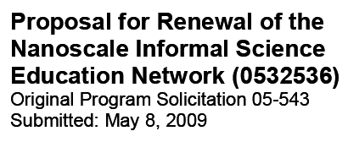
Nanoscale Informal Science Education Network
3
10
100
10/2005 -
2006 -
2007 -
2008 -
2009 -
2010 -
2011 -
2012 -
2013 -
2014 -
10/2015 -

Slide 17
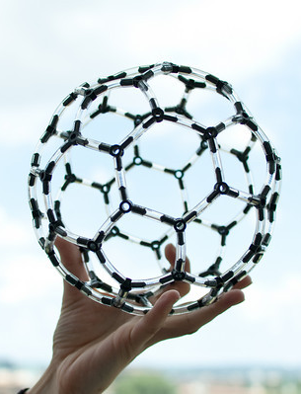
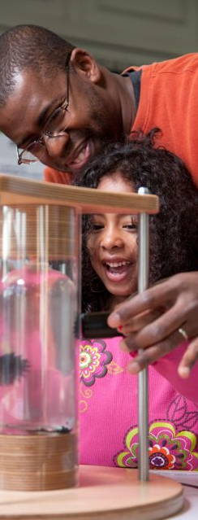
Years 1-5: (2005-2010)
Building the network
Years 6-10: (2010-2015)
Engaging the public through the network

Slide 18
Nanoscale Informal Science Education Network
14
100
200
3
10
10/2005 -
2006 -
2007 -
2008 -
2009 -
2010 -
2011 -
2012 -
2013 -
2014 -
10/2015 -

Slide 19
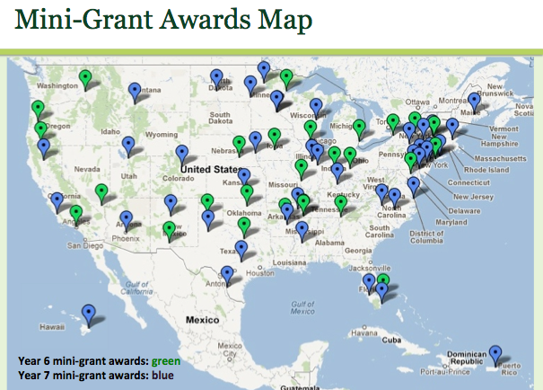
Nanoscale Informal Science Education Network
14
200
10/2005 -
2006 -
2007 -
2008 -
2009 -
2010 -
2011 -
2012 -
2013 -
2014 -
10/2015 -

Slide 20
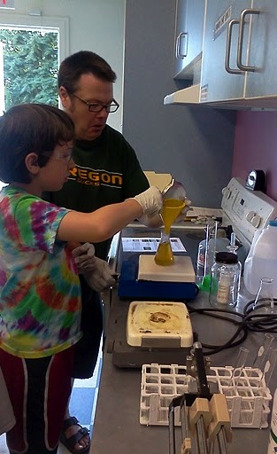
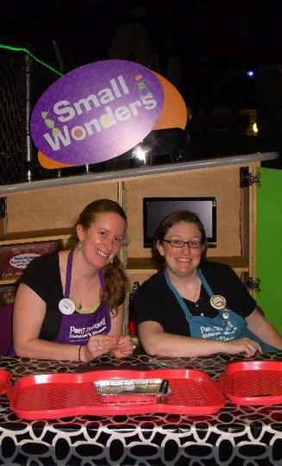
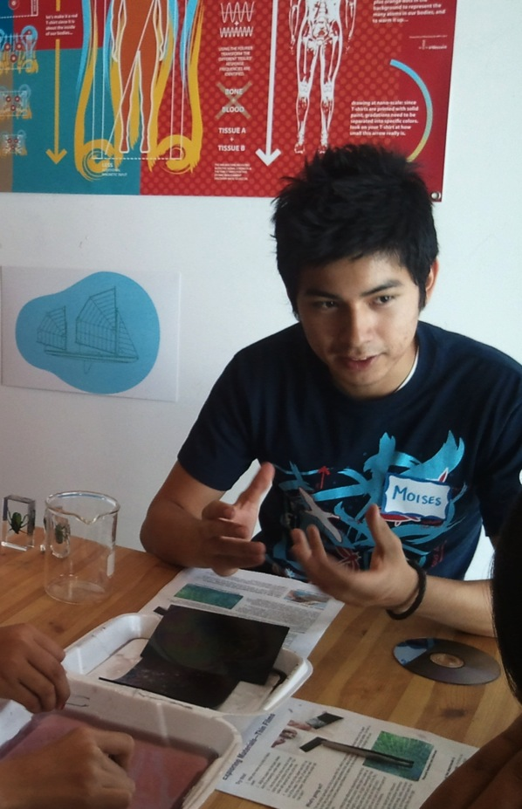
110 awarded to date, more to come
Notes:
Also heard demand from partners

Slide 21
Nanoscale Informal Science Education Network
14
200
10/2005 -
2006 -
2007 -
2008 -
2009 -
2010 -
2011 -
2012 -
2013 -
2014 -
10/2015 -

Slide 22
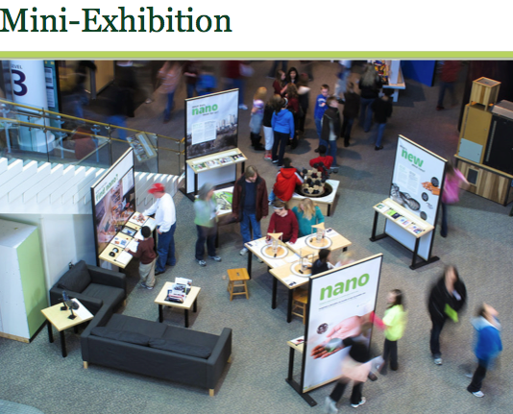
Nanoscale Informal Science Education Network
14
200
10/2005 -
2006 -
2007 -
2008 -
2009 -
2010 -
2011 -
2012 -
2013 -
2014 -
10/2015 -

Slide 23
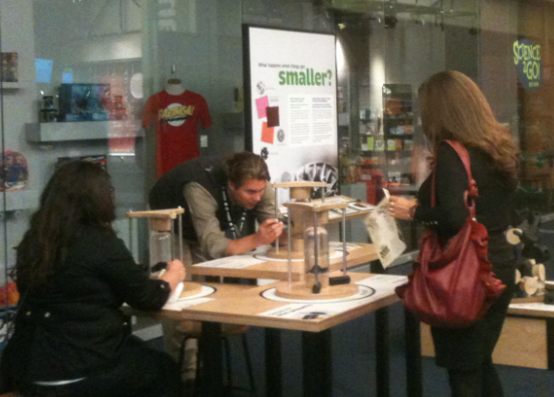
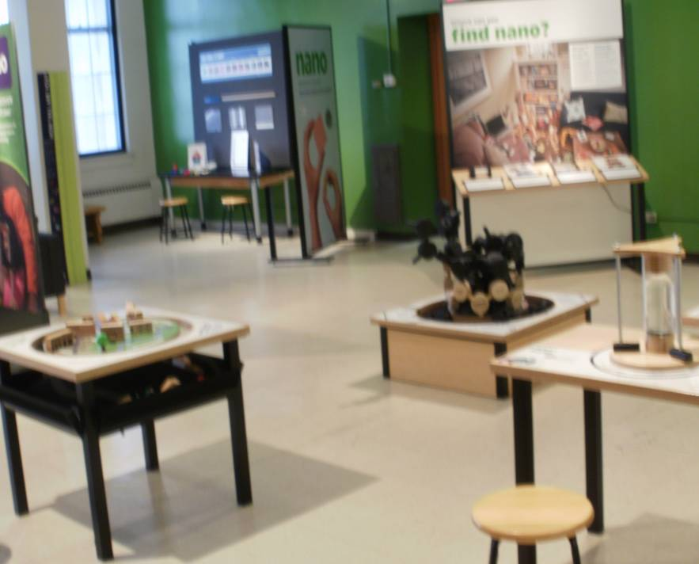
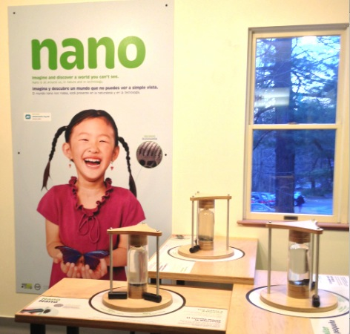
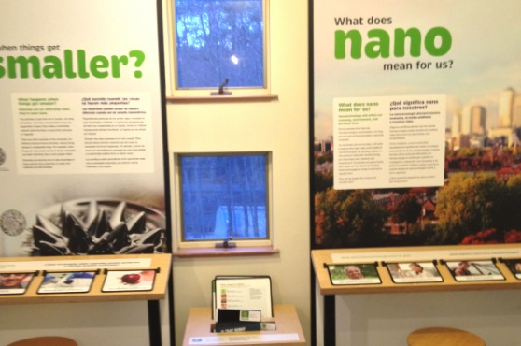
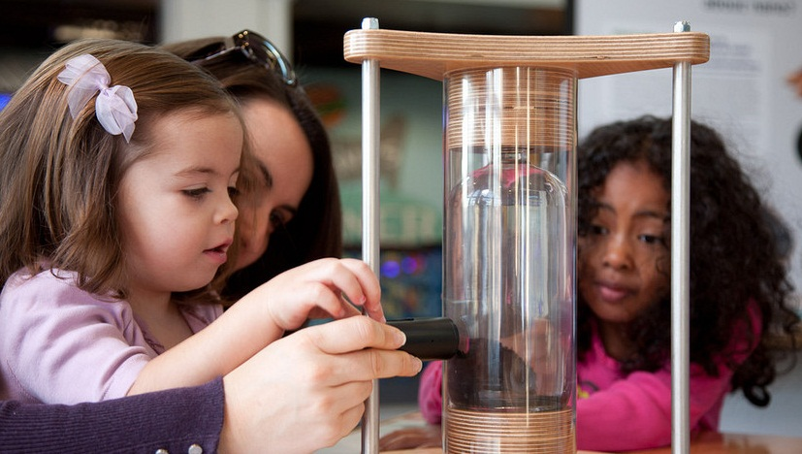
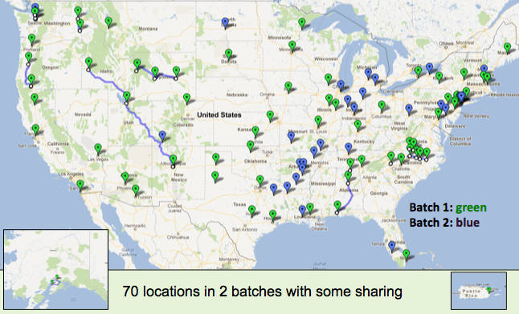
Mini-exhibit slide
Nano Mini-Exhibition in 70 locations

Slide 24
Nanoscale Informal Science Education Network
14
200
10/2005 -
2006 -
2007 -
2008 -
2009 -
2010 -
2011 -
2012 -
2013 -
2014 -
10/2015 -

Slide 25
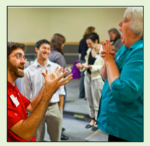
Nanoscale Informal Science Education Network
14
200
10/2005 -
2006 -
2007 -
2008 -
2009 -
2010 -
2011 -
2012 -
2013 -
2014 -
10/2015 -
Professional development

Slide 26
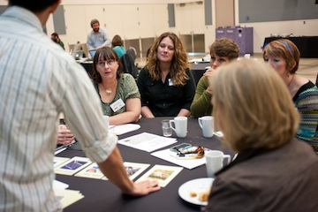
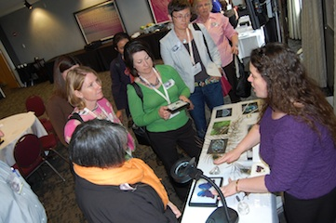
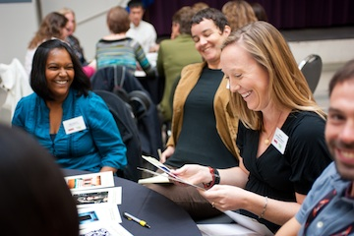
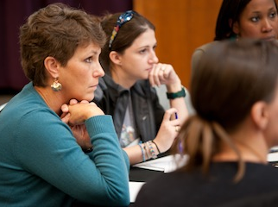
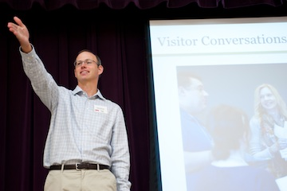
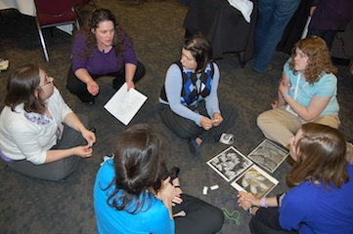
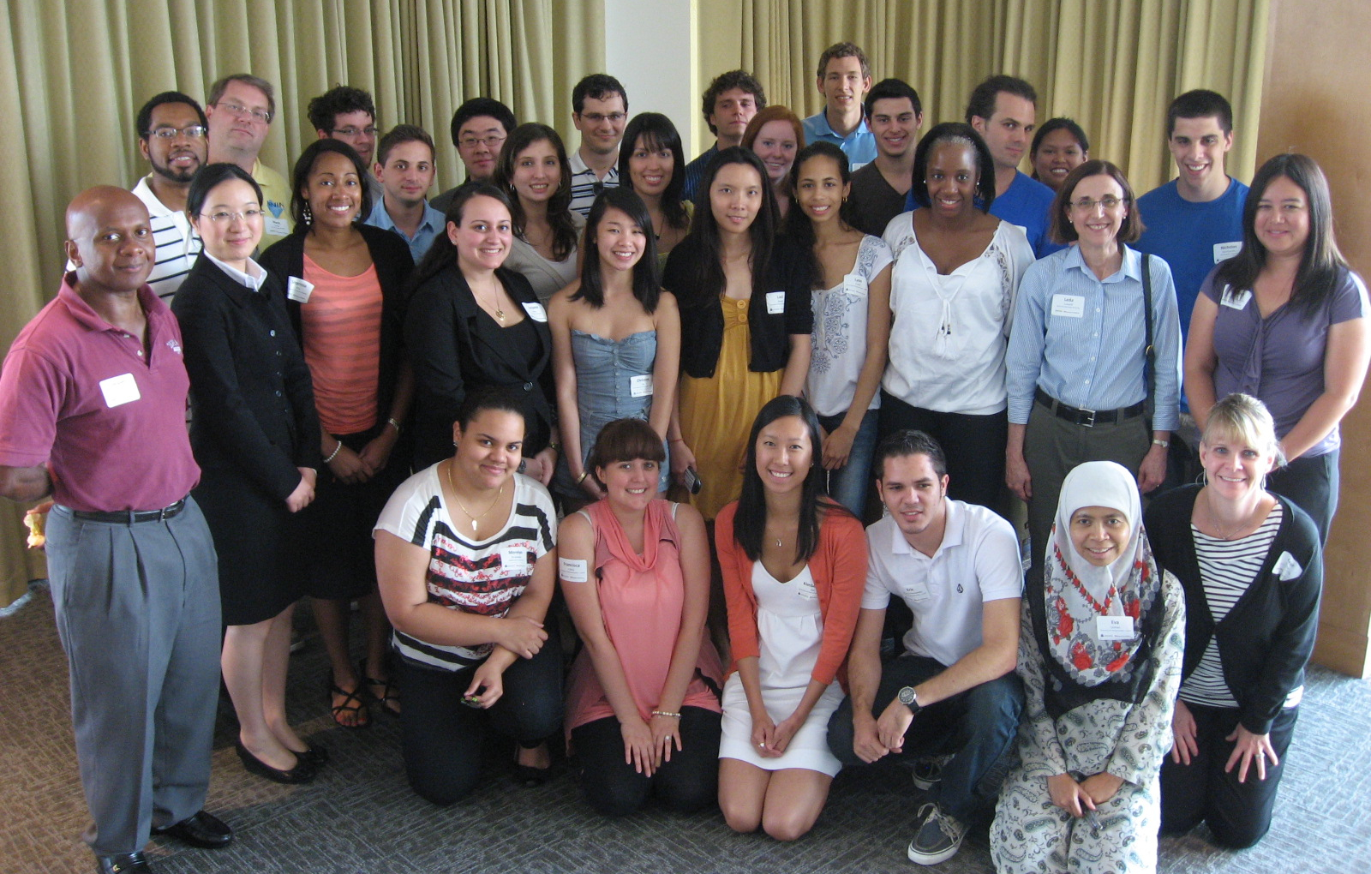
hands on program training • programming for young audience • science theater • best practices • universal design • nano and society • team-based inquiry • science communication
Coming up this year:
On-line brown- bags
Universal Design Workshop
Bi-lingual Workshop
TBI pre-conference workshop
MRS PD activities

Slide 27
Nanoscale Informal Science Education Network
14
200
10/2005 -
2006 -
2007 -
2008 -
2009 -
2010 -
2011 -
2012 -
2013 -
2014 -
10/2015 -
Professional development

Slide 28
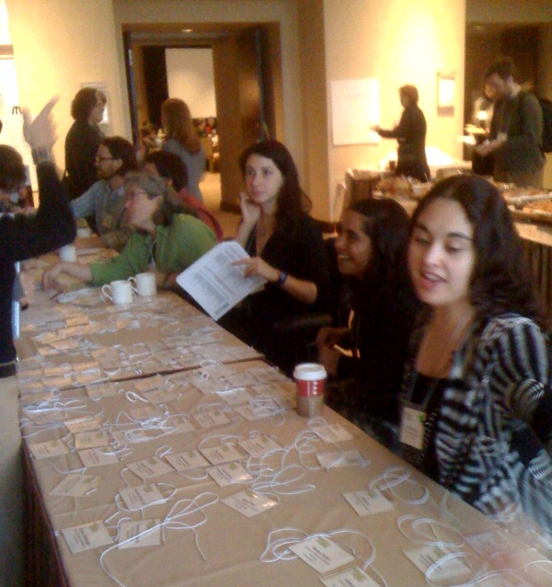
Nanoscale Informal Science Education Network
14
200
10/2005 -
2006 -
2007 -
2008 -
2009 -
2010 -
2011 -
2012 -
2013 -
2014 -
10/2015 -
Professional development

Slide 29
Nanoscale Informal Science Education Network
188
312
10/2005 -
2006 -
2007 -
2008 -
2009 -
2010 -
2011 -
2012 -
2013 -
2014 -
10/2015 -
Professional development

Slide 30
About this meeting
In last year’s network communication study we learned that partners were very interested in:
learning new ways to implement NISE Net products, particularly NanoDays programming;
hearing how other institutions in the Network modified, adapted, or “hacked” activities;
learning how other institutions might be integrating nano beyond the yearly NanoDays events and activities; and
sharing more with others to communicate their own implementation ideas, activities, and program modifications, as well as nano-related activities they developed at their own institutions.

Slide 31
Nanoscale Informal Science Education Network
188
312
10/2005 -
2006 -
2007 -
2008 -
2009 -
2010 -
2011 -
2012 -
2013 -
2014 -
10/2015 -
Professional development

Slide 32
Nanoscale Informal Science Education Network
188
312
?
10/2005 -
2006 -
2007 -
2008 -
2009 -
2010 -
2011 -
2012 -
2013 -
2014 -
10/2015 -
Professional development

Slide 33
What happens after 2015
Online catalog?
NanoDays?
Partnerships?
Regional Hubs?
Professional Development?
What do you value most?
Use this meeting to make connections and develop ideas to make the most of the remaining 2 ½ years and extend the benefits to your institution into the future!

Slide 34
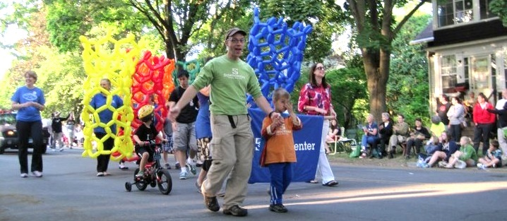
Thank you to all our partners
This presentation is based on work supported by the National Science Foundation under Grant No. 0940143.
Any opinions, findings, and conclusions or recommendations expressed in this presentation are those of the author(s) and do not necessarily reflect the views of the Foundation.

Slide 35
Ponder next-generation nanotechnologies in electronics, medicine, and biology with three leading innovators. Then brainstorm ideas for sharing these innovations and their potential impacts more broadly. Listen, chose a topic, post a color-coded card, plan a deliverable, write it up, post it.
Nano 2012 and Beyond

Slide 36
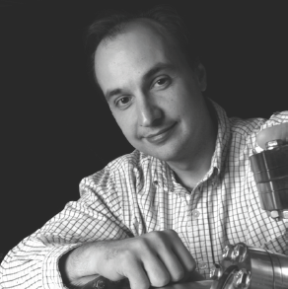
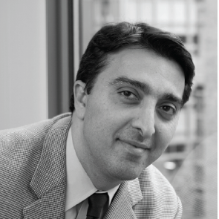
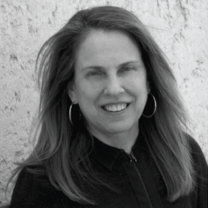
Nano 2012 and Beyond
Light and Power: Opportunities in Optoelectronics
Vladimir Bulovic, Professor of Electrical Engineering at MIT, where he leads the Organic and Nanostructured Electronics laboratory, directs the Microsystems Technology Laboratories, and co-directs the MIT-ENI Solar Frontiers Center.
Bringing Nanomedical Technologies from Bench to Bedside
Omid Forokhzad, Associate Professor at Harvard Medical School, and a physician-scientist at Brigham and Women’s Hospital, where he directs the Laboratory of Nanomedicine and Biomaterials and is a member of the Brigham Research Institute Cancer Research Center.
Organic Nanomanufacturing: Building with Biology
Pamela Silver, Professor of Biochemistry and Systems Biology at Harvard Medical School and founding member of the Wyss Institute for Biologically Inspired Engineering. Her lab focuses on predictable design and re-programming of biological systems for applications in health and sustainability

Slide 37
NISE Net Regional Hub Structure
Ballroom A
West
Northeast
Skyline A & B
Skyline D & E
Midwest
Mid-Atlantic
Ballroom B
Southwest
Skyline C
Ballroom B
Ballroom B
South
Southeast
Notes:
To build the network and raise the capacities of its members, we have 7 regional hubs that
Share NISE Network resources with partners
Support the infusion of nano content into partner museum institutions—increasing public impact
Encourage further involvement in the network
Connect informal science educators and local researchers

