Slide 1
Nano in Rural Outreach spectrUM Discovery Area
Montana spectrUM Science Experience
(MosSE)
Jessie Herbert
December 12, 2012

Slide 2
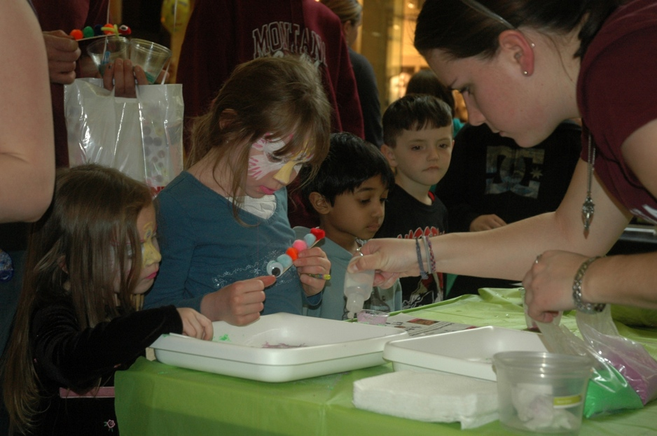
Nano in Outreach
Notes:
We travel to powwows and festivals around the state, bringing bins of hands on science, and we have since before we opened our doors.
When we travel, we will often bring NanoDays activities to powwows and community events.
Nano Activities we have done: Hydrogel, Thin Films, Scented Balloon, Graphene, Nano Sand, Nano Fabric, Butterfly, Extracting DNA, Nano IceCream
Outreach is still a large part of what we do. spectrUM’s mission is to inspire a culture of curiosity and discovery for ALL MONTANANS. Given the size of Montana, this is a very bold goal.

Slide 3
Mission
Notes:
When compared to the eastern US, Montana stretches from the equivalent of Washington, DC to Chicago, yet it only has a population of one million.
Montana is a very rural state. Over 1/3 of Montana’s population live in just seven cities. Montana’s largest city, Billings, has just over 100,000 people, while Montana’s eighth largest “city”, Havre, has only 9,000. Needless to say, that really spreads the rest of Montanans thin around the state. Montana’s smallest county has only 494 people!

Slide 4
Mobile Science Program
Montana spectrUM Science Experience
Travels exhibits around the state of Montana
Notes:
In order for spectrUM to reach ALL MONTANANS, we have developed a Mobile Science Program, the Montana spectrUM Science Experience. We travel full exhibitions to rural and tribal communities every fall and spring. Currently, we have travelled the Exploratorium’s Weather Exhibit, and our own Motion, Hands on Health, and Brain Exhibits. The Nano mini exhibit is scheduled to travel in the fall of 2013.
Being a small science center, we do not own our own vehicles, so we travel in a…

Slide 5
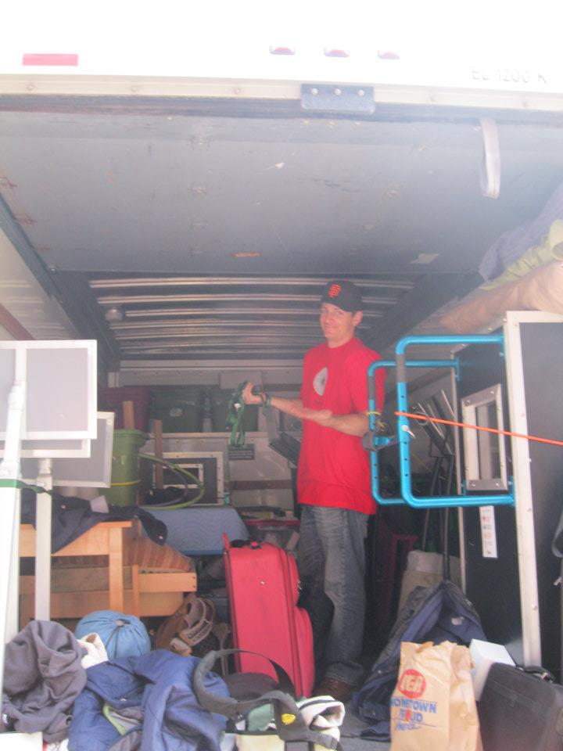
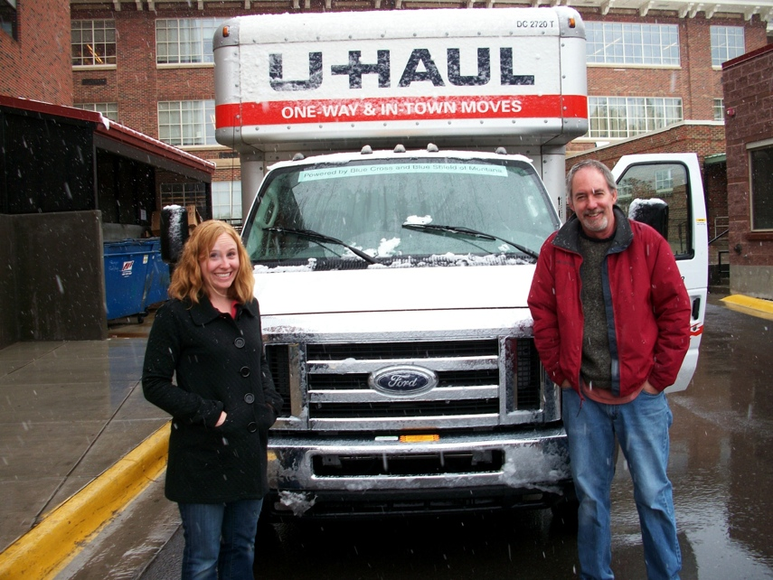
U-Haul!
Notes:
U-Haul! We load exhibits into the back of a U-Haul – carefully, and drive it for many miles, sometimes over 500 miles, to set up in a new community.

Slide 6
Travel across the state
Notes:
Since the beginning of our mobile outreach program in 2006, spectrUM has driven over 20,500 miles to bring educators, exhibitions, and programs to 53 different schools in 23 Montana counties (multiple visits to some counties and school), including all 7 Montana Indian Reservations. All together our mobile science program has served over 30,600 people, of which over 30% are Native American and 75% from rural communities.

Slide 7
Travel across the state
2009
Notes:
2009 started our first “tours”, where educators visited multiple sites on one trip.

Slide 8
Travel across the state
2010

Slide 9
Travel across the state
2011

Slide 10
Travel across the state
2012
Notes:
Our hope for the future is to visit all 56 counties.
2012: 25 schools in 13 counties

Slide 11
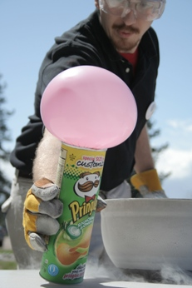
Funding
Cost is often prohibitive for many schools
Partner with local organizations
Find funding from other sources
Notes:
So it costs a lot to travel across the state.
Cost of this program is often prohibitive to many schools, especially from rural, tribal, or poor communities. We have tried to meet this demand by partnering with local organizations that serve in those communities and by writing grants for our mobile science program. School can also apply for scholarships.

Slide 12
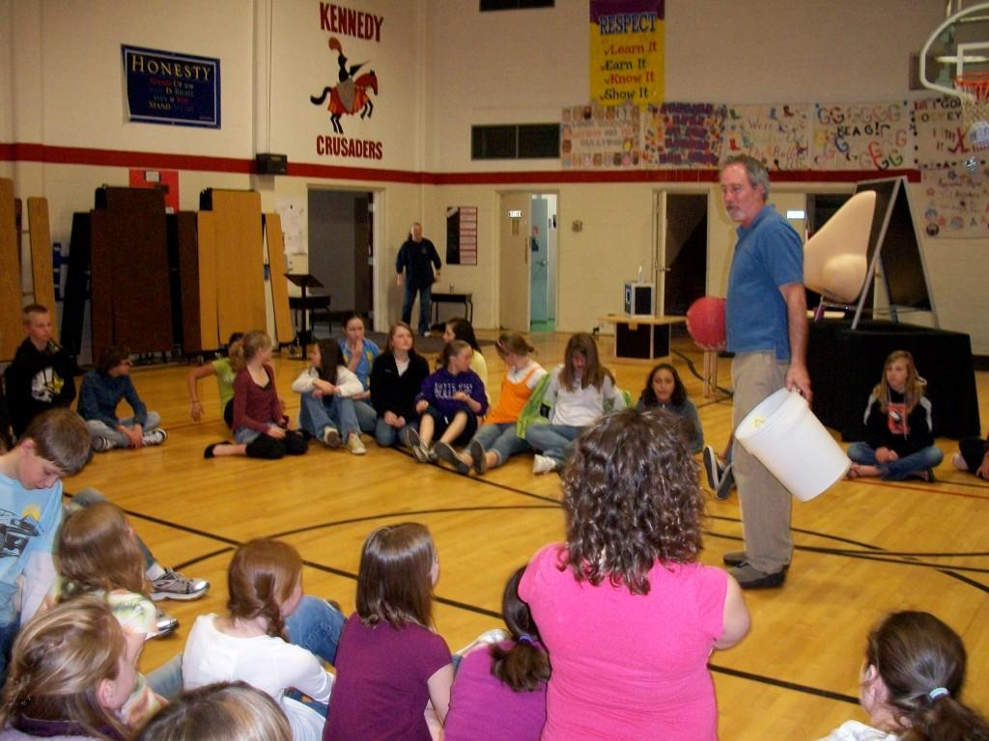
Visits to schools
Two-days of field trips
Family Science Night
Notes:
When we arrive in a school, we transform their gymnasium into a science museum. Two educators travel with an exhibit. When we arrive at a school, we usually set up for 2 days. Each day is packed with field trips so every students in the school can visit. The evening of the second day is a Family Science Night, where families can visit for free, and the students get to become the teachers, and share what they learned with their family and friends.

Slide 13
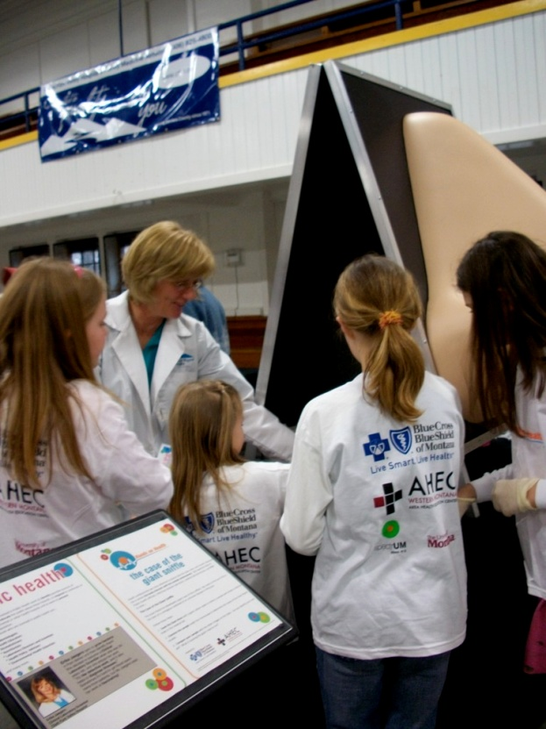
Career Component
Power of local role models
Showcase University of Montana as a place to study
Notes:
An important piece of our program is the Career Component. When traveling to a community, we reach out to local role models. Nurses, doctors, engineers, pilots, weathermen, neurologists, chemists, etc. They get featured on our signage, and we invited them to attend and/or volunteer at the Family Science Night. We often have our contact at the community/school help with finding role models.
-Excited to connect Montanans with local nano role models.
-Great way to excite kids about a career path
-Affiliation with UM, so we take the opportunity to showcase UM as a great place to study these topics. (highlight careers from a variety of educational backgrounds)

Slide 14
Blog : Come along for the ride:
http://spectrummosse.wordpress.com
jessie.herbert@umontana.edu
Notes:
We have a great blog detailing all our adventures. Be sure to follow it while we travel Nano across Montana.

