Slide 1
Summer Programming for Reaching New Audiences
Ruomei Gao, Jackson State University
Nick Spicher, Science Factory (Eugene, OR)
Christine Stull, Discovery Center (Elmira, NY)
Karlisa Callwood, Miami Science Museum

Slide 2
Summer Program for Reaching New Audiences – Nano-Informal Education at Jackson State University
Ruomei Gao
Department of Chemistry and Biochemistry at Jackson State University
Chemistry and Physics Department at SUNY College at Old Westbury

Slide 3
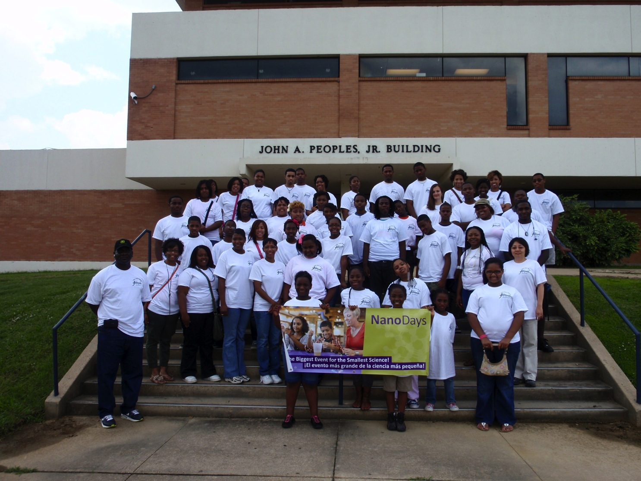
1-Day NanoCamp at JSU on June 16, 2012
Projects:
Morning session: Hydrophobic and Hydrophilic Polymers, Solar Energy, Wind Power, Spectrophotometric Mini-Experiment
Afternoon session: NanoDay and Story time with ~ 15 hand-on project
Students/faculty/staff instructors:
Josephine Cain-Smith, Dalephine E. Davis, Plato Davis, Attilah Edges, Ruomei Gao, Anastasia Golius, Megan Lowe, Danielle McShan, Jean Negou-Negou and Willie Wesley

Slide 4
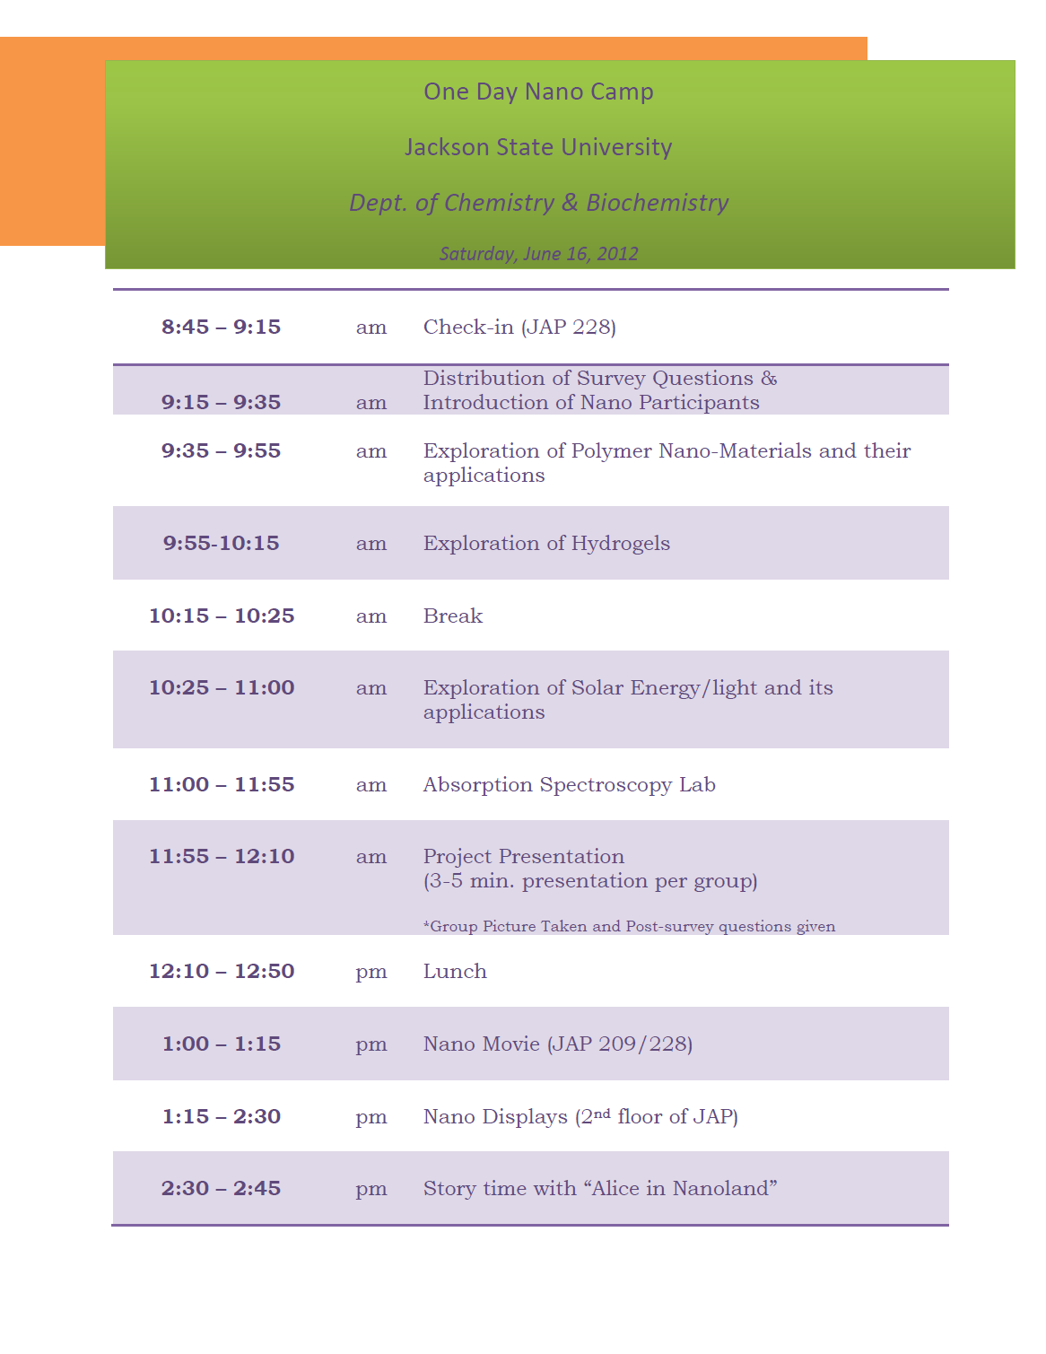
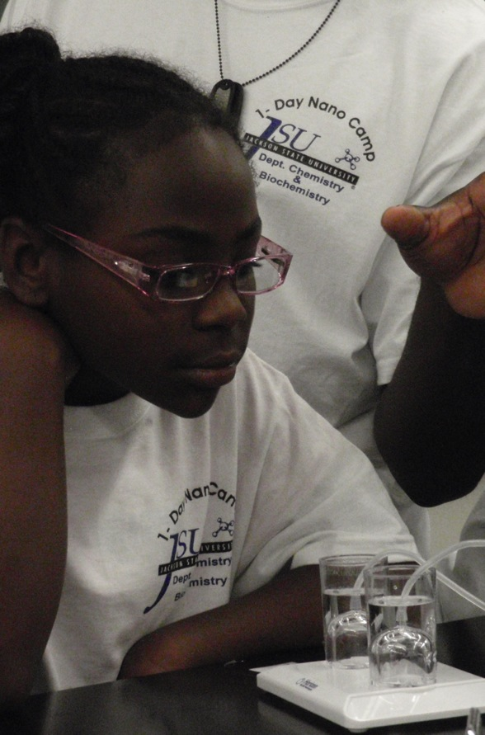
1-Day Nano Camp

Slide 5
1-Day Nano Camp Projects
Polymer Nano-Materials
Water-Resistant Polymeric materials and their applications
Hydrogels
Experiment: Hydrophobicity Test
Solar Energy/Wind Power/Fuel Cells and their applications
Hand-on Projects:
Morning Session with 35 students: Fluorescent glow polymer, Solubility and absorption spectrum measurements, Hydrophobic and hydrophilic polymer, Solar car and fan, Wind power fan and light and Fuel cell fan and light
Afternoon Session with 200 participants: Fluorescent glow polymer, Solubility and absorption spectrum measurements, Hydrophobic and hydrophilic polymer, Solar car and fan, Wind power fan and light, Fuel cell fan and light, nano-size and me, Puzzle, Sun screen, Soda geyser, Story time: Alice in Nanoland

Slide 6
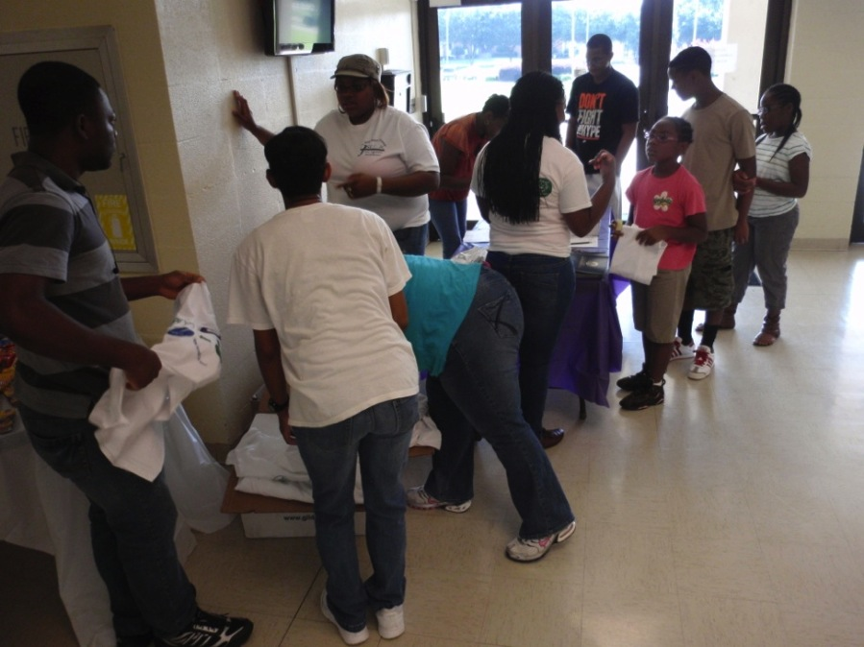
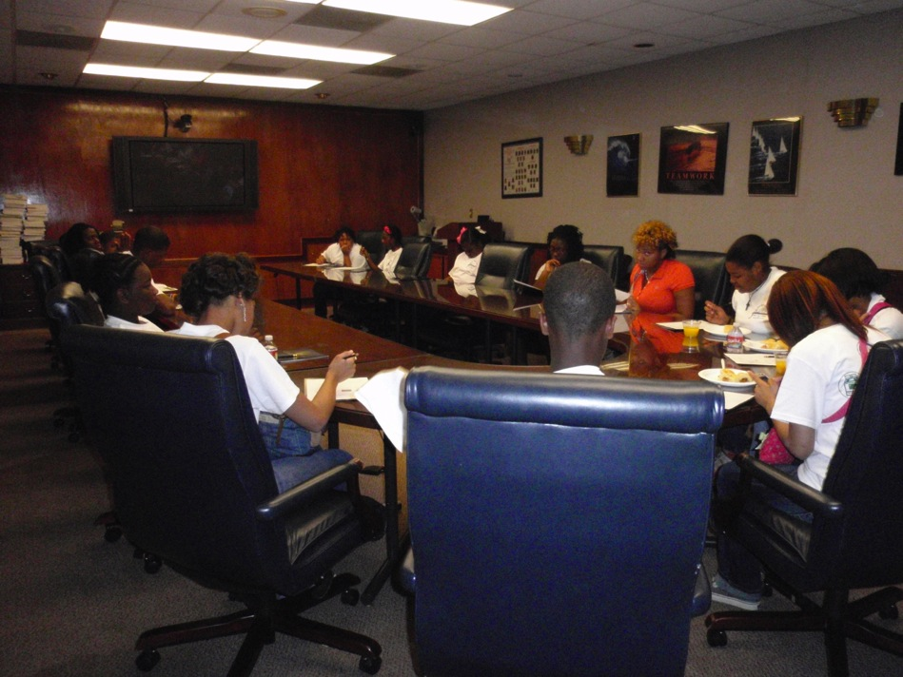
Registration
Survey Time and Breakfast

Slide 7
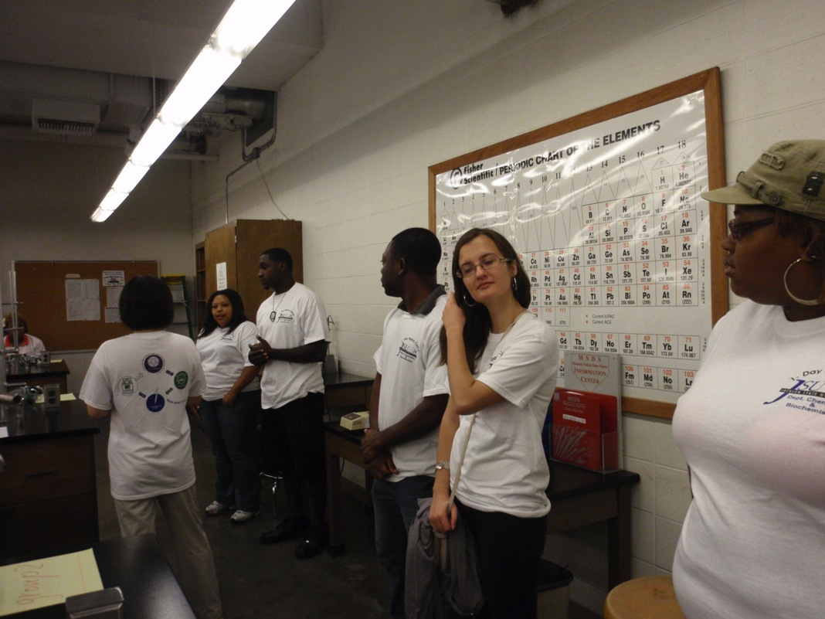
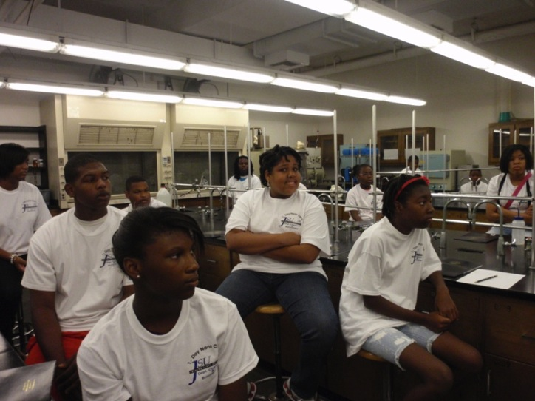
Instructors’ Introduction

Slide 8
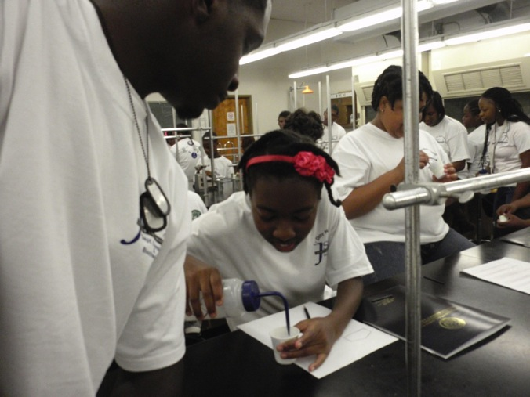
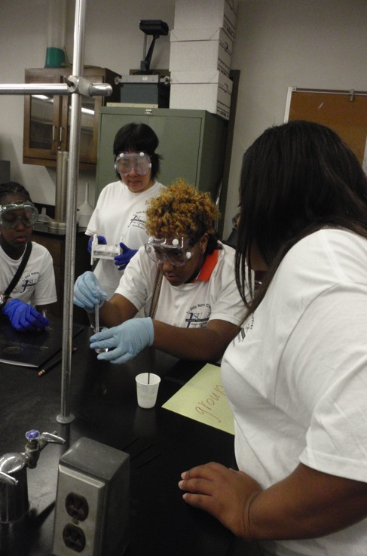
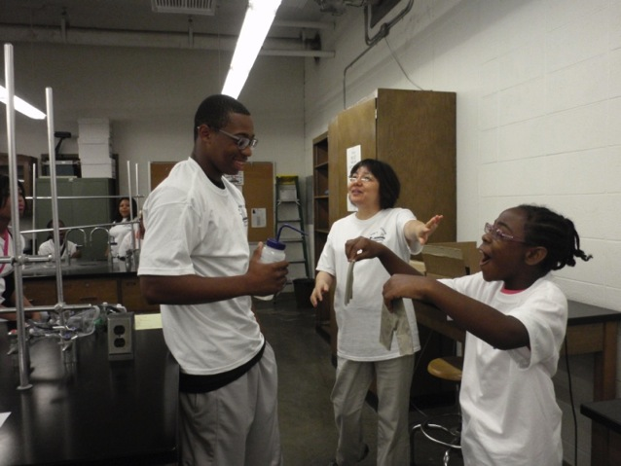
Hydrophobic and Hydrophilic Polymers

Slide 9
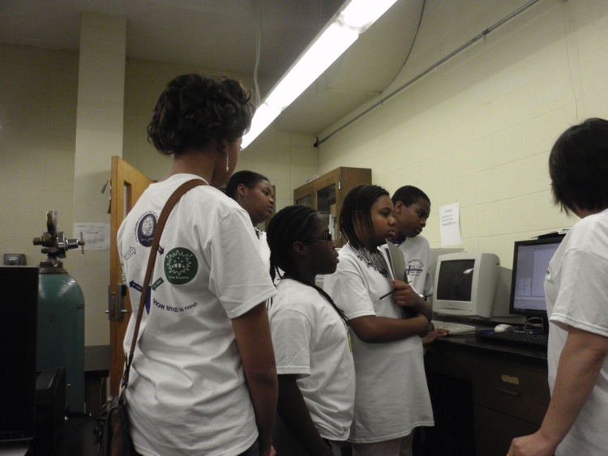
Spectrophotometeric Measurements

Slide 10
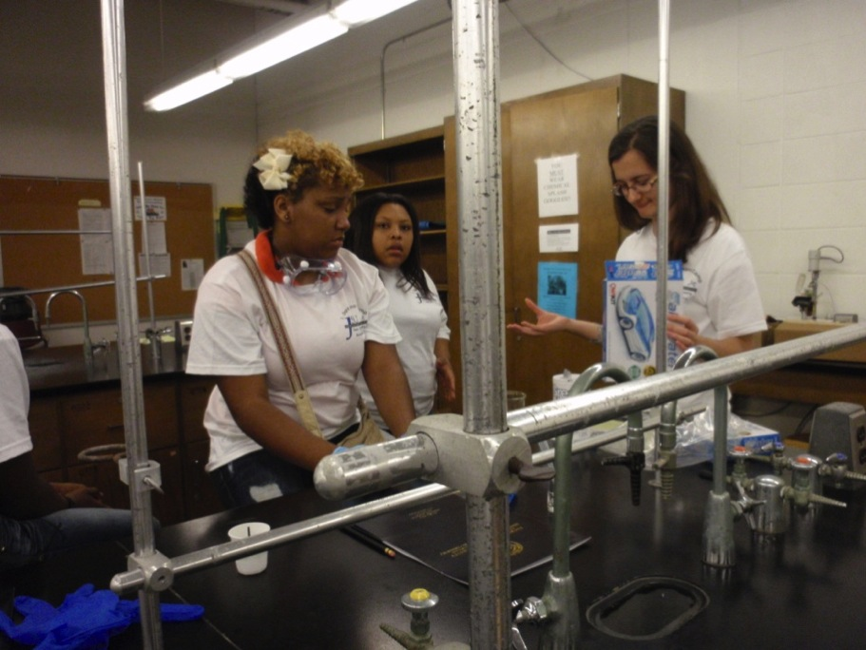
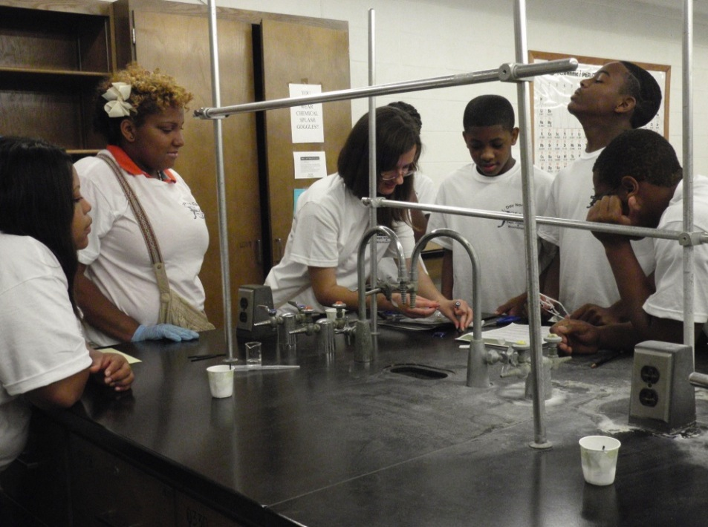
Fuel Cell Group

Slide 11
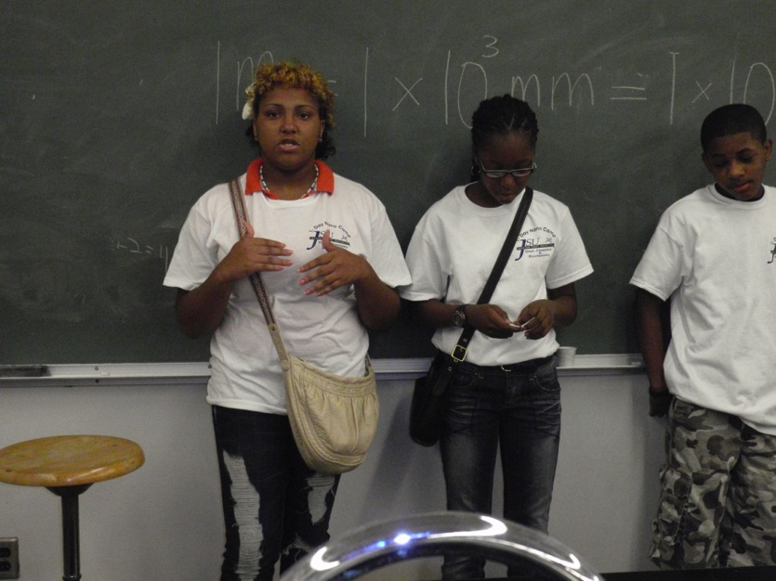
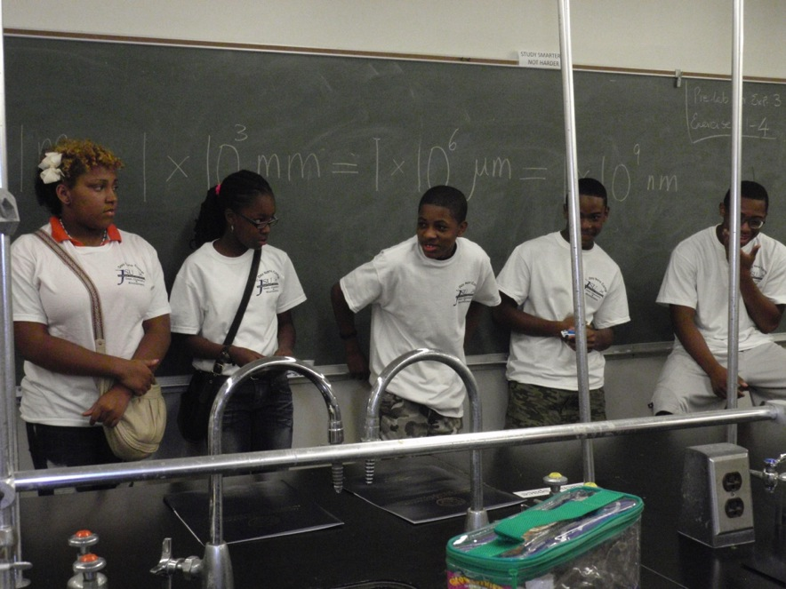
Fuel Cell Group Presentation in Class

Slide 12
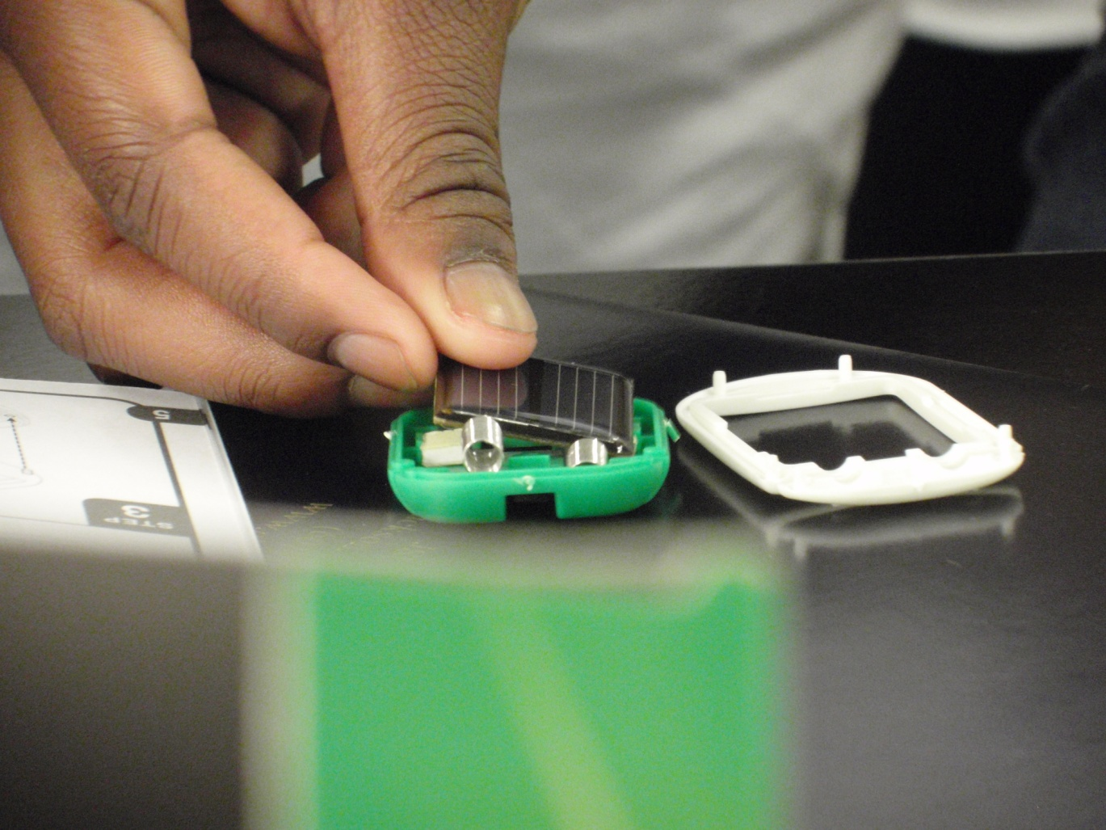
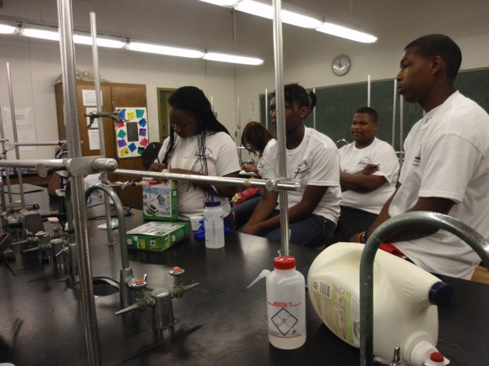
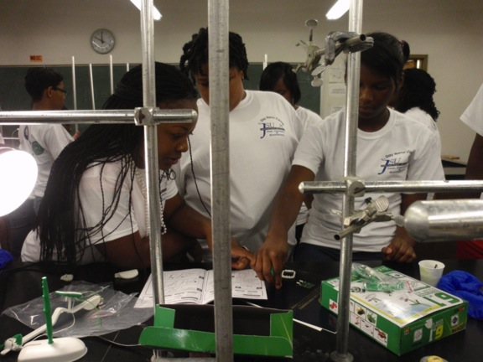
Solar Cell Group

Slide 13
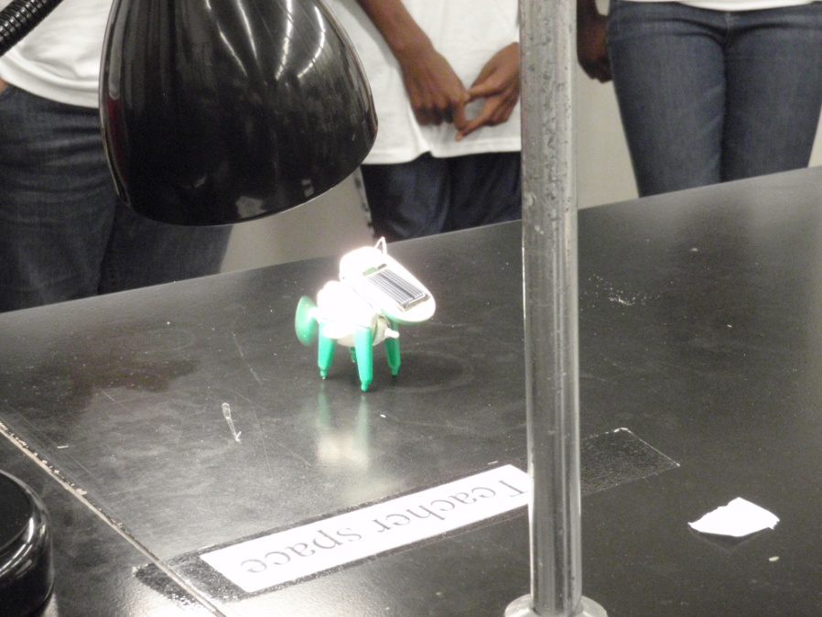
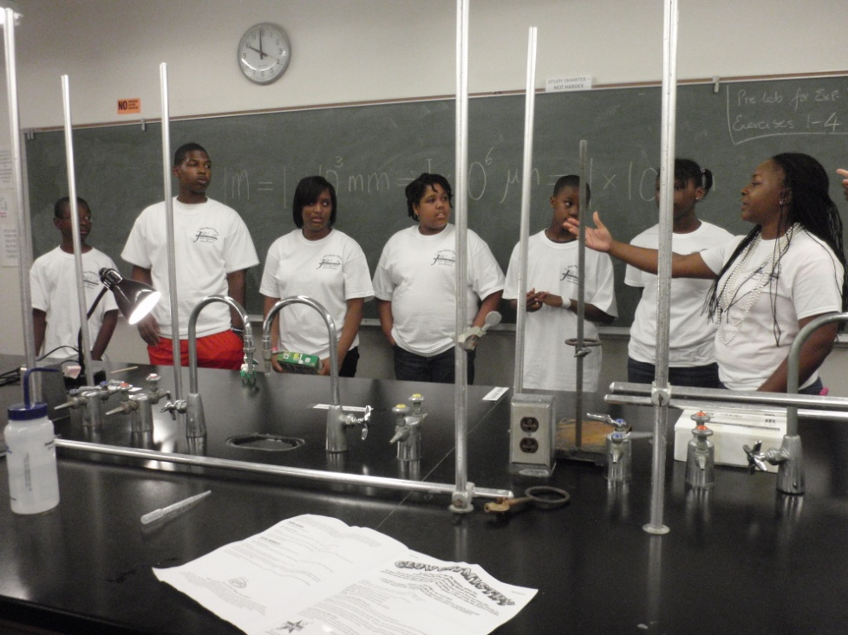
Fuel Cell Group Presentation in Class

Slide 14
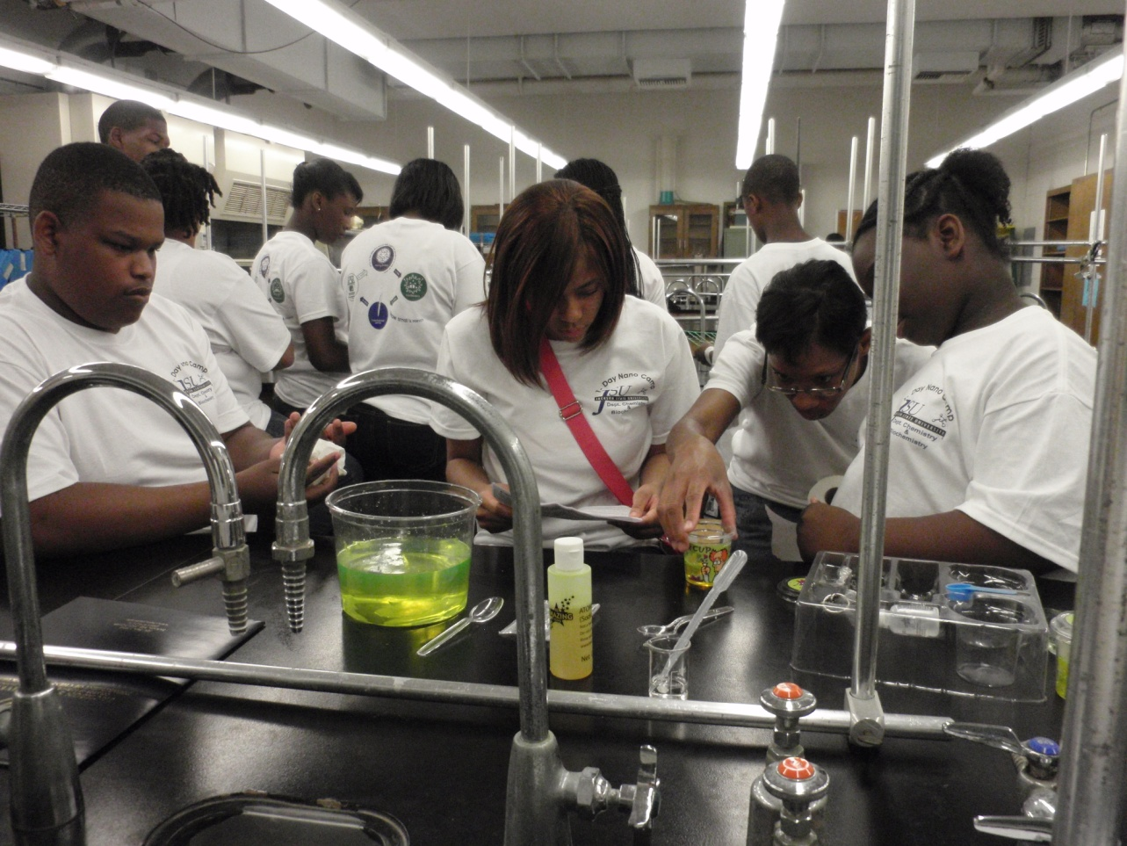
Fluorescent Glow Polymer Group

Slide 15
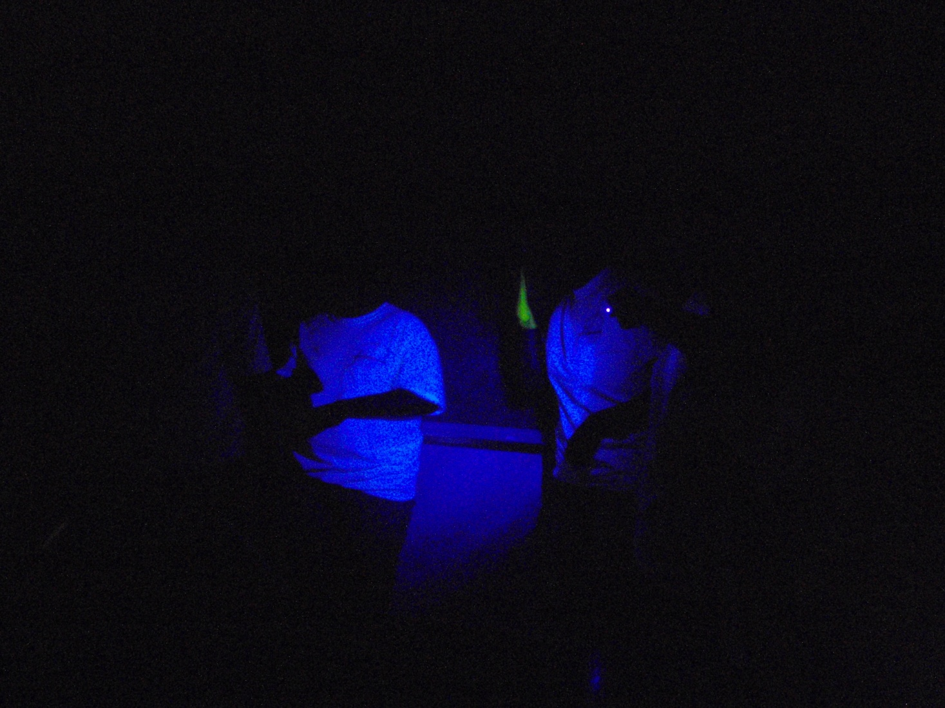
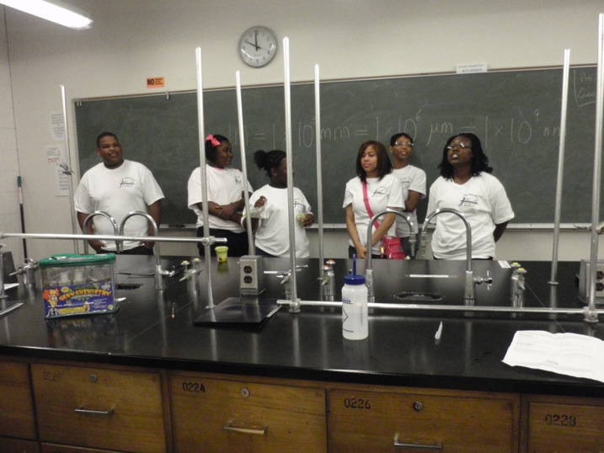
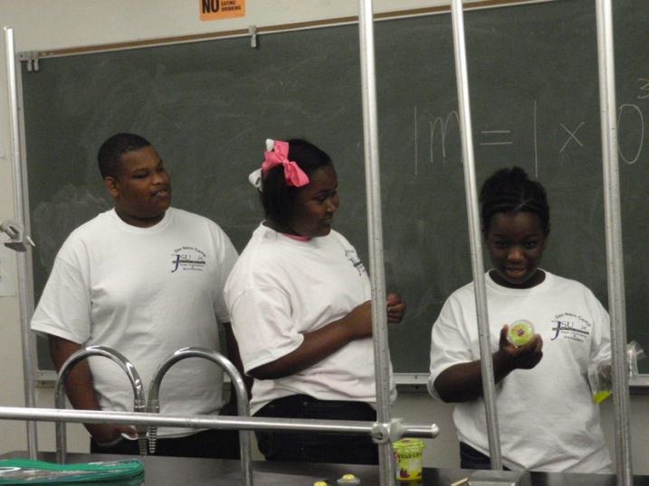
Fluorescent Glow Polymer Group Presentation in Class

Slide 16
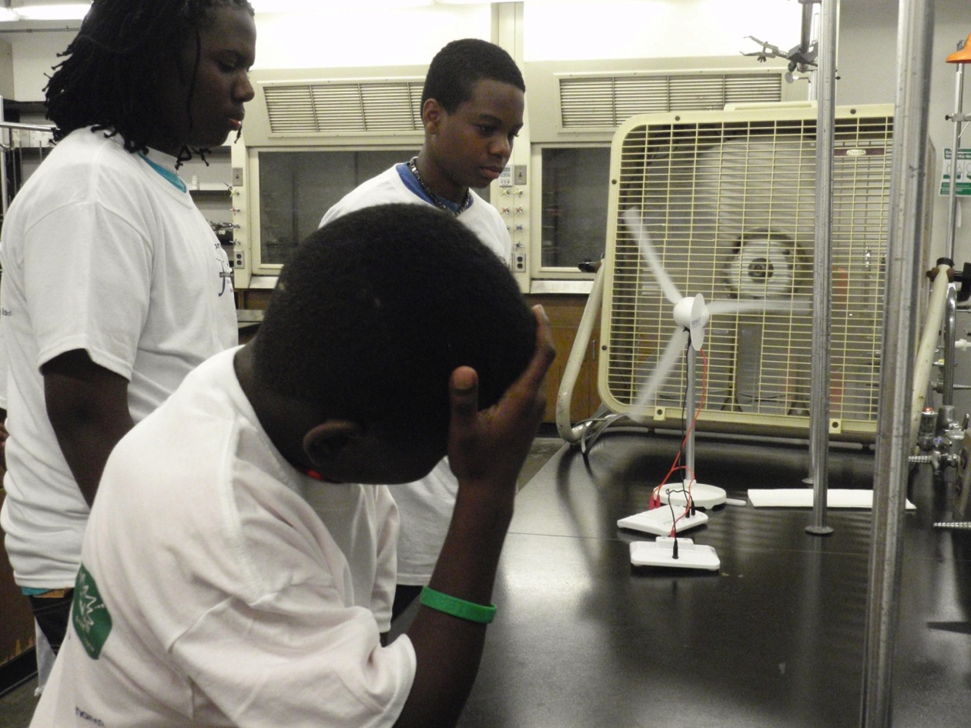
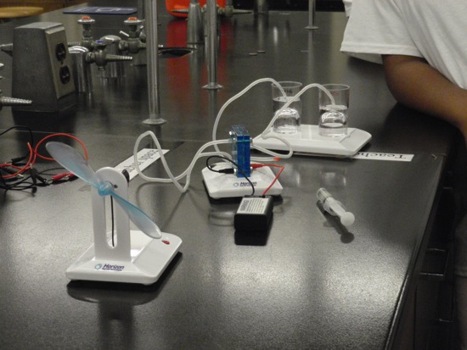
Wind Power & Fuel Cell Group

Slide 17
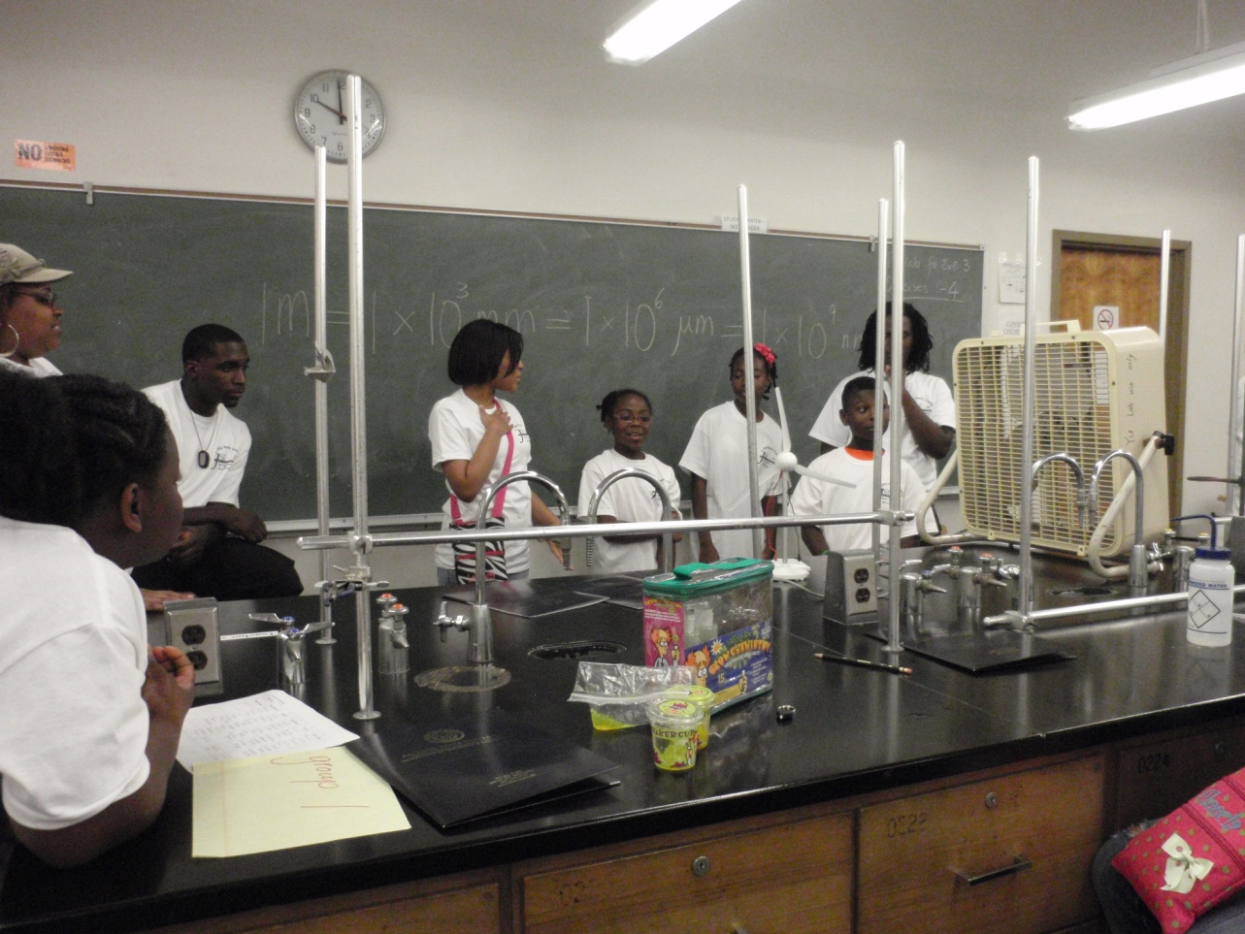
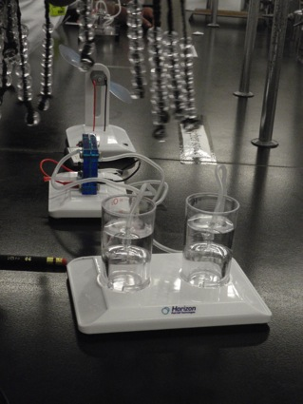
Wind Power & Fuel Cell Group Presentation in Class

Slide 18
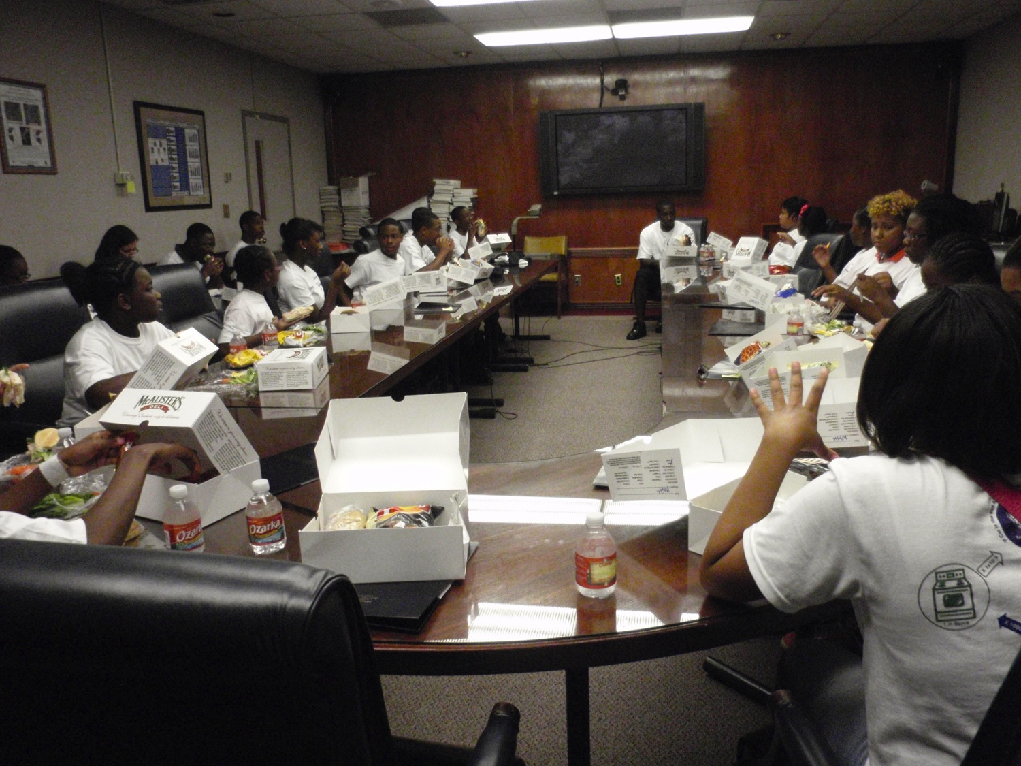
Lunch Time

Slide 19
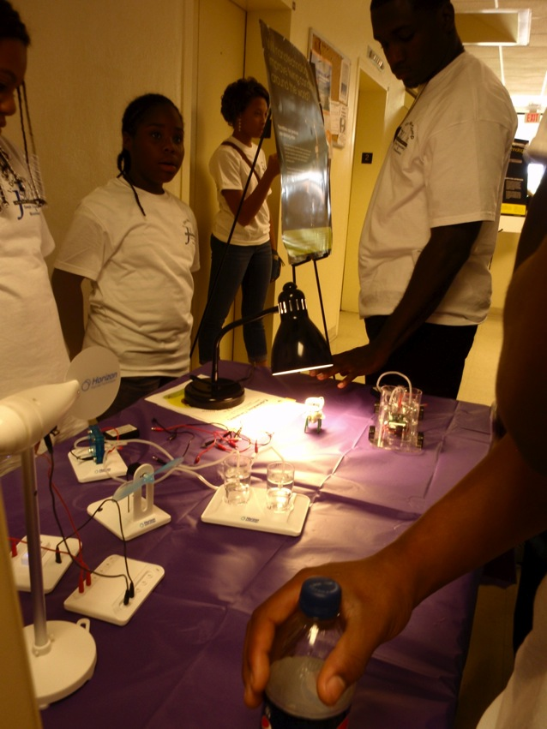
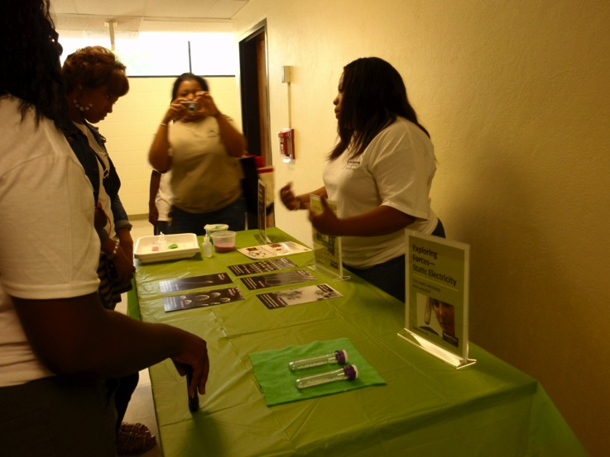
Nano Display in the Afternoon

Slide 20
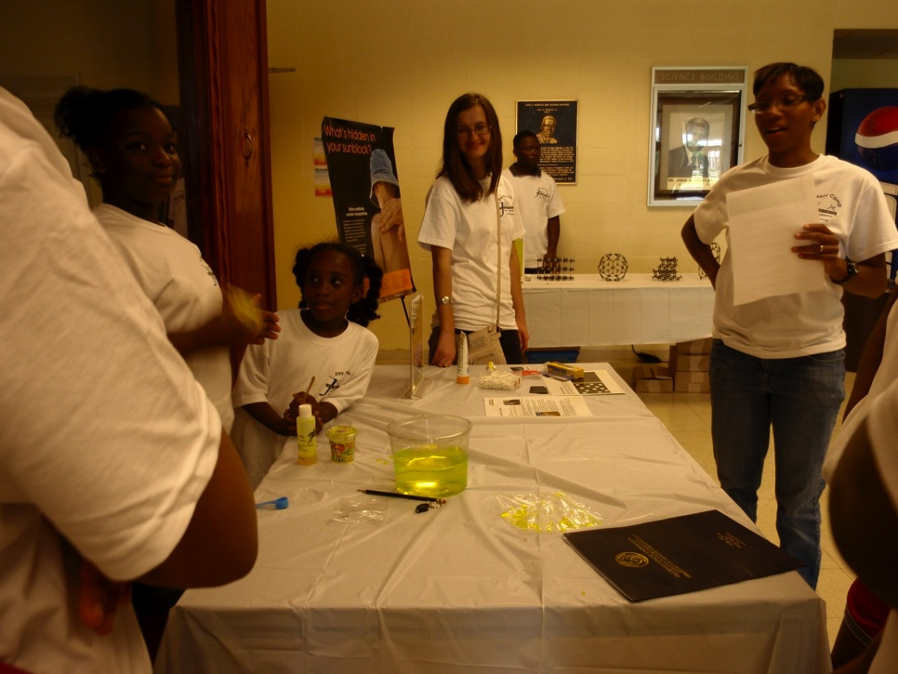
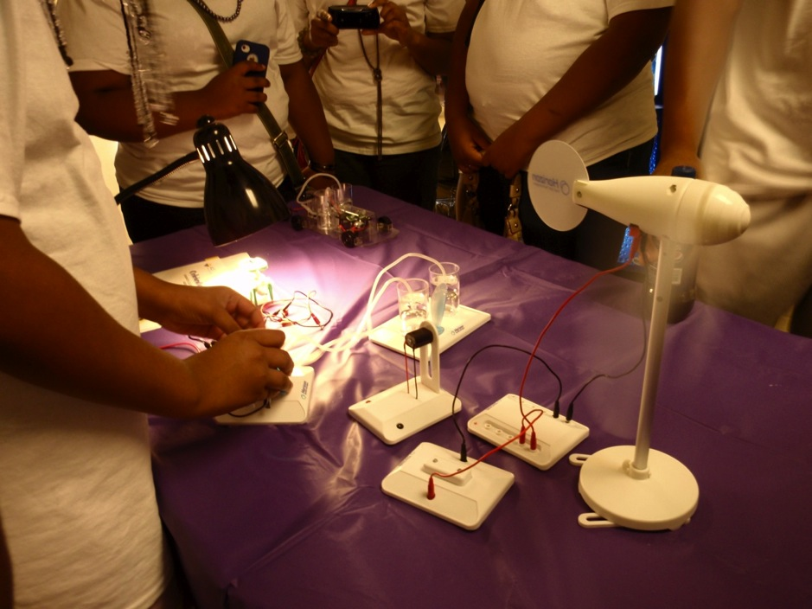

Slide 21
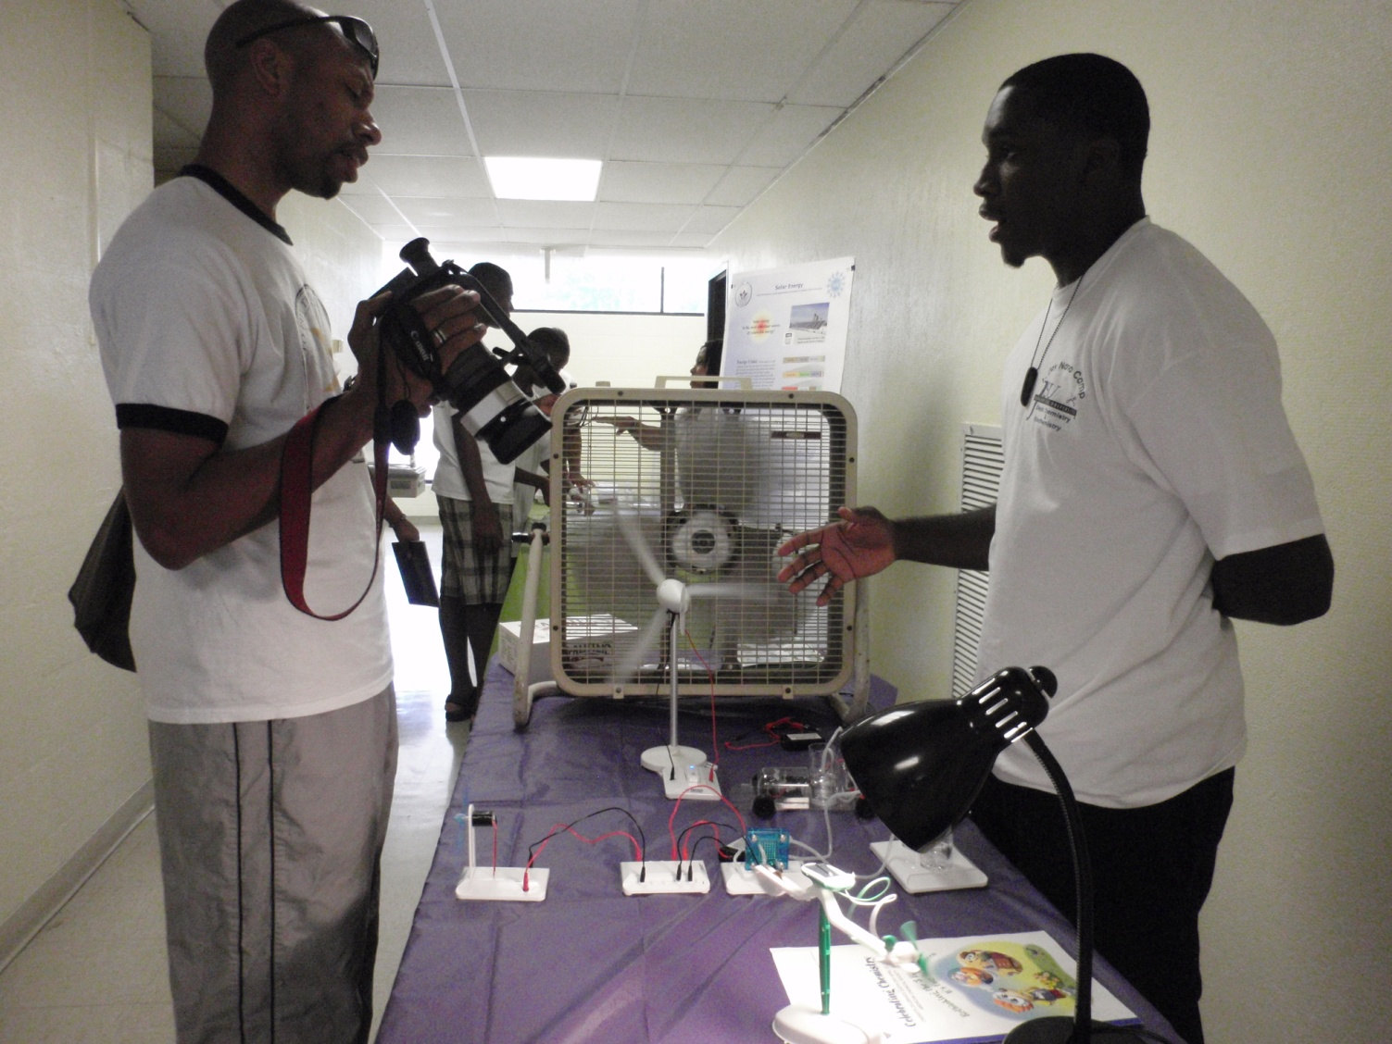
Reporter’s Interview

Slide 22
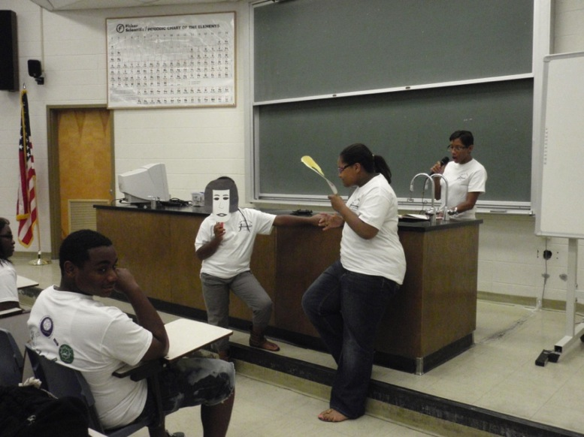
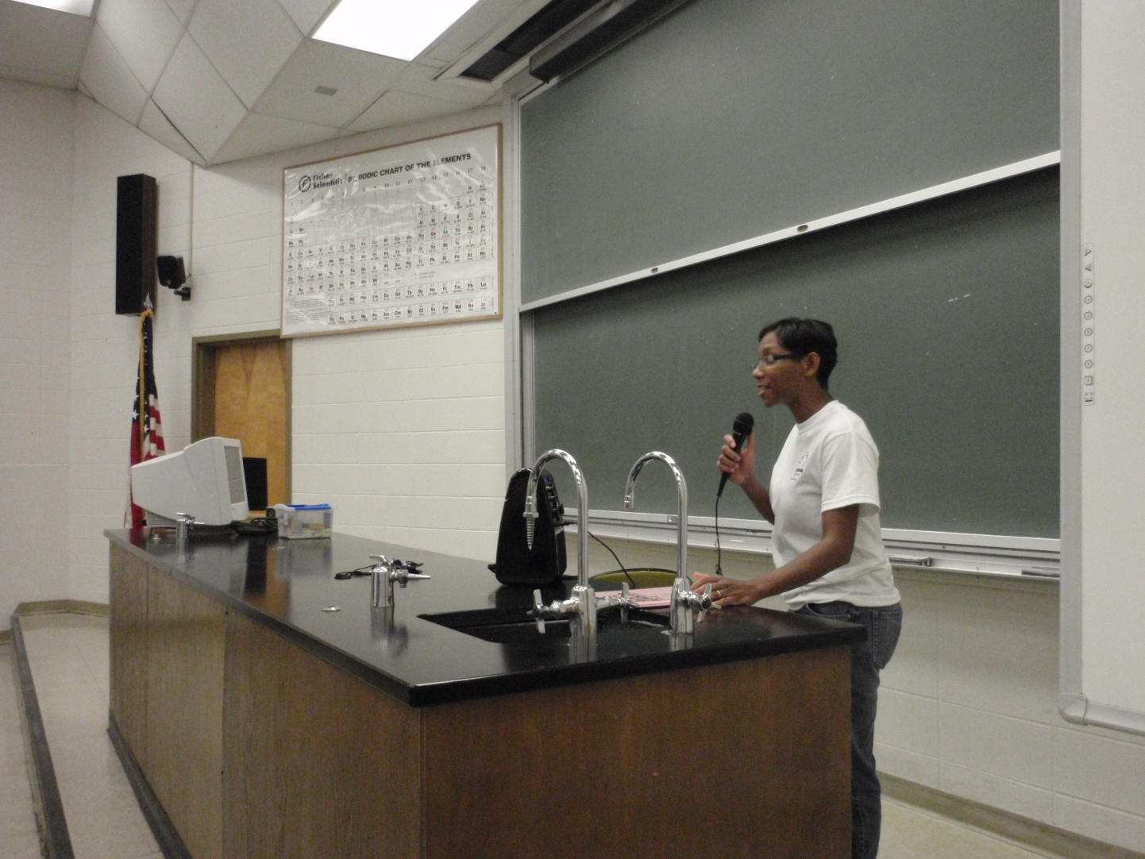
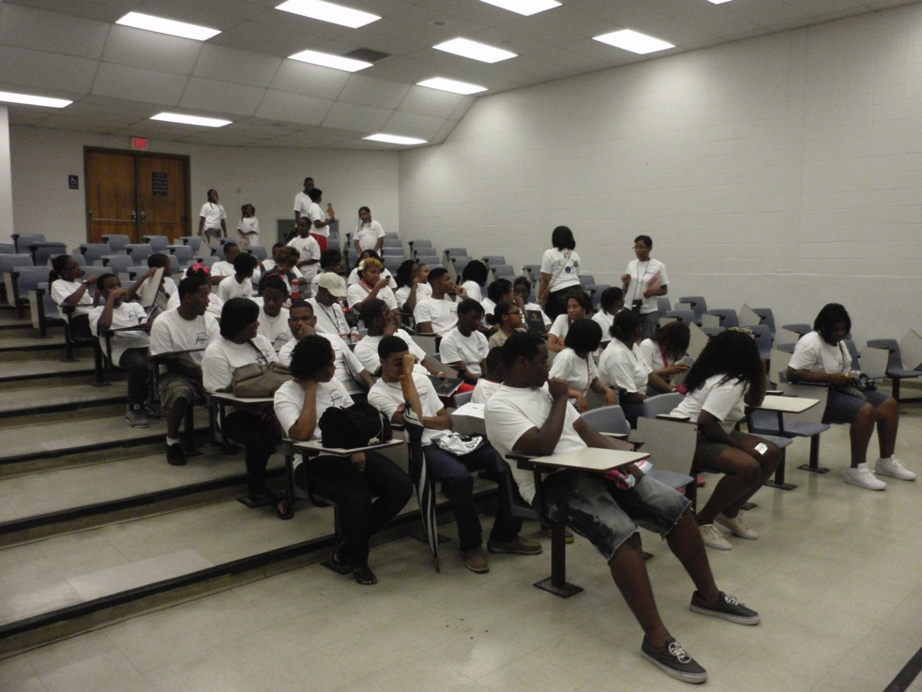
Story Time

Slide 23
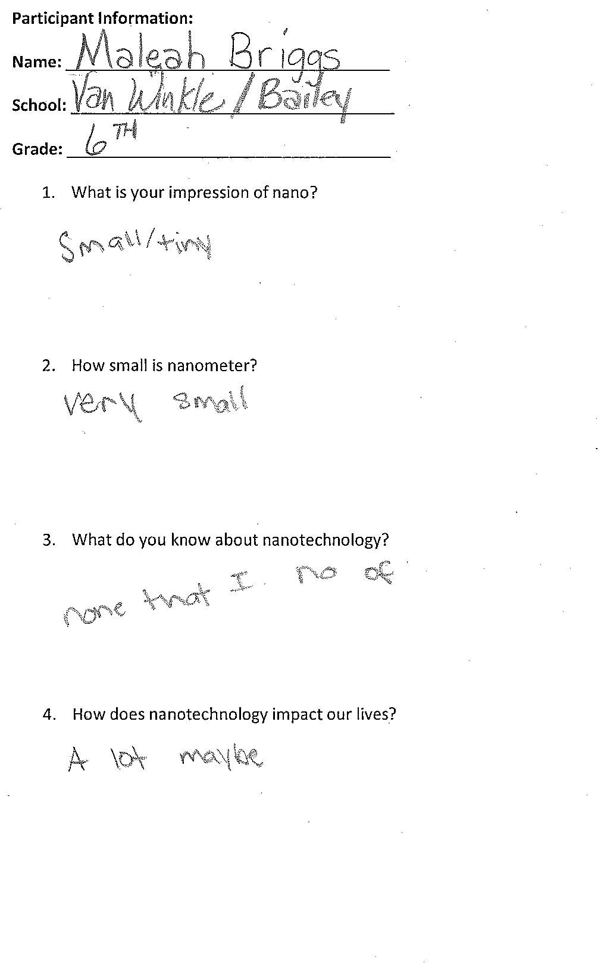
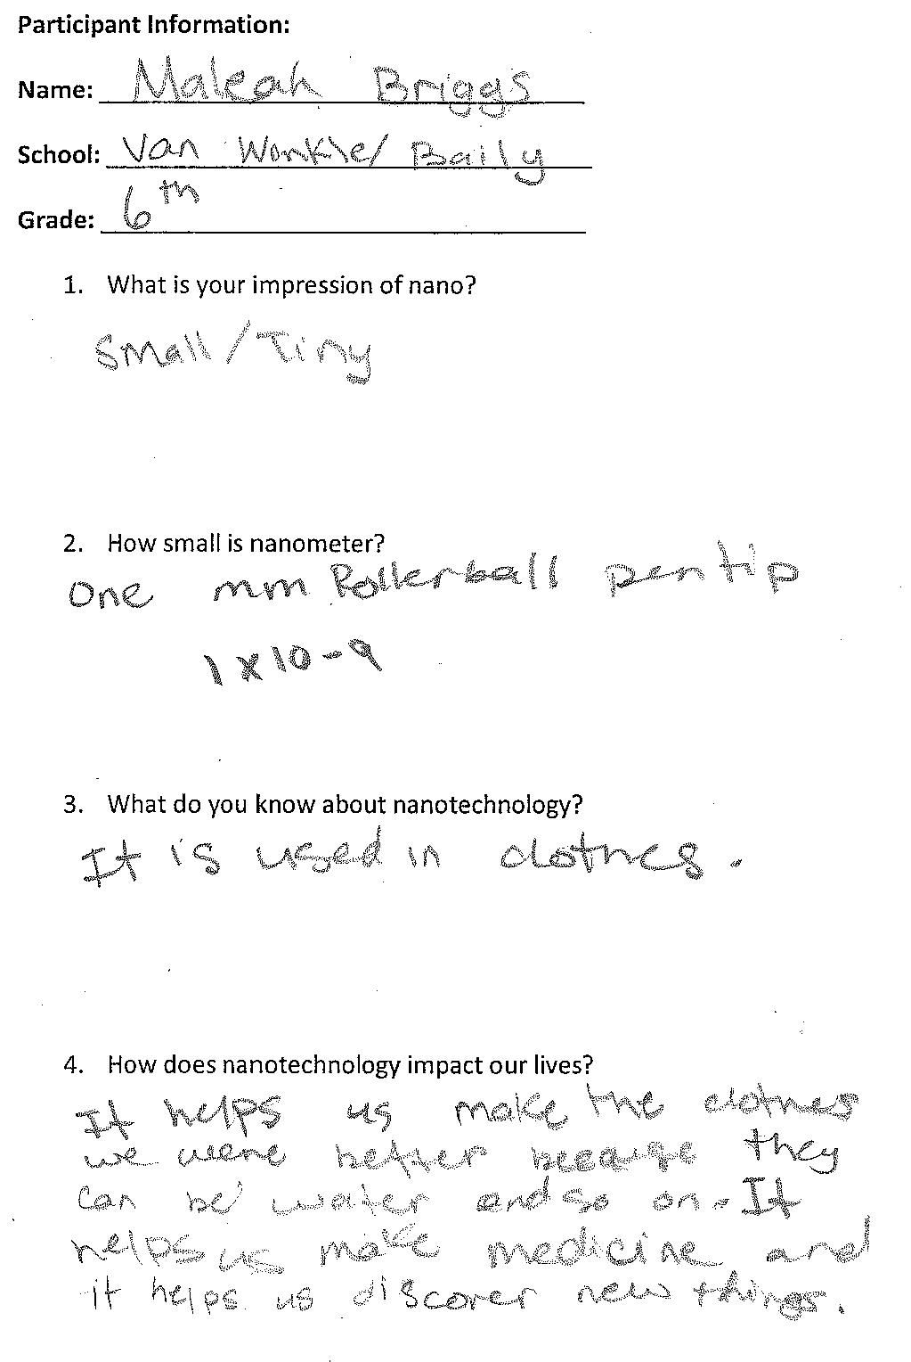
Nano Knowledge Surveys in the Morning and Afternoon

Slide 24
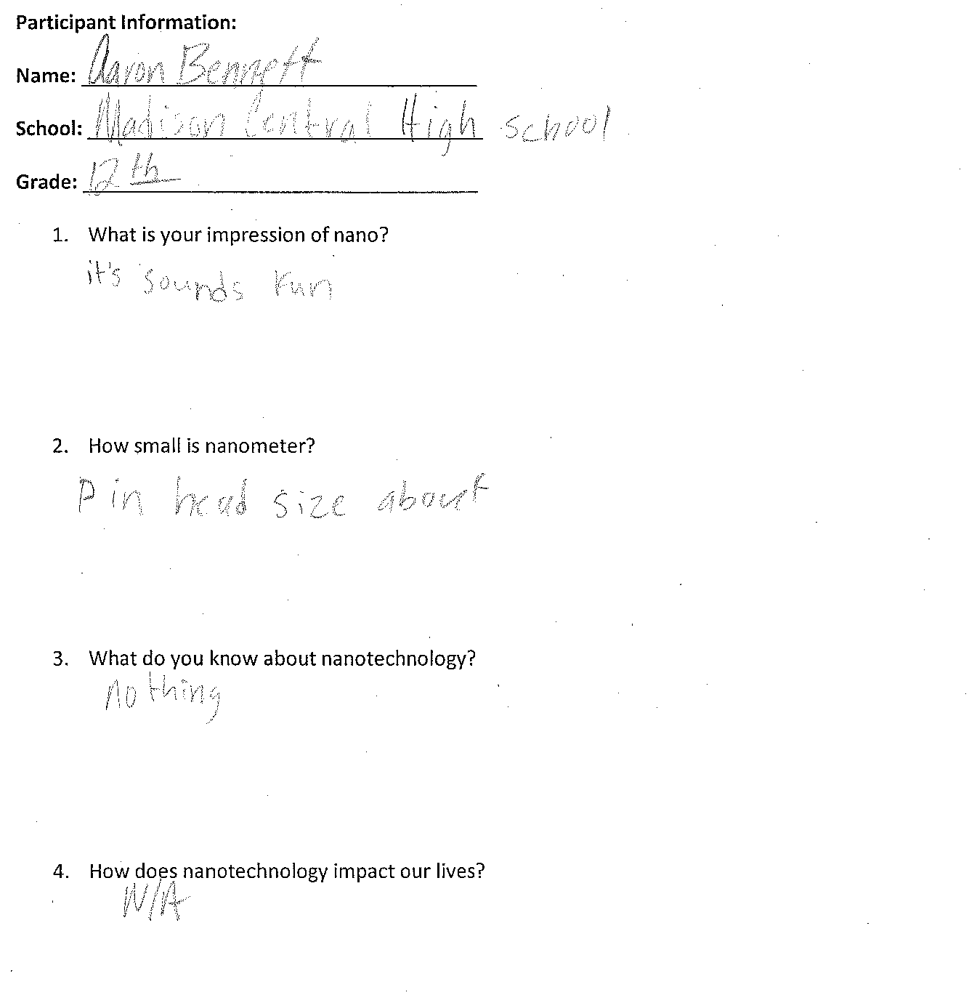
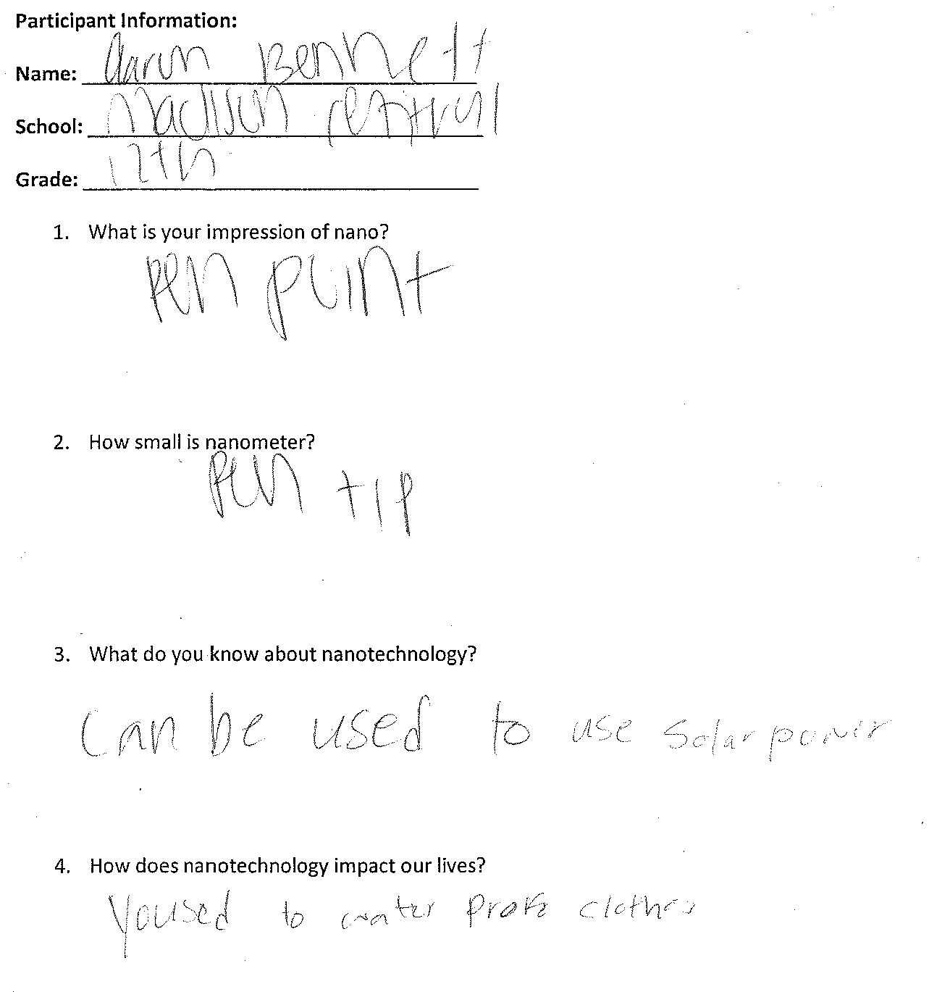

Slide 25
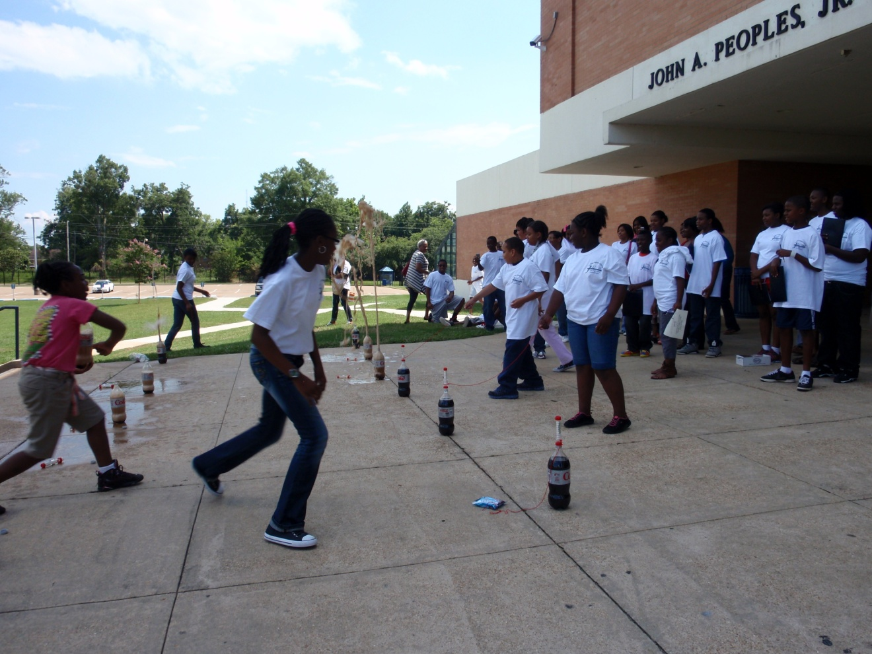
End of 1-Day Nano Camp

Slide 26
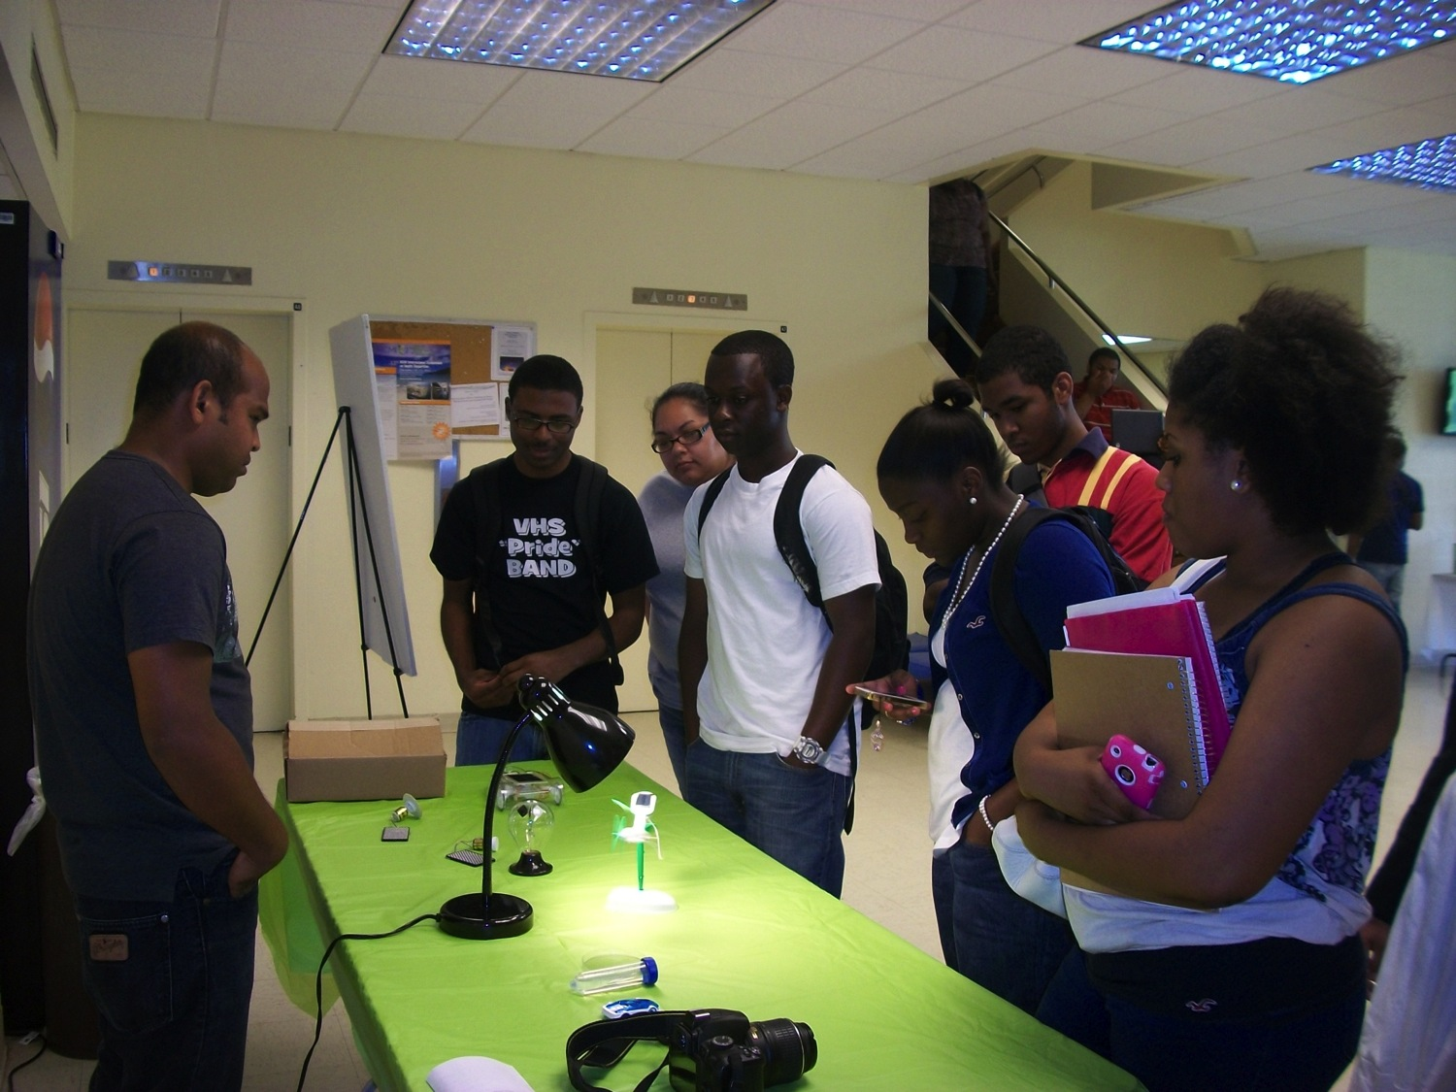
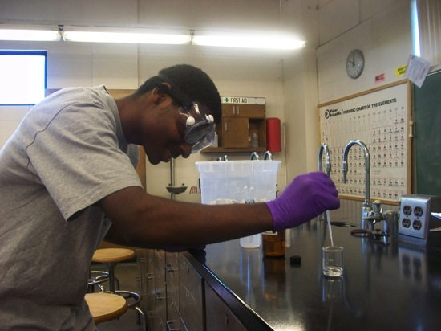
Mini-Nano Event at JSU on June 17, 2012
Projects:
Forms of carbon, solar cells, puzzle, soda geyser and general chemistry lab
Students/faculty/staff instructors:
Dalephine E. Davis, Jala Morrow, Mhahabubur Rhaman and Nya Williams

Slide 27
Quick Facts on Nano 2012 (March-June)
Date | Event | Location | No. projects | No. Audiences | No. JSU Instructors
March 24 | NanoDay | JSU | 14 | 100 | 17
March 28 | Chem. Demonstration* | Callaway High School | 4 | 30 | 6
March 31 | High School Day | JSU | 5 | 60 | 6
April 11-12 | Chem. Demonstration* | Wingfield High School | 6 | 45 | 6
April 17 | Chem. Demonstration* | Bailey Magnet High School | 4 | 45 | 3
May 17 | Chem. Demonstration* | Jim Hill High School | 4 | 25 | 4
May 25 | Chem. Demonstration* | Provine High School | 4 | 25 | 4
June 16 | 1-Day NanoCamp* | JSU | 20 | 200 | 10
June 17 | Mini-Nano Event | JSU | 5 | 40 | 4
 |  |  |  | Total: 570
* Supported by NISE Mini-Grant 2012

Slide 28
Acknowledgment
NISE Network
NISE Mini-grant
Students/Faculty/Staff instructors
NSF-PREM program
Department of Chemistry and Biochemistry at Jackson State University

Slide 29
Nanotechnology in Our World Science Factory, Eugene, OR August 2011
Monday | Tuesday | Wednesday | Thursday | Friday
What is Nano? Nano changes properties | Forms of carbon Hydrophobic surfaces | Thin films Liquid crystals Solar cells | Nanogold and nanosilver applications Nano stained glass | Tour of UO chemistry labs and SEM facility

Slide 30
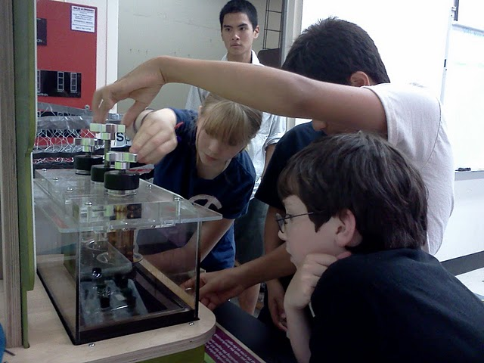
Monday: What is Nano?

Slide 31
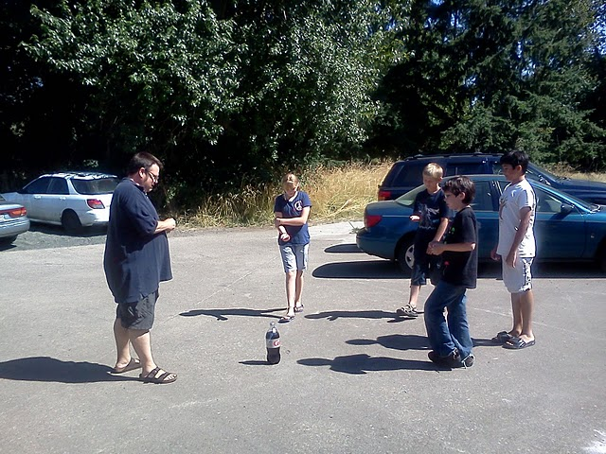

Slide 32
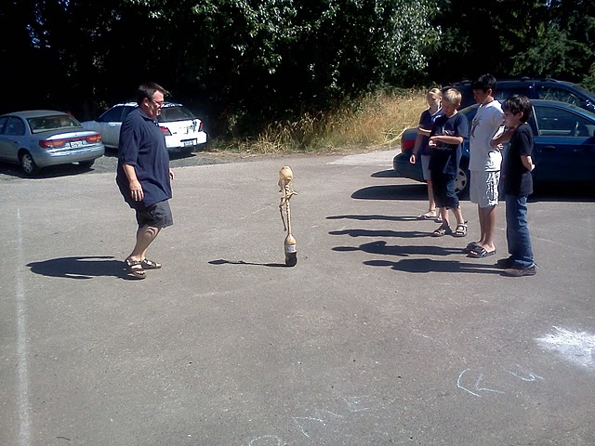

Slide 33
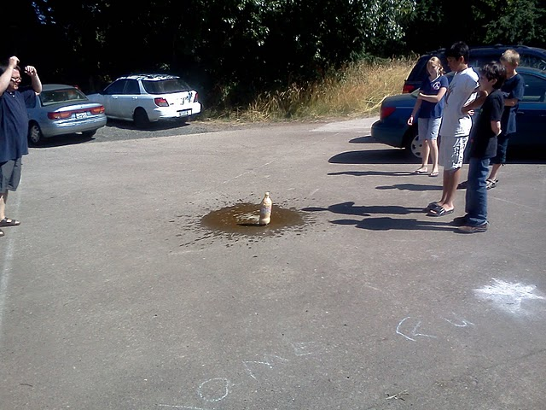

Slide 34
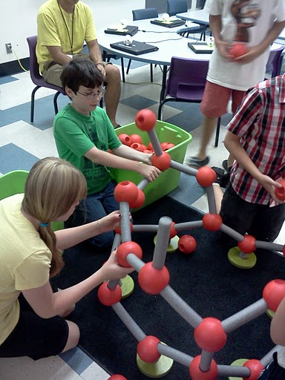
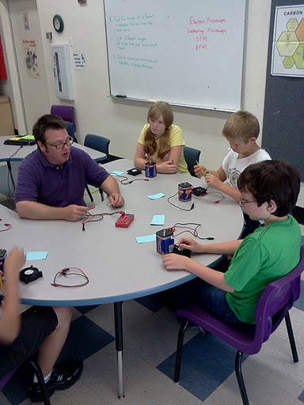
Tuesday: Nano structures

Slide 35
Tuesday: Nano structures

Slide 36
Wednesday: Nano products

Slide 37
Thursday: Silver and gold

Slide 38
Thursday: Silver and gold

Slide 39
Friday: Tour of UO Labs

Slide 40
A Science Center Without Walls

Slide 41
Outdoor Biology Camp at Spencer Crest Nature Center Summer 2012

Slide 42
Pond Water Testing Looking at Macro and Micro Sized Organisms

Slide 43
How big is a nanometer?

Slide 50
Summer Programming for Reaching New Audiences
NANO BITES

Slide 51
Objective of Grant
Develop and deliver a nanoscience themed class during our 2012 summer camp
Introduce nanoscience and technology education to camp participants, including underserved youth
Translate 5 Nano Days demos and Bump and Roll exhibit text to Creole

Slide 52
Description of Class
Components
Hands-on activities and experiments
Nano Exhibits
Activities from Nano Days kits
Nano Theater Shows
Culminating Activity: Develop own hands-on nano-themed demo, skit, or presentation; some in additional languages

Slide 53
Description of Participants
Offered to general camp participants in 4th-8th grade
To reach additional new audiences, also offered as one of the options for students in our Summer Science Camp scholarship program
6th-8th grade: 20 student
4th-5th grade: 15 students

Slide 54
Nano Bites – Week at a Glance
Day 1: Intro to Nano
Introducing the term Nano and the concept of a Billion
Exploring Scale
Properties of Materials Change at the Nano Scale
Introduction to culminating activity

Slide 55
Nano Bites – Week at a Glance
Day 2: Biomimicry
The Lotus Effect
Light Waves and Iridescence
Sticky Feet

Slide 56
Nano Bites – Week at a Glance
Day 3: Manipulating Things at the Nano Scale
Nano Shapes
Self-Assembly

Slide 57
Nano Bites – Week at a Glance
Day 4: Special Tools
Why do we need special tools at the Nano Scale?
Scanning Probe Microscopes
Using Atomic Force Microscopes
Nanobots

Slide 58
Nano Bites – Week at a Glance
Day 5: Innovations and Societal Implications
Nano Innovations
Implications
Presentation of Final Projects

Slide 59
Resources

Slide 60
Lessons Learned
“Why are we doing so much math? I thought this was a science class.”
Modifying other activities
Games & Group Activities
Younger students able to get through quicker
Sourcing Specialty Supplies difficult/time consuming

